Slide 1
Coastal Mid-Atlantic Water Resources II
Measuring Evapotranspiration using the METRIC Model in the Mid-Atlantic Coastal Plain
Kent Sparrow
Jelly Riedel
Nathan Qian
Cassandra Morgan
Zakaria Boston
Oyinlayifa Porbeni
Notes:
Introduce title
Introduce team members

Slide 2
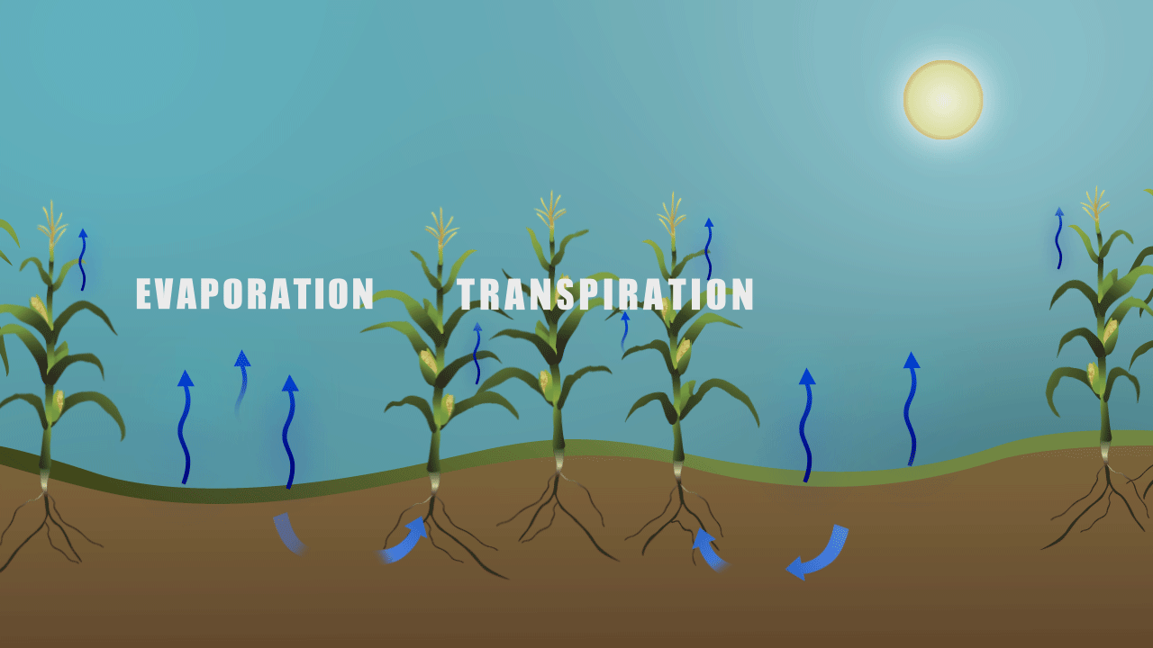
METRIC Model
METRIC – Measuring Evapotranspiration at High Resolution With Internalized Calibration
Evapotranspiration (ET) - The combined processes through which water is transferred to the atmosphere from open water and ice surfaces, bare soil, and vegetation that make up the earth's surface (AMS Glossary)
Source: NASA
Notes:
Define METRIC acronym
Define ET – evaporation from plants and soil in photo

Slide 3
Project Partners & End Users
Digital Harvest
Young Kim, General Manager
Ed Hassell, Agronomist
Virginia Department of Environmental Quality
David Paylor, State Water Commission
Virginia Secretary of Technology
Karen Jackson, Secretary
Virginia Secretary of Natural Resources
Molly Ward, Secretary
Virginia Secretary of Agriculture & Forestry
Todd Haymore, Secretary
Notes:
Who’s interested?....
Digital Harvest would like to use METRIC for measuring ET on days when they are unable to fly UAV’s. They would eventually like to use METRIC applications for forecasting ET rates.
State officials would use METRIC for drought monitoring applications.

Slide 4
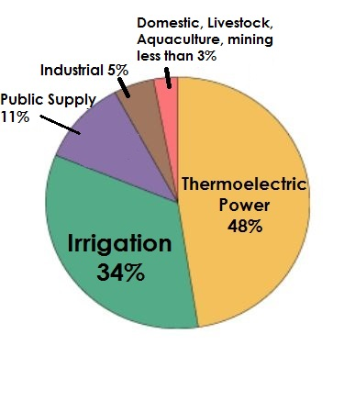
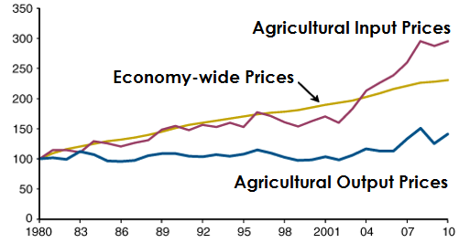
Community Concern
The USDA states that irrigated agriculture accounts for a significant amount of water consumption nationwide
U.S. irrigated cropland relies on traditional, less efficient irrigation methods, despite technological advances
Wasteful and costly irrigation practices place an unnecessary economic burden on farmers and may negatively affect productivity
Cost
Index
Year
Source: USDA
Source: USGS
Notes:
The USDA states that irrigated agriculture accounts for a significant amount of water consumption nationwide. Refer to pie chart percentage.
U.S. irrigated cropland relies on traditional, less efficient irrigation methods, despite technological advances. The typical method of irrigation practices are based on a crop coefficient that is multiplied by a reference ET rate for a specific crop.
Wasteful and costly irrigation practices place an unnecessary economic burden on farmers and may negatively affect productivity. Refer to USDA graph.

Slide 5
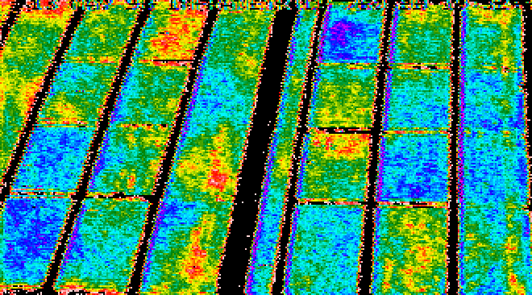
Research Inspiration
METRIC could be adapted to the Mid-Atlantic Coastal Plain
ET estimates from remotely sensed data could be more effectively used to display areas where irrigation is needed
Drought monitoring could be improved through applications of the METRIC model
The above image displays remotely sensed canopy temperatures of Arizona cotton fields to measure heat stress. Source: USDA
Notes:
METRIC is used throughout the West in states such as Washington, Oregon, Nevada, Colorado
Idaho Dept of Water Resources uses METRIC to monitor water use and water right distribution.
ET estimates from remotely sensed data could be more effectively used to display areas where irrigation is needed. The image below displays how heat stress is determined using IR imagery. The METRIC model can be executed daily with the use of local weather inputs. This makes METRIC a more effective method for determining crop irrigation needs.

Slide 6
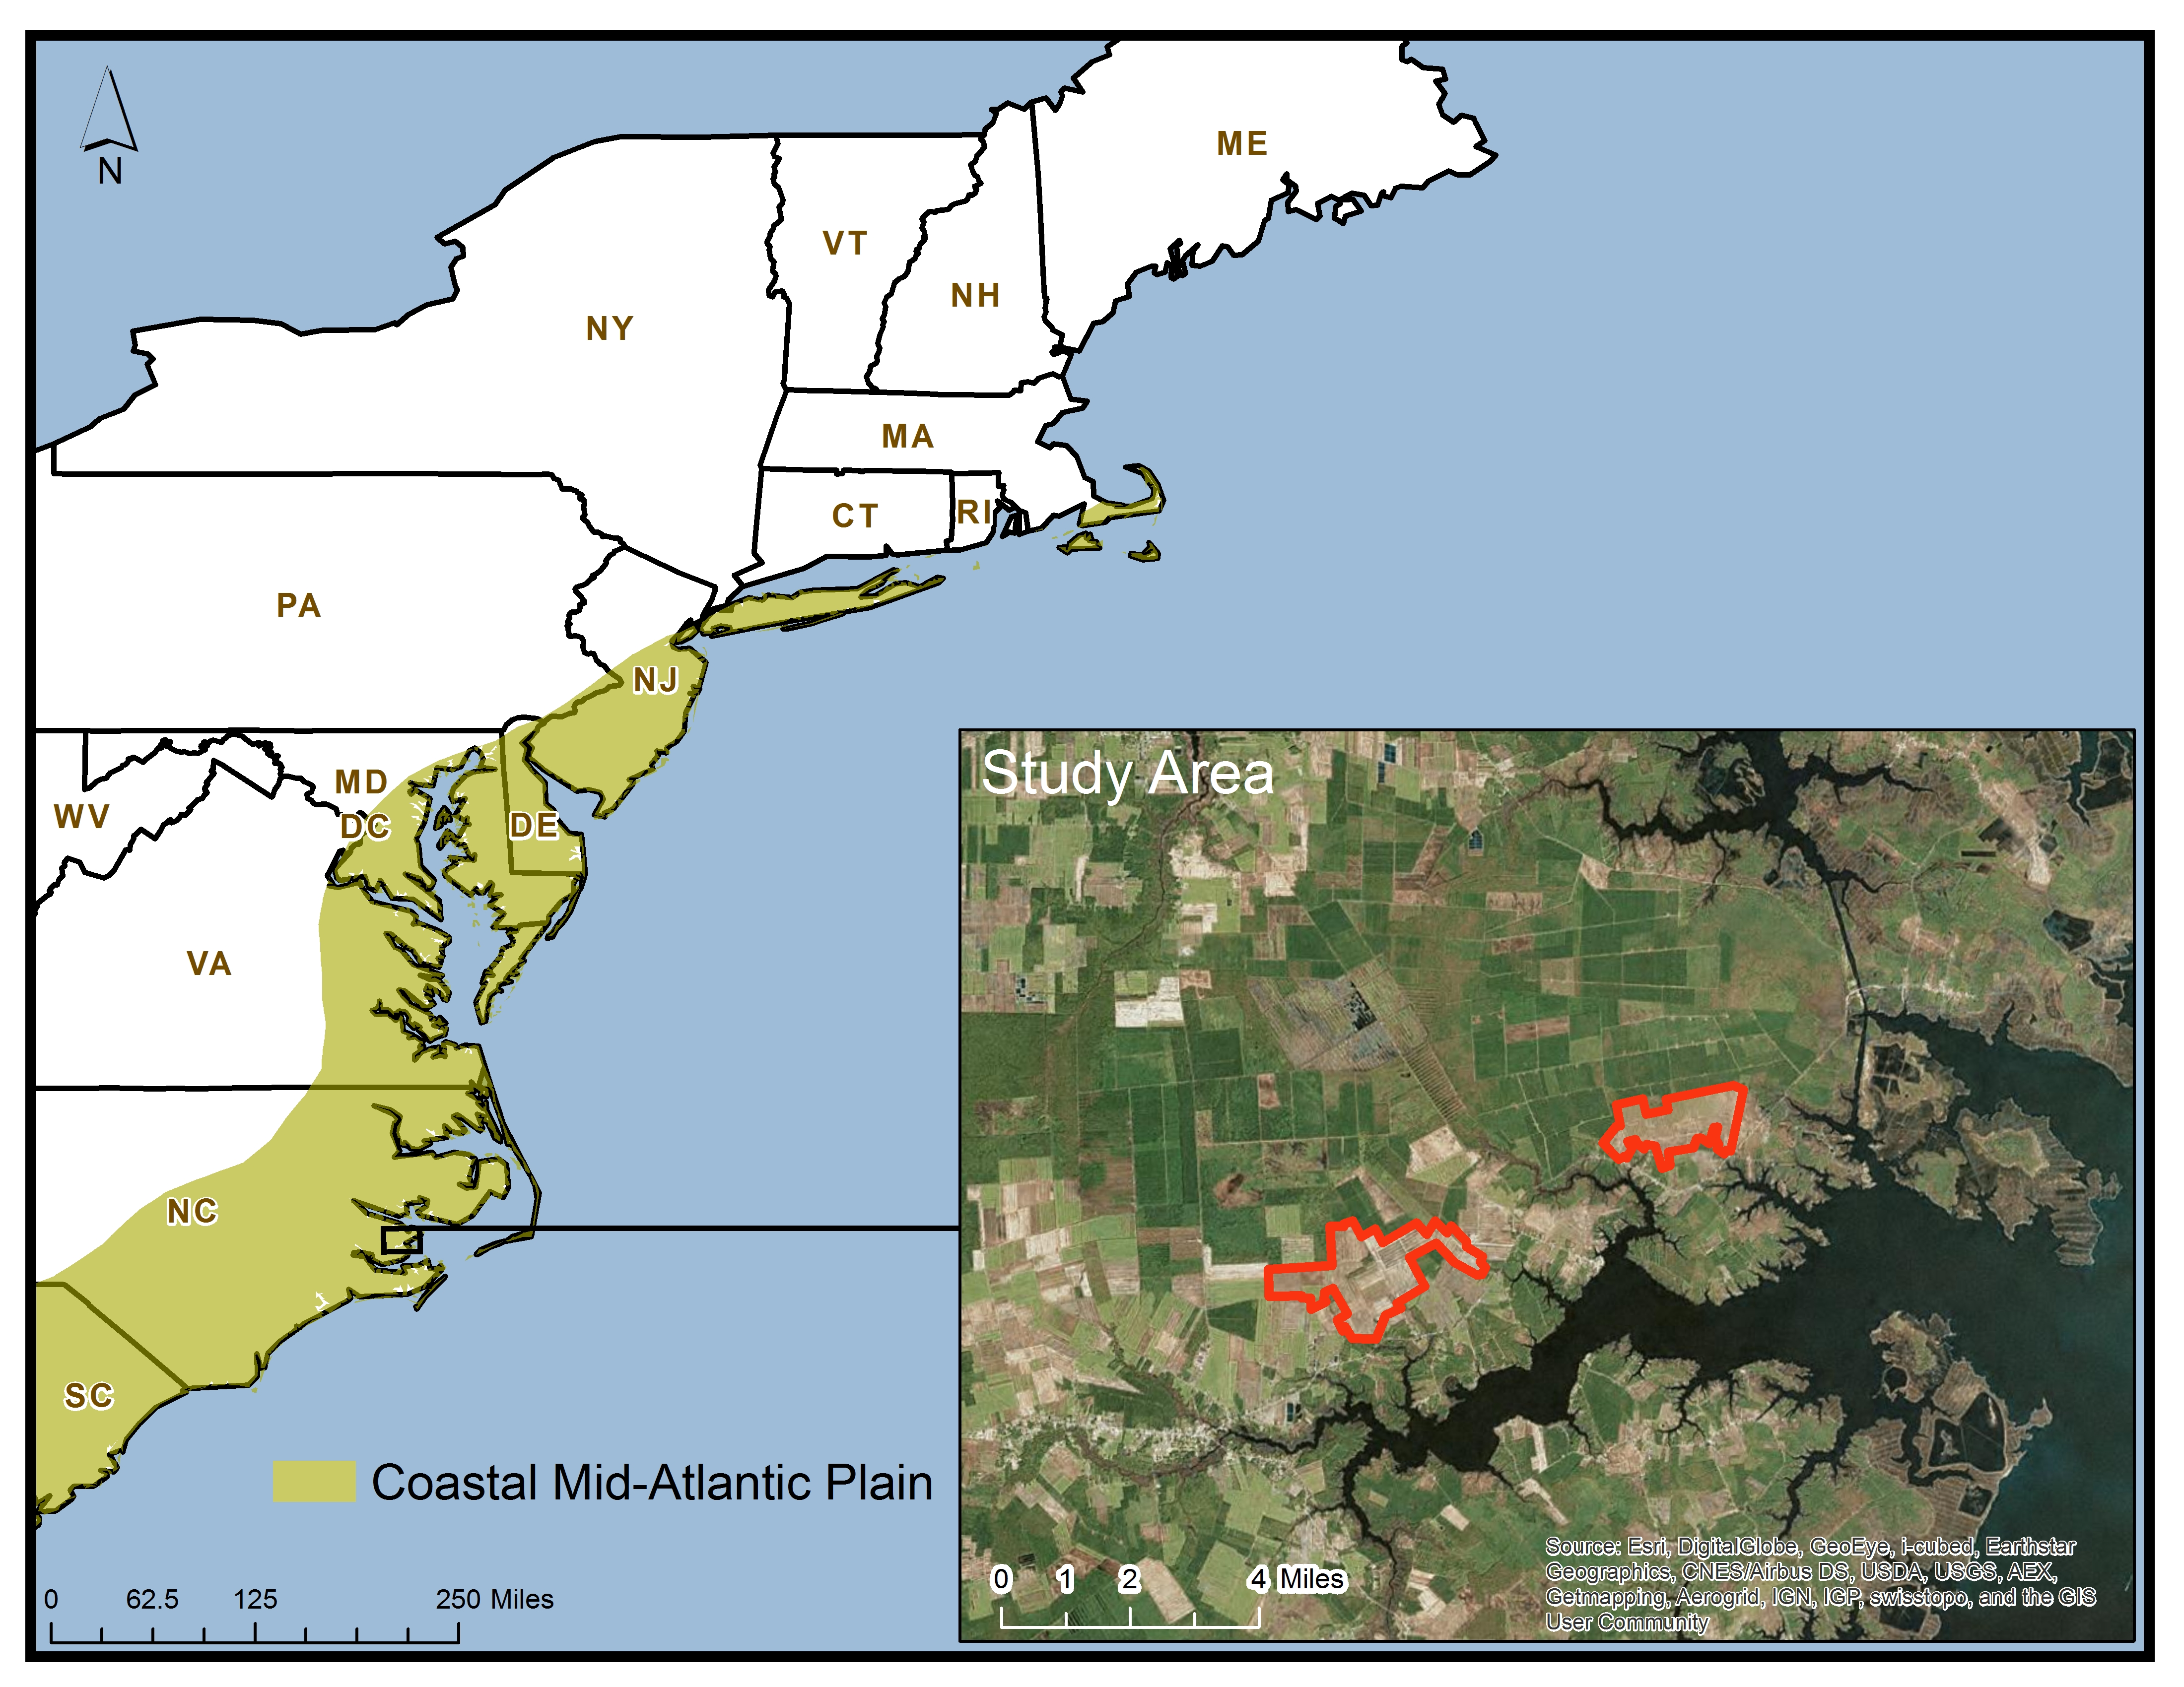
Study Area: Coastal Mid-Atlantic
Notes:
Digital Harvest’s “fields of interest” highlighted in red in inset map

Slide 7
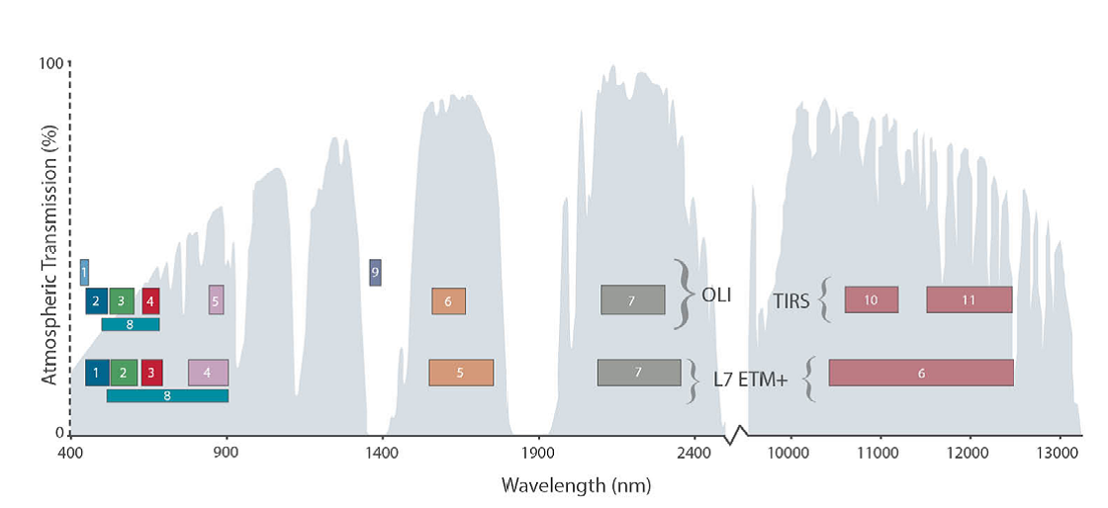
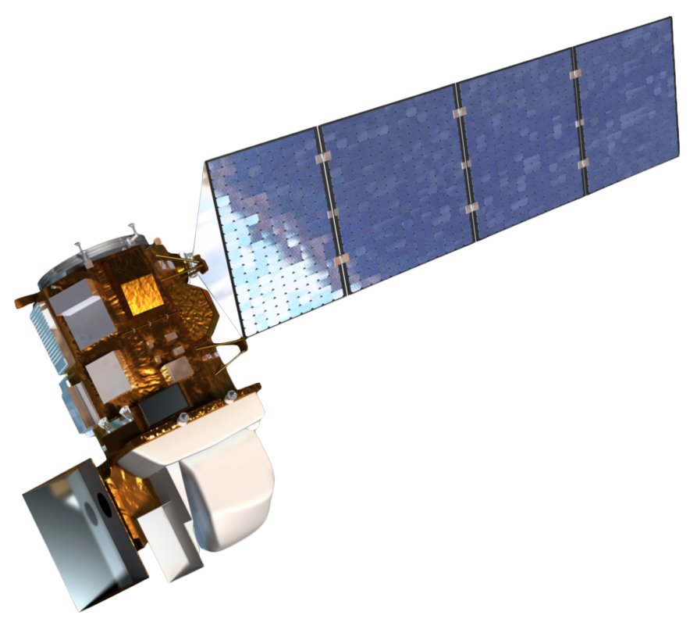
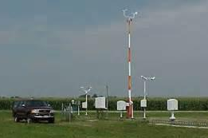
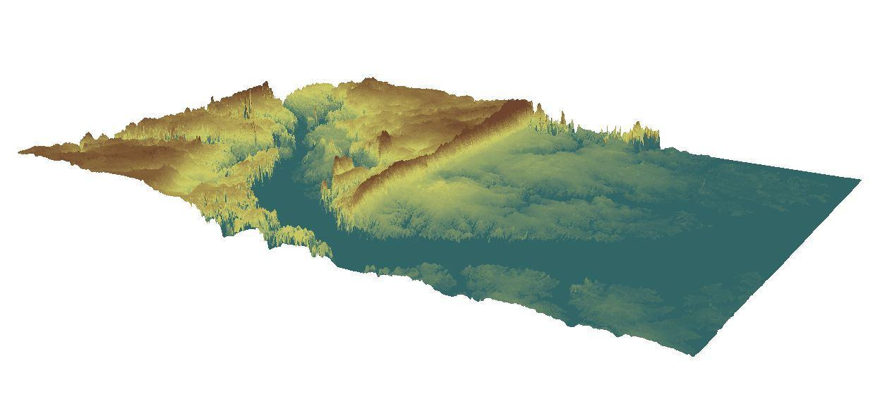
Earth Observations & Data Acquisition
Landsat 8 bands
Source: NOAA
Automated Weather Observing System (AWOS) Hourly Weather Data
USGS Digital Elevation Model
Source: NOAA
Source: USGS
Notes:
Landsat 8 OLI/TIRS data from July 2013 was used exclusively for this project because it falls within the growing season when the METRIC model would be useful for irrigation planning.
Landsat 8 level 1 T data were acquired from the USGS Global Visualization viewer. Data from bands 2-7 and 10-11 were used as input to make the METRIC model compatible with Landsat 8 data (see difference in band #’s). Bands 2-4 represent visible blue, red and green. Bands 5-7 represent NIR and SWIR, and 10-11 are the thermal bands.
A DEM with a ~30m resolution was acquired from the USGS Center for Earth Resources Observation and Science (EROS) website. Elevation, slope, and aspect were needed throughout the series of equations.
Weather data, recorded from automated weather observing system (AWOS) stations, were retrieved from the NOAA National Climate Data Center (NCDC) for local weather inputs.

Slide 8

METRIC Model
R_{n} (radiation from sun and sky)
ET
H (heat to air)
LE = R_{n} – G – H
Latent Energy consumed by ET
G (heat to ground)
Allen et. al, 2007
Notes:
METRIC has been proven to be helpful with water rights allocations and long-term resource management. The Metric model calculates ET by subtracting heat lost to the ground and heat lost to the air from the total radiation received from the sun and sky. ET is a residual of the energy balance.
METRIC – Mapping Evapotranspiration with high Resolution and Internalized Calibration was developed in 2006 as an adaptation of a previous model, SEBAL. METRIC improved the accuracy of ET calculations by incorporating a reference ET and internal calibration.

Slide 9
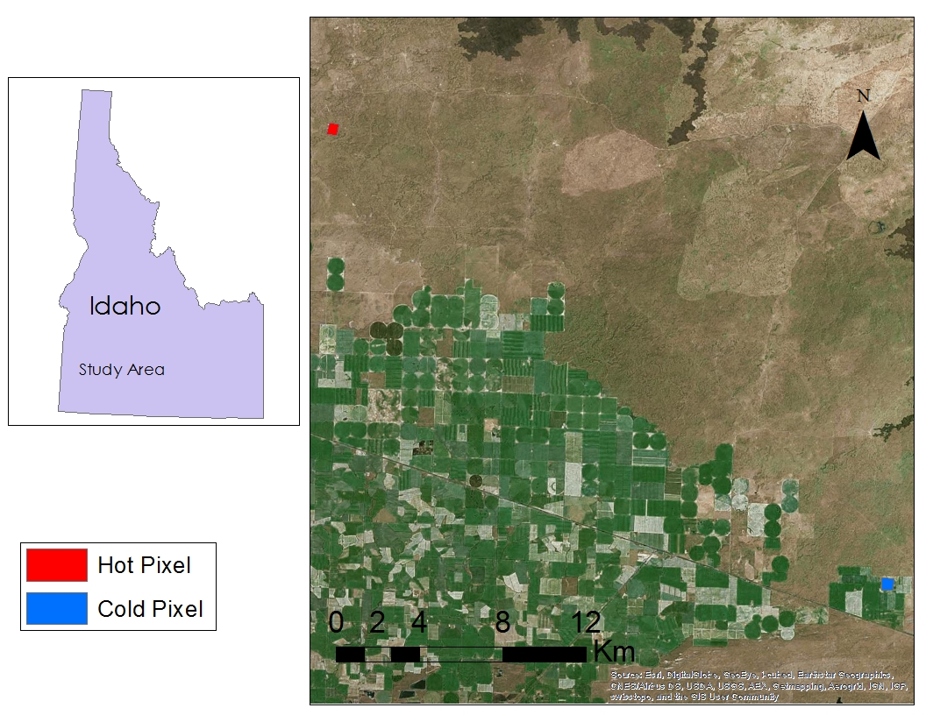
METRIC Model
Internalized Calibration: data from a HOT and COLD sample area, referred to as “pixels”
“Pixels” are actually polygons representing several raster pixels each
“Hot Pixel”- a dry, bare area where ET is effectively zero
“Cold Pixel”- a wet, irrigated area with continuous crop coverage
Notes:
The IC in metric stands for internalized calibration. ??? This is how METRIC differs from other remote sensing ET models
Use CROP data layer from USDA to help identify
METRIC – Mapping Evapotranspiration with high Resolution and Internalized Calibration was developed in 2006 as an adaptation of a previous model, SEBAL. METRIC improved the accuracy of ET calculations by incorporating a reference ET and internal calibration.
The reference “pixels” set boundary conditions for ET output and “train” the model to fit local conditions.

Slide 10
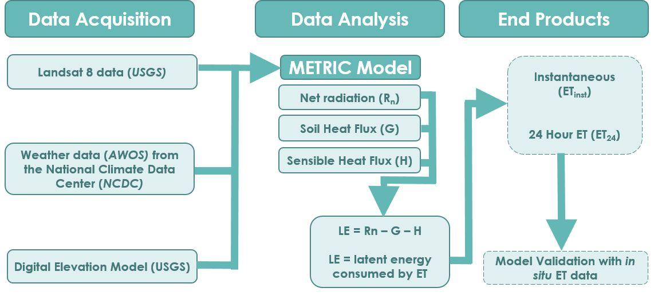
METRIC Model
Notes:
The steps taken to produce evapotranspiration estimates are found in the left portion of our flowchart. The METRIC model requires a variety of inputs which we gathered from Landsat 8 (USGS Global visualization viewer), USGS Digital Elevation Models, and AWOS data from local meteorological stations.
From those data, METRIC calculates net radiation, soil heat flux, sensible heatflux and then the residual from that energy balance = LE.
LE is energy consumed by ET. From there you can estimate instantaneous ET, 24 et
Last step is to validate with in situ or land based data

Slide 11
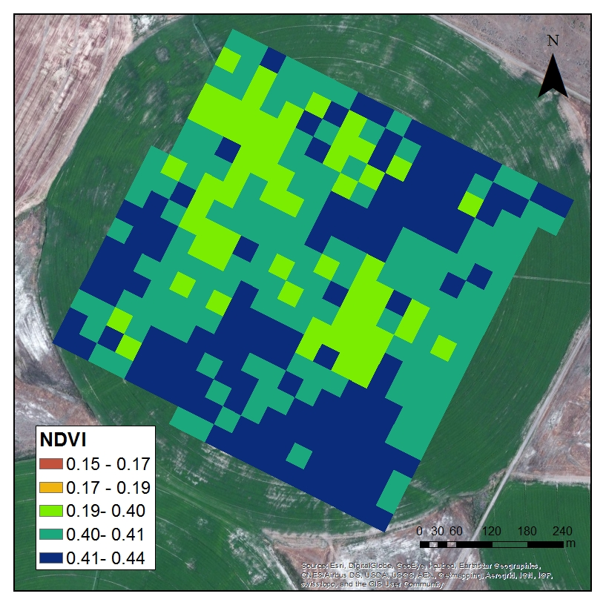
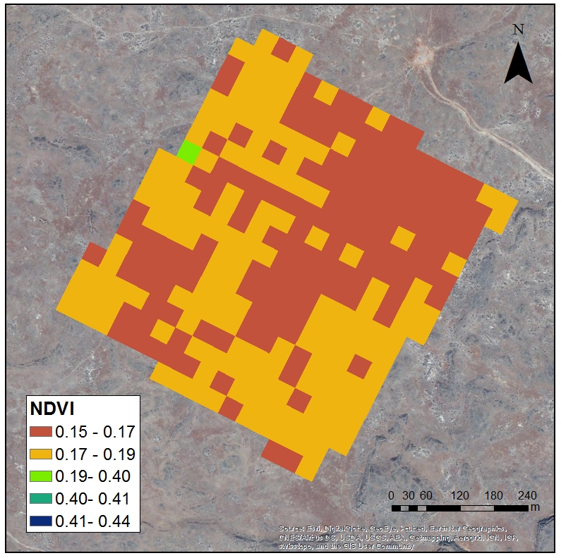
Intermediate Results
Normalized Differential Vegetation Index (NDVI)
Cold Pixel
Hot Pixel
Notes:
NDVI is the ratio of the differences in reflectivities for the NIR band and the red band to their sum. It indicates if the area being observed contains live green vegetation or not. NDVI > 0 indicates soil or vegetation. NDVI < 0 indicates snow, water, or clouds. A dense canopy will have values of .3 - .8.

Slide 12
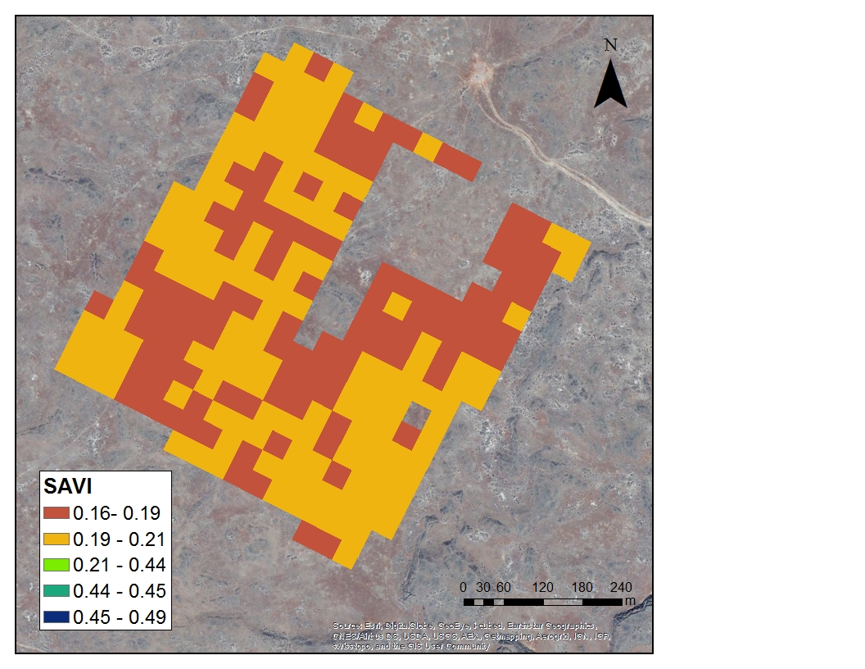
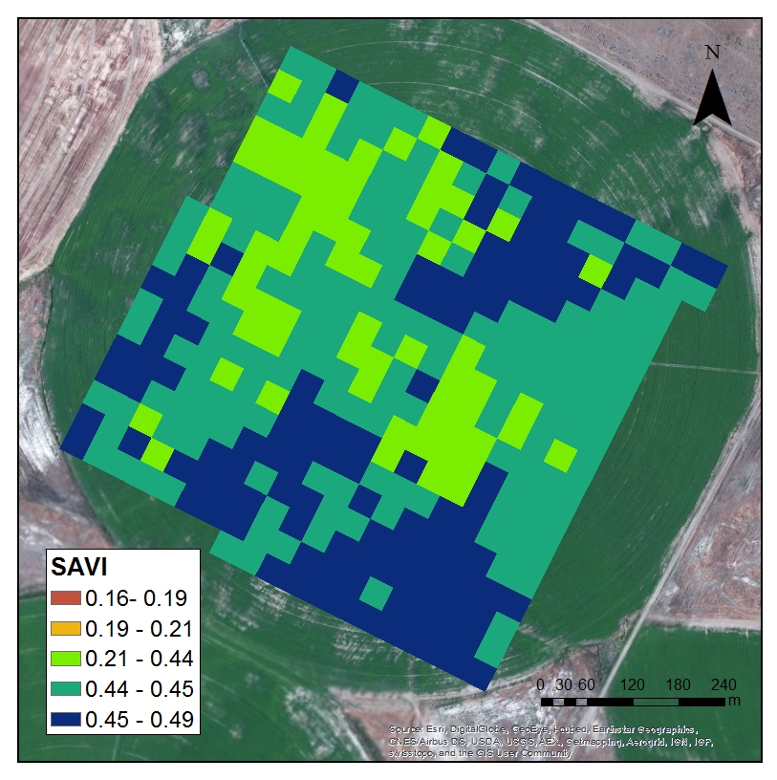
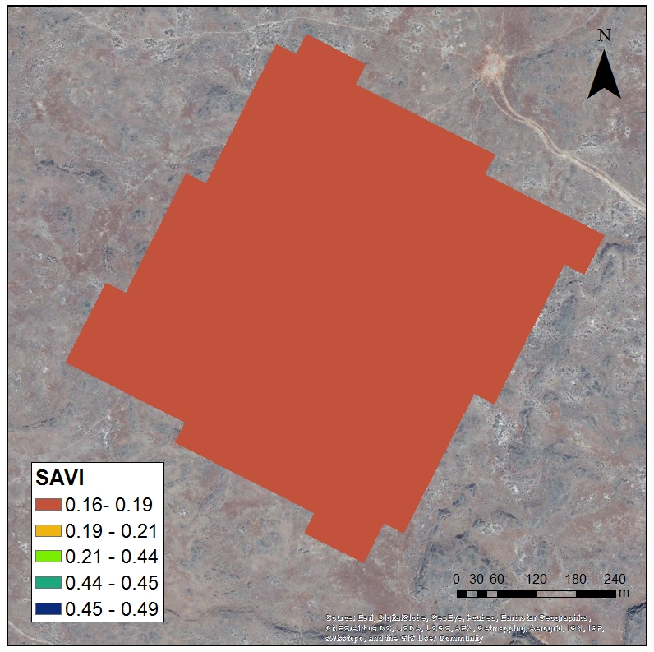
Intermediate Results
Soil Adjusted Vegetation Index (SAVI)
Cold Pixel
Hot Pixel
Notes:
SAVI – Soil adjusted vegetation index. In areas where the soil is exposed, the reflectance of light in the NIR and red spectra can influence vegetation index values. SAVI was developed as a modification of NDVI to correct for the influence of soil brightness when vegetation cover is low.

Slide 13
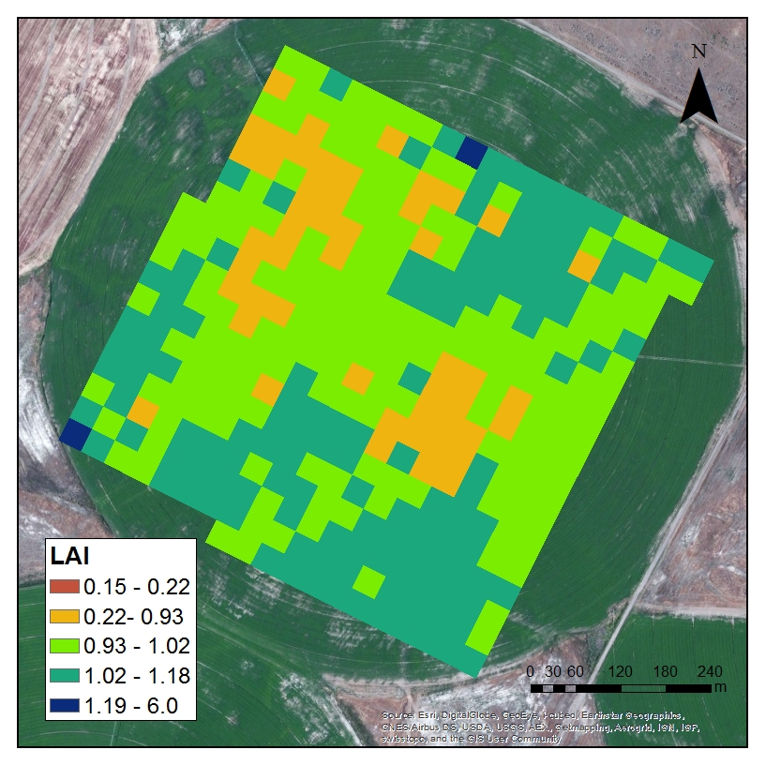

Intermediate Results
Leaf Area Index (LAI)
Cold Pixel
Hot Pixel
Notes:
LAI is an indicator of biomass and canopy resistance to vapor flux. LAI is defined as the ratio of total leaf area for the surface (one side of leaves) per unit if ground area.

Slide 14
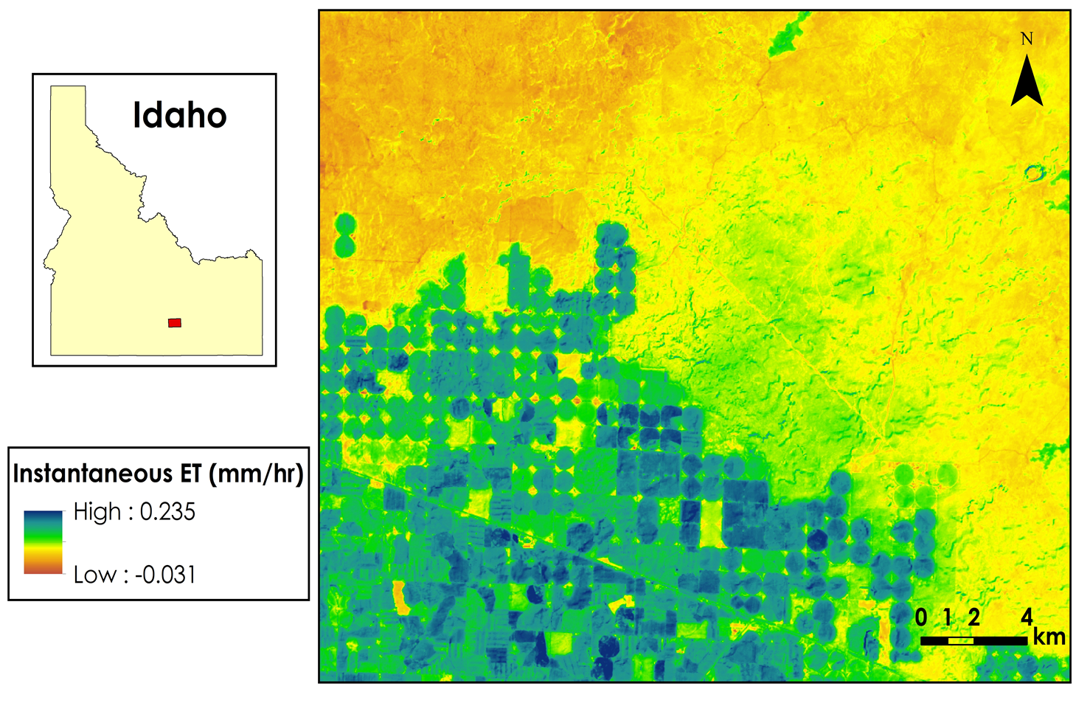
Results
Instantaneous ET

Slide 15

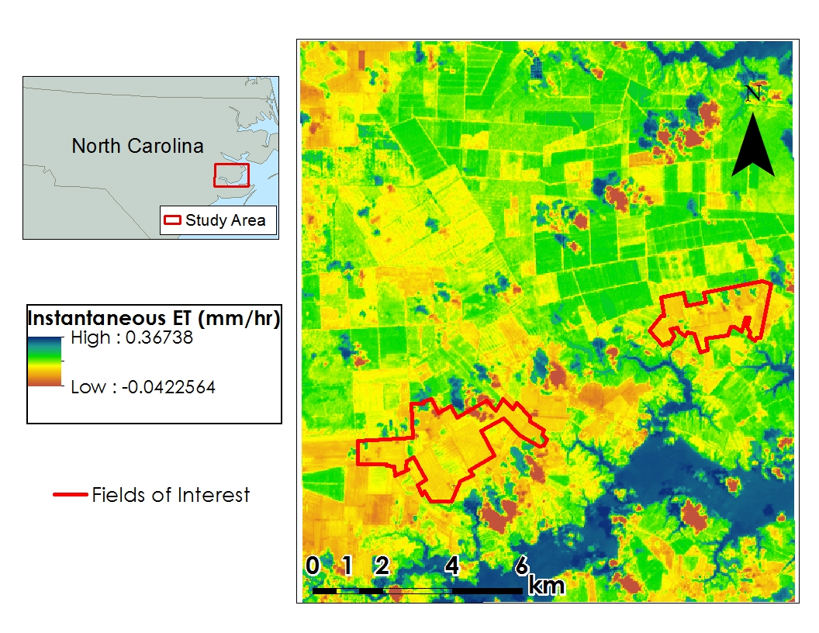
Results

Slide 16
Conclusion/Future Work
The Python script written to run the METRIC model successfully calculated ET_{inst} using Landsat 8 imagery, AWOS weather data, and a DEM.
The model is in the final stages of becoming a useful tool for calculating ET₂₄ to improve irrigation planning and drought monitoring for the agriculture industry.
The use of the METRIC model will be beneficial to government officials and private industries involved in the agriculture industry.
Future work will need to focus on the methods of Allen et al. (2007) to derive ET₂₄ and validate the model in Idaho and the Coastal Mid-Atlantic region.
Once a validated model for deriving ET₂₄ rates is established, it should be packaged into a tool, available in ArcToolbox.

Slide 17
Acknowledgements
Dr. Kenton Ross – National Science Advisor
Nathan Owen – Center Lead
Lauren Makely – Assistant Center Lead
Lauren Childs – National Lead
Lance Watkins – DEVELOP Young Professional
Jamie Favors – Deputy National Lead
Digital Harvest – General Manager, Young Kim and Agronomist, Ed Hassell

