Slide 1
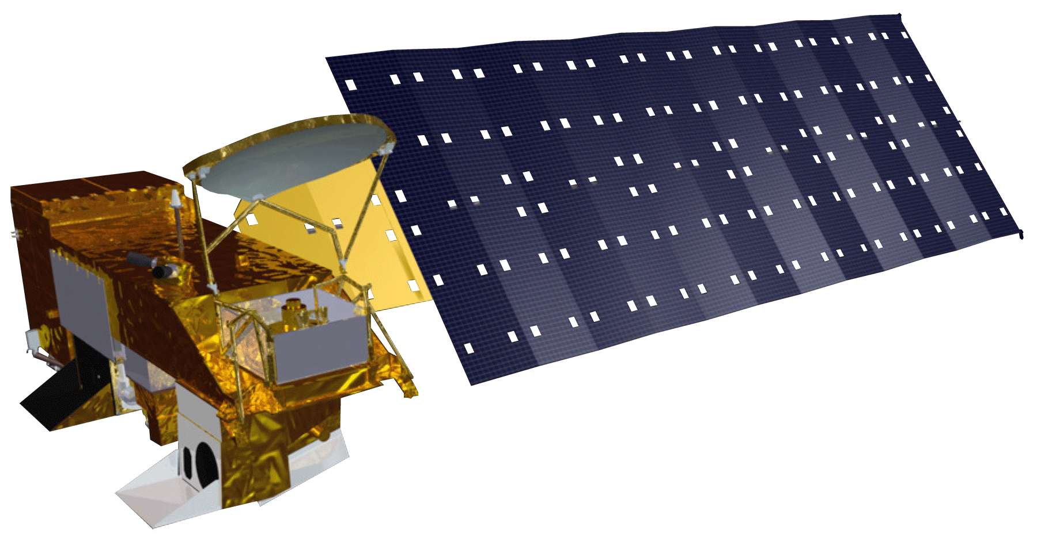
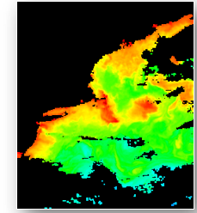
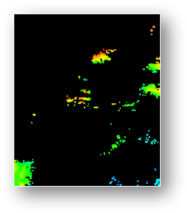
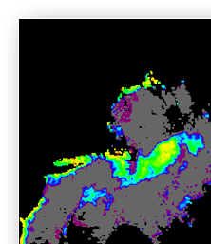
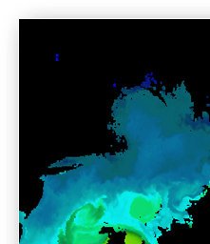
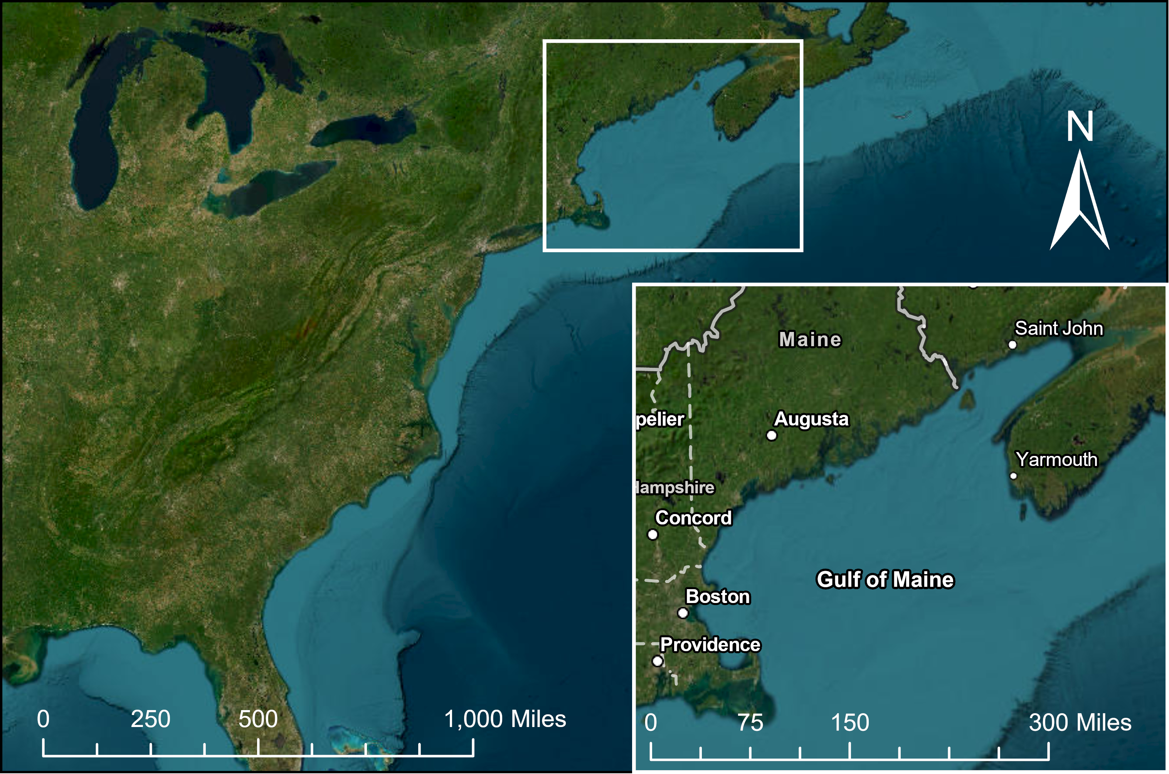
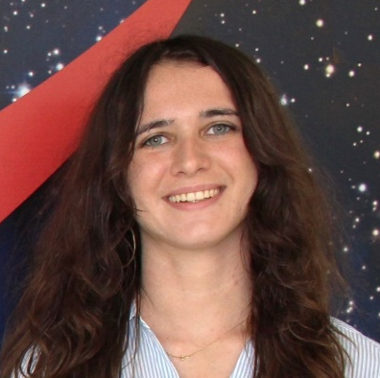
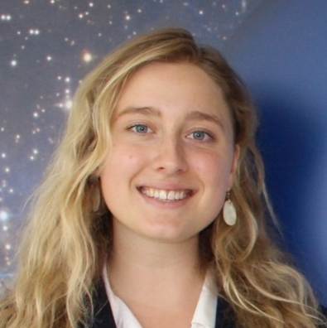
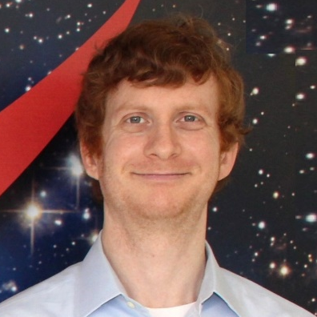
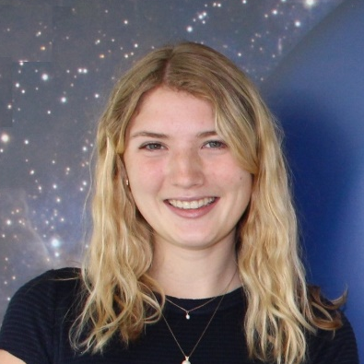
PACE Water Resources
Demonstrating the Use of NASA's PACE Hyperspectral Ocean Color Instrument Data for Enhanced Coastal Management
Project Synopsis
Objectives
The NASA Plankton, Aerosol, Cloud, ocean Ecosystem (PACE) mission, scheduled to launch in early 2024, will advance NASA’s commitment to using Earth observations to measure global ocean biology, aerosols, and clouds. The purpose of this DEVELOP Tech & Innovation project was to create tools that will be useful for the incorporation of PACE OCI hyperspectral data in future DEVELOP projects and applied science research efforts through the development of Python code and data visualization content for Story Maps or instructional materials.
Equip the research community and nontechnical end users with software tools to access and apply PACE data
Build code for future DEVELOP teams to acquire, clean, and display PACE hyperspectral data
Visualize harmful algal blooms with hyperspectral and multispectral imagery for comparison
Methodology
Earth Observations
Level 2 Data ​
​
Select Remote Sensing Reflectance
Value(s)
Level 3 Data ​
​
Select parameters, dates, and resolutions of interest
PACE OCI
Aqua MODIS
Results
Process netCDF
Generate visualizations
Calculate
statistics
The graphical user interface (GUI) tool produced by the Python script allows end-users to easily set coordinates and variables of interest to produce relevant visualizations and statistics. Specific regions and points of interest can be examined, with statistics available for a given point. The tool downloads and merges netCDF files and produces visualizations in easy-to-use GeoTIFF formats.
Process netCDF
Generate
image
composites
80
100.00
60
20.00
40
20
2.99
0
Latitude [degrees_north]
Chlorophyll Concentration (mg/m³)
Merge netCDFs and export to GeoTIFF
-20
0.45
-40
0.07
-60
Study Area
-80
-150
-100
-50
0
50
100
150
0.01
This tool displays PACE OCI hyperspectral data across a global extent and subsets the display by region according to user choice. Data visualizations shown in the results spotlight Harmful Algal Blooms in the Gulf of Maine.
Longitude [degrees_east]
Conclusions
The GUI facilitates the ease of use of hyperspectral data for a wide range of end users including water managers, fishermen, public health officials, and researchers.
Data are accessible to those without sophisticated coding and analysis skills.
End users are able to enhance public safety and health while assisting people avoid unsafe areas through region-specific subsetting and providing statistics for points of interest.
The data complements in-situ water quality tests.
Merging different variables into composite images and converting netCDF data to GeoTIFFs is simplified for end users.
Esri World Imagery Basemap: Earthstar Geographics, ESRI, HERE, Garmin, FAO, NOAA, USGS, EPA, NRCan, Parks Canada
Team Members
Project Partner
NASA PACE Mission Applications Program
Acknowledgments
Jules Kourelakos
Isabel Lubitz
Matt Romm
Grace Thorpe
Partners: Natasha Sadoff (NASA GSFC, Science Systems & Applications, Inc.), Dr. Erin Urquhart (NASA GSFC, SSAI)
Science Advisors: Sean McCartney (NASA GSFC, SSAI), Emerson Sirk (NASA GSFC, SSAI), Dr. Bridget Seegers (NASA GSFC, Morgan State University)
Fellow: Carli Merrick (NASA GSFC, SSAI)
Maryland – Goddard

