Slide 1
HAWAI’I ISLAND
Disasters
Using NASA Earth Observations to Assess Coastal Flood Risk with Measures of Land Cover Change, Flood Extent, and Vulnerability for Adaptation and Mitigation Planning on Hawai‘i Island
Garren Kalter, Anna Mikkelsen, Rose Eichelmann, Sanketa Kadam, & Erin Azuma
Arizona – Tempe
Notes:
Hello! We are the Hawai'i Island Disasters Team, and we are so excited to share the story of our ten-week journey with you all today.
Hi, my name is Garren Kalter. I am currently at Clark University completing my Masters in Geographic Information Science. My undergraduate degree, also from Clark, is in Urban Geography and Economics with a concentration in Ethics and Public Policy. My areas of expertise/emphasis include GIS and remote sensing, strategic planning/project management, climate change mitigation, and sustainable urban/transportation planning. I was the project lead for the project.
Hi, my name is Anna Mikkelsen. I am currently a master’s student at the University of Hawai‘i at Mānoa in Earth Sciences graduating this semester (Fall ’21). I have a Bachelors in Marine Science from the University of Hawai‘i at Hilo. My area of emphasis/interest is coastal change, climate change adaptation/resiliency and GIS and remote sensing applications.
Sanketa Kadam : M.A in Climate and Society (Columbia University), Masters in Urban and Regional Design (New York Institute of Technology) and Bachelors in Architecture (Mumbai University). Area of expertise/emphasis includes Climate Change Impact Research, Climate modeling, Urban Adaptation/Mitigation frameworks and Risk Analysis.
Hi, my name is Rose Eichelmann. I am graduating from the University of Texas at Austin this semester with a Bachelors in Sustainability Studies and in Geography. I'm interested in environmental justice, climate change adaptation, human/wildlife conflict management, intersectional environmentalism, and the use of remote sensing/GIS applications and software engineering to address these topics.
My name is Erin Azuma, and I am a current Global Management grad student at Arizona State University. My bachelor's (also from ASU) was in Conservation Biology, and I'm interested in intersectional environmentalism, social GIS applications, and climate justice.

Slide 2
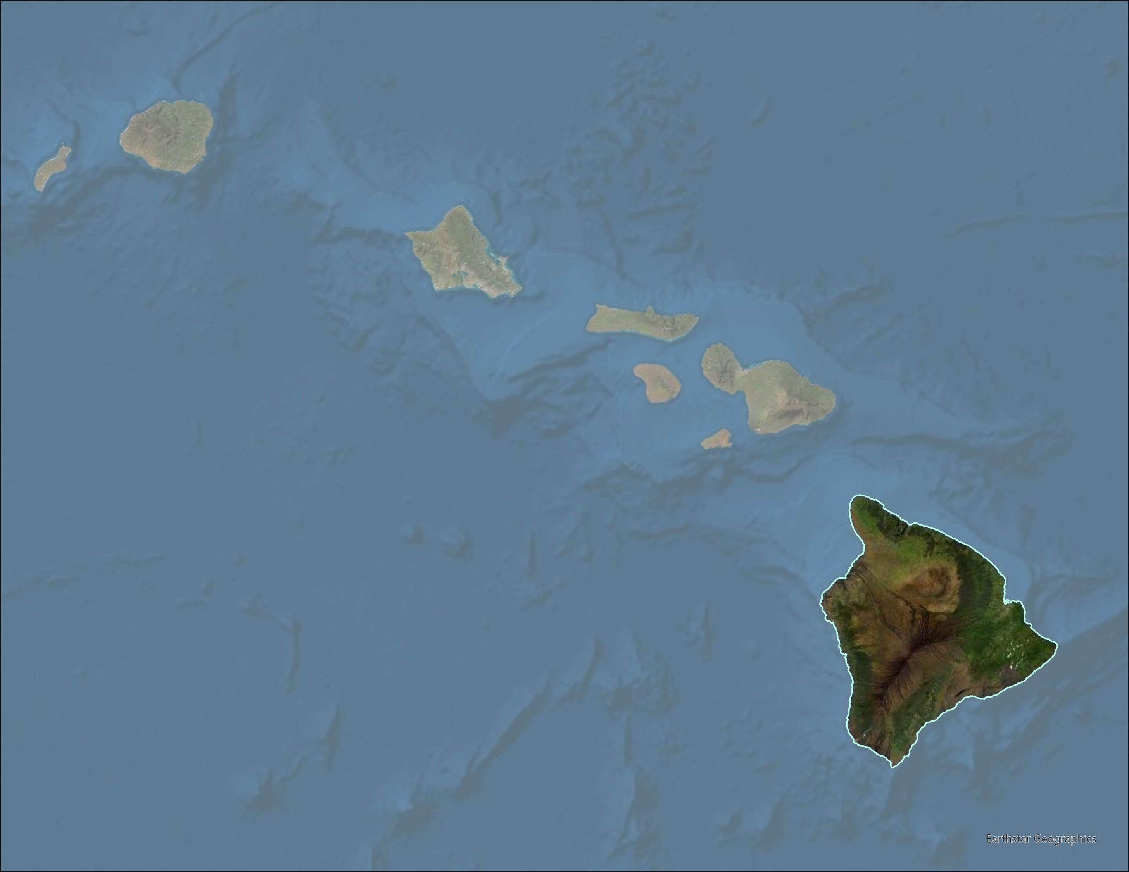
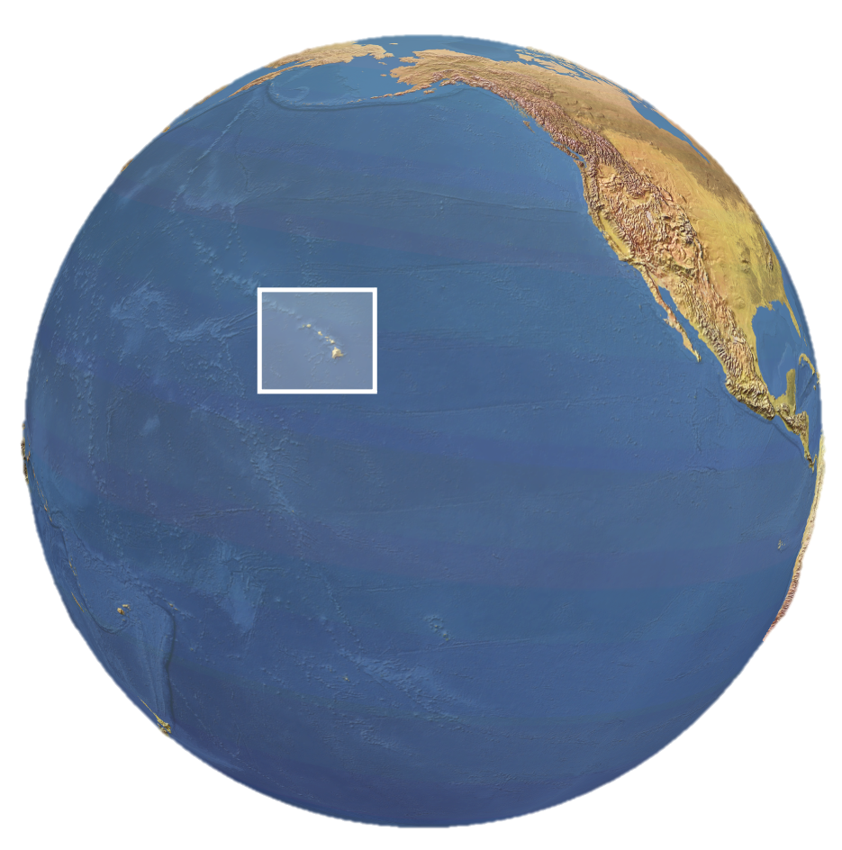
STUDY AREA – Hawai'i Island
Hawai'i
Most isolated land mass in the world
Coextensive with Hawai'i County
Largest county in the state
Various substrate ages and life zones
Complex socio-ecological matrix of topography
Hawai'i Island
Hilo
Kona
Map of Hawai'i Island. (2021).
Notes:
Located in the middle of the Pacific Ocean, the Hawaiian Islands are the most isolated land mass in the world. Our study area for the term is Hawai'i Island, also known to Hawai'i locals as the Big Island, and is coextensive with Hawai'i County governmental jurisdictions. It is the largest county in the state, at 4,028 square miles, making it over 3x the size of Rhode Island. Hawai'i Island has a unique geology -- with five volcanoes on the Island (some of which remain active), there are various substrate ages and life zones throughout the island. As a result, there is a rich, complex socio-ecological matrix of diverse topography and land covers for the Island.

Slide 3
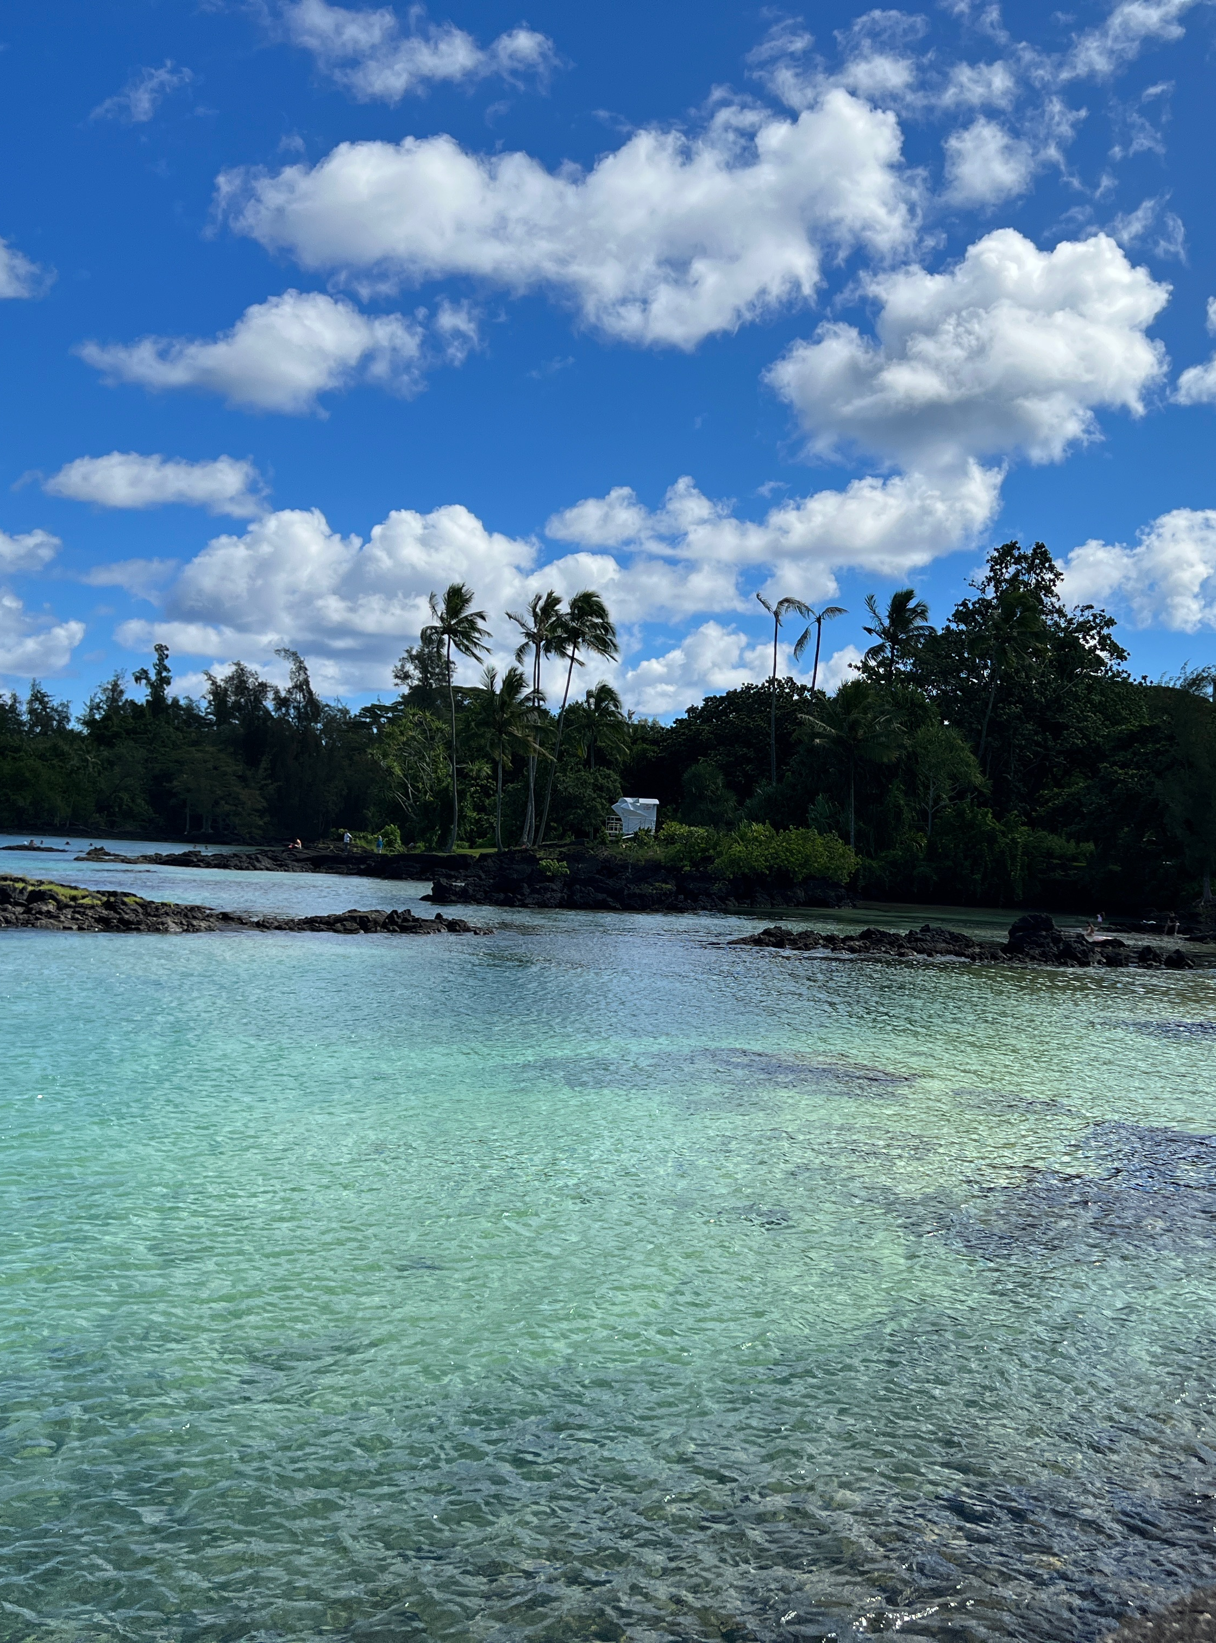
PROJECT PARTNERS
County of Hawai‘i
Arizona State University’s Center for Global Discovery and Conservation Science (GDCS)
University of Hawai‘i Hilo
Hilo, Hawai'I Island
Image Credit: Dr. Roberta Martin
Notes:
For this project, we partnered with the County of Hawai'i to target their needs for geospatial data expansion in decision-making. We worked under the advisorship of Arizona State University's Center for Global Discovery and Conservation Science, which is based in Hilo, HI.
University of Hawai'i Hilo was also involved in creating the project proposal.
------------------------------Image Information Below ------------------------------
•Images Credit: Hilo, Hawai‘i Island. Taken by Dr. Roberta Martin.
•Images Source: Dr. Roberta Martin (AZ Fall '21 Science Advisor)

Slide 4
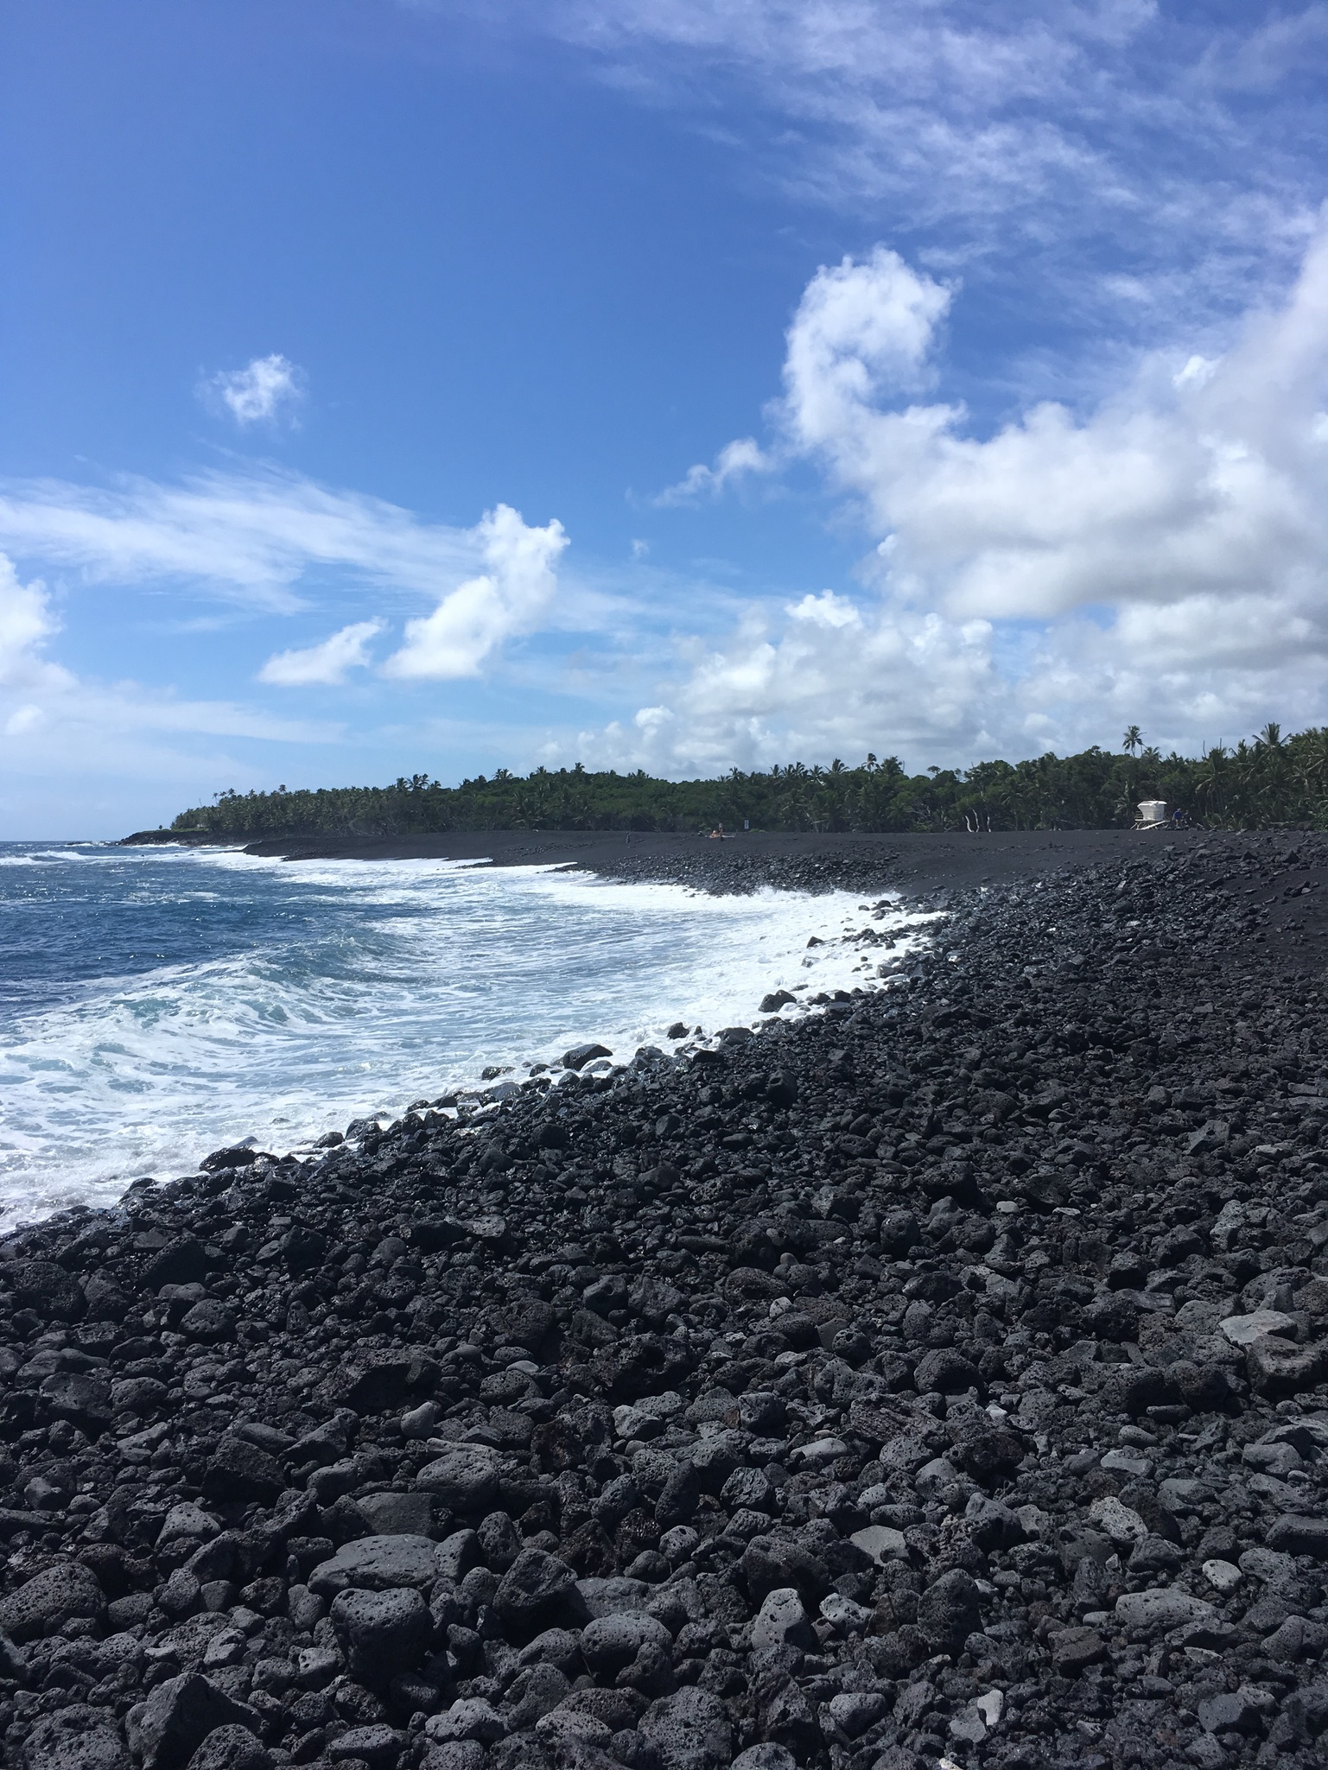
COMMUNITY CONCERNS
Climate change impacts:
Ex: Sea-level rise, flooding, intensified storms
Vulnerability to coastal threats due to:
Intensified natural phenomena such as king tides
Increased anthropogenic pressure on coastlines (i.e., urbanization)
High isolation from other land masses
Pohoiki Beach, Hawai‘i Island.
Image Credit: Anna Mikkelsen
Notes:
Main community concerns surround climate change and its impacts, which include sea-level rise, coastal flooding, and intensified storms. As Hawai'i Island has already begun to see the impact of climate change, finding ways to mitigate and adapt are of great interest to the community.
Because it is surrounded by water on all sides, Hawai'i Island is particularly vulnerable to coastal threats. For example, with climate change comes intensified natural phenomena, like king tides and stronger hurricanes. With increased development along the coastlines, the amount of people vulnerable to coastal threats are increasing. Lastly, the high isolation from mainland land masses makes receiving aid for disasters more difficult for the Island.
------------------------------Image Information Below ------------------------------
•Images Credit: Pohoiki Beach, Hawai‘i Island. Taken by Anna Mikkelsen.
•Images Source: Anna Mikkelsen (DEVELOP AZ Fall '21)

Slide 5
COMMUNITY CONCERNS
Difficulties assessing shorelines due to:
Unique Hawai'i Island characteristics
Diverse land cover types
Large spatial extent
Diverse topography
Disproportionate impact of coastal threats to vulnerable populations.
Ka Lae, Hawai‘i Island.
Image Credit: Anna Mikkelsen
Notes:
Additionally, Hawai'i Island holds many characteristics that make it difficult to assess shorelines properly. For example, Hawai'i Island has rocky shorelines that makes it difficult to capture spatial data for the area. The sheer size of the island and its diverse topography further makes it more difficult to capture spatial data for shorelines.
There is also disproportionate impacts of coastal threats to vulnerable populations. Coastal communities are vital to island community well-being, livelihoods, and culture, making these communities critical for the social, ecological, and economic survival of islands.
------------------------------Image Information Below ------------------------------
•Images Credit: Ka Lae, Hawai‘i Island. Taken by Anna Mikkelsen.
•Images Source: Anna Mikkelsen (DEVELOP AZ Fall '21)

Slide 6
PROJECT OBJECTIVES
Build geospatial capacity within the county to use NASA Earth observation data.
Classify land cover across the island.
Create a framework and tools for the county to analyze disaster risk in the future.
Test the framework utilizing Hurricane Lane as a case study.
Demonstrate an example of how our tools could be used to assess exposure and vulnerability variables in relation to flood.
Notes:
The County has identified a desire to utilize more NASA Earth Observation data rather than rely on contractors to conduct GIS analysis as NASA earth observation data is available for free and is consistently updated. Therefore, one of the main goals of this project was to aid the County in building their geospatial capacity to use NASA Earth observation data. We did this by creating several tools that utilize earth observation data for the County to use in future environmental and disaster mitigation research, including a program to classify land cover across the island, a tool to extract storm flood extents from historical floods, and a tool that maps extreme rainfall over a period of interest. For the purposes of this project, the team used the 2018 disaster of Hurricane Lane, a powerful cyclone that brought heavy rains and flash flooding to the island, as a case study to test the flood and precipitation tools on. Incorporating social and physical vulnerability variables and exposure metrics such as building and population data allowed the team to create an example of how the County could analyze the risk and effects of disasters in the future once they acquire the data to do so.
------------------------------Image Information Below ------------------------------
All icons from Powerpoint.

Slide 7
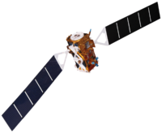
EARTH OBSERVATIONS
Landsat 5 TM
Landsat 8 OLI
Sentinel-1 C-SAR
Sentinel-1 SAR - Storm
Landsat 5 TM – Land Cover
Landsat 8 OLI – Land Cover
2013
1984
2014
Sept. 2021
Images Credit: NASA DEVELOP
Notes:
We utilized Earth Observation data from these three satellites in order to meet the County's needs. Landsat 5 and Landsat 8 Surface Reflectance data were used in the creation of a supervised land cover analysis tool. Sentinel-1 data was used to map storm flood extent.
------------------------------Image Information Below ------------------------------
•Images Credit: NASA DEVELOP
•Images Source: https://www.devpedia.developexchange.com/dp/index.php?title=List_of_Satellite_Pictures (Images provided by NASA DEVELOP)

Slide 8
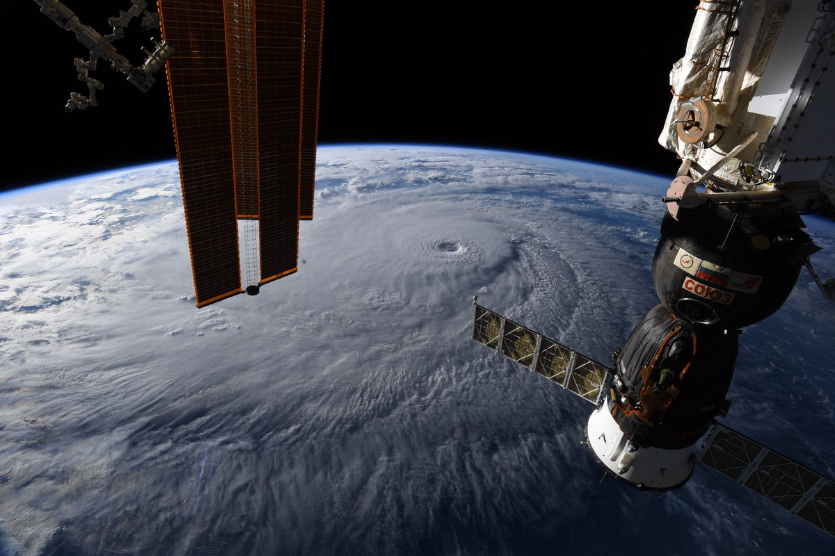
Study Period
Jan. 1981 – Sept. 2021
Using NASA Earth Observations
Frequently updated
Free, readily available
High temporal resolution
Covers large spatial ranges
Hurricane Lane (2018) from the International Space Station
Image Credit: NASA GSFC
Notes:
For this project, we looked at Earth Observation data ranging from January 1981 to September 2021, to observe how coastal threats have changed over this period and to create accurate models for the future.
Using NASA Earth Observation data provides the County of Hawai'I with frequently updated data that is free and readily available. With high temporal resolutions, Earth Observation data provides a more detailed, nuance perspective of Hawai'I Island, and is able to cover data for the large spatial ranges. The benefits of using Earth Observation data addresses many previous issues of data collection that the Island presents.
------------------------------Image Information Below ------------------------------
•Images Credit: Hurricane Lane from the ISS.
•Images Source: NASA GSFC. (2018). Retrieved from https://www.flickr.com/photos/gsfc/44154169732/in/photostream/

Slide 9
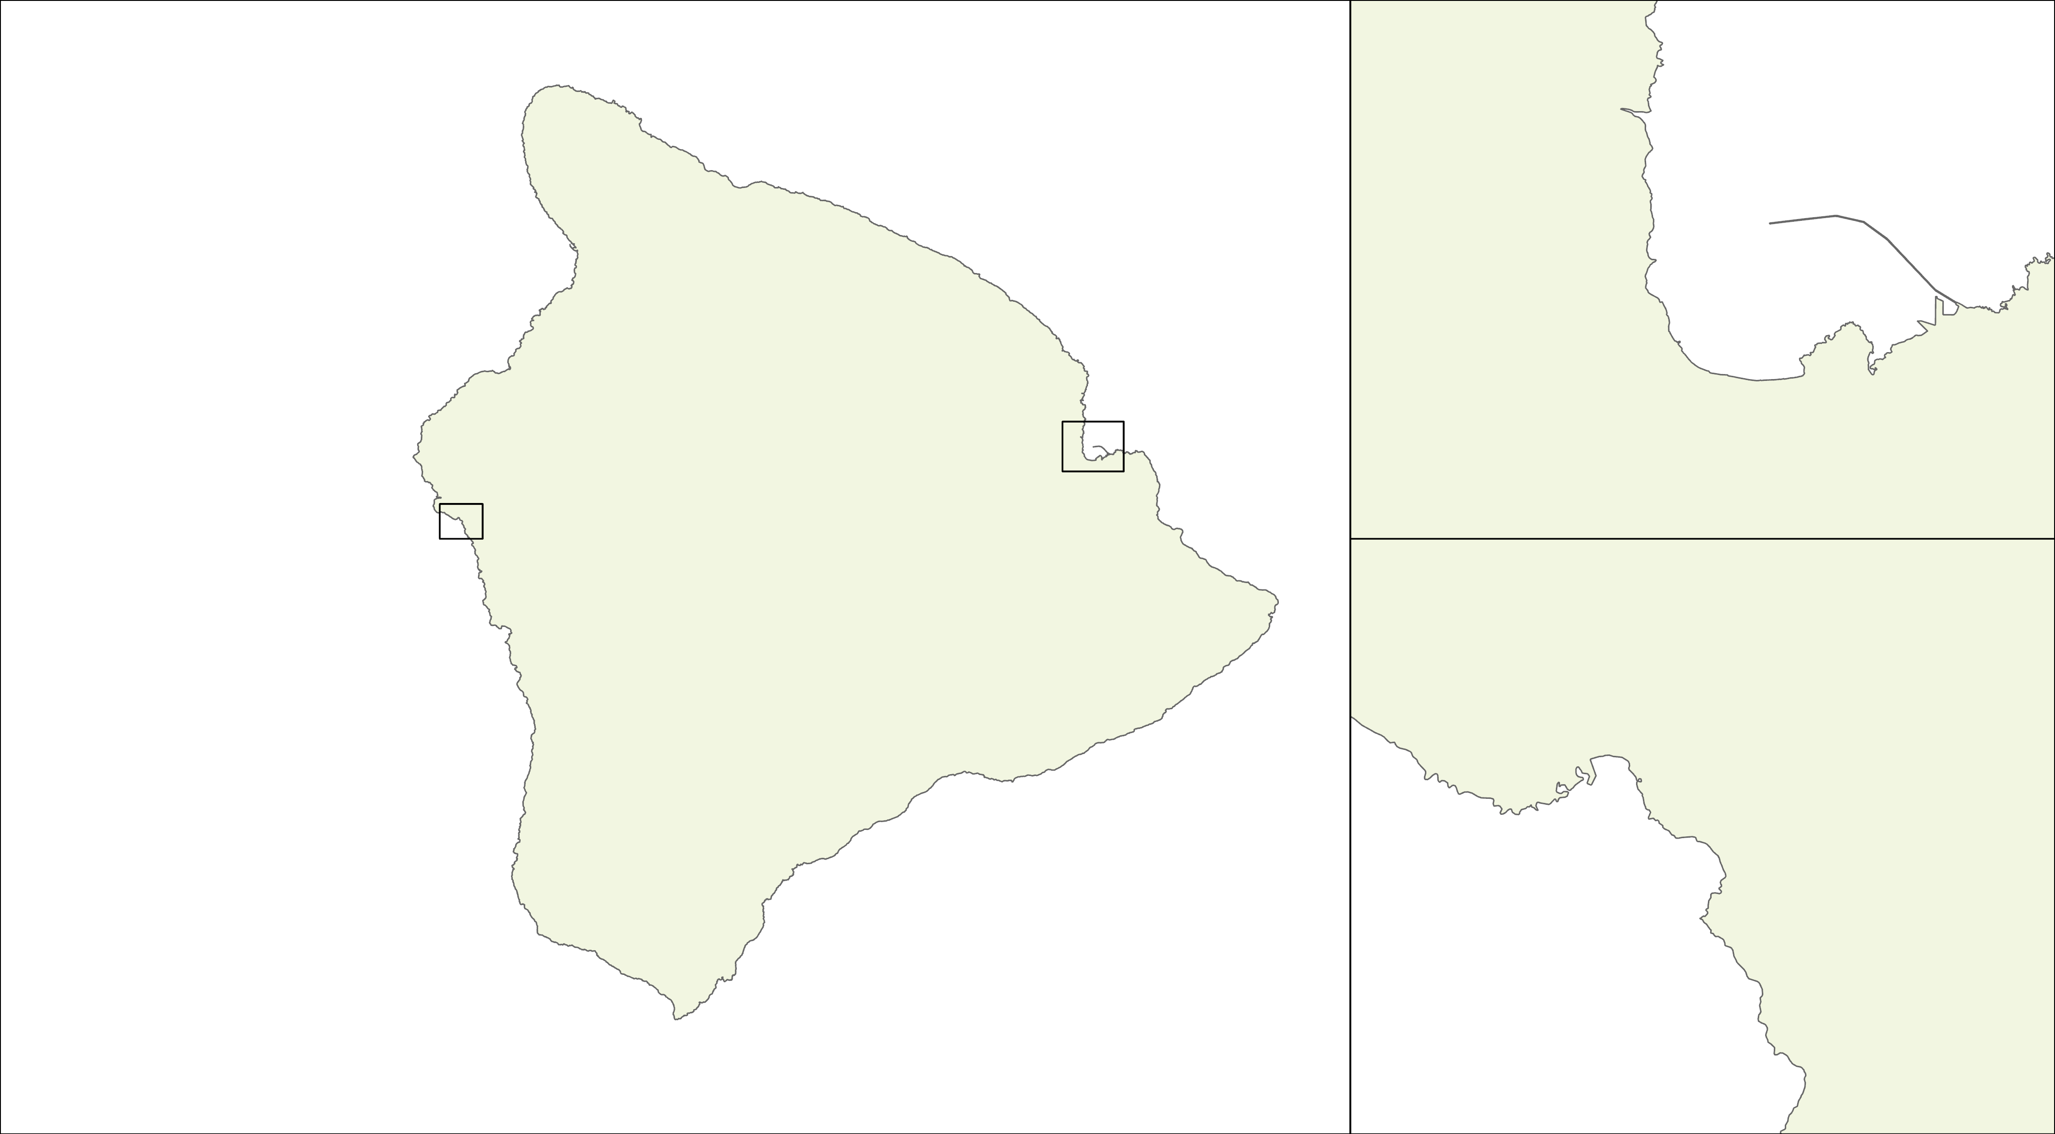
Maps – Focus Areas
Hilo
Hilo
Kailua-Kona
Kailua-Kona
Notes:
Given that we are interested in human impact due to these flood events we paid a closer mind to the two major population centers on the Island – Hilo and Kailua-Kona.

Slide 10
DATA SOURCES
Indicators | Data Source
Disaster: Sea Level Rise | County: State of Hawaiʻi Sea-Level rise Passive Flooding Scenario Maps
Disaster: Storm Extent | Satellite: Sentinel-1 SAR GRD
Disaster: Precipitation | Satellite: CHIRPS Daily : Climate Hazards Group InfraRed Precipitation With Station Data
Vulnerability: Land Cover | Satellite: Landsat 8 Operational Land Imager (OLI), Landsat 5 Thematic Mapper (TM)
Vulnerability: American Community Survey | US Census Bureau and Hawaii Statewide GIS Program
Exposure: Building Footprint | Open Street Maps
Exposure: Population | US Census Bureau, Gridded Population of the World Version 4.11 (GPWv411)
Notes:
To approach data processing, we started with three types of indicators that makes up risk: Disaster, Vulnerability, and Exposure. Within each indicator type, we retrieved data from the following sources to work with.

Slide 11
DATA PROCESSING
Indicators
Data
Processing
Analysis
=
Output
HydraFloods
Disaster
Indicators
Sentinel1-SAR
Precipitation
'Flag' Approach
HiFloRT
Toolbox
Land Cover/ Land Cover Change
Supervised Random Forest
Comparative
Geostatistical
Analysis
Vulnerability Indicators
=
Maps
Social Variables
Normalizing and Aggregation
Statistics
Population Density/Count
Exposure
Indicators
Building Footprint OSM
Reprojection
Methodology for Data Processing
Notes:
(Slide for public-facing closeout)
The above highlights our methodology and data processing. The indicator categories were chosen with the intention of one day being used in a risk assessment index when sufficient exposure events (like hurricanes, floods, etc.) could be accumulated in a repository to reflect a statistically significant number of events. This is the methodology for ONE EXPOSURE EVENT. For each indicator, the data was sourced from a variety of satellites and governmental entities and our processing highlights key ways of accomplishing a replicable and reproducible set of useful analytic tools. We ran it through various processing techniques in order to create layers for a comparative geostatistical analysis. The ultimate outputs were the HiFloRT toolbox, which contains individual tools for examining land cover, flood extent, and precipitation, the maps of each dataset, and relevant geostatistics.

Slide 12
Indicators
Data
Processing
Analysis
=
Outputs
HiFloRT
Toolbox
Sentinel1-SAR
Hydrafloods
Disaster
Indicators
Storm Flood Extent
Daily Precipitation
HiLO Tool
'Flag' Approach
HydraFloods Tool
Flood Proxy Extent
Comparative
Geostatistical
Analysis
FloPPE Tool
Land Cover/ Land Cover Change
Vulnerability Indicators
Landsat 5 TM & 8 OLI
Supervised Random Forest
=
Statistics
Social Variables
Social Vulnerability
Normalizing and Aggregation
Population Density/Count
Population Density/Count
Exposure
Indicators
Maps
Building Footprint OSM
Reprojection
Building Footprint
F Methodology for Data Processing
Notes:
(Slide for partner presentation)
The above highlights our methodology and data processing. The indicator categories were chosen with the intention of one day being used in a risk assessment index when sufficient exposure events (like hurricanes, floods, etc.) could be accumulated in a repository to reflect a statistically significant number of events. This is the methodology for ONE EXPOSURE EVENT. For each indicator, the data was sourced from a variety of satellites and governmental entities and our processing highlights key ways of accomplishing a replicable and reproducible set of useful analytic tools. We ran it through various processing techniques in order to create layers for a comparative geostatistical analysis. The ultimate outputs were the HiFloRT toolbox, which contains individual tools for examining land cover, flood extent, and precipitation, the maps of each dataset, and relevant geostatistics.

Slide 13
HiFloRT – Hawaii Flood Risk Toolbox
HiLO Tool
Hawaii Land Observations
HydraFloods Tool
FloPPE Tool
Flood Proxy Precipitation Extent
Notes:
The above showcases the HiFloRT toolbox which is a package of individual tools we developed for the County. When used in tandem this toolbox can assess land cover and change as well as the risk of coastal flood and precipitation threats to Hawai'i Island.
We will further describe each of these tools in the following section.
------------------------------Image Information Below ------------------------------
All icons from Powerpoint.

Slide 14
LAND COVER
Notes:
First we will talk about a tool created for classifying land cover types in Hawai'I Island.
------------------------------Image Information Below ------------------------------
All icons from Powerpoint.

Slide 15
HiLO Tool – Hawai'i LandCover Observations
Google Earth Engine Tool – Back End
Data
Training
Classification
Validation
Landsat 5 SR
1984 - 2012
References:
ESRI 2020 LC
CCAP 2010 LC
CAH 2017 LC
GEE 2021 Satellite Basemap
Supervised Random Forest Classification
Withheld 10% training for validation
Landsat 8 SR
2013 - Now
Classes:
Urban
Water
Barren Land
Forest
Shrubland
Grassland
Overall Accuracy
Scale factors and cloud/shadow masking
Validation Error Matrix
100 – 200 training points/class
Add NDVI, NDMI, NDWI,NDBI Indices
2 sets of training points for different sensors
Notes:
The HiLO tool, which stands for Hawai'i LandCover Observations, is a tool that allows the user to generate land cover maps for Hawai'I Island from 1984 – the current year. It utilizes data from Landsat 5 TM Surface Reflectance and Landsat 8 OLI Surface Reflectance products from the Google Earth Engine database. The code first imports the data collections from the database, with the years 1984 – 2012 for Landsat 5 and 2013 – current for Landsat 8, then applies a scaling factor function and a cloud and cloud shadow masking function to both Surface Reflectance products. The script adds Normalized Difference Vegetation Index, Normalized Difference Moisture Index, Normalized Difference Water Index, and Normalized Difference Built-Up Index to the bands of the image collections in order to aid the classifier in identifying vegetation, water, and urban surfaces. We utilized ESRI 2020 land cover map, the Carbon Assessment of Hawaii 2017 Land cover map, NOAA’s Coastal Change Analysis Program (C-CAP) 2010 land cover map, and the GEE 2021 high-resolution satellite basemap imagery as references for collecting training points for each class. About 100 –200 training points were collected for each class, and two different sets of training points and classifiers were created for each sensor. The script utilizes a supervised random forest classification algorithm for the classification of the imagery, with the classes urban, water, barren land, forest, shrubland and grassland. The classifier had trouble differentiating between croplands and forests, because many of the crops on the island are trees/shrubs (papaya, macadamia), so a croplands class was left out and instead added in later from a 2020 agriculture vector map downloaded from the Hawaii GIS Portal, this is a limitation of the classifier and further work could be done to improve its accuracy in classifying agricultural classes. 10% of the training points were withheld for validation and were used to produce overall accuracies and validation error matrices for the classified images produced.
------------------------------Image Information Below ------------------------------
All icons from Powerpoint.

Slide 16
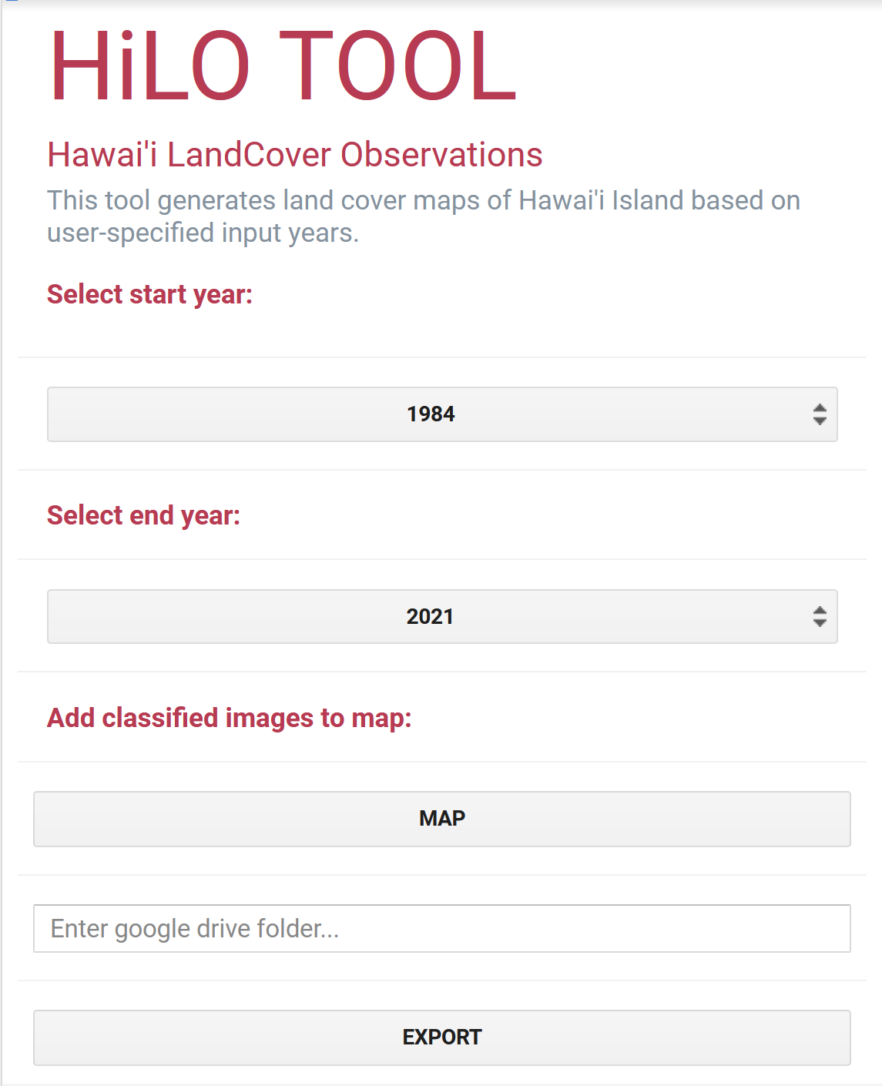
HiLO Tool – Hawaii LandCover Observations
Google Earth Engine Tool – Front End (GUI)
Notes:
On the front end side of the tool, the user interacts with a graphical user interface, entering their dates of interest, with options ranging from 1984 to the current year. The user then clicks the "map" button which will trigger the script to run the classification and add the classified images for each year to the GEE map. Then, the user has the option to export the produced imagery to their google drive by entering their folder name in the textbox and clicking "export". If no drive folder is specified, the images will export to their root drive folder.
------------------------------Image Information Below ------------------------------
All icons from Powerpoint.

Slide 17
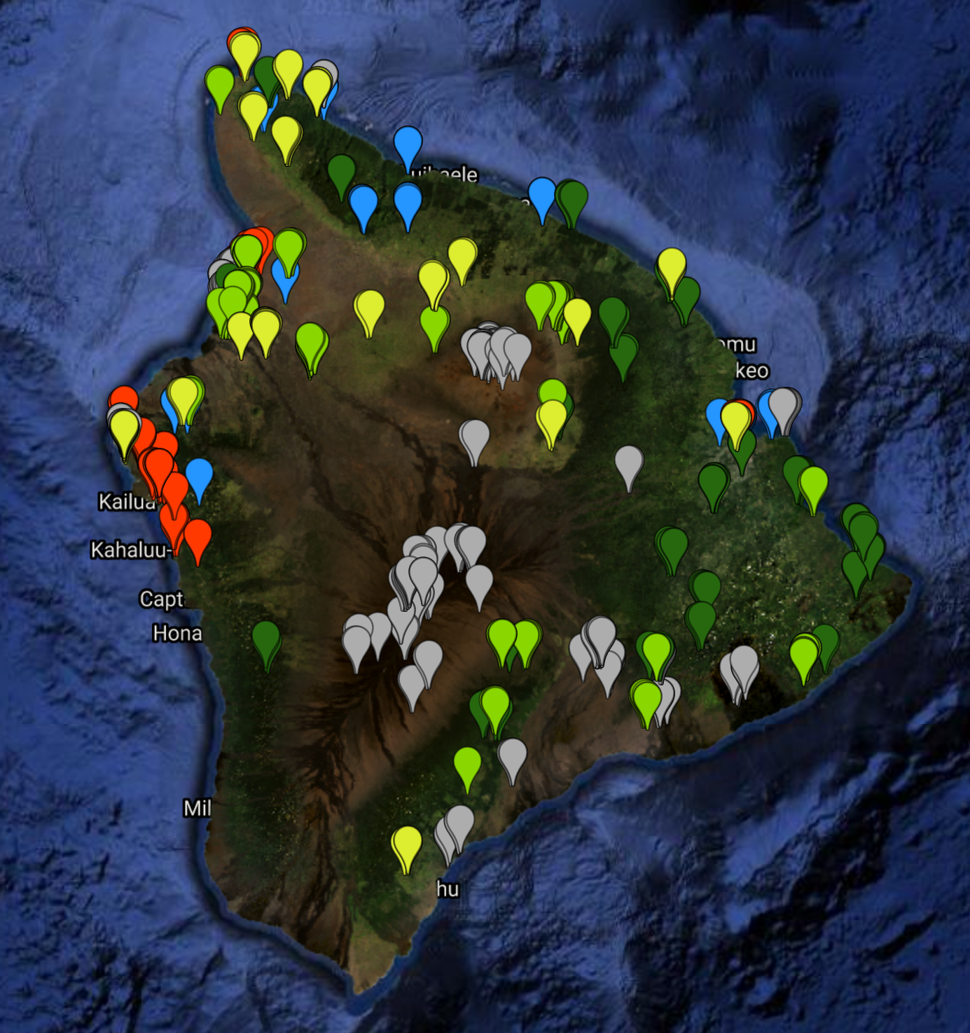
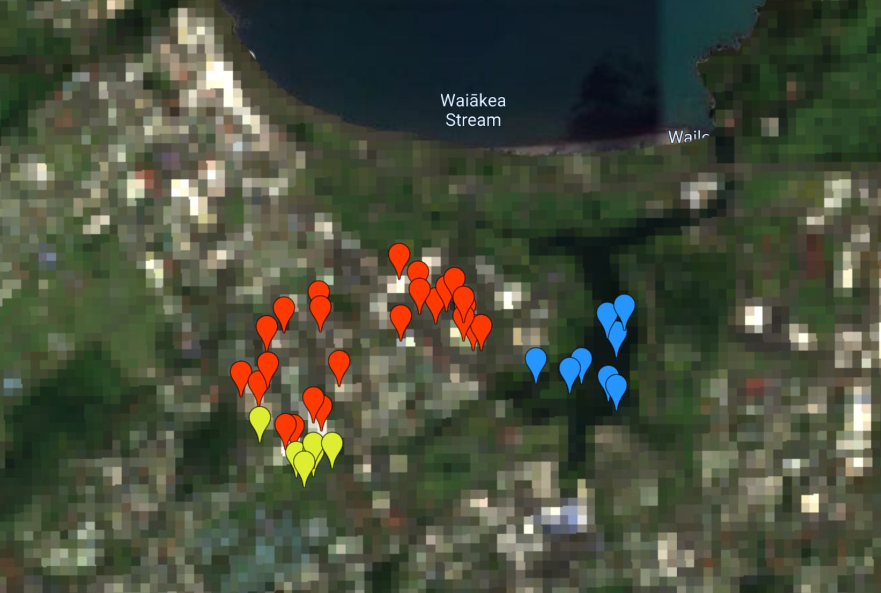
TRAINING POINTS
Notes:
The above shows an example of training points used to train the Landsat 8 classifier, with the various colors indicating different land cover types. The zoomed in section shows a portion of Hilo, which has diverse land cover in a small area.

Slide 18
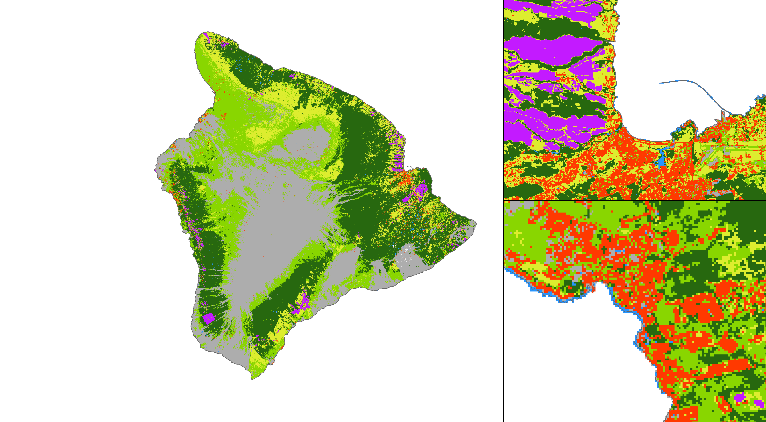
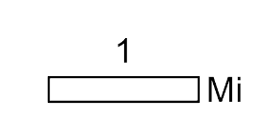
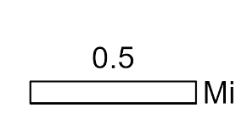
OUTPUTS – LAND COVER MAP 2021
Land Cover Class
Hilo
Urban
Water
Barren Land
Forest
Shrubland
Grassland
Cropland
Kailua-Kona
Notes:
The above is the output map of the HILO tool for 2021 Landsat 8 imagery. The GUI interface allows for the analysis of land cover types across a wide temporal window. The zoomed in portions of the map show Hilo (top right) and Kailua-Kona (bottom right). The classifier for this image had an overall accuracy of 92%.

Slide 19
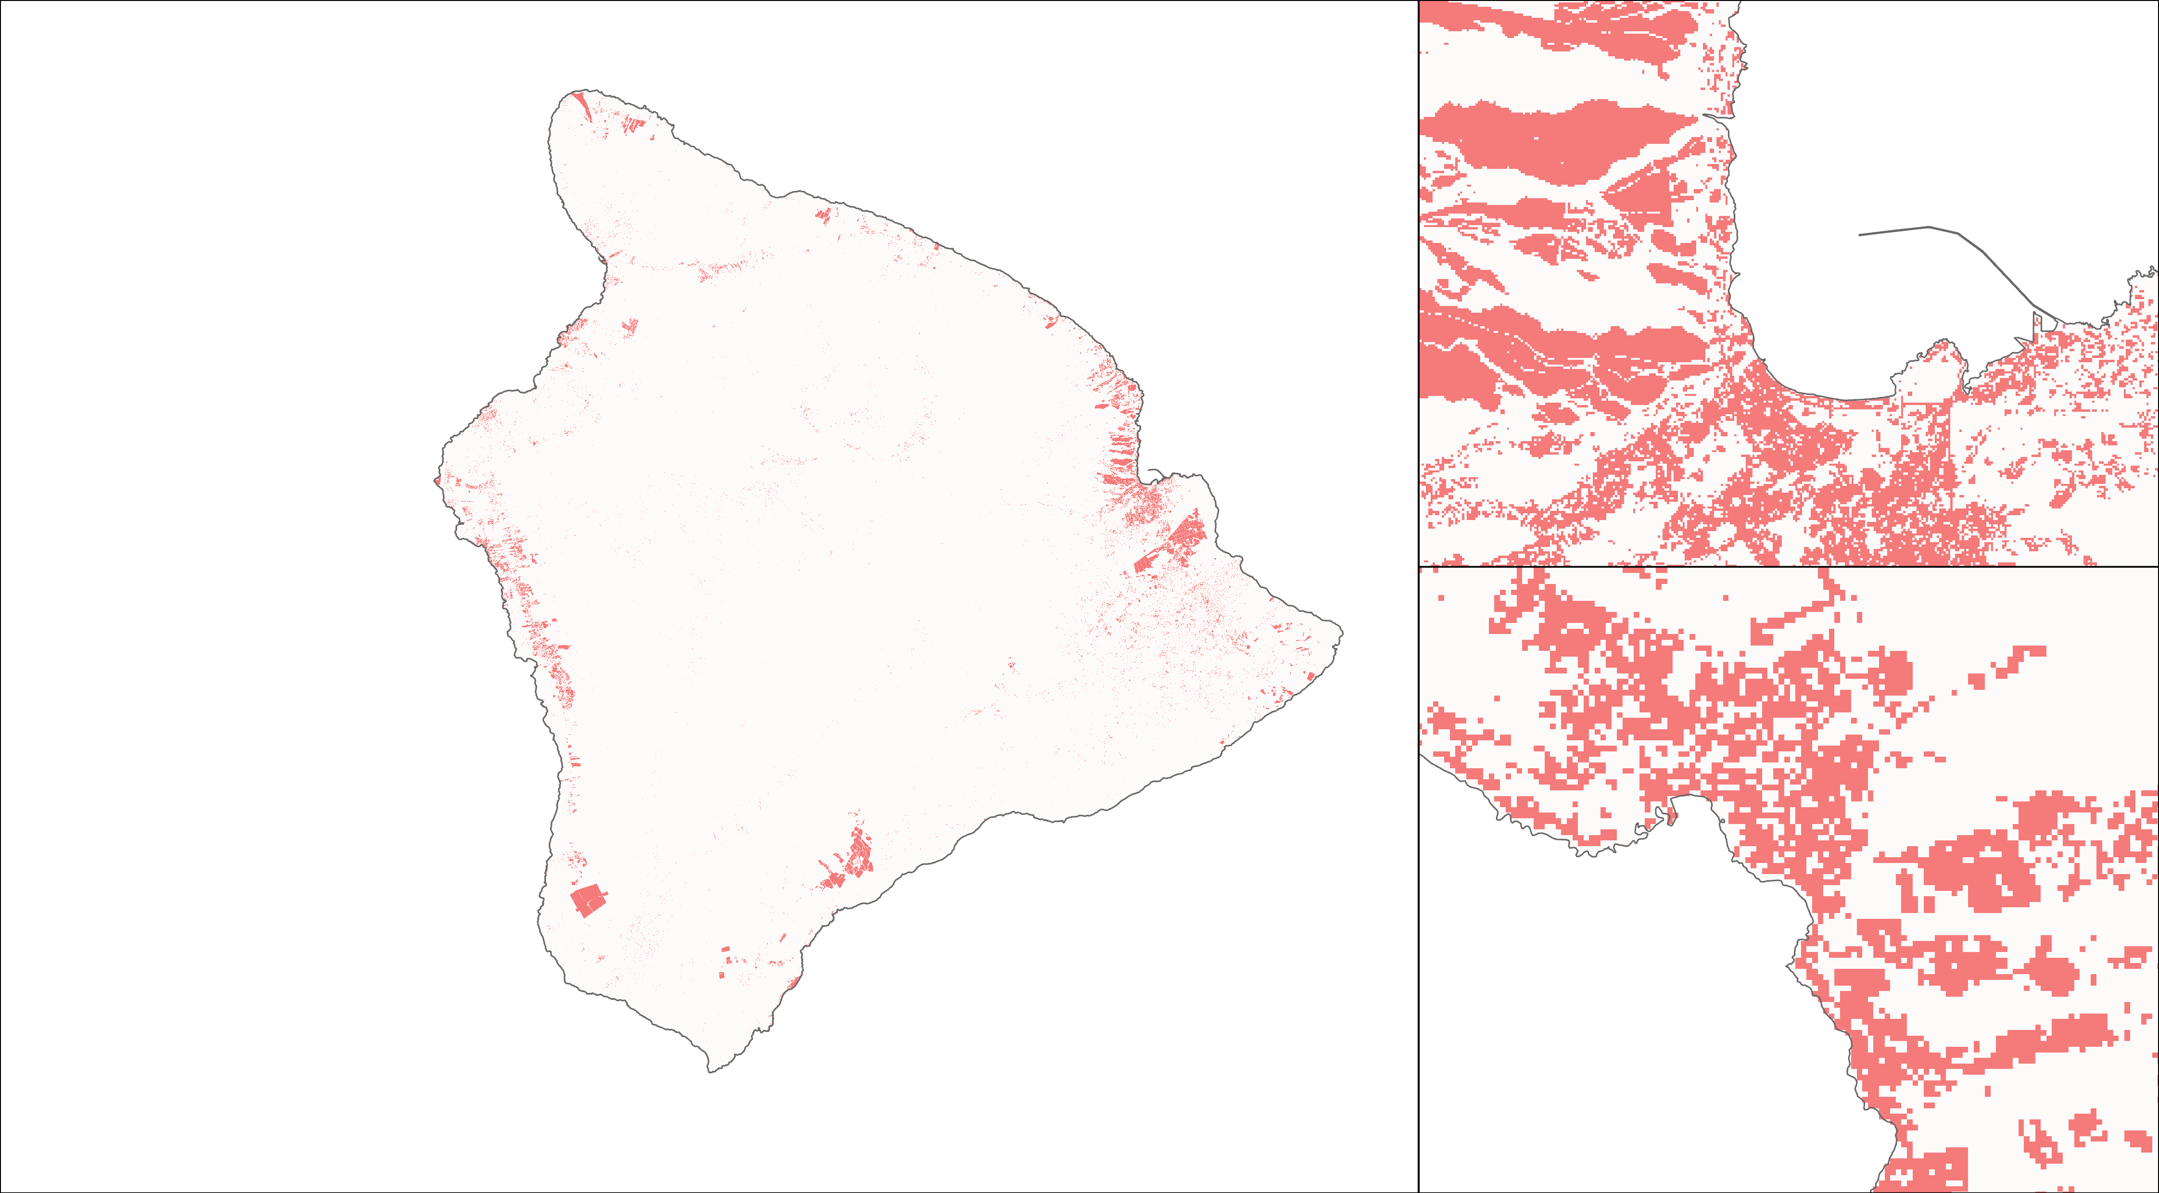
OUTPUTS – LAND COVER SUSCEPTIBILITY 2021
Land Cover Risk
Low risk
Hilo
High risk
Kailua-Kona
Notes:
Given that land cover types are more or less susceptible to different disasters this layer highlights which of the land cover types are at heightened risk due to flooding and sea level rise, for the purposes of this analysis we chose the "urban" and "cropland" classes. This can be easily swapped depending on disaster (erosion, wildfire, lava flow, etc.)

Slide 20
FLOOD EXTENT
Notes:
Next, we will share a tool to delineate flood extent following heavy rains or storms, with Hurricane Lane, 2018 as an example.
------------------------------Image Information Below ------------------------------
All icons from Powerpoint.

Slide 21
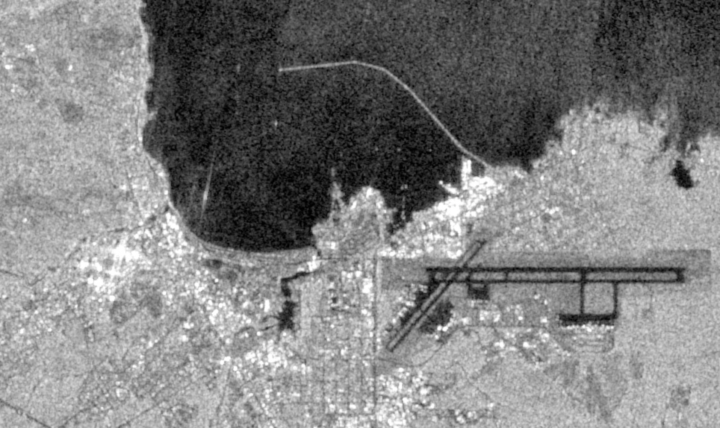
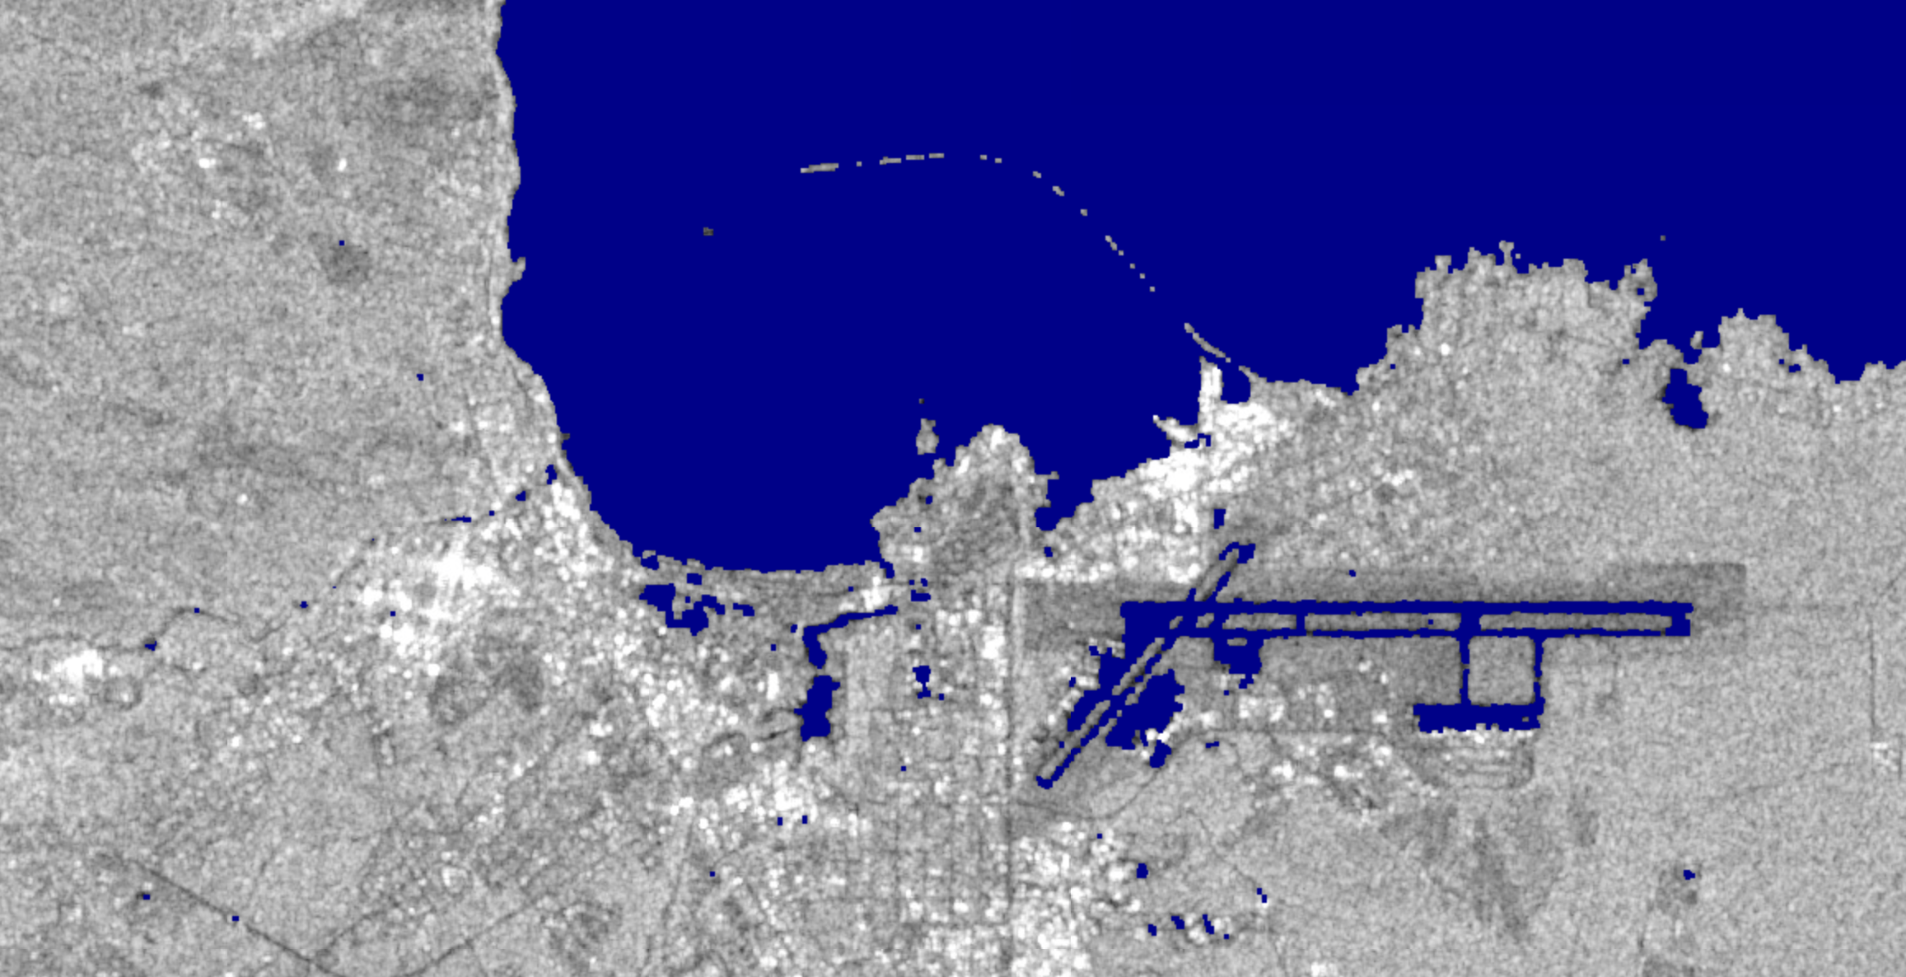
HydraFloods Tool
Sentinel-1 image and flood extent, Hilo, Aug 2018
Purpose: Map flood extent
How:
Detects surface water from SAR imagery
Uses HydraFloods algorithm
Masks out slopes and elevated areas
Usability:
Python API for Google Earth Engine
User-defined time range, region, flood sensitivity and buffer
View output or save as map
Notes:
(Slide for public-facing closeout)
The purpose of this tool is to map flood extent. It works by detecting surface water from sentinel-1 SAR images, using an existing open-source tool called HydraFloods. This tool differentiates each pixel between water or not water. Then we mask out slopes above 10 degrees and elevated areas -
It runs on a google collab notebook so all this processing is done in the cloud. It is a python API for google earth engine and doesn’t require software downloads or installation
The user defines time range, e.g after a storm and a region of interest - the default is Hawaii Island. Then resulting maps can be viewed in the script or output as a .tif file
Lastly, there is an option to add a buffer and adjust the flood sensitivity, as well as what slopes of elevations to use as thresholds. But all these are set to reseanable defualt values and the script runs as is.
------------------------------Image Information Below ------------------------------
All icons from Powerpoint.
Images; top screenshot of sentinel-1 image, Hilo Bay, August 24, 2018
Images; bottom screenshot of flood extent output from tool overlain on of sentinel-1 image, Hilo Bay, August 24, 2018.

Slide 22
HydraFloods Tool
Google Collab: Python API for Google Earth Engine
User Interaction
Processing
Output
Define date range
Speckle Filtering
Define region
Terrain Filter
Flood extent map
Delineate Surface Water
Flood extent map
with buffer
Mask out slopes
Mask out areas above HAND
Create buffer
Notes:
This is graphic illustrates the workflow for the hydrafloods tool.
The user defines date range and region at the start of the script
Then, sentinel 1 imagery is aquired from GEE, and processed with to reduce speckles and with a terrain filter
Surface water is deliniates from hydrafloods.
From the flood map, the script masks out slopes and areas 20 m above nearest drainage – because we expect water to flow toward drainage points and would not expect flood on slopes.
The algorithm is limited in detecting flood in urban areas / by buildings, so we create a buffer around flood extents to assess which urban areas are impacted. This can also be changed.
Laslty, the reuslts can be viewed in the script or exported as a tif file to your google drive.
------------------------------Image Information Below ------------------------------
All icons from Powerpoint.

Slide 23
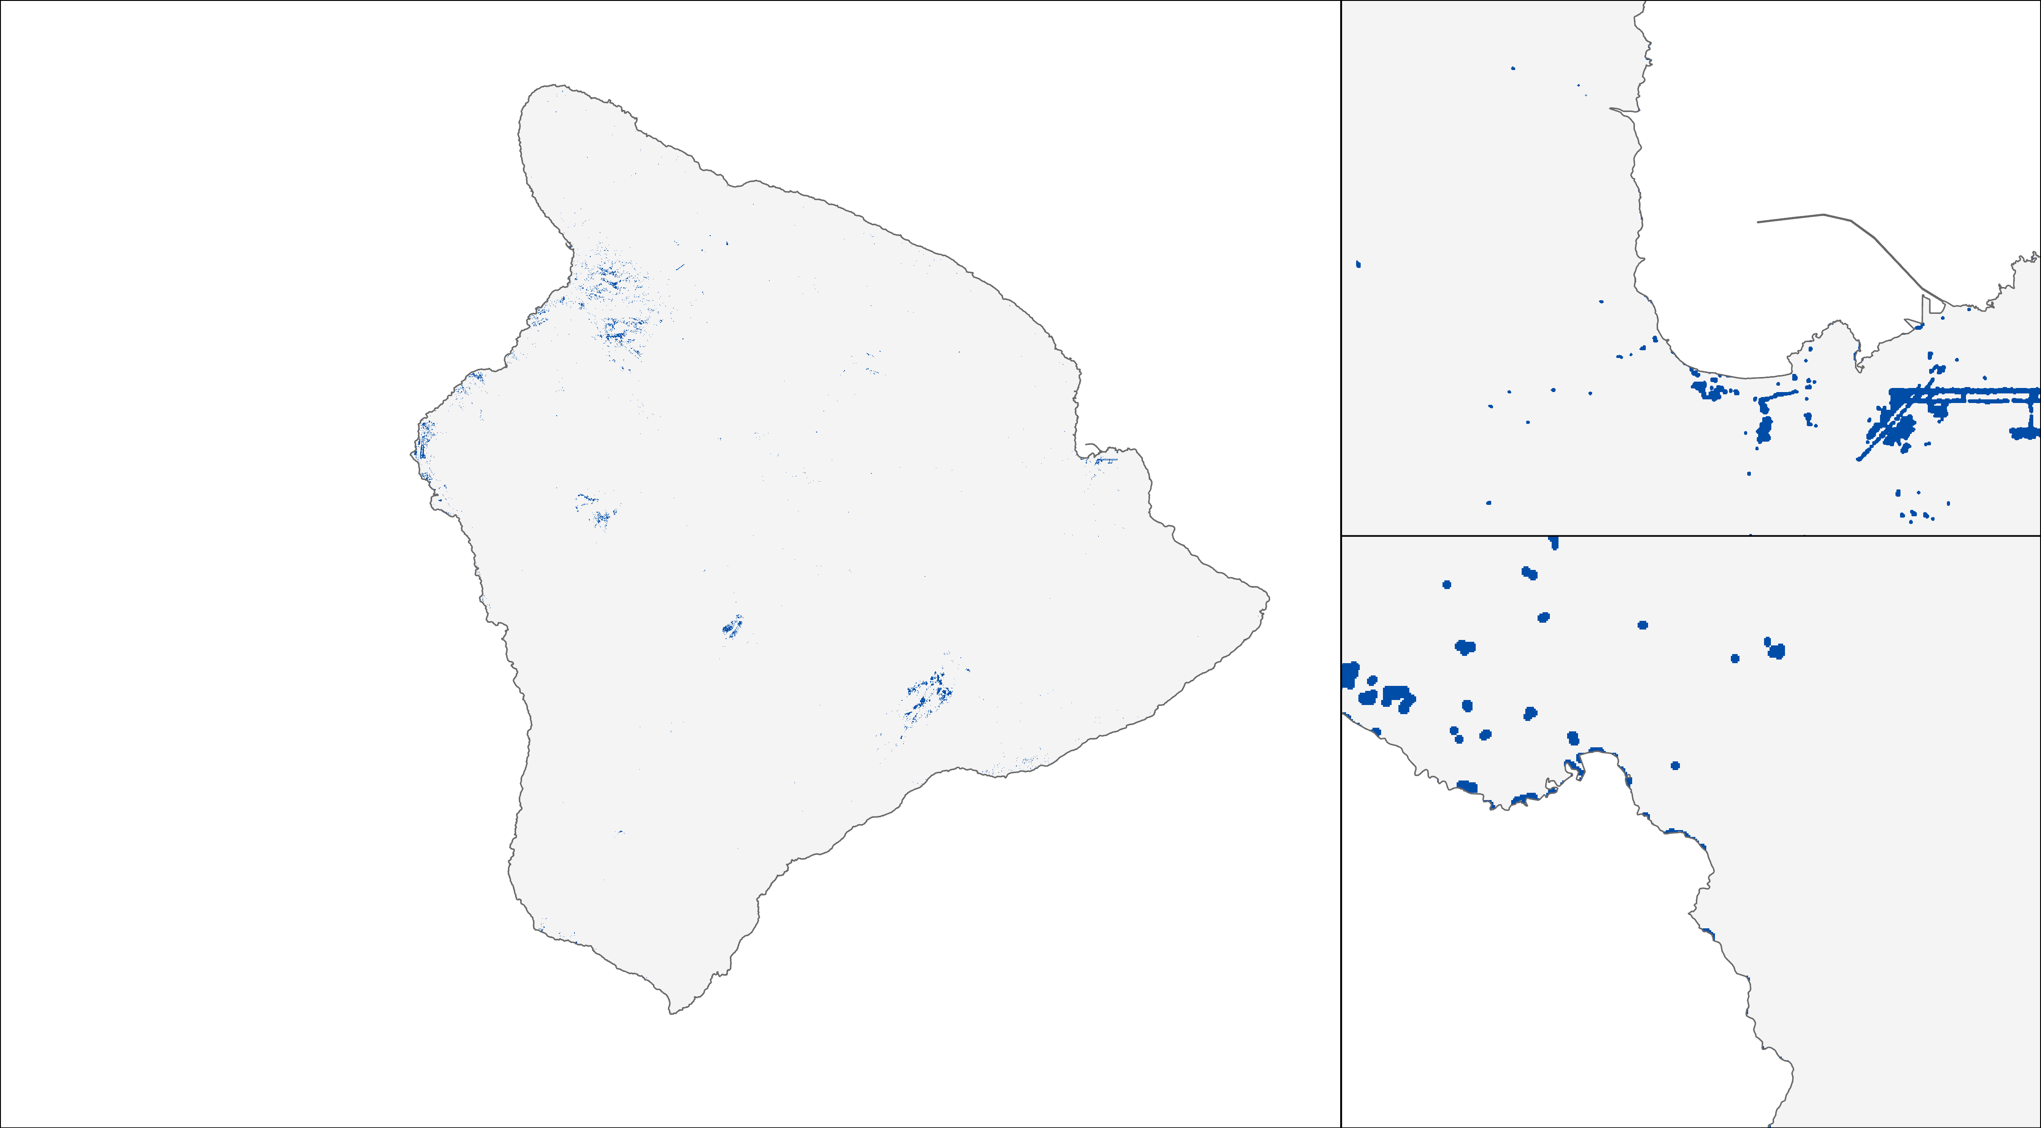
OUTPUTS – STORM FLOOD MAP
Storm flood
No flood
Hilo
Flood
Kailua-Kona
Notes:
This is an example output for hurricane lane for 2018. When you zoom in you can view flooded areas better. Overall it captures open flooded areas, such as Hilo Bayfront, but also underestimates some flood extents around Hilo.

Slide 24
PRECIPITATION
Notes:
Next, we will discuss the precipitation flood proxy tool.
------------------------------Image Information Below ------------------------------
All icons from Powerpoint.

Slide 25
FloPPE – Flood Proxy Precipitation Extent
Google Earth Engine Code Editor
Creating Threshold
CHIRPS Daily: Climate Hazards Group InfraRed Precipitation With Station Data (Version 2.0 Final)
Loads data for Historical Period 1981-2010
Select months Nov – Mar (Wet Season) &
band 'precipitation'
Take 99th (Default) and 90th (Optional) Percentiles
Analyzing Event
CHIRPS Daily: Climate Hazards Group InfraRed Precipitation With Station Data (Version 2.0 Final)
Select Event Dates (1 to 4 days) &
Band 'precipitation'
Iterate through a function of greater-than-equal-to operator against Historical 99th and 90th Perc. thresholds
Outputs are binary 'flag' maps of areas receiving more than 90th and 99th perc. Of rainfall
i.e. Possible areas to flood (Chu et al 2008, Groisman et al 2004 – Flood Proxy maps
Notes:
(Slide for partner presentation)
Google Earth Engine (GEE) script
Considers historical data from 1981-2010 for Nov-Mar
Creates a threshold of historical data by taking 90th and 99th percentiles for heavy and extreme rainfall definition as defined by chu et al 2008 and Groisman et al. (2004)
Per their study areas receiving more than 90th and 99th perc of rainfall have higher probability of experiencing flooding
We use this theory to create flood proxy maps for high estimate of risk for policymakers
The code lets you select any number of days for an event you want to analyze
Calculates areas receiving more than 90th and 99th percentile of rainfall during the event selected
Output is a flood proxy or extreme event map
------------------------------Image Information Below ------------------------------
All icons from Powerpoint.

Slide 26
FloPPE – Flood Proxy Precipitation Extent
Google Earth Engine (GEE) script
Considers historical data from 1981-2010 for Nov-Mar
Creates a threshold of historical data by taking 90th and 99th percentiles
Select any number of days for an event
Calculates areas receiving more than 90th and 99th percentile of rainfall during the event selected
Output is a flood proxy or extreme event map
CHIRPS Mean Global Rainfall Nov 2020 – Mar 2021
Notes:
(Slide for public-facing closeout)
Google Earth Engine (GEE) script
Considers historical data from 1981-2010 for Nov-Mar
Creates a threshold of historical data by taking 90th and 99th percentiles for heavy and extreme rainfall definition as defined by chu et al 2008 and groisman et al 2004
Per their study areas receiving more than 90th and 99th perc of rainfall have higher probability of experiencing flooding
We use this theory to create flood proxy maps for high estimate of risk for policymakers
The code lets you select any number of days for an event you want to analyze
Calculates areas receiving more than 90th and 99th percentile of rainfall during the event selected
Output is a flood proxy or extreme event map
------------------------------Image Information Below ------------------------------
All icons from Powerpoint.
Image Credit: CHIRPS Mean Global Rainfall Nov 2020 – Mar 2021.

Slide 27
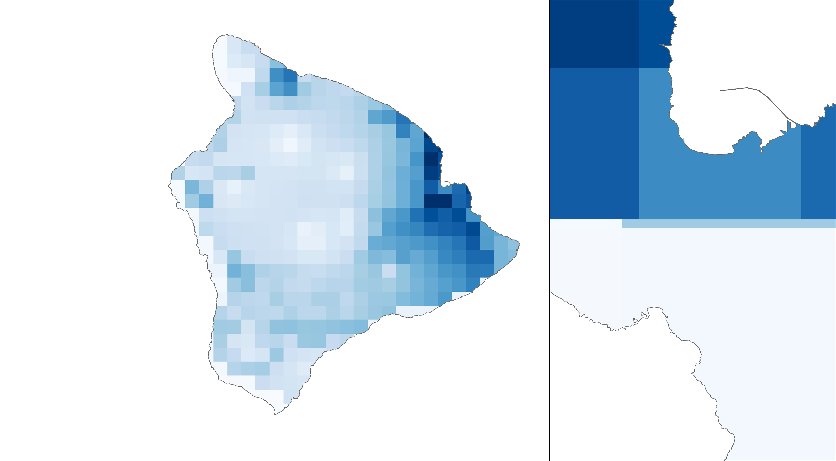
OUTPUTS – PRECIPITATION MAP
Accumulated precipitation
(mm/4day)
598
Hilo
7
Kailua-Kona
Notes:
Hurricane Lane ( 2018 ) is the sample exposure event used in the code as an extreme rainfall event. The map above shows 4 day accumulation of daily rainfall in mm from August 22nd to 25th.

Slide 28
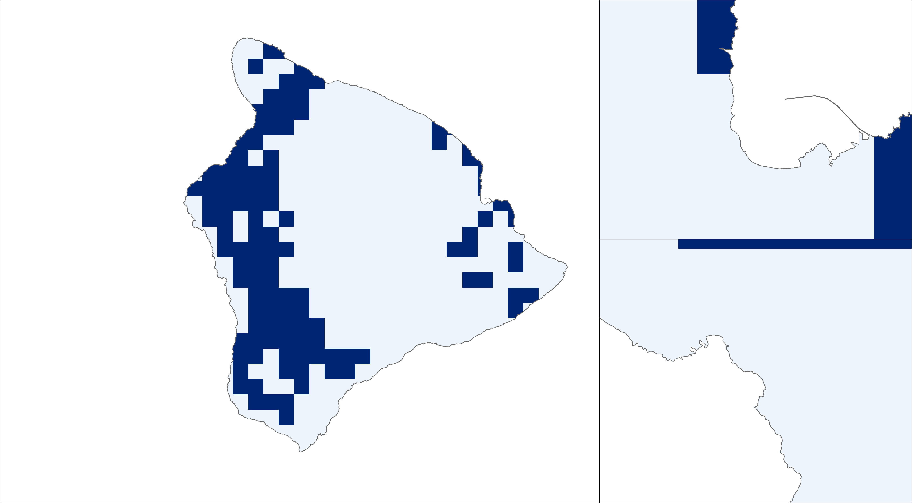
OUTPUTS – EXTREME RAINFALL MAP
Extreme rainfall
Rain below 99th percentile
Hilo
Rain above 99th percentile
Kailua-Kona
Notes:
This is the possible flood extent map after selecting areas receiving more or less than 99th percentiles of historical rainfall for Hurricane Lane.

Slide 29
SOCIAL VULNERABILITY
Notes:
Next, we'll talk about how we examined Social Vulnerability.
------------------------------Image Information Below ------------------------------
All icons from Powerpoint.

Slide 30
Social Vulnerability Processing
Data of interest identified from Census Bureau and Hawai'i GIS Repository (shapefile)
Downloaded and preprocessed into Excel sheet
Variables normalized and aggregated
Input into ArcGIS, saved into geodatabase
Indexed variables and ensured compatible data types
Joined with Shapefile
Rasterized and Geostatistics run
Notes:
The above highlights how the social vulnerability index was generated and constructed. First, data of interest was identified and collected from the Census Bureau and the Hawai'i Statewide GIS Program. Next, the data was downloaded and preprocessed into Excel, where the variables were normalized and aggregated. They were then inputted into ArcGIS Pro and saved into a geodatabase. The variables were indexed and ensured compatible data types. Then they were joined with the shapefile from the GIS Repository, and rasterized.
------------------------------Image Information Below ------------------------------
All icons from Powerpoint.

Slide 31
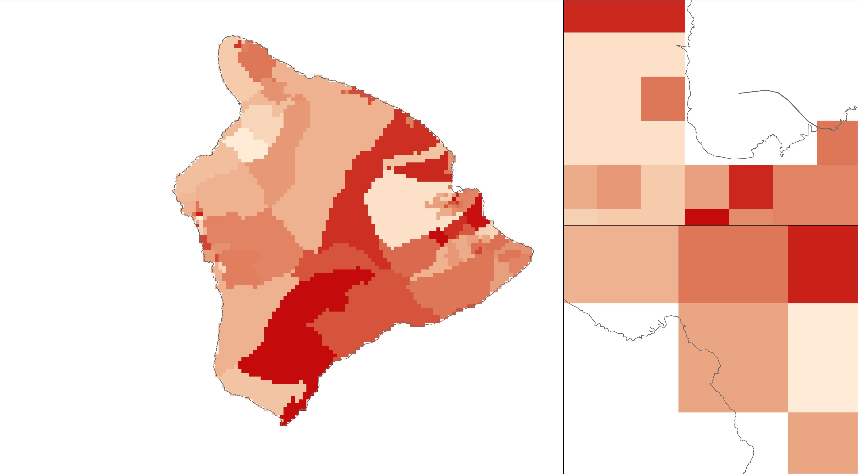
OUTPUTS – SOCIAL VULNERABILITY
Social vulnerability
Value
Hilo
High
Low
Kailua-Kona
Notes:
As a result, this layer showcases the final aggregated index for our four social indicators. The indicators chosen as the four core indicators for our index are as follows: Poverty, Limited English, Non-White Population, and Population over 65. These indicators were chosen due to the normative use of the Poverty, English Proficiency, and Minority population in popular policy tools like Environmental Justice Populations. Population over 65 and English proficiency were of specific interest to the County and reflects their specific data needs.
-----

Slide 32
BUILDING FOOTPRINTS
Notes:
Next, we'll talk about Building Footprints.
------------------------------Image Information Below ------------------------------
All icons from Powerpoint.

Slide 33
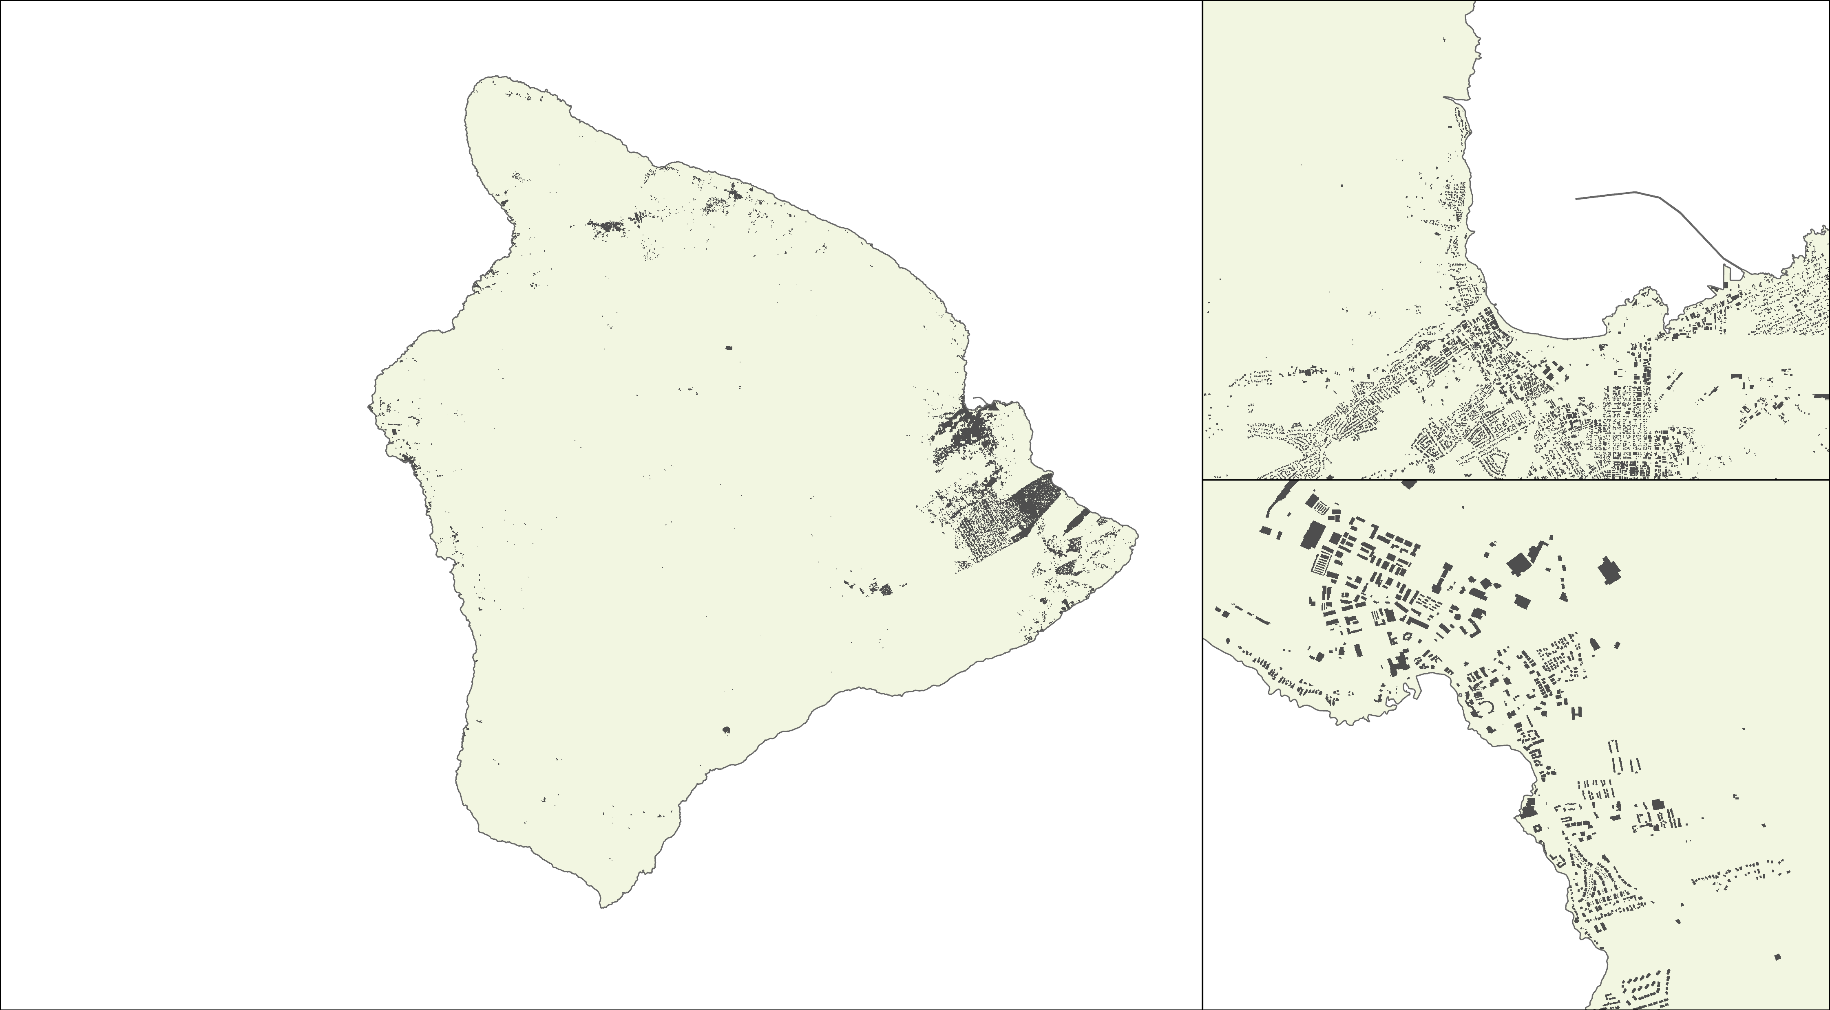
OUTPUTS – BUILDING FOOTPRINTS
Building footprints
Hilo
Kailua-Kona
Notes:
Using data from OpenStreetMap, the Building Footprints layer shows the locations of buildings across the Island. This layer will help to show the areas exposed to coastal threats.

Slide 34
ANALYSIS
Notes:
As we combine these maps and tools together, we are then able to statistically analyze the data to create conclusions.
------------------------------Image Information Below ------------------------------
All icons from Powerpoint.

Slide 35
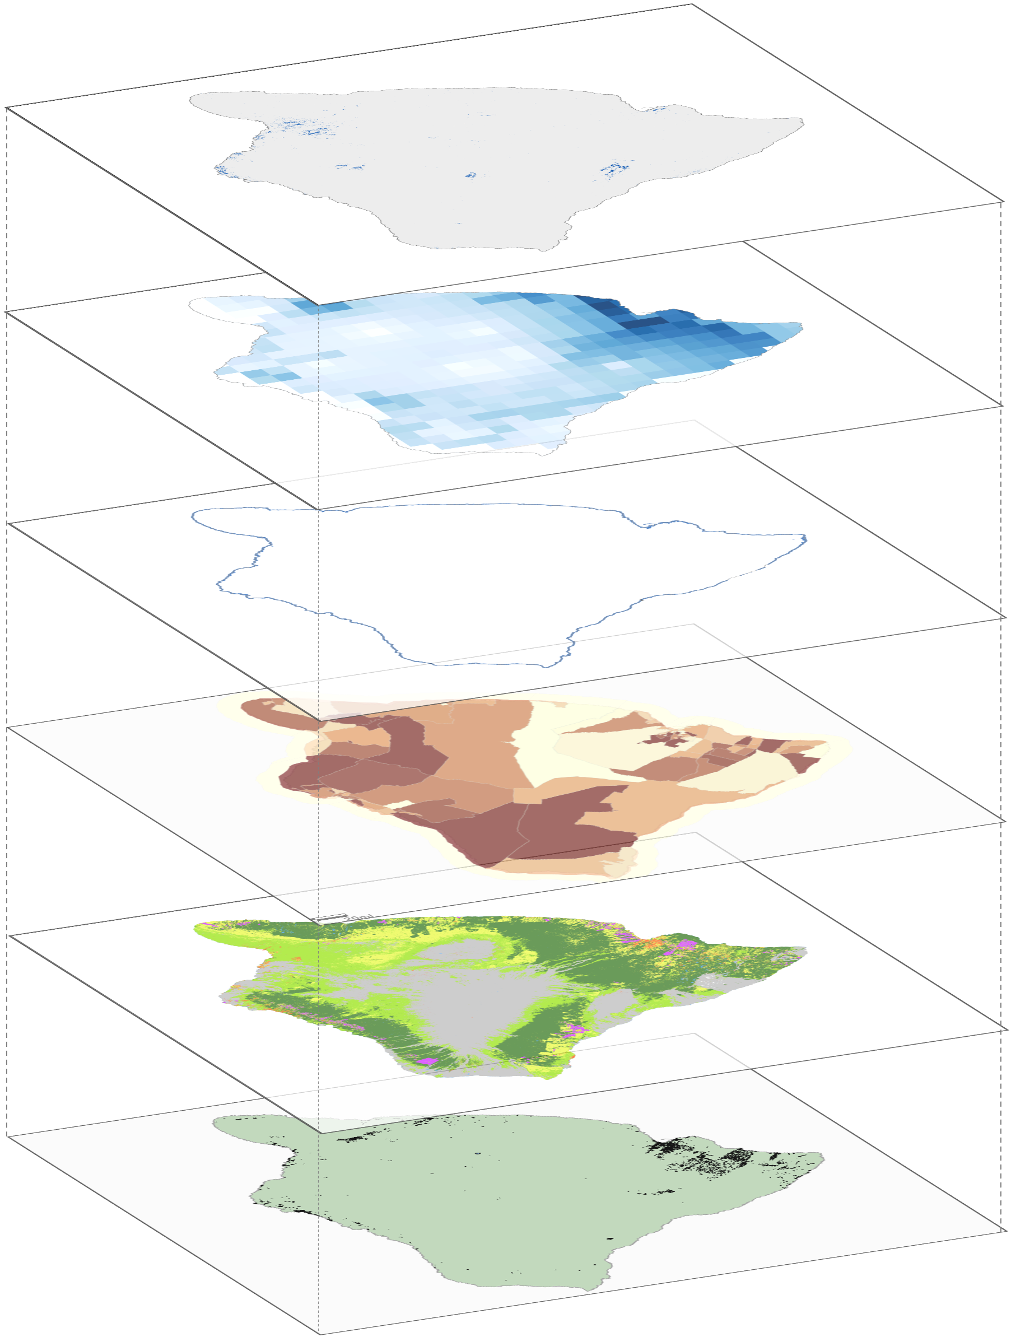
COMPARING INDICATORS
Storm flood
Overlaying Flood Extent
With Vulnerability Indicators
With Exposure Indicators
Calculating Geospatial statistics to understand risk
Precipitation
Sea-level rise
Social vulnerability
Land cover
Building footprints
Methodology for Risk Analysis
Notes:
By overlaying the flood and storm extent relative to social indicators and physical exposure indicators we can begin to understand and assess the risk these types of flooding events pose to the island.

Slide 36
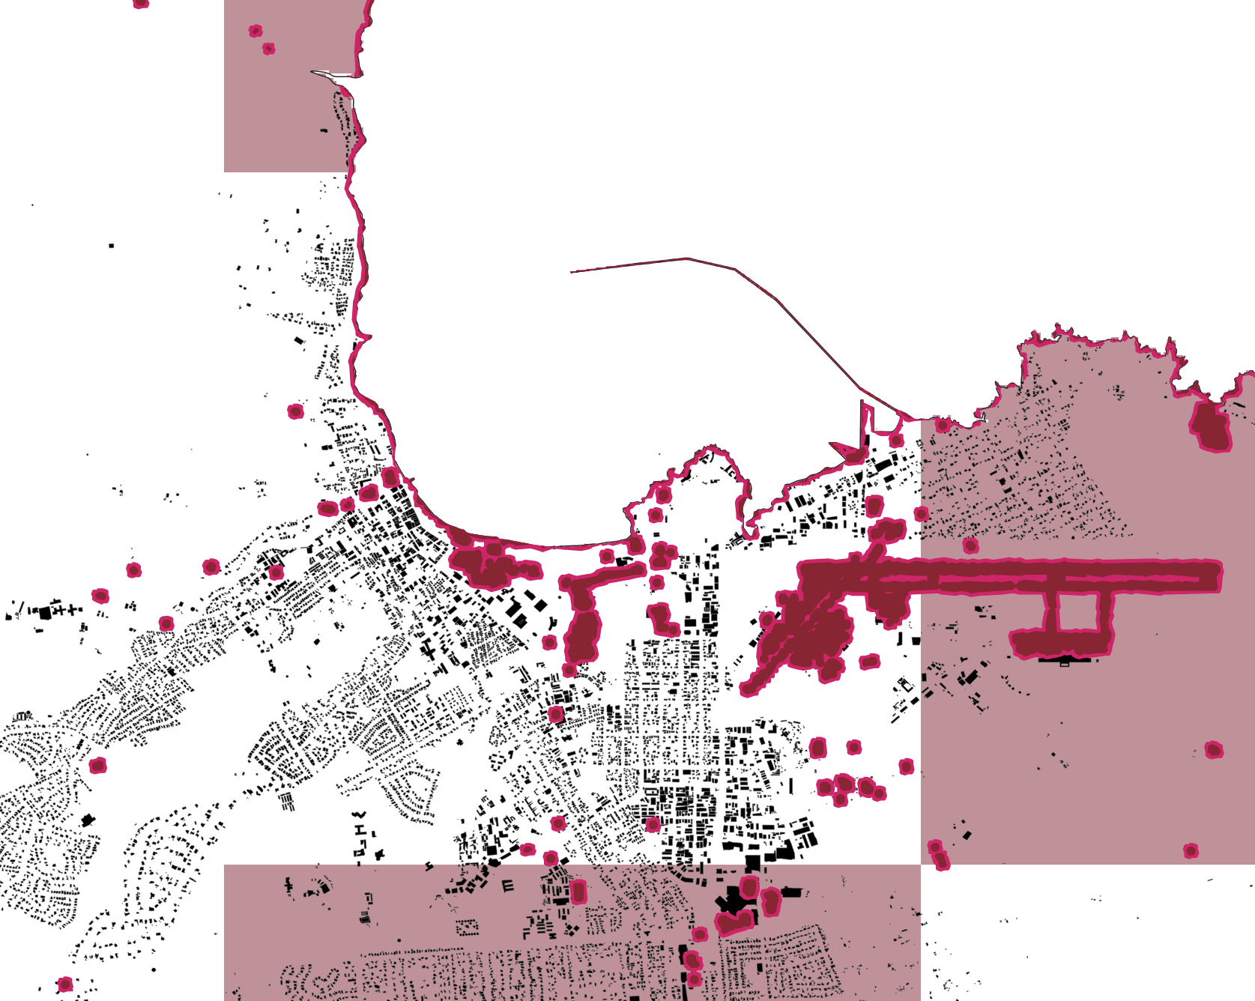
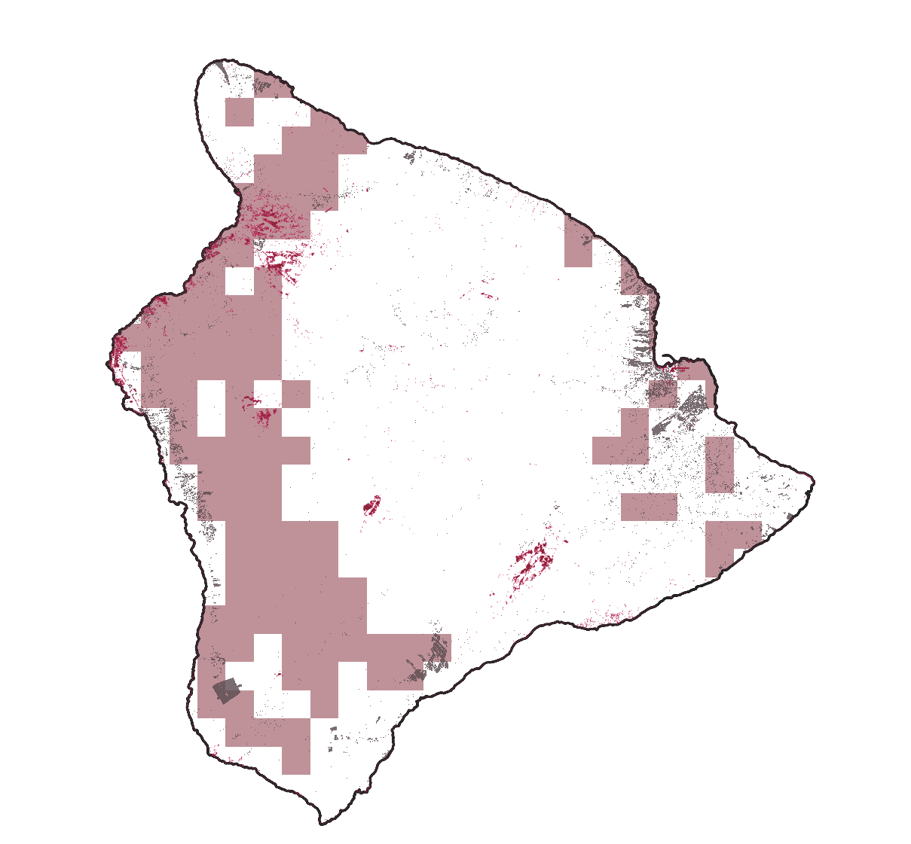
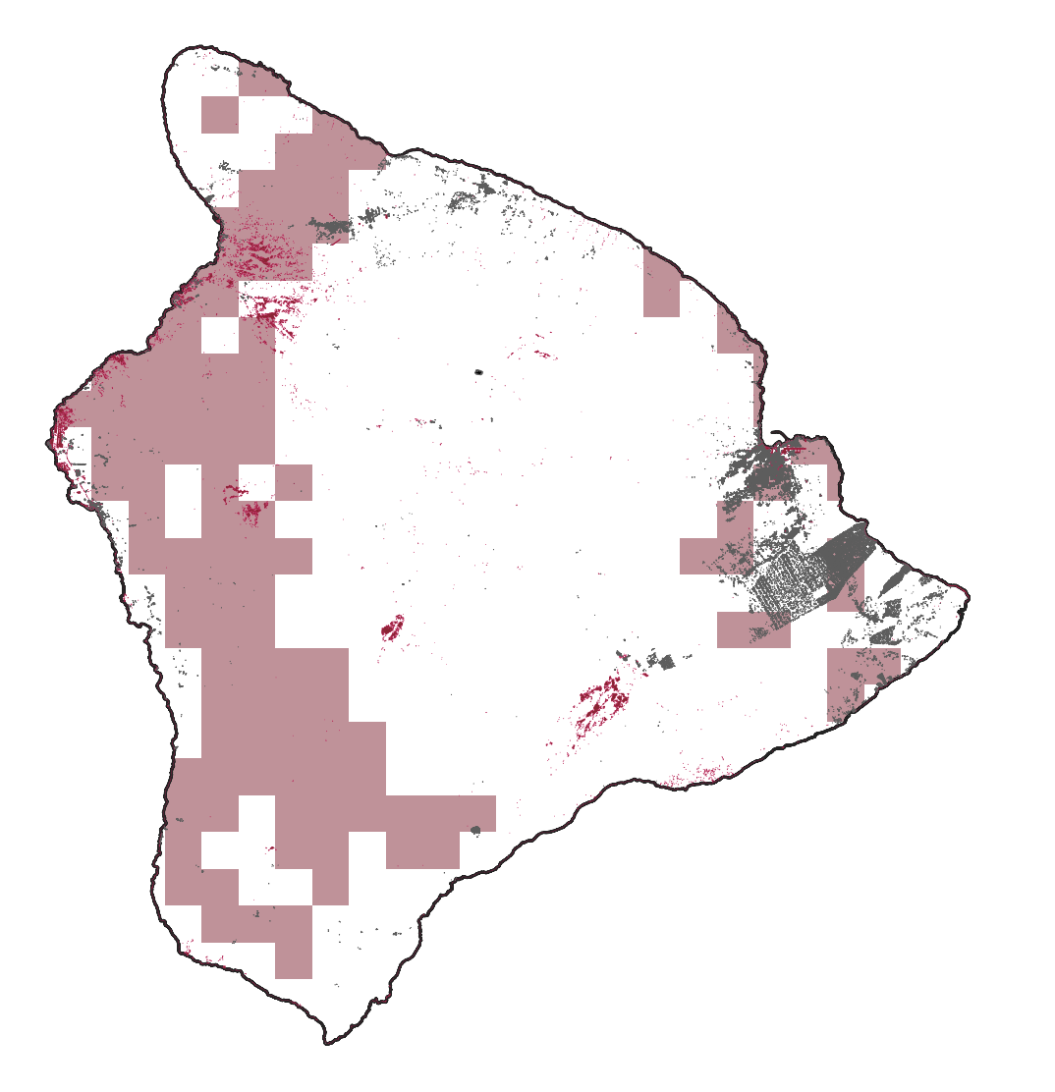
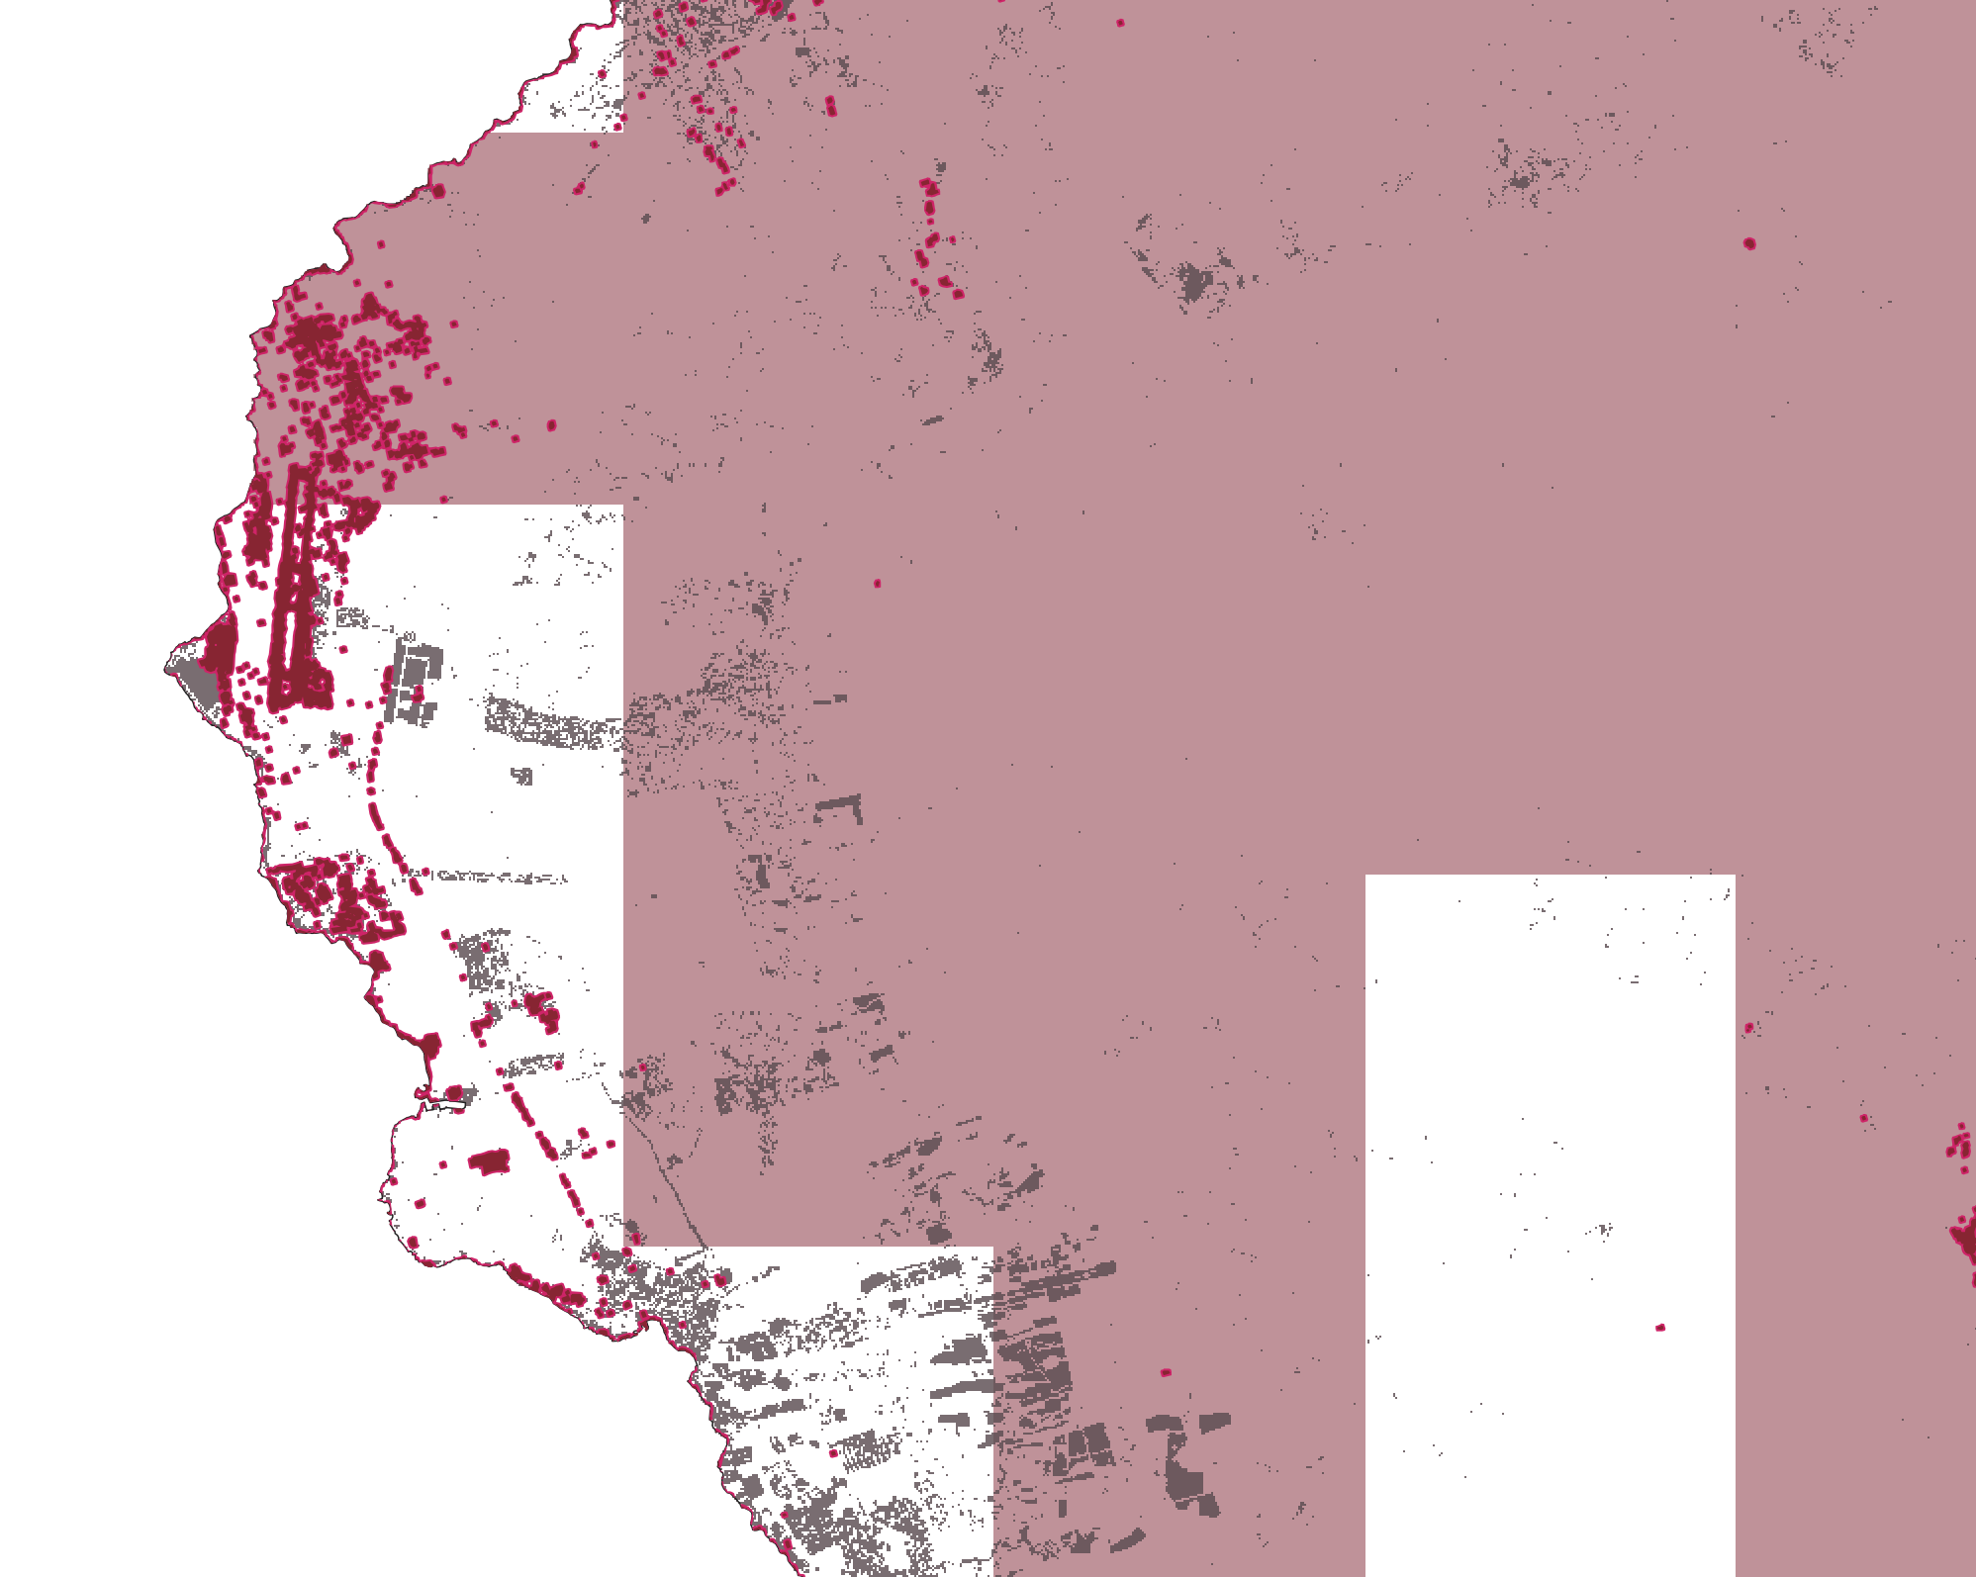
RESULTS – EXAMPLE OVERLAY MAPS
Hilo
Kona
Extreme Precipitation
Extreme Precipitation
Storm Flood Extent
Storm Flood Extent
Building Footprint
Land Cover Susceptibility
Notes:
This is a visual representation of how our methodology can be deployed. The left map highlights building footprints and the right map highlights susceptible land cover types. Take a look above at Hilo, by identifying a low estimate (storm flood extent) and a high estimate (extreme precipitation) the County can now model the impact of Hurricane Lane. For example, the Northeastern portion of Hilo shows up a lot in both models where as the northern coastal portion of the town shows up well in the storm extent. This is in part due to distinctions in the methodology between the two models but provides a baseline that the County can use to assess the impact of flood events as they occur. When overlaid further with other products, like the social vulnerability index, at risk populations and their characteristics can roughly identified and analyzed. This allows the County to better focus attention where resources and mitigation efforts are most needed. This should be ground tested and validated as events occur, as this is a model .

Slide 37
SAMPLE RESULTS FOR THE CASE STUDY
Preliminary analysis models the population in the storm extent ranges from ~ 1152 (lower) to ~ 2782 (low) and population in the extreme precipitation extent is ~ 87122 (high)
Urban land cover in the storm extent ranges from ~2.28 sq km (low estimate) to ~5.76 sq km (lower estimate) and in the extreme precipitation extent is ~42.6 sq km (high estimate)
Cropland land cover in the storm extent ranges from ~0.32 sq km (low estimate) to ~0.45 sq km (lower estimate) and in the extreme precipitation extent is ~71.3 sq km (high estimate)
Approximate number of buildings in the storm extent ranges from ~ 218 (lower estimate) to ~ 875 (low estimate) and in the extreme precipitation extent is ~ 24712 (high estimate)
Notes:
While there are many applications for the tools that we have created here are just a few sample outputs that our package of products was able to produce:
Preliminary analysis models the population in the storm extent ranges from ~ 1152 (lower) to ~ 2782 (low) and population in the extreme precipitation extent is ~ 87122 (high)
Urban land cover in the storm extent ranges from ~2.28 sq km (low estimate) to ~5.76 sq km (lower estimate) and in the extreme precipitation extent is ~42.6 sq km (high estimate)
Cropland land cover in the storm extent ranges from ~0.32 sq km (low estimate) to ~0.45 sq km (lower estimate) and in the extreme precipitation extent is ~71.3 sq km (high estimate)
Approximate number of buildings in the storm extent ranges from ~ 218 (lower) to ~ 875 (low) and in the extreme precipitation extent is ~ 24712 (high)
These statistics are the outputs of models and as such are not necessarily a reflection of reality but highlight some of the ways these tools can illuminate the impact of flood events. The distinction between the modeled outputs is due to the varying methodologies deployed between the storm flood extent and extreme precipitation. Because the storm extent output underrepresents flooding in urban areas, we used two buffers (20 meter & 50 meter) noted here as lower and low estimates to assess affected assets. We also deployed a high estimate model using extreme precipitation extent as an alternative means to estimate where flooding might have occurred, as the output of this model displays a much larger area of potential flooding.

Slide 38
ERRORS & UNCERTAINTIES
Sources of error:
Actual flood extent from Sentinel-1 vs. false positive signals.
Missing and misclassified pixels in land cover analysis
Subjective determination of training points for classifier, esp. "shrubland" class
Limitations:
Rainfall estimates cover large resolution; it does not give a clearer picture of rainfall extremes on granular scale
Coastal data gaps with high resolution data
Classifier can't differentiate between croplands and forest/shrubland
Conclusions are modeled
Notes:
Sources of error for this project include determining actual flood extent from Sentinel-1 in comparison to false positive signals. For example, floods were mapped along very steep slopes on the southern part of Hawai‘i island. The team masked out flood extents on slopes above 5 percent but it shows possibility of false positives.
In addition, the land cover classification maps included some missing pixels due to cloud cover. Also, the determination of training points for classes such as the "shrubland" class could be subjective at times. Another limitation of the land cover classifier was that the classifier couldn’t differentiate between croplands and forest or shrublands.
Rainfall estimates were a limitation in this project, as it covers a larger resolution and does not give a clear picture of rainfall extremes. Furthermore, there are limitations to models in that they are not exact representations of reality. Many of our models have large differences in estimate due to the methodology used and should be taken with a grain of salt.

Slide 39
FUTURE WORK
Formula for Risk
DISASTER
INDEX
VULNERABILITY
INDEX
RISK
x
=
Compile flood extent from historical flood events
Calculate frequency of flooding per pixel
Normalize to create disaster index
Normalize vulnerability indicators
Aggregate all indicators and normalize for a total vulnerability index
Multiply to achieve compound risk
This formula can be used to get statistics for exposure indicators
Notes:
One way the County could use our tool is to compile flood events as they occur along with historic data to create a repository of flood extents using our two flooding models and begin to calculate frequency of flooding per pixel. Additionally, this can be combined with a probabilistic flood model to create a robust disaster index in the future. Once a disaster index is created it can be multiplied with a vulnerability index composed of social and physical variables; we have already started this process by creating a social vulnerability index which the County can add to along with our land cover outputs as a physical indicator of vulnerability. These compounded indices would result in a flood risk map.
This framework can be utilized by the County as a baseline to analyze risk for other types of disasters, such as wildfire, however different disaster variables will need to be considered for analysis, and the County can adjust the variables used in the vulnerability index depending on what is most important for that specific type of disaster. For example, in our Flood analysis, urban and agriculture types are susceptible for flooding, however in a wildfire disaster scenario, different land cover types are susceptible to fire such as grassland. Following this, exposure variables such as number of people or buildings in the risk zone can be calculated.

Slide 40
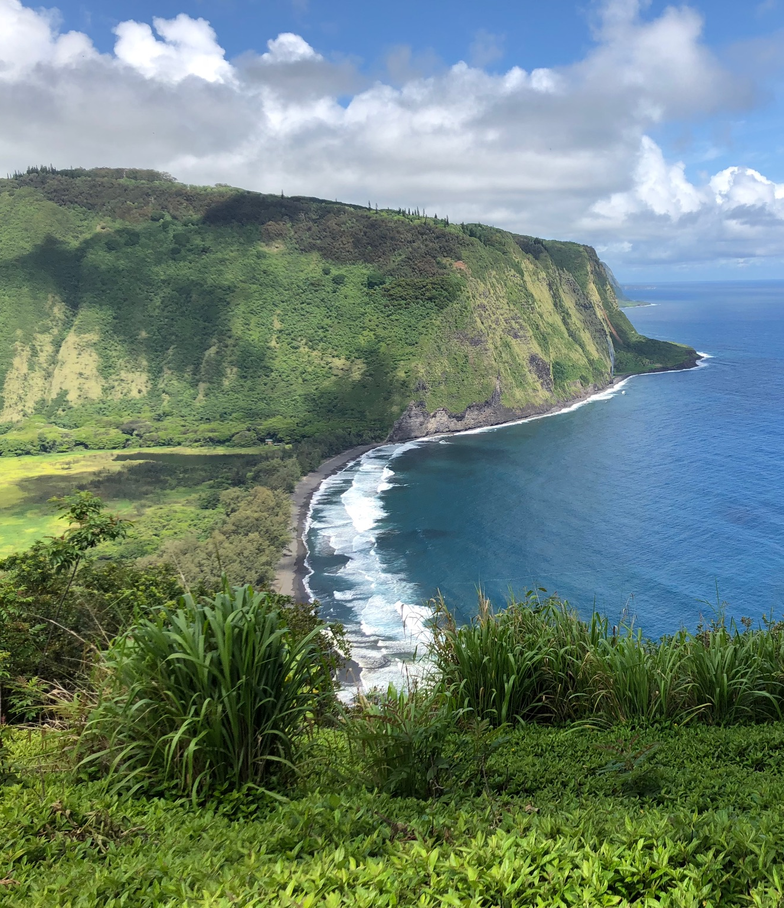
FUTURE WORK
Acquire higher resolution satellite data
More detailed analysis on the building footprint extraction.
Incorporate Sentinel-6 data
Clarifies sea surface height variability around the island.
Incorporate more variables from US Census Bureau data
Provides deeper picture into exposed communities' demographics.
Examine consecutive disasters
Tailor risk assessment to other application areas at the County
Waipi‘o Valley, Hawai‘i Island
Image Credit: Anna Mikkelsen
Notes:
There are many strategies to improve and expand the scope of this project. These maps could be built on in the future by adding relevant variables.
First, acquiring higher resolution satellite data would allow for a more detailed analysis on the building footprint extraction. As the County is looking to improve their capacity to assess physical susceptibility to disasters, they require regularly updated data on building footprint.
Secondly, future work could involve incorporating Sentinel-6 data for clarifying sea surface height variability around the island.
Sentinel-6 is a newer satellite, and incorporating this satellite can help to provide even more accurate data.
Third, including the most recent US Census Bureau data that is set to come out by the end of the year would perhaps give a deeper picture into exposed communities and their demographics like age and language.
This project can also invest efforts into examining consecutive disasters.
Lastly, our map products and methodologies are created so that the County could build upon it and tailor the risk assessment to other application areas such as using flood risk assessments for food systems, infrastructure, wetlands etc. And also to other disaster risks such as fires and lava flows.
------------------------------Image Information Below ------------------------------
•Images Credit: Waipi‘o Valley, Hawai‘i Island. Taken by Anna Mikkelsen.
•Images Source: Anna Mikkelsen (DEVELOP AZ Fall '21)

Slide 41
CONCLUSIONS
The experimental overlay concludes that Earth observation data can be utilized for assessing flood extent/risk and land cover change
Doing in house assessments and having rough estimates can help policy makers assess resources
Considering high estimates can help plan precautionary policies
Methodology can be used to assess many future and past disaster events to create a disaster exposure index for future risk analysis
Notes:
One main takeaway of this project is that earth observation data is effective in modeling flood extent and extreme precipitation events, and the County will be able to utilize earth observation data in the future to further explore the impacts of disasters and issues of environmental concern.
The experimental analysis shows that having access to tools that were created by the team can help County look at estimates of social and physical indicators under risk. These estimates can aid the County assess in their allocation of resources.
Lastly, our methodology and the tools we developed can be used by the County to assess many future and past flooding events to create a disaster exposure index for future risk analysis.

Slide 42
DEVELOP Advisors:
Dr. Roberta Martin, Associate Professor, Arizona State University
Dr. David Hondula, Associate Professor, Arizona State University
Dr. Kenton Ross, Lead Science Advisor, NASA Langley Research Center
Ryan Hammock, Arizona Fellow & Lead, NASA DEVELOP
Project Partners:
Bethany Morrison, County of Hawai'i
Erik Lash, County of Hawai'i
Kevin Sullivan, County of Hawai'I
This material contains modified Copernicus Sentinel data, processed by ESA.
Notes:
We'd like to express our gratitude to our science advisors from Arizona State University, Dr. Roberta Martin and Dr. David Hondula. We'd also like to thank Dr. Kenton Ross for his technical guidance, and our NASA DEVELOP Node Fellow, Ryan Hammock, for your support, organization, and feedback throughout the term.
Additionally, we'd also like to thank our contacts at the County of Hawai'i - Bethany Morrison, Erik Lash, and Kevin Sullivan – for partnering us for this project, and being great collaborators for this project. We hope this is a product that you will be able to utilize in future planning efforts.

