Slide 1
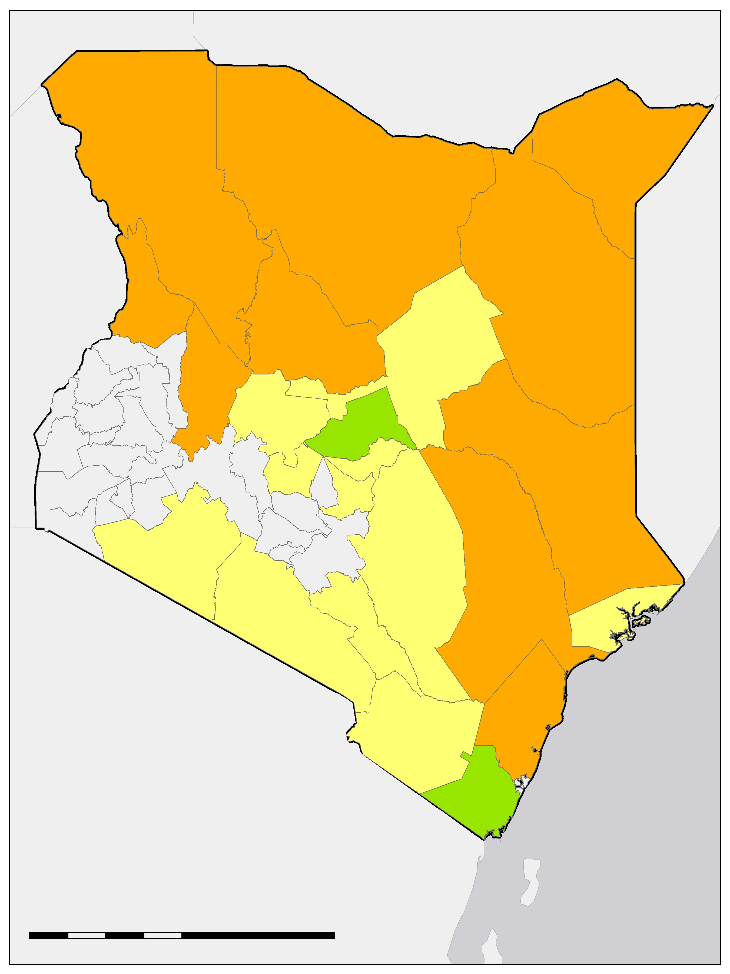
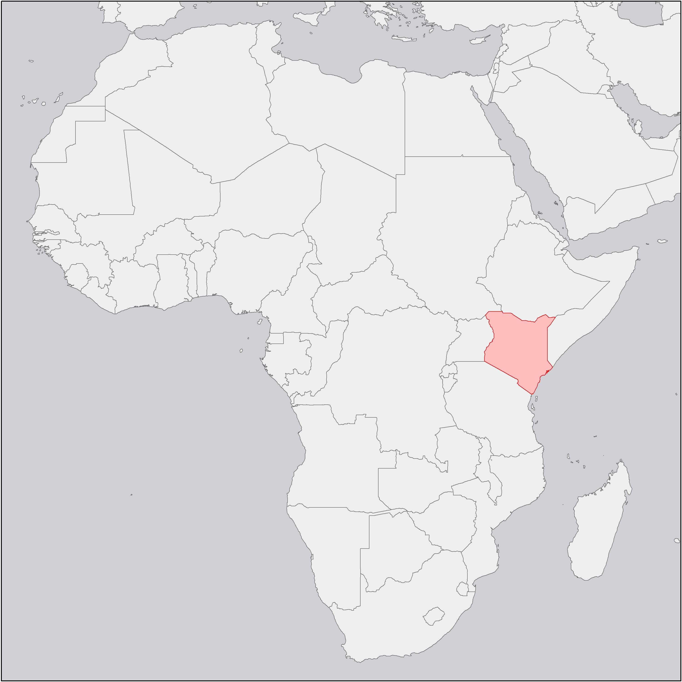
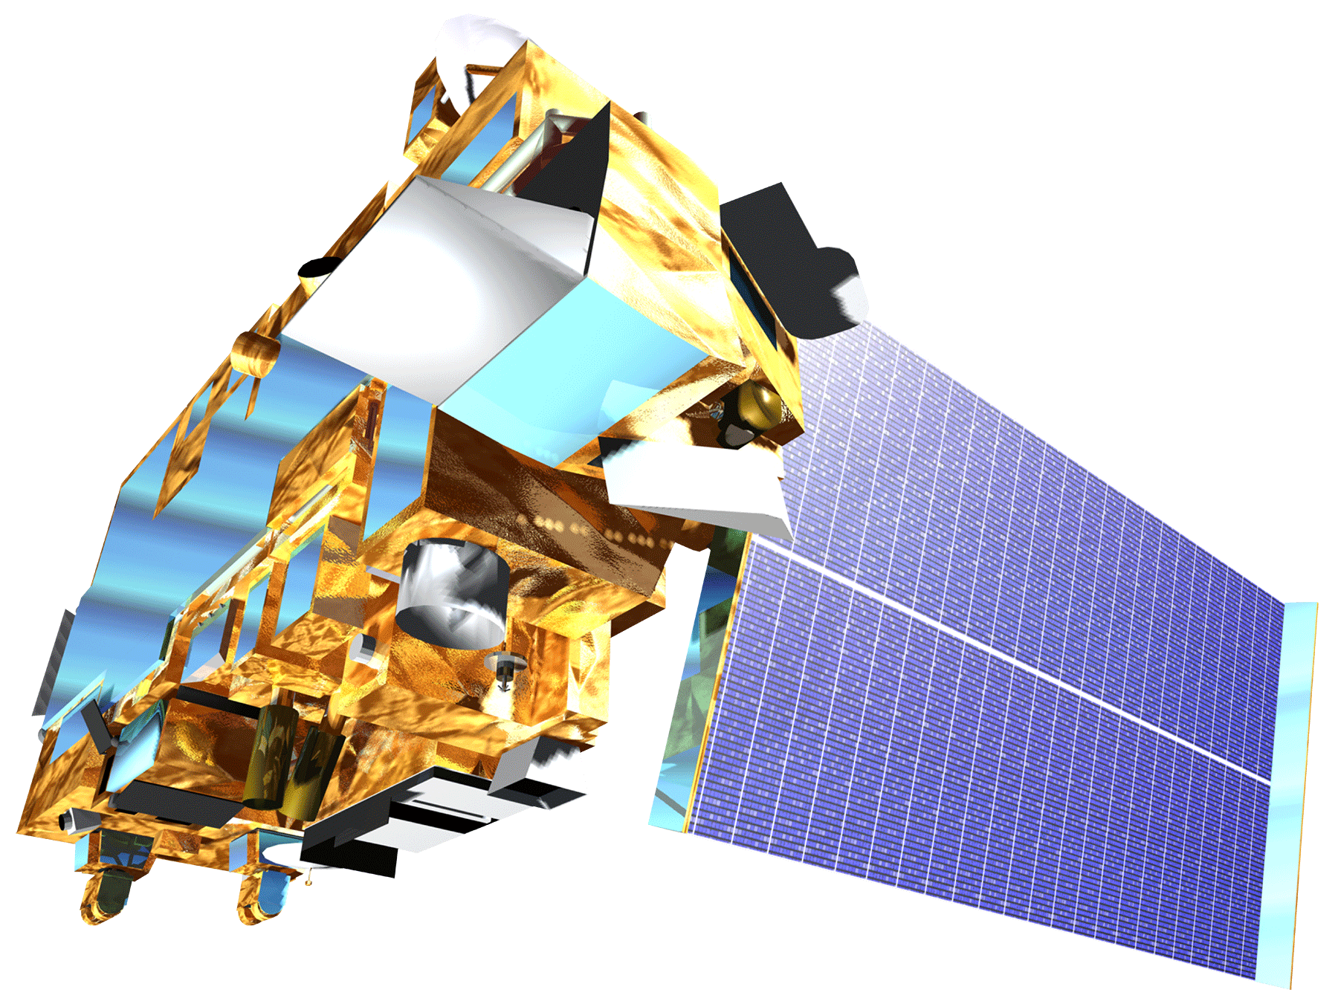
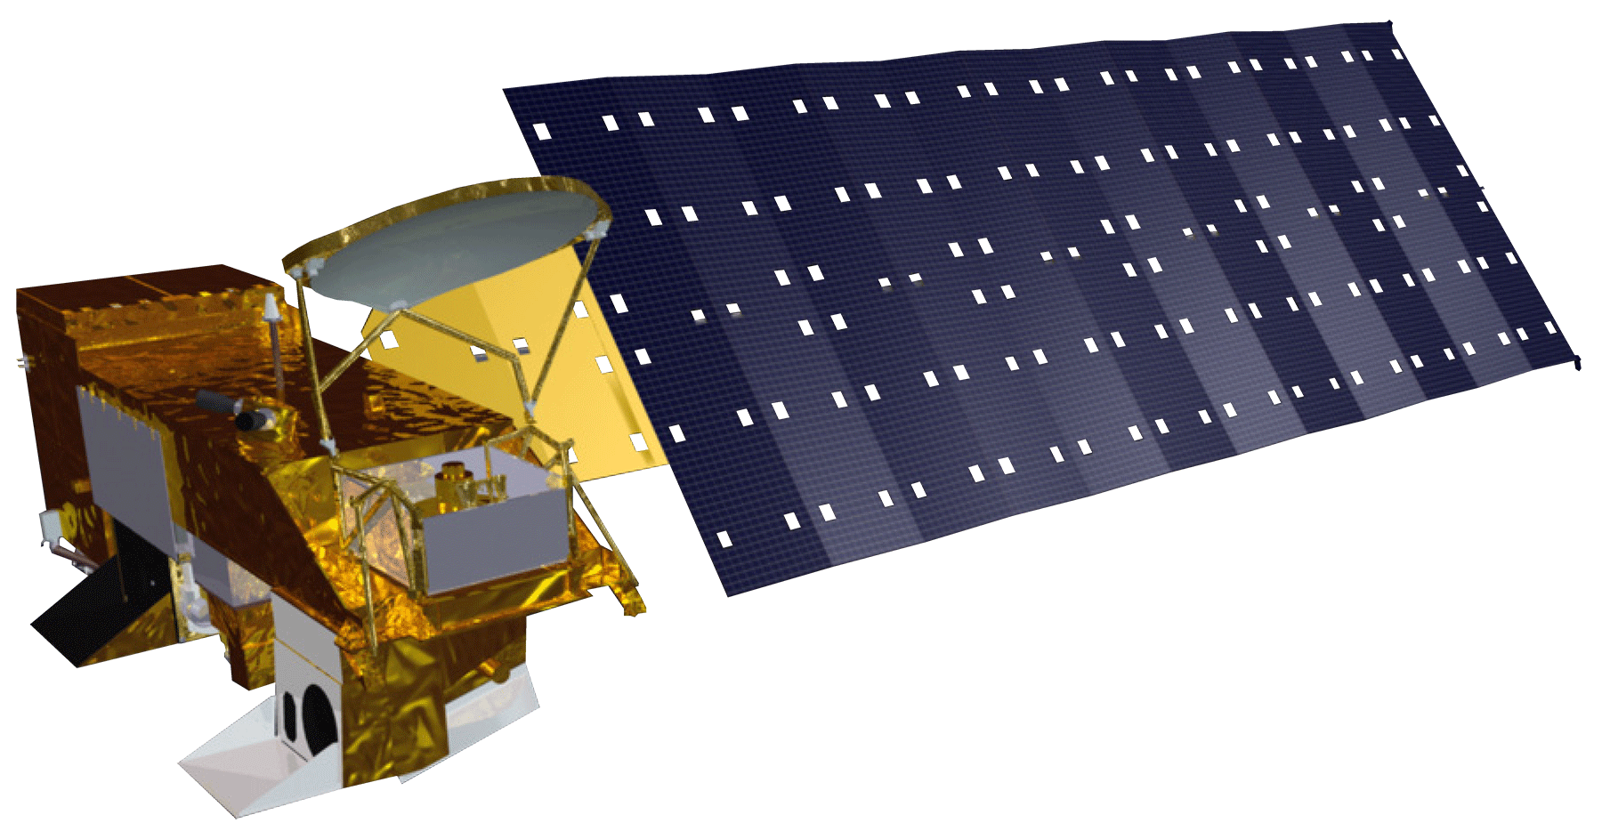
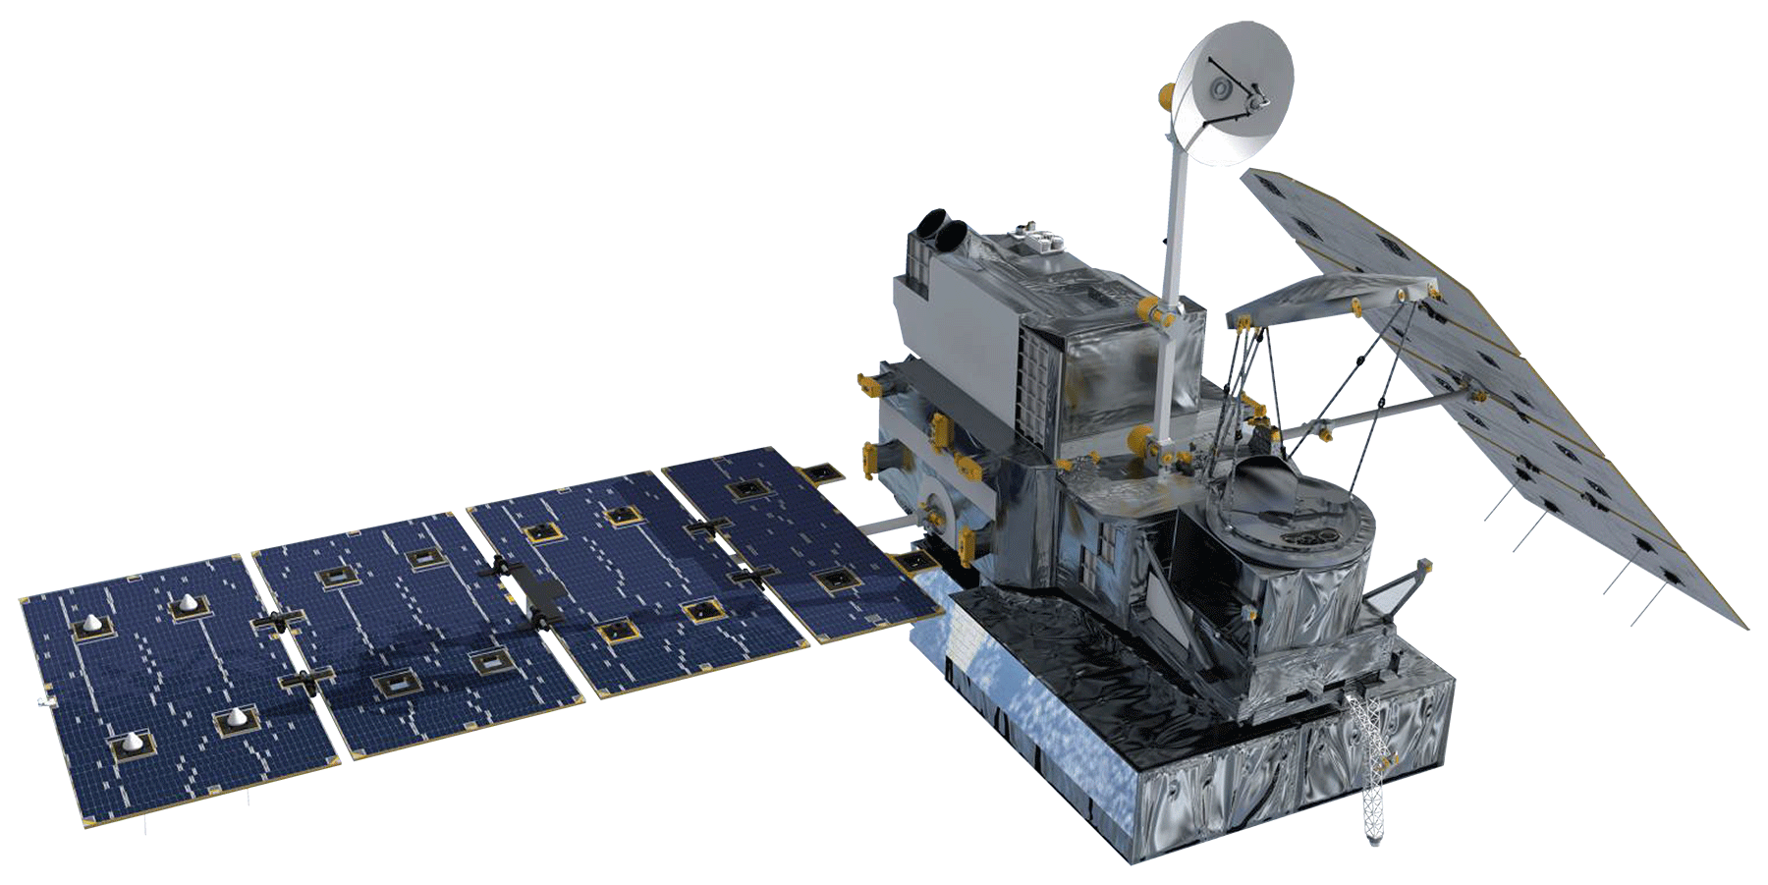
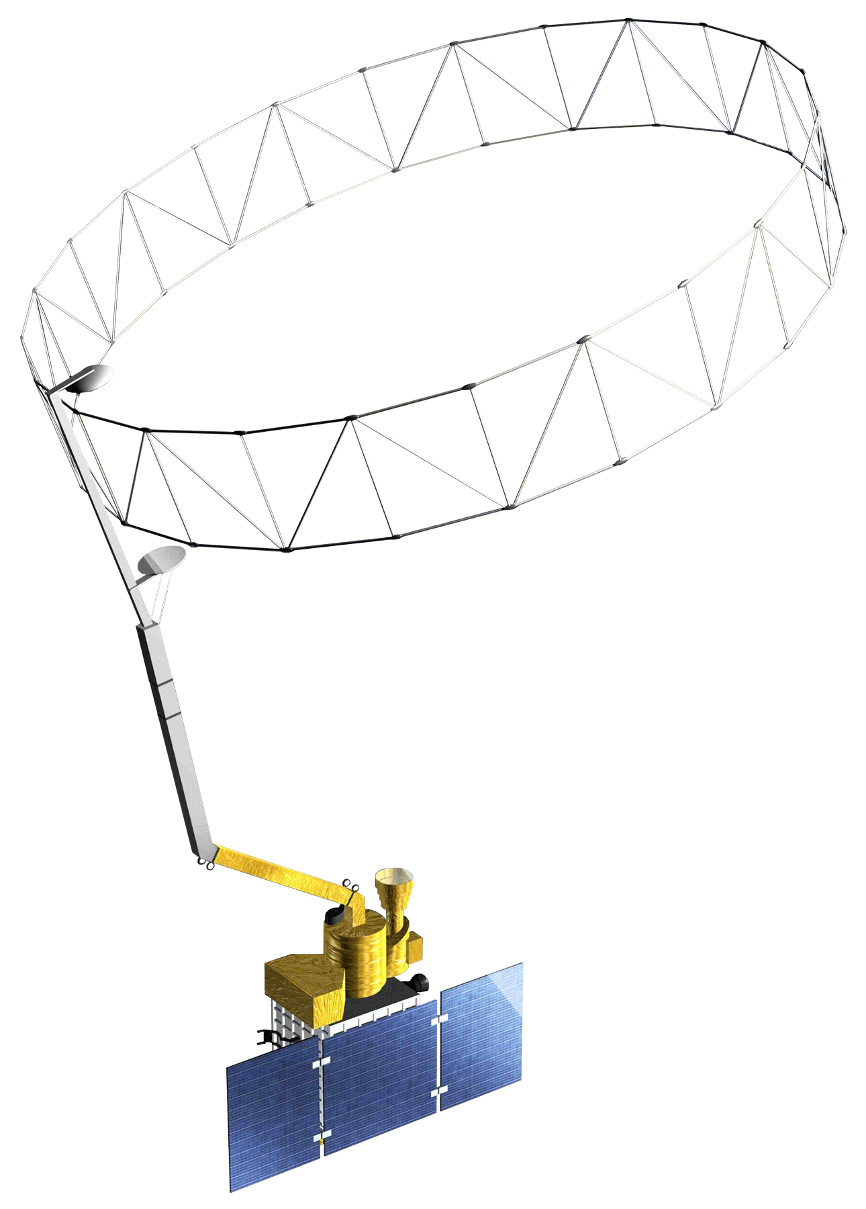
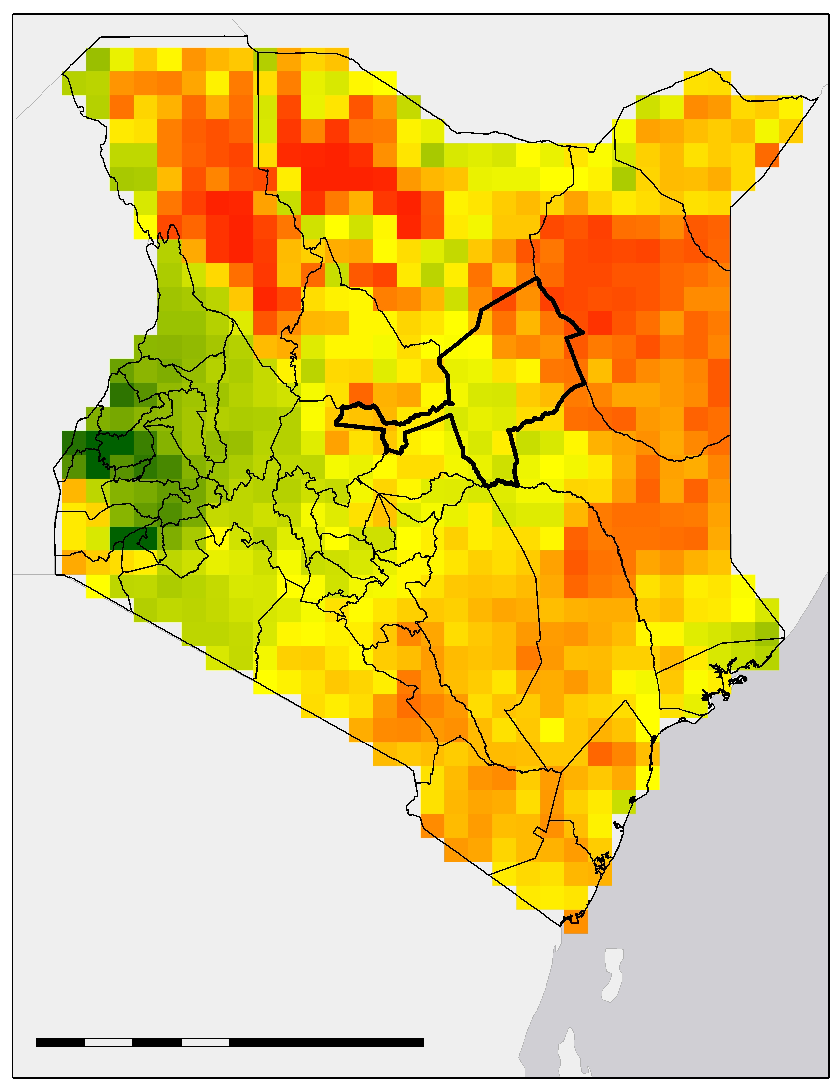
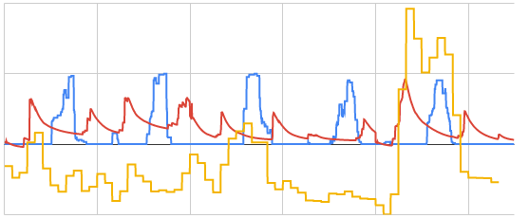
Utilizing NASA Earth Observations in the RHEAS Model to Enhance Drought Monitoring
and Mitigation in Kenya
Abstract
Objectives
Many regions of Kenya historically and regularly experience severe drought, necessitating a robust and well-informed response to drought events to protect agricultural production and minimize drought impact on food security. The National Drought Management Authority currently publishes monthly Early Warning Bulletins that depend on Moderate Resolution Imaging Spectroradiometer (MODIS) indices and are not sufficient in assessing current drought status nor predicting its trajectory. This project utilized Soil Moisture Active Passive (SMAP) L-band Radiometer, Aqua and Terra MODIS, and Global Precipitation Measurement Core Observatory (GPM) Dual-Frequency Precipitation Radar (DPR) data as inputs into the Regional Hydrologic Extremes Assessment System (RHEAS). This model supports an unlimited number of variables, as it relies on a land surface model that can be easily customized, allowing data from multiple resolutions to be used without the need for preprocessing. Using inputs from the Regional Centre for Mapping of Resources for Development, the team created multiple drought time series to better assist stakeholders in implementing drought mitigation and adaptation measures. Initial results showed that drought indices that cover a longer time period provided a clearer trend of drought conditions by county. The team also provided partners an initial analysis of the indices produced and a story map derived from the time series. Follow on work will validate these products and create training documents for end users.
Generate rasters derived from drought indices for study area using RHEAS
Create an assimilation framework matching outputs from the model to partner needs
Compile an Operating and Procedure manual to assist second term team
Present initial results to partners and solicit feedback for refinements to the model
Study Area
Study Area:
Kenya
Study Period:
January 2016 to April 2019
Methodology
Data Acquisition
Ingest data through RHEAS model
Compile data on soil moisture, land surface temperature (LST), precipitation
This map showcases the counties of Kenya and their drought classifications for April 2019 according to the National Drought Management Authority’s Early Warning Bulletins.
Data Processing
Process data using Variable Infiltration Capacity (VIC) model
Standardize outputs through RHEAS
0
100
200
400
No data
Alert
Data Analysis
Analyze time series for indices
Calculate correlation values between model outputs and NDMA bulletins
km
Normal
Alarm
Earth Observations
Aqua MODIS
End Products
Drought Time Series
RHEAS Drought Indices and Evaluation of RHEAS Indices
Story Map
Kenya Agriculture & Food Security
Terra MODIS
GPM DPR
SMAP L-band radiometer
Results
Project Partners
Results included the generation of the Standardized Precipitation Index and the Standardized Runoff Index for 1, 3, 6, and 12 month accumulation periods; the Combined Drought Indicator; and the Soil Moisture Deficit Index; calculated for each of Kenya's 47 counties, with daily visualizations from January 1, 2014 to April 30, 2019 for a total of 743,070 data points.
National Drought Management Authority
Regional Centre for Mapping of Resources for Development (RCMRD)
NASA SERVIR Science Coordination Office
4
Example Drought Time Series for Isiolo County
Conclusions
Combined Drought Indicator (CDI)
Drought indices that cover a longer period of time (SPI12, SRI12) provided a clearer connection to the water table while indices that look at shorter time periods of time are more closely linked to soil moisture (SPI1, SRI1).
SPI1 and SRI1 have high potential for use in a short-term forecasting system.
VCI, NDMA's current measure, does not effectively measure smaller changes in drought as well as the RHEAS-generated indices, making it comparatively limited for inferring drought status.
Soil Moisture Deficit Index (SMDI)
0
100
200
400
2
Standardized Vegetation Condition Index (VCI)
km
-1.68 to -0.934
-0.934 to -0.403
-0.403 to -0.081
0
-0.081 to 0.238
0.238 to 1.07
Model output for SMDI on January 1st, 2019. Isiolo County is bolded for reference.
-2
2015-01-01
2017-01-01
2019-01-01
Team Members
2014-01-01
2016-01-01
2018-01-01
Acknowledgements
Dr. Jeffrey Luvall (NASA Marshall Space Flight Center)
Dr. Robert Griffin and Maggi Klug (University of Alabama in Huntsville)
Dr. Lee Ellenburg, Emily Adams, Dr. Vikalp Mishra, Sara Miller, and Helen Baldwin (NASA SERVIR)
Lilian Ndungu (RCMRD)
Nelson Mutanda (NDMA)
Madison Murphy (NASA DEVELOP)
Ryan Good
Project Lead
Ryan Marshman
Amanda Tomlinson
Chiara Phillips
Alabama – Marshall | Summer 2019

