Slide 1
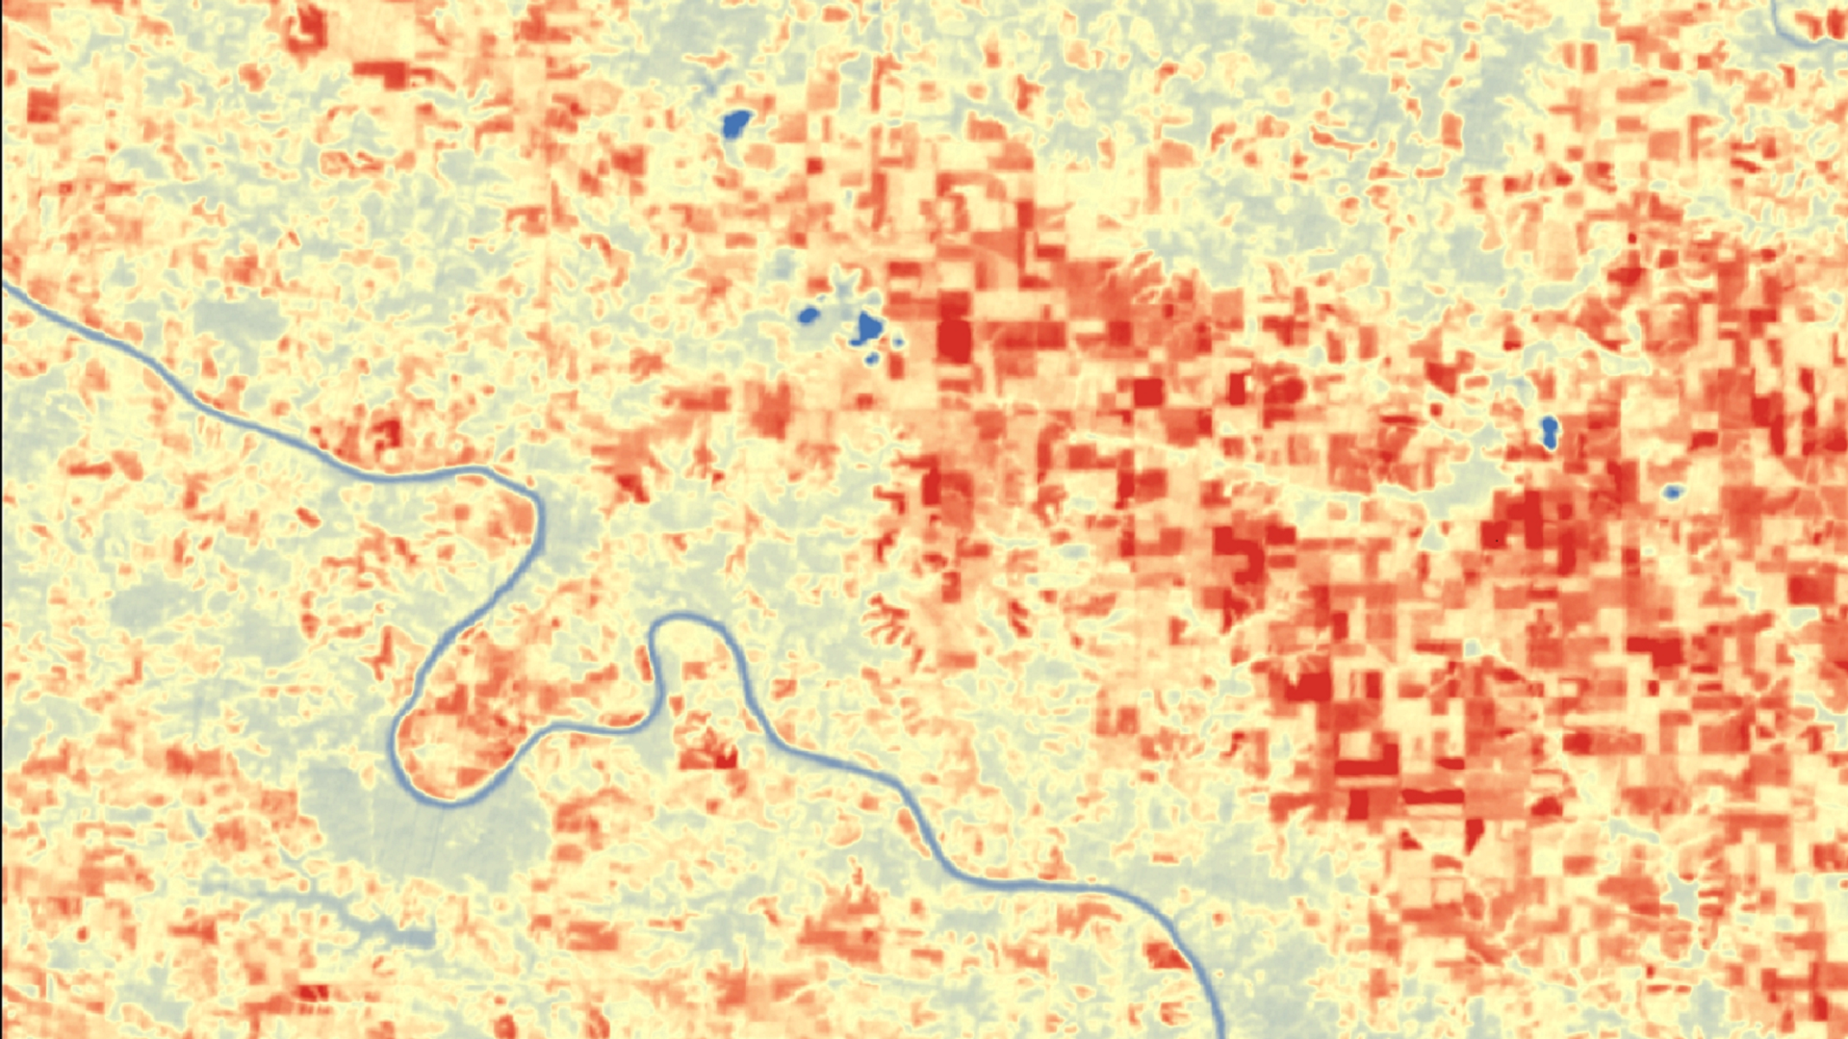
IOWA AGRICULTURE & FOOD SECURITY
Assessing Drought-Induced Vegetation Stress and its Impact on Crop Production Across Iowa
Brittany Greene
Audrieauna Beatty
Abigail Whiteside
Alabama – Marshall| Spring 2019
Notes:
Hello everyone, and thank you for attending. We are the Iowa Agriculture and Food Security team, and we assessed drought-induced vegetation stress and its impact on crop production across Iowa. I’m Brittany Greene, I graduated this past December from UAH with a Bachelors in Biology.
I’m Audrieauna Beatty, and I graduated this past December from University of North Alabama with a Bachelors in GIS.
I’m Abigail Whiteside, and I will graduate this May with a Bachelors in Earth System Science.

Slide 2
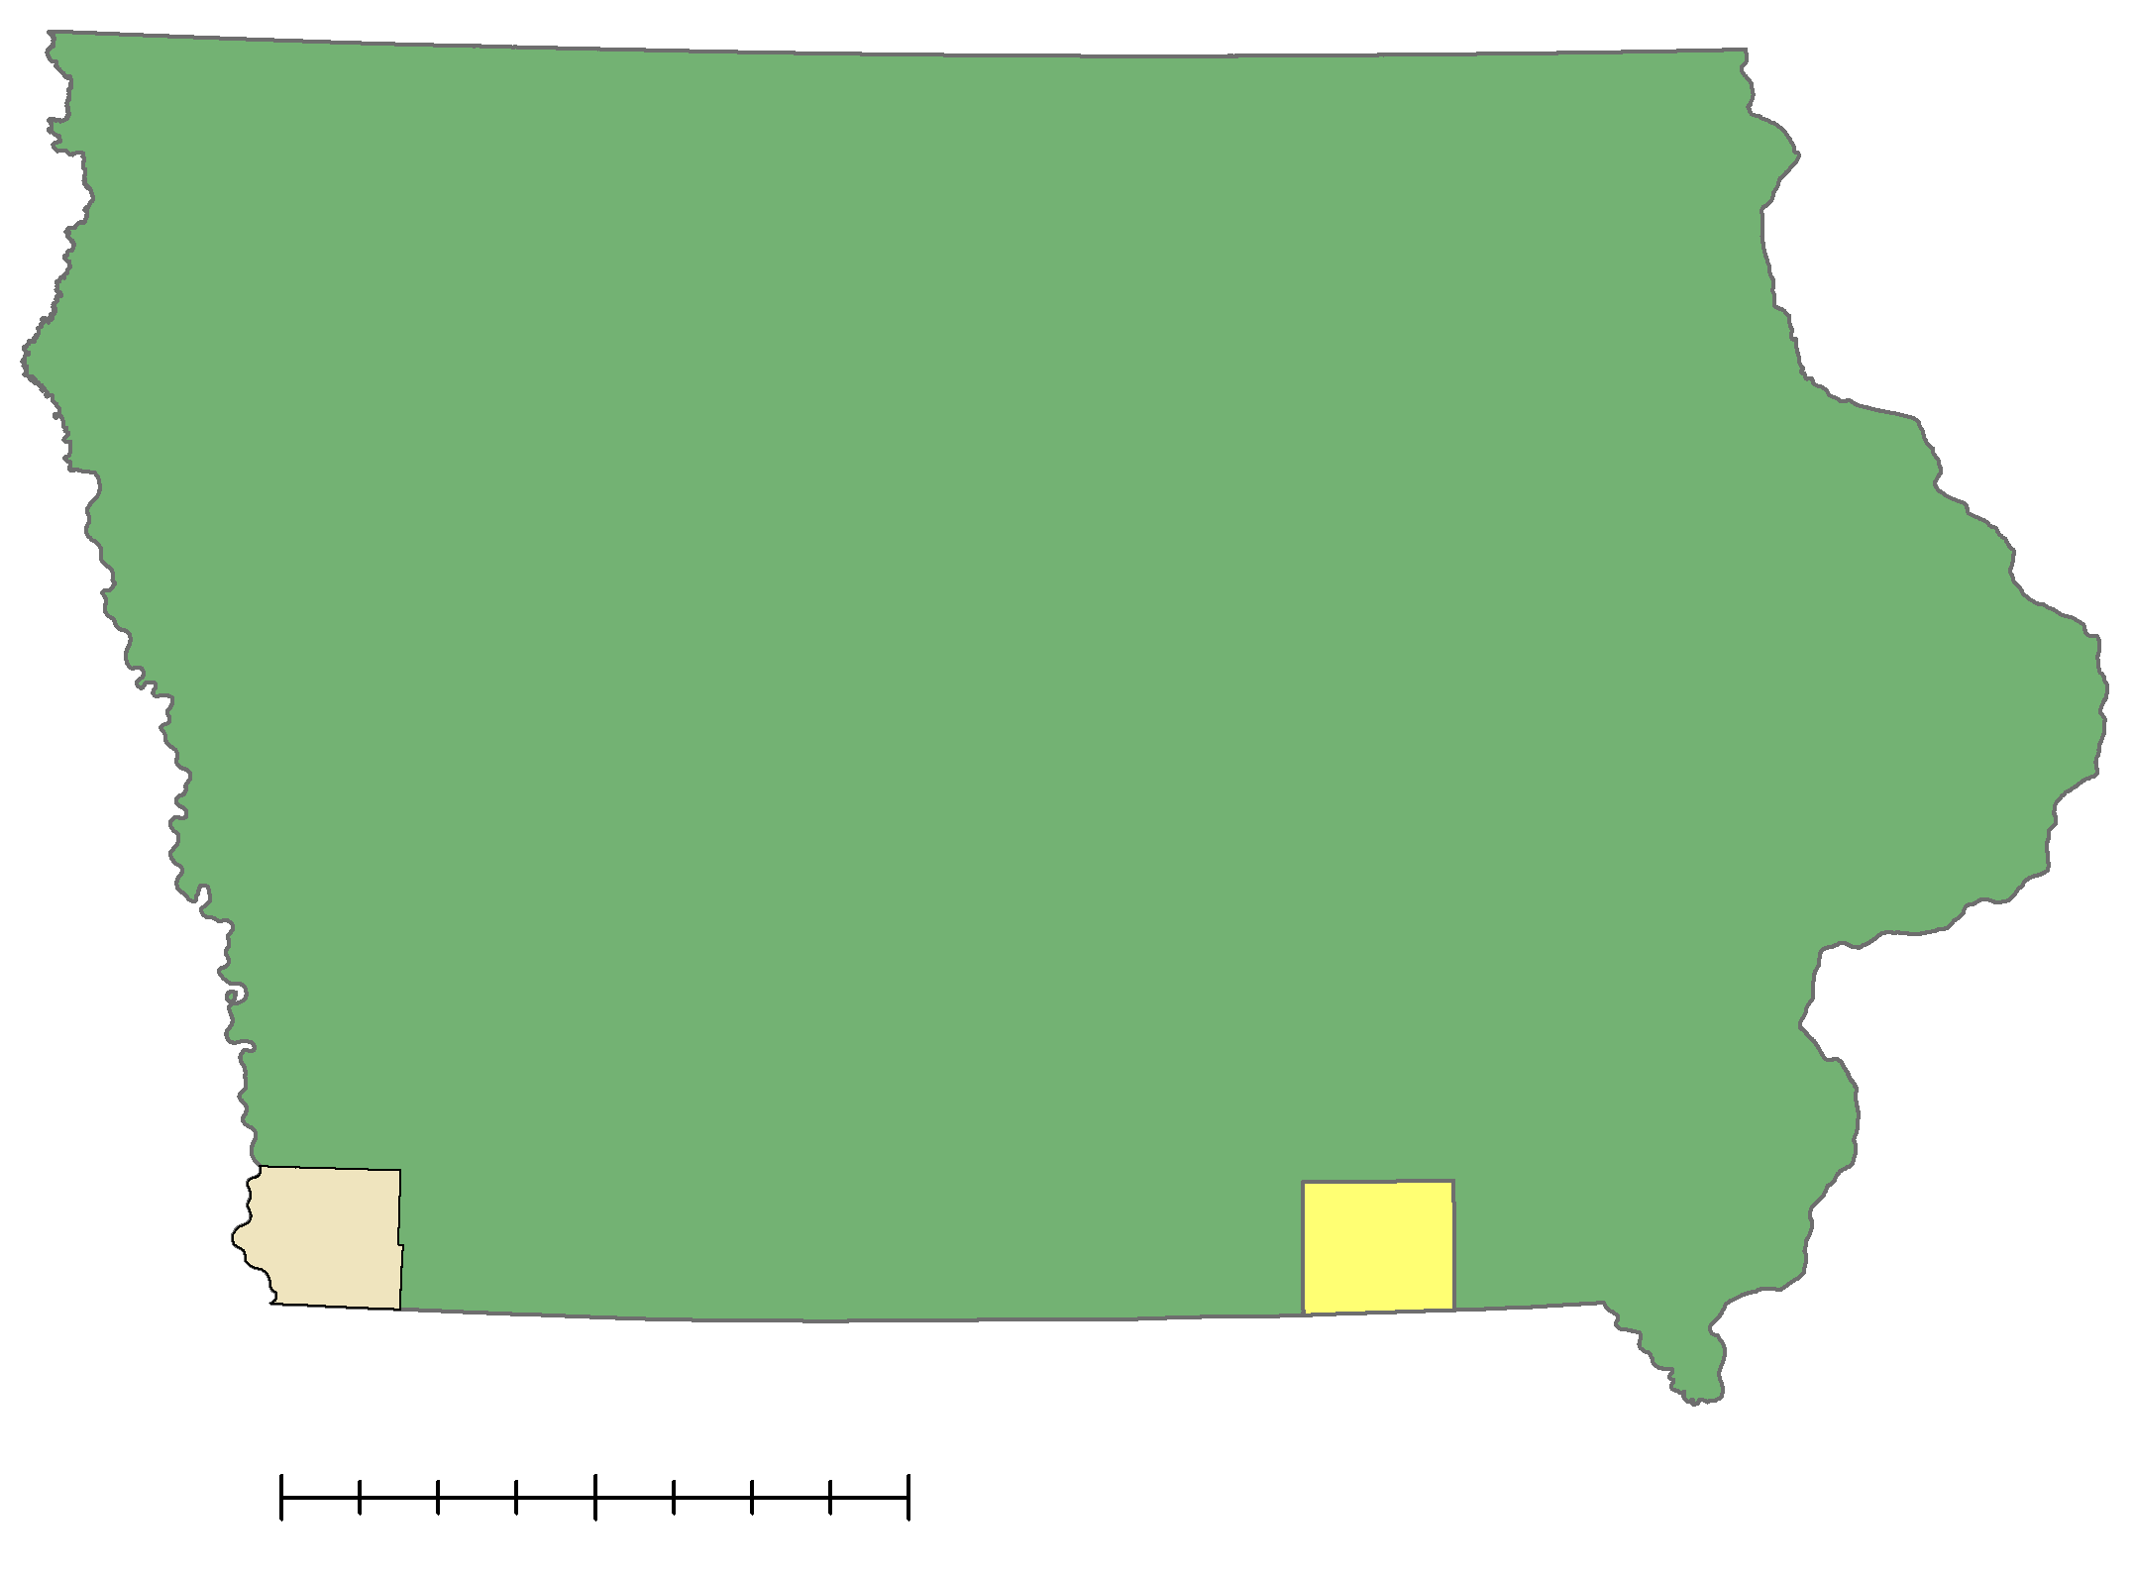
Project Overview
Study Area:
Iowa
Case Studies:
Davis and Fremont Counties
Study Period:
July to September 2018
0
50
100
Fremont County
miles
Davis County
Iowa
Image Credit: Iowa Agriculture & Food Security Team
Notes:
Our study area is the state of Iowa, a fertile state in the Midwest which dedicates 92% of their land to agriculture, and is a leader in the US in both corn and crop production.
We focused on Davis and Fremont counties for further analysis. We chose Davis county for our case study because it was deeply affected by drought in 2018 but there were some limitations to Davis county which we will explain further in this presentation. We chose Fremont County because it was not affected too heavily by the 2018 drought, allowing us to compare different circumstances in our analysis.
Our study period ran from July to September of 2018. The 2018 drought peaked in Iowa on August 21st, 2018.
Map sources: Iowa is from a shapefile that was acquired from the U.S. Census Bureau TIGER Products, 2018 TIGER/Line Shapefiles (https://www.census.gov/cgi-bin/geo/shapefiles/index.php?year=2018&layergroup=States+%28and+equivalent%29.

Slide 3
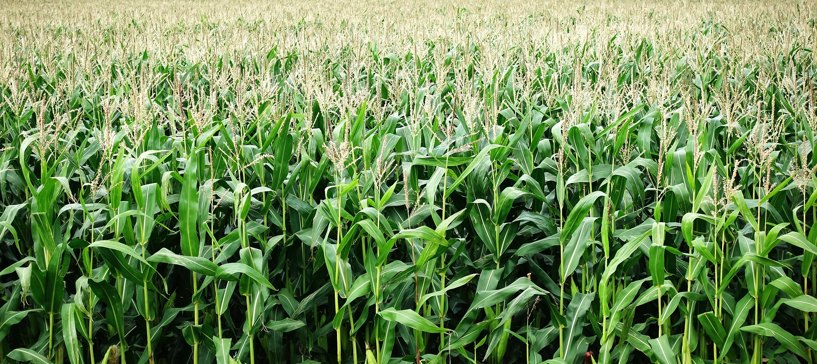
Community Concerns
92% of land in Iowa is dedicated to agriculture, and 27% of Iowa’s economy is dependent on agriculture
Drought costs an average of $9.4 billion per drought event
Corn yield per acre decreased 20% from 2011 to 2012 from drought-induced vegetative stress
Increasing dependence on the state’s aquifers for irrigation
Image Credit: aitoff (Pixabay)
Notes:
92% of land in Iowa is dedicated to agriculture, and 27% of Iowa’s economy is dependent on agriculture, leaving the state vulnerable to environmental factors.
Current climate trends show increasing temperature and decreasing precipitation, which has increased the frequency of droughts across the Midwest.
As you can see, drought is the second most expensive disaster in the United States, costing an average of $9.4 billion per drought event.
From 2010 to 2014, Iowa experienced a drought that lasted 151 weeks which placed the entire state of Iowa in a “D3 extreme drought” classification.
The 151-week drought led to shortages of water across the state, caused widespread crop loss, water emergencies and corn yield per acre decreased 20% from 2011 to 2012 from drought-induced vegetative stress.
Farmers have turned to irrigation during drought conditions to protect their crops, but increasing dependence on state aquifers have led to dry well, declining lake levels, and damaged natural fisheries.
In the summer of 2018, southeast Iowa experienced a severe drought that stunted corn growth, dried up waterways, and burned pastures.
Farmers and decision makers are invested in gaining a better understanding of how the changing climate will affect agricultural revenue.
Image Source:
Pixabay License
https://pixabay.com/en/corn-maize-crop-grow-agriculture-2655525/

Slide 4
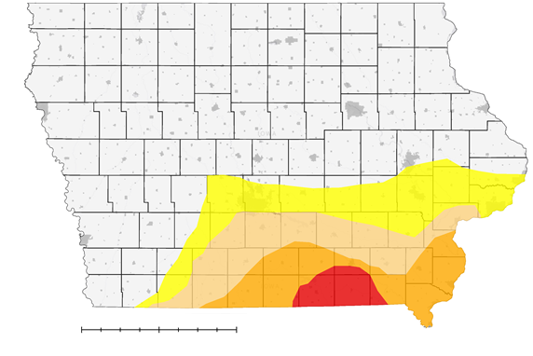

Project Partner
Iowa Department of Agriculture and Land Stewardship,
Climatology Bureau (ICB)
ICB map for the week of
August 21 to 28, 2018
Peak of the 2018 Iowa Drought
No Drought
Abnormally Dry
Moderate Drought
Severe Drought
Extreme Drought
0
50
100 miles
Image Credit: Iowa Agriculture & Food Security Team
Notes:
Our Project Partner is the Iowa Climatology Bureau within the Iowa Department of Agriculture and Land Stewardship.
Currently, the ICB relies on a “convergence of evidence” to indicate drought conditions across Iowa.
They use a variety of satellite-derived products, precipitation totals delivered by experts across the state, and to create a weekly drought conditions map for the United States Drought Monitor (USDM) archives.
The USDM can instigate disaster declarations, mitigation practices, and increase the state’s eligibility for low-interest loans.
Our team worked to provide a new tool for the ICB to help monitor drought conditions for future assessments.
This map is an example of what the ICB produces each week, which we will later compare to the maps our team produced.

Slide 5
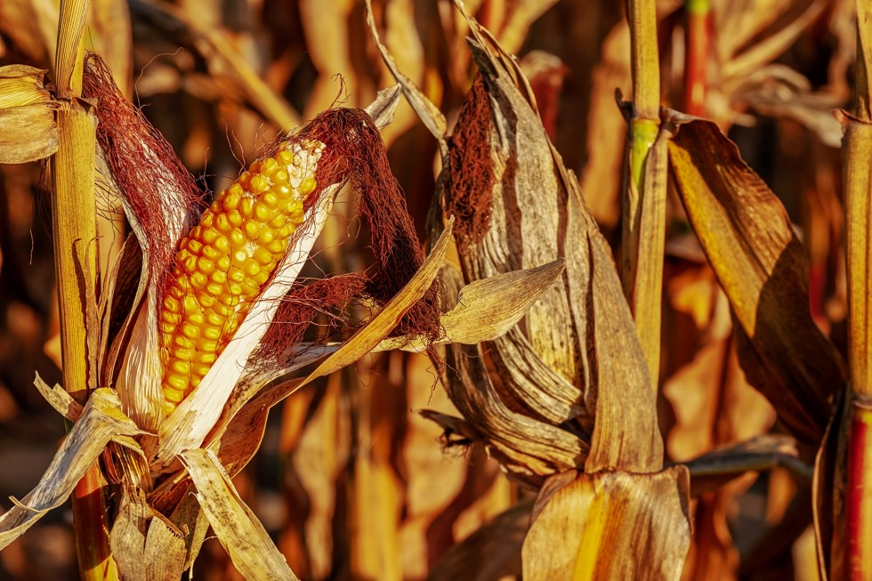
Project Objectives
Compare current drought monitoring methods with new techniques using the International Space Station ECOsystem Space-borne Thermal Radiometer Experiment on Space Station Evaporative Stress Index (ISS ECOSTRESS ESI) and the Atmosphere-Land EXchange Inverse (ALEXI) ESI
Analyze the differences between the ISS ECOSTRESS ESI and the ALEXI ESI to determine the added value to using an ESI product in drought monitoring methods
Image Credit: Couleur (Pixabay)
Notes:
This team chose to work with a new instrument, ECOSTRESS, to test its Evaporative Stress Index product over areas experiencing drought.
It worked well for some areas but not all, leading us to choose our countywide case studies to show what ECOSTRESS is capable of.
We used ALEXI ESI for a statewide analysis to show how ECOSTRESS could potentially work over large scales.
The two ESI products are very similar, but ECOSTRESS has a higher resolution.
We will provide further details on the differences later in this presentation.
Image Source:
Pixabay License
https://pixabay.com/en/corn-on-the-cob-corn-zea-mays-3664569/

Slide 6
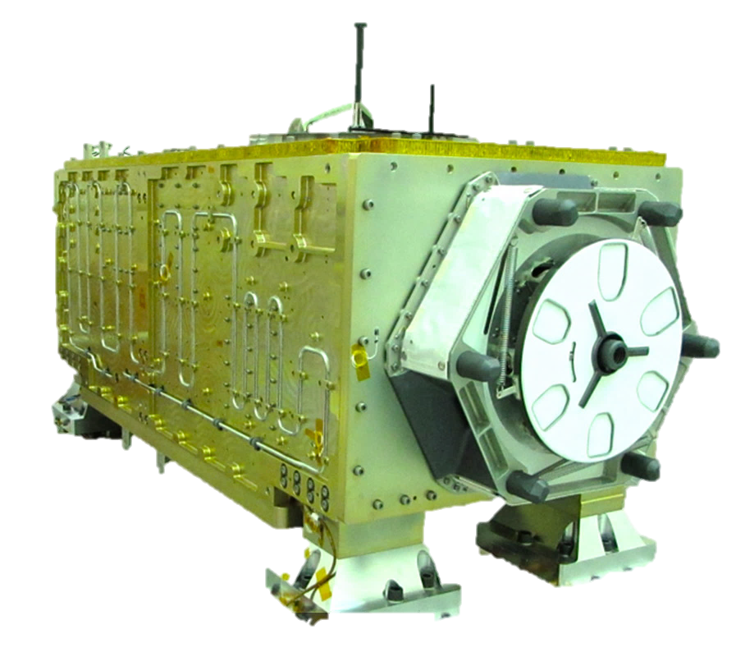

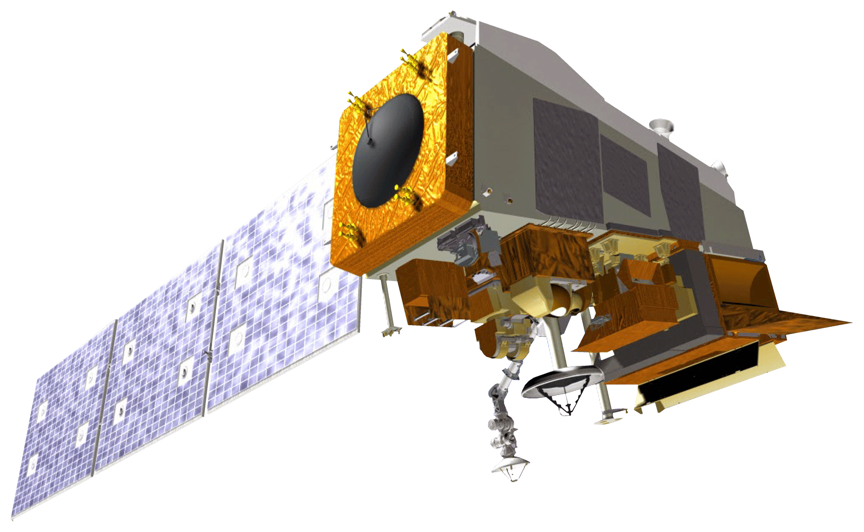
Earth Observations
ISS ECOSTRESS ESI
Evaporative Stress Index
Spatial Resolution:
38 x 68 m
Repeat Cycle: 3 days
Landsat 8 TIRS
Land Surface Temperature
Spatial Resolution:
100 m
Repeat cycle: 16 days
Suomi NPP VIIRS
Land Surface Temperature
Spatial Resolution:
750 m
Repeat Cycle: 16 days
Image Credit: NASA
Notes:
We used three The NASA Earth Observations in this project.
ECOSTRESS was used for getting average ESI values for Davis and Fremont counties for our ECOSTRESS Drought Assessment. This is due to its high spatial resolution of 38m x 68m.
Landsat 8 TIRS was used in conjunction with ECOSTRESS for Land Surface Temperatures over Fremont and Davis counties for the ECOSTRESS Drought Assessment. Suomi NPP VIIRS was used for Land Surface Temperatures over the whole state of Iowa for our ALEXI Drought Assessment.
From Suomi, you can get a whole image of Iowa to use for Land Surface Temperatures.
ECOSTRESS – ECOsystem Spaceborne Thermal Radiometer Experiment on the Space Station
Landsat 8 TIRS – Landsat 8 Thermal Infrared Sensor
Suomi NPP VIIRS – Suomi National Polar-orbiting Partnership Visible Infrared Imaging Radiometer Suite
SPoRT – Short-Term Prediction Research and Transition Center
ALEXI – Atmosphere-Land Exchange Inversion
MRMS – Multi-Radar/Multi-Sensor System
LIS – real-time Land Information System
Image Credit: NASA (public domain)

Slide 7
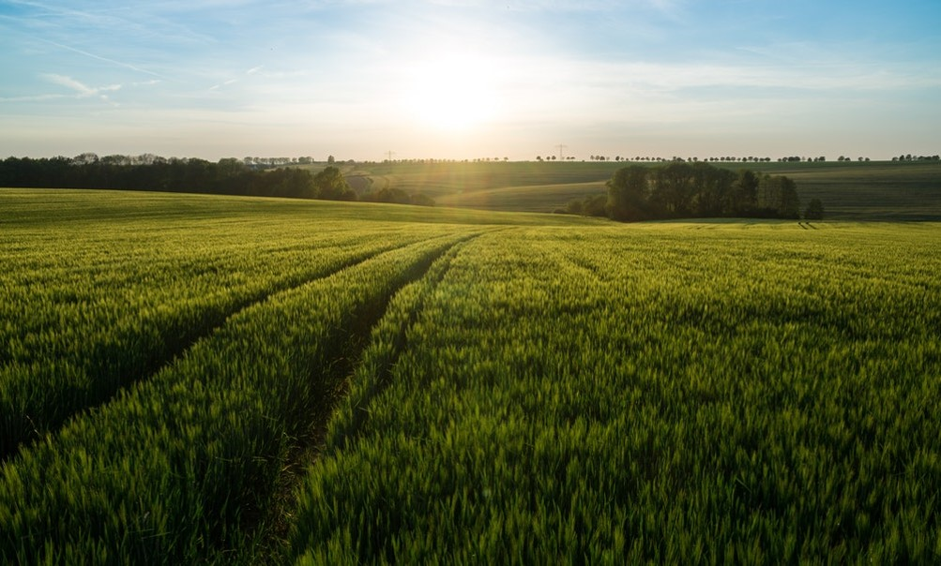
Ancillary Datasets
ALEXI ESI – to conduct statewide analysis of drought
Multi-Radar/Multi-Sensor System (MRMS) – to provide precipitation measurements for the statewide drought analysis
Land Information System (LIS) Soil Moisture 0-10cm – to supply soil moisture measurements for statewide drought analysis
ICB maps – to compare current methods with ESI products
Image Credit: Pascal Uhlig (Unsplash)
Notes:
We also used ancillary datasets: NASA Short-Term Prediction Research and Transition Center’s (SPoRT’s) ALEXI ESI product, Multi-Radar/Multi-Sensor System (MRMS) precipitation data, and real-time Land Information System (LIS) data. ALEXI was used to supplement ESI data from ECOSTRESS for the entire state for an ALEXI Drought Assessment.
MRMS was used to provide precipitation amounts for the whole state of Iowa and for Fremont and Davis counties for the ECOSTRESS and ALEXI Drought Assessments.
LIS Soil Moisture 0-10 cm was used for computing average soil moisture from 0-10cm over the state of Iowa and for Fremont and Davis Counties for the ECOSTRESS and ALEXI Drought Assessments. Data was available for every day of our study period from the precipitation and Soil Moisture products. This data was made available by SPoRT.
SPoRT – Short-Term Prediction Research and Transition Center
ALEXI – Atmosphere-Land Exchange Inversion
MRMS – Multi-Radar/Multi-Sensor System
LIS – real-time Land Information System
Image Source:
Pascal Uhlig on Unsplash
https://unsplash.com/photos/e-TvotGNDtc (Free Use)

Slide 8
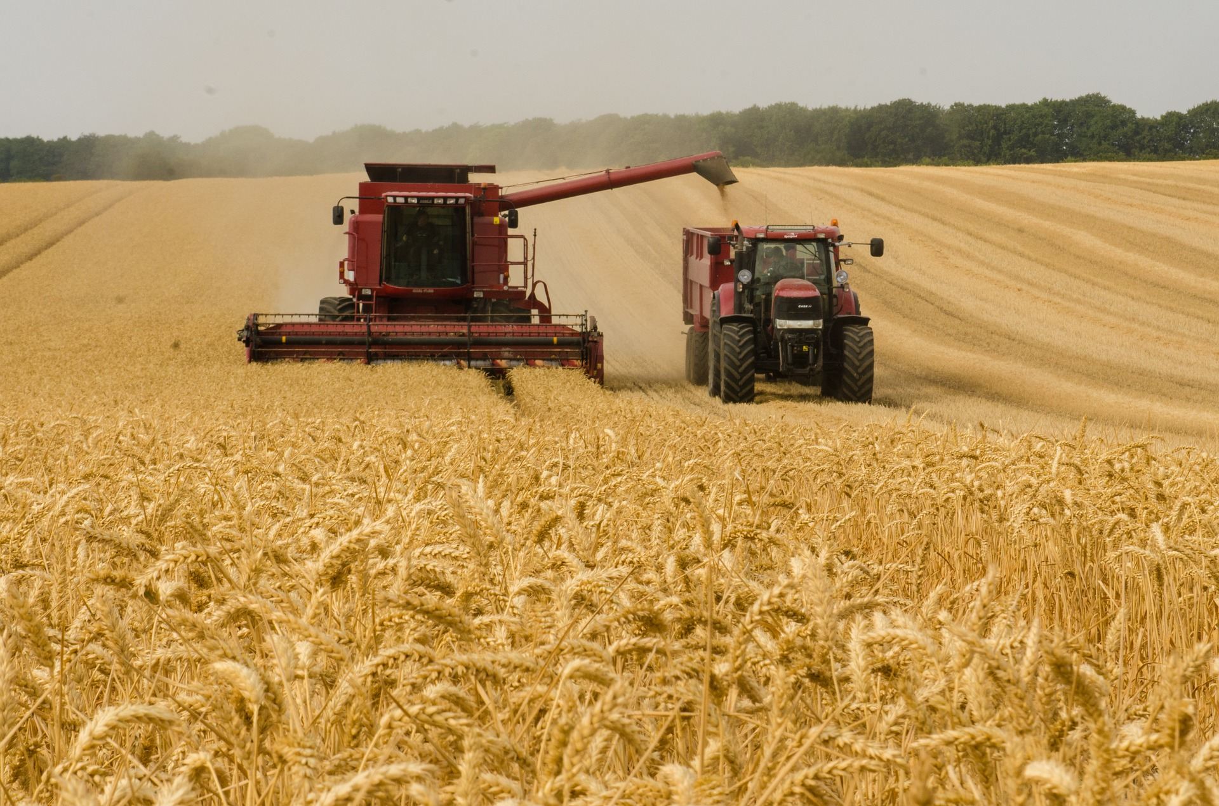

Methodology
Data Acquisition
Landsat 8 TIRS
Suomi NPP VIIRS
ALEXI ESI
ISS ECOSTRESS ESI
MRMS Precipitation
NASA LIS Soil Moisture
Data Processing
Calculate Land Surface Temperature
Calculate Average Precipitation and Soil Moisture values
Clip and Project Data over Iowa
Data Analysis
Fuzzy Logic
Percent Difference
End Products
ALEXI ESI Drought Assessment
ISS ECOSTRESS ESI Drought Assessment
Comparative Drought Assessment
Image Credit: stanvpetersent (Pixabay)
Notes:
Our methodology began with data acquisition from ISS ECOSTRESS ESI, Landsat 8 TIRS, Suomi NPP VIIRS, ALEXI ESI, MRMS, and LIS for the state of Iowa during the summer of 2018.
We used geostatistical and spatial analyst tools in ArcMap to process and analyze the data.
This data was overlayed in different combinations and analyzed with Fuzzy Logic, a tool for overlaying data and assigning relationships between the layers.
The closer to 1 a value is shows a higher chance of being in the relationship, in this case drought.
50 random points were generated over the whole state of Iowa and these points were compared to the same 50 points over the corresponding ICB map for our ALEXI ESI Drought Assessment end product.
30 random points were generated for both Fremont and Davis counties.
The same process was done as the whole state but for the counties.
This data went into our ECOSTRESS Drought Assessment.
Image Source:
Pixabay License
https://pixabay.com/photos/harvester-tractor-wheat-agriculture-3562476/

Slide 9
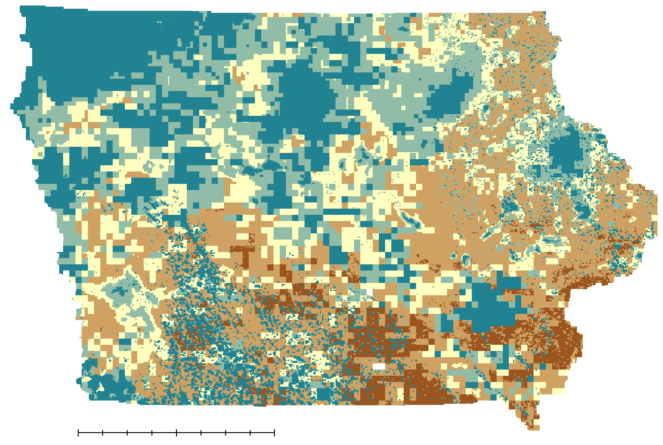
ALEXI ESI Statewide Drought Analysis:
One Week Before Peak Drought, August 12 to 18, 2018
14% of Iowa was under Extreme Drought
No Drought
Abnormally Dry
Moderate Drought
Severe Drought
Extreme Drought
miles
0
50
100
Image Credit: Iowa Agriculture & Food Security Team
Notes:
This is the map we created for a week before peak drought over Iowa. Brown values show where there is most likely to be a drought while green values show where there is likely no drought. One thing to note, the splotchy green spots over SW and NE Iowa are clouds. You can remove the clouds from the Land Surface Temperature images but they fill in as no drought when computing a Fuzzy Logic image. Our map provides a higher resolution image of where drought could be potentially occurring. 14% of Iowa was under Extreme Drought.

Slide 10
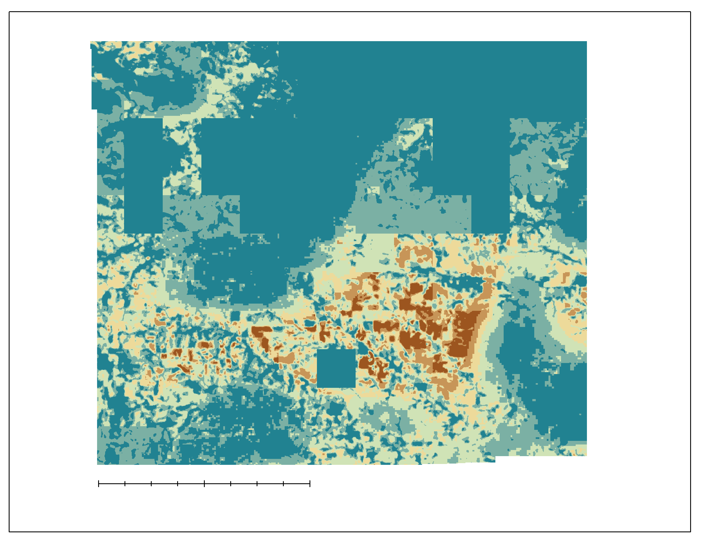
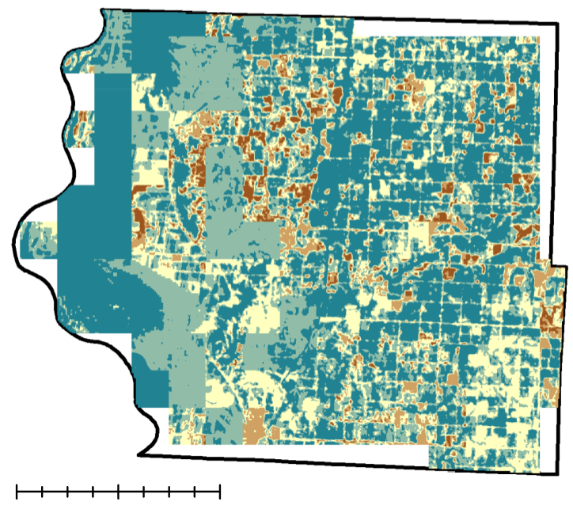
ECOSTRESS ESI County Drought Analysis
One Week Before Peak Drought, August 12 to 18, 2018
Davis County
Fremont County
No Drought
Abnormally Dry
Moderate Drought
Severe Drought
Extreme Drought
miles
0
5
10
Image Credits: Iowa Agriculture & Food Security Team
Notes:
This is Davis County on the left and Fremont County on the right. Each map is a week before peak drought in Iowa. These maps were computed using ECOSTRESS, Landsat 8 TIRS LST, and LIS Soil Moisture 0-10 cm. As with the Iowa map, brown indicates areas more likely to be under a drought and green indicates areas more likely to not be in a drought. These maps show a higher resolution of drought across the counties.

Slide 11
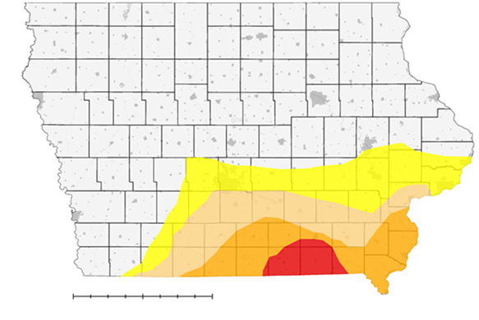
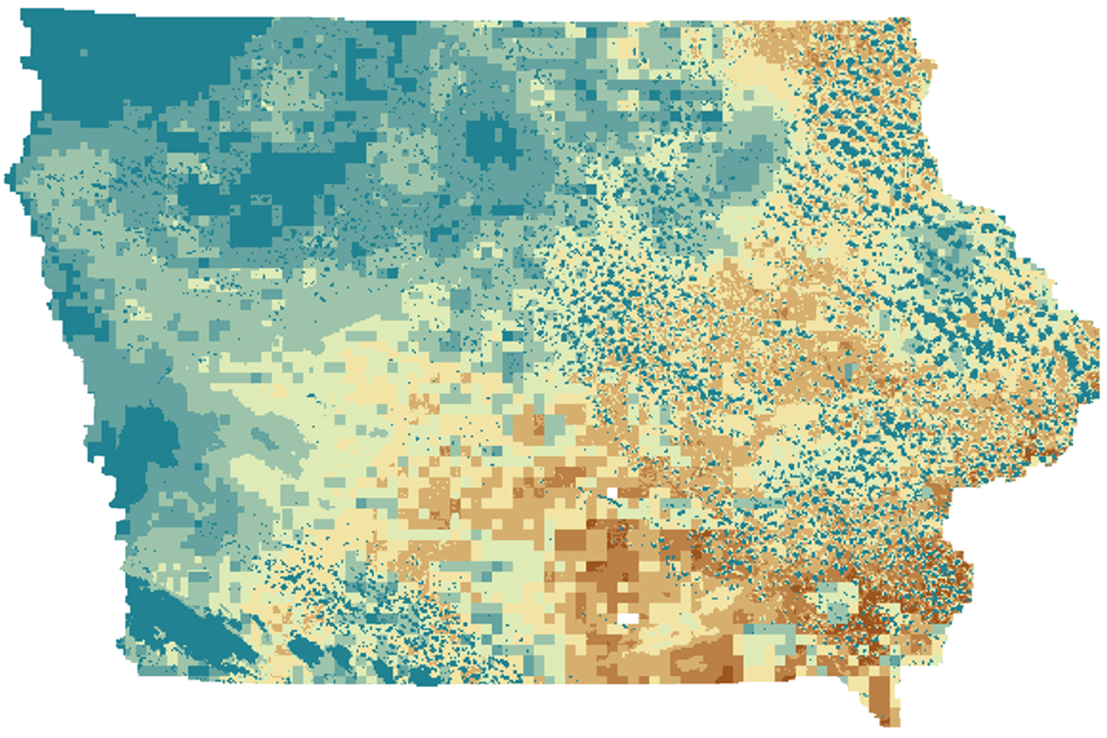
Results: ICB vs ALEXI ESI Comparison
Week of Peak Drought, August 19 to 25, 2018
ICB Map
ALEXI ESI Map
miles
0
0
50
100
50
100
miles
<25% under Moderate to Extreme Drought
50 to 75% under Moderate to Extreme Drought
No Drought
No Drought
Abnormally Dry
Abnormally Dry
Moderate Drought
Moderate Drought
Severe Drought
Severe Drought
Extreme Drought
Extreme Drought
Image Credits: Iowa Agriculture & Food Security Team
Notes:
ICB Map overgeneralizes areas of where different levels of drought are occurring while our map gives a higher resolution image of what is occurring. Our map shows about 50 to 75% of Iowa being under a Moderate to Extreme Drought. The ICB map shows less than 25% of Iowa being under a Moderate to Extreme Drought. Our map does correlate with the general shape of the ICB drought map, however, our map indicates drier conditions extending further north and east into Iowa.

Slide 12
Results: ICB vs ALEXI ESI Comparison
Week of Peak Drought, August 19 to 25, 2018
Average Percent Difference: 58.35%
Notes:
These are the 50 random points generated over Iowa. Our ALEXI map values are show in the green, while ICB is in the black. Based on the random points generated, the ICB had more instances of no drought while our ALEXI product had higher instances of drought occurring. Average Percent Difference was 58.35%.

Slide 13

Results: ICB vs ECOSTRESS Comparison
One Week Before Peak Drought, August 12 to 18, 2018
Davis County
No Drought
miles
No Drought
Abnormally Dry
0
5
10
ICB Map
Abnormally Dry
Moderate Drought
ECOSTRESS Map
Moderate Drought
Severe Drought
Severe Drought
Extreme Drought
Image Credits: Iowa Agriculture & Food Security Team
Extreme Drought
Notes:
For the Davis County case study we compared the ICB map to our ECOSTRESS map.
The two maps in comparison show a visualization on how this county was affected by drought.
The ICB map indicated severe and extreme drought through the entire county in August of last year.
Our ECOSTRESS map that shows that not all of the county was affected by drought, and some areas showed no drought.
We generated random points across the county to compare how the county was affected by drought.

Slide 14
Results: ICB vs ECOSTRESS Comparison
One Week Before Peak Drought, August 12 to 18, 2018
Average Percent Difference: 54.14%
Notes:
The random points across Davis County indicated fewer cases of drought using ECOSTRESS than the ICB map.
As you can see from this graph, our ECOSTRESS map has areas that consisted of no data.
The reason there is no data showing on this graph is because when the random points were generated, some of the points were located outside of the county, despite our efforts to confine the points to Davis county.
ECOSTRESS also has a higher resolution compared to the current ICB maps, which allowed there to be a difference within the data.

Slide 15
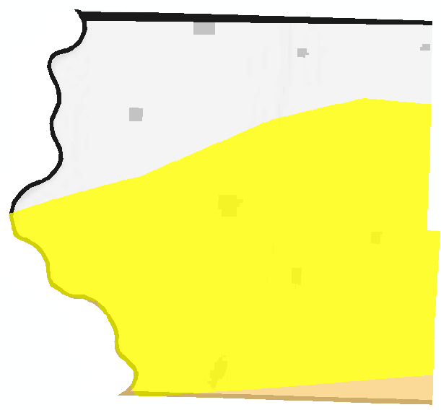
Results: ICB vs ECOSTRESS Comparison
One Week Before Peak Drought, August 12 to 18, 2018
Fremont County
No Drought
ICB Map
0
5
10
ECOSTRESS Map
No Drought
Abnormally Dry
miles
Abnormally Dry
Moderate Drought
Moderate Drought
Severe Drought
Severe Drought
Extreme Drought
Image Credits: Iowa Agriculture & Food Security Team
Extreme Drought
Notes:
For this analysis we will be comparing the ICB map of Fremont County to the ECOSTRESS map of Fremont County. This two maps in comparison show a visualization on how this county was affected by drought. The ICB indicated that the county had no drought in the northern area of the county, abnormally dry within the middle of the county, and moderate drought in the southeastern portion of the county. For the ECOSTRESS map, it shows that Fremont County was affected by drought but not as bad as Davis County and that the affects of drought happened all over the county instead in certain areas. To get a better analysis of the two maps we generated random points to compare how the county was affected by drought.

Slide 16
Results: ICB vs ECOSTRESS Comparison
One Week Before Peak Drought, August 12 to 18, 2018
Average Percent Difference: 53.11%
Notes:
With the random points ECOSTRESS showed slightly higher case of drought than the ICB in Davis County. ECOSTRESS map shows that there weren’t any abnormally dry areas but many areas were in moderate drought and had no drought. This could be the reason due to the higher resolution of data from ECOSTRESS than the ICB maps. As stated before the one point that is represented as no data is in area where data is not present. The one thing the graph doesn’t show is the abnormally dry data that was shown in the ECOSTRESS map and this could be due to the amount of points that was generated for the counties. For the two counties we generated 30 random points, if we generated more points we could have had points that had the abnormally dry areas.

Slide 17

Conclusions
ALEXI ESI detected more drought conditions over the state of Iowa when compared to current ICB maps.
ISS ECOSTRESS ESI could provide higher spatial and temporal resolution of drought conditions compared to current ICB maps.
Current ICB methods can be supplemented with finer resolution ESI products to offer a field by field view of drought conditions.
Image Credit: Gabriel Jimenez (Unsplash)
Notes:
Through our work on this project, we determined that ALEXI ESI detected more drought conditions over the state of Iowa compared to current ICB maps, as we saw with the statewide analysis.
We also determined through our work with the county cases studies that ISS ECOSTRESS ESI provided higher spatial and temporal resolution of drought conditions than current ICB maps.
After working with the data and formulizing our fuzzy logic maps, we concluded that current ICB methods can be supplemented with finer resolution ESI products to offer a field by field view of drought conditions.
Image Source:
Gabriel Jimenez on Unsplash
https://unsplash.com/photos/jin4W1HqgL4

Slide 18
Current Limitations
ECOSTRESS data are unavailable during critical growth periods.
ECOSTRESS is currently in an Early Adopter stage.
Different dates pulled for land surface temperatures for county maps.
Fuzzy overlay can distort data (cloud cover, extent).
There is a slight deviation of coordinates between ICB and our maps.
Data resampling is limited by the original spatial resolution.
Notes:
ECOSTRESS is in the Early Adopter stage and data unavailable during critical growth periods
Land Surface Temperatures from Landsat 8 TIRS for Fremont and Davis counties had to be acquired from July 2018 and September 2018, respectively, due to clouds.
Fuzzy Overlay fills in cloud gap areas as a “No Drought” relationship and cuts off small sections of data around the boarders of areas.
ICB images received were in JPEG format which had to be georectified over Iowa; this caused a slight deviation of coordinates.
Data resampling was limited by the original spatial resolution in the soil moisture resolution and precipitation data. Due to this limitation patchiness can be seen on our maps.

Slide 19
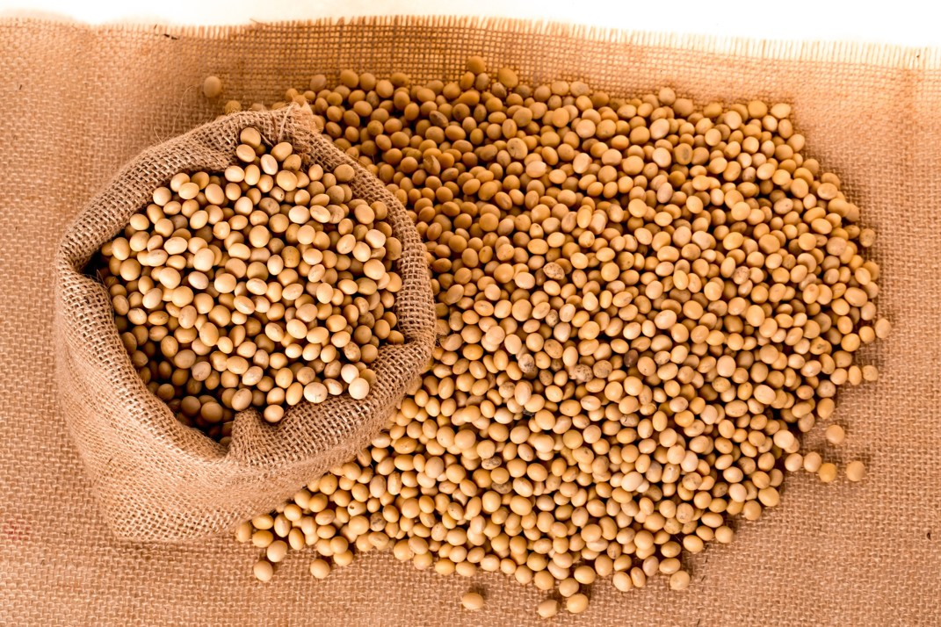
Future Work
ECOSTRESS has the potential to be involved in large-scale studies that can provide higher resolution thermal imagery in locations where cloud cover is not an issue.
Future studies would observe crop drought vulnerability at the beginning of the growing season, which is the most critical phase of plant development.
Continuous coverage from April to November would increase understanding of the water requirements of corn and soybeans throughout the entire growing season.
A Crop Vulnerability Assessment would help farmers decide if they should plant corn or soybean in a given area based on tendency towards drought.
Image Credit: pnmralex (Pixabay)
Notes:
ECOSTRESS has the potential for being involved in large-scale studies which can provide the higher resolution thermal imagery in locations where cloud cover is not an issue.
Future studies would observe crop drought vulnerability at the beginning of the growing season, the most critical phase of plant development.
Continuous coverage from April to November would increase understanding of the water requirements of corn and soybeans throughout the entire growing season.
A Crop Vulnerability Assessment would help farmers decide if they should plant corn or soybean in a given area based on tendency towards drought. We ran out of time when trying to complete this assessment.
Image Source:
Pixabay License
https://pixabay.com/en/soybeans-plants-seeds-bag-burlap-2039638/

Slide 20
Partner:
Dr. Justin Glisan (Iowa Department of Agriculture and Land Stewardship, Climatology Bureau)
Advisors & Mentors:
Dr. Jeffrey Luvall (NASA Marshall Space Flight Center)
Dr. Robert Griffin (University of Alabama in Huntsville)
Madison Murphy (NASA DEVELOP National Program, Alabama – Marshall Node)
Kathrene Garcia (NASA DEVELOP National Program, Alabama – Marshall Node)
Maggi Klug (University of Alabama in Huntsville)
Leigh Sinclair (University of Alabama in Huntsville, Information Technology & Systems Center)
Helen Baldwin (University of Alabama in Huntsville)
Dr. Chris Schultz (NASA Short-term Prediction Research and Transition Center)
Dr. Chris Hain (NASA Short-term Prediction Research and Transition Center)

Slide 21




Questions?
Brittany Greene
Project Lead
Audrieauna Beatty
Abigail Whiteside

