Slide 1
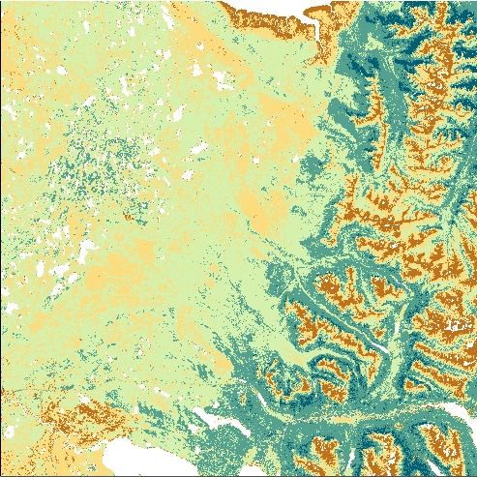
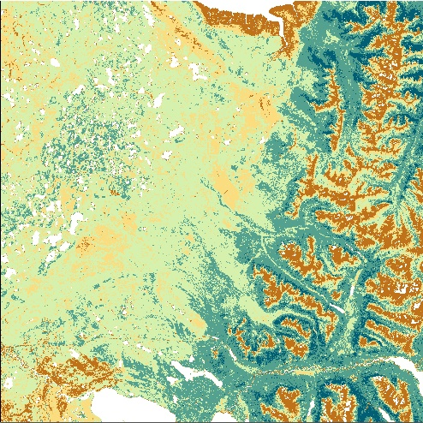
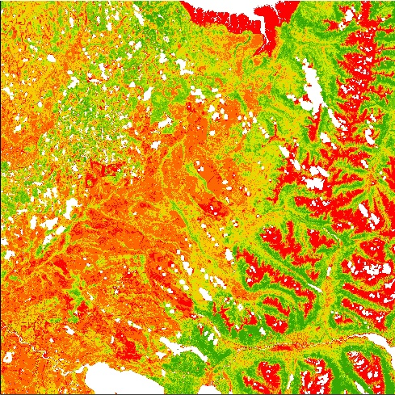
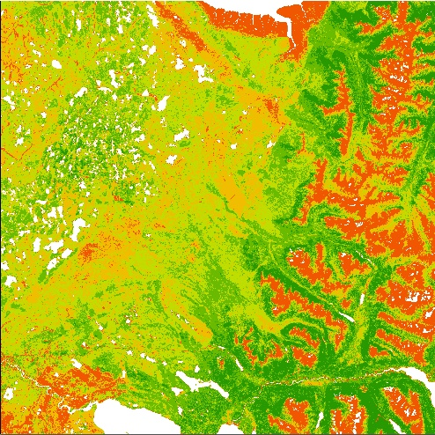
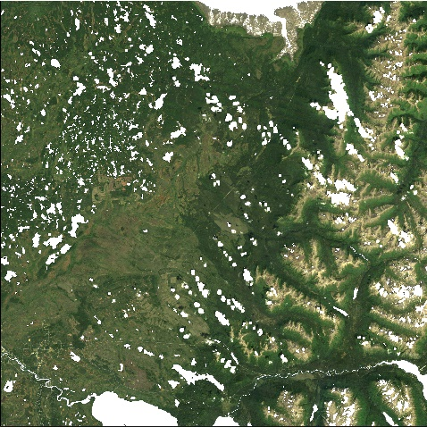
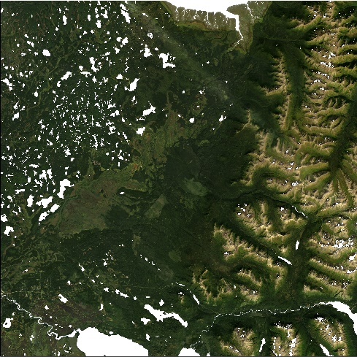
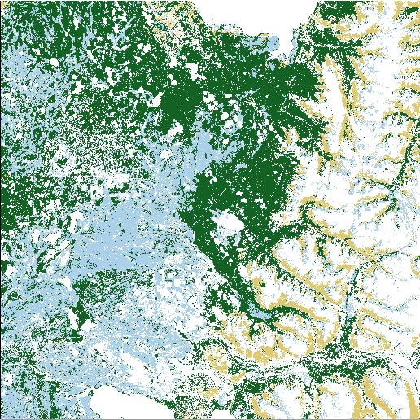
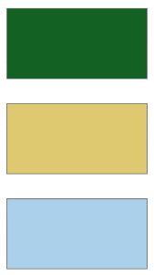
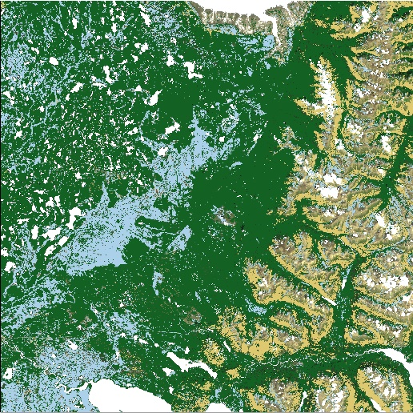
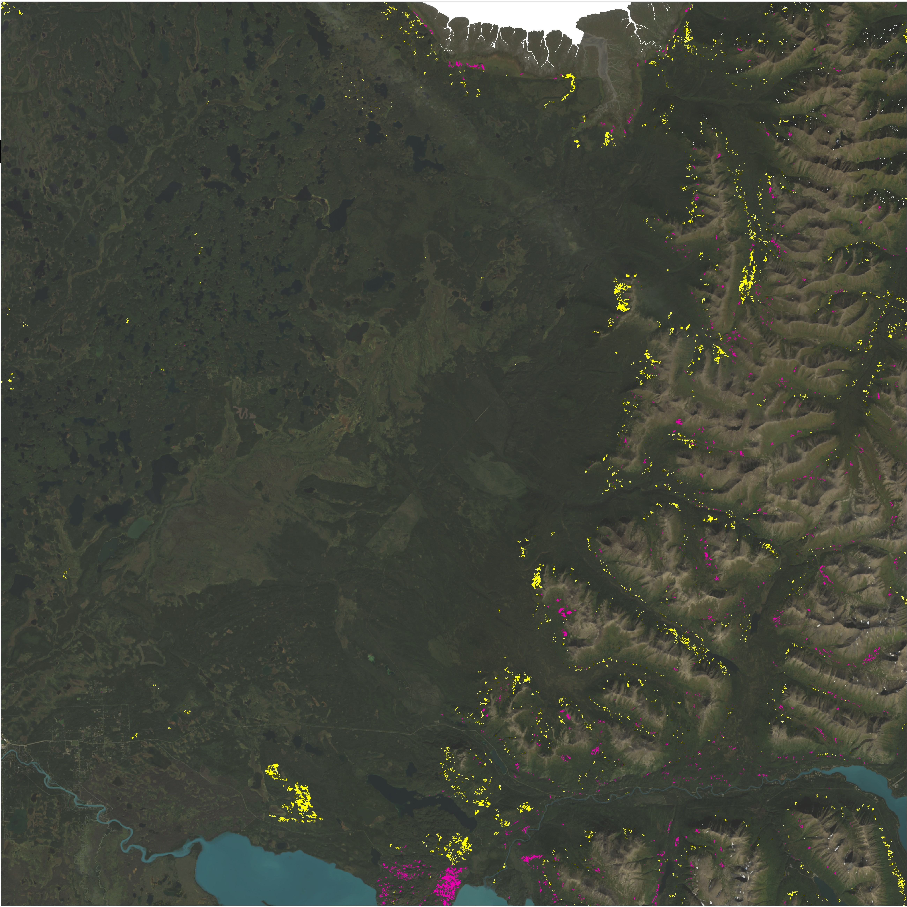
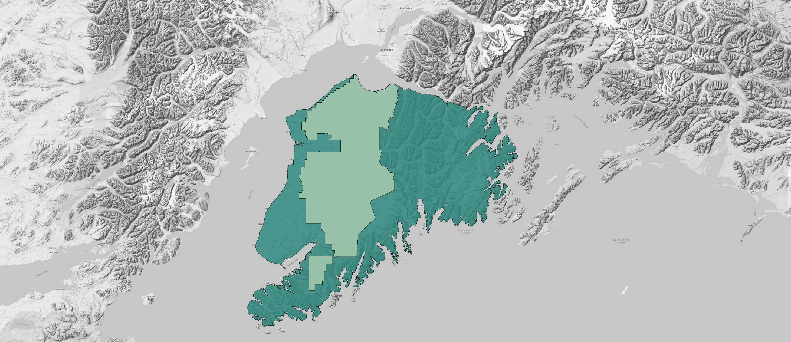
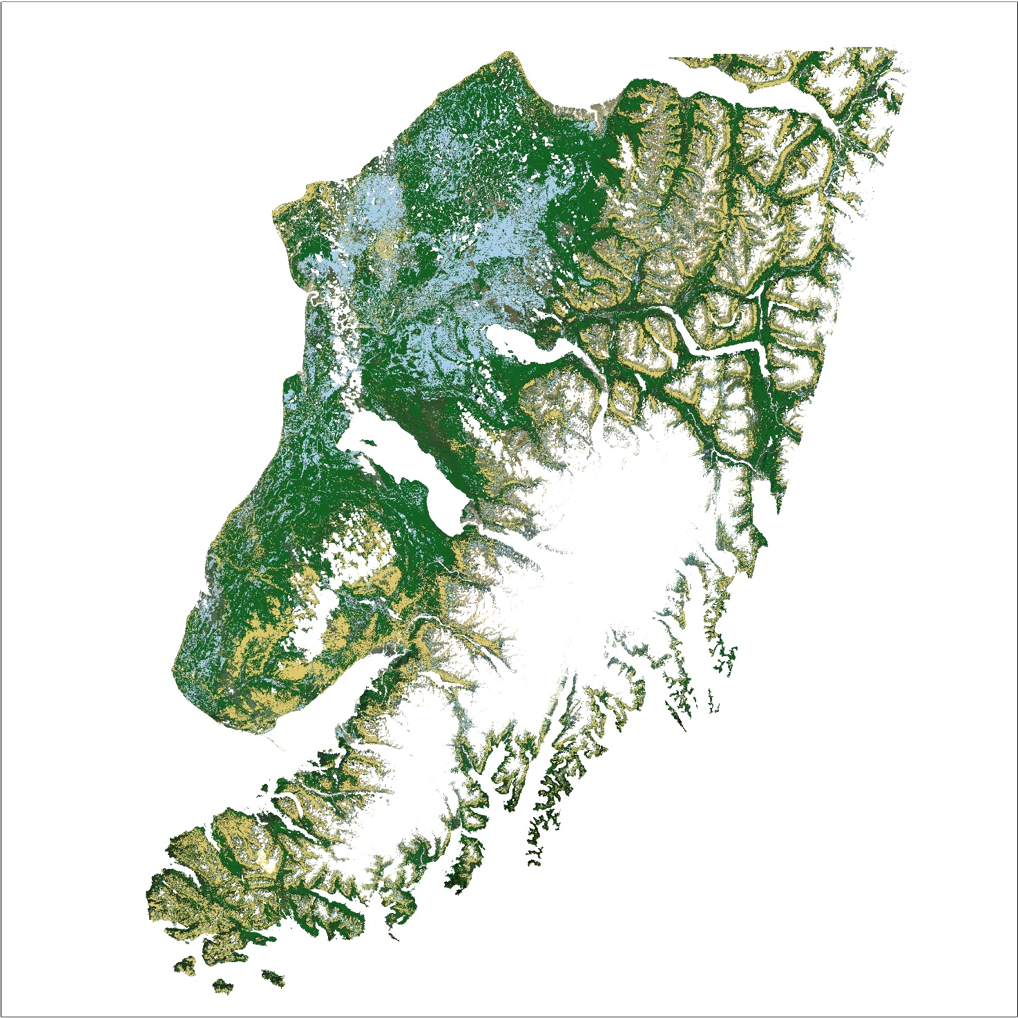
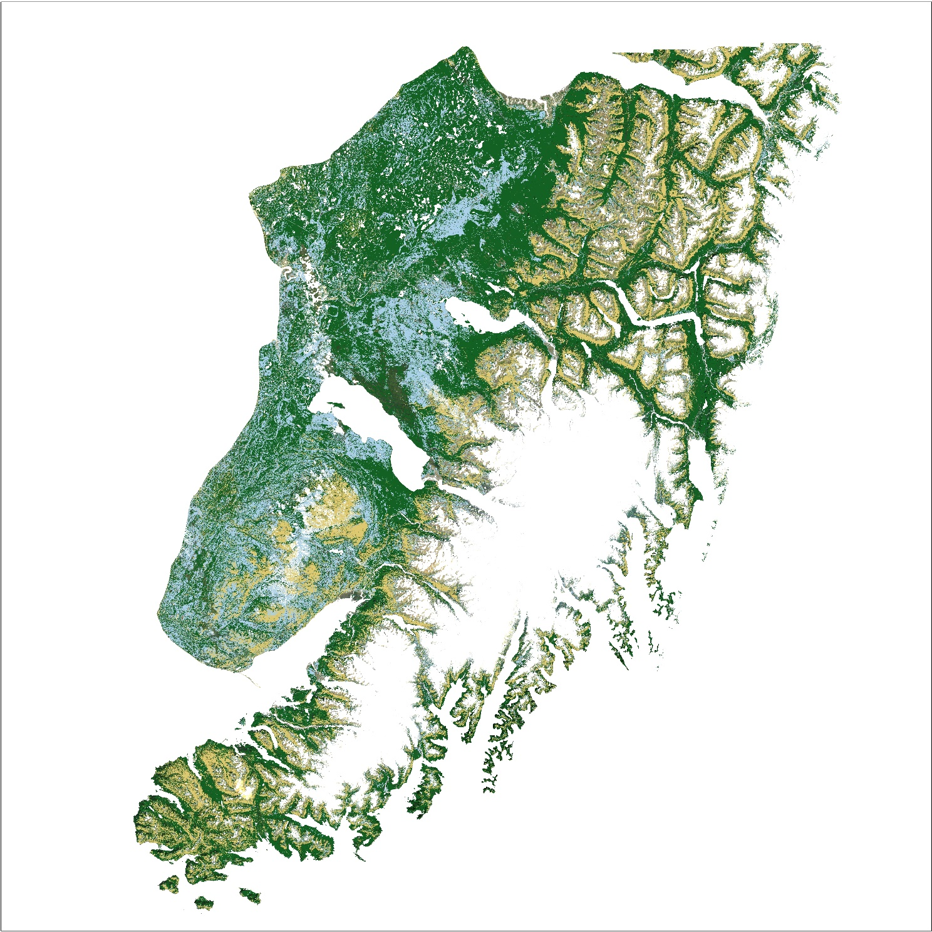
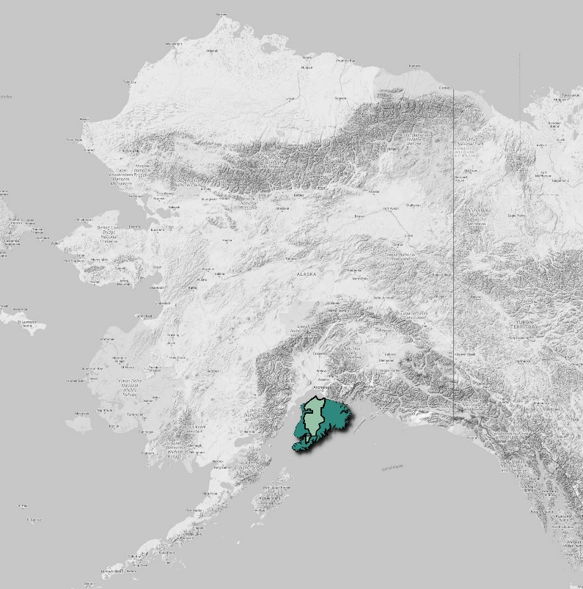

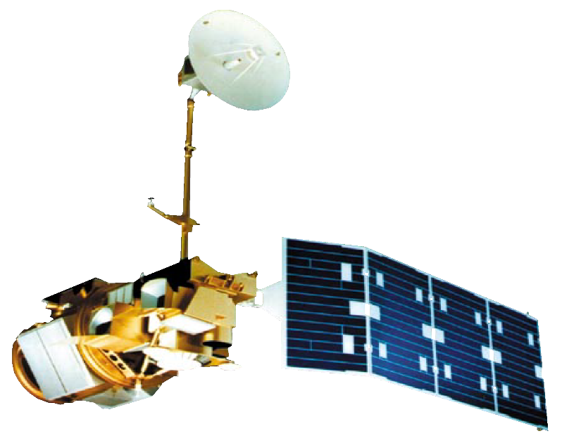

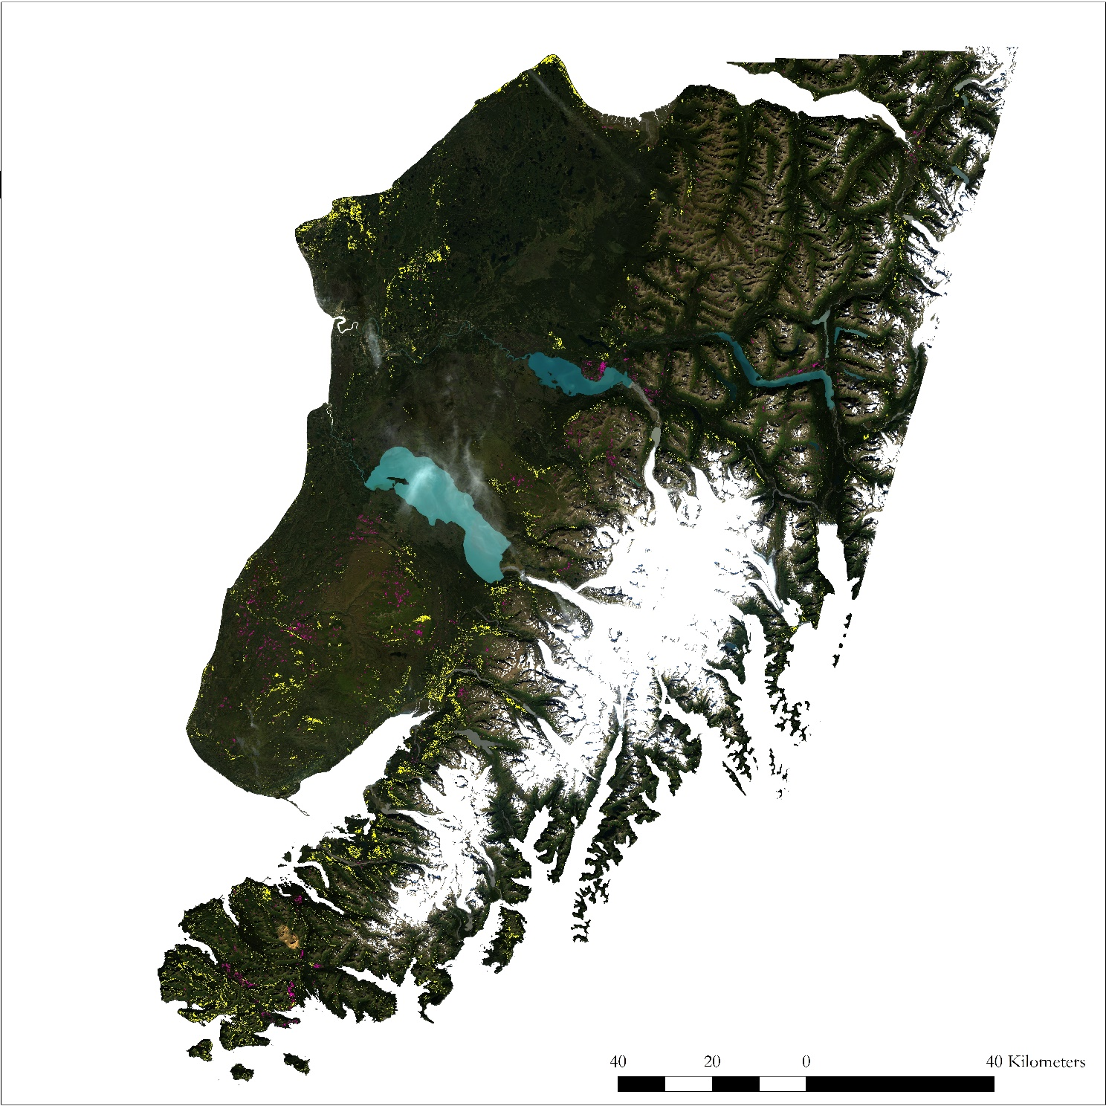

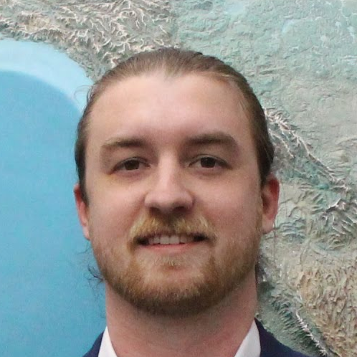
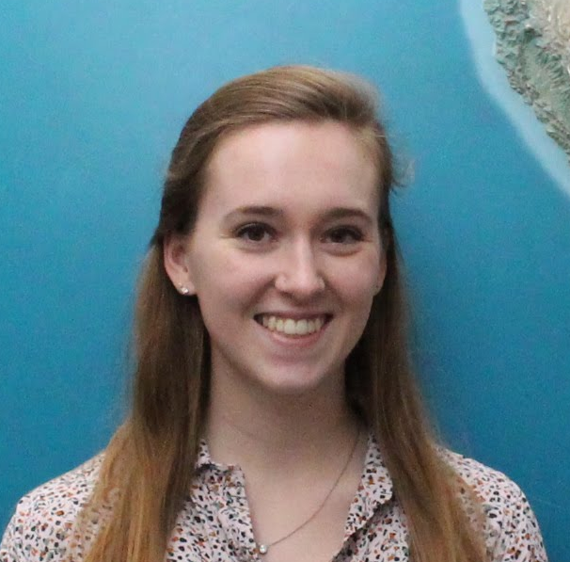


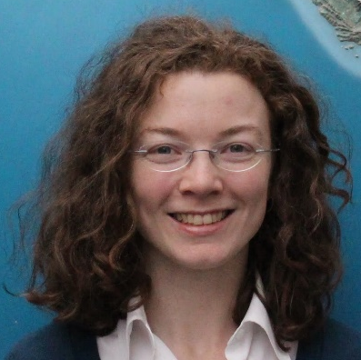



Mapping Treeline Rise and Wetland Conversion to Supplement Resource Management Actions in a Changing Alaskan Climate
Abstract
Methodology
Rising temperatures alter growing conditions for vegetation that result in changes to habitat distribution and abundance. In Alaska, these ecological changes present challenges to land managers planning to accommodate species of interest such as Dall’s sheep and ptarmigan. NASA DEVELOP partnered with the Kenai National Wildlife Refuge (KENWR) to identify areas of wetland afforestation and treeline rise on the Kenai Peninsula from 1989 to 2016 and to forecast these trends into 2050 and 2100. The DEVELOP team generated historical land cover classification maps for the Kenai Peninsula from Earth observations acquired by Landsat 4 Thematic Mapper and Landsat 8 Operational Land Imager. We performed supervised classification of the Landsat imagery by training a maximum likelihood image classifier. We selected training areas for the classifier by referencing the USGS National Land Cover Database for 2001 and 2011 along with visual verification. We then analyzed the historical land cover maps to identify areas of wetland conversion and treeline rise. The team then created forecast maps of these trends to 2050 and 2100 using TerrSet Land Change Modeler (LCM) which can provide KENWR staff with a better understanding of how rates of afforestation vary across the landscape and inform future land management strategies.
Stack Images
1989
Landsat Surface Reflectance bands with NDVI and EVI
2016
Classify Land Cover
Forest
Shrub
Wetlands
Objectives
Produce land cover time series maps to observe treeline movement and conversion of wetland ecosystems from 1989 to 2016
Map areas where woody plants have encroached into alpine and wetland ecosystems
Visualize historic rate of treeline advance and wetland afforestation
Forecast wetland loss and treeline rise to 2050 and 2100
Forecast changes to 2050 and 2100
Change Detection
Study Area
Results
Anchorage
1989
2016
Alaska
Cook Inlet
Gulf of Alaska
Kenai Peninsula
N
Forest
Shrub
Wetlands
Earth Observations
Kenai National Wildlife Refuge
Land cover classification of the Landsat images was performed using the Semi-Automatic Classification Plugin within QGIS to identify land occupied by forest, shrub, and wetlands.
Change detection analysis was then performed on the land cover maps to identify areas of wetland and shrubland that became forestland during the study period.
Forecast of land cover changes to 2050 and 2100 was performed with TerrSet’s Land Change Modeler (LCM) with climate data input as driving variables.
Change Detection
Landsat 4 Thematic Mapper
Landsat 8 Operational Land Imager
Team Members
Shrub to Forest
Wetlands to Forest
Brendan
McAndrew
Project Lead
Kate
Hess
Victor
Lenske
Sara Lubkin
Megan
Maloney
Helen
Plattner
Conclusions
Similarities in the spectral reflectance of forestland, shrubland, and wetlands limited the accuracy of image-based land cover classification.
            Wildfires that occurred prior to, and during, the study period were responsible for the largest areas of land cover conversion on the Kenai Peninsula.
Wetland afforestation was most apparent in the northern lowlands of the Kenai Peninsula.
Limited treeline rise was observed despite the slow pace of advance (~1 m/yr) relative to the spatial resolution of the data (30 m/pixel).
If warming trends follow current patterns, afforestation will likely continue to 2050 and 2100.
Acknowledgements
Project Partner
Dr. John Bolten, NASA Goddard Space Flight Center
Dr. Adrianna Foster, Universities Space Research Association
Dr. Keith Gaddis, NASA
Dr. Dawn Magness, US Fish and Wildlife Service
Sean McCartney, Science Systems & Applications, Inc
Dr. Joseph Spruce, Science Systems & Applications, Inc
DEMs provided by the Polar Geospatial Center under NSF OPP awards 1043681, 1559691 and 1542736.
Kenai Ecological Forecasting
Maryland – Goddard | Spring 2018

