Slide 1
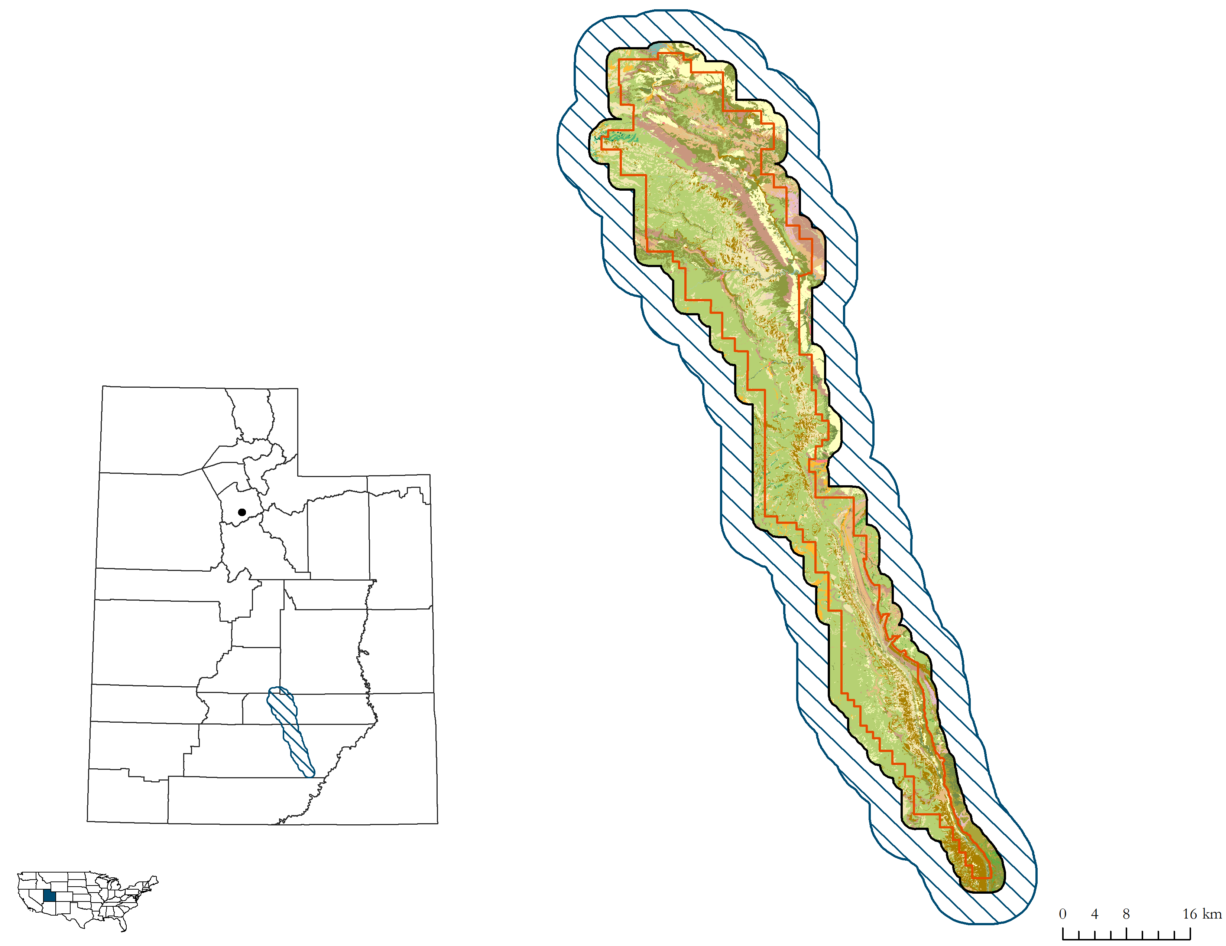
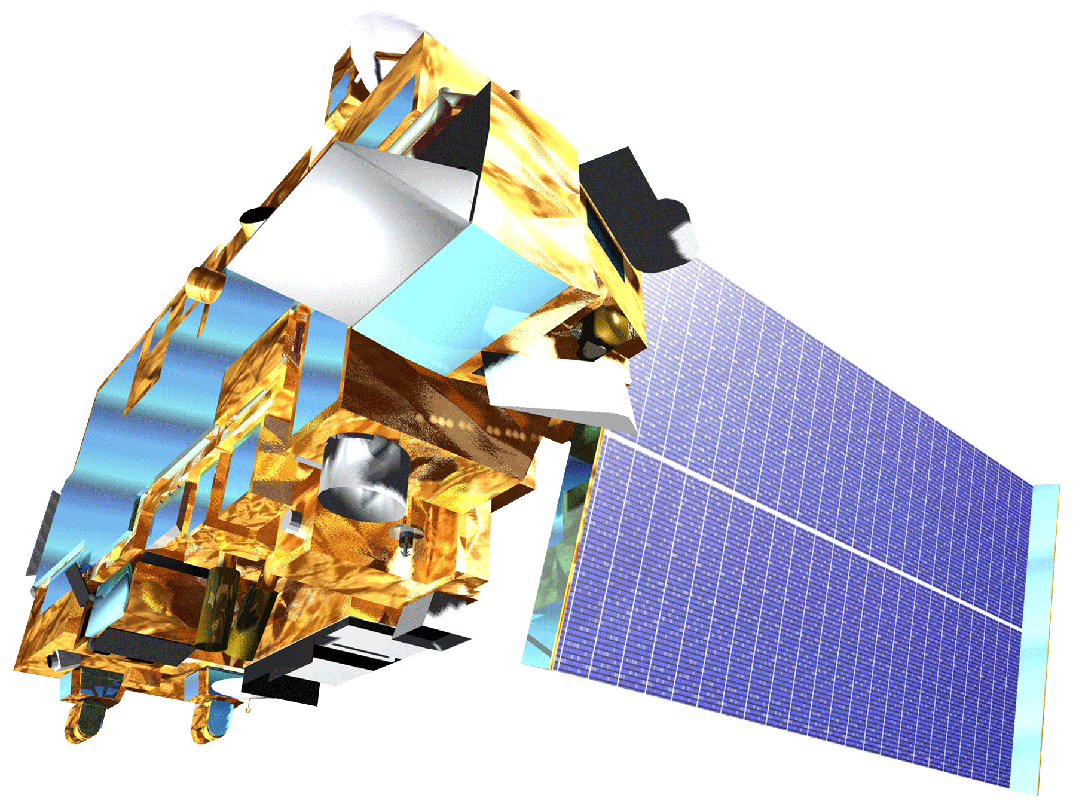
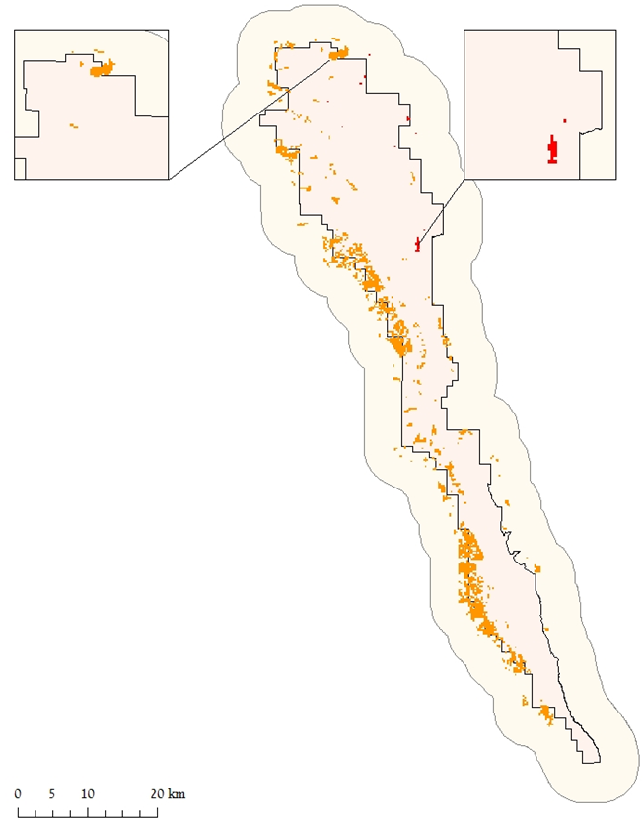
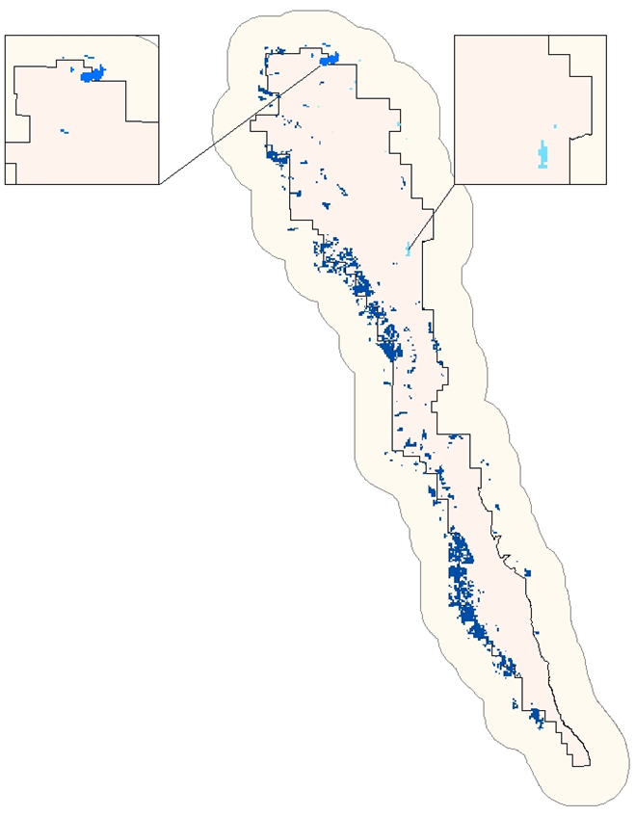
Assessing Landscape Vulnerability to Drought and Climate Change in National Parks of the Western United States
Abstract
Study Area
A changing climate has been an issue of growing concern over recent decades. Drought frequency has increased and water availability has become more limited, especially in the western United States. With semi-arid regions typically becoming warmer and dryer, knowledge on how to identify shifts in vegetation productivity, which are early warning signs of changes in ecosystem stability, are of great interest to national park land managers. Guided by project partners from the National Park Service (NPS) and the United States Geological Survey (USGS), this project utilized a climate pivot point framework to assess the capacity of vegetation in Utah’s Capitol Reef National Park to resist drought when water is scarce. We analyzed multiple climatic variables including precipitation, temperature, and evapotranspiration, against delta NDVI across a 15 year time span from 2000 to 2014. This project will benefit our partners by providing information about which vegetation types are the most vulnerable to climate change and drought. The framework of this analysis can be replicated for other national parks and can be used by land managers to make critical decisions.
Capitol Reef National Park, Utah
Objectives
Utilize NASA Earth observations to determine climate pivot points for different environmental factors for varying vegetation types.
Formulate a methodology for land managers of large tracts in the western United States to determine vegetation response to climate change.
Identify vegetation types that are vulnerable to drought and warming environmental conditions by utilizing various climate pivot points as indicators of sensitivity and ecosystem stability.
National Park Boundary
Proposed Project Boundary
4 Kilometer Buffer
Earth Observations
Project Partners
Results
Terra MODIS:
Moderate Resolution Imaging Spectroradiometer
Methodology
Create a multiple linear regression (MLR) model to identify significant climate variables
Western US Water Resources
Data acquisition and processing for climate variables and NDVI
Temperature (°C)
Precipitation (mm)
Investigate whether a lag time exists between precipitation events and vegetation response
Extract pivot point values for each climate variable from our MLR
Vegetation Type | Temperature (°C) | Precipitation (mm)
Colorado Plateau Mixed Low Sagebrush Shrubland | 20.18 | 202.59
Inter-Mountain Basin Semi-Desert Grassland | 18.08 | 216.48
Colorado Plateau Pinyon-Juniper Woodland | 18.64 | 230.64
Conclusions
Samples from three different vegetation types—Sagebrush Shrubland, Semi-desert Grassland, and Pinyon Juniper Woodland—were analyzed and the results found that all three of our climate variables were significantly correlated with delta NDVI.
Looking into the future, the results indicate that Sagebrush Shrublands will be more resilient to high temperatures, whereas Semi-desert Grasslands will be more resilient to lower precipitation.
Team Members
Acknowledgements
Dr. Seth Munson, Plant Ecologist, United States Geological Survey Southwest Biological Science Center
Dr. David Thoma, Ecologist, National Park Service Inventory and Monitoring Program
Dr. Kenton Ross, NASA DEVELOP National Program Science Advisor
Emily Gotschalk and Tyler Rhodes, Center Leads
Kelley Meehan
Project Lead
Tom Smith
Teresa Fenn
Any opinions, findings, and conclusions or recommendations expressed in this material are those of the author(s) and do not necessarily reflect the views of the National Aeronautics and Space Administration. This material is based upon work supported by NASA through contract NNL11AA00B and cooperative agreement NNX14AB60A.
Molly Spater
Grant Jaccoud
Kaylie Taliaferro
NASA Langley Research Center – Summer 2016

