Slide 1

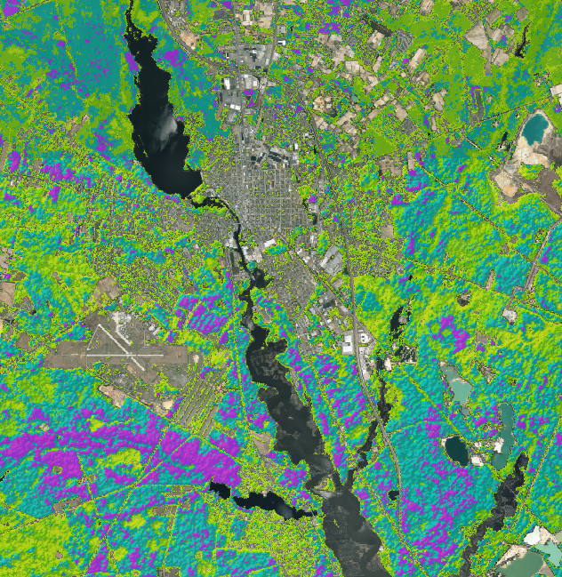

New Jersey Urban Development
Identifying Optimal Regions within New Jersey’s Pine Barren Forest for Urban Development Based on Wildfire Risk and the Wildland Urban-Interface Theory
Man Kumari Giri
Mercedes Bartkovich
Olivia Buchanan
Nicholas McVey
Notes:
Man

Slide 2
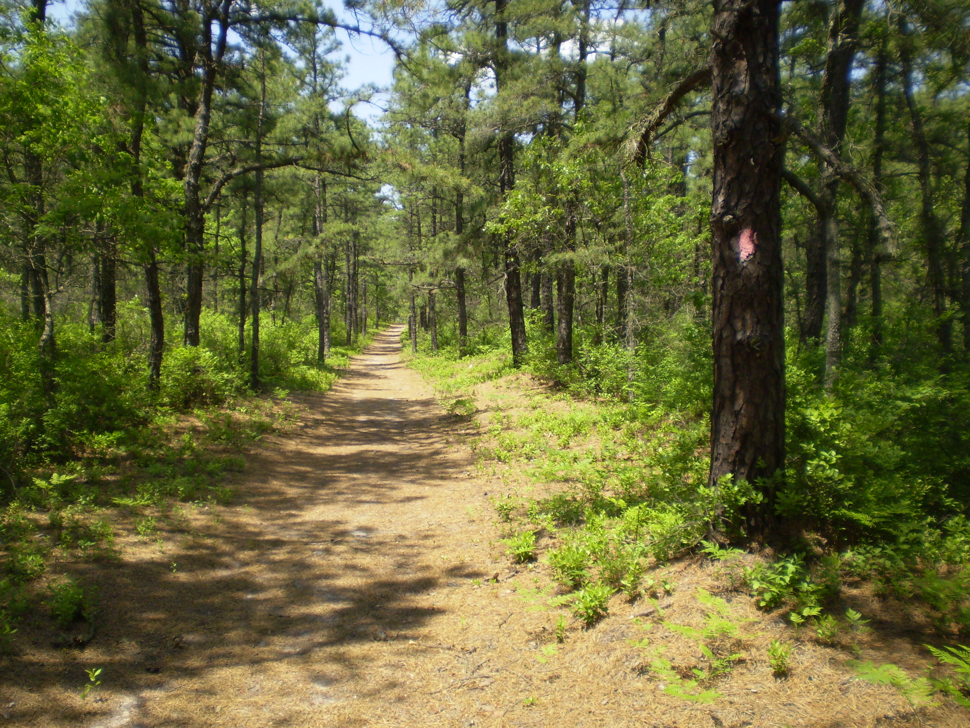
Outline
Community concerns
Study area/Study period
Partners/Objectives
Earth observations
Methodology
Results
Conclusions
Uncertainties
Future work
Acknowledgements
Image Credit: Joel Mott/Pinelands Commission
Notes:
Mercedes
Image Credit: Joel Mott, New Jersey Pinelands Commission, http://www.nj.gov/pinelands/images/photo_library_2/images_video_library/landscape/BATONA_Trail.jpg

Slide 3
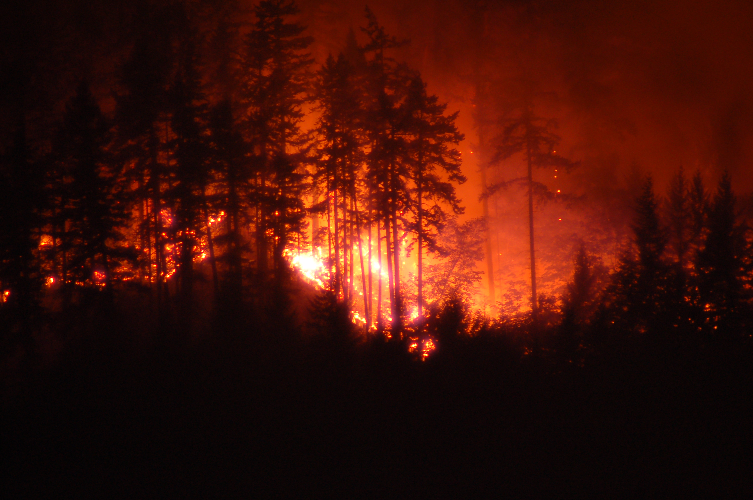
Community Concerns
New Jersey is the most densely populated state in the U.S.
Tremendous increase in housing growth
More people are relocating near forest areas, also known as Wildland Urban Interface (WUI)
Increasing risk of wildfire, a potential threat to life and property
Need for updated maps and tools for urban development planning
Image Credit: Paul Kline/Flickr
Notes:
Mercedes
Housing growth has tremendously increased in the United States. As population density is increasing, people want to live in rural areas close to nature where they can enjoy their privacy. New Jersey being the densely populated state with a 1224.4 population per square miles, more people are relocating to the areas near forest which is known as Wildland Urban Interface (WUI). Currently, more than 25% of the total population of New Jersey inhabit WUI. In one hand, the people can enjoy the scenic beauty, recreate outdoors and enjoy privacy. On the other hand, due to the increasing human interference in WUI region, there is higher risk of wildfire. It is estimated that 99% of the wildfire are caused due to anthropogenic activities with exceptions like lightning and military practices. The picture on the right shows the wildfire caused accidentally by a military test near Stafford, New Jersey in May 2007, causing 2,500 homes to be evacuated. Not only the risk of wildfire has increased but also the threat to the life and property has increased. It is the need for the stakeholders to help them map fire risk and hazards which will help them in decision making process to support developmental activities in WUI region.
Image URL: https://www.flickr.com/photos/paulelijah/14216683618/in/dateposted/

Slide 4
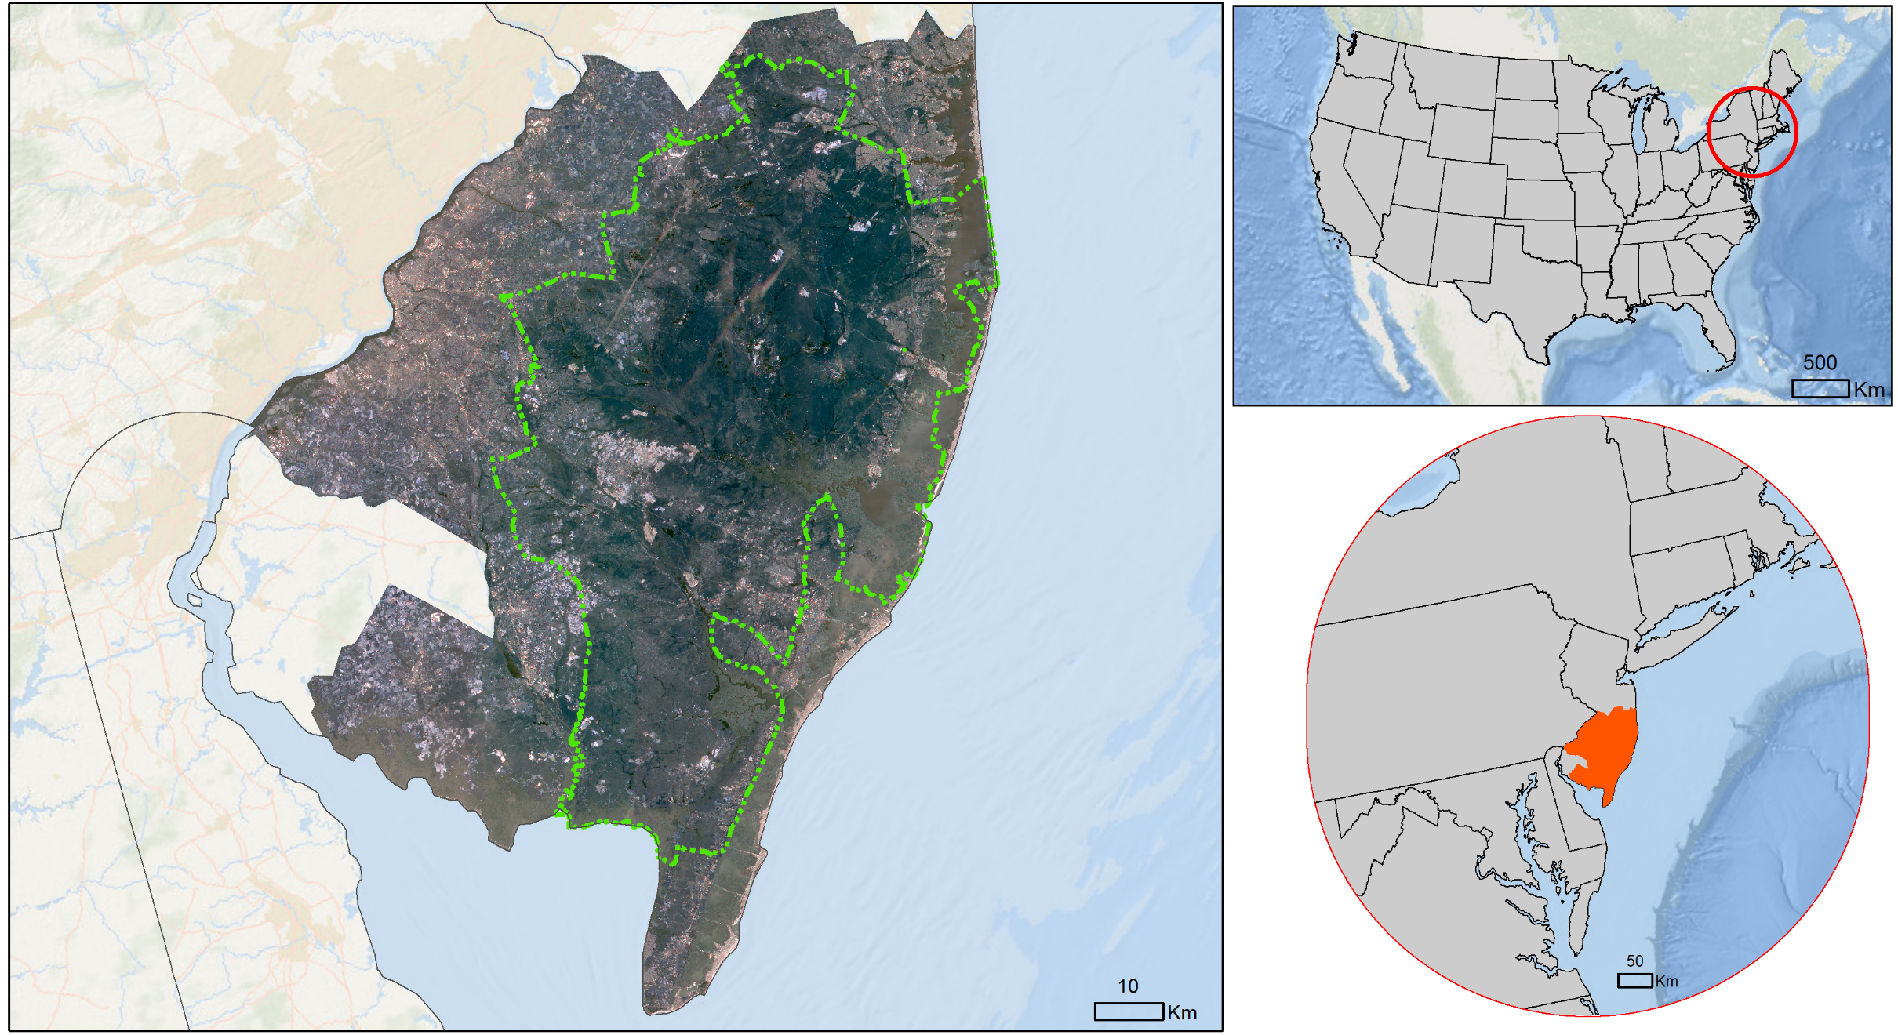

Study Area
Study Area:
  New Jersey Pinelands
Characteristics:
  ~1.1 million acres
  Gently sloping terrain
  ~1500 annual fires
Study Period:
  Jan - Dec 2017
NY
MA
CT
PA
NJ
DC
DE
MD
VA
Pinelands Management Area
Study Area
Notes:
Mercedes
Our study area is the southern New Jersey outlining the Pinelands Management Area. It covers the part of seven different southern counties, including Ocean, Atlantic, Burlington, Gloucester, Camden, Cape May, and Cumberland, and 53 municipalities within the area. Pinelands area covers almost a million acres of land with gentle sloping terrain and sandy soil. Sandy soil has low water retention capacity which contributes to wildfire. The area is dominated by Pine-Oak forest and pygmy pines which are considered to have higher fire risk. Annually there are average of 1500 wildfires in the area.
Our study period is from January to December 2017.

Slide 5
Partner and Objectives
Partner:
New Jersey Pinelands Commission
Objectives:
Classify fire risk throughout the study area and ensure the utility of the Fire Risk Assessment Tool for our partners for years to come
Analyze fire risk in the Pinelands WUI to aid our partners in identifying areas suitable for urban development
Locate areas where our partners should apply fire mitigation efforts to minimize fire induced economic and infrastructure losses
Image Credit : Joel Mott/Pinelands Commission
Notes:
Mercedes
This project partnered with the New Jersey Pinelands Commission to conduct a Fire Risk Assessment for the counties making up the Pinelands Management Area. Assisting with this assessment was the New Jersey State Forest Service. The forest service was invaluable providing us with numerous ideas for conducting the risk assessment as well as providing us with critical ignition point source data. The objectives of this project were to classify fire risk throughout the study area and ensure the utility of the Fire Risk Assessment Tool for our partners for years to come, analyze fire risk in the Pinelands WUI to aid our partners in identifying suitable areas for urban development and locate areas where our partners should apply fire mitigation efforts to minimize fire induced economic and infrastructure losses.
Image URL: Joel Mott/Pinelands Commission, http://www.nj.gov/pinelands/images/photo_library_2/images_video_library/landscape/BATONA_Trail.jpg

Slide 6
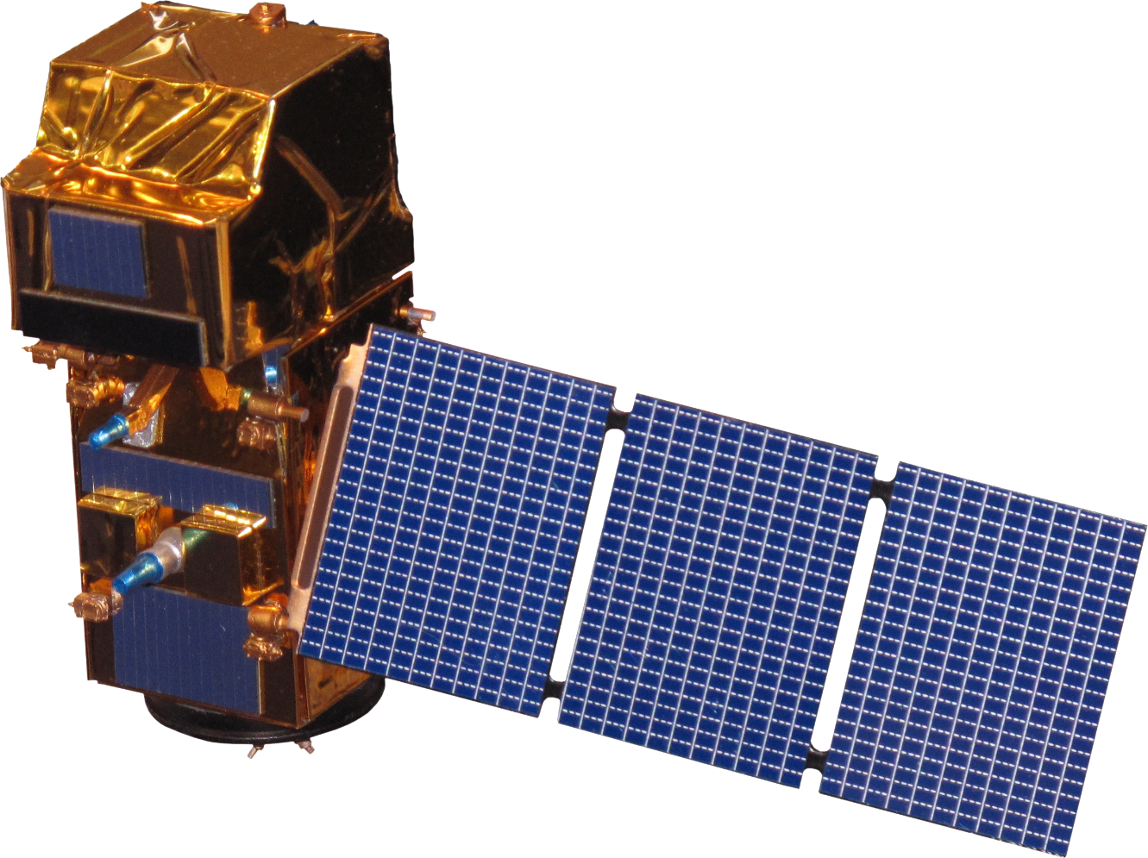
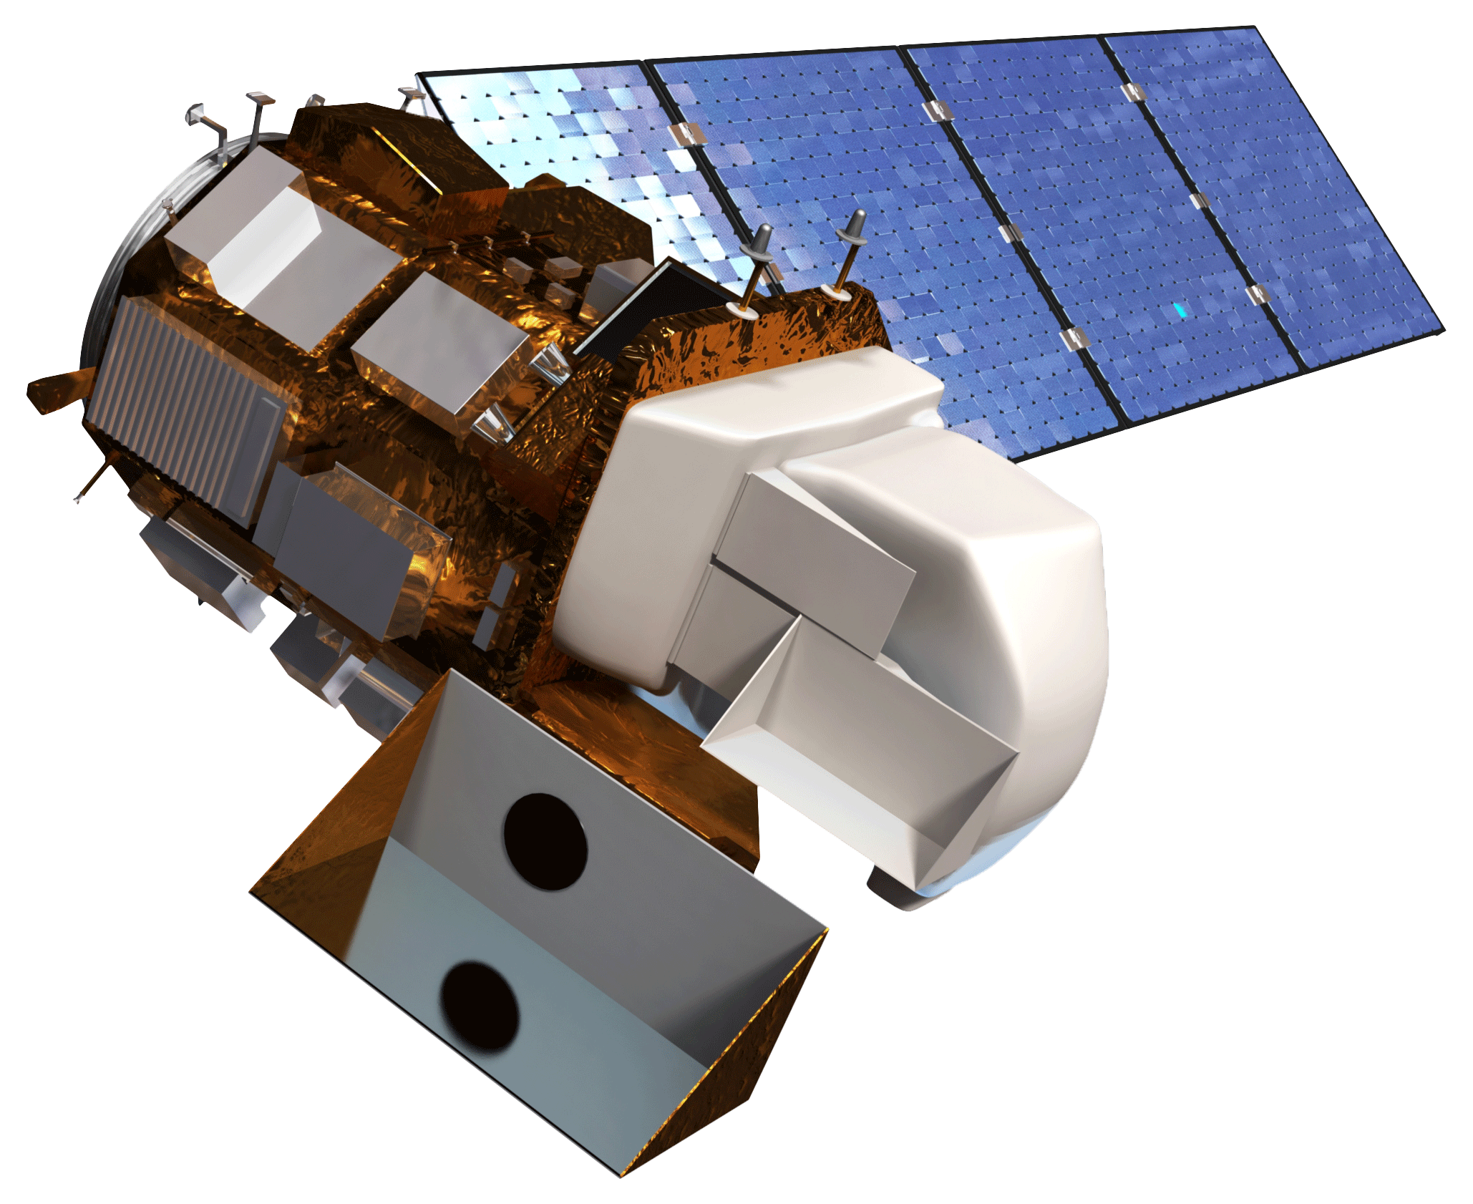
Earth Observations
Image Credit: Monet
Sentinel-2 Multi-Spectral Instrument (MSI)
Landsat 8 Operational Land Imager (OLI)
Image Credit: NASA/ESA
Notes:
Mercedes
This project incorporated several different data sets into its methodology. Those sources include the Sentinel-2 MultiSpectral Instrument’s 10m resolution visible bands, and 20m resolution infrared bands. The Sentinel-2 system is on a 5 day return period, 10 days per satellite. The Landsat 8 Operational Land Imager 30m resolution visible and infrared bands were also used. Landsat 8 is on a 16 day return period. We incorporated soil moisture data from the Soil Moisture Active Passive satellite. Lastly we used Suomi NPP, VIIRS Day / Night bands, which is also on 16 day return period, with a spatial resolution of 750m.
Image Credit: NASA
Sentinel-2: http://www.devpedia.developexchange.com/dp/images/d/dd/24_Sentinel2.png
Landsat 8: http://www.devpedia.developexchange.com/dp/images/c/c2/03_Landsat8.png

Slide 7
Methodology
DATA
Landsat 8 OLI & Sentinel-2 MSI
3DEP
Ignition Sources
LANDFIRE
TIGER
NDVI
TCW
Elevation
Vegetation Types
Roads
Correlation
Fuzzy Membership & Overlay
Fire Risk Assessment Map
Fire Risk Analysis of the Pinelands WUI
Notes:
Man: Using the NASA Earth observations previously mentioned, along with other ancillary datasets, we developed our risk assessment tool using Fuzzy logic modeling. For this initial assessment we focused on landcover variables, specifically paying attention to vegetation density and condition, soil moisture, topography, and vegetation types, and roads. We gave each of these parameters a fuzzy membership that coincided with its ability to fuel a fire. We used the Sum Fuzzy overlay, with the end result being our fire risk assessment map of the pinelands. We’ll go over the methodology more thoroughly in the next couple of slides.

Slide 8
Vegetation Reclassification
Land Use Classification | Rank
Conifer | 1
Conifer-Hardwood | 2
Hardwood | 3
Grassland | 4
Exotic Herbaceous/Exotic Tree-Shrub | 5
Sparsely Vegetated/Agriculture | 6
Riparian | 7
Developed | 8
Open Water/Quarries/Gravel Pits/Roads/Barren | 9
Correlated with ignition sources to generate ranking
Consulted with NJPC to finalize rankings
Rank indicates likelihood and susceptibility for wildfire occurrence
Notes:
Man
We then asked the New Jersey Pineland Commission for their opinion on the matter. Their expect opinions coupled with what we derived from the correlation.
The rank indicated how susceptible to fire and how likely that classification type is to a fire occurance.

Slide 9
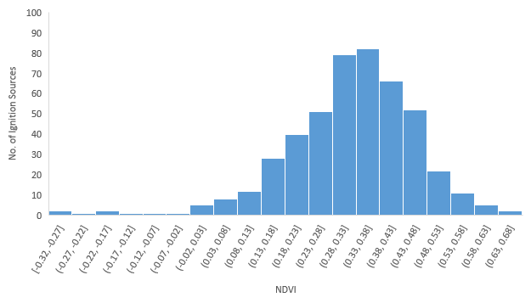
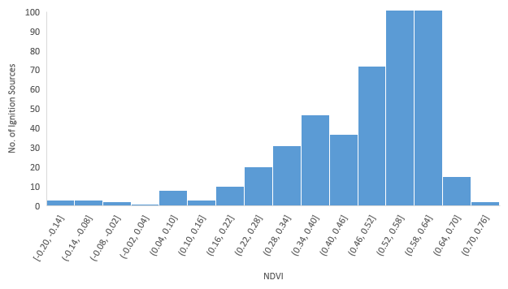
Correlation with Ignition sources
Sentinel-2 MSI
NDVI Leaf-on
NDVI Leaf-off
Notes:
Man
Pictured here is an example of our correlation strategy. We extracted the NDVI values at the point that ignition occurred using the source dataset provided by the New Jersey Forest Service.
We found that ignition was most likely to occur around an average Sentinel-NDVI values of .47 for the Leaf-On period, and occur around ..35 for the leaf period.

Slide 10
Fuzzy Membership
Data Source | Dataset | Fuzzy Membership
USGS 3 DEP | Elevation | Near (29)
Sentinel-2 MSI | NDVI Leaf-on | Near (0.47)
 | NDVI Leaf-off | Near (0.35)
 | TCW Leaf-on | Linear
 | TCW Leaf-off | Linear
Landsat 8 OLI | NDVI Leaf-on | Near (0.7)
 | NDVI Leaf-off | Near (0.58)
 | TCW Leaf-on | Linear
 | TCW Leaf-off | Linear
TIGER | Roads | Linear
LANDFIRE | Vegetation Type | Linear
Notes:
Man
These table depicts the different fuzzy memberships we assigned to ultimately generate our Fire Risk Assessment Map.

Slide 11
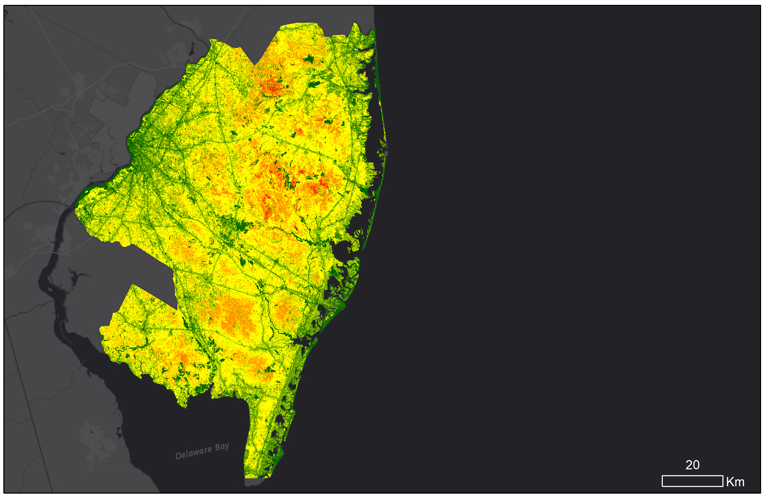
Results
Fire Risk Assessment Map
Fire Risk Classification
Extremely Low (0-20%)
Low (20-40%)
Moderate (40-60%)
High (60-80%)
Extremely High (80-100%)
Notes:
Alex
A 30 x 30 meter resolution Fire Risk Assessment Map was produced by the fuzzy overlay with an scale of 0 to 1 equivalent to 0 to 100 % of fire risk. This map was classified into five categories of equal interval. That includes Extremely Low (0-20%) in dark green, Low (20-40%) in light green, Moderate (40-60%) in yellow, High (60-80%) in orange and Extremely High (80-100%) in red. This map at pixel level can explain the fire risk of the area equal to the twice the size of a basketball court.

Slide 12
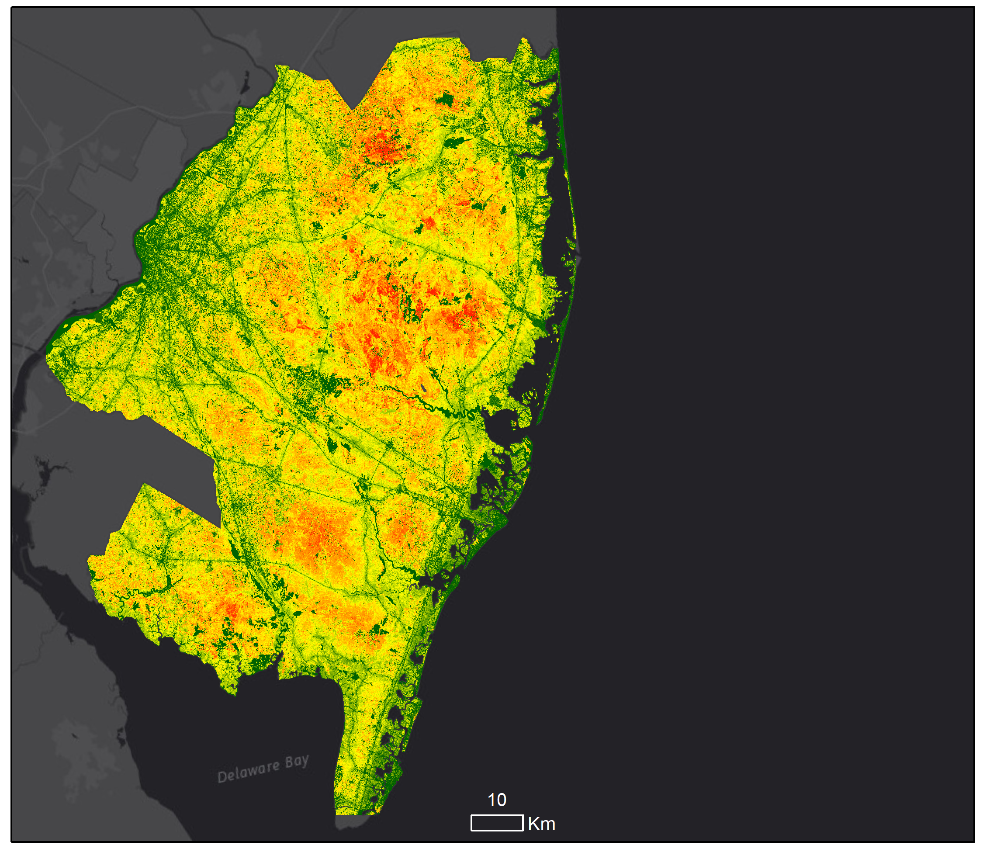
Fire Risk Assessment Map
Fire Risk Classification
Extremely Low
Low
Moderate
High
Extremely High
Notes:
Alex
More than half (52%) of the study area were in moderate fire risk followed by low, extremely low and high. Model showed that 0.4% of the total area are in extremely high fire risk (Pine forests).

Slide 13
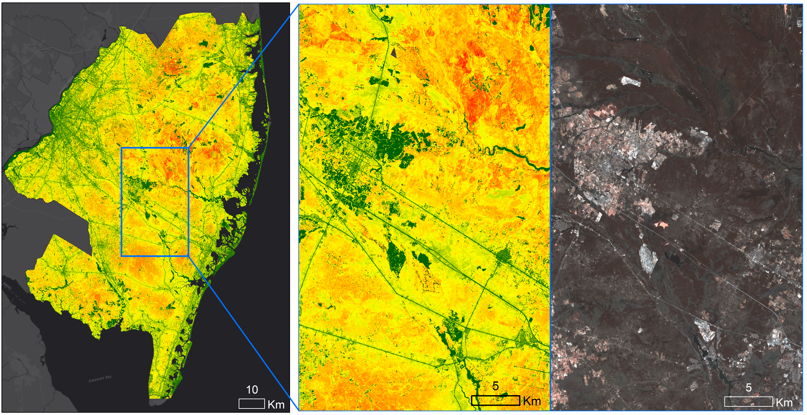
Results
Wharton State Forest
Hammonton
Image Credit: Monet
Hamilton Township
Fire Risk Classification
Extremely Low
Low
Moderate
High
Extremely High
Notes:
Alex
This is an inset map of fire risk showing the reliability of the model. The developed areas in dark green color shows the lower fire risk and forested area in orange and red color shows that the higher fire risk based on the fuel loads.

Slide 14
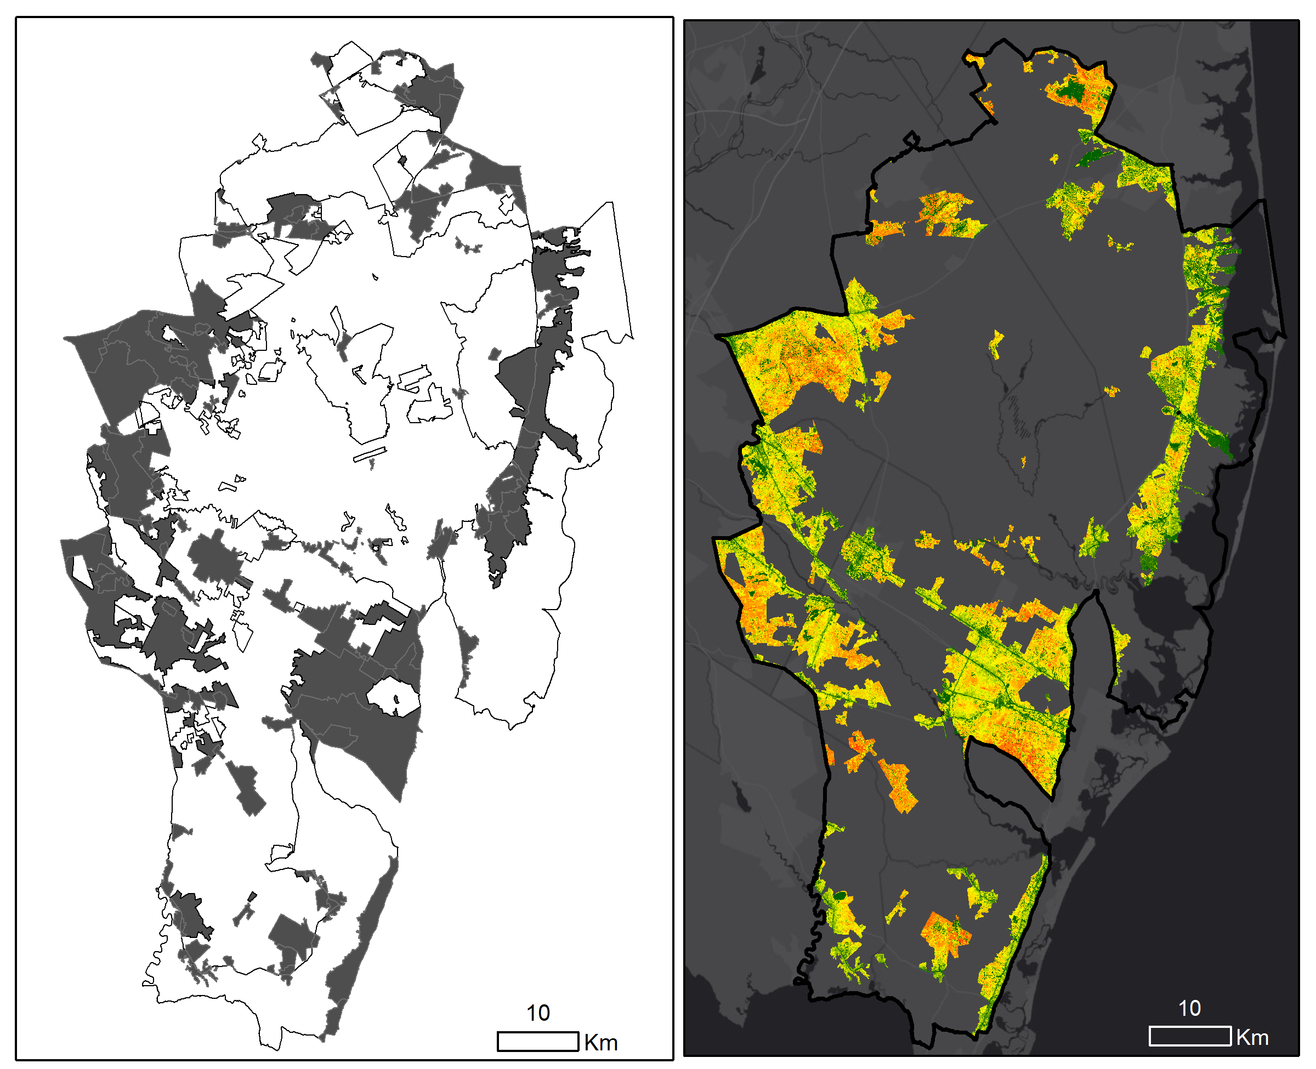
Pinelands WUI
Regional Growth Area
Rural Development Area
Pinelands Villages
Pinelands Towns
Pinelands Management Area
Pinelands WUI
Fire Risk Classification
Extremely Low
Low
Moderate
High
Extremely High
Notes:
Alex
Within the Pinelands management area, our partners are mainly focused on regional growth area, rural development area, pinelands village, pinelands towns for developmental activities, as shown in the map on the left. To the right is the fire risk map for WUI in Pinelands management area. The WUI covers 24% of the total Pinelands management area. Appx. 200,000 acres of land in Pinelands WUI lies in moderate and low fire risk. Only 13% of the total Pinelands WUI lies on high and extremely high fire risk.

Slide 15
Fire Risk Analysis
Fire Risk
Extremely Low
Low
Moderate
High
Extremely High
Notes:
Olivia
The fire risk map was clipped to the four types of Pinelands management area and fire risk analysis was carried out. Here in the top left corner, fire risk in regional growth area shows that most of the habitat are in low and moderate fire risk and it is similar to all other types including rural development area, pinelands villages and town.

Slide 16
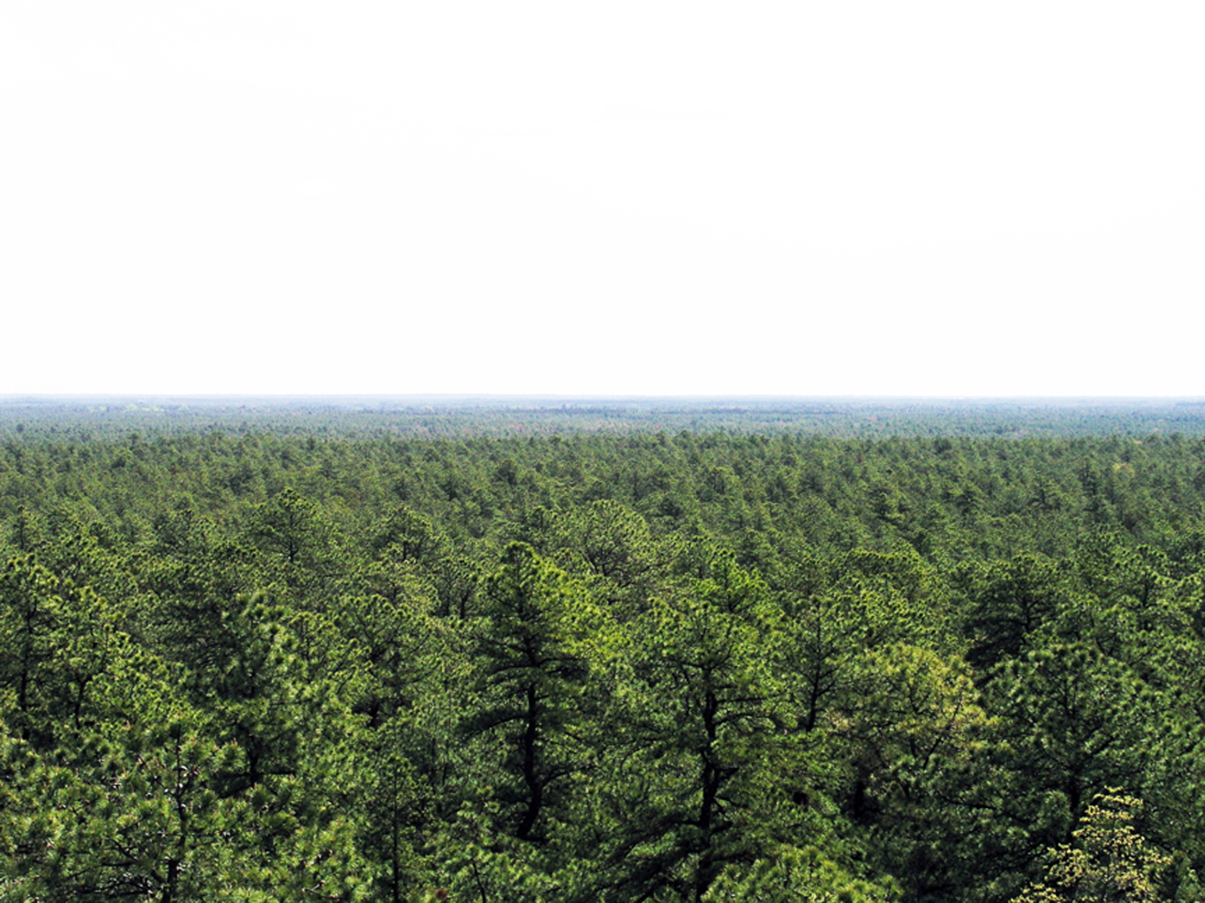
Conclusions
A majority of the study area is under extremely low to moderate fire risk which are considered to be the suitable areas for the developmental activities.
The areas under extremely high fire risk primarily lie within the Pineland preservation area. Fire mitigation efforts should be applied in these areas to reduce the chance of wildfire.
The regional growth area of the Pinelands WUI has the least total area under high fire risk compared to the other sub-regions of the WUI.
Image Credit: Paul Leakan/Pinelands Commission
Notes:
Oliva: As the previous slide indicated, most of the study area is under moderate and low fire risk which are considered to be the most suitable areas for the developmental activities. Very few areas fall under extremely high fire risk, most which lies in the preservation area of the Pinelands. This fire mitigation efforts should be especially applied to these areas within preservation areas. The regional growth area within the Pinelands WUI has the least area under high fire risk in comparison to the other sub-regions, and therefore is the most suitable of the management areas for urban development.
Image Source: Paul Leakan/New Jersey Pinelands Commission, http://www.nj.gov/pinelands/images/photo_library_2/images_video_library/landscape/Apple-Pie-Hill-1.jpg

Slide 17
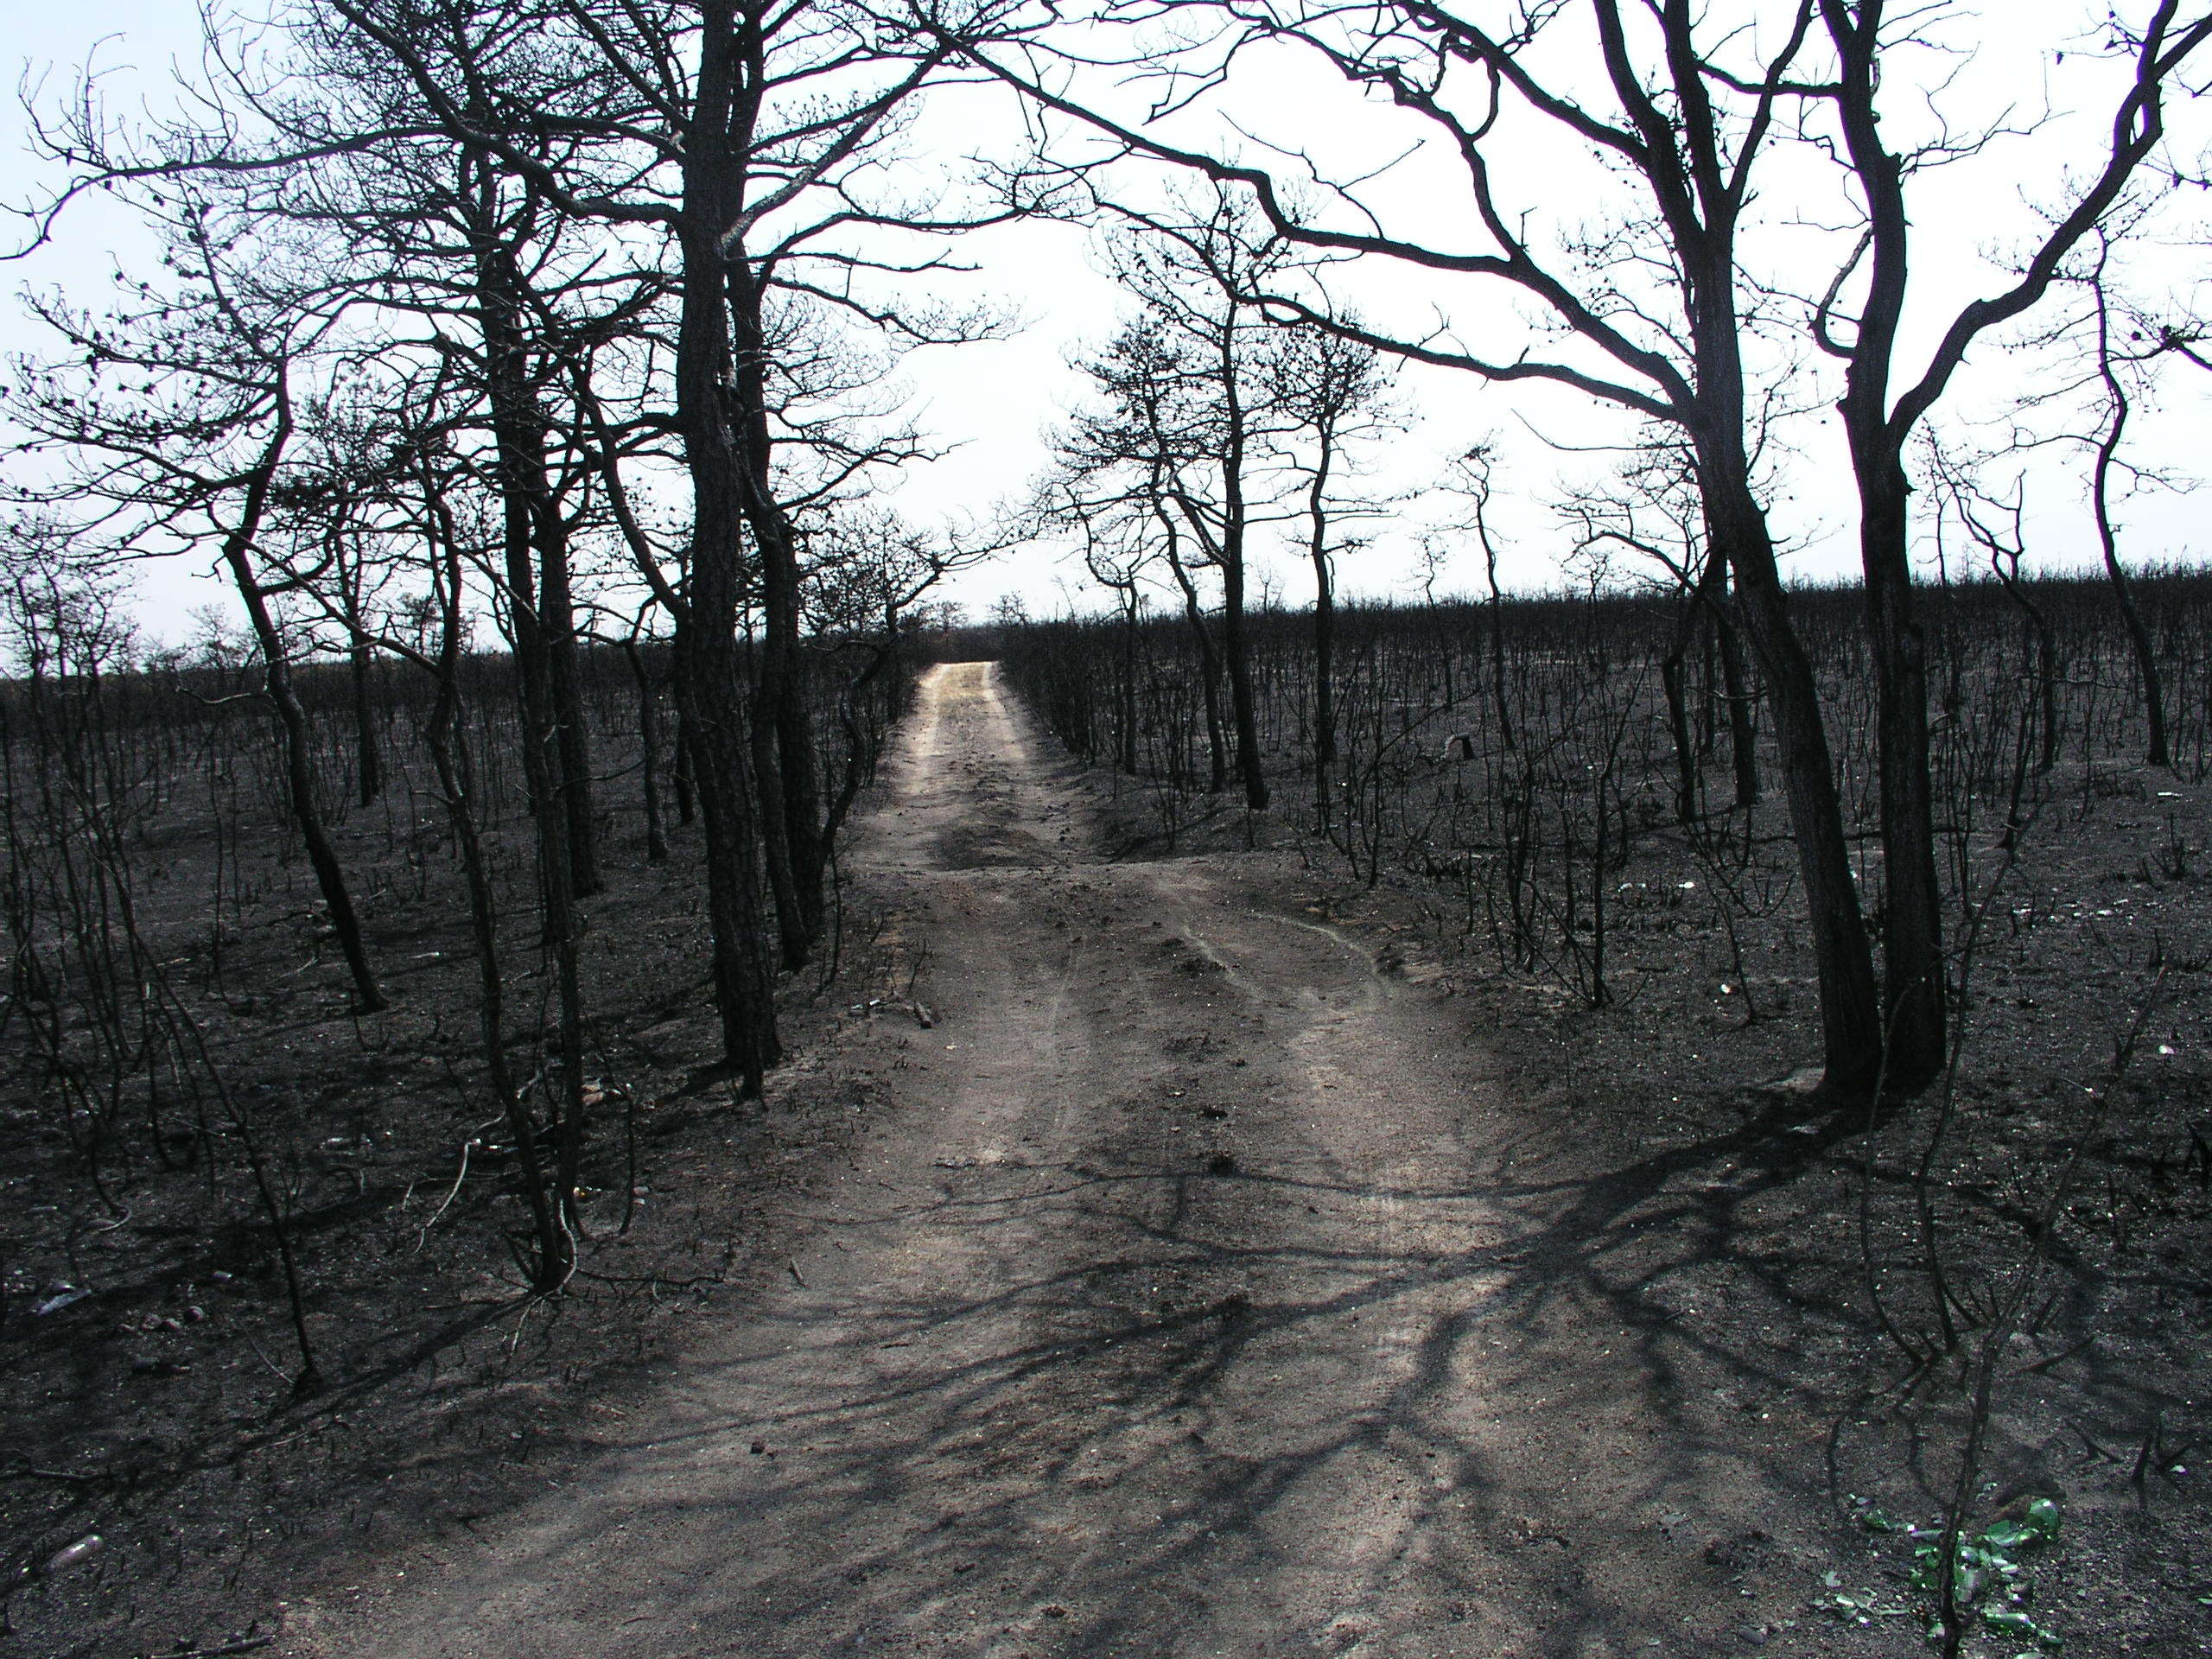
Uncertainties
Outdated WUI data
Lack of validation methods
Minimal current fire or prescribed burned data
Image Credit: Paul Leakan/Pinelands Commission
Notes:
Olivia: As the project progressed, multiple issues arose which gave the project these uncertainties: the data used to define the boundaries of the Wildland-Urban Interface were from 2010, as there was no data available which was more recent; while plotting the variables against recorded ignition sources, there was not really a viable means for data validation considering the distance from the study area, length of the project term, etc.; moreover, the most recent major fires or prescribed burns occurred in 2014 and so current data was not available for validation.
Image Source: Paul Leakan, New Jersey Pinelands Commission

Slide 18
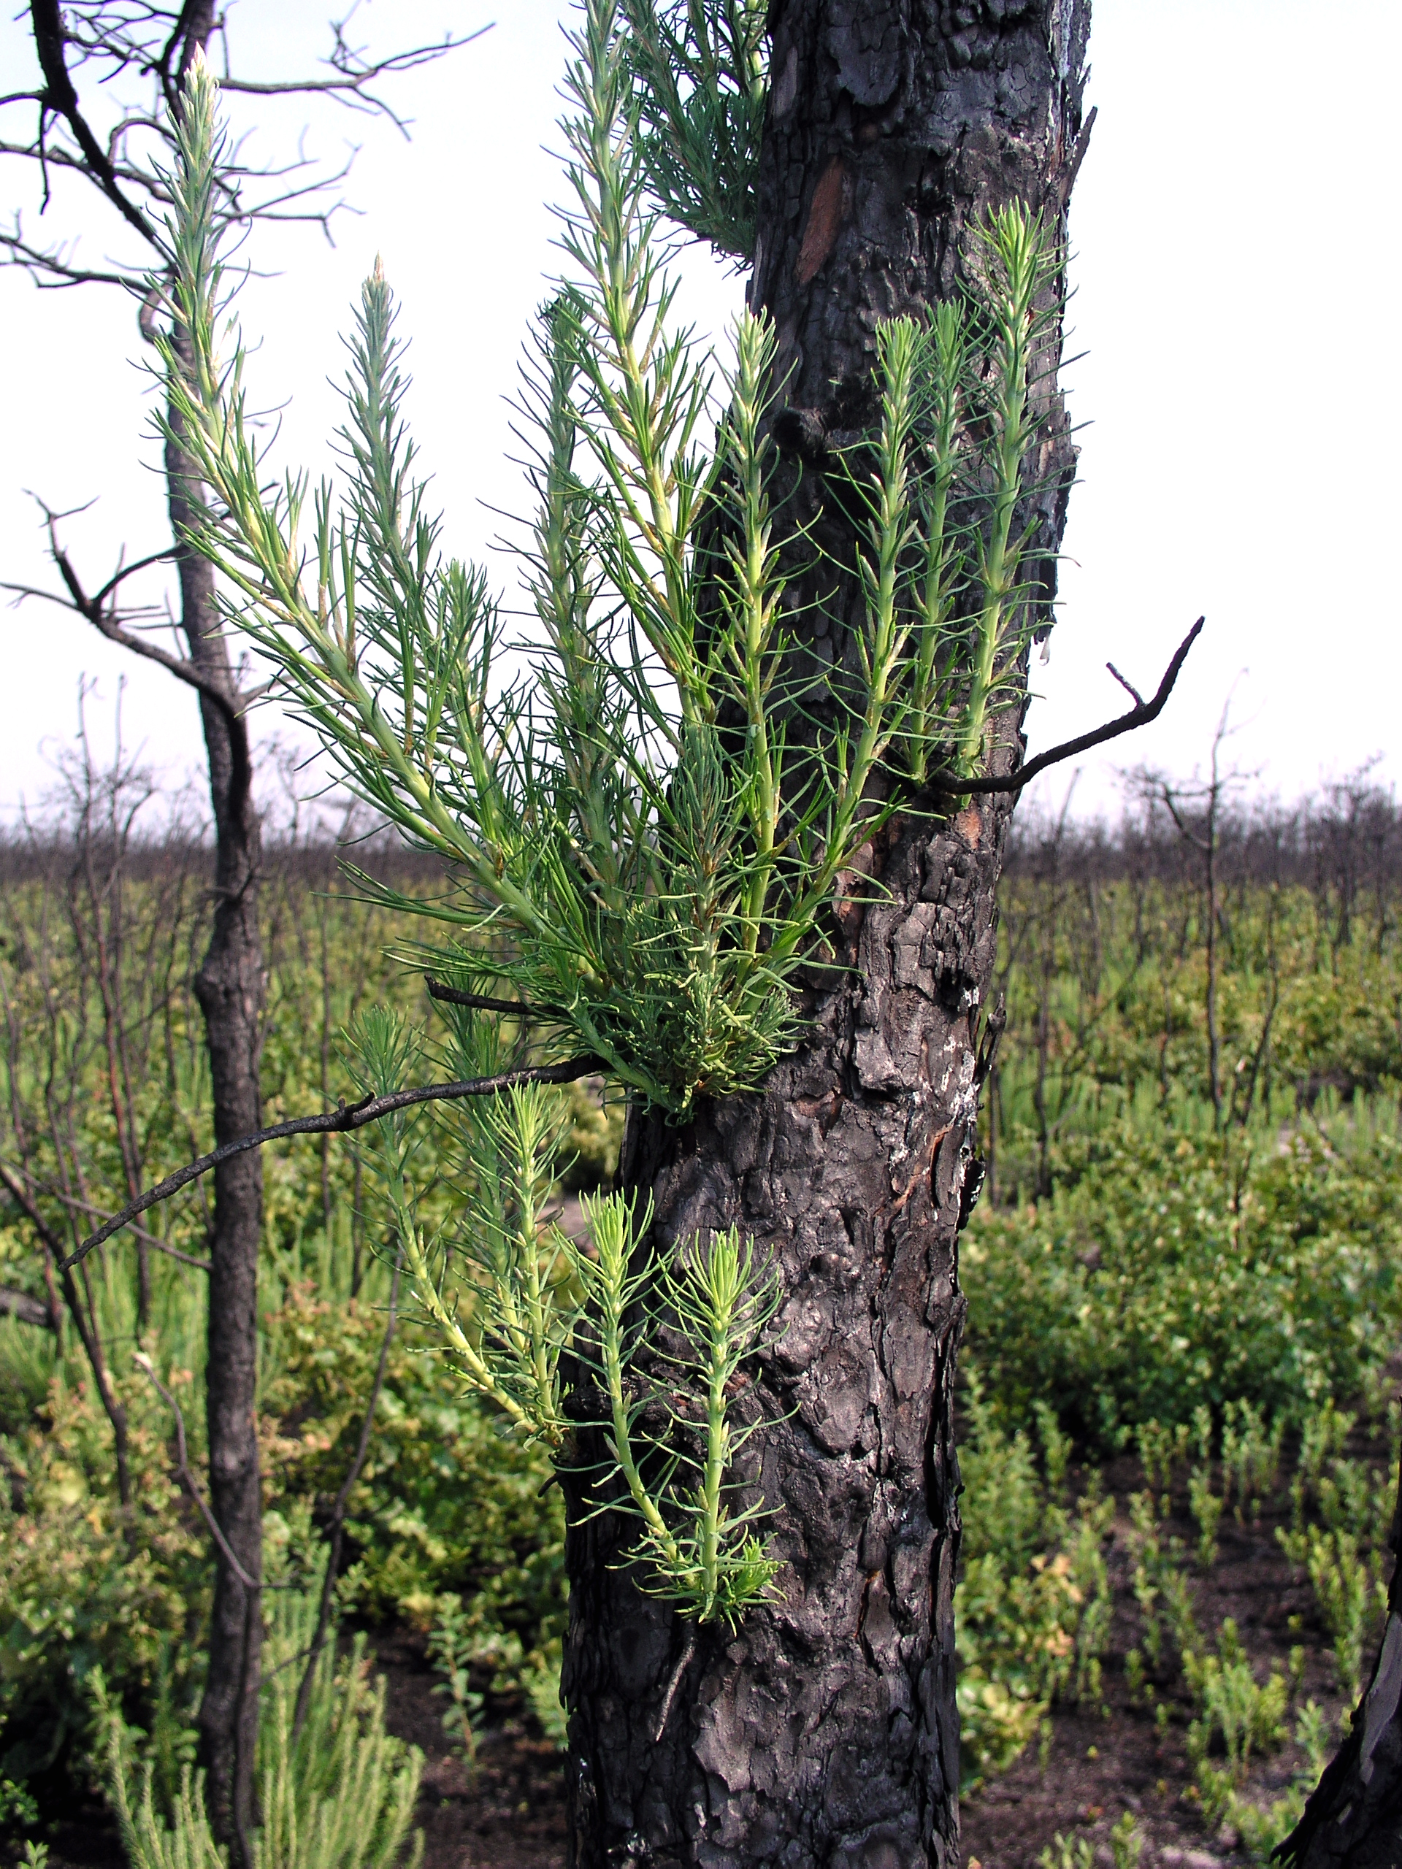
Future Work
Input updated data into the tool as becomes available for more accurate assessment
Acquire higher resolution climate and soil moisture data
Image Credit: Monet
Image Credit: Paul Leakan/Pinelands Commission
Notes:
Olivia: Considering the aforementioned uncertainties, any future work with this project’s end products can include data that is more up to date so as to create accurate and updated fire risk assessments. Additionally, it can include higher resolution climatic and/or soil moisture data to use as a variable in fire risk assessment. This project initially aimed to include these variables in its fire risk assessment, but was unable to due to the quality of the data.
Image Source: Paul Leakan, New Jersey Pinelands Commission

Slide 19
Acknowledgements
Dr. Jeffrey Luvall (NASA Marshall Space Flight Center)
Dr. Robert Griffin (University of Alabama in Huntsville)
Leigh Sinclair (University of Alabama in Huntsville/Information Technology and Systems Center)
Maggi Klug (University of Alabama in Huntsville)
Larry Liggett (New Jersey Pinelands Commission)
Gina Berg (New Jersey Pinelands Commission)
Paul Leakan (New Jersey Pinelands Commission)
Williams Zipse (New Jersey Forest Service)
Jeremy Webber (New Jersey Forest Service)
Notes:
Olivia

