Slide 1
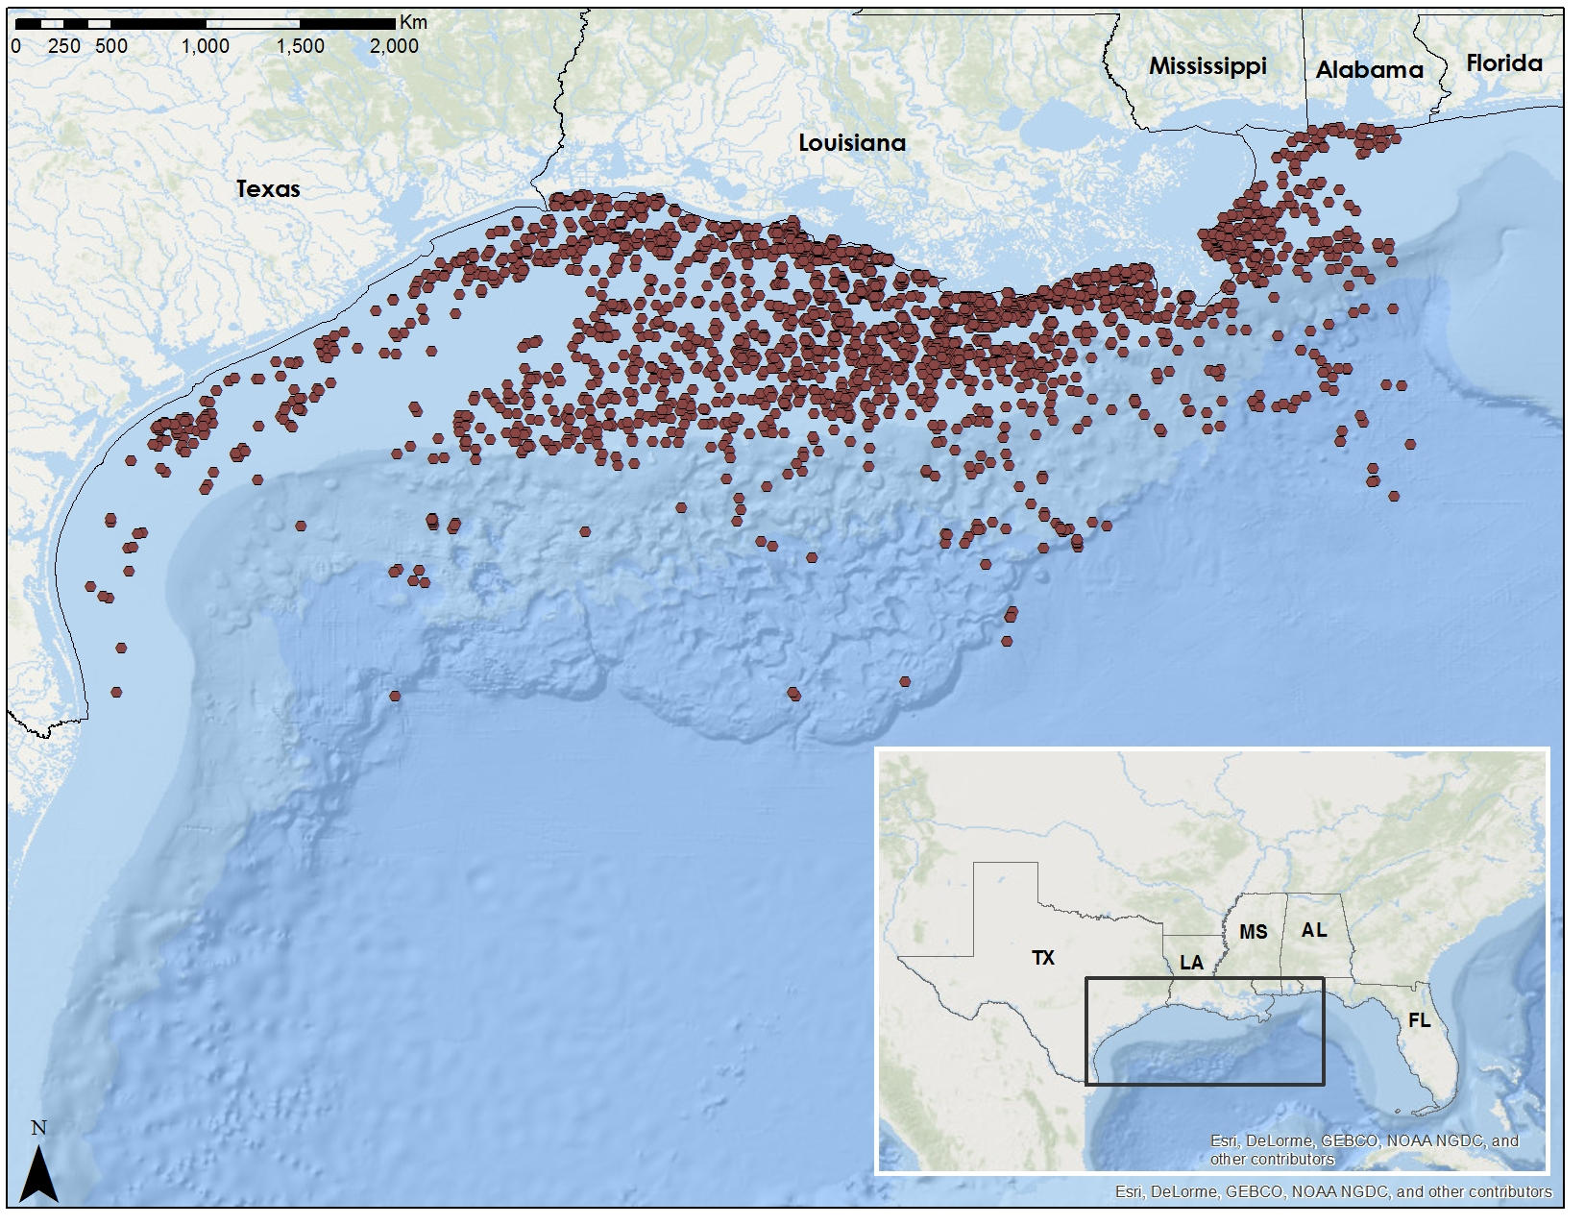
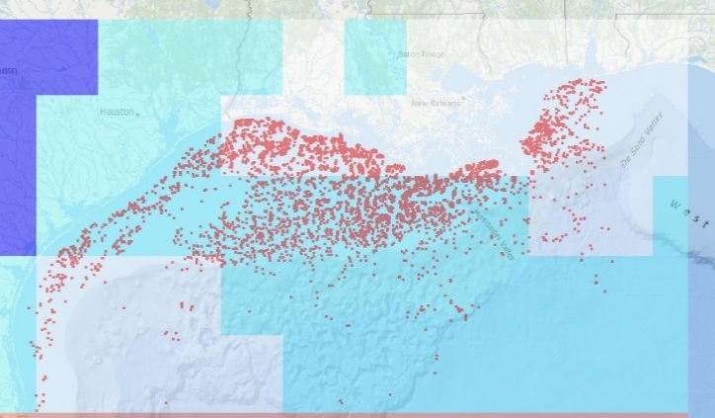
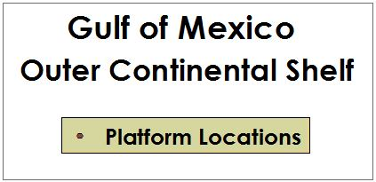
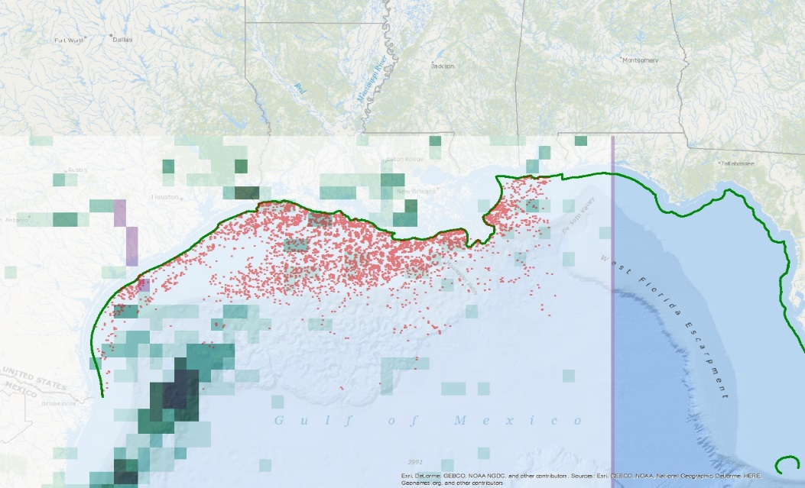
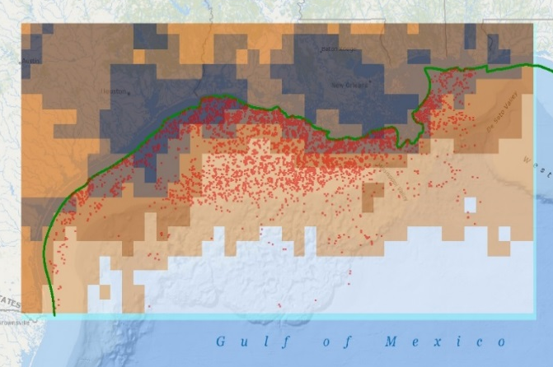
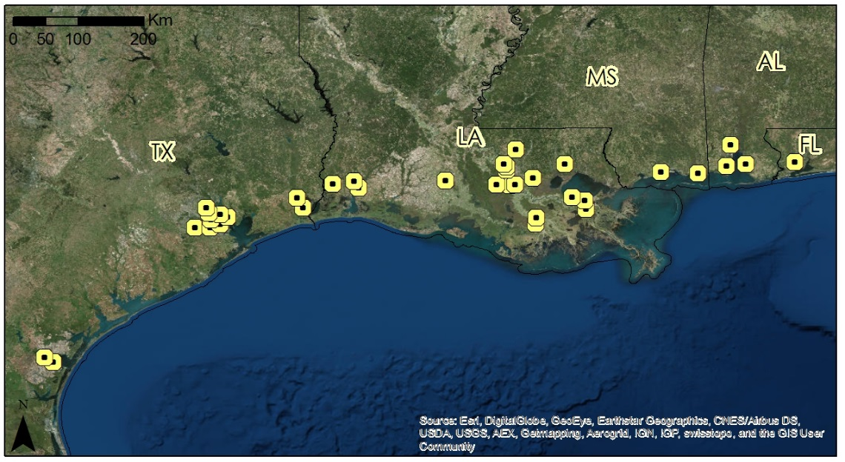

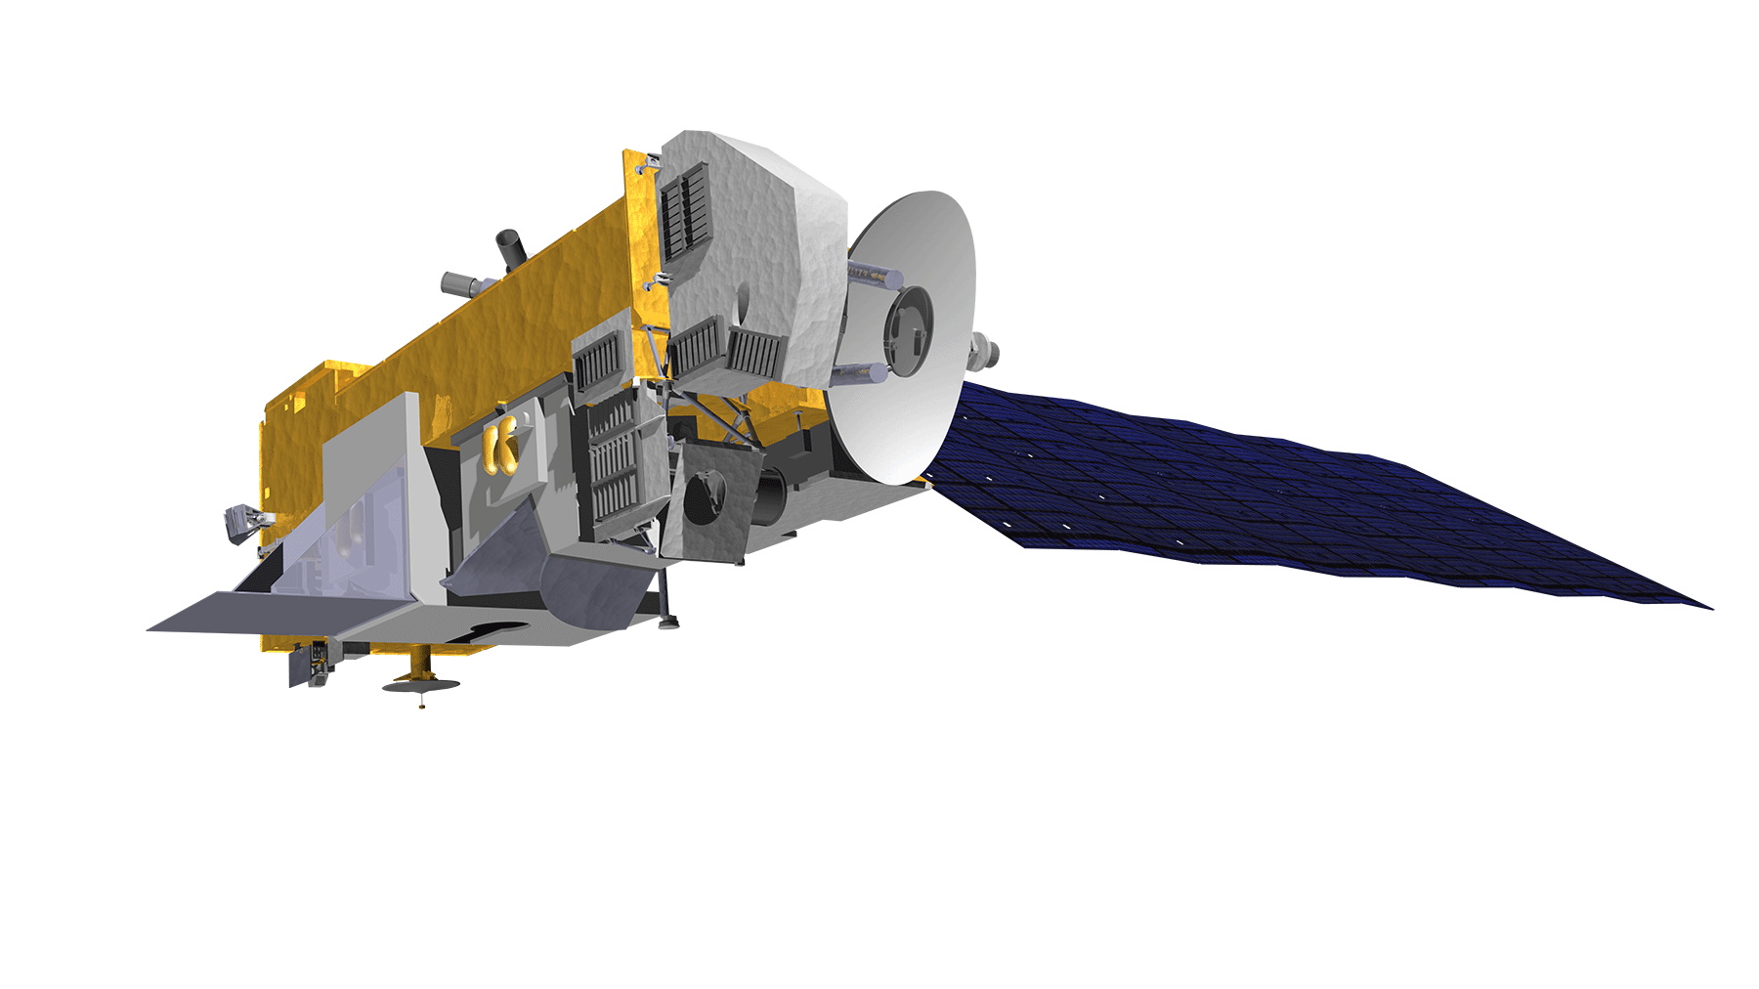

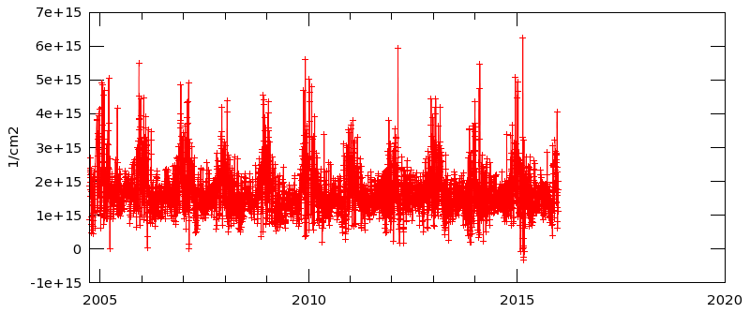
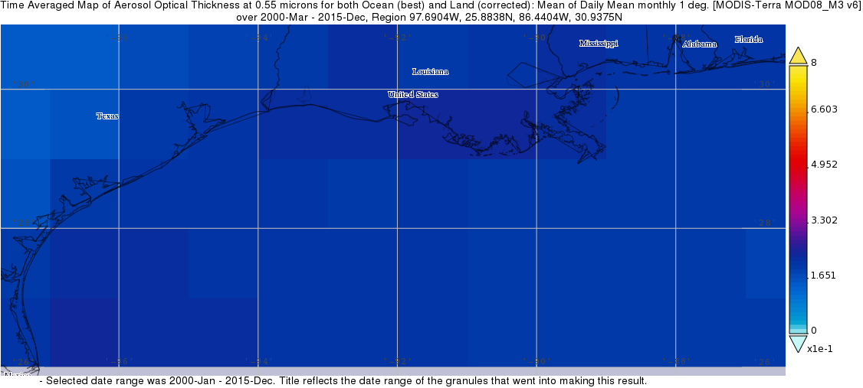
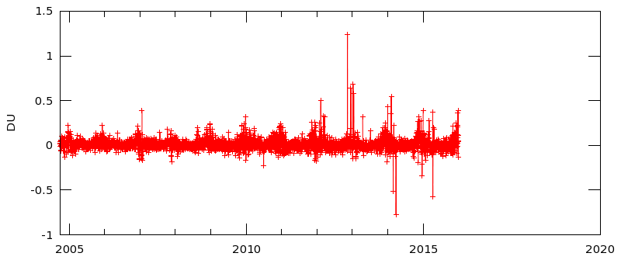
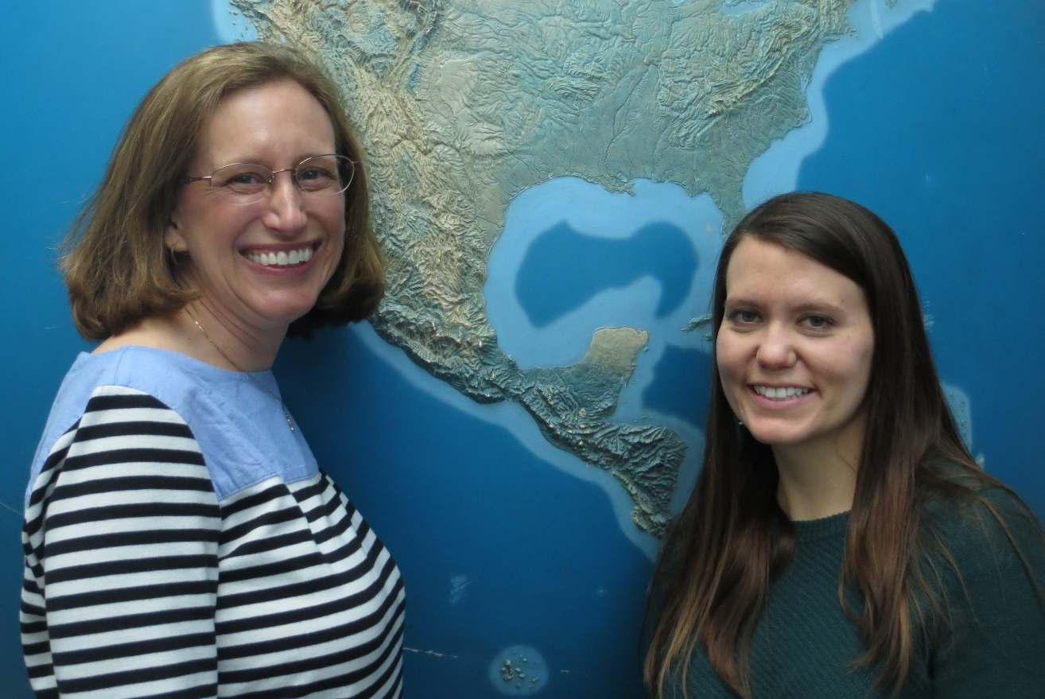

Gulf of Mexico Health & Air Quality
Utilizing NASA Earth observations to manage air quality and pollutants over the Gulf of Mexico
Amanda Clayton (Project Lead), Lori Mandable
DEVELOP National Program at NASA Goddard Space Flight Center
Abstract
Objectives
Map and analyze remotely sensed airborne pollutant concentrations of PM_{2.5}, nitrogen dioxide (NO₂), and sulfur dioxide (SO₂)
Obtain in situ data from BOEM and the EPA to determine correlations between pollutants and primary emission sources
Develop methodology for continuing emissions monitoring utilizing NASA Earth observations
Methodology
Study Area
Level 3 Data Product
Level 2 Data Product
In Situ Data
Area-Averaged Time Series and Time-Averaged Maps in GIOVANNI
[In Progress]
BOEM Gulfwide Emission Inventory (2000, 2005, 2008, 2011)
Aura/OMI NO₂ (OMNO2D_hr)
Aura/OMI SO₂
Terra/MODIS Aerosol Optical Depth (AOD)
Aura/OMI Total Column NO₂
Aura/OMI Total Column SO₂
Terra/MODIS
[In Progress]
EPA AirData
Onshore air quality monitors
Earth Observations
Aura
Results
Terra
[In Progress]
Conclusions
Area-averaged time series of NO2 tropospheric column
[In Progress]
Time averaged map of Aerosol Optical Thickness, 2000 - 2015
Area-averaged time series of SO2 column amount
Project Partners
Acknowledgements
Team Members
From NASA Goddard Space Flight Center:
Dr. Robert Levy
Dr. Bryan Duncan
Dr. Nickolay Krotkov
Dr. Pawan Gupta
Dr. Lok Lamsal
Lori Mandable and Amanda Clayton
NASA Goddard Space Flight Center

