Slide 1
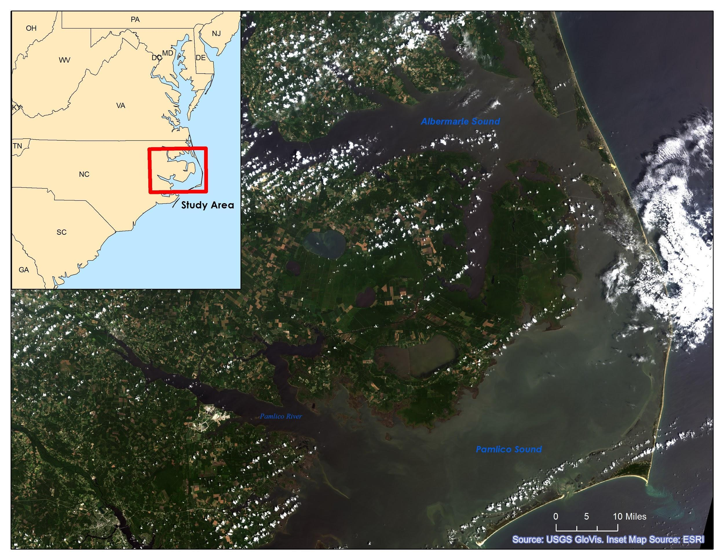
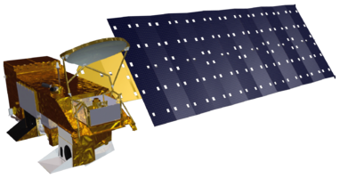
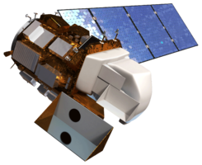
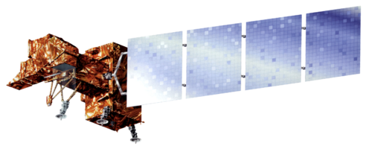
North Carolina Water Resources
Utilizing NASA Earth Observations to Explore Extent of Harmful Algal Blooms
in the Albemarle and Pamlico Sounds
Chad Smith (Team Lead), Jelly Riedel, Keith Benjamin, Daniel Wozniak, Matthew Carter
Langley Research Center
[PENDING]
Provide a ten year time series representation of harmful algal blooms (HABs) in the Albemarle-Pamlico National Estuary
Compare MODIS-derived Chl-a estimates with in situ data
MODIS Level 2 Daily Swath Ocean Color Data
Reject Partial Images
Decompress, Image Processing
Reproject Images
Bands 9, 10, and 12
Clip/ Limit Processing Extent
MODIS OC3M Algorithm
MODIS-derived Chl-a Maps
MODIS Chl-a Band
Clip/ Limit Processing Extent
Aqua, MODIS
Landsat 8, OLI
Landsat 7, ETM+
Landsat 1-5 MSS
USGS NC Water Science Center Data
Sample Point Shapefiles
Compare with Point Sample Data
Water Sampling Locations - NWQMC
[PENDING]
[PENDING]
Chad Smith (Team Lead)
Jelly Riedel
Keith Benjamin
Daniel Wozniak
Matthew Carter
[insert picture]
U.S. Geologic Survey North Carolina Water Science Center, Dr. Michelle Moorman, Biologist (Science Advisor)
Albemarle-Pamlico
National Estuary Partnership
Dr. Bill Crowell, Dean Carpenter & Jim Hawhee (Science Advisors)
Dr. Kenton Ross
National Program Science Advisor
Jeffrey Ely
Geoinformatics Scientist
Nathan Owen
DEVELOP Langley Center Lead

