Slide 1
Peru Climate
Monitoring and Forecasting Shifting Climate and Land Change Impacts in Peru’s Parque de la Papa for Enhanced Agricultural Management
Rebekke Muench (Project Lead)
Michael Sclater
Kayla McDonald
Richard Rose
Ryan Murphy
Dajon Begin

Slide 2
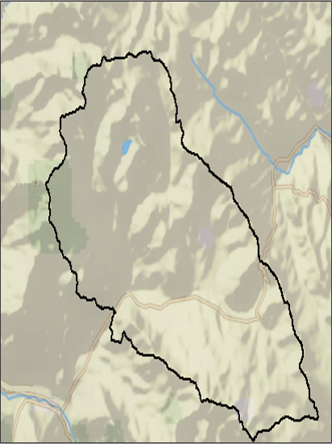
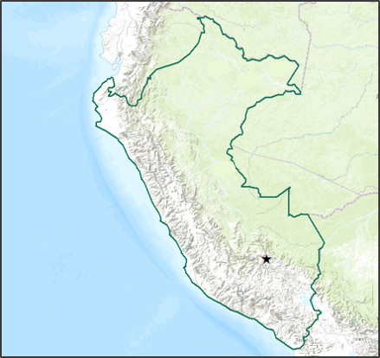
Study Area
Study Period
Temperature (MODIS)
  July, 2002 – June 2015
Precipitation
  November, 1997 – April, 2015
Landuse
  Current and historic
Legend
Parque de
la Papa
Peru

Slide 3
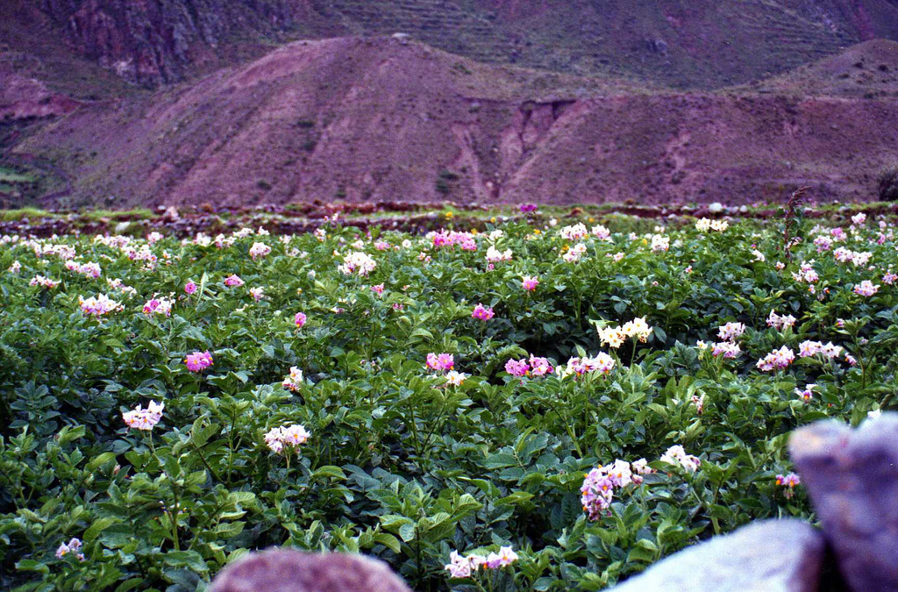
Community Concerns
Peru is the center of origin for potatoes.
The Parque de la Papa was created to conserve traditional potato varieties and agricultural practices.
Potato biodiversity is threatened by many factors, including:
  An increase in temperature.
  A change in precipitation patterns.
  Increased damage from pests.
Image Credit: Leonora Enking
Notes:
Peru is the center of origin for potatoes.
The Parque de la Papa was created to conserve traditional potato varieties and agricultural practices.
Potato biodiversity is threatened by many factors, including:
An increase in temperature.
A change in precipitation patterns.
Increased damage from pests.

Slide 4
Objectives
Create growing degree days, chill hours, elevation, slope, and weevil suitability maps
Use Landsat imagery to determine how potato crop locations have changed over the past 30 years
Develop a methodology that can be applied throughout Peru to determine potato suitability

Slide 5
Growing Degree Days & Chill Hours
Growing Degree Days (GDD) are the number of days that have an average max and min temperature above the a specified number dependent on the crop
Chill hours are the number of hours the temperatures are between 32 and 45 degrees Fahrenheit

Slide 6
Methodology
Data Acquisition
MODIS Aqua, Terra, TRMM and Landsat Data was downloaded
Processing
MODIS data was corrected from errors from clouds using Python
Analysis
TRMM and MODIS data were stacked so a value could be given to each pixel for every day during their given study periods
TRMM data was interpolated

Slide 7
Errors & Uncertainties
Future Work

