Slide 1
Sacramento
Urban Development
Quantifying and Mapping Urban Heat to Support Urban Planning Initiatives in Sacramento, California
Karina Alvarez, Elspeth Gates, Nicole Keller, Anjelica Petsch
Virginia – Langley

Slide 2
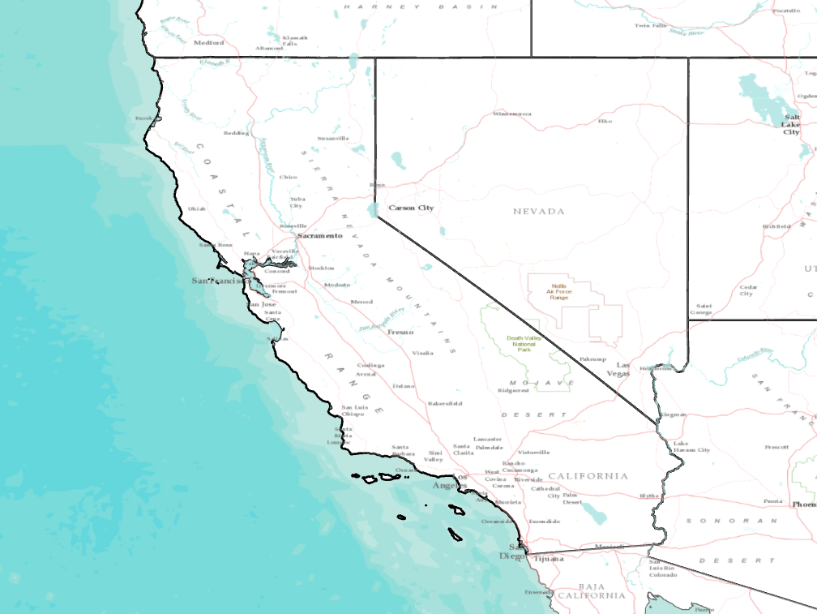
Project Overview
Study Area
Sacramento, California
Study Period
2016-2020
Summer months:
May 1st – September 30th
ESRI Basemaps: World Terrain Reference, World Terrain Base
Notes:
This project’s aim was to study the urban heat island effect in Sacramento, California. The City of Sacramento, California is in the process of updating the City’s General Plan, which is a policy guide for future development and preservation of resources within the City. As one component of broader sustainability goals, the City hopes to strategize against the urban heat island effect, which will likely be exacerbated by warmer temperatures within the coming decades. Heat islands are urbanized areas that experience higher temperatures compared to surrounding areas due to impervious materials, such as asphalt, that absorb and re-emit solar heat more than natural vegetation (US EPA, 2014). This project focused on the summer months of May through September 2016- 2020 to gather the latest data and provide an up-to-date understanding of the heat islands within Sacramento.
Next slide please
------------------image credits--------------------------
ESRI basemap: World Terrain Reference, World Terrain Base

Slide 3
Community Concerns
Increasing Temperatures
Urban Greening
Social Vulnerability
Future Development
Notes:
Sacramento is California’s fastest-growing large city in terms of population; City officials anticipate growth of nearly 200,000 people over the next 20 years. The City wants to ensure that this growth is sustainable, equitable, and inclusive. Older adults, low-income populations, non-Hispanic black residents, and those with pre-existing health conditions are all more susceptible to heat-related illness or death. Some crucial steps to increase community resiliency and promote equity include planting urban vegetation and strategically prioritizing the implementation of green infrastructure, particularly in transit corridors or neighborhoods with a high proportion of vulnerable populations.
Next slide please
-------------------Image Credits------------------------------
Vacant lot activation by LA Great Streets, US (Public Domain) from the Noun Project
https://thenounproject.com/search/?q=urban+development&i=476745
Tree canopy by LA Great Streets, US (Public Domain) from the Noun Project
https://thenounproject.com/term/tree-canopy/476740/
Heat Stroke by Luis Prado, US (Creative Commons) from the Noun Project
https://thenounproject.com/search/?q=heat+stroke&i=924682
Global Warming by Creative Mania, IN (Creative Commons) from the Noun Project
https://thenounproject.com/term/global-warming/1028784/
Offices by Made by Made, AU (Creative Commons) from the Noun Project
https://thenounproject.com/term/offices/707660/

Slide 4
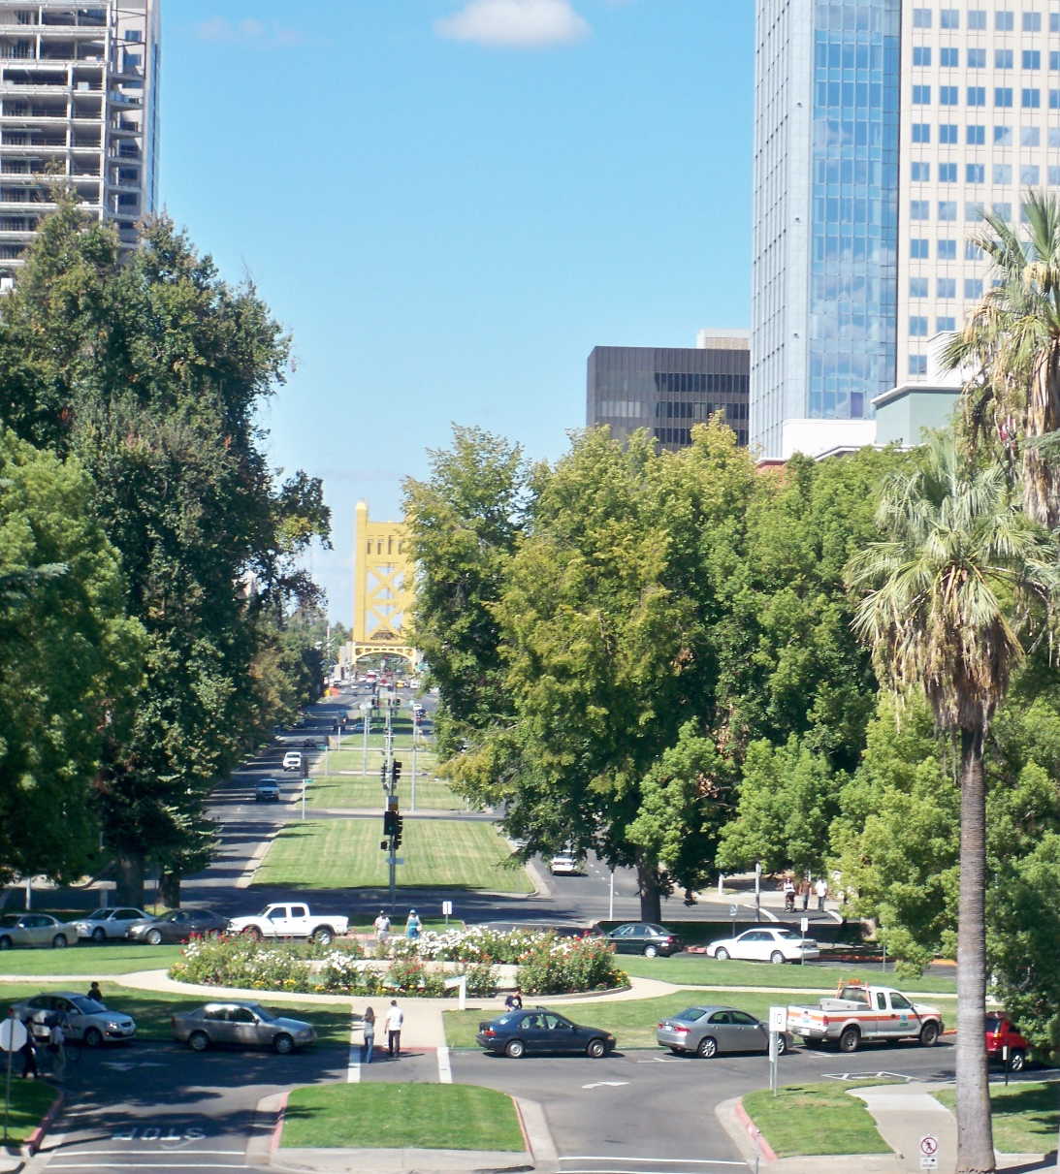
Project Partners
The City of Sacramento
Dyett & Bhatia Urban Planning Firm
Image Credit: City of Sacramento
Notes:
This project partnered with The City of Sacramento and the urban planning firm Dyett & Bhatia. The City of Sacramento has hired the urban planning firm, Dyett & Bhatia, to assist with updating the General Plan for 2040. These partners have provided the team with on the ground knowledge of the city and datasets to have a more detailed analysis of urban heat. Insights from our study will guide sustainable and equitable development goals set forth in the Sacramento General Plan for 2040.
Next slide please
-----------------------Image Credits--------------------------------------
Image provided by the City of Sacramento

Slide 5
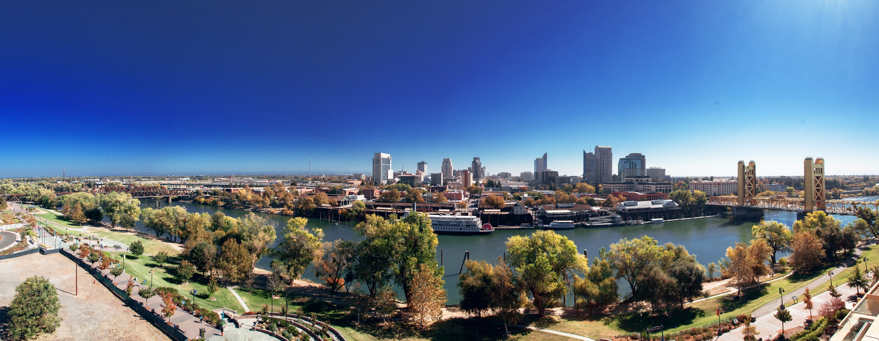
PROJECT OBJECTIVES
Vulnerability Analysis
Urban Heat Islands (UHI)
InVEST Model Valuations
Image Credit: City of Sacramento
Notes:
Previous reports have established that the City of Sacramento suffers from an urban heat island problem that disproportionally affects certain communities (Cooley et al., 2012; Kim et al., 2020; Sacramento County, 2017; Sacramento Department of Public Works, 2018). These studies lack information on the sources of heat at a very fine scale. To complement existing data, city management needs high resolution data on urban hot spots and how effectively and equitably the UHI is currently being mitigated across communities. By using NASA earth observations, we show surface temperature patterns at 30m and 70m resolutions for daytime and nighttime temperatures, respectively, in contrast to the 2km resolution of the City’s previous analyses. Analyses of social vulnerability to extreme heat in California have typically used cumulative indexes of vulnerability metrics and were conducted at the county scale (Cooley et al., 2012; Sacramento County, 2017). Our team will be examining extreme heat exposure over several vulnerability metrics, TBD. Finally, we apply the Integrated Valuation of Ecosystem Services and Tradeoffs (InVEST) Urban Cooling model (InVEST | Natural Capital Project) to illustrate high-value opportunities for further UHI heat mitigation. This model will show the Partners where the UHI is being mitigated effectively already and where opportunities for improvement exist. It will also allow us to do some scenario planning to compare mitigation strategies and placement.
Next slide please.
-------------------Image Credits-------------------------------
City of Sacramento 2040 General Plan Update Repository
City of Sacramento http://www.cityofsacramento.org/Visitors

Slide 6
SATELLITE & SENSORS
Landsat 8 Thermal Infrared Sensor (TIRS)
ISS ECOSTRESS
Image Credit: NASA
Notes:
For mapping the urban heat island in Sacramento, satellite imagery for summer days (1 May – 30 September) was retrieved via two platforms. Landsat 8 data for 2016-2020 were retrieved from Google Earth Engine. The Landsat 8 Surface Reflectance data was retrieved and processed using a script developed by the NASA DEVELOP Spring 2020 AZ node, Philadelphia Health and Air Quality team and modified for this study area and study period. This data was used in the calculation of albedo and daytime land surface temperatures. ECOSTRESS land surface temperature and cloud mask level 2 data for 2018-2020 were retrieved from the NASA Application for Extracting and Exploring Analysis Ready Samples (AppEEARS). ECOSTRESS data was used in the calculation of nighttime land surface temperature measurements.
Evapotranspiration data from ISS-ECOSTRESS were also retrieved through the NASA AppEEARS. Level-3 Evapotranspiration products representing daily evapotranspiration for summer days in 2018-2020.
-----------------Image Credits----------------------------
NASA

Slide 7
METHODOLOGY: OVERVIEW
Land Surface Temperature (LST)
InVEST model
Day and night averages
Reference and study areas
UHI magnitude
Model to map and value ecosystem services
Index of heat mitigation
Scenario planning
Vulnerability Analysis
Heat risk index
Scenario planning
Notes:
Day and night absolute land surface temperatures were averaged for the summer months for the City of Sacramento and two reference sites outside of the City limits. The team produced an urban heat island magnitude map for the study area by using the reference sites as a baseline temperature. The urban heat island magnitude map was used to conduct the team’s heat vulnerability analysis. The InVEST model used the maximum of the urban heat island magnitude to calculate cooling capacity and an urban heat island mitigation index. Multiple scenarios of varying land use and tree canopy cover were simulated in the model and their results compared. InVEST outputs were then compared to the vulnerability analysis to identify high risk high opportunity areas.

Slide 8
METHODOLOGY: LAND SURFACE TEMPERATURE
LANDSAT 8 TIRS
LST
(K TO °F)
Day and Night LST Maps
Cloud Mask
ISS ECOSTRESS
Image Credit: NASA Developedia, Clipart-Library, Microsoft Stock Images
Notes:
The team collected Land Surface Temperature (LST) data from both satellites. Although processing slightly differed for each dataset, processing overall followed the same steps. Quality assurance bands/layers were used from each dataset to mask clouds and cloud shadows. This data was then converted to Fahrenheit. Finally, average values per pixel from the study period were calculated and used to generate day and nighttime LST maps.
The Landsat 8 TIRS Surface Reflectance product was processed to LST (F) in Google Earth Engine using a script developed by the 2020 Spring AZ Philadelphia Health and Air Quality team and adapted to this study area and period.
The ECOSTRESS LST data underwent additional processing to filter for nighttime images and scale to Kelvin. ECOSTRESS images were filtered to a predetermined nighttime range, 11pm – 4am Pacific Time, using R Studio. From that point, used ArcGIS Pro to calculate the average nighttime temperature of Sacramento.
Mean relative LST was calculated for both daytime and nighttime for the study area and reference sites. Mean relative temperature was calculated by subtracting the mean LST of reference sites from mean LST of the study area.
Next slide please.
------ Image Credits ------
ISS from Clipart-Library: http://clipart-library.com/clipart/cliparts-space-station_10.htm
Landsat 8 from Developedia: http://www.devpedia.developexchange.com/dp/index.php?title=List_of_Satellite_Pictures
Cloud: from Microsoft Stock Images
Landscape: from Microsoft Stock images

Slide 9
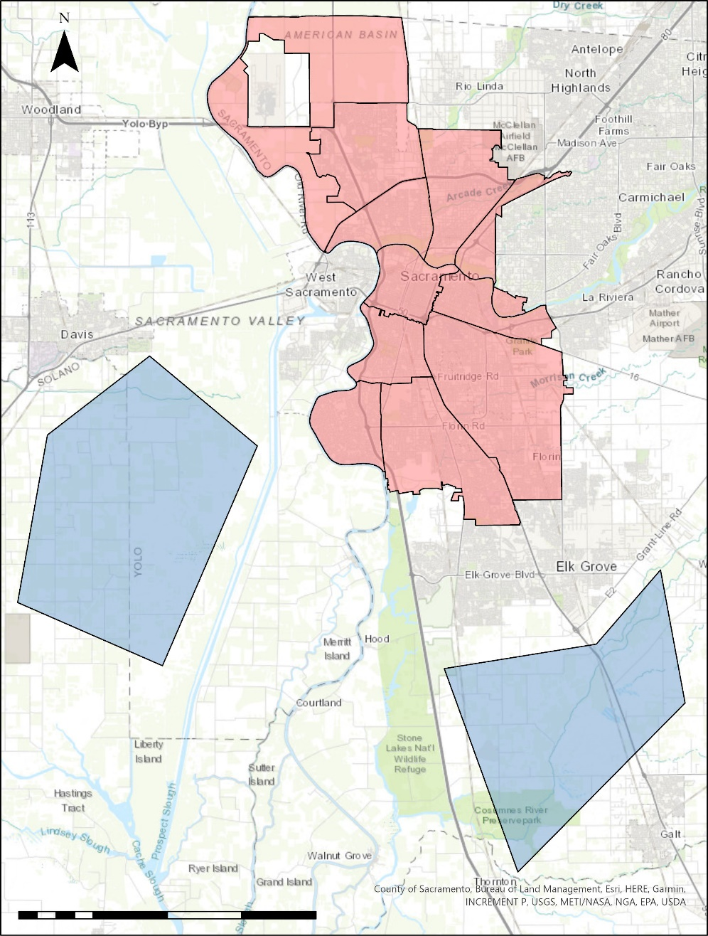
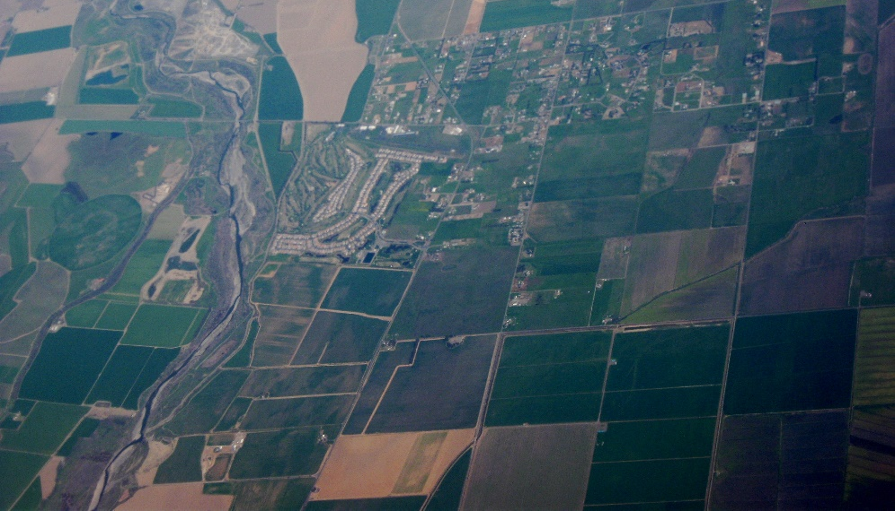
METHODOLOGY: REFERENCE SITES
Sacramento
Study Area
Reference sites
0
1.5
3
6
9
12
Miles
Image Credit: City of Sacramento, Dcoetzee
Notes:
Reference sites were selected to assess the degree of the urban heat island effect in the city. The cumulative area of the reference sites was similar to that of the city. Reference sites were selected according to the following criteria: outside of the city, little urbanization, similar elevation. Bodies of water and major transportation corridors were excluded. In this case, the reference sites selected were predominantly agricultural land.
Next slide please.
-------------------Image Credits-------------------------------
City of Sacramento: http://www.cityofsacramento.org/Visitors
Aerial view of Watts Woodland Airport and surrounding area, Yolo County, California Wikipedia, by Dcoetzee under a CC-BY2.0 license (https://en.wikipedia.org/wiki/Yolo_County,_California#/media/File:Aerial_view_of_Watts-Woodland_Airport_and_surrounding_area.jpg)

Slide 10
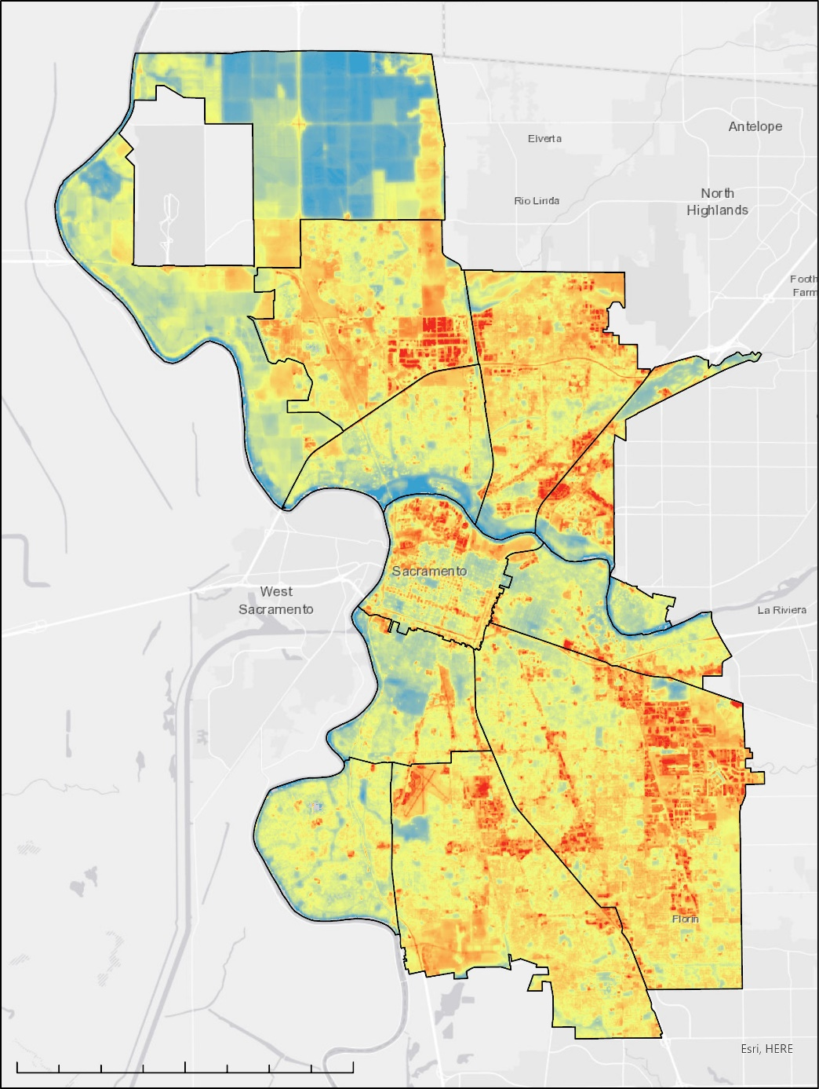
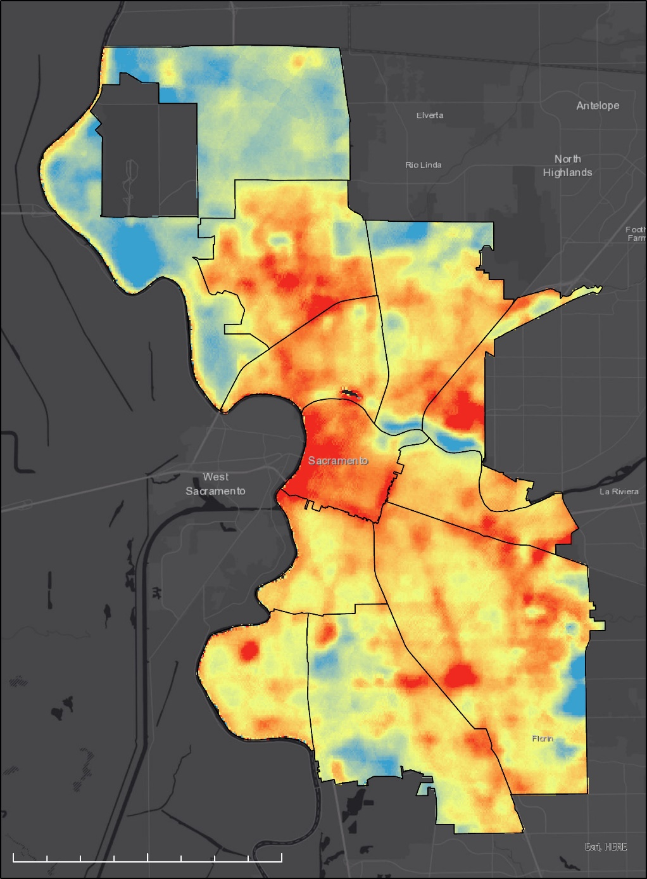
Results – Land Surface Temperature
Daytime LST
Nighttime LST
Temperature (°F)
Temperature (°F)
138
75
70
50
Sacramento Study Area
Sacramento Study Area
0
1.75
3.5
7
0
1.75
3.5
7
Miles
Miles
Average Summer Daytime LST (°F)
Average Summer Nighttime LST (°F)
Notes:
We have previously shown you all land surface temperature maps for the City, but maybe not side by side. So in front of you we all can see that the temperatures on average fall from 138 °F during the day to 75 °F at night. We can see some similarity along major corridors and roadways for higher temperatures and cooler absolute land surface temperatures in rural and agricultural areas. However, to fully understand the impact of the urban heat island has on the City of Sacramento we need to compare these average temperatures to our reference areas we established outside of the city with less commercial and industrial build up. *next slide*

Slide 11
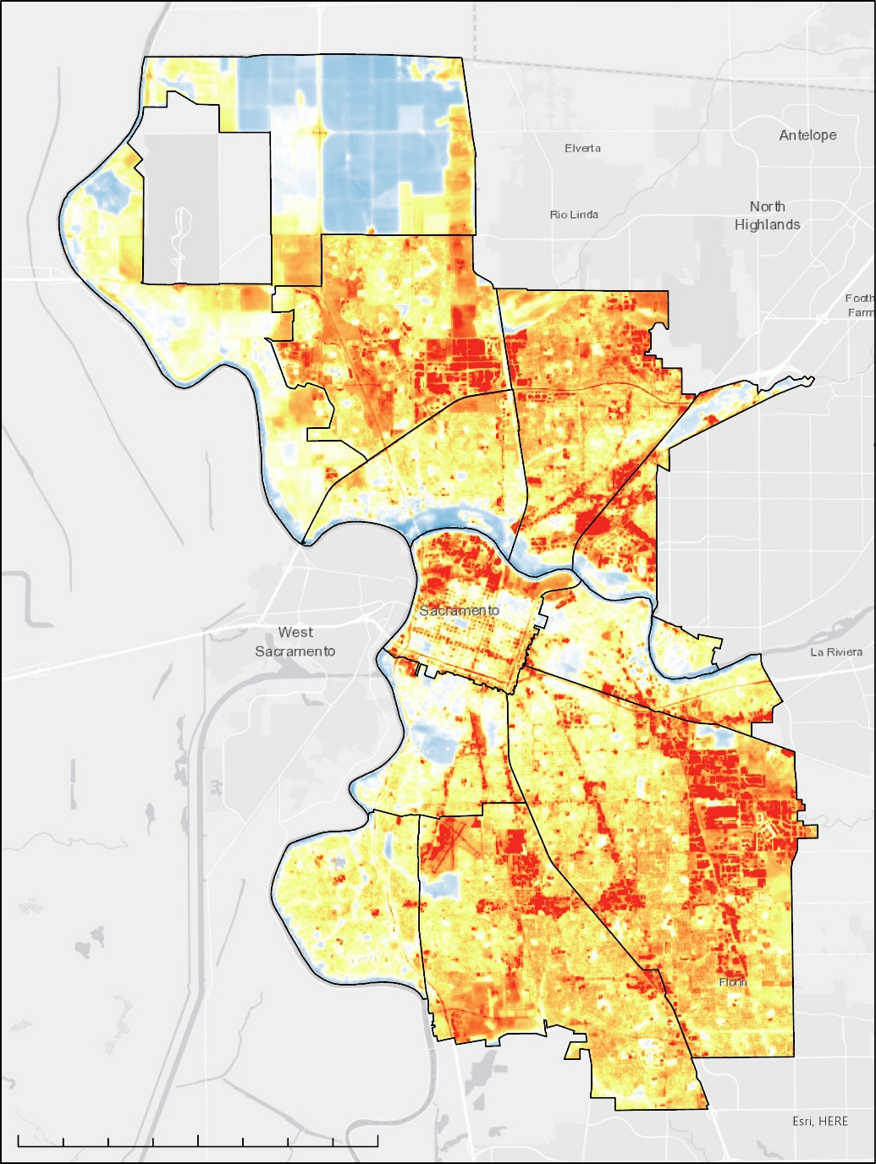
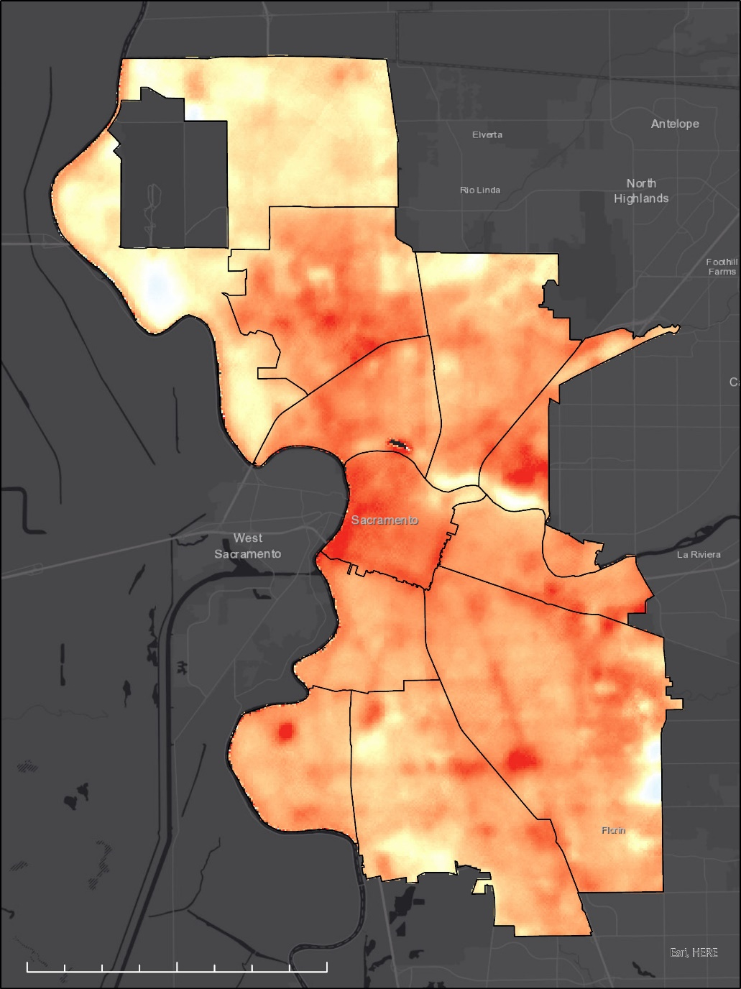
Results – UHI Magnitude
Daytime UHI
Magnitude
Nighttime UHI
Magnitude
Temperature (°F)
Temperature (°F)
20
8
-20
-8
Sacramento Study Area
Sacramento Study Area
0
1.75
3.5
7
0
1.75
3.5
7
Miles
Miles
Average Summer Daytime UHI Magnitude (°F)
Average Summer Nighttime UHI Magnitude (°F)
Notes:
So now in front of you we have the average difference of temperatures from within City limits to outside in more rural areas. There is still a similar trend between these two maps and the two prior as we see pockets of areas that are around 20 degrees greater during the day and around 8 degrees warmer at night when compared to the reference areas outside of the city. We made the color ramp for the maps to have white be able to break up the two ends of the spectrum and represent zero change in temperature between our reference sites and the City. From these maps we can understand that the more urban areas prove to impact daytime temperatures and heat retention at night, but I will pass it to Karina where she will be able to connect the temperature effects of urban heat island to the populations within Sacramento.
And we were able to observe that areas within the Central City, along large corridors, and within areas like Fruitridge and North Sacramento experienced higher heat during the day as well as larger heat retention into the night hours. To show
The average nighttime temperature difference of the City of Sacramento Study Area from the mean nighttime temperature of the reference sites outside of the city limits, 56.579043 °F, for all of the 2018-2020 summer months (April – September)

Slide 12
METHODOLOGY: Social Vulnerability
Exposure
4Nighttime LST
4Daytime LST
(half weight)
Vulnerability
Sensitive Populations
4Age < 11
4Age > 65
4Age > 65 and living alone
4Asthma
4Cardiovascular disease
Socioeconomic Factors
4BIPOC communities
4Homelessness
4Housing burden
4Linguistic Isolation
4Poverty
4Unemployment
Risk*
*Brody et al. 2012, CalEnviroScreen
x
=
Notes:
For our vulnerability assessment, we build off upon these quantitative aseessments of heat that Anjelica just showed us. Heat risk, which is a combination of exposure and vulnerability, was calculated using the risk equation from Brody et al. 2012 and used by CalEnviroScreen. Let’s walk through each variable of the equation to understand which indicators were chosen, and why, for each.
As we mentioned, exposure in this case is the heat, as measured by land surface temperature. Both daytime and nighttime temperatures were taken into account for exposure. Because nighttime temperatures are the greatest indicators of health-related heat outcomes, it was weighted more heavily than daytime (twice as heavily).
Vulnerability indicators were informed by previous research on heat vulnerability. Vulnerability accounts for sensitivity indicators (e.g. age, preexisting conditions) and socioeconomic indicators (such as race, housing burden, and poverty).
Individual indicators were measured as percentiles relative to the city of Sacramento and combined into one variable. The final score was then also scaled to the city. The next slide will show the results for each variable and the final result.
Next slide please.
-----------------Image Credits--------------------------------------------------
Safety Support by Hawaii Open Data, US, The Noun Project Public Domain
https://thenounproject.com/search/?q=vulnerable&i=41337

Slide 13
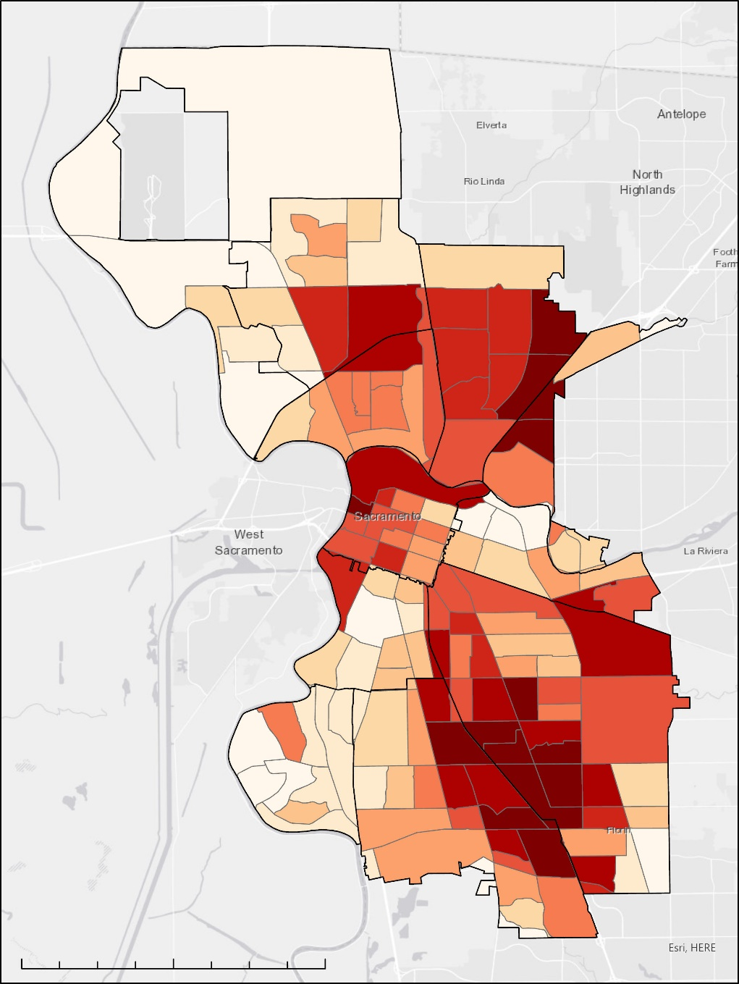
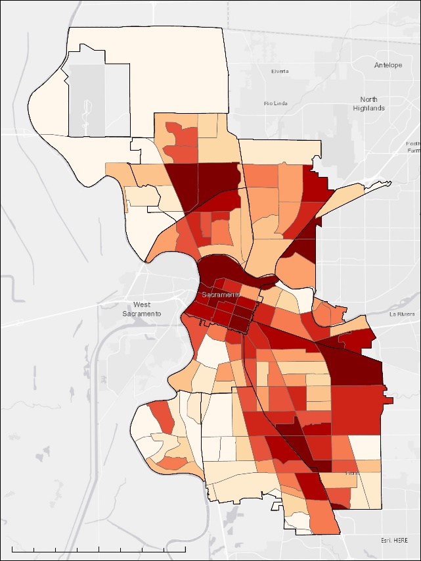
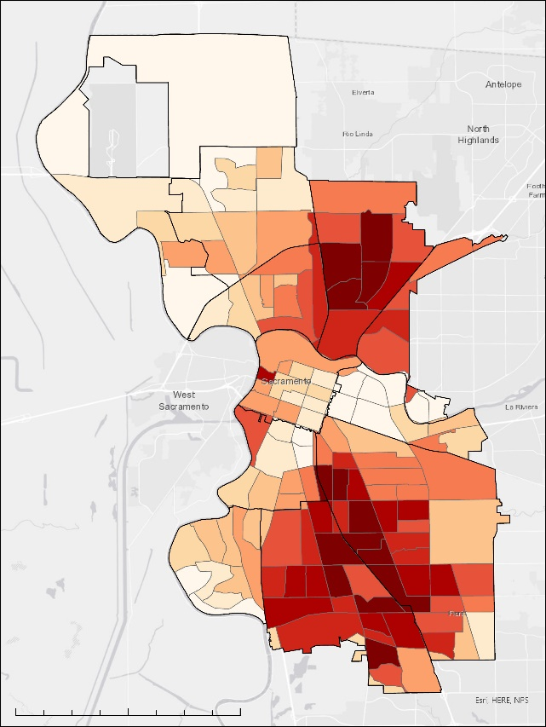
Results: Heat Risk
x
=
1- 10%
11-20%
21-30%
31-40%
41-50%
51-60%
61-70
0
1.75
3.5
7
0
1.75
3.5
7
71-80
Miles
Miles
81-90%
Exposure (heat)
Vulnerability
91-100%
Sacramento Study Area
0
1.75
3.5
7
Miles
Risk
Notes:
These maps show the /percentile/ of each variable in the heat risk equation, where darker colors indicate higher percentiles. What is pretty clear from these images is that areas of the highest exposure (city center) and areas of the highest vulnerability (the north and south parts of city) do not always coincide. This risk map is therefore a combination of these two factors.
Next slide.

Slide 14
METHODOLOGY: InVEST Urban Cooling Model
MODEL INPUTS
Land Cover Map
Biophysical
Table
Land Surface Temperature
Areas of Interest
Evapotranspiration
v
Shade Value: (0:1)
Crop Coefficient
Green Area
Albedo value (0:1)
Building Intensity
Image Credit: City of Sacramento
Notes:
We applied the Integrated Valuation of Ecosystem Services and Tradeoffs (InVEST) Urban Cooling model (InVEST | Natural Capital Project) to illustrate high-value opportunities for further UHI heat mitigation. The InVEST urban cooling model calculates an index of heat mitigation based on shade, evapotranspiration, albedo, and cooling islands. The model has the option to estimate the value of heat mitigation service in terms of work productivity and energy consumption, which can be a focus of future work.
Main inputs for the model include a raster of land use/land cover, an area of interest vector, and a raster of evapotranspiration. A .csv biophysical table defines additional parameters for each land use/land cover category: shade, crop evapotranspiration coefficient, green area indication, albedo, and building intensity. The shade cover was calculated from the 2016 NLCD Tree Cover Dataset. Green area was a binary designation. The albedo values were calculated from the Landsat 8 satellite data.
The biophysical table along with the, LULC map, Reference Evapotranspiration and air temperature from outlying areas, the area of interest, a cooling distance factor, and daytime and nighttime cooling capacity were inputs for the model. Several outputs were generated; rasters of Cooling Capacity for daytime and nighttime identify how much of the UHI effect is being mitigated by shade, ET, albedo, and building intensity. These rasters show where cooling capacity is low and thus where there is an opportunity to improve in these areas. Next, a raster of heat mitigation is generated showing where cooling capacity and greenspace >2ha that provide additional cooling to nearby areas offset UHI. A raster of estimated air temperature is created that takes into account UHI, the heat mitigation index, and air mixing. Finally, ten communities outlined by the partners along with the city will have average cooling capacity, average air temperature, and average temperature anomaly (UHI) calculations generated by the model.
----------------- Image Credits ------------------
Image provided by the City of Sacramento

Slide 15
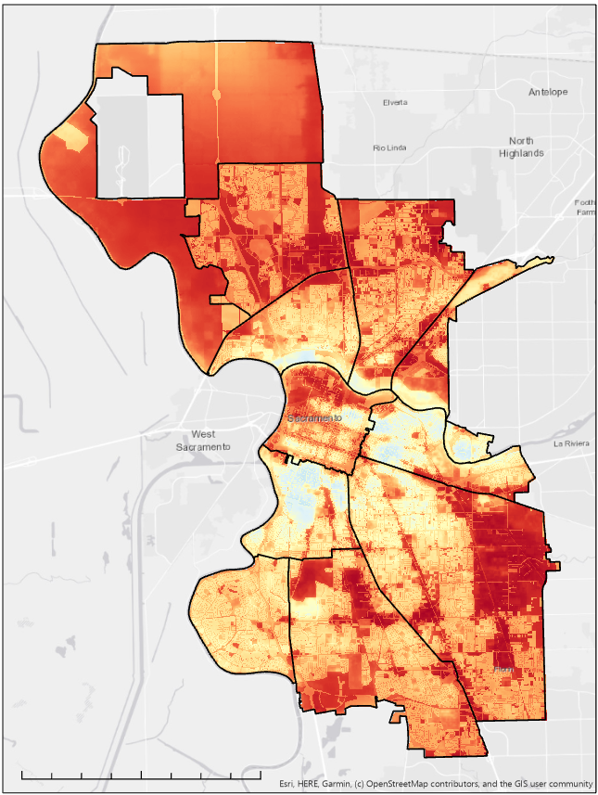
Results:
InVEST Cooling Capacity
Cooling Capacity is a zero to one ratio.
Higher ratios have better capacity to cool compared to surrounding pixels.
Capacity to cool is higher in the lighter/blue colored pixels and lower in the red pixels.
Current Cooling Capacity
Ratio
0.4
0.1
0
1.75
3.5
7
Miles
Notes:
Cooling capacity is a product of shade, albedo, and evapotranspiration by land use type.
You can interpret this map by thinking of the darker red areas as the low hanging fruit. They are locations where there is low capacity currently, and therefore an opportunity for improvement.
One caveat, however, are the large swaths of agricultural land. Because the ag land has near no shade and low albedo, the CC misleadingly categorizes it as an area for improvement. This is where the Heat Mitigation Index is more useful, and we will explain that in a couple slides.

Slide 16
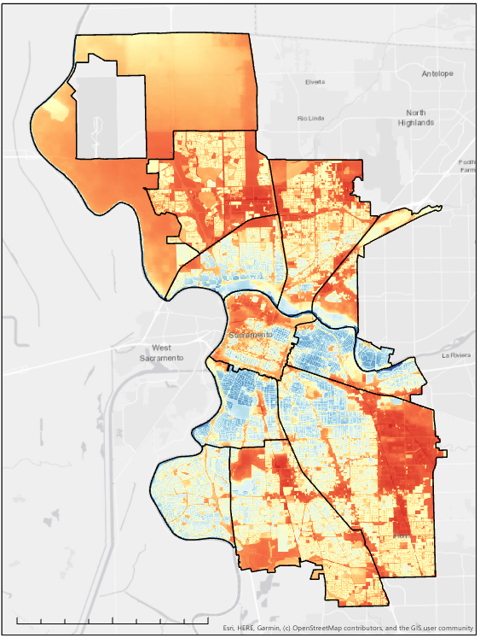
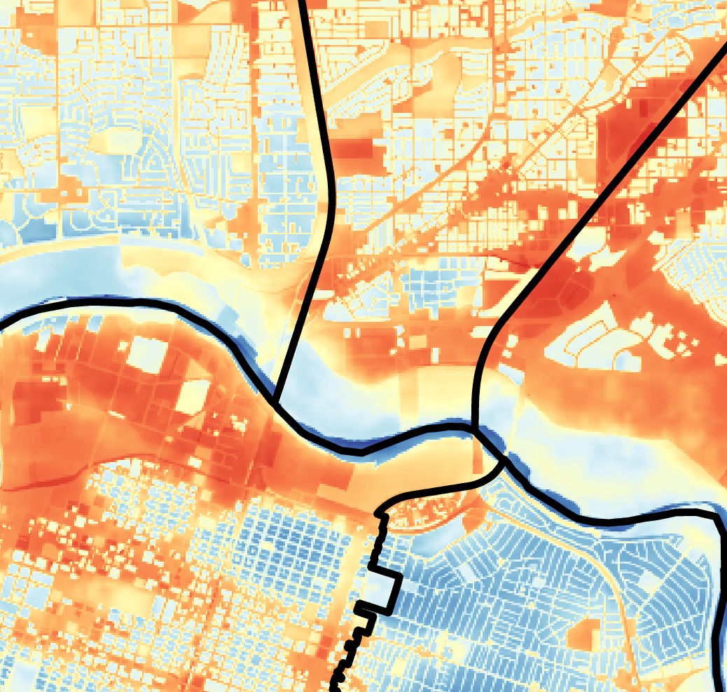
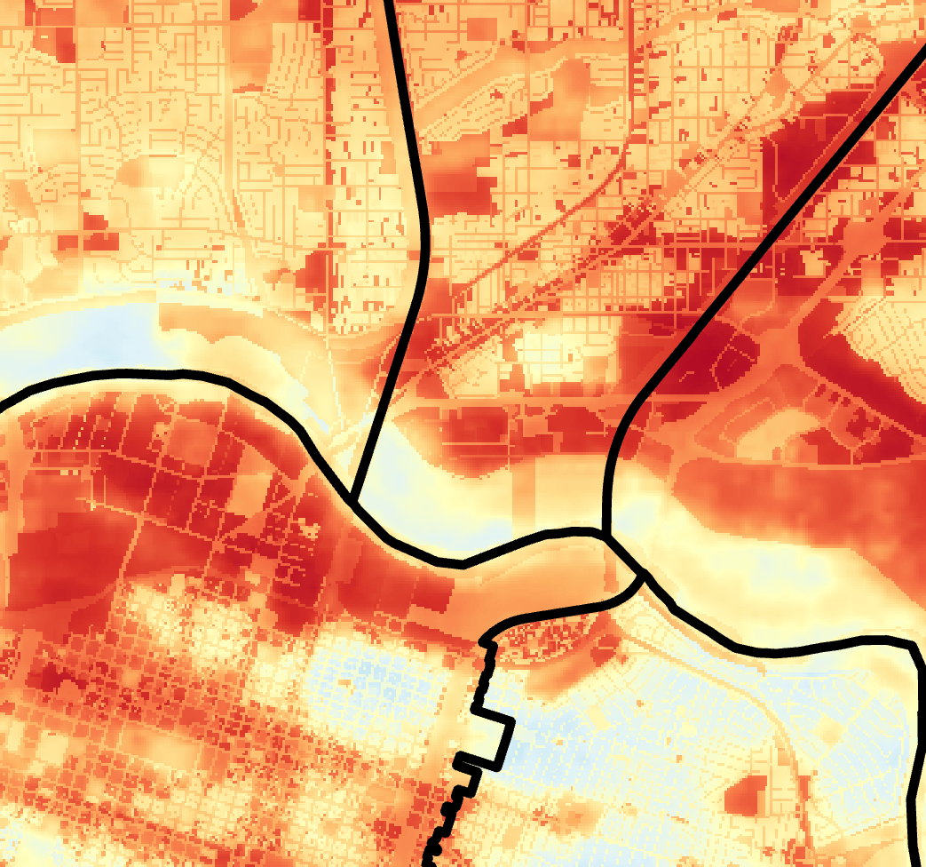
Results – Planned Tree Cover Cooling Capacity
Current Cooling Capacity
Potential Cooling Capacity with Planned Tree Cover
Current Cooling Capacity
Planned Cooling Capacity
Ratio
Ratio
0.4
0.4
0.1
0.1
0
1.75
3.5
7
0
1.75
3.5
7
Miles
Miles
Notes:
Our team looked at the Urban Tree Canopy Cover Assesment from the Davey Resource Group and used the community’s plan for growth in specific areas as an input for the InVEST model to scenario plan for potential cooling capacity in the City. So on the left you have the current cooling capacity within the City and on the right is the potential cooling capacity if the City increases its tree canopy cover by the percentages outlined in the Urban Tree Canopy Cover Assessment. The blue pixels have better capacity to cool compared to surrounding pixels.

Slide 17
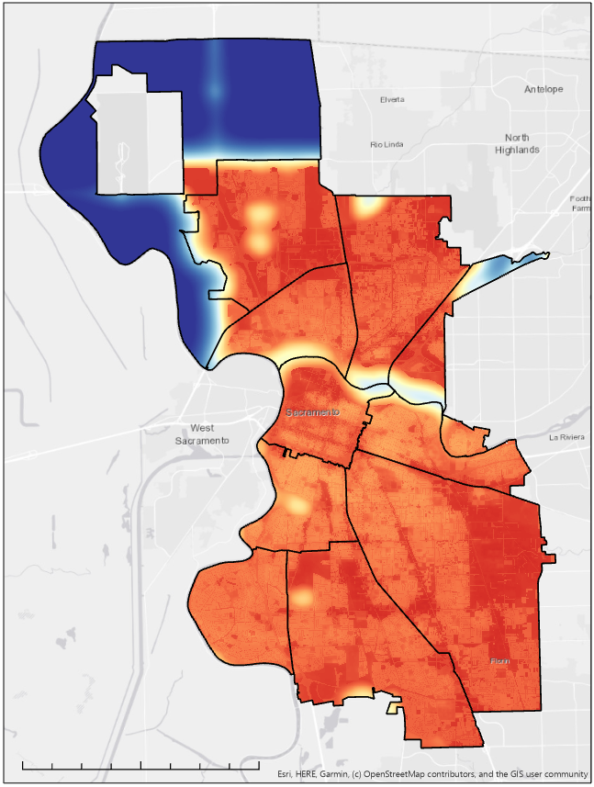
Results:
InVEST Heat Mitigation
Heat Mitigation is an index evaluating spatial interactions.
Takes into account air blending and proximity to large contiguous green areas.
Current Heat
Mitigation
Index
0.4
0.1
0
1.75
3.5
7
Miles
Notes:
Heat mitigation differs from cooling capacity in one important way. It takes into account the cooling impact of large swaths of green space. So you can interpret this map in the same way as the CC- dark reds are places where there is not much heat mitigation happening, and white/blue areas are where heat is being mitigated more effectively.
You'll notice in this view that the ag land of N. Natomas is now deep blue, and it is providing some cooling benefits to the border areas of the. The River Park, the Zoo, and the Park underneath the private airport in S. Sacramento are also providing extra cooling benefits to the surrounding areas.
You can clearly see certain transit corridors and blocks that have low HM indexes and may be good places for investment.

Slide 18
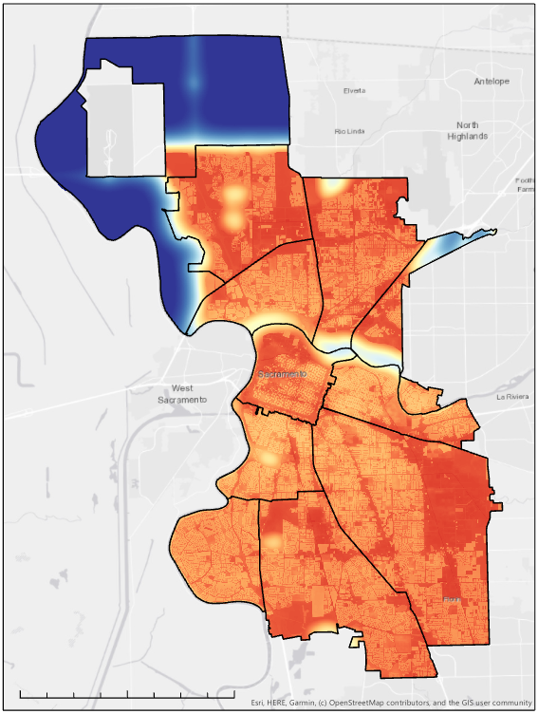
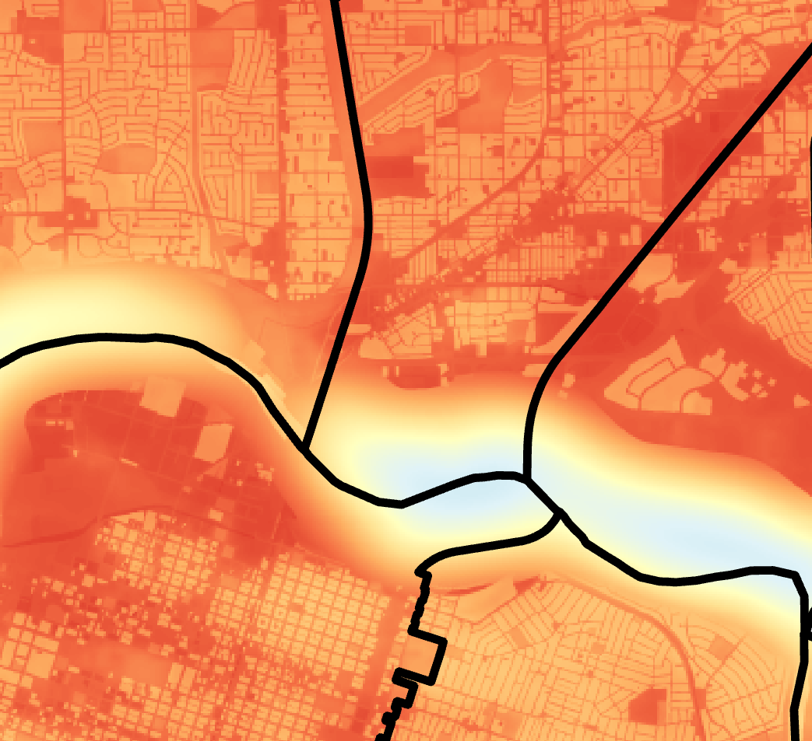
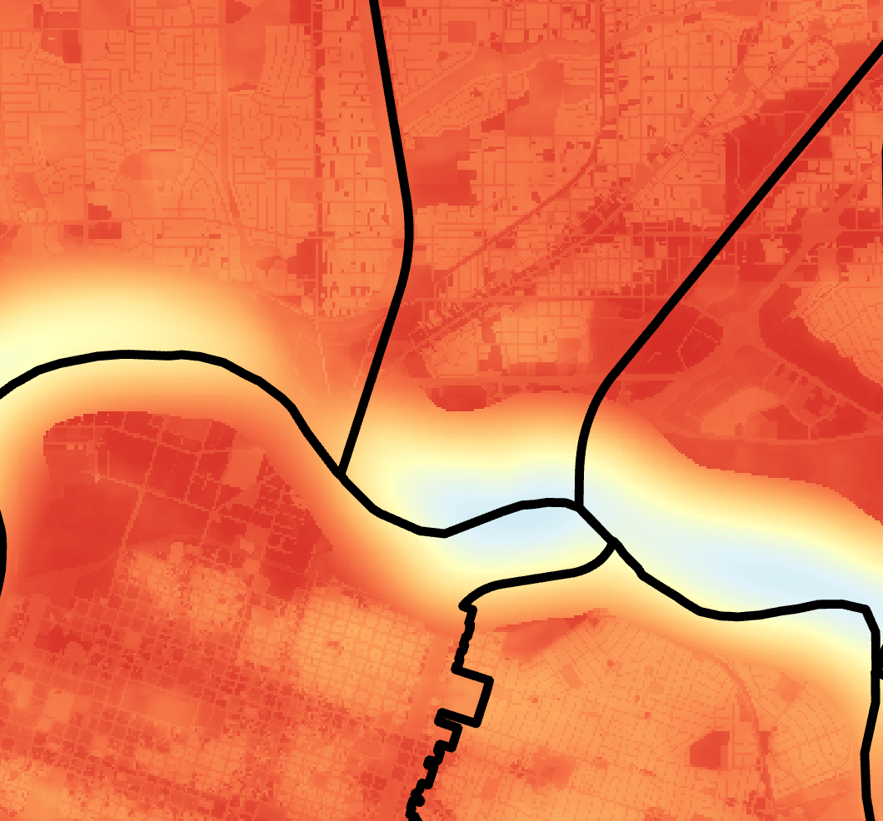
Results – Planned Tree Cover Heat Mitigation
Current Heat Mitigation
Potential Heat Mitigation With Planned Tree Cover
Current Heat
Mitigation
Planned Heat
Mitigation
Index
Index
1
1
0.02
0.02
0
1.75
3.5
7
0
1.75
3.5
7
Miles
Miles
Notes:
This result again used the Urban Tree Canopy Cover Assessment to scenario plan for what heat mitigation might look like using the community’s plan for tree growth. The map on the left shows current heat mitigation and the map on the right shows potential heat mitigation with increased growth. And again the lighter areas are where heat is being mitigated at a higher rate. You can see he change in heat mitigation where the percentages for growth have increased.

Slide 19
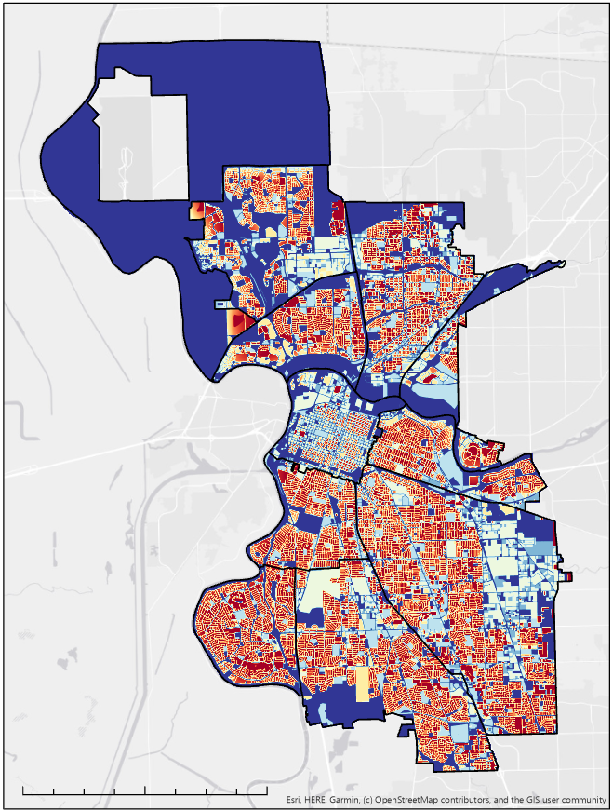
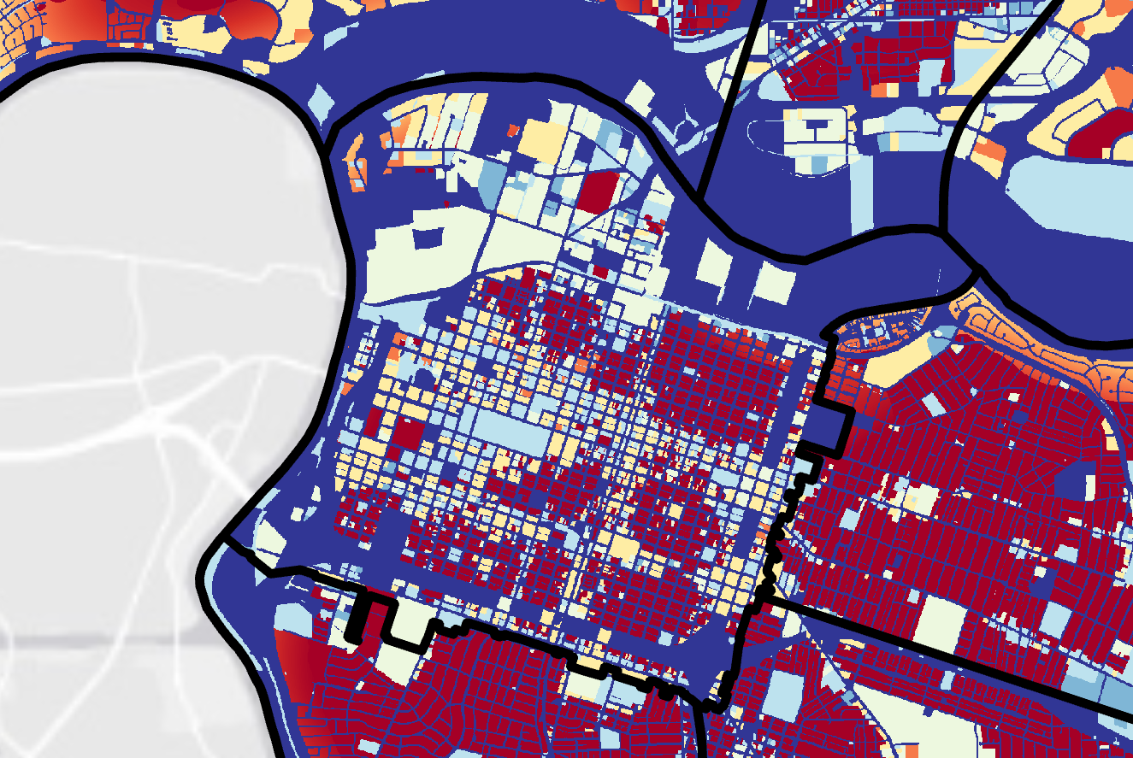
Results:
InVEST Nighttime CC
Current Cooling Capacity
Nighttime method takes into account building intensity.
Building intensity is
floor area / by land area.
Ratio
0.4
0.1
0
1.75
3.5
7
Miles
Notes:
Nighttime method takes into account /only/ building intensity.
Building Intensity is a product of the cumulative floor area of buildings on a certain land use category / the area of land of that category.
From Dyett and Bhatia, we had a cartographic layer of some buildings, but most buildings had no height. So we made some assumptions and generalizations to complete the dataset. We looked at the typical height of buildings in each land use category for which we did have data, and chose a value that seemed reasonable. For example, for single family homes, we chose 25 ft, for Offices we chose 30 ft. Then, to estimate the #of floors in each building, we divided the height by a typical floor-to-floor distance (9ft for residential types; 15ft for everything else). We will provide documentation on all of the assumptions we made in the materials you receive after the end of the term you can play around with these assumptions. Or update the layers if you acquire more accurate datasets. So that is all to say that the building density values should be understood to be very, very generalized.
You will notice that residential areas are actually quite red in the nighttime map, meaning low capacity. This is a function of the high number of housing units packed very tightly together on small parcels of land, moreso than a function of their height. In City Center, where there are much taller buildings, you see patches of dark red where buildings are tight together, but you also see patches of blue and yellow where there is open space or where the category of building tends to be less intense (so public buildings usually have larger parcels so the building intensity value associated with public buildings is low.

Slide 20
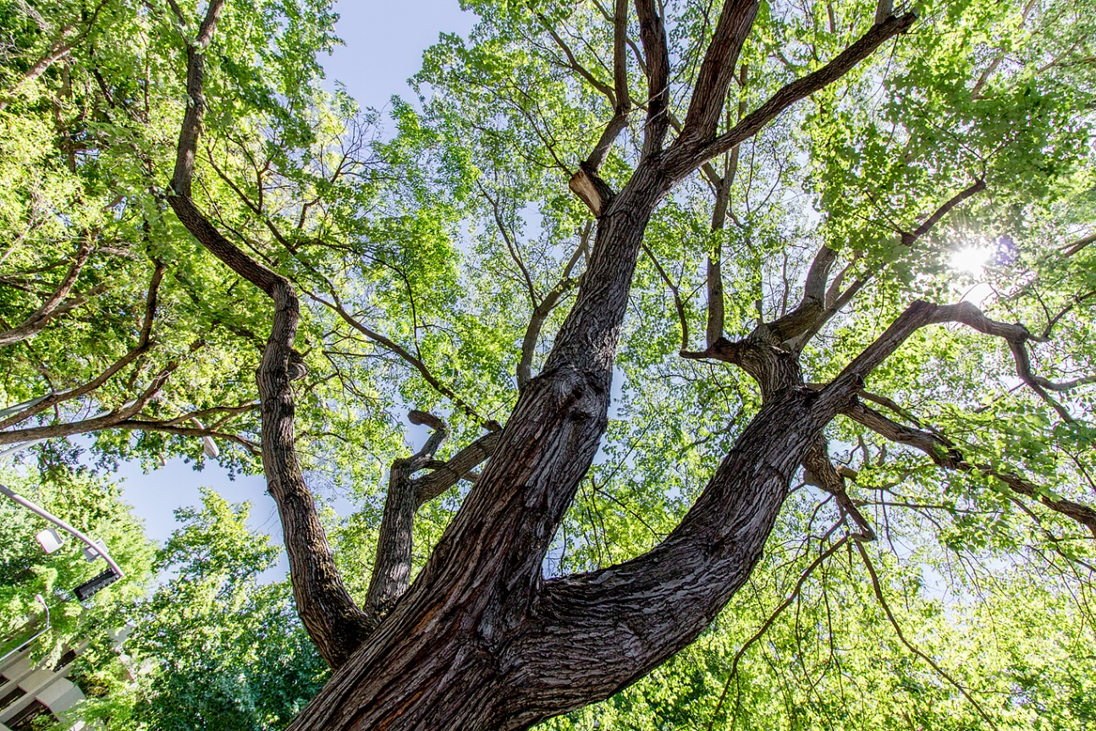
Conclusions
Priority areas identified for cooling initiatives that overlap with vulnerable populations.
Tree canopy cover will increase cooling capacity and heat mitigation around the city.
Image Credit: City of Sacramento
Notes:
Increased tree canopy cover provides cooling benefits to neighborhoods within the city. With InVEST model scenario planning we can identify opportunities for improved cooling capacity and then visualize how these areas change when shade is increased. Our team was able to create an index of risk to map regions that would most benefit from cooling interventions. Communities in these areas experience both high heat exposure and high sensitivity to heat. Partners will be able to use these urban cooling model results to identify regions that have low cooling capacity and highest risk communities so they can plan to prioritize an increase in tree canopy cover in areas with greatest need.
--------------Image Credits-------------------
Image provided by the City of Sacramento

Slide 21
Uncertainties
Nighttime hours assumption
Accuracy of cloud mask
Daytime exposure scores were weighted half as much as nighttime scores
InVEST model input assumptions:
Building heights
Air mixing
Shade
Kc Value
Notes:
Nighttime hours were selected to represent the coolest part of the day and to maximize the number of images to ensure a stable mean. Studies over longer periods of time may consider designating shorter periods as ‘nighttime.’ Additionally, the default cloud masks were applied for both Landsat and ECOSTRESS satellite imagery. Although cloud masks can always introduce error, nighttime cloud masks can be particularly difficult to ensure accuracy as they are based on only temperature, not optical imagery. In future studies of nighttime urban heat, customization of the cloud mask may be considered. Daytime’s averaged land surface temperatures were given half the weight of nighttime to create an exposure risk that support findings that nighttime LST is a greater risk for health-related indicators. For several InVEST model inputs certain assumptions were made. Due to lack of available data from the city, the building height in some areas and the air mixing value were assumed. Shade was calculated using the National Land Cover Database but had a low resolution and did not always match the city owned trees data layer which we were unable to use because it did not incorporate the entire city. Because our evapotranspiration data already included the crop coefficient value, the Kc value was inputted as one in order to run the model.

Slide 22
Future Work
Inclusion of additional heat vulnerability factors based on literature (e.g. diabetes, homelessness)
InVEST Model Valuations
InVEST Scenario Generator
Notes:
Potential future work for this project includes further research into additional vulnerability data sets to include for a greater understanding of vulnerability and risk. The InVEST model allows users to run additional valuations and scenarios that our team was not able to run due to the ten-week timeframe.

Slide 23
Dr. Kenton Ross
Adriana LeCompte
City of Sacramento – Remi Mendoza, Nguyen N. Nguyen, Josh Cannon
Dyett and Bhatia – Rajeev Bhatia, Jossie Ivanov, Mayu Tanaka

Slide 24
Backup Slide

Slide 25
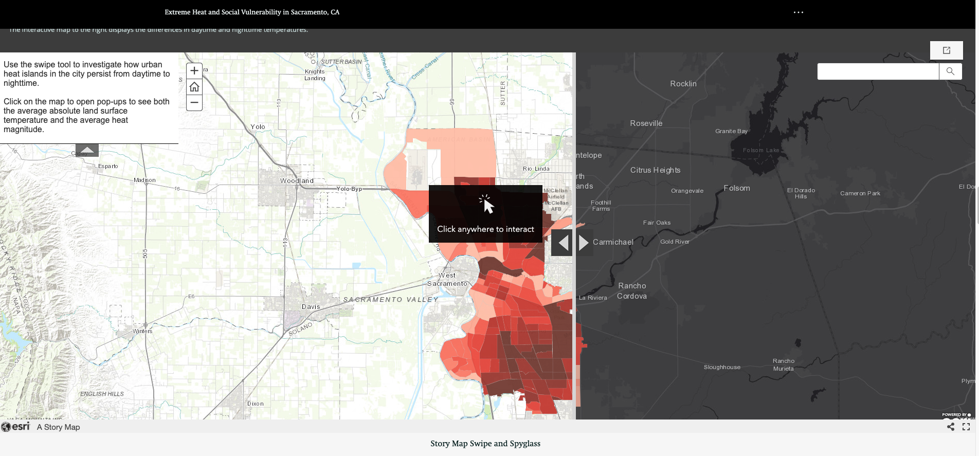
AGOL Story Map
Notes:
To communicate the results of this project, the team produced a creative communication tool via the public facing StoryMap in ArcGIS Online, “Extreme Heat and Social Vulnerability in Sacramento, California”

