Slide 1
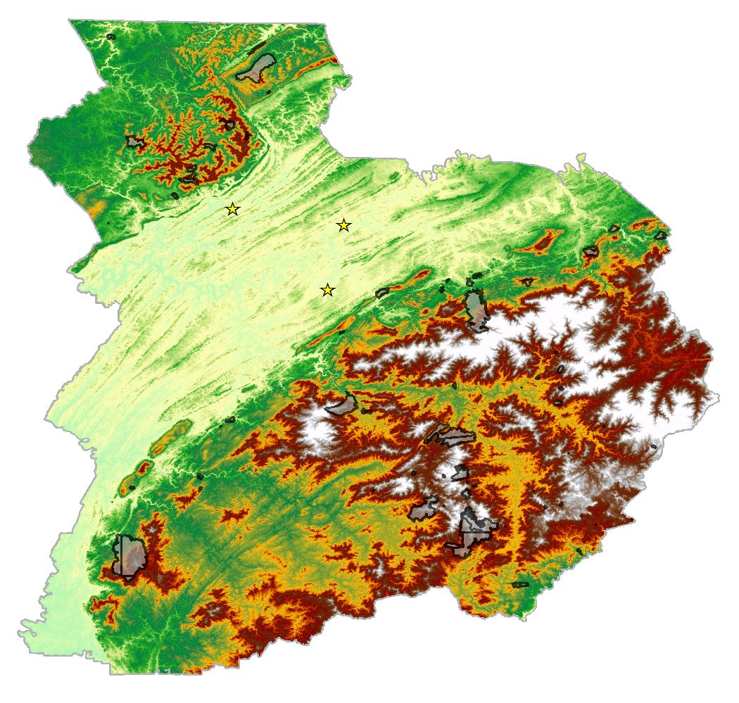



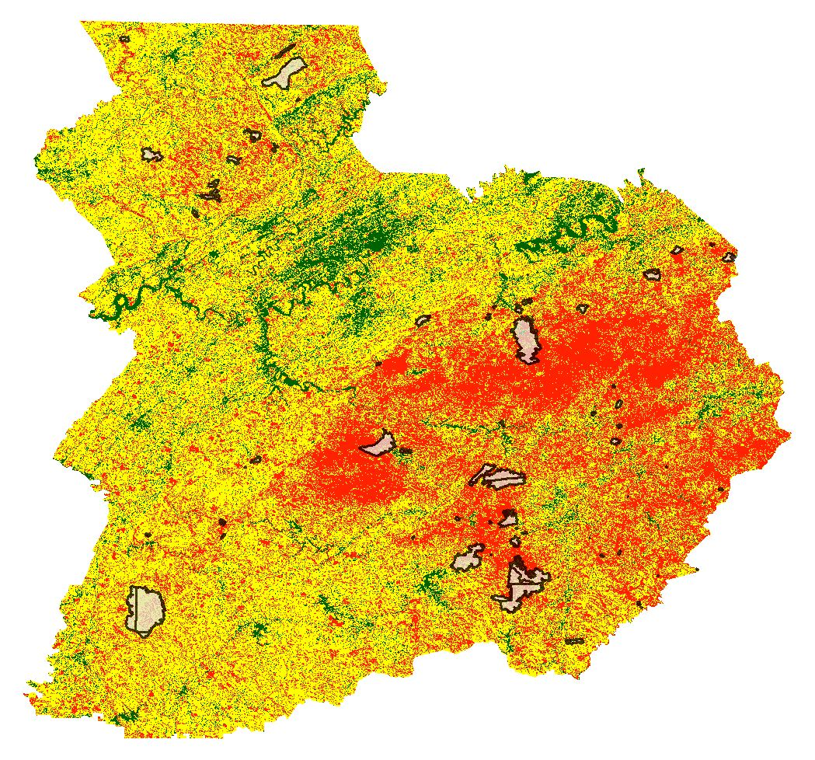









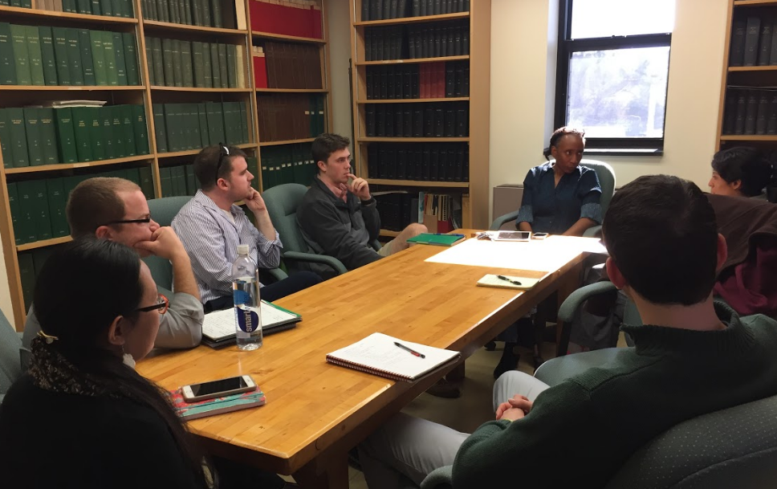




Using NASA Earth Observations to Monitor Vulnerability, Wildfire Damage, and Recovery in the Appalachian Forests
Abstract
Objectives
Wildfires in the southeastern US are less-understood compared to other portions of the nation. In October and November of 2016, over 60 individual wildfires ignited among seven states in the Southern Appalachian region. These fires damaged hundreds of buildings, caused numerous power outages, and resulted in several fatalities. The devastating effects led to the evacuation of cities such as Gatlinburg and Pigeon Forge, TN and highlight the need to improve understanding of fire-susceptibility and risk in the southeastern US. The US Forest Service requires a thorough understanding of wildfire vulnerability, damage, and recovery to effectively help local communities respond to and prepare for these unfortunate events. The University of Georgia NASA DEVELOP team partnered with US Forest Service’s Southern Research Station to assess vegetation dynamics before and after the 2016 major wildfire events, focusing on GA, NC, and TN. This was accomplished by utilizing Landsat 8 OLI, Terra ASTER, and Terra MODIS data to evaluate land cover changes and air quality from October to December 2016 and assess the severity of these fires. In addition to physical environmental parameters associated with the fire, this project incorporated demographic data to examine the relationship between fire risk and fuel build-up associated with under-managed lands, such as heirs’ properties. The results of this project provided researchers at the US Forest Service with an increased understanding of how property ownership and community management practices can affect the risks for future wildfires.
Analyze vegetation and fire fuel change before, during, and after the fall 2016 wildfires using Landsat 8, Terra MODIS, and Terra ASTER data
Explore the physical and biological factors that may lead to increased wildfire susceptibility in this region of the United States
Create a wildfire risk model based on a range of environmental
factors including elevation, vegetation health, and land cover type
Study Area
KY
VA
Knoxville
TN
NC
Oak Ridge
GA
SC
Maryville
Methodology
Data Acquisition | Processing and Analysis |  | Output | End Product
 | NDVIs (250m) Forest Thrive/Decline | Biological Risk Factors | Fire Risk Model | Wildfire Vulnerability Index
 | Land Cover Land Use NDVIs (30m) NDMIs (30m)
 | DEM Slope Aspect | Physical Risk Factors
 | CWPPs FireWise Communities Heirs’ Properties Census Data
 | Aerosols Particulate matter Health effects
Terra MODIS
Biological Risk Factors
Landsat 8 OLI
Fire Risk Model
Earth Observations
Terra ASTER
Physical Risk Factors
Wildfire
Vulnerability
Index
Socio-
Demographic Data
  Social Impacts and Risk Factors
Southern Appalachia Disasters
Terra
MODIS
Air Quality
Landsat 8, OLI
Terra, ASTER & MODIS
Conclusions
Results
NASA satellite data was successfully integrated into a wildfire risk model categorizing areas as low, medium, or high risk based on 9 parameters.
The fire risk maps predicted that 51% and 48% of the area within the actual 2016 fire areas were at high and medium risk levels, respectively.
This wildfire model predicted major events, such as the Chimney Top fire near Gatlinburg, with 67% and 30% of the area contained in fire zones classified at high and medium risk levels.
Additional work will improve our understanding of socio-demographic and management factors that affect wildfire potential.
Wildfire Vulnerability Risk-Level Based Within Area %
Acknowledgements
We would like to thank our science advisors Dr. Marguerite Madden and
Dr. Sergio Bernardes for their advice and guidance on this project.
We also would like to thank our partners at the US Forest Service, Southern Research Station, Dr. Cassandra Johnson Gaither, and the US Forest Service Eastern Forest Environmental Threat Assessment Center, Dr. Steven Norman and William Christie for their support and involvement throughout the project.
Team Members
Project Partners
Amanda Aragón Team Lead
Matt Hevert
Stephen Jordan
Joshua Willis
US Forest Service
Christopher Cameron
Caren Remillard
Natalia Bhattacharjee
Southern Research Station
The University of Georgia – Spring 2017

