Slide 1
Levant & Central American Climate
Monitoring Drought through Vegetation to Enhance U.S. Air Force Predictions and Decision-Making in the Levant and Central America
Alec Courtright (Project Lead)
Hayley Hajic
Christie Stevens
Notes:
- Introduce team members and project title.

Slide 2
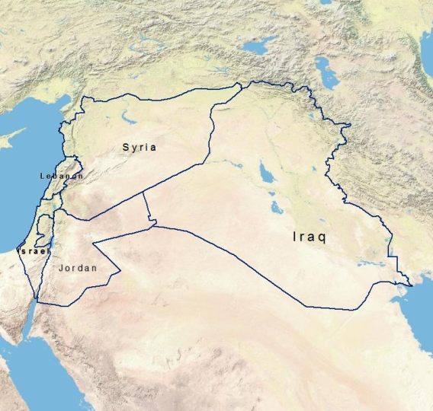
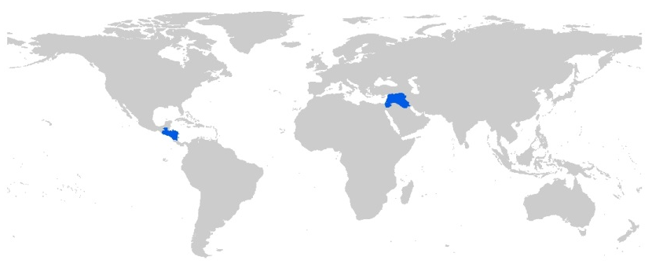
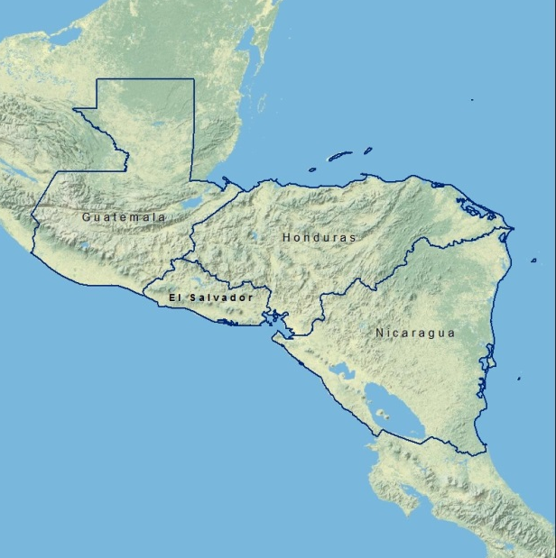
Study Area
The Levant: Syria, Lebanon, Israel, Jordan and Iraq
Central America: Guatemala, Honduras, El Salvador and Nicaragua
Study period:
June 1981- December 2014
Notes:
Image Source: Made by team
- The study area consists of two regions and nine countries. The Levant covers Syria, Lebanon, Israel, Jordan and Iraq and, for the purposes of our study, Central America is comprised of Guatemala, Honduras, El Salvador and Nicaragua.
- The Levant: has held the position of one of the most arid regions in the world for centuries.
- Central America: these countries contain the “Dry Corridor” of Central America and experience a variety of climatic extremes.
- The two regions have drastically different geographic characteristics, yet both areas are prone to similar climatic changes that can significantly impact the stability of countries within each region.

Slide 3
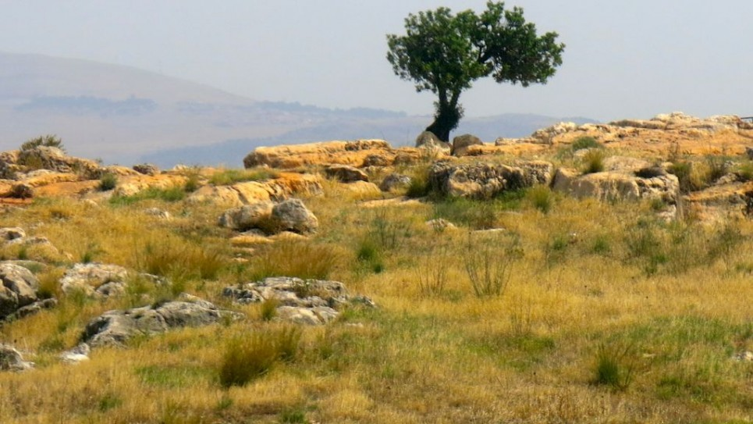
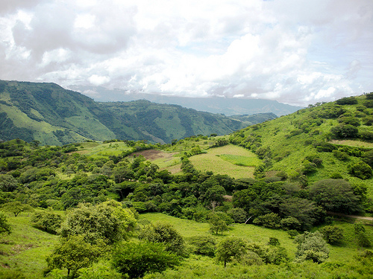
Israel
Image credit: Qanta Ahmed
Nicaragua
Image Credit: Bioclimate.org
Central American
“Dry Corridor”
Climate: tropical, humid, microclimates
Agriculture: coffee, bananas, sugar, cotton
The Levant
Climate: hot summers, short winters, arid, dry, desert
Agriculture: cotton, wheat, barley, olives
Notes:
Image Source:
In the Levant temperature and rainfall vary across the region depending on proximity to the sea. In general, summers are hot with high temperatures and winter and spring months bring limited rain. The growing season for this region is September to December. The major staple crops are wheat and barley.
Central America lies within the tropics but for such a small strip of land it has diverse local climates. Rainy season typically may through september.
Discuss the climate of each study area and what they grow etc.
What is their main water resource?
Israel image: http://www.timesofisrael.com/this-is-the-land/
Central America image: http://www.brdt.org/nicaragua

Slide 4
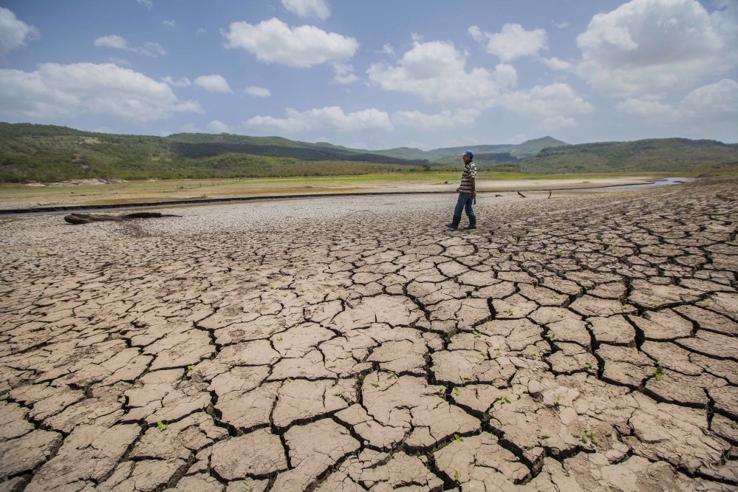
Nicaragua Drought 2014
Dry Las Canoas Reservoir
Image Credit: Diana Ulloa
Community Concerns
Heavy Precipitation
  Flooding, water contamination, landslides
Drought
  Depletion of water resources
  Crop failure and livestock die off
Water Stress
  Agricultural stress, strain on resources, catalyst to conflict
Notes:
Image source: http://www.ticotimes.net/wp-content/uploads/2014/08/140807NicaraguaDrought01-1000x666.jpg
Drought
Drought exacerbates food and water security
Water Stress
Socio-economic tensions increase as natural resources decrease
Heavy Precipitation (From Alec: we should focus mostly on drought)
The first area of concern of both regions is dense precipitation, which can have drastic consequences in the form of extreme weather events
Flooding, water contamination, and landslides are only a few of the environmental damages resulting from heavy precipitation
These types of natural disasters greatly impact community life and security

Slide 5

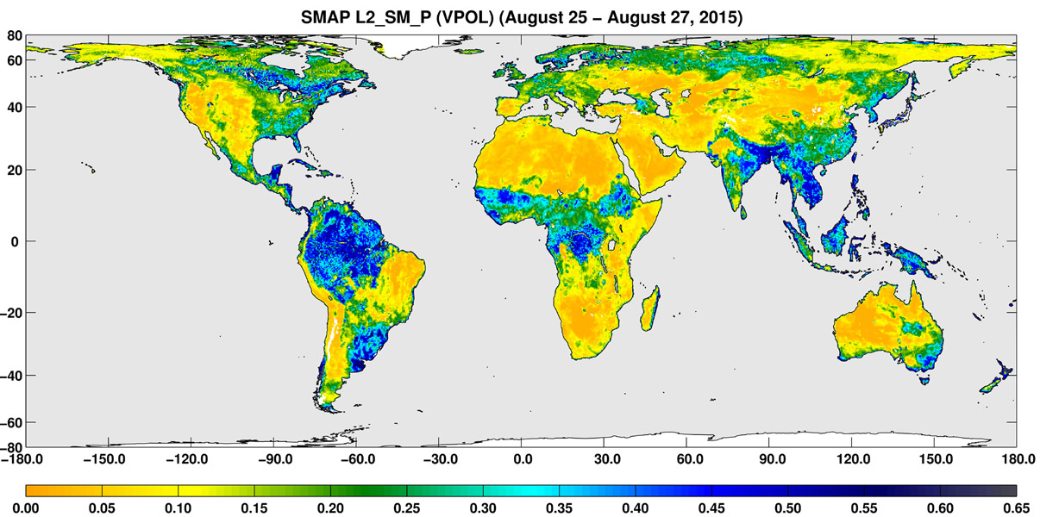
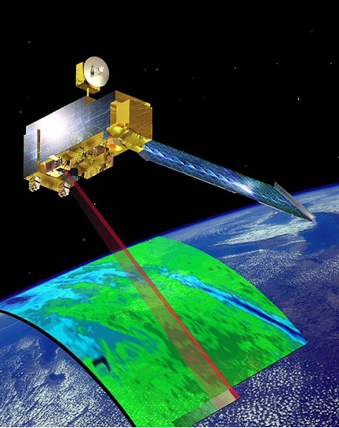
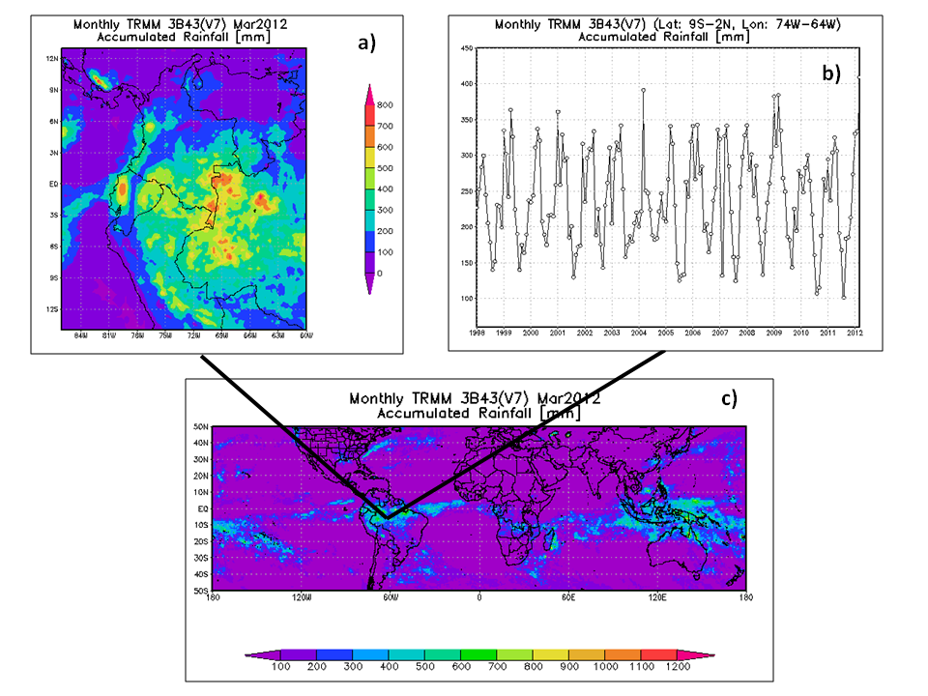
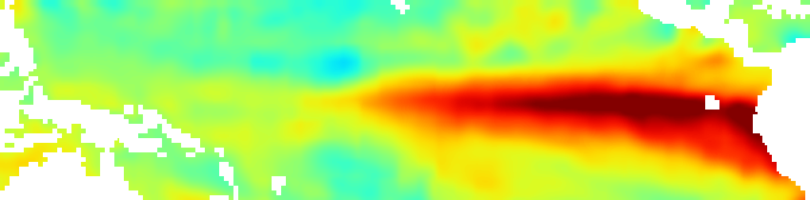

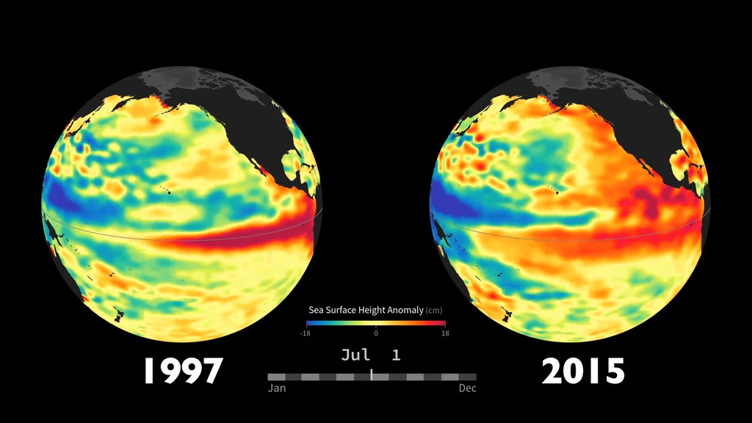
United States Air Force 14th Weather Squadron
Project Partner
Tico Times
U.S. DOD
NASA Jet Propulsion Laboratory
Monitoring
Reuters
End Users
NASA ESDIS
NASA Goddard Space Flight Center
Analysis
Prediction
Notes:
Image Source: 14th Weather Squadron
Our partners for this project are the United States Air Force 14th Weather Squadron. They are interested in the drought conditions and precipitation patterns of our study regions for increased response for military decision-making and crisis aid.
Water and agricultural stress have the power to catalyze conflicts. Water management wars that have occurred in Central America and the Syrian conflict beginning in 2011 are just two examples of this.
Monitoring regions that are vulnerable to water resource stress can help the Air Force better assist areas susceptible to conflict.
The 14th Weather Squadron is part of the 2nd Weather Group in the United States Air Force.
Mission statement: “Collect, protect and exploit authoritative climate data to optimize military and intelligence community operations and planning.”
Monitoring: Use remote sensing and in situ data for a variety of variables but focus heavily on precipitation.
Analysis: Anlaysis of weather and climate data is used to aid in military decision-making
Prediction:
End Users: Most of their data is used to help the Department of Defense. The Squadron also provides environmental and climatic information to the United States Air Force, the Army, and the Intelligence Community.

Slide 6
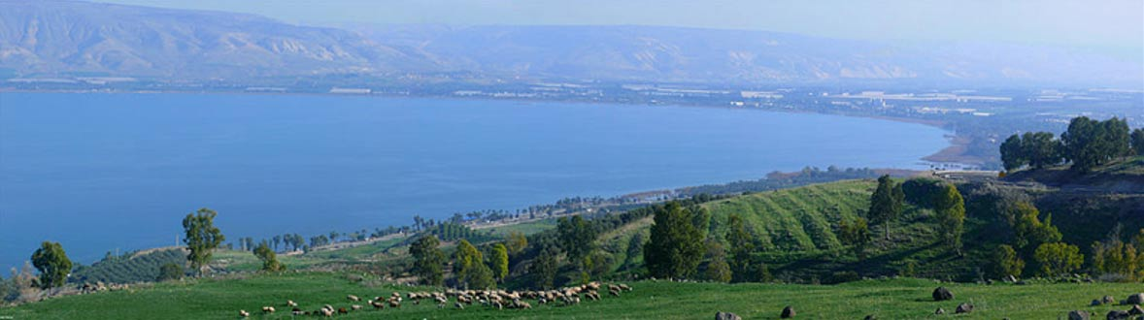
Objectives
1
Analyze Normalized Difference Vegetation Index (NDVI) data and create climatologies of both Central America and the Levant region to enhance the 14th Weather Squadron’s decision-making capabilities.
2
3
Examine specific El Niño years and drought events.
Calculate linear vegetation trends over the 33 years.
Image credit: Zachi Evenor
Notes:
Image source: http://www.ancient-origins.net/news-history-archaeology/scientists-discover-earliest-known-evidence-plant-cultivation-levant-003494
Analyze NDVI
Using NOAA AVHRR NDVI data, we created difference maps comparing monthly averages over the 30-year period to overall yearly averages.
Calculations in ArcGIS were used to find percent difference and create maps with the results.
NDVI monthly averages over the 30-year period were classified into five NDVI signatures. Percentages were calculated and graphed for both regions.
NDVI yearly averages were classified into wet and dry delineations. Maps of each country were created to show these distinctions.
Document Anomalous Years
Trend maps displaying pixel by pixel _____
Evaluate NOAA and NASA NDVI
Determine the capabilities of both NOAA AVHRR and NASA MODIS to estimate which may be more beneficial and reliable for drought monitoring tools.
“and compare capabilities of both NOAA AVHRR and NASA MODIS NDVI in drought and heavy precipitation monitoring” from original objectives

Slide 7
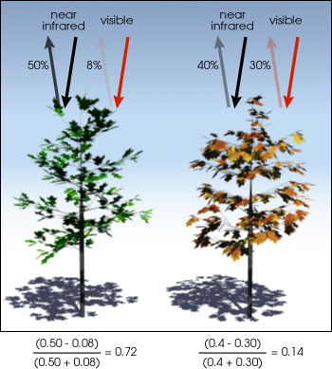
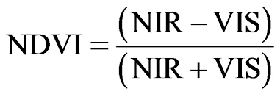
NDVI
Normalized
Difference Vegetation
Index
Image Credit:
NASA Earth Observatory
Notes:
Image Source: NASA Earth Observatory
The normalized difference vegetation index measures the density of chlorophyll green in a given area.
The different colors observed are from different wavelengths of visible and near- infrared light reflected from the plants that satellites pick up.
When sunlight strikes the leaves some wavelengths are absorbed while others are reflected. Chlorophyll in plants strongly absorbs visible light to use in photosynthesis but strongly reflects near infrared light.
If there is a large difference between near infrared wavelengths reflected and visible wavelengths reflected then vegetation is dense, green and likely a forest. Very little difference indicates sparse green coverage and may indicate more of a tundra or desert environment.
The different colors observed are from different wavelengths of visible and near- infrared light reflected from the plants that satellites pick up.
The difference formula on the slide is used to quantify the density of greenness with a range from -1 to 1 for each pixel.

Slide 8
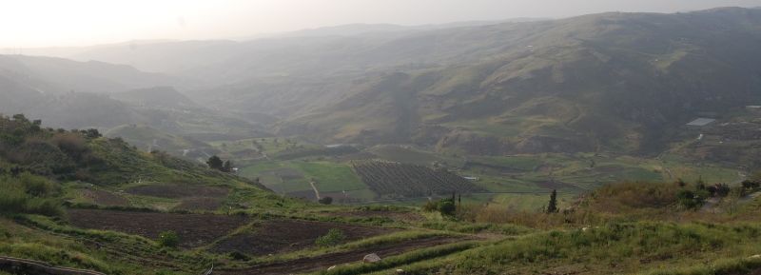
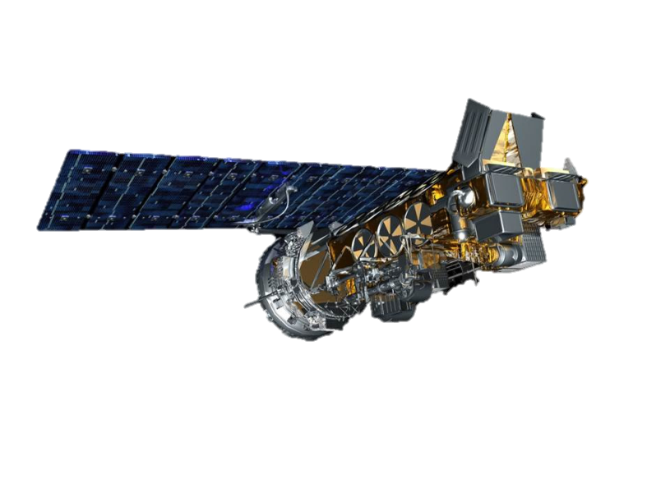
Image Credit: Paul
Methodology
Data Acquisition and Processing
Data Analysis
Results
AVHRR – multiple NOAA satellites.
0.05 degree resolution; daily
Notes:
Image Source: http://spankyford.aminus3.com/image/2012-05-08.html
For this project we went through the process of acquiring NDVI data and processing and subsetting it, analyzing the data in a variety of ways, and ultimately producing maps and graphs as results for our partners as foundational knowledge of NDVI to be used with the Weather Squadron’s drought tools.

Slide 9
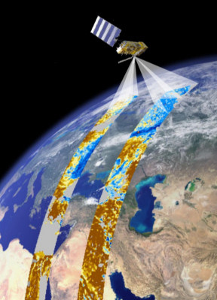
Data Acquisition
Downloaded NDVI from NOAA CDRs
Processed with R statistical program
Used R code to subset data into daily and monthly averages from 1981 - 2014
Image Credit: Image and Signal Processing Group
Notes:
Image Source: http://isp.uv.es/images/remote_sensing.jpg (Image and Signal Processing Group)
Using R the team downloaded AVHRR from NOAA Climate Data Records (CDR’s)
MODIS was subset and downloaded from NASA’s Reverb data discovery site
R-code was used to average data into daily and monthly 33-year climatologies

Slide 10
Data Analysis
Climatologies
Daily and monthly climatology maps
Classified data by NDVI signatures
Periods of Interest
Percent difference of ENSO and drought years
Trends
Monthly and seasonal linear trends
Notes:
Data analysis conducted for this project fall in three main categories: climatologies, periods of interest, and trends.
This project utilized R Programming and ArcGIS to evaluate various components of NDVI data and possible current and future trends in terms of seasonality and extreme weather events such as El Niño and drought episodes.
Climatologies: Each day was averaged over the 33 year period to provide end-users with climatologies
Daily averages were aggregated to create Monthly climatology baselines
Classified the data into five NDVI signatures
Classified “wet” and “dry” areas to further categorize areas of low and high vegetative activity
Periods of Interset (ENSO events and drought periods): we tested vegetation responses to extreme weather events by calculating the percent difference of months from the baseline climatologies in both regions
For Central America we examined the variation in NDVI from a baseline average specifically in the strong El Nino season of 1997-1998
For the Levant we examined vegetative response to the detrimental drought occurring from 2007-2010
Trends: analyzed monthly and seasonal linear NDVI trends
Compared the NDVI values of the growing season and regular 4 seasons in each region.
From previous data analysis “Analyzed anomalies for season and ENSO event related trends”

Slide 11
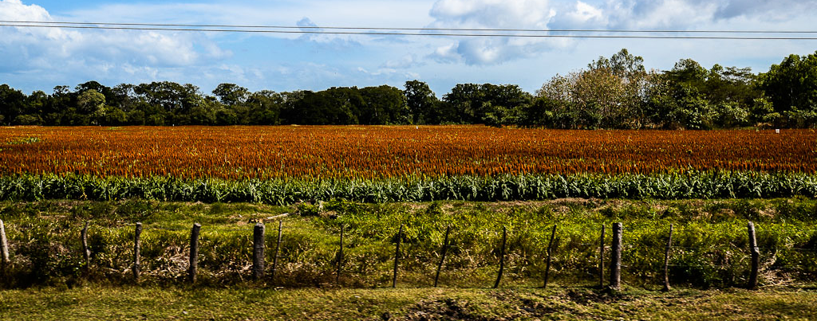
Results
Climatology Maps
Percent Difference Maps and Classification Graphs
Seasonal and Monthly Trend Maps
Image Credit: Ben Moffitt and Pegah Pourkarimi
Notes:
Image Source: http://www.tothenextjourney.com/2012/12/28/nicaragua-a-land-of-volcanoes-wind-and-waves/
- We took our results and put them into both graphs and maps.

Slide 12
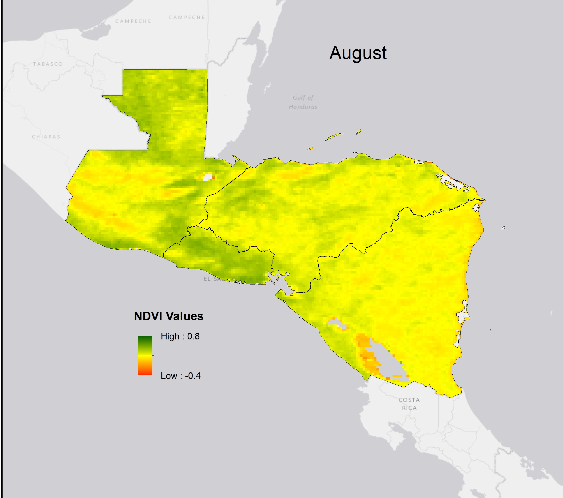
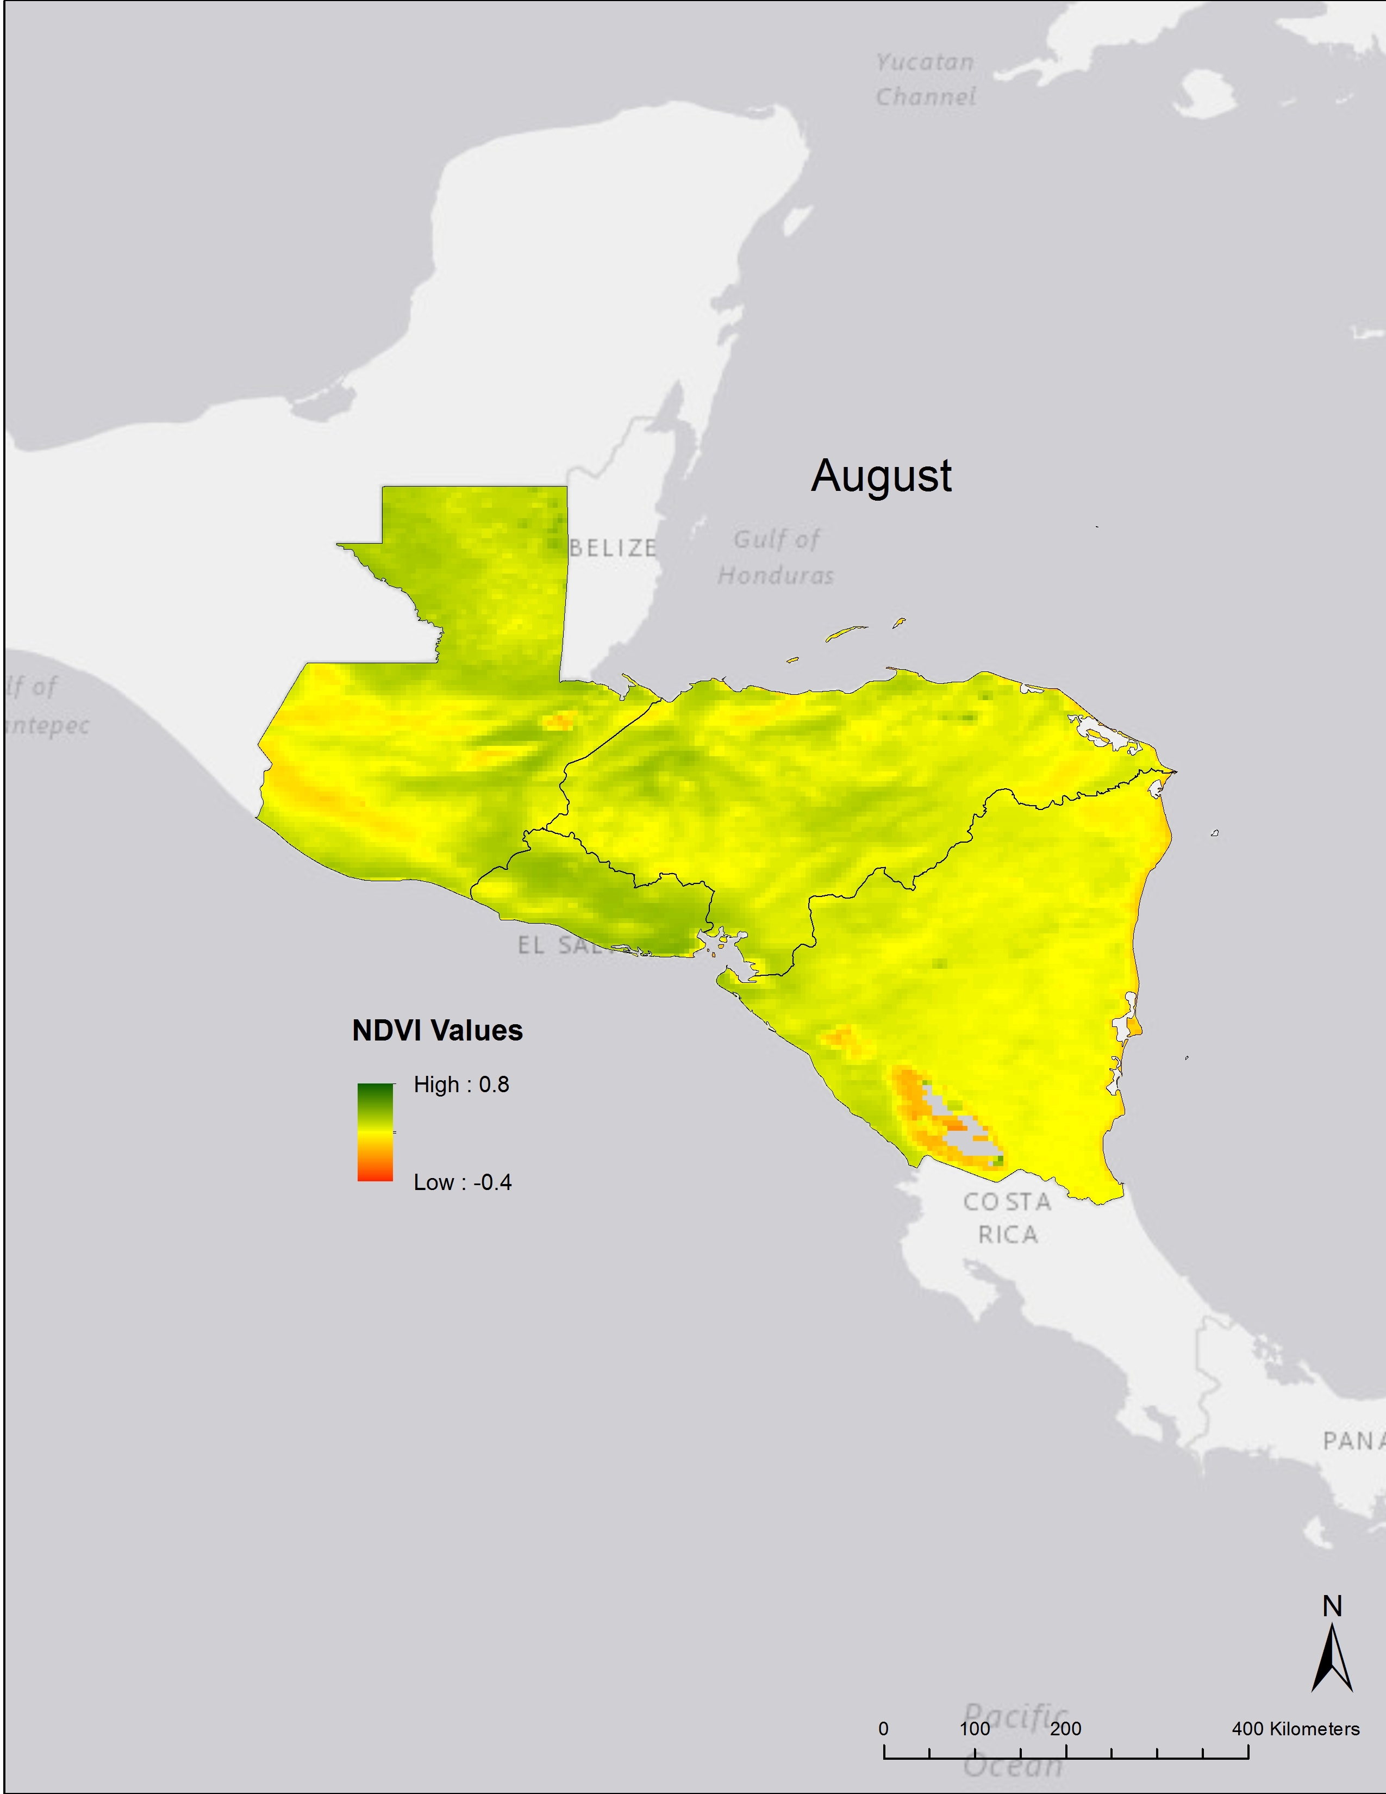
Climatologies
NDVI values for each day were averaged from 1981 - 2014
NDVI values for each month is then averaged over the 33 years
Baseline climatology
14
Daily Average
Monthly Average
Notes:
Image Source: Made by team
Each year has each one of its months averaged
The data was then divided into averages for each month over a 33 year time period.
Specific years were pinpointed that were El Nino years or anomalous years to compare the difference in these years from the baseline months over the 33 years previously created.

Slide 13
Classifying NDVI
Examine each region’s overall monthly NDVI averages
Divide NDVI values into 5 classes
Create graphs based on percent coverage for each class
 | NDVI Signatures | NDVI Value Range
Class 1 | Barren rock, sand, snow | -1 and <0.1
Class 2 | Soil | >0.1 and <0.2
Class 3 | Shrub & grassland | >0.2 and <0.3
Class 4 | Dense vegetative canopy | >0.3 to <0.6
Class 5 | Temperate/ tropical rainforests | >0.6 to <0.8
Notes:
Using the average NDVI value for each month over 33 years, we converted raster data to point feature classes in ArcGIS.
From this point data the NDVI values were separated into five classes for each month based on NDVI signatures and their corresponding NDVI value ranges.
The NDVI signatures are classified as follows:
Class 1 (NDVI values -1 to 0.1): Barren rock, sand, snow
Class 2 (NDVI values 0.1 to 0.2): Soil
Class 3 (NDVI values 0.2 to 0.3): Shrub and grassland
Class 4 (NDVI values 0.3 to 0.6): Dense vegetative canopy
Class 5 (NDVI values 0.6 to 0.8): Temperate or tropical rainforests
From the separated classes, percentages were calculated based on the number of points in each class and the whole region.
Graphs displaying months, classifications, and percentages were created for the Levant and Central America.

Slide 14
Central America NDVI Signature Classification 1981-2014
Notes:
- Image Source: Made by team
This is an example map of classifications for Central America.

Slide 15
Levant NDVI Signature Classification 1981-2014
Notes:
- Image Source: Made by team
This is an example map of classifications for the Levant.

Slide 16
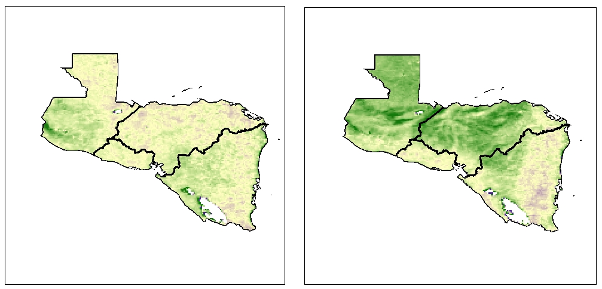
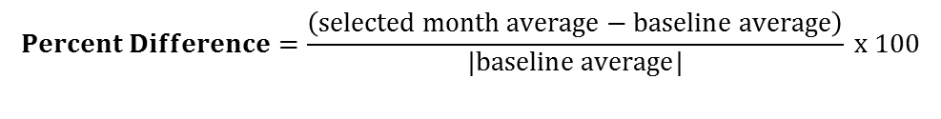
Periods of Interest
February
Percent Difference
Percent difference from baseline 33 year average
EL Niño Southern Oscillation events and drought years
Percent Difference
Percent Difference
100%
100%
-100%
-100%
1996
1998
Weak La Niña
Strong El Niño
$$Percent Difference=\frac{\left(selected month average−baseline average\right)}{|baseline average|} x 100$$
Notes:
Image Source: Made by team
The difference for the specific month from the baseline was calculated by taking the difference between the month and the baseline average and dividing the difference by the absolute value of the baseline average and multiplying that value by 100.
Seasonal (wet and dry as well as traditional) differences

Slide 17
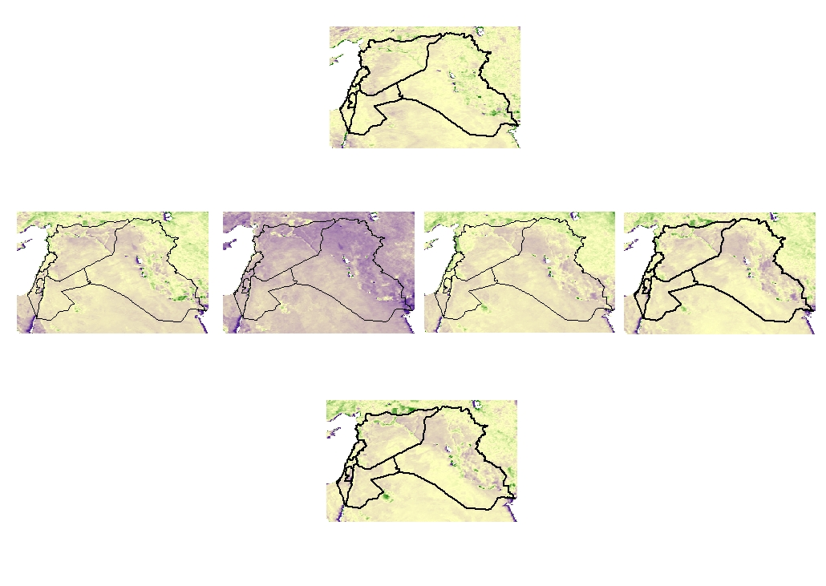
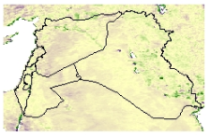
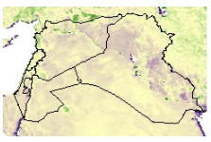
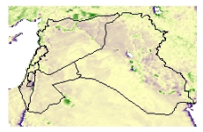
September
2006
(Before drought)
2007
2008
2009
2010
(During drought)
Percent Difference
100%
2011
(After drought)
-100%
Notes:
Image Source: Made by team

Slide 18
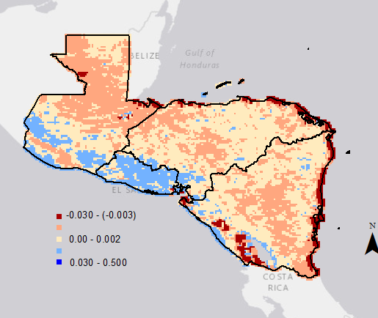

Seasonal Trends
-0.030 – (-0.003)
Assess Seasonality
0.00 – 0.002
Analyze NDVI trends over study period
Examine seasonality for 90-day season comparisons
Evaluate NDVI trends in wet and dry seasons
0.030 – 0.500
Decreasing
Slight Decrease
Slight Increase
Increasing
Central America January trend map
Notes:
Image Source: Made by team
-For our final analysis we analyzed linear trends of each pixel over the 33-year period.
-We created these trends to give our end-users an indication of how vegetation has changed since 1981 and how it may change in the future both seasonally and regionally.
-The map here indicates the linear trends of January over our study period. Each monthly trend map will be grouped by typical 90-day seasons (i.e. Winter = December, January, and February)
-Essentially, positive trends (in blue) represent areas that got more green over the 33-year period for the particular month. Red and orange represent opposing negative trends. Tan pixels represent little to no change over the 33-year period.
-Each value represents the general change per year over the study period.
-Values along the gulf coast and along the lower half of lake Nicaragua are outliers and most likely showcase water issues with the NDVI AVHRR sensors.
-P-values of f tests proved the trends to be significant (see tables in appendix section)

Slide 19
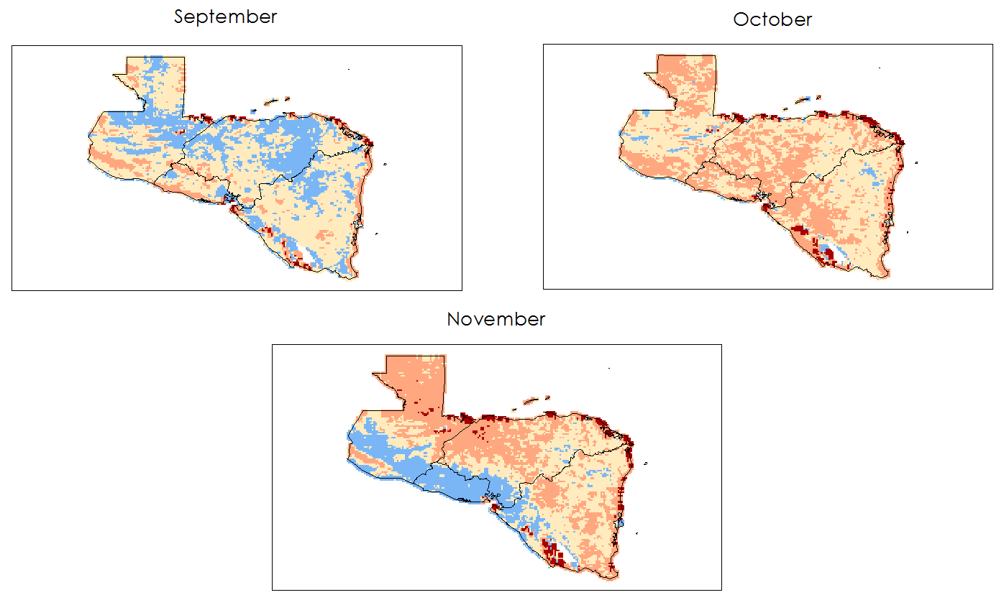
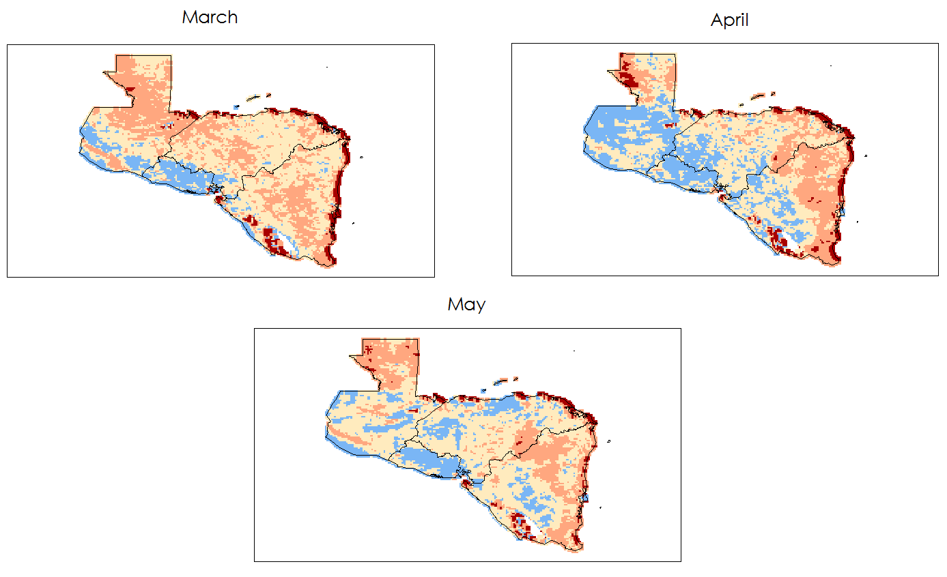
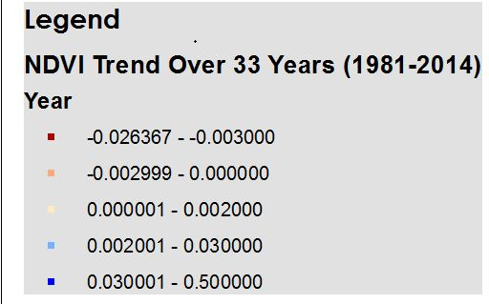

Central America Growing Seasons
Decreasing
Slight Decrease
Slight Increase
Increasing
NDVI Spring Trends from 1981-2014
Notes:
Image Source: Made by team
-The primary purpose of these maps and calculations is to help the 14th Weather Squadron assess vegetation changes within these regions and to help them in making predictive forecasts (redundant?).
-the trends also allow us to see how vegetation is changing during crucial seasons: i.e. rainy seasons and planting seasons.
-These maps above represent 33-year trends for the spring time which makes up the majority of the Primera or first growing season in most of Central America.
-During this season there are positive vegetative trends in the Southwestern part of the regions, especially along the upper western coast (El Salvador). This could indicate increases in agriculture for these regions or climatic changes that benefit vegetative health.
-The next three monthly maps represent the fall months which make up the majority of the Postrera, or second growing season in most of Central America. These three months show a lot of change throughout the months. The vast majority of positive vegetative trends are still in the western portion of the region. However, the positive trends switch from the gulf coast to the pacific coast from September to November. October sees a widespread slightly negative trend to no trend at all.

Slide 20
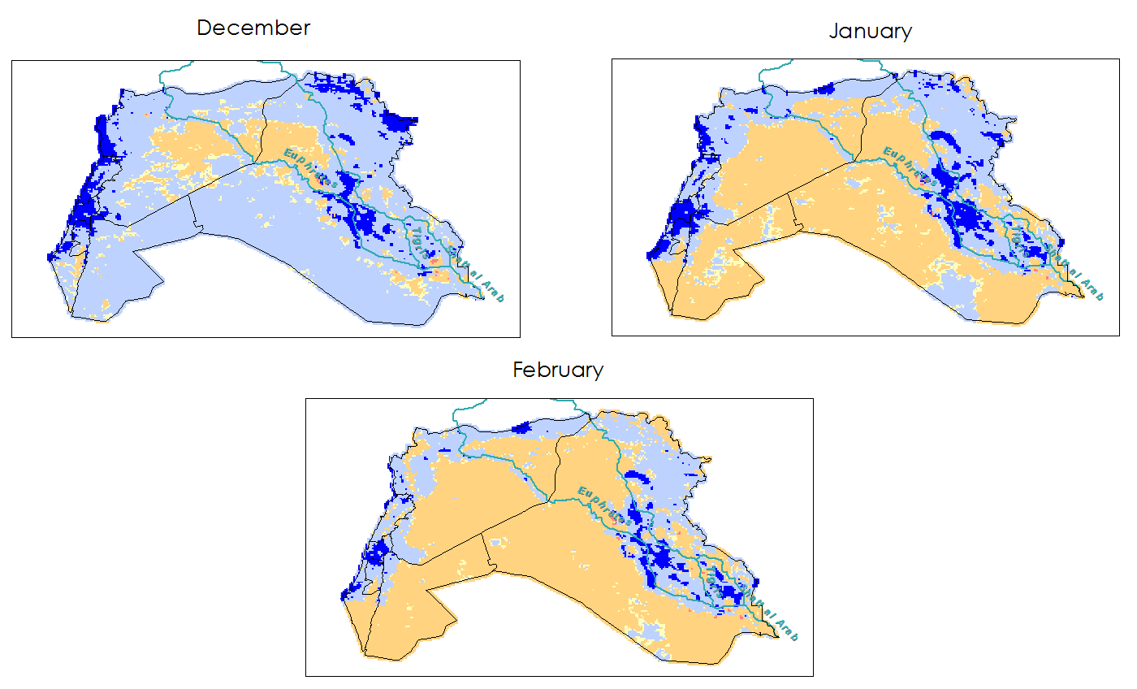
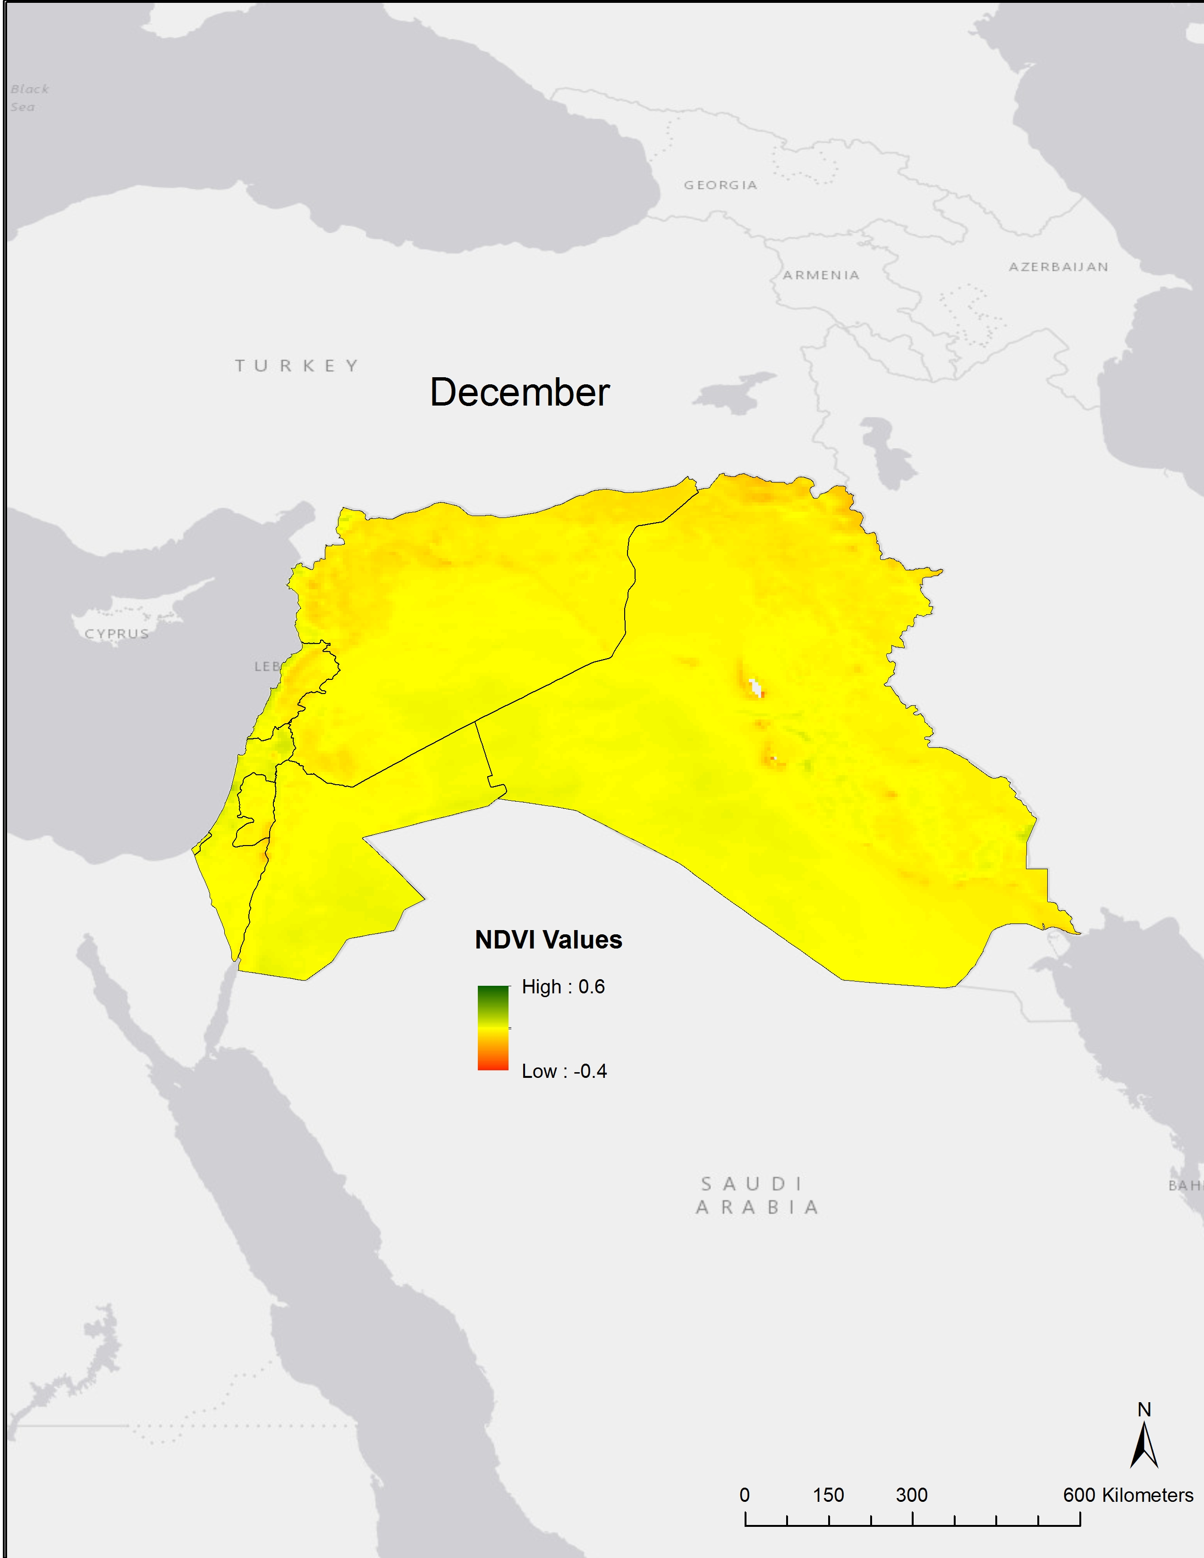
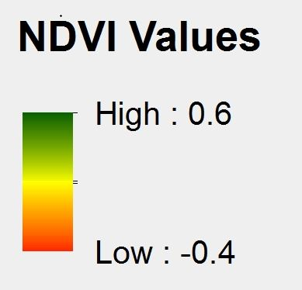
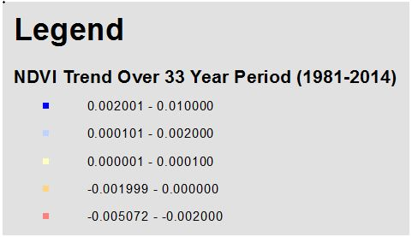
Levant Rainy Season
Slight Increase
Minimal Increase
Minimal Decrease
Slight Decrease
NDVI Winter Trends from 1981-2014
December 33-year Average NDVI
Notes:
Image Source: Made by team
-The Levant region saw a lower range of NDVI trends than did Central America. However, some regional patterns were evident. For example, the northern border and western, Mediterranean coast saw largest trend changes throughout the year. Most of the region is experiencing slightly decreasing trends through most of the year with larger decreases evident in the marshes of Southeastern Iraq (results to be expected)
-The maps show the trends for the winter season in the Levant: the rainy season for Lebanon, Syria, Jordan, Iraq, and Israel.
-The most widespread, positive NDVI trends can be seen during these seasons. Especially along the coast, Northeast Iraq, and between the Tigris and Euphrates. The positive trend in the middle of Iraq is showing the most consistent NDVI increases during the rainy season – up to 0.002 per year or about 0.3, which is a large change in NDVI.
-Although December is the only month that shows a majority positive trend throughout the region, most of the trends are minimal. (*after slide transition)
-The NDVI average for December looks like this. So, obviously there isn’t a lot of vegetative activity going on at the beginning of the rainy season. However, the trends tell us that December may be getting a tiny bit more green than it has been.

Slide 21
Conclusions
Central America
NDVI matches precipitation
Strong El Niño
El Salvador low NDVI – Increasing trends
Linear Trends regional/seasonal changes
The Levant
NDVI matches Precipitation
2007-2010 drought impacts
Slight decreasing trends
Notes:
Central America:
Saw a significant difference in NDVI values during the rainy season in Central America – NDVI lines up as expected with precip.
Most of the agricultural regions had the highest NDVI values during the rainy season but saw the largest range during off months
Saw a significant increase in NDVI values during the strong ENSO event in 1997-1998. The largest change was seen in El Salvador. This country had the most extreme of both high and low values
El Salvador had the lowest NDVI values consistently, but showed the most consistent positive trends throughout the year
There was a wide range in linear NDVI trends. The Southwestern portion of the region showed the most frequent positive trends, however positive and negative trends changed regionally throughout the seasons (could be due to “noisey” data).
The Levant
The Levant only had 3 of the 5 NDVI signatures present while all were present in Central America demonstrating the aridity of the Levant.
NDVI correlated with the major drought event between 2007-2010 – dramatically identifying the worst drought year, 2008.
Linear trends showed an slight decrease in NDVI trends over a vast majority of the region – except for the Mediterranean coast (especially the Syrian coast.) A wide range of positive and negative NDVI trends could be seen in the marshes of Iraq, Israel, and between regions of Syria.

Slide 22
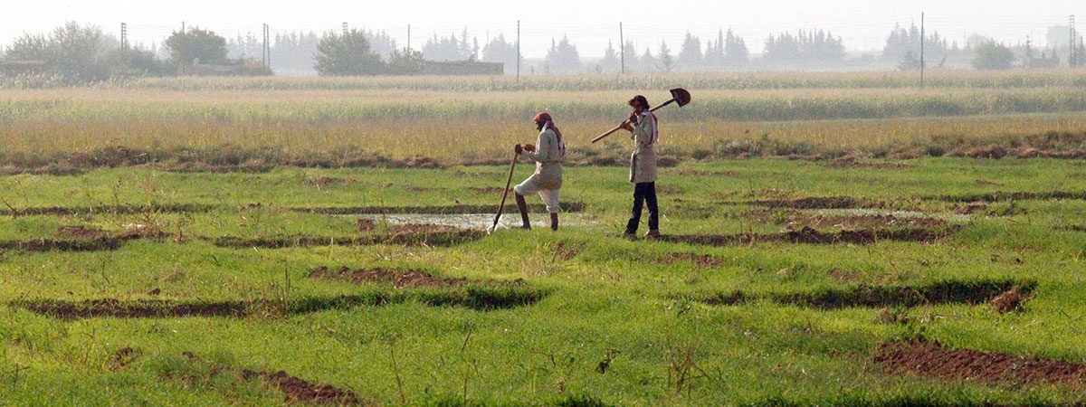
Future Plans
Near-real time NDVI tool
Land Use Change: desertification
Growing degree days
Evapotranspiration (ET) and Evaporative Stress Index (ESI)
Ground water
Image Credit: Nour Fourat
Notes:
Image Source: http://modernfarmer.com/2014/09/food-war-syria/
-The next project will take the analyses that we did and create a near-real time tool for the 14th Weather Squadron to integrate updated data into their drought monitor.
-The 14th Weather squadron is also interested in a closer look at land use change-particularly desertification
-Growing degree days: relevant for Certain crops, removing temperature distortion of NDVI anomalies, and Levant
-Other variables could be analyzed for our partners including evapotranspiration or the evaporative stress index and ground water. These variables could be combined with our NDVI research as well as their current drought monitor.
-GDD
(temperature measurement)
Measure heat accumulation to predict plant development rates
(Tmax + Tmin)/2 - Tbase (There is a base temperature at which the organisms won’t grow or will grow slowly.
Would be very applicable to agriculture
A way to eliminate temperature from distorting NDVI data
- ESI is based on the ratio of actual to potential ET; identifies areas of anomalous crop water use in agricultural areas; can serve as an indicator of declining vegetative health (based on reduced transpiration rates)
ESI product from NASA GOES satellite
- Land cover, land use using Landsat

Slide 23

Advisors
Dr. DeWayne Cecil, NOAA NCEI
Partners
US Air Force, 14th Weather Squadron
POC: Major Ryan Harris
Raymond Kiess
David Ramsaur
Ryan Smith
Jeremy Anthony
Others
Jessica Sutton, Center Lead, NASA DEVELOP, NCEI
Emma Baghel, Assistant Center Lead, NASA DEVELOP, NCEI

Slide 24
References
Becker, Emily. 2015. September 2015 El Niño Update and Q&A. National
Oceanic and Atmospheric Administration, https://www.climate.gov/news-features/blogs/enso/september- 2015-el-ni%C3%B1o-update-and-qa.
Gleick, Peter. 2014. Water, Drought, Climate Change and Conflict in
Syria. American Meteorological Society, 6, 331-340.
Gourmelon, Gaelle. 2015. Who Will Pay for Central America’s Climate
Change Losses? Worldwatch Institute. http://blogs.worldwatch.org/who-will-pay-for-central-americas-
climate-change-losses/.
Kaniewski, David, Van Campo, Elise, and Weiss, Harvey. 2011. Drought is
a recurring challenge in the Middle East. PNAS, 109 (10), 3862- 3867.
Kelley, Colin. et al. 2014. Climate change in the Fertile Crescent and
implications of the recent Syrian drought. PNAS, 112 (11), 3241- 3246.

Slide 25
References
Maddocks, Andrew, Young, Samuel and Reig, Paul. 2015 Ranking the
World’s Most Water-Stressed Countries in 2040. World Resources Institute. http://www.wri.org/blog/2015/08/ranking- world%E2%80%99s-most-water-stressed-countries-2040.
Maregno, Jose et al. 2014. Climate Change in Central and South
America: Recent Trends, Future Projections, and Impacts on Regional Agriculture. International Center for Tropical Agriculture, 73, 1- 93.
Martinez, Stephanie. 2016. The Disproportionate Consequences of
Climate Change.
National Center for Disaster Preparedness NDCP Earth
Institute|Columbia University. http://ncdp.columbia.edu/ncdp-perspectives/the- disproportionate-consequences-of-climate-change/
Maurer, E. P., Adam, J.C. and Wood, A. W. 2009. Climate model
based consensus on the hydrologic impacts of climate change to the Rio Lempa basin of Central America. Hydrology and Earth System Science, 13, 183-194.

Slide 26
References
Vidal, John. 2015. Middle East faces water shortages for the
next 25 year, study says. The Guardian Magazine. http://www.theguardian.com/environment/2015/aug/2 7/midd le-east-faces-water-shortages-for-the-next-25- years-study-says.
Watson, Kate. 2015. Guatemala families struggle for food in
Central American drought. BBC News. http://www.bbc.com/news/world-latin-america- 34416771.
The State of Food Insecurity in the World 2015. Food and
Agriculture Organization of the United Nations. http://www.fao.org/hunger/en/.

Slide 27
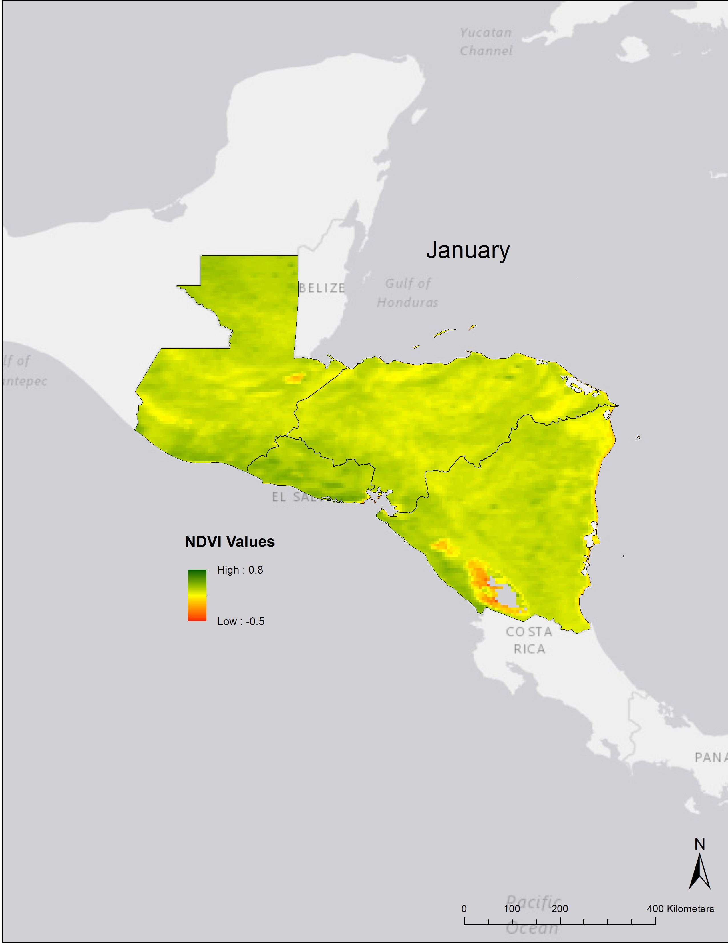
Central
America
Baseline Climatologies
1981 - 2014

Slide 28
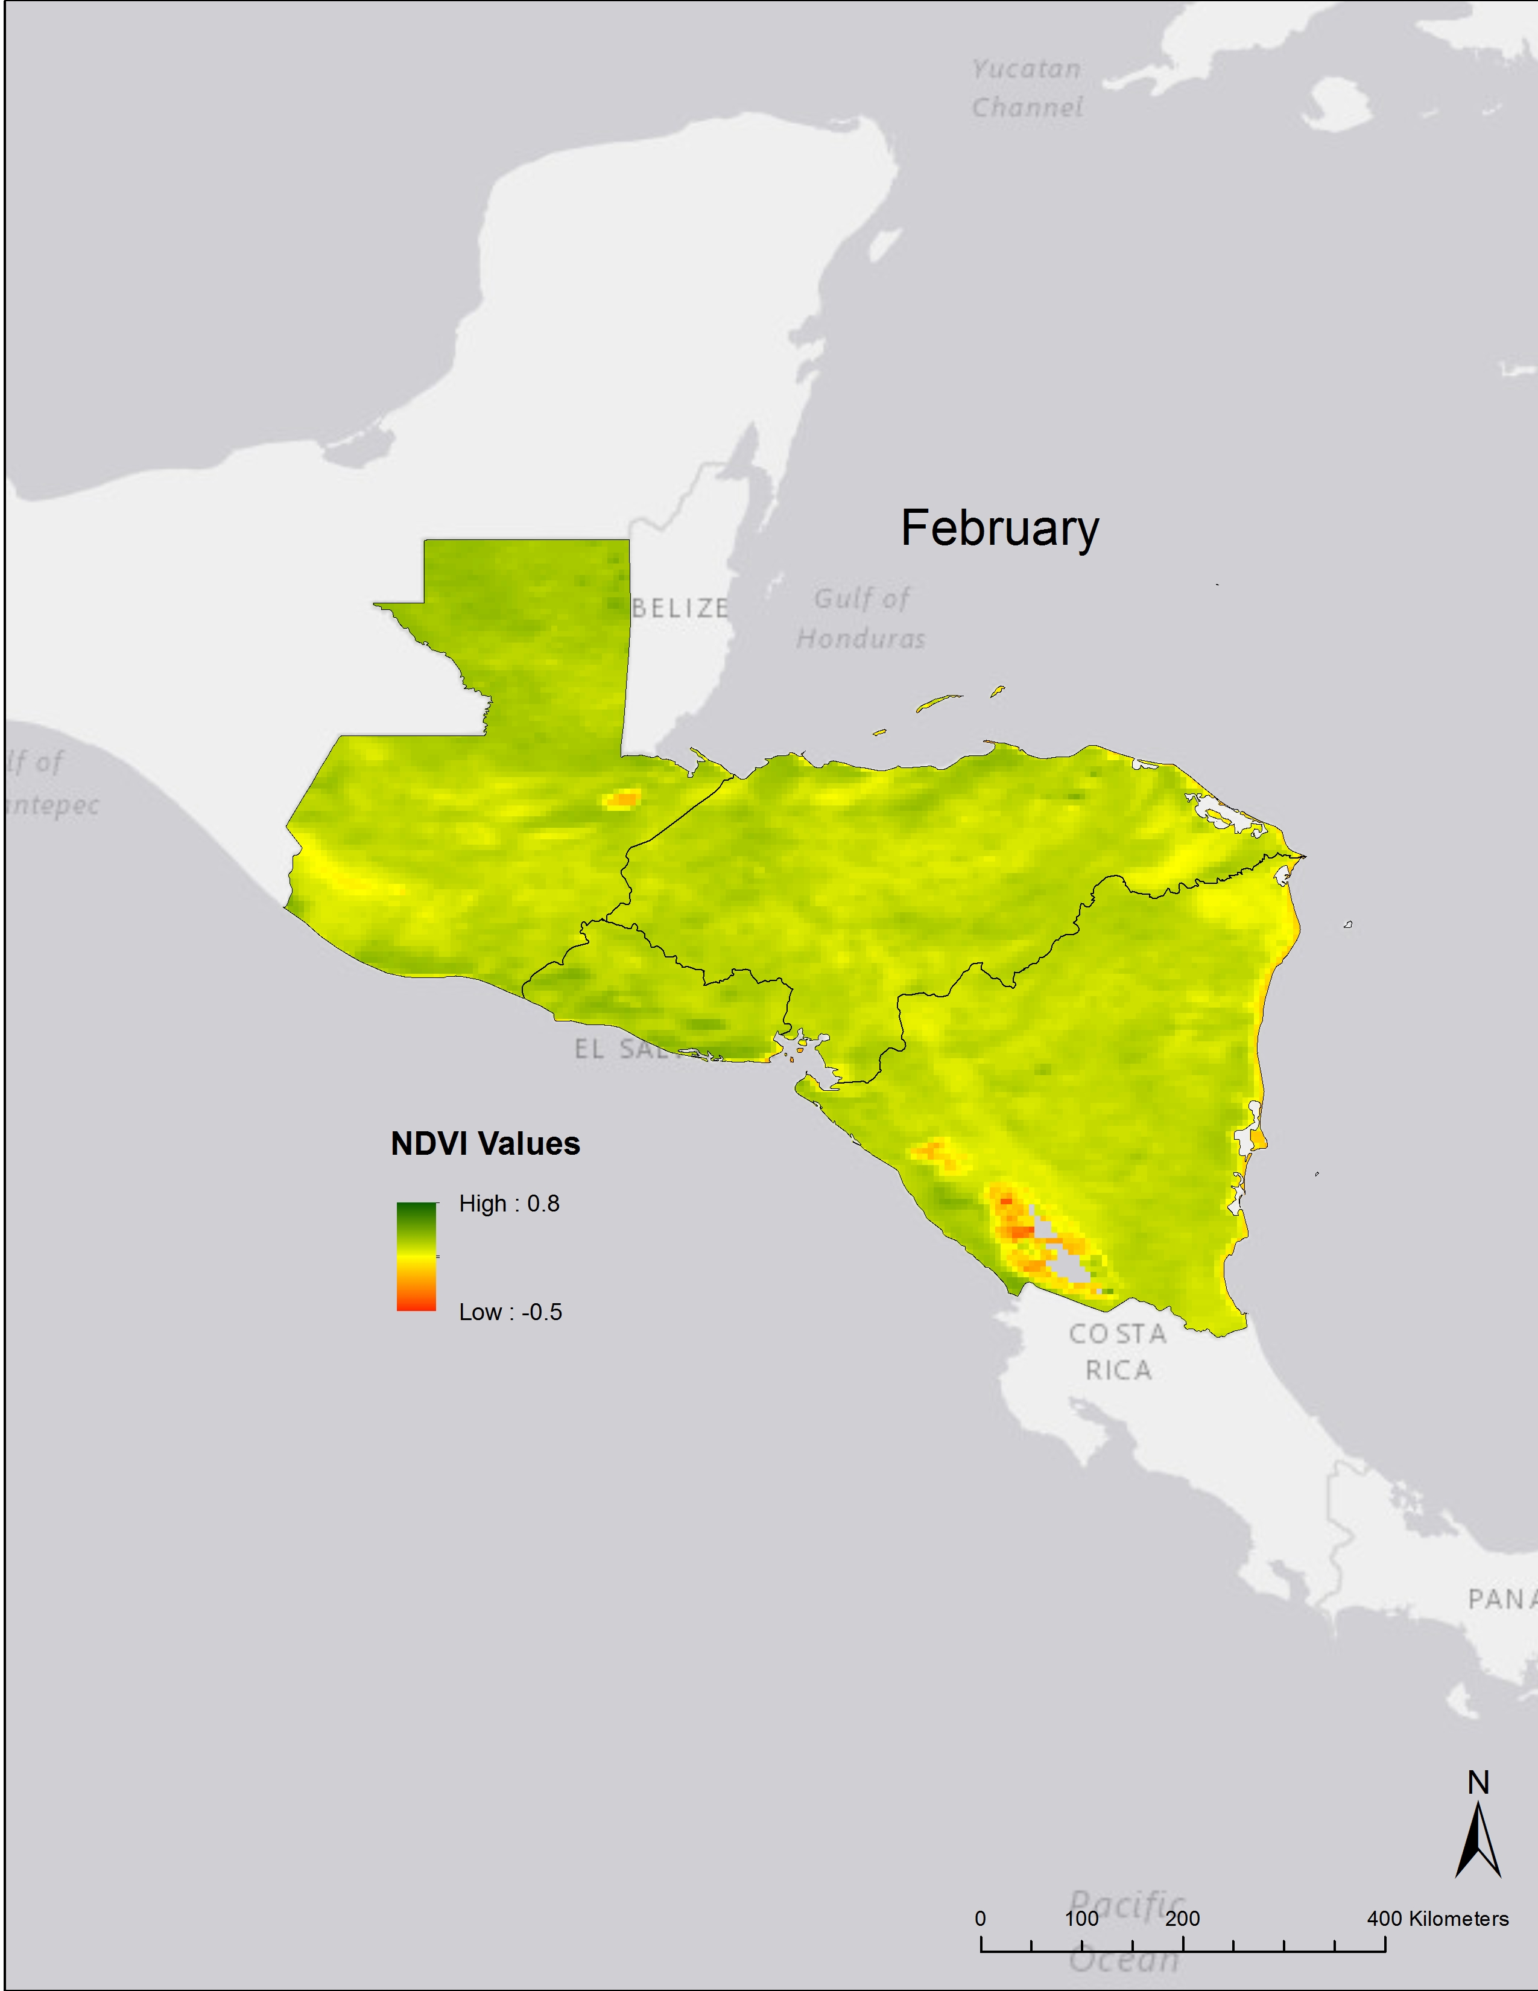

Slide 29
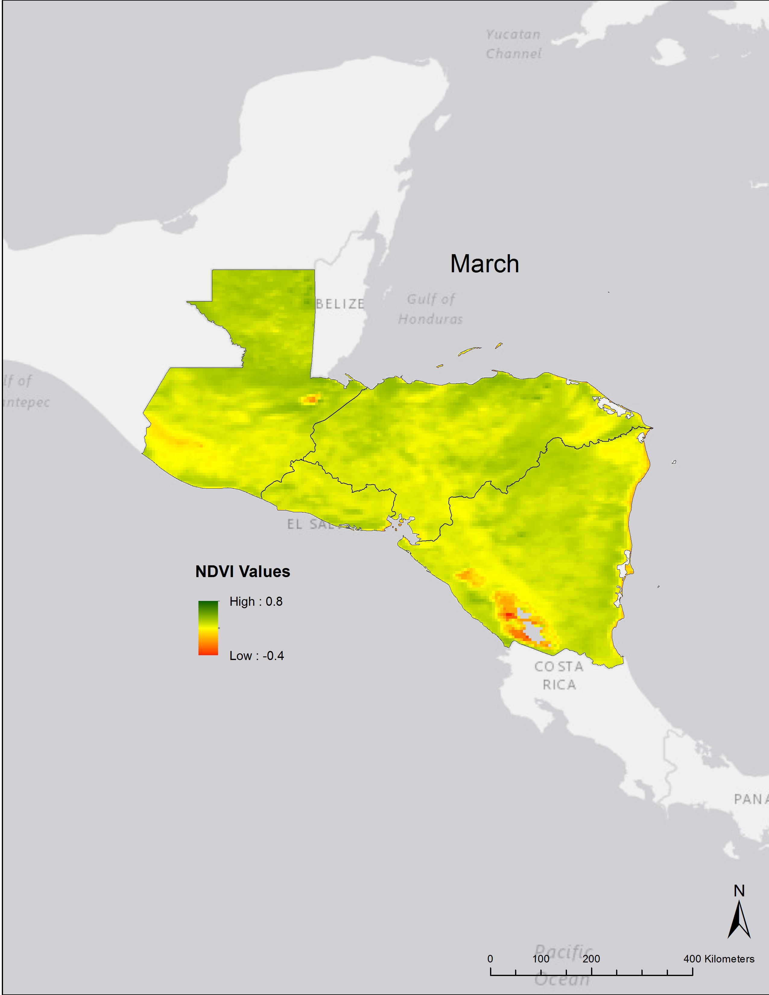

Slide 30
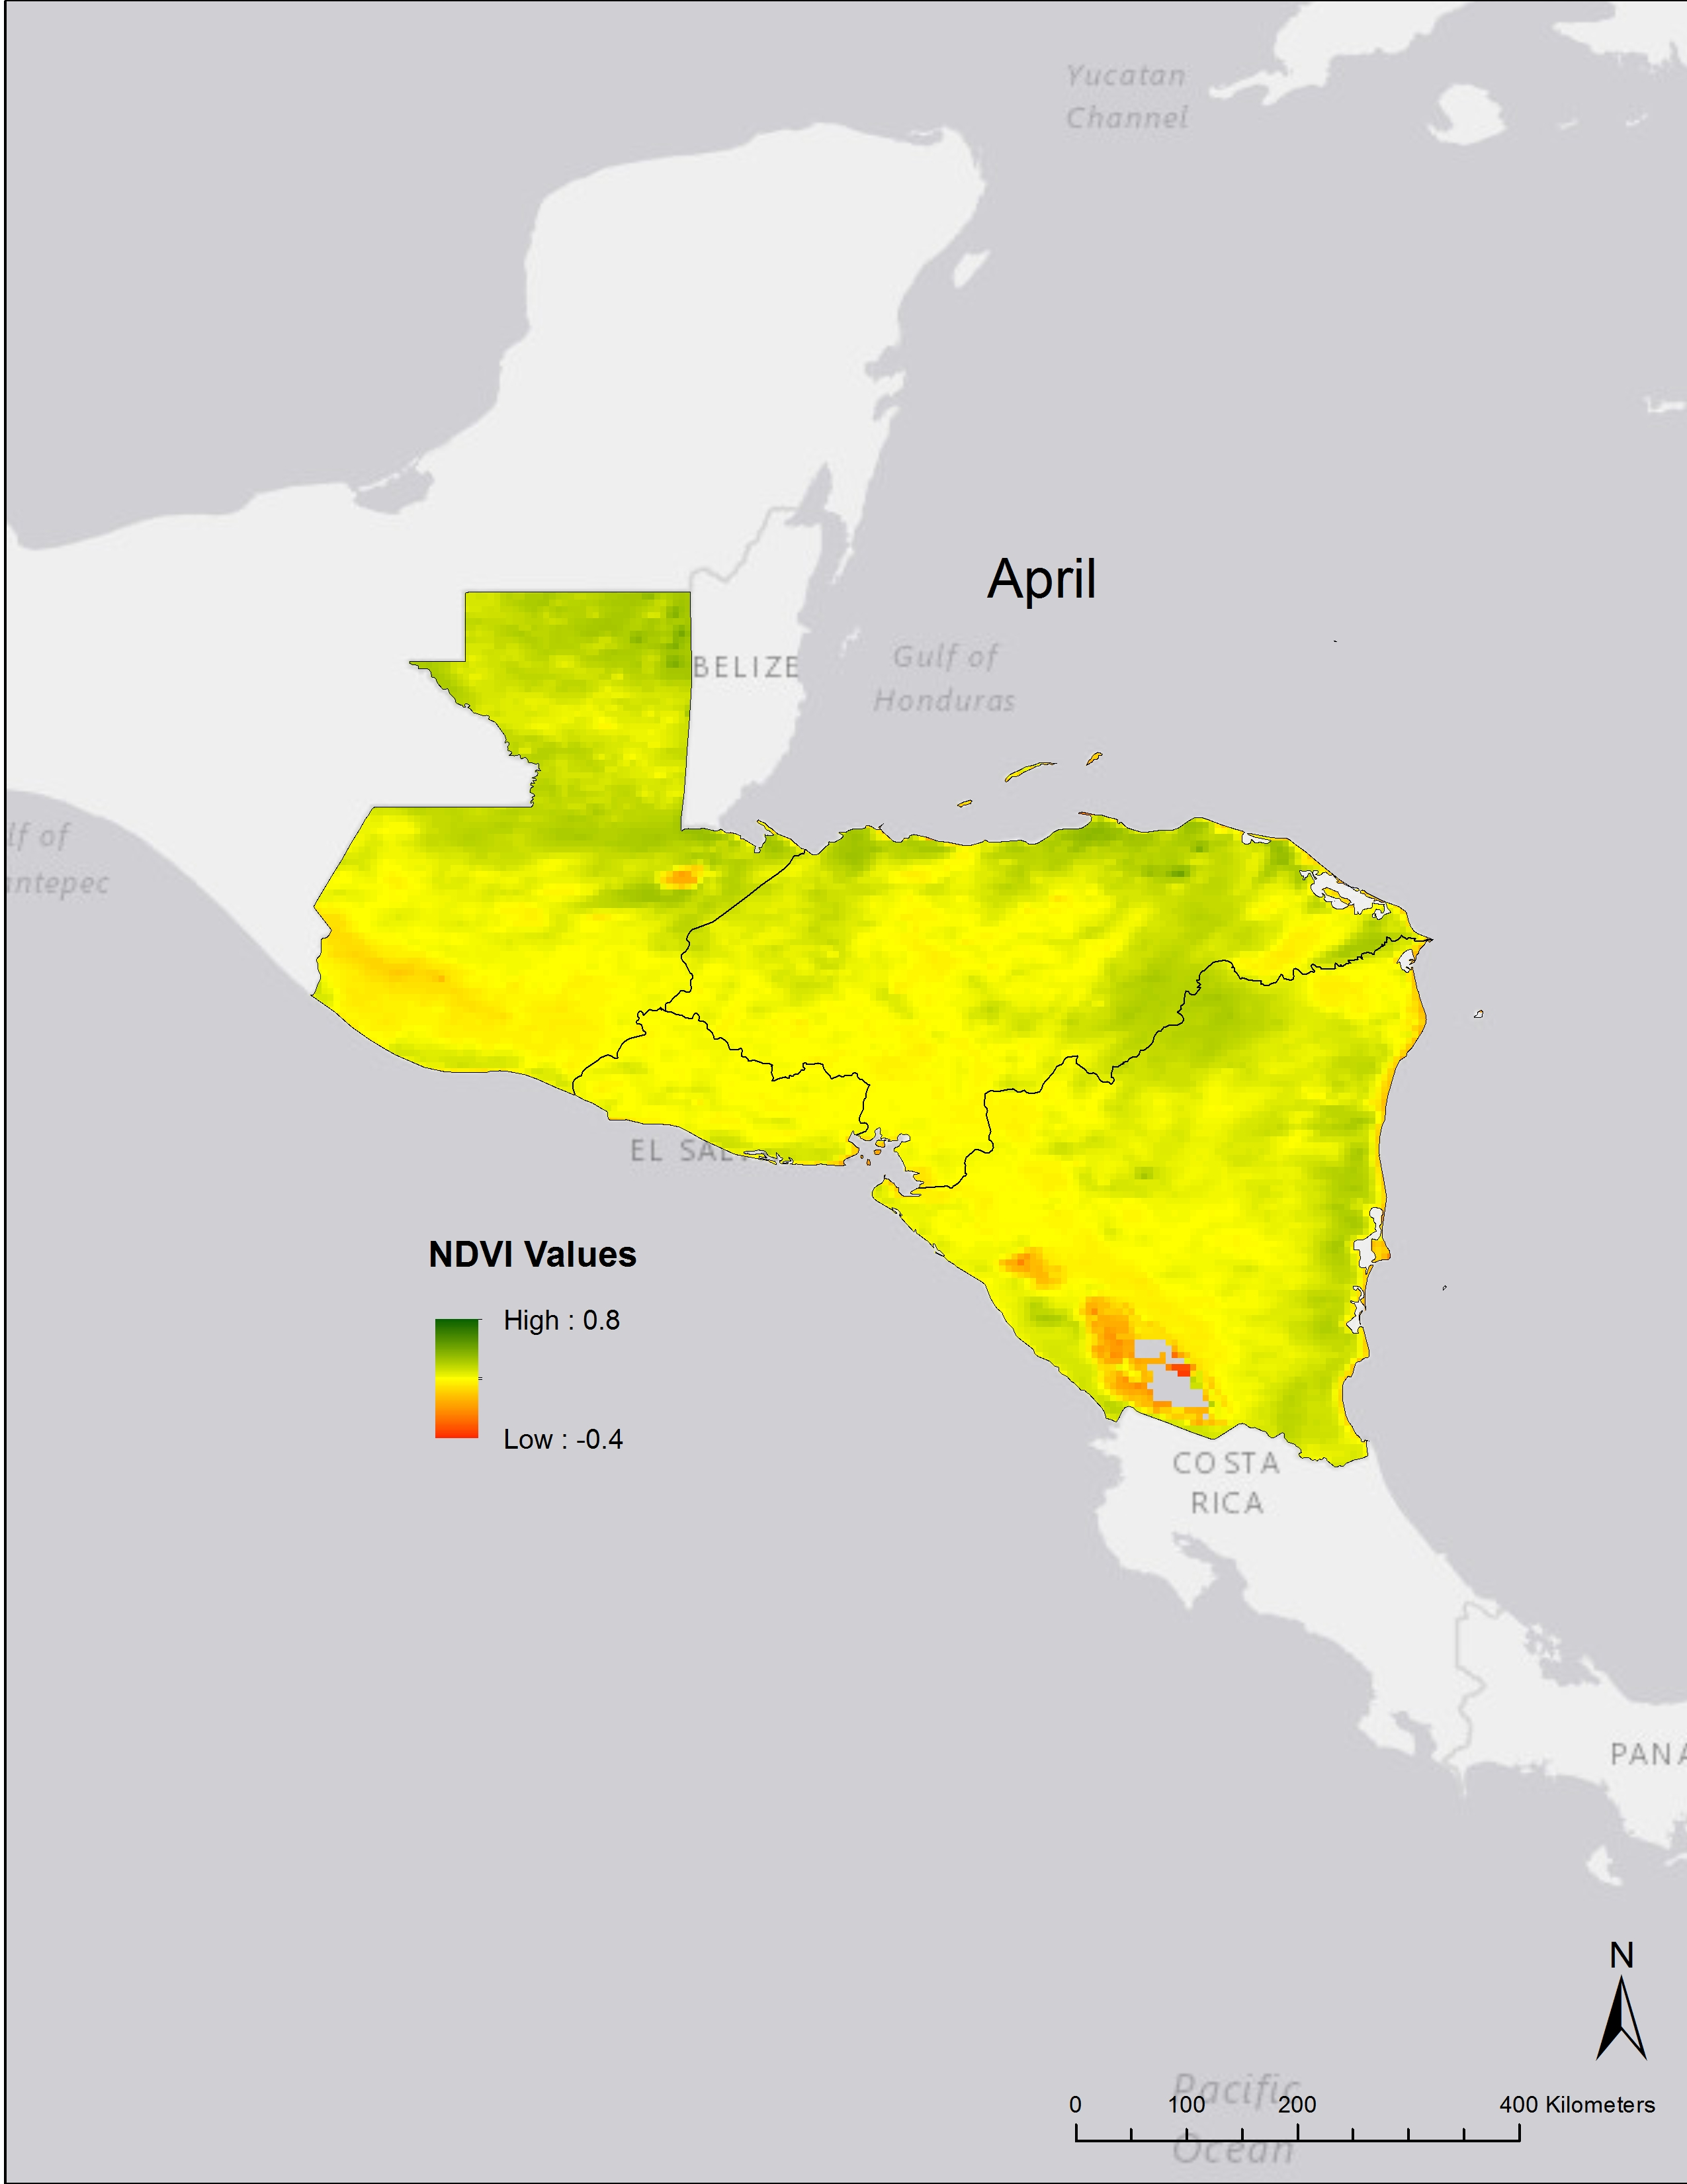

Slide 31
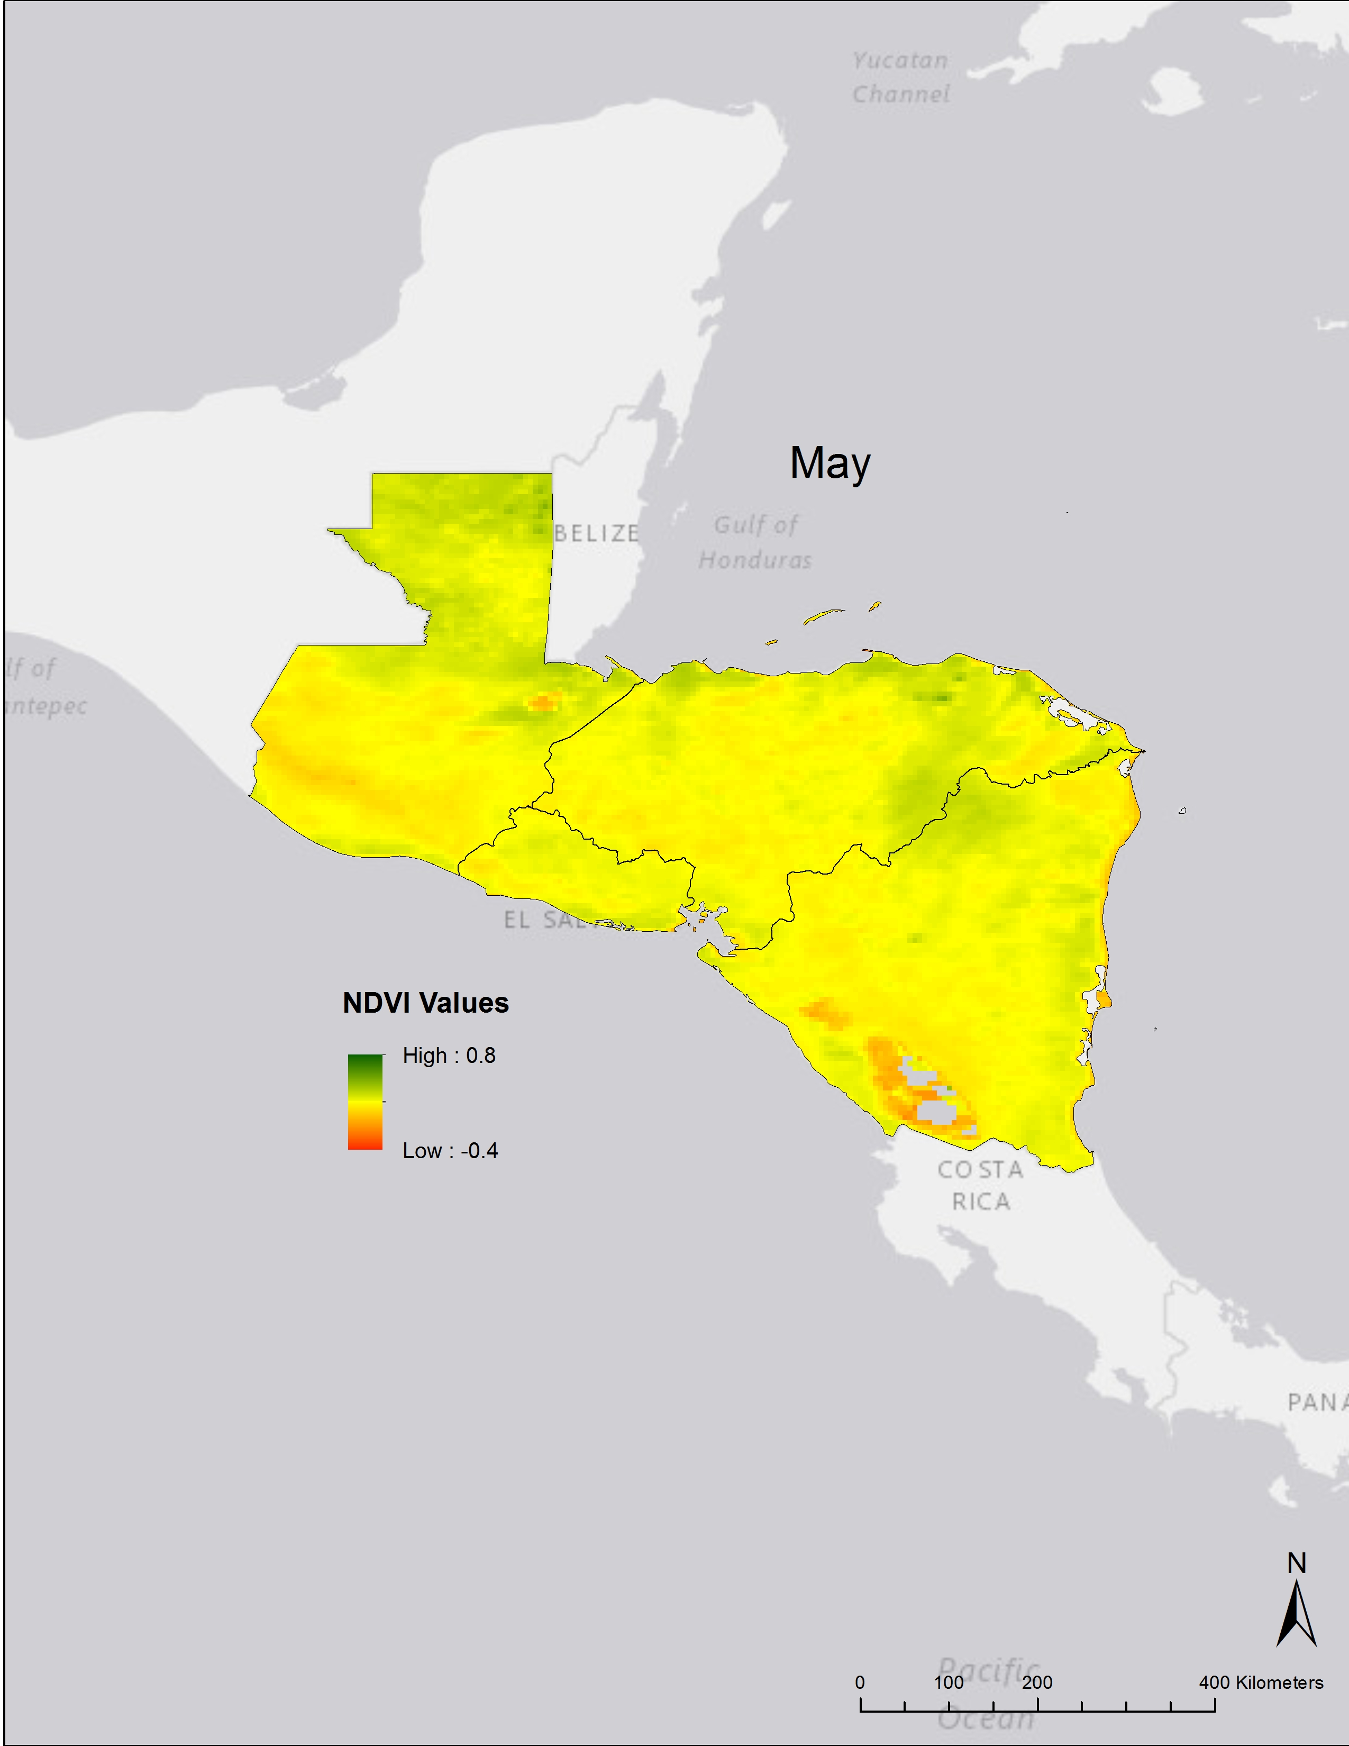

Slide 32
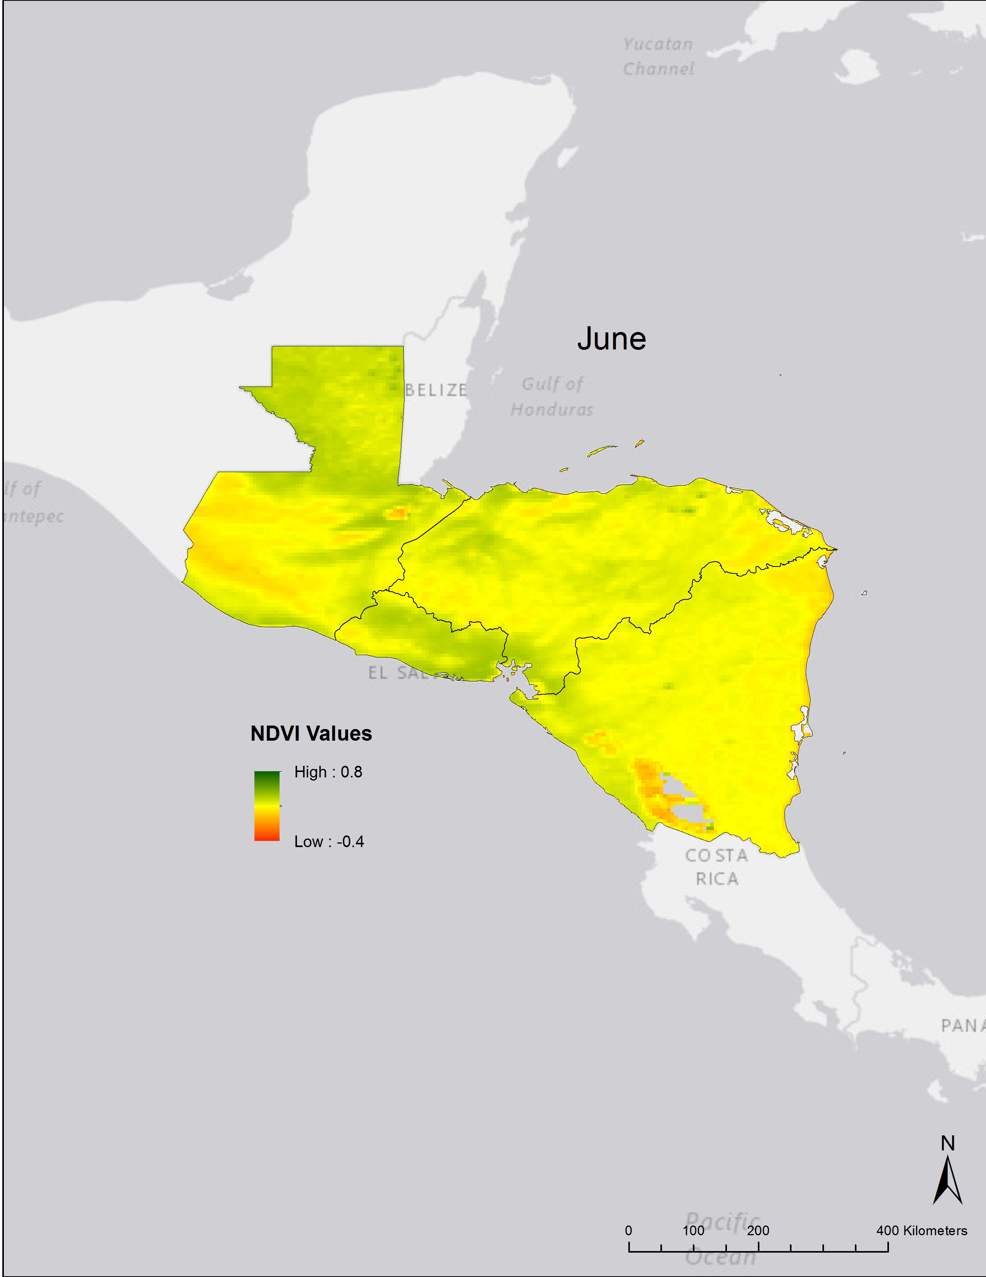

Slide 33
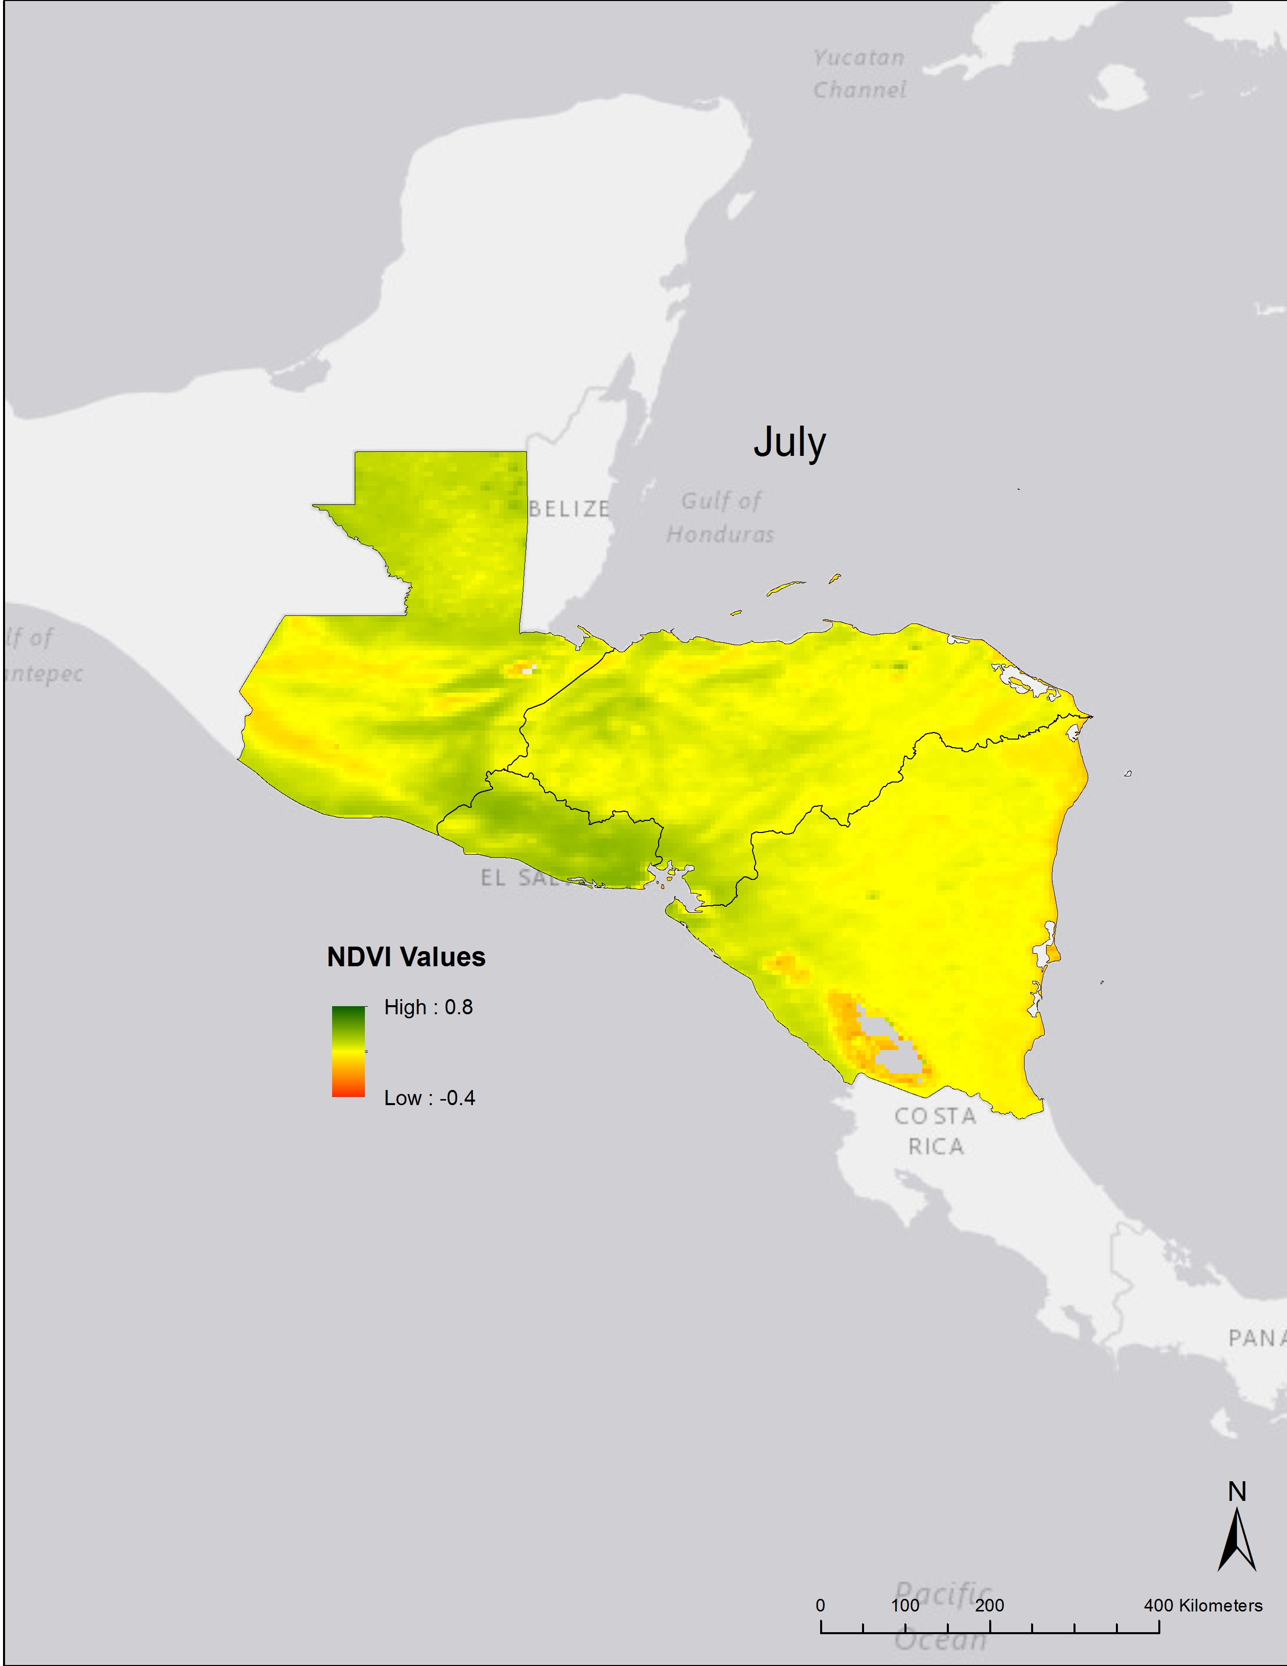

Slide 35
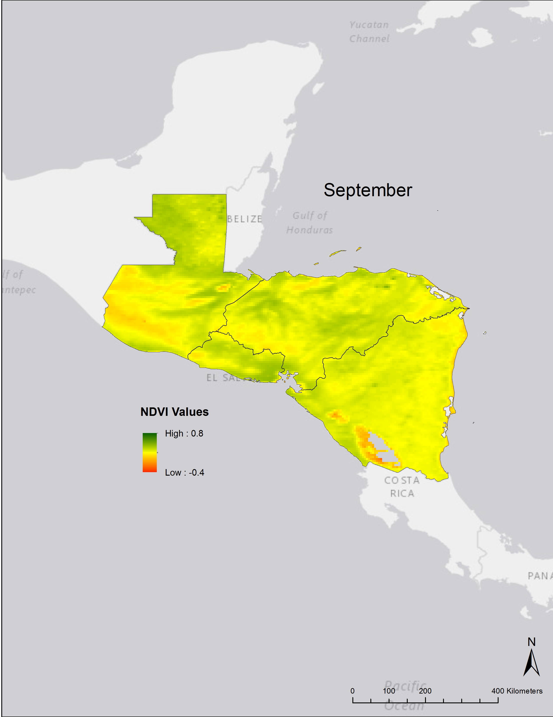

Slide 36


Slide 37
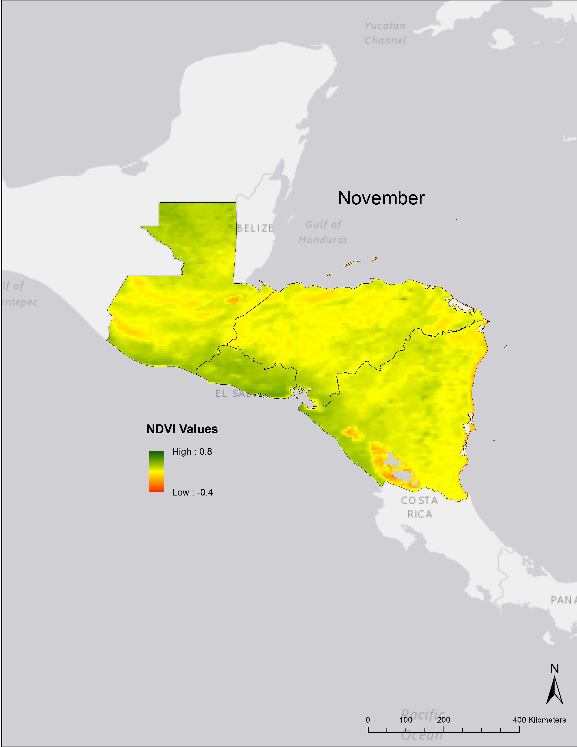

Slide 38
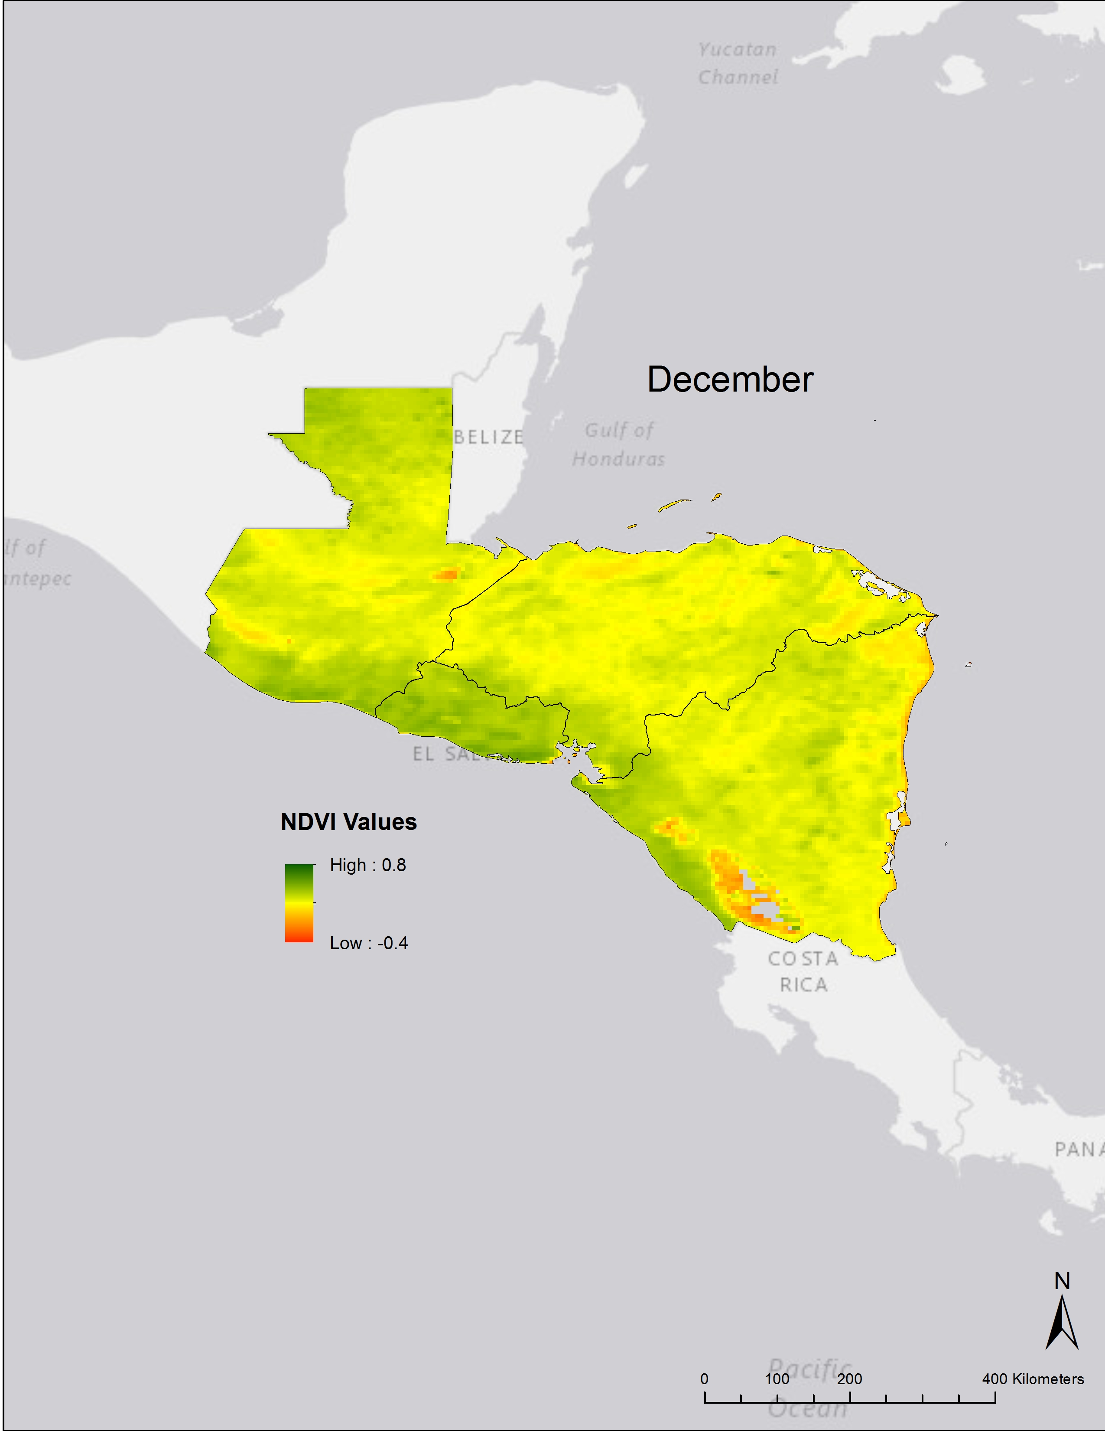

Slide 39
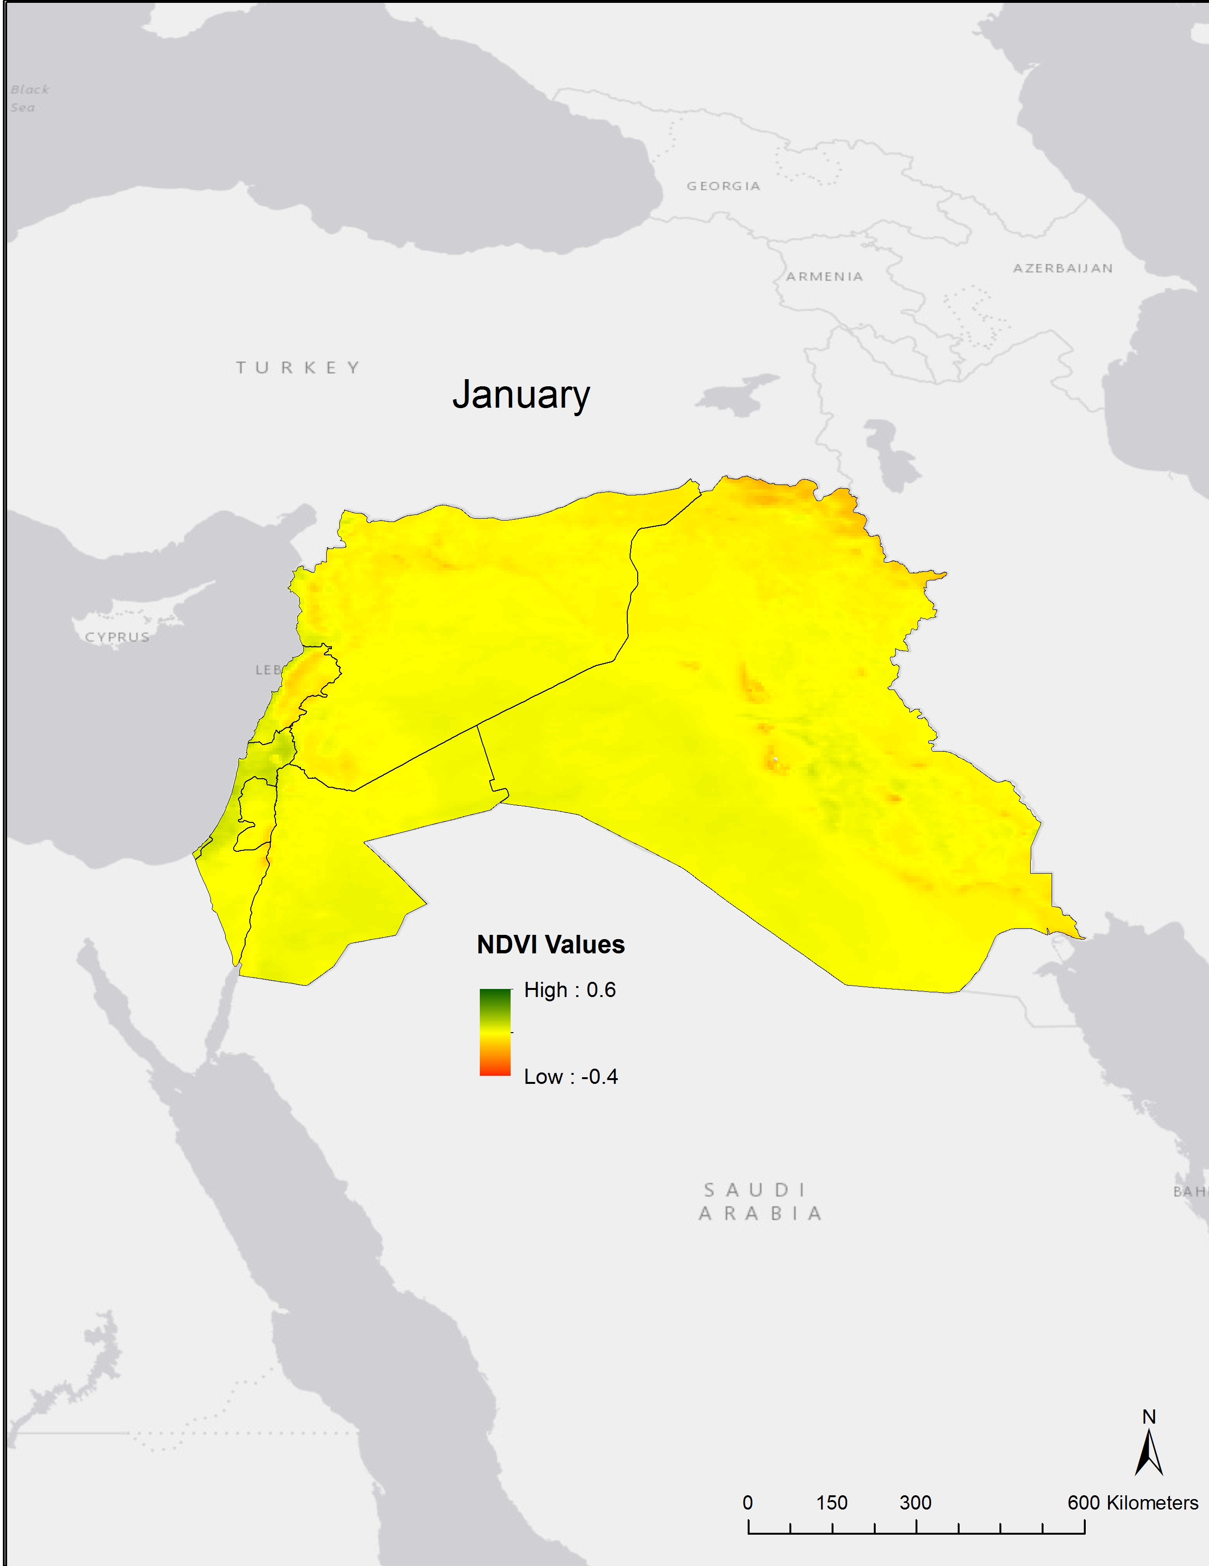
Levant
Baseline Climatologies
1981 - 2014

Slide 40
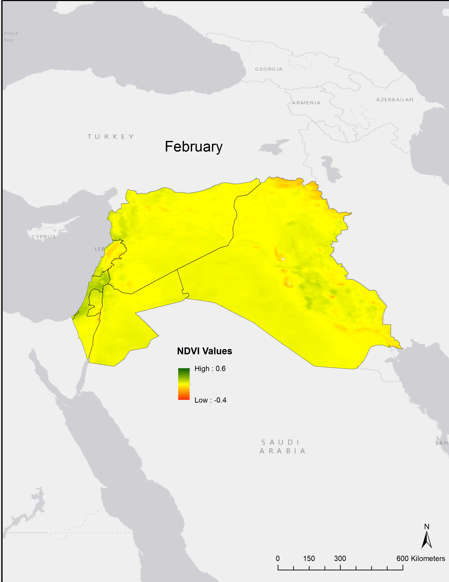

Slide 41
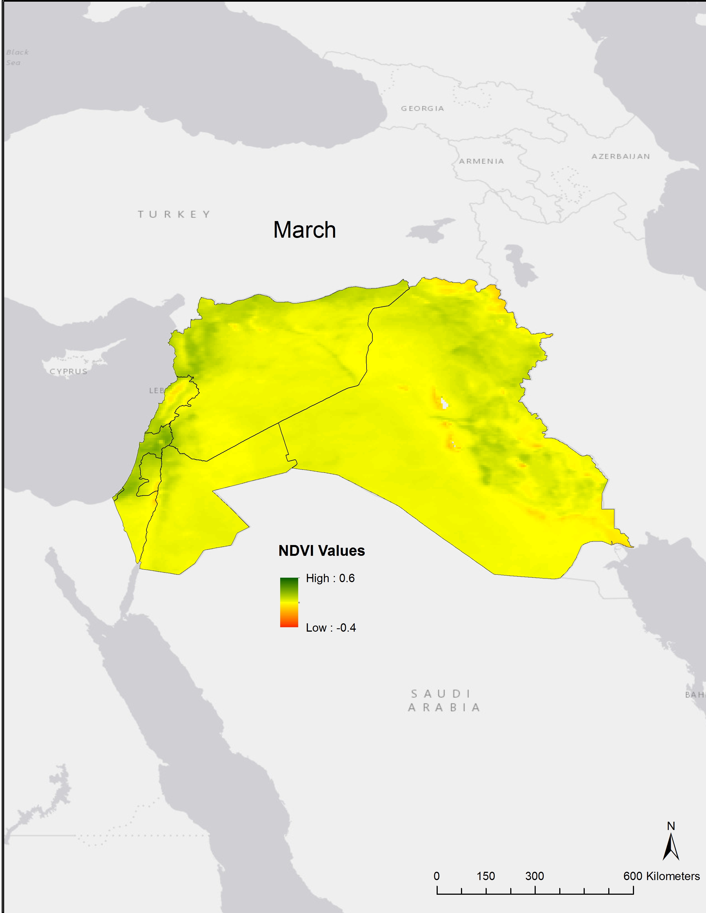

Slide 42
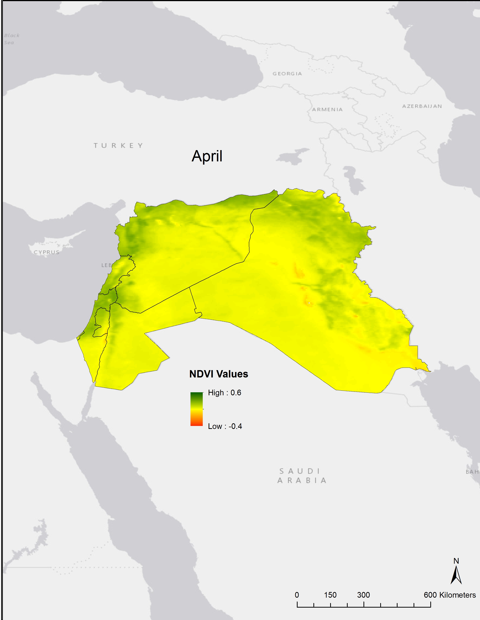

Slide 43
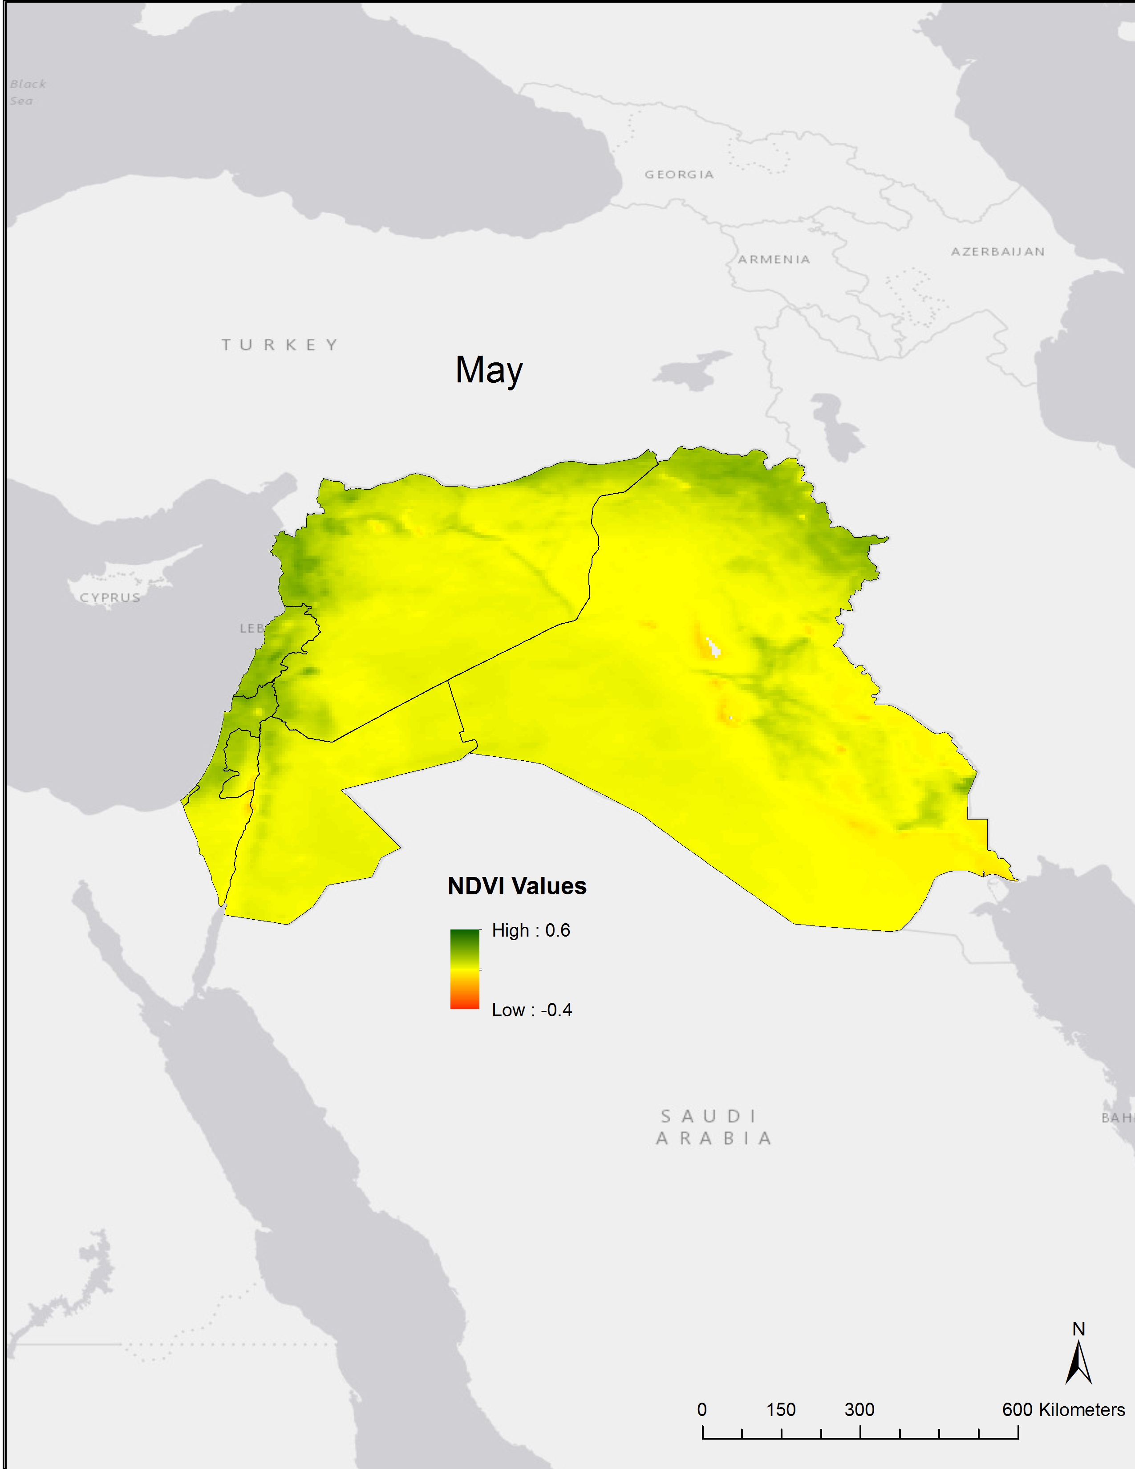

Slide 44


Slide 45


Slide 46


Slide 47


Slide 48


Slide 49


Slide 51

High vs. Low Vegetation
Category | NDVI Values
High | 0.2 to 1
Low | -1 to 0.2
Wet
Dry

Slide 52

High vs. Low Vegetation
Category | NDVI Values
High | 0.2 to 1
Low | -1 to 0.2
Wet
Dry

Slide 53

January – December 1997 Central America

Slide 54

January – December 1998 Central America

Slide 55

2008 Drought Levant

Slide 56

Central America Seasonal Trend Maps
NDVI Winter Trends from 1981-2014
December
January
February

Slide 57

Central America Seasonal Trend Maps
NDVI Spring Trends from 1981-2014
March
April
May

Slide 58

Central America Seasonal Trend Maps
NDVI Summer Trends from 1981-2014
June
July
August

Slide 59

Central America Seasonal Trend Maps
NDVI Autumn Trends from 1981-2014
September
October
November

Slide 60

Levant Seasonal Trend Maps
NDVI Winter Trends from 1981-2014
December
January
February

Slide 61

Levant Seasonal Trend Maps
NDVI Spring Trends from 1981-2014
March
April
May

Slide 62

Levant Seasonal Trend Maps
NDVI Summer Trends from 1981-2014
June
July
August

Slide 63

Levant Seasonal Trend Maps
NDVI Autumn Trends from 1981-2014
September
October
November

