Slide 1
Southwest US Disasters
Incorporating CDRs and MODIS to Create a Predictive Model of Post-Burnout Vegetation Regrowth in Relation to Flood Risk
Jason Zylberman (Project Lead)
Jennifer Holder
Lance Watkins

Slide 2
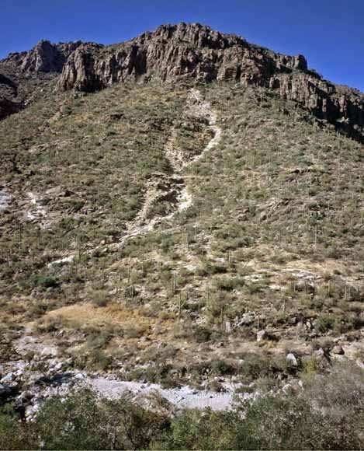
Introduction Data Methods Results Limitations Future Work Conclusions
Objectives
1
Record post-wildfire vegetation response
Identify post-wildfire precipitation thresholds
Establish spatio-temporal relationship between vegetation and precipitation
2
3
Image Credit: USGS
Notes:
Image Source: http://pubs.usgs.gov/of/2008/1274/images/coverphoto.jpg

Slide 3
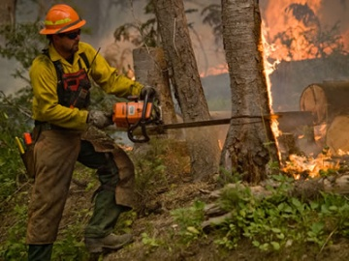
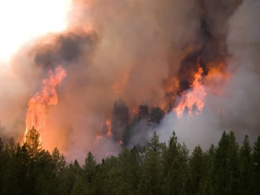
Introduction Data Methods Results Limitations Future Work Conclusions
Community Concerns
Wildfires and flooding cause economic damage and loss of life in the Southwest
Flood events lead to increased soil erosion and larger debris
“Remote Sensing capabilities are an important tool for situational awareness to understand extent of wildfires in both the wildland urban interface and remote and rugged terrains.”
- USGS Southwest Region Wildfire Science Plan, p1
Image Credits: US Forest Services
Notes:
Image Source: http://www.fs.fed.us/managing-land/fire

Slide 4
Introduction Data Methods Results Limitations Future Work Conclusions
Study Area

Slide 5
Introduction Data Methods Results Limitations Future Work Conclusions
NOAA Climate Data Records
PERSIANN - Precipitation Estimation From Remote Sensing Information Using Artificial Neural Network
Specifications:
0.25 deg * 0.25 deg
Daily Product
Notes:
Image Source: Derived from PERSIANN data in ArcMap

Slide 6
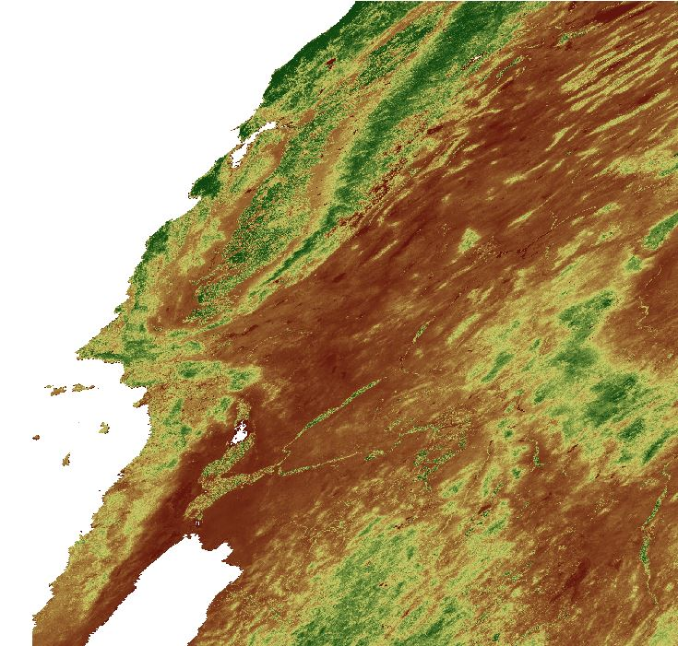
Introduction Data Methods Results Limitations Future Work Conclusions
Terra MODIS NDVI
MODIS NDVI: Moderate Resolution Imaging Spectroradiometer Normalized Difference Vegetation Index
Consistent spatial and temporal comparisons of vegetation conditions
Notes:
Image Source: Derived from MODIS NDVI data in ArcMap

Slide 7
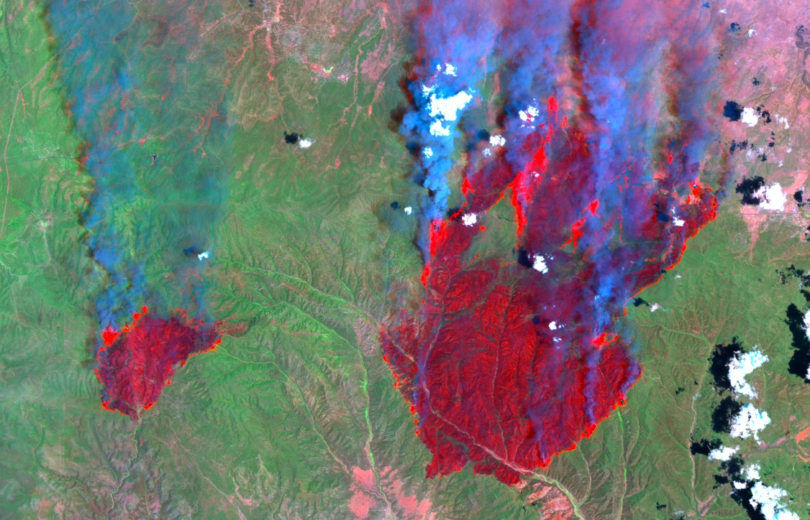
Introduction Data Methods Results Limitations Future Work Conclusions
BAER Data
USDA Forest Service Burned Area Emergency Response (BAER) Imagery Support
Burn severity product called the Burned Area Reflectance Classification (BARC)
differenced Normalized Burn Ratio (dNBR)
Image Credit: BAER Team
Notes:
Image Source: http://activefiremaps.fs.fed.us/baer/download/2002/rodeo_20020824_postfire_quicklook.jpg

Slide 8
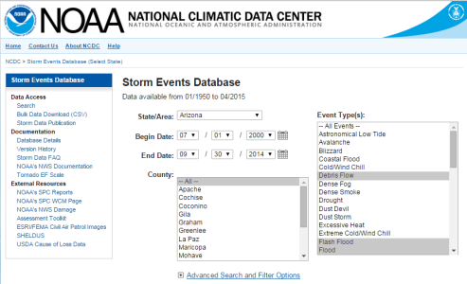
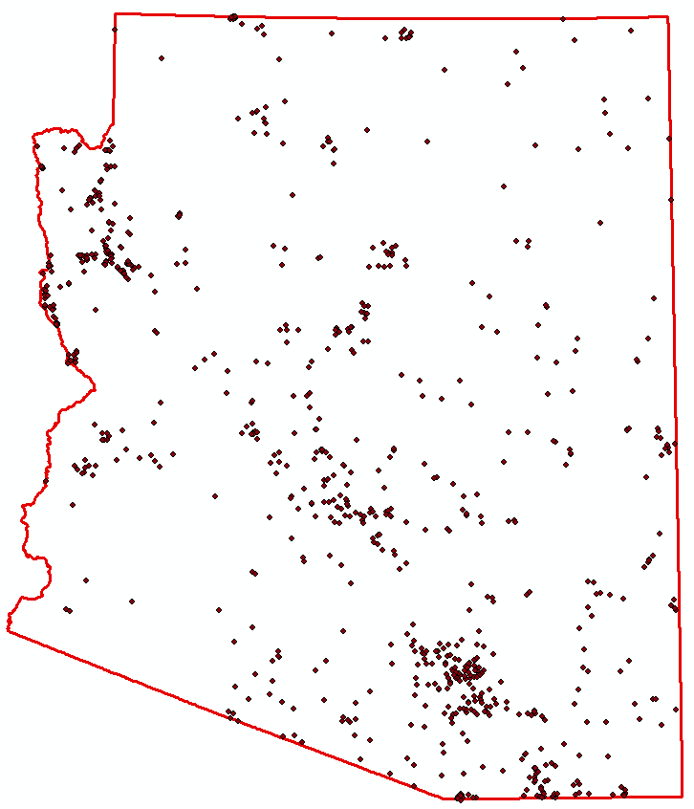
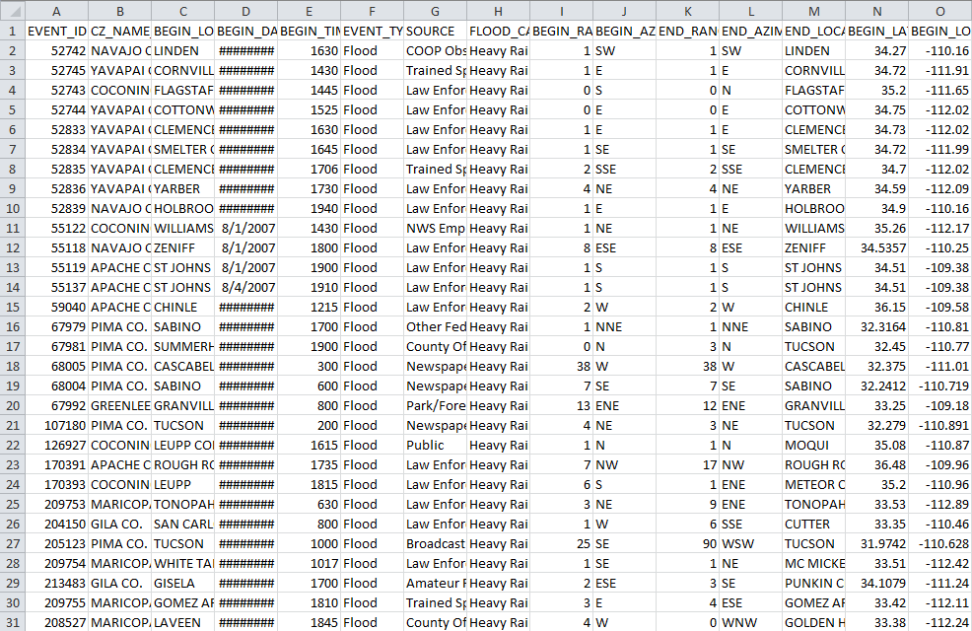
Introduction Data Methods Results Limitations Future Work Conclusions
NOAA Storm Events Database

Slide 9
Introduction Data Methods Results Limitations Future Work Conclusions
Spatial Methodology
Calculate monthly average NDVI for burned areas
Resample rasters to common resolution
MODIS NDVI
Identify relationships using a multivariate statistical regression
Aggregate data to monthly sums
Calculate normals and anomalies
Resample rasters to common resolution
PERSIANN precipitation
BARC burn severity maps
Associate flood records to fire events
Convert floods in study area to raster format
*Process was repeated for all three basins – Salt, Santa Cruz, and Little Colorado
Notes:
Pre-process satellite records (PERSIANN and MODIS), identify spatial extent, aggregate to temporal scale, run analysis

Slide 10
Introduction Data Methods Results Limitations Future Work Conclusions
Tabular Methodology
Calculate monthly average NDVI for burned areas
Generate raster statistics for monthly data
MODIS NDVI
Align NDVI, flood, and precipitation data to identify trends across variables each year after a wildfire
Calculate daily and monthly normals and anomalies for historical floods
Average daily values for each summer month
Generate raster statistics for raw data and anomalies
PERSIANN precipitation
BARC burn severity maps
Associate flood records to fire events
Use flood dates to determine
precipitation
*Tabular statistics were combined for all three basins
Notes:
Pre-process satellite records (PERSIANN and MODIS), identify spatial extent, aggregate to temporal scale, average spatial statistics to get a single summary statisitc, run analysis

Slide 11
Introduction Data Methods Results Limitations Future Work Conclusions
Data Alignment
Animation Credit: Jennifer Holder
MODIS NDVI and PERSIANN precipitation data, 2001-2014
Animation created in GRASS GIS
Notes:
Demonstrate how data was aligned

Slide 12
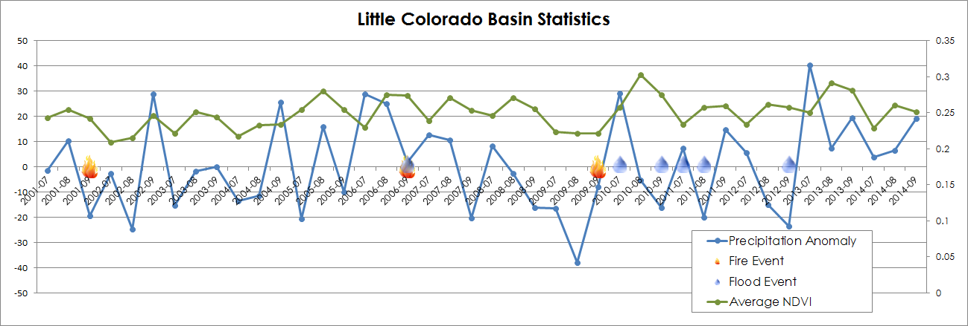
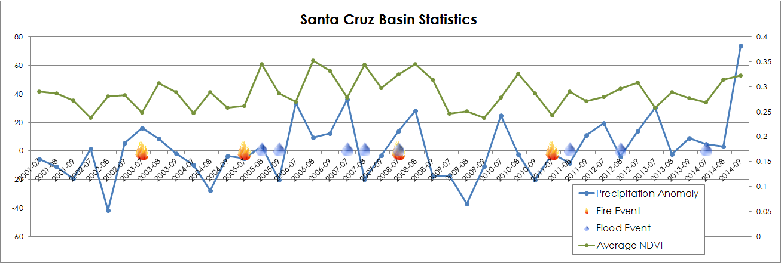
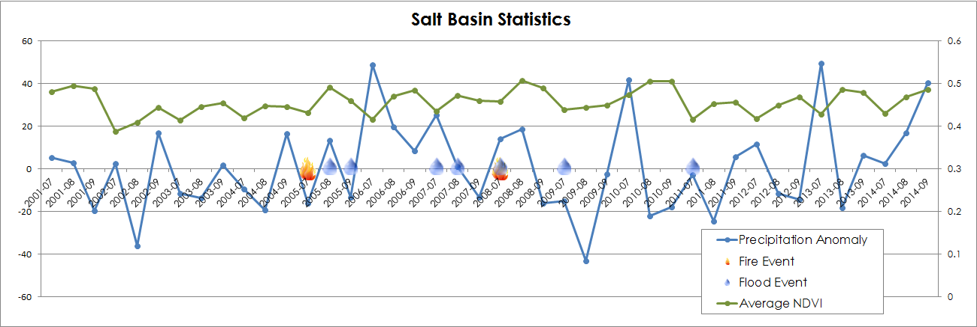
Introduction Data Methods Results Limitations Future Work Conclusions
Basin Statistics
Precipitation anomalies, average NDVI, fire events, and flood events were combined for each of the three study basins

Slide 13
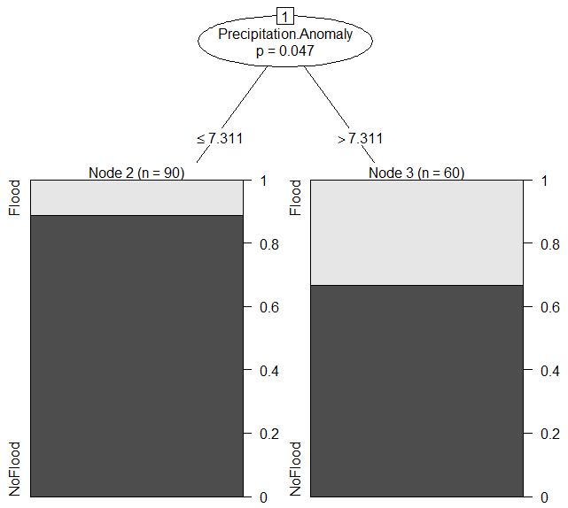
Introduction Data Methods Results Limitations Future Work Conclusions
Basin Statistics
Little Colorado Basin
Negative precipitation anomalies correlate to post-fire floods
Flood Event ~ Precipitation Anomaly + Average NDVI
 | Coefficient | Std. Error | Z-value | Pr(>|z|)
(Intercept) | 0.46966 | 1.88487 | 0.249 | 0.8032
Precipitation Anomaly | -0.02583 | 0.01173 | -2.202 | 0.0277 (0.01 significant )
Average NDVI | 1.93816 | 3.55814 | 0.545 | 0.5860
Generalized Linear Models (left) and Classification Trees (right) were calculated for each basin

Slide 14
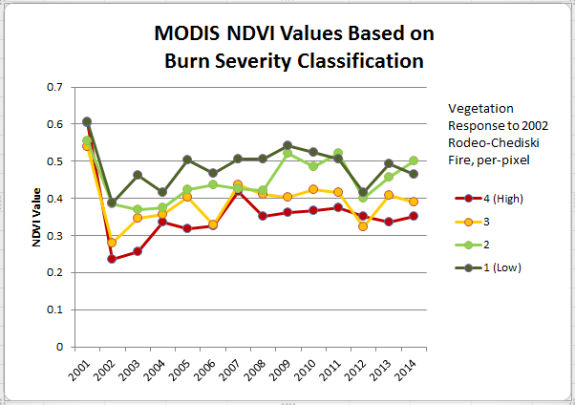
Introduction Data Methods Results Limitations Future Work Conclusions
NDVI Trends
Animation Credit: Jennifer Holder
Animation of NDVI Regrowth for Rodeo-Chediski Fire, 2001-2014
created in GRASS GIS
Notes:
More specifically looking at NDVI regrowth

Slide 15
Introduction Data Methods Results Limitations Future Work Conclusions
NDVI Trends
Vegetation response was calculated monthly for historical wildfire events

Slide 16
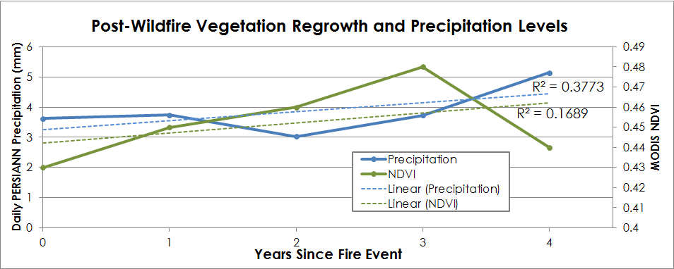
Introduction Data Methods Results Limitations Future Work Conclusions
Linear Trends
In general, a positive correlation is present between post-fire vegetation response and related flooding incidents

Slide 17
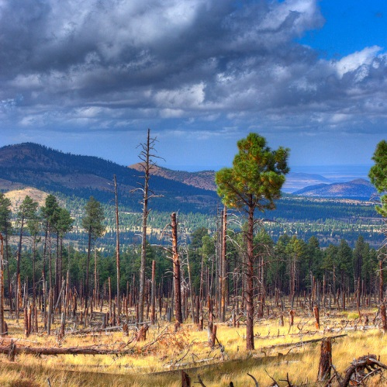
Introduction Data Methods Results Limitations Future Work Conclusions
Data Limitations
Flood Data:
Need more consistent, longer flood record indicating flood magnitude
Current ground network is sparse
Flood product from satellite records could be useful (future CDR)
Burn Data:
Inconsistent quality and completeness
Image Credit: Kevin Dooley
Notes:
Image Source: https://www.flickr.com/photos/pagedooley/3992185515

Slide 18
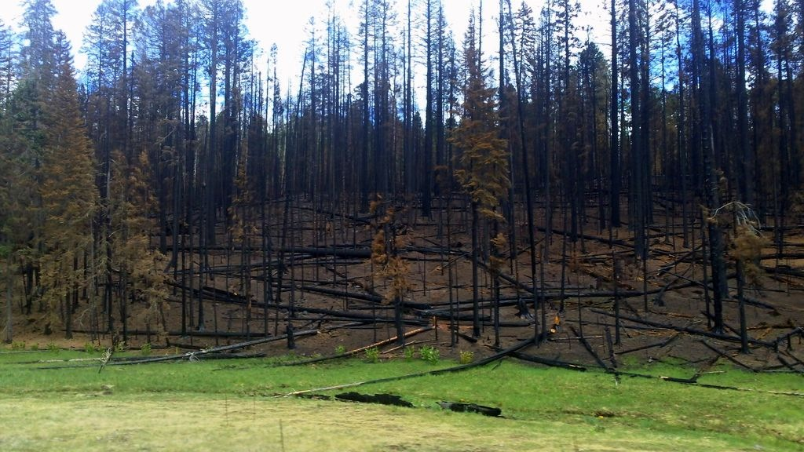
Introduction Data Methods Results Limitations Future Work Conclusions
Limitations
Methodology:
Better identify which floods are linked to burned areas
Resampling data to common formats reduces detail
Aggregating data eliminates spatial and temporal factors
Image Credit: Apache-Sitgreaves National Forest
Notes:
Image Source: https://www.flickr.com/photos/apachesitgreavesnf/5967273538/in/photolist-a6iQww-a6fZ3p-a6rKRa-a6rmLF-a6fVAx-a6iLZL-a6reVn-a6qFH8-a6fVvP-a6phvM-a6sdc6-6ufSim-9EWhJV-hxTB8U-e3ssQT-nQfvLt-9SL2T4-acSJSH-edDHmJ-ahY71V-acVxoU-6TZVJ3-9pGaQy-btQFBW-bsmW6C-7cCASW-9pLqR4-ownMPc-9pGaTL-3mRJZ6-a2Q3H-3mWbrs-6gEqRS-cYsJAA-bwPYke-bwPYpK-5dVYDo-24pqAv-cFqcvJ-9Mxjph-e18KQx-dbWsLy-awvWae-2Xz1NL-2Xuy3x-2XuA88-2XyQb3-2Xuuza-2XuEsZ-2Xz5vq

Slide 19
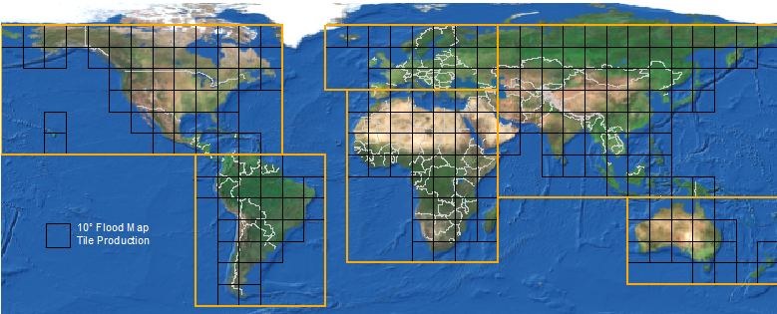
Introduction Data Methods Results Limitations Future Work Conclusions
Future Work
Improve flood inputs:
Potential flood data alternatives
Identify flood extent via satellite brightness pixel values
Creation of a NOAA Flood CDR
Image Credit: NRT Global Flood Mapping

Slide 20
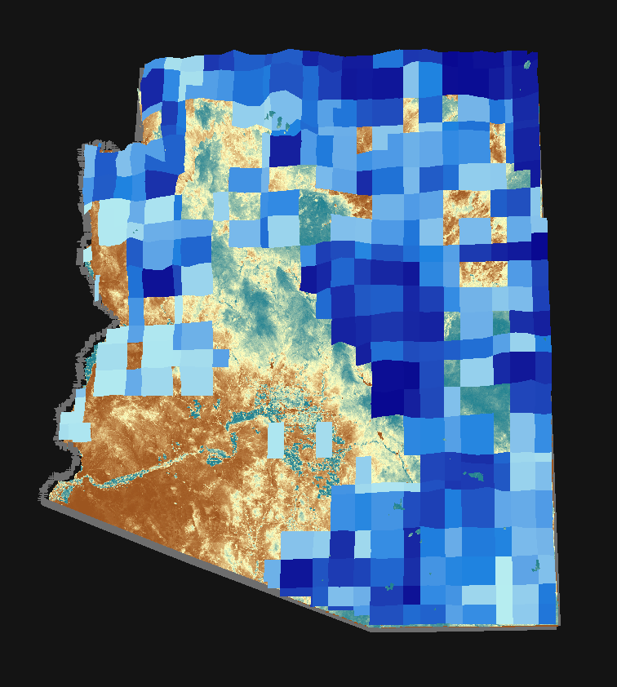
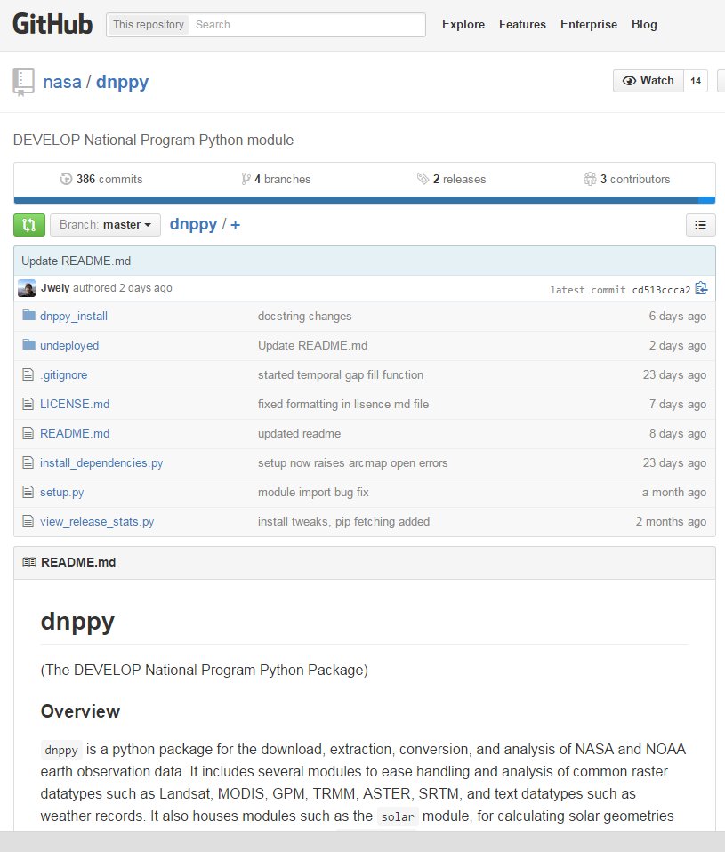
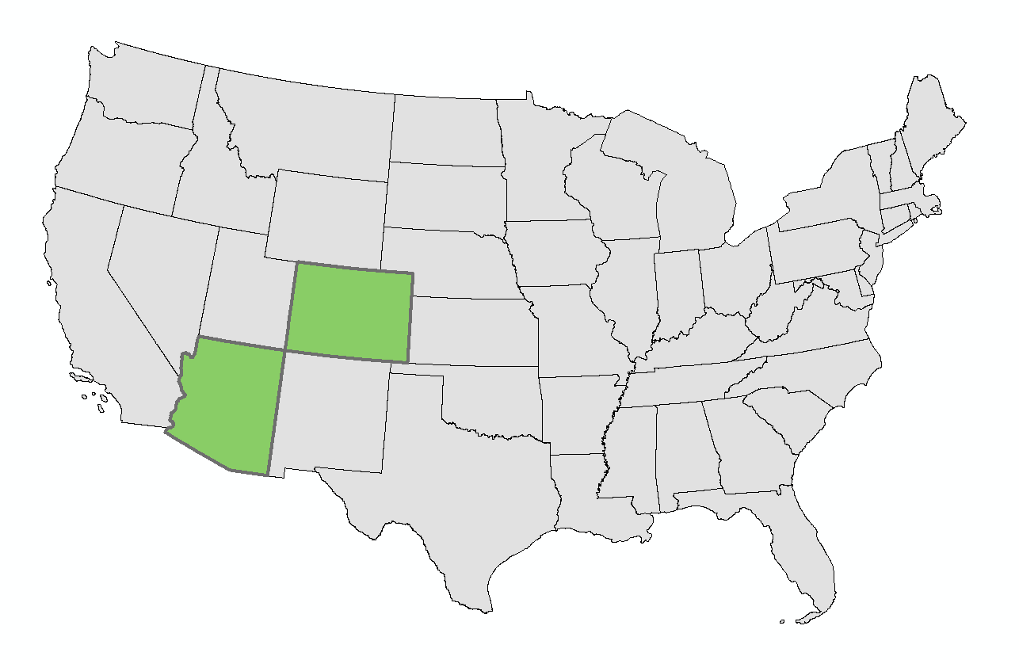
Introduction Data Methods Results Limitations Future Work Conclusions
Future Work
Refine Methodology:
Examine change in modeled flood hazard during regrowth
Establish easier access to useful flood data (i.e. NASA DEVELOP Python Module)
Study a different area with better flood records

Slide 21
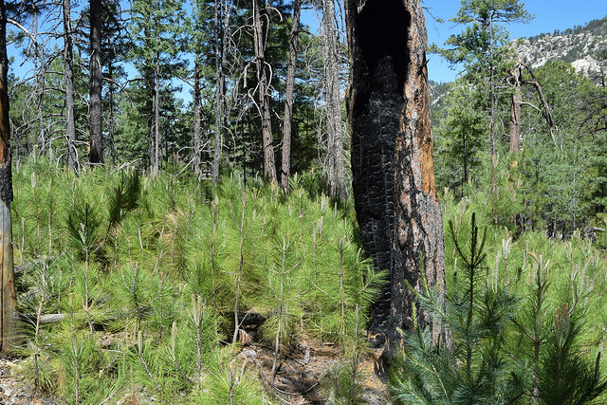
Introduction Data Methods Results Limitations Future Work Conclusions
Conclusions
More precipitation is needed to initiate post-wildfire floods as vegetation recovers
Trends are observable in the field, but complicated to capture across space and time
Satellite data provides a regional picture in areas with limited in situ data
Image Credit: Ken Bosma
Notes:
Image Source: https://www.flickr.com/photos/kretyen/14367691482/

Slide 22
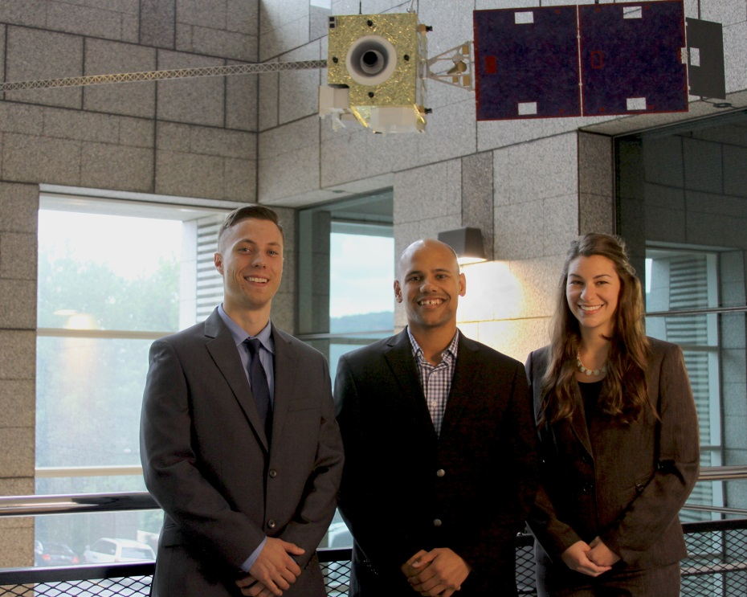
Introduction Data Methods Results Limitations Future Work Conclusions
More Information:
NASA DEVELOP National Program
ArcGIS Online Web Map

Slide 23
Advisors
Dr. DeWayne Cecil, NOAA National Centers for Environmental Information
Partners
Dr. Gregg Garfin, Climate Assessment for the Southwest
Tim Brown, Western Regional Climate Center
Dennis Staley, USGS Landslides Hazards Team
Jason Kean, USGS Landslides Hazards Team
Others
Michael Schaffner, NWS
Christopher Smith, USGS

