Slide 1
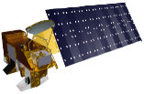
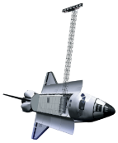
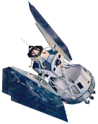
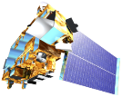
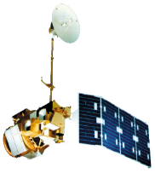
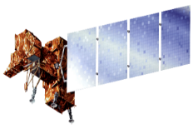
Stephen Chignell – Team Lead
Chandra Fowler
Kelly Hopping
Darin Schulte
Dr. Paul Evangelista,
Natural Resource Ecology Laboratory, Colorado State University
Terra/Aqua
Shuttle Radar Topography Mission
Landsat 1 & 3
Landsat 5
Landsat 7
Landsat 8

Slide 2
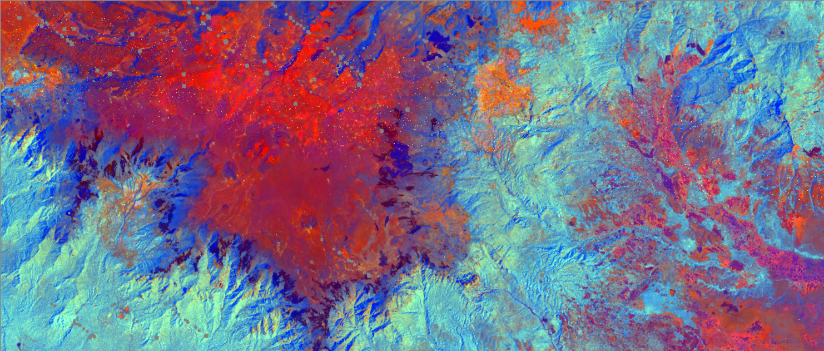
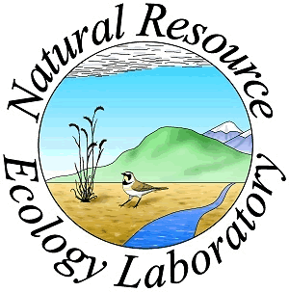
Mapping Four Decades of Fire History for Targeted Conservation in the South-Central Highlands of Ethiopia
Project Imagery
The Murulle Foundation
Natural Resource Ecology Lab,
Colorado State University
South-central Ethiopia, 1973-2015
Burning shrubs in the Bale Mountains of Ethiopia can increase grazing value, control toxic caterpillars, and reduce predator attacks on livestock.
Natural and intentional burning of Afro-alpine grasslands and Ericaceous heath shrublands in this area may also reduce the critical habitat of the endangered mountain nyala and increase soil erosion.
However, cessation of intentional burning is predicted to allow shrubs to replace Afro-alpine grasslands, to grow out of reach of pastoralists’ cattle, and to create high fuel loads susceptible to much larger, high-intensity fires when they do eventually burn.
A lack of data regarding fire history in the Bale Mountains impedes future management planning.
Ethiopian pastoralists have a long history of managing high-elevation shrublands with intentional burning, but these fires may lead to unintended consequences such as reduced habitat for the endangered mountain nyala. We quantified fire distribution in Ericaceous shrublands of the Bale Mountains, Ethiopia, mapping burned areas over 42 years. Our findings improved the understanding of past fire extent, which will inform future management decisions and conservation efforts in this unique region.
Landsat 1 & 3 MSS, Landsat 5 TM, Landsat 7 ETM+, Landsat 8 OLI, MODIS Burned Area Products, and SRTM earth observations were used to create the most comprehensive and detailed map of fire extent and frequency in the Bale Mountains to date.

