Slide 1
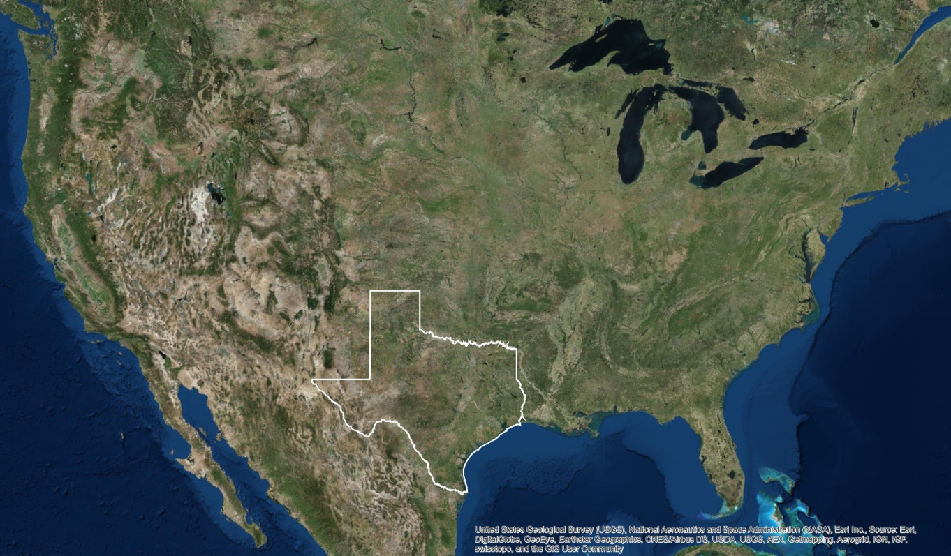
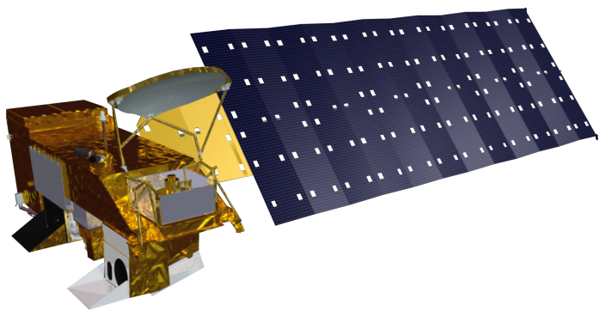
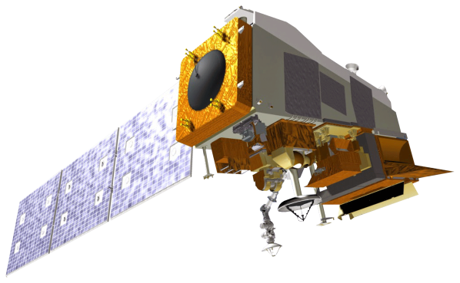
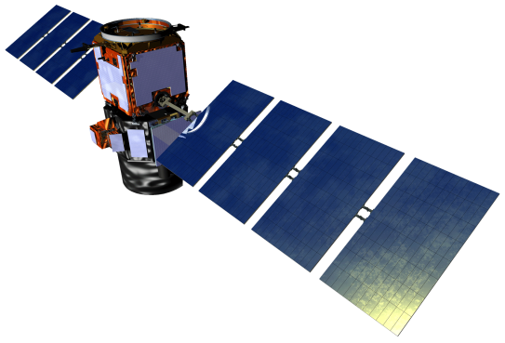
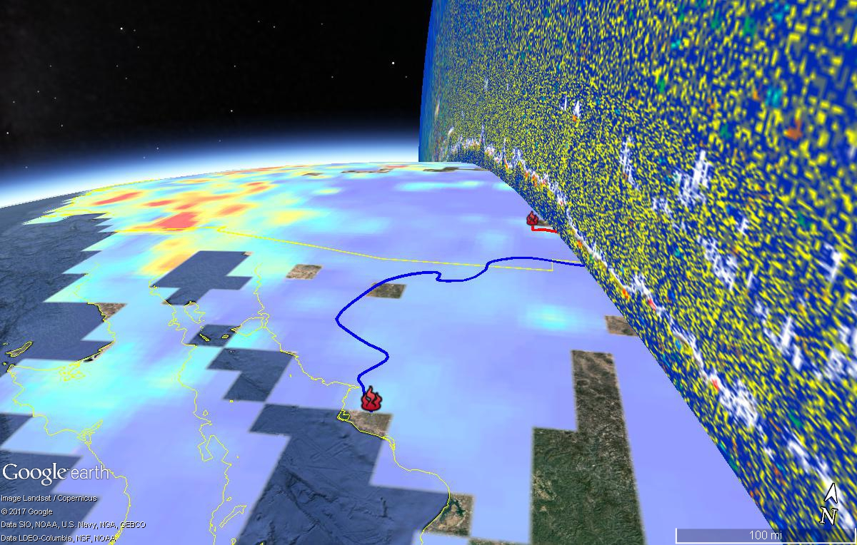
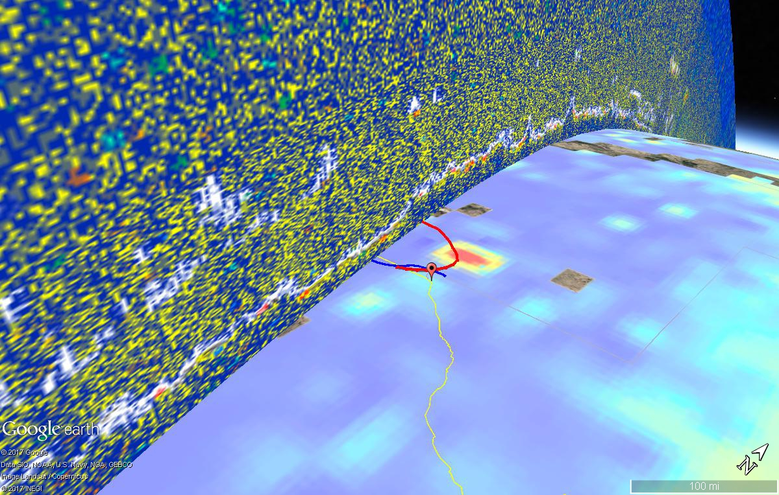

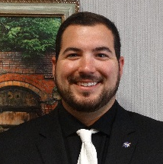



Monitoring Exceptional Air Pollution Events in Texas Using NASA Earth Observations
Abstract
Objectives
Texas (TX), U.S., is surrounded by areas prone to wildfire and agricultural burning (collectively referred to as biomass burning) and smoke plumes from these fires can be driven by meteorological conditions to travel across the state, depositing a variety of pollutants. These pollutants include aerosols, which exert several negative effects on the environment and human health and are especially harmful when deposited in highly-populated metropolitan areas. In El Paso, TX, elevated atmospheric concentrations of ozone and PM 2.5 occur when aerosol-carrying biomass burning smoke plumes reach the city. One such pollution episode was identified by El Paso UTEP (CAMS 12) ground monitor on July 16th, 2016. To identify the sources of this pollution episode, this study utilized NASA Earth Observations including Terra MODIS aerosol optical depth (AOD) and CALIPSO CALIOP calibrated and geo-located vertical profiles of aerosols and clouds to perform 3-D spatial temporal plume tracking. Thermal anomaly maps from Suomi NPP VIIRS were also used in conjunction with NOAA Hybrid Single Particle Lagrangian Integrated Trajectory (HYSPLIT) Model trajectories. Results from these analyses indicated several potential source wildfires that could have contributed to the elevated pollutant concentration levels, of which the School and Black Range Complex Fires in the Gila Wilderness of New Mexico, U.S. and agricultural biomass burning in Guaymas, Mexico were identified as the main contributors. 3-D aerosol transport maps produced using Terra MODIS AOD data for the exceedance date and CALIPSO CALIOP vertical profiles for a date leading up to the exceedance further validated this result. The results of this study can be replicated for other dates in other locations where similar elevated pollutant concentration levels are observed via ground monitors. This analysis, which combined in situ data, trajectory models and remote sensing data, proves itself a valuable tool for studying air pollution events caused by biomass burning.
Utilize Terra MODIS, CALIPSO CALIOP, and Suomi NPP VIIRS to track aerosols from wildfire smoke plumes around dates specified by the TCEQ
Monitor aerosol concentration and distribution within the plumes as they move from source to destination
Provide a 3-D aerosol transport map to track aerosol deposition in Houston and El Paso, Texas
Assist the TCEQ in locating the origins of aerosols that cause air pollution events
Project Partner
Texas Commission on Environmental Quality (TCEQ), Air Quality Division
Study Area
Methodology
El Paso
Observe vertical profile of smoke plume using CALIPSO CALIOP data
N
Houston
Track the aerosol movement across Texas using Terra MODIS data
Resample Level 3 MODIS data to finer spatial resolution using ArcMap
Earth Observations
3-D Aerosol Transport Map
Terra
Suomi NPP
CALIPSO
Results
Locate fires using the Suomi NPP VIIRS
I-band
Compute forward and backward air parcel trajectories using HYSPLIT
Texas Health & Air Quality
3-D Aerosol Transport Map
Identify possible wildfire signatures using in situ data
CALIOP vertical profile
Conclusions
wildfire
A combination of in situ ozone and PM 2.5 measurements, HYSPLIT backward and forward trajectories, and Suomi NPP VIIRS thermal anomalies facilitates identification of wildfires that cause air pollution events.
The School Fire and Black Range Complex Fires in New Mexico and agricultural biomass burning in Mexico are potential contributors to the air pollution event in El Paso, TX on July 16, 2016.
The 3-D aerosol transport map produced can be used by the TCEQ in exceptional event reporting for El Paso, TX on July 16, 2016.
Terra MODIS and CALIPSO CALIOP, while limited in their spatial and temporal resolution, provide a basis for creating 3-D maps to track aerosol transport from wildfires to cities.
Additional in situ and meteorological data should be consulted for more certainty in exceptional event reporting to compensate for the limited resolution of Terra MODIS and CALIPSO CALIOP data.
agricultural burning
HYSPLIT forward trajectory
MODIS AOD
HYSPLIT forward trajectory
El Paso, TX
Team Members
Acknowledgements
David Westenbarger, Texas Commission on Environmental Quality
Dr. Kenton Ross, NASA Langley Research Center
Dr. DeWayne Cecil, NOAA National Center for Environmental Information, Global Science & Technology, Inc.
Bob VanGundy, The University of Virginia’s College at Wise
Dr. Travis Knepp, NASA Langley Research Center
Roman Kowch, NASA Langley Research Center
Eric White
(Team Lead)
Brooke Colley
Kannikha Kolandaivelu
Audrey Odwuor
Wise County Clerk of Circuit Court’s Office – Summer 2017

