Slide 1
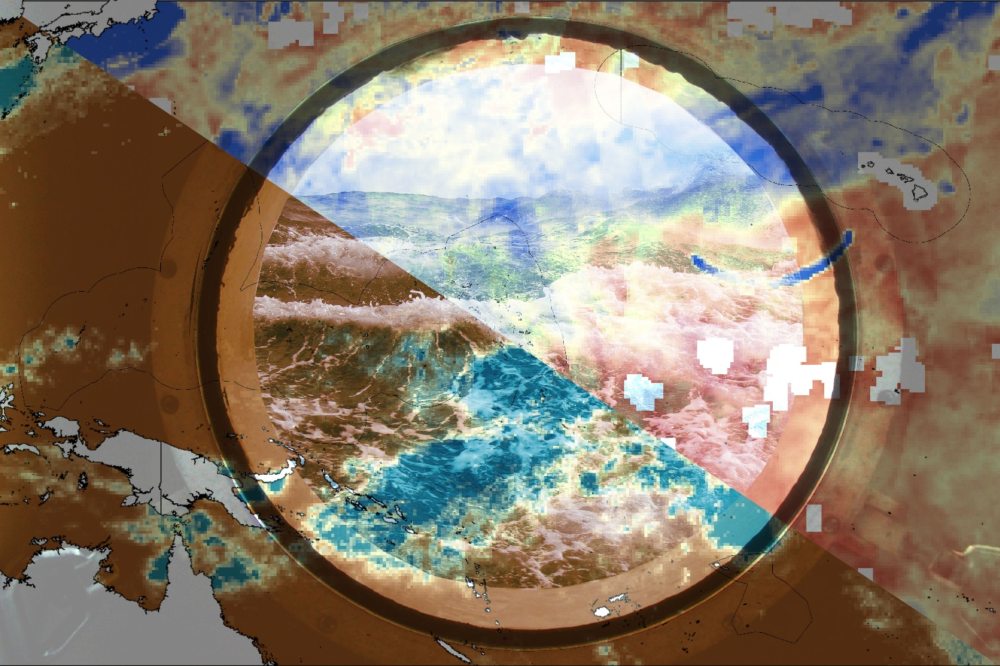
Hawai’i & US Affiliated Pacific Islands Disasters
Using Global Climate Models to Project Monsoon and Future Extreme Weather Trends in the Pacific
Andrew Shannon
David Mackey
Rachel Wegener
North Carolina – NCEI
Fall 2017
Notes:
Introductions

Slide 2
Acknowledgements
James Adams, NOAA NCEI
Xungang Yin, NOAA NCEI
Dongsoo Kim, NOAA NCEI
Jonathan Brannock, North Carolina Institute for Climate Sciences
Michael Kruk, Science Advisor
Matthew Widlansky, University of Hawaii
Jared Rennie, North Carolina Institute for Climate Sciences
Ryan Smith, US Air Force, 14th
Weather Squadron
This material is based upon work supported by NASA through contract NNL16AA05C and cooperative agreement NNX14AB60A. Any mention of a commercial product, service, or activity in this material does not constitute NASA endorsement. Any opinions, findings, and conclusions or recommendations expressed in this material are those of the author(s) and do not necessarily reflect the views of the National Aeronautics and Space Administration and partner organizations.
Notes:
We would like to thank you mentors and advisors for their critical guidance.

Slide 3
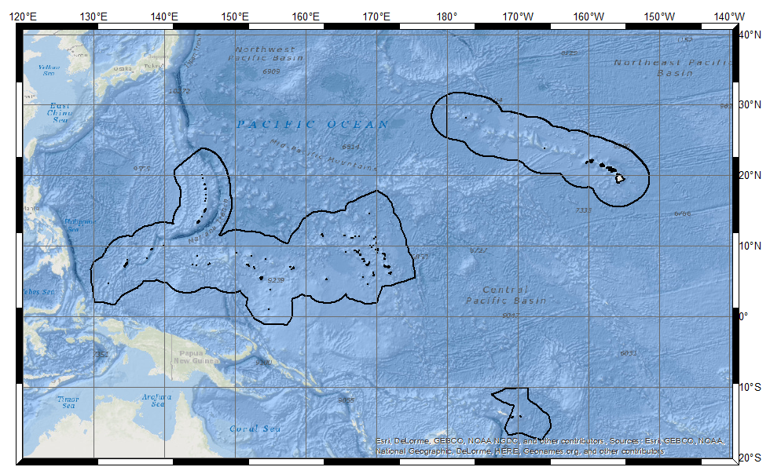
Hawaii & US Affiliated Pacific Islands (USAPI)
Hawai’i
Commonwealth of the Northern Mariana Islands
Republic of the Marshall Islands
University of Guam
NOAA
RCSD
Guam
Republic of
Palau
Federated States of Micronesia
American Sāmoa
John Marra , NOAA Regional Climate Services Director (RCSD), Pacific Region
Mark Lander, Professor, University of Guam
Notes:
What are Hawai’i and UASPI?
2,000 islands of 1.9 million people, diverse languages (20+) and cultures
what are affiliated countries? (currency, travel, etc.)
These islands comprise our study area of …
(120E to 140W, 20S to 40N)
Project partners (provide interface)
They work with communities and local decision makers in natural resources, agriculture, and city planning
Image (HI/USAPI EEZs) : from ESRI basemaps with overlay EEZs

Slide 4
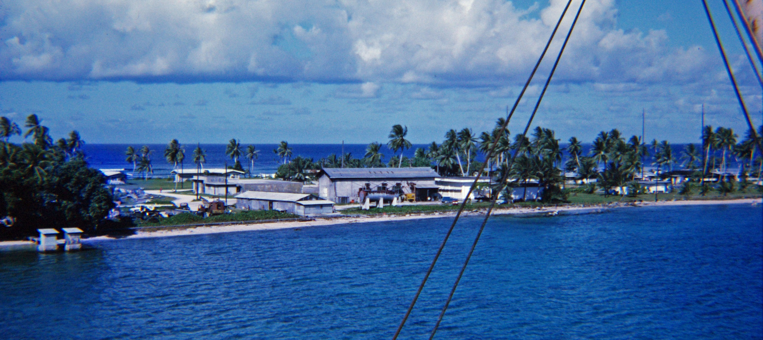
Community Concern
Iakwei Atoll, Marshall Islands
Image Credit: Flickr
Notes:
“physical geography and limited economic resources make the USAPI particularly vulnerable to impacts from natural disasters. Many islands only a few meters in elevation; remediation costs when compared to GDP are high”
Image (Iakwei Marshalls): https://www.flickr.com/photos/drheath/4016084488/in/pool-45142793@N00/

Slide 5
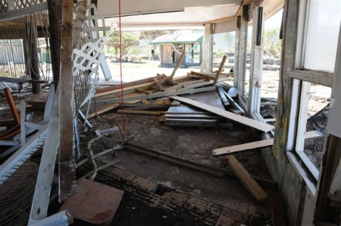
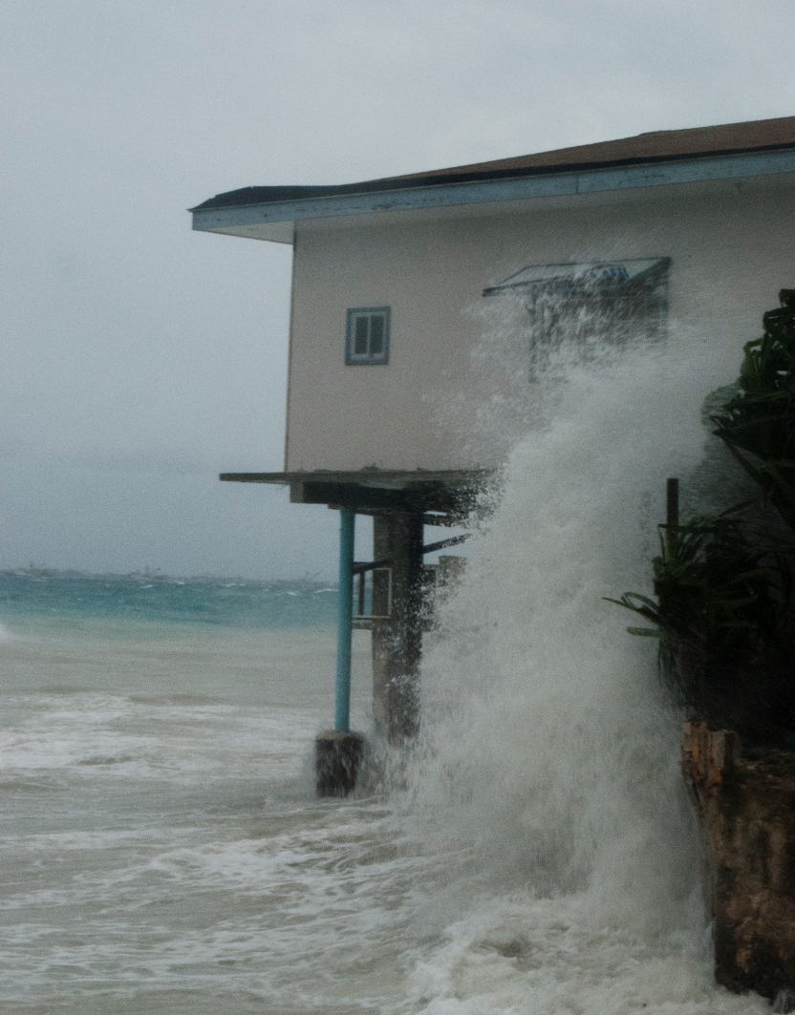
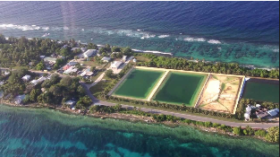
Community Concern
Coastal erosion in Marshall Islands
Freshwater Reservoirs in Majuro
Image Credit: Flickr
Infrastructure damage in American Samoa
Image Credit: Mike Kruk
Image Credit: Flickr
Notes:
For example storm surges, wave run-up and squalls associated with heavy wind and rain contribute to coastal erosion(such as __) and damage infrastructure(such as __). Ex. March 2014 wind driven waves + high tide event caused devastating flooding on the island of Majoro in MI resulting in more than 1000 people needing to seek shelter/ leave their homes
Additionally many communities are dependent upon rain events for freshwater. High tides and waves that flood the island can pollute freshwater reservoirs and create water shortages
Image (Am. Samoa Cyclone Damage): https://www.flickr.com/photos/tckc/3974891236/
Image (Am. Samoa Cyclone Damage): https://www.flickr.com/photos/archivesnz/30055104911/
Image (Majuro Storm Surge): https://www.flickr.com/photos/poetry/19185133940/in/pool-45142793@N00/

Slide 6
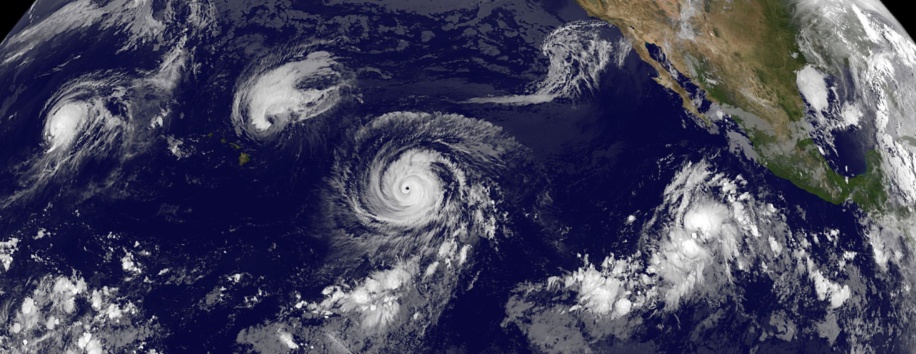
These natural disasters present a variety of economic, environmental, and human health concerns for vulnerable Pacific populations with low adaptive capacity. Wind and rain events are a threat multiplier to these disasters, the impacts of which will be seen over the course of the 21st century.
Image Credit: NASA Goddard Space Flight Center
Notes:
“These natural disasters present a variety of economic, environmental, and human health concerns for vulnerable Pacific populations with low adaptive capacity. Wind and rain events are a threat multiplier to these disasters, the impacts of which will be seen over the course of the 21st century.”
“While historic trends in wind and rain pattern are well-studied, there is a lack of knowledge of future trends. In order to enhance our partner’s understanding of these trends, our project is focused on projecting changes in wind and rain extremes and phenomena.”
Image (4 Pacific TCs): https://www.flickr.com/photos/gsfc/21057720552/in/photolist-y5NjFs-9e69Pc-YYiPbk-dAPp2W-9dk33P-8iCefR-DtjK8x-aktAEq-dBMwPx-c5meib-T7VLEo-WpgVTd-drsge9-9fLqJ7-66XLhL-ejeXqA-ejeX1S-ejeWP9-9eX8qp-bMxMtZ-akGNGz-4P3FJ6-NQka-ejeXdY-aBchPi-FxUorT-9f6Xc9-dAPoX1-AzTceC-b19bex-fvJDAm-4TB3PQ-87qkDQ-5B5D8-AG2EcD-ubabDt-fvuodn-azGyiH-bxAKaB-fvJDpS-fvJDmA-fvJDwW-bjn71t-bxyU3P-fvuogT-pz4Z3g-pPpwao-h69c78-fvJDis-UU7d8S

Slide 7
Project Objectives
Verify Global Climate Models against NOAA datasets
Phase 1:
Model Selection
Calculate extreme percentile values of wind and rain
Phase 2:
Wind and Rain Extremes and Phenomena Projections
1
50
Compute return intervals of wind and rain events
Create projected trend in regional monsoon
Notes:
“In order to make future projections our project was divided into two phases. In phase 1 we used NOAA CDR to verify climate projections from CMIP5, a suite of 25 + global climate models.”
“In phase 2 we used three approaches to represent future changes in wind and rain extremes and phenomena: extreme percentiles, return intervals, and monsoon distribution maps.”
Image: http://www.freepngimg.com/download/globe/2-2-globe-free-download-png.png
Image: http://www.clker.com/cliparts/z/g/U/q/e/l/check-mark-hi.png
Image: http://icons.iconarchive.com/icons/graphicloads/100-flat/256/percentage-icon.png

Slide 8
Project Objectives
Verify Global Climate Models against NOAA datasets
Phase 1:
Model Selection
Calculate extreme percentile values of wind and rain
Phase 2:
Wind and Rain Extremes and Phenomena Projections
1
50
Compute return intervals of wind and rain events
Create projected trend in regional monsoon
Notes:
Introduce Phase 1: Model Selection process, verification of narrowed set of CMIP5 data against NOAA CDR

Slide 9
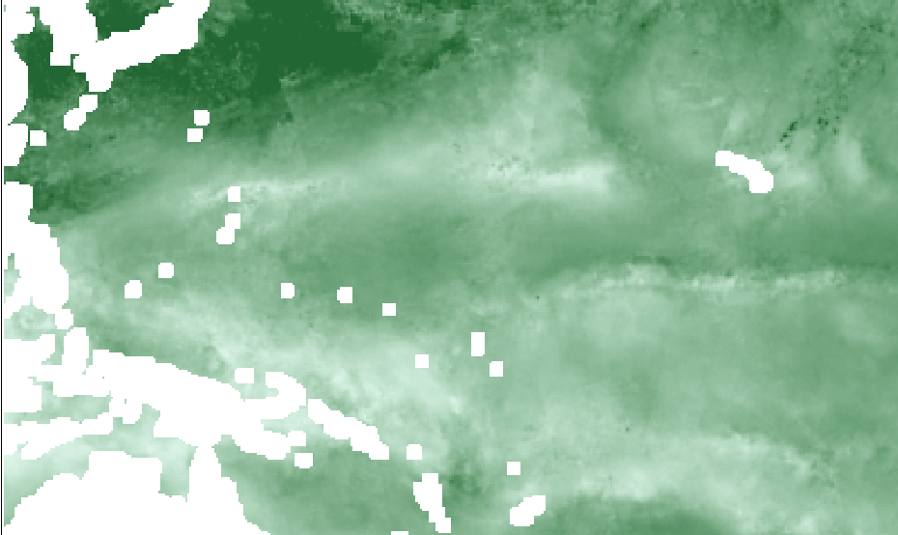
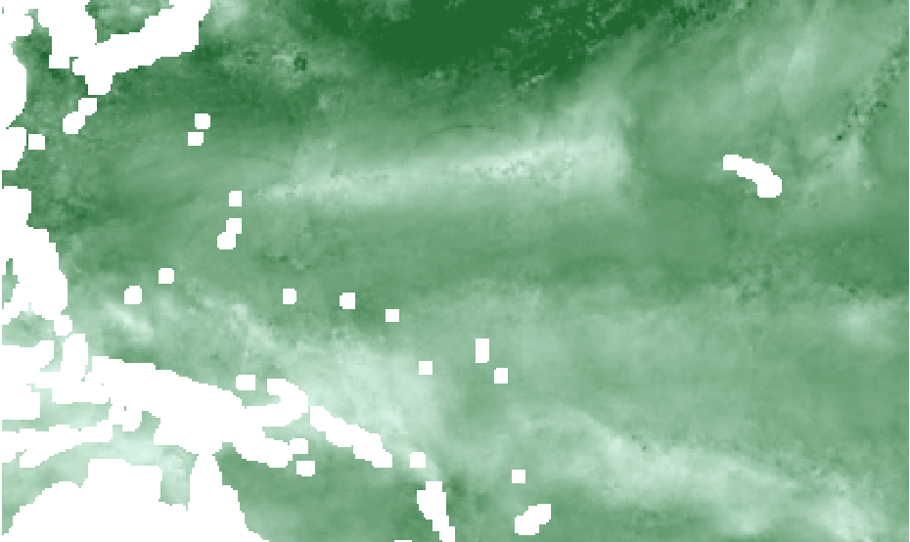
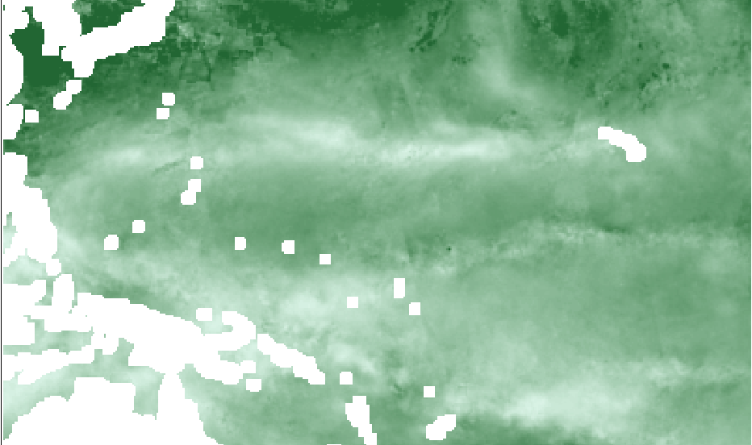
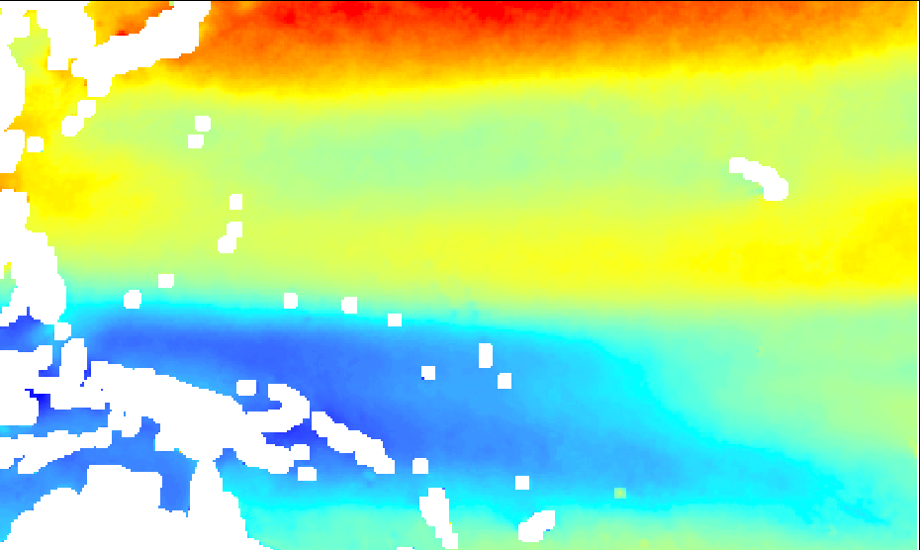
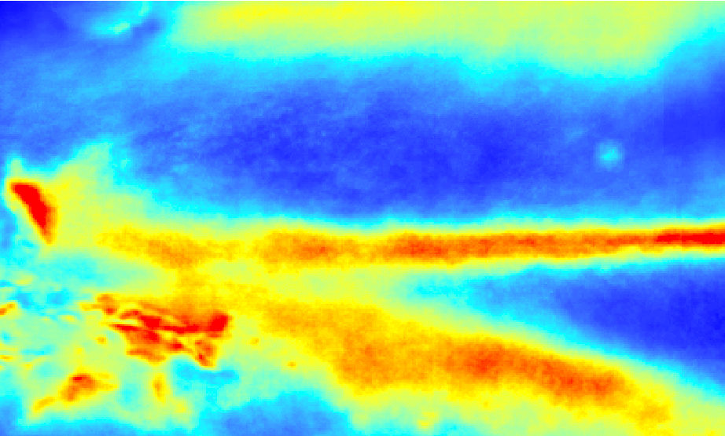
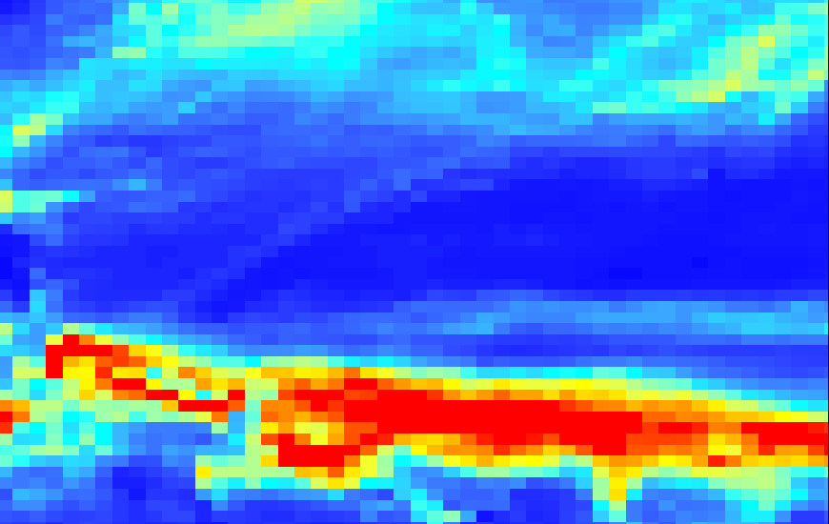
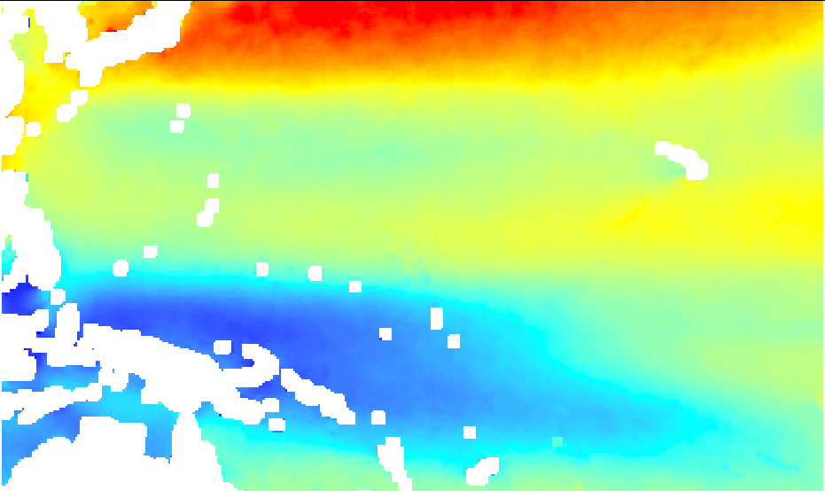
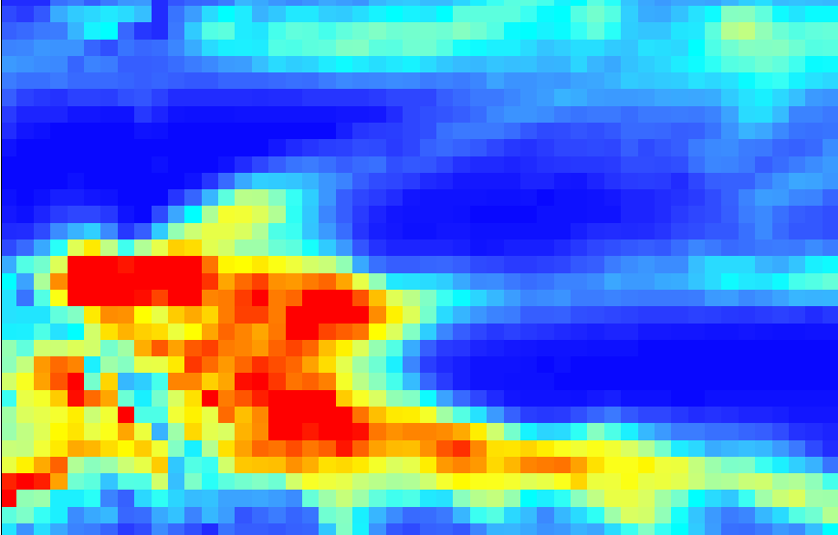
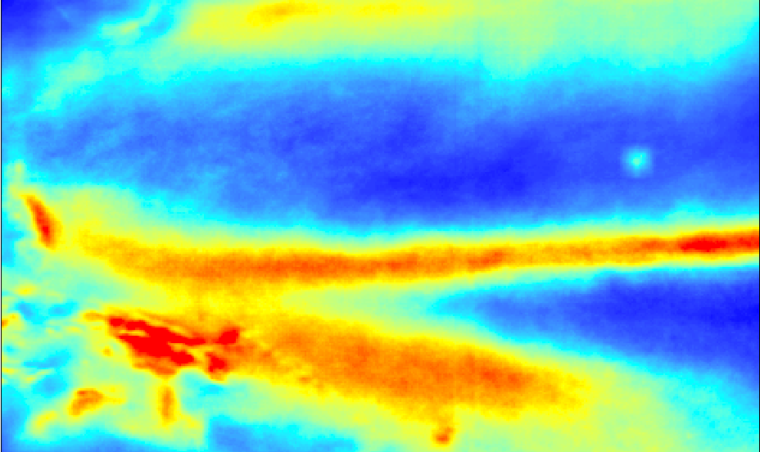
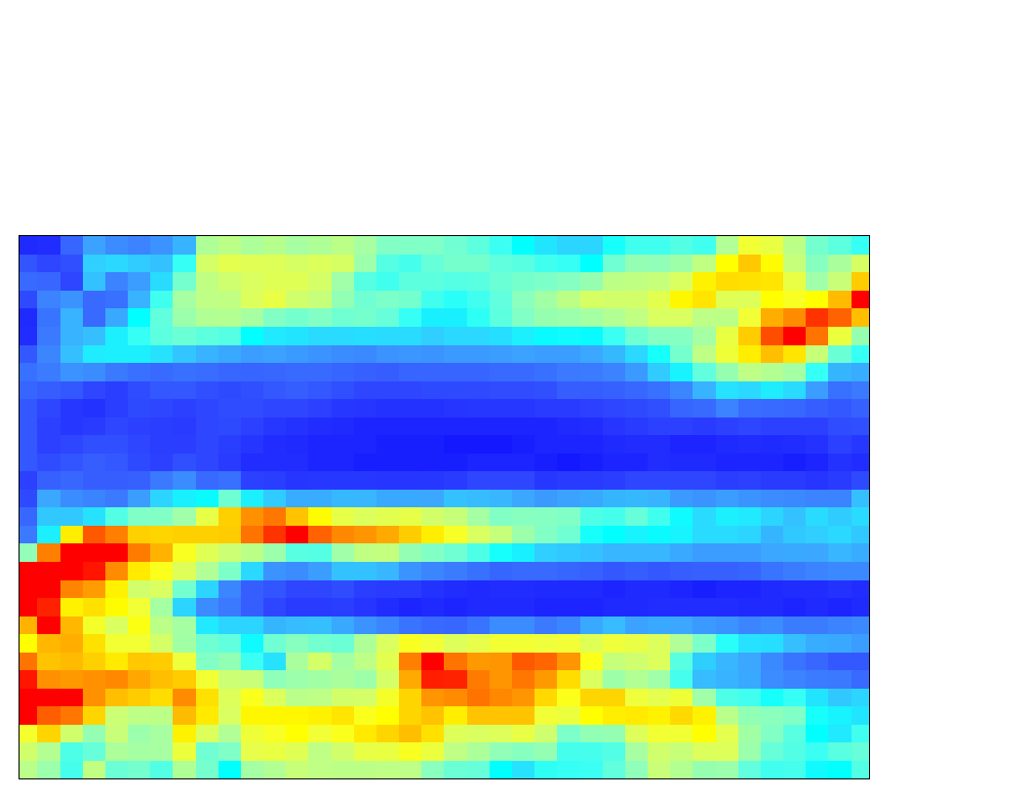
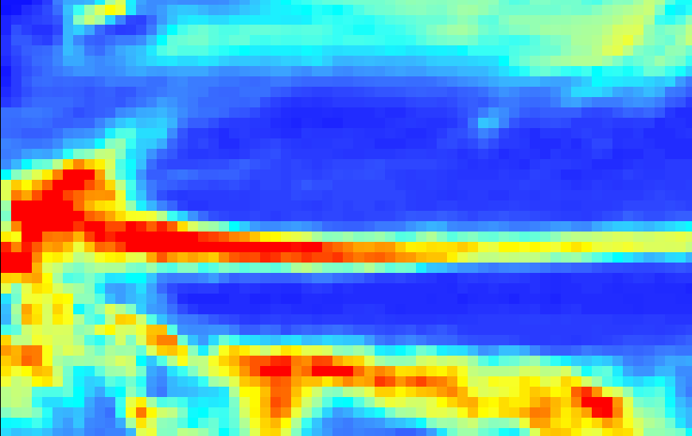
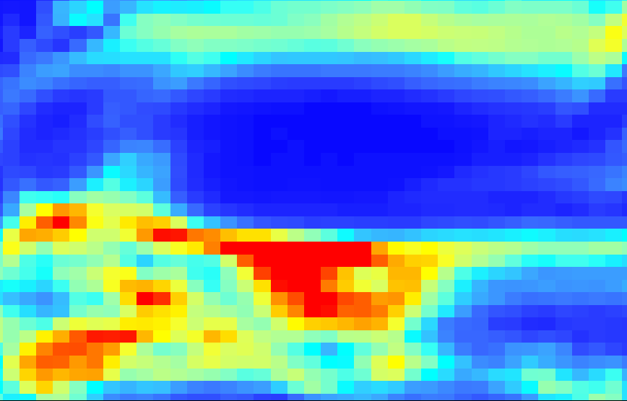
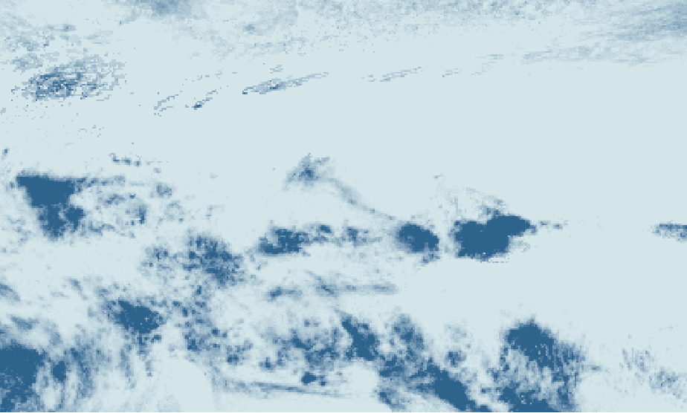
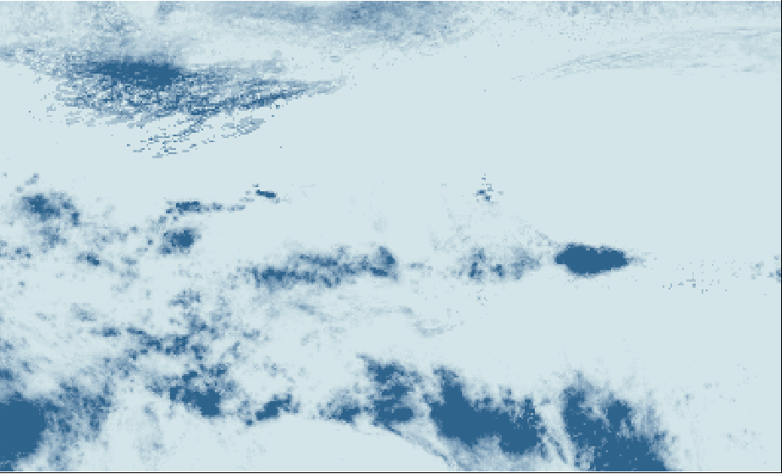
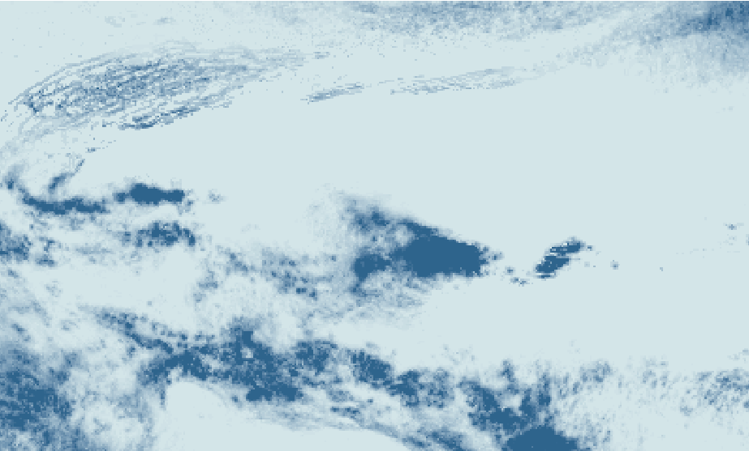
Methods: Model Verification
Data Download
Compute Pearson Correlation Coefficient
SSM/I
Wind speed
Jan
Jan
Dec
Dec
+
PERSIANN
6 CMIP5 models
Rain totals
PERSIANN and SSM/I climatologies
Historic Period: 1988-2005
Notes:
Download NOAA CDR to create historic climatologies
Compute correlation coefficient for each of the 6 selected models based on previous work

Slide 10
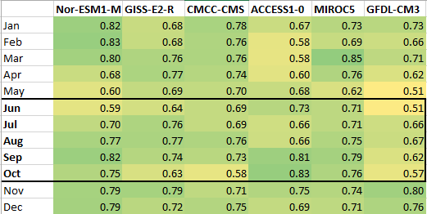
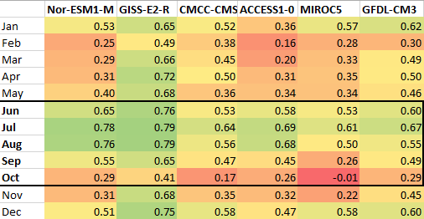
Results: Model Verification
Pearson R: CMIP5 model precipitation totals and PERSIANN precipitation totals
Pearson R: CMIP5 model wind speed and SSM/I wind speed
Monsoon months
Yearly deliverables:
Extreme Percentiles
Return Intervals
Seasonal deliverable:
Monsoon Distribution
GISS-E2-R Resolution:
2.0 x 2.5 degrees
ACCESS1-0 Resolution:
1.241 x 1.875 degrees
Notes:
We choose the circled models based on their r-values and availability of data
Monsoon is a seasonal feature, monsoon months are highlighted
Model selection limited by data availability

Slide 11
Project Objectives
Verify Global Climate Models against NOAA datasets
Phase 1:
Model Selection
Calculate extreme percentile values of wind and rain
Phase 2:
Wind and Rain Extremes and Phenomena Projections
1
50
Compute return intervals of wind and rain events
Create projected trend in regional monsoon
Notes:
Once we had our model selected we were able to carry out the methods for our three different approaches for measuring wind and rain extremes and phenomena
First we calculated the extreme values of wind and rain across our domain

Slide 12
Background: Percentiles
How do we quantify “extreme”?
5th
95th
1 | 2 | 3 | 4 | 5 | 6 | 7 | 8 | 9 | 10 | 11 | 12 | 13 | 14 | 15 | 16 | 17 | 18 | 19 | 20 | 21 | 22 | 23 | 24 | 25 | 26 | 27 | 28 | 29 | 30 | 31 | 32 | 33 | 34 | 35 | 36 | 37 | 38 | 39 | 40
Magnitude: Value of the 95th/5th percentile
Exceedance Days: number of observations above/below 95th/5th percentile
Notes:
The list represents what the magnitude and exceedance days of 95th/5th percentile threshold means. We did this for each location in our study area.

Slide 13
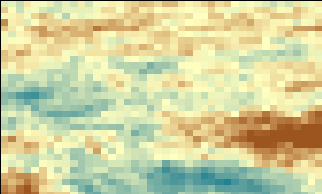
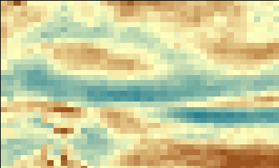
Methods: Percentiles
Magnitude Maps
95th
5th
Percentile
values
95th
5th
Percentile
values
Exceedance Day Maps
5th
95th
GISS-E2-R daily wind speed and precipitation rate
Notes:
Extract wind speed and rain rate data
Compile into decadal groups for each future decade from 2030 to 2100
Calculate 95th/5th
Represent them as gridded maps of magnitude and number of expected days a future decade exceeds the historic periods 95th and 5th percentile values

Slide 14
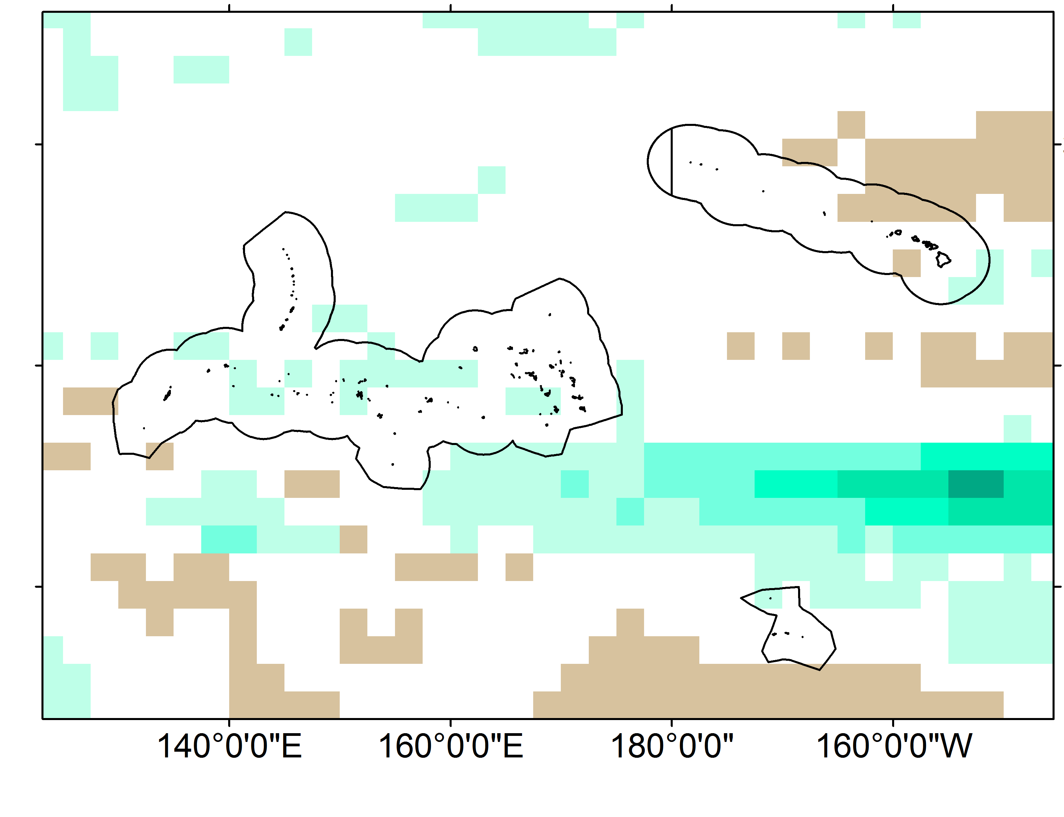
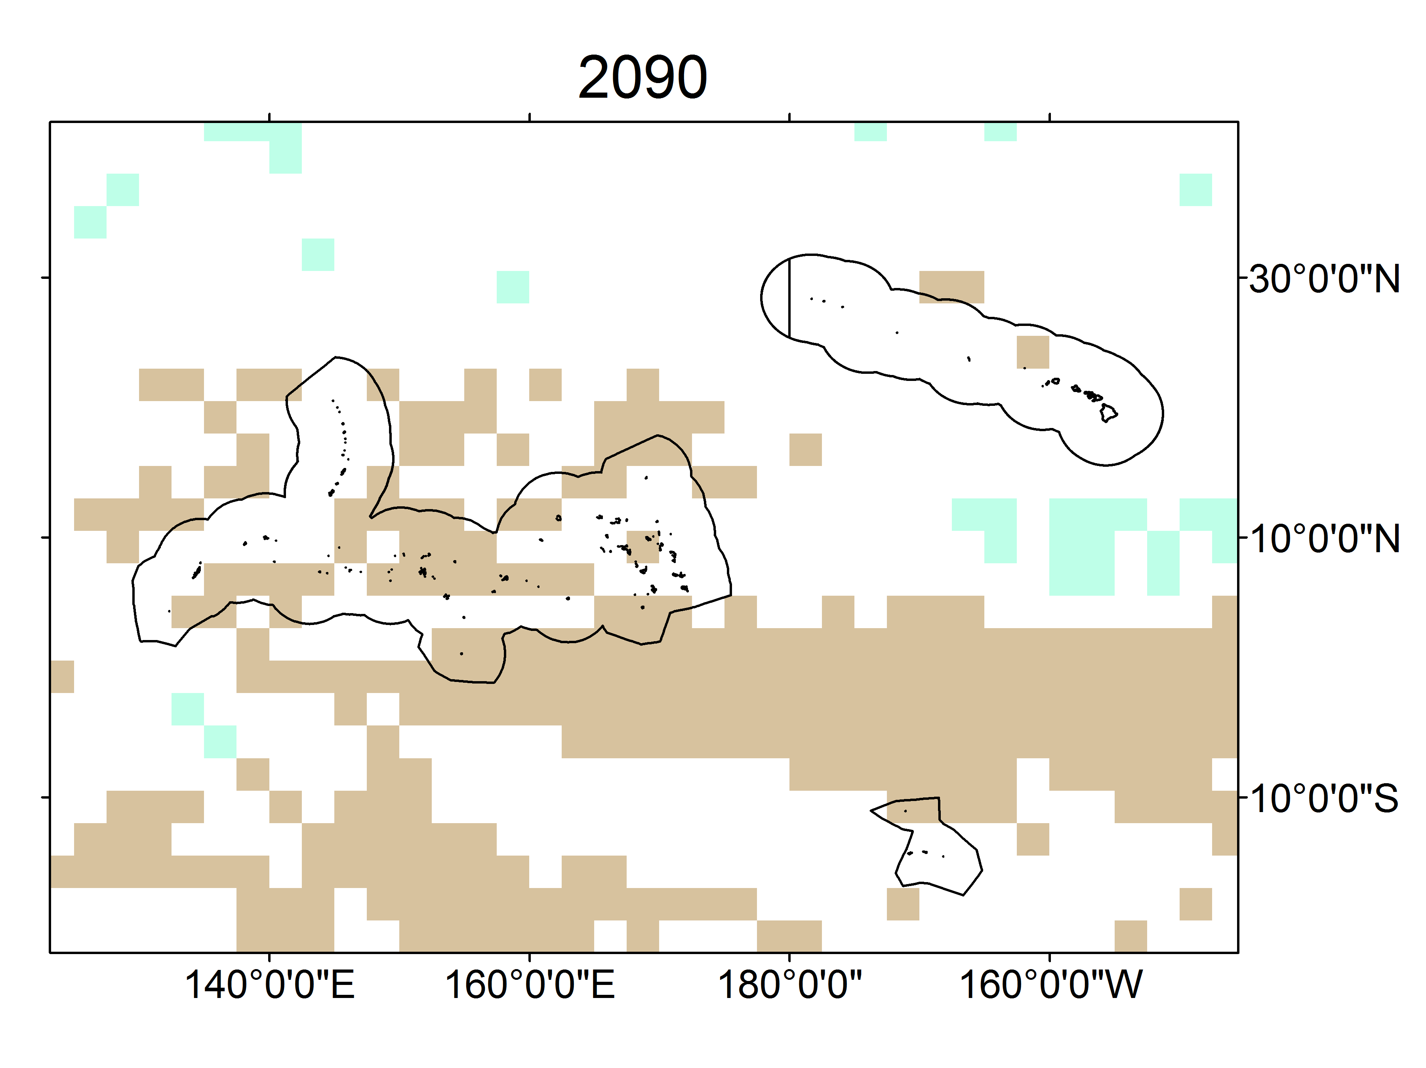
Results: Percentiles
Change in Exceedance Days
95th Percentile Rain Rate
2090-2099
Change in Exceedance Days
5th Percentile Rain Rate
2090-2099
Spatial resolution: 2.5 x 2 degree grid boxes
Notes:
Equator gets more days of most intense rain, less days of least intense rain

Slide 15
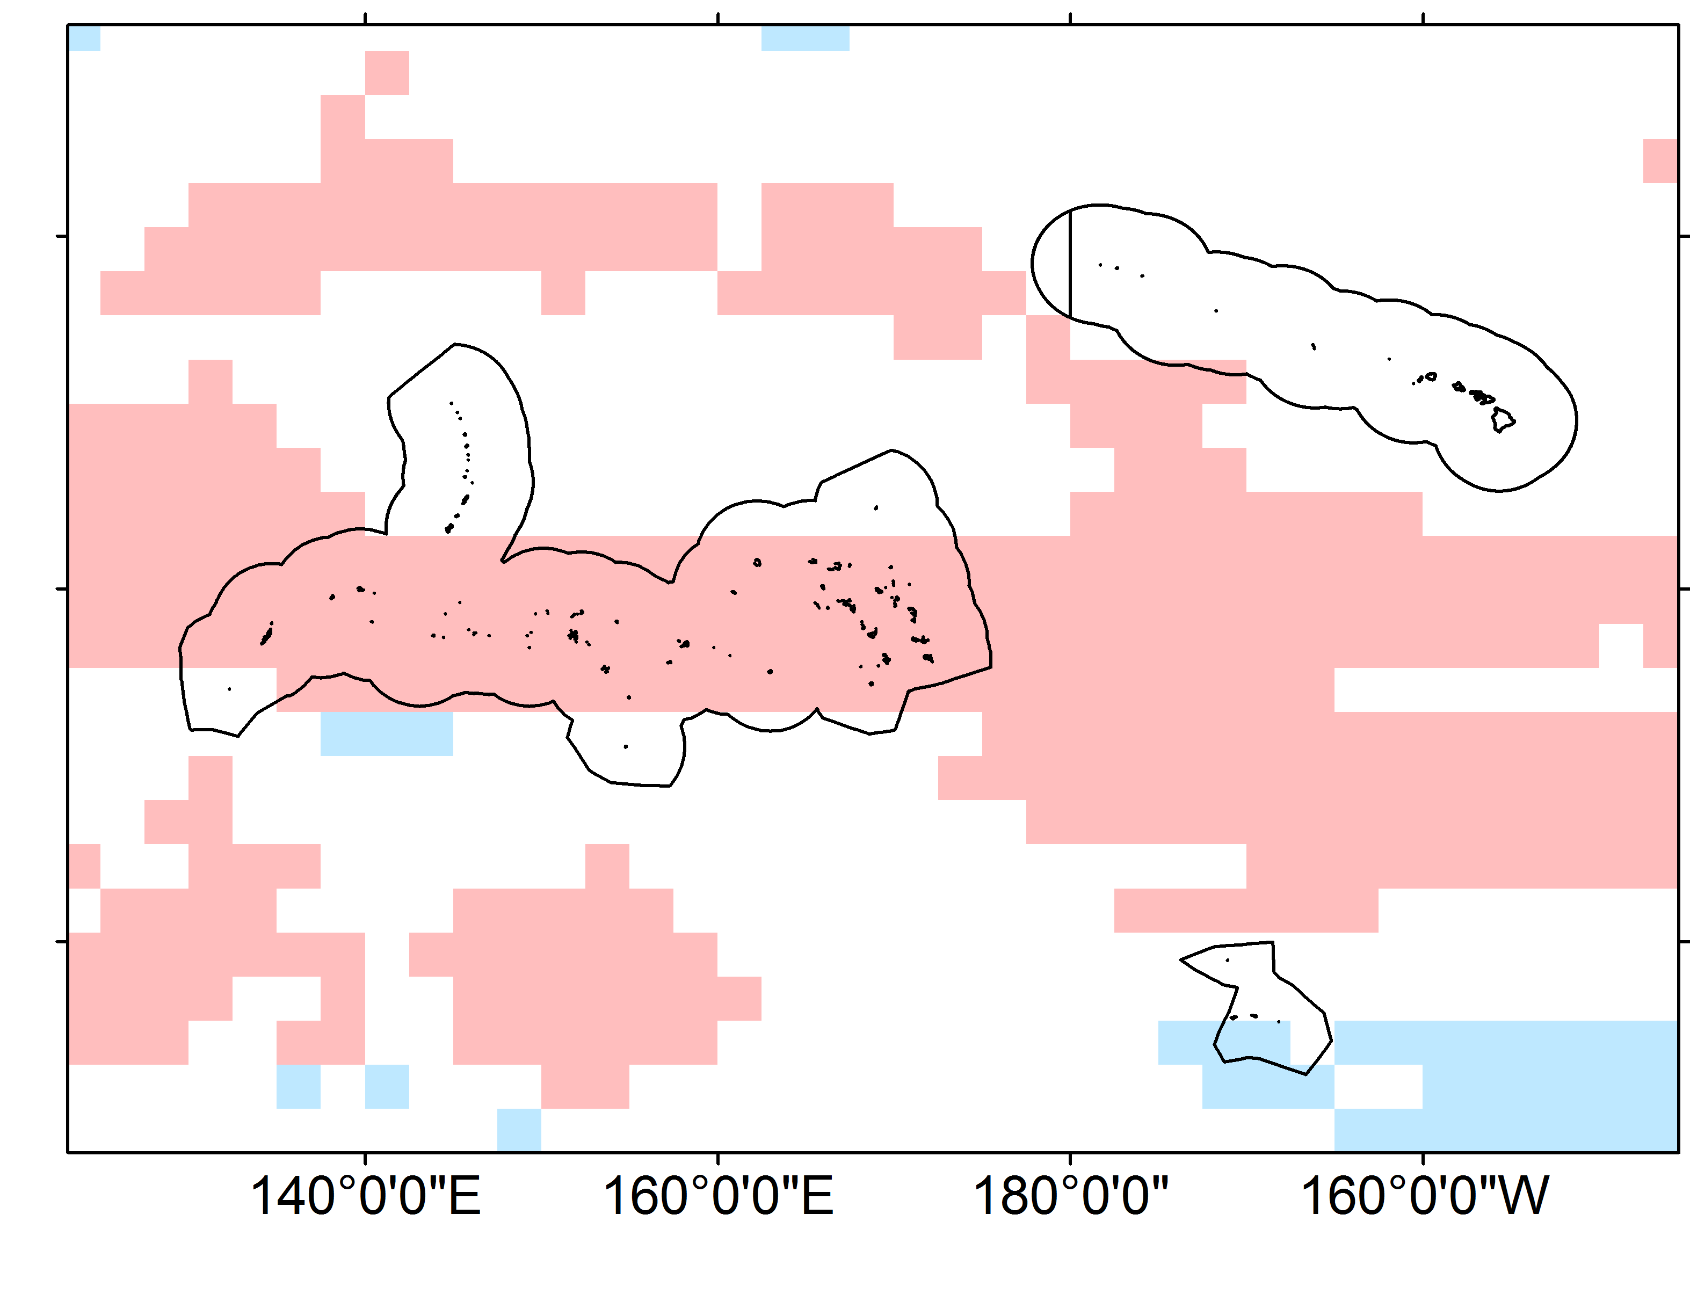
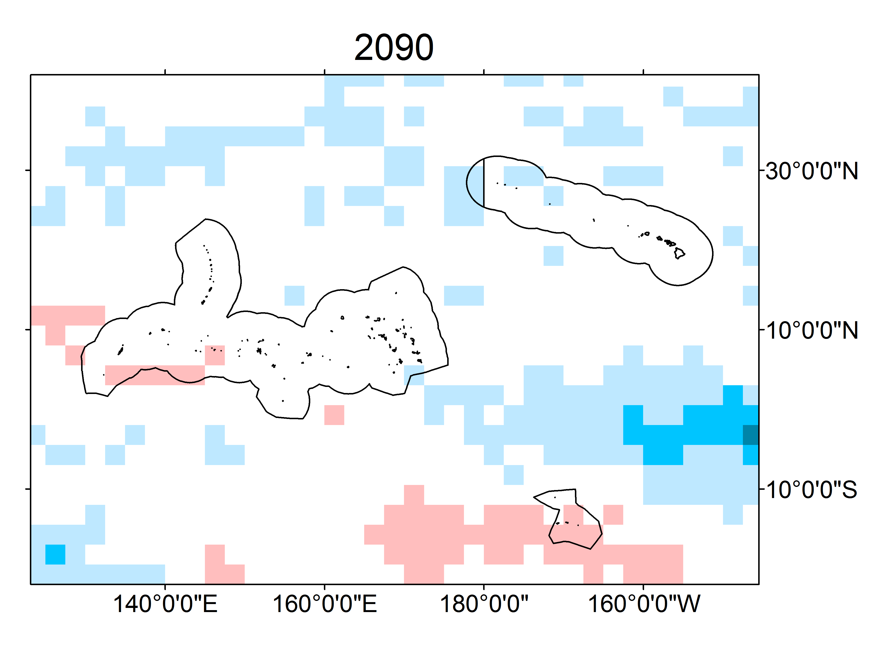
Results: Percentiles
Change in Exceedance Days
95th Percentile Wind Speed
2090-2099
Change in Exceedance Days
5th Percentile Wind Speed
2090-2099
Spatial resolution: 2.5 x 2 degree grid boxes
Notes:
Equator gets more days of least intense rain, less days of most intense rain
These results answer the question: How often will there be extreme wind and rain events through the end of the 21st century?

Slide 16
Project Objectives
Verify Global Climate Models against NOAA datasets
Phase 1:
Model Selection
Calculate extreme percentile values of wind and rain
Phase 2:
Wind and Rain Extremes and Phenomena Projections
1
50
Compute return intervals of wind and rain events
Create projected trend in regional monsoon
Notes:
Next step was computing the return intervals of wind and rain

Slide 17
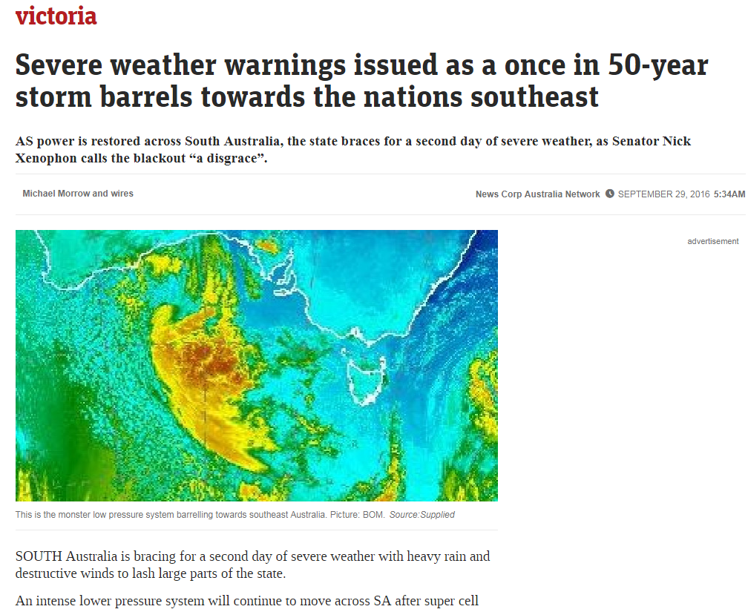
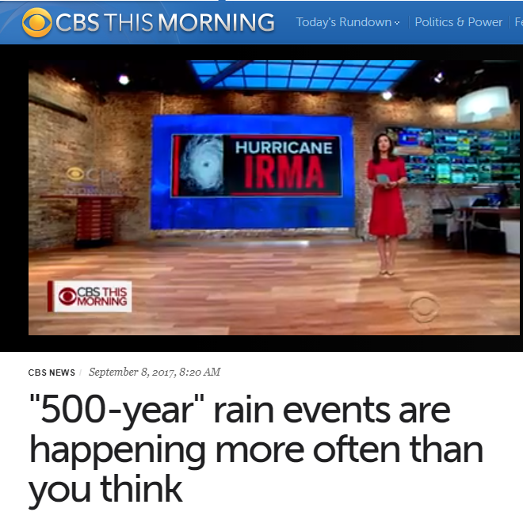
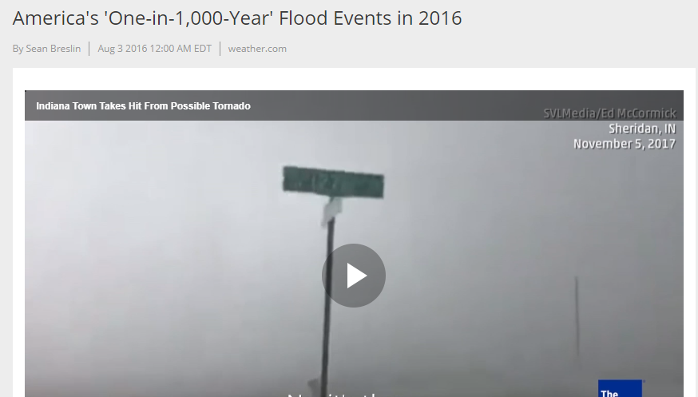
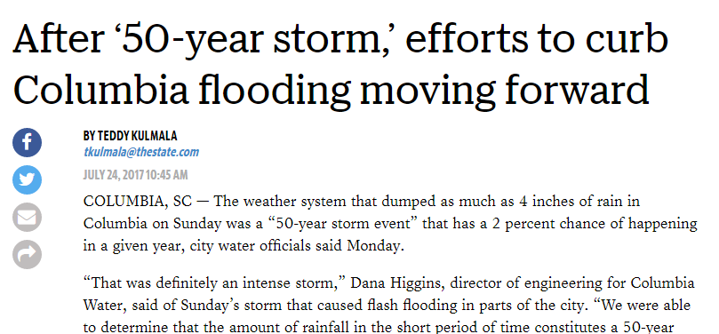
Background: Return Intervals
Return Interval (years) | Probability of Occurrence per year | Yearly Percent Chance of Occurrence
1000 | 1 in 1000 | 0.1%
500 | 1 in 500 | 0.5 %
100 | 1 in 100 | 1 %
50 | 1 in 50 | 2 %
6 | 1 in 6 | 16.7 %
Notes:
“50-yr” return period is a phrase that often appears in the media…We explain what it means (it is a percent chance of an event happening in a given year)

Slide 18
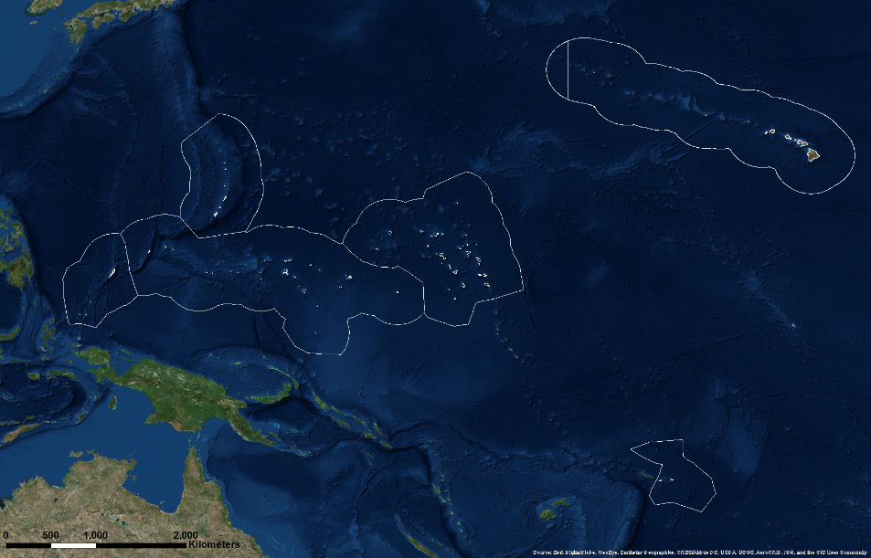
Methods: Return Intervals
Commonwealth of the Northern Mariana Islands
Hawai’i
Republic of the Marshall Islands
Republic of Palau
Federated States of Micronesia
GEV
American Sāmoa
Return levels
Generalized Extreme Value Functions
GISS-E2-R monthly RCP8.5
Wind speed and precipitation totals
2030-2060
2040-2070
2050-2080
2060-2090
2070-2100
Notes:
We extracted data from the model, compile into future decades with 30-yr running climatologies, ran through a blackbox of GEV equation and produce time series of return levels

Slide 19
Results: Return Intervals
Palau
Guam
Palikir,
FSM
Majuro,
RMI
Pago Pago, Am. Samoa
Honolulu, HI
Monthly Precip Total (mm)
Monthly Avg. Wind (m/s)
Notes:
These return levels are comparable to the results produce by the extreme percentiles

Slide 20
Project Objectives
Verify Global Climate Models against NOAA datasets
Phase 1:
Model Selection
Calculate extreme percentile values of wind and rain
Phase 2:
Wind and Rain Extremes and Phenomena Projections
1
50
Compute return intervals of wind and rain events
Create projected trend in regional monsoon
Notes:
Next step was the monsoon distribution

Slide 21
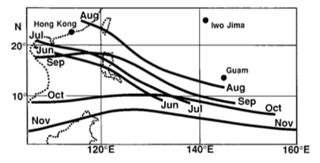
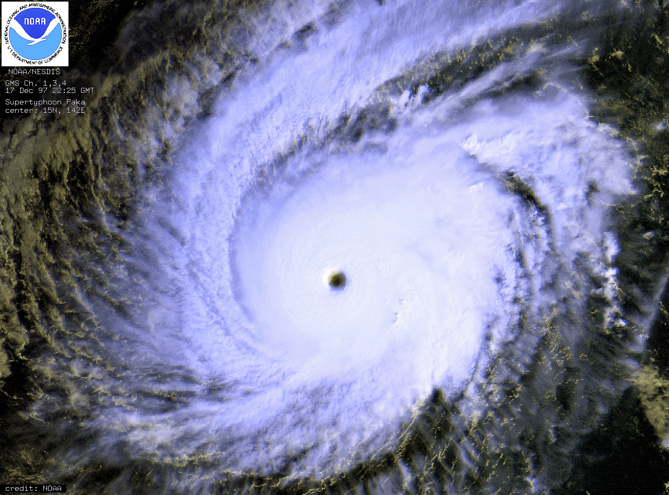
Background: Monsoons
“seasonal reversal of winds”
Monsoon Trough
band of low pressure
southwest winds
Tropical Cyclones
Notes:
Explain what a monsoon is:
Monsoon trough = low pressure trough
Trough migration is unique to WNP
TC Paka
Image: http://web.gccaz.edu/~lnewman/gph111/topic_units/pressure_winds/pressure/high_low_vertical.jpg
Image: http://www.physicalgeography.net/fundamentals/images/surfacecirculation.gif
Image: https://i.ytimg.com/vi/KQZdSul3Kgk/maxresdefault.jpg
Image: http://www.clker.com/cliparts/K/K/x/n/7/H/rain-md.png
Image: https://upload.wikimedia.org/wikipedia/commons/7/7a/Typhoon_Paka.gif

Slide 22
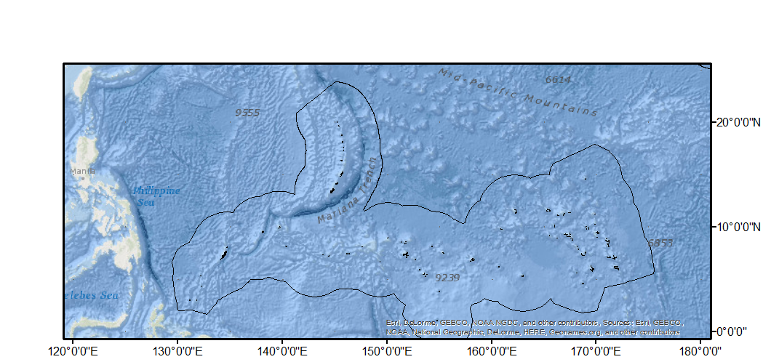
Methods: Monsoon
User’s Monsoon Criteria
1) Rain rate > 0 mm/hr 2 + days 2) Southwest wind direction
Frequency Maps
June – October
Average Number of Monsoon Days Per Year
ACCESS1-0 daily
Wind direction and precipitation rate
Notes:
We used criteria from our partners to define monsoons and compiled into future decades. Marked cells as “yes monsoon happened here on this day or not” and counted number of yes days in a decade, normalized to year
Image: http://cliparting.com/wp-content/uploads/2016/07/Free-magnifying-glass-clip-art.png
Image: https://i.stack.imgur.com/qPzBM.png

Slide 23
Results: Monsoon
Historic Period
2090-2099
ACCESS1-0 Resolution:
1.241 x 1.875 degrees
Notes:
We see an increase in the number of monsoon days in the Fed States of Micronesia at the end of the 21 century.
** location of monsoon trough == potential forecasting of TCs

Slide 24
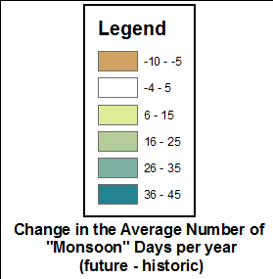
Results: Monsoon
ACCESS1-0 Resolution:
1.241 x 1.875 degrees
Notes:
We see an increase in the number of monsoon days in the Fed States of Micronesia at the end of the 21 century.

Slide 25
Discussion
Limitations
Model selection
Spatial resolution
Future Work
Compute multi-model ensemble
User engagement & tradition environmental knowledge
Definition of "event"
Notes:
The limitations in our methodology were A,B,&C. This will lead to future work that will address the limitations by computing an MME and engaging TEK.

Slide 26
Conclusions
GISS-E2-R model best represented the climate variables against satellite observations
FSM & and RMI expect to have more days of intense rain and less days of intense wind
1
50
50-yr return level rain and wind events vary locally and support trends in percentile results
Monsoon events expect to increase in frequency in most of the Western North Pacific

