Slide 1
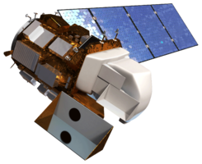
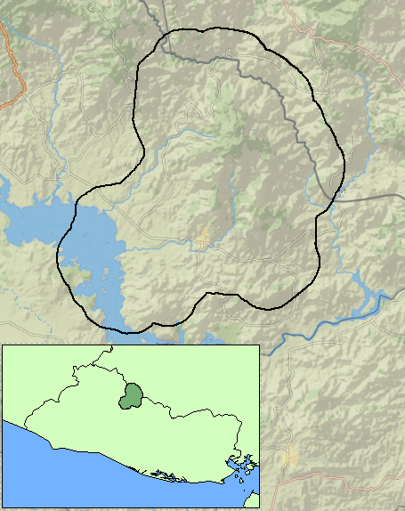
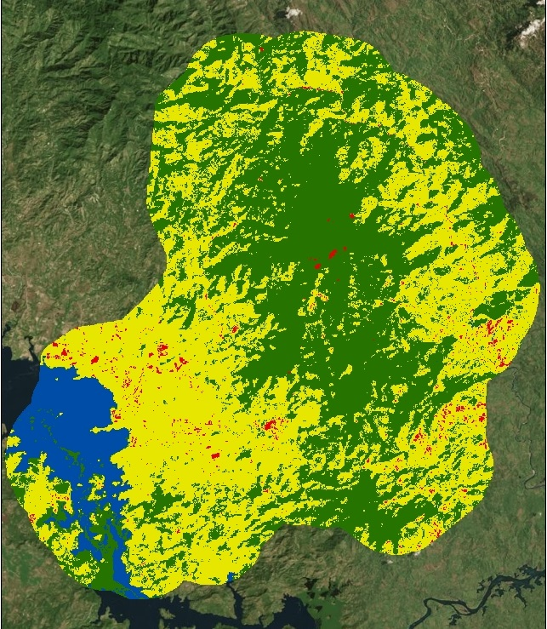
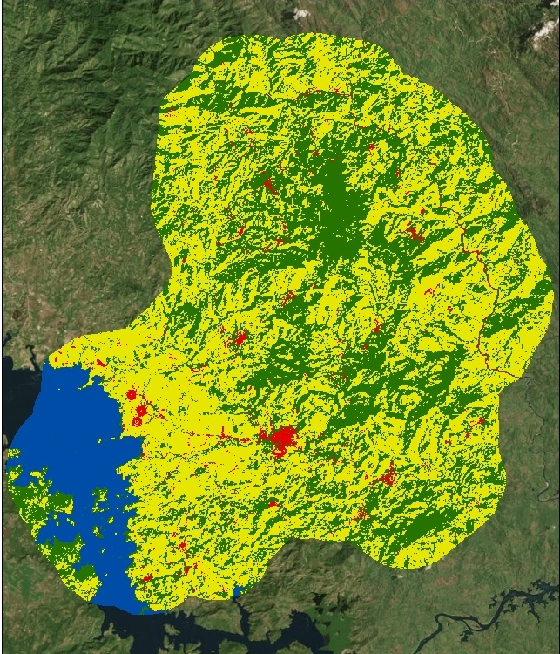
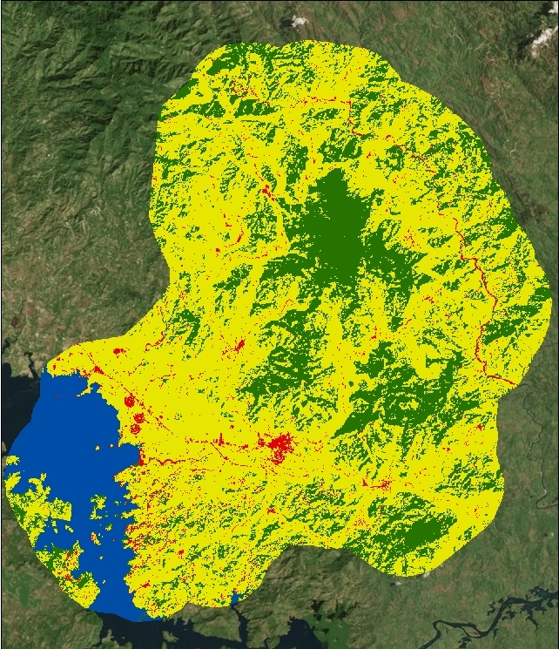
El Salvador Ecological Forecasting II
Utilizing NASA Earth Observations to Develop a Historically Based Trajectory of Deforestation and Forest Degradation in El Salvador
Britta Dosch (Project Lead), Garrett Kidd, Labreshia Mims, Rebekke Muench, Jacob Patrick, and Amy Wolfe
NASA DEVELOP National Program at NASA Langley Research Center
Abstract
The micro-region of La Mancomunidad La Montañona in Chalatenango, El Salvador is a hilly, forested area with a population dependent upon subsistence and livestock farming, often utilizing slash and burn agricultural techniques. Unfortunately, due to a number of factors, the forests are threatened by deforestation and degradation and are in need of comprehensive management strategies. Using NASA Earth observations in collaboration with El Salvador’s ministry of the environment, Ministerio de Medio Ambiente y Recursos Naturales (MARN), the Earth Institute at Columbia University, and Agroforestry for Biodiversity and Ecosystem Services (ABES) Project, a methodology was developed for stakeholders and policy makers to monitor long-term changes in forest cover and to predict significant changes in woody forest biomass. A baseline time series showing forest cover and land use land cover (LULC) from December 1986 to January 2016 during the dry season was used to forecast forest cover change through the year 2030. These predictions will allow stakeholders to identify at-risk regions to focus forest conservation efforts and management strategies.
Earth
Observations
Objectives
Develop methodology for monitoring and forecasting ecological change in study area
Delineate Land Use/Land Cover (LULC) using four predominant land categories: water, rural/non-forest, forest, and urban
Quantify the rate of change for each land category over the years 1986 to 2015
Identify patterns in LULC changes, with primary interest in forest cover change
Forecast land changes to the 2030 dry season using historical LULC patterns
Landsat 5 TM
Shuttle Radar Topography Mission
Study Area
Data Processing
Training sites created in ArcGIS
Data Analysis
End Products
Historical land use/ land cover maps
Google Earth Engine
Delineated watershed
2030 Forecasting model
Classifications & accuracy assessment
Rate of change calculation
Confusion matrices
Calculated distance to water and roads
Percent slope and aspect
2015 RapidEye Imagery
ABES Project Field Survey Data
Shuttle Radar Topography Mission (SRTM)
Landsat 5 TM & 8 OLI
Data Acquisition
TerrSet Land Change Modeler forecasting
Open Street Map
La Mancomunidad La Montanona, Chalatenango, El Salvador
Methodology
Landsat 8 OLI
Honduras
Guatemala
Honduras
Results
El Salvador
N
1986 Dry Season
Random Forest Classification
2015 Dry Season
Maximum Entropy Classification
2030 Dry Season
Forecast Model Classification
--Study Area
Conclusions
NASA Landsat imagery coupled with Google Earth Engine are easily accessible and useful tools for identifying land cover change.
Urban expansion played a minor role in forest reduction.
Rural/non-forest expansion had a significant impact on deforestation, specifically along the forest edge.
Deforestation and forest degradation will continue to occur if the current land change trends remain constant.
Legend
Water
Forest
Urban
Rural/Non-Forest
Team Members
Project Partners
Acknowledgements
Collaborator:
The Earth Institute, Columbia University (ABES Project) POC: Dr. Sean Smukler & Sean Kearney
USAID El Salvador Mission
POC: Dr. Jason Landrum
End Users:
Ministerio de Medio Ambiente y Recursos Naturales (MARN)
POC: Giovanni Molina
Dr. Kenton Ross
NASA DEVELOP National Program
Emily Adams
NASA DEVELOP National Program
Previous contributors from NASA DEVELOP Fall 2015: Jordan Ped, Courtney Duquette, Clarence Kimbrell, Susannah Miller, and Stephen Zimmerman
Britta Dosch Garrett Kidd Labreshia Mims
Rebekke Muench Jacob Patrick Amy Wolfe
Langley Research Center

