Slide 1
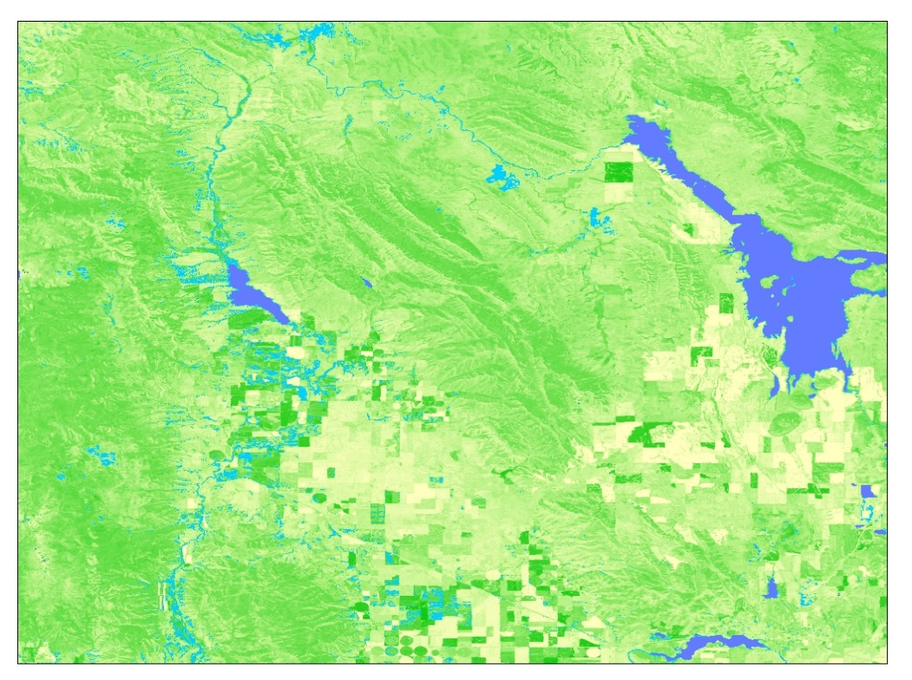
Southeastern Idaho Water Resources
Leveraging NASA Earth Observations to Identify Existing Surface Water Features and Improve Water Management and Resource Allocation in Southeastern Idaho
SOUTHEAST IDAHO WATER RESOURCES
Traci Olson (Project Lead)
Leveraging NASA Earth Observations to Identify Existing Surface Water Features and Improve Water Management and Resource Allocation in Southeastern Idaho
Cody O’Dale
Dylan Thomas
Caitlin Toner
Courtney Ohr
Notes:
Hi I’m Traci let me introduce you to our team:
I am the project lead
Cody O’Dale: Arc and Python
Dylan Thomas: video and public relations
Caitlin Toner: our assistant center lead and NASA’s communications fellow
Courtney Ohr: center lead
Let’s talk about water resources in the desert of southeastern Idaho

Slide 2
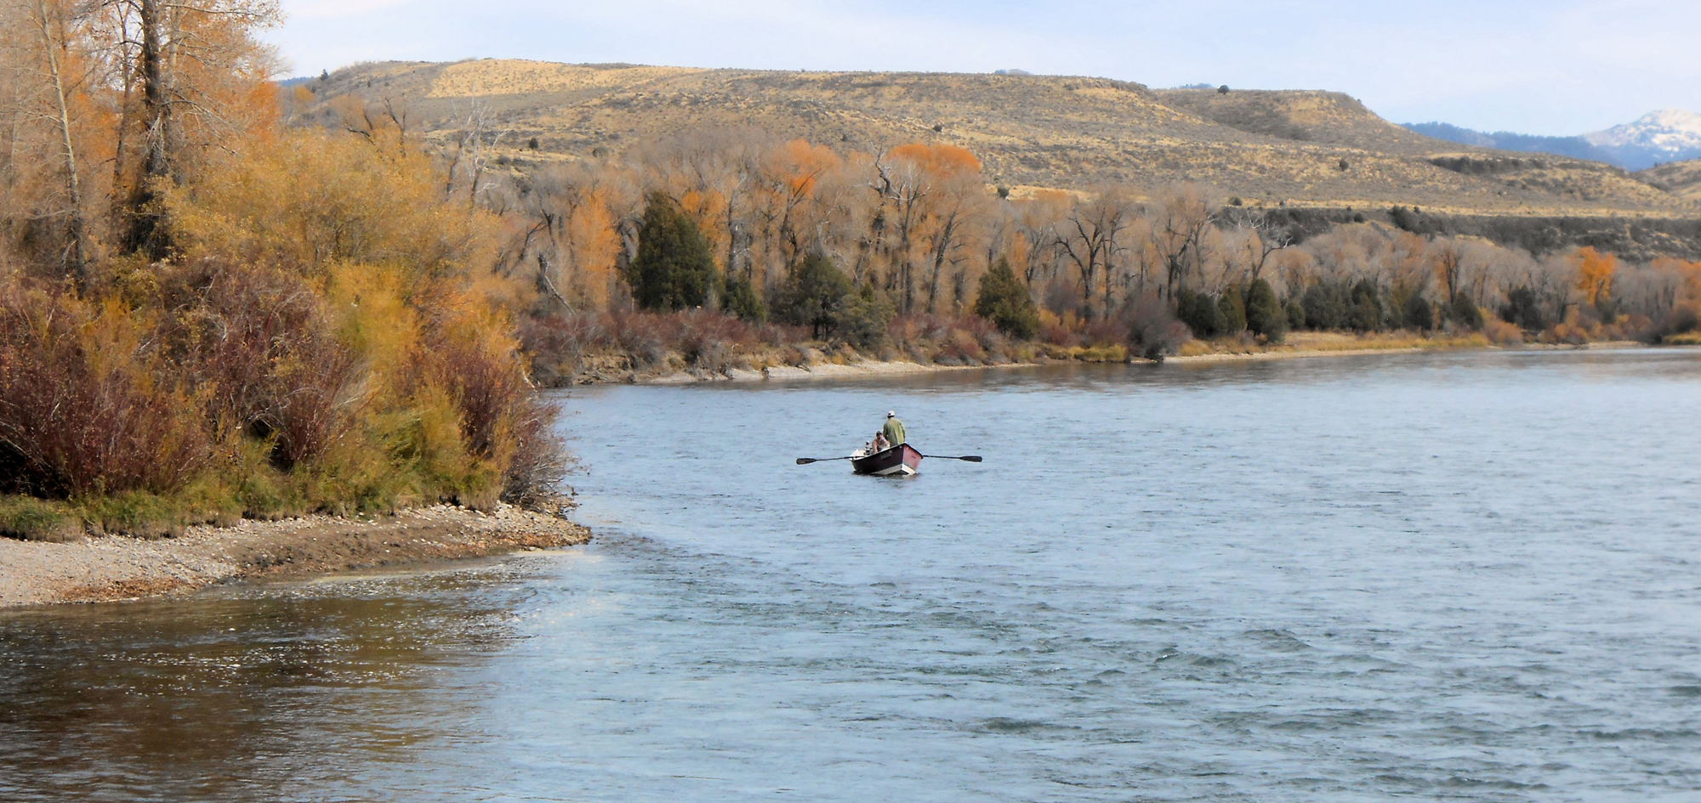
Background
Semi-arid region = limited water
Economic resource
Ecological benefits
Images credit: Traci Olson
Notes:
Living in a semi-arid region means that water is a very limited resource.
Resource managers have to consider economic concerns like use by domestic stock or diversion for agricultural irrigation.
…but also we need to protect our resources for ecological benefits. Idahoans love hunting, fishing, and recreation on public lands, and all must be supported by healthy ecosystems.

Slide 3
Study Area
Wildfire protection
Sensitive species
Partners:
Easter Idaho Bureau of Land Management
Idaho Department of Water Resources
Image Source: ESRI, OpenStreeMap, GIS user community
Notes:
These ecological concerns branch into many areas in a semi-arid climate. Water is a vital resource in fire suppression, but also in protecting all the species diversity.
Over the past couple of decades, water management practices have become more of a concern. Our partners, Eastern Idaho Bureau of Land Management and Idaho Department of Water Resources, focus a lot on water management. To execute effective management practices, it’s important to have reliable data and information about where water exists in the region.

Slide 4
Community Concerns
Local Knowledge
Outdated Maps
Field Research
National Hydrography Dataset (NHD)
Image Source: ESRI
Lines: NHD
Notes:
The Bureau of Land Management, or BLM, needs to know where water bodies exist in order to protect or restore natural habitats. Further, water must be as thoroughly accounted for as possible for water adjudication. Their current methods include: using local knowledge, having people go out into the field (land held assessments), and using the National Hydrography Dataset (NHD). Going out into the field is time consuming and costly, while the National Hydrography Dataset has high amounts of error for our study area.
This image shows some downfall of the NHD.
(((((((use animation here))))))))
1. On the left, the flowline links together several separate ponds and ignores the ridge created by the old railroad.
2. To the right of the current railroad tracks you can see where the NHD flowline did not follow the river in several places,
3. …and it branches off right through farmland and a rural residential area.
Why NHD is insufficient: As you can see, the NHD is outdated and would need frequent updates to stay current. Consequently, it does not accurately represent the needs for land managers.
For instance, the BLM is required to place a buffer around each NHD river or stream before they can implement weed control, even if water does not exists in those areas. This can allow for continued inhabitation of invasive species and increase control costs. They are also required to claim the water bodies they manage for water rights adjudications, which entails documenting the waterbody location with georeferenced photographic evidence.
The Idaho Department of Water Resources (IDWR) also uses the NHD, combined with local knowledge and maps, to identify water sources. Surface water bodies are important to IDWR because these water sources are often tied to many regulations. IDWR uses this information to decide annual allowances of water usage and diversions. The standard use of the NHD increases BLM’s resource costs and the likelihood of the IDWR making inaccurate water rights decisions.

Slide 5
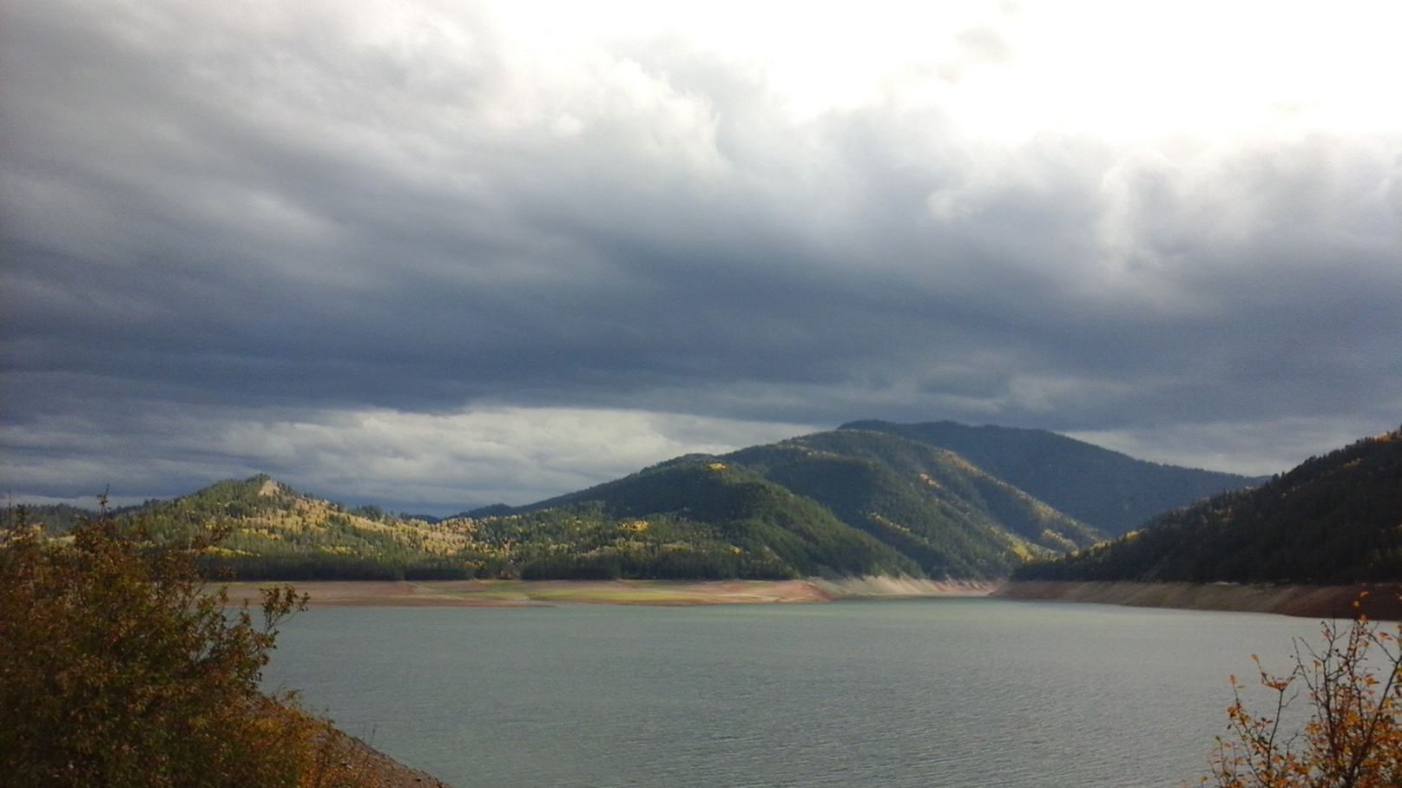
Objectives
Improve water monitoring and detection
Leverage NASA earth observations
Create Surface Water Indication Model (SWIM)
JavaScript for Google Earth Engine
Python script in ArcMap 10.3
Photo Credit: Traci Olson
Notes:
To bridge these shortcomings, past studies have looked at identifying water bodies using various water indices (McFeeters, 2013) or classification trees (Wright & Gallant, 2007).
Used alone, each method falsely identifies water from features like the shadows of mountains and clouds (Jin et al. 2013), urban asphalt (Feyisa et al. 2014), basaltic lava flows, or dark vegetation (Jawak et al. 2015). This study combines each method into a single tool to create a more accurate surface water indicator.
Hence, the SWIM tool will be used by our partners to identify surface water in their management area by utilizing the most current NASA Earth Observations. Most importantly, they can create temporal comparisons of surface water to monitor changes in water resources.
(side note: this image is Palisades Reservoir at the dam, September 2016 reported below 25% capacity)

Slide 6
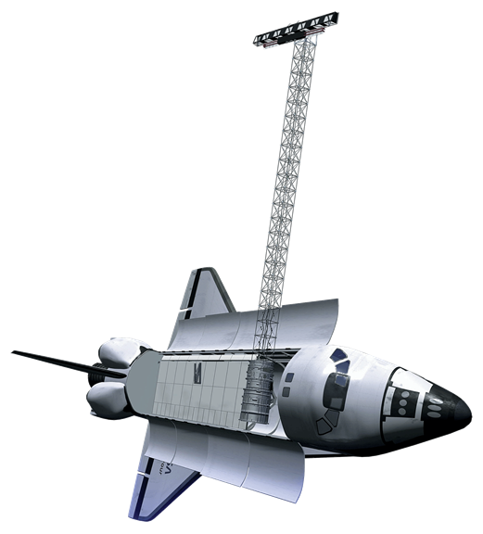
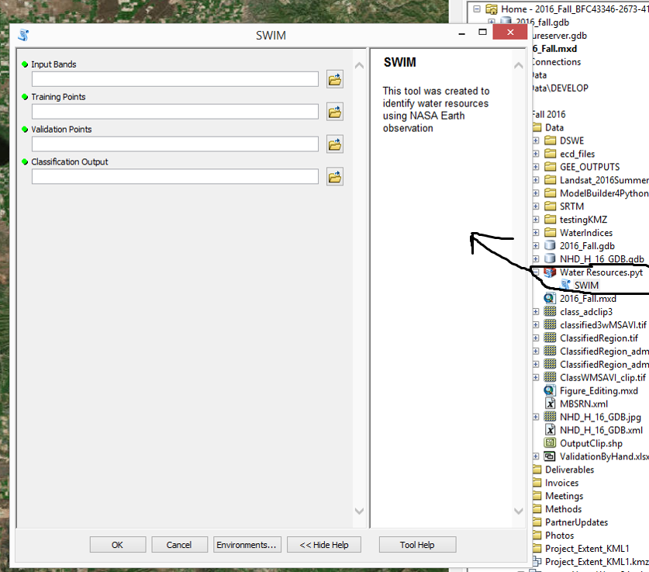
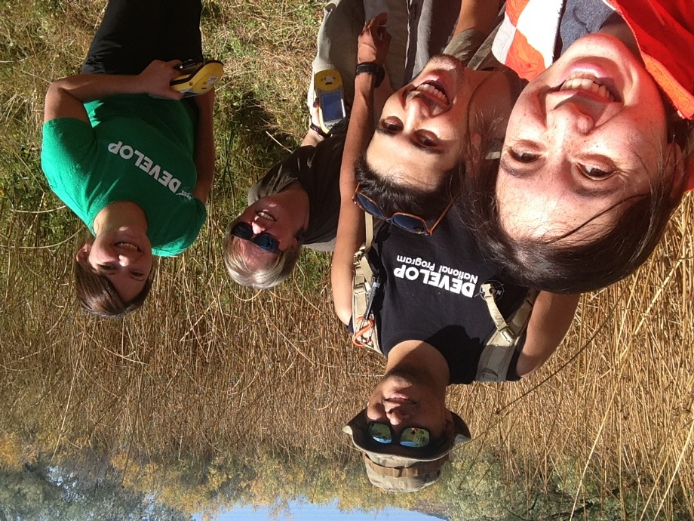
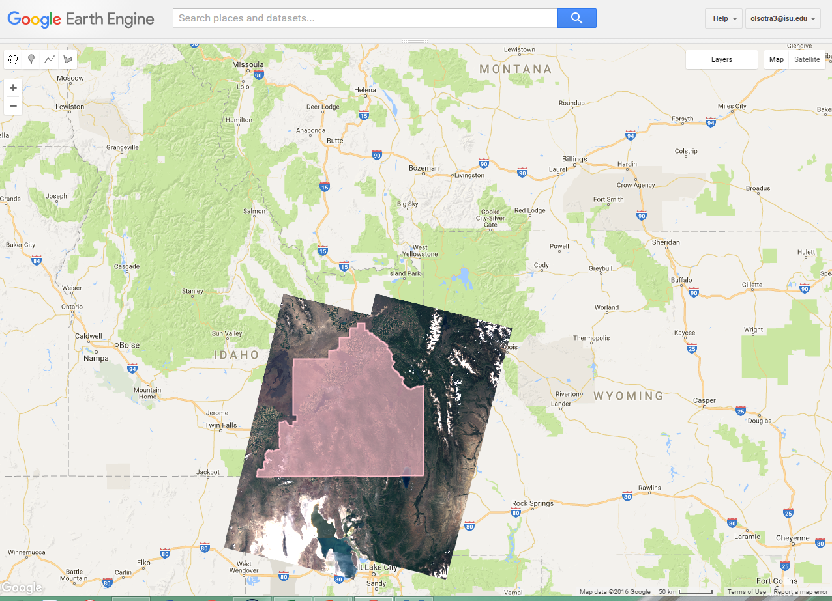
Surface Water Indication Model (SWIM)
Landsat 8 OLI and TIRS
Shuttle Radar Topography Mission (SRTM)
Google Earth Engine and ArcMap
Georeferenced points from field site
GPS
Notes:
To create our Surface Water Indication Model (SWIM):
We used Landsat 8 for spectral bands and SRTM for the topography component.
If you look down here you will see the four Landsat scenes needed to cover the study area: the included paths 38 & 39, rows 30 & 31.
We also utilized Google Earth Engine and ArcMap 10.4 to create the SWIM tool so that it can be used across two separate platforms.
Let’s go over each of these platforms

Slide 7
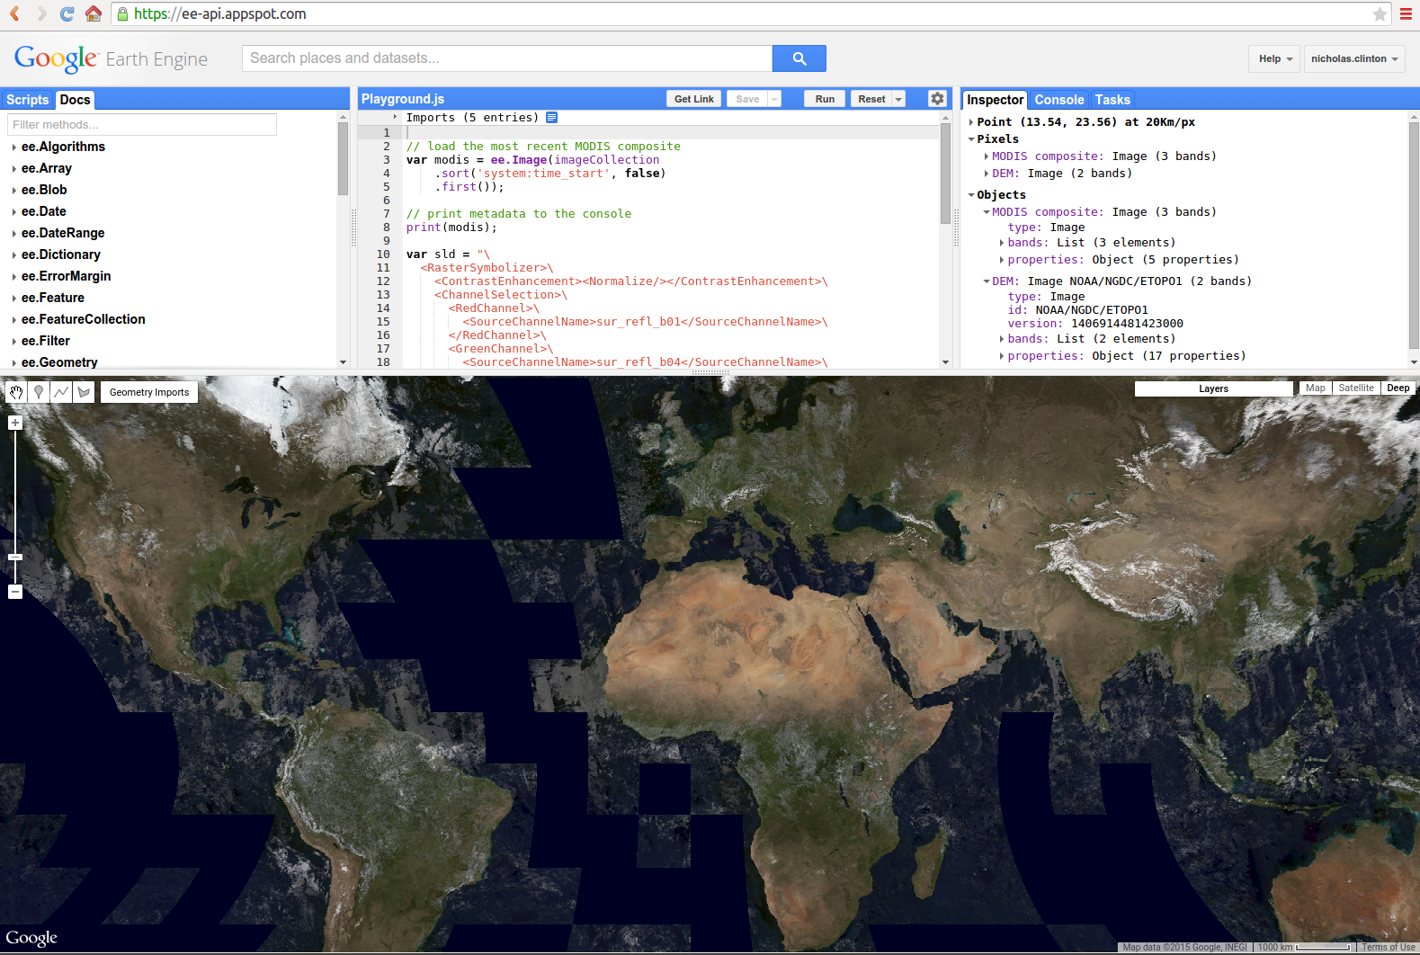
SWIM in Google Earth Engine
Easy sharing ability
Powered by Google Servers
Hosts many imagery datasets
Ability to run large dataset without issue
Uses Python and JavaScript API
Archives Sentinel – 2 imagery and other datasets
Notes:
Google’s Earth Engine is an internet-cloud-based geospatial platform that processes remotely sensed data. This platform integrates a variety of available public datasets and utilizes Google’s server capacity to perform a plethora of geospatial processing. Landsat 8 and other image collections which can be seamlessly called into a map and filtered through many types of algorithms.
We used Earth Engine because the scripts and tools can be shared easily since it is hosted in a web format. The processing capacity is excellent because it uses the Google servers, and the google server hosts many different datasets. The ones we used for this project was Landsat 8 imagery and Digital Elevation Model imagery. Datasets already archived in the google server saved us time from finding and downloading the images from USGS website. For term two we plan on utilizing Google’s already archived dataset of Sentinel-2 imagery. This is interesting because ESA the host of Sentinel-2 imagery only keeps the data on a rolling 6-month archive.
There are three major components to the Google Earth Engine API. The top left is where the catalog of scripts are saved. Documents and example scripts are there for reference. The top center is the code editor where all the variables and commands are written. The top right panel provides more information of the data that was processed. Finally, the map below is where the images are displayed.
This tool will require user to change the time period and landsat scene before running the model.
A downfall of this platform is that it may inhibit use by persons who are intimidated by editing script, however it does allow users further control over the variables used in the model.

Slide 8
SWIM in ArcMap
Easy Usage
ArcMap is available to many users
Does not allow flexibility with editing.
Notes:
The ArcMap platform was used because users will not need to edit a script, instead it looks like any other tool within ArcMap.
As you can see here, the tool is added to the catalog. Things to put into the tool are input bands, such as landsat and DEM imagery. Users can import their own shapefile training points and then determine how many of these points will be used as validation points. The tool will then run a classification model that takes into account all of the water indices, elevation, thermal bands, etc to produce a classification map that identifies water bodies.

Slide 9
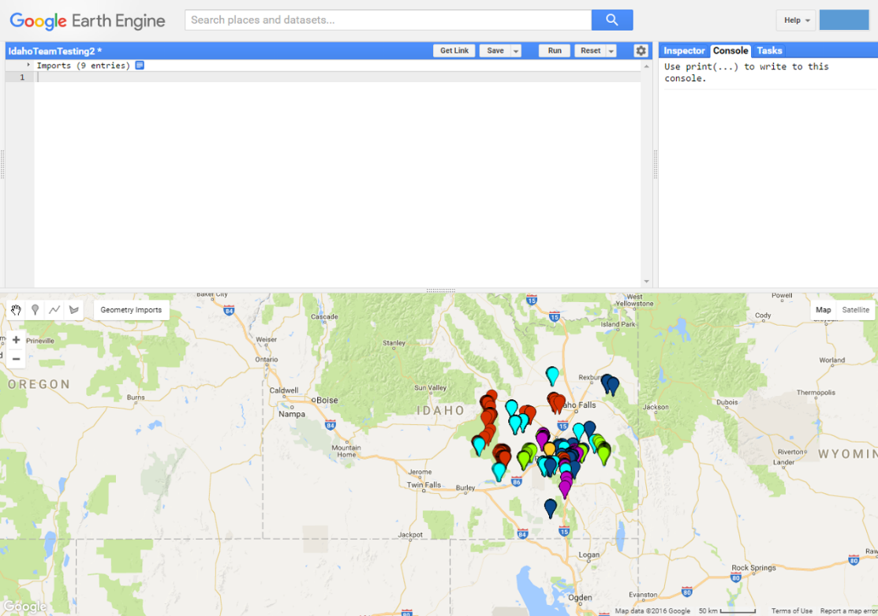
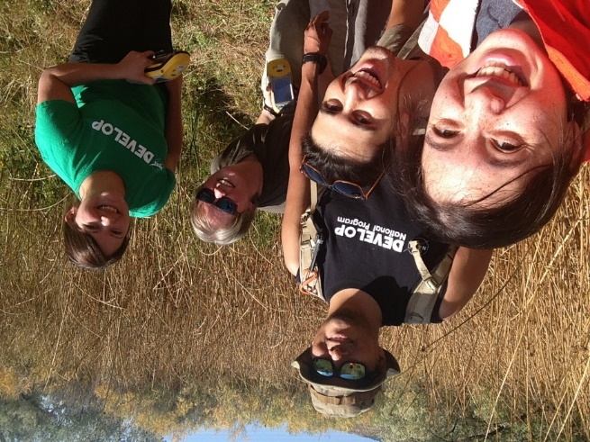
Georeferenced point
Identified Features were sampled in Earth Engine and taken in the field.
Classes:
Basalt
Sagebrush steppe or bare soil
Dark Vegetation
Partial Water
Open Water
GPS
Notes:
Before we show you the band inputs for the model, let’s talk about the points used to identify features.
The points used to identify features were sampled in the field and then collected within Earth Engine using the high resolution imagery available provided by Google. The total points used were more than 2,000. These points were grouped into five classes:
Basalt: sometimes water and basalt can be easily confused and therefore we thought it best to create a class that represents basalt alone
Sagebrush Steppe or Soil: this is supposed to represent bare earth or vegetation that is sparse which indicates a lack of available water
Dark Vegetation: because we want to use this tool to detect water that is not always there but supports a riverine habitat we need a category for lush vegetation
Partial Water: this is the water bodies that may have a canopy cover
Open Water: easily detected water

Slide 10
SWIM Workflow
Water Indices
MNDWI
AWEsh
MBSRV
MBSRN
MBSRV>MBSRN
Final Results
ArcMap
Accuracy Assessment
Topography
Classification of Surface Water
Slope
Aspect
Elevation
Support Vector Machine (SVM) Classifier
Final Results
GEE
Accuracy Assessment
Secondary Variables
SAVI
Iron ratio
Thermal band “B10”
Notes:
This is our simplified workflow.
We began with Landsat 8 scenes from June 2016 to make the water indices and the secondary variables
The added slope, aspect, and elevation from the Shuttle Radar Topography Mission (SRTM) is in the same 30 meter resolution as the Landsat scenes.
Our model had each of these layers written into the code and used as a band stack that was sent through the classifier.

Slide 11
Water Indices
MBSRV
MNSRN
NDWI
MNDWI
AWEsh
Notes:
Five different water indices were included in this analysis because they all bring different attributes to the model.
MBSRV and MNSRN or multi-band spectral relationship visible and near-infrared were used because the near infrared spectral ranges are absorbed by water making water features appear darker while the visible bands (green and red) highlights areas of vegetation. These two bands are compared to each other so that when pixels values have MBSRV greater than MBSRN the pixel is more likely to contain more water than vegetation.
Between the NDWI (normalized difference water index ) and MNDWI (modified normalized water index) we considered the MNDWI in this model because unlike NDWI, MNDWI uses the green band with the middle short wave infrared band. NDWI uses the near infrared band and often overestimate the amount of water due to spectral noise caused by vegetation and soil. The MNDWI is able to remove this noise therefore more effectively detect surface water bodies.
Finally AWEsh or the automated water extent with shadow index builds upon the water indices already discussed but it is a multiband index rather than a two band index. This index separates water and non-water dark pixels which allows us to get rid of false water detection when it is caused by shadowing. In other words, when a hill creates a shadow a two band method would show the shadow as a water body while the AWEsh will have a better chance of knowing it is not water body rather it is a shadow.

Slide 12
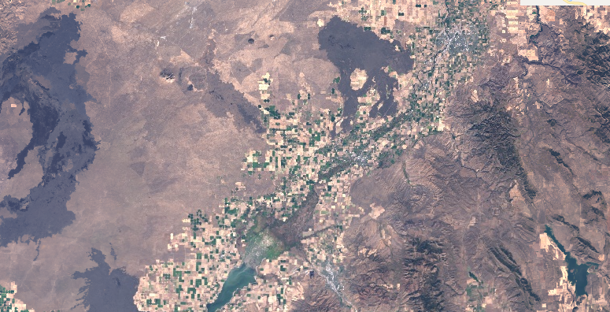
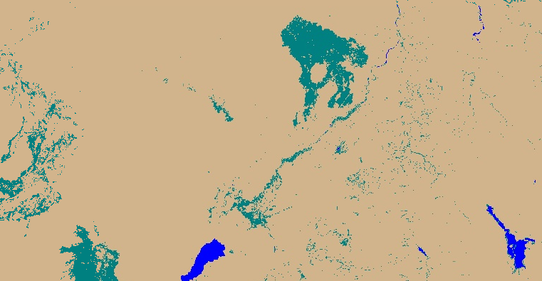
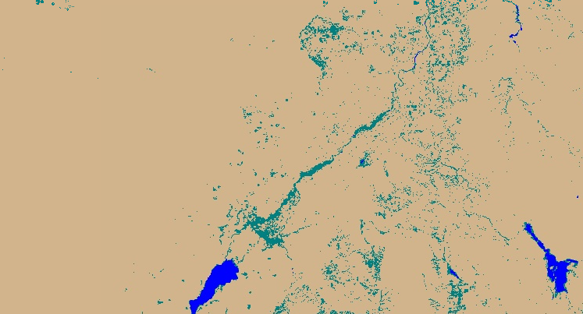
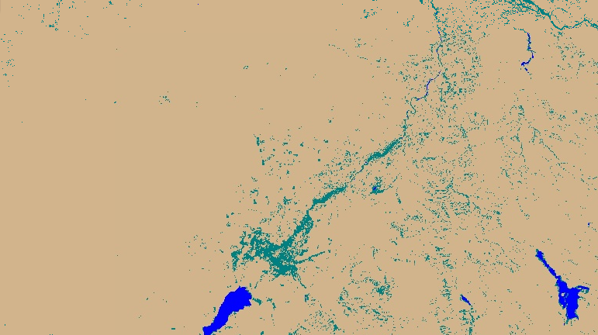
Basalt bands
Starting Landsat 8 scene
Without Iron Ratio
Without thermal B10
Both Basalt bands included
C
A
B
D
Notes:
Continuing along with the idea that water can be overestimated because of darker features, let’s talk about Basalt. The model included two separate layers that helped ensure that basalt was not identified as water – the iron ratio and a thermal band. So if we look at Craters of the Moon National Monument and some other bare-earth areas with exposed basalt you will see that in B & C basalt is detected as “partial water” when using only one or the other. In image D where both the iron ratio and thermal band are included, basalt is indicated as “not water” as it should be.

Slide 13
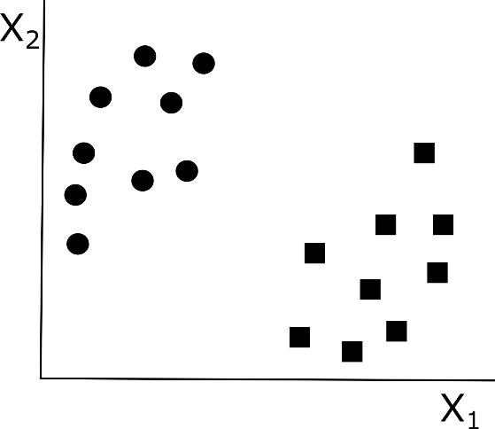
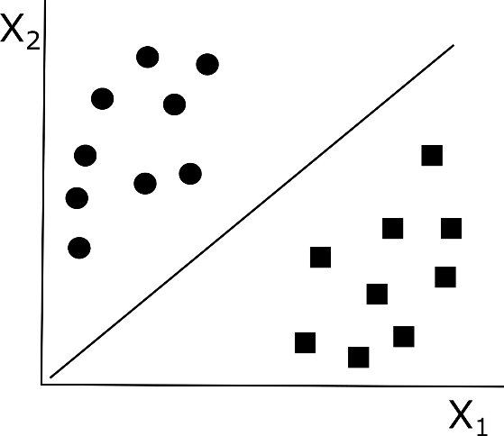
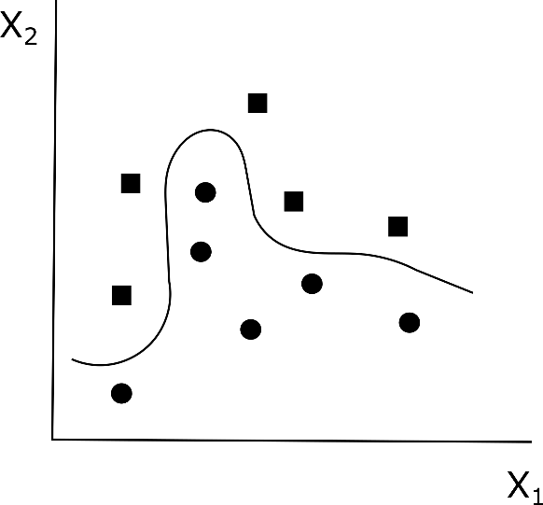
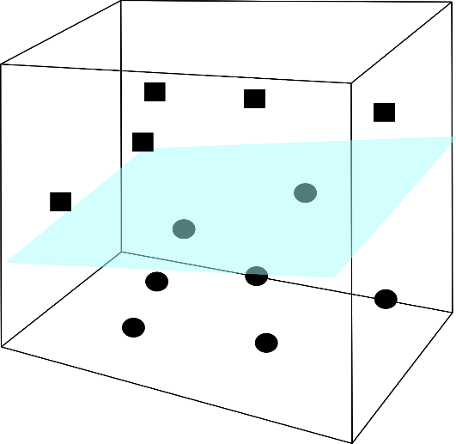
Support Vector Machine
A)
B)
Notes:
The classifier method used for this research is called Support Vector Machine, or SVM. The figure above displays how SVM works. The dots represent one data feature (such as water) and the squares are another data feature (non water features) that will be categorized based on how the line classifies them. The line (or classifier) classifies the features based on how we define water (if water has a particular value, while non water features have a different value). When the same data features don’t fit neatly next to each other, and become more mixed, the classifier takes the linear plane the features are on and puts them into a nonlinear feature space (kernelling) to be able to separate them.
This creates a hyperplane in the nonlinear feature space.

Slide 14
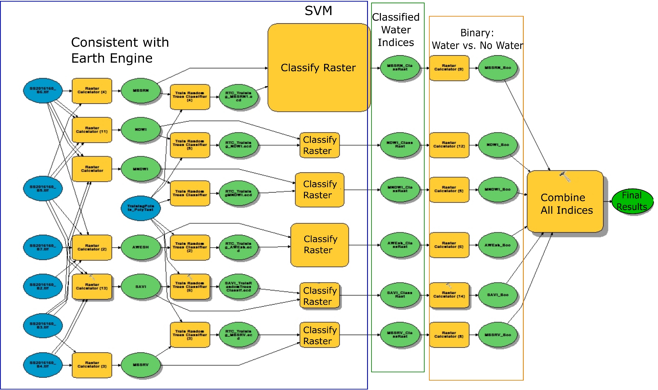
SWIM in ArcMap
Notes:
The SWIM in ArcMap differs from Google Earth Engine after the classifer. In ArcMap, after the bands have been classified they are converted into water vs. non water and then those bands are combined so that they are given a value of 0-5 where 0 means that the pixel was identified as non water across all of the classified water indices. 1 means that one of the five classified water indices showed that the pixel had water while 2 mean that two of the five classified water indices indicated water and so forth. This gave a degree of confidence for the ArcMap results. For instance, if a pixel is classified as 5 then we are highly confident that water was correctly identified for that pixel where a value of 1 means we have the lowest confidence that water actually exists there.

Slide 15
Results & Discussion
Final classifications tests as 87 percent accurate against validation points.
Partial water needs further restricting
Notes:
This is one of our classifications from Google Earth Engine. The to water classes are displayed in dark blue and light blue, while the three other non-water classes are displayed in white.
Intuitively I can zoom in on smaller area and think “yeah, I can see how there might have been water in this area on the day we gathered that Landsat scene” Things to look out for are that clouds may be labeled as water and block the actual land cover type. Additionally, some narrow streams are broken by vegetation but our indicator model usually still gives good impressions of those streams.

Slide 16
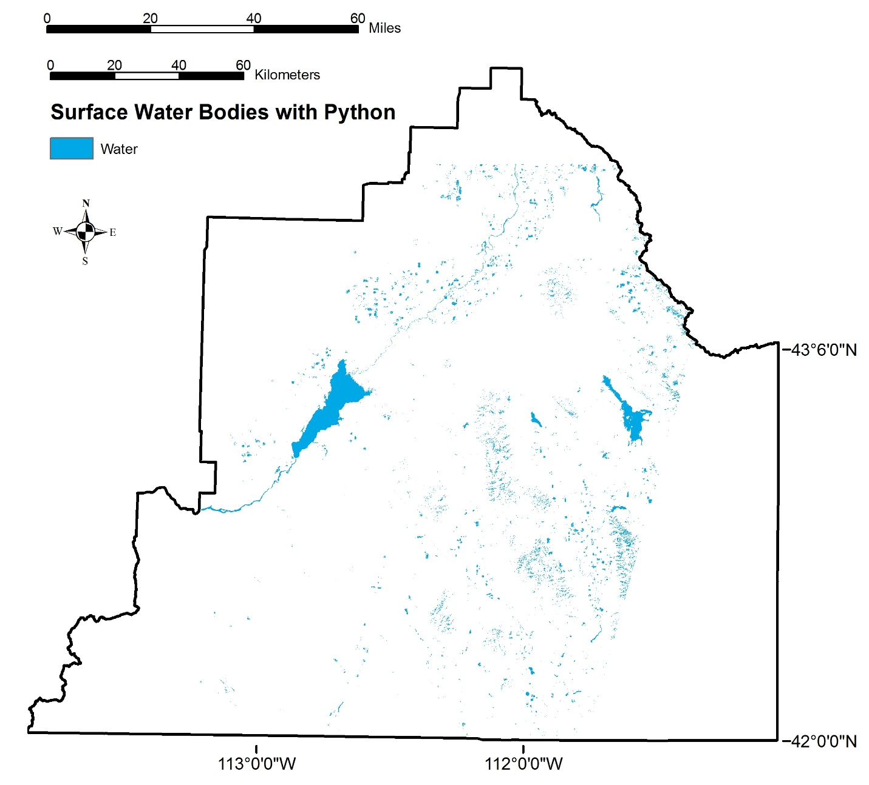
Results & Discussion
Final classifications tests as ~96 percent accurate against validation points.
Partial water class is more restricted however there are visually more areas of water than should be.
Notes:
This is the water classification using the python scrip within ArcMap.
Only one landsat scene was run for this initial analysis, but it does appear that we can already see a difference between the two platforms. As mentioned before, the Arc tool does not have landcover classes, but have classes from 0-5 based on level of confidence of it being water with zero being no confidence in water, and five being high confidence of water. In this map, any pixel that has at least a level one confidence of water is displayed in blue, and white is all the pixels with 0 water of confidence. With just a visual comparison we see the python map matches the GEE map for major water bodies, but some places such as the northern part of the American Reservoir do not show up in python while it showed up in GEE.

Slide 17
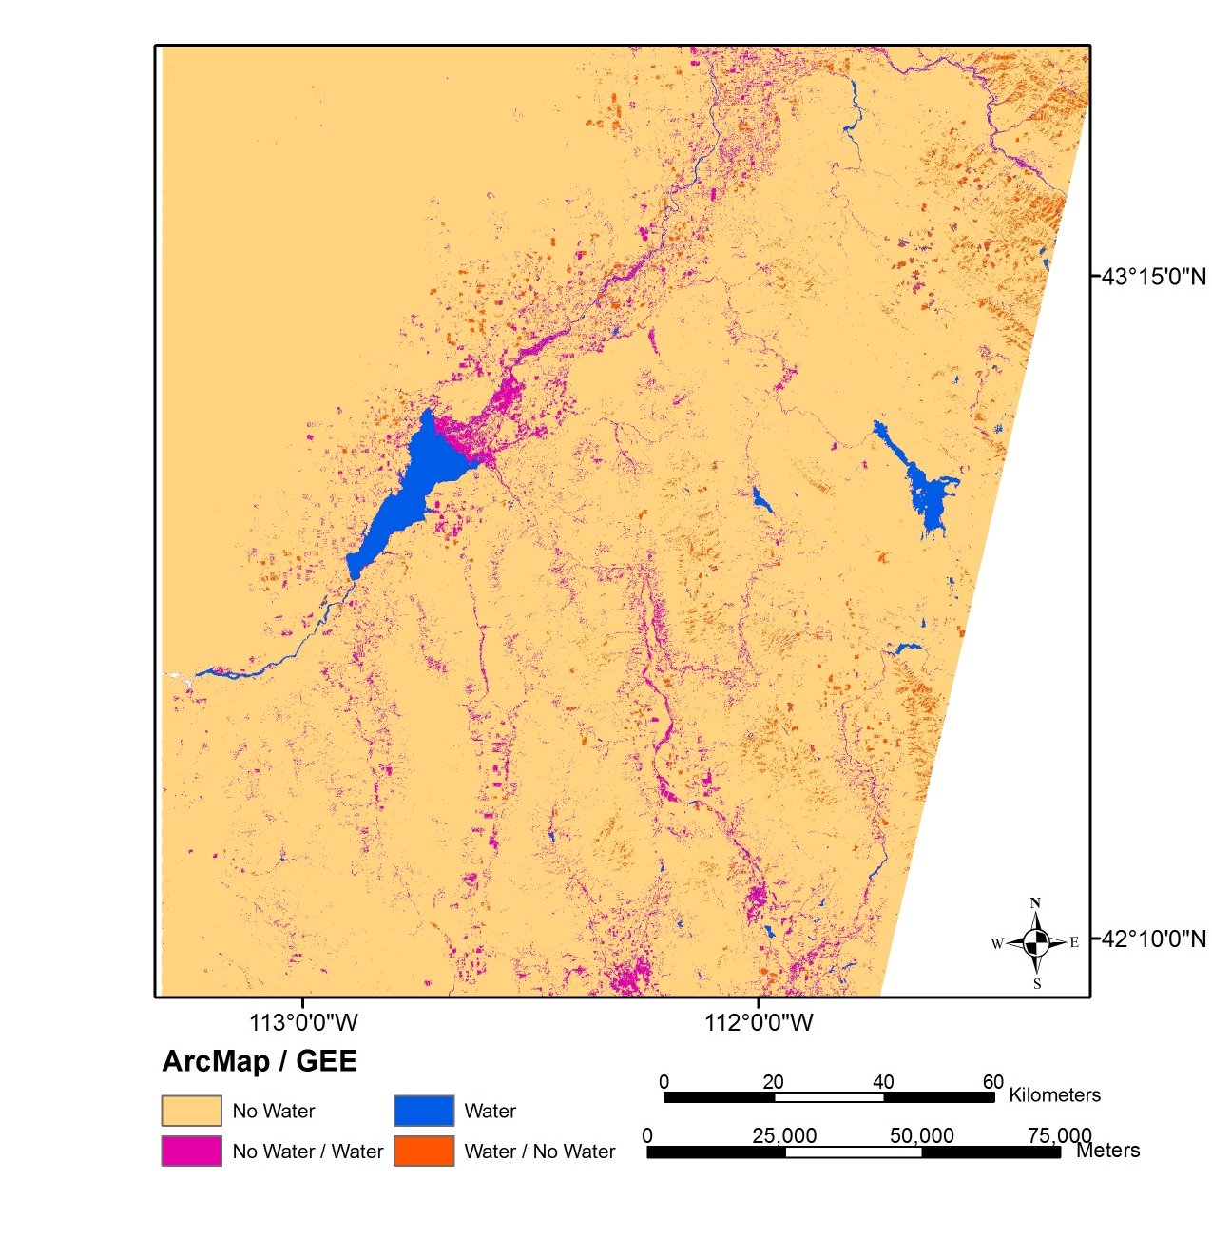
Earth Engine vs. ArcMap
ArcMap / GEE | Area
 | Square kilometer | Percentage
No Water | 25094.81 | 93.80%
Water | 333.0243 | 1.24%
No Water / Water | 930.4983 | 3.48%
Water / No Water | 394.1712 | 1.47%
Total Agreeance | 25427.84 | 95.05%
Total Disagreeance | 1324.67 | 4.95%
Reasons for disagreement
Classifier Performance
Model Difference
Notes:
When the results from the Earth Engine and ArcMap are compared we can see that for the most part they agree on where water is not, but there is some variation when it comes to where water is located. This could be caused by two separate things:
It cold be a difference of platform classifiers. Though SVM was the chosen classifier in each platform it does not mean they will operate the same or have the same abilities.
It could be that the last step after the classifier causes a difference in what is considered water and what is not.
Because most of the disagreement is sourced to when ArcMap says there is not water but GEE says there is water, the cause of disagreement is probably a mix of the two sources. The ArcMap platform itself may not be detecting as much of the partial water when compared to the GEE platform. In addition, those last steps in ArcMap where everything is turned into water vs. nonwater rather than attempting to determine whether or not all classes are consistent across each classified imagery; could result in more of the partial water detections becoming filtered out.

Slide 18
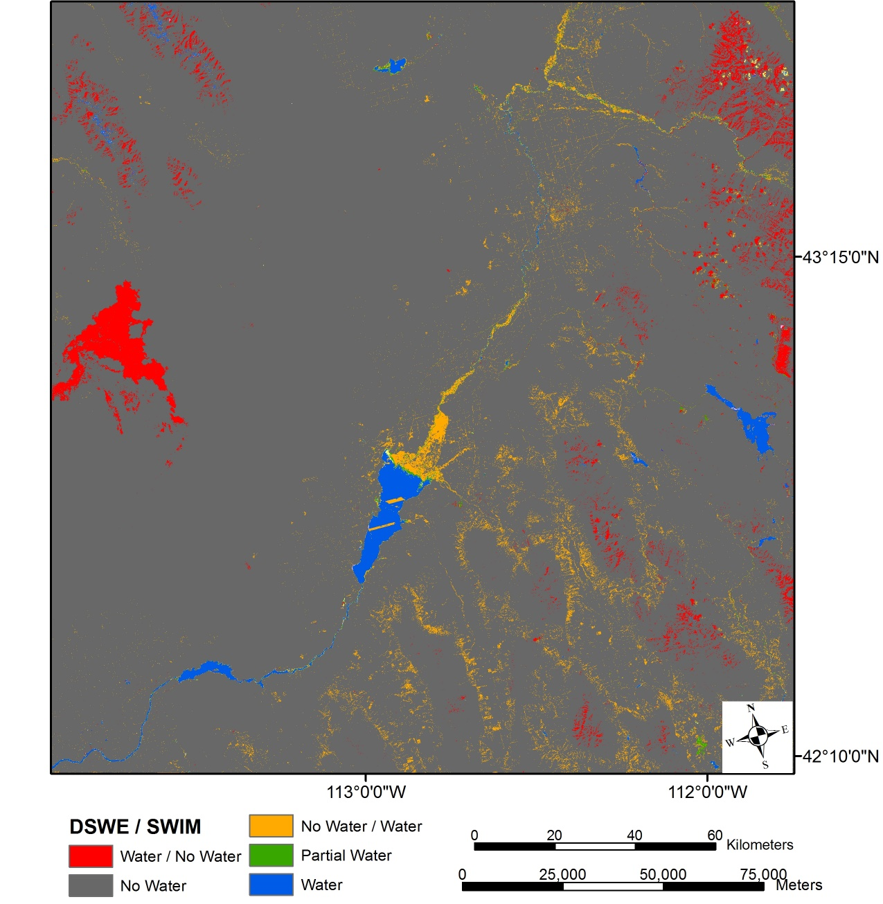
DSWE vs. ArcMap
DSWE / SWIM | Area
 | Square kilometer | Percentage
Water / No water | 872.0361 | 2.46%
No Water / Water | 900.0621 | 2.54%
Partial Water | 74.7441 | 0.21%
Water | 397.7991 | 1.12%
No Water | 33250.9608 | 93.68%
Total Agreeance | 33723.504 | 95.01%
Total Disagreeance | 1772.0982 | 4.99%
Reasons for disagreement
Classifier Performance
Model Difference
Notes:
The U.S. Geological Survey (USGS) is in the process of creating Dynamic Surface Water Extent (DSWE) products with the aim of providing increased spatial and temporal monitoring of the dynamics of non-ocean surface water extents. These products are being produced to include the entire archived and currently available Landsat imagery. The provisional invalidated data products that matched our study area and period were compared with the results from this project. This comparison included the full Landsat scene to maximize the evaluation. Prior to comparison an agriculture mask produced from the 2011 National Land Cover Dataset (NLCD) was applied the results produced within GEE in such a way that when the two results were compared the mask was also applied to the DSWE results. After this mask was applied the GEE no water, open water, and mixed water classes were compared to the five classes produced in DSWE, no water, high confidence of water, moderate confidence of water, and partial surface water. The classes for each of these results were generalized so that when a pixel was not classified the same between the two results, classes with classified with a confidence level or said to be partial water were shown as water.
Most of the 4.99% disagreement between DSWE and SWIM are due to DSWE classifying basalt as water and SWIM classifying non-water as water, where 2.15 % of the 2.54% of the No Water / Water comparison is due to partial water classification rather than open water.

Slide 19
Results
Overall accuracy is excellent
Accuracy of water detection is also excellent
There is a need to further restrict detected surface water
River fragmentation is present
Photo Credit: Evan Ohr

Slide 20
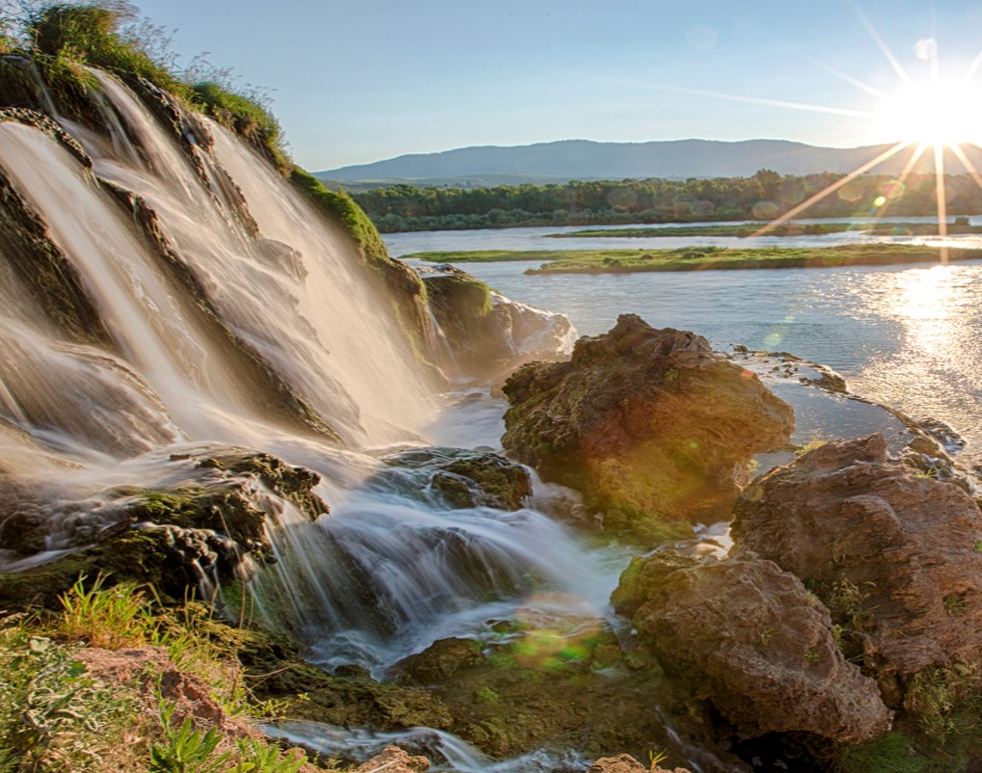
Future Work
Temporality
Seasonality
Probability index for intermittent and perennial water
Introduction of path-tracking algorithm to solve fragmentation problem
Create more thresholds to decrease false water detection
Photo Credit: BLM
Notes:
In order to more thoroughly understand how each model (DSWE, GEE, and ArcGIS) performs over time, an analysis will need to be run on more Landsat, and possibly Sentinel 2, scenes. This will establish each model’s robustness over time and determine how much more or less reliable our GEE and ArcGIS models are compared with the USGS’s DSWE.
Testing more scenes will reveal further information about our models’ performance under different seasons.
The model will need to discern between intermittent and perennial waterways. To accomplish this, a probability index will made to assess the likelihood of wet areas falling into one of these categories. The current results detected disjointed river networks, this problem may be fixed by employing additional variables and/or introducing new methods for boundary detection. For instance, a path-tracking algorithm can be applied to the pixels which indicates the likelihood of the pixel belonging to a linear feature and then connecting the features, this would aid in decreasing fragmentation. In addition, other thresholds may be necessary eliminate falsely identified water pixels.

Slide 21
A special thank you to our contributors for their time and assistance with this project
Advisors
Keith Weber, Lead Science Advisor (GIS Training and Research Center at Idaho State University)
Charles Peterson (Biology Department, Idaho State University)
Mark Carroll (NASA GSFC)
Project Partners
Karen Kraus, Bureau of Land Management (BLM), Range Technician
Michele Mavor, Bureau of Land Management (BLM), Fire Ecologist
Linda Davis, Idaho Department of Water Resources (IDWR), Senior GIS Analyst
Danielle Bruno-Fayreau, Idaho Department of Water Resources (IDWR), GIS Analyst
Others
Kelly Meehan, NOAA National Centers for Environmental Health, Geoinformatics Fellow
David Thau, Google, Senior Developer Google Earth Engine

