Slide 1
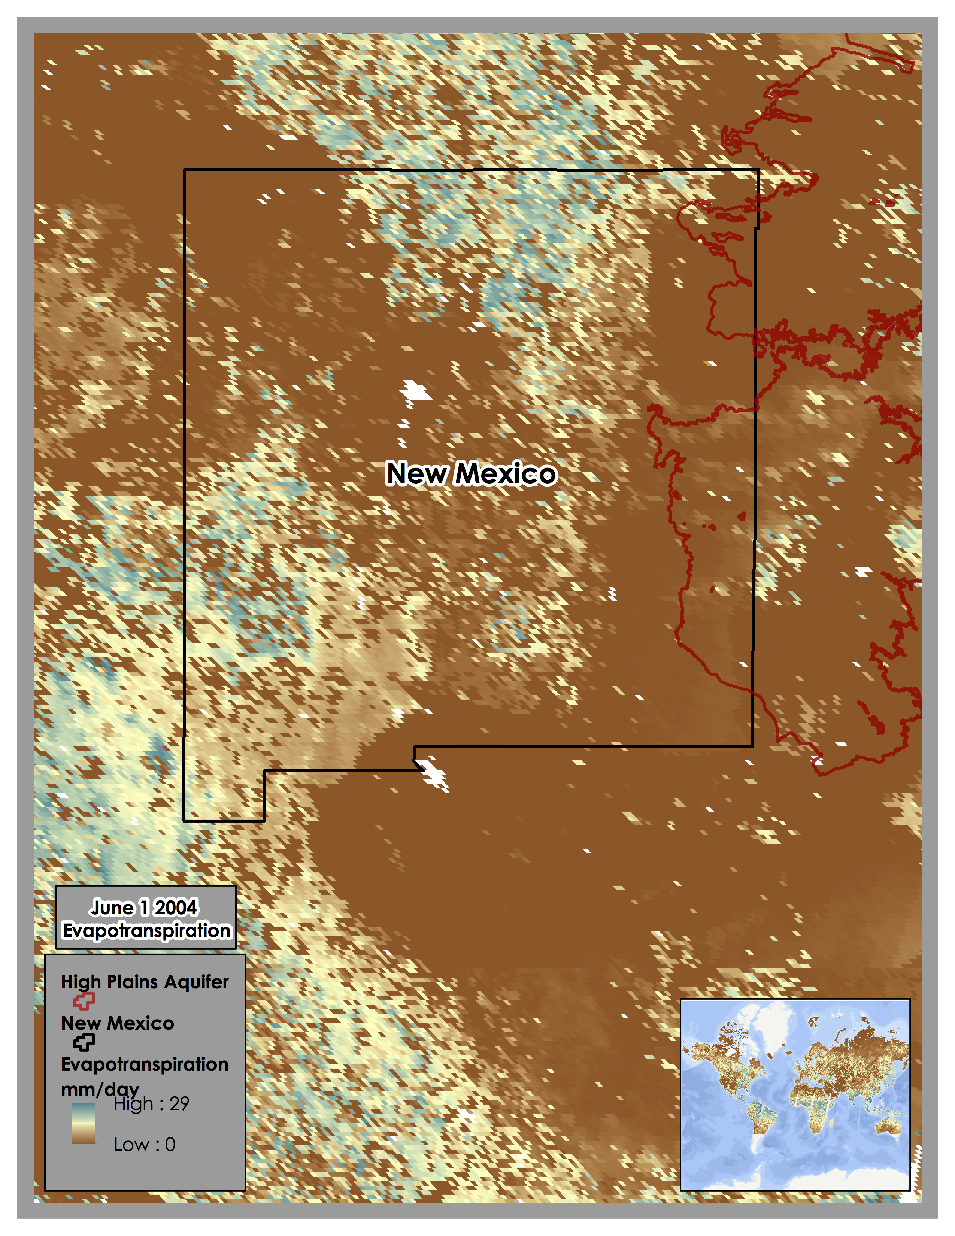
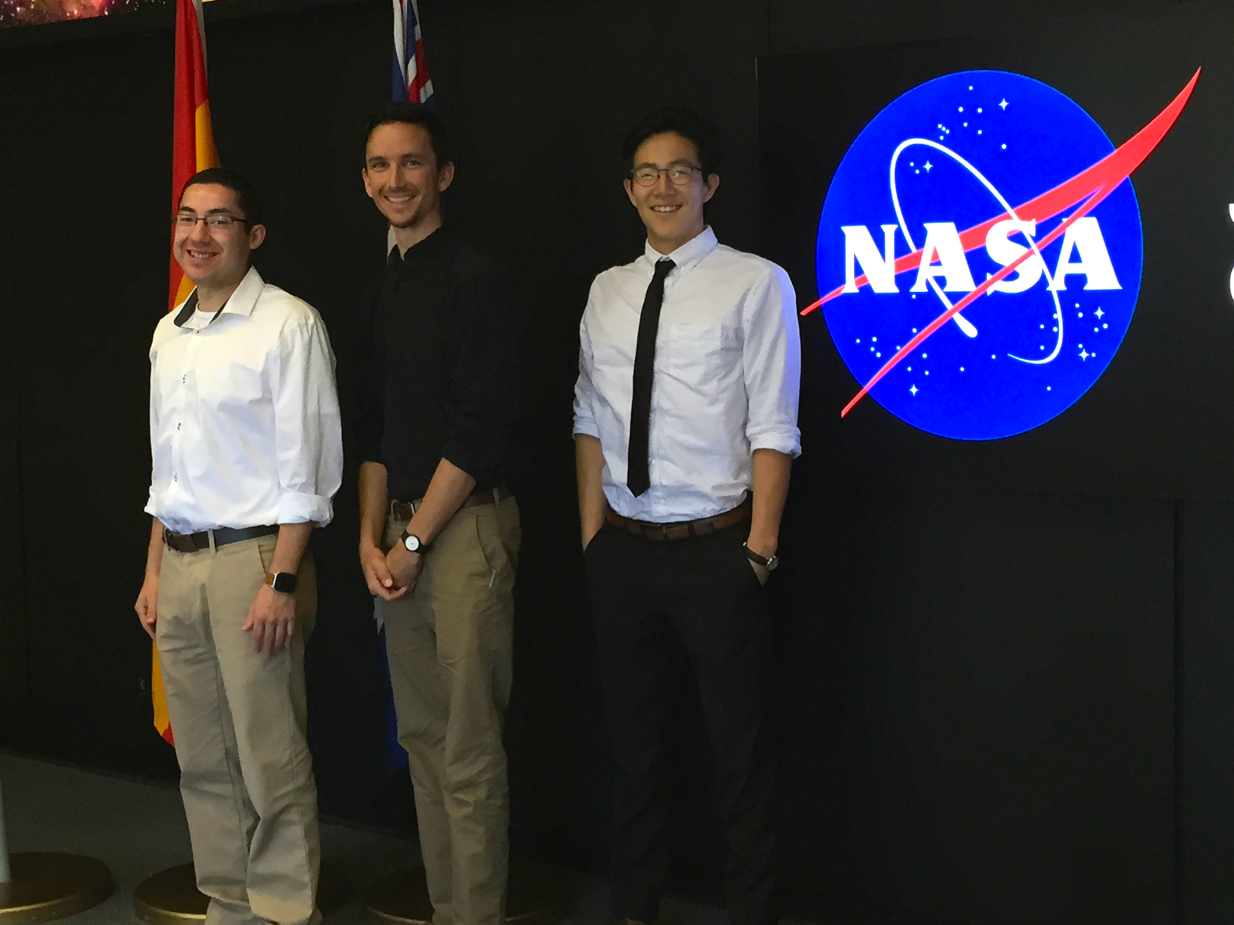
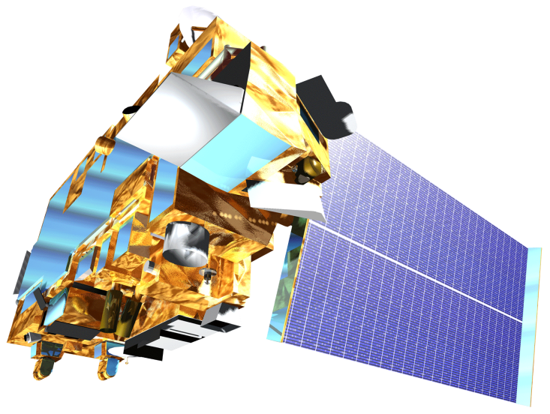

New Mexico Water Resources and Agriculture
Delivering automated evapotranspiration data to the New Mexico Office of the State Engineer for enhanced water resource decision making in New Mexico
Sol Kim (Project Lead), Agustin Muniz, Trevor McDonald
NASA Jet Propulsion Laboratory Summer 2015
NASA DEVELOP National Program at NASA Jet Propulsion Laboratory
Abstract
Objectives
As New Mexico is experiencing some of the most severe drought in the US, equipping water resource management with evapotranspiration data becomes increasingly vital. Knowledge of rangeland conditions is necessary for decisions regarding cattle management, emergency response for rapid rangeland and farmland deterioration, fire management risk decisions, and determining drought severity. New Mexico land managers and decision-makers currently assess rangeland conditions using spatially-limited in situ spot checks which provides limited information. Additionally, weekly Normalized Difference Vegetation Index (NDVI) and evapotranspiration products for New Mexico counties are not widely distributed nor easily accessible. By providing an automated, streamlined, non-proprietary evapotranspiration product to the New Mexico Office of the State Engineer, New Mexico decision makers will have easy access to critical evapotranspiration data which will drive water resource decision making and drought assessment. To create the evapotranspiration product, we utilized the MODIS sensors on NASA’s satellites Aqua and Terra to retrieve several six MODIS land and four MODIS atmosphere datasets.
Automate MODIS data acquisition
Streamline evapotranspiration product generation and delivery to the New Mexico Office of the State Engineer
Disseminate products to decision-makers in the ranching, water resources, drought assessment and fire-response communities in the Eastern Plains Region of New Mexico through an easily-accessed online interface.
Study Area
Methodology
A visual representation of the automated data pipeline architecture. The pipeline initially retrieves the data and sends some data for processing. Once processing is done, all data is fed into an evapotranspiration (ET) algorithm to create ET outputs. The outputs will be hosted on a web server.
Data Retrieval
Pre-Processed Data
Internet
Data Conversion
ET Inputs
ET Algorithm
ET Outputs
Web Server
Databases
Results
Team Members
Earth Observations
Terra Aqua
Conclusions
Individual components of the pipeline successfully implemented.
Automation and integration of entire pipeline will continue in the next term.
Front end web server in the works for next term.
From Left to Right: Agustin Muniz, Trevor McDonald, Sol Kim
Project Partners
Acknowledgements
New Mexico Office of the State Engineer, End-User
We thank everyone who helped in our project. Science advisors Joshua Fisher, Greg Moore, and Manish Verma provided insight and expertise that greatly assisted the research. Gwen Miller, Christine Rains, and Daniel Jensen assisted throughout the project guiding us through deliverables and answering research questions.
Modeled Evapotranspiration (ET) within New Mexico, Blue indicates high ET while brown indicates low ET. ET was derived using the Priestley–Taylor based Evapotranspiration method and MODIS data. Image Credit: New Mexico Agriculture and Water Team.
NASA Jet Propulsion Laboratory

