Slide 1
Malawi Disasters II
Applications of Flood Definitions and NASA Earth Observations to Create a Flood Forecasting Methodology
Andrew Kruczkiewicz
Helen Cen
Brigitte Moneymaker

Slide 2
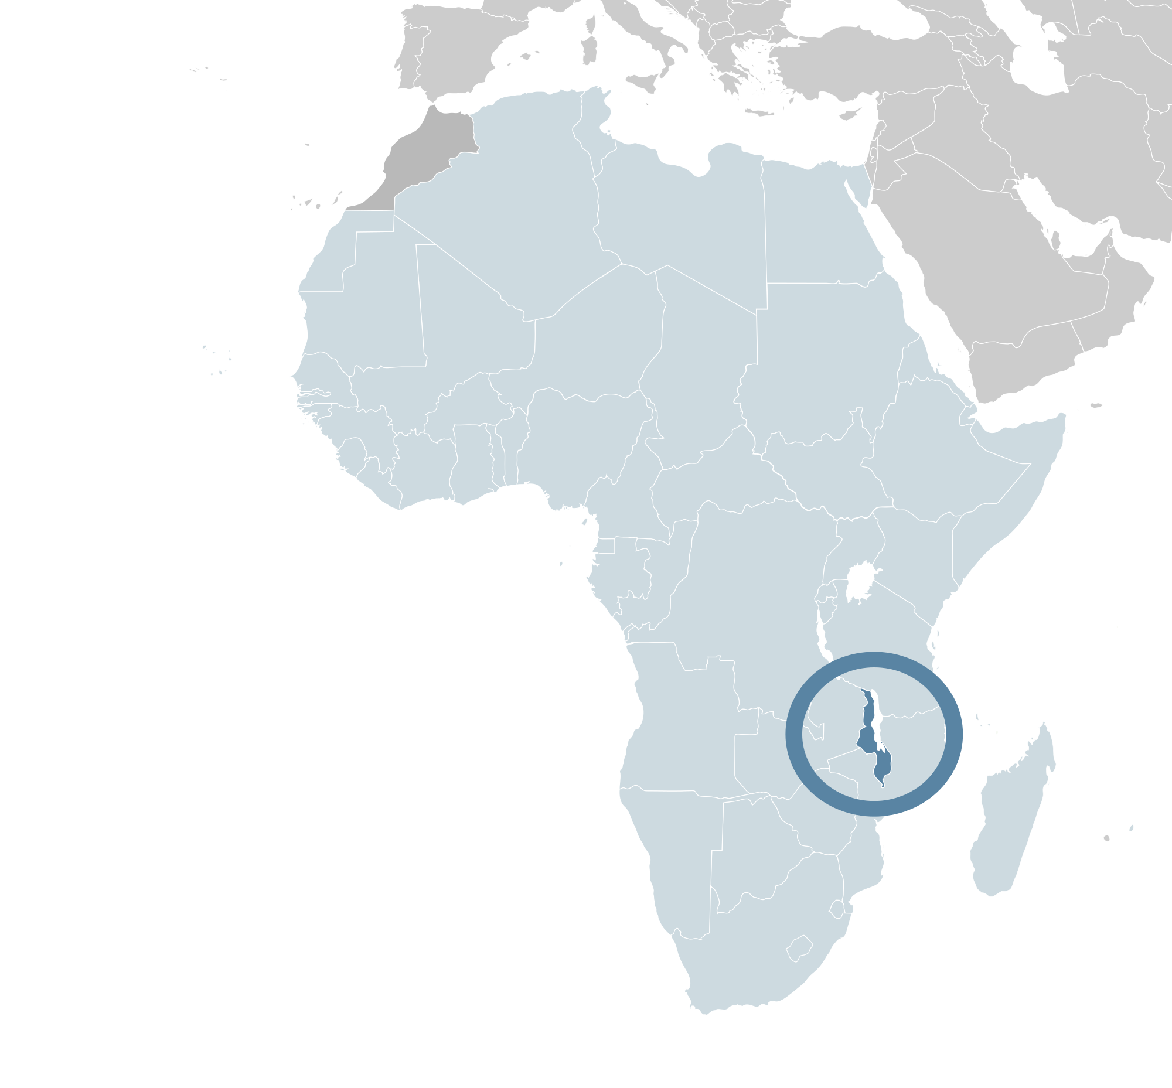
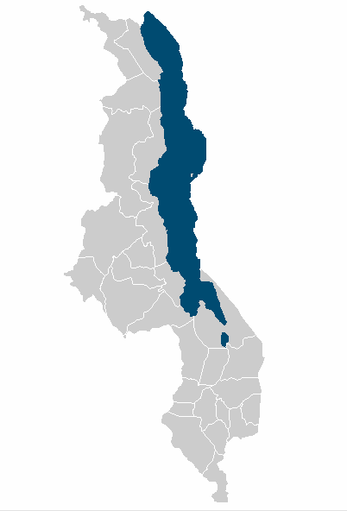
Study Area
Malawi, Africa
Image source: Alvaro1984 18 Wikipedia Commons
Image source: Natural Earth
Notes:
Demographics
3rd poorest country in the world (World Bank 2014)
GDP- $780
Life expectancy- 58
Water Availability
Lake Malawi ~ 20% of the land surface cover
“Has significant volumes of water in lake and rivers…”
“….however, water resources are declining” (UNEP 2013)
Climate change
Land degradation (deforestation)
Pollution
Considered water-stressed
Base Layer: Natural Earth
Image Credit: https://en.wikipedia.org/wiki/File:Location_Malawi_AU_Africa.svg
http://www.unpei.org/sites/default/files/e_library_documents/Malawi_Policy_Brief_Water_Resources_MSEOR.pdf
http://data.worldbank.org/indicator/NY.GDP.PCAP.PP.CD?order=wbapi_data_value_2013+wbapi_data_value+wbapi_data_value-last&sort=desc

Slide 3
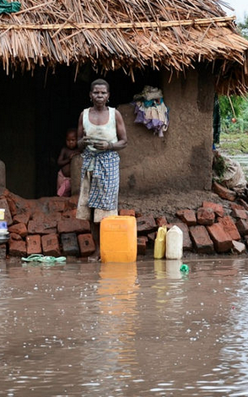
Malawi Vulnerability
Strong Seasonal Precipitation
Diverse Topography
Largely Poor Population
Image Credit: Arjan van de Merwe/UNDP
Notes:
Image credit: https://www.flickr.com/photos/unitednationsdevelopmentprogramme/16194370068/in/album-72157650093828759/
Malawi has both a high vulnerability and high risk of natural hazards, leading to a high risk for disasters.
The pictures show left- a flood, middle- a hand drawn map showing a synoptic weather map with an ITCZ location which leads to heavy rain and right- poor construction of homes and poor location of homes increases vulnerability
A region with sparse climatic and environmental data
Prone to flooding (occasionally leading to a national disaster)
Needs reliable time series of climatic and environmental data to analyze flood impact
Temporally and spatially

Slide 4
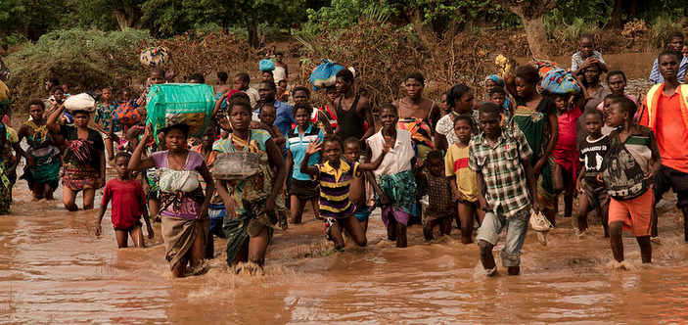
Image Credit: Arjan van de Merw UNDP
January 2015
Floods
Displaced over 230,000 residents
276 people reported dead or missing
Notes:
Image: https://www.flickr.com/photos/unitednationsdevelopmentprogramme/16356020316/in/album-72157650093828759/

Slide 5
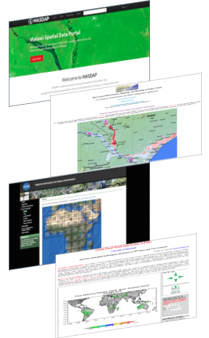
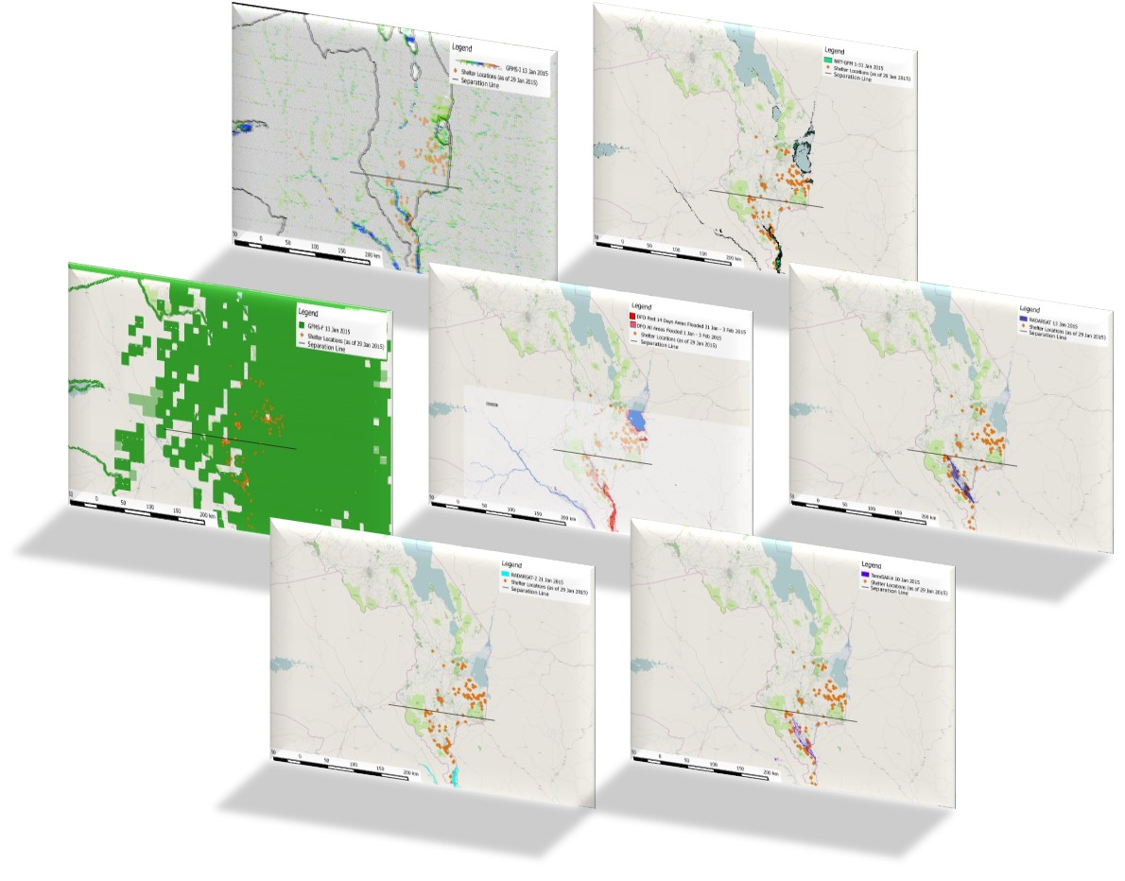
Previous Work
Comparison of Flood Detection Products
Revealed large discrepancies in the accuracy of detecting different flood types
Notes:
This project builds on the previous term’s Project comparing techniques of inundation detection for January 2015 floods using NASA earth observationsA previous study of several inundation products provided insight into potential disparities between spatial distribution of flood signals relative to the specific type of flood.
The current project builds on this analysis of various EO flood detection products and incorporates specific flood definitions to better identify and evaluate flash floods versus riverine floods. These definitions will then be incorporated into a comprehensive framework to better monitor and forecast flash flood events in vulnerable areas. By incorporating flash floods into the analysis, this project aims to further assist our project partners, as well as other humanitarian agencies, to better monitor the spatial extent of different flood events and further improve disaster relief response.
_________
The Malawi Spatial Data Platform
TerraSAR-X, RADARSAT & RADARSAT-2
The Dartmouth Flood Observatory website
DFO
NASA Goddard’s Office of Applied Science’s NRT Global Flood Mapping website
NRT-GFM
University of Maryland’s Global Flood Monitoring System website
GFMS-FD & GFMS-I
All flood detection products were then added into QGIS for processing and visualization
-------
Analysis of product comparison
Qualitative spatial analysis of relationship between shelters and inundation products
Through visual comparison across all flood detection products, it was apparent that spatial coverage and accuracy differ approximately north of Chikwawa district and south of it. Hence, a black horizontal line was drawn to help analyze results. Above the line are areas prone to flash floods, and below the line areas are susceptible to riverine floods.
As shelters are usually located in close spatial proximity to inundated communities (usually within 10 km), we assume that inundation signals nearby shelters are valid. Further quantitative analysis will be completed in the next term
-----------

Slide 6
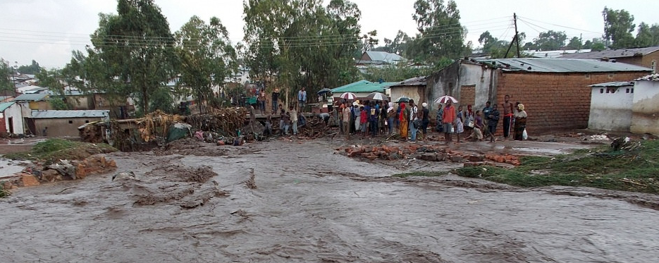
Objectives
Validate Previous Term’s results with new Ground Truth Data
Produce a methodology for analyzing flood detection skill relative to flash floods
Image Credit: Arjan Merwe UNDP
Notes:
Newly provided ground truth from our project partners allowed us to validate the previous term’s results.
Image Credit: https://www.flickr.com/photos/unitednationsdevelopmentprogramme/16194370778/in/album-72157650093828759/

Slide 7
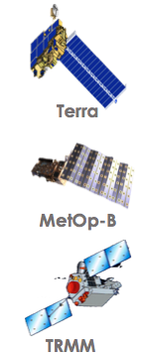
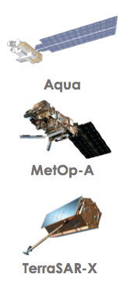
Earth Observations Utilized
NASA Earth Observations
  MODIS sensor aboard Terra and Aqua satellites
  TRMM, Aqua (AMSR-E & AMSU-A), & Defense Meteorological Satellite Program satellites
European Space Agency (ESA)
  ASCAT Sensor (EUMETSAT METOP Satellites)
Other Earth observations
  Synthetic Aperture Radar (SAR)
Notes:
MODIS sensor aboard Terra and Aqua satellites
DFO (Dartmouth Flood Observatory Flood Detection Product) & NRT-GFM (NASA Goddard’s Office of Applied Science’s NRT Global Flood Mapping product)
TRMM, Aqua (AMSR-E & AMSU-A), & Defense Meteorological Satellite Program satellites
GFMS-FD & GFMS-I (Global Flood Monitoring System’s Flood Detection and Inundation product))
Synthetic Aperture Radar (SAR)
TerraSAR-X (Germany),
RADARSAT (Canada) &
RADARSAT-2 (Canada)

Slide 8
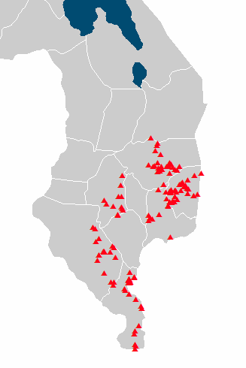

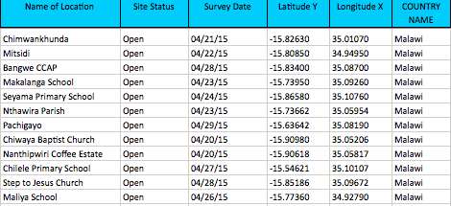
Project Methodology 1
Ground Truth Data Provided by Red Cross Red Crescent
Notes:
Base Layer: Natural Earth
The ground truth provided by Red Cross Red Crescent included the Lat/Long coordinate of each shelter site, along with the location of the village the majority of the displaced residents came from.

Slide 9
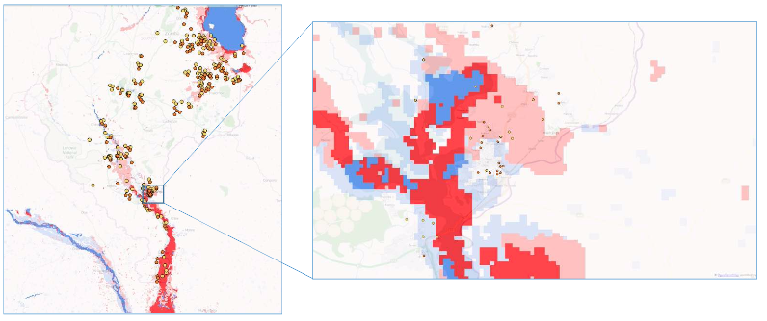

Dartmouth Flood Observatory
Analysis
  Reprocess Flood Products with accurate Shelter Sites for displaced residents
Notes:
Image Base Layer: OpenStreet Map
DFO flood product reprocessed with ground truth data

Slide 10
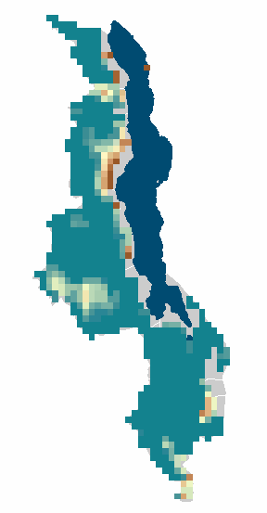
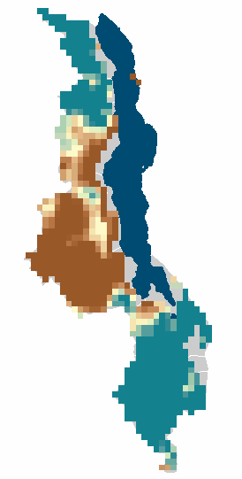
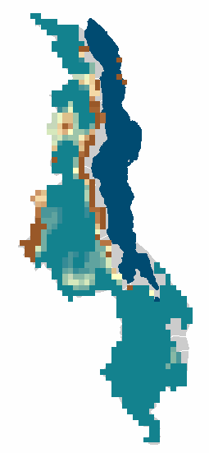
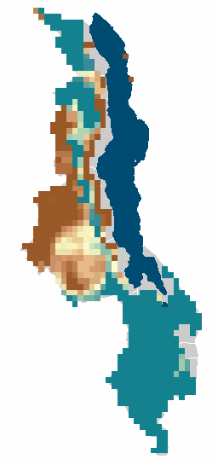

Jan 11, 2015
Jan 14, 2015
Project Methodology 2
Compare Soil Moisture for the duration of the Study Period
Notes:
Visual Time Series of Soil Moisture index, 0 is dry 200 is highly saturated.
Jan 11, Jan 12, Jan 13, Jan 14,
Base Layer: Natural Earth

Slide 11
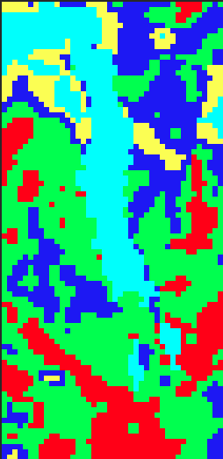
Analysis
Isocluster image classification analysis, coming soon!
Notes:
ENVI analysis

Slide 12
Project Methodology: 3
Extreme Rainfall Events
TRIMM
CMOPRH
IFRC
Notes:
Times series of Soil moisture will be here

Slide 13
Analysis

Slide 14
Discussion
Flood Product Analysis
Soil Moisture Analysis
Extreme Rainfall Event
Notes:
Potentially 3 separate slides if there are too many images
Reprocess FP layers
Put in new Shelter Data Red Cross Red Crescent
IDP information,
Soil Moisture Analysis
3. Extreme Rainfall Analysis

Slide 15
General Guidelines I
Things that are typically included in a presentation:
The slides provided in the template are just a starting point for teams. Feel free to expand upon these topics, alter the headings, and change the order of the slides to fit your needs.
Study area
Study period
Objectives
Community concerns
NASA satellites/sensors used
Methodology
Results
Conclusions
Errors & uncertainties
Future work
Acknowledgements
Backup slides
Required Statement

Slide 16

General Guidelines II
Header text point size should be between 40 and 60 on most slides.
Body text point size should be at least 20.
Use Century Gothic.
Keep text to a minimum.
Try to use a consistent font size between slides.
Image Credit: Monet
Notes:
Image Source: http://commons.wikimedia.org/wiki/File:Claude_Monet_-_The_Magpie_-_Google_Art_Project.jpg

Slide 17
Image Credit: Monet
General Guidelines III
Include speaker notes for each slide (see below).
Include a visual on each slide, if possible.
Arrange content to minimize white space.
Notes:
These notes should be thorough enough for someone not familiar with the project to clearly present the material.
Image Source: http://commons.wikimedia.org/wiki/File:Claude_Monet_-_The_Magpie_-_Google_Art_Project.jpg

Slide 18
Maps & Logos
Maps
Import the legend separately.
Make sure all text is legible and editable.
Cite base layer source in speaker notes.
Logos
US Federal logos only.
No state, NGO, local and or international government logos, or software logos.

Slide 19
Photos & Figures I
You may only use images taken by your team, provided by your partners (as long as you have permission from them), from a Federal Agency, from the new DEVELOP stock imagery collection on DEVELOP’s Flickr page, or Creative Commons images.
Obtain a media release form from all people in photos that your team has taken — no children!
All image sources should be cited using a consistent format and should be visible on the slide.

Slide 20
Photos & Figures II
Please do not include the image URL in the source text box but rather place it in the notes section below.
If you use a border for your images include it on all photographs to keep your presentation consistent.
Keep all images and text boxes editable, including individual elements of flowcharts.
Background images are discouraged. If you use one, make sure that your text remains clear and legible.

Slide 21
Advisors
Dr. Pietro Ceccato, Lead Environmental Monitoring Program, IRI
Partners
Eri Coughlan de Perez, Red Cross/Red Crescent Climate Centre
Hastings Kandaya, Malawi Red Cross Society
Others
Alex Sweeney & Jerrod Lessel, Past Project Contributors

