Slide 1
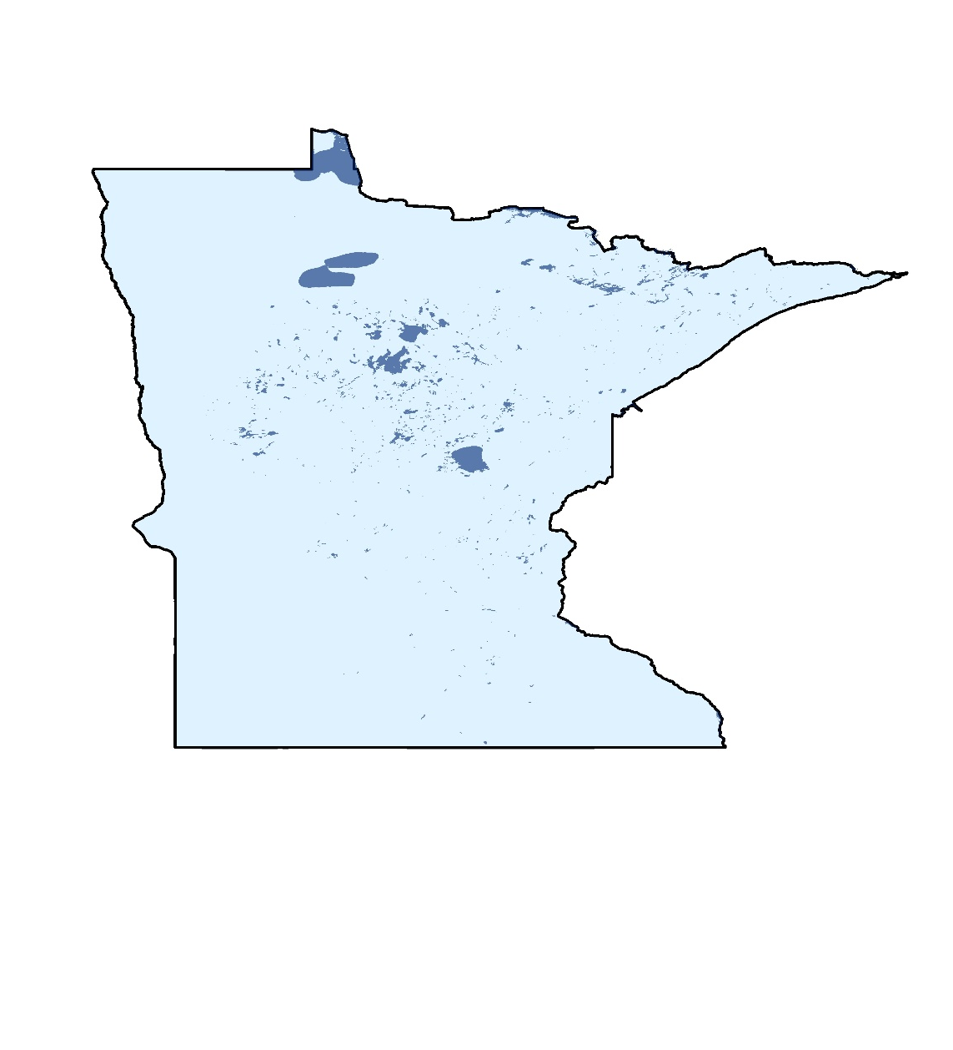
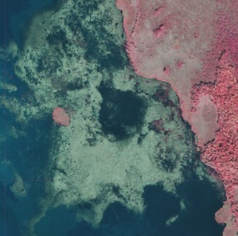
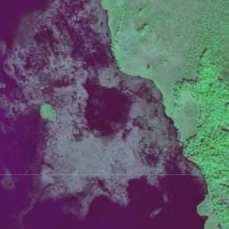
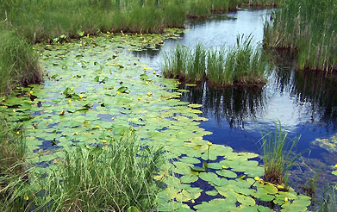
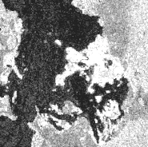
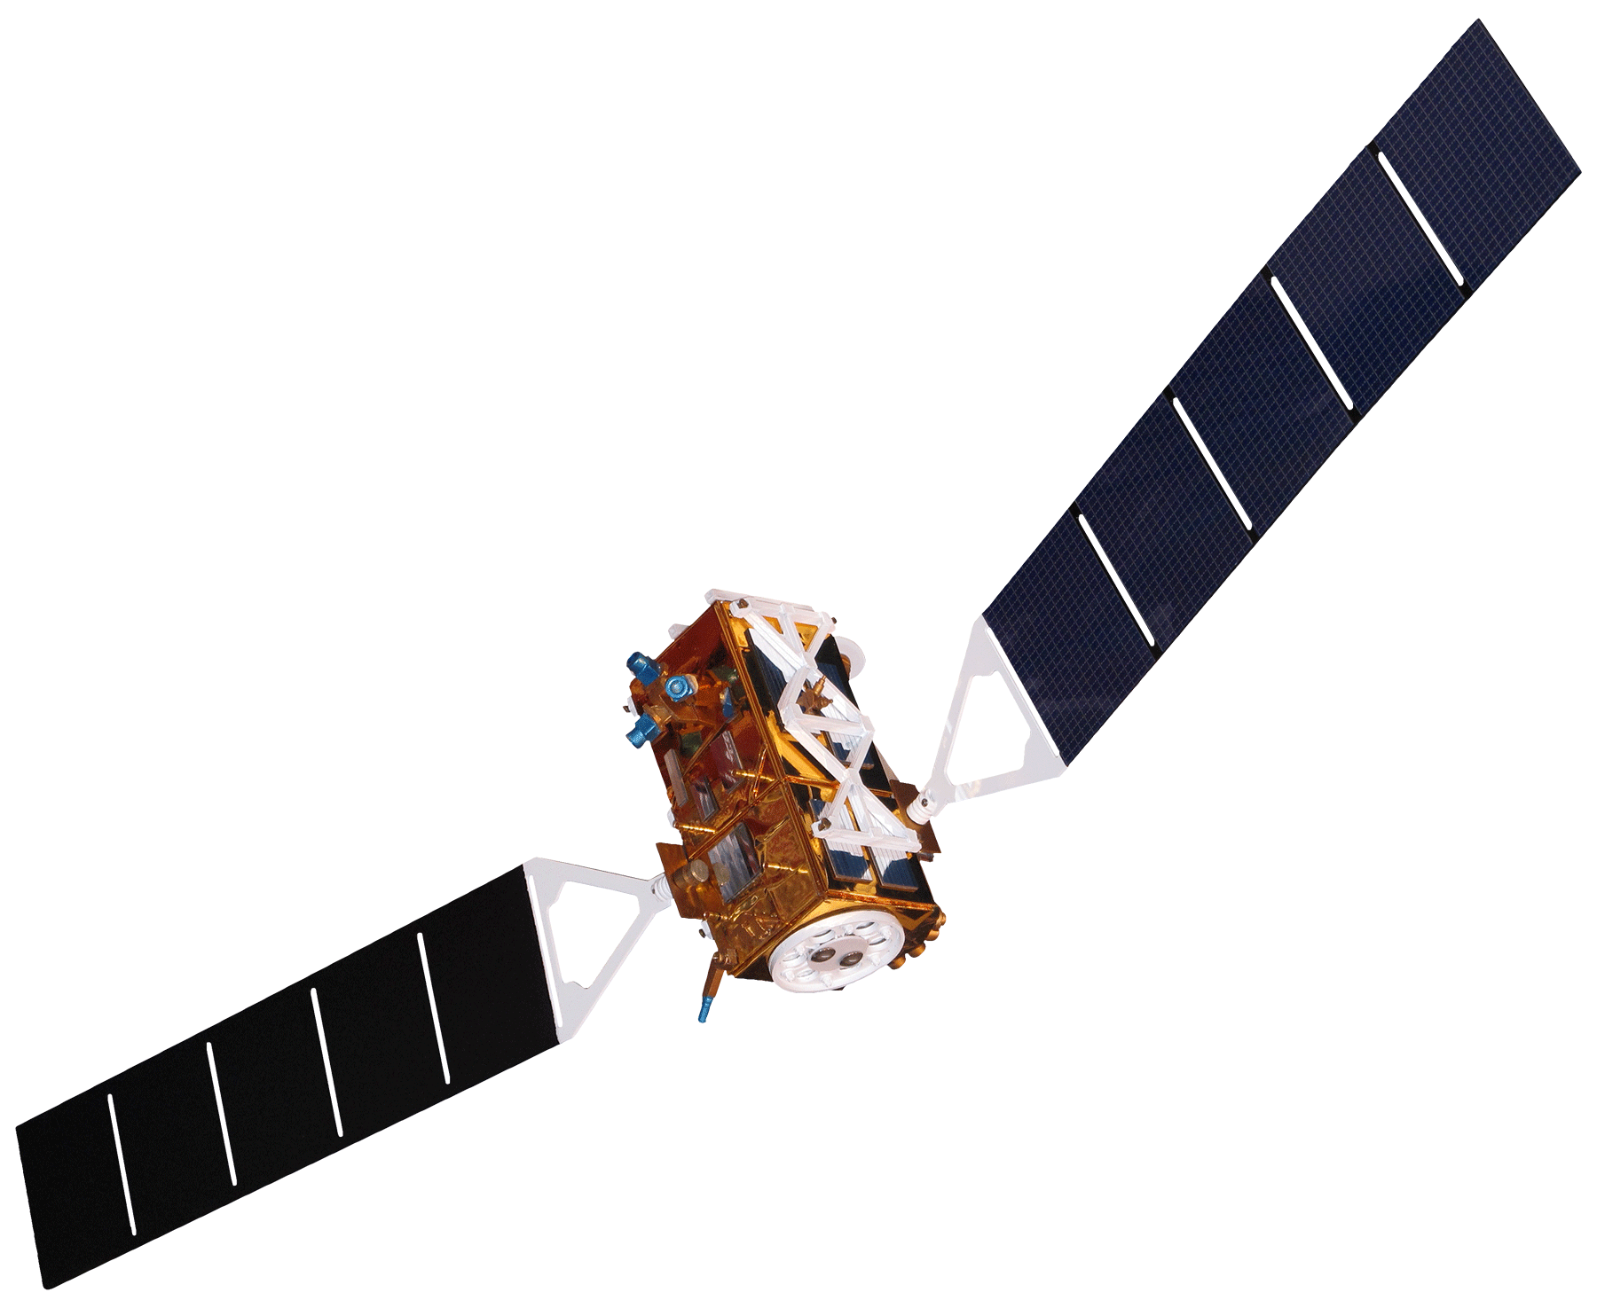
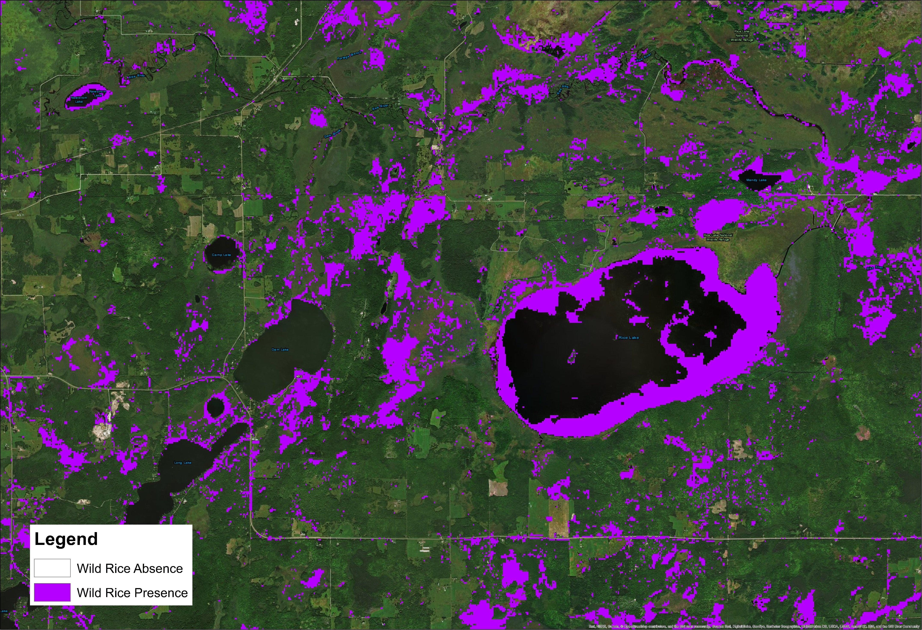
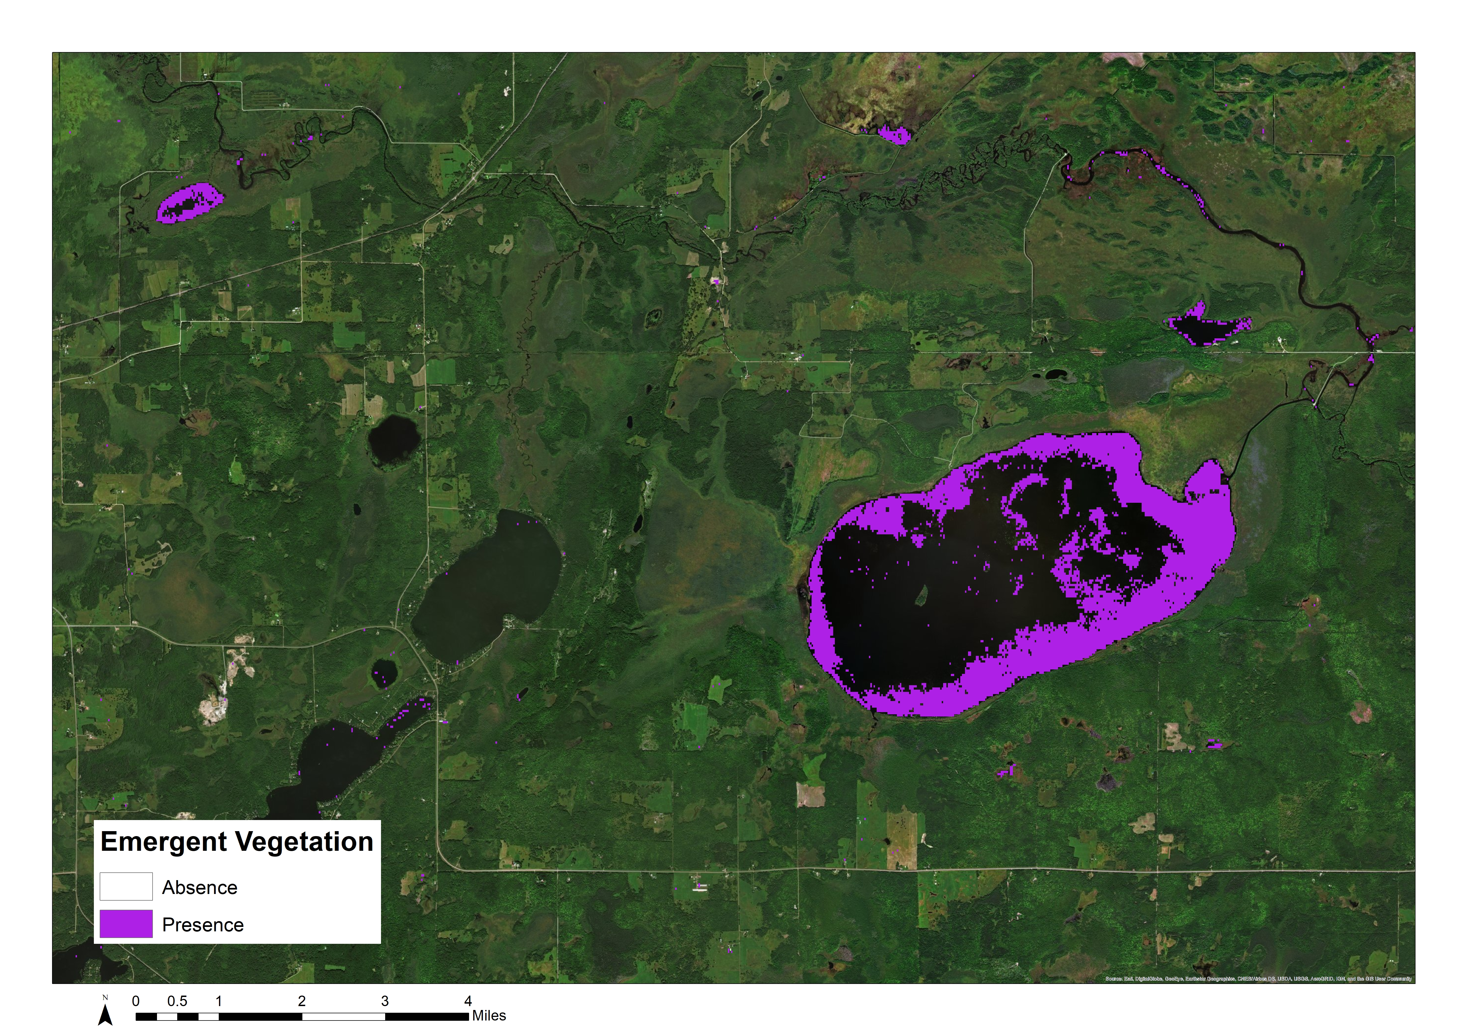
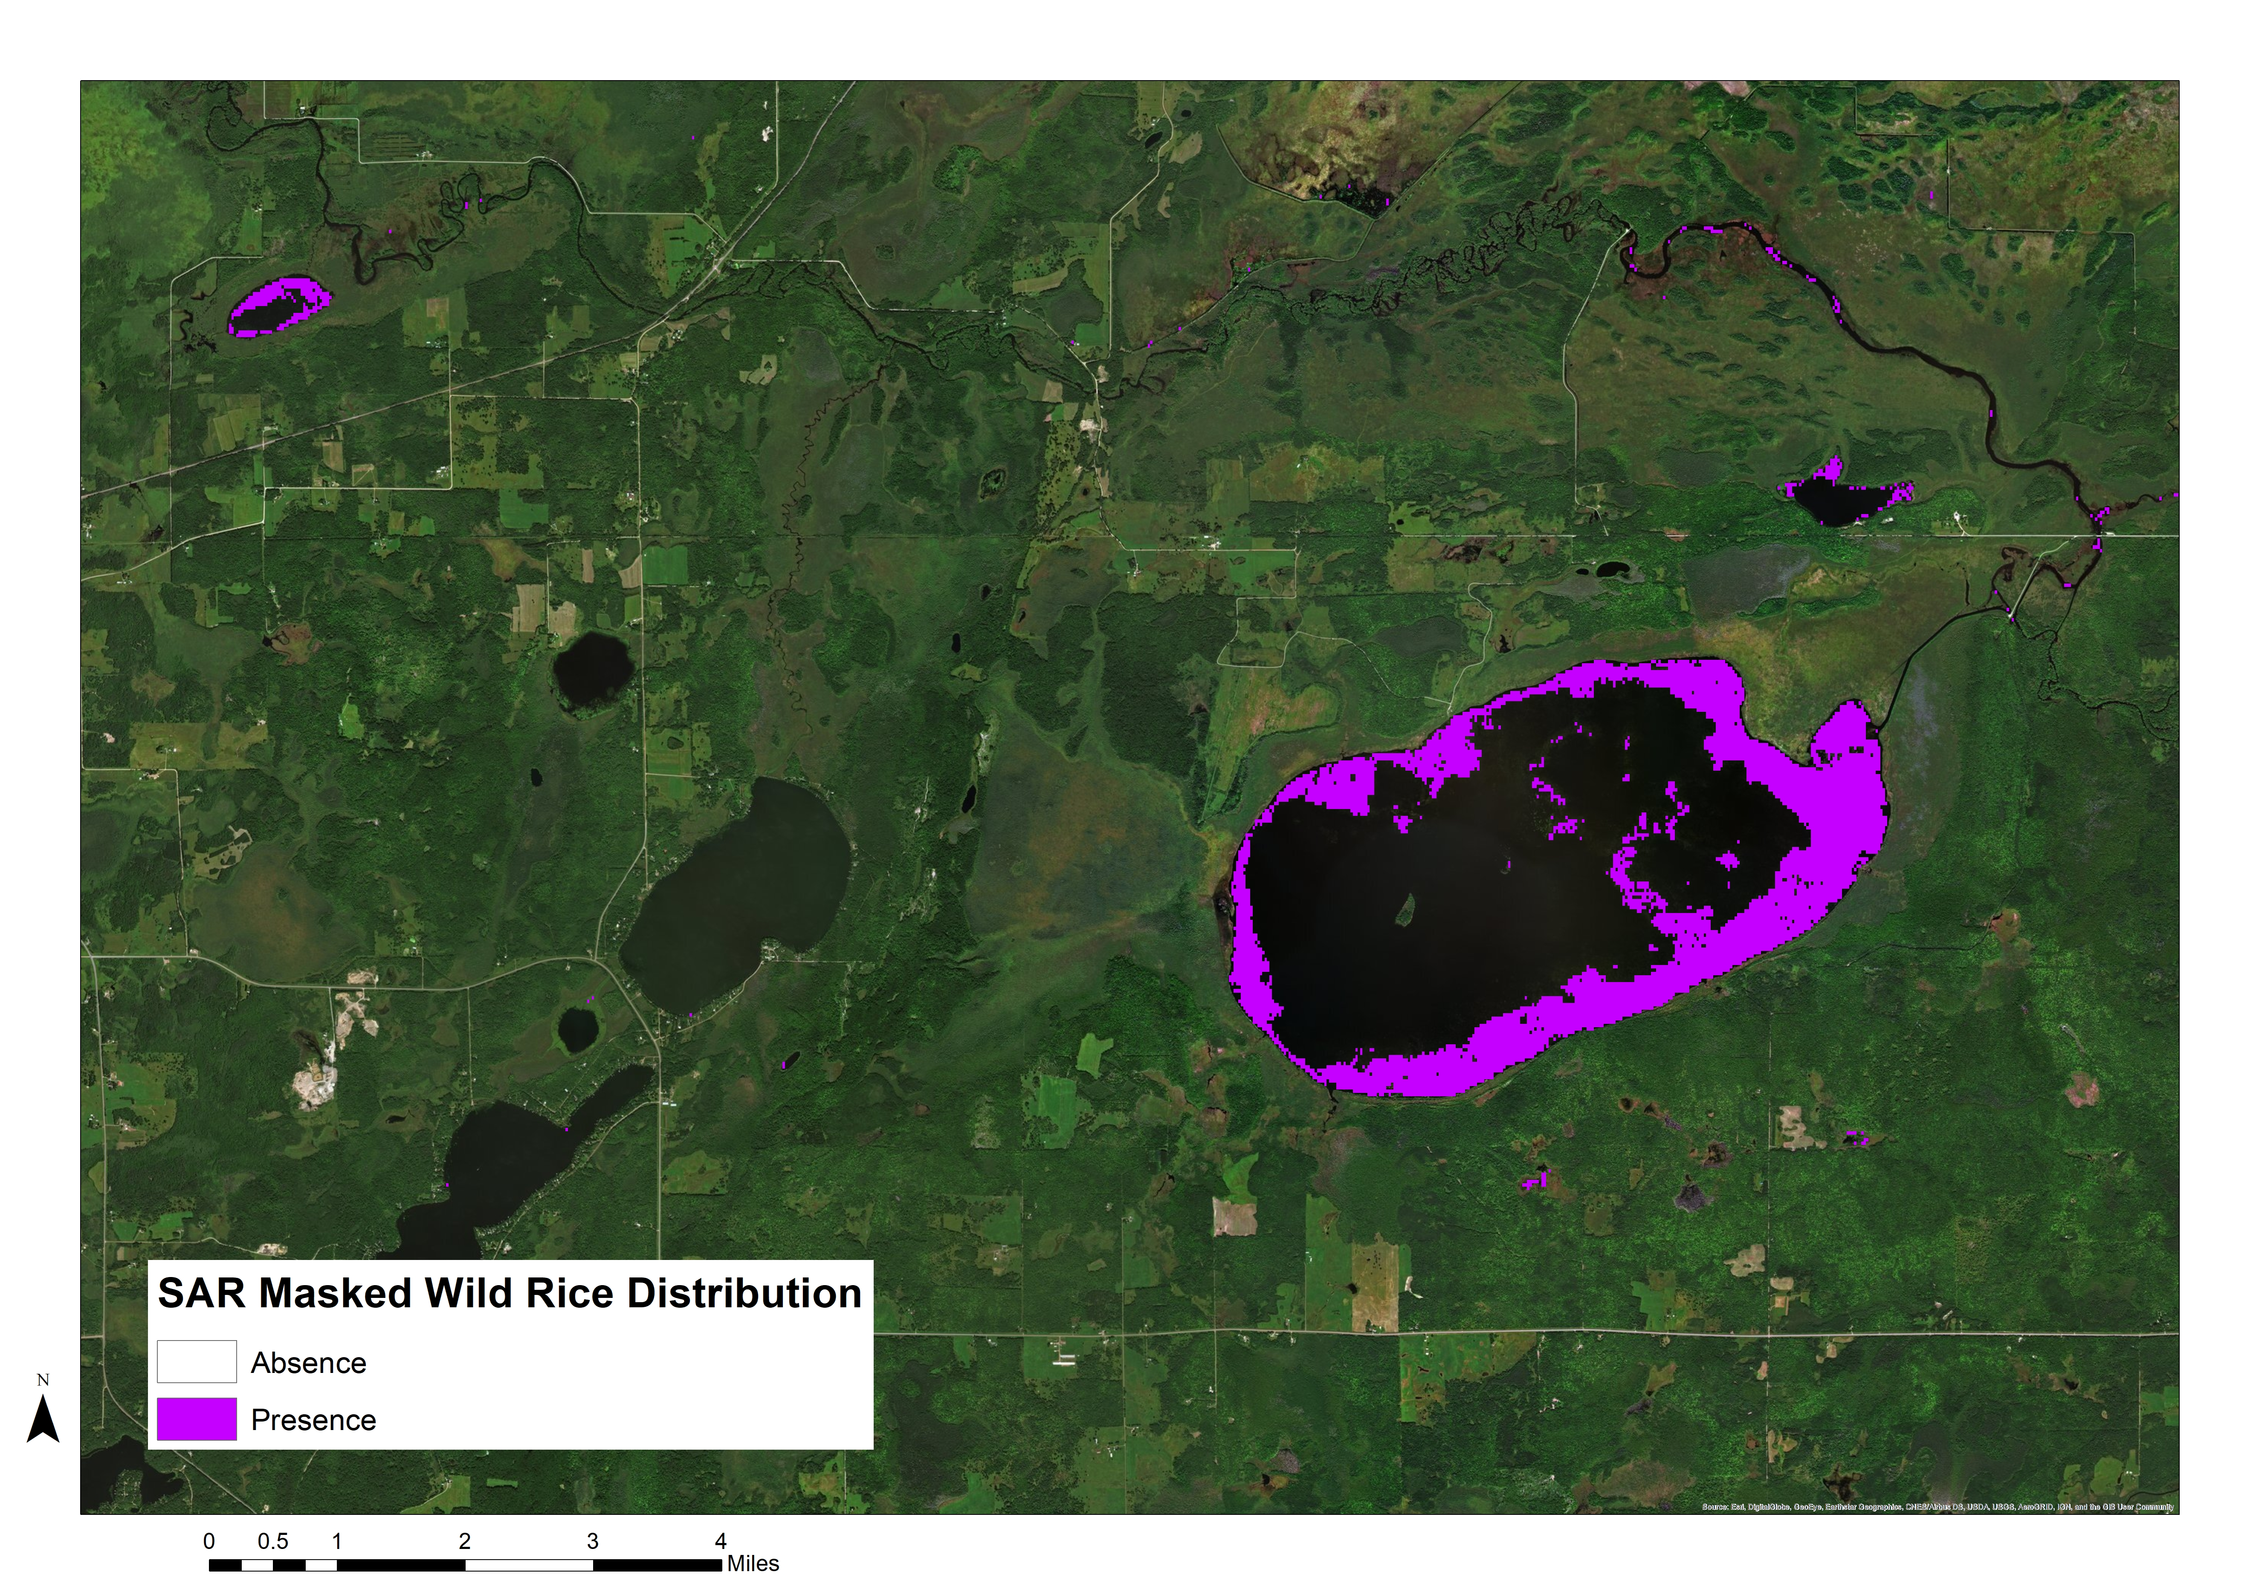
Employing NASA Earth Observations to Model Current and Historic Distribution of Crop Wild Relative, in Support of USDA ARS Genetic Resource Conservation Efforts
Abstract
Objectives
Northern wild rice (Zizania palustris L.) and Texas wild rice (Zizania texana) provide valuable ecosystem services, food sources, economic development, and cultural resources to local populations in Minnesota and Texas. Research on crop wild relatives, wild plants closely related to cultivated plants, is imperative to understanding gene flow and genetic diversity of harvested species. The United States Department of Agriculture (USDA) Agricultural Research Service (ARS) is responsible for conserving the genetic diversity of valuable species, such as wild rice. However, this organization lacks insight to the geographic distribution of Zizania populations. NASA Earth observations, including Landsat 5 Thematic Mapper, Landsat 8 Operational Land Imager and the Shuttle Radar Topography Mission version 3 were used to create models to detect wild rice presence. The team provided partners at the USDA ARS with distribution maps for northern wild rice and Texas wild rice populations in 2005 and 2015. Partners at USDA ARS will apply the end products to effectively enable strategic ecological planning, and better target field collections for species conservation.
Detect wild rice stands in Minnesota and Texas using NASA Earth observations
Monitor changes in wild rice distribution over time and across various sensors
Investigate the geographic scale at which this methodology can be successfully applied
Provide guidance and methodology to allow the project partner to complete this process on their own
Study Area
Hays County, Texas
Wild Rice Areas, Minnesota
Methodology
NASA Earth Observations
Landsat 8
Google Earth Engine
Compute Predictor Indices
R
Random Forest Model
Wild Rice Presence Map
NAIP Imagery
Habitat masks
Field Data
ESA Sentinel-1 SAR
Earth Observations
Data
Software
Algorithm
Output
1
2
3
4
Landsat 5
Landsat 8
Sentinel-1
Results
SRTM
Wild Rice Model Distribution
Wild Rice Binary Map: Rice Lake, MN (2015)
Binary SAR Variance Based on Threshold: Rice Lake, MN (2015)
Wild Rice Presence Masked by Variance: Rice Lake, MN (2015)
Project Partners
Conclusions
The team successfully detected wild rice using NASA Earth observations.
Remote sensing may be a useful tool for the detection of other crop wild relatives.
It is difficult to distinguish wild rice from other emergent aquatic vegetation using NAIP imagery.
Incorporating the phenology of wild rice is necessary.
Using two types of imagery (Sentinel-1 SAR and Landsat Spectral) helps to distinguish the unique spectral signatures and structure of wild rice.
USDA, Agricultural Research Service, National Plant Germplasm System
Acknowledgements
Team Members
Dr. Paul Evangelista (Natural Resource Ecology Laboratory, Colorado State University)
Nick Young (Natural Resource Ecology Laboratory, Colorado State University)
Timothy Mayer (SSAI, NASA DEVELOP)
Dr. Colin Khoury (US Department of Agriculture, Agricultural Research Service)
Dr. Scott Herron (Biology Department, Ferris State University)
Catherine Jarnevich (US Geological Survey)
Stephanie Greene (Supervisory Plant Physiologist, USDA)
Katie Walker
Project Lead
Daniel Carver
Jillian LaRoe
Charles Nicholas Whittemore
Minnesota & Texas Agriculture & Food Security
Colorado – Fort Collins| Spring 2018

