Slide 1
NASA DEVELOP National Program
DEVELOP Resources
What’s Available?

Slide 2
DEVELOPedia
DEVELOPedia is an internal wiki intended to serve three purposes:
Enhance project workflow
Capture lessons learned and make them available to future project teams
Record data required for operational metrics
DEVELOPedia is a collaborative effort whose utility is directly related to the efforts of previous DEVELOP participants.
DEVELOPedia is a living document, constantly adapting to meet the needs of the NASA DEVELOP National Program and the people that make the program great (That’s you!).
Training Resources Homepage:
http://www.devpedia.developexchange.com/dp/index.php?title=Training_Resources_Homepage
Geospatial Programs and Methods
Remote Sensing
Code and Programming Tutorials
Technical Skill Development
Professional Development: EdX Classes, Coursera Classes, Alison Classes
POC – Jordan Vaa
http://www.devpedia.developexchange.com

Slide 3
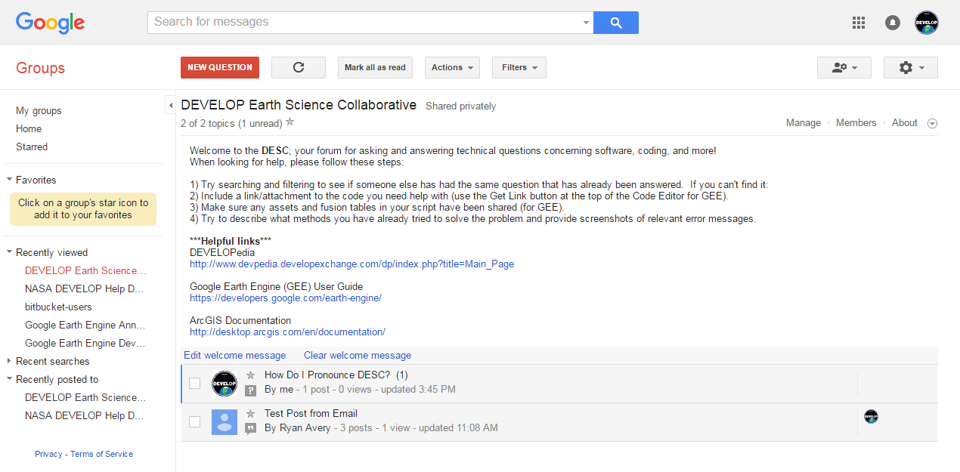
The DEVELOP Earth Science Collaborative
A forum for software, geospatial, and coding questions
Can email forum directly like a regular email address
Moderated by the Geoinformatics Team
Copy link, go join, and bookmark the DESC on your favorite browser!
https://groups.google.com/d/forum/developesc

Slide 4
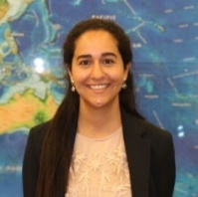
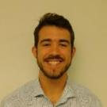
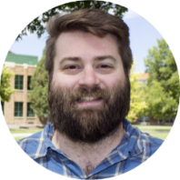
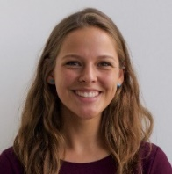
FY18 Fellow Class
Fellow Elements are here to assist teams, feel free to reach out to them with questions!
Project Coordination
DEVELOP.ProjectCoordination@gmail.com
Impact Analysis
DEVELOP.ImpactAnalysis@gmail.com
Information Technology
DEVELOP.Information Technology@gmail.com
Amanda Clayton
Virginia – Langley
PC Senior Fellow
Danielle Quick
Virginia – Langley
IA Senior Fellow
Jordan Vaa
Virginia – Langley
IT Senior Fellow
Jerrold Acdan
California – Ames
PC Fellow
Neda Kasraee
California - JPL
IA Fellow
Madison Broddle
Virginia – Langley
IT Fellow
Communications
DEVELOP.Communication@gmail.com
Geoinformatics
DEVELOP.Geoinformatics@gmail.com
Austin Stone
Virginia – Langley
Comm Senior Fellow
Dane Coats
Idaho – Pocatello
Geo Fellow
Kathrene Garcia
Alabama – Marshall
Comm Fellow
Megs Seeley
Arizona - Tempe
Geo Fellow

Slide 5
National POCs
DEVELOP
NPO
Mike Ruiz
Lindsay Rogers
Dr. Kenton Ross
Lauren Childs-Gleason
Karen Allsbrook
Senior Fellows
Amanda Clayton (PC)
Danielle Quick (IA)
Austin Stone (Comm)
Jordan Vaa (IT)
DEVELOP
Fellows
Kathrene Garcia (Comm)
Dane Coats (Geo)
Jerrold Acdan (PC)
Megs Seeley (Geo)
Madison Broddle (IT)
Neda Kasraee (IA)
DEVELOP Node Leadership
Alabama – Marshall & Alabama – Mobile
Helen Baldwin (CL)*
Kathrene Garcia (F – MSFC)
Maryland – Goddard
Victor Lenske (CL)
North Carolina – NCEI
Aaron Mackey (CL)
Virginia – Langley
Patrick Frier (CL)
Madison Broddle (F)
Massachusetts – Boston
Zach Bengtsson (CL)
Georgia – Athens
Marie Bouffard(CL)
California – Ames
Farnaz Bayat (CL)
Jerrold Acdan (F)
CL – Center Lead
Colorado – Fort Collins & Idaho – Pocatello
Timothy Mayer (CL)*
Dane Coats (F – ID)
* – CL multiple nodes
F – Fellow
California – JPL & Arizona – Tempe
Erika Higa (CL)*
Neda Kasraee (F – JPL)
Megs Seeley (F – AZ)
Notes:
May need updating.

Slide 6
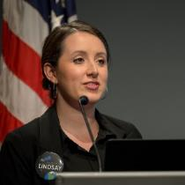
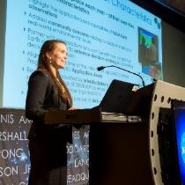
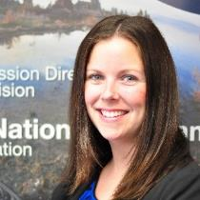
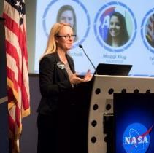
Questions?
Lindsay Rogers: Lindsay.M.Rogers@nasa.gov, 757-864-7283
Danielle Quick: Danielle.L.Quick@nasa.gov, 757-864-5548
Amanda Clayton: Amanda.L.Clayton@nasa.gov, 757-864-5552
Jordan Vaa: Jordan.S.Vaa@nasa.gov, 757-864-4554
Karen Allsbrook: Karen.N.Allsbrook@nasa.gov, 757-864-1276
Austin Stone: Austin.H.Stone@nasa.gov, 757-864-3762
Lauren Childs-Gleason: Lauren.M.Childs@nasa.gov, 757-864-4204
Deadlines, telecons, Fellow class, CL position competition, print materials, recruiting, VPS, Capacity Building Program activities
Impact Analysis Team-related items, tracking metrics, indicators, socioeconomic impact analysis, PSI, participant surveys, alumni survey, using the national telecon line
Project Coordination Team-related items, publications, deliverables, deadlines, webinars, DEVELOPedia project pages
IT Team-related items, DEVELOPedia, DEVELOP website, DEVELOP Exchange, software, hardware, software release authority
Contracts, payroll, status reports/invoices, schedule adjustments, online application system, travel, employment verifications, SSAI
Communications Team-related items, social media, newsletter, recruiting, military engagement, outreach activities, Ambassador Corps, media requests
Conferences, publications, international activities, partner engagement, project hand-offs, graphic design support, print materials, recruiting
Topics Not Listed Here: ANYONE! We love answering questions and will direct you to the right person if we can’t answer ☺

Slide 7
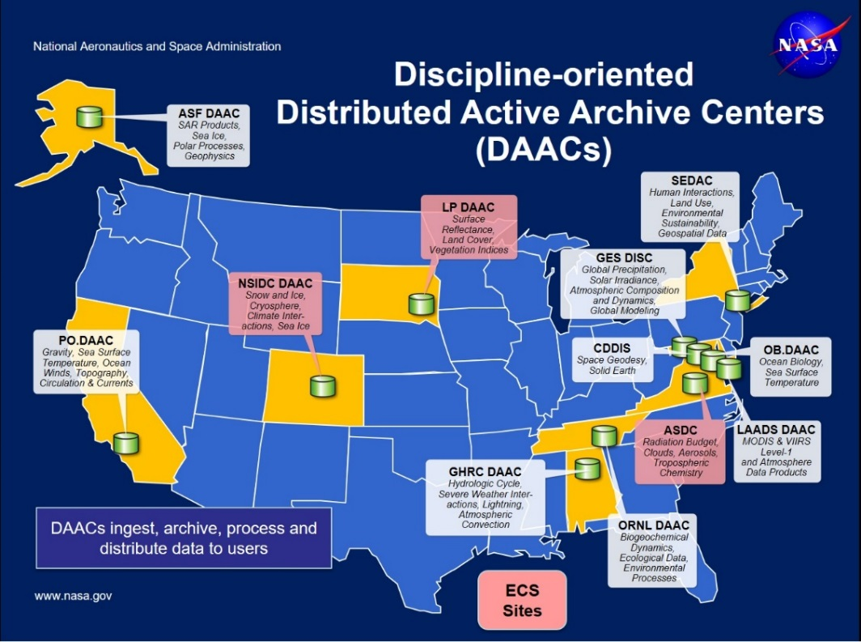
NASA Data Centers
Earth Observing System Data and Information System (EOSDIS) is designed as a distributed system, with major facilities at Distributed Active Archive Centers (DAACs) located throughout the United States. These institutions are custodians of EOS mission data and ensure that data will be easily accessible to users. The EOSDIS DAACs process, archive, document, and distribute data from NASA's past and current Earth-observing satellites and field measurement programs. Acting in concert, the DAACs provide reliable, robust services to users whose needs may cross the traditional boundaries of a science discipline, while continuing to support the particular needs of users within the discipline communities. User services include:
Assistance in selecting and obtaining data
Access to data-handling and visualization tools
Notification of data-related news
Technical support and referrals
EOSDIS Distributed Active Archive Centers (DAACs)
https://earthdata.nasa.gov/about/daacs
Earth Data Search
https://search.earthdata.nasa.gov/search

Slide 8
ARSET Trainings
https://arset.gsfc.nasa.gov/
Through ARSET trainings, you can learn how to:
Use NASA data for environmental management
Search and access NASA resources relevant to your needs
Visualize, interpret, and apply remote sensing data and imagery
Remote Sensing Fundamentals: These webinars are available for viewing at any time. They provide basic information about the fundamentals of remote sensing, and are often a prerequisite for other ARSET trainings. https://arset.gsfc.nasa.gov/webinars/fundamentals-remote-sensing
Session 1: Fundamentals of Remote Sensing
Session 2A: Satellites, Sensors, Data and Tools for Land Management and Wildfire Applications
Session 2B: Satellites, Sensors, and Earth Systems Models for Water Resources Management
Session 2C: Fundamentals of Aquatic Remote Sensing

Slide 9
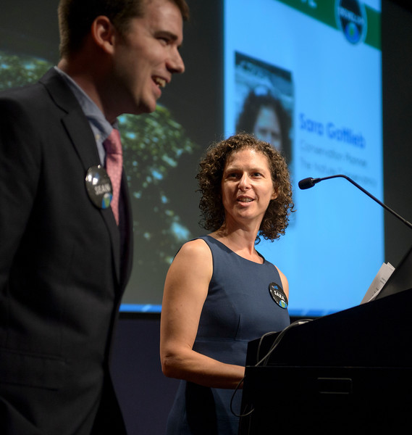
Thank You!
Ask lots of questions!

