Slide 1
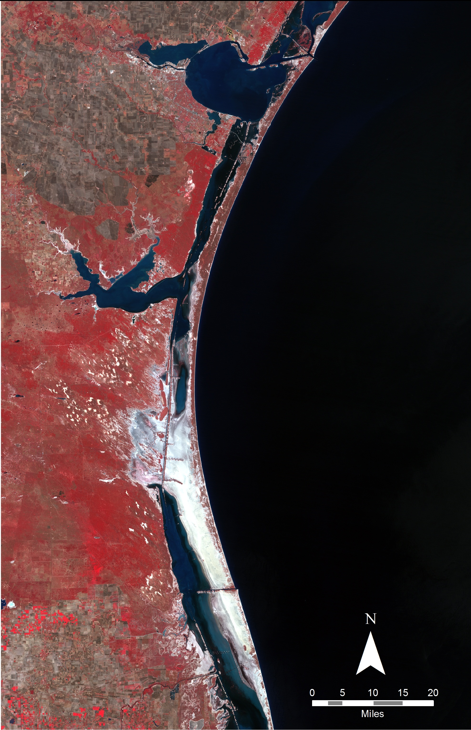
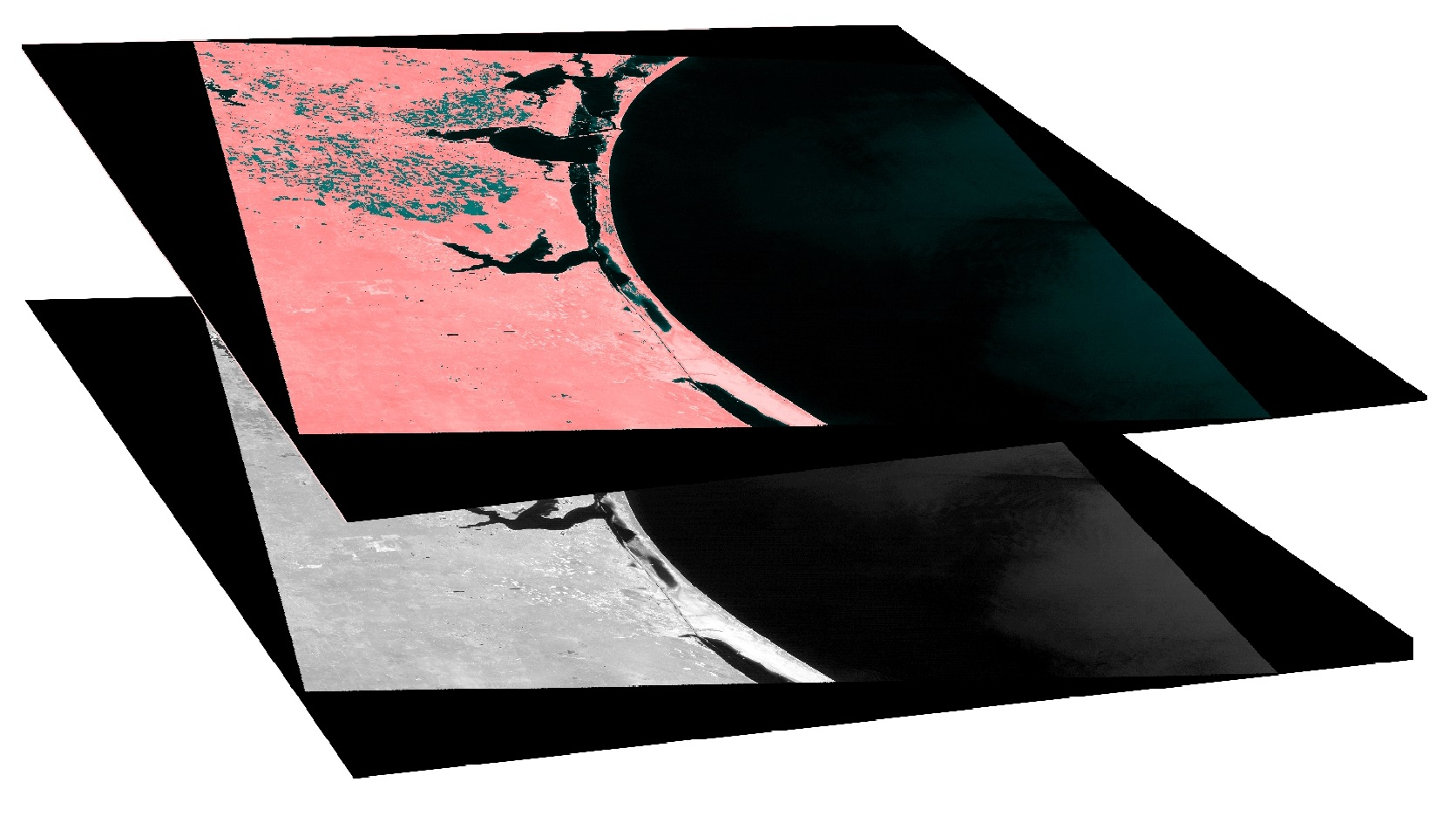
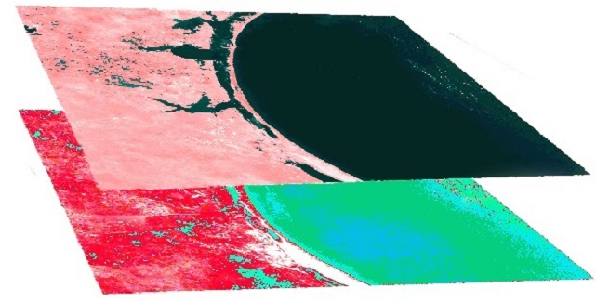
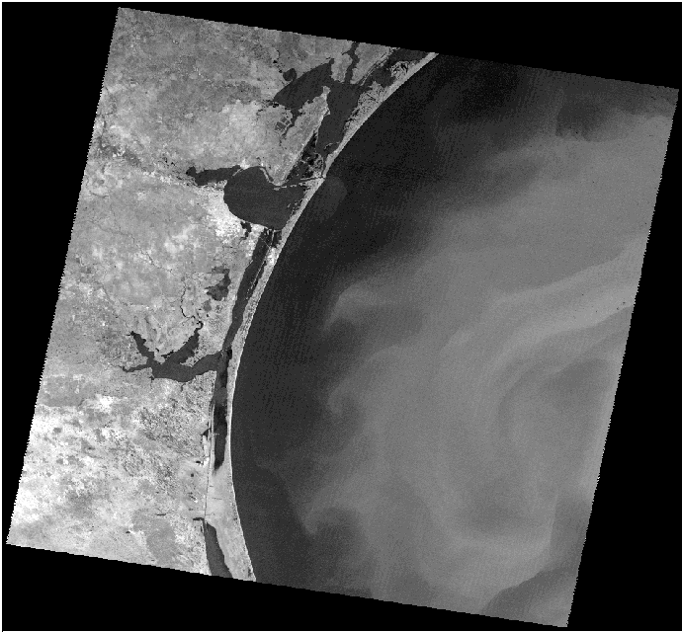
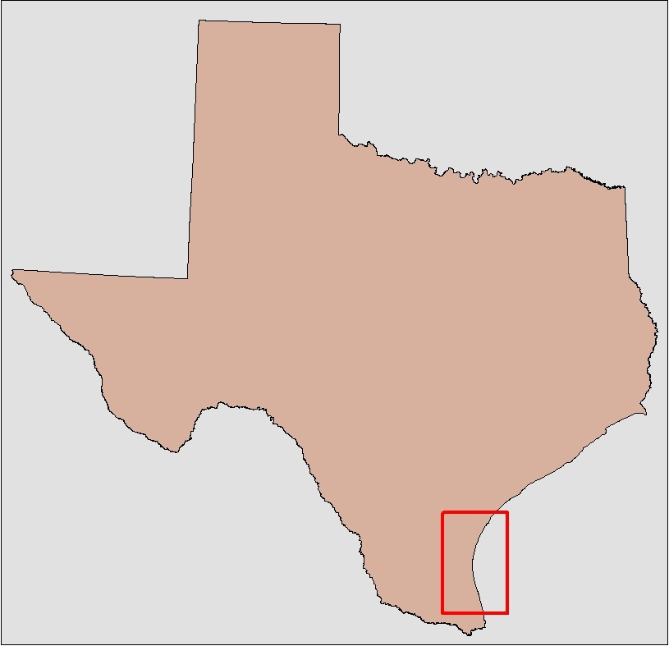
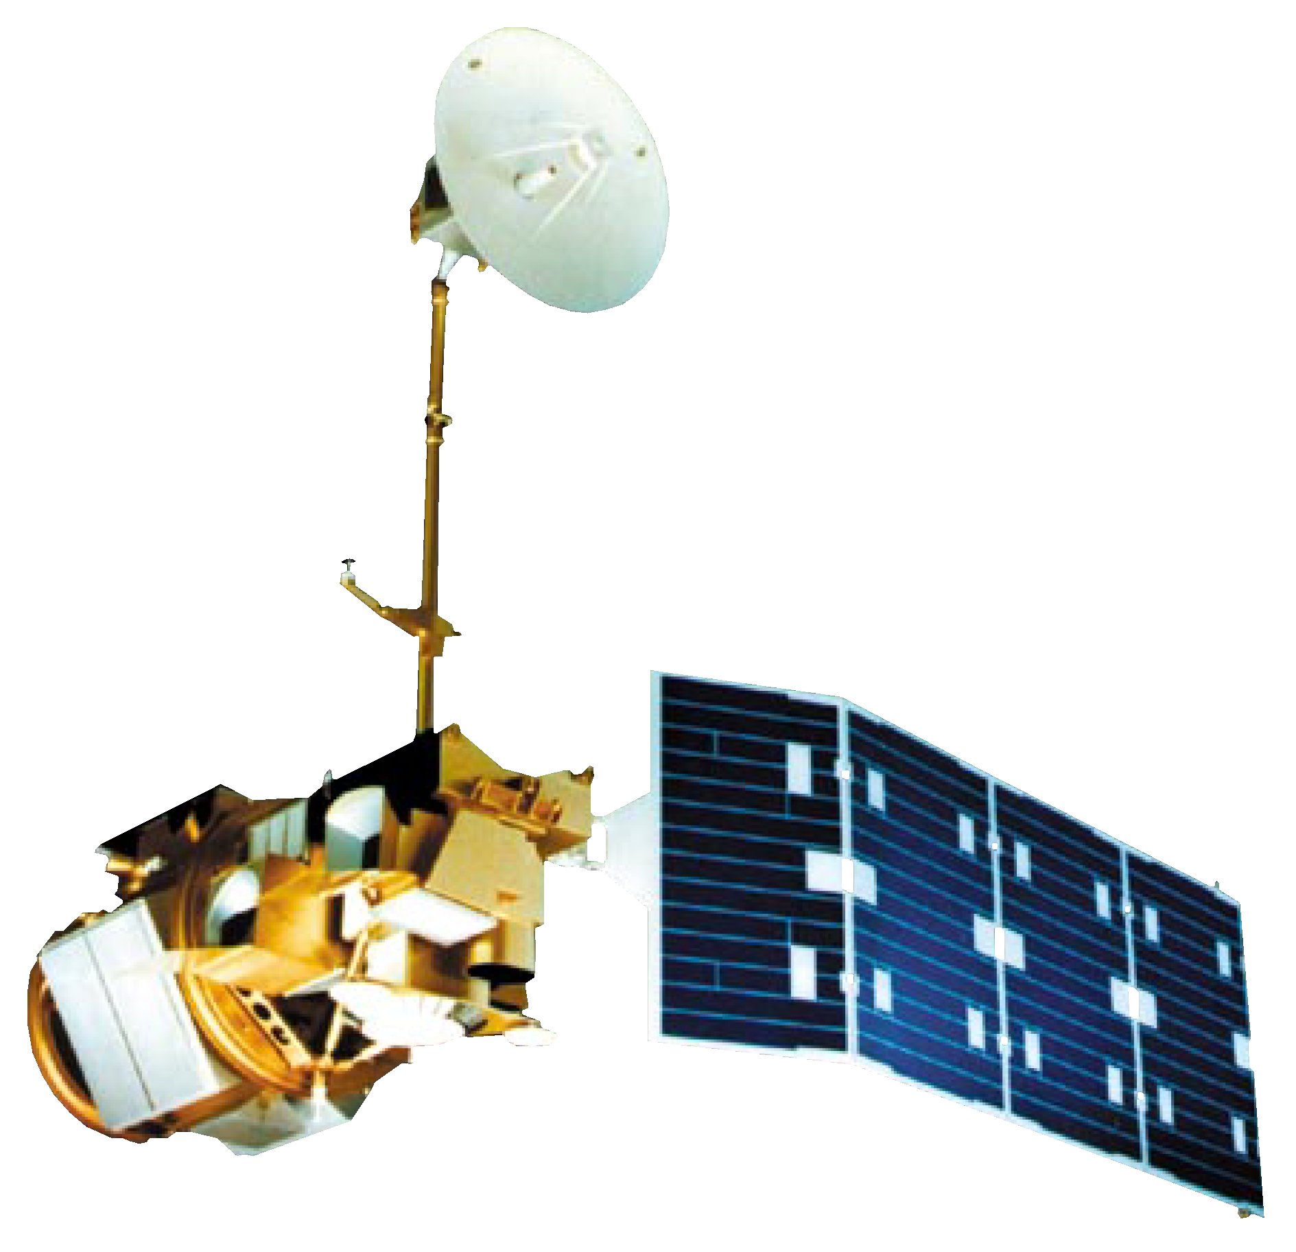
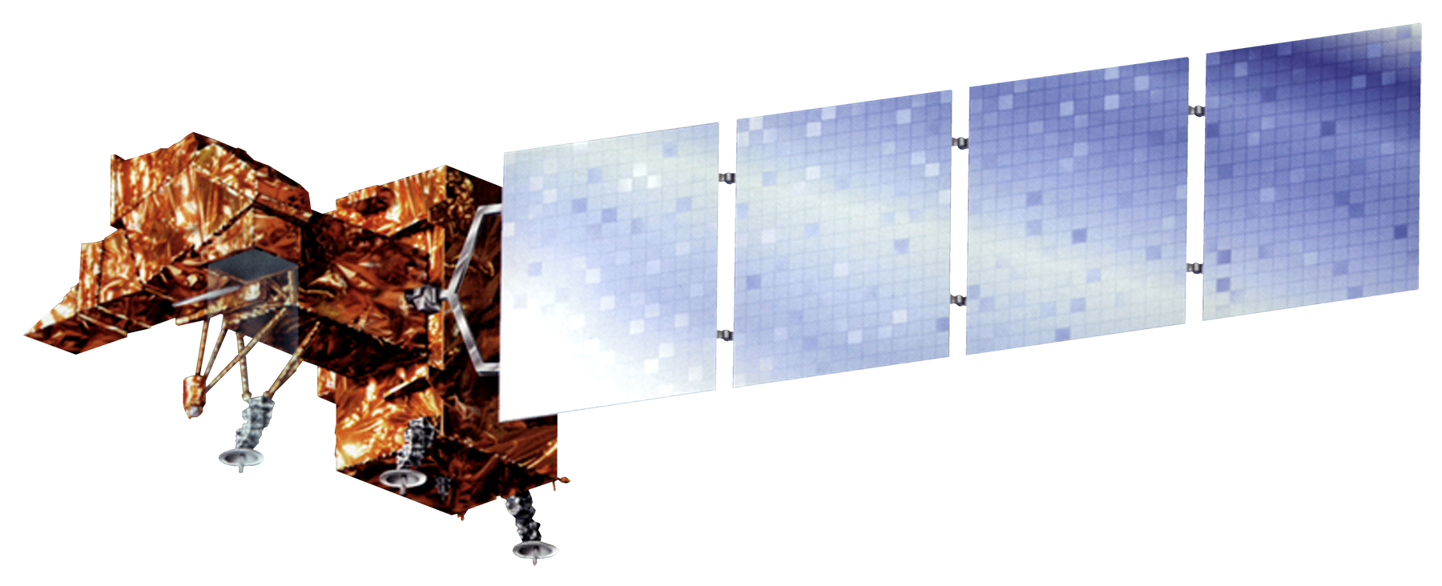
Coastal Texas Water Resources II
Using NASA Earth observations to assess the health of the Laguna Madre through land cover mapping and thermal analysis
Elaina Gonsoroski (Project Lead), Vishal Arya, Jennifer Boyd
DEVELOP National Program at the Mobile County Health Department
Abstract
Objectives
Keep this blank for now.
Body text point size should be at least 24.
Caption text point size should be at least 16.
Feel free to rename, move, and resize sections as needed.
Use remote sensing technologies to investigate the relationship between the salinity of the Laguna Madre and the increase in honey mesquite trees
Identify potential areas of groundwater inflow to the Laguna Madre using thermal imagery
Compare areas of mesquite tree coverage and underlying geology to investigate relationship between soil type and tree presence
Predict possible tree expansion to forecast how future groundwater resources for the Laguna Madre may be affected
Methodology
Study Area
Land Use/Land Cover (LULC)
Vegetation Indices
Thermal Analysis
Laguna Madre
Padre Island National Seashore
Study Period:
1984-2000
TOA Reflectance
Earth Observations
NDII = $\frac{NIR −SWIR}{NIR+SWIR}$
NDII = $\frac{NIR −Red}{NIR+Red}$
DN to TOA Radiance to Celsius
LULC Map
Landsat 5
Landsat 7
Results
Conclusions
TBD
TBD
Team Members
Project Partners
Acknowledgements
TBD
Dr. Bernard Eichold, M.D., Dr. PH
Mobile County Health Department
Joe Spruce
CSC, NASA Stennis Space Center
James “Doc” Smoot
CSC, NASA Stennis Space Center
Dr. Kenton Ross
NASA Langley Research Center
Joe Meiman
National Park Service
Dr. Dorina Murgulet
Texas A&M, Corpus Christi, Texas
Georgina Crepps, Tyler Lynn, Rodrigo Pereira da Silva, and Ryan Schick
Previous Project Participants of the DEVELOP National Program at the Mobile County Health Department
Mobile County Health Department

