Slide 1
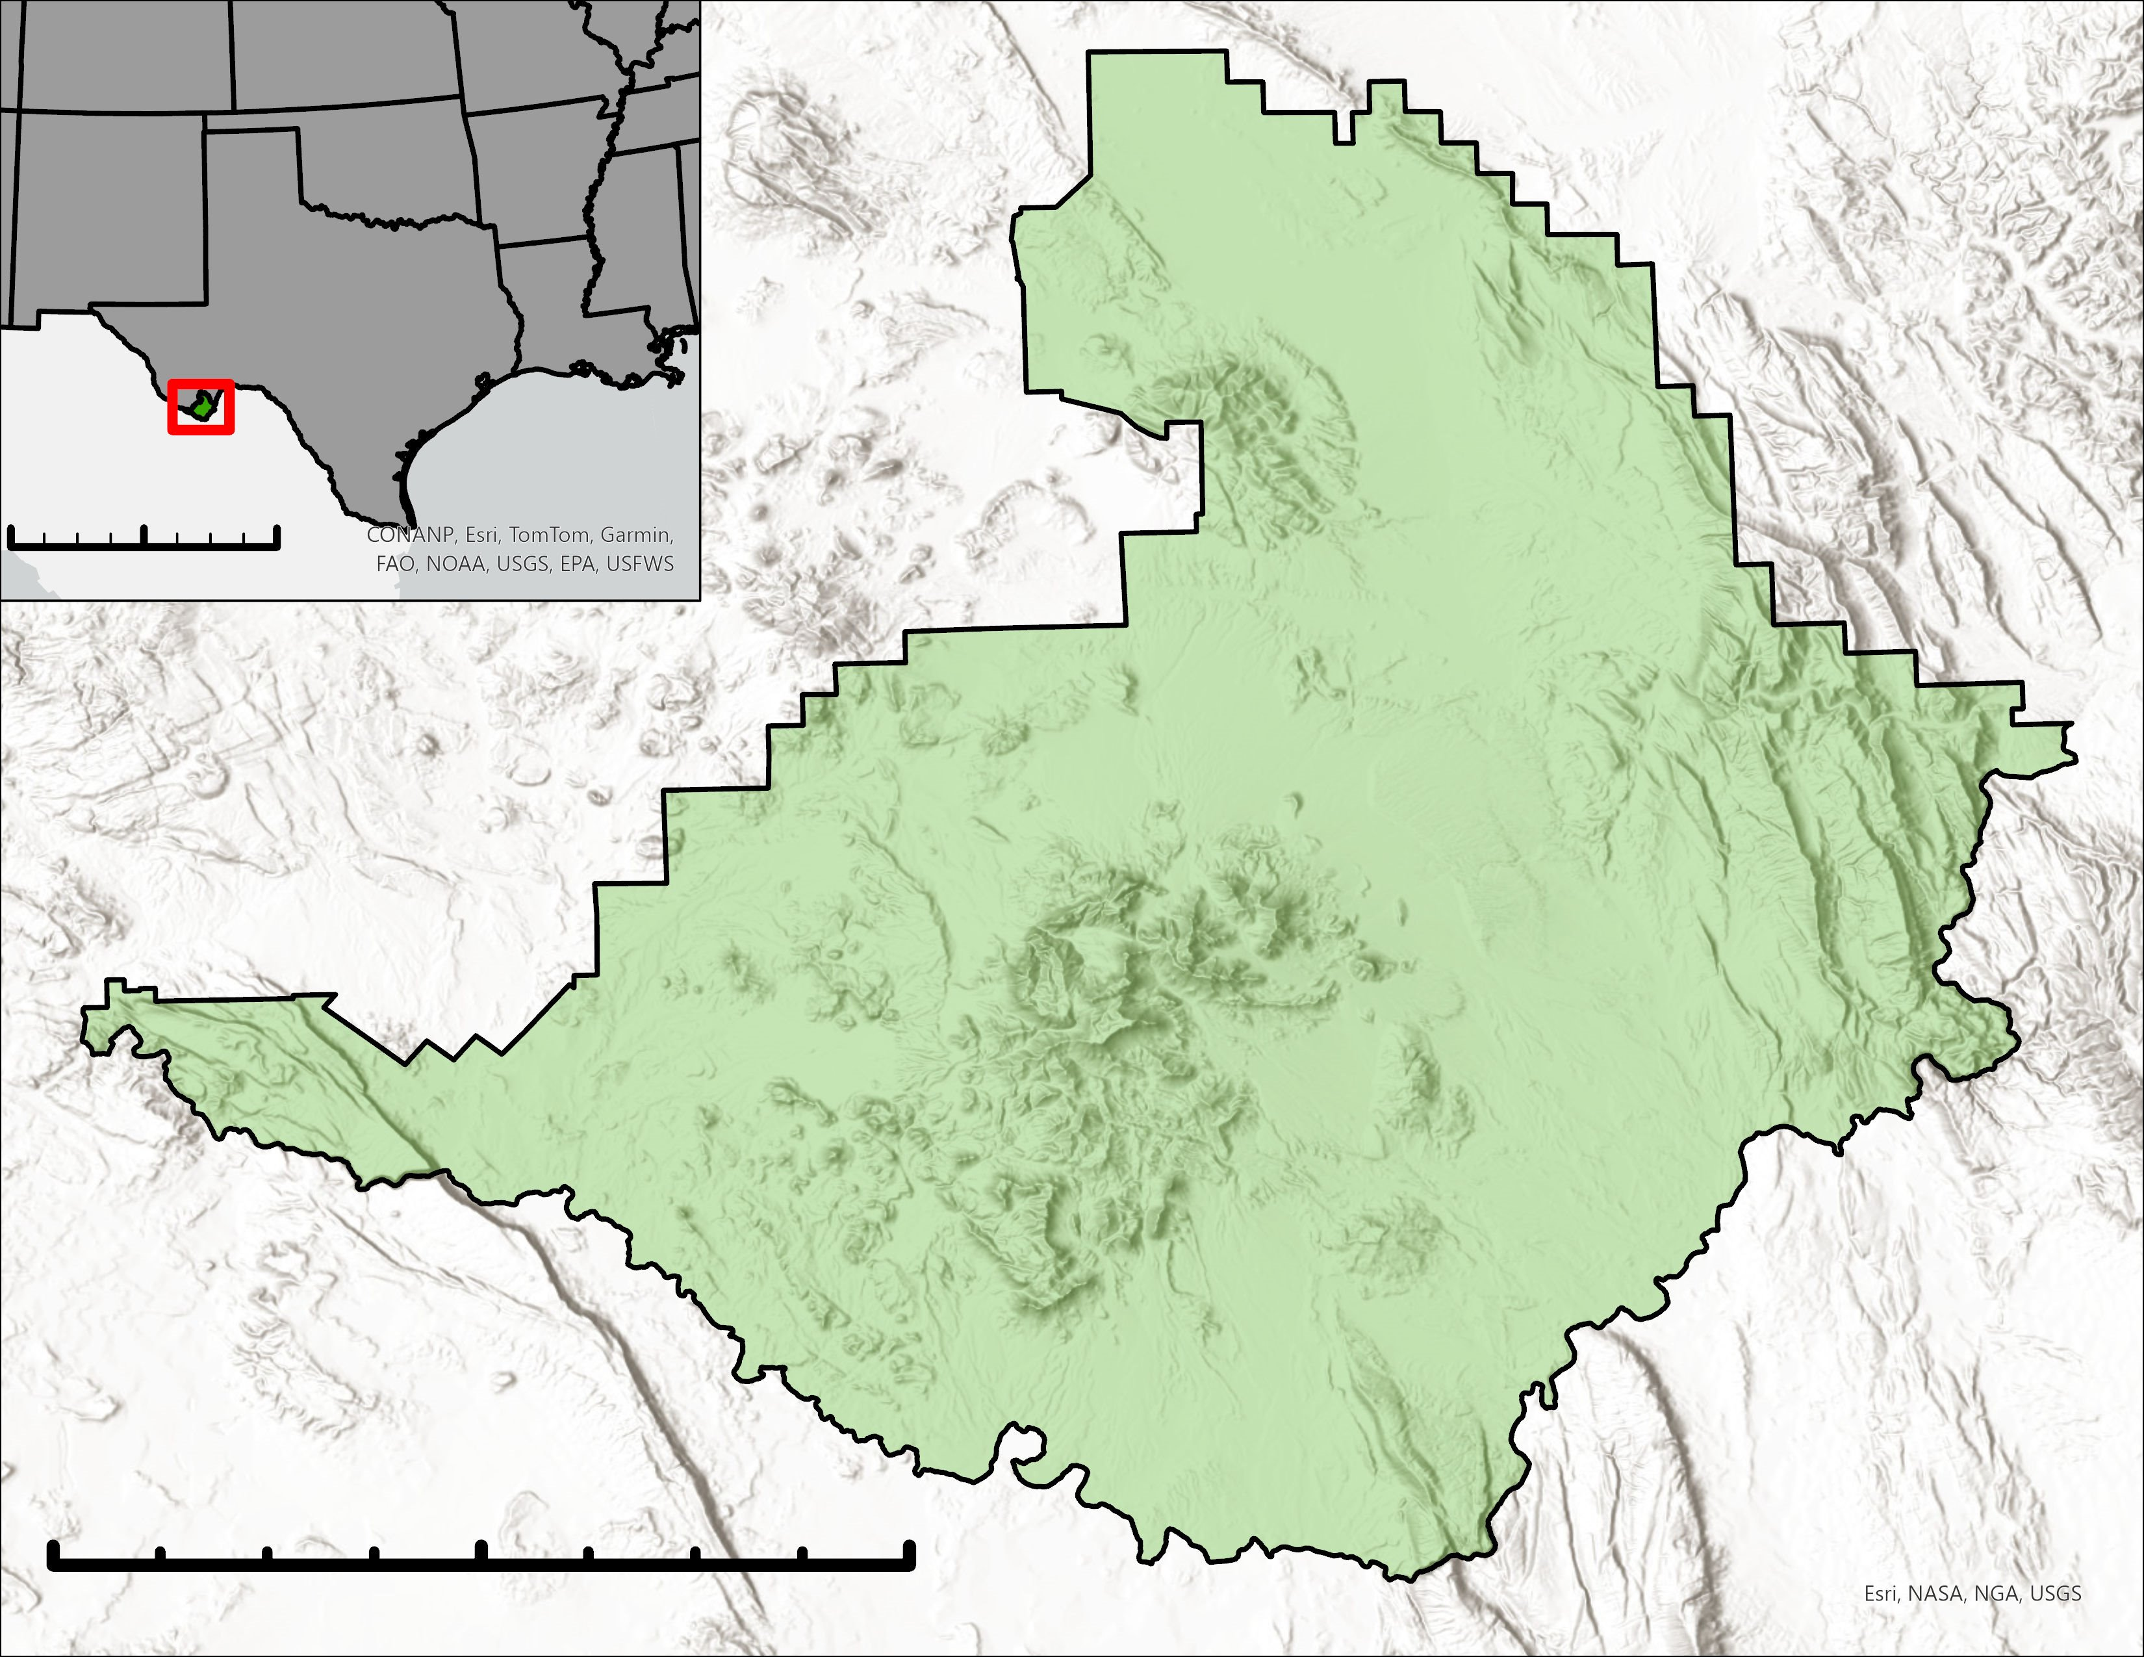
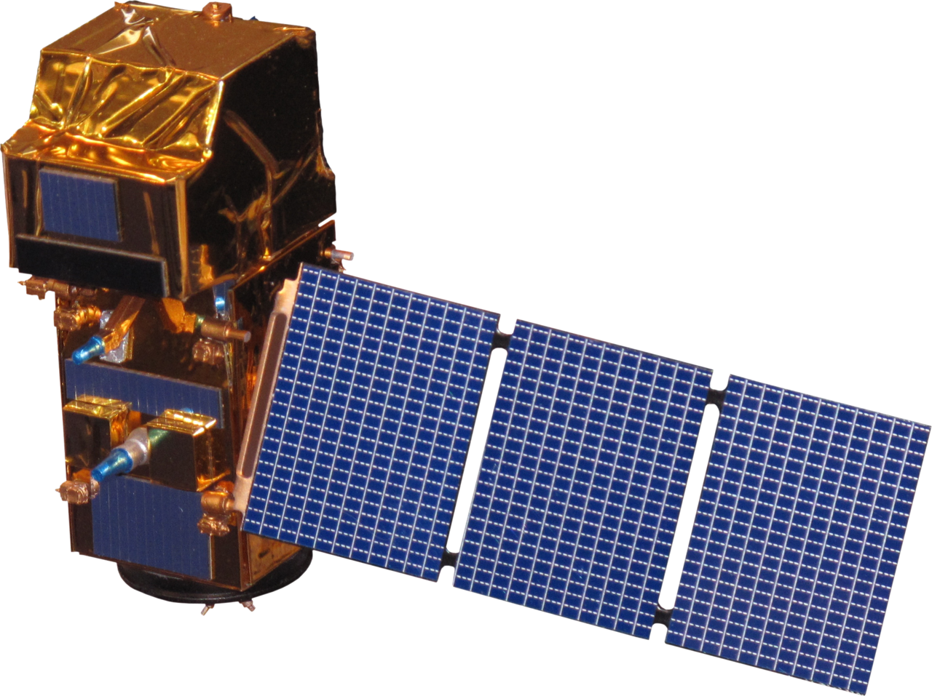
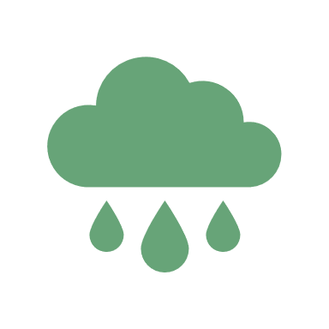
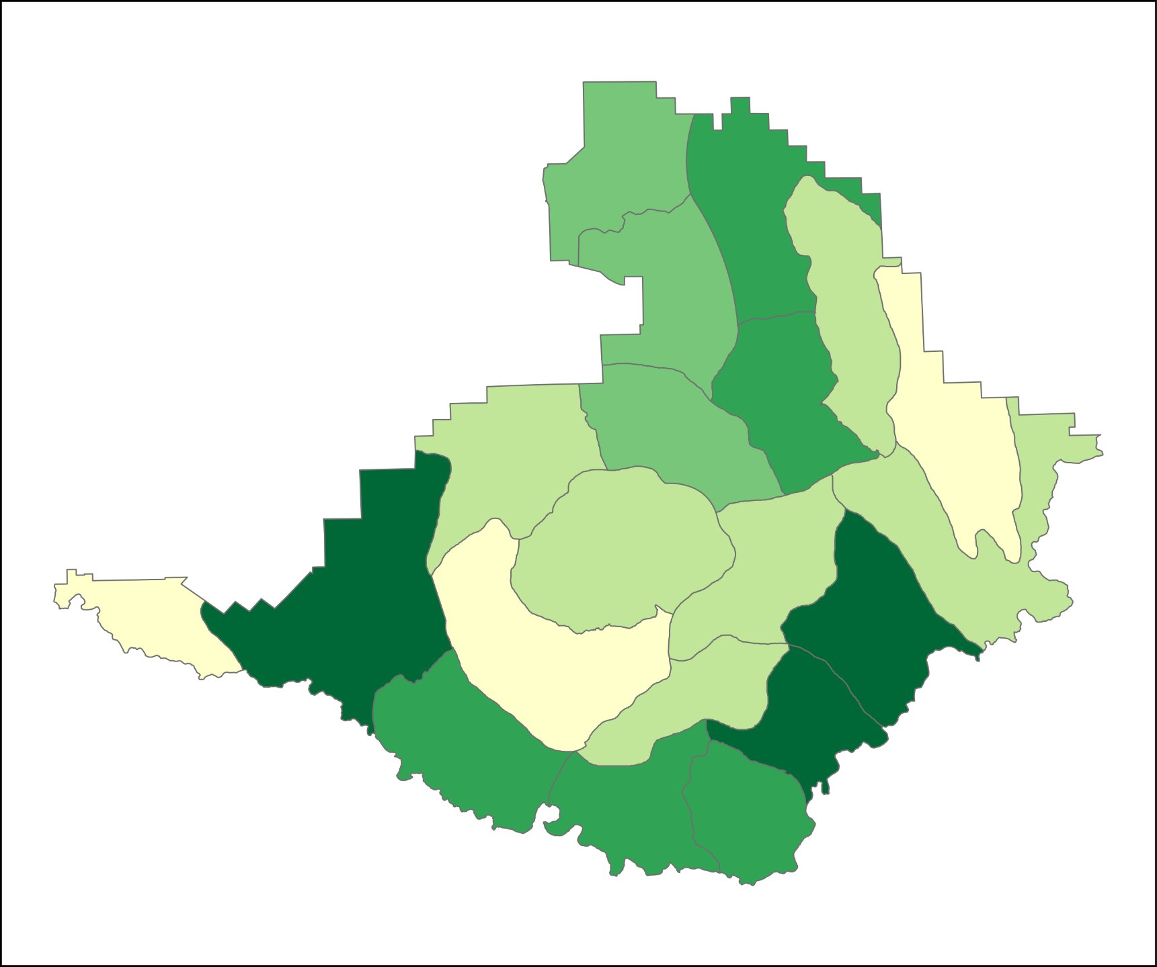
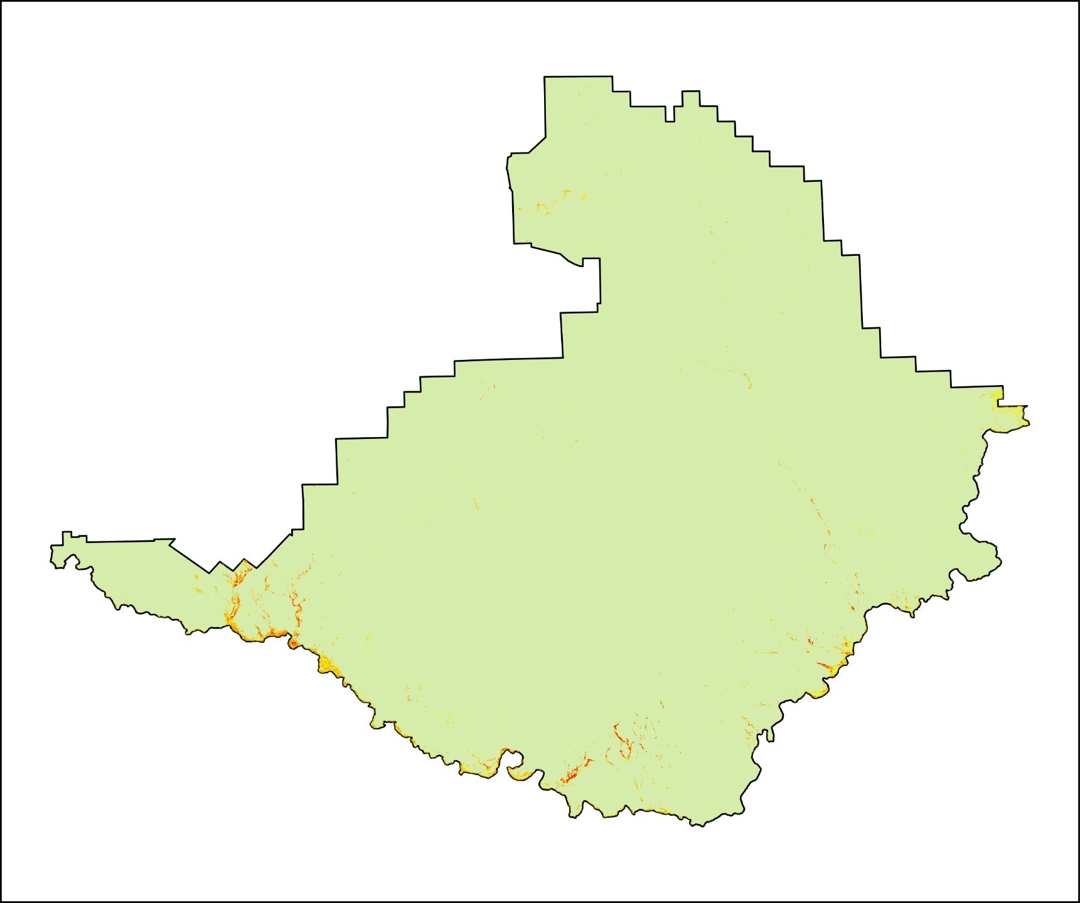
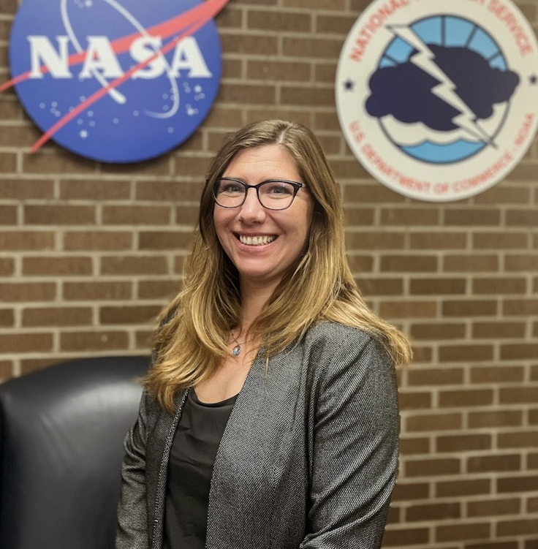
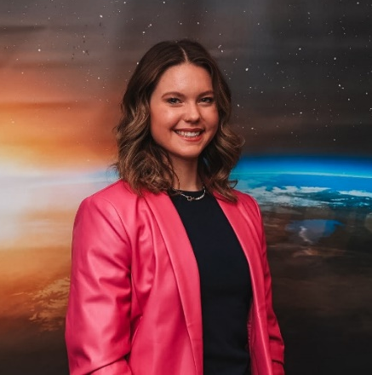
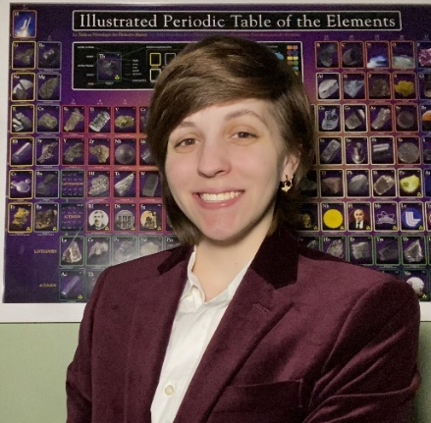
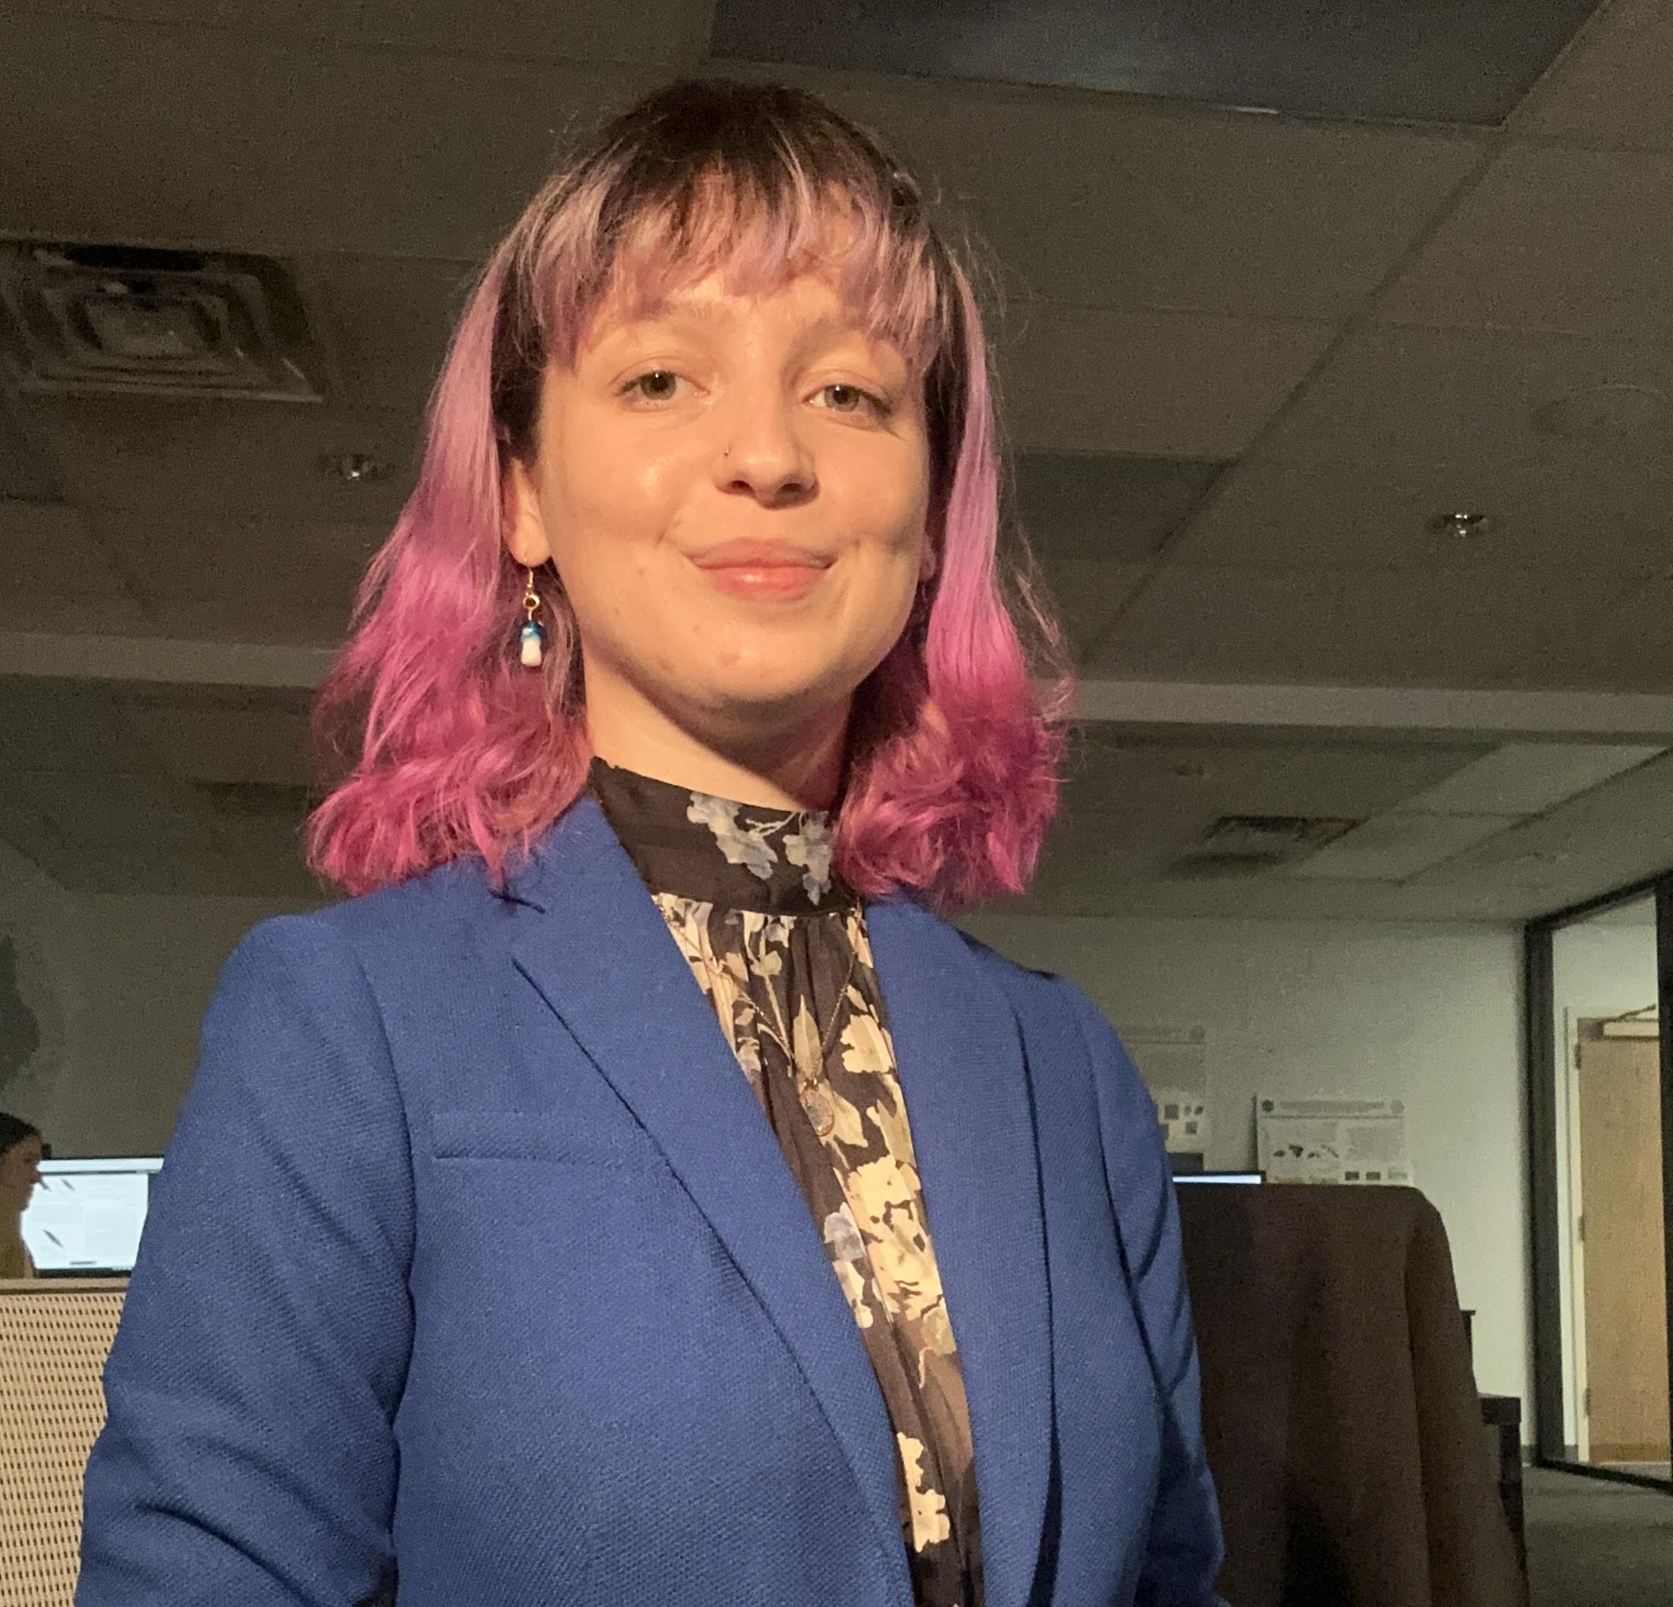
Big Bend Ecological Conservation
Integrating Earth Observations into Invasive Species Management Decisions in Big Bend National Park in Texas
Project Synopsis
Objectives
Located in Brewster county Texas, U.S., along the Texas-Mexico border, Big Bend National Park is 3,243 square kilometers of desert, mountains, and rivers. NASA’s MSFC Spring 2024 DEVELOP Team partnered with the National Park Service (NPS), to address the environmental concern of perennial invasive grasses in Big Bend National Park. Buffelgrass (Cenchrus Ciliaris), introduced to the park in the 1940’s, poses an ongoing threat, and causes habitat destruction for many of the park’s native ecosystems. Buffelgrass amplifies fire risk in the park, aids in the destruction of historic structures, and alters stream channels. To address the rising concern of Buffelgrass presence, the team constructed a habitat suitability model and performed a comprehensive fire risk assessment. The habitat suitability model considered climate, vegetation, and phenological variables, as well as physical and topographical variables. Subsequently, the team developed a fire risk model, which took fire history data, accessibility factors, climate trends and predictions, and developed areas into account. Sentinel-2 Multi-Source Land Surface Phenology (LSP) and Landsat 8 (OLI) imagery were used to predict Buffelgrass hotspot locations throughout the park. Through these analyses, the team identified optimal Buffelgrass habitat and hotspot locations, as well as park zones that reflect greatest risk for future Buffelgrass invasion and fire risk. The collective results of the habitat suitability model, fire risk assessment, and buffelgrass hot spot identification will allow the NPS to facilitate efficient mitigation measures and management strategies and improve resource allocation in critical areas.
Assess Buffelgrass habitat suitability and fire risk zones within the park
Create reproducible models to assist in future management and mitigation
Identify Buffelgrass locations using Sentinel-2 and Landsat 8 (OLI) imagery
Study Area
N
Big Bend National Park, Brewster County, TX
Big Bend National Park is 1,100 squared miles of desert, mountains, and rivers in the southwest part of Texas. This National Park is the largest protected area if the Chihuahua Desert in the United States.
Earth Observations
₊
Landsat 8, Sentinel-2A and 2B
Methodology
Habitat Suitability Model
Buffelgrass Detection
Fire Risk Assessment
Physical and Typographical Variables
Vegetation and Phenological Variables
Climate Variables
Spectral Imaging
Habitat Suitability
Specific Study Area Variables
Climate History and Trends
Vegetation Variables
Vegetation Cover Type
Normalized Difference Vegetation Index
Previous Fire Locations
Normalized Difference Vegetation Index
Optimal Elevations (3DEM)
Trails and Roads
Precipitation Data
Known Buffelgrass Locations
Optimal Elevations (3DEM)
Visible Vegetation
Temperature Trends
OGMx 90% maximum greening increase
Vegetation Cover Type
Developed Areas and Campsites
Maximum Temperature Change
Invasive Species Locations
Percent Green-up
Total Summer Precipitation
Visible Vegetation
Protected Areas
Fire History Points
Results
Dominant Co Species
Cattle Trespass Points
Suitability Level
Presence Probability
Very Low
1
Low
Low
2
Moderate
Medium Low
High
3
5
Medium
Very High
12
11
4
6
Medium High
20
19
10
9
8
7
High
Conclusions
18
13
17
14
15
Created park zones that allowed for a systematic method of analysis for calculating habitat suitability and fire risk
Performed a comprehensive habitat suitability and fire risk assessment which prioritized mitigation and management efforts for Big Bend National Park
Combined multi-source land image phenology data with optimal habitat suitability to generate a species detection map with 81% overall accuracy
0
5
10
20
30
40
16
Zone Risk Level
Kilometers
Very Low
0
5
10
20
30
40
Low
1
2
Kilometers
Moderate
High
3
5
Very High
12
11
4
6
20
19
13
10
14
9
8
7
18
17
16
15
Acknowledgements
0
5
10
20
30
40
Kilometers
Cristina Villalobos-Heredia (NASA DEVELOP, Lead)
Dr. Jeffery Luvall (NASA Marshall Space Flight Center, Science Advisor)
Dr. Robert Griffin (The University of Alabama Huntsville, Science Advisor)
Dr. Mark Friedl (Boston University, Director for Center Remote Sensing)
Dr. Kent Ross (NASA DEVELOP, Program Manger)
Eric Anderson (NASA SERVIR)
Helen Parache (NASA Marshall Space Flight Center)
Team Members
Kait L. Lemon
Project Lead
Margaret L. Birks
Beck De Fazio
Chloe A. Marini
Alabama - Marshall │ 2024

