Slide 1
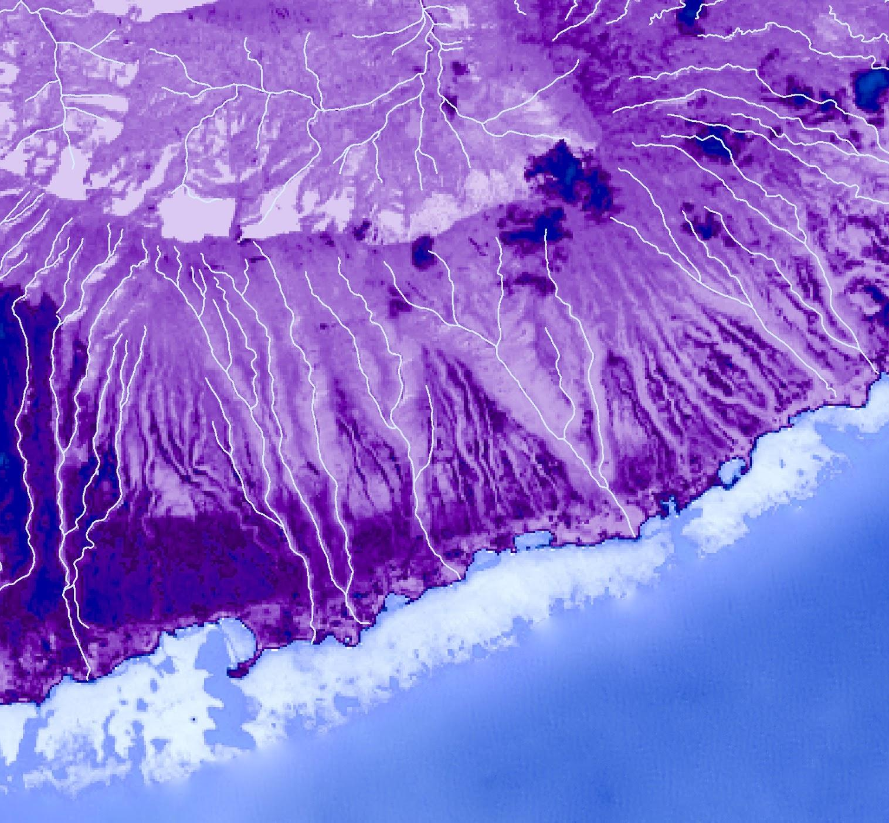
MOLOKA’I
WATER RESOURCES
Employing NASA Earth Observations to Map the Impacts of the Ohi’a Rust on Forest Health and Coastal Turbidity on Molokai, Hawaii
Nicole Pepper
Sophia Leiker
David Fluharty
Caroline Odell
Colorado – Fort Collins | Summer 2019
Notes:
Goodmorning/afternoon lads!
We are the Moloka’i Water Resources team located at the Fort Collins Node. We are Nicole Pepper, Sophia Leiker, David Fluharty, and Caroline Odell.
For this project we are focusing on the impacts of the ohi’a rust.

Slide 2

Partners
The Nature Conservancy
Pu’u O Hoku
Ranch
Stephanie Tom
GIS Specialist
Moloka’i, Hawaii
Dr. Stephanie Dunbar
Project Manager
Moloka’i, Hawaii
Dr. Helen Soafer
Research Ecologist
Pacific Islands Ecosystem Research Center, Honolulu, HI
Rudi Hunke
Ranch Manager
Eastern Moloka’i
Notes:
We partnered with the Nature Conservancy, the United States Geological Survey (USGS), and the Pu’u O Hoku Ranch.
The Nature Conservancy is focused on conserving the biodiversity of the Moloka’i. This partner provided us with presence points and is interested in better understanding the ohi’a defoliation and understanding the quantifiable effects of exclosure assessments.
The USGS has an interest in managing invasive species and mapping vegetation health. This project will help build the USGS’s capability to apply NASA and ESA earth observations to management decisions.
The Pu’u O Hoku Ranch is located on the east end of Moloka’i surrounded by 14,000 acres of protected forests. This collaborator provided us with island based knowledge of the issue.

Slide 3
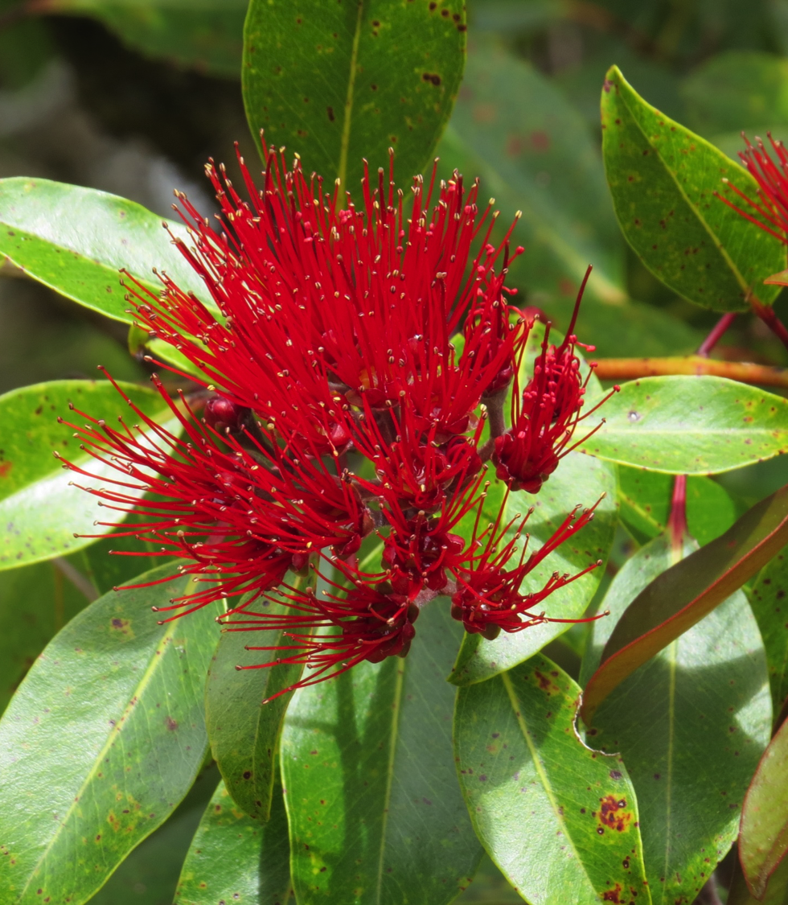
The ‘Ohi’a
Background
Most abundant native tree across the Hawaiian Islands
Tolerant of wide range of environmental conditions
Grows sea to summit
First to grow on lava fields
Image Credit: Dr. Paul Evangelista
Notes:
Here is a little background information on the Ohi’a.
It is the most abundant native tree across the Hawaiian Islands
It is tolerant of a wide range of environmental conditions so it is able to grow from sea to summit.
In addition, ohi’a trees are first to grow on lava fields.
------------------------------Image Information Below -----------------------------
image from: Dr.Paul Evangeslista

Slide 4
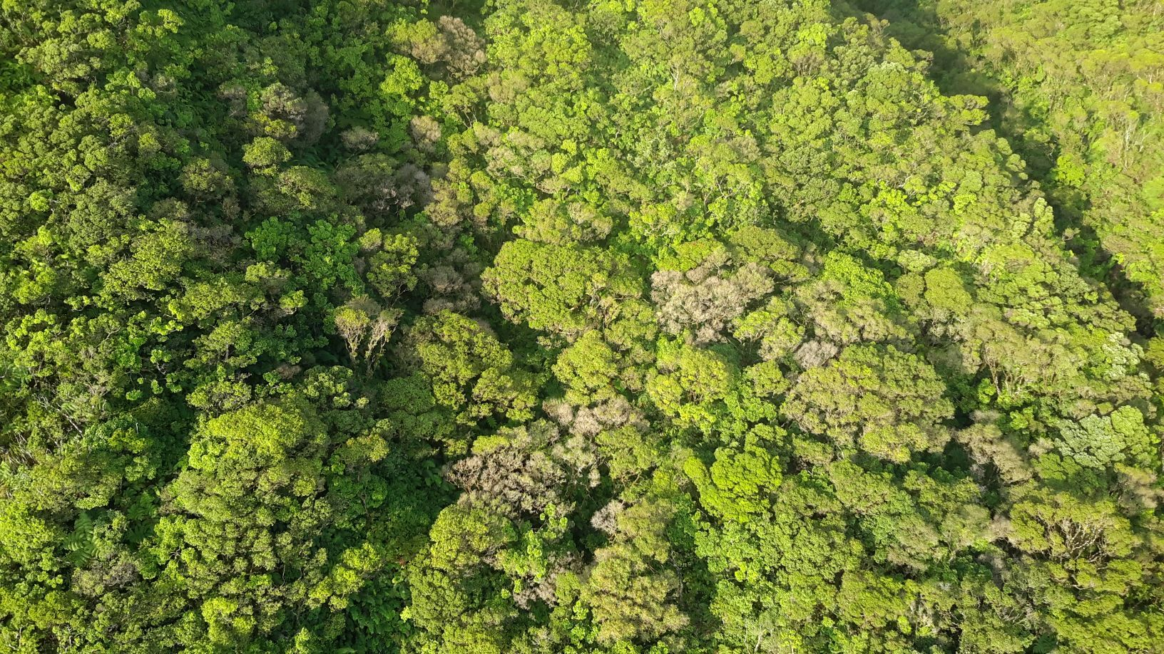


‘Ohi’a Significance
Ecological Significance
Important role in maintaining the island’s hydrologic cycle
Year round nectar source
Cultural Significance
Religious symbol
Referenced in traditional Hawaiian stories and songs
Image Credit: The Nature Conservancy
Notes:
The ohia holds both ecological and cultural significance.
Ecological Significance
The ohia has an important role in maintaining the island’s hydrologic cycle. The ohi’a has an ability to store surface and groundwater.
It also serves as a year round nectar source. Many native birds and insects rely on this tree as a food source
Cultural Significance
The Ohi’a is seen by some islanders as a religious symbol. The flowers are used as adornments in hula ceremonies and the branches and leaves are used to make hula skirts.
The Ohi’a is also referenced in traditional Hawaiian stories and songs. Due to these references, the ohi’a is often considered a physical manifestation of the gods.
------------------------------Image Information Below -----------------------------
image (flyover): The Nature Conservancy

Slide 5
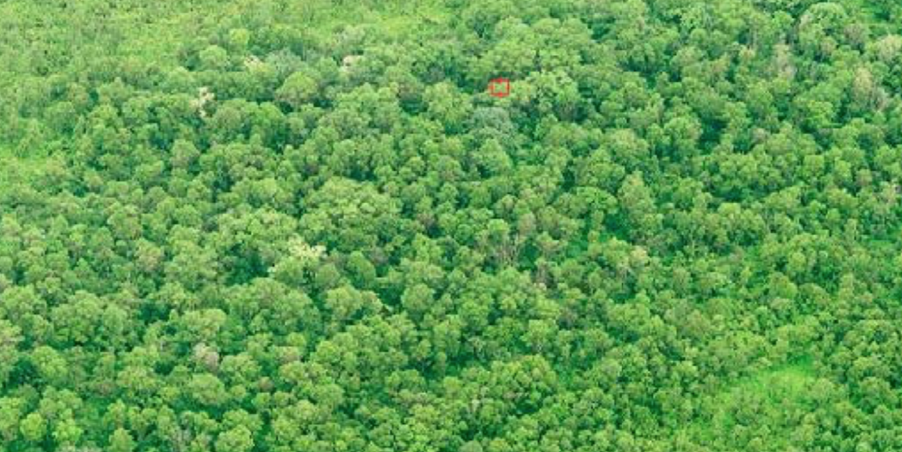
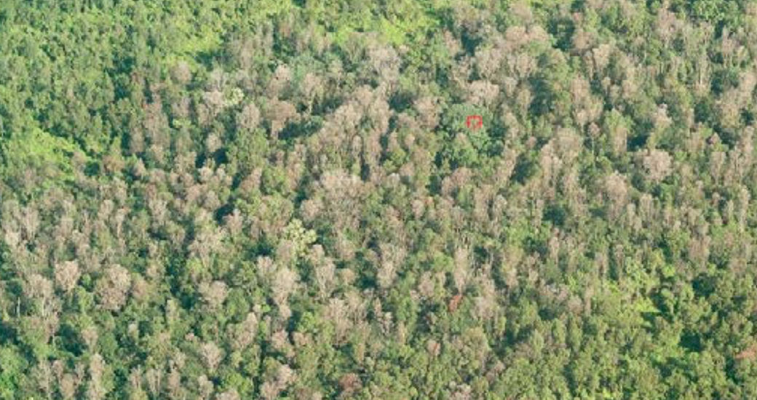
Ohi’a Rust Outbreak
Unimpacted Forest
Rust Impacted Forest
Image Credit: USFS
Notes:
Here we have a photograph of a section of healthy forest.
(transition slide) And here is what an ohi’a stand looks like after it has been impacted by the rust.
As you can see, some of the trees look a “rusty” brown and sometimes white color. And they look less foliated than the other trees.
------------------------------Image Information Below ------------------------------
Both Images from: The United States Forest Service

Slide 6
Ohi’a Rust Outbreak
Healthy Ohi’a
Yellow powder & brown spots form
on leaves & stems
Leaves turn to a
red & grey
colors
Defoliation
Notes:
This is a detailed slide of how the rust affects the ohi’a leaves.
It starts off attacking a healthy host by displaying yellow powder and brown spots on the leaves.
It then progresses to a red color making the leaves look “rusty”.
And in some cases, the pathogen causes defoliation.

Slide 7
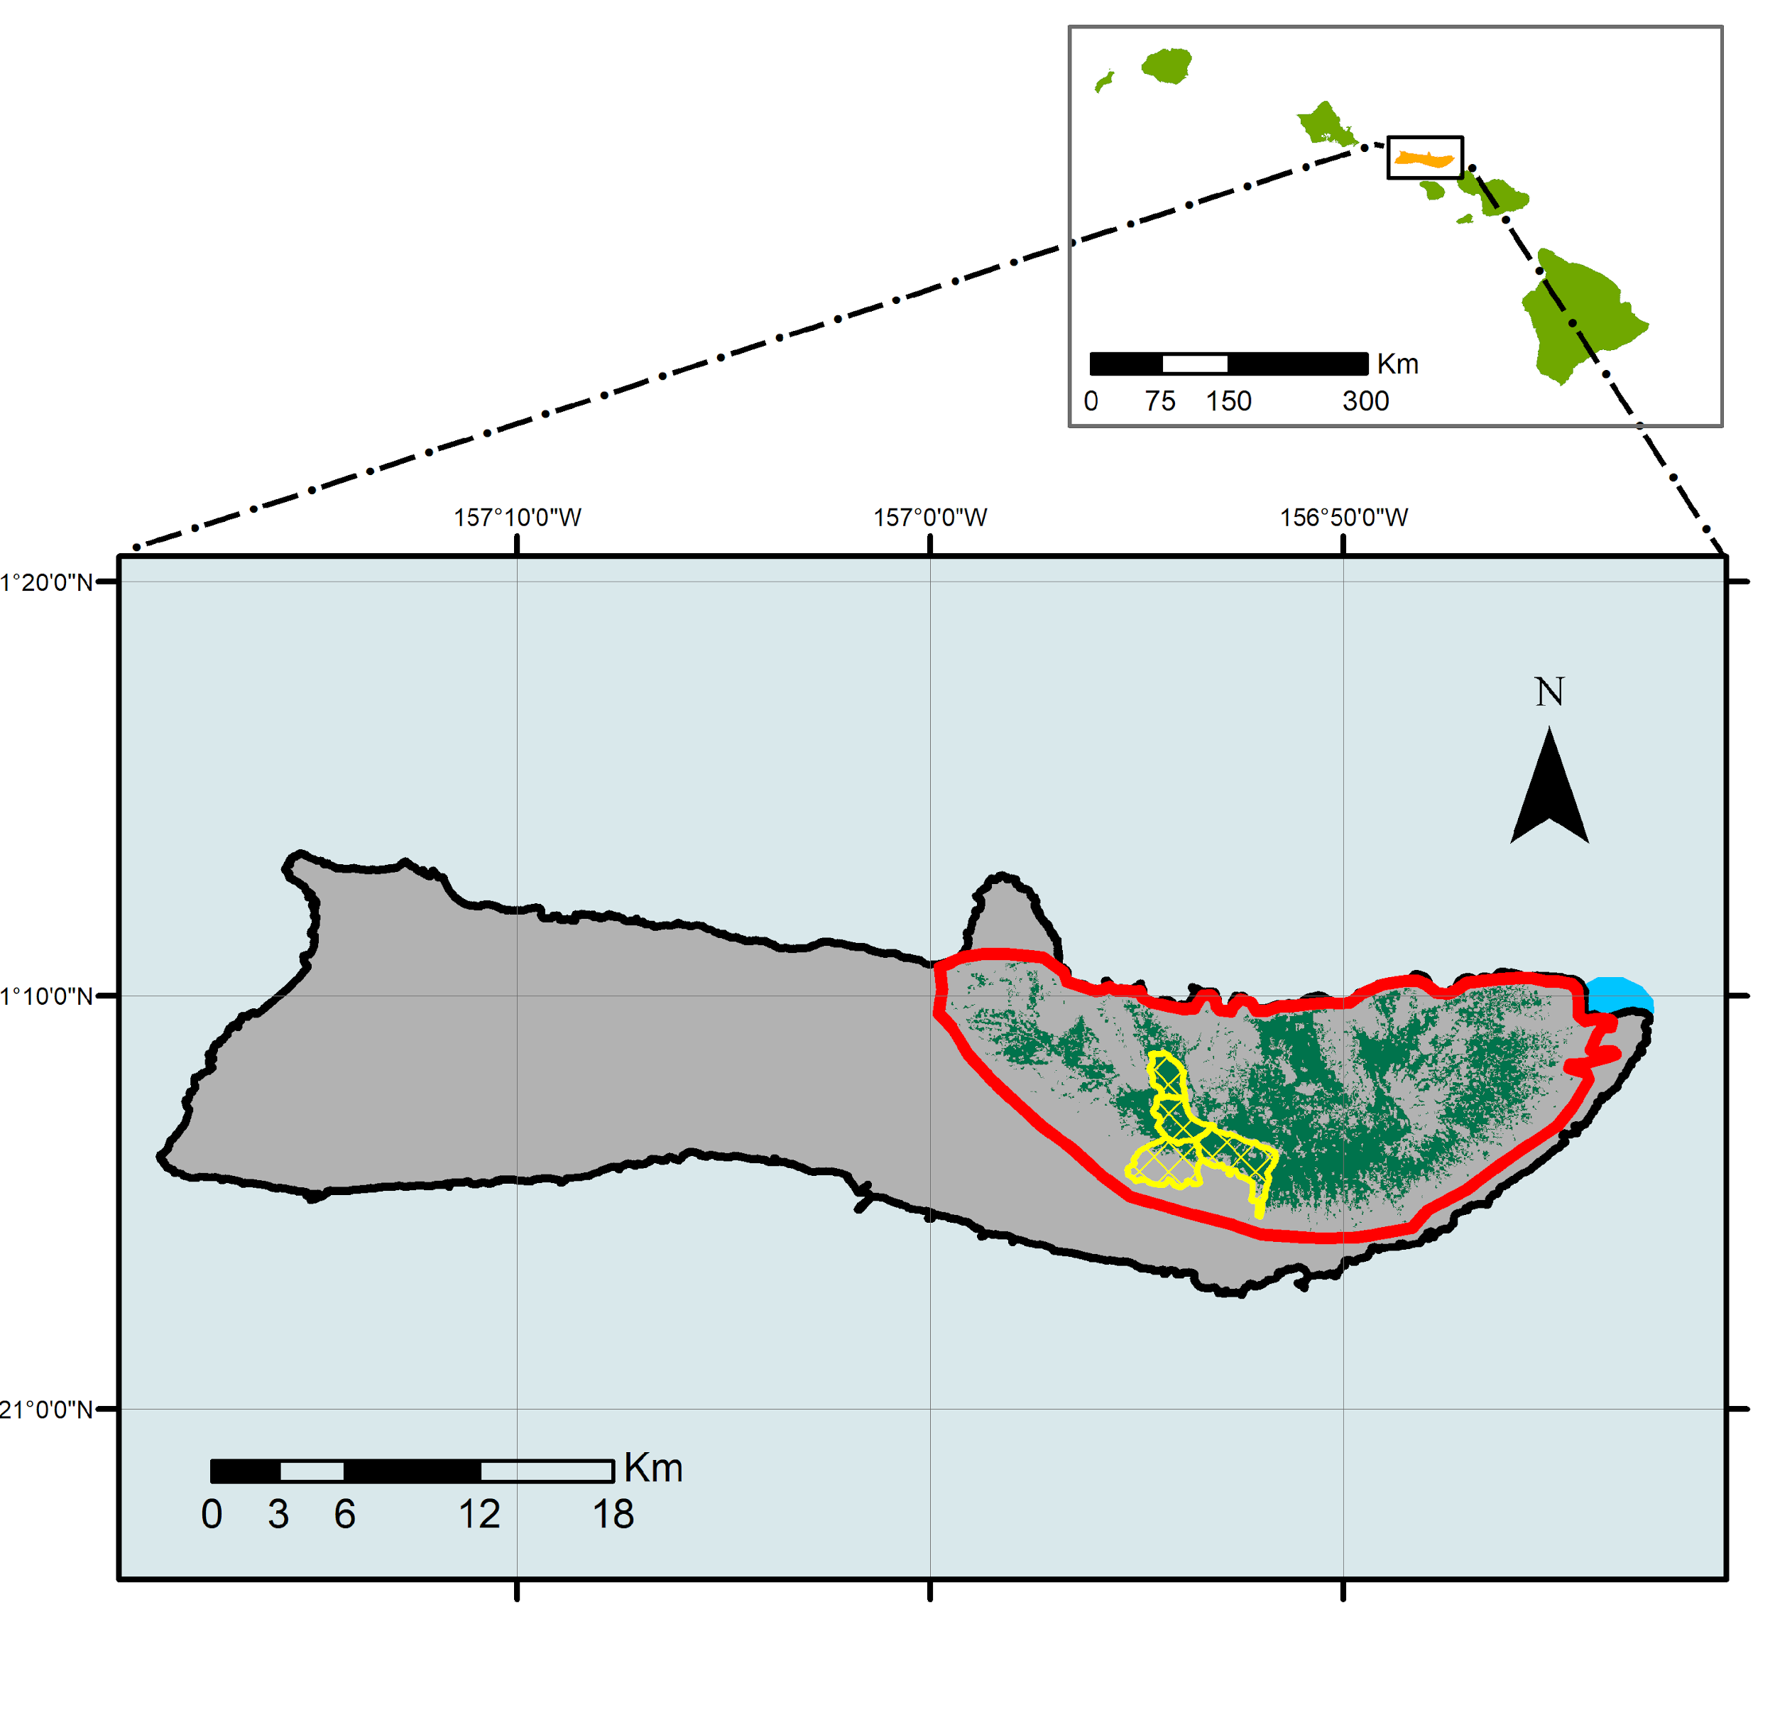
Study Area
Hawaiian Islands
Moloka’i, Hawaii
Elevation: 0 - 1,493 meters
Precipitation: over 300 inches/year
Ecosystem types:
  Lowland wet forest
  Shrubland
  Montane wet forest
  High plateau
Forest Cover:
  Eastern side of the island
  Ohi’a is the dominant cover
  Diverse flora and fauna understory
Ohi’a Study Area
River Outlet
TNC Exclosures
Ohi’a Forest
Notes:
Speaker Notes:
1) location
2) ecosystem types
3) land cover on east to west
4) point out study area and exclosures

Slide 8
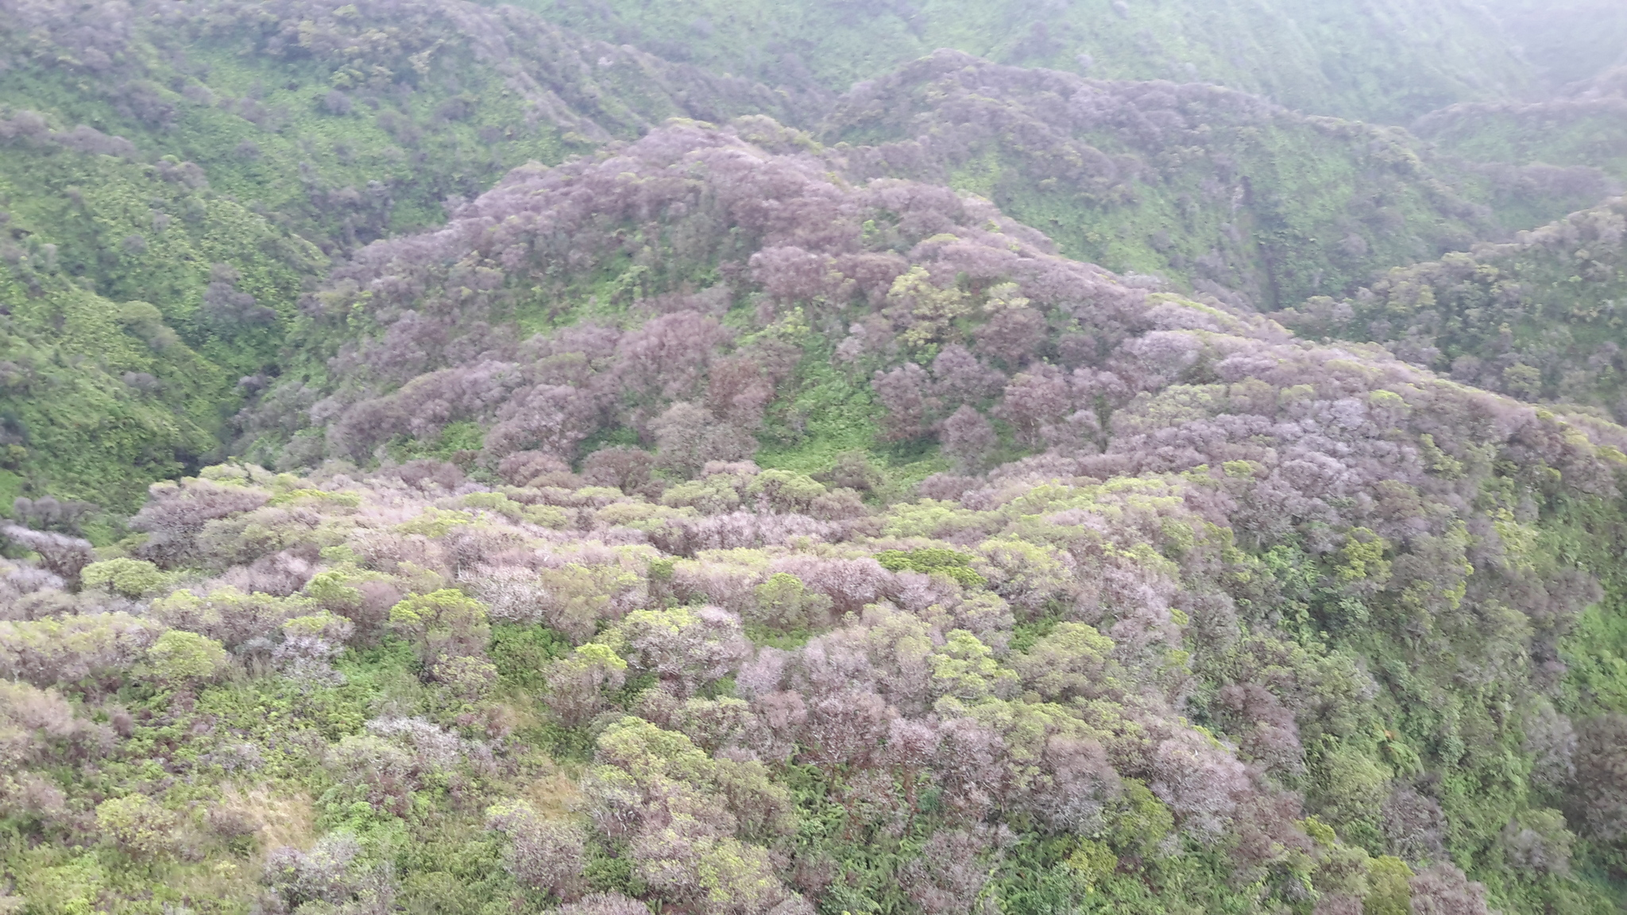
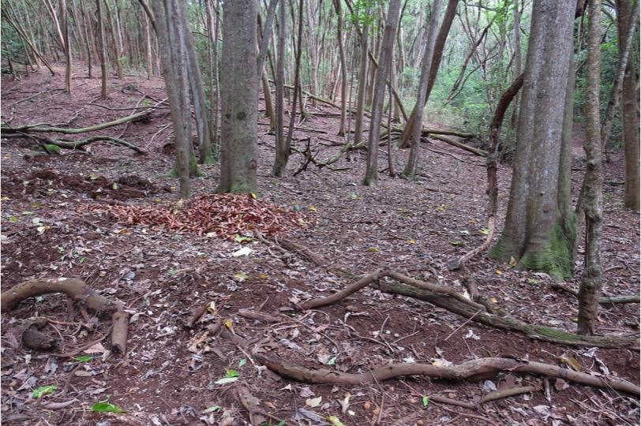
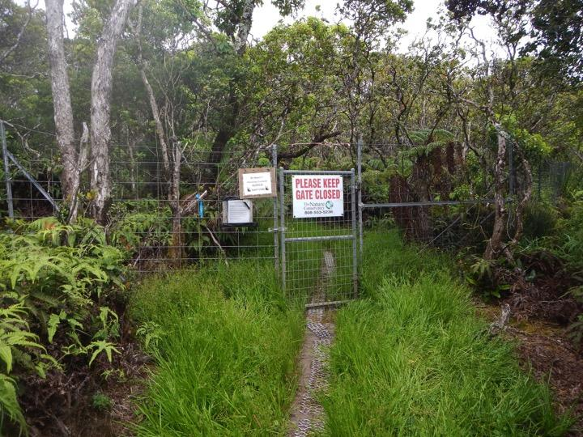
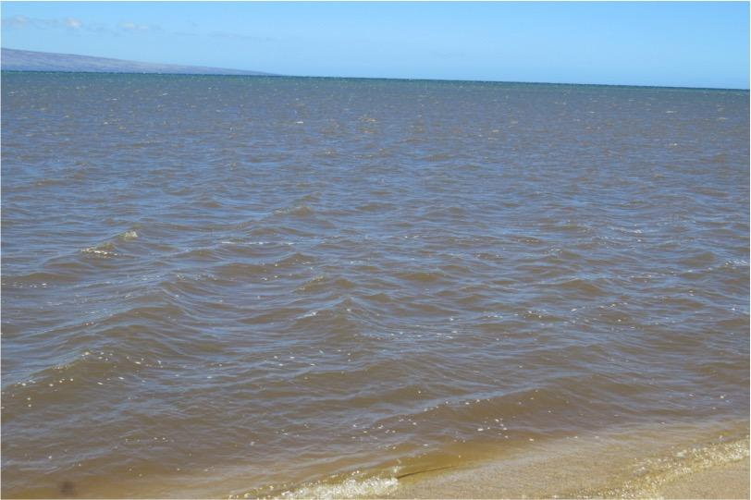
Community Concerns
2017 ‘Ohi’a Rust Outbreak
Invasive Ungulates
Changes in Watershed Dynamics
Image Credit: USGS
Widespread ‘Ohi’a
Defoliation & Mortality
Overgrazing of
the Forest Understory
Image Credit: USGS
Increased Erosion & Increased Turbidity
In Coastal Waters
Image Credit: The Nature Conservancy
Image Credit: Dr. Paul Evangelista
Notes:
The concerns of the community can be summed into three groups,
1) the rust outbreak, that includes the defoliation and the mortatlily of the ohi’a
2) the invasive ungulates which are degrading the understory of the forest and are further spreading the rust by causing stress to the trees
3) the change in Moloka’i’s watershed dynamics due to the decline of the ohi’a trees is resulting in increased erosion and turbidity in coastal waters.
------------------------------Image Information Below -----------------------------
Image (defoliation flyover) - The Nature Conservancy
Image (understory) - Dr. Paul Evangeslista
Image (exclsoure) - Dr. Paul Evangeslista
image (coastal) - Dr.Paul Evangeslista

Slide 9
Objectives
Create
Evaluate
Assess
The impacts of The Nature Conservancy exclosures on ‘ohi’a health
The feasibility of detecting turbidity for big runoff events off the coast of Moloka’i
Ohi’a forest impact maps & analyze changes over time
Image Credit: The Nature Conservancy
Image Credit: The Nature Conservancy
Notes:
Our three objectives for this project are to
1) create an Ohi’a forest impact maps & analyze changes over time
2) Evaluate the impacts of The Nature Conservancy exclosures on forest health
3) Assess the feasibility of detecting turbidity for big runoff events off the coast of Moloka’i
------------------------------Image Information Below -----------------------------
Image from The Nature Conservancy

Slide 10
Study Period
2013
2014
2015
2016
2017
2018
2019
Peak Rust Outbreak
Landsat 8 - OLI
Sentinel-2 MSI
Notes:
1) Our study period begins in 2013 and spands to the present
2) We chose to focus on the pre-rust outbreak, the year that the Peak rust outbreak occurred in 2017, and post outbreak.
3) We chose to start w the earliest landsat data available in 2013 and sentinel 2 data available in 2016
Sentinel 2: 10 days with one satellite and 5 days with 2 satellites
Landsat 8 - 16 day return date

Slide 11
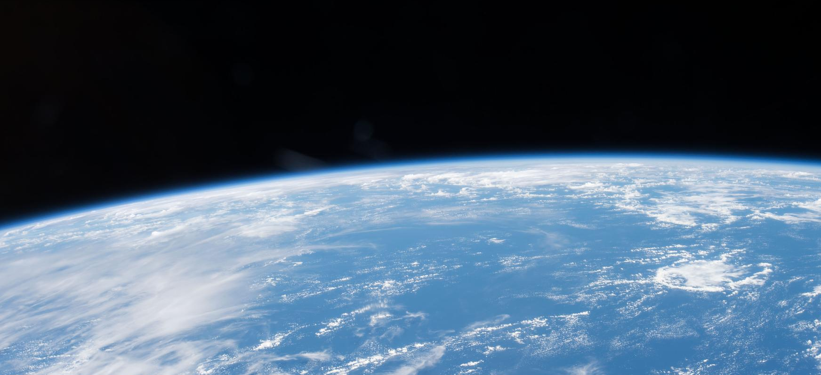
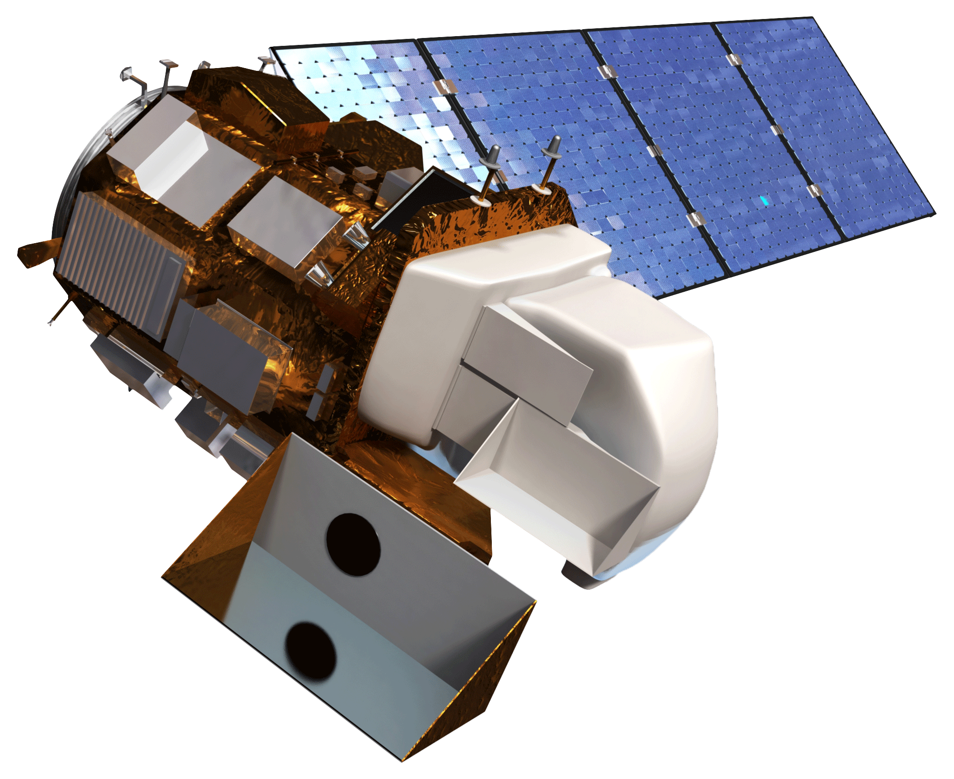
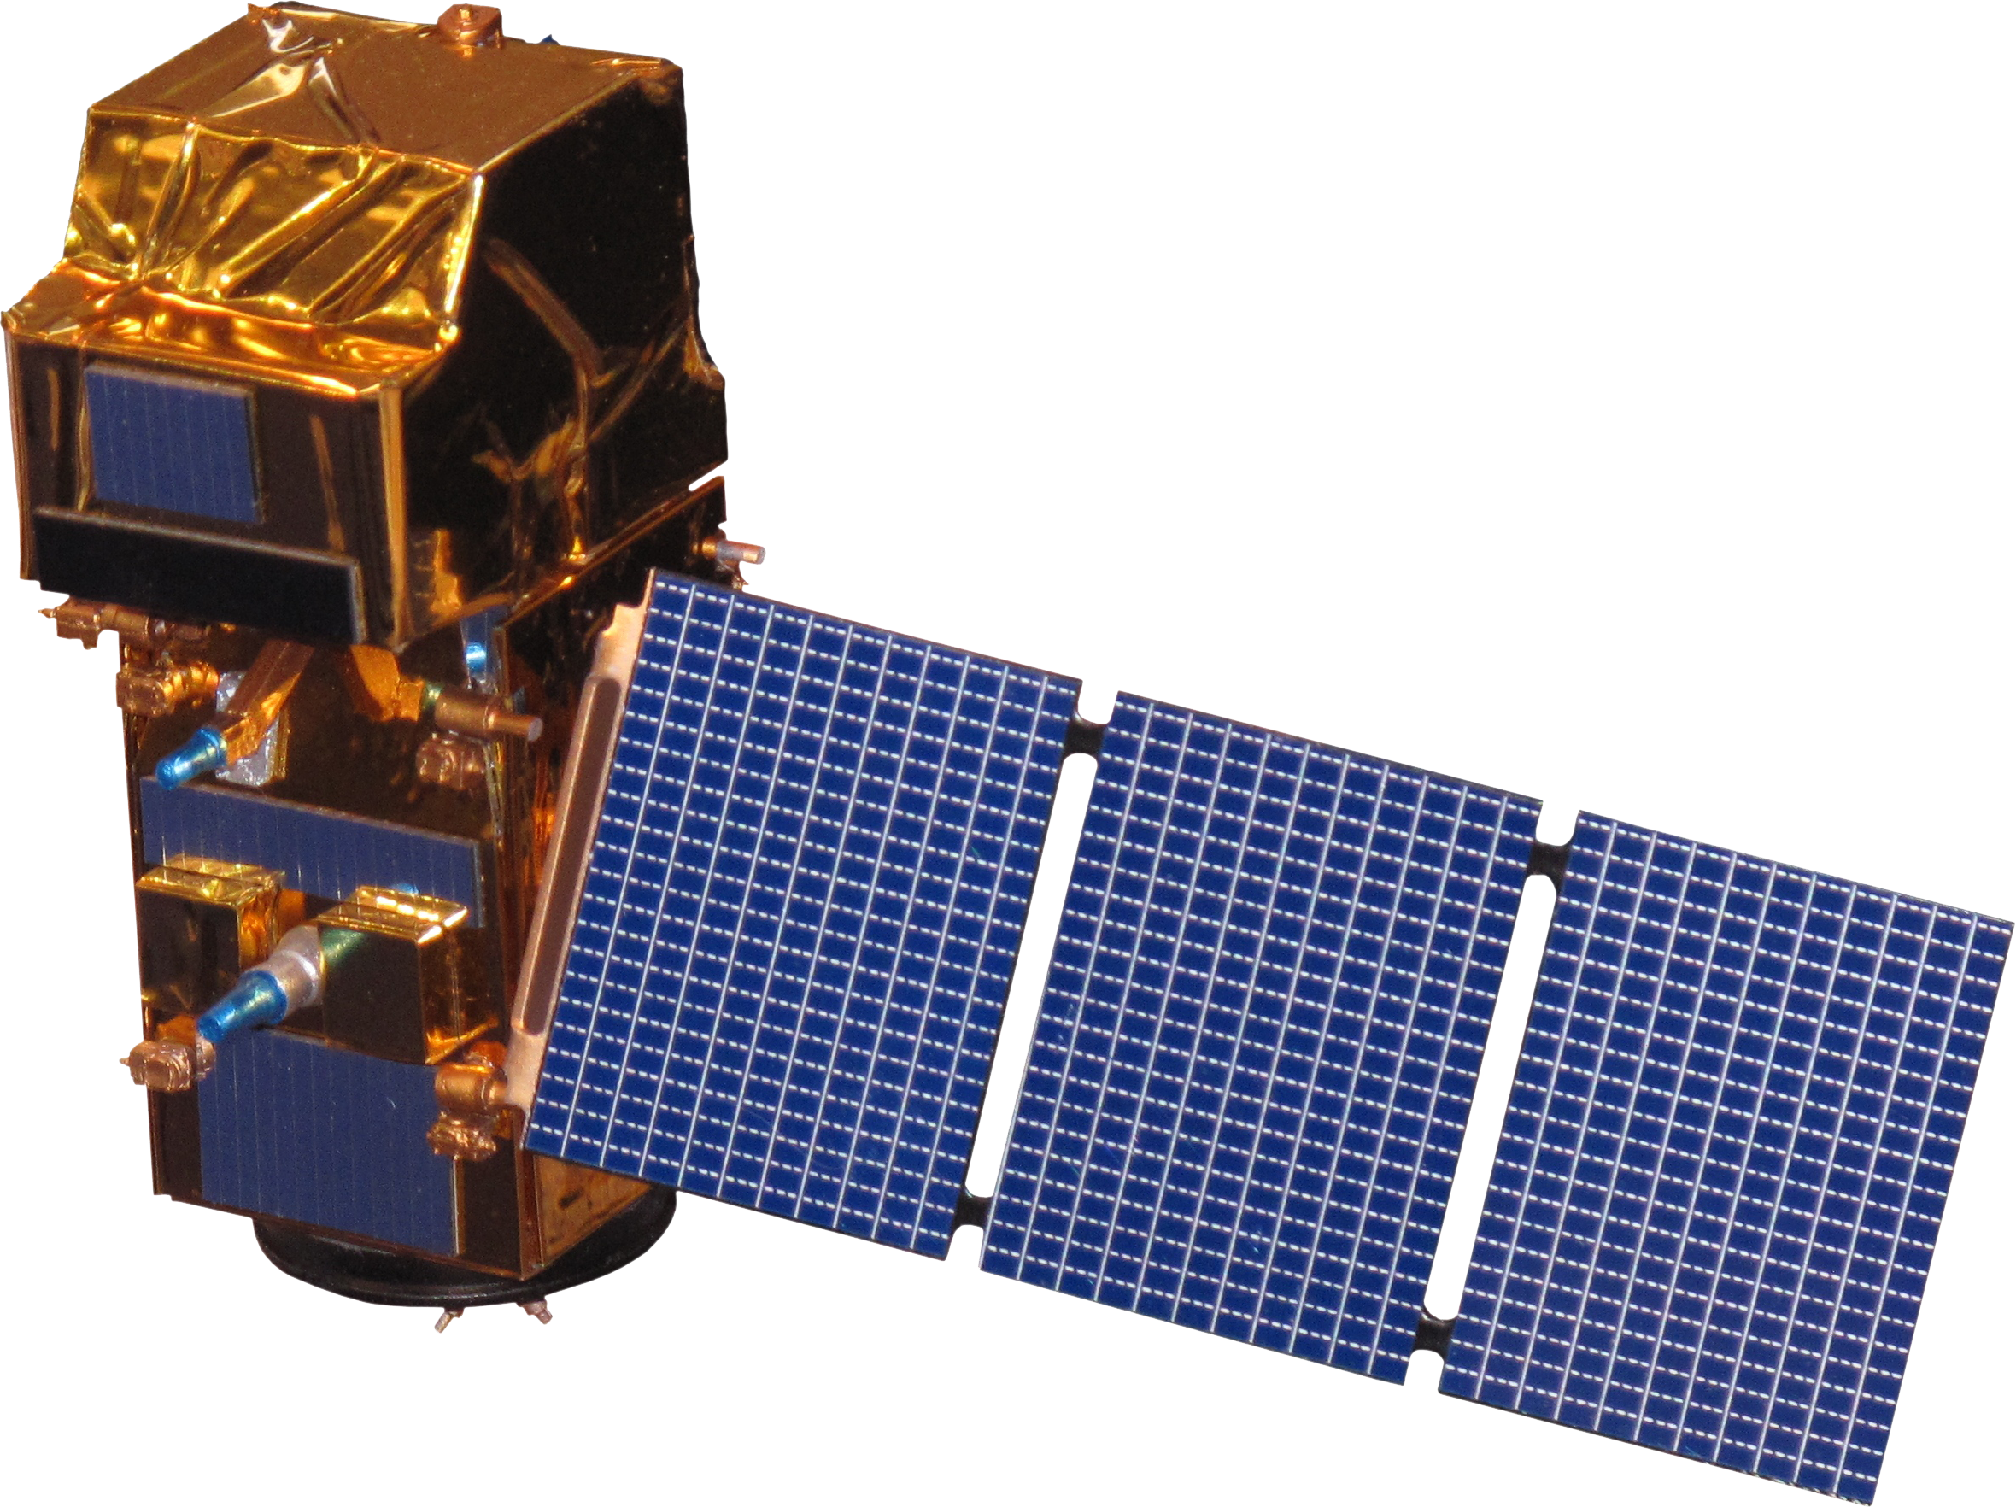
Satellites and Sensors
NASA
ESA
Landsat 8 OLI
Sentinel-2 MSI
Image Credit: NASA
Notes:
1) Again, for this project we used one NASA satellite, Landsat 8, and one ESA satellite, Sentinel-2.
2) Landsat 8 - 16 day return date, 30m resolution
Sentinel 2: 10 days with one satellite and 5 days with 2 satellites
3) Additionally we used Worldview 3, but we only had 1 photo and it was used for the supervised classification
------------------------------Image Information Below -----------------------------
(landsat 8 OLI) http://www.devpedia.developexchange.com/dp/images/c/c2/03_Landsat8.png
(SRTM) http://www.devpedia.developexchange.com/dp/images/a/ab/12_SRTM.png
(Sentinel-1 C-SAR) http://www.devpedia.developexchange.com/dp/images/8/81/23_Sentinel1.png
(Sentinel-2 MSI) http://www.devpedia.developexchange.com/dp/images/d/dd/24_Sentinel2.png

Slide 12
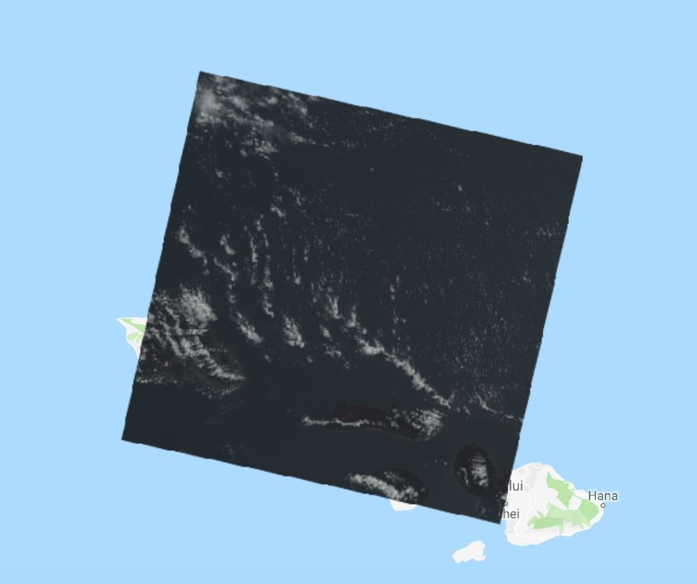
The Cloud Issue
Landsat 8 - OLI (April 2013)
Landsat 8 OLI Image (‘2013-05-14’)
Notes:
1) The biggest issue we faced that influenced our approach to this project is the amount of cloud cover over our study area.
2) This is 1 landsat tile and the island of Moloka’i is shown in red. Our study area was just the eastern portion of the island
3) In total we had something like 6 cloud free landsat images and about the same for sentinel

Slide 13
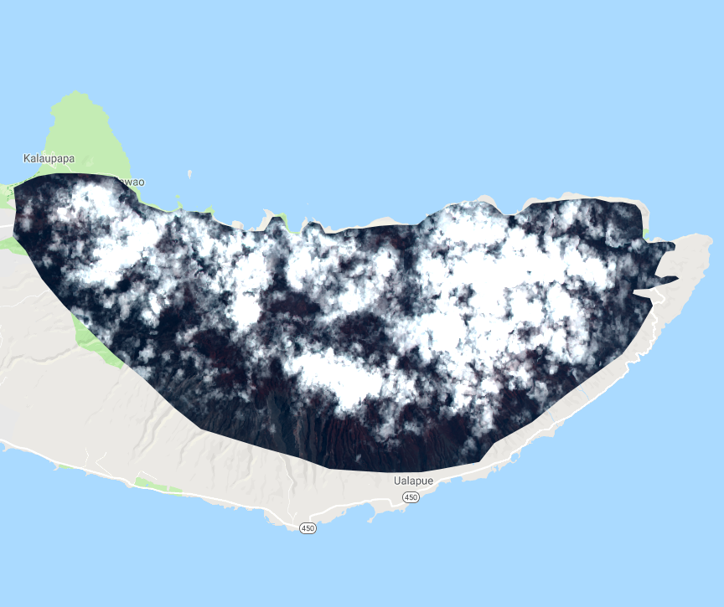
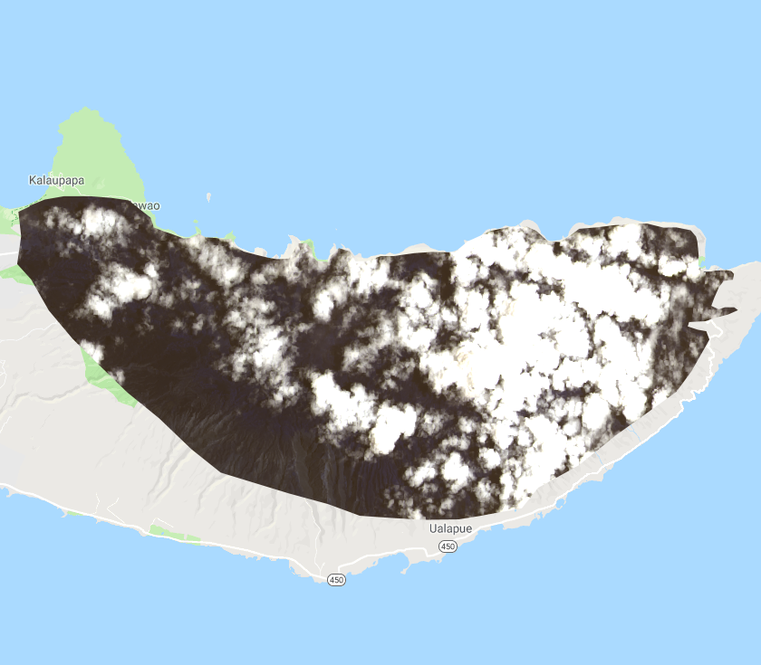
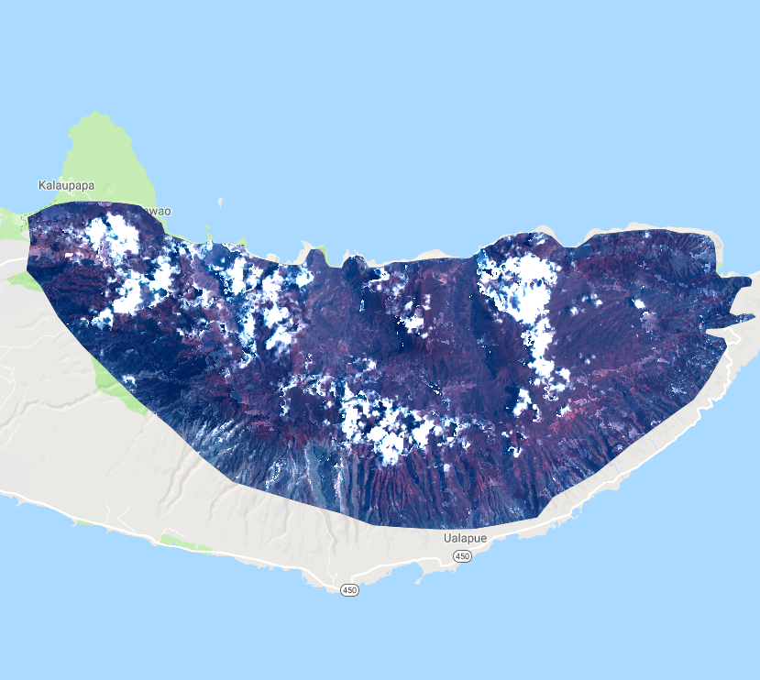
The Cloud Issue
Landsat 8 - OLI (April 2013)
('2013-05-14')
('2013-04-11','2013-06-30)
('2013-04-11','2013-06-30)
Raw Image
Median Composite
Greenest Pixel Composite
Notes:
1) We had to switch gears a couple times in terms of choosing imagery to process
2) Raw image, median composite
3) Explain greenest pixel

Slide 14


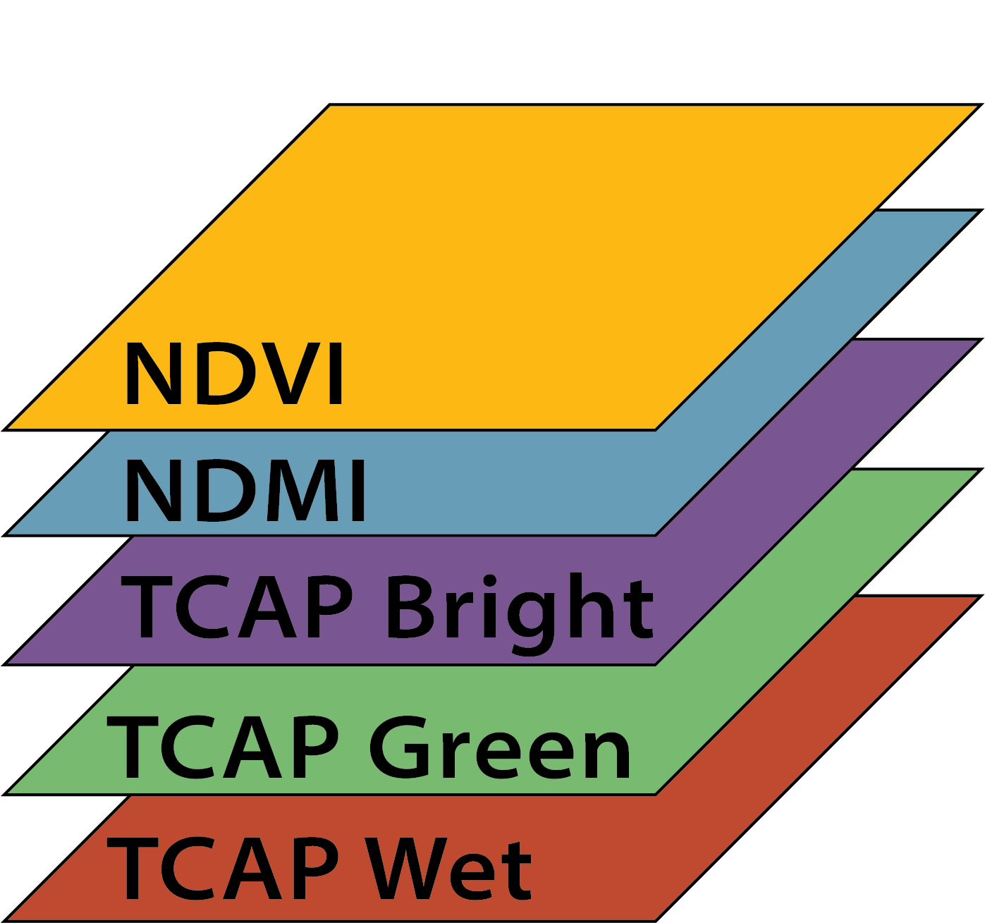
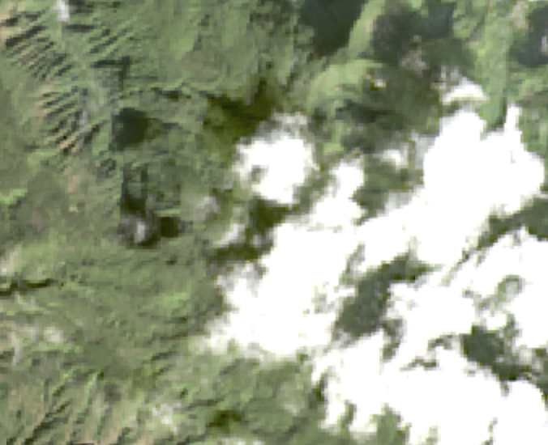
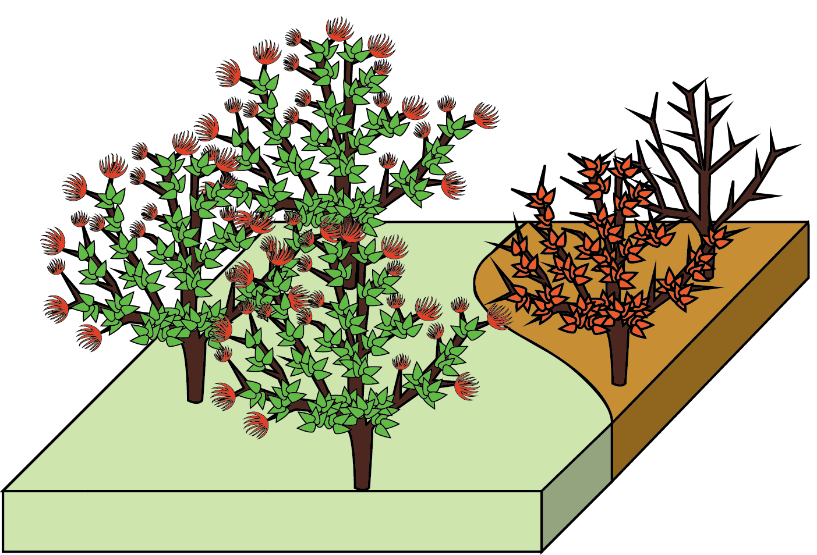
Methodology: ‘Ohi’a Health
Data Acquisition:
Landsat 8 (OLI)
Sentinel 2 (MSI)
Data Processing:
Greennest Pixel Composite
Calculate
Indices
Asses Changes in ‘Ohi’a Health
Time Series:
Within Exclosures
Mean of 500 random points in each area
Time Series:
Outside Exclosures
Change Detection:
Entire Study Area
Processing done in Google Earth Engine
Notes:
To meet our first objective, which was to create ohia impact maps and assess their health over time, we used Google Earth Engine.
In google earth engine we accessed Landsat 8 OLI and Sentinel 2 MSI imagery. As David mentioned, we quickly came to realize the challenges of studying Molokai via remote sensing when it comes to clouds. So what, hypothetically, seemed like a fairly linear process, quickly turned into a series of trouble shooting to find ways to get around cloud cover when looking at Molokai over time. We settled with using the Greenest Pixel Composite.
So to do this, we split up both the image collections into quarterly units per year from 2013 - 2019 for Landsat and 2016 - 2019 for Sentinel. For each of these quarters we used the quality mosaic tool to create an image composite using the NDVI greenest pixel.
We then created functions to apply all of our indice calculations to each quarter. We calculated the NDVI, NDMI, Tasseled Cap Brightness, Greenness, and Wetness. But for this presentation we will be focusing on just the NDVI and NDMI outputs.
We then created a change detection for NDVI and NDMI over our entire study area using the greenest pixel composite from early 2014 and early 2019, to see which areas how changed the most.
Additionally, to address our second objective of evaluating the impacts of the TNCs exclosures on ohia health, we performed a time series analysis. For this analysis we created a time series for both NDVI and NDMI over time for each exclosure and a separate comparison area. Within each area we generated 500 random points for each quarterly image and then plotted then the mean indice value based on those 500 points.

Slide 15
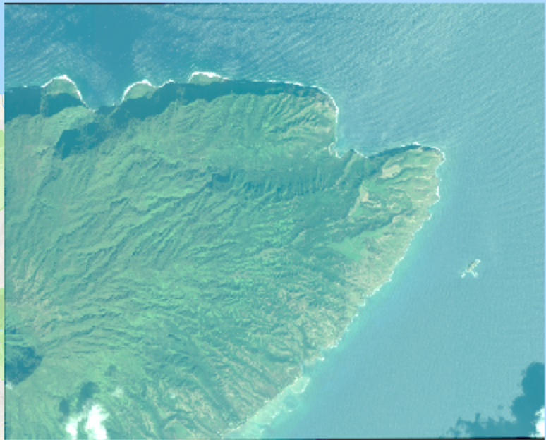
Methodology: Rust Classification
Data Acquisition: Worldview 3
Data Processing in GEE
  Location:
East Molokai
  Date:
February 2017
  Resolution:
1.2m
  Bands:
Red, Green, Blue
Infrared
Calculate NDVI
Supervised Classification:
User generated points
7 classes
100 - 150 points per class
Notes:
In addition we wanted to look at ohia health using a high resolution image, common high resolution images like NAIP, aren’t yet available over molokai. But we were able to obtain a Worldview 3 image that you can see here on the screen. This image is at a 1.2m resolution and covers the eastern portion of our study area. This image was taken in February of 2017 so around the time of the peak outbreak. The image we use had four bands (RGB and IR)
We took an exploratory look at this image to see if it was feasible to perform a supervised classification of the ohia rust. We used informative polygon layers that we received from our partners including Landfire Classification for Ohia, to help assist in creation of point classes. We generated between 100-150 points for 7 classes each. These classes included healthy ohia, rust impacted ohia, other vegetation, water, shadow, bare ground, and clouds
worldview 3 image → only high resolution image over any part of Moloka’i, resolution is 1.2m. Taken in early 2017 which was at the peak of the outbreak
From there we ran our NDVI function over the image to observe vegetation health. Again areas of green represent higher vegetation health, yellow is moderate veg health, red is low veg health. From here we wanted to carry out the exploratory approach of a supervised classification where we ocularly created training data by placing 100 to 150 points for each class.
Packaged this all up and ran it through a random forest model, trained the classification tested the classification, and created a confusion matrix

Slide 16
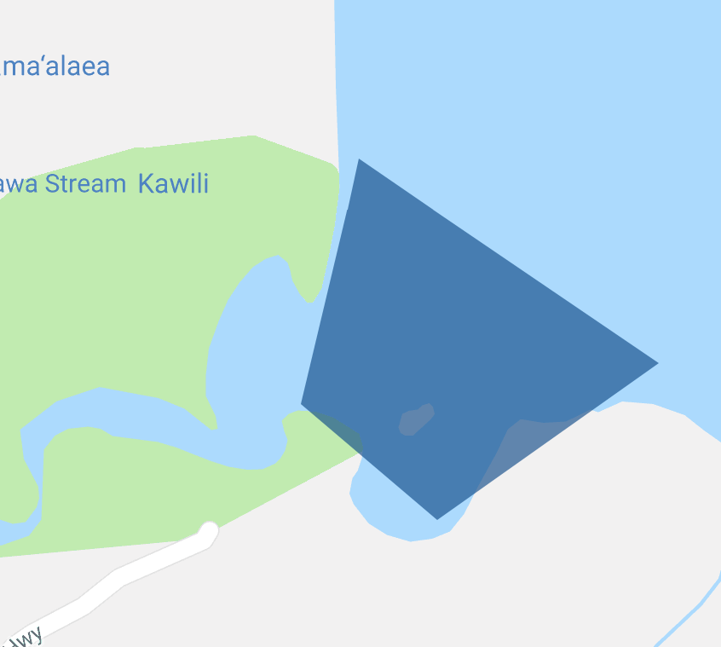
Methodology: Turbidity
  Flood Date:
Sept. 12, 2017
  Landsat Date:
Sept. 17, 2017
  Sentinel Date:
Sept. 18, 2017
Turbid Event
Data Acquisition
Differenced
Change
Detection
  Landsat Date:
Feb. 2, 2017
  Sentinel Date:
Feb. 20, 2017
Non Turbid Event
Data Acquisition in GEE
Data Processing in ArcMap
Notes:
To find a turbid event, we utilized the USGS water watch flood tracker.
The flood date chosen was September 12th 2018, the flood index was 9.5 feet.
We calculated the Normalized Difference in Turbidity Index for a Turbid and Non Turbid Event
Based on the peak flood events from the USGS and comparing hydrographs for different dates, a non-peak event was selected.
These two images were differenced in ArcMap using the raster calculator to calculate a change detection.

Slide 17
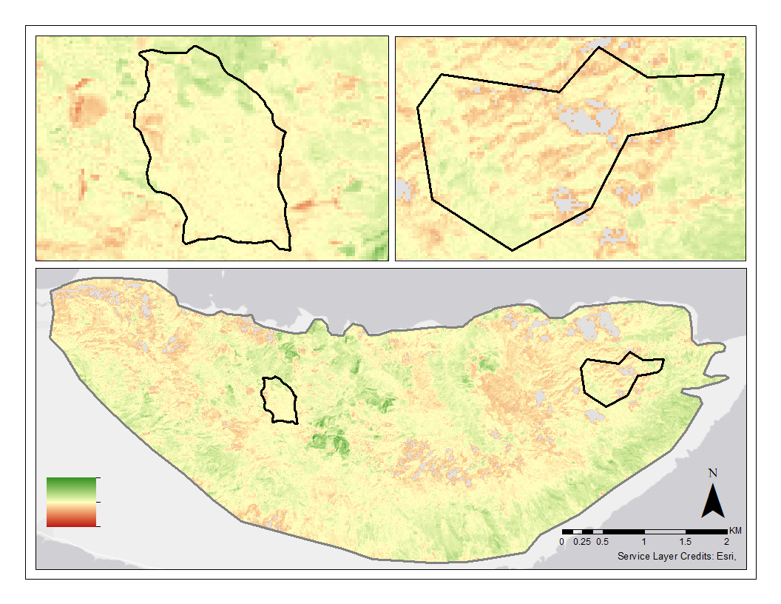
Results: NDVI Change Detection
Comparison
Exclosure 1
High: 0.5
Low: -0.5
Notes:
On the screen you can see the results of our NDVI change detection. This image is based on the greenest pixel composites from the Landsat Image Collection. Green indicates regions where the NDVI has increased. We can see some of this increase along the southern extent of our study area and a notable increase in the central section of our study area. Conversely the red indicates regions that have negative changes in NDVI. We see the most notable concentrations of these negative changes in the eastern and northwestern portions of our study area. If we take a look at the change detection within Exclosure 1, the longest established exclosure that has been ungulate free for the 10 years, you see a decent amount of more neutral and some negative values in the southern portion and a section of positive change in its northern extent. In the comparison area, there is negative and neutral change all over its central portion with some pockets of positive change on the eastern and southwestern corners.
An important note to keep in mind as we continue with these impact maps, when we are referring to forest or ohia impacts is not specific to just ohi’a and you may be detecting other NDVI disturbances/ dynamics as well. We did however use the borders of the Landfire Ohia classification to delineate this study area as to keep it relatively true to the ohia forest.

Slide 18
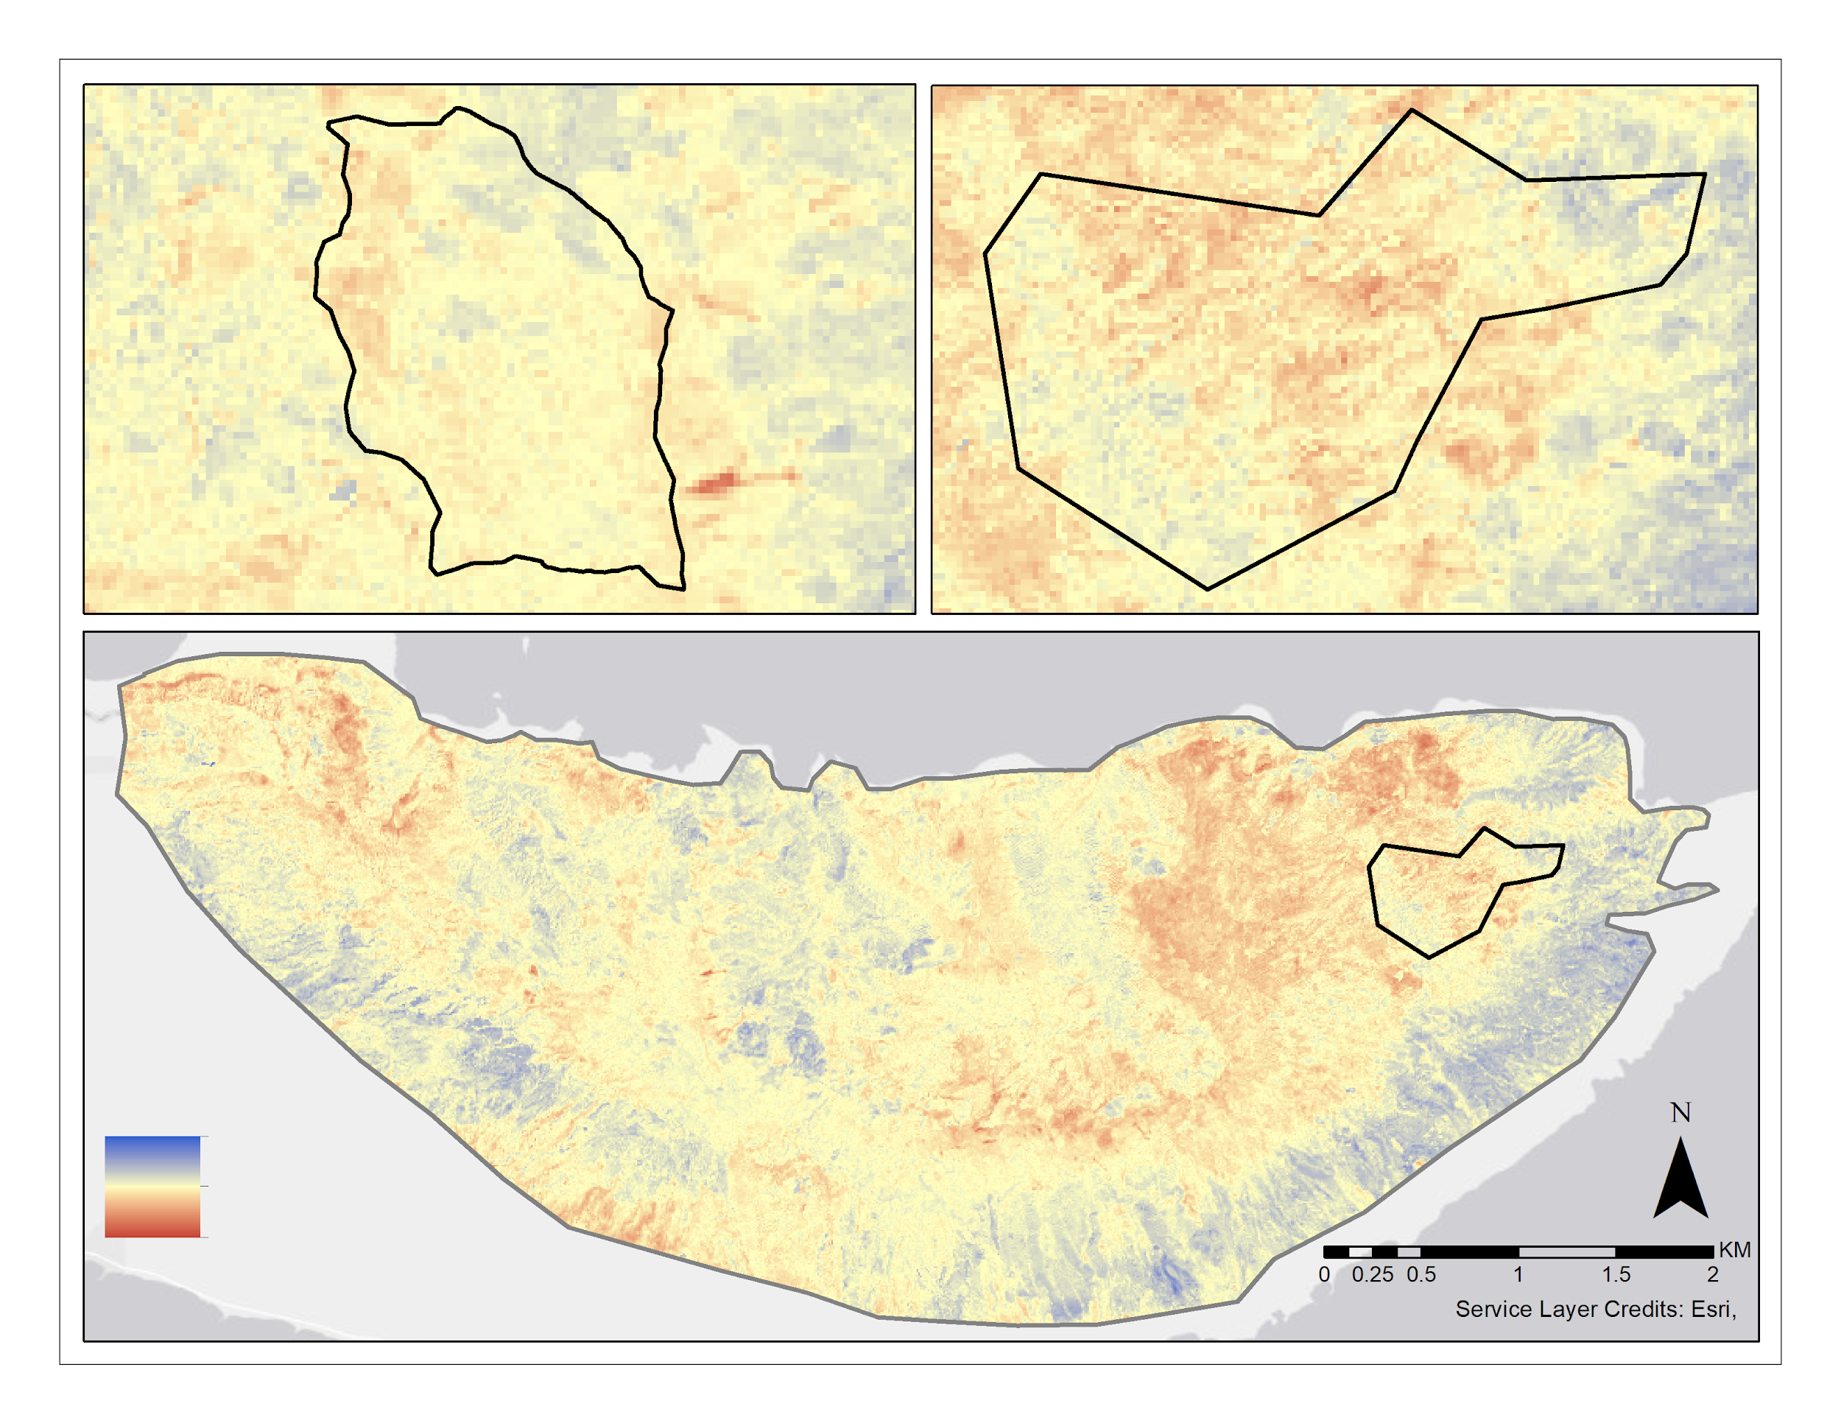
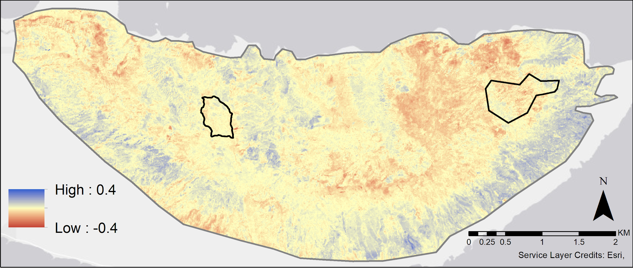
Results: NDMI Change Detection
Comparison
Exclosure 1
Notes:
Similar results to the NDVI change detection
Positive change is indicated in blue so those are the areas that saw an increase in moisture and red indicates that areas that saw a decrease in soil moisture.
Again we see increases along the southern extent of our study area
and we also we see the eastern portion of the island facing the most widespread and pronounced negative increase. If we look the change detection over Exclosure 1 and the Comparison Area

Slide 19
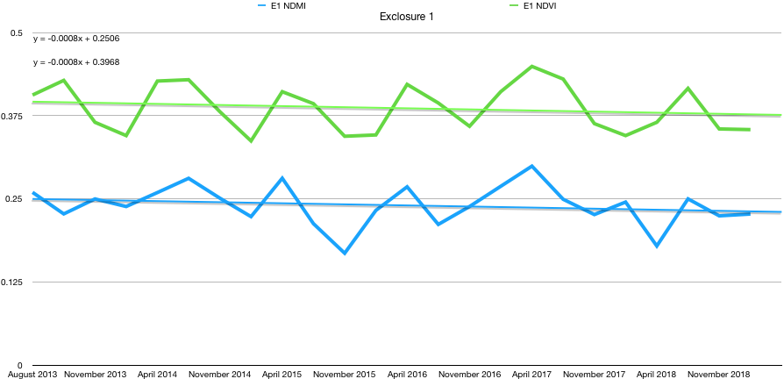
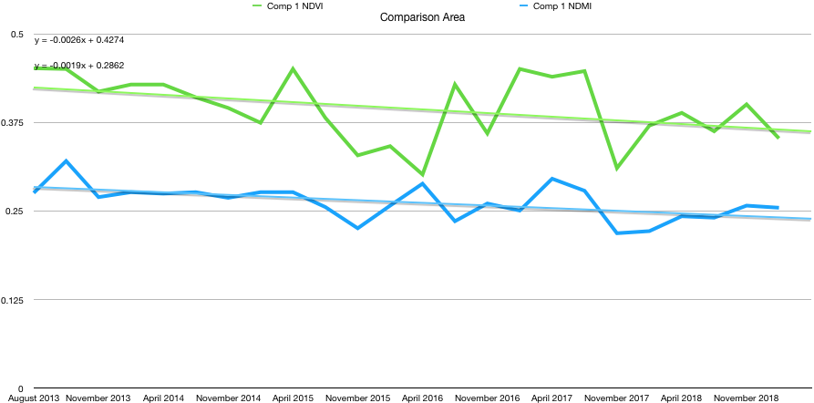
Results: ‘Ohi’a Time Series
Legend
NDVI
NDMI
Exclosure 1
Comparison Area
0.5
0.5
0.375
0.375
Mean Value
Mean Value
0.25
0.25
0.125
0.125
0.0
0.0
2013
2014
2015
2016
2017
2018
2019
2013
2014
2015
2016
2017
2018
2019
Date (Quarterly Values)
Date (Quarterly Values)
Notes:
Here is a comparison of the Ohia time series charts. These charts compare the quarterly mean NDVI values from 2013 to 2019 using Landsat 8 30m resolution imagery. These values are based on the greenest pixel composite for each quarter. There are slight declines in both of these areas. In comparison 1 you see a decrease from .4 to .37 where in the Comparison Area you see a more distinct decline from 0.45 to 0.35. NDVI naturally vary over time and from season to season. We found it interesting that in our data, we saw a more cyclical pattern in NDVI variations over time within the Exclosure, while in the Comparison Area there didn’t appear to be a pattern in the changing NDVI (find word). However, in both areas we didn’t see a particular drop in NDVI in 2017, the peak of the outbreak, as we would have initially expected.
**CHANGE COLORS IN CHART TWO

Slide 20
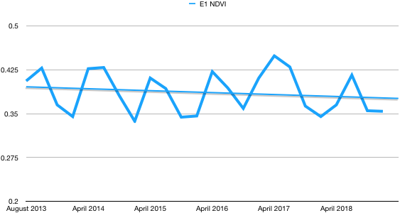
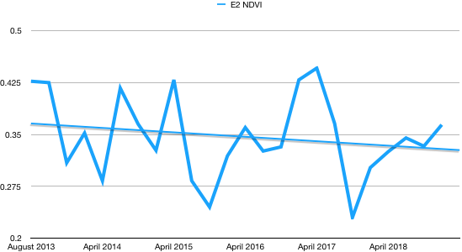
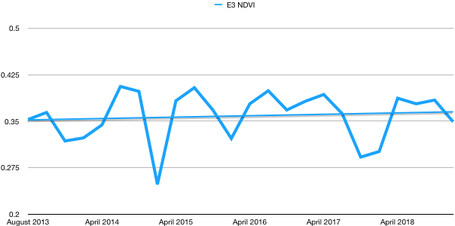
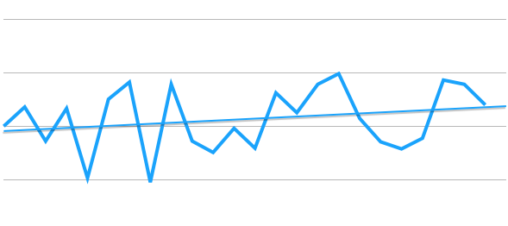
Results: NDVI for Exclosures
Exclosure 1
Exclosure 2
0.5
0.5
0.425
0.425
Mean NDVI
Mean NDVI
0.35
0.35
0.25
0.25
0.2
0.2
2013
2014
2015
2016
2017
2018
2019
2013
2014
2015
2016
2017
2018
2019
Slope: -0.0008
Date (Quarterly Values)
Slope: -0.0016
Date (Quarterly Values)
Exclosure 3
Exclosure 4
0.5
0.5
0.425
0.425
Mean NDVI
Mean NDVI
0.35
0.35
0.25
0.25
0.2
2013
2014
2015
2016
2017
2018
2019
0.2
2013
2014
2015
2016
2017
2018
2019
Slope: 0.0006
Date (Quarterly Values)
Slope: 0.0015
Date (Quarterly Values)
Notes:
Using the Landsat 8 Image Collection these charts compare the mean quarterly NDVI greenest pixel composite from 2013 to 2019.
Once again these values were based off of the quarterly NDVI greenest pixel composite. Honestly at this level it’s hard to see any significant trends. Exclosures 1 & 2 have slight decreases in mean NDVI and Exclosures 3 and 4 have slight increases.

Slide 21
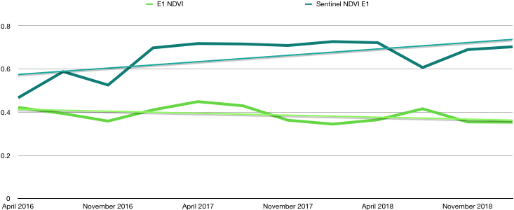
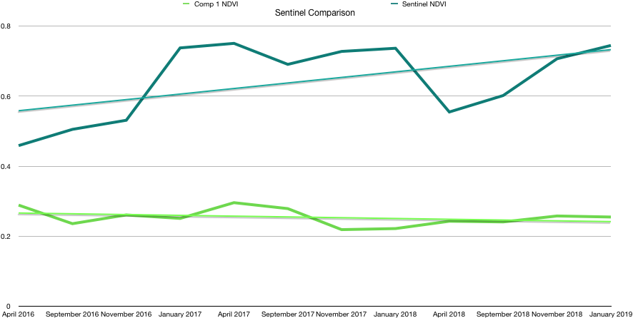
Results: Sensor Comparison
Legend
Landsat 8
Sentinel 2
Exclosure 1
Comparison Area
0.8
0.8
0.6
0.6
Mean NDVI Value
Mean NDVI Value
0.4
0.4
0.2
0.2
0.0
0.0
2016
2017
2018
2019
2016
2017
2018
2019
Date (Quarterly Values)
Date (Quarterly Values)
Notes:
These charts compare the NDVI values between Landsat and Sentinel
It’s hard to say which sensor is doing a better job in calculating the indice because we don’t have in field data to relate it with.

Slide 22
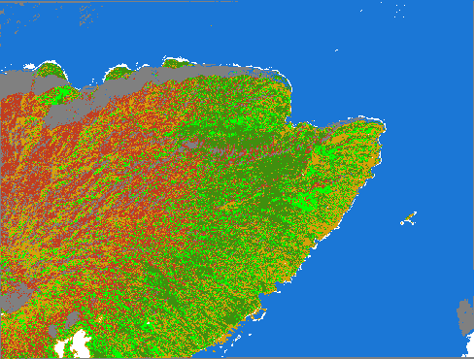
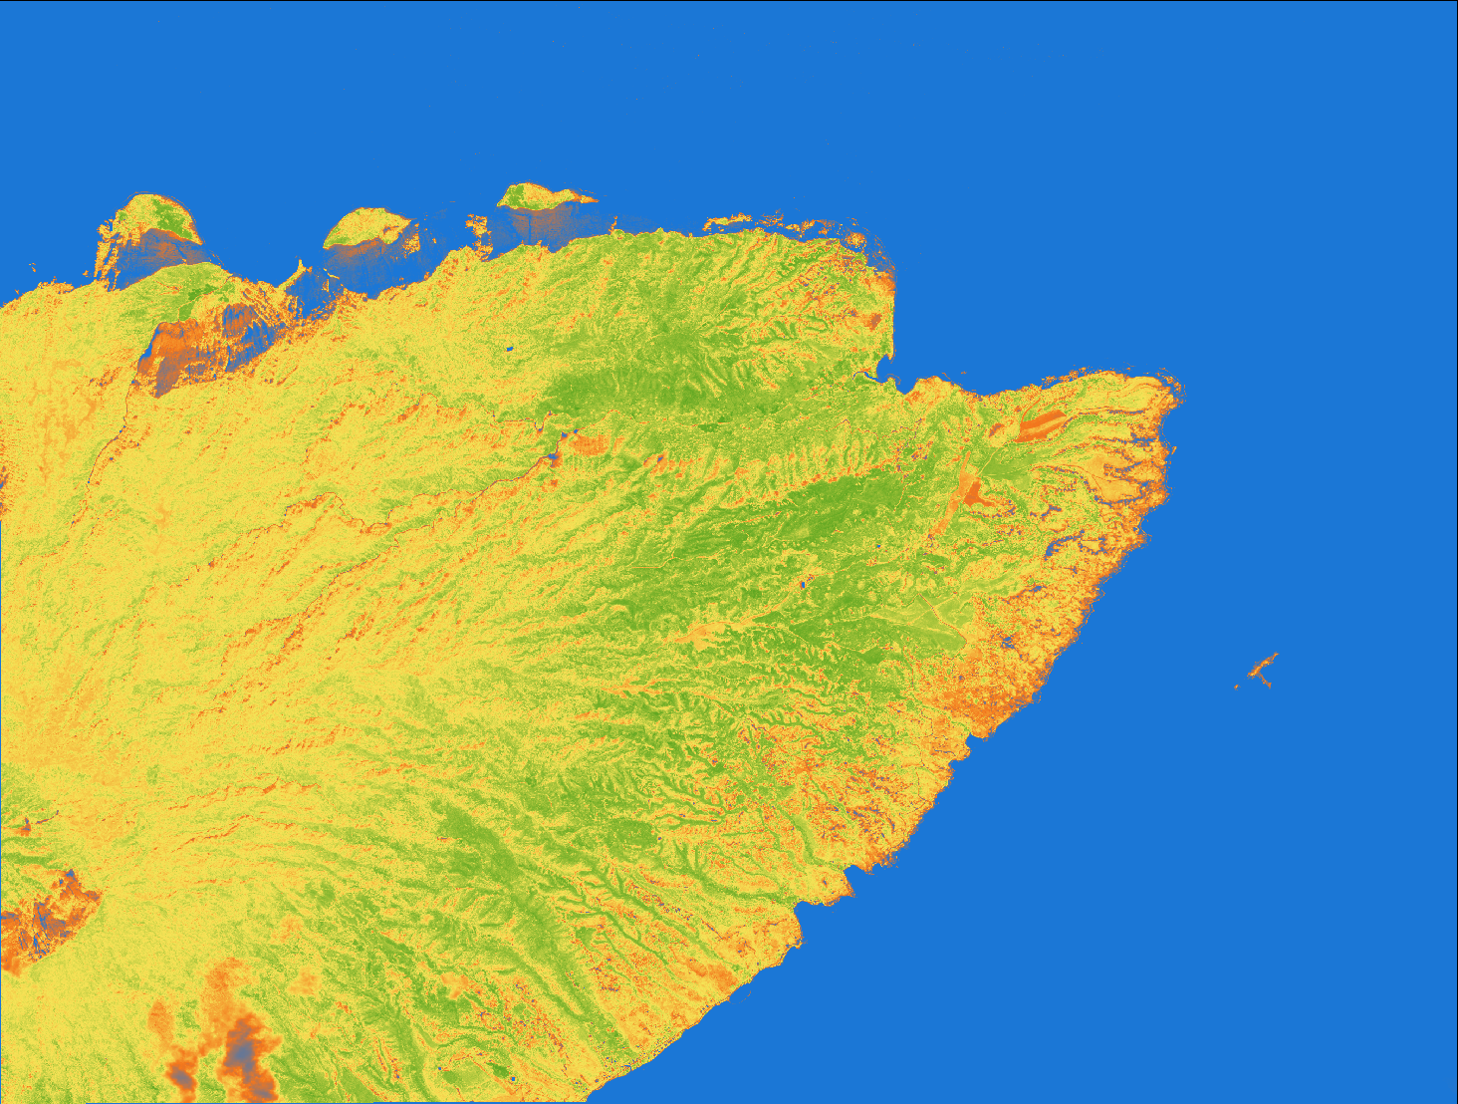
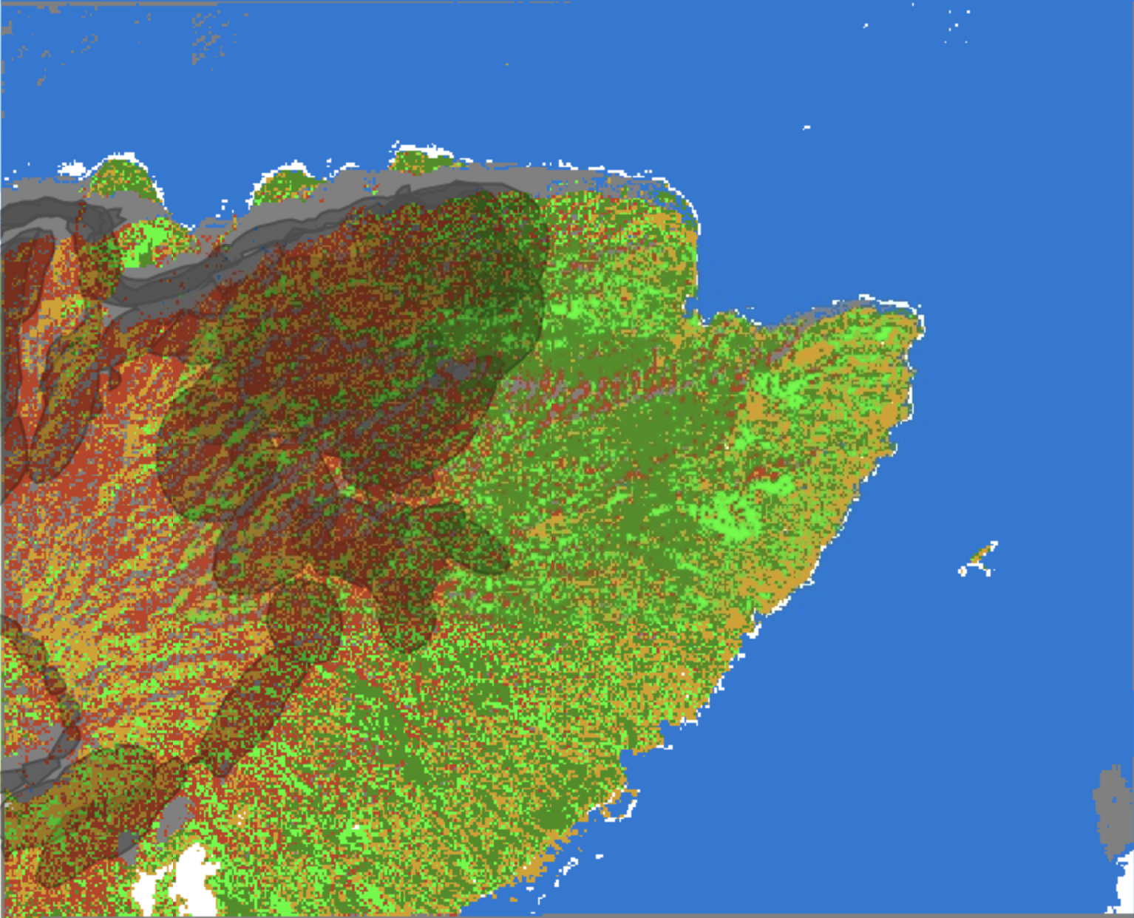

Results Classification
Worldview NDVI, Feb 2017
Supervised Classification
PCC Rust: 75%
NDVI Value:
Low
High
Rust
Healthy Veg
Grass/
Understory
Soil/Ag
Water
Shadow
Notes:
worldview 3 image → only high resolution image over any part of Moloka’i, resolution is 1.2m. Taken in early 2017 which was at the peak of the outbreak
From there we ran our NDVI function over the image to observe vegetation health. Again areas of green represent higher vegetation health, yellow is moderate veg health, red is low veg health.
Exploratory approach to see if it was possible to create a rust classification model.
Red areas indicate regions of rust related impacts, green healthy vegetation, lighter green is the grass or understory and then you have a few other classifications such as soil, water and shadow.
You can see that regions with lot to moderate values for NDVI match up with the regions impacted by the rust. Using additional visually derived validation points we had a Rust Percent Correctly Classified value of 75%. Again without validation points it is hard to assess how accurate this model is in picking up rust and it seems that our model is overestimating rust presence. We calculated that our model is sometimes misclassifying the grass for rust as they have similar spectral characteristics.
We then overlaid the affected polygon data received from our partners as representing areas of impacted forest and visually you can see there is some overlap with our classification.
Obviously this model could be strengthened with in field presence points to validate our overall accuracy as the classification seemed to overestimate rust presence. It also was confusing rust with some of the understory due to similar spectral characteristics.
-Don’t draw any major conclusions with the polygon data

Slide 23
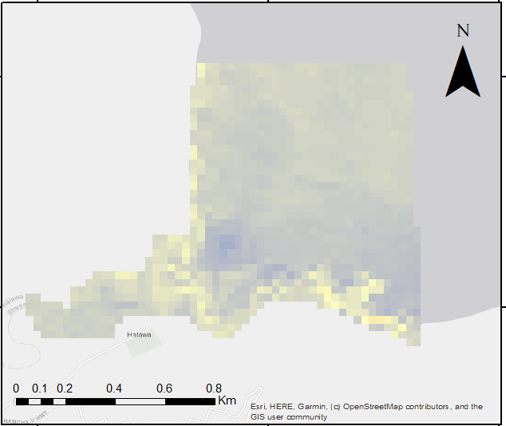
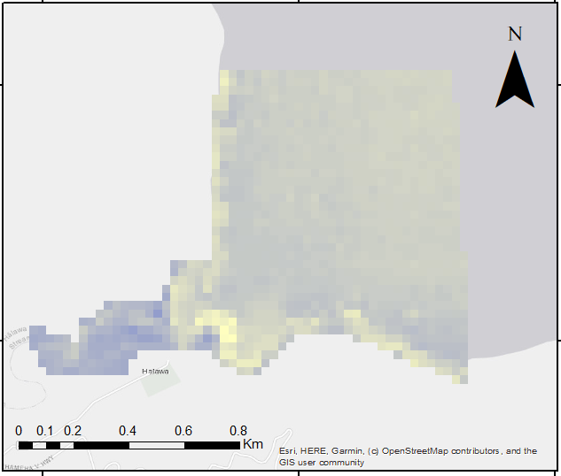
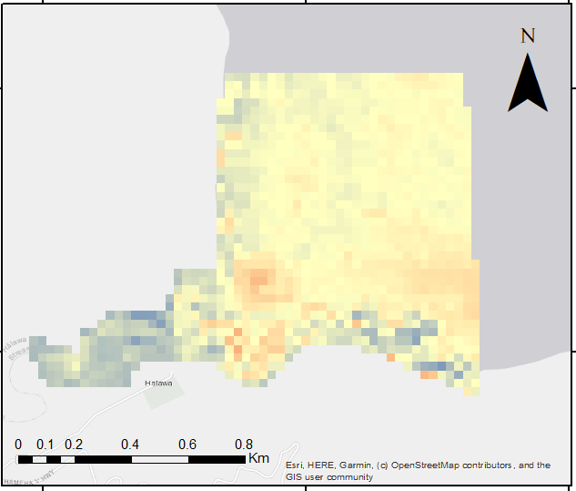
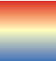
Results: Turbidity - Landsat 8
Non-Turbid
Turbid
Change Detection
High:
0.2
Waves?
High:
0.2
Change in Turbidity
High:
0.1
Low:
-0.2
Low:
-0.2
Low:
-0.1
Notes:
Now for our turbidity assessment results. Again we chose a turbid event that occured 5 days after a peak flood event which we determined using USGS stream gauge values. After looking at the change detection you can see that we calculated some changes in turbidity at the outlet of the river
This map portrays our study area for the turbidity assessment -The Halawa Stream
Turbid → 5 days after a peak flood event (which we chose from USGS stream gauges/flood tracker)
To find a turbid event, we utilized the USGS water watch flood tracker.
The flood date chosen was September 12th 2018, the flood index was 9.5 feet.
The closest landsat flyover date to the flood event was September 17 2018.
The non flood date was February 2, 2017.
A lot of the yellow that is around the coast line are waves, and since the water is so clear, it was interpreted as turbid water.
*referring to the differenced image* As you can see indicated by the red, there is an increase in turbidity near where the stream meets the Hawala Bay
-Highlight

Slide 24
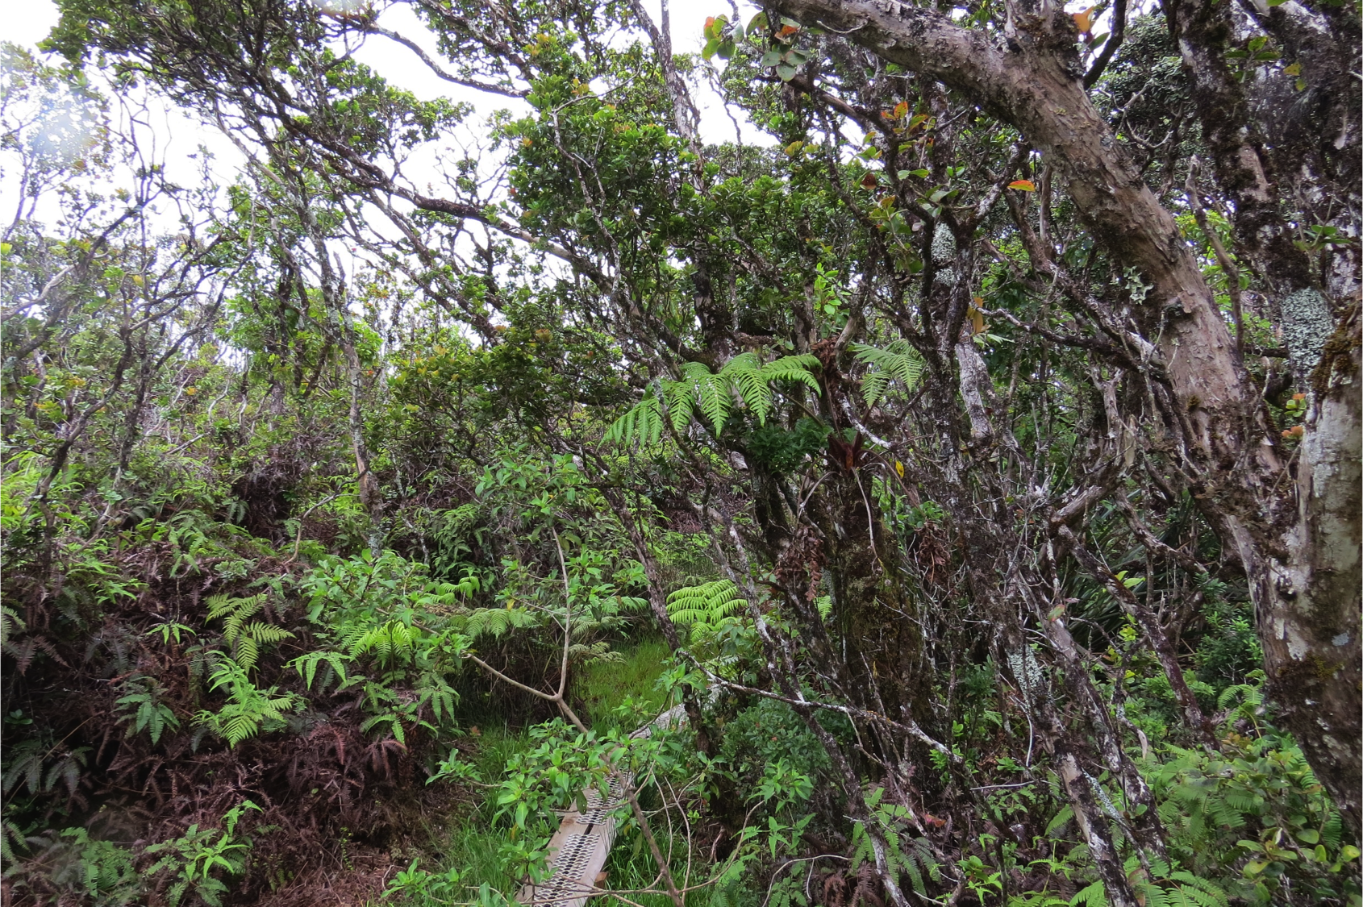
Conclusions
Created forest impact
  No definitive way to indicate that these trends are related to the ‘ohi’a rust
‘Ohi’a time series
  Not conclusive on overall trends of ‘ohi’a health
  NDVI Variations, understory growth
Turbidity
  Need cloud free images closer to flood event
Image Credit: Dr. Paul Evangelista
Notes:
Variation in NDVI, rapid understory growth
Turbidity: It seems feasible to detect changes in turbidity, however this analysis is dependent on sufficient cloudless satellite images to support a more extensive look
natural changes in NDVI beyond just rust related impacts, even after a section of the forest is impacted by ohia, it is common for the understory to regrow so it
------------------------------Image Information Below -----------------------------
(image) - Paul Evangelista

Slide 25
Challenges & Recommendations
Cloud Cover Over Molokai
Cloud Mask
Median Composite
Greenest Pixel Composite
Tree Mortality Using Remote Sensing
NDVI
NDMI
Sentinel 1 C-SAR
Limited Spatial Resolution
Landsat 8 (30m)
Sentinel 2 (10m)
Worldview 3 (1.24m)
In-Field Data
Would allow for validation and improved accuracy
TNC Presence Points
Notes:
While many of our results didn’t seem conclusive, much of the value of this project will come from the troubleshooting process we worked through especially in a region with high levels of cloud cover and a low amount of high resolution data availability.
Cloud mask → loose alot of values
Median → works well with areas with less cloud cover, but in Moloka’i still had influence of cloud cover on output calculations
When looking at a range of dates → Greenest pixel composite, looking at quarterly values, depending on project you are looking at you can change interval
NDMI/NDVI had very similar trends and these indicies could be good indicators for forest health, because when looking at these indicies overlaid with impacted polygons they did well. Alternatively we think in the future it might be interesting to look at tree mortality because it doesn’t deal with clouds and has high resolution
Sometimes these rust related impacts are happening at a tree level so it is difficult to pick up at these 10m/30m resolution so in the future it would be great to have more high res images,natural changes in NDVI beyond just rust related impacts, even after a section of the forest is impacted by ohia, it is common for the understory to regrow so it
Need validation points for our overall assessment of rust related impacts

Slide 26
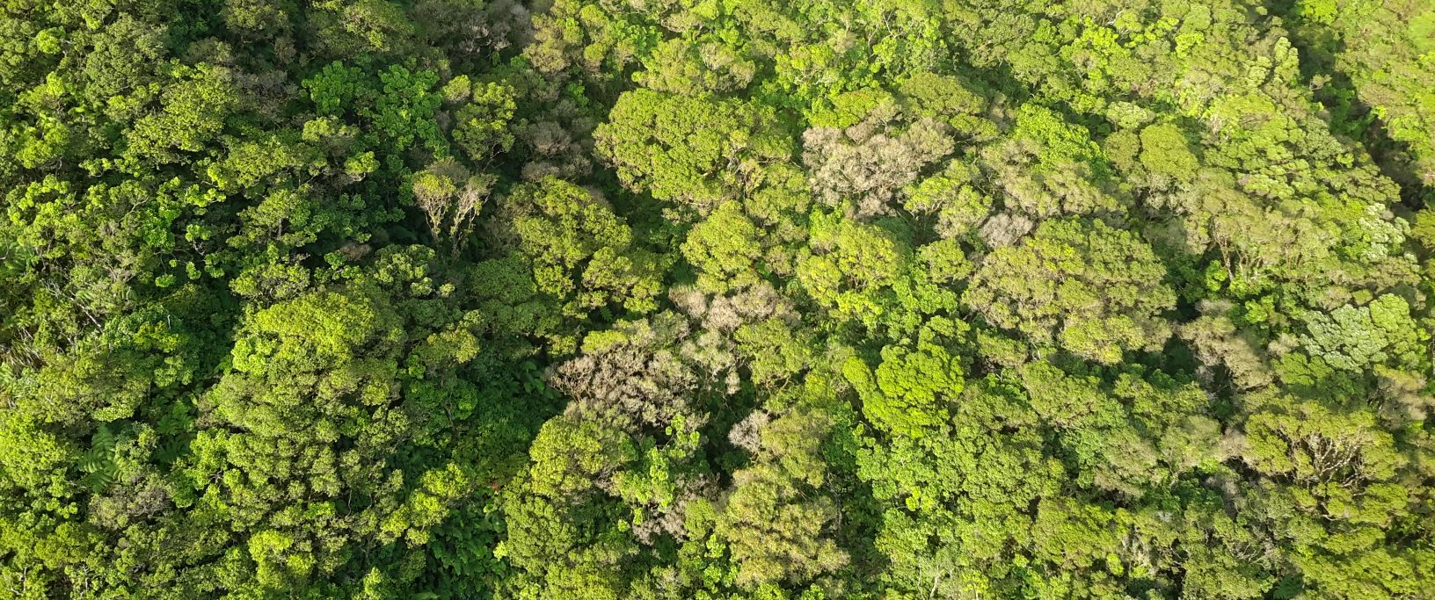
Looking Forward...
Image Credit: The Nature Conservancy
Notes:
This project is a small piece of the puzzle in understanding the patterns and impacts of the ohia rust outbreak. Looking forward we hope that our partners can use this information and our recommendations to help improve their mitigation efforts and improve their understanding of this issue and other complex ecological questions.
------------------------------Image Information Below -----------------------------
Image (understory) - Dr. Paul Evangeslista

Slide 27
A special thanks to all of our Colorado support in the creation of this project and continuous guidance throughout this process
Dr. Paul Evangelista (Colorado State University, Natural Resource Ecology Laboratory)
Dr. Catherine Jarnevich (United States Geological Survey – Fort Collins Science Center)
Nicholas Young (Colorado State University, Natural Resource Ecology Laboratory)
Tony Vorster (Colorado State University, Natural Resource Ecology Laboratory)
Peder Engelstad (Colorado State University, Natural Resource Ecology Laboratory)
Kristen Dennis (NASA DEVELOP, Center Lead)
This material contains modified Copernicus Sentinel data (2016-2018), processed by ESA
Notes:
This a special thank you to all our science advisors, especially Paul evangelista for all his photographs and insight on the project and Nick Young our advisor for his advice and support on this project. Thank you again to all of our partners. And lastly a special thank you to our center lead, Kristen Dennis, for her leadership and dedication to making sure our team succeeded.

Slide 28
Special thanks to our partners for sharing their advice and providing us with data to make this research possible
Dr. Stephanie Dunbar (The Nature Conservancy)
Stephanie Tom (The Nature Conservancy)
Dr. Helen Soafer (USGS - Pacific Islands Ecosystem Research Center, Honolulu HI)
Rudi Hunke (Pu’u O Hoku Ranch)

Slide 29
Questions?
Image Credit: The Nature Conservancy
Notes:
This research is a small piece of the puzzle in understanding the patterns and impacts of the ohia rust outbreak. Looking forward we hope that our partners can use this information and our recommendations to help improve their mitigation efforts and improve their understanding of this issue and other complex ecological questions.
------------------------------Image Information Below -----------------------------
Image (understory) - Dr. Paul Evangeslista

