Slide 1
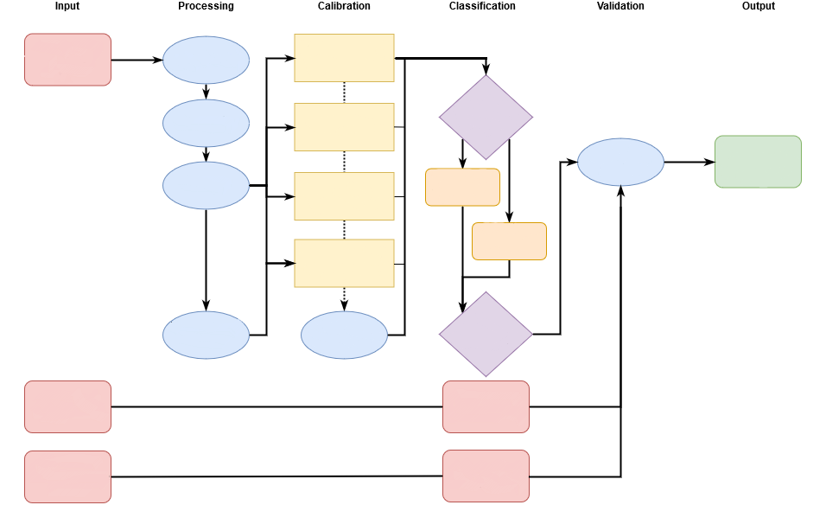
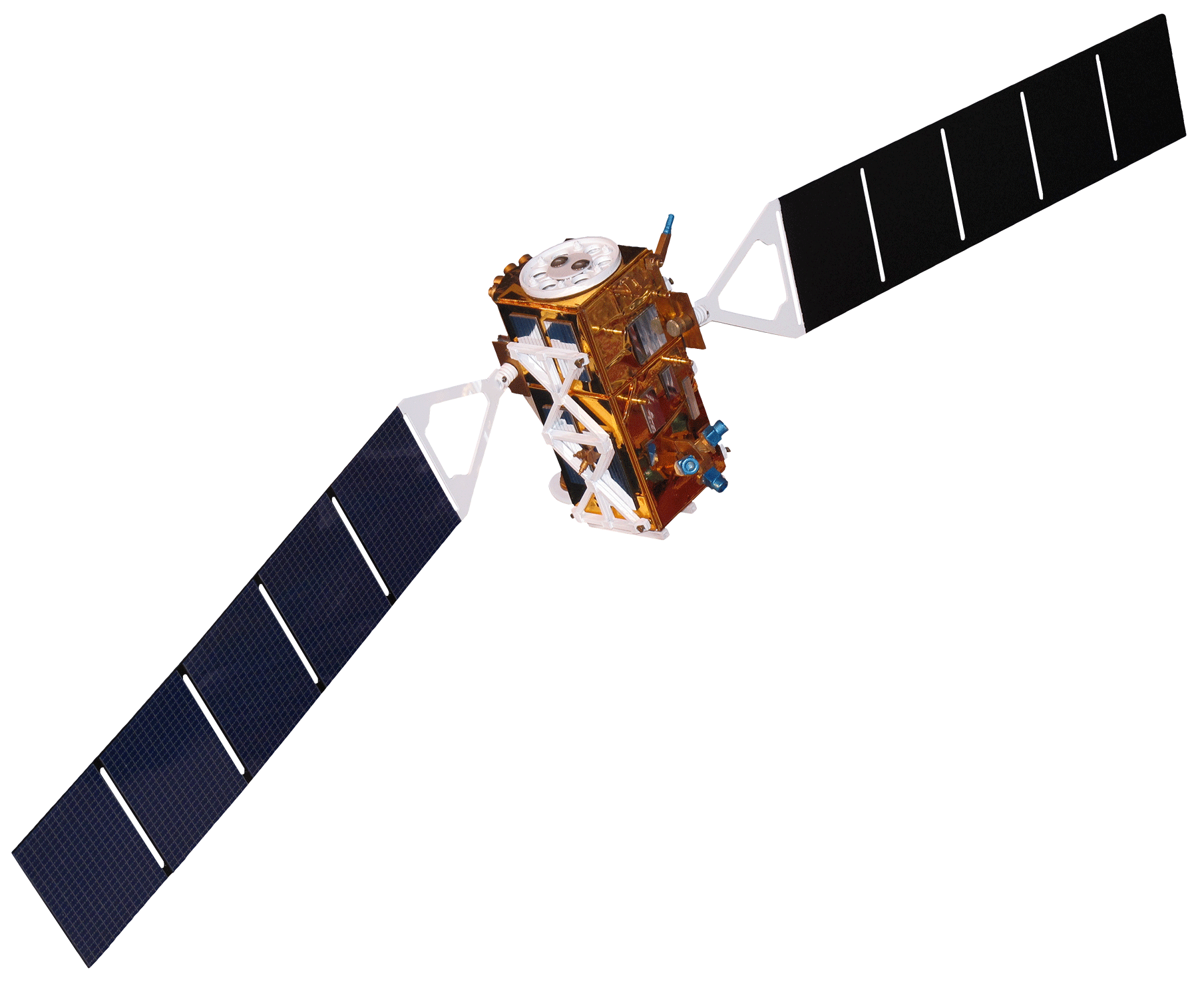
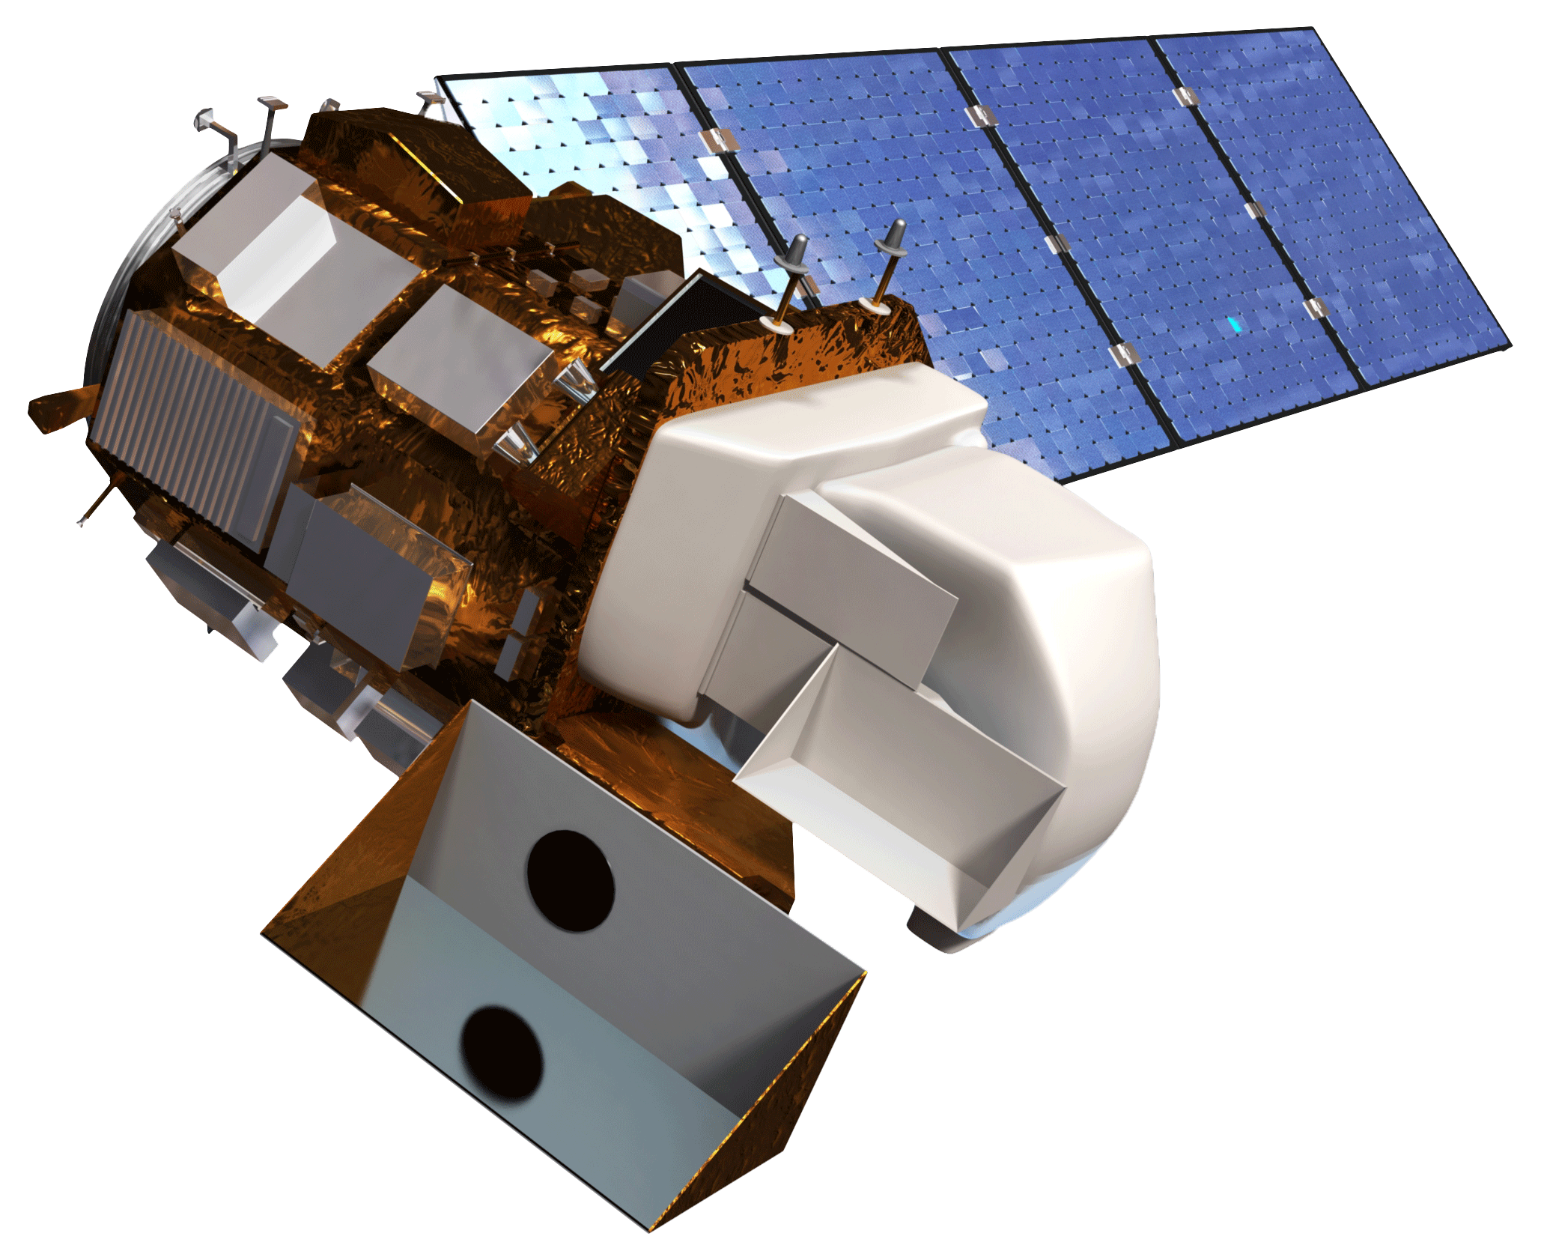
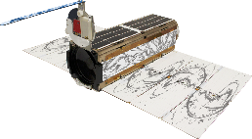
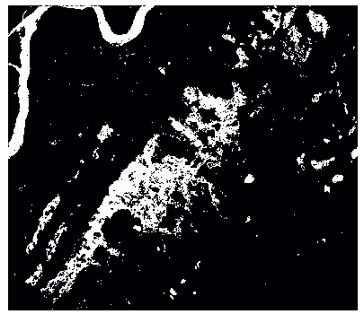
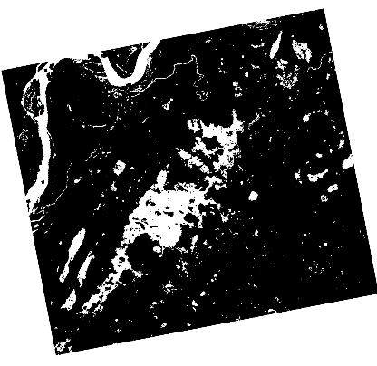
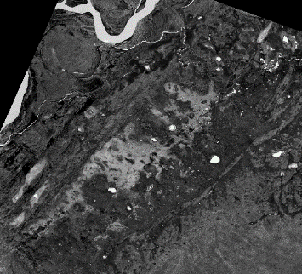
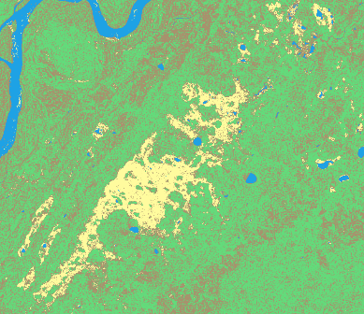
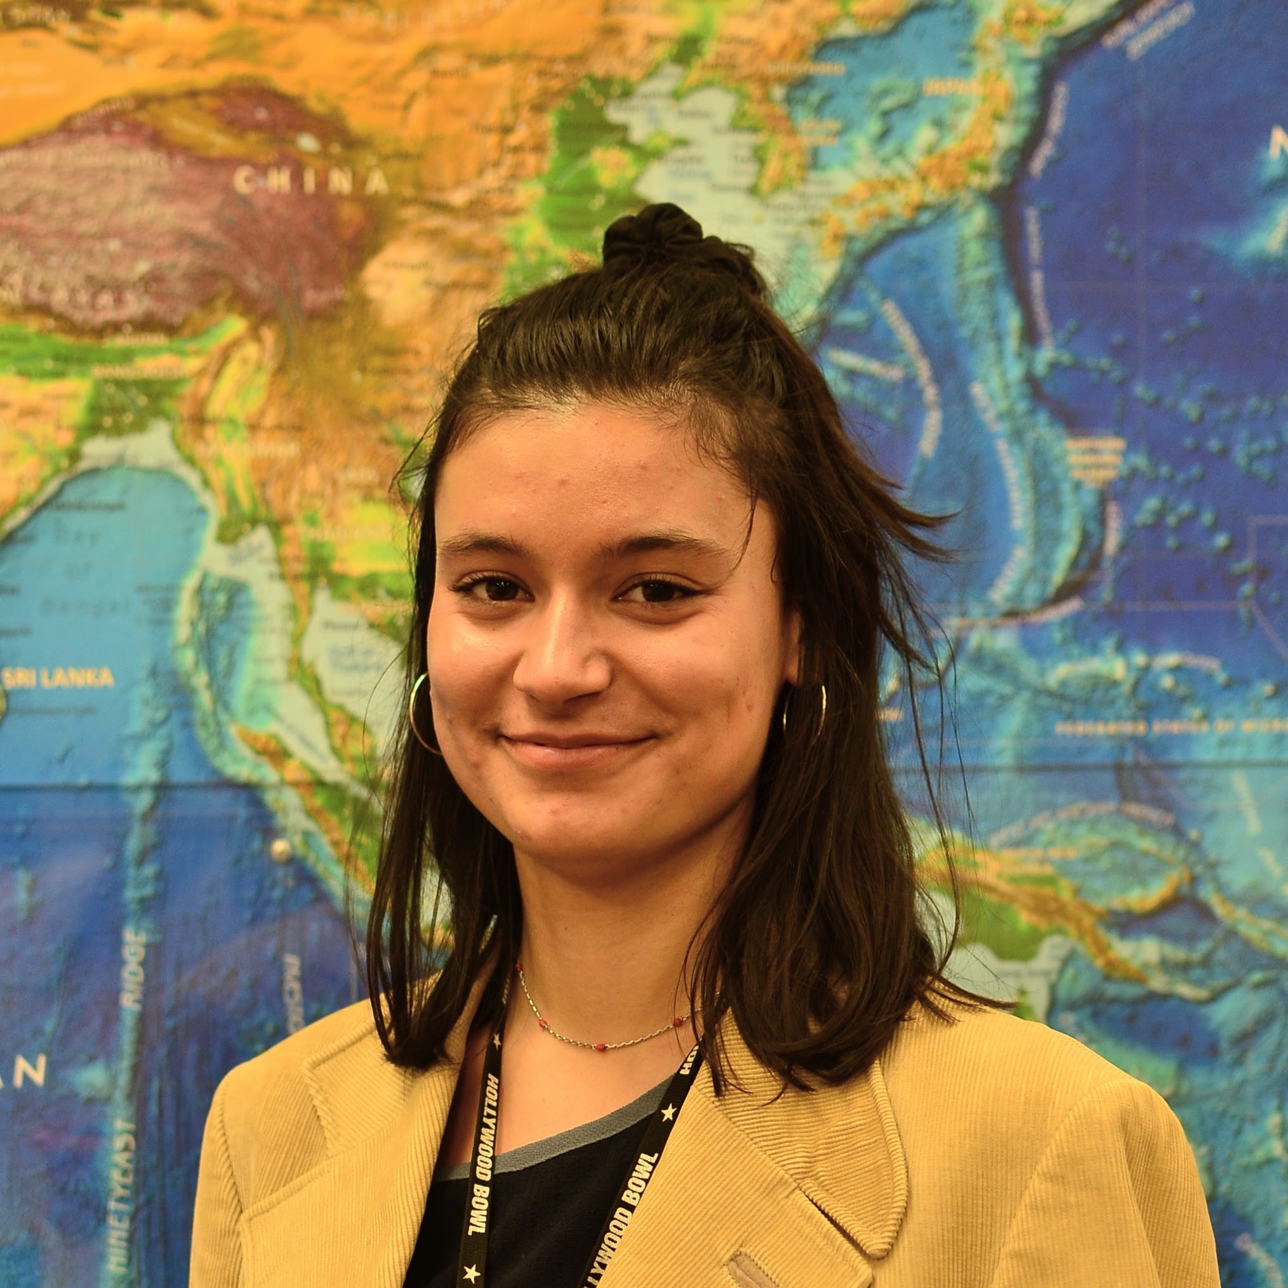
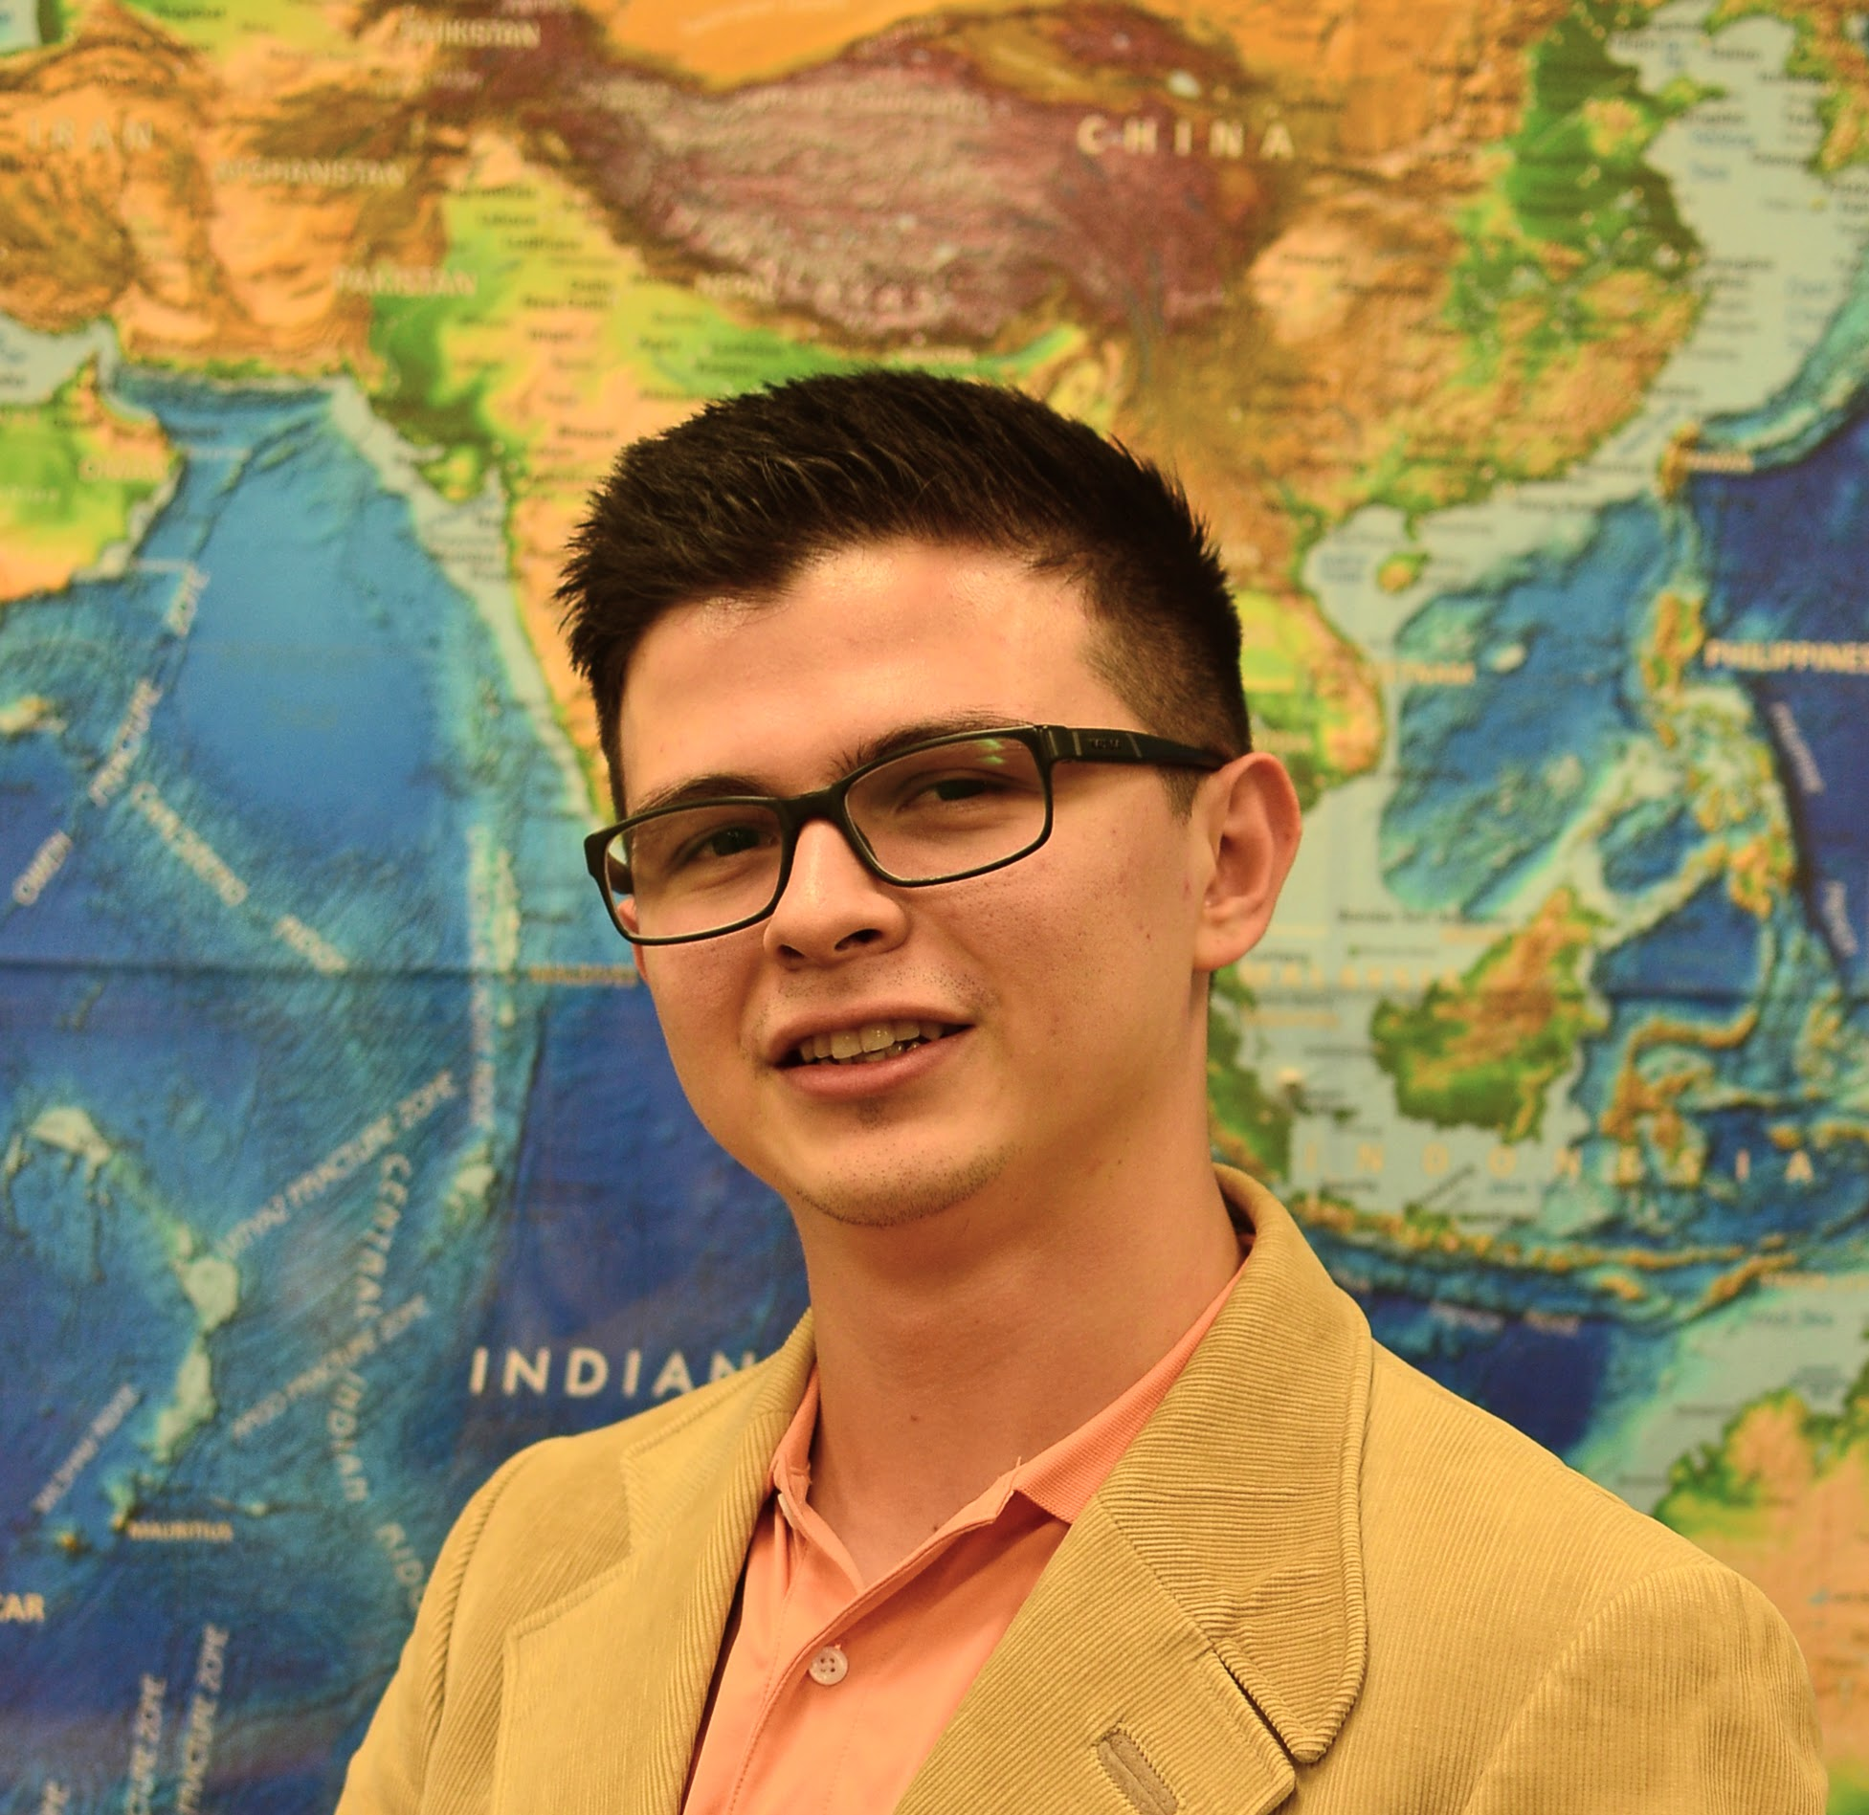
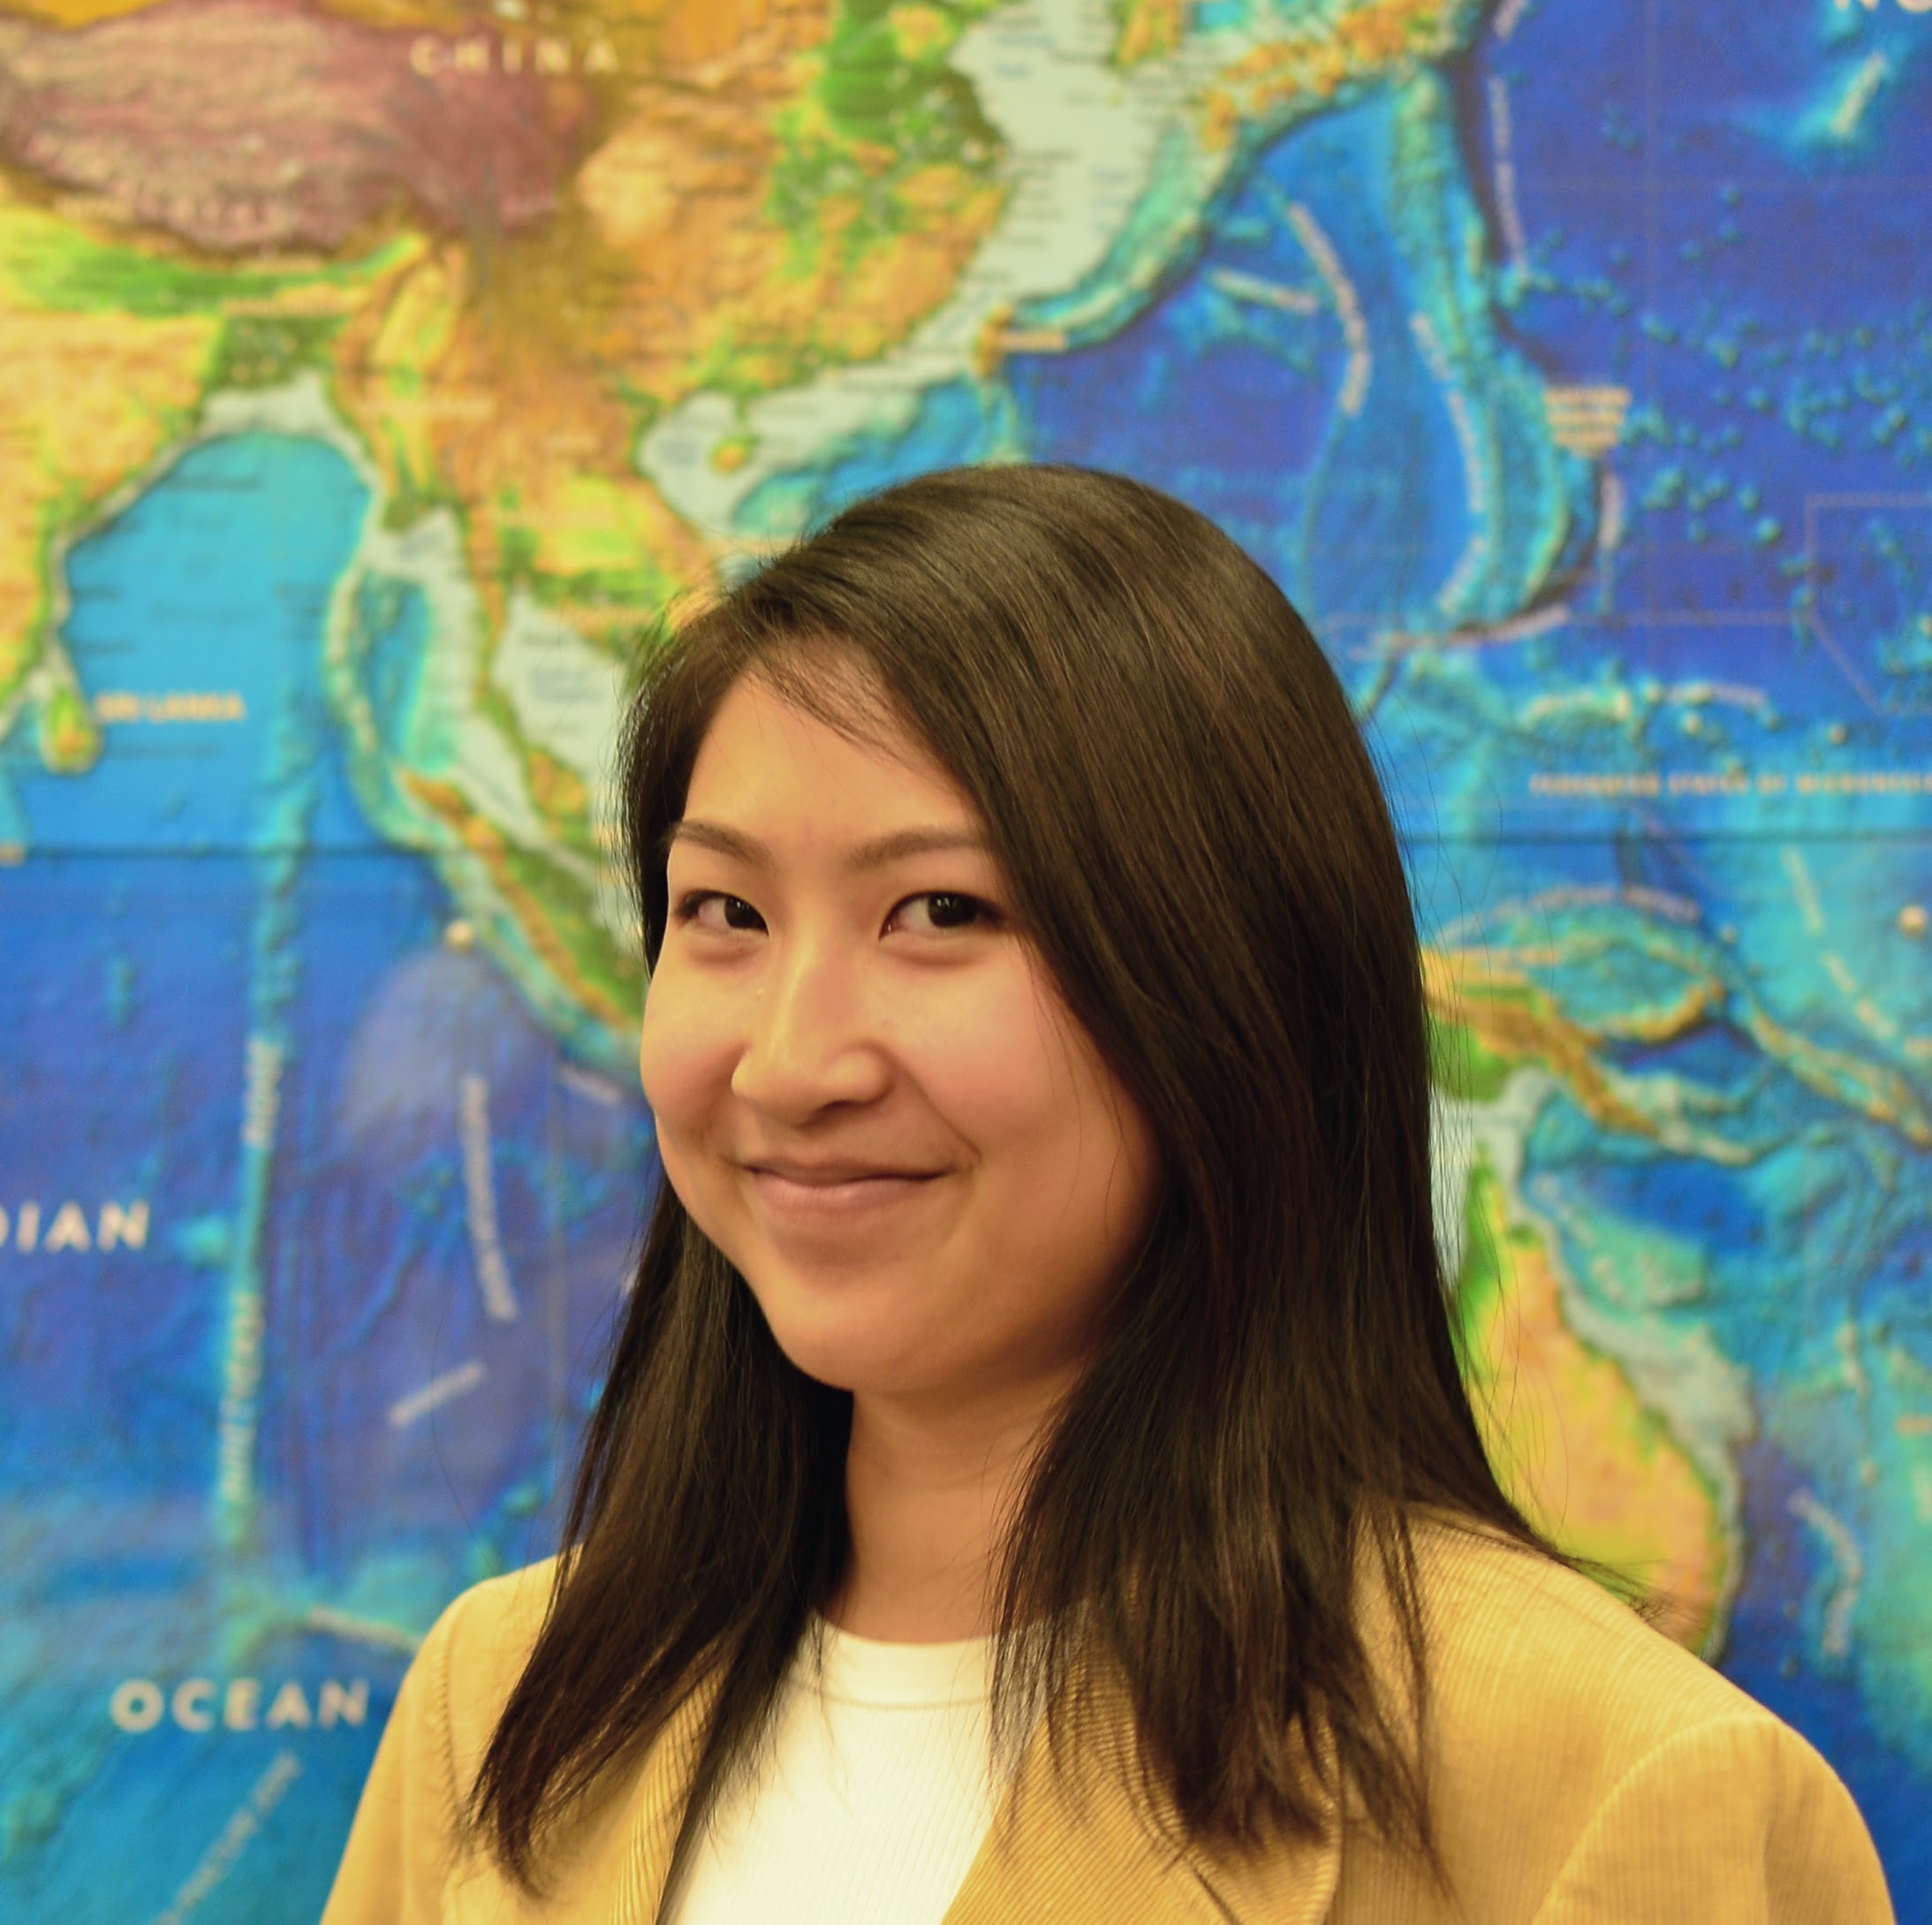
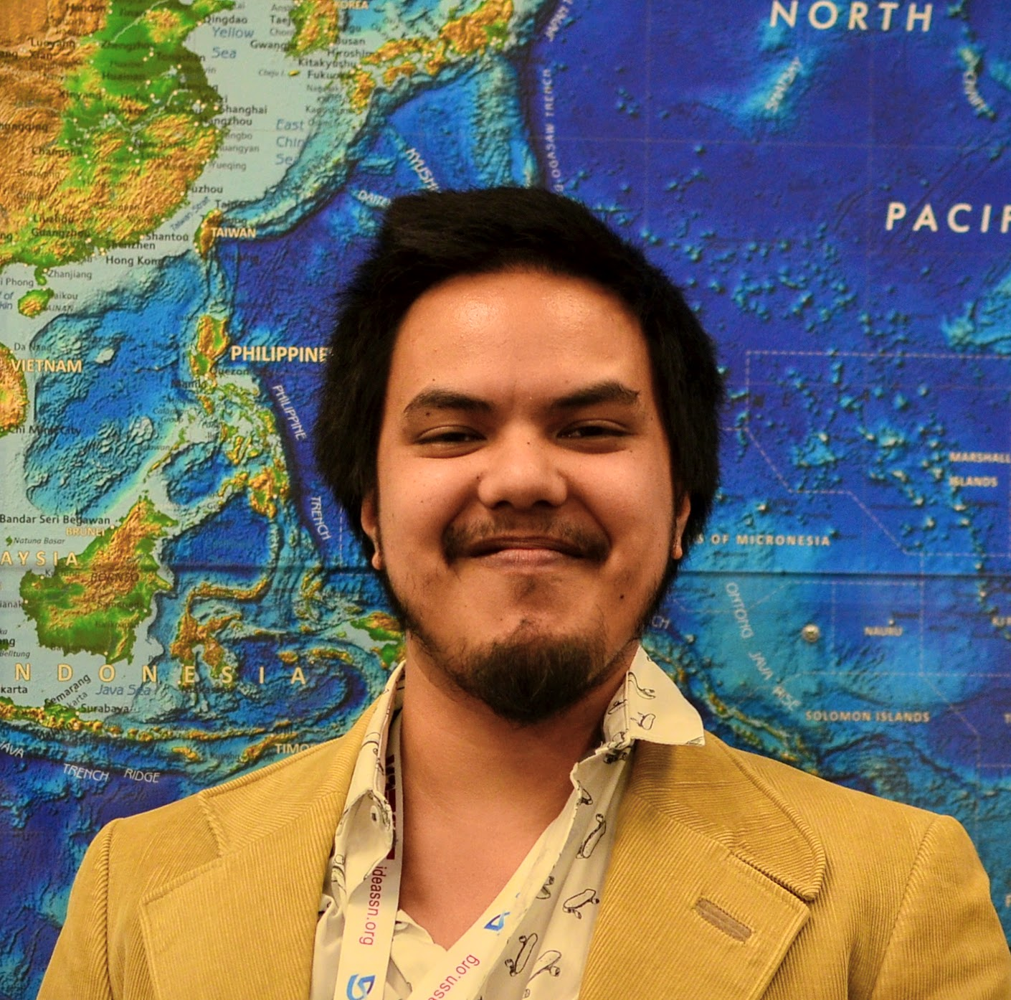
Automated Wetland Hydroperiod Mapping Integrating Optical Satellite Imagery and Synthetic Aperture Radar
Abstract
Objectives
Alaska’s wetlands cover approximately one third of the state and provide a multitude of ecosystem services, including nutrient retention, water purification, and provision of habitat for fish, wildlife, and vegetation. The temporal variation in wetland inundation affects these ecosystem functions, and for effective wetland policy and management, it is important to track patterns and changes in inundation. In collaboration with the US Fish and Wildlife Service (USFWS), Alaska Satellite Facility (ASF) and the University of Alaska Fairbanks (UAF), the fall 2018 NASA DEVELOP Alaska Ecological Forecasting team produced an inundation tool to detect and classify inundation extent in Alaska’s wetlands from C-band synthetic aperture radar (C-SAR) data. The team used Earth observation products, including Sentinel-1 C-SAR, Landsat 8 Operational Land Imager (OLI), PlanetScope, and RapidEye satellite imagery, to create the tool’s thresholding algorithm and generate land cover classifications for validation. The inundation tool effectively mapped wetland inundation due to SAR imagery’s sensitivity to water and reliable data collection on cloudy days. The optical datasets, Landsat 8 OLI and high resolution Planet imagery, were limited by cloud cover and detection of inundation below vegetation and canopy cover but were helpful for visual validations of Sentinel-1 C-SAR classifications. The tool’s ability to map wetland inundation can support the development and refinement of National Wetland Inventory (NWI) wetland maps in Alaska and build the capacity of operational federal programs to use SAR.
Create algorithm to detect inundation extent from Sentinel-1 C-band SAR data
Validate algorithm using optical imagery
Integrate algorithm with the Alaska Satellite Facility SAR processing tool, HyP3
Enhance the National Wetland Inventory’s mapping capability through efficient inundation map generation
Methodology
Input
Processing
Calibration
Classification
Validation
Output
Sentinel - 1
C-SAR
VV VH
UTM Projection
Multi-Temporal
Mean Ratio
Study Area
Earth Observations
Image Coregistration
VV / VH
Ratio
VV, VH,
VV/VH
Thresholds
Sentinel-1 C-SAR
Subset
Average Region
Brightness
Classification
Per Date
Confusion Matrix
Wetland Inundation Map
Crea Creek
Area 1002
Landsat 8 OLI
Average Pixel
Brightness
Multi-Temp
Classification
Selawik
Canvasback Lake
Bear Lake
Goldstream Valley
Multi-Temporal
Average
Normalize by
Image Mean
Refined
Classification
PlanetScope & Rapid Eye
Landsat 8 OLI
DSWE
Classification
0
125
250
500 km
PlanetScope
Optical
Data
Land Cover
Classification
Results
Bear Lake: Single Date Classifications
Bear Lake: Typical Inundation State
Unclassified
Inundated
Not inundated
Figure 1: Landsat 8 OLI RGB image
Figure 2: Inundation extent derived from Sentinel C-SAR data
Figure 3: Dynamic Surface Water Extent output from Landsat 8 OLI
Figure 4: Normalized difference water index for PlanetScope image
Open water
Conclusions
SAR can effectively map wetland inundation, with its sensitivity to water and reliable data collection on cloudy days.
Landsat 8 OLI and Planet Labs Imagery were limited by cloud cover and detection of inundation below vegetation and canopy cover, but were more accurate for open water and helpful for validating Sentinel-1 C-SAR classifications.
This algorithm allows for the efficient production of inundation maps in Alaska that can supplement current wetland mapping efforts
Project Partners
Acknowledgements
Team Members
US Fish and Wildlife Service, National Wetlands Inventory
Alaska Satellite Facility
Bruce Chapman, NASA Jet Propulsion Laboratory
Megan Lang, US FWS, National Wetlands Inventory
Jeremy Nicoll, Alaska Satellite Facility
Franz Meyer, Alaska Satellite Facility
Annemarie Peacock
Project Lead
Briant Fabela
Alice Lin
Adam Vaccaro
Alaska Ecological Forecasting
California – JPL | Fall 2018
Notes:
DO NOT PLACE THIS SECTION DIRECTLY ABOVE THE HEXAGONAL APP AREA ICON. List Team Leads first and include their title below their name.
Headshots should include professional business attire.
Images should be cropped to a circle shape at a 1.8” x 1.8” dimension and centered in aperture shape. Instruction on how to do this can be found here. [ Placeholders ▼ ]

