Slide 1
2018 Fall | Georgia – Athens
Osa Peninsula Water Resources III
Evaluating Potential Sites for Coral Reef Rehabilitation in the Golfo Dulce, Costa Rica Based on Turbidity and Sea Surface Temperature
Hikari Murayama
McKenna Barney
Soroush Esmaeili Neyestani
Samuel Furey

Slide 2
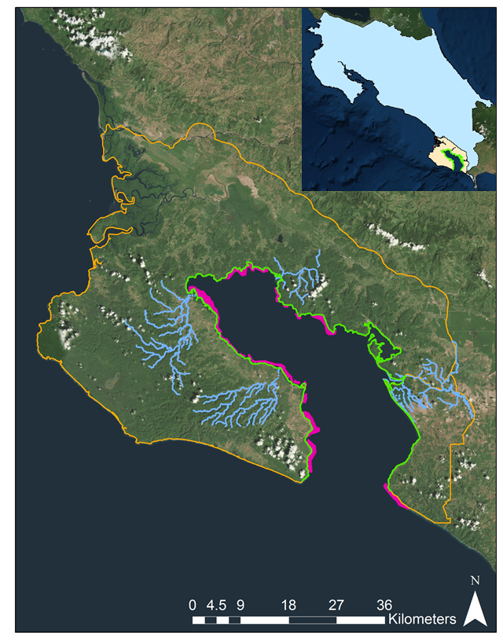
Study Area
Costa Rica
Osa Peninsula and Golfo Dulce, Costa Rica
Home to 2.5% of the Earth’s biodiversity
“The most biologically intense place on Earth”– National Geographic
Four river deltas of interest
Rio Coto, Rio Esquinas, Rio Rincon, and Rio Tigre
Esquinas
Rincon
Golfo Dulce
Tigre
Coto
Study Area
Golfo Dulce
Focal Rivers
Coral
Notes:
For our current project, we studied the Osa Peninsula in Costa Rica. National Geographic has called the Osa Peninsula, “the most biologically intense place on Earth” because it houses 2.5% of the world’s biodiversity. The Osa Peninsula surrounds one of four tropical fjords on the planet, the Golfo Dulce. We focused on coral reefs, which are indicated in pink along the gulf’s coastlines.
For more details on the biodiversity in the Osa Peninsula, please check: http://osaconservation.org/about-the-osa-peninsula/
Basemap credit: ESRI ArcMap Pro 10.5

Slide 3
Partner: Osa Conservation
Dedicated to protecting the biodiversity of the Osa Peninsula
Hilary Brumberg, Dr. Noelia Hernandez, and Mónica Espinoza Miralles
Credit: Osa Conservation
Notes:
We partnered with Osa Conservation, a grassroots nonprofit organization dedicated to conserving the wealth of biodiversity.
Photo Credit (top): http://osaconservation.org/
Photo Credit (bottom): http://osaconservation.org/

Slide 4
Community Concerns
Human Impact: Deforestation and the extensive use of pesticides and fertilizers have caused water pollution and a loss of biodiversity, specifically increasing the need to protect biological corridors.
River Health: Runoff from these land use changes has impacted river health, which in turn deposit pollutants into the gulf.
Coral Reef Health: Understanding how changes in water parameters impact the health of coral reefs in the gulf is essential to protecting marine ecosystems and local food security.
Credit: Osa Conservation
Notes:
In the Osa region, land use changes, such as deforestation and urbanization, have destabilized river banks and increased pollutant runoff into local rivers that drain into the gulf. In response, scientists at Osa Conservation have extended their work to cover the adjacent Golfo Dulce. They are currently using extensive field monitoring and lab analysis to study and manage species within the gulf.
As part of these efforts, the organization is looking for areas to implement coral rehabilitation where reefs have been damaged by natural or human settlement disturbances. Since coral are highly sensitive to changes in water quality, these increased pollutants have caused coral die offs in the gulf. Coral reefs in the Osa region provide key ecosystem services like shoreline protection, habitat, and food security for aquatic species and humans.
Photo Credit: http://osaconservation.org/

Slide 5
Objectives
Produce time series maps for median annual turbidity from 1986 to 2016
Produce maps of seasonal differences in median turbidity and average SST (February-May and August-November) for 2002 to 2018
Investigate river deltas in the Golfo Dulce and assess turbidity change per season
Identify areas of the Golfo Dulce most suitable for coral restoration
Create a correlation chart for the relationship between turbidity and SST
Produce a bivariate change in SST and turbidity map to identify areas in the Golfo Dulce most suited for coral restoration
Produce an interactive SST map tool for 2002 to 2018
Credit: Osa Conservation
Notes:
Here are our objectives for the term. Today, we’re going to focus on the changes in turbidity since 1986, seasonal changes in Sea Surface Temperature, and our final bivariate suitability map.
Photo Credit: http://osaconservation.org/

Slide 6
Key Parameters
Normalized Difference Turbidity Index (NDTI)
$$NDTI=\frac{ρ_{red }−ρ_{green }}{ρ_{red }+ρ_{green }}$$
Sea Surface Temperature (SST)
Notes:
The two water parameters we focused on were the Normalized Difference Turbidity Index (NDTI) and Sea Surface Temperature (SST). For the purposes of this presentation, I’ll refer to these as turbidity and temperature.

Slide 7
Data Acquisition
NASA Satellites and Sensors:
Turbidity
Landsat 5 TM
Landsat 7 ETM+
Landsat 8 OLI
Sea Surface Temperature
Aqua MODIS
Notes:
We used several satellites and sensors from NASA to conduct our analysis. For our 30 year turbidity study, we used Landsat 5, 7, and 8. For our seasonal temperature study, we used Aqua MODIS.

Slide 8
Methodology
Landsat 5 TM
NDTI annual time series
Landsat 7 ETM+
Landsat 8 OLI
1986 1991 … 2016
NDTI seasonal time series
Landsat 8 OLI
Coral restoration suitability map
2015 2016 2017
SST seasonal time series
Aqua MODIS
2015 2016 2017
2002 to 2018
Notes:
We completed our analysis using the Google Earth Engine API. We used Landsat red and green bands for surface reflectance to analyze turbidity from 1986 to 2016 in five year intervals. Our analyses of turbidity and temperature were then overlaid to create a final coral restoration suitability map.

Slide 9
End Products
Land Cover Time Series
High Resolution Land Cover Map
NDVI Analysis
Term I
1987
1999
2017
2016
2017
ArcMap (Landsat)
ArcMap (PlanetScope)
Refined
Land Cover Time Series
Watershed Health Maps
Carbon Sequestration Time Series
Outreach Materials
Term II
GEE
SWAT model
GEE
ArcGIS Story Map
In-situ water quality data
Notes:
Since this is the third term of the project, we need to understand the work of the previous terms, summarized here. Term one focused on land use changes on the peninsula, before and after the passing of Forest Law 7575 in 1996. Term two looked at the impact of these land use changes on watershed health.

Slide 10
End Products
NDTI Time Series
Seasonal Turbidity and SST Fluctuations
Interactive SST analysis tool
Coral restoration suitability map
Term III
1986 to 2016
2015
2016
2017
2002 to 2018
GEE (Landsat)
GEE
(Landsat, Aqua)
GEE
(Aqua)
GEE and ArcGIS
Notes:
This diagram shows the final end products of our term, Osa Water Resources 3. Used in conjunction with the end products from the previous two terms, these resources will help Osa Conservation in their efforts to protect terrestrial and marine environments.

Slide 11
Results
Credit: Osa Conservation
Notes:
Photo Credit: http://osaconservation.org/

Slide 12
Notes:
An interactive temperature tool allows the user to view a time series chart of temperature fluctuations on any selected point within the gulf. The user can also select years and seasons of interest to display and export maps of temperature for that period.

Slide 13
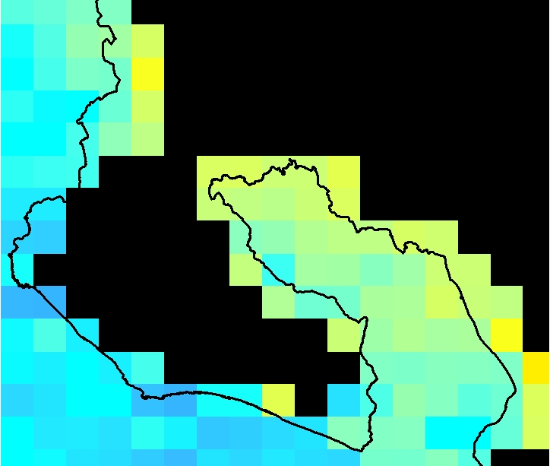
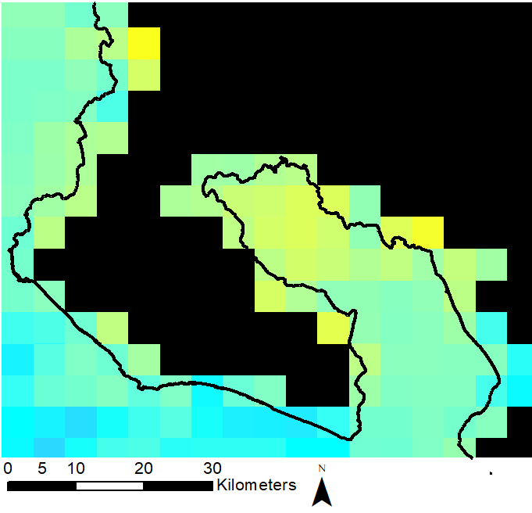
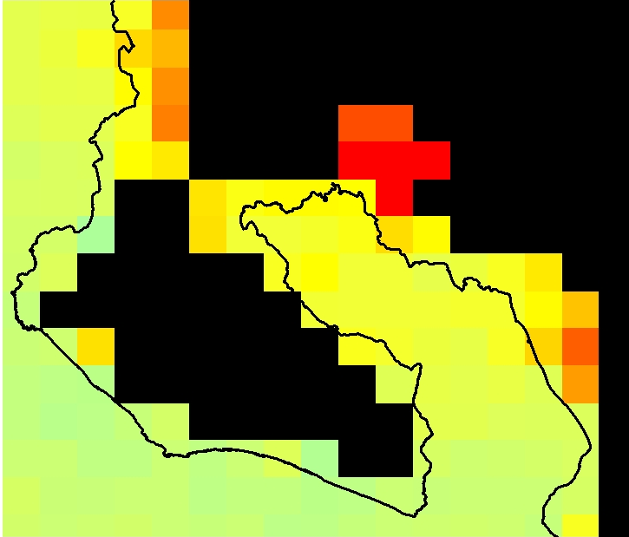
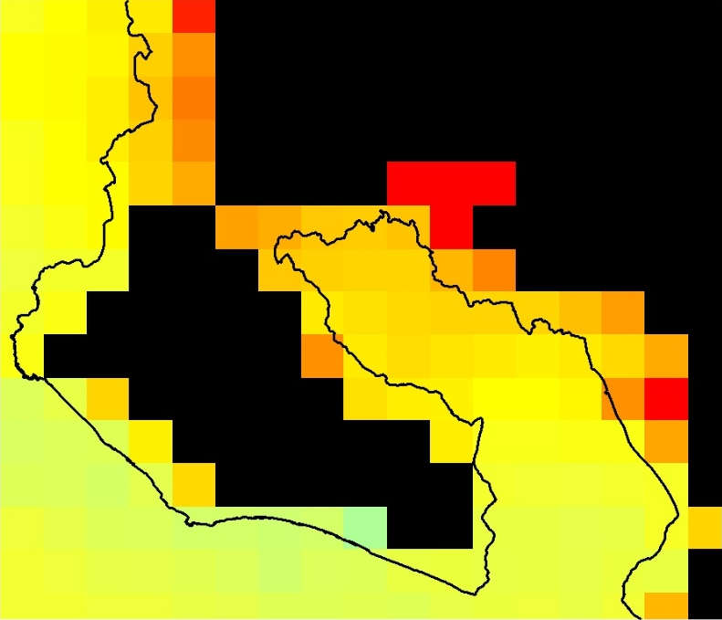
Results: SST
2003 Wet
2017 Wet
SST for wet and dry seasons for 2003 and 2017
2003 Dry
2017 Dry
SST (C°)
High: 33
Low: 26
Osa Coastline
N
Notes:
Here are some examples exported maps from our Aqua MODIS tool. Temperatures have increased from 2003 to 2017 across the gulf. Our maps also show seasonal fluctuations between 26 and 33 degrees Celsius.

Slide 14
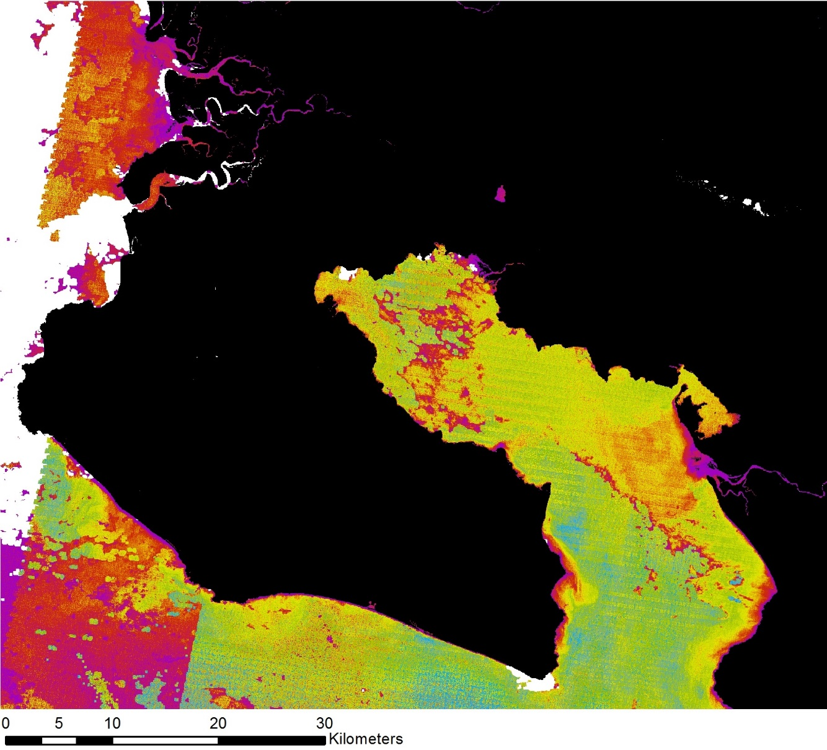
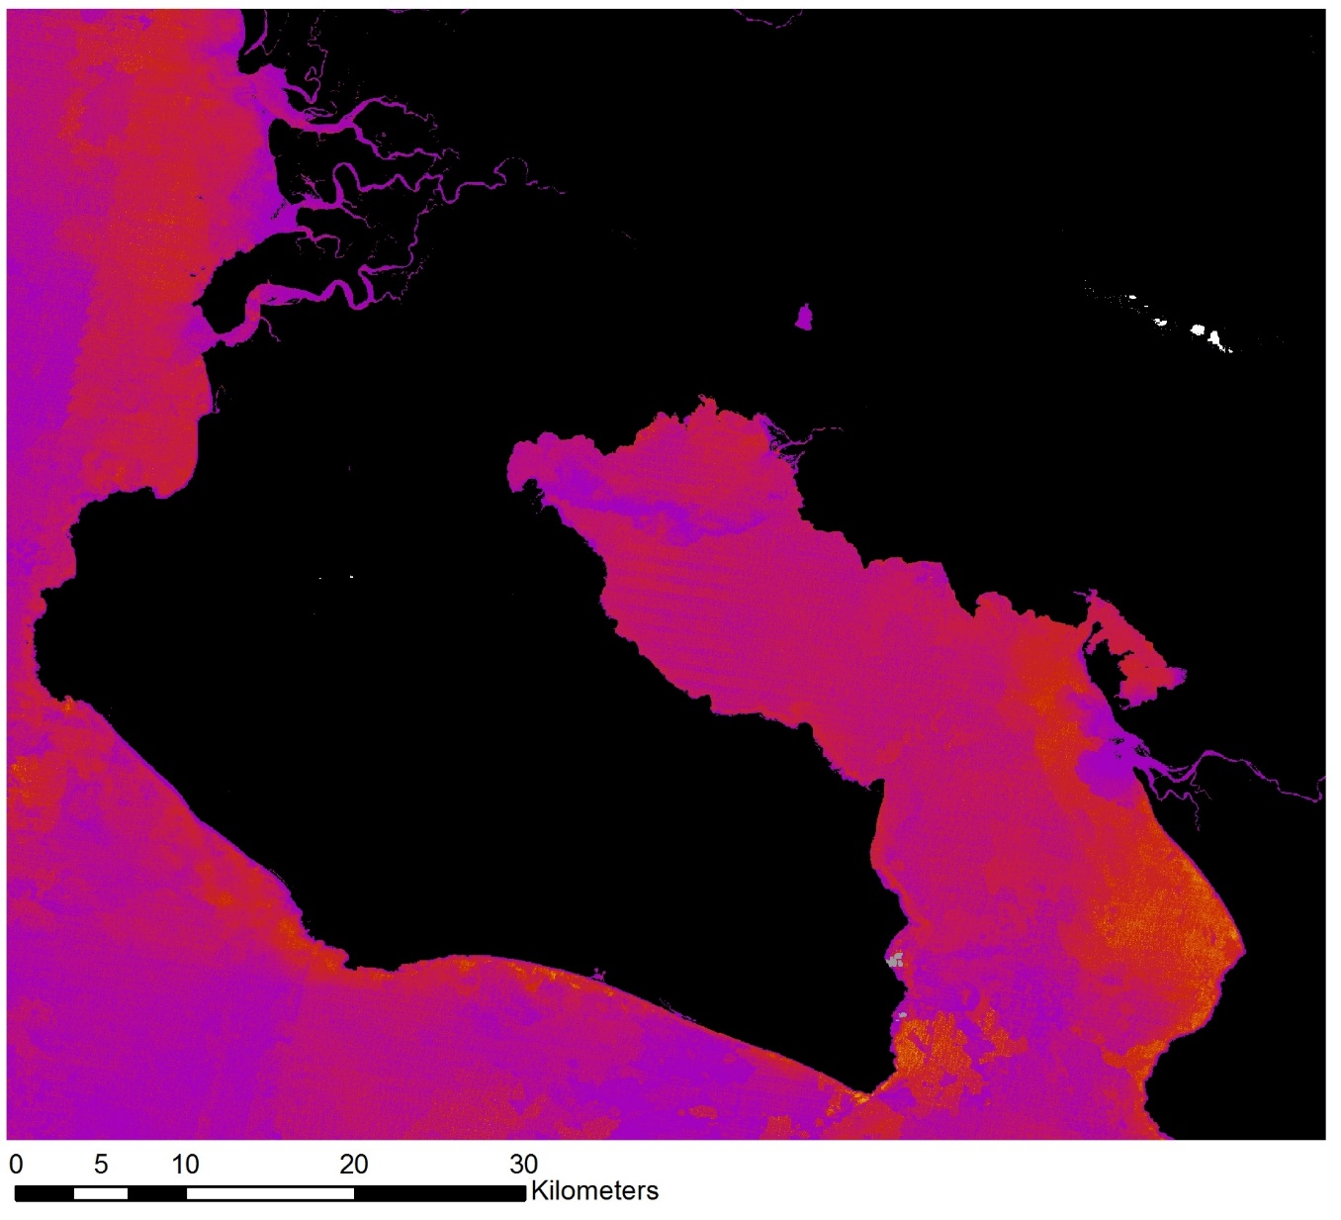
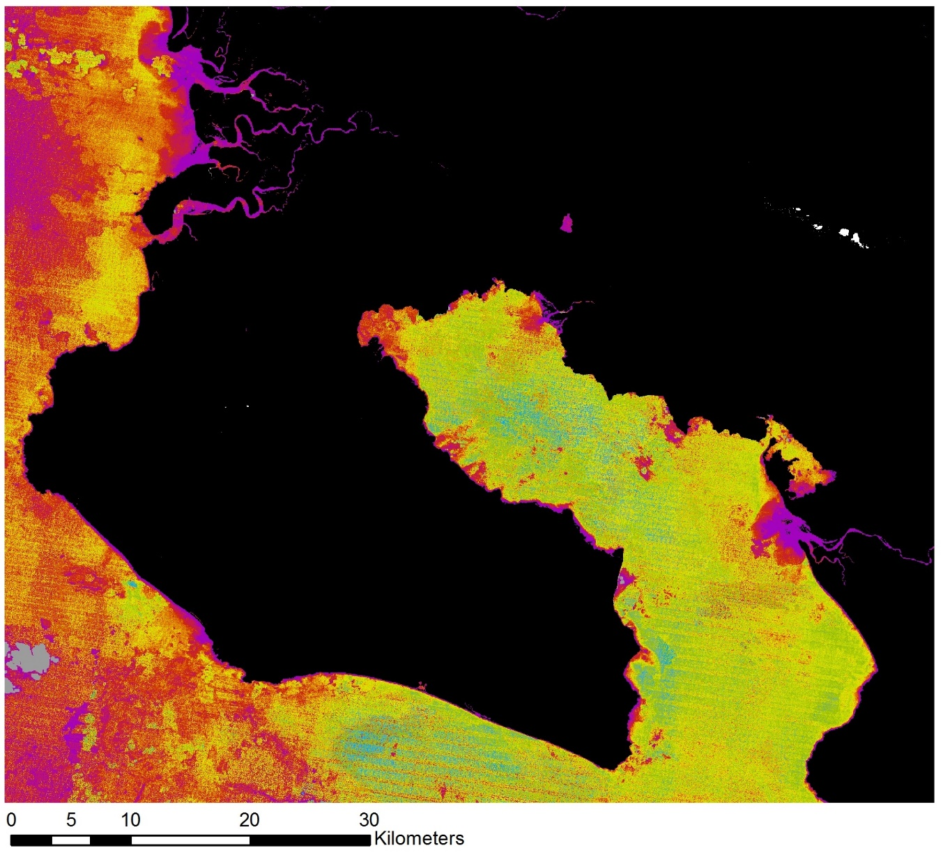
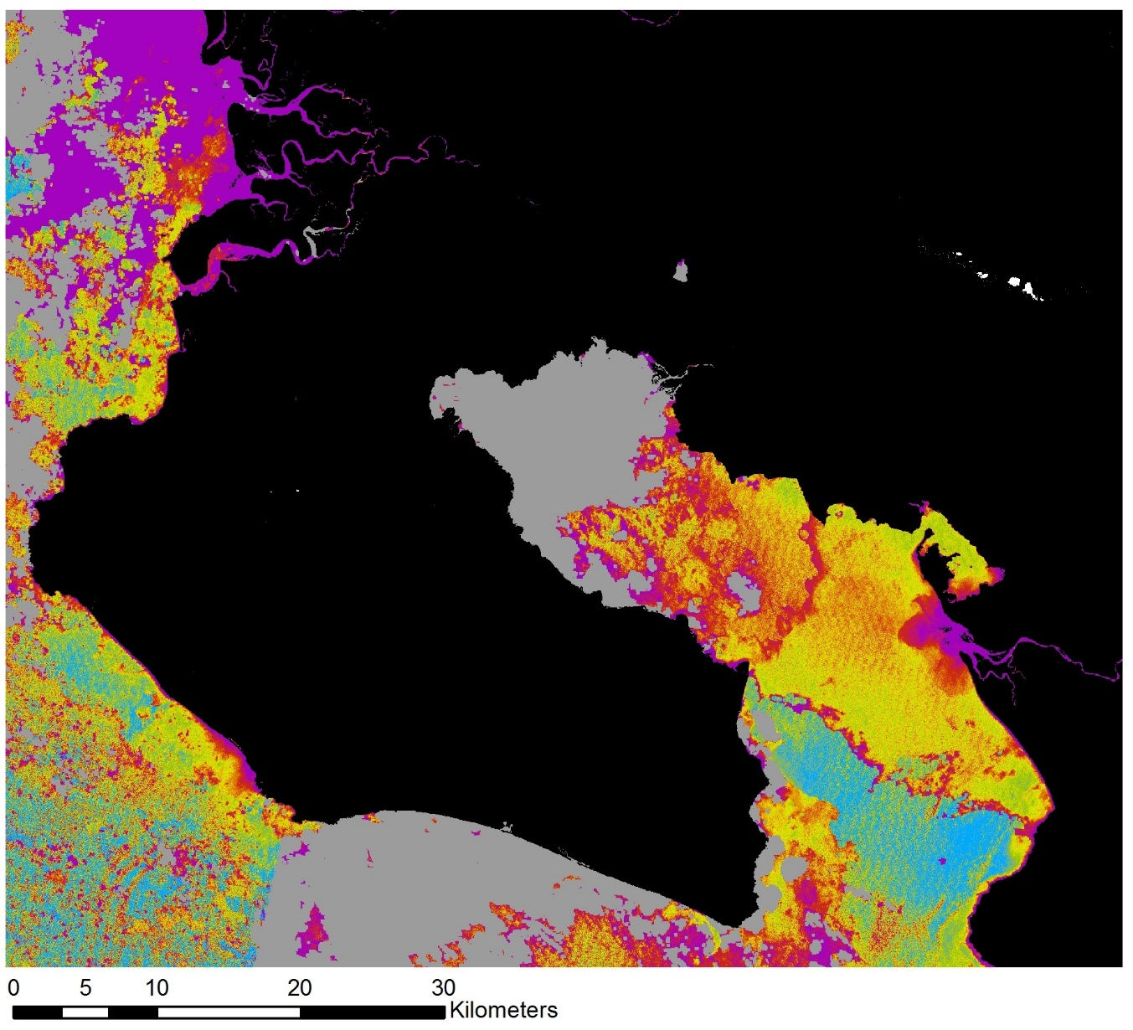
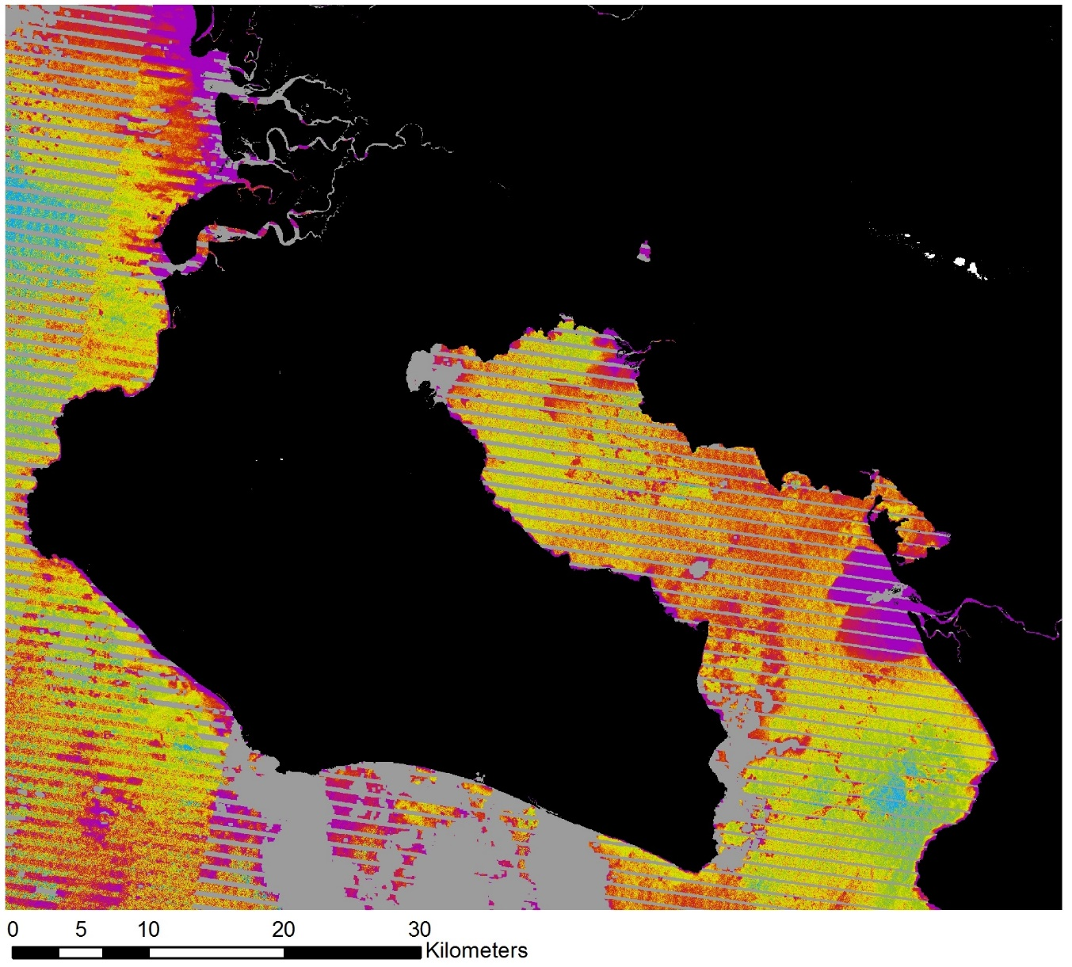
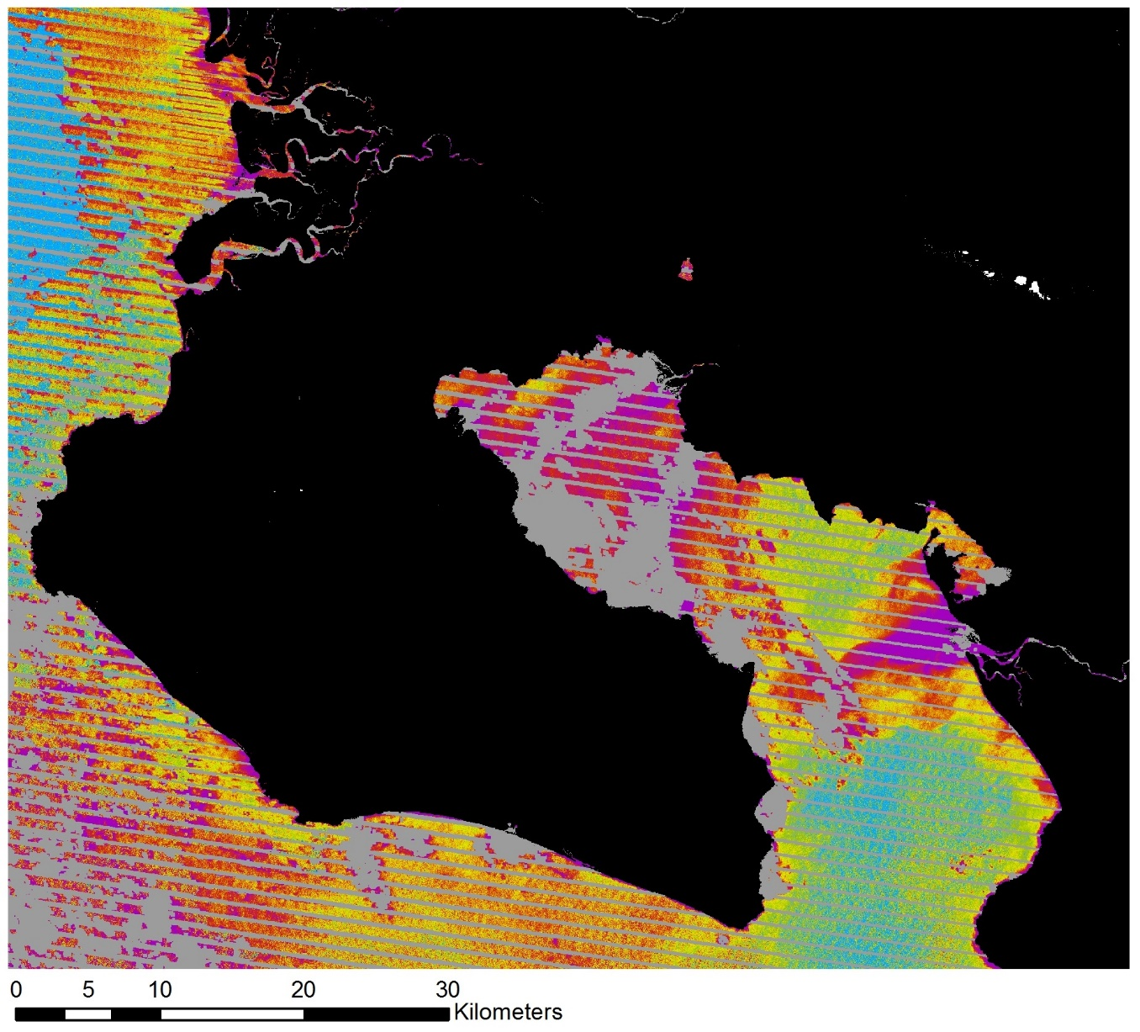
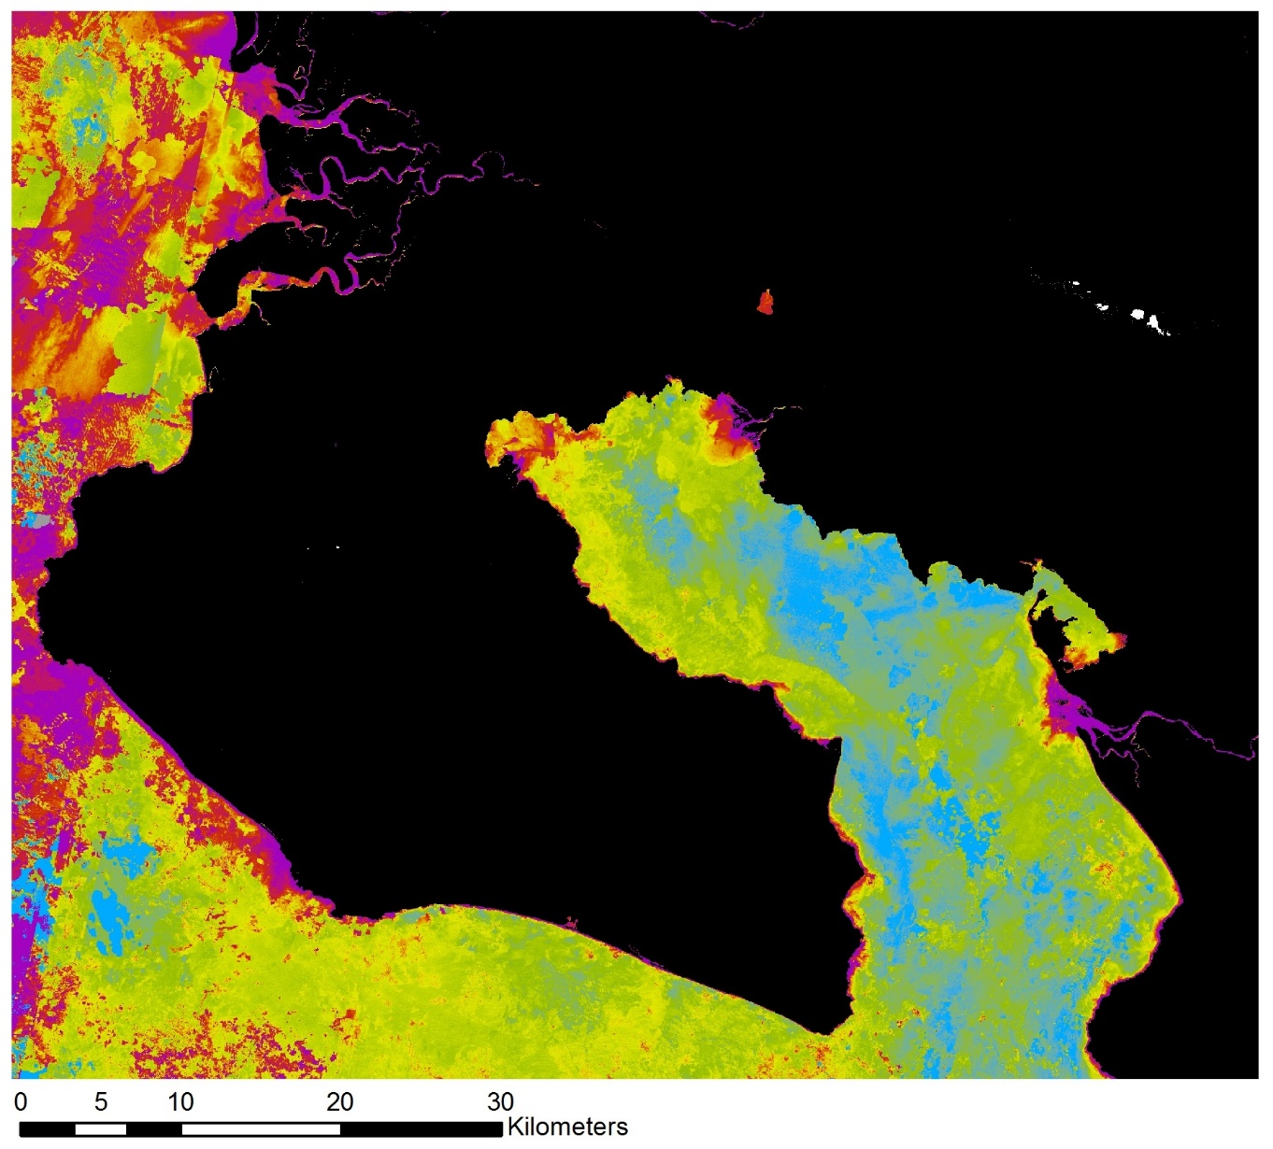
Results: Turbidity
1986
1991
1996
2001
2006
2011
2016
1986 to 2016: Composites of wet season turbidity on five-year intervals
High turbidity
N
Low turbidity
Notes:
For turbidity, we conducted our analysis from 1986 to 2016 on five year intervals. By observing the gulf over this time period we were able to analyze long term effects and draw connections to Forest Law 7575, enacted in 1996, which mandated reforestation efforts in the region.

Slide 15
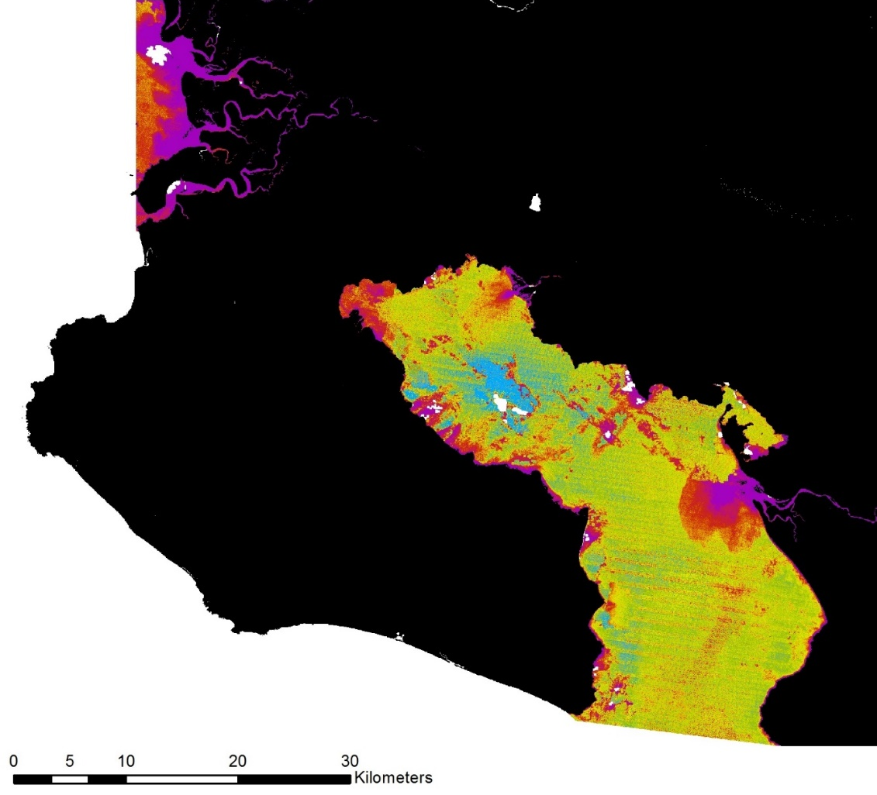
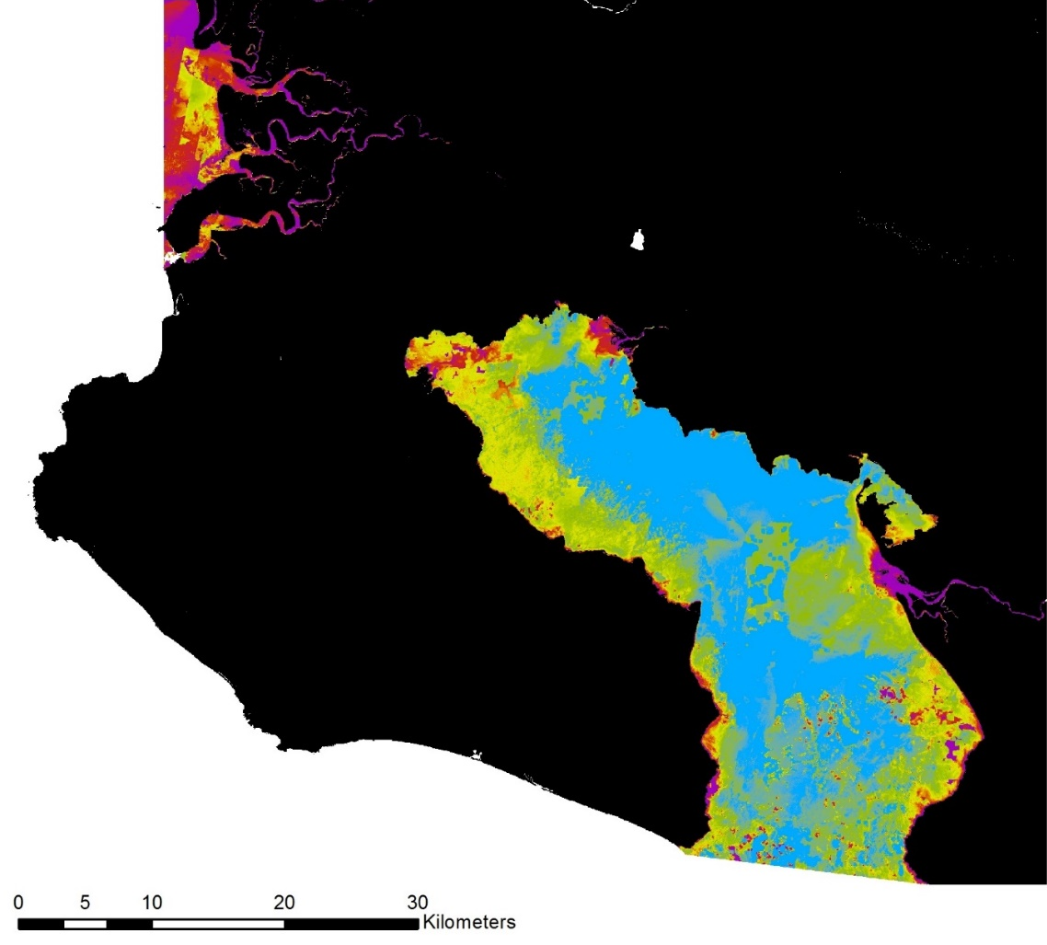
Results: Turbidity
High turbidity
Low turbidity
1996
2016
N
Notes:
To assess the impact of the law more closely, we compared our turbidity maps from 1996 and 2016. When we compare the two maps, there is a notable decrease in turbidity throughout the gulf. Note that turbidity around the largest river delta, the River Coto, remains relatively high and constant over the time period. This helps to validate our results showing a significant decline in turbidity.

Slide 16
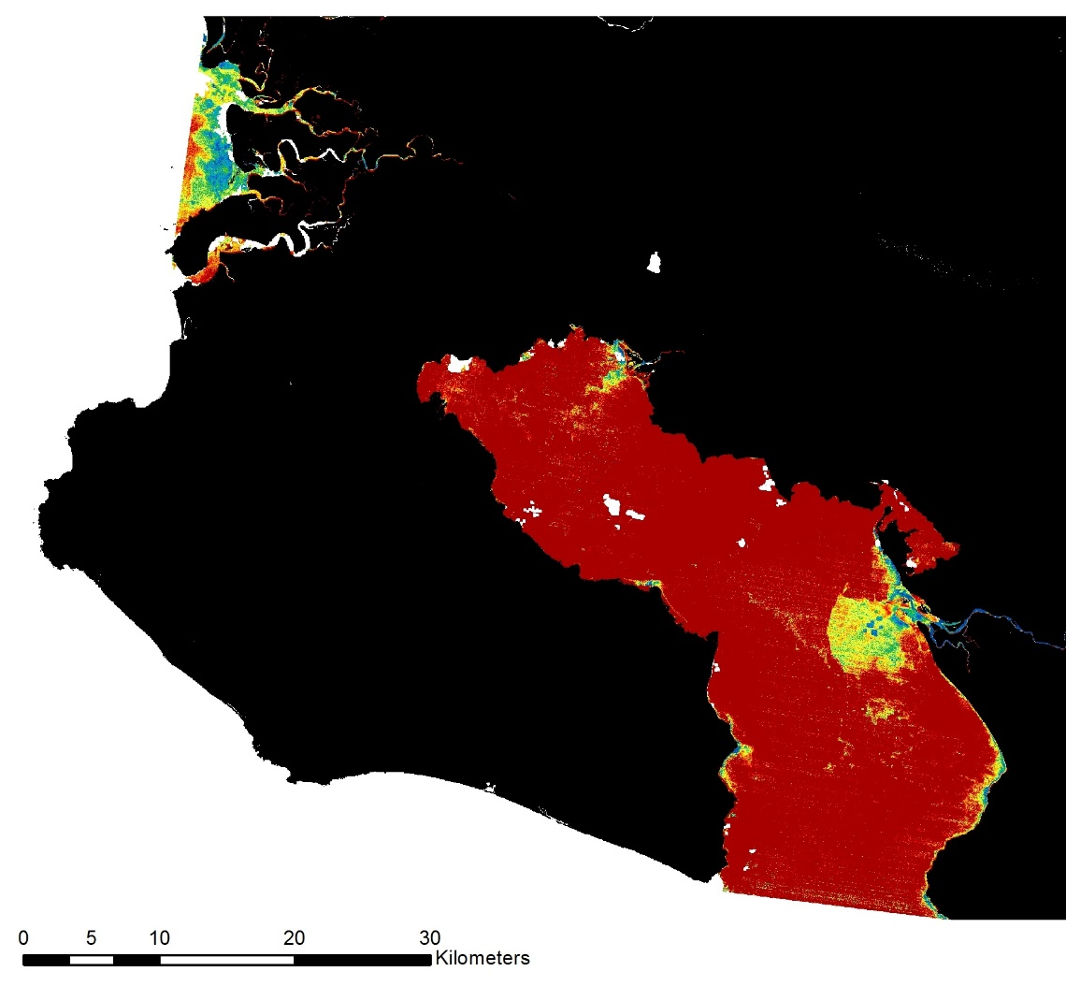
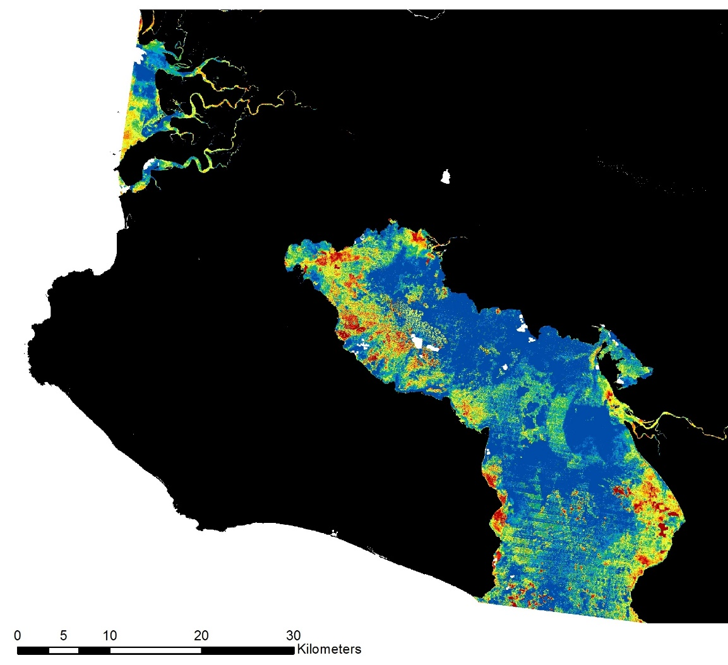
Results: Turbidity
Difference Map: 1986 to 1996
Difference Map: 1996 to 2016
Increase
Decrease
N
Notes:
The significance of the year 1996 became even more apparent when we took difference maps of turbidity levels. Between 1986 and 1996, turbidity levels increased significantly, indicated by the red color. In the 20 years after 1996, turbidity has decreased significantly. These changes may be due to incentives for reforestation associated with the forest law.

Slide 17
Results: Bivariate
SST
Fluctuation
NDTI
Fluctuation
Bivariate Key
High
Turbidity
Change
+
=
Low
High
Low
Temperature
Change
Notes:
We chose to use a bivariate key to display our final suitability analysis. The bivariate key can be thought of as a color gradient for the two water characteristics, with white being the most stable and purple being the least stable. White represents low turbidity and temperature fluctuations, red represents low turbidity and high temperature fluctuations, blue represents areas of high turbidity and low temperature fluctuations, purple represents areas of high turbidity and high temperature fluctuations.

Slide 18
Results: Bivariate
SST
Fluctuation
NDTI
Fluctuation
+
N
Notes:
The bivariate map can also be thought of as a combination of the temperature and turbidity fluctuation maps.

Slide 19
Results: Bivariate
NDTI
Change
Mean suitability map for 2015 through 2017
SST
Change
N
Notes:
The map shown here is averaged from 2015 through 2017 and shows various degrees of changes in our two water parameters. The northwest region of the gulf appears to be the most stable with regards to turbidity and temperature. With the sensitive nature of coral, this area could potentially be a good location for coral restoration

Slide 20
Results: Bivariate
Notes:
When comparing the medians of our two parameters during the wet seasons, we see opposing trends. Temperature increased and turbidity decreased since 2003.

Slide 21
Conclusions
There is a noticeable decrease in NDTI over the gulf from 1996 to 2016 potentially due to incentives for reforestation efforts after Forest Law 7575.
Río Coto shows little fluctuation in NDTI over the past 20 years. However, the mouth feeding into the gulf is a highly turbid area.
Minimal fluctuations in NDTI and SST are seen in the northwest region of the gulf. With the sensitive nature of coral, this area is the most suitable for their restoration.
NDTI and SST do not show strong correlations. However, median SST in the gulf has continually increased over the past 15 years while NDTI is variable with a downward trend.
Credit: Osa Conservation
Credit: Osa Conservation
Notes:
Based on our analyses, we drew some conclusions about the water parameters in the gulf. Over the last 30 years, turbidity decreased within the gulf. Analysis of the largest river, River Coto, shows consistent high turbidity with low fluctuations. We observed only small changes in temperature and turbidity in the northwest region of the gulf, indicating good suitability for restoration. Although temperature and turbidity showed opposing trends, we cannot conclude a direct correlation between the two.
Photo Credit: http://osaconservation.org/

Slide 22
Limitations
Credit: Osa Conservation
SST data from Aqua MODIS had a low spatial resolution of 500m. It is difficult to differentiate between the land and gulf on the bivariate and SST maps because of type overlapping in 500 m pixels.
We were unable to study NDTI upstream of the river deltas with Landsat data because the rivers’ widths are less than 30m.
The Landsat green band used to calculate NDTI cannot differentiate between inorganic pollutants and organic molecules suspended in the water.
Without ground truth data points, we cannot calculate absolute values for turbidity in the gulf.
Credit: Osa Conservation
Notes:
Our chosen analyses had some quality limitations because of the lack of available data for Costa Rica. Aqua MODIS temperature data has a spatial resolution of only 500m. Similarly, Landsat data has a 30m resolution which prevented us from studying turbidity upstream of the river deltas.
Because our turbidity analysis was based on surface reflectance, we could not perfectly extract whether fluctuations were a result of sediment pollution, chlorophyll, or aquatic vegetation. Finally, due to the lack of available, current in-situ data for the gulf, we were unable to devise an empirical formula for calculating the absolute value of turbidity.
Photo Credit: http://osaconservation.org/

Slide 23
Future Work
Analyze seasonal salinity fluctuations in the gulf.
Analyze river deltas using finer spatial resolution data from PlanetScope (3m) and Sentinel-2 (MSI) (10m).
Assess how changes in water parameters impact mangrove population health in the gulf.
Analyze SST using finer spatial resolution data from Terra ASTER (90m).
Calculate absolute turbidity using an empirical formula to differentiate between organic and inorganic matter.
Determine sources of upstream pollutants from land use change.
Credit: Osa Conservation
Notes:
The Osa region has a lot of potential for future work with remote sensing. One example would be to analyze river delta turbidity with a finer spatial resolution and extend this analysis further upstream to more concretely connect terrestrial, riverine, and marine health.
Though this is the final term of Osa Peninsula Water Resources, we hope that Osa Conservation has found our analyses valuable and continues to seek resources to implement remote sensing in their future works, enhancing their abilities to conserve their local environments.
Photo Credit: http://osaconservation.org/

Slide 24
Acknowledgments
Science Advisors – University of Georgia
Dr. Marguerite Madden, Director for Center for Geospatial Research
Dr. Sergio Bernandes, Associate Director for Geospatial Research
Project Partner – Osa Conservation
Hilary Brumberg, Rios Saludables Program Coordinator
Dr. Noelia Hernandez, Science Director
Mónica Espinoza Miralles, Marine Biologist
Past Members and Contributors
Marie Bouffard
Tanner Johnson
John Langstaff
Candice Lee
Emily Pauline
Taufiq Rashid
Suravi Shrestha
Sam Tingle
Notes:
We would first like to thank our science advisors, Dr. Marguerite Madden and Dr. Sergio Bernandes, for their invaluable support.
We would also like to thank our project partners from Osa Conservation, Hilary Brumberg, Mónica Espinoza Miralles, and Dr. Noelia Hernandez, for their consistent cooperation and enthusiasm.
We could not have completed this third term without the hard work and support of past project members and advisors.
Finally, we would like to thank Marie Bouffard, the DEVELOP Center Lead at our Athens node, for her support and feedback throughout the term.
.

Slide 25
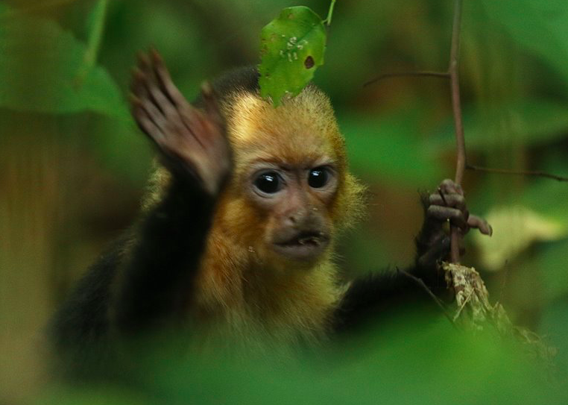
Questions?
Credit: Osa Conservation
Notes:
Thank you so much for listening! We will now take any questions or comments.

Slide 26
Appendix

Slide 27
Future updates to tools
Coordinate imports
Drop down option to select points of interest
Anomaly detection
Increased flexibility in user interface

Slide 28
NDTI Equation
$$NDTI=\frac{ρ_{red }− ρ_{green }}{ρ_{red }+ ρ_{green }}$$

Slide 29
Results: SST v. NDTI
Notes:
. Mean SST time series over Golfo Dulce in wet season (blue) and dry season (red) from 2003 to 2017

Slide 30
Results: SST/NDTI Ratio
Notes:
. Mean SST time series over Golfo Dulce in wet season (blue) and dry season (red) from 2003 to 2017

Slide 31
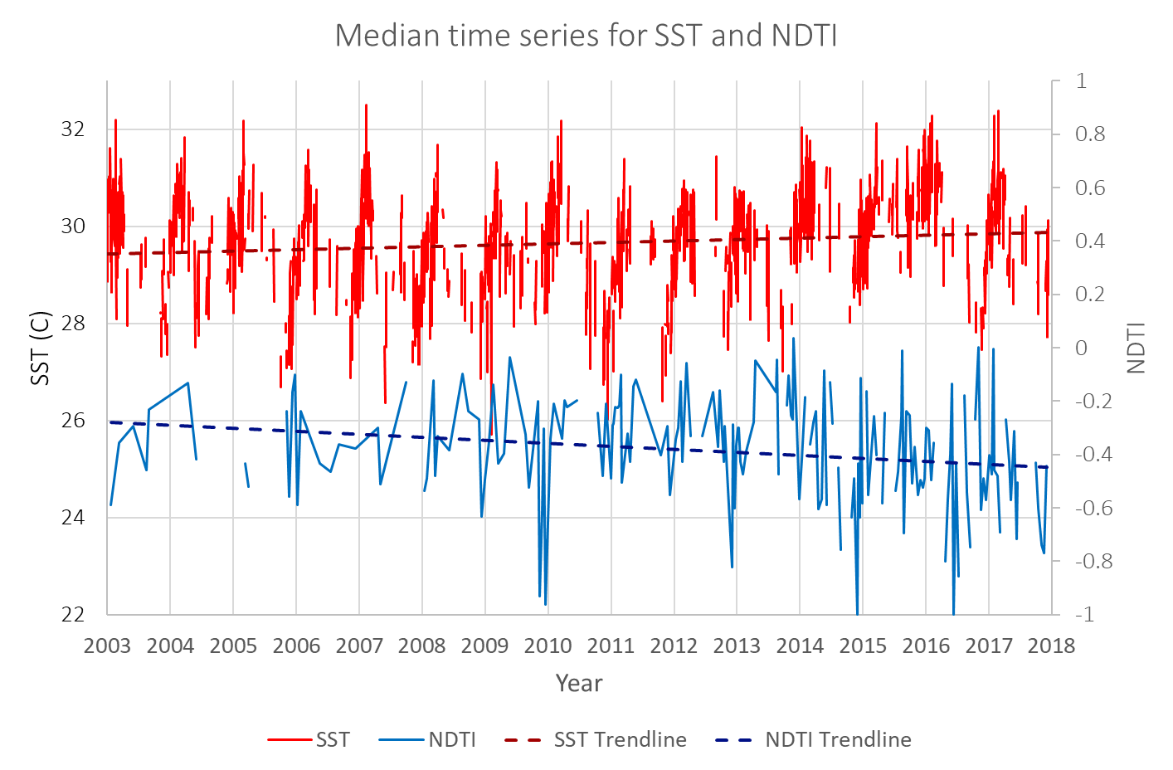
Results: Median Time Series
Notes:
Mean SST (blue) and NDTI (red) time series over Golfo Dulce from 2003 to 2017

Slide 32
Results: Seasonal Scatter Plot
Notes:
Scatter plot for SST and NDTI over Golfo Dulce in wet season (blue) and dry season (red) from 2003 to 2017

Slide 33
Results: NDTI by Season
Notes:
Mean NDTI time series over Golfo Dulce in wet season (purple) and dry season (green) from 2003 to 2017

Slide 34
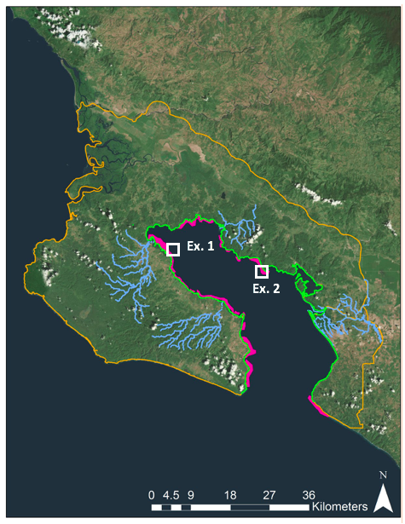
Results: SST Example 1
Notes:
SST chart example- example location one

Slide 35
Results: SST Example 2
Notes:
SST chart example- example location one

Slide 36
Notes:
The NDTI tool looks at turbidity on five year intervals.

Slide 37
Notes:
This bivariate tool looks at fluctuations in SST and NDTI between the wet and dry seasons for 2015 to 2017.

Slide 38
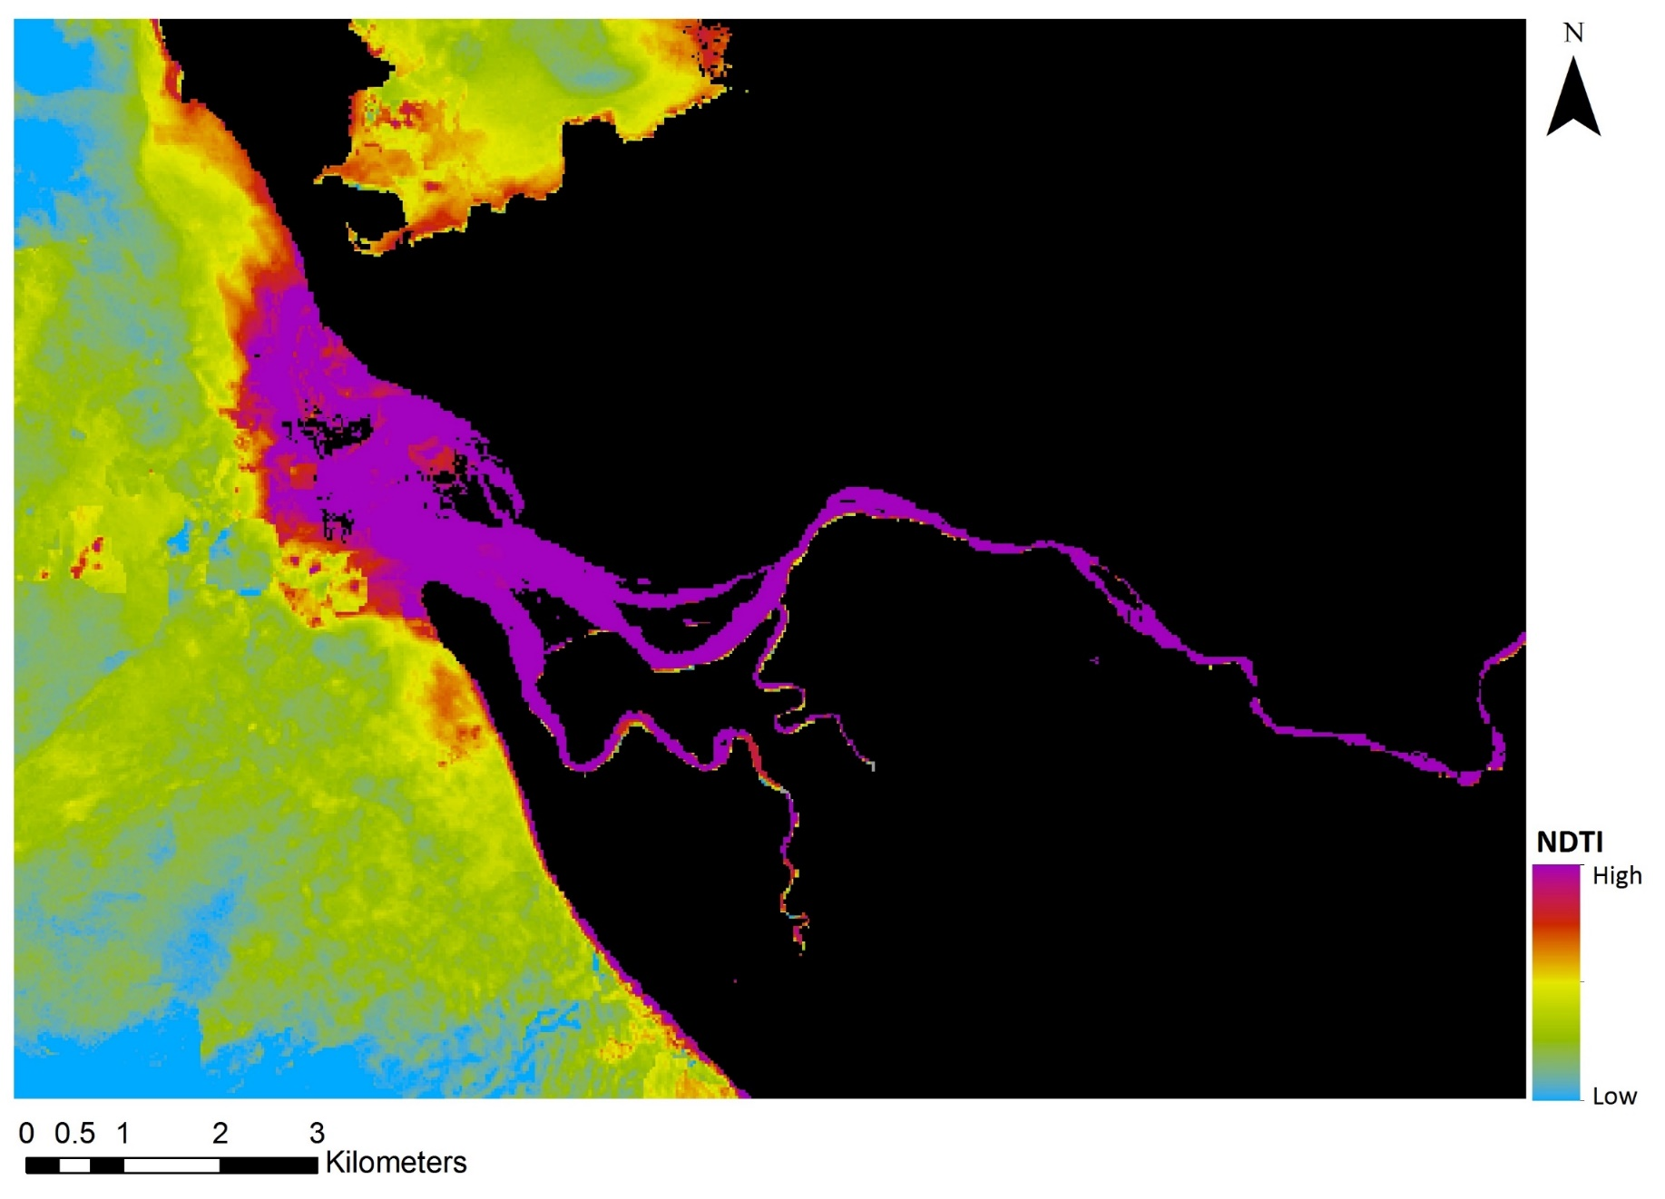
Results: Rio Coto
High turbidity
Low turbidity
N
Notes:
Rio Coto shows high turbidity

Slide 39
Results: Turbidity
Increase
Decrease
Change in turbidity from 1986 to 1996
N
Notes:
This decrease is also evident when we take a difference between the medians for the two years. This may be due to incentives for reforestation associated with the forest law.

