Slide 1
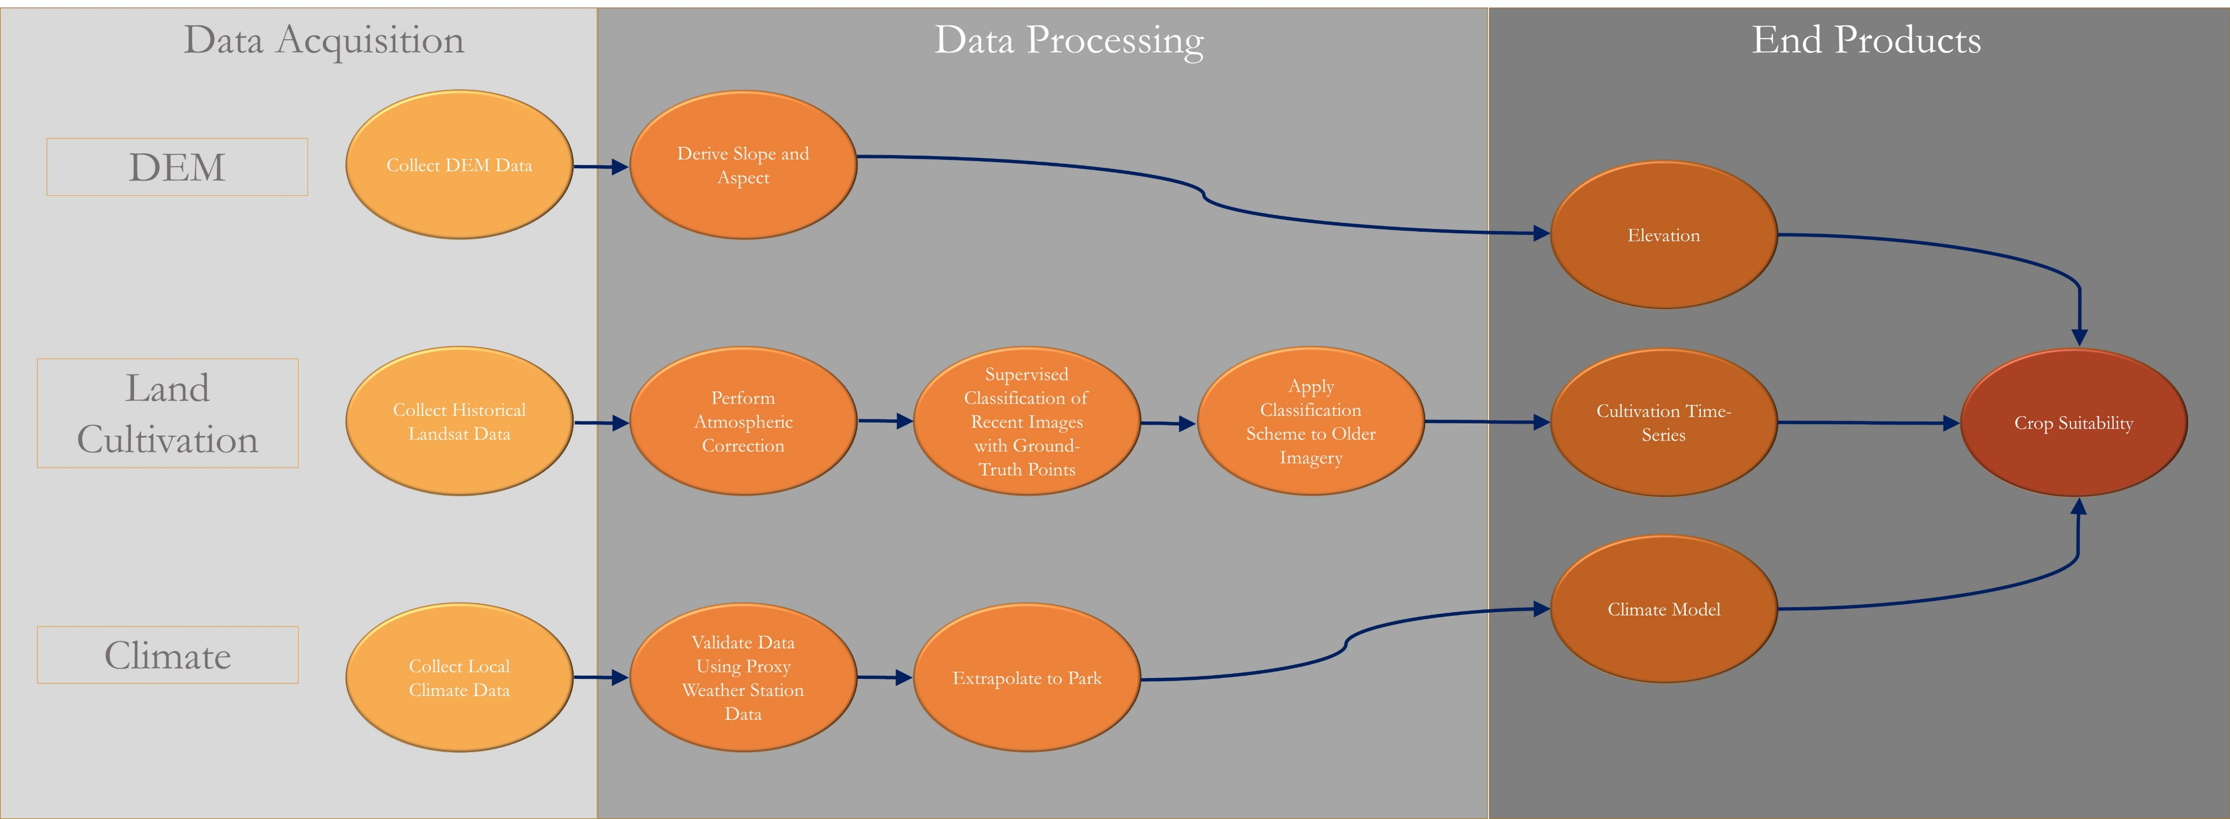
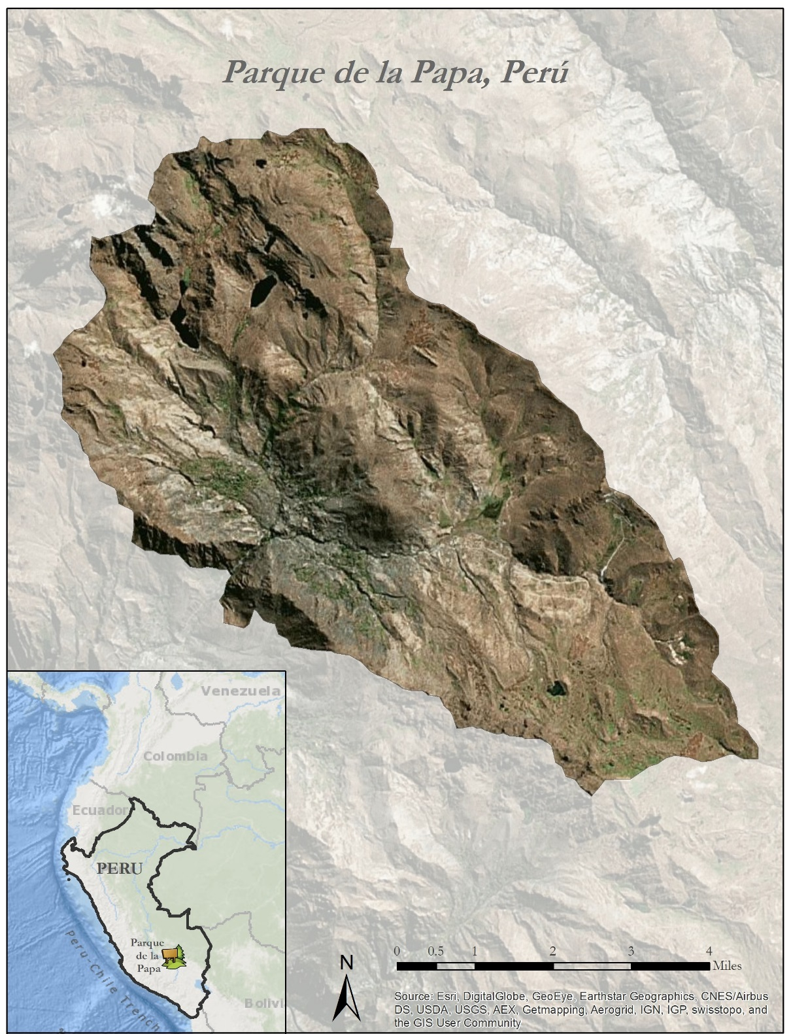
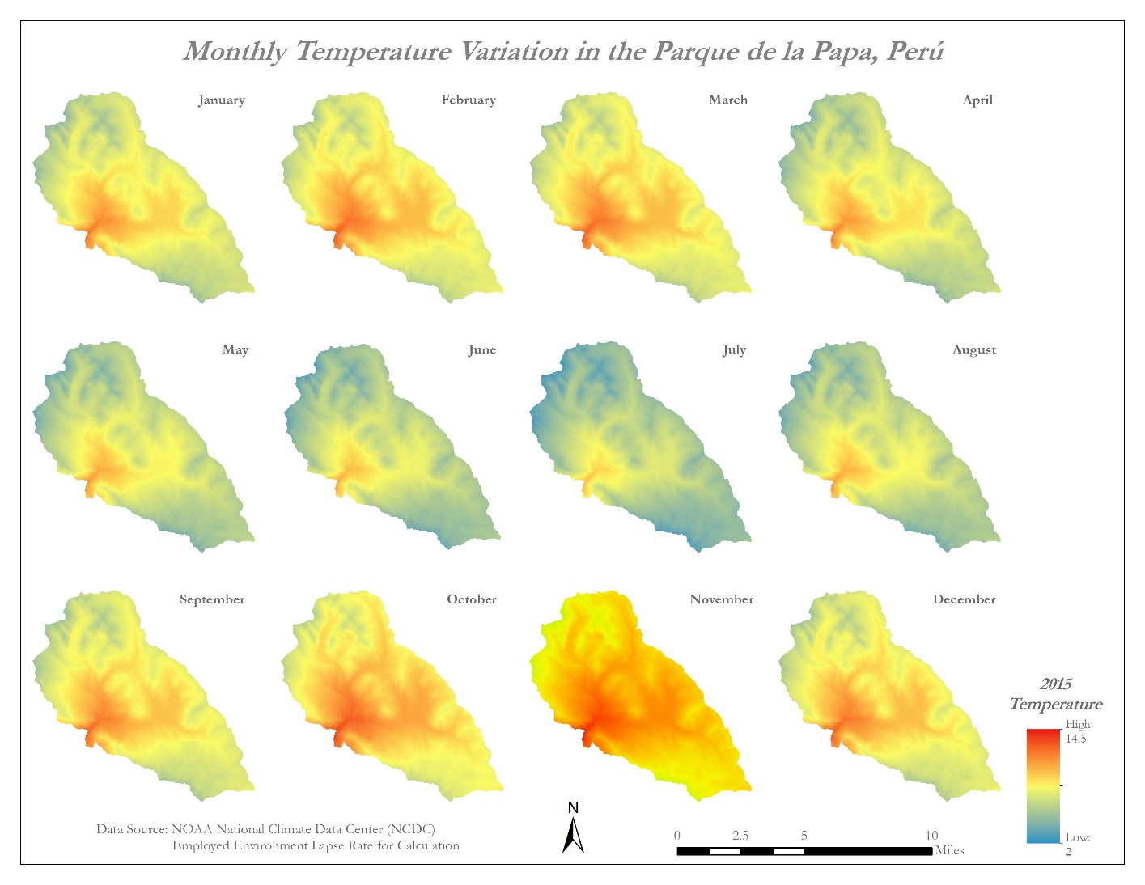
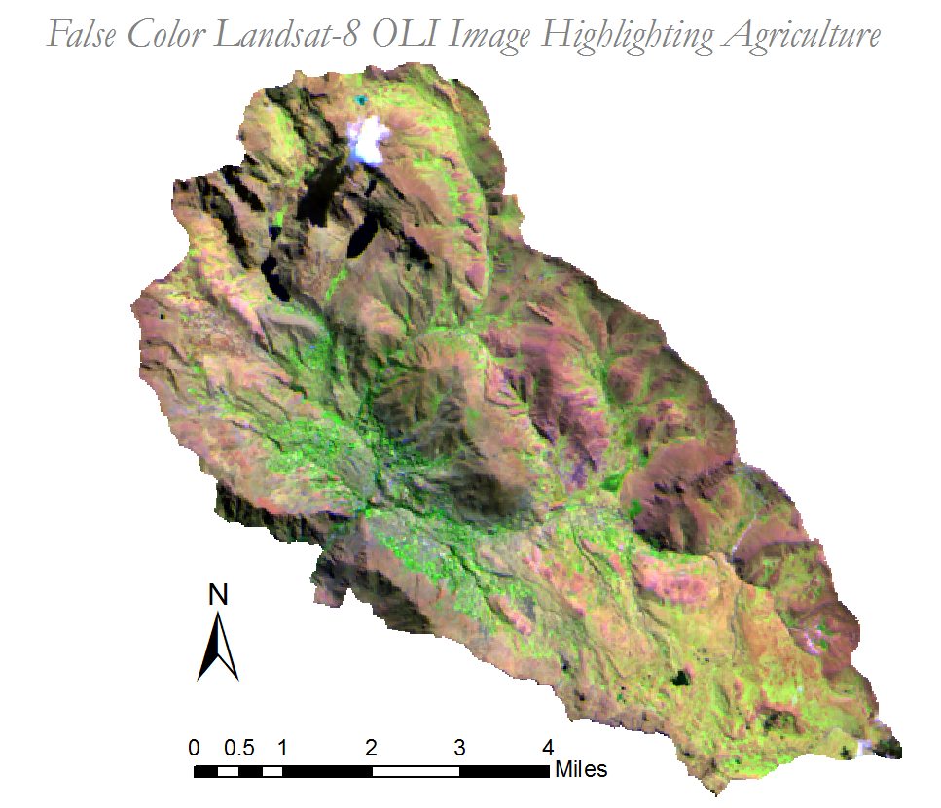
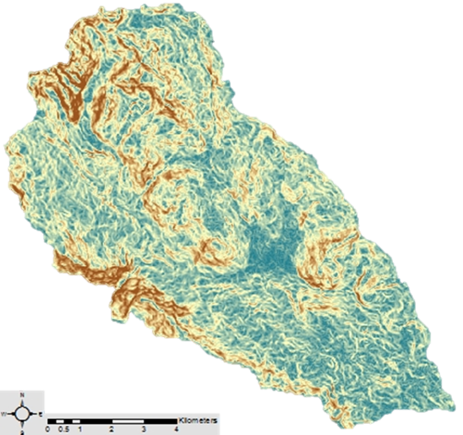
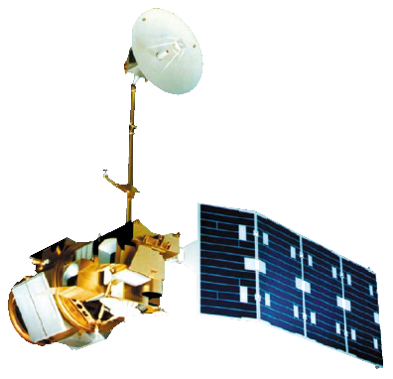
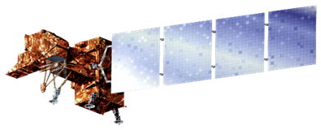


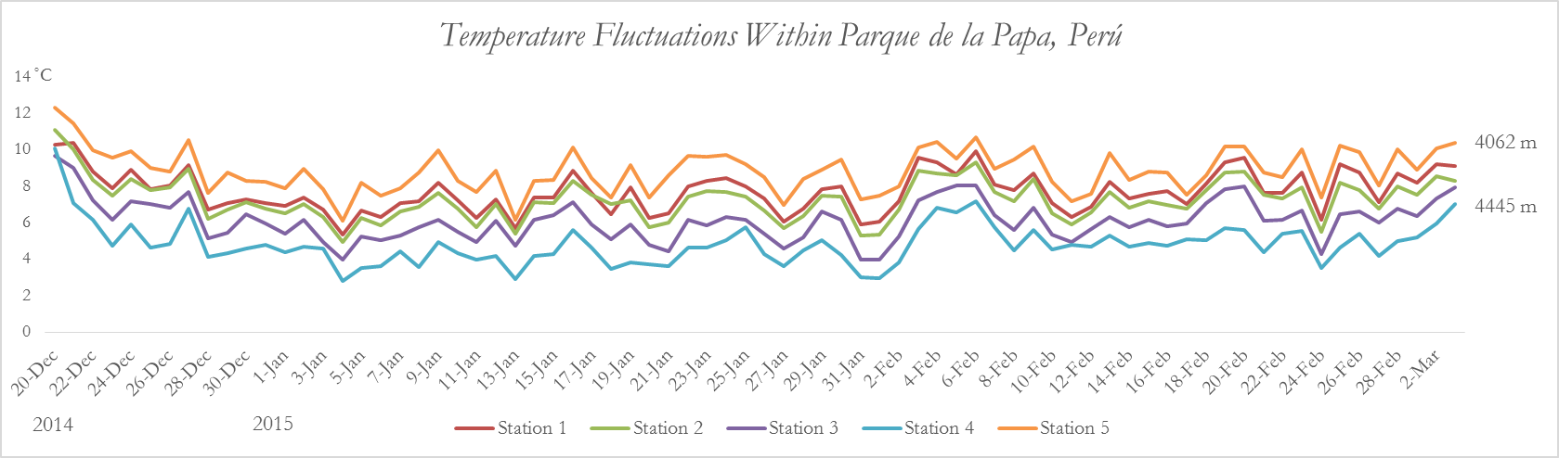
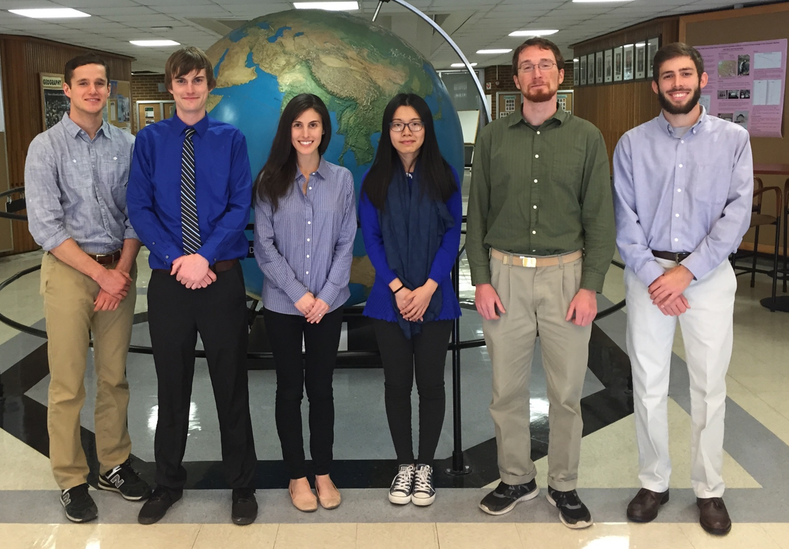
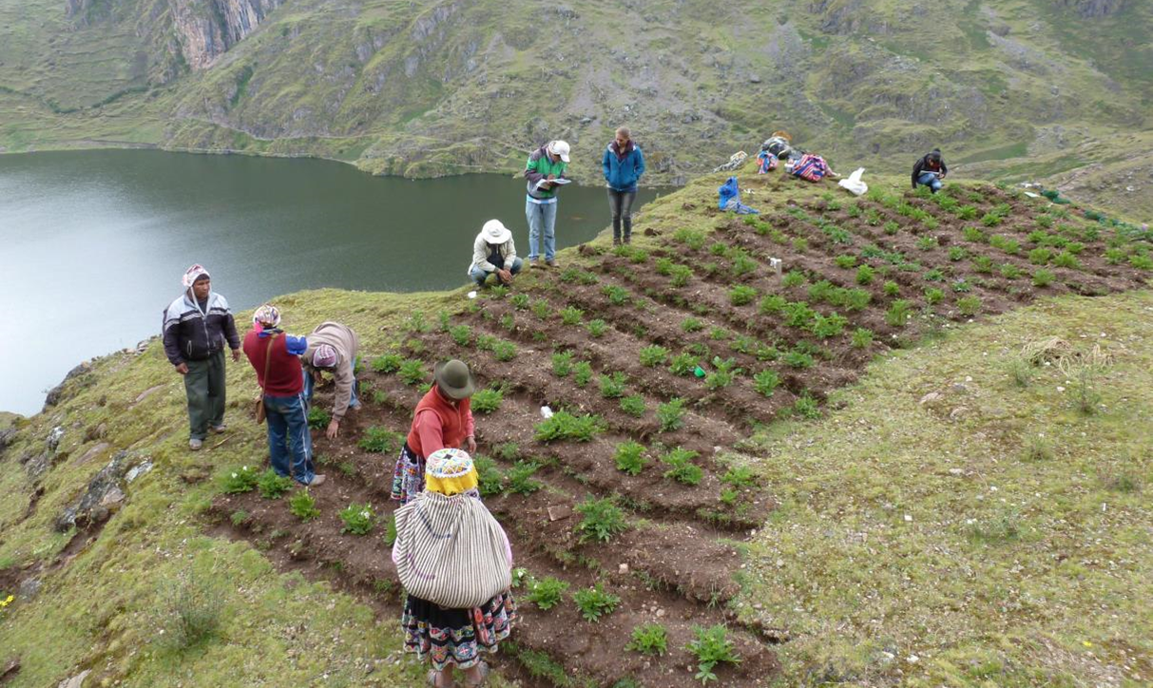
Perú Climate II
Monitoring and forecasting shifting climate and land change impacts in Perú’s Parque de la Papa for enhanced agricultural management
Caren Remillard (Project Lead), Brandon Hays, Benjamin Page, Adam Salway, Sam Weber, Xuan Zhang
DEVELOP National Program at The University of Georgia
Abstract
Objectives
Keep this blank for now.
Body text point size should be at least 24.
Caption text point size should be at least 16.
Feel free to rename, move, and resize sections as needed.
Identify changes in growing patterns in Parque de la Papa
Quantify changes in climatic patterns in Parque de la Papa
Develop a predictive model to assess areas for optimal potato cultivation
Provide project partners with outreach materials
Enable indigenous communities to continue using traditional agricultural methods
Methodology
Study Area
Results
Earth Observations
ASTER Derived Slope
Landsat 5, TM Landsat 7, ETM+
Landsat 8, OLI Terra, ASTER
Conclusions
Use bullets.
Use complete sentences with periods.
3
3
3
3
3
Temperatures were observed by HOBO weather data logging units situated throughout Parque de la Papa
Team Members
Project Partners
Acknowledgements
Left to right: Sam Weber, Benjamin Page, Caren Remillard, Xuan Zhang, Brandon Hays, Adam Salway
International Potato Center (CIP)
Association for Nature and Sustainable Development (ANDES)
We would like to thank our science advisors: Drs. Marguerite Madden and Kenton Ross
Great thanks are due to the members of CIP and ANDES: Genesis Abreu, Alejandro Argumedo, Noelle Barkley, David Ellis, and Rene Gomez
We would also like to acknowledge the previous work of the Perú Climate I team: Rebekke Muench, Kayla McDonald, Michael Sclater, Richard Rose, Dajon Begin
The University of Georgia

