Slide 1
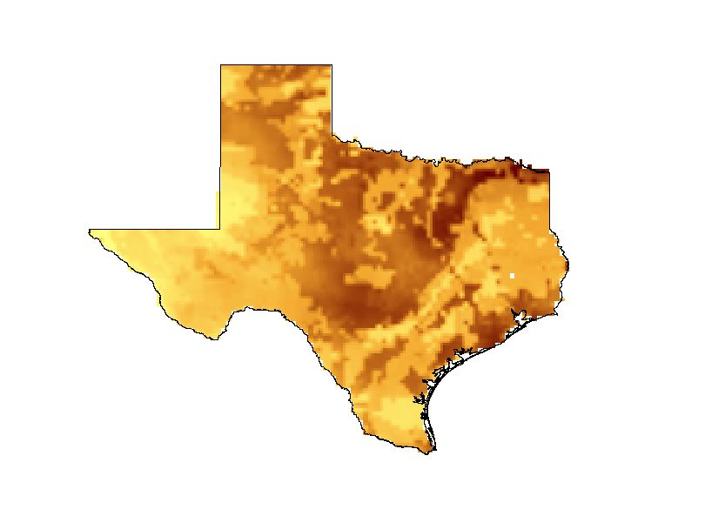

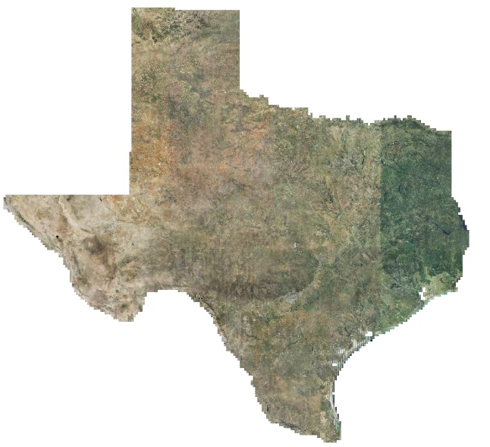

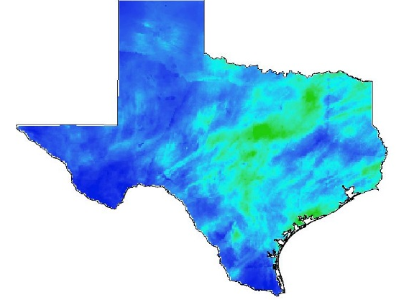


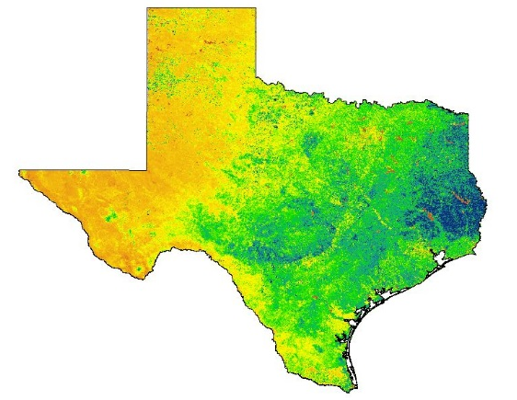


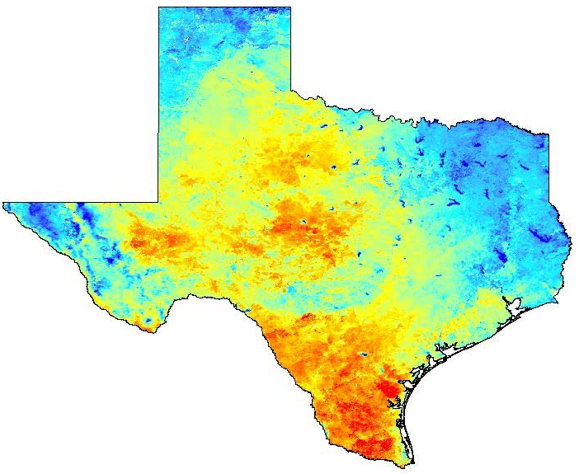

Texas Water Resources
Utilizing NASA Earth Observations to Monitor Drought Severity in Texas for Wildfire Mitigation Support
Megan Buzanowicz, Zacary Richards, Laura Lykens, Jeff Close
Hampton University, Arizona State University, Old Dominion University, US Air Force
Abstract
Objectives
Keep this blank for now.
Body text point size should be at least 24.
Caption text point size should be at least 16.
Feel free to rename, move, and resize sections as needed.
Expand upon the Scaled Drought Condition Index (SDCI) created by Rhee et. al. (2010) by including a soil moisture component.
Design a template for the Texas Forest Service to utilize in order to identify locations within the state most prone to wildfire disasters.
Compare and contrast the accuracy of the Drought Severity Index with other drought indices.
Methodology
Study Area
Data Acquisition
Data Processing
Data Analysis
Summer 2010 - Summer 2011
Summer 2014 – Summer 2015
Noah-2.8 Model
Soil Moisture
Texas
Land Data Assimilation System (NLDAS)
ArcMap
10.3
Daily Observed Precipitation
Python
2.7
Multi-Sensor Precipitation Data (MPE)
Normalized Difference Vegetation Index (NDVI)
Earth Observations
Modified Drought Severity Index
scaled LST
+ scaled NDVI
+ scaled MPE
+ scaled NLDAS
Terra
MODIS
Aqua
MODIS
Aqua/Terra MODIS
Land Surface Temperature (LST)
Results
Conclusions
Use images.
Make sure that it has some sort of flow, that it makes sense. Show your results in a logical order.
No bullets.
Use bullets.
Use complete sentences with periods.
Team Members
Project Partners
Acknowledgements
Use a professional-looking photo.
Individual headshots are ok, if they aren’t pixelated and are all the same size.
Include a caption that states the team members’ names.
Dr. Kenton Ross: NASA DEVELOP National Program (Science Advisor)
Lance Watkins: NASA DEVELOP National Program, Geoinformatics/Center Lead
Grant Mercer: University of Nevada – Las Vegas
Rocky Garcia: City University of New York
Tiffani Miller: NASA DEVELOP, Project Coordinator Senior Fellow
Curt Stripling: Texas Forest Service, Geospatial System Coordinator
Tom Spencer: Texas Forest Service, Department Head of Predictive Services
Langley Research Center

