Slide 1
Cincinnati & Covington
Urban Development II
Assessing Flooding and Landslide Susceptibility along the Ohio-Kentucky Border
Paxton LaJoie, Edward Cronin, John Perrotti, Erin Shives, & Sophie Webster
Massachusetts – Boston
Notes:
Hello everyone, we are the summer 2021 NASA DEVELOP Boston team. Today we’ll be telling you about our work the past 10 weeks assessing flooding and landslide susceptibility along the Ohio-Kentucky border.

Slide 2
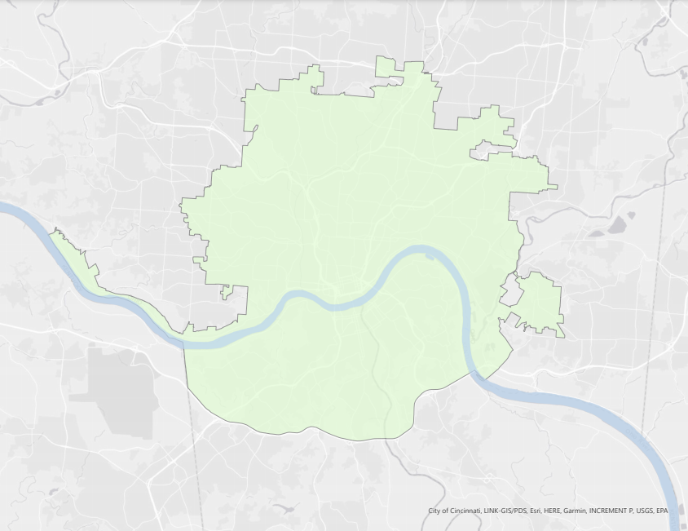

Project Overview
N
Study Area
Cincinnati, Ohio & Northern Covington, Kentucky
Study Period
2004 – 2021
Ohio
Cincinnati
Northern Kenton and Campbell Counties
Study Area
Kentucky
0
1.5
3
mi
Notes:
(Paxton): Neighboring cities Cincinnati, Ohio and Covington, Kentucky are densely populated urban environments near major water bodies, with surrounding geologic conditions making the local communities vulnerable to potential flooding and landslides. To meet partner goals for local analysis, the team focused on the city of Cincinnati and a portion of Covington within I-275, as it is more urbanized than the southern portion of the Covington area. This includes Northern Kenton County and Northern Campbell County surrounding Covington. The data used for the project spanned from 2004 to 2021 which narrowed the team’s analysis to focus on recently-occurring storm events to assess the region’s flood and landslide susceptibility.
------------------------------Image Information Below -----------------------------
Study area base layer: City of Cincinnati, LINK-GIS/PDS, Esri, HERE, Garmin, INCREMENT P, METI/NASA, USGS, EPA, USDA

Slide 3
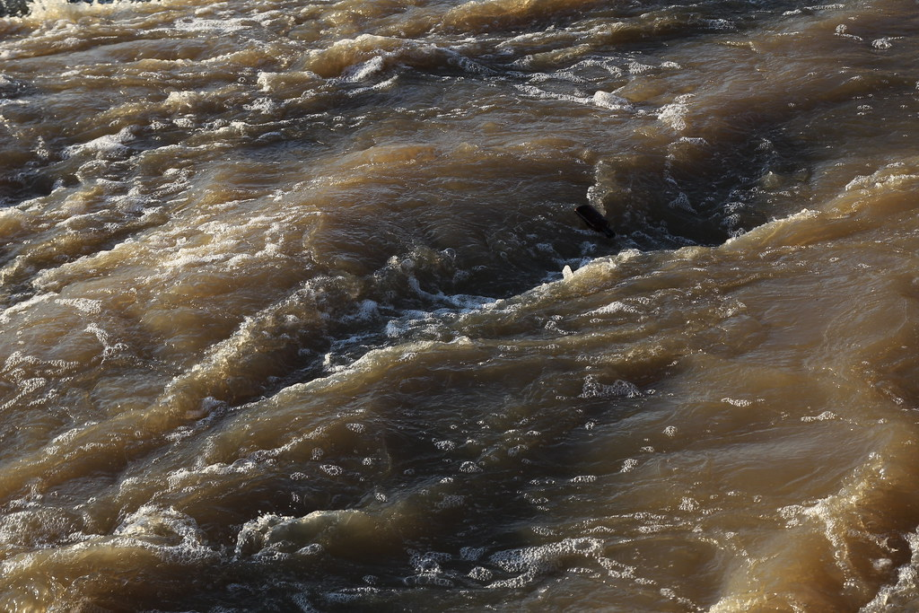
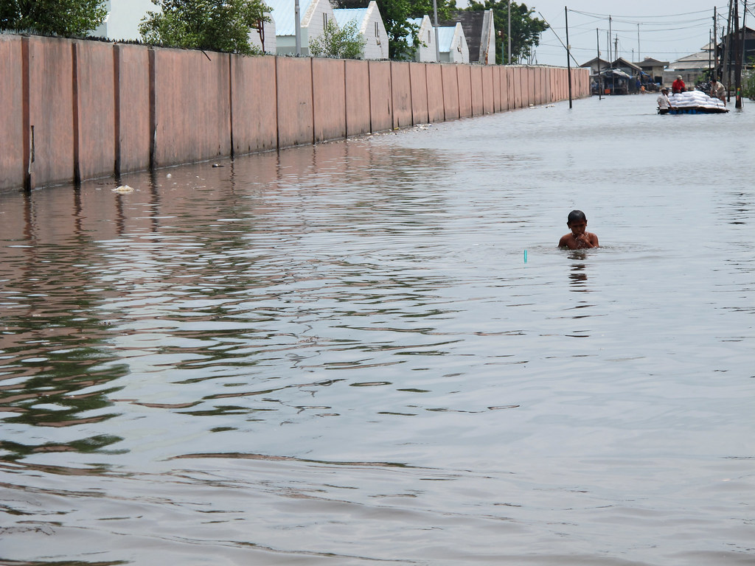
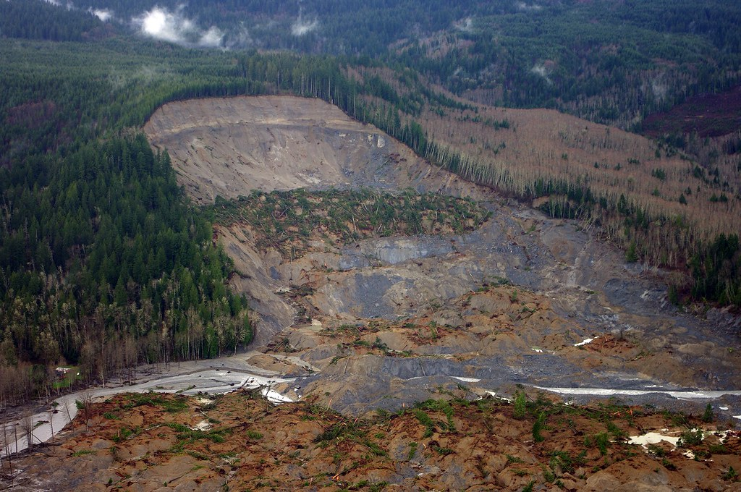
Community Concerns
Damage to community health and safety
Loss of local infrastructure
Costly repairs
Image Credit: World Bank Photo Collection, Bitsorf, USGS
Notes:
(Paxton): Destructive flooding and landslide events pose significant safety risk and take an economic toll in the Cincinnati, Ohio and Covington, Kentucky communities. Local communities are at risk for rainfall-triggered landslides and flooding events, which can cause injury and significant damage to local infrastructure. Even without being directly hurt by a flooding or landslide event, contaminated stormwater can cause illness and infection in those exposed to it.
These environmental hazards also take a substantial economic toll on these municipalities and their residents. Between 2015 and 2019, Ohio spent nearly $300 million on landslide damages, while Kentucky spent $85 million repairing state roads alone. Without adequate susceptibility mapping and analysis, these municipalities cannot identify priority risk areas to minimize the health and economic risks to local populations.
------------------------------Image Information Below ------------------------------
Image Credit: World Bank Photo Collection
Image Source: https://search.creativecommons.org/photos/cc6de0c9-bc92-47e2-a741-e621f0e341d2 (licensed by CC BY-NC-ND 2.0)
Image Credit: bitsorf
Image Source: https://search.creativecommons.org/photos/fd4fcfa6-a05d-4e19-9bd6-8cbf760123f5 (licensed by CC BY-NC 2.0)
Image Credit: USGS
Image Source: https://search.creativecommons.org/photos/77496b9f-4c19-4c5e-b591-31145a10179f (licensed by CC0 1.0)

Slide 4


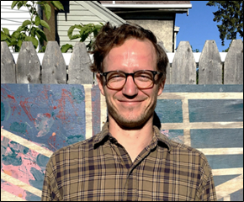

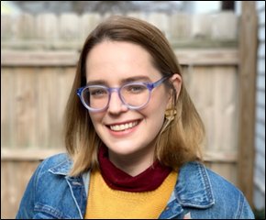
Project Partners
Groundwork USA
Groundwork Ohio River Valley
Cate
Mingoya
Lawrence
Hoffman
Tanner
Yess
Sarah
Morgan
Image Credit: Groundwork USA
Notes:
(Paxton): This project partnered with Groundwork USA and Groundwork Ohio River Valley. Groundwork USA is a network of nonprofit organizations that primarily focuses on the regeneration, improvement, and management of urban spaces to help mitigate environmental, economic, and social inequalities within marginalized communities. Groundwork Ohio River Valley is a subsidiary of Groundwork USA that focuses on expanding environmental awareness and environmental justice in their local communities through the communication of spatial data. Both Groundwork USA and Groundwork Ohio River Valley use NASA Earth Observations and GIS mapping to educate the public about environmental issues within their communities and build local capacity for city-specific resilience planning.
------------------------------Image Information Below ------------------------------
Image Credit: Cate Mingoya, Groundwork USA
Image Credit: Lawrence Hoffman, Groundwork USA
Image Credit: Tanner Yess, Groundwork Ohio River Valley
Image Credit: Sarah Morgan, Groundwork Ohio River Valley
Pictures used with permission/media release

Slide 5
Project Objectives
1
Map stormwater runoff, runoff retention, and potential damage cost
2
Map landslide susceptibility and exposure
3
Create a standard operating procedure for future analysis
Notes:
(Erin): For this project we incorporated several objectives to provide for Groundwork USA and Groundwork Ohio River Valley. The first objective was to utilize the InVEST Urban Flood Risk Mitigation Model to identify areas with the greatest risk of flood and associated damage cost. This is done by using the model to calculate potential stormwater runoff, runoff retention, and potential service values of effected infrastructure within the study area. The InVEST model outputs allow for the partners at Groundwork USA and ORV to better identify high flood risk areas in both cities.
The next goal was to map regional landslide susceptibility and exposure using NASA Earth observations. The gridded landslide susceptibility maps will allow the partners to identify landslide potential at a finer spatial resolution than current local alerts. These maps allow for partners to assess landslide vulnerability relative to population and infrastructure locations.
For the third objective, we developed a methodology for producing consistent flood and landslide vulnerability maps to aid Groundwork USA and Groundwork Ohio River Valley in reproducing project analyses for partner cities nationwide. This will better enable the partners to use NASA Earth observations and incorporate them into additional future analyses.

Slide 6



Satellites & Sensors
Landsat 8
Operational Land Imager & Thermal Infrared Sensor
Global Precipitation Measurement
Microwave Imager & Dual-frequency Precipitation Radar
Image Credit: NASA
Notes:
(Erin): Two of NASA's earth observation satellites were used to gather and analyze data for this project. Landsat 8 was used to calculate the normalized difference vegetation index (NDVI) for 2020 in our study area, which was then implemented in our landslide susceptibility map. The Global Precipitation Measurement (GPM) Integrated Multi-satellitE Retrieval was used to reference relevant rainfall events to the Cincinnati and Covington bordering area for the InVEST Model's depth in rainfall input.
------------------------------Image Information Below ------------------------------
Image Credits: NASA
Image Sources:
https://www.devpedia.developexchange.com/dp/index.phptitle=List_of_Satellite_Pictures
https://www.nasa.gov/image-feature/viewing-earth-from-the-space-station
Image Credit: NASA
Image Source, IMERGE Satellite and Background Image:
https://gpm.nasa.gov/missions/GPM

Slide 7
Methodology: InVEST
Land Use & Land Cover
Curve Number Values
Watersheds Vector
Depth of Rainfall (mm)
Soil Group Layer
Land Cover Map
Biophysical Table
Built Infrastructure Vector
Damage Loss Table
Urban Flood Risk Mitigation Model
Runoff Retention
Flood Risk Service
Runoff Values
Flood Volume
Potential Damage
Service Built
Notes:
(Erin): We applied the Integrated Valuation of Ecosystem Services and Tradeoffs (InVEST) Urban Flood Risk Mitigation model from the Natural Capital Project illustrate the Cincinnati and Covington area's runoff retention capacity. It is important to note the results only include stormwater values, riverine data is not included in the model software.
The model requires several inputs to generate runoff retention, runoff values, and flood risk service. These include a land cover raster map, a watershed vector, a depth of rainfall value in millimeters, a raster map of soil hydrological groups, a biophysical table containing curve numbers of the study area’s soil types associated to land cover classes, and two optional values to produce the flood risk service output which is the built infrastructure vector and damage loss table.
To create the biophysical table and map land cover within the study area watersheds, the team use the 2010 USGS National Land Cover Database land use and land cover raster dataset. The team utilized the USDA Gridded Soil Survey Geographic soil type and drainage class datasets from the study area to determine curve number calculations. The input for depth of rainfall in millimeters was derived by the team referencing specific storm events known to have caused flooding in the Cincinnati and Covington area. They were chosen to approximate different depths of rainfall based off storm events to determine a range of rainfall causing flooding and landslide events in the region.
To best understand how the watershed interacts with storm events based on duration and size, multiple models were run with a change in depth of rainfall in millimeters. The change of depths of rainfall were decided to be at levels of 60, 90, 120, and 150 millimeters.
The InVEST model produced primarily raster outputs regarding runoff retention, flood volume, and potential damage to built infrastructure. The outputs allowed for a quantifiable visualization of impact based on storm event for predictions in flooding capacity.

Slide 8
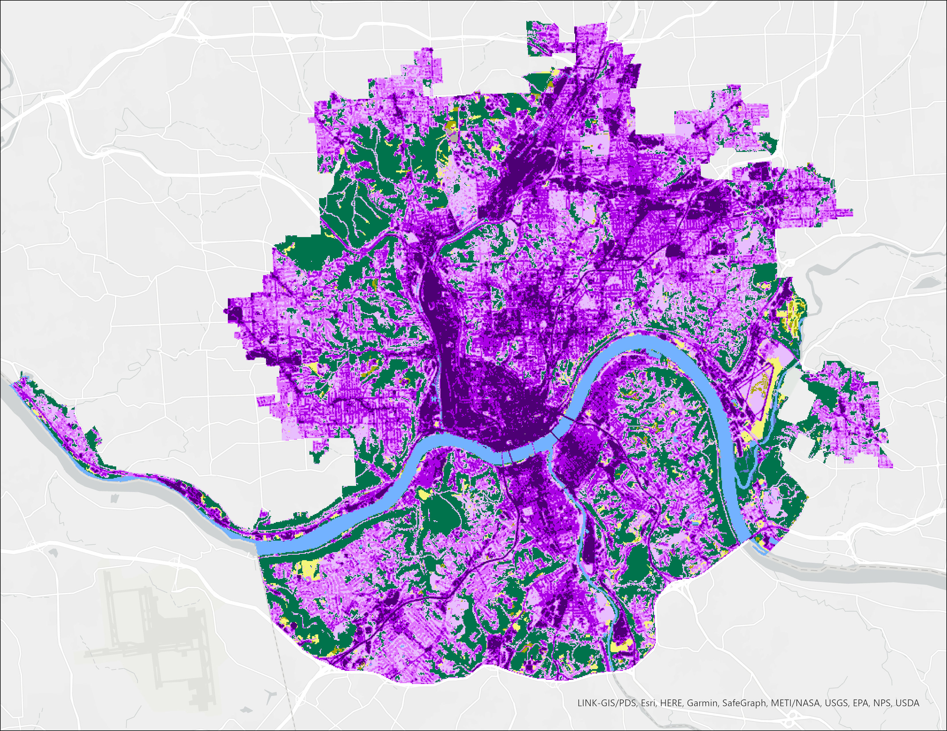
Land Use Land Cover
N
Developed, Open Space < 20% impervious surface
Developed, Low 20 – 49% impervious surface
Developed, Medium 50 – 79% impervious surface
Developed, High 80 – 100% impervious surface
Open Water
Wetlands
Forest
Shrub & Grassland
Agriculture Fields
0
1.5
3
mi
Barren Land
Notes:
(Erin): This map shows the land cover data from the National Land Cover Database from 2010 we used as an input for the InVEST model. The urbanized areas are defined by varying levels of purple from light to dark. The darkest purple shows most developed areas with the highest percentage of impervious surfaces, mostly consisting of buildings, roads, and commercial and industrial complexes. The land use data was used in the InVEST model in determining where flooding susceptibility is likely to occur based on a given storm size. Since impervious surfaces have almost zero runoff retention capacity, the purple areas are most likely to experience flood resulting impacts. Assessing the land use land cover in our study area helped to validate our results in the runoff retention and runoff value consistencies based on land use trends.

Slide 9
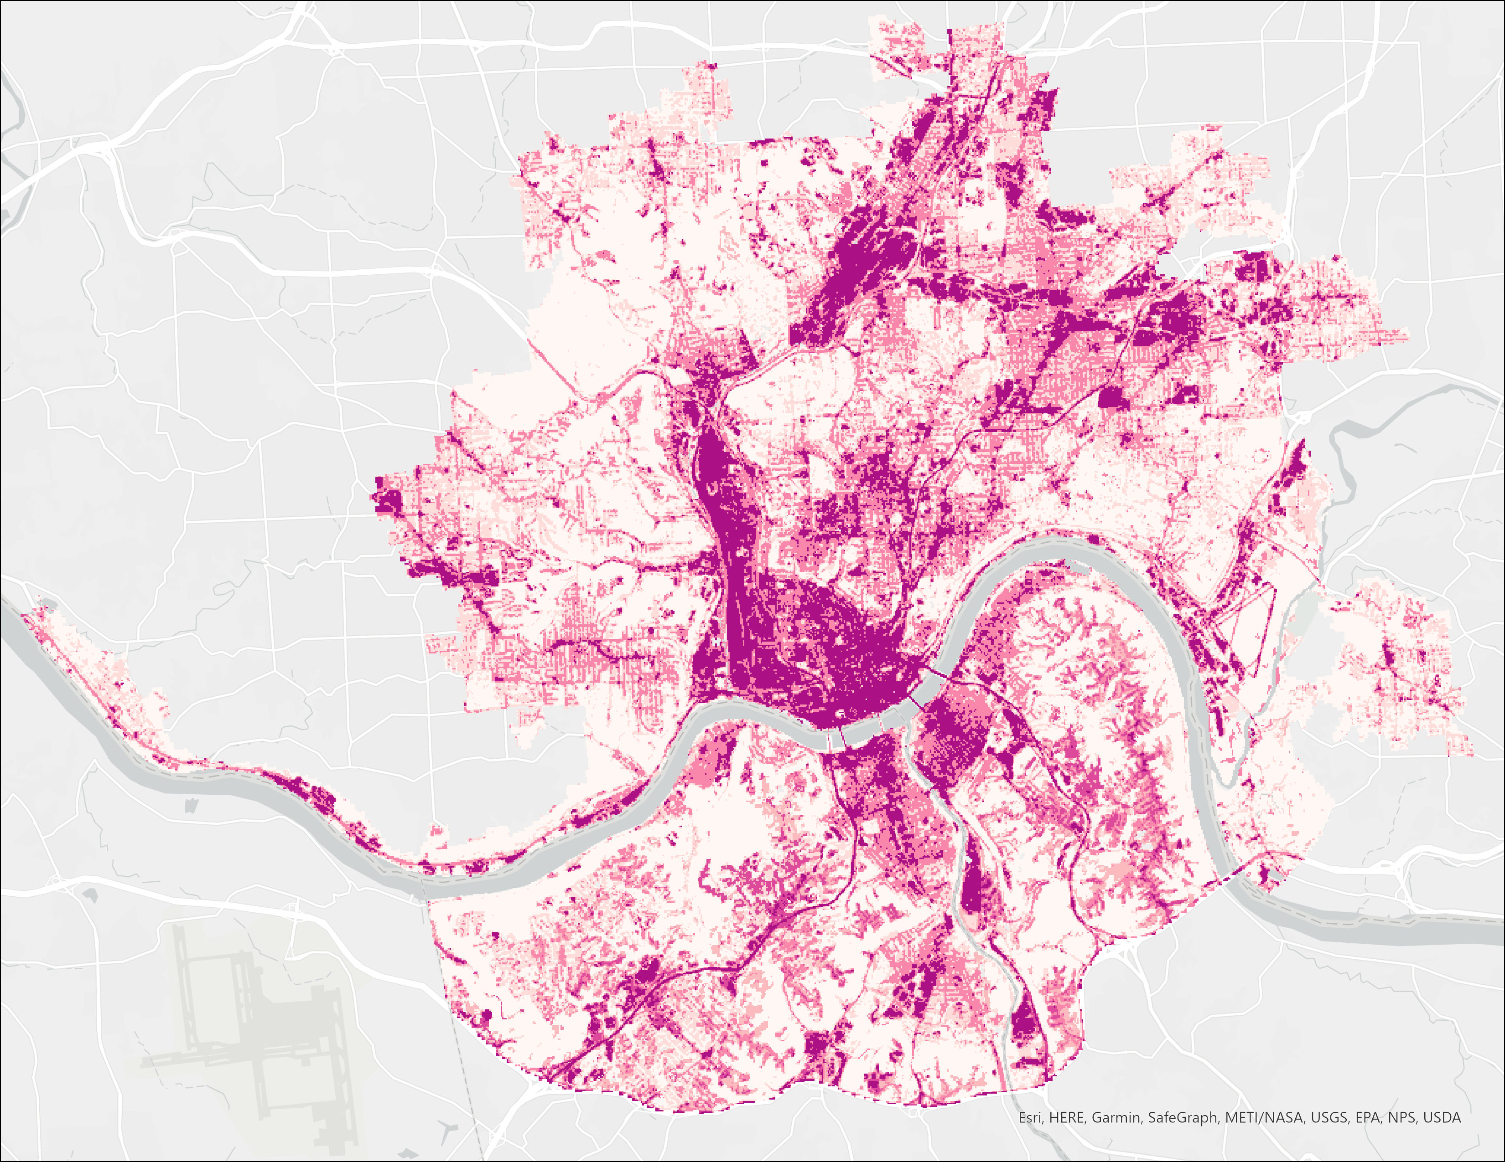
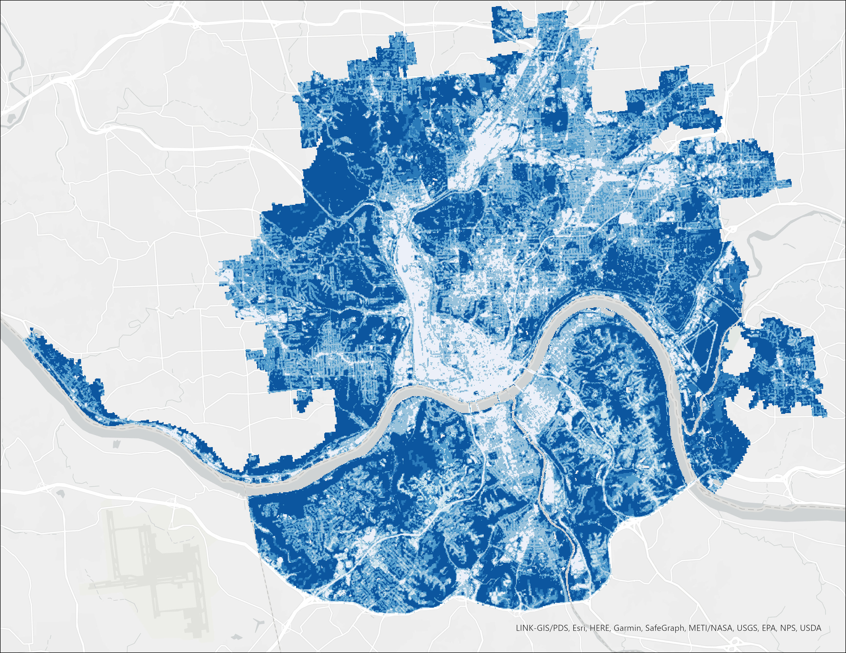
InVEST Results: 2.3-inches of Rainfall
0-10%
N
0-10%
N
11-30%
11-30%
31-50%
31-50%
51-70%
51-70%
71-89%
71-89%
90-95%
90-95%
96-100%
96-100%
0
1.5
3
mi
0
1.5
3
mi
Runoff Values
Runoff Retention
Notes:
(Erin): These two maps are the results of the model based off a 60 mm depth of rainfall which is about a 2.3inch storm. The map to left displays the runoff value measured in millimeters, shown in percent of total rainfall. The whiter areas indicate higher retention rates suggesting vegetation and pervious surfaces to allow for water to seep into the ground. While the darker pink colors represent downtown urbanized areas show where water will not be absorbed due a high percentage of impervious surfaces. To the right is the runoff retention raster measured in meters cubed. The opposite in color value holds true for this graph. The dark areas show where little runoff is to occur and the lighter areas show where more runoff will persist based on a storm. Though similar, one map demonstrates the positive aspects of the region’s landcover in its ability to retain stormwater, while the other displays the region’s local infrastructure and impervious surface contributing to high stormwater runoff.
The percent values shown are to show what percent runoff or runoff retention occurred at each pixel out of the possible maximum value for each storm event (in this case, 2.3inches). So for example, 100% would mean that the 100% of the max amount of rainfall, 2.3inches, was retained or runoff. 50% would have half of that, etc. This was done for the maps to be easier to understand, and was recommended by our science advisors.

Slide 10
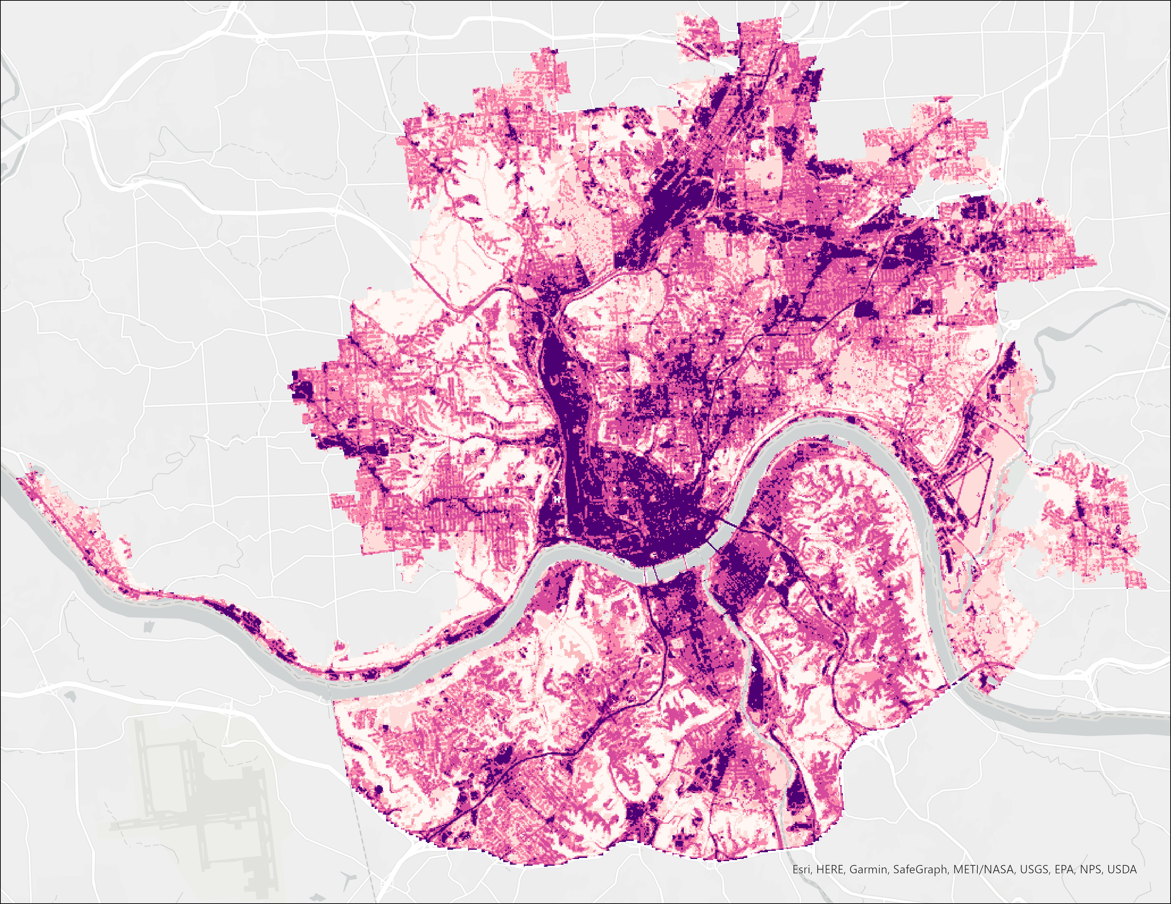
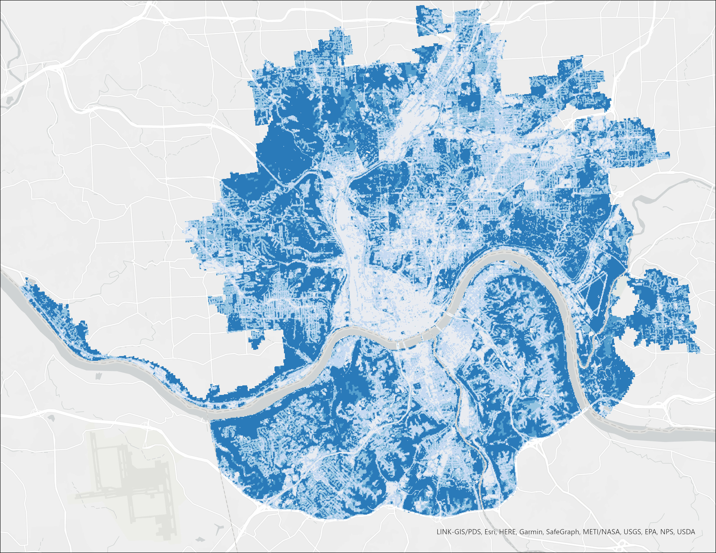
InVEST Results: 6-inches of Rainfall
0-10%
N
0-10%
N
11-30%
11-30%
31-50%
31-50%
51-70%
51-70%
71-89%
71-89%
90-95%
90-95%
96-100%
96-100%
0
1.5
3
0
1.5
3
mi
mi
Runoff Values
Runoff Retention
Notes:
(Erin): To get a better understanding of how this area interacts with different size storm events, a storm size of 150 millimeters, or roughly 6 inches, was also run. The results are analyzed per slide as runoff retention compared to runoff values to display the inverted affects within each community. The highly developed areas, which increased in the 150 millimeter storm size, are the focal point of negatively impacted areas while forested and green areas, as seen in the Northwest corner, show the positive impact of how greener interacts within this environment. For a clearer assessment of these results, we compared both storm events directly.

Slide 11
InVEST Results: Runoff Retention
0-10%
N
0-10%
N
11-30%
11-30%
31-50%
31-50%
51-70%
51-70%
71-89%
71-89%
90-95%
90-95%
96-100%
96-100%
0
1.5
3
mi
0
1.5
3
mi
2.3-in/day Rainfall Event
6-in/day Rainfall Event
Notes:
(Paxton): Here are the two runoff retention maps created to distinguish the difference of an average size storm for this region (2.3in of storm rainfall in 1 day) versus a much larger and rarer in frequency size storm (6in of storm rainfall in 1 day). The map to left displays closer to 100% retention capacity in the dark blue areas that have land covers such as forests and agriculture. The change is seen in the map to the right, as even the dark blues turn into lighter shades meaning their percentage for retaining water is steadily decreasing.

Slide 12
InVEST Results: Runoff
0-10%
N
0-10%
N
11-30%
11-30%
31-50%
31-50%
51-70%
51-70%
71-89%
71-89%
90-95%
90-95%
96-100%
96-100%
0
1.5
3
0
1.5
3
mi
mi
2.3-in/day Rainfall Event
6-in/day Rainfall Event
Notes:
(Paxton): The same results but inverted are seen in the runoff map. As storm size increases, so does the percent runoff value per area. Moving from small to large rainfall event, this change is most notably seen in the highly developed communities where the purple has darkened and increased in percentage of runoff occurrence. Areas with very little runoff are the same as those with high runoff retention, while areas like the Ohio River cannot support any additional water from storm events and majorly contribute to flooding in the study area.

Slide 13
Runoff Retention per Landcover Class
6
5.5
5
4.5
4
3.5
3
Runoff Retention (inches)
2.5
2
1.5
1
0.5
0
Wetlands
Shrub &
Grassland
Open Water
Barren Land
Forest
Developed,
80-100%
Developed,
50-79%
Developed,
20-49%
Agricultural
Lands
Developed,
<20%
2.3-inches Daily Rainfall
6-inches Daily Rainfall
Notes:
(Paxton): Because the InVEST Urban Flood Risk Model assesses flood risk based on landcover type and associated soil curve numbers, we were able to determine the runoff retention per landcover class for each storm event. Forests provided the most runoff retention, retaining nearly the entire rainfall volume of 2.3 and 6 inches respectively. Meanwhile, urban areas were increasingly unable to retain stormwater as impervious surface percentage increased. Areas like wetlands, grasslands, and agricultural lands were also beneficial landcover types contributing to stormwater retention within the study area.
The raw output for InVEST calculating runoff retention is in meter cubed, however to make it easier for audiences to understand, this was calculated from m^3 -> mm -> inches.

Slide 14
Runoff per Landcover Class
6
5.5
5
4.5
4
3.5
3
Runoff (inches)
2.5
2
1.5
1
0.5
0
Wetlands
Shrub &
Grassland
Open Water
Barren Land
Forest
Developed,
80-100%
Developed,
50-79%
Developed,
20-49%
Agricultural
Lands
Developed,
<20%
2.3-inches Daily Rainfall
6-inches Daily Rainfall
Notes:
(Paxton): Consistently with the runoff retention per landcover class, the runoff per landcover class indicates little ability of increasingly developed areas to retain stormwater. Runoff was very low in the forested areas, with similar lower values shown in the agricultural lands, grasslands, and wetlands. Identifying specific contributions different landcover types make to stormwater retention, and what land use is causing increasing runoff, will help partners prioritize areas of concern and identify land-use land cover types that will best suit individual cities working to mitigate flood risk.

Slide 15
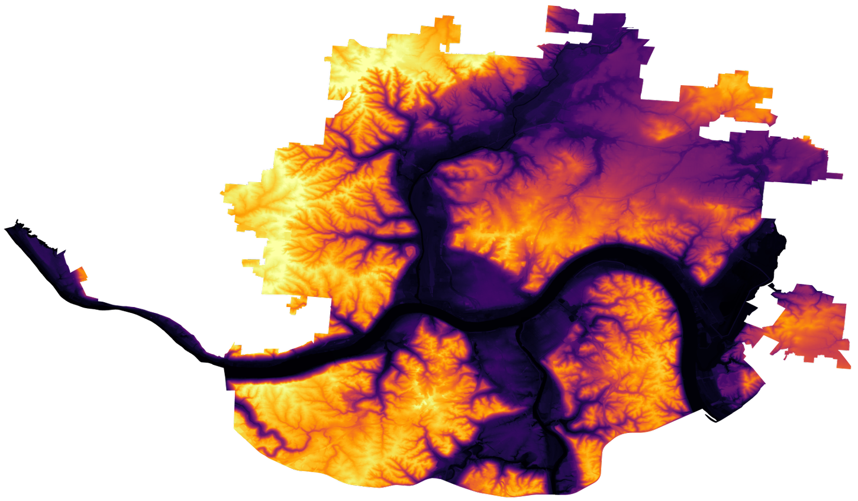
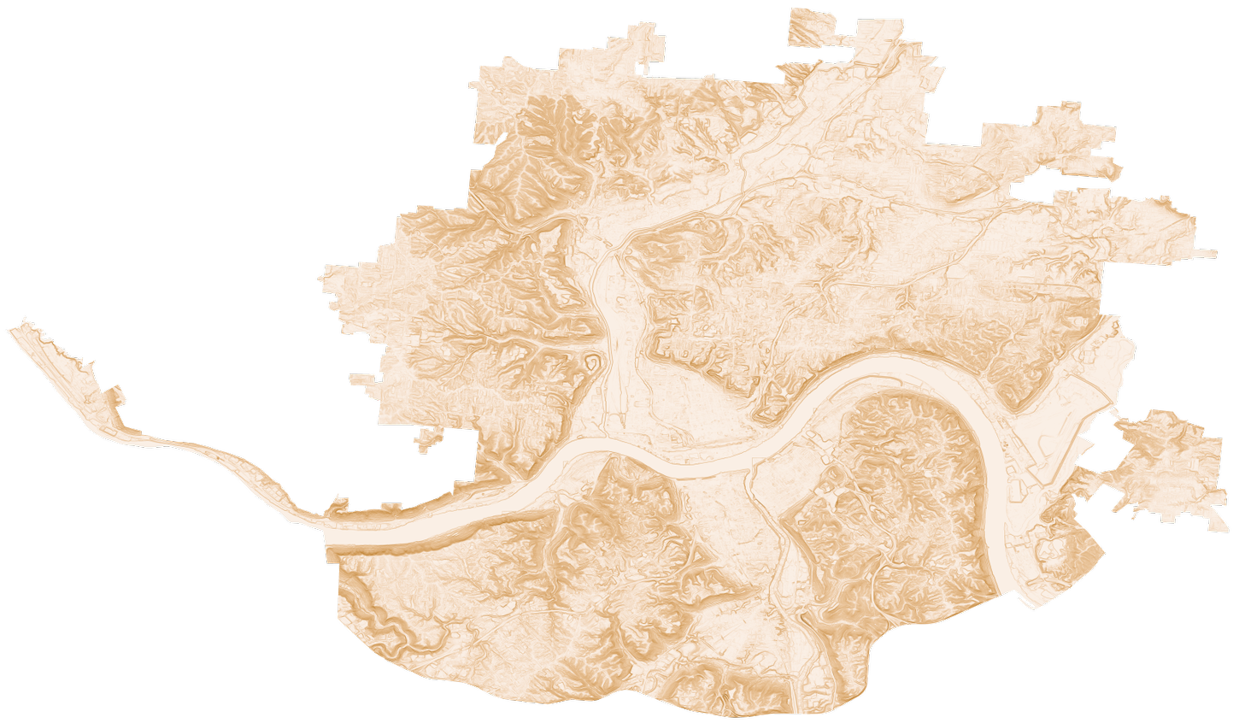
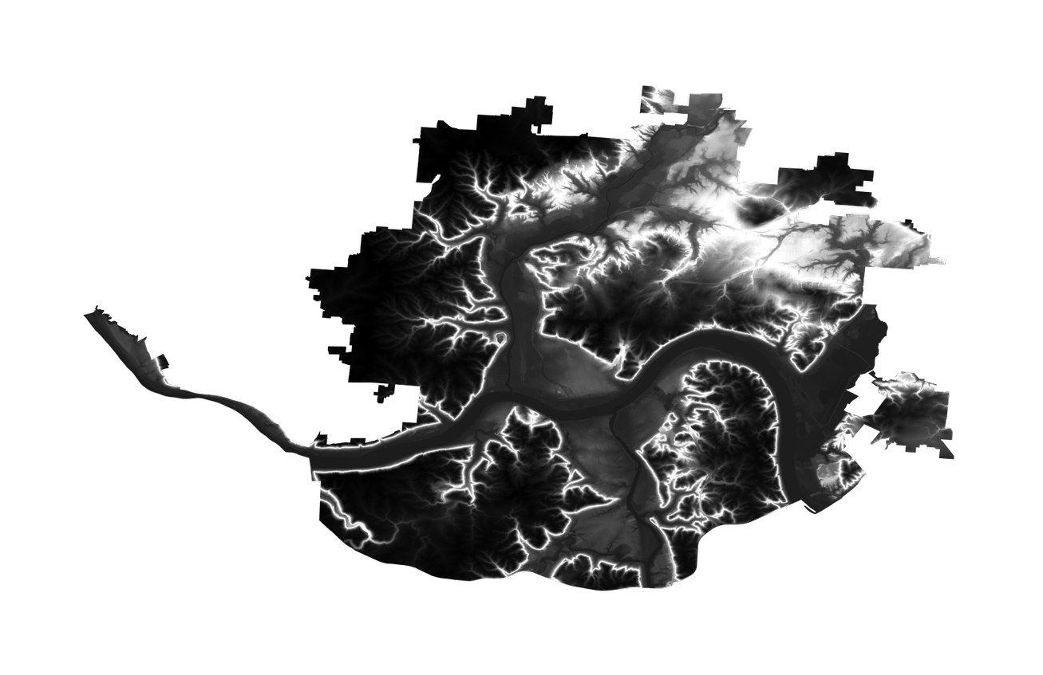
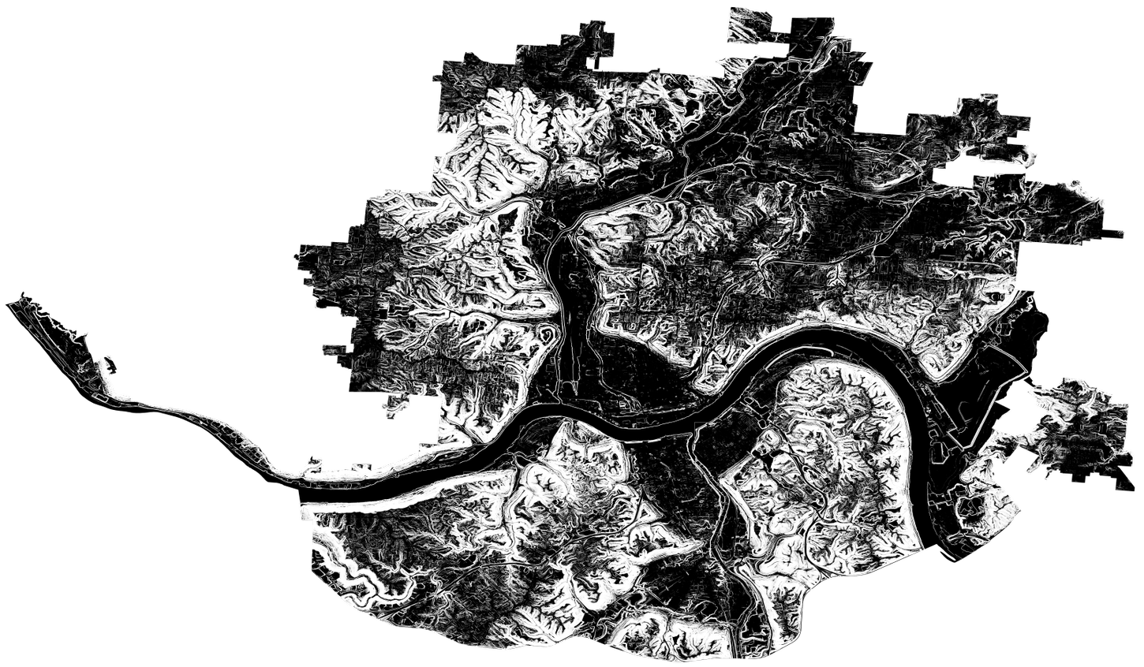
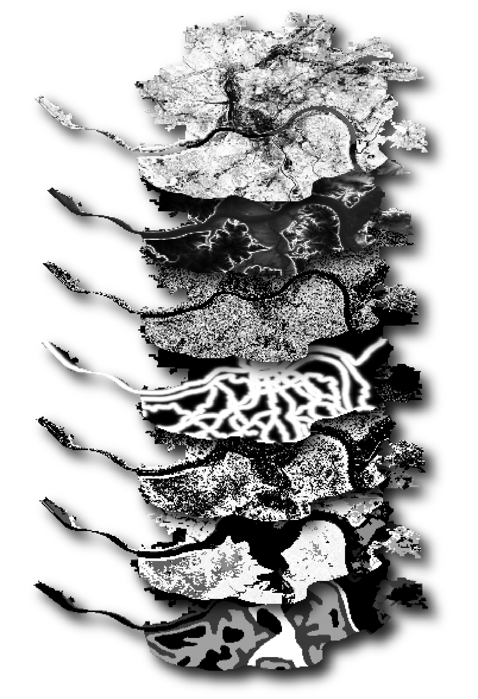
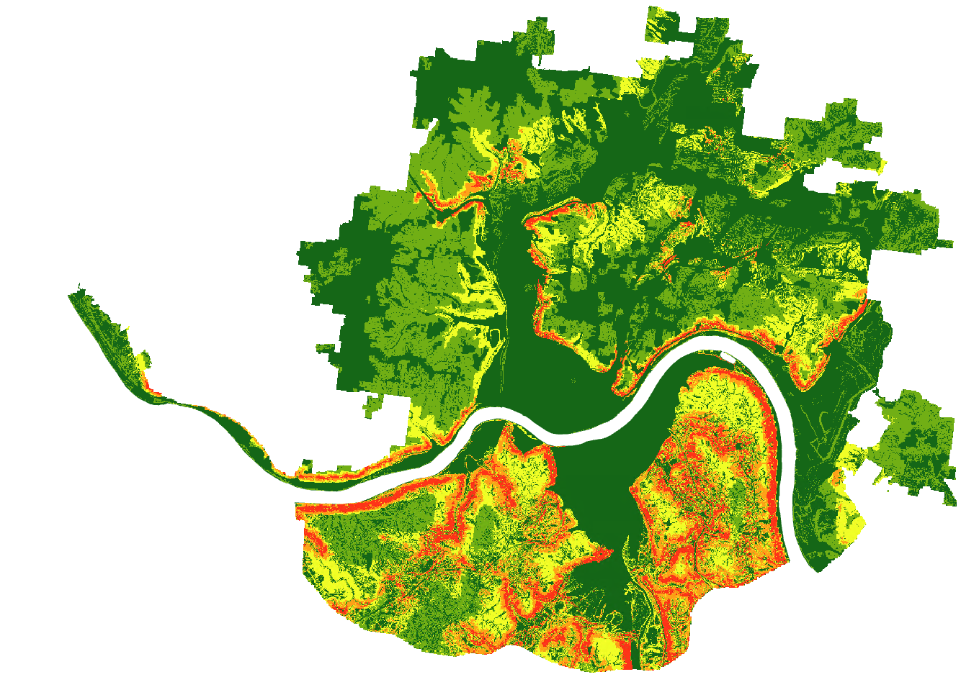
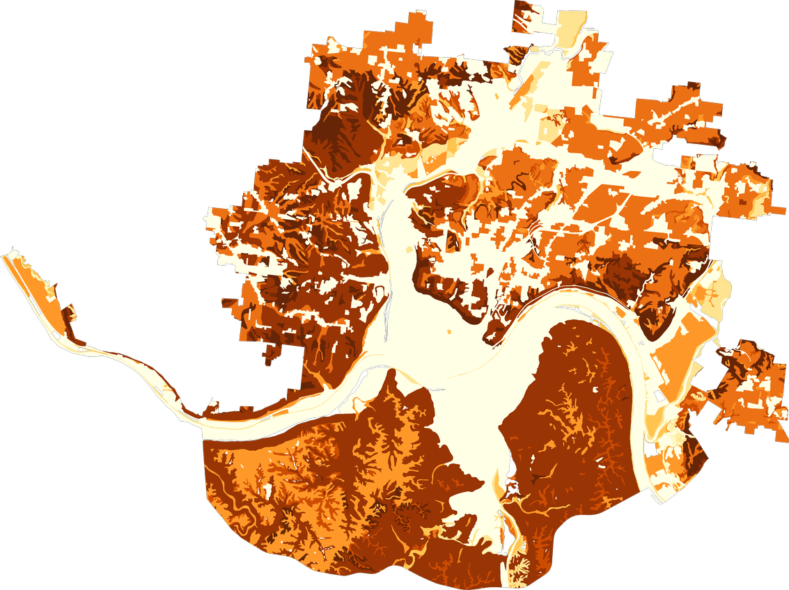
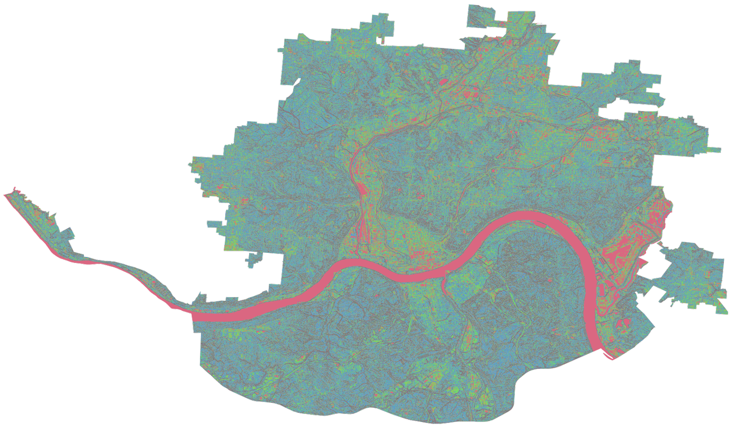
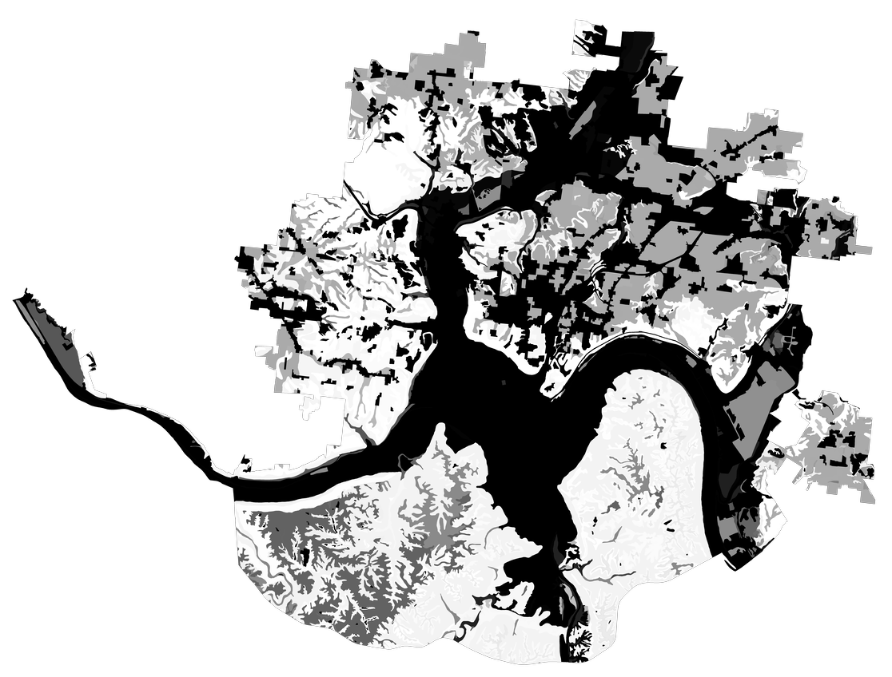
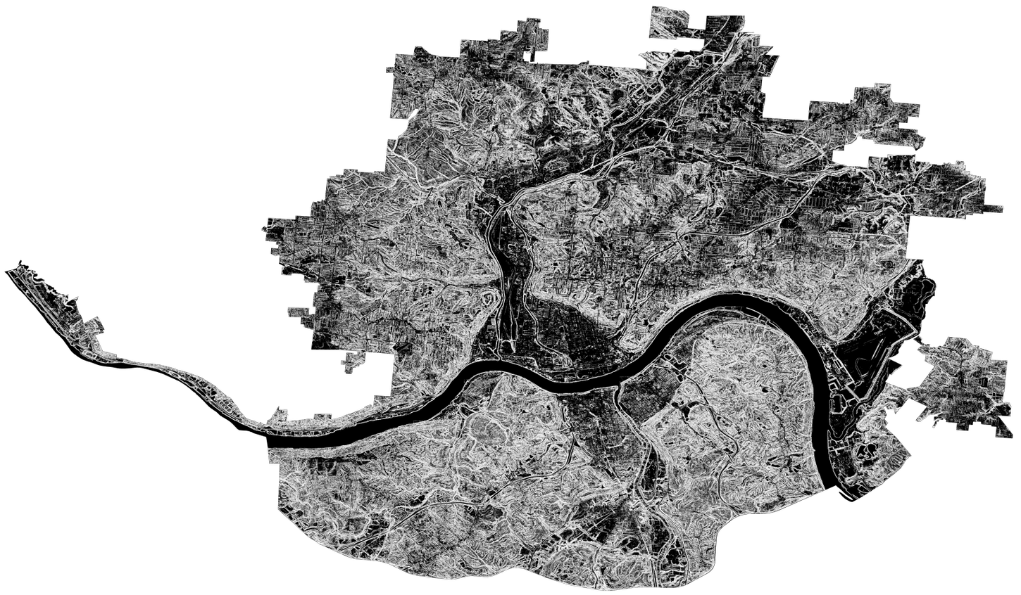
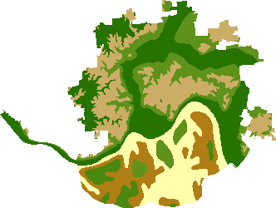
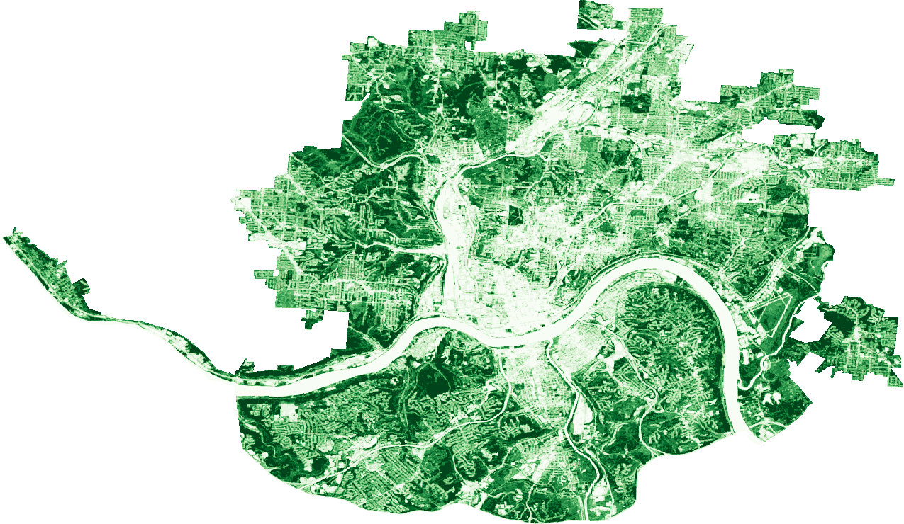
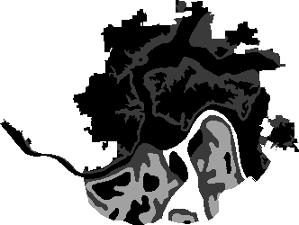
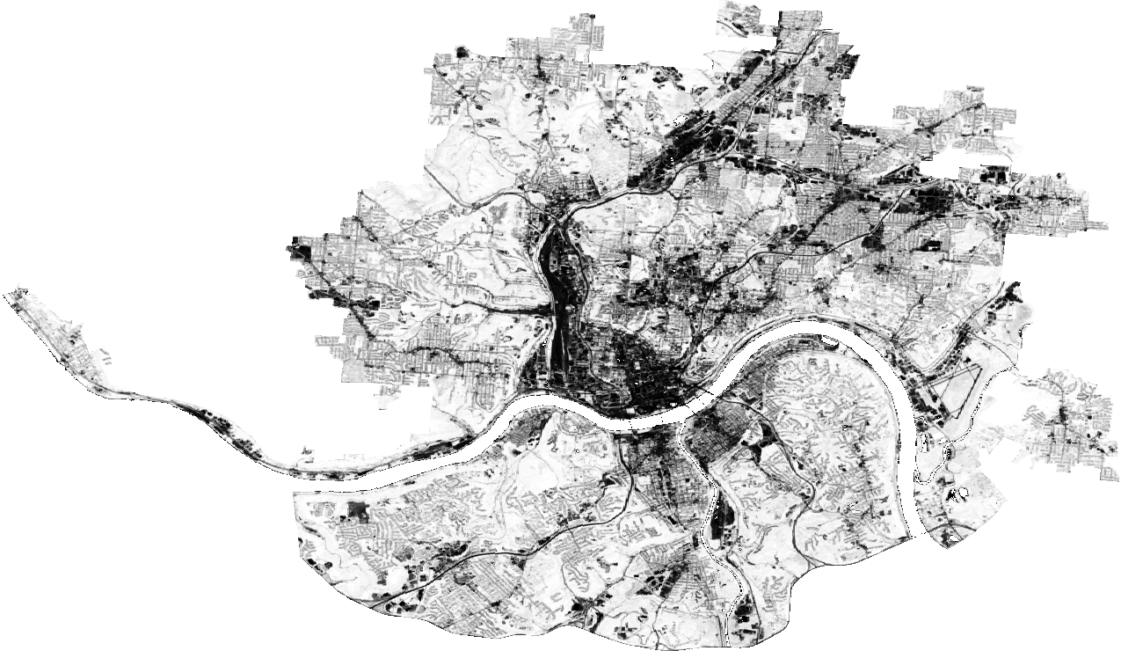
Methodology: Landslide Susceptibility Mapping
Determine Landslide Factors
Rescale Factors
Overlay Factors
Final Susceptibility
Elevation
Slope
Elevation
Slope
Clay %​
Roughness
Clay %​
Roughness
Lithology
δNDVI
Lithology
δNDVI
Distance to Roads
Distance to Roads
Notes:
(Sophie): This slide showcases our methods at a broad overview, and we'll take you inside each step. To create our landslide susceptibility map, we first had to identify landslide factors relevant to the study area, which you can see on the left. The datasets for each variable was obtained and run through a weight of evidence model on ArcGIS Pro, called the Fuzzy Membership Model. This standardized the data, resampling them into rasters with common 0-1 scale. These rasters were then overlaid together using a Fuzzy Overlay Model and combined into the final landslide susceptibility map. We used a landslide inventory map, obtained from USGS, to validate our susceptibility map.

Slide 16
Determining & Rescaling Landslide Factors
Clay %​
Elevation
Lithology
Slope
δNDVI
Distance
to Roads
Roughness
Notes:
(Sophie): In our literature review, we identified seven landslide factors relevant to the study area. We selected elevation, slope, clay percent, roughness, lithology, change in NDVI, and distance to roads as the dominant factors contributing to landslides. These decisions were based on pre-existing literature of the study area and consultation with a local expert, Dr. Matt Crawford of the Kentucky Geological Survey. This region is underpinned by the flaggy Kope formation, a primarily shale bedrock that’s prone to erosion. The resultant colluvium is quick to slide, especially where slopes are steeper and more variable and the soil has less capacity for water (i.e., clay percent). Roughness also measures how frequently slope changes, capturing how erratic the landscape is. Vegetation also plays a role; disturbed surfaces, whether they’ve lost or gained vegetation, also show a propensity for increasing landslide risk. This region is also historically prone to landslides along important roads and thoroughfares, like Columbia Parkway, hence our inclusion of ‘distance to roads’.

Slide 17
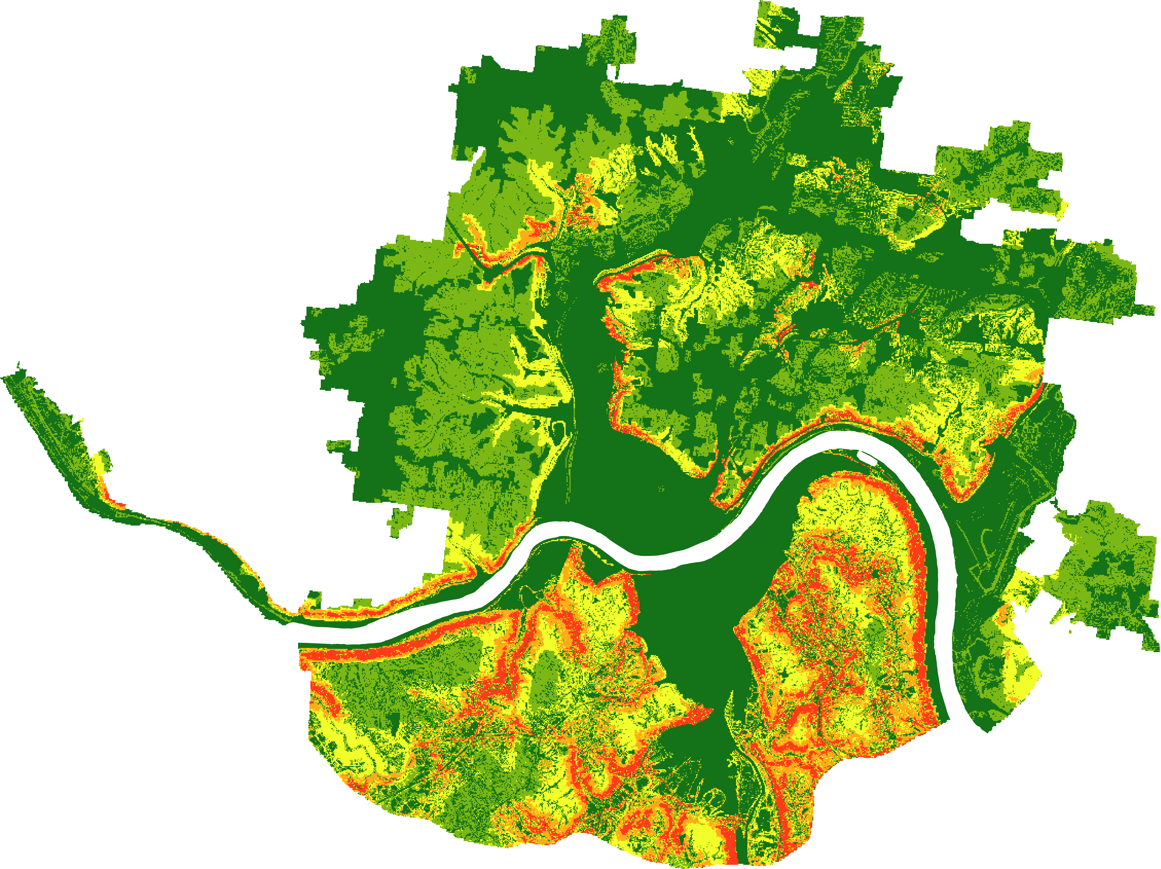
Fuzzy Overlay
Rescaled Layers
Composite Susceptibility Map
Fuzzy Overlay Tool
Notes:
(Sophie): The Fuzzy Overlay tool in ArcGIS Pro was used to combine the different resampled rasters to create one image. Within ArcGIS Pro there are different types of Fuzzy Overlay options that can be utilized to extract different outcomes. These "types" include: Fuzzy And: which finds and displays the least common denominator among the input criteria, Fuzzy Or: which finds the highest value among input criteria, Fuzzy Product: which multiplies input criteria (has limited uses), Fuzzy Sum: which adds input values based on criteria, and Fuzzy Gamma: which is essentially a compromise that utilizes both Fuzzy Sum and Fuzzy Product to create an outcome that is more than a single membership. This means Fuzzy Gamma creates an outcome that combines all inputs in a process that avoids favoring the extreme values. Fuzzy Gamma was chosen to create this susceptibility map due to its use in previous susceptibility maps and its convenience when weighing the evidence of the contributing factors. The final susceptibility map used Fuzzy Overlay Gamma to combine only six out of the seven factors: Elevation, Clay %, Lithology, change in NDVI, Roughness, and Distance to Roads. Once these five were combined the slope raster was overlain using Fuzzy Overlay “And.” This was performed separately as slope was identified to be a more important factor for the study area in creating landslide susceptibility.

Slide 18
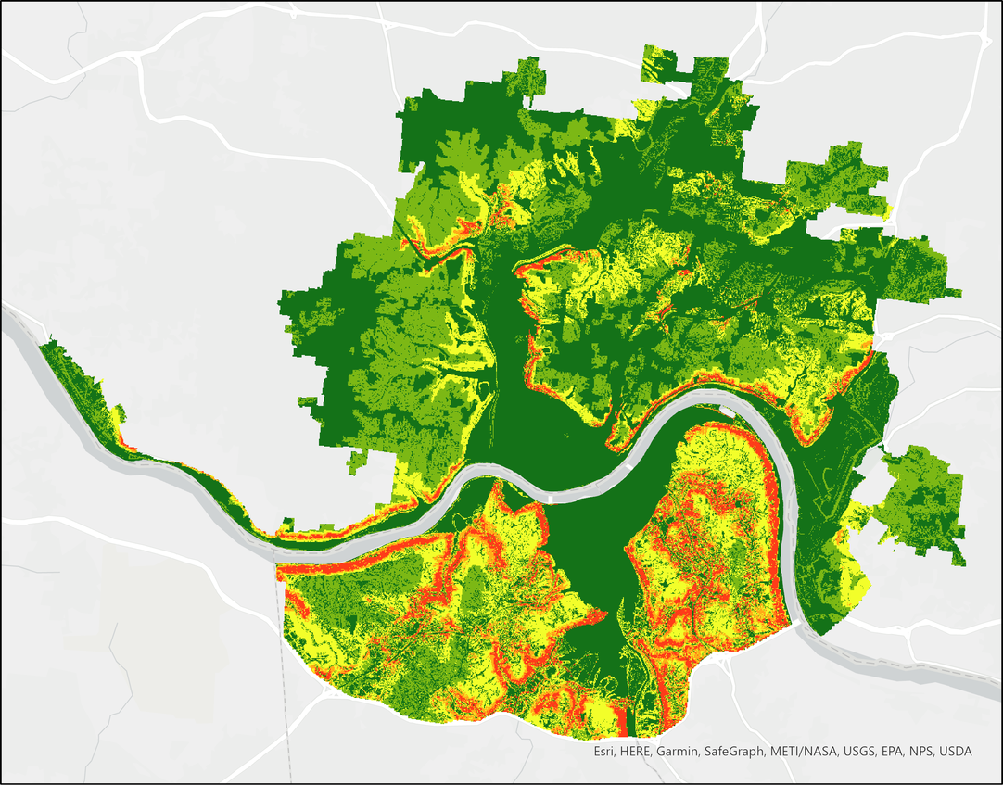
Results: Landslide Susceptibility Map
N
Very High Susceptibility: 95-100%
High Susceptibility: 90-95%
Moderate Susceptibility: 75-90%
Low Susceptibility: 50-75%
Very Low Susceptibility: 0-50%
0
1.5
3
mi
Notes:
(Sophie): The results of this final Fuzzy Overlay was a susceptibility map that was reclassed by percentile to appropriately showcase landslide susceptibility. Based on a previous DEVELOP team's similar work, we elected to use the raster’s 50th, 75th, 90th, and 95th percentiles as cutoffs for our 5 categories of susceptibility assessment. These reflect very low, low, moderate, high, and very high areas of susceptibility, respectively. This ensures we're accurately communicating the region's susceptibility with our viewers, as 'very high susceptibility' is reserved only for areas that are in the top 5% of quantified susceptibility.
The map reveals that areas along major roads -- including U.S. Route 50, Mary Ingles Highway, and Kentucky Route 8 -- are zones of very high susceptibility, following the curvature of the Ohio River. This is, of course, reminiscent of the many landslides that peppered Columbia Parkway (part of Route 50) in 2019 and could lead to damage, more slowdowns, and cleanups in years to come.

Slide 19
Validation: Frequency Ratio Analysis
Number of Landslides in Class i
Number of Pixels in Class i
Landslide Ratio =
Pixel Ratio =
Total Number of Landslides
Total Number of Pixels
Landslide Ratio
Frequency Ratio =
Pixel Ratio
In other words
Frequency Ratio = Landslide Occurrence Adjusted by Area
Notes:
(John): To validate the landslide susceptibility map, the team conducted a Frequency Ratio Analysis using the landslide inventory provided by the United States and Kentucky Geological Surveys. This process provides insight into whether or not the areas deemed "High Susceptibility" in the map are actually associated with more frequent landslide events.
The first step is to calculate the normalized landslide occurrence, which is the ratio of the number of landslides in each susceptibility category divided by the total number of landslides.
Similarly, the pixel ratio is calculated by taking the number of pixels in each susceptibility category and dividing by the total number of pixels. This effectively returns the percentage of the map that each susceptibility category makes up.
Finally, to calculate the frequency ratio, the landslide ratio is divided by the pixel ratio. The final value returned here thus represents the landslide occurrence within each category adjusted for the different areal sizes of each respective category. The higher the frequency ratio is above 1, the more associated that category is with increased landslide occurrence.

Slide 20
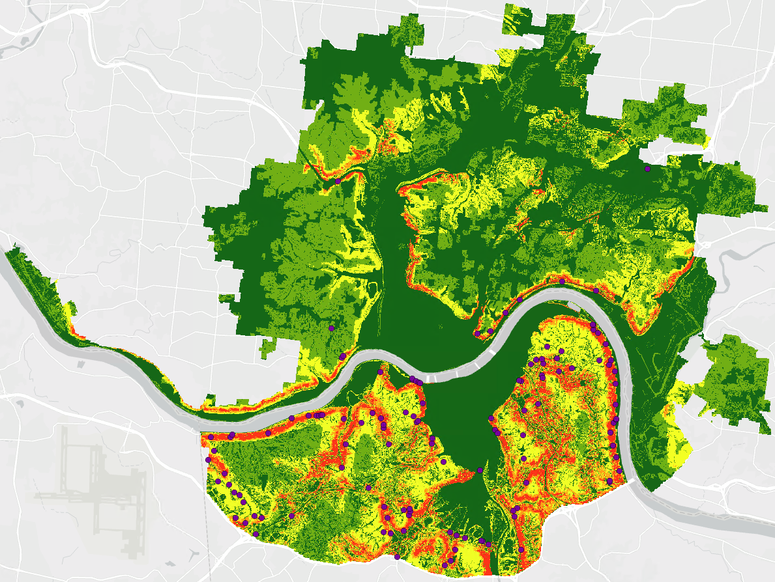
Validation: Landslide Occurrence
n = 125
N
Very High Susceptibility: 95-100%
High Susceptibility: 90-95%
Moderate Susceptibility: 75-90%
Low Susceptibility: 50-75%
Very Low Susceptibility: 0-50%
Landslide Occurrence
0
1.5
3
mi
Notes:
(John): The landslide inventory (125 landslides total) used in the frequency ratio analysis is shown here, overlain on the susceptibility map. Each purple circle represents the point location of a landslide event. There is a spatial correlation between areas identified as "Very High Susceptibility" and the actual physical locations of landslides. This is especially pronounced in the "High Susceptibility" regions alongside roads and riverbanks, like in the southeastern quadrant. To quantify this relationship for the frequency ratio analysis, the landslide susceptibility category underneath each occurrence point was extracted.

Slide 21
n = 125
Validation: Frequency Ratio Analysis
8.0
6.0
4.0
Frequency Ratio
2.0
0
Very Low
Low
Moderate
High
Very High
Susceptibility Category
Notes:
(John): This is the final result of the frequency ratio analysis, which plots frequency ratio versus landslide susceptibility category. Higher frequency ratios reflect a higher normalized landslide occurrence. The "Very Low" and "Low" categories see very few occurrences of landslides, even when adjusted for their differing shares of area. As susceptibility increases into the "Medium", "High", and "Very High" categories, the frequency ratio values passes 1 and continues to increase. In other words, areas mapped in the higher susceptibility categories see a greater amount of landslides than areas mapped as lower susceptibility. The positive trend validates our methodology and indicates that our map accurately categorizes the study area's landslide susceptibility.

Slide 22
Methodology: Landslide Exposure Mapping
Landslide Susceptibility
Socioeconomic and Population Factors
Landslide Exposure Maps
Notes:
(John): After validation, the team used the susceptibility map to create a series of exposure maps. Exposure maps build off of susceptibility maps to include various population characteristics that may affect resiliency to a natural disaster. For the Cincinnati and Covington region, the team focused on three of these socioeconomic factors -- poverty, the population of elderly residents (85+), and the population of African-American residents. To conduct this analysis, the average landslide susceptibility of each Census Block Group within the study area was calculated. Then, the three socioeconomic factors (again at the Census Block Group resolution), were joined to the susceptibility layer. The result was three separate maps that highlight the intersections of landslide susceptibility and the respective socioeconomic variable, and one collective exposure map looking at susceptibility and all three socioeconomic/population factors.

Slide 23
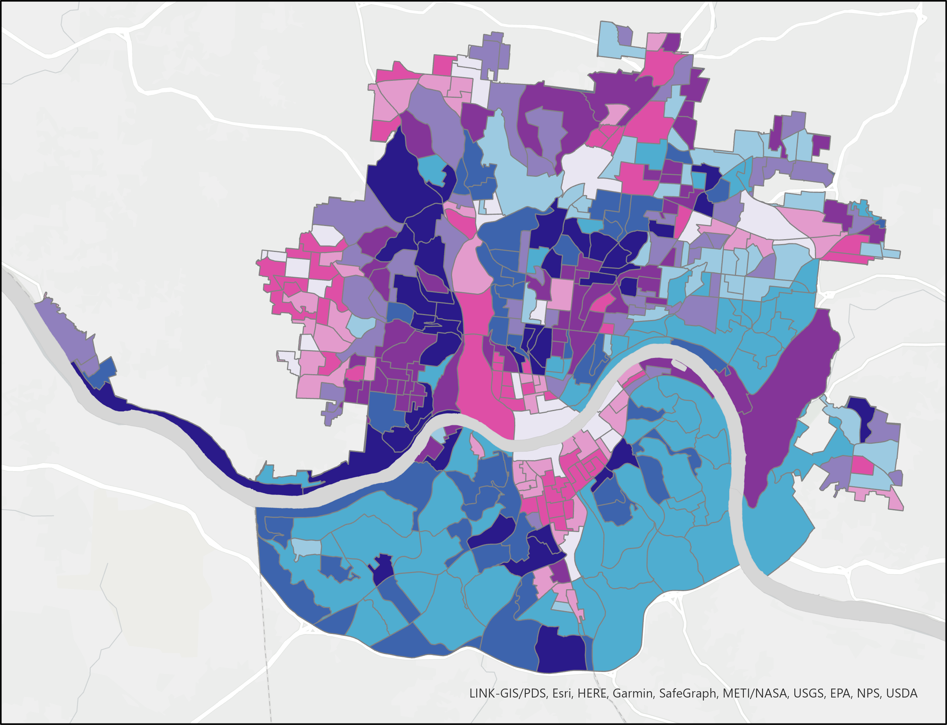
Results: Impoverished Population Exposure Map
N
High
Landslide Susceptibility
Low
High
Impoverished Population Density
0
1.5
3
mi
Notes:
(Eddie): This map used census block group data of individuals in poverty in 2019 and the previously produced landslide susceptibility map to highlight vulnerable populations that are exposed to landslides. The data from the census was cut and merged from both Ohio and Kentucky before being joined to the susceptibility dataset. The poverty population was normalized using total population. A bivariate color scheme was chosen to display how both of these factors combined in the areas. The resulting exposure map was derived from combining population and susceptibility information.

Slide 24
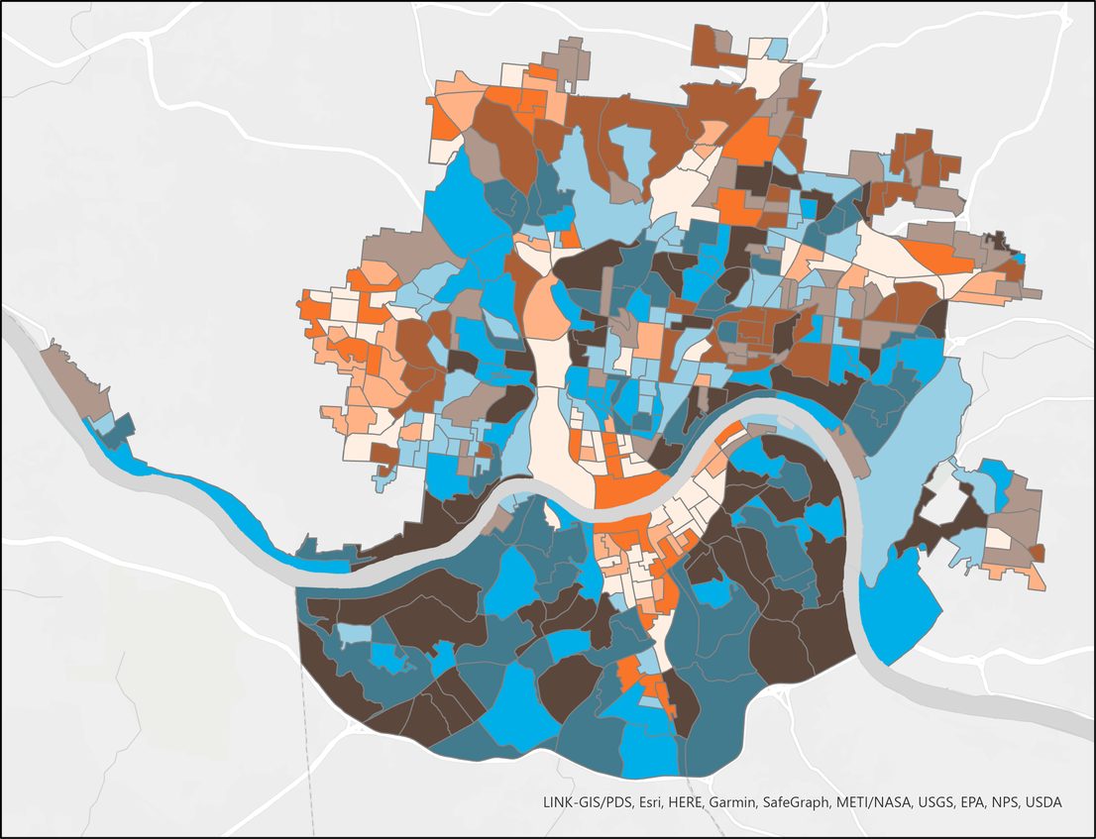
Results: Elderly Population Exposure Map
N
High
Landslide Susceptibility
Low
High
Elderly
Population Density
0
1.5
3
mi
Notes:
(Eddie): Elderly population was obtained from the census block groups, the male and female data for individuals 85 years and older were combined to produce an elderly dataset for the study area. This data was then displayed similarly to the previous data to highlight how vulnerable elderly populations are exposed to landslides.

Slide 25
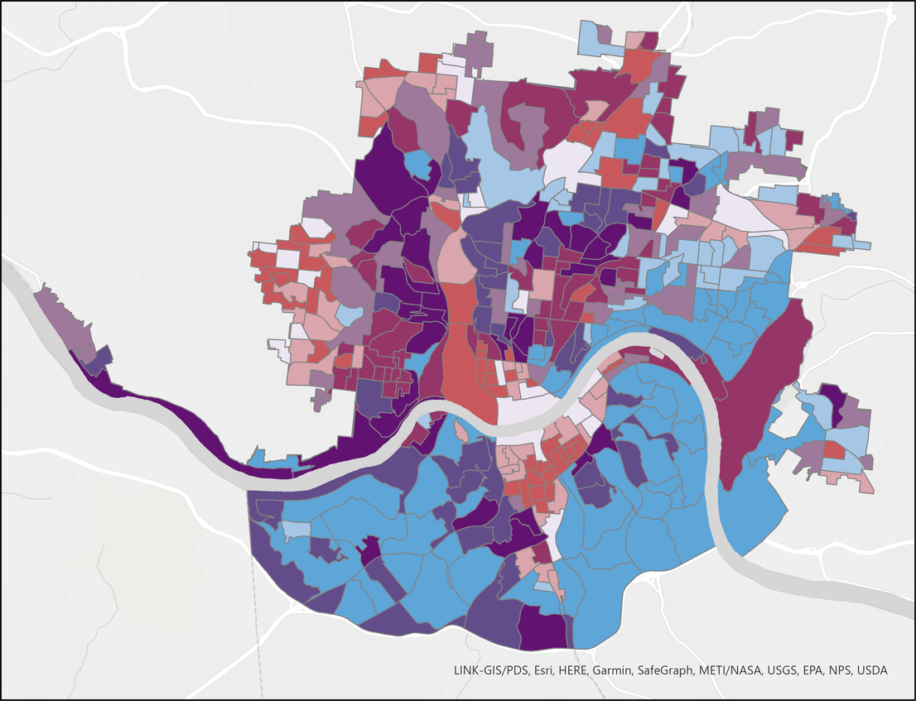
Results: African American Exposure Map
N
High
Landslide Susceptibility
Low
High
African American Population Density
0
1.5
3
mi
Notes:
(Eddie): African American data was obtained by census block groups. African Americans were chosen to be represented as they were the largest minority population in the study area and the partners at Groundwork wanted to focus on this group specifically. A similar process was performed here as in the previous exposure maps to create the bivariate color scheme that displays susceptibility and population data.

Slide 26
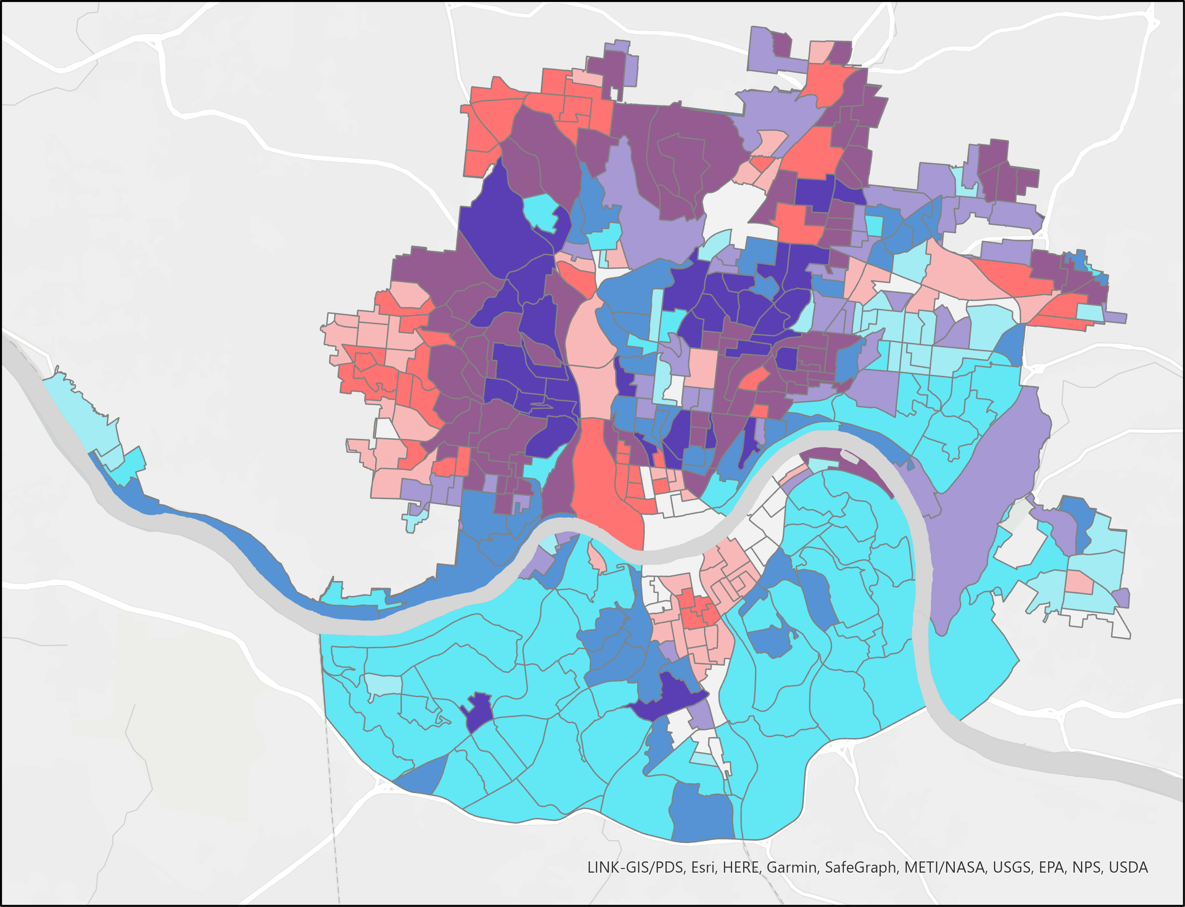
Results: Combined Landslide Exposure Map
N
High
Landslide Susceptibility
Low
High
Vulnerable Groups Population Density
0
1.5
3
mi
Notes:
(Eddie): The final landslide exposure map was produced by combining the three previously created vulnerable population datasets to produce a uniform map that focused on general exposure for the area. Landslide susceptibility was used in relation to vulnerability to create the resulting exposure map. The exposure map shows that there are many intersections between vulnerable populations, who may be less resilient to landslide events, and heightened landslide occurrence. A few neighborhoods with high combined vulnerability and high landslide susceptibility are North and South Fairmount, along with the area around Avondale.

Slide 27
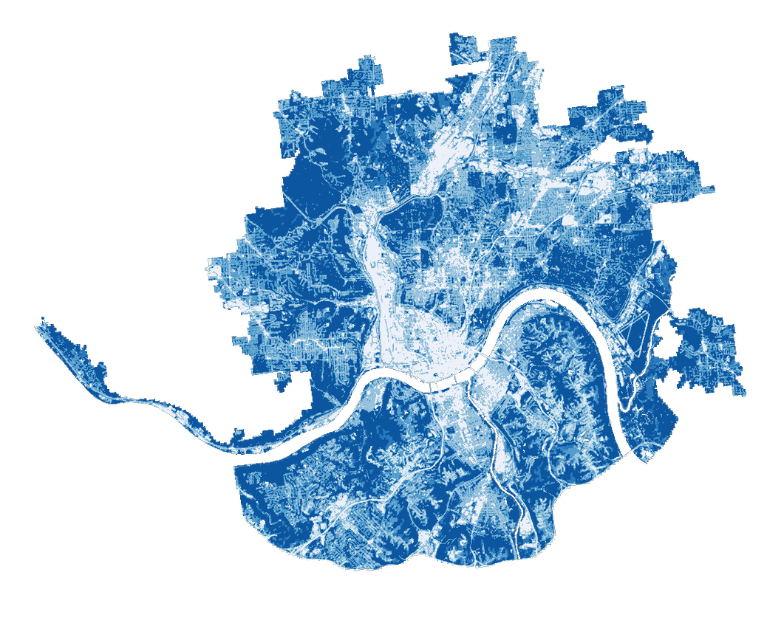
Conclusions
In storms affecting the area, highly urbanized land cover types retained barely 10% of rainfall, while forested areas retained up to 90%
The Downtown Cincinnati, Queensgate, and Over-the-Rhine neighborhoods retained the least amount of rainfall, between 10 – 15%
Slope was the most predictive variable in assessing landslide susceptibility
Slopes near major highways, such as US 50 and KY 8, were found to have very high landslide susceptibility
The area around Avondale, along with North and South Fairmont had the highest determined landslide exposure
Notes:
(John): Urban areas, like downtown Cincinnati, experience much more runoff and retain less water than the highly forested areas in the northwest. In particular, the Downtown, Queensgate, and Over-the-Rhine neighborhoods retain the least amount of rainfall.
As validated by the frequency ratio analysis, the landslide susceptibility map accurately reflects the locations of actual landslide events. Frequency ratio analyses on the individual variables have also shown that slope is the most predictive variable in determining landslide susceptibility. Specifically, steep slopes near major roads, like US Routes 50 and 72 in Ohio, and Kentucky Route 8, have very high landslide susceptibility. Beyond that, regions in southern Kentucky appear especially susceptible to landslides. The exposure map shows that there are many intersections between vulnerable populations, who may be less resilient to landslide events, and heightened landslide occurrence. Two such neighborhoods with high combined vulnerability and high landslide susceptibility are North and South Fairmount.

Slide 28



Uncertainties and Limitations
InVEST Inputs
Landslide Inventory
Susceptibility Factors
Rainfall estimates
Watershed limits
Completeness
Location accuracy
Rock strength
Vegetation cover
Image Credit: Vectors Market, Claudia Revalina, Gan Khoon Lay
Notes:
(John) For the InVEST portion of the project, uncertainties and limitations arose within the model's inputs. Estimates for the daily depth of rainfall for used to calculate the model's runoff and estimated damage values. These estimates were informed by historical storms, and future weather may be significantly more extreme in the face of climate variability. The InVEST model also relies on clearly defined and complete watershed limits. Watersheds within this study area, however, often had portions located outside our area of interest. The impact of this discrepancy appeared negligible and was partially accommodated for with the inclusion of the sewer-shed analysis within Hamilton County.
The landslide portion of this project used a landslide inventory compiled by the United States and Kentucky Geological Surveys in order to validate the susceptibility map. A non-exhaustive inventory may undercount landslides in some regions and would thus introduce uncertainty into our validation process. A similar effect would be observed with inaccurate occurrence locations. If a landslide point was erroneously reported in a different susceptibility category, our validation process would record a different level of confidence for our map.
Finally, the inputs for the landslide susceptibility map also required some assumptions. For example, before use in the final overlay model, the lithology layer needed to report relative landslide risk – not the geological unit name. To do this conversion, we calculated the number of landslides that occurred within each rock type (adjusted by area) and used that value to calibrate risk. However, if the rock layers were improperly mapped or the landslide inventory was not exhaustive, these risk values would be incorrect. Similarly, our NDVI layer had some innate limitations. Despite the stabilizing effect provided by plant roots, the absolute extent of vegetation did not appear to be correlated with landslide occurrence. This was likely due to the conflicting effects of urban areas, which while unvegetated, have few areas covered in sloped soils that could fail. This was accommodated for by analyzing the change in vegetation cover.
------------------------------Image Information Below ------------------------------
Image Credits: Vectors Market, Claudia Revalina, Gan Khoon Lay (all licensed under Creative Commons)
Image Sources: https://thenounproject.com/search/?q=landslide&i=2108415
https://thenounproject.com/search/?q=rain+flood&i=1674921
https://thenounproject.com/search/?q=rock&i=1925927

Slide 29

Future Work
Riverine flooding maps
1
Critical infrastructure exposure maps
2
Real time susceptibility map
3
Updated Ohio landslide inventory
4
Image Credit: Edward Mao
Notes:
(Eddie): Future work should identify and develop watersheds contained within the bounds of the study area. Additionally, the assessment of riverine flooding events in addition to storm events would improve the applicability of our analyses to a greater number of flooding events. Furthermore, a more comprehensive historical landslide inventory for Ohio would enhance the nuance of the susceptibility results in Hamilton County.
1. Maps that predict the extent of and damage caused by river flooding would be a desired product from future work. Highlighting which areas would experience the heaviest burden from fluvial flooding events would be a great aid for local community's efforts to increase resiliency to these hazardous events.
2. Exposure maps that highlight at-risk populations based on socio-economic factors like age and income would increase the specificity of our exposure analysis. Further exposure maps of critical infrastructure like roads, bridges, hospitals, and schools could be created, expanding on the information presented in the landslide susceptibility maps. The data for these socio-economic and critical infrastructure factors could be obtained from census block and urban planning databases.
3. A susceptibility map utilizing rainfall data would be useful in creating a real-time, updating product that reflects the present landslide susceptibility of the region. Rainfall is a known landslide trigger, so this would effectively showcase how such triggers might prompt landslides in conjunction with more static risk factors, like those we analyzed here.
4. An up-to-date and more exhaustive landslide inventory for the area would elevate the methods used in this project by allowing the frequency ratio analysis validation steps be more accurate and eliminate potential bias.
------------------------------Image Information Below ------------------------------
Image Credit: Edward Mao
Image Source: https://search.creativecommons.org/photos/daa4f762-1991-4e7b-91e6-14b1ad373e8a

Slide 30
The team would like to thank the following people for their contributions to this project:
Fellow
Celeste Gambino, DEVELOP MA – Boston Node
Project Partners
Cate Mingoya, Groundwork USA
Lawrence Hoffman, Groundwork USA
Tanner Yess, Groundwork Ohio River Valley
Sarah Morgan, Groundwork Ohio River Valley
Science Advisors
Dr. Cedric Fichot, Boston University
Dr. Kenton Ross, NASA Langley Research Center
Dr. Matthew Crawford, Kentucky Geological Survey
Previous Contributors
Olivia Cronin-Golomb, DEVELOP MA
Samuel Feibel, DEVELOP MA
Katrina Rokosz, DEVELOP MA
Notes:
Thank you to everyone who contributed to our project—including our fellow, science advisors, project partners, and first term contributors.

