Slide 1
Southern Bhutan
Ecological Forecasting
Modeling Asian Elephant (Elephas Maximus) Habitat Suitability along the Southern Bhutan Border with NASA Earth Observations
Palchen Wangchuk, Tashi Choden, Kuenley Pem Dem, Sonam Choden, Kelzang Jigme
Maryland – Goddard

Slide 2
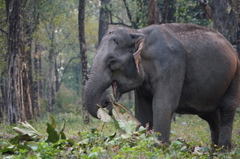
CONTENTS
Community Concerns
Project Background
Objectives
NASA Satellites/Sensors Used
Methodology
Results
Conclusions
Errors & Uncertainties
Future Work
Acknowledgements
Image Credit: Bhutan Foundation
Notes:
Hi everyone, thank you for joining us today. We're the Bhutan Eco Forecasting team and today we'll talk to you about our work looking at habitat suitability for elephants in southern Bhutan. Here's an idea of what our contents will be today.
Image Credit: Bhutan Foundation, provided to team with partner permission to use

Slide 3
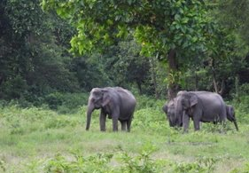
COMMUNITY CONCERNS
Asian elephants (Elephas maximus) are a flagship species
Environmental engineers
Human Elephant Conflicts (HECs) in Bhutan
Bhutan's Elephant conservation plan 2019
Image Credit: Bhutan Foundation
Notes:
Speaker Notes:
The diverse Landscapes of Bhutan host a rich biodiversity of animal and plant species.
Asian Elephants are a flagship species and are environmental engineers whose conservation is essential for the functioning of Bhutan's sub-tropical forest ecosystems.
Since 1986, the Asian elephant has been listed as Endangered on the IUCN Red List, as their population has declined by at least 50% over the last three generations.
The Asian Elephant faces threats of extinction throughout its range mainly due to Human Elephant Conflicts (also commonly referred to as HECs).
There has been an increase in incidents of human-elephant conflicts due to recent clearing of forests, creating close proximity of human settlements to forested areas. These conflicts lead to retaliatory killing and injury of elephants and also results in farmers in the South sacrificing their annual harvest as well as their own lives.
In 2019, Bhutan implemented an elephant conservation plan with eight stated objectives, including prevention of habitat loss and improvement of the existing habitat condition.
Image Credit: The Bhutan Foundation
Image source : partner organization

Slide 4
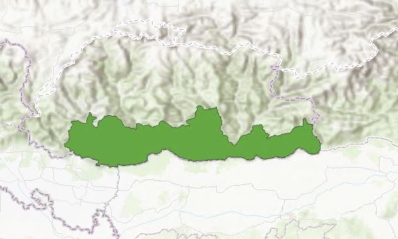
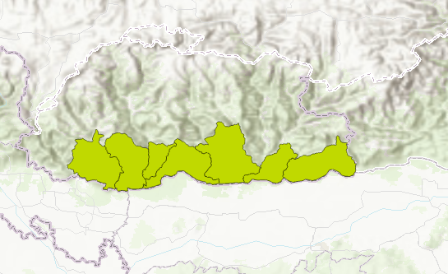
PROJECT BACKGROUND
Study Area: Southern Bhutan border
Study Period: 1999 to 2019 (January through December)
Partners: Bhutan Foundation and Bhutan Tiger Center
Bhutan
Bhutan
India
India
0 15 30 60 Kilometers
Study Area
0 15 30 60 Kilometers
Dzongkhags
Notes:
The DEVELOP Southern Bhutan Ecological Forecasting team partnered with the Bhutan Foundation and Bhutan Tiger Center to address this issue.
We integrated NASA Earth observations and other available resources in order to acquire information on land cover change and elephant habitat suitability along the southern border of Bhutan.
We focused along the Southern Bhutan border, with a specific interest around the Gelephu area.
We referenced data from 1999 – 2019 to give us a 20-year time span for the study period.

Slide 5
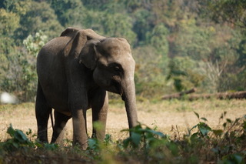
OBJECTIVES
Produce Land Use and Land Cover Classification maps
Analyze and create an Elephant Habitat Suitability Model which will help in identifying areas needing wildlife corridors
Image Credit: Bhutan Foundation
Notes:
We used elephant occurrence data and environmental variables to model current and future suitability of the habitat for migrating elephant populations.
Our objectives were to produce Land Use and Land Cover Classification maps to serve as reference for historical land use trends for our study period.
We also created an Elephant Habitat Suitability Model which will help in identifying wildlife corridors.
Image Credit: The Bhutan Foundation
Image source : partner organization

Slide 6
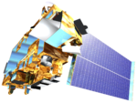
NASA SATELLITES/SENSORS USED
NASA Earth Observations
Socioeconomic Data and Application Center (SEDAC)
Climate Hazards Group InfraRed Precipitation with Station Data (CHIRPS)
Landsat 5
Landsat 8
SRTM
Terra MODIS
Image Credit: NASA
Notes:
The Satellites and Sensors that we used in the project are:
Landsat 8 used for 2019 data extraction for Land cover and NDVI
Landsat 5 used for 1999 data extraction for Land cover and NDVI
MOD11A1.006 Terra Land Surface imported for image collection since it provided daily land surface temperature
Emissivity values in a 1200 x 1200 km grid and used 'LST_Day1_1km' band to extract daytime and land surface temperature
Population density data was acquired from SEDAC
CHIRPS for precipitation
Image source: NASA DEVELOP
http://www.devpedia.developexchange.com/dp/index.php?title=List_of_Satellite_Pictures

Slide 7
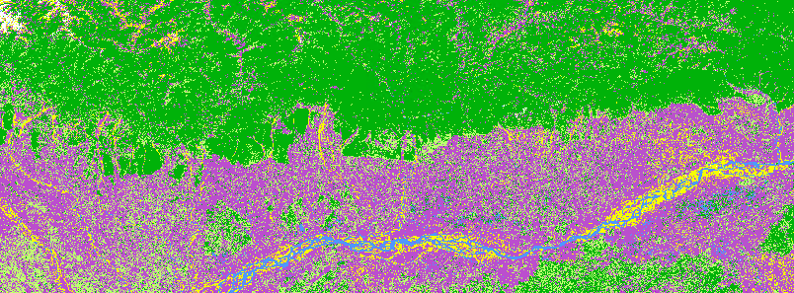
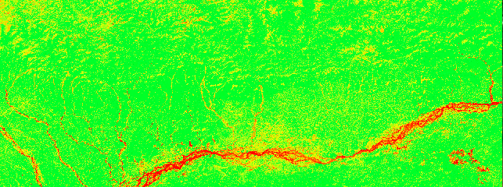
METHODOLOGY
Data Acquisition
Land Cover Land Use
Normalized Difference Vegetation Index (NDVI)
Land Cover Land Use (Landsat)
NDVI Phenology (Landsat)
Notes:
To study the elephant habitat suitability, we looked at 9 different variables which affected the elephant habitats. The 9 variables are Land cover classification, phenology in the form of NDVI, Elevation, slope, precipitation, Land surface temperature, population density, distance to roads, distance to rivers.
Variable data and occurrence data were collected for southern Bhutan and the adjoining parts of north-eastern India to include at least 20 points of Asian Elephant occurrence.
The team scripted short codes on Google Earth Engine for calculating both Land Cover and NDVI utilizing Landsats 5 and 8 which were imported into ArcGIS Pro.
In ArcGIS Pro, we mosaicked the Landsat scenes and performed an unsupervised classification to produce a land cover land use classification map.
For NDVI, we set the band combinations (Red: 5 Green: 4 Blue: 3), which allowed us to quickly and easily symbolize our Landsat multi-band composite images.

Slide 8
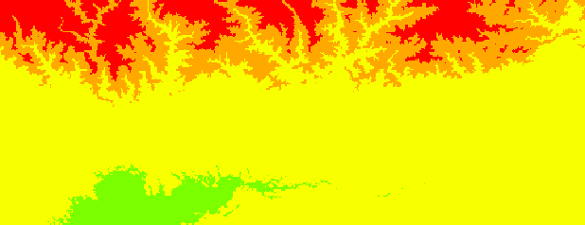
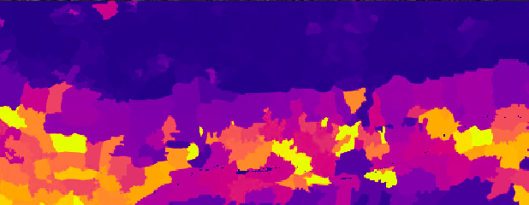
METHODOLOGY
Distance to Road and Urban Settlements
Elevation and Slope
Precipitation
Water Sources/Distance to Water
Population Density
Land Surface Temperature
Elevation (SRTM)
Population Density (SEDAC)
Notes:
Major water bodies and roads/urban settlement data were gathered from the project partner, The Bhutan Foundation. While elevation and slope remains constant, landcover changes over time, which prompted the team to look at the latter variable for both the years 1999 and 2019.
Data for DEM was obtained from the Bhutan Foundation and from the DIVA-GIS website. We used the DEM to develop slope and aspect layers.
Population density dataset and roads data were acquired from SEDAC .
The population data was also imported into ArcGIS Pro and the program was used to compute the population of the region where, the high value pixels showed high concentration and the low value pixels showed low concentration.
The team also scripted short codes in Google Earth Engine for land surface temperature (LST) and precipitation, to collect monthly average land surface temperature and monthly precipitation sum for both the years 1999 and 2019.
For precipitation, we imported CHIRPS which is a 30+ year quasi-global rainfall dataset. CHIRPS incorporate 0.05° spatial resolution satellite imagery with in-situ station data to create gridded rainfall time series.

Slide 9
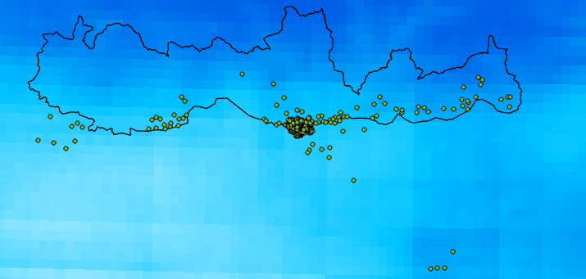
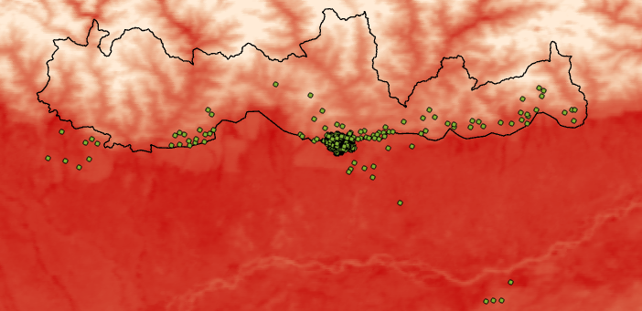
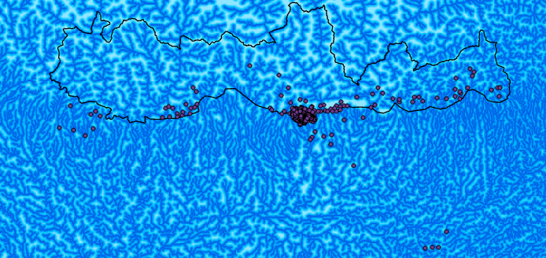
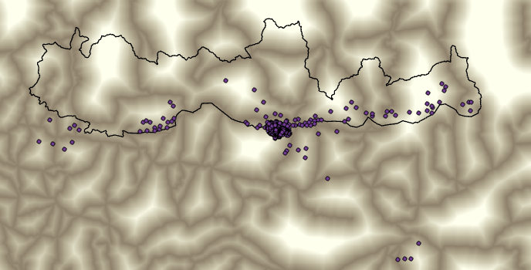
TRAINING DATA
Maps of environmental variables compared to elephant occurrence
Annual Average Precipitation vs.
Elephant Occurrence
Annual Average LST vs. Elephant Occurrence
Distance to Rivers vs. Elephant Occurrence
Distance to Roads vs. Elephant Occurrence
Notes:
These images are maps of environmental variables, Annual average Precipitation for 2019, Annual Average Land Surface Temperature, Distance to rivers and Distance to Roads, all shown with elephant occurrence points.
The lighter blue represents higher annual average precipitation and darker blue represents lower annual average precipitation.
For the annual Average Land Surface Temperature, red represents higher temperature and white represents lower temperature.
For Distance to Rivers, white represents longer distance to rivers from that given point and blue means the place is closer to the rivers.
For Distance to roads, white regions represent places farther away from the roads and brown represents places closer to roads.

Slide 10
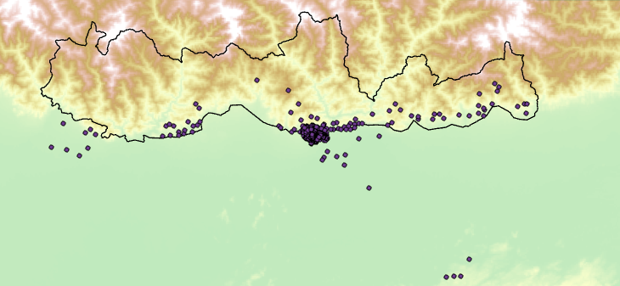
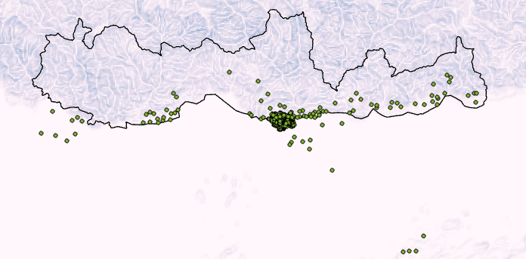
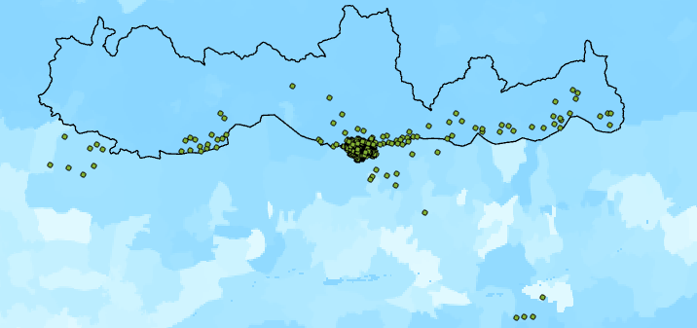
TRAINING DATA
Elevation vs. Elephant occurrence
Slope vs. Elephant Occurrence
Population Density vs. Elephant Occurrence
Notes:
The remaining variables, DEM-digital elevation model, slope, and population density are shown here along with elephant occurrence points.
For Elevation, green represents lower elevation and white represents higher elevation.
For slope, light lavender represents gentle slope and dark lavender represents steeper slope.
And finally, for population density, lighter blue represents higher population density and darker blue represents lower population density.

Slide 11
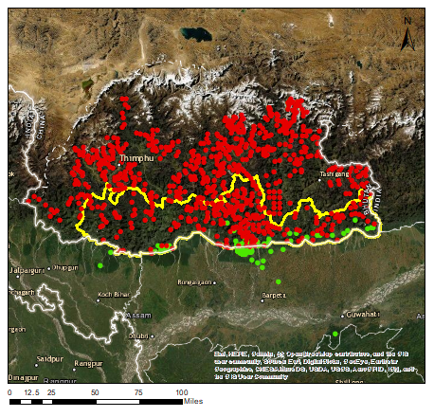
TRAINING DATA
50 m buffer between predictors
Even split training data 759 P, 759 A
Original P:A ratio of 2:1
Ratio rebalanced with presences randomly selected from buffered training set
Notice high clustering and low spatial distribution of presences
Elephant Occurrence
Notes:
Since the elephant occurrence data were very clustered and we had more presence than absence data. Some points existed within the same 30 m pixel, so a 50 m buffer was applied between each training point to prevent this. Additionally, we balanced the presence: absence ratio by randomizing and deleting a large number of the presence points. Here you can see that despite these measures, the presence points are limited in their spatial extent and highly clustered
Red tiger center - Sonam Wangdi,
Chief Forestry Officer,
Nature Conservation Division,
Project Director,
Bhutan for Life Fund,
Department of Forests and Park Services.
Green gbif

Slide 12
METHODOLOGY
Data Processing
Data Analysis
ArcGIS Pro
Mosaic Landsat Scenes
Compute NDVI and Population of the region
Compute LULC Map
Distance to Roads and Rivers
SAHM
Pre-processing, formatting and standardizing data from different sources for modeling
ArcGIS Pro
SAHM
Notes:
After prepping most of the data in ArcGIS Pro, they were imported into Software for Assisted Habitat Modeling (SAHM). SAHM is a very efficient tool for pre-processing, formatting and standardizing data from different sources for modeling. SAHM uses 4 different models to produce 4 different types of probability maps which can be used to determine the probability of elephant occurrence in places with sets of different environmental variables.

Slide 13
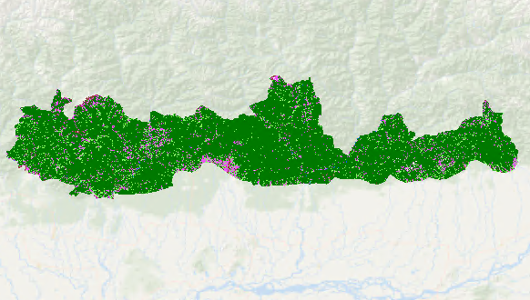
RESULTS – 2019 Land Cover Classification
Bhutan
Immature Forests
Cultivated Area
Barren Land
Mature Forests
Water
India
Snow
0 16 32 64
Kilometers
Notes:
This is a Land Cover Map that our team created for the year 2019 and clipped to our study area which is Southern Bhutan. We created this through an unsupervised classification method in ArcPro, which used training data and a machine learning algorithm to identify different land cover classes. We grouped the classes and reclassified them into these five classes which are the most significant in the context of elephant habitat.

Slide 14
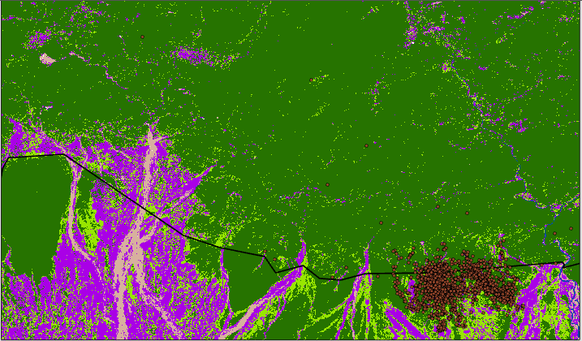
RESULTS – 2019 Land Cover Classification
Immature Forests
Gelephu
Cultivated Area
Barren Land
Mature Forests
Water
Snow
Elephant Occurrence
0 3 6 12
Kilometers
Notes:
Here is the land cover classifications of 2019 zoomed in on to Gelephu region. The elephants tend to occur more in the regions of immature forests near the cultivated areas. We can see that the Land cover has changed in this way in the past twenty years.

Slide 15
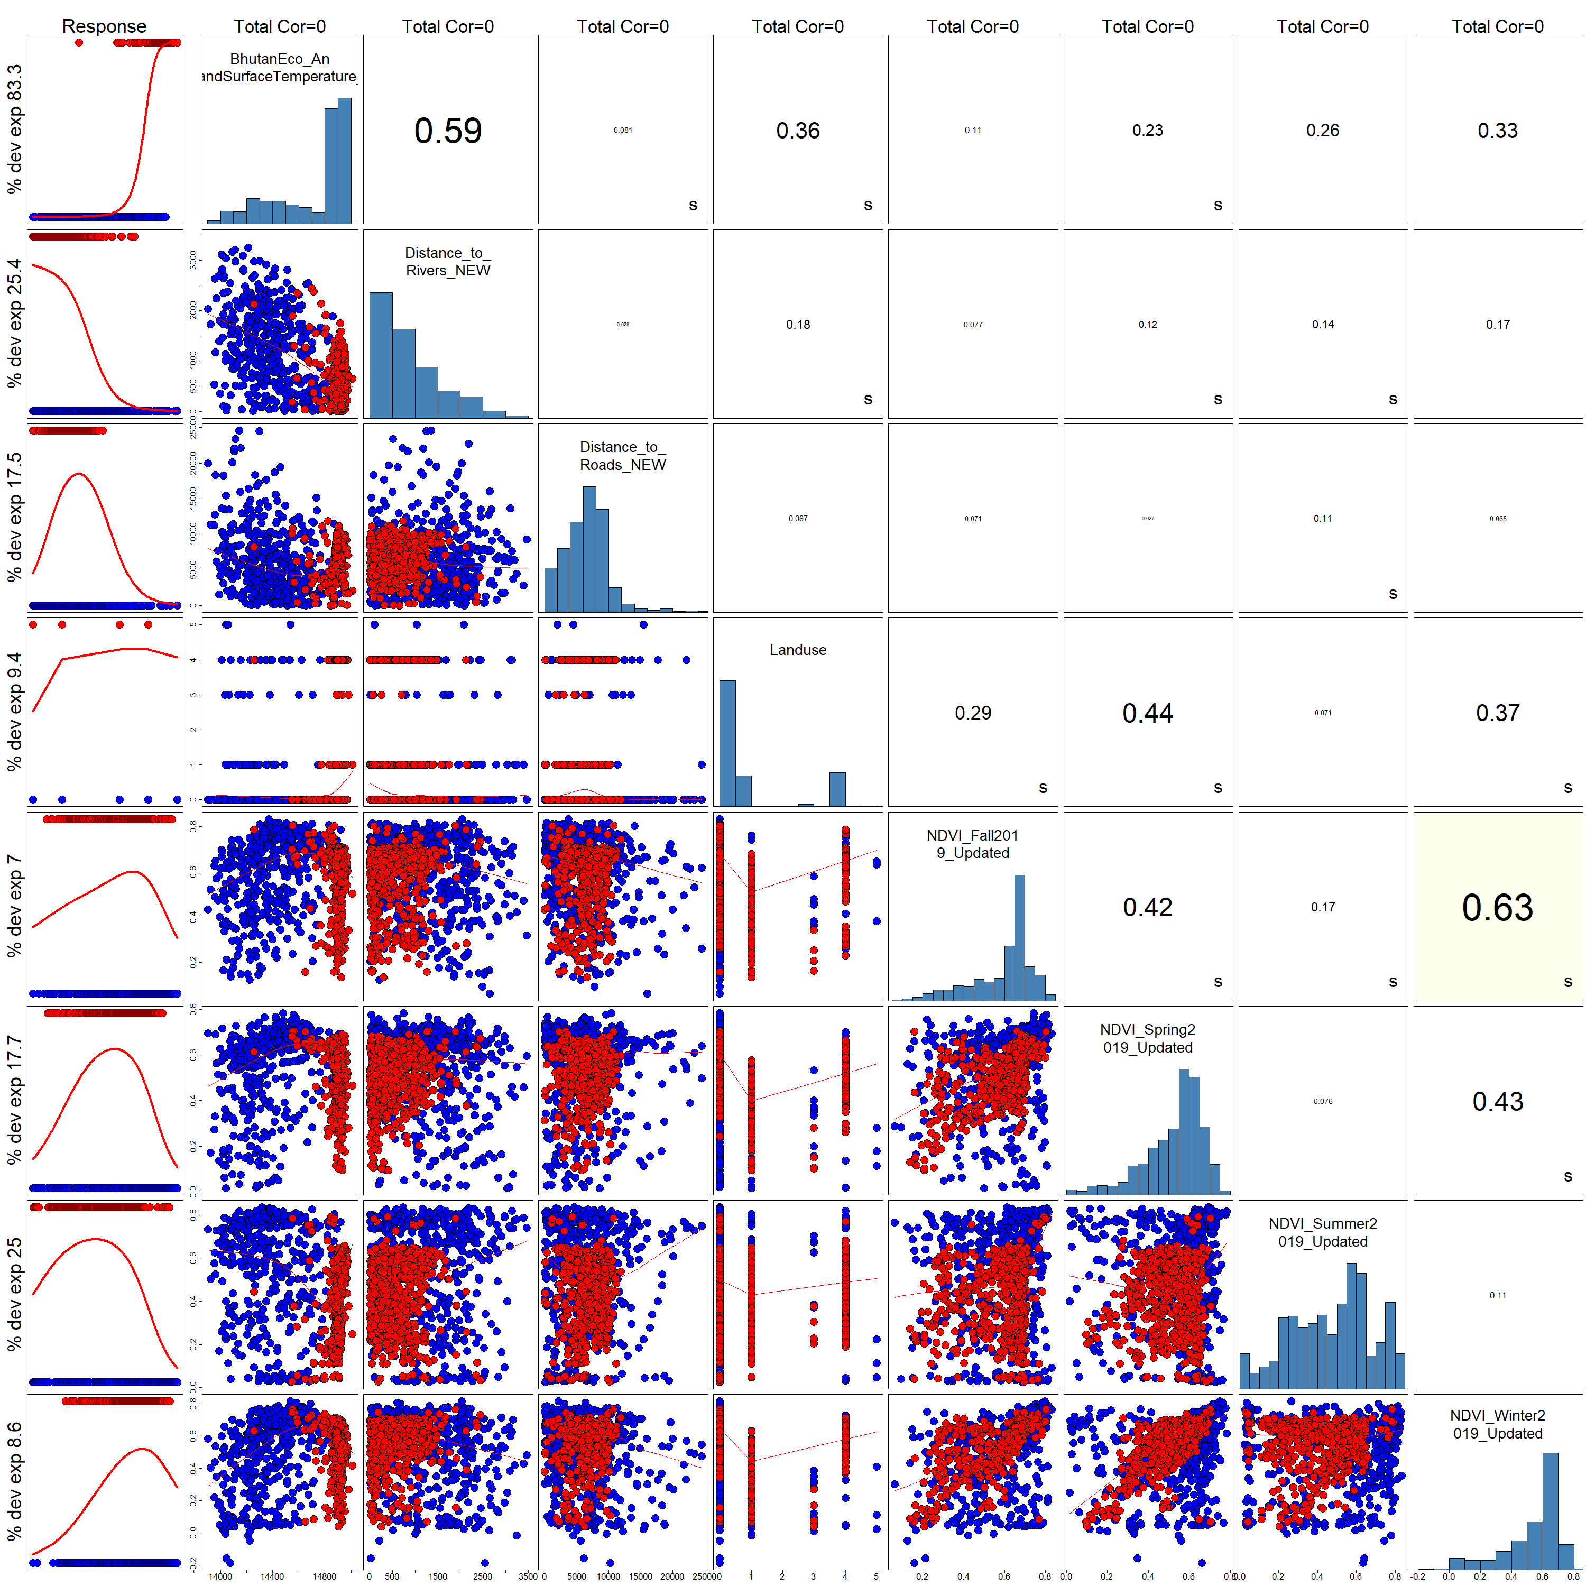
RESULTS – Correlated Variables
Correlated variables over .70 were dropped
Slope
Elevation
Precipitation
Notes:
The results from our SAHM models indicated that Land surface temperature, slope, elevation, and precipitation were highly correlated and land surface temperature was additinally the best predictor of elephant occurrence- likely because it indivated the conditions of these other variables. We dropped slope, elevation and precipitation, because on their own, these each had lower deviance explained than land surface temperature.

Slide 16
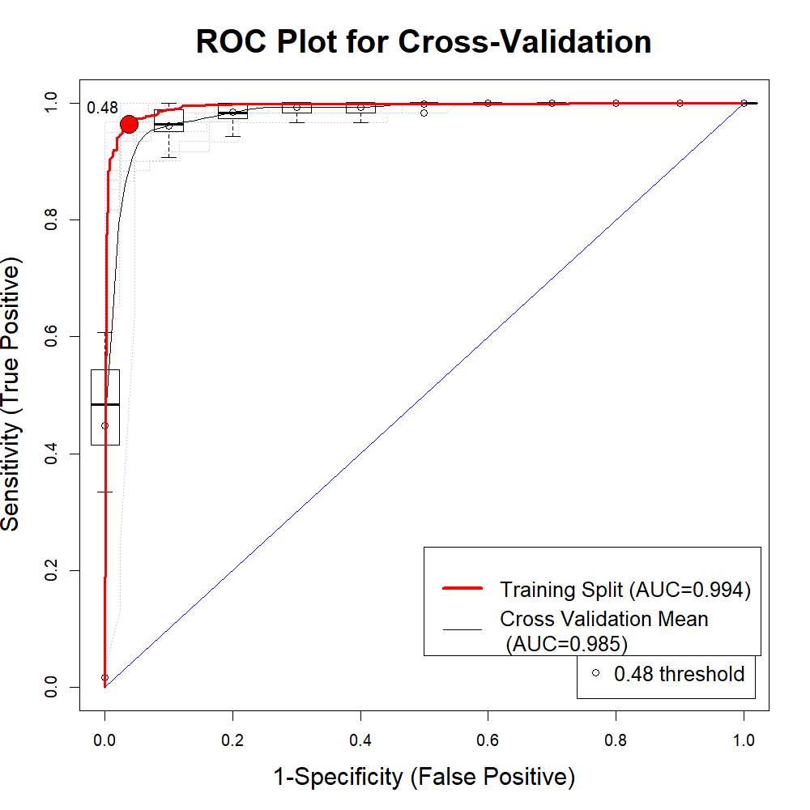
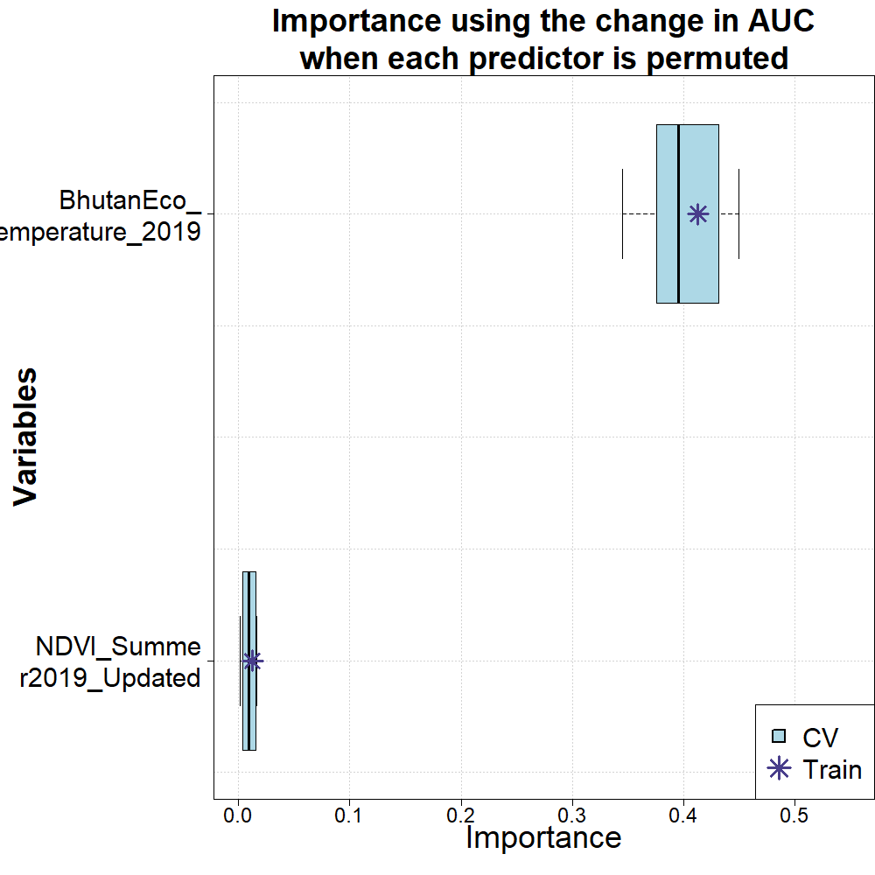
Boosted Regression Tree Evaluation
Notes:
SAHM produces these outputs for each of the 4 models we run. The chart on the left shows the accuracy under the curve of the model as well as the training split (between presence and absece data) When splitting the presence and absence data,you can see from the .48 threshold that this is the point at which there is the most accuracy of the model. This model is performing extremely well with an AUC of .994
The chart on the right demonstrates the importance of each predictor when it is taken out and run through the model on its own, or permuted. Here you can see how significantly Land surface temperature and how most of the model's prediction is based off of this one variable. This is likely related to how correlated LST is with elevation and slope, leading to an effect where the variables are wrapped up into a single predictor.

Slide 17
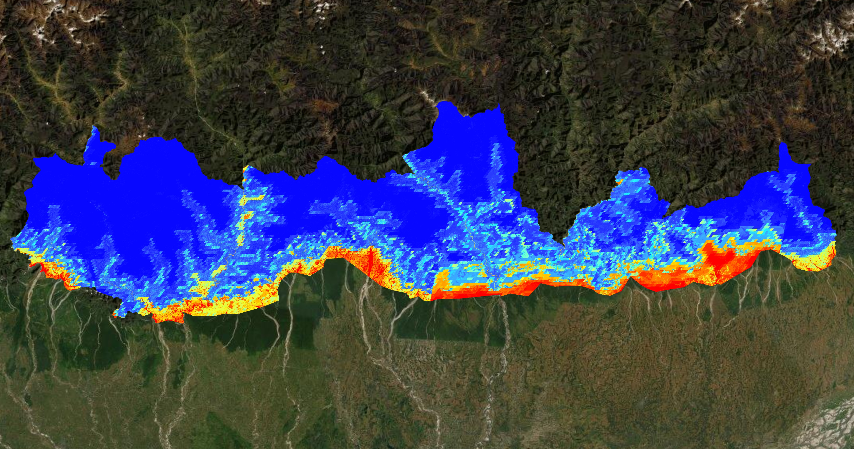
Boosted Regression Tree Probability Map
Elephant Occurrence
LOW
HIGH
0 30 60 120 180 240
Kilometers
Notes:
This map shows the probablility map for one of the four model types, the boosted regression tree model. The areas in blue represent the lowest probability of elephant occurrence and red represents the highest. Here you can see yellow and light blue up in the mountains, as well as some variation along the southern border of bhutan.

Slide 18
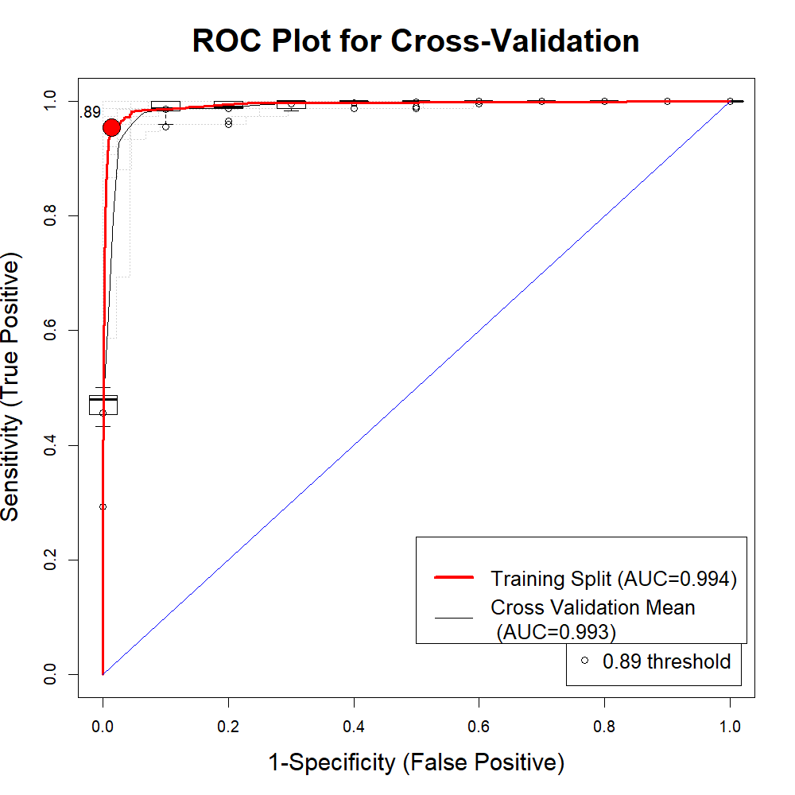
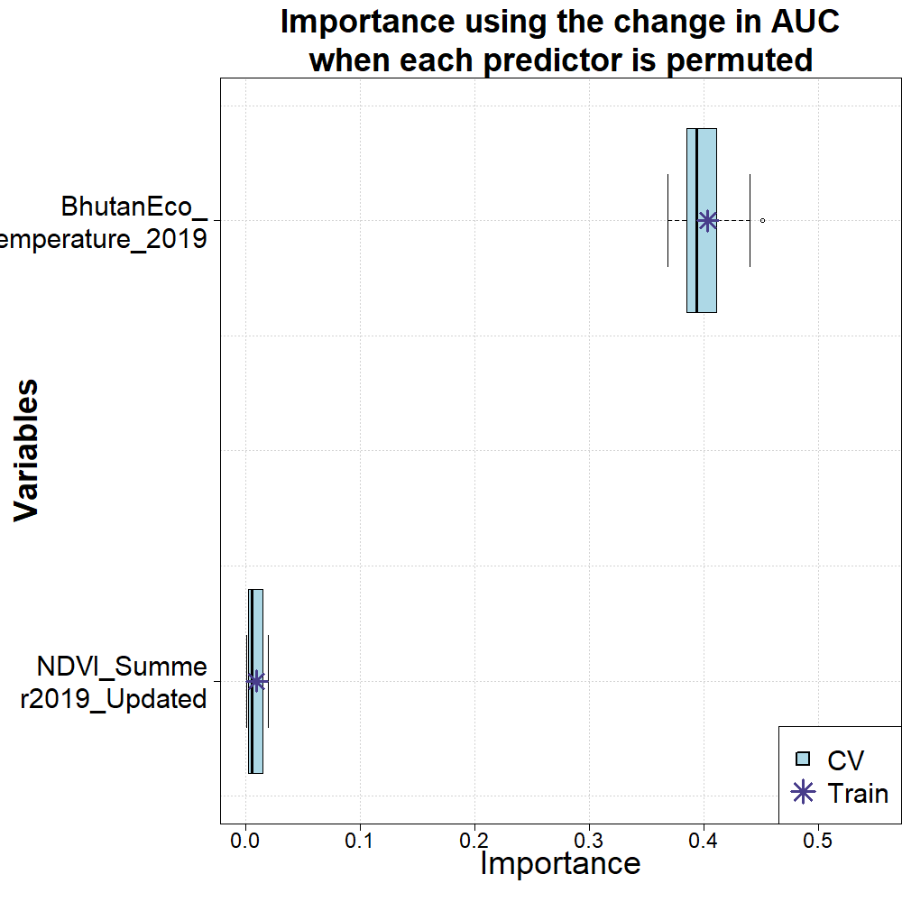
Generalized Linear Model Evaluation
Notes:
The chart on the left shows the accuracy under the curve of the model as well as the training split (between presence and absece data) When splitting the presence and absence data,you can see from the .89 threshold that this is the point at which there is the most accuracy of the model. This model is performing extremely well with an AUC of .994
The chart on the right demonstrates the importance of each predictor when it is taken out and run through the model on its own, or permuted. Here you can see how significantly Land surface temperature and how most of the model's prediction is based off of this one variable. This is likely related to how correlated LST is with elevation and slope, leading to an effect where the variables are wrapped up into a single predictor.

Slide 19
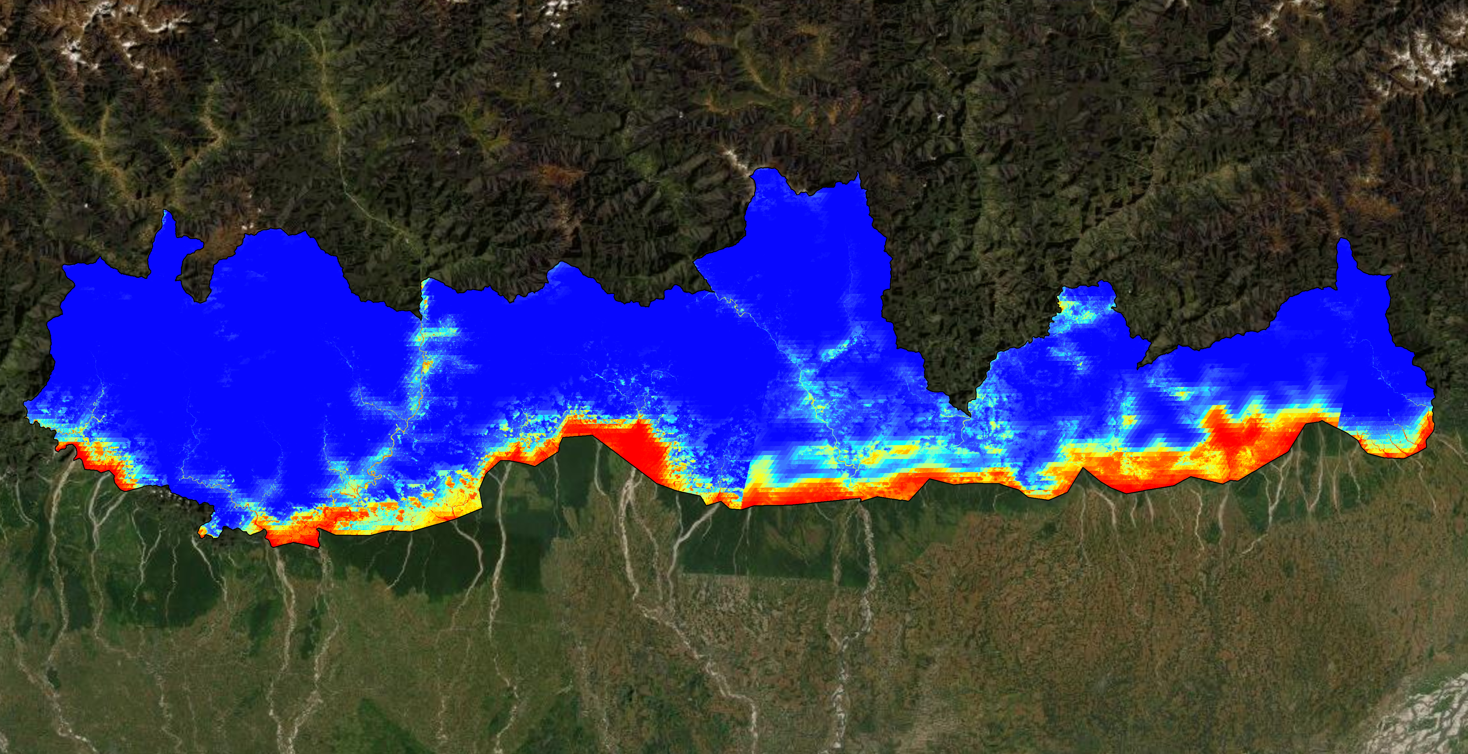
Generalized Linear Model Probability Map
Probability
LOW
HIGH
0 30 60 120 180 240
Kilometers
Notes:
This map shows the probablility map for one of the four model types, Generalized Linear model. The areas in blue represent the lowest probability of elephant occurrence and red represents the highest.

Slide 20
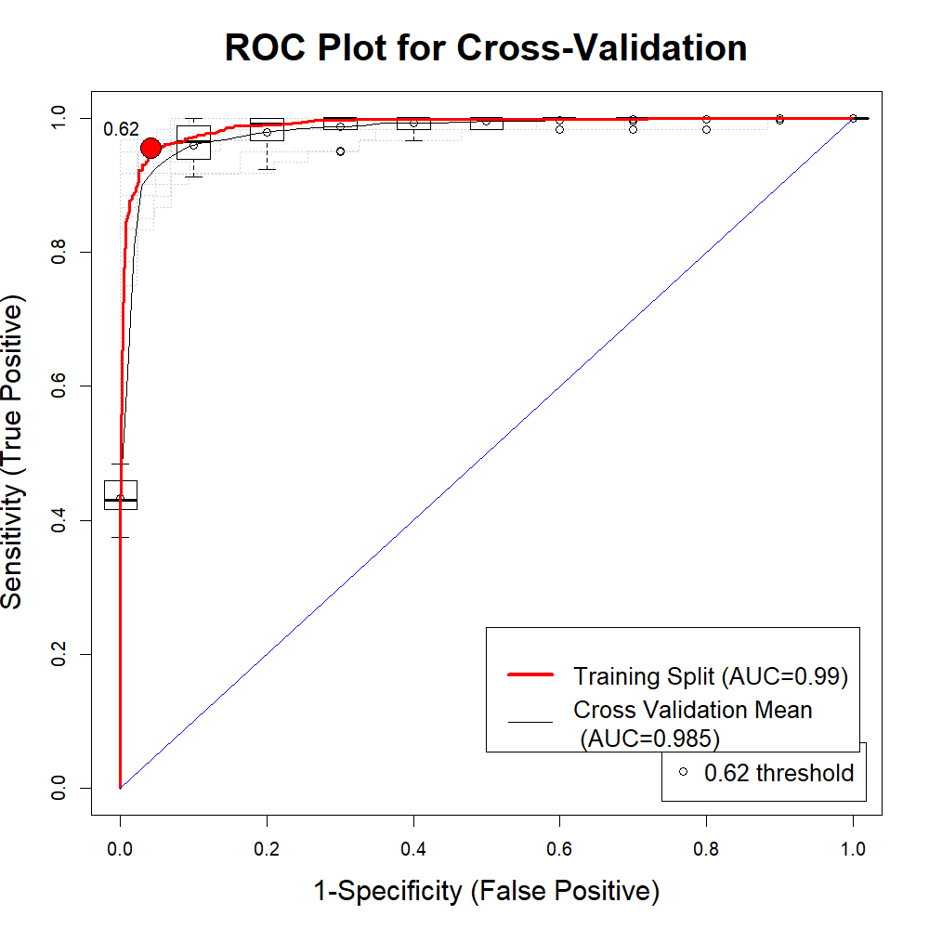
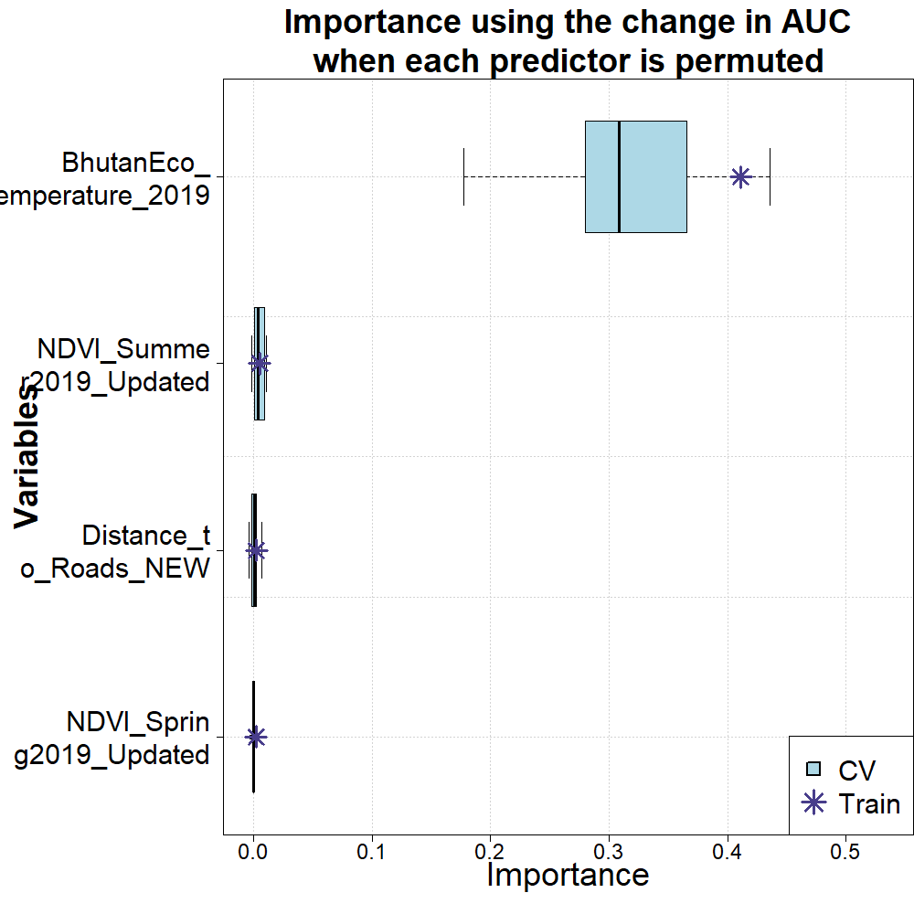
Multivariate Adaptive Regression Splines Evaluation
Notes:
The chart on the left shows the accuracy under the curve of the model as well as the training split (between presence and absece data) When splitting the presence and absence data, you can see from the .62 threshold that this is the point at which there is the most accuracy of the model. This model is performing extremely well with an AUC of .99
The chart on the right demonstrates the importance of each predictor when it is taken out and run through the model on its own, or permuted. Here you can see how significantly Land surface temperature and how most of the model's prediction is based off of this one variable. This is likely related to how correlated LST is with elevation and slope, leading to an effect where the variables are wrapped up into a single predictor.

Slide 21
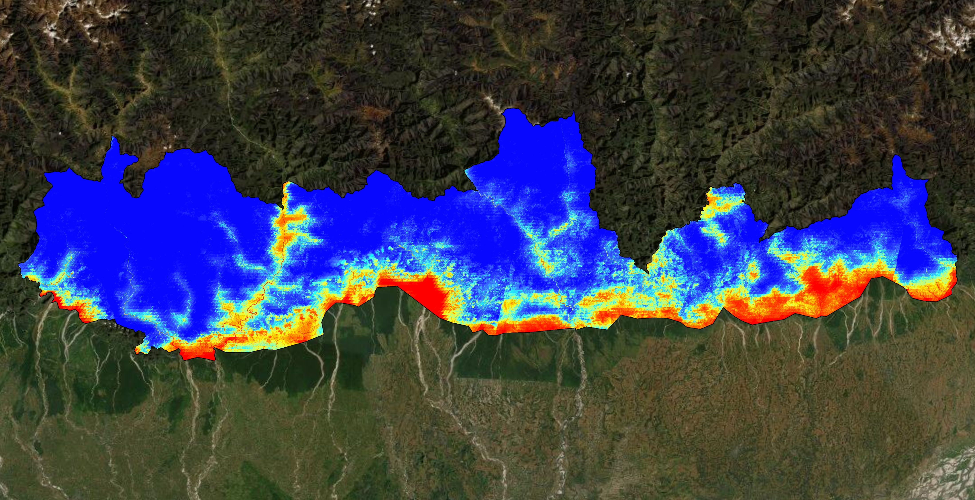
Multivariate Adaptive Regression Splines Probabability Map
LOW
HIGH
0 30 60 120 180 240
Kilometers
Notes:
This map shows the probability map for one of the four model types, the Multivariate Adaptive Regression Splines model. The areas in blue represent the lowest probability of elephant occurrence and red represents the highest.

Slide 22
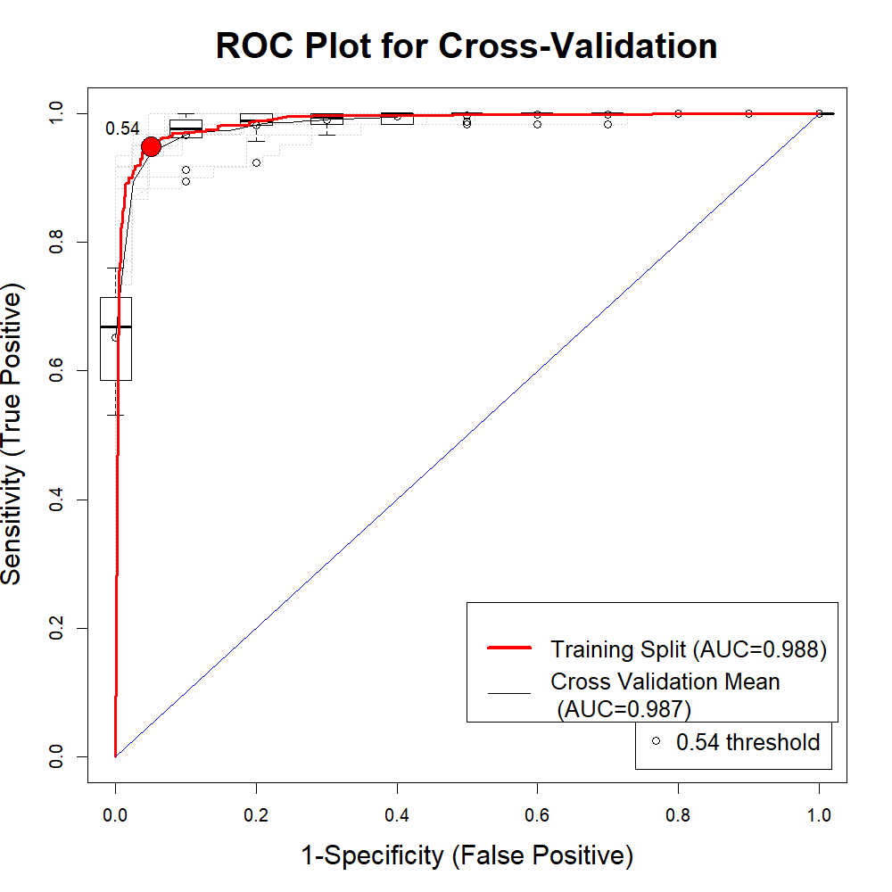
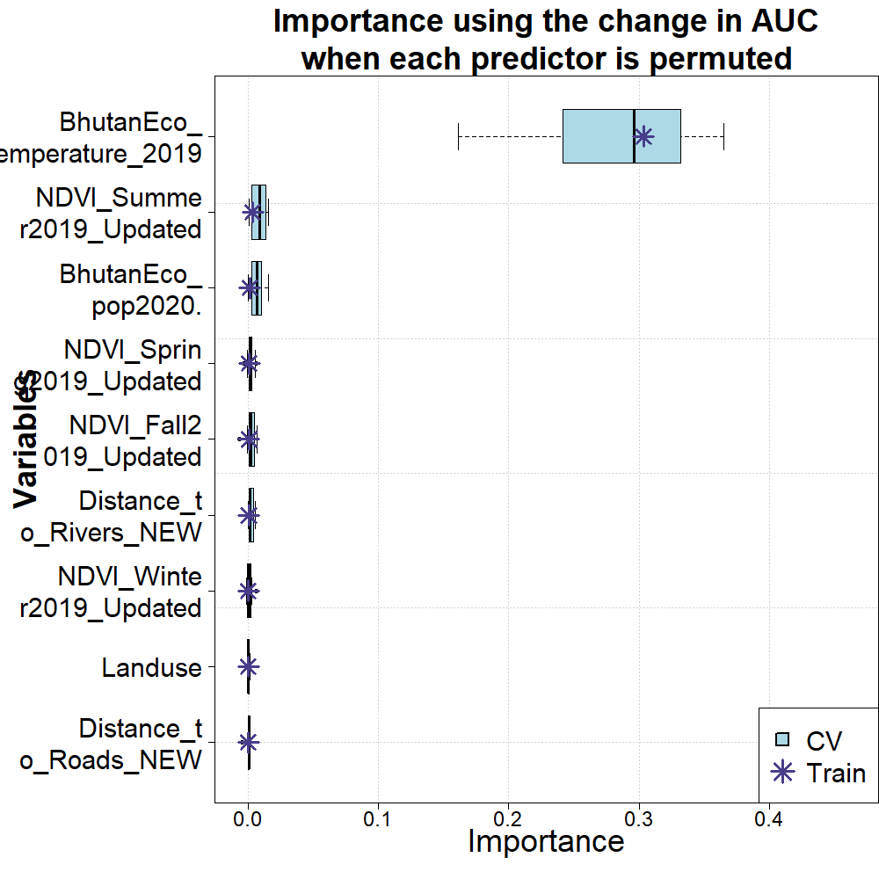
Random Forest Evaluation
Notes:
The chart on the left shows the accuracy under the curve of the model as well as the training split (between presence and absece data) When splitting the presence and absence data, you can see from the .54 threshold that this is the point at which there is the most accuracy of the model. This model is performing extremely well with an AUC of .988
The chart on the right demonstrates the importance of each predictor when it is taken out and run through the model on its own, or permuted. Here you can see how significantly Land surface temperature and how most of the model's prediction is based off of this one variable. This is likely related to how correlated LST is with elevation and slope, leading to an effect where the variables are wrapped up into a single predictor.

Slide 23
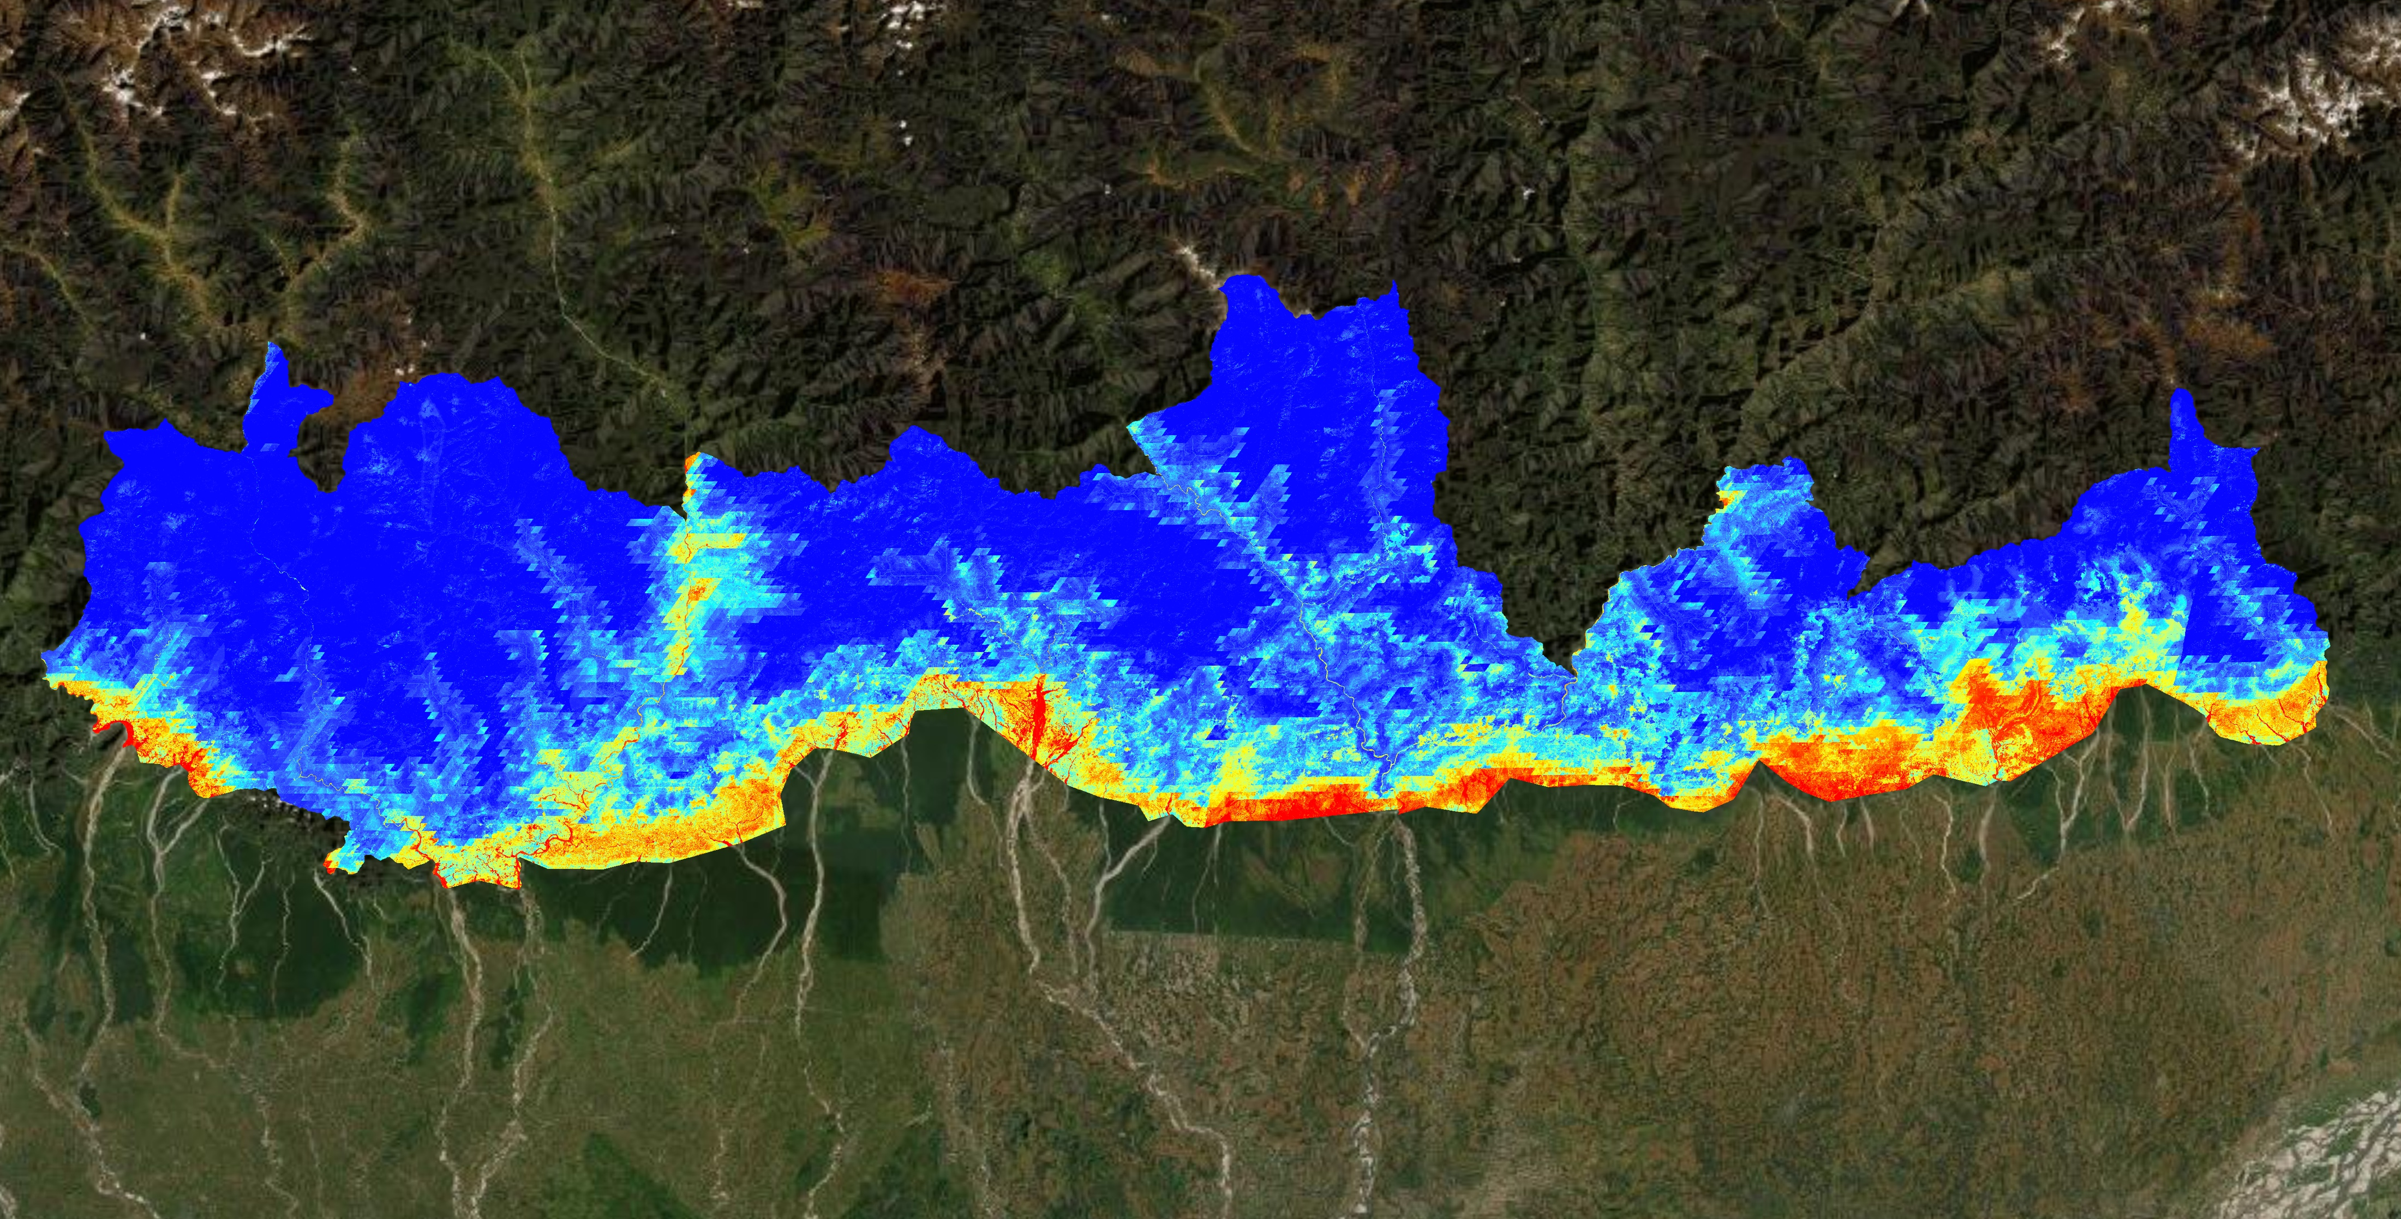
Random Forest Probability Map
LOW
HIGH
0 30 60 120 180 240
Kilometers
Notes:
This map shows the probability map for one of the four model types, Random Forest. The areas in blue represent the lowest probability of elephant occurrence and red represents the highest.

Slide 24
ERRORS & UNCERTAINTIES
Sampling bias of elephant occurrence data
Crowd-sourced data from GBIF
Highly correlated variables
Notes:
All the elephant data spans that we used spans from the year 2014 – 2019. So, this could have also affected our model due to a disparity in the data collection study period.
Some parts of the elephant occurrence data were obtained from Global Biodiversity Information Facility (GBIF) which is crowd sourced.
We gathered data from GBIF, and combined it with the data sent to us by the Bhutan Tiger Center and the Bhutan Foundation.
The elephant occurrence data in Bhutan was not entirely collected from the elephant camera traps.
The elephant occurrence data obtained from the Bhutan Tiger Center was a byproduct of the tiger research and not specifically designed for surveying elephant occurrence.
The road and the river data sets, used as the variables, were considered static in the elephant habitat suitability model. The distance to road and the distance to water variables for the past years were considered as static since these variables, specifically for the year 1999, could not be determined.

Slide 25
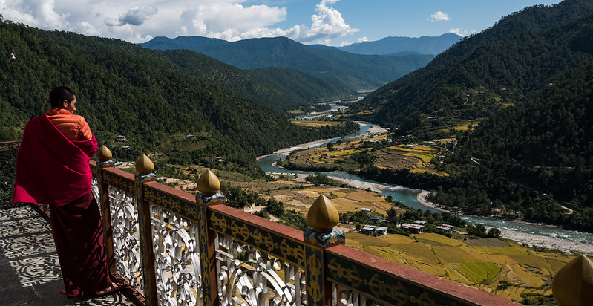
CONCLUSIONS
LST, slope, and elevation are highly correlated predictors in the model
Suitability maps suggest where more camera traps can expand understanding
Results indicate importance of roads and waterways to elephant occurrence
Results can help reduce HEC in Southern Bhutan
Image Credit: Adam Singer
Notes:
The modeling results suggest that elephants tend to occur in areas near roads and waterways.
Given available documentation, we think that Southern Bhutan elephant habitat conditions could change for the worse if management measures such as biological corridors are not maintained and managed.
The project yielded methods, maps, data products, and documentation that is being provided to project partners for reducing Human Elephant Conflicts and aiding wildlife management.
---------------------
Image Credit: Adam Singer
Image Source: https://flic.kr/p/21EpxBF (CC BY-ND 2.0)

Slide 26
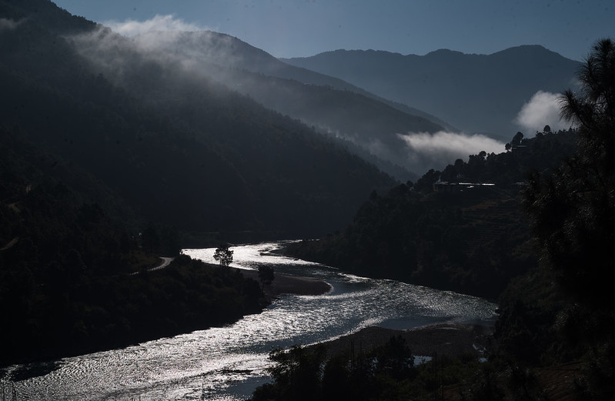
FUTURE WORK
Input additional data (elephant presences and absences) and model variables (disturbance, tree cover)
Refine land cover land use analysis
Analyze historic and future data for Habitat suitability
Improve models, methods, and data products can be provided to project end-users, building off results for the initial study
Image Credit: Adam Singer
Notes:
A follow-on project is recommended to build upon results, products, and capabilities resulting from our initial study.
> In the future, more in situ data could be gathered so that the future terms can increase accuracy in elephant occurrence.
>More work is needed to further develop certain modeling inputs and outputs so, the future participants could work on the LULC map to classify the land cover to see the trend better.
> We used the datasets as the variables (precipitation, slope, elevation, population density, LST, land classification, distance to rivers and roads) for the year 2019 to set up our habitat suitability model on SAHM but we couldn’t get the data for some of the variables for the year 1999. So, the future participants could gather data for the year 1999 and also for other years to compute results on SAHM and have a variety of results to compare and contrast.
> We hope that our work will be used to build upon to improve decision-making capabilities of end-users.
--------------------------------------------------------------------------------
Image Credit: Adam Singer
Image Source: https://flic.kr/p/21uYWjy (CC BY-ND 2.0)

Slide 27
Joe Spruce (SSAI Research Consultant, Diamondhead, MS)
Dr. Kenton Ross (NASA Langley Research Center)
Sean McCartney (SSAI, NASA Goddard Space Flight Center)
Tshewang Wangchuk (Bhutan Foundation)
Dr. Tshering Tempa (Bhutan Tiger Center)
Darcy Gray (DEVELOP fellow at Goddard Space Flight Center)
Peder Engelstad (Natural Resource Ecology laboratory, Colorado State University)
Kristen Dennis (CO Lead, Geoinformatics Fellow)
Notes:
The Southern Bhutan Ecological Forecasting team would like to thank our science advisors, mentors and partners for all their help in making this project possible.

