Slide 1

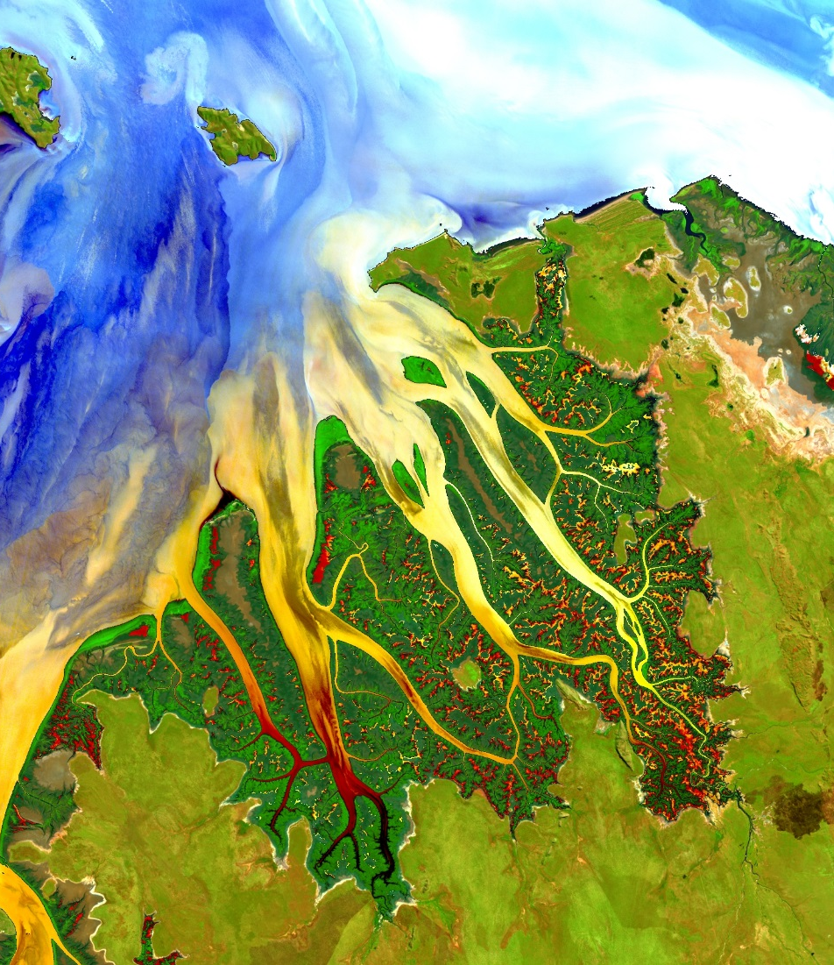

Your project Website Image should be placed behind the hexagon grid. An example image has been placed in this position for your reference. Delete the example image, insert your image, right click your image and select the “Send to Back” option. Position and adjust the size of your image so that it lines up with the provided margin rulers.
Delete this text box.
PROJECT SHORT TITLE (ALL CAPS)
Long Title Goes Here (Title Case)
Team Member 1
Team Member 4
Team Member 2
Team Member 5
Team Member 3
Team Member 6
Spell Out Team Location (ex. Maricopa County Department of Public Health and Arizona State University)
2017 Summer
Notes:
Your project Website Image should be placed behind the hexagon grid. An example image has been placed in this position for your reference. Delete the example image, insert your image, right click your image and select the “Send to Back” option. Position and adjust the size of your image so that it lines up with the provided margin rulers.

Slide 2
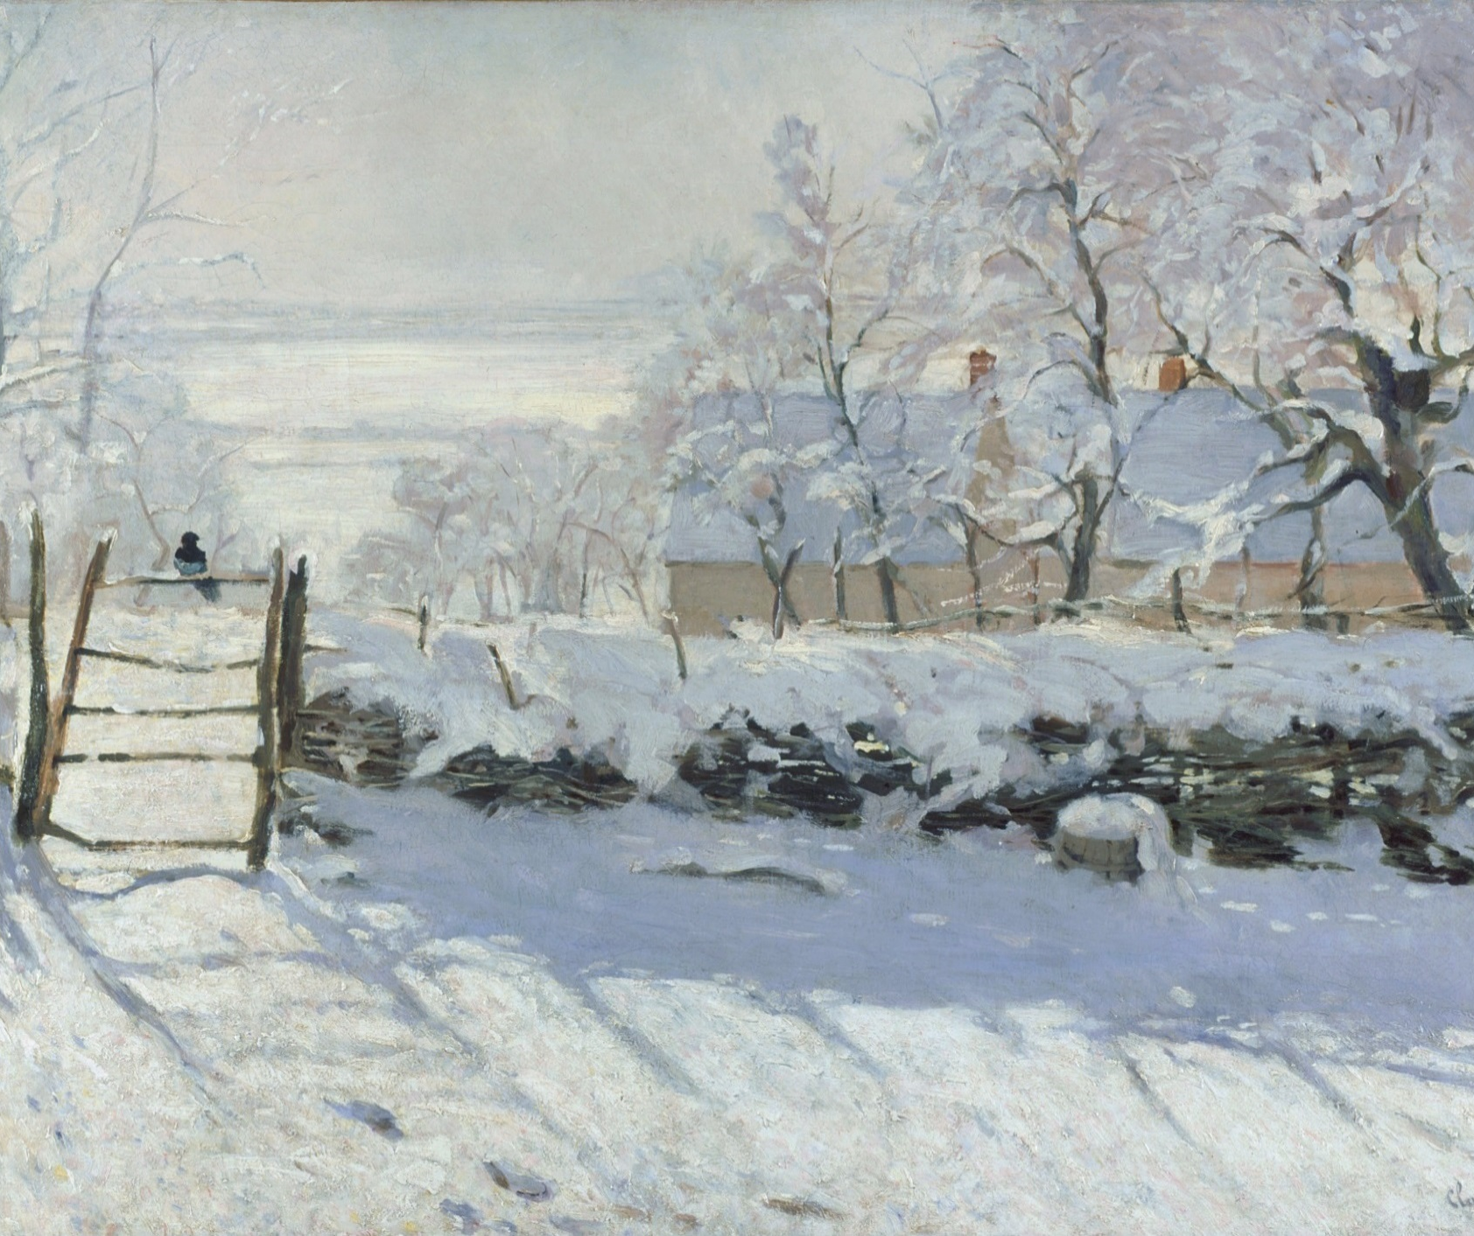
Components
Study area
Study period
Objectives
Partners
Community concerns
NASA satellites/sensors used
Methodology
Results
Conclusions
Errors & uncertainties
Future work
Acknowledgements
Backup slides
Required Statement
Feel free to vary slide templates – you don’t have to use only one!
See HOME Tab -> Layout drop-down menu for layout options.
Delete this text box.
The slides provided in the template are just a starting point for teams. Feel free to expand upon these topics, alter the headings, and change the order of the slides to fit your needs.
Image Credit: Monet
Notes:
These notes should be thorough enough for someone not familiar with the project to clearly present the material.
NOTE: For every image on the slide include an image source in the speaker notes (ex. URL; Name, Affiliation, etc.)
Image Source: http://commons.wikimedia.org/wiki/File:Claude_Monet_-_The_Magpie_-_Google_Art_Project.jpg

Slide 3
Components II
Header text point size should be between 32 and 48 on most slides.
Body text point size should be at least 20.
All other text (captions, legend, image credits, etc) should be at least 12.
Use Century Gothic.
Keep text to a minimum.
Try to use a consistent font size between slides.
Image Credit: Monet
Notes:
These notes should be thorough enough for someone not familiar with the project to clearly present the material.
NOTE: For every image on the slide include an image source in the speaker notes (ex. URL; Name, Affiliation, etc.)
Image Source: http://commons.wikimedia.org/wiki/File:Claude_Monet_-_The_Magpie_-_Google_Art_Project.jpg

Slide 4

General Guidelines
Image Credit: Monet
Include speaker notes for each slide (see below).
Include a visual on each slide, if possible.
Arrange content to minimize white space.
Notes:
These notes should be thorough enough for someone not familiar with the project to clearly present the material.
NOTE: For every image on the slide include an image source in the speaker notes (ex. URL; Name, Affiliation, etc.)
Image Source: http://commons.wikimedia.org/wiki/File:Claude_Monet_-_The_Magpie_-_Google_Art_Project.jpg

Slide 5
General Guidelines
Include speaker notes for each slide (see below).
Include a visual on each slide, if possible.
Arrange content to minimize white space.
Image Credit: Monet
Notes:
These notes should be thorough enough for someone not familiar with the project to clearly present the material.
NOTE: For every image on the slide include an image source in the speaker notes (ex. URL; Name, Affiliation, etc.)
Image Source: http://commons.wikimedia.org/wiki/File:Claude_Monet_-_The_Magpie_-_Google_Art_Project.jpg

Slide 6
Maps & Logos
Maps
A scale bar is required for reference on all maps.
A North arrow is suggested. Otherwise all maps should be oriented such that North is the top of the slide.
Make sure all text is legible and add legends separately (so they can be moved or resized).
If text is not editable, a team member must be available to make changes with a very short turn-around time (hours, not days) after submission.
Cite base layer source in speaker notes.
Logos
US Federal logos only.
No state, NGO, local and or international government logos, or software logos.
Notes:
These notes should be thorough enough for someone not familiar with the project to clearly present the material.

Slide 7
Backup Slides
This slide can be used as a section transition, if needed for your presentation.

Slide 8
Photos & Figures I
You may only use images taken by your team, provided by your partners (as long as you have permission from them), from a Federal Agency, from the new DEVELOP stock imagery collection on DEVELOP’s Flickr page, or Creative Commons images.
Obtain a media release form from all people in photos that your team has taken!
All image sources should be cited using a consistent format and should be visible on the slide (see slides 2, 3, and 4).
Notes:
These notes should be thorough enough for someone not familiar with the project to clearly present the material.

Slide 9
Photos & Figures II
Please do not include the image URL in the source text box but rather place it in the notes section below (see slides 2, 3, and 4).
If you use a border for your images include it on all photographs to keep your presentation consistent.
Keep all images and text boxes editable, including individual elements of flowcharts.
Background images are discouraged. If you use one, make sure that your text remains clear and legible.
Notes:
These notes should be thorough enough for someone not familiar with the project to clearly present the material.

Slide 10
Acknowledgements
List advisors, partners, and others who have contributed in any way to the project.
If your project is a multi-term one, acknowledge past contributors.
Choose one of the two following slides as an acknowledgements page. Feel free to modify them as needed to fit your content.

Slide 11
Acknowledgements

