Slide 1
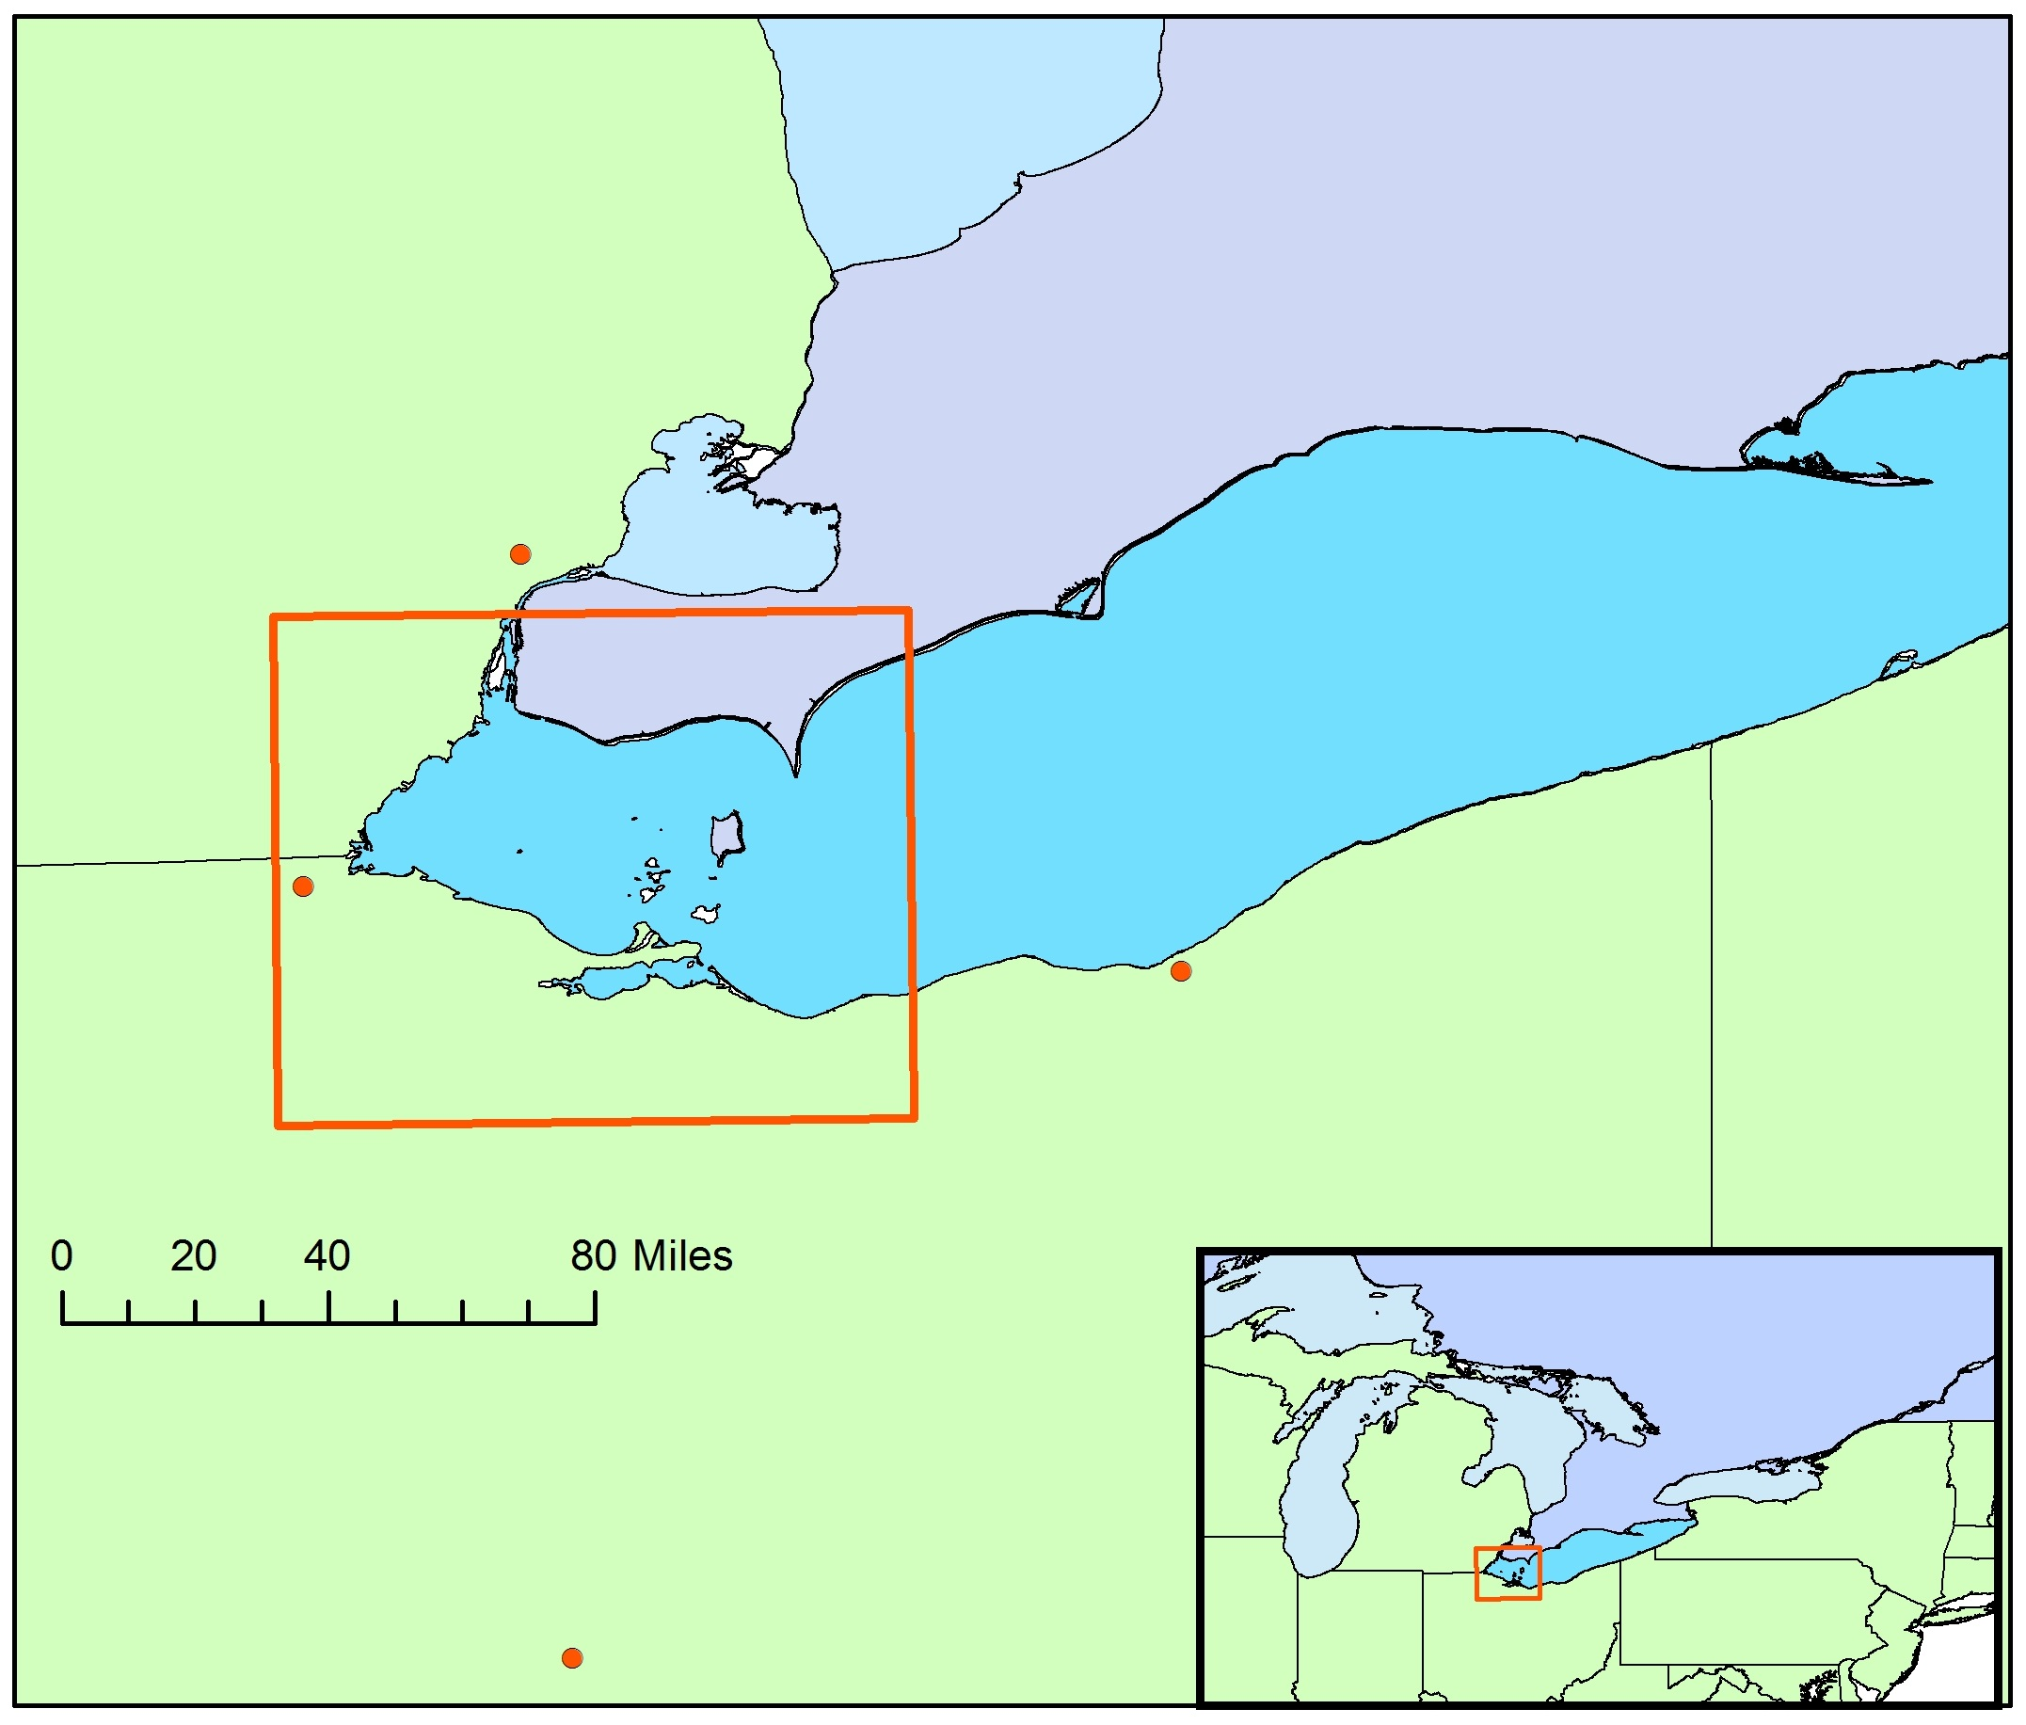


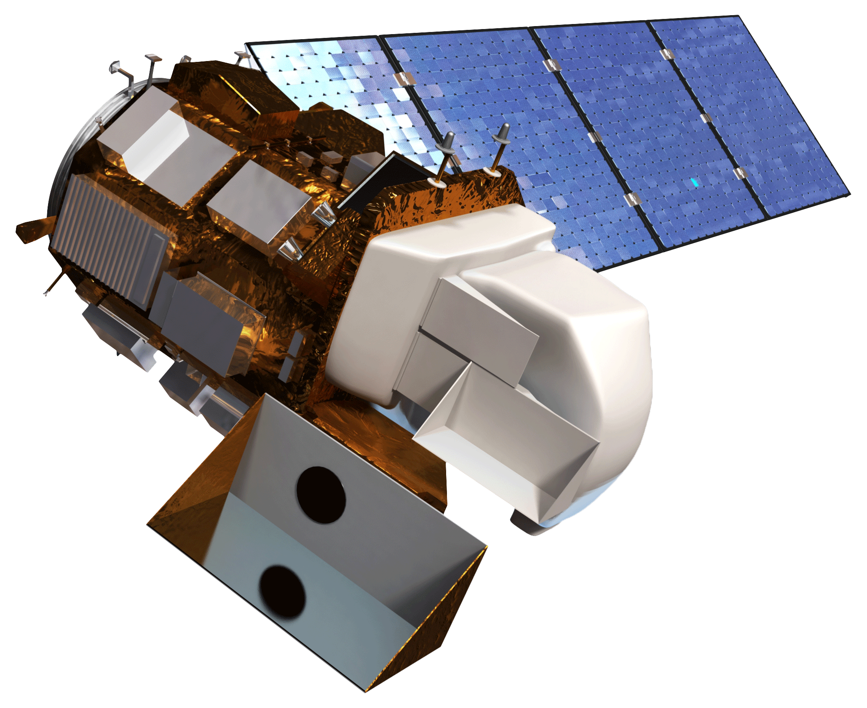
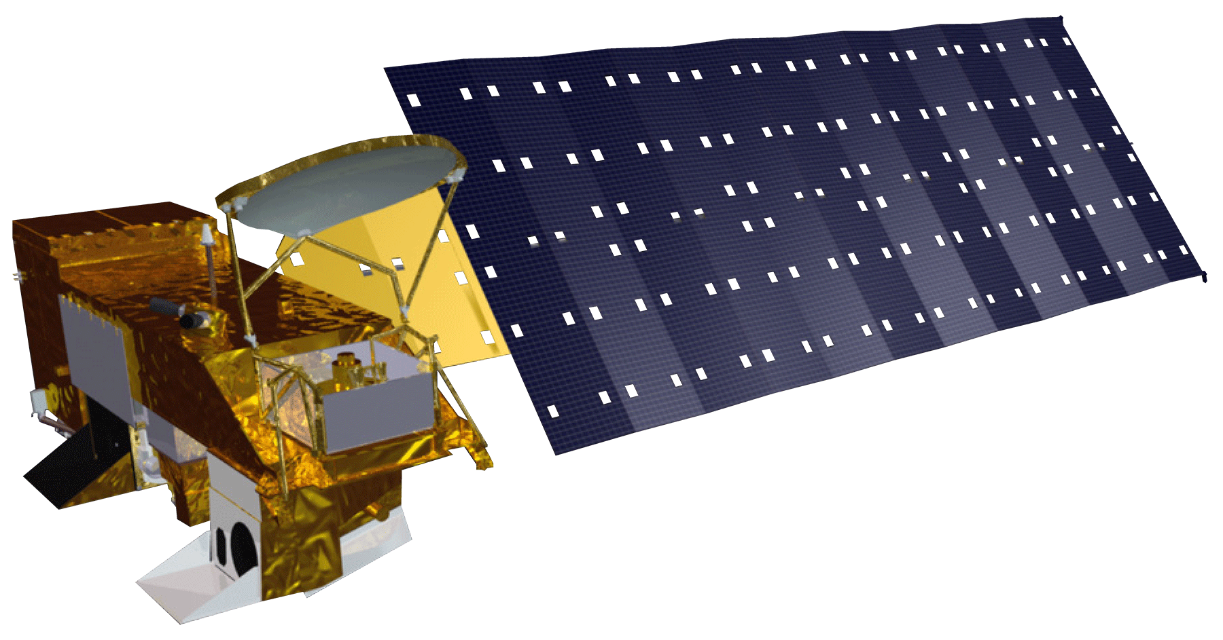
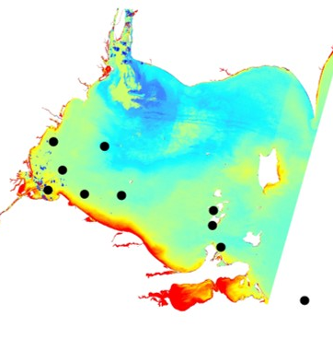
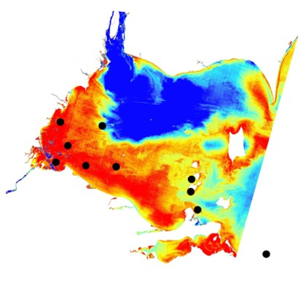
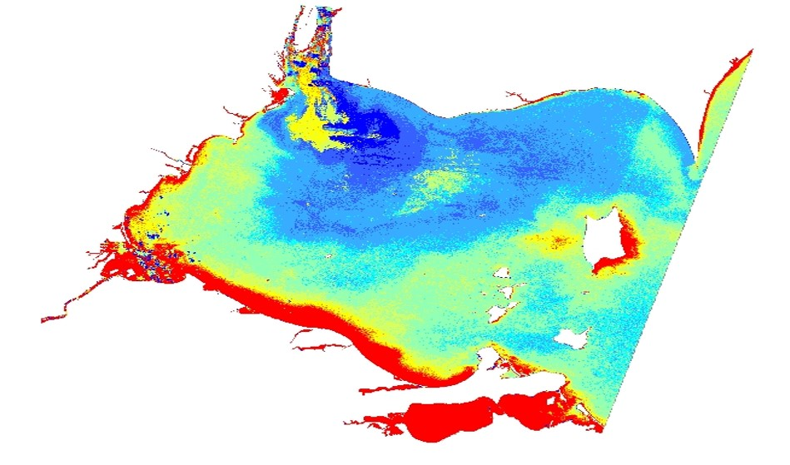
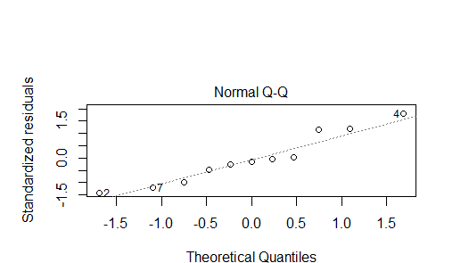
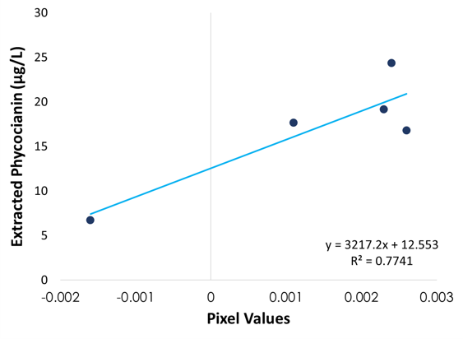
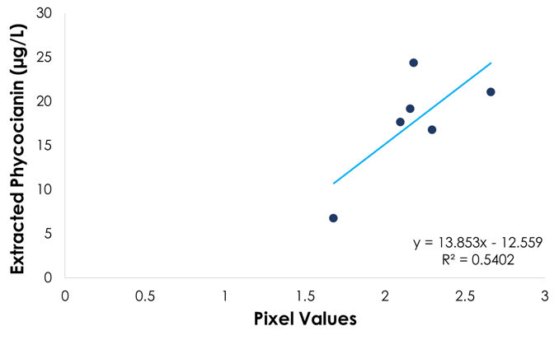
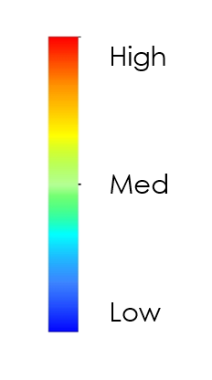
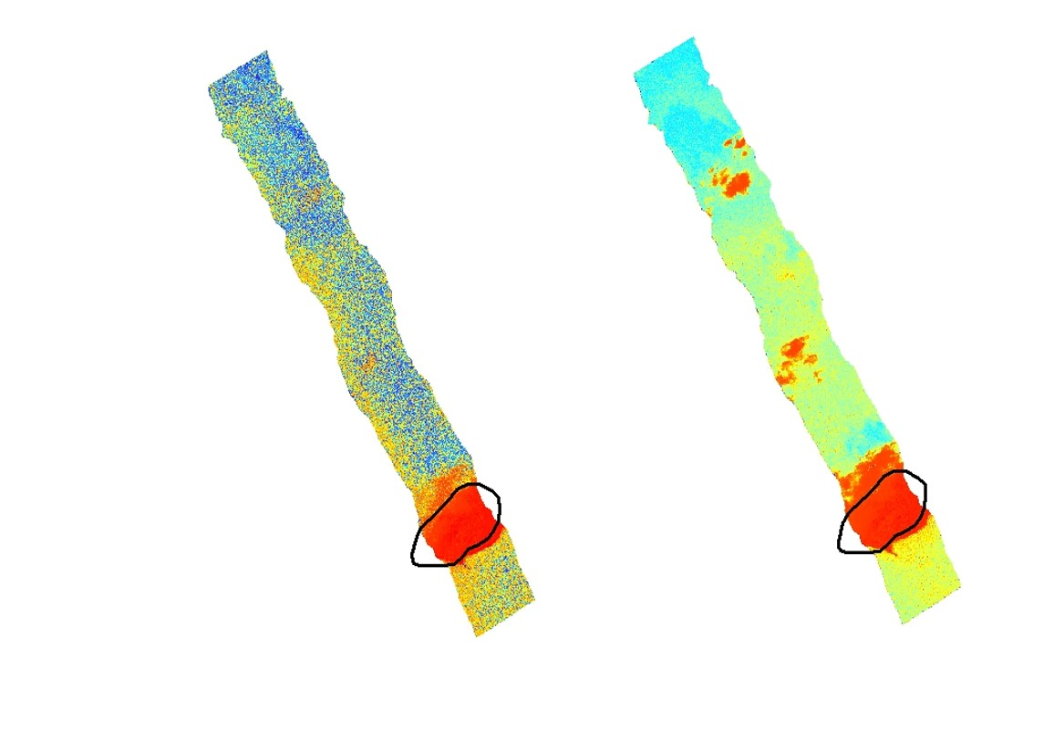
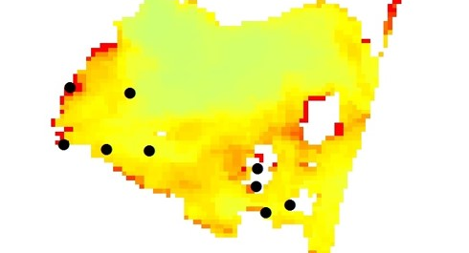
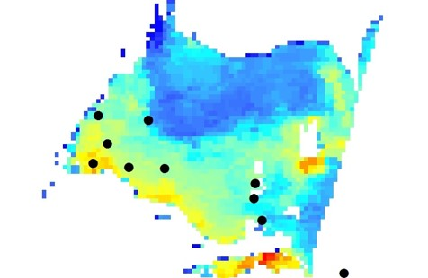
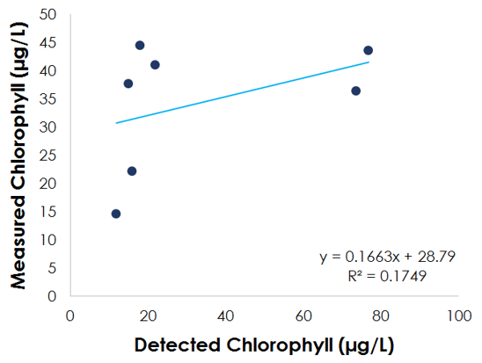
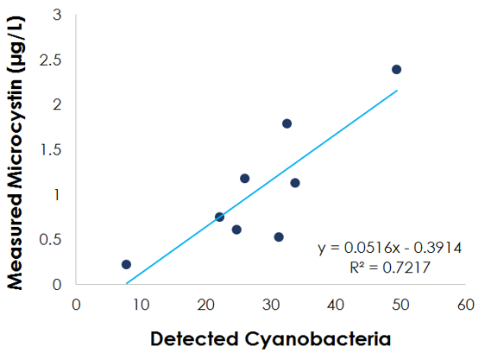






Utilizing Satellite Multispectral and Airborne Hyperspectral Imagery to Identify Annual and Seasonal Trends of Harmful Algal Blooms and Resulting Water Quality in Lake Erie’s Western Basin
Abstract
Objectives
Harmful algal blooms (HABs) in the Western Basin of Lake Erie have been increasing in frequency and severity over the past decade. Cyanobacteria is the dominant phylum in the blooms that occur in Lake Erie. Microcystis, a species of cyanobacteria, is of particular concern due to its ability to produce microcystin, a toxin that can adversely affect human health in high enough concentrations. So far, abnormally high concentrations of microcystin have incited the temporary shutdown of two water treatment facilities causing the communities dependent on those facilities to be without drinking water. Additionally, the blooms harm ecological, economic, and recreational services in the region. This study utilized Landsat 8 - Operational Land Imager (OLI), Aqua - Moderate Resolution Imaging Spectroradiometer (MODIS), NASA Glenn Research Center’s aircraft hyperspectral imaging (HSI) sensor, Glenn Hyperspectral Imager II, and corresponding in situ data to aid in monitoring and predicting HAB events. The Cyanobacteria Index (CI), Normalized Difference Turbidity Index (NDTI), Phycocyanin detection, Near infrared with Simple Atmospheric Correction(NIR SAC), Chlorophyll-a, and Mishra et. al 2009 band ratio algorithms were correlated with in situ data to determine the most effective method of cyanobacteria detection and prediction. The comparative analysis can be used to better inform managers of the most efficient and effective observational platforms so to optimize the response time for HAB events.
Determine whether hyperspectral airborne imagery can be used as a more effective tool to monitor and predict microcystin production compared to multispectral satellite imagery or in situ measurements
Implement remote sensing algorithms to test their strength in detecting harmful algal blooms
Conduct a comparative analysis of airborne hyperspectral imagery versus NASA Earth observations when considering monitoring and predictability of microcystin production in Lake Erie
Provide statistical analysis of algorithm performance validated with in situ data and enhanced algorithm for bloom detection
Study Area
Methodology
Earth observations
Algorithms
Comparative Statistics &
Regressions
Glenn Hyperspectral Imager II
HSI
  Mishra et. al 2009
  Cyanobacteria Index
MODIS
  Chlorophyll-a
  Cyanobacteria Index
Landsat 8
  NDTI
  Phycocyanin detection Vincent et al. 2004
  NIR with SAC Wang and Shi, 2007
In situ Data
Comparative and statistical analysis of sensor performance and algorithm accuracy
Lake Erie Western Basin
Pre-Processing
(Empirically corrected to reflectance, SeaDAS, masking, projections)
NOAA Great Lakes
Environmental
Research Laboratory
Cities with 250k or Greater Population
Lake Erie
Aqua MODIS
Other Great Lakes
Ohio State University Stone Lab
Earth Observations
Landsat 8 OLI
Lake Erie Water Resources
Results
Near infrared with simple atmospheric correction algorithm (left) and Blue to Green ratio applied (right) to Landsat 8 OLI imagery.
Algorithm developed from multivariable regression analysis depicting dissolved microcystin (DsMc).
DsMc = c₁(NDTI) + c₂(NIR-SAC) + 0.107
Glenn HSI
Landsat 8 OLI
Aqua MODIS
Data | 8/3/2015 | 9/21/2015 | 10/7/2015 | 5/18/2016 | 6/19/2016 | 9/7/2016
Landsat 8 | x | x | x | x | x | x
Aqua MODIS | x | x | x | x | x | x
HSI |  | x
In Situ sampling | x | x |  |  | x
Extracted Phycocianin (µg/L)
Extracted Phycocianin (µg/L)
Standardized residuals
Normal Q-Q
y= 3217.2x + 12.553
R² = 0.7741
y = 13.853 – 12.559
R² = 0.5402
Theoretical Quantiles
Conclusions
Pixel Values
Pixel Values
High
Low
Using existing algorithms for Landsat 8 as inputs for developing more complex and refined algorithms created a unique method for detecting dissolved microcystin.
Hyperspectral imagery offers a significant advantage in enhancing HAB research by providing imagery below cloud cover, at a very high resolution, and at a relatively flexible temporal resolution as it is taken from an aircraft.
By combining or refining existing algorithms, the detection accuracy of HABs can be improved.
More consistent and constant monitoring is needed both remotely and in situ (for validation) in order to monitor the rapid daily, and even hourly, changes of these events.
Measured Chlorophyll (µg/L)
Measured Microcystin (µg/L)
HSI swath with Cyanobacteria Index (left) and Mishra et. al 2009 (right) algorithms applied.
Acknowledgements
Detected Chlorophyll (µg/L)
Chlorophyll-a algorithm (left) and Cyanobacteria Index (right) applied to Aqua Modis imagery.
Detected Cyanobacteria
Dr. John Lekki, NASA Glenn Research Center
Dr. Carol Tolbert, NASA Glenn Research Center
Dr. Andrea Vander Woude, NOAA Great Lakes Environmental Research Laboratory
Dr. Joseph Ortiz, Professor, Department of Geology, Kent State University
Dr. Juan Torres-Perez, Bay Area Environmental Research Institute (Science Advisor)
Dr. Sherry Palacios, Bay Area Environmental Research Institute (Science Advisor)
Brittany Zajic, NASA Ames Research Center DEVELOP Center Lead
Jenna Williams, NASA Ames DEVELOP Assistant Center Lead
Team Members
Rachel Green
Point of Contact
John Dilger
Rachel Johnson
Project Partners
Kent State University
NASA Ames Research Center – 2017 Spring

