Slide 1
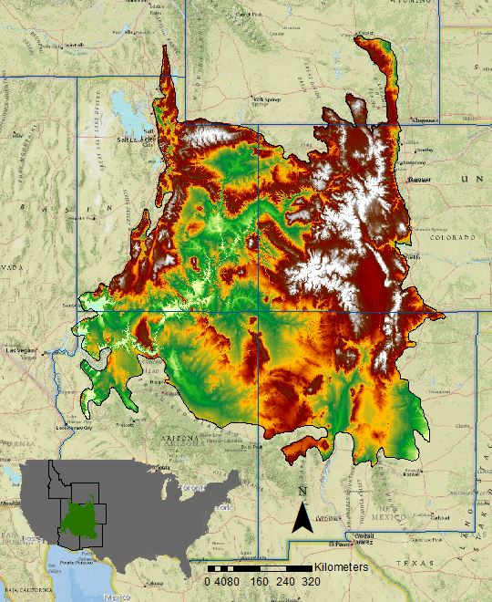
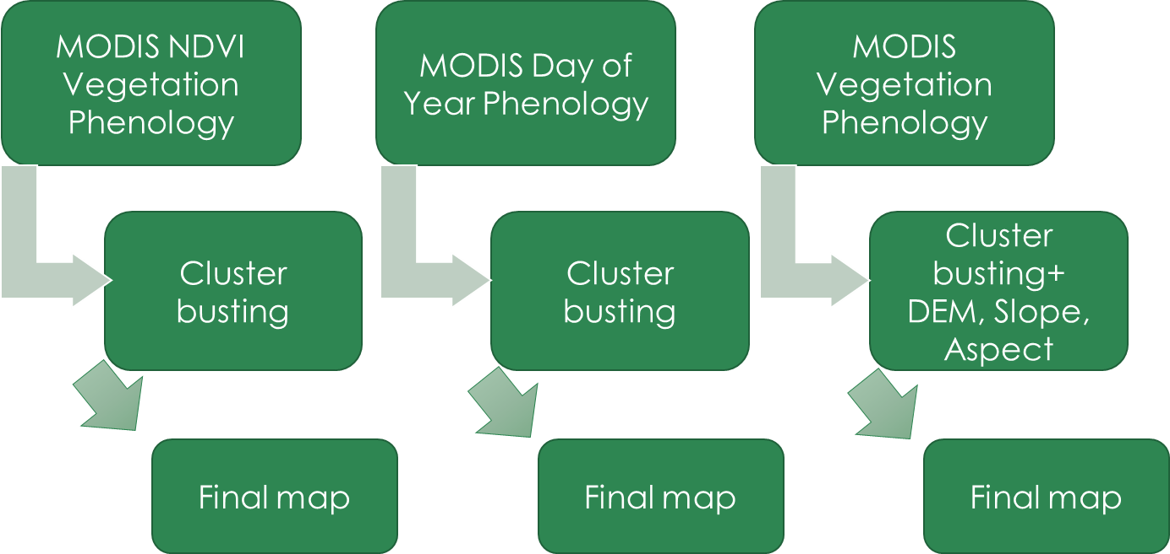
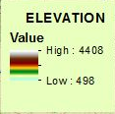
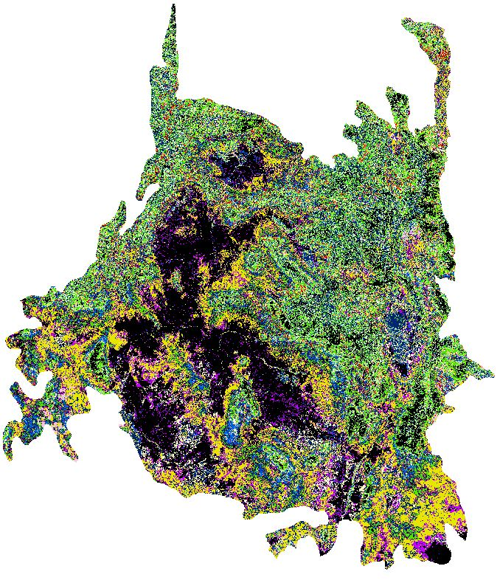
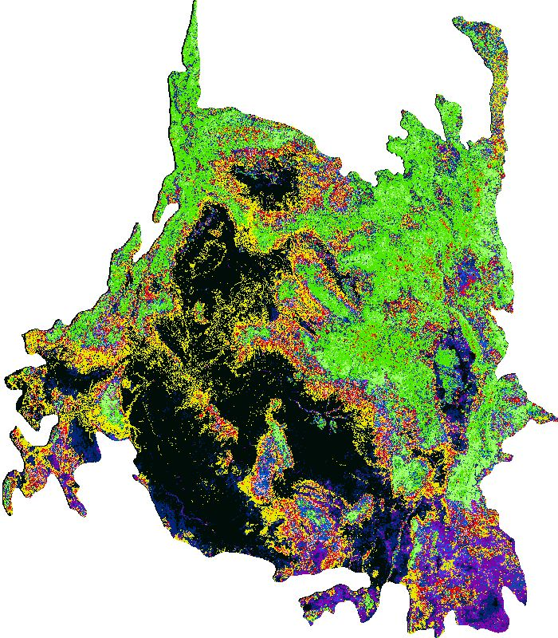
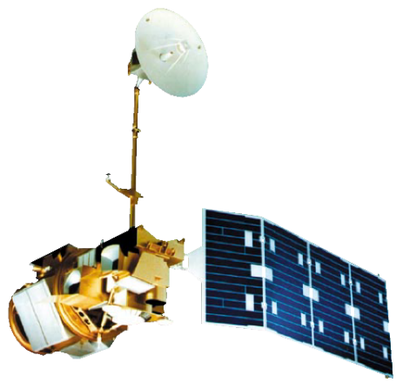
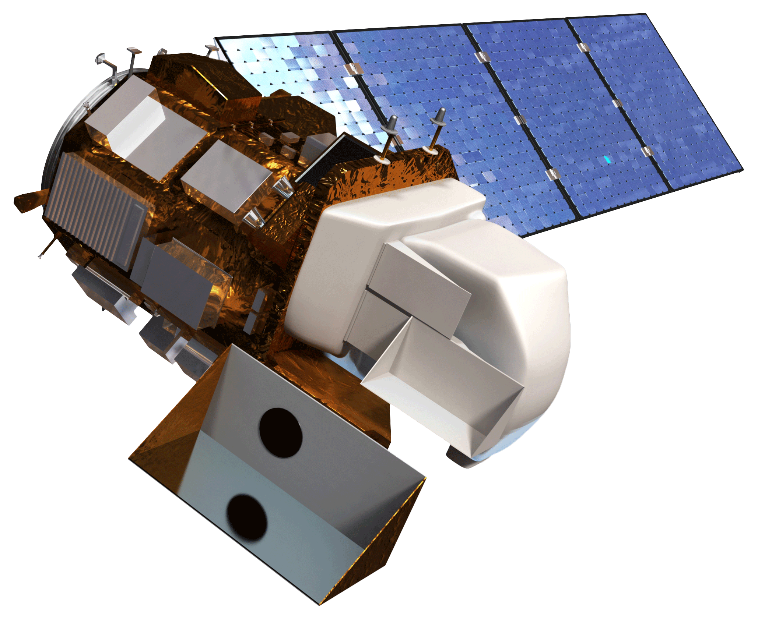
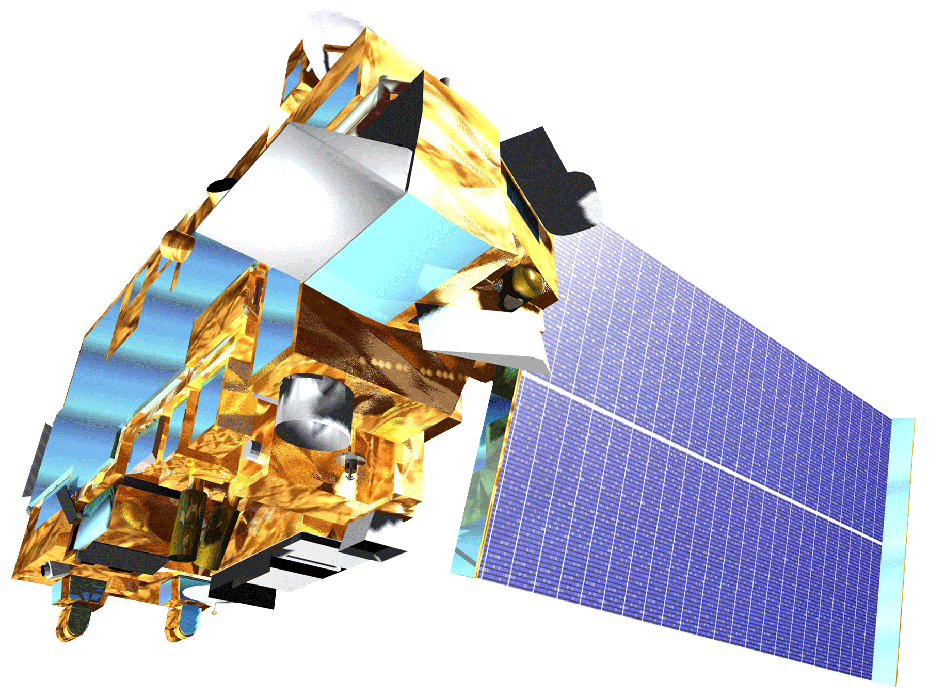
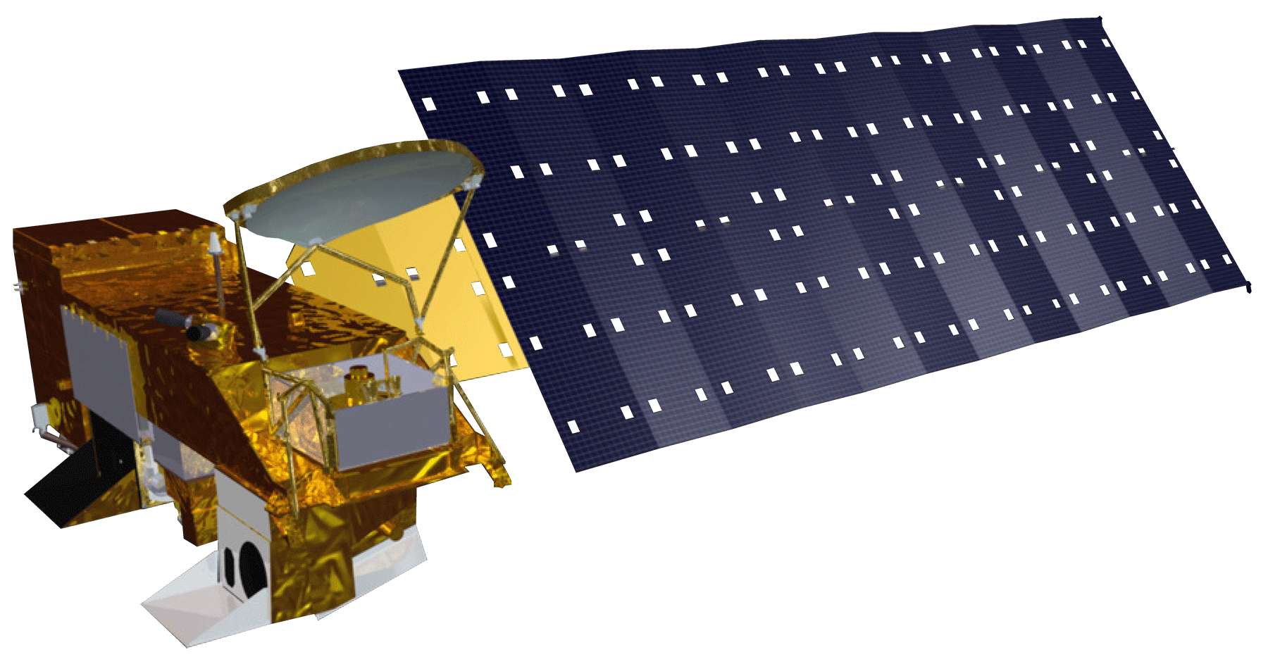
Tracking Mule Deer for Wildlife Corridors between Seasonal Habitats in the Southern Rockies
Abstract
Objectives
Mule deer are economically and ecologically important to the Southern Rockies, however, their populations are currently on the decline. Mule deer are migratory animals that are capable of traveling a few hundred miles from their summer to winter habitats, thus require undefiled corridors that will allow them to continue migrating without traversing over anthropogenic disturbances such as roads, oil well pads, and fences. Such disturbances have interrupted their migration corridors and contributed to mule deer population decline. NASA DEVELOP provided spatial analysis in the form of maps to aid in the conservation of mule deer and their habitats in support of Southern Rockies Landscape Conservation Cooperative (SRLCC) and the Western Association of Fish and Wildlife Agencies (WAFWA) Mule Deer Working Group. The project encompassed the SRLCC boundary, comprised of land in Idaho, Wyoming, Utah, Colorado, Arizona and New Mexico, from 2011 to 2014. Aqua and Terra Moderate Resolution Imaging Spectroradiometer (MODIS) data were primarily used to evaluate vegetation phenology and Normalized Difference Vegetation Index (NDVI) to assess migratory patterns. Terra ASTER data were utilized to create a Digital Elevation Model (DEM) and slope map to aid in determining suitable habitats, additionally, ground temperature and precipitation layers provided by Prism were included. Landsat 5 TM and 8 OLI were utilized to determine current and historical land use, land cover, patch size, and winter to summer connectivity corridors. These factors were incorporated into a species distribution model and mule deer range maps.
Improve understanding of mule deer migration
Determine how anthropogenic features affect migration
Document ideal conservation areas
Identify migratory corridors to maintain the current population
Study Area
Methodology
Results
Southern Rockies Ecological Forecasting II
Earth Observations
Landsat 5 TM
Landsat 8 OLI
Terra MODIS
Aqua MODIS
Conclusions
Three maps were created from a cluster busting technique, these maps included MODIS NDVI vegetation phenology, MODIS day of year phenology, and MODIS vegetation phenology respectively.
The MODIS vegetation phenology map also contained DEM, slope, and aspect layers that were cluster busted to create the third final map.
A tutorial was created to replicate the method of cluster busting for remote sensing..
Team Members
Project Partners
Acknowledgements
Southern Rockies Landscape Conservation Cooperative
John Rice
Mule Deer Western Association of Fish and Wildlife Agencies (WAFWA) Working Group
Jim Heffelfinger
Dr. Kenton Ross
NASA DEVELOP National Program Science Advisor
Emily Adams
NASA DEVELOP Langley Center Lead
Rebekke Muench
NASA DEVELOP Langley Assistant Center Lead
Past Contributors from Fall 2015
Ross Reahard (Project Lead)
Teresa Fenn
Jeri Wisman
This material is based upon work supported by NASA through contract NNL11AA00B and cooperative agreement NNX14AB60A.
Tyler Rhodes
Team Lead
Michael Sclater
Amanda Flake
Allison Chappell
Maggie Jenkins
Cody Walker
NASA Langley Research Center – Spring 2016

