Slide 1
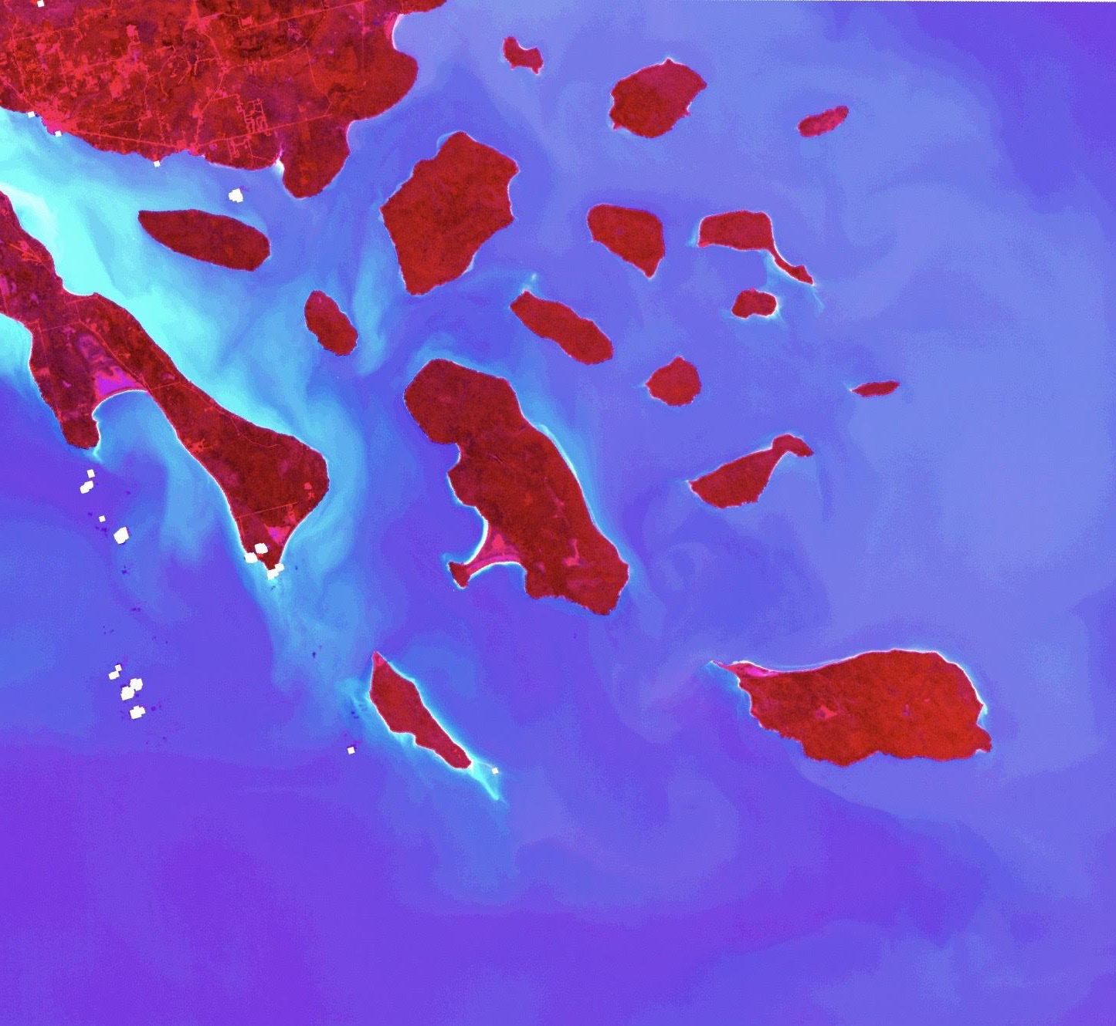
Apostle Islands Water Resources
Mapping Sediment Plumes and Algal Blooms using Earth Observations in the Apostle Islands National Lakeshore
Sarah Wingard
Lea Davidson
Erin Johnson
Brandy Nisbet-Wilcox
Colorado - Fort Collins| Fall 2019
Notes:
Image Source: Landsat 8 OLI, ENVI

Slide 2
PARTNERS
National Park Service (NPS),
Water Resources Division
Dr. Brenda Moraska Lafrancois
Midwest Region Aquatic Ecologist
University of Minnesota- Duluth,
Large Lakes Observatory
Dr. Bob Sterner
Director
Notes:
We partnered with Dr. Brenda Moraska Lafrancois, Midwest Region Aquatic Ecologist, from the National Parks Service and Dr. Bob Sterner, Director of Univ. of MN Duluth’s Large Lakes Observatory. Our project assessed sediment plumes and algal blooms in the Apostle Islands National Lakeshore and western Lake Superior.
Image Source: https://nps.org (public domain)

Slide 3
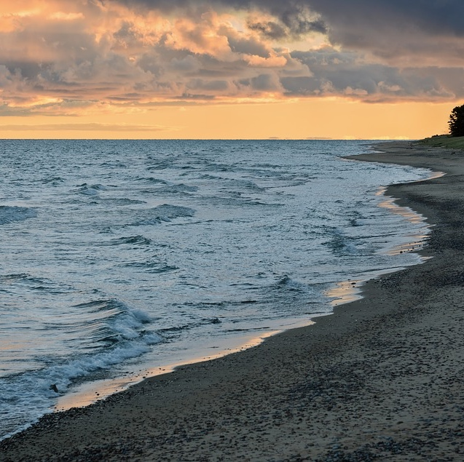
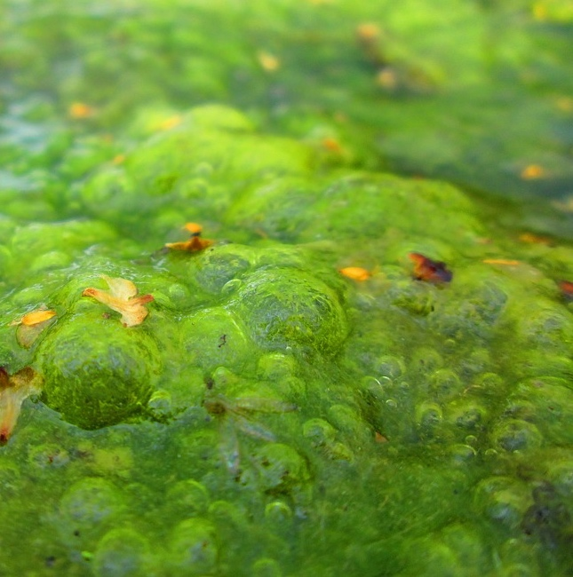
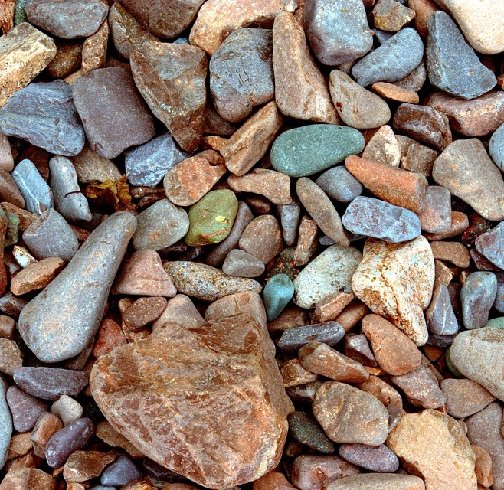
BACKGROUND
Sediment Plumes and Algal Blooms
Changing climate, changing patterns
Perceived increase in phenomena in
western Lake Superior
Sediment Plumes → carry suspended sediment, nutrients
Decreased light penetration, Increase temperature
Algal blooms→ require nutrient surplus, warm temperatures
Decreased oxygen , Cyanobacteria toxin production
Image Credits: Pixabay
Notes:
For this project, we focused on two main phenomena, sediment plumes and algal blooms. Within this study, a sediment plume is defined as an influx of sediment at a high enough concentration to be visible within the water column. Energy within a system keep sediment particles in suspension as sediment particles disperse throughout the water, often lasting in the order of weeks. An algal bloom is defined as a rapid increase in algal population within an area, similarly resulting in extreme high densities visible by change in pigment within the system.
With climate change, project partners are concerned that algal blooms may increase in frequency, as precipitation events become increasingly extreme. Sediment plumes can happen at any time, but are exacerbated by extreme storm events which result in greater erosion. Heavy rain events in the region may exacerbate sediment runoff into the St. Louis and Namidji River tributaries and coastal erosion in Lake Superior, resulting in in changes in frequency and extent of sediment plumes. Runoff carries with it not only inorganic sediment particles, but additional nutrients in the form of nitrogen and phosphorus fertilizers often carried from agricultural land bordering tributaries. Sediment plumes greatly impact water quality, as plumes increase reflectivity, ultimately reducing the amount of sunlight capable of penetrating the water surface and limiting photosynthetic benthic activity.
With increases in available nitrogen and phosphorus from agricultural runoff, algae populations have the ability to rapidly increase in a matter of days. Algal blooms disproportionally use oxygen within a system, while blocking photosynthesizers lower in the water column from accessing sunlight. This creates what are known as ‘dead zones’, where aquatic life can no longer effectively be sustained due to low oxygen levels. In the instance of blue-green algae, Cyanobacteria, toxins are produced during blooms, negatively impacting wildlife and recreation. For this project, our partners were interested in understanding how changing climatic conditions in western Lake Superior alter regional patterns of such phenomena.
Image 1 Credit: “Algae”, ‘3007774’, Pixabay
Image 1 Source: https://pixabay.com/photos/algae-lake-plant-green-pond-1578953/
Image 2 Credit: “Lake Superior”, ‘MikeGoad’, Pixabay
Image 2 Source: https://pixabay.com/photos/lake-superior-shoreline-4047501/
Image 3 Credit: “Lake Superior Beach Gravel”, ‘Skeeze’, Pixabay
Image 3 Source: https://pixabay.com/photos/lake-superior-beach-gravel-background-3537841/

Slide 4
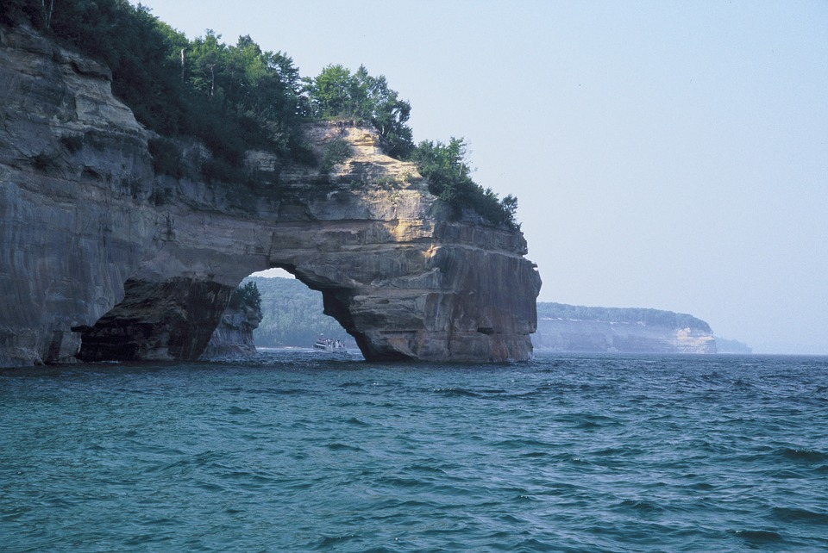
COMMUNITY CONCERNS
Understand sediment plume and algal bloom dynamics
Extent
Temporal trends
Impacts
Water Quality
Ecosystem Health
Tourism
Implications for future management practices
image Credit: Pixabay
Notes:
As Lake Superior holds 10% of the Earth’s freshwater, changes in algal bloom and sediment plume frequency and distribution hold implications for humans and wildlife, affecting water quality, ecosystem health, and tourism. Partners on this project are interested in better understanding this phenomena within the Apostle Islands National Lakeshore, and how it has developed and changed in presence, extent, and duration over time.
This project utilized remote sensing data to quantify sediment plume and algal bloom extent, as well as temporal trends. This information and resulting deliverables was created for utilization by project partners to better understand sediment plume and algal bloom dynamics within the study area, with implications for future management and mitigation practices.
Image Credit: “Landscape Scenic Lake Superior” ‘Skeeze’, Pixabay
Image Source: https://pixabay.com/photos/landscape-scenic-lake-superior-2062850/

Slide 5
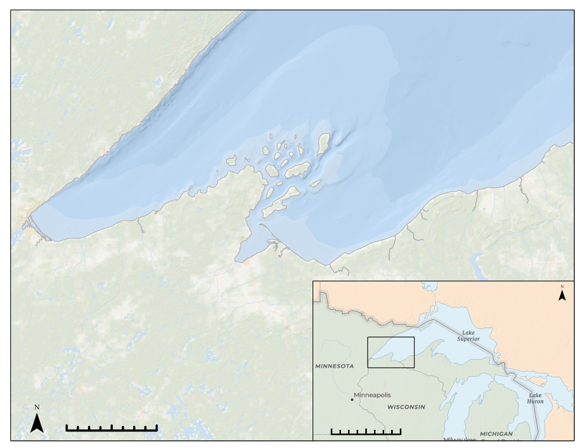
STUDY AREA
Study Period:
Years: 2011-2019
Months: June-August
Study Area:
Western arm of Lake Superior including Apostle Islands National Lakeshore
Apostle Islands National Lakeshore
0 40 60 Kilometers
0 300 600 Kilometers
Notes:
Our study area focused on the Apostle Islands National Lakeshore and parts of western Lake Superior. The Apostle Islands National Lakeshore investigated in this study spans 69,372 acres of shoreline and includes 21 islands along the northern tip of Wisconsin in western Lake Superior-- the largest and deepest freshwater system in the world (NPS, 2015)
Our study period was within the years 2011-2019, specifically looking at the summer months of June-August. We focused on the summer months because algal blooms primarily occur during these months due to frequent precipitation events and warm temperatures.
Basemap Source: ESRI, ArcGIS Pro

Slide 6
OBJECTIVES
Assess
Analyze
Apply
Determine which NASA/ESA Earth observing satellite sensors are appropriate for monitoring sediment plumes & algal blooms
Investigate which remote sensing indices are effective for sediment plume & algal bloom detection
Generate a model to map sediment plumes in the western arm of Lake Superior
Image Credit: Pixabay
Notes:
Our first objective was to assess the feasibility of incorporating NASA & ESA Earth Observing satellites. We looked at Landsat 8 Operational Land Imager (OLI), Moderate Resolution Imaging Spectroradiometer (MODIS) Aqua/ Terra, and Sentinel-2 Multispectral Instrument (MSI) to monitor sediment plume and algal bloom presence, extent, and duration at the Apostle Islands National Lakeshore. To determine which satellite sensors were appropriate for sediment plume and algal bloom monitoring, we focused our assessment on spatial, spectral, and temporal satellite resolutions - putting less emphasis on radiometric resolution.
Our next step was to investigate remote sensing indices used for detecting sediment plumes and algal blooms using total suspended solids (TSS) and Chlorophyll-a values as proxies for water quality measurements. We used satellite imagery in conjunction with in-situ Chlorophyll-a data to produce spatiotemporal trend analyses of sediment plume and algal bloom events.
Lastly, we generated a model based on top performing indices to map sediment plumes in the western arm of Lake Superior.
Image Credit: “Lake Superior Beach Gravel”, Pixabay
Image Source: Pixabay https://pixabay.com/photos/lake-superior-beach-gravel-background-3537841/

Slide 7
ASSESS
Platform & Sensor | Spatial Resolution | Temporal Resolution | Years of Coverage
Landsat 8 OLI | 30 m | 16 days | February 11th, 2013 - Present
Sentinel-2 MSI | 10-60m | 5 days | June 23rd, 2015 - Present
Aqua MODIS | 500m-1km | 1-2 days | May 4th, 2002 - Present
Terra MODIS | 500m-1km | 1-2 days | December 18th, 1999 - Present
Sentinel-3 OLCI EFR | 300m | 2 days | February 16th, 2016 - Present
MERIS | 300m | 3 days | March 2002 - April 12, 2012
Notes:
Moving forward with our first objective to assess which satellites and sensors were appropriate for this study, our search started with these 6 satellites: Landsat 8, Sentinel 2 MSI, Aqua MODIS, Terra MODIS, Sentinel-3 OLCI EFR, and MERIS. Landsat 8 and Sentinel-2 were promising due to their high spatial resolution where we could potentially get a detailed picture of plumes and blooms within western Lake Superior. However, we know based on how rapidly these phenomena can change that a fine temporal resolution is key for water quality monitoring. We then incorporated Aqua MODIS, Terra MODIS, and Sentinel-3 OLCI EFR, and MERIS which don’t have a very fine temporal resolution, but are able to flyover every 1-3 days.

Slide 8
ASSESS
Notes:
Our partners initially gave us a list of bloom event dates with descriptions of their observed duration and extent. To determine which sensors would be appropriate to incorporate into this study, we looked at available imagery for each proposed sensor within 2-6 weeks of the event. Within this timeframe, we compiled all imagery in which the western arm of Lake Superior was visible.

Slide 9
ASSESS
Platform & Sensor | Spatial Resolution | Temporal Resolution | Years of Coverage
Landsat 8 OLI | 30 m | 16 days | February 11th, 2013 - Present
Sentinel-2 MSI | 10-60m | 5 days | June 23rd, 2015 - Present
Aqua MODIS | 500m-1km | 1-2 days | May 4th, 2002 - Present
Terra MODIS | 500m-1km | 1-2 days | December 18th, 1999 - Present
Sentinel-3 OLCI EFR | 300m | 2 days | February 16th, 2016 - Present
MERIS | 300m | 3 days | March 2002 - April 12, 2012
Notes:
Based off the availability of images, we chose to narrow down our scope in the continuation of our project.
We went forward using Aqua/ Terra MODIS for sediment plume detection, and Sentinel-3 OLCI EFR for algal bloom detection.

Slide 10
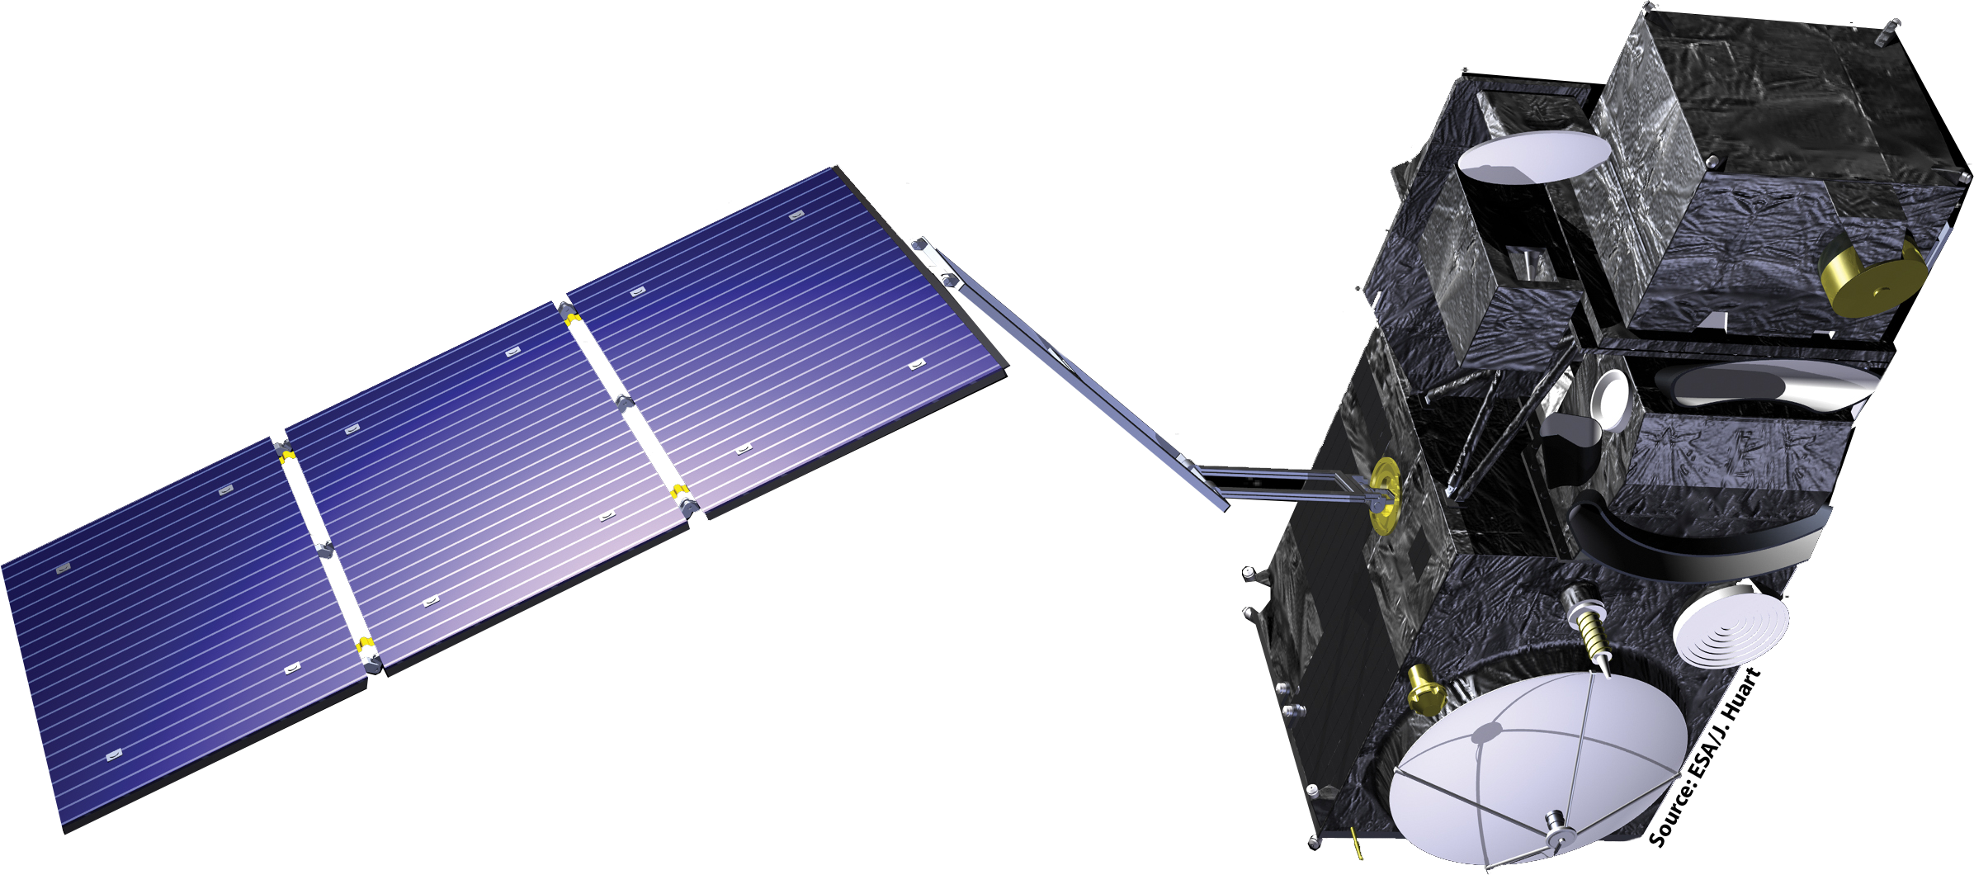
SATELLITES AND SENSORS
Terra MODIS
Spatial Resolution: 500 m
Temporal Resolution: 1 day
Available from: 2000 to present
Aqua MODIS
Spatial Resolution: 500 m
Temporal Resolution: 1-2 days
Available from: 2002 to present
Sentinel-3
Spatial Resolution: 300 m
Temporal Resolution: 2 day
Available from: 2016 to present
Notes:
We used Aqua and Terra MODIS (Moderate Resolution Imaging Spectroradiometer) to perform our study. Of all of the sensors that we explored prior to making our selection (including Sentinel-2 MSI, Sentinel-3 OLCI EFR, and Landsat 8 OLI), it had the coarsest spatial resolution of 500 m, but the highest temporal resolution of one day and best coverage of our study area. Having full coverage daily imagery allowed us to perform a time series analysis to track the state of the study area before notable precipitation events by two weeks and after the events by a month in an attempt to detect subsequent sediment plumes and algal blooms over time.
We initially looked into using MODIS sensors, Landsat 8 OLI, and Sentinel 2 MSI for studying algal blooms, but ultimately selected Sentinel 3 OLCI EFR. MODIS had the most available imagery, with nearly two images per day, but spatial resolution of 500m-1km is not suitable for observing these nearshore phenomena. Landsat 8 OLI and Sentinel 2 MSI had much finer spatial resolution, but very coarse temporal resolution with infrequent flyover dates near described bloom events and incomplete coverage of the study area. The coarse temporal resolution is not suitable for observing these rapidly changing, ephemeral phenomena. Sentinel-3 OLCI EFR struck the most acceptable balance between spatial resolution and temporal resolution, although this sacrifice of temporal resolution is less than ideal.
Satellite Image Source: DEVELOPedia

Slide 11
METHODOLOGY
METHODOLOGY
Index 1
Index 2
Index 3
Index 4
Acquire imagery from Aqua MODIS, Terra MODIS, and Sentinel-3
Cloud mask Aqua MODIS and Terra MODIS imagery
Compile and apply indices
for chlorophyll-a and transmissivity
Notes:
The first step of our process was acquiring imagery from Terra MODIS, Aqua MODIS, and Sentinel-3 using Google Earth Engine. We compiled images from the event dates of field collection as well as one day before and one day after. We then compiled indices to test for the detection of chlorophyll-a and turbidity within Lake Superior based on previous successful studies of using band indices for water quality monitoring in lake systems similar to Lake Superior or the Great Lakes. We then processed our imagery by stacking our collection of images, applying a cloud mask, and running our band indices within Google Earth Engine.
Image Credits:
Satellite: http://clipart-library.com/satellite-cliparts.html
Lake Superior: Powerpoint

Slide 12
METHODOLOGY
Index Value
Field Measurement
Extract raster values from field collection points
Correlate field collected data and remotely sensed data
Develop and apply model to detect extent of plume
Notes:
We then extracted the raster value from the pixel that intersected the field collection points taken by our project partners and correlated the field collected transmissivity measurements to the pixel values to determine if a relationship existed using spearman’s correlation coefficient in R. We then ran Random Forest in R to determine the most important indices for building a model to detect sediment plumes within western Lake Superior and applied that model to our study area.
Image Credit: PowerPoint

Slide 13
RANDOM FOREST
What is Random Forest?
Ensemble learning method for classification
Uses large number of decision trees
Our Model:
Random Forest intakes predictors (indices)
Ran VSURF (Variable Selection Using Random Forest), ordered predictors by importance
Selected top 6 indices
Trained and ran our decision trees with a continuous model
Notes:
Random Forest is an ensemble learning method for classification through the construction of a large number of decision trees.
In the creation of our model, we had random forest take in a variety of predictors, specifically different indices. We then ran VSURF, or variable selection using random forest, which allowed us to order our predictors by importance to the model. From this, we selected our top 6 indices, which we trained and ran our decision trees on with a continuous model.
Image Credit: PowerPoint

Slide 14
RESULTS: TOP PLUME INDICES
Index
Sensor
Equation
Study Area
Wang 3 | Terra MODIS | B2 + B6 | Yangtze River, China
Wang 6 | Terra MODIS | B2 - B6 | Yangtze River, China
Wang 21 | Aqua MODIS | -1.91*1140.25(B1) | Hangzhou Bay, China
Notes:
Our top 3 performing indices displayed above appear to effectively identify plume and non-plume events. All top performing indices were produced by a single author, yet from different studies. The above indices were applied over a river and a bay in China.

Slide 15
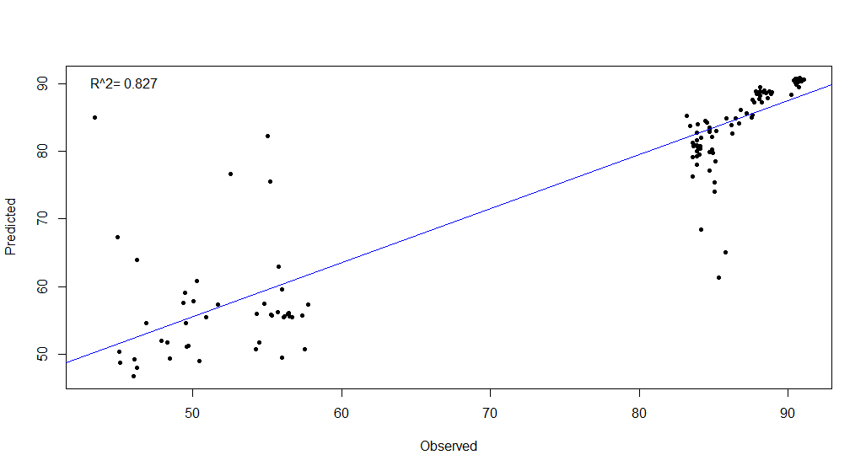
RESULTS
Random Forest Model
Top Performing Plume Indices for Events on 6/19
90
80
70
60
50
R² = 0.827
Predicted Transmissivity (%)
50 60 70 80 90
Observed Transmissivity (%)
Notes:
A spearman’s correlation is a statistical measure of the strength of a relationship between paired data, in this case in situ data and satellite data at the same location within the study area. Applying a Random Forest method for classification further corroborated these views, indicating a close match between observed and predicted transmissivity.
Random Forest Graph: Generated in RStudio

Slide 16
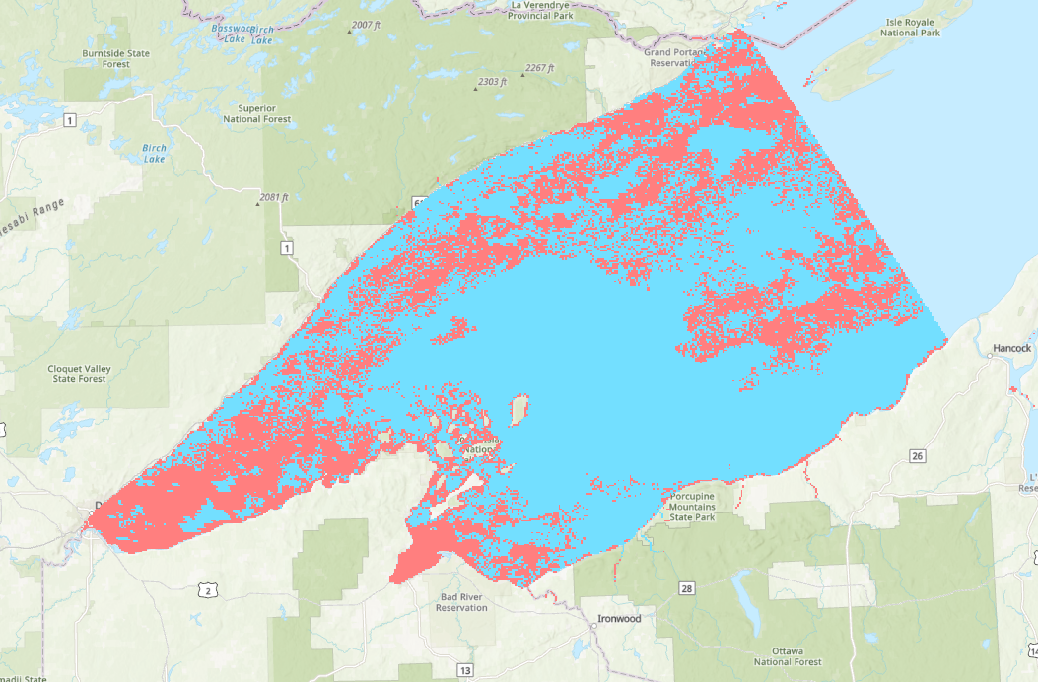
PREDICTION MAP
Red indicates plume presence, blue indicates plume absence
Complications due to noise in MODIS satellite imagery
Future studies may want to explore Sentinel-3 OLCI for monitoring plumes from 2016-present
Transmissivity below 75%
Transmissivity above 75%
Notes:
We ran Random Forest in GEE using those same top performing (from slide 14) indices to build a model to predict transmissivity values. The above prediction map displays two extremes of classification-- plume presence versus plume absence. We did not have any field data in a middle region between 60-80% transmissivity. Lack of “intermediate” data may be creating the noise seen in the map above (especially in the off-shore waters of the lake).
Map: ArcGIS Pro

Slide 17
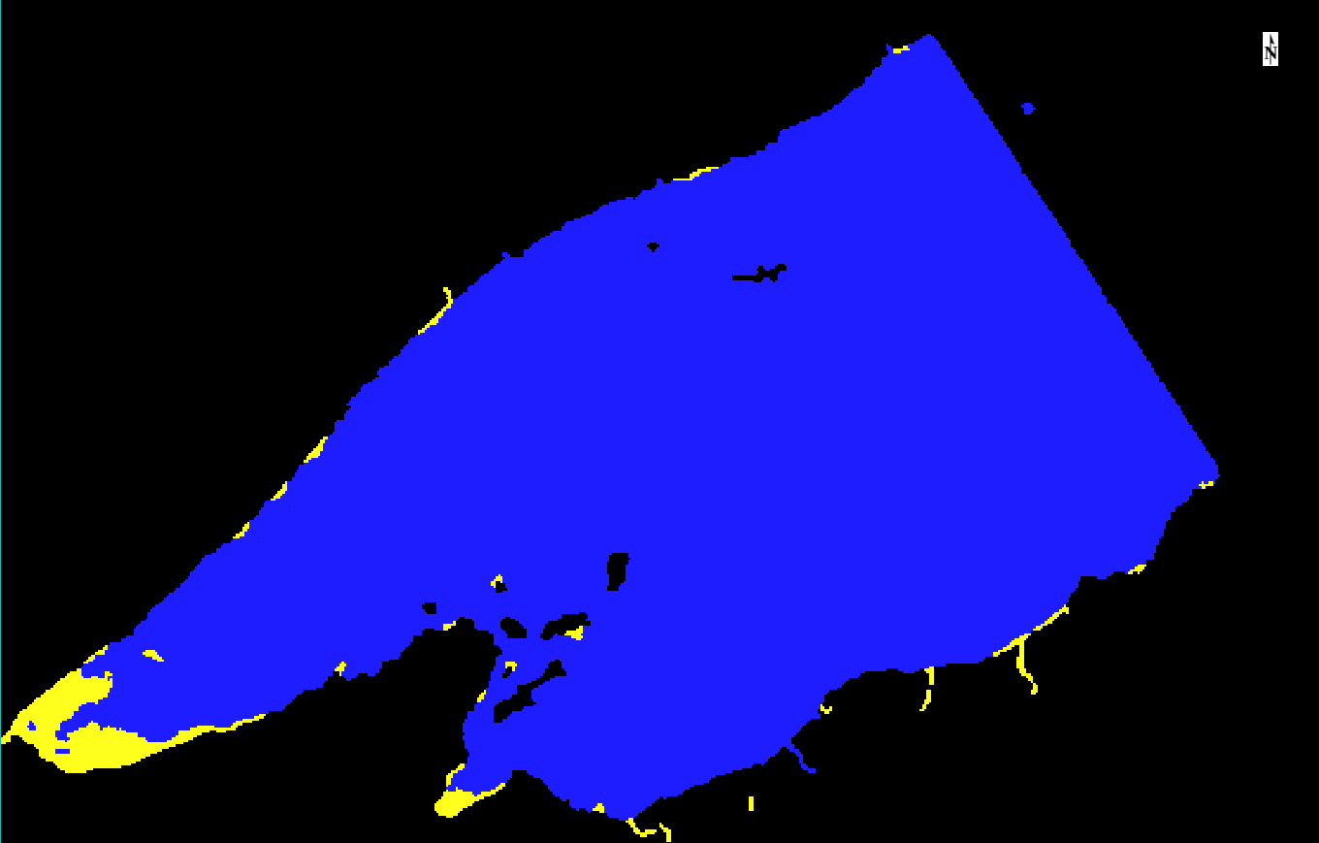
Visually Enhanced Prediction Map
Transmissivity 25 – 35%
Transmissivity 39 – 90%
Image visually enhanced in ENVI
Classes were combined & map was smoothed to reduce sensor noise
Must interpret with caution!
Notes:
To reduce noise in our prediction map, our GEE random forest model output was loaded into ENVI. An unsupervised classification was run on the GEE random forest output, then classes were combined to smooth the resulting map above.
Map: ENVI

Slide 18
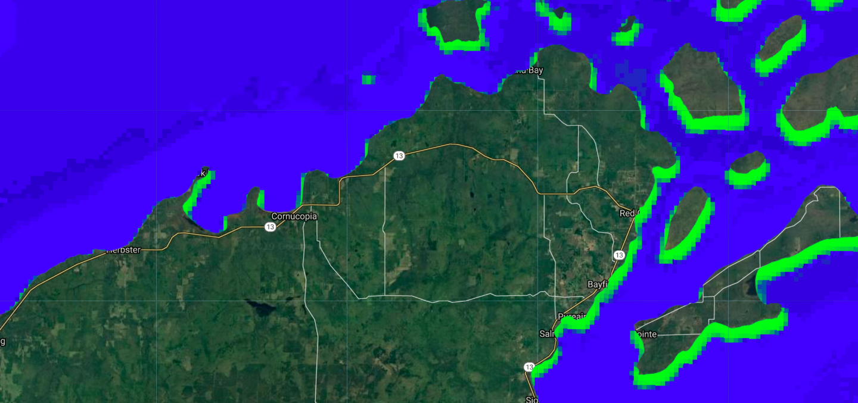
RESULTS: Before Bloom 7/07/2018
High chlorophyll-a values
Low chlorophyll-a values
Notes:
Because we didn’t have field data during a bloom, our best index was chosen by doing a visual evaluation. We accomplished this by following descriptions of bloom events from our partners in regards to where the blooms were and how far into the lake they spanned. We then acquired imagery from before the bloom, during the bloom, and after to visually detect if any of our indices were picking up this change.
Green pixels on the eastern shore areas are bright and visible before, during, and after the described bloom dates. It is likely that the green pixels here do not represent an algal bloom, but instead may represent terrestrial vegetation in areas where our buffered shapefile overlaps with land, or due to fluctuating water levels changing the extent of the shoreline and contributing to the mixed pixel effect.
Index applied: Toming 2, for date 7/07/18
Image Source: Google Earth Engine, Sentinel-3 OLCI EFR: Ocean and Land Color Instrument Earth Observation Full Resolution

Slide 19
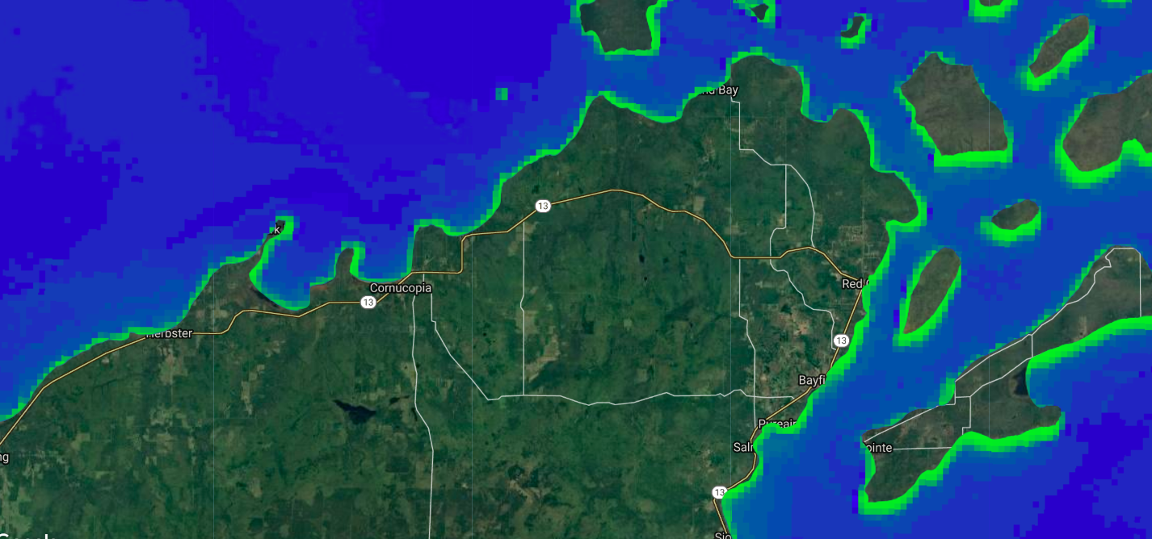
RESULTS: During Bloom 8/11/2018
High chlorophyll-a values
Low chlorophyll-a values
Notes:
Our partners’ largest observed event occurred in August 2018, around the 5th-15th. This bloom spanned 90 km from Twin Ports of Duluth to the Apostle Islands National Lakeshore. This is an image of Cornucopia Beach to the Apostle Islands National Lakeshore and the index Band 8/Band 12 or roughly Red/NIR on August 11, 2018. Our partners identified a bloom along this shoreline extending about .5 kilometers into the lake which this index seems to be detecting algae.
Index applied: Toming 2, for date 8/11/2018
Image Source: Google Earth Engine, Sentinel-3 OLCI EFR: Ocean and Land Color Instrument Earth Observation Full Resolution

Slide 20
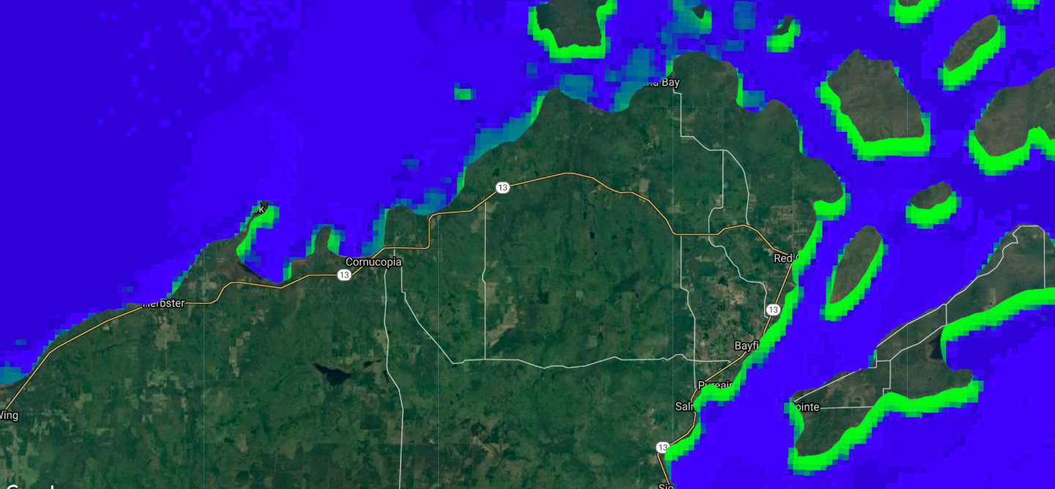
RESULTS: After Bloom 8/30/2018
High chlorophyll-a values
Low chlorophyll-a values
Notes:
Here is what the index is detecting after the bloom date on August 30, 2018. You can see that there is not as strong of a signal along the shoreline here, although it is picking up some clouds within this image. Because blooms are so close to the shoreline, mixed pixels may potentially be an issue in this study as well
Index applied: Toming 2, for date 8/30/18
Image Source: Google Earth Engine, Sentinel-3 OLCI EFR: Ocean and Land Color Instrument Earth Observation Full Resolution

Slide 21
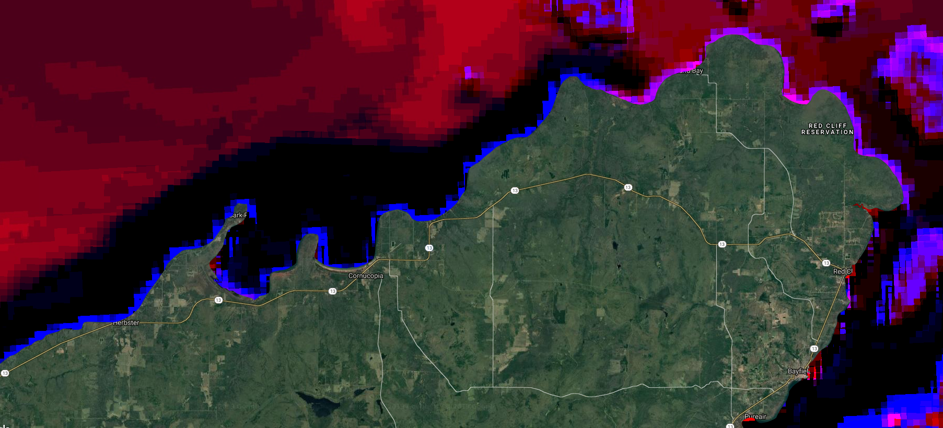
RESULTS: Image Differencing
Areas of Potential Change
Notes:
In image differencing, images of two different dates are subtracted to generate an image that shows changes of land use/ land cover. A Sentinel-3 satellite image obtained before the algal bloom (7/07/2018) was subtracted from an image acquired during the algal bloom (7/31/2018). The blue and pink areas shown hugging the coastline reveal areas of potential change. Image differencing appears to reinforce that there are changes happening along the coast of the Apostle Islands.
It is important to note the potential effect of mixed pixels. Mixed pixels encompass more than one type of land cover class-- therefore having the potential to introduce misleading results. Mixed pixels are especially apparent along the edges of land cover features such as a shoreline.
Another source of error in our visual evaluation may arise from changing variable lake water levels.
Image Source: Google Earth Engine, Sentinel-3 OLCI EFR: Ocean and Land Color Instrument Earth Observation Full Resolution

Slide 22
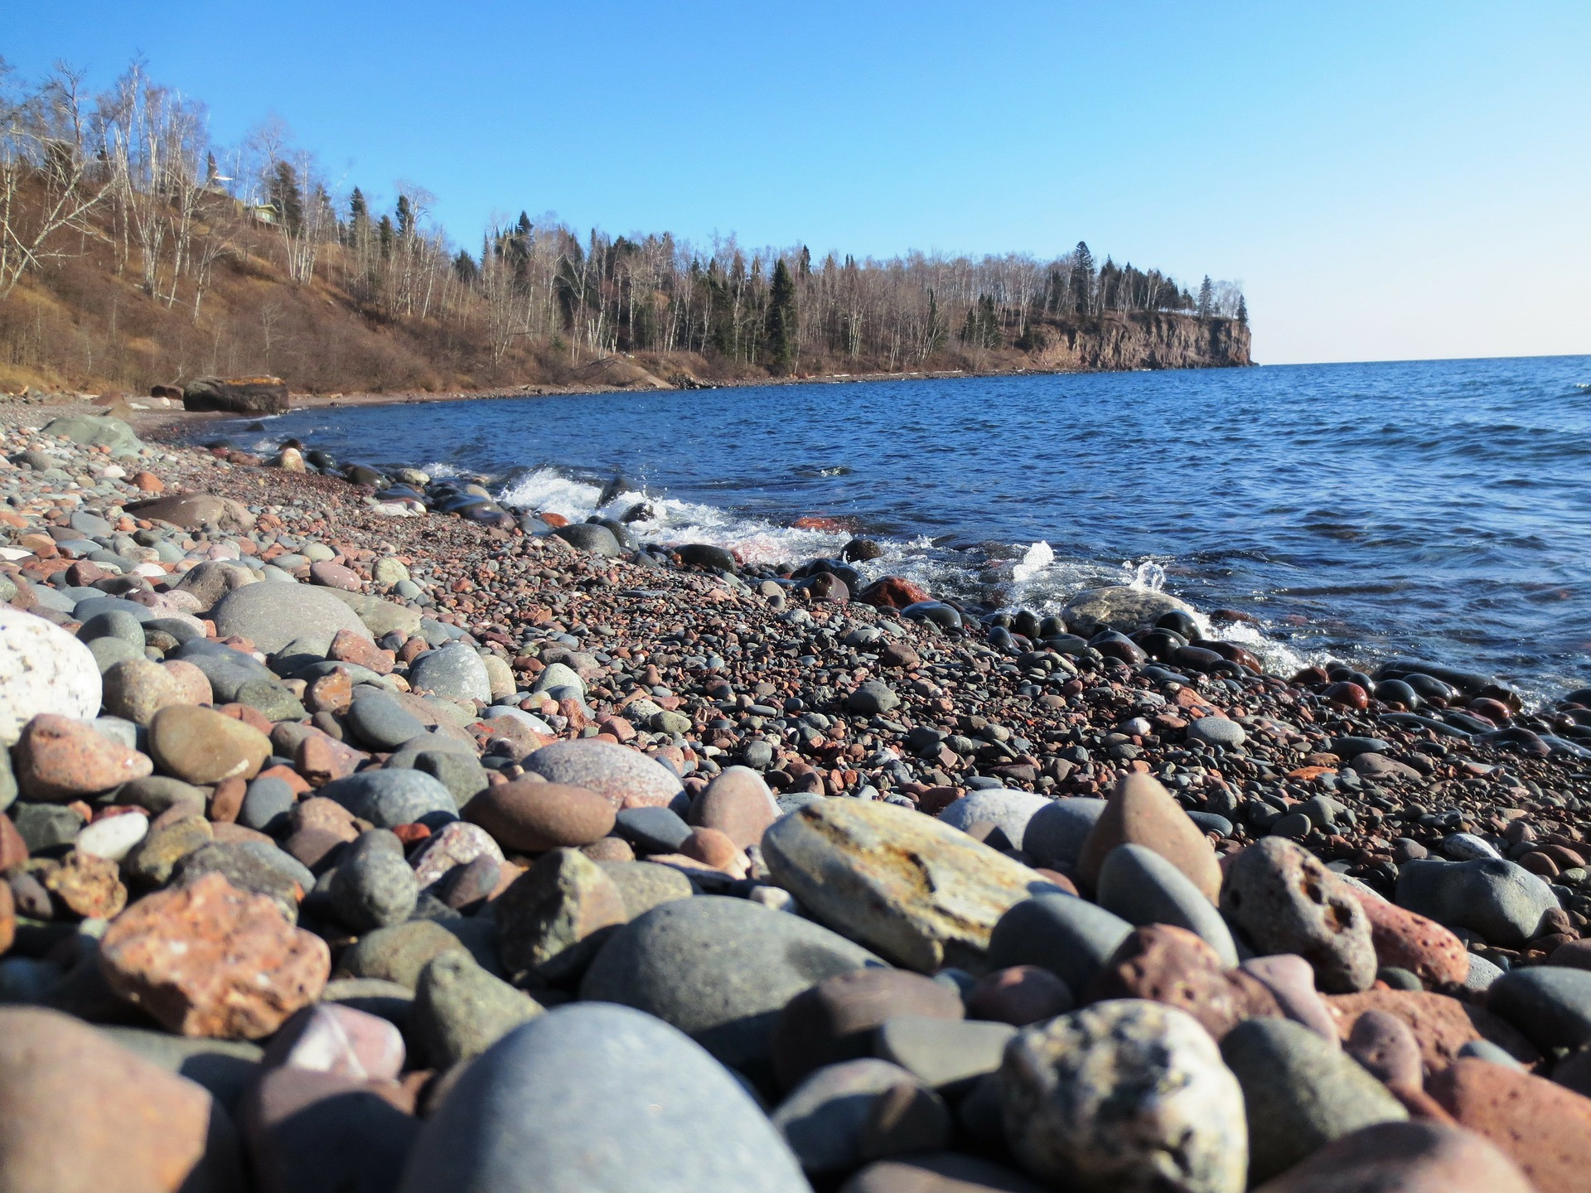
LIMITATIONS & FUTURE WORK
Available imagery:
Blooms change within a matter of hours
Temporal resolution vs. spatial resolution tradeoff
Data compatibility:
More field collection locations required
Necessary to consistently monitor chl-a concentrations and transmissivity
Important to have measurements for presence and absence of plume/ bloom events
Image Credit: Pixabay
Notes:
During this project, one of our main limitations centered around satellite feasibility. Specifically, we wrestled with the question of temporal vs. spatial resolution, and the tradeoffs of prioritizing one over the other. This was particularly an issue when assessing blooms, which are seen less than a kilometer from shore, but change in a matter of days. We ultimately prioritized the finer spatial resolution of Sentinel-3, but had to settle for lower temporal resolution.
Additionally, we struggled throughout this project with questions of data compatibility. For future exploration of sediment plumes and algal blooms with remote sensing technology, we recommend data collection take place on each consecutive day of an event, with multiple samples taken at multiple locations throughout a study area. It would further be useful for measurements to be taken in the absence of such phenomena at identical locations. Increasing the quantity of data for presence and absence of events helps provide a more complete data set better suited for training a model.
Image Credit: “Minnesota”, antigurugirl, Pixabay
Image Source: https://pixabay.com/photos/minnesota-lake-superior-shore-211395/

Slide 23
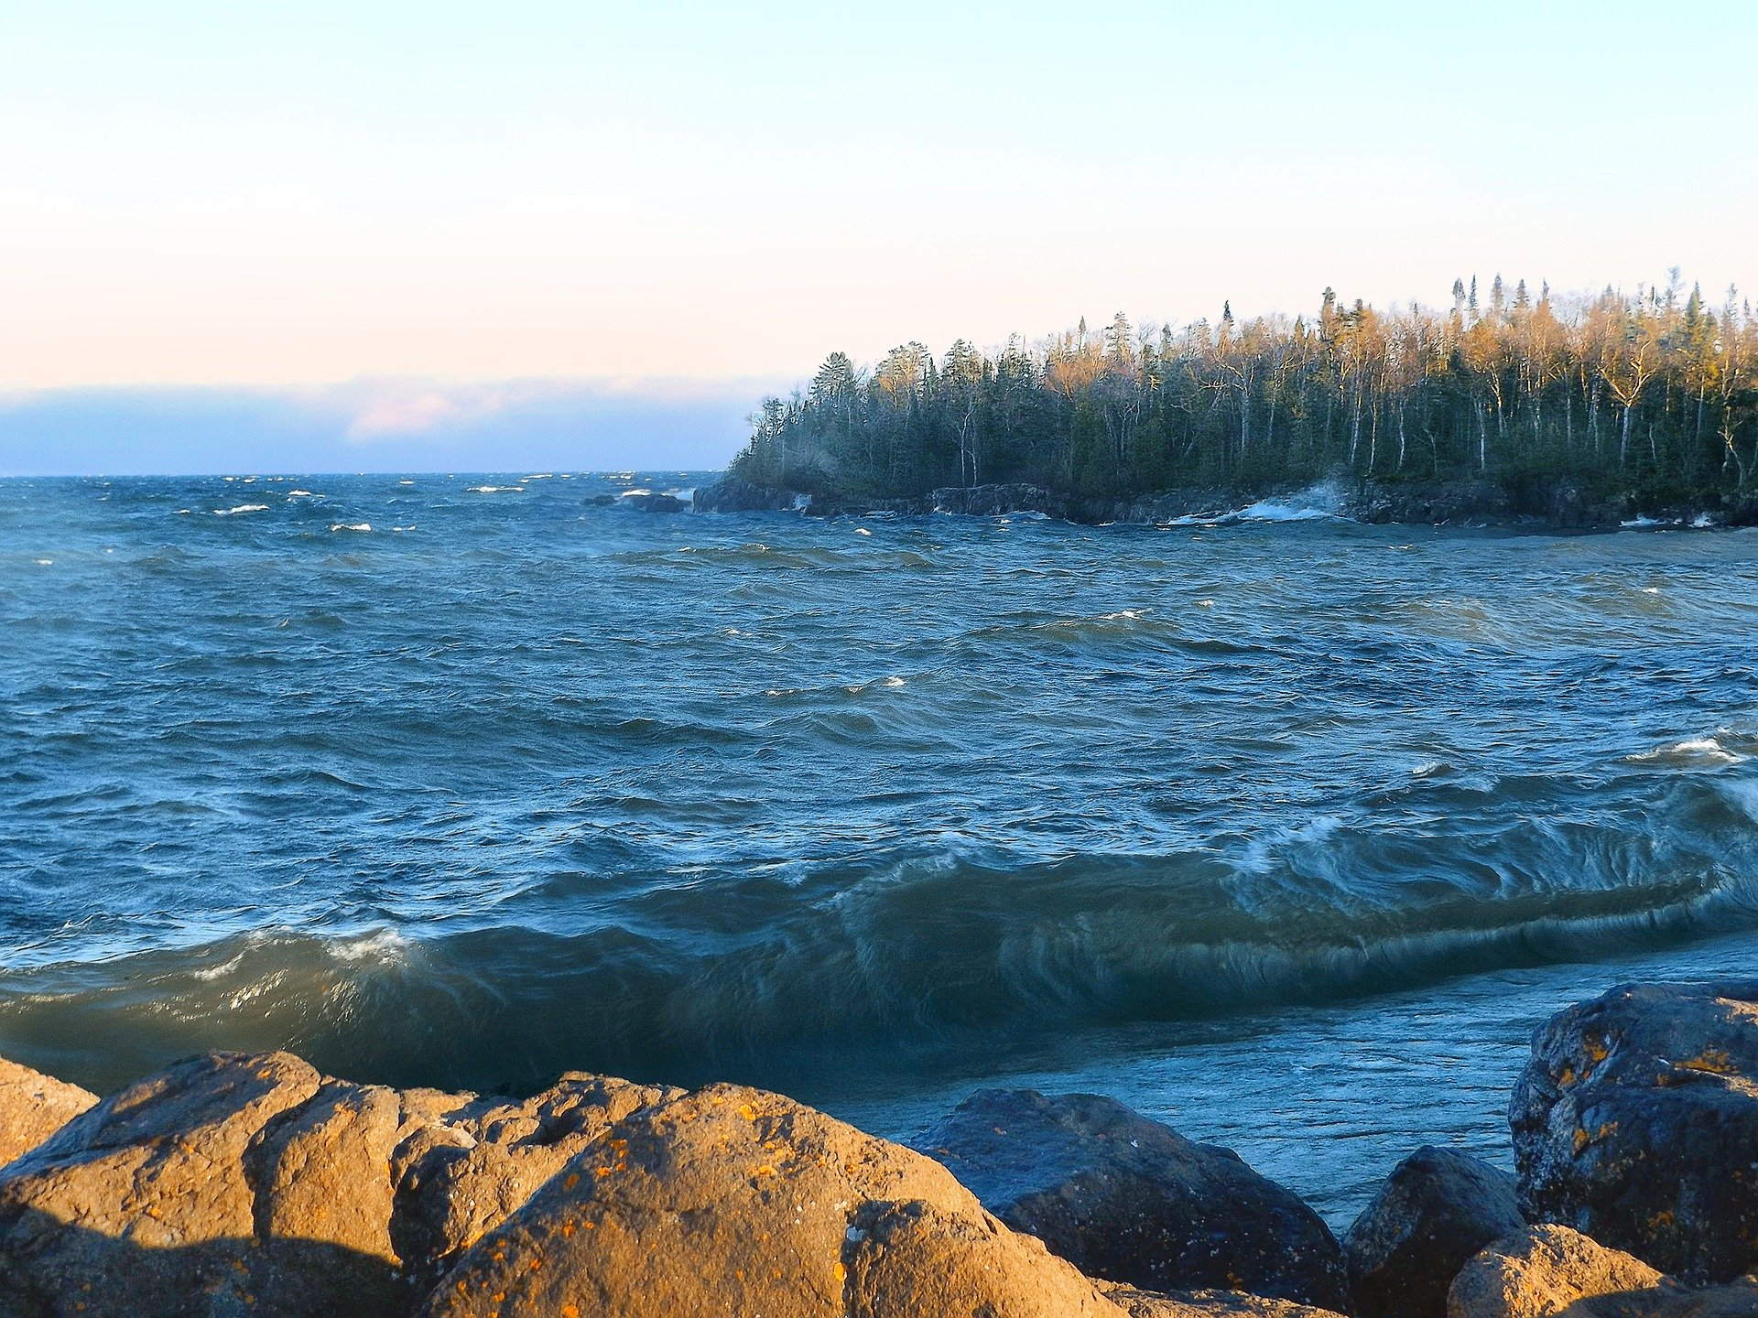
CONCLUSIONS
High temporal resolution is necessary for water quality remote sensing
Sentinel-3 bands 8 & 12 are the most promising for detecting algal blooms
The highest correlated index to field-collected transmissivity was a polynomial equation of MODIS Band 1
Random Forest approach with multiple indices forms a model with the strongest predictive power
Image Credit: Pixabay
Notes:
Our study highlighted the importance of high temporal resolution satellites when monitoring water quality parameters with remotely sensed data. We initially set out to include imagery from Sentinel-2 and Landsat 8, but the courser temporal resolution and the lack of cloud-free imagery proved to be a problem. Because of this, we moved forward with Terra/Aqua MODIS for sediment plume detection, and Sentinel-3 for algal bloom detection.
We found that Sentinel-3 bands 8 & 12, or the red and NIR regions of the electromagnetic spectrum respectively, appear to be the most promising for detecting algal blooms from space.
In regards to sediment plumes, we found that the highest correlated index to our field-collected transmissivity data was a polynomial equation that utilized MODIS’s band 1 - AKA the red band.
Image Credit: “Artist Point”, havenshell, Pixabay
Image Source: https://pixabay.com/photos/artist-point-lake-superior-1581746/

Slide 24
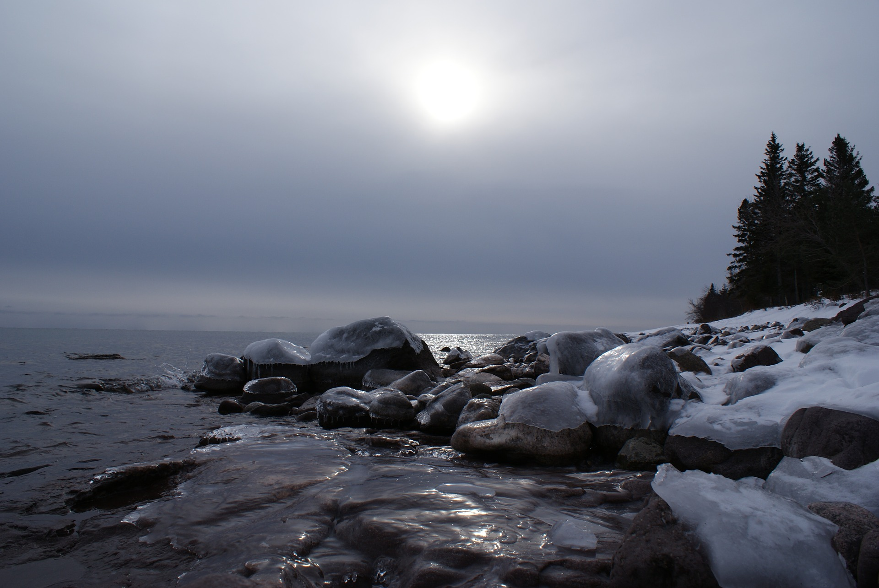
Lake Superior is Important!
Water quality impacts:
Major source of drinking water
Diverse aquatic ecosystems
Beloved recreational areas
Image Credit: Pixabay
Notes:
In conclusion, maintaining the health of freshwater ecosystems is vital for both human and aquatic life. Lake Superior serves as a major source of public drinking water, and is home to an array of diverse aquatic ecosystems, as well as popular recreational sites.
Remote sensing offers real time ability to monitor water quality, aid in creation of informed mitigation strategies, and communicate with the public about current conditions
Image Credit: “Lake Superior”, Standuppaddle, Pixabay
Image Source: https://pixabay.com/photos/lake-superior-superior-great-lakes-2093792/

Slide 25
A special thanks to everyone at the Fort Collins node for their support and guidance in the creation of this project
Dr. Paul Evangelista (Colorado State University, Natural Resource Ecology Laboratory)
Dr. Catherine Jarnevich (United States Geological Survey – Fort Collins Science Center)
Tony Vorster (Colorado State University, Natural Resource Ecology Laboratory)
Nicholas Young (Colorado State University, Natural Resource Ecology Laboratory)
Peder Engelstad (Colorado State University, Natural Resource Ecology Laboratory)
Kristen Dennis (NASA DEVELOP, Fellow)

Slide 26
A special thanks to our Project Partners who provided us with field data and their expertise throughout the project
Dr. Brenda Moraska Lafrancois (National Park Service, Water Resources Division)
Dr. Bob Sterner (University of Minnesota- Duluth, Large Lakes Observatory)
Dr. Liz Minor (University of Minnesota- Duluth, Large Lakes Observatory)
This material contains modified Copernicus Sentinel data (2018), processed by ESA.
Notes:
Image Source: https://nps.org (public domain)

