Slide 1
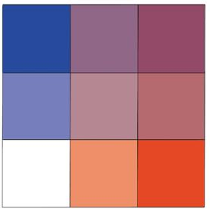
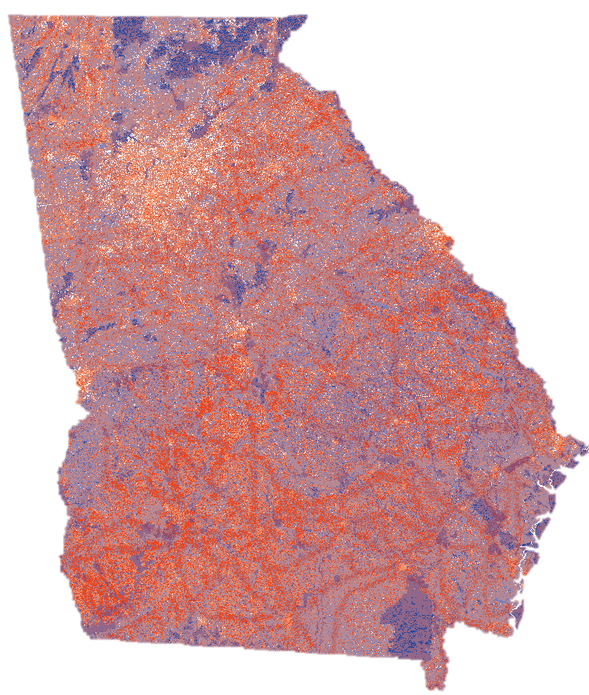
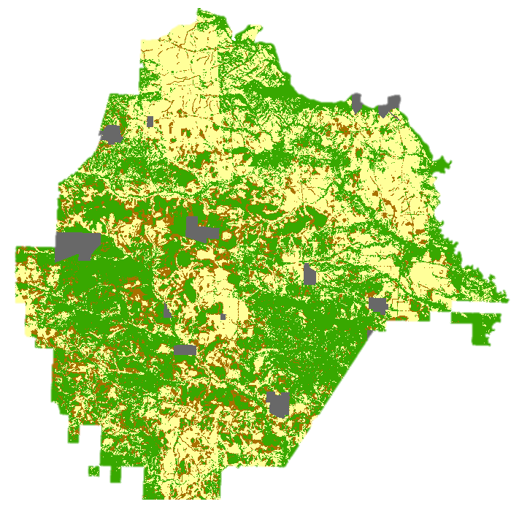
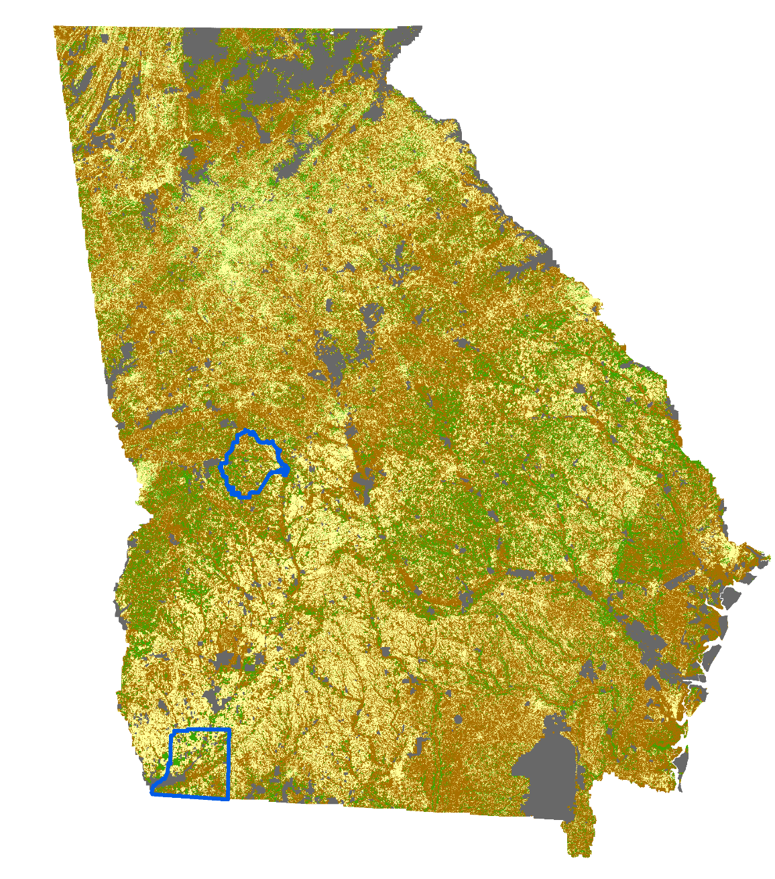
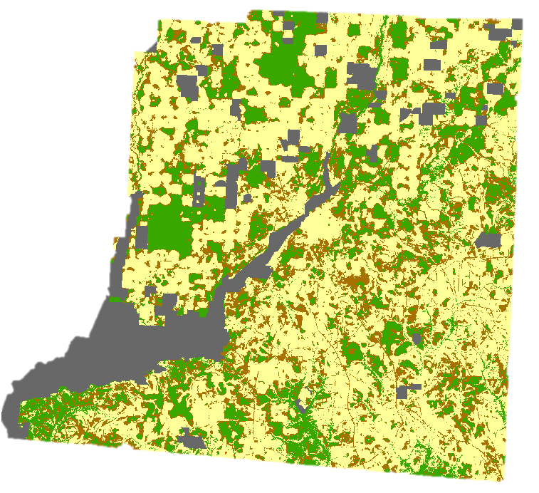
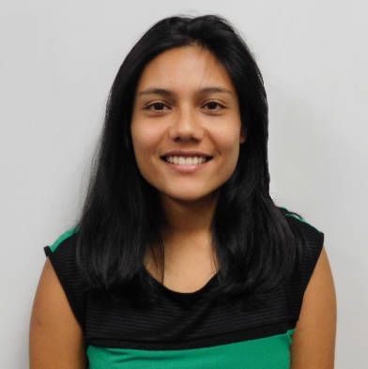
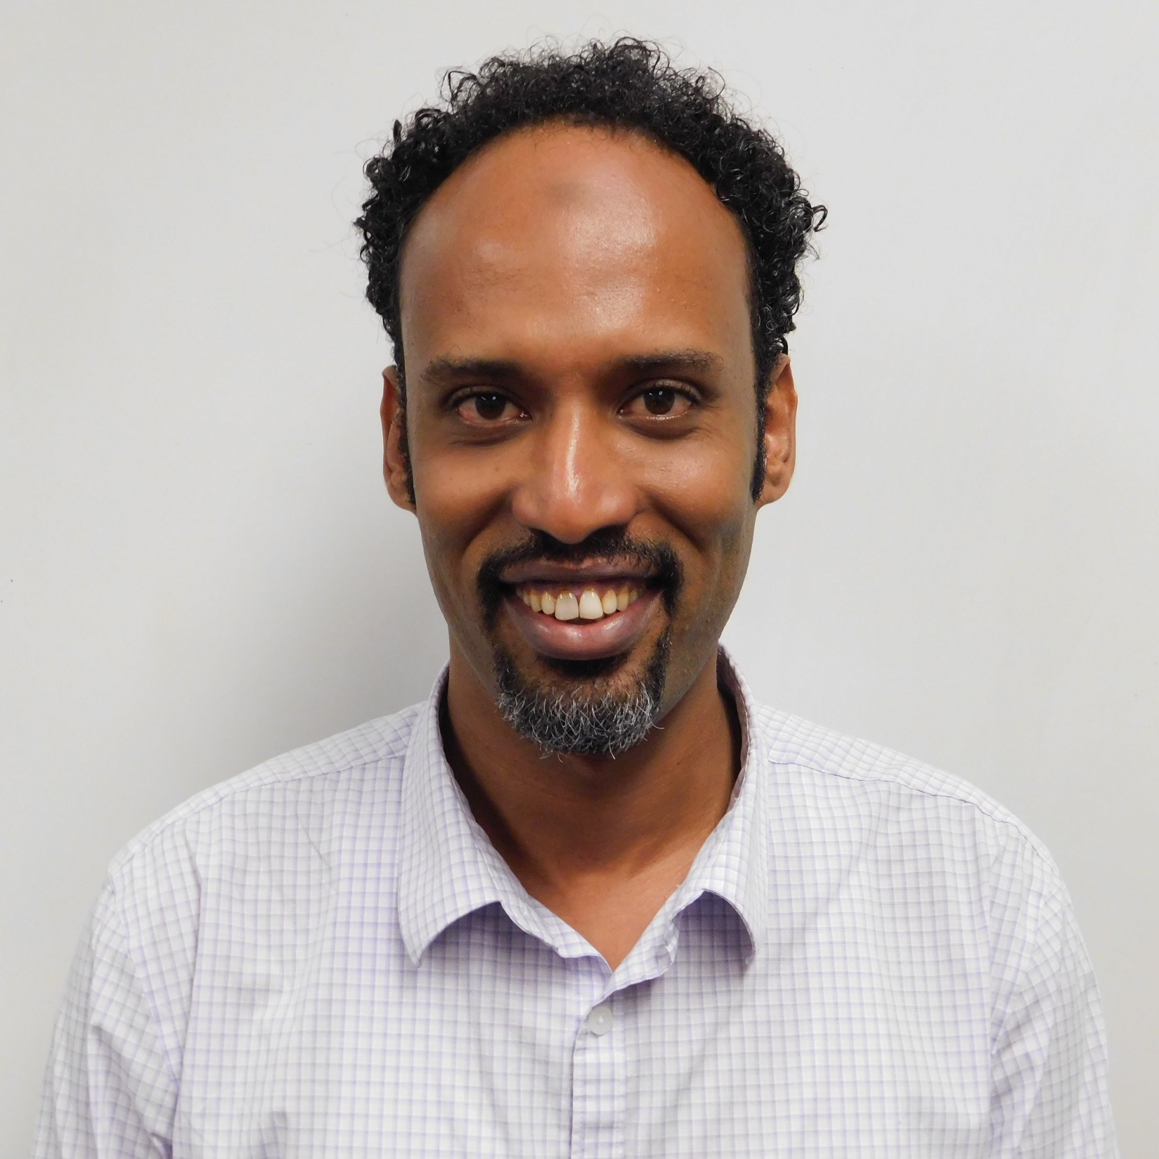
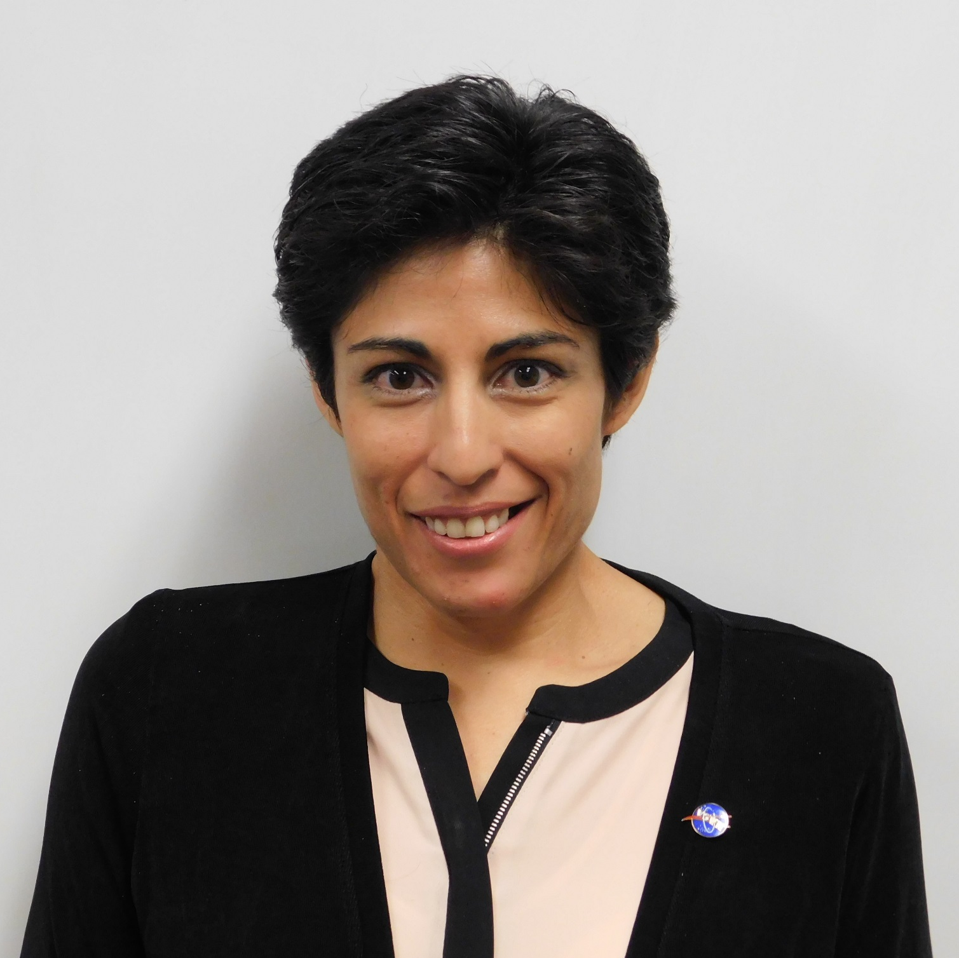
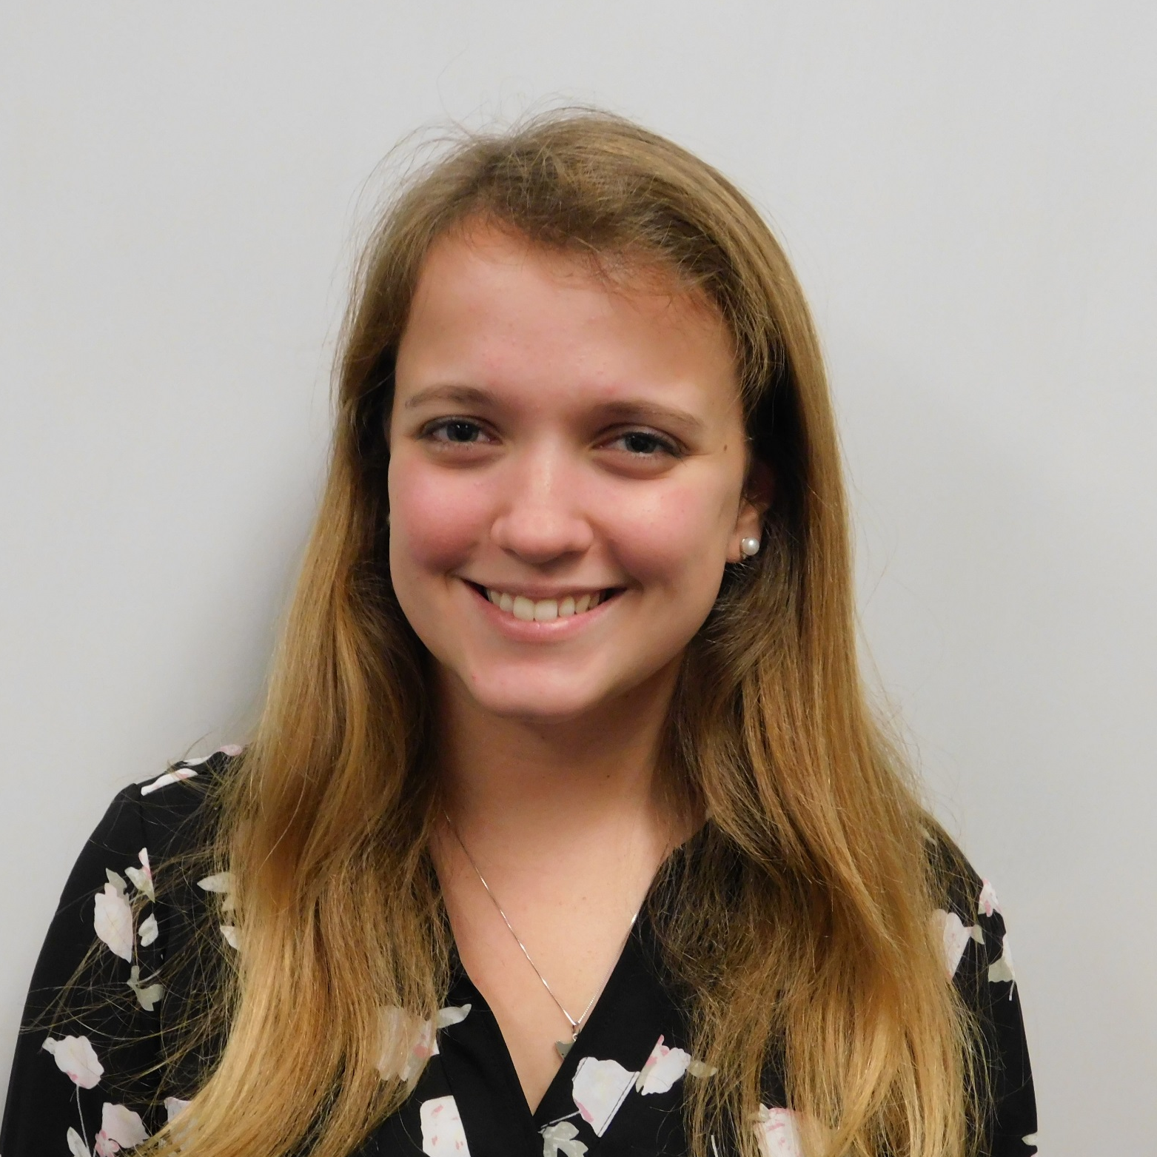
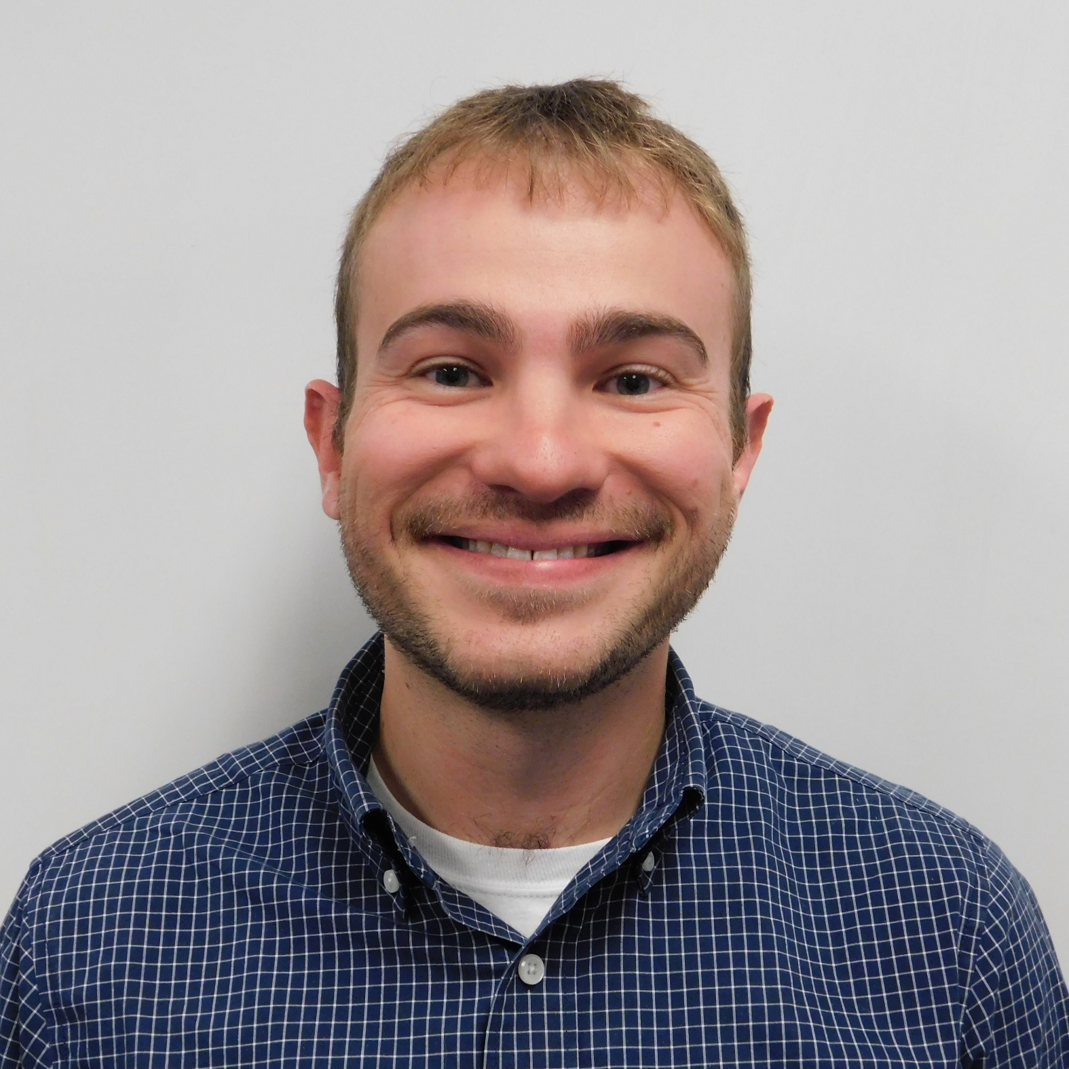
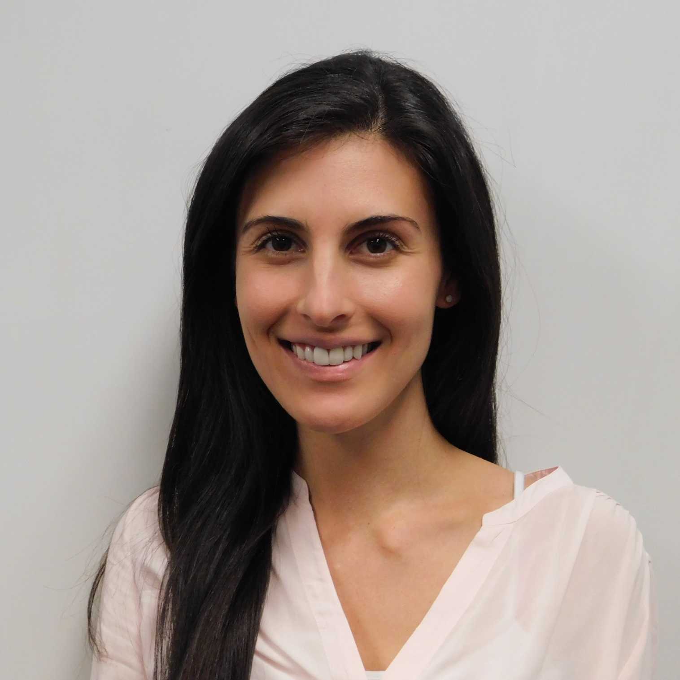
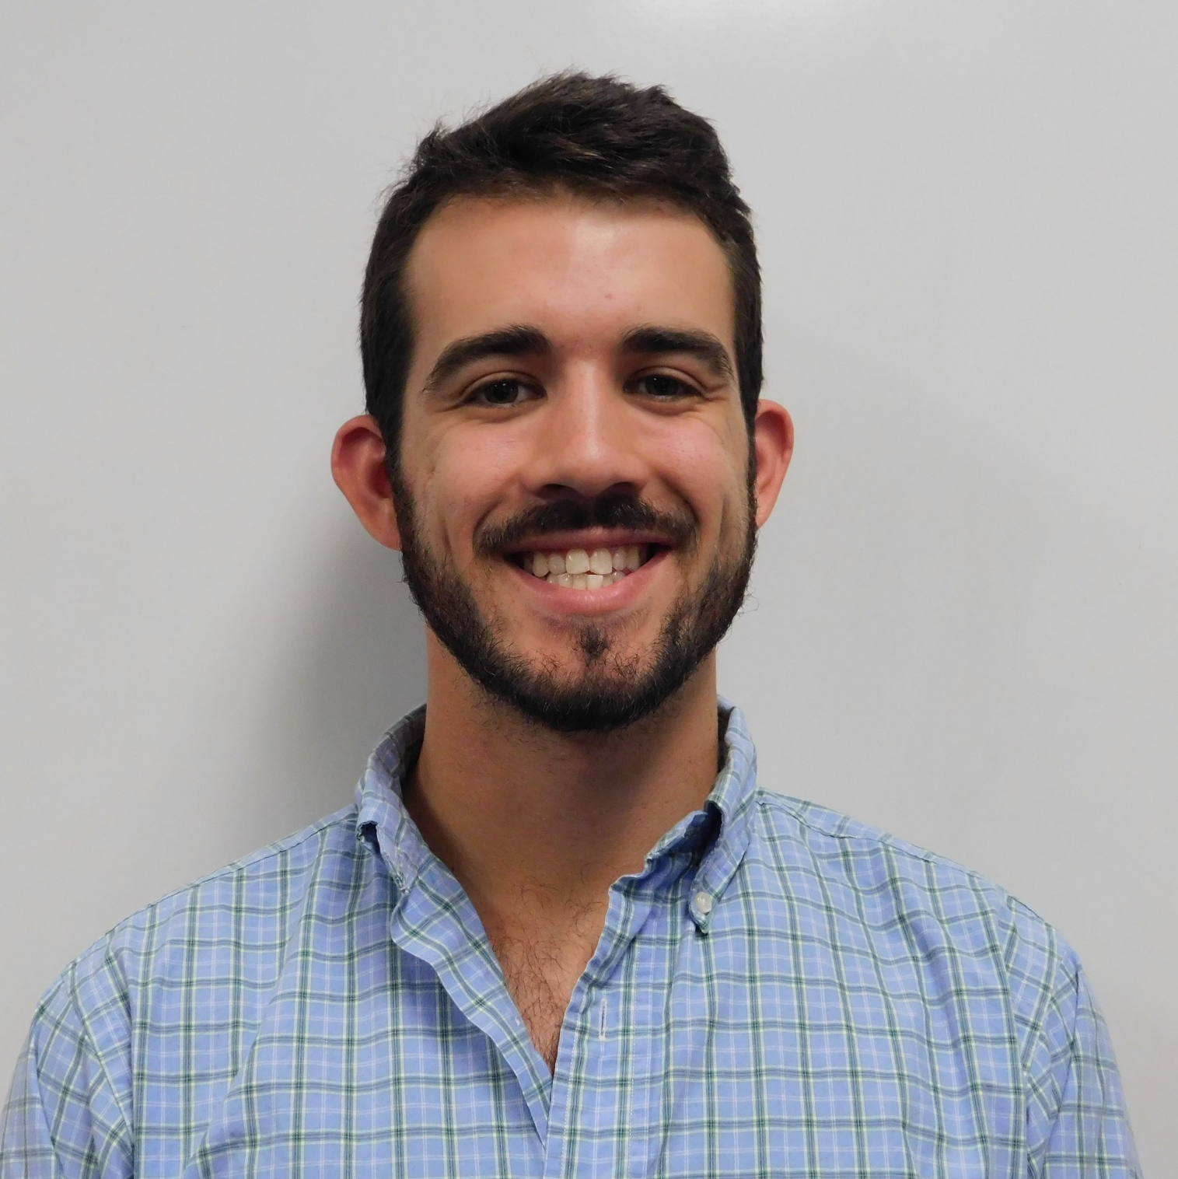
Identifying Suitable Areas for Solar Power Generating Facilities while Reducing Conflicts with Sensitive Habitats
and Wildlife Populations
Abstract
Study Area
Objectives
Solar energy is a rapidly growing industry in the state of Georgia. The increasing popularity of solar farms has encouraged decision-makers and developers to incorporate a sustainable plan for utility-scale solar developments. However, the construction and siting of solar farms could have a threatening impact on environmentally sensitive habitats and associated species. NASA DEVELOP partnered with The Nature Conservancy and the Georgia Department of Natural Resources to conduct an analysis to inform solar site planning and to communicate with key stakeholders. The team analyzed land cover trends from Landsat 8 Operational Land Imager (OLI), in addition to solar insolation data sets from Terra’s Clouds and the Earth’s Radiant Energy Systems (CERES) sensor. These Earth observations were combined to classify and extract data layers for a solar site suitability and conflict identification model following the Land Use Conflict Identification Strategy (LUCIS). Additionally, the DEVELOP team utilized habitat layers of the endangered gopher tortoise (Gopherus polyphemus) primarily due to its role as a keystone species in these sensitive areas. These data were used to generate end products that depict potential conflicts between ideal solar energy sites and endangered species habitats, and prioritize development areas outside of these conflicts. The team examined potential conflicts in Decatur and Taylor counties with additional datasets on existing solar utility infrastructure and parcel data to provide a local-level analysis. The results of this project will be utilized by The Nature Conservancy and Georgia Department of Natural Resources to recommend suitable sites for environmentally conscious solar farm construction.
Conduct in-depth solar site suitability analysis on Decatur and Taylor counties
Analyze land cover change in selected counties with regards to solar development
Integrate data on environmental sensitivity and infrastructural site suitability to map ideal locations for utility-scale solar development within Georgia
Provide decision-makers with tools to assist in selecting solar development sites
Georgia
Earth Observations
Platform | Instrument
Terra (1999) | Clouds and the Earth’s Radiant Energy System (CERES)
Landsat 8 (2013) | Operational Land Imager/Thermal Infrared Sensor (OLI/TRIS)
Methodology
Stakeholder Needs: Environmental and Solar Developer
Develop Goals, Objectives, and Criteria for Land-Use Conflict Identification Strategy (LUCIS) Model
Acquire and Input Data into Land-Use Scenarios
Results
Environmental Sensitivity
Solar Development Potential
Bivariate Map
Environmental Sensitivity
Environmental Sensitivity
Solar Insolation (CERES)
Slope
(DEM)
Gopher Tortoise Habitat (UGA)
Protected Lands (GADNR)
Georgia Energy II
Granite Rock Outcrops (NRCS)
Land-Use (CropScape)
Land-Use (CropScape)
Aspect
(DEM)
Solar Farm
Development Potential
Prime Farmland
(NRCS)
Streams
(NWI)
Roads
(GA)
Parcels
(GA)
Transmission Lines (TNC)
Floodplains
(FEMA)
Taylor
County
Solar Suitability Map
Product: Map Indicating Environmentally Sensitive Areas
Product: Suitability Map for Solar Development Potential
Product: Bivariate Map
Decatur
County
Product: Suitability Map
Project Partners
Low Suitability
Protected Areas
The Nature Conservancy
Georgia Department of Natural Resources
Moderate Suitability
Counties
Conclusions
Acknowledgements
High Suitability
We would like to thank our science advisor, Dr. Marguerite Madden, for her advice and guidance throughout this project, as well as our past contributors Lynn Abdouni, Natalia Bhattacharjee, Roger Bledsoe, Christopher Cameron.
We would also like to thank our partners Cassidy Jordan and Mat Elliot for their support and involvement throughout the project as well as Sara Gottlieb, Dr. Paul Stackhouse, and Dr. Jeff Hepinstall-Cymerman for their assistance.
Higher suitability for solar development was found in southern regions of the state and areas in proximity to transmission lines.
A majority of the existing solar farms in the counties showed areas of high potential for solar development and low environmental sensitivity.
According to the analysis, Decatur county showed more suitable sites for solar farm development than Taylor county.
Team Members
Suravi Shrestha
Project Lead
Emad
Ahmed
Amanda
Aragon
Marie
Bouffard
Fabiola
Clermont
Peter
Hawman
Nick
Morgan
Caren
Remillard
Austin
Stone
Georgia – Athens
Fall 2017

