Slide 1
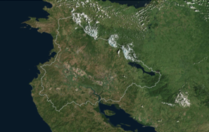
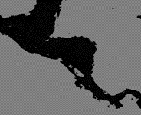

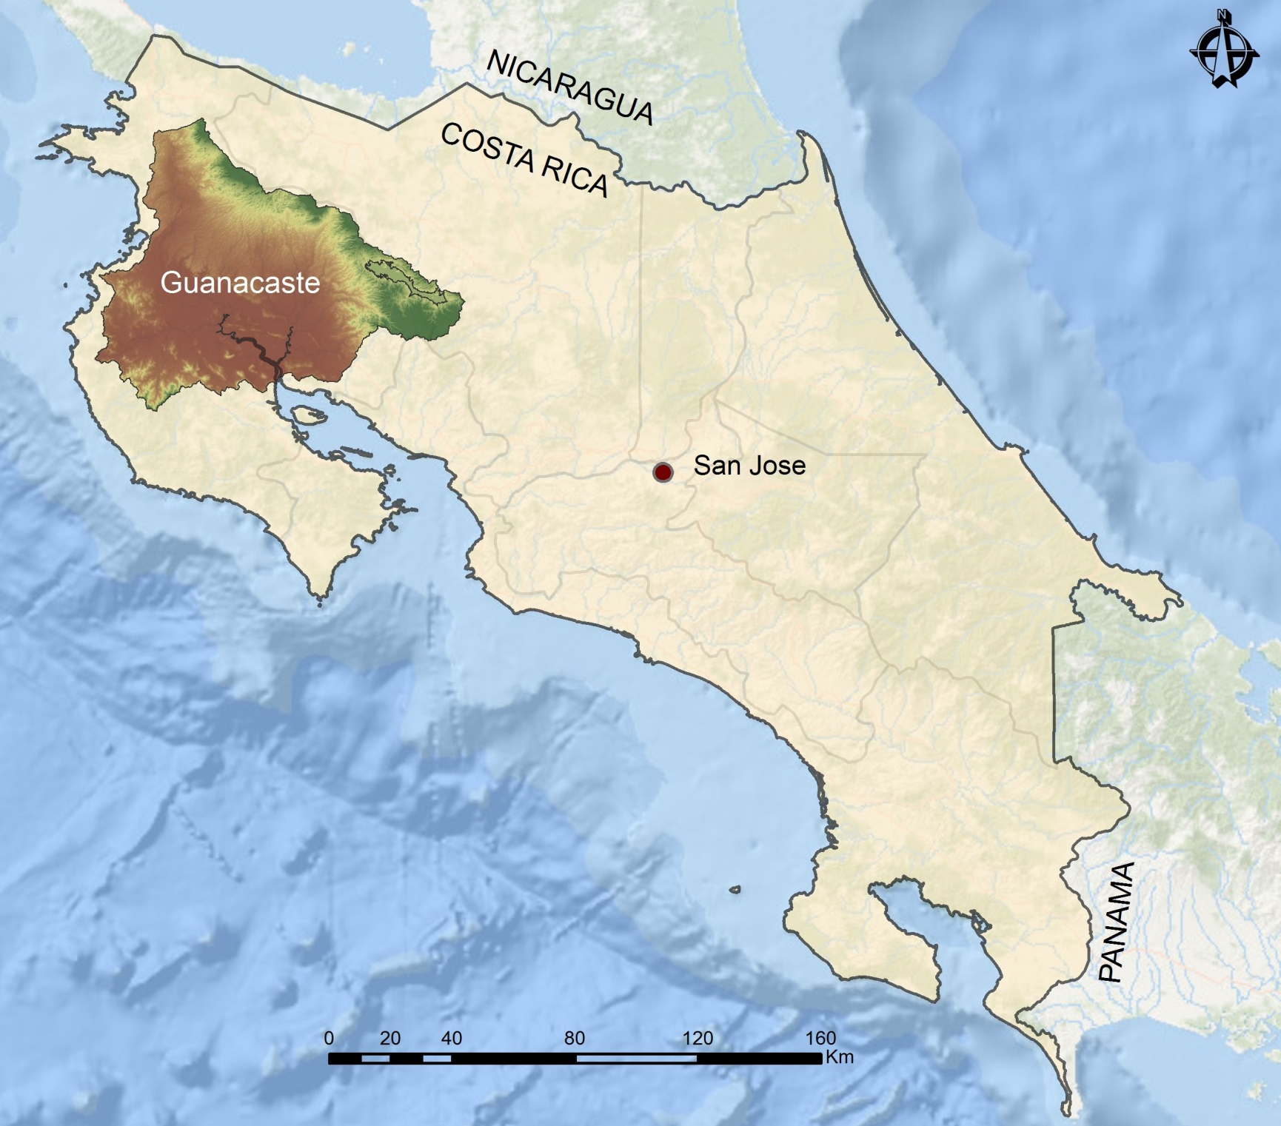
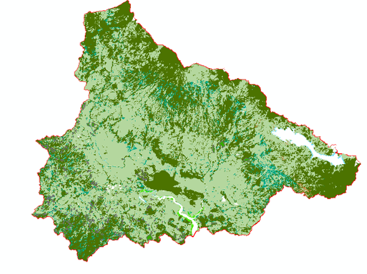
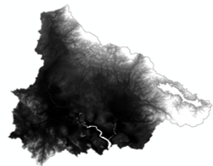
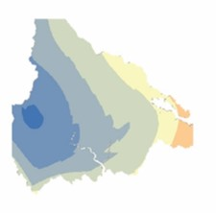
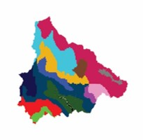
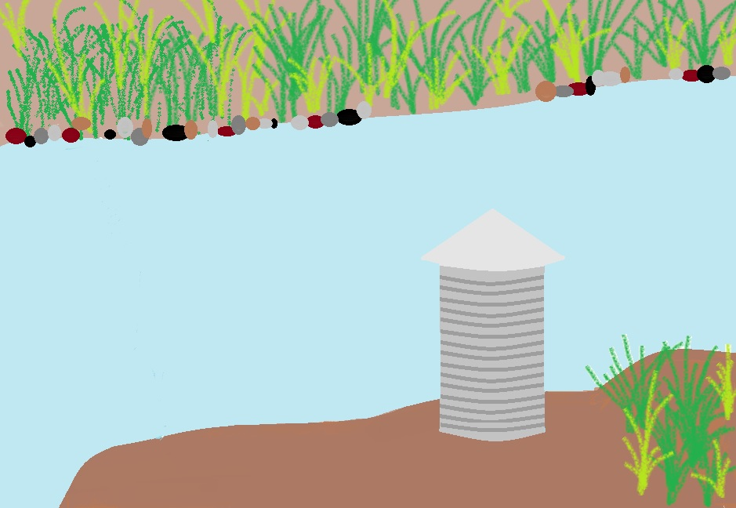
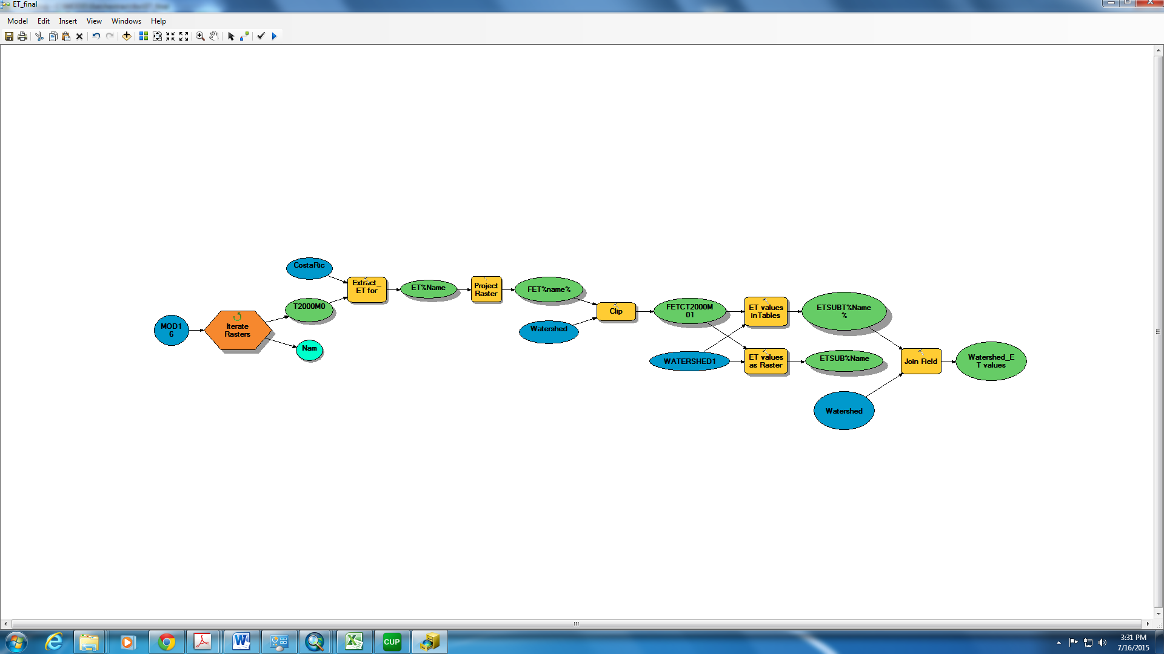







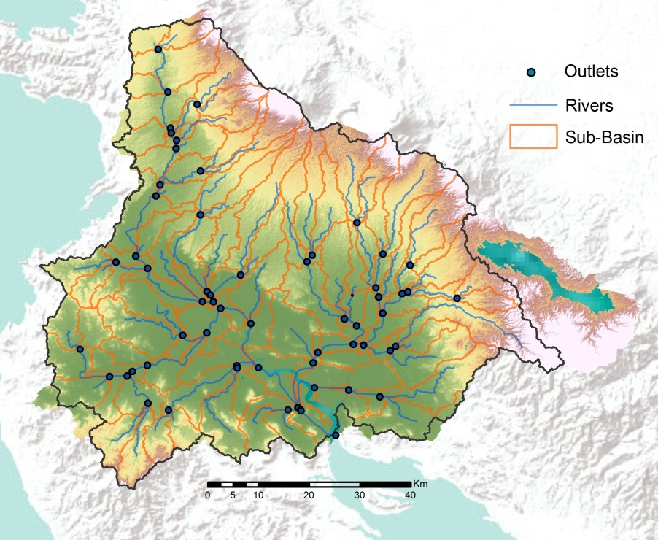
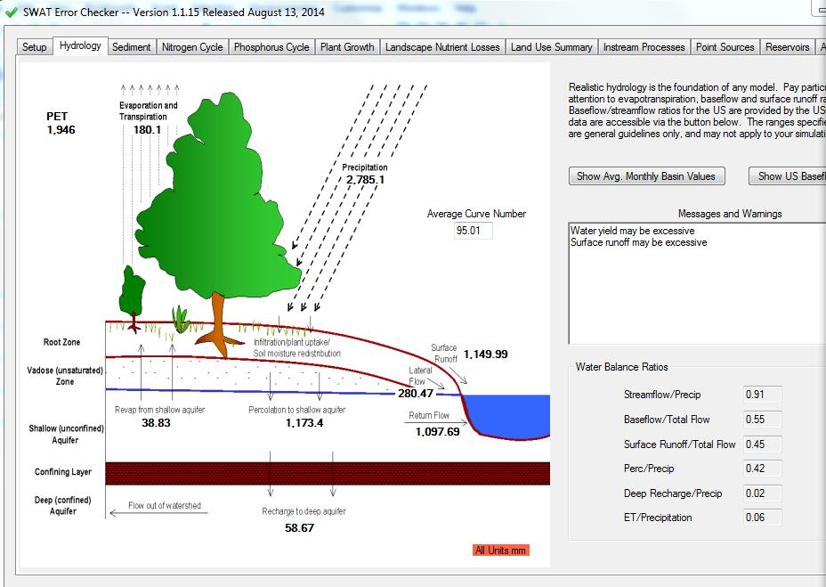
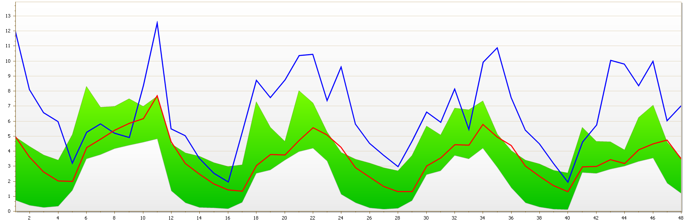

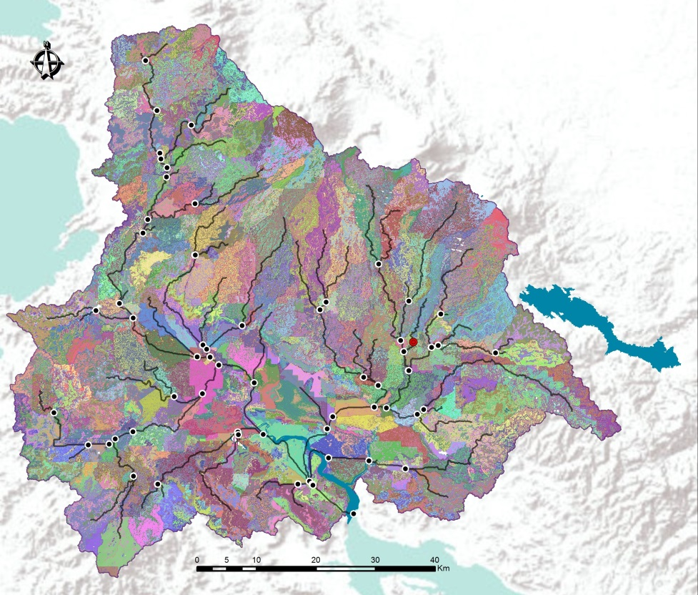
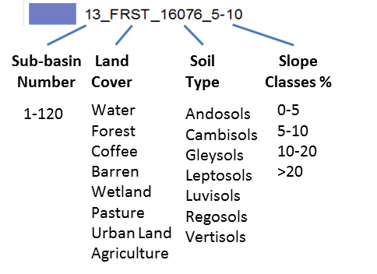
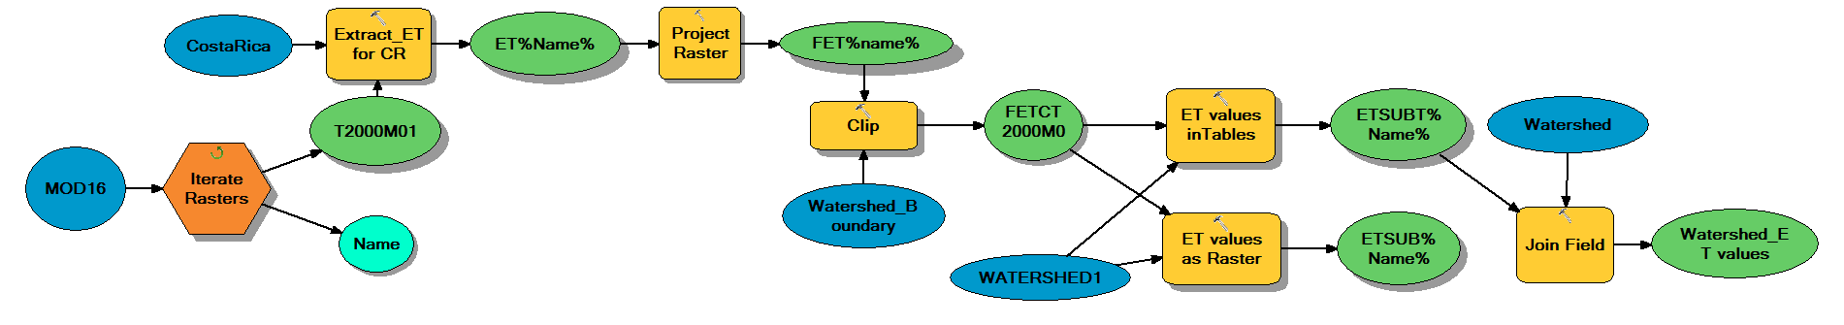
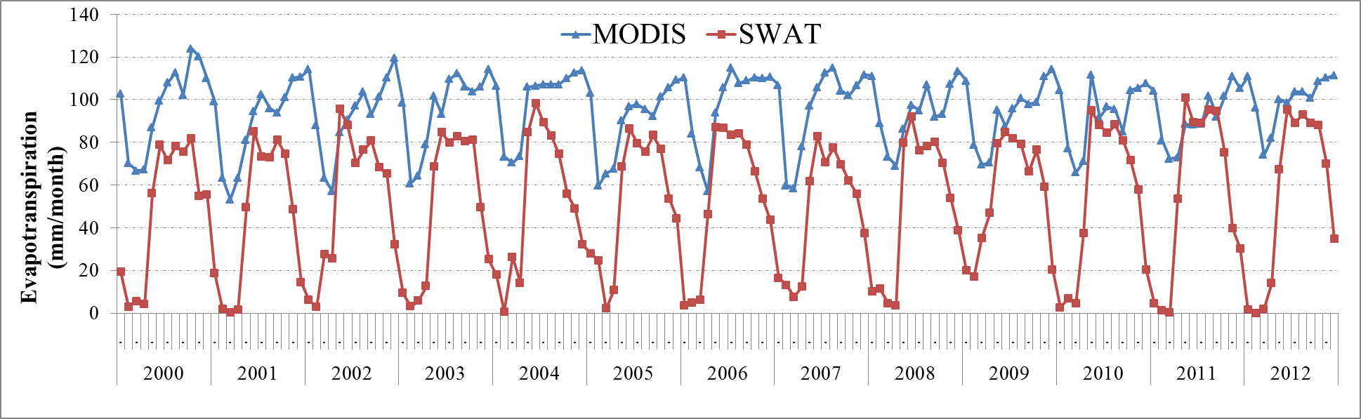
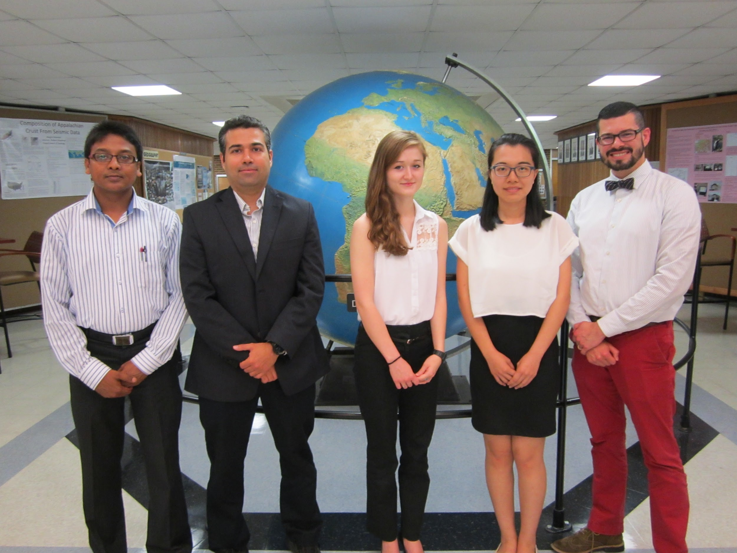
Costa Rica Water Resources II
Utilizing NASA Earth observations to develop a comprehensive water budget for the Arenal-Tempisque Watershed of Costa Rica
Veronica Fay (Project Lead), Steve Padgett-Vasquez, Caren Remillard, Eduardo Rendon, Kamala Kanta Sahoo, Xuan Zhang
NASA DEVELOP at University of Georgia
Abstract
Objectives
For the past three years, the Arenal-Tempisque Watershed has experienced drought conditions complicating water management and agricultural production. To facilitate a responsive water management decision-making process, the team collaborated with Costa Rica’s National Service of Underground Water, Irrigation, and Drainage (SENARA), University of Georgia Costa Rica, and the Embassy of Costa Rica in Washington D.C. A model was created in the Soil and Water Assessment Tool (SWAT) modeling software for the Arenal-Tempisque Watershed using NASA Earth observations, ancillary data sources, and in situ data. The model’s results were calibrated and validated through the use of the Soil and Water Assessment Tool- Calibration and Uncertainty Procedures (SWAT-CUP) software. The evapotranspiration data (MOD16) from Terra’s Moderate Resolution Imaging Spectroradiometer (MODIS) sensor were used to offer another source of continuous data to supplement the SWAT model’s outputs. Additionally, the project partners were provided with tutorials that will enable the SWAT model’s hydrological outputs to be calibrated and validated for different future scenarios. The results obtained from the SWAT model and the MOD16 data will provide greater insight into the region’s hydrologic processes, which will allow for the development of a water resource inventory for the study area. Upon receiving the hydrological data and tutorials, SENARA will be able to replicate the project’s methods to continuously update their water budget; this will allow them to make a more efficient water management plan, benefitting the local inhabitants and stakeholders.
Create a SWAT (Soil and Water Assessment Tool) model to simulate and assess the local hydrological processes of the Arenal-Tempisque Watershed
Utilize SWAT-CUP (Soil and Water Assessment Tool- Calibration and Uncertainty Procedures) to calibrate and validate the outputs of SWAT
Utilize MOD 16 data from Terra’s MODIS sensor to supplement SWAT’s evapotranspiration (ET) values
Develop tutorials so partners will be able to replicate methods and update their water budget through the use of SWAT and SWAT Calibration Uncertainty Procedures (SWAT-CUP) software
Methodology
Study Area
Landsat 8-OLI Terra - ASTER
Data Acquisition &
GIS Processing
Land Cover DEM Weather Soil
In Situ Stream Gauge Date
Model Builder Terra - MODIS
S W A T
S W A T - C U P
M O D 1 6
Comprehensive Water Budget for the
Arenal-Tempisque Watershed
Tutorial Video
Earth Observations
Results
Landsat 8 - OLI Terra - ASTER, MODIS
SWAT
SWAT-CUP
cms
Conclusions
Number of Observed Months
We simulated the local hydrological processes of the Arenal-Tempisque Watershed through SWAT and calibrated SWAT’s outputs in SWAT-CUP for one sub-basin.
Limitations of in situ data included:
  Calibration data ranged from 1979 to 1993, while our study period spanned from 1979-2013.
  Data were nonconsecutive with only 64 semi-successive months to calibrate and validate the model.
  Stream gage location was not on the watershed’s main confluence, which prevented us from calibrating the outputs for the entire watershed.
The tutorial for SWAT and SWAT-CUP will allow project partners, who have access to more current datasets, to replicate our methodology, to calibrate and validate their model’s findings, and to update the region’s water budget for future water management policies.
Water Balance Ratios | %
Streamflow/ Precipitation | 91
Base Flow/ Total Flow | 55
Surface Runoff/ Total Flow | 45
Percolation /Precipitation | 42
Deep Recharge/ Precipitation | 2
ET/ Precipitation | 6
MOD 16
Team Members
Acknowledgements
Dr. Adam Milewski -- Department of Geology, University of Georgia
Dr. Kenton Ross -- NASA DEVELOP National Program
Dr. Marguerite Madden -- Department of Geography, University of Georgia
Javier Artiñano Guzmán -- SENARA
Other Contributors: Rachel Will, Benjamin Page, Grant Bloomer, Sarah Medley, Wondwosen Seyoum
Project Partners
SENARA (Costa Rica’s National Service of Underground Water, Irrigation, and Drainage)
University of Georgia Costa Rica
The Embassy of Costa Rica in Washington D.C.
Kamala Kanta Sahoo, Eduardo Rendon, Veronica Fay, Xuan Zhang, Steve Padgett-Vasquez
University of Georgia

