Slide 1
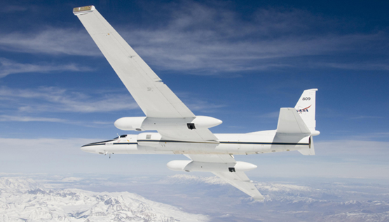
Heather Nicholson (Team Lead)
Amber Todoroff
Madeline LeBoeuf
Joseph Spruce
James “Doc” Smoot
Dr. Kenton Ross
Landsat 8 OLI
Simulated HyspIRI Onboard a NASA ER-2 Aircraft

Slide 2
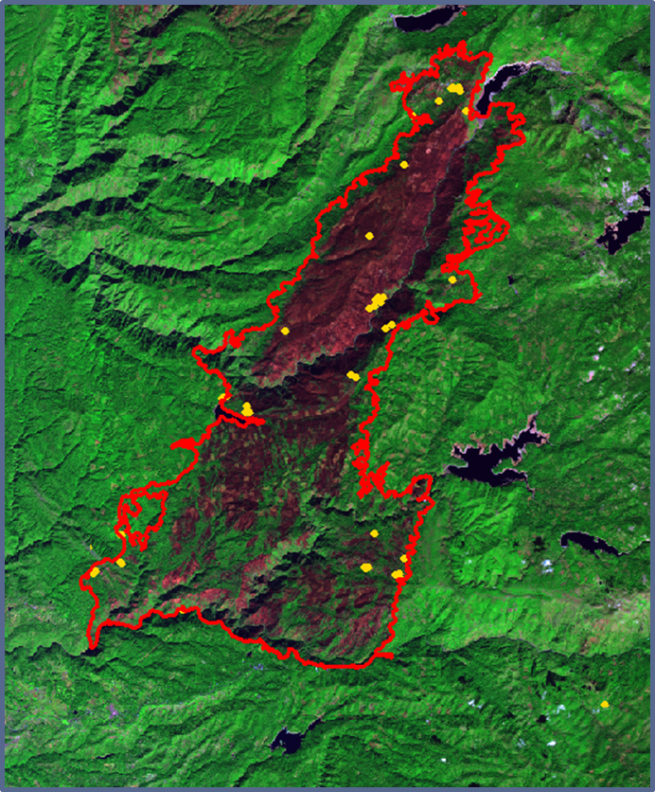
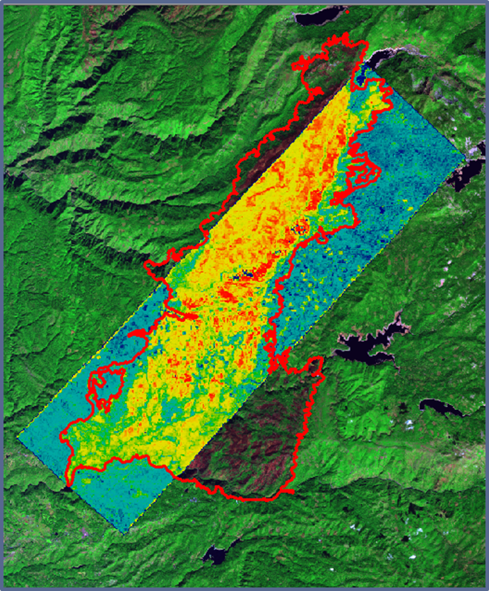
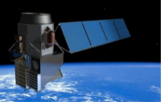
Assessing the Effectiveness of Simulated HyspIRI Data for Use in USDA Forest Service Post-Fire Vegetation Assessment and Decision Support.
King Fire, Landsat 8
King Fire dNBR, Simulated HyspIRI
(from AVIRIS sensor)
Brad Quayle
Steve Norman
Robert Keane
Robert Green
The study area includes three California fires: the Aspen Fire(2013), the French Fire (2014), and the King Fire (2014). Simulated HyspIRI data was collected to produce wildfire burn severity and vegetation assessment products which are used to aid post wildfire remission. The resulting simulated HyspIRI products were quantitatively compared to similar Landsat-based products to assess and show how hyperspectral satellite data can improve current wildfire assessment products’ capabilities.
The increase of wildfires in California is causing soil erosion, increase of invasive plant species, and loss of property and life. In 2022, NASA’s Hyperspectral Infrared Imager Satellite (HyspIRI) will be launched. HyspIRI’s sensors will offer an unprecedented mix of spectral, temporal, and spatial resolution. It is necessary to evaluate the simulated HyspIRI products before the mission is launched to maximize the benefits of HyspIRI’s future capabilities.
Simulated HyspIRI data was used to calculate burn severity products. Visual comparison suggests that simulated HyspIRI imagery differs considerably from current Landsat produced imagery. Statistical analyses supports this visual observation. The burn severity indices used for each sensor also highly correlated with ground truth data obtained for the King Fire. The results from this project suggest that future HyspIRI data will be valuable for forest service post-fire decision support.

