Slide 1
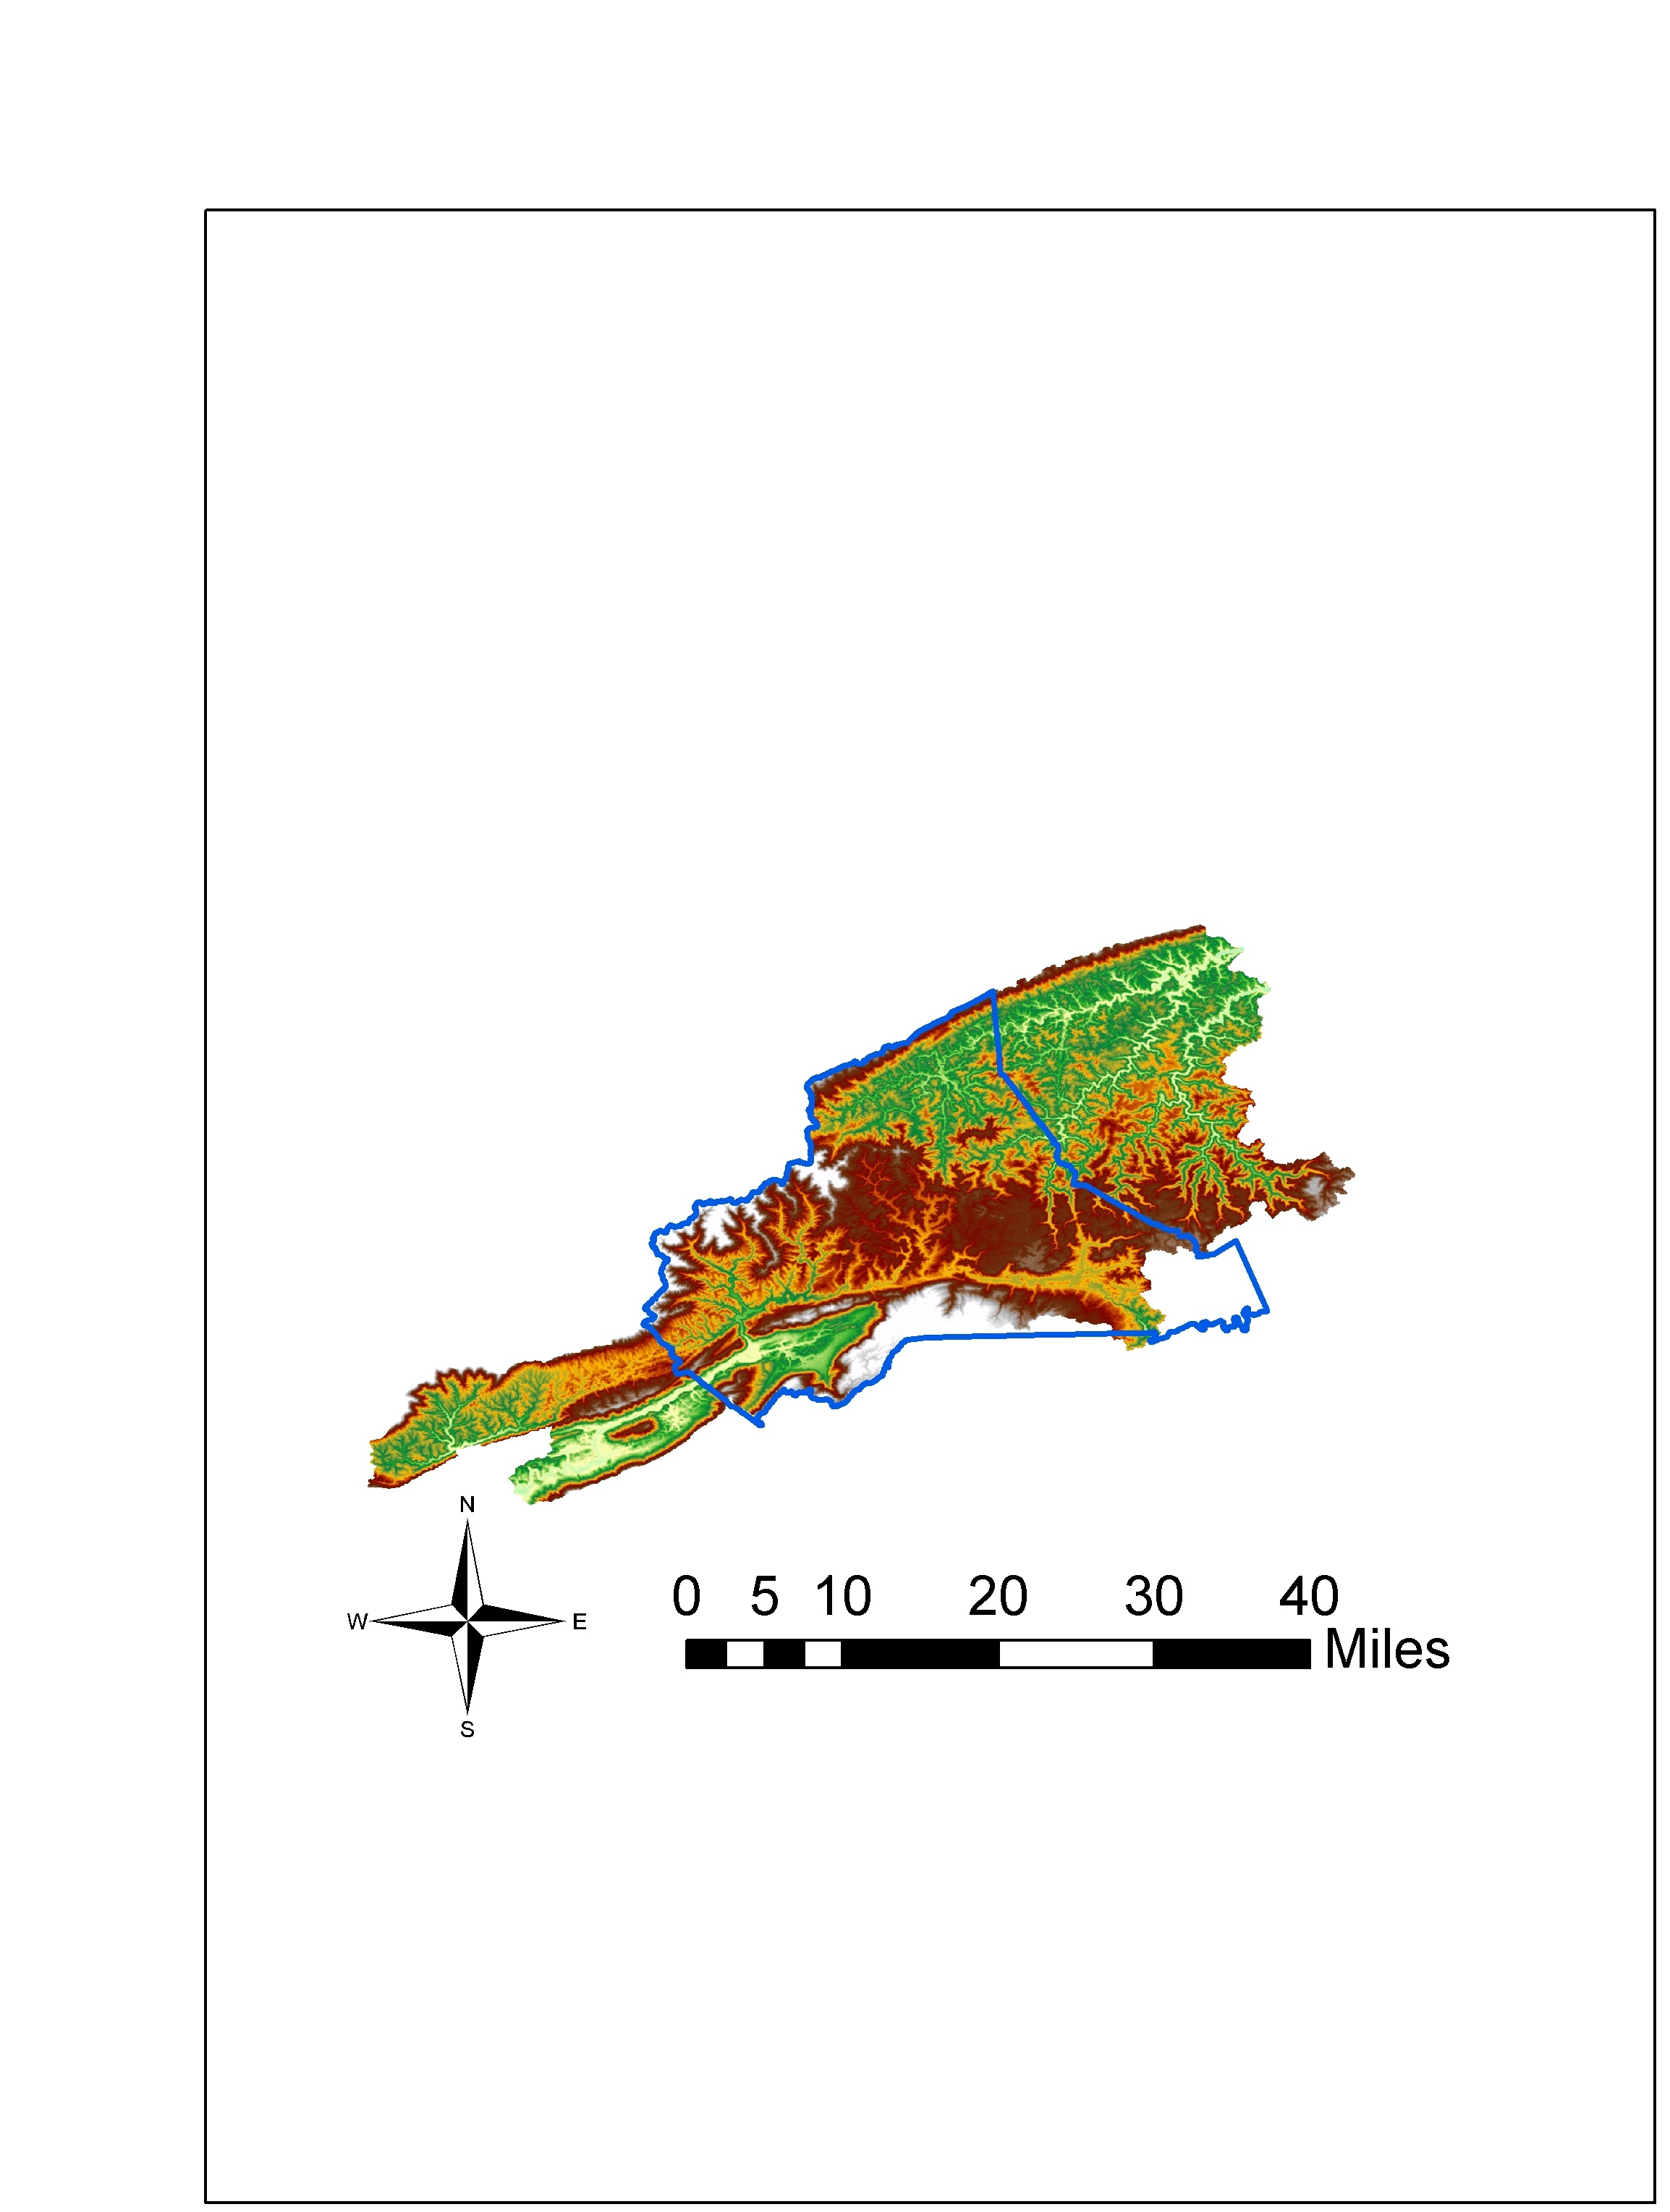
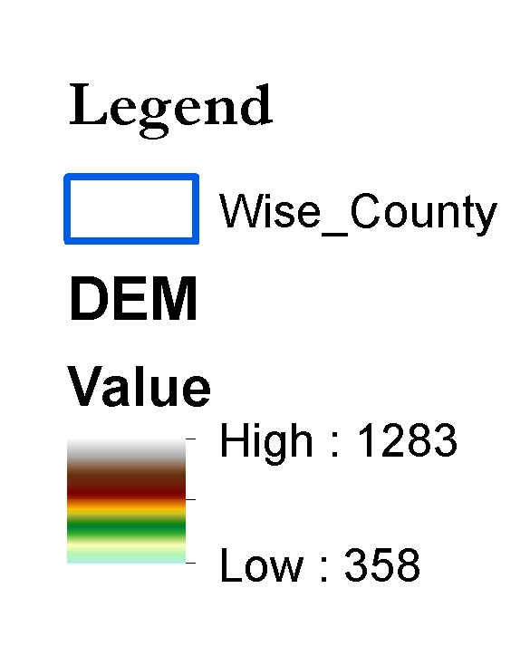
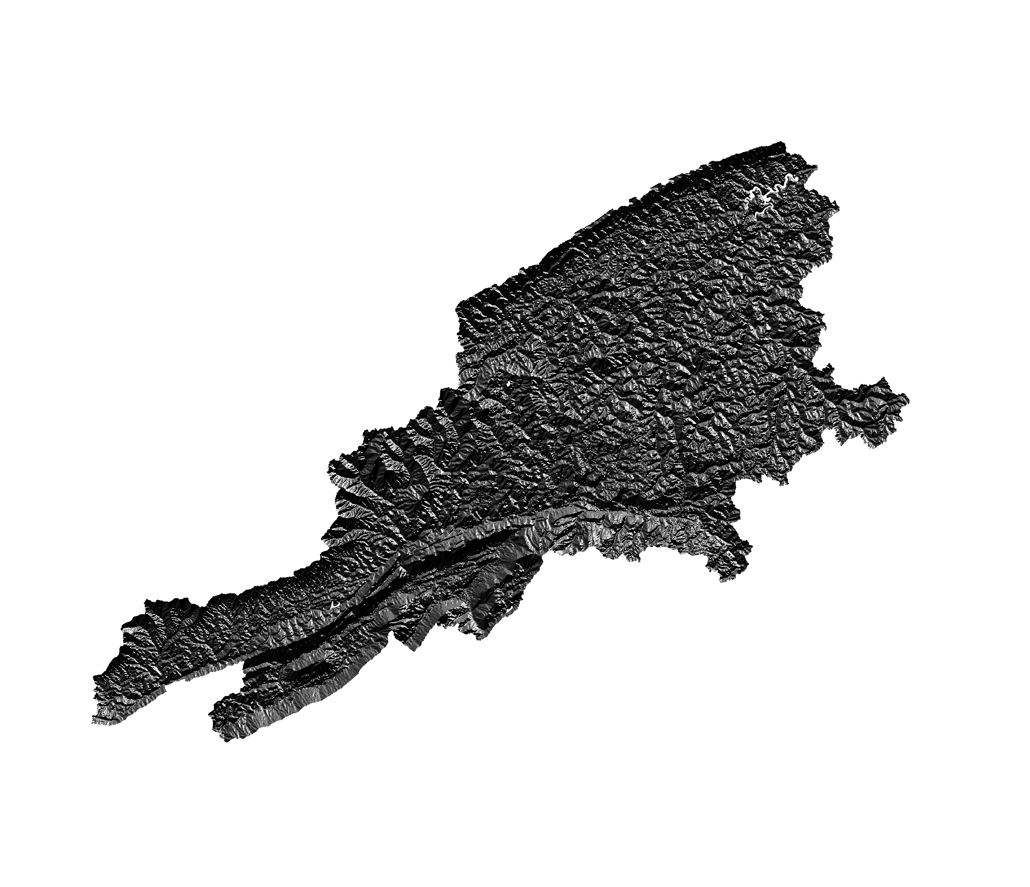

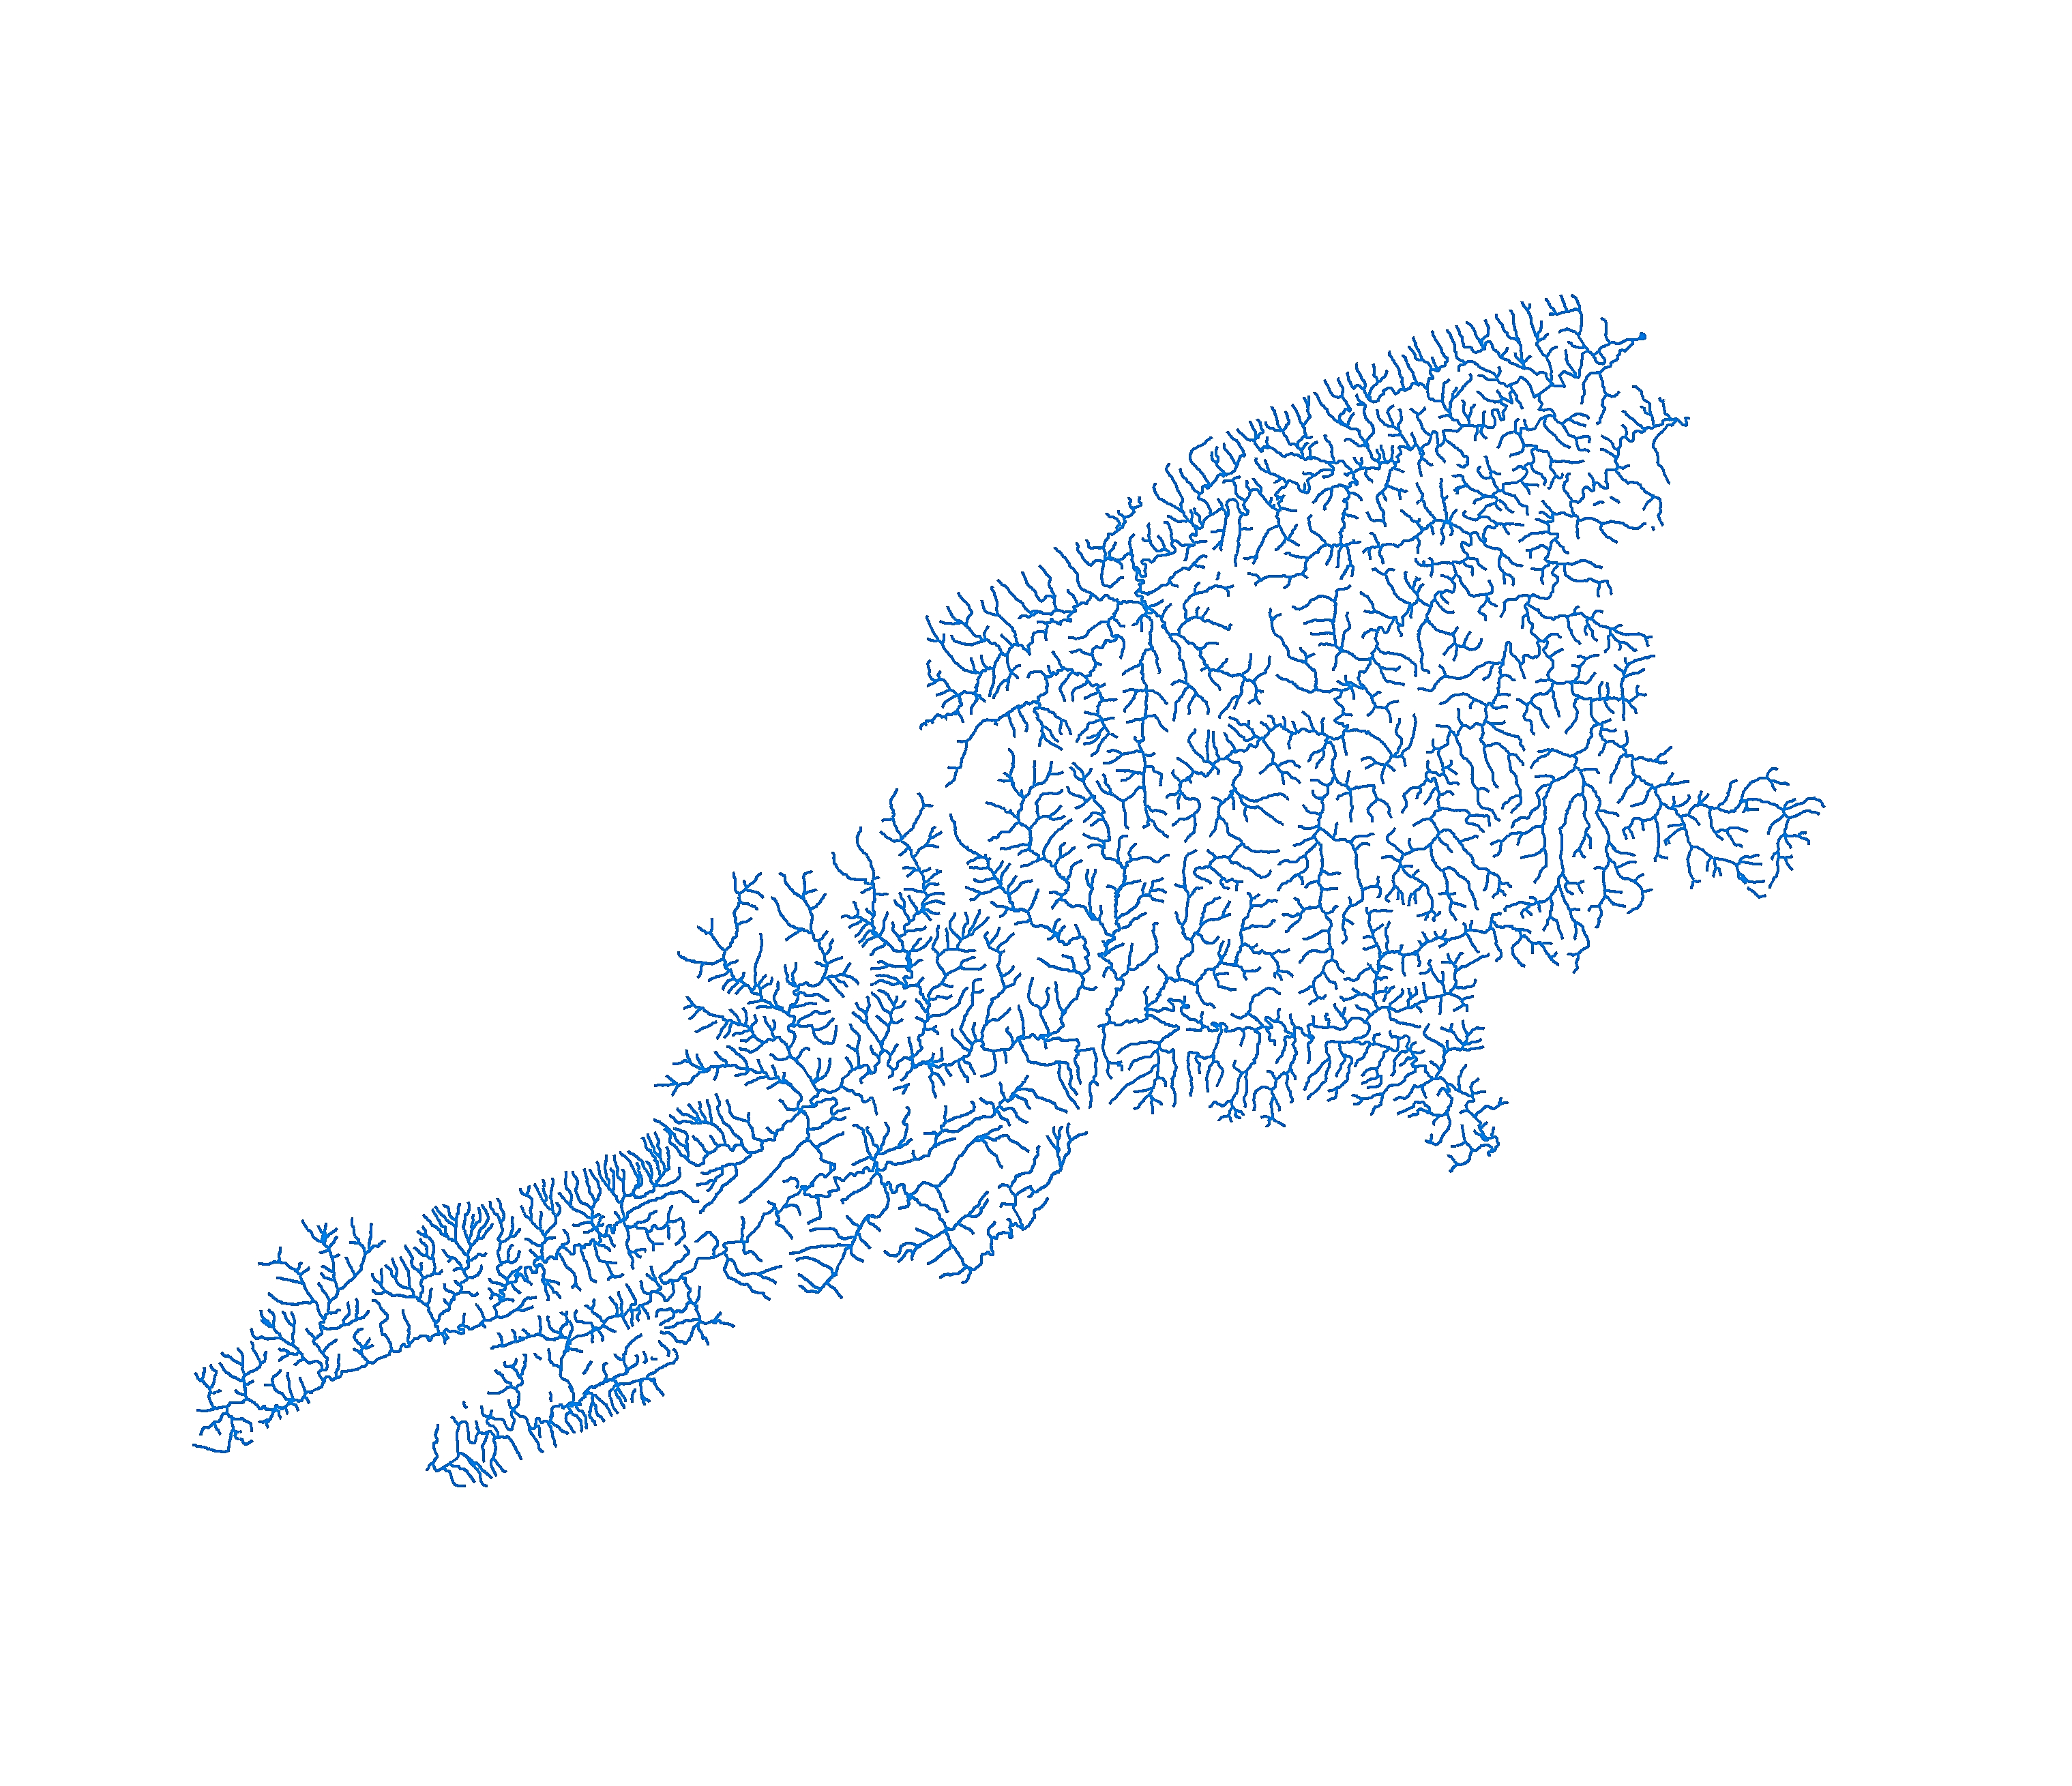
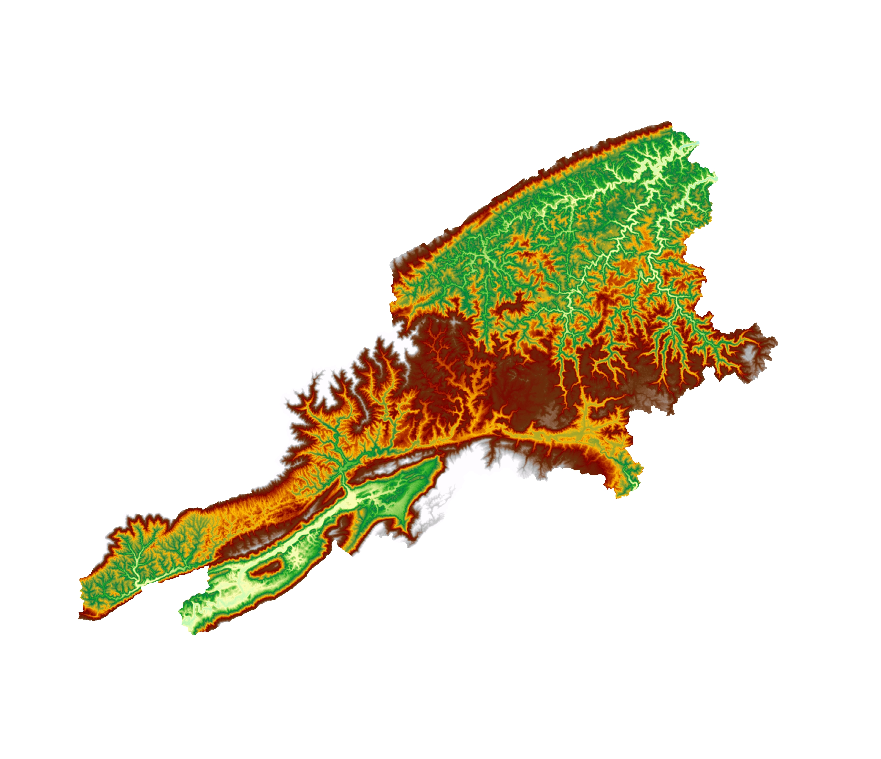

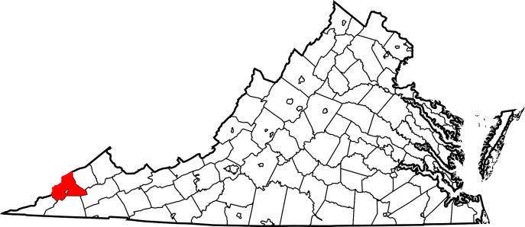
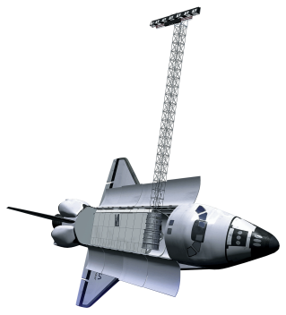
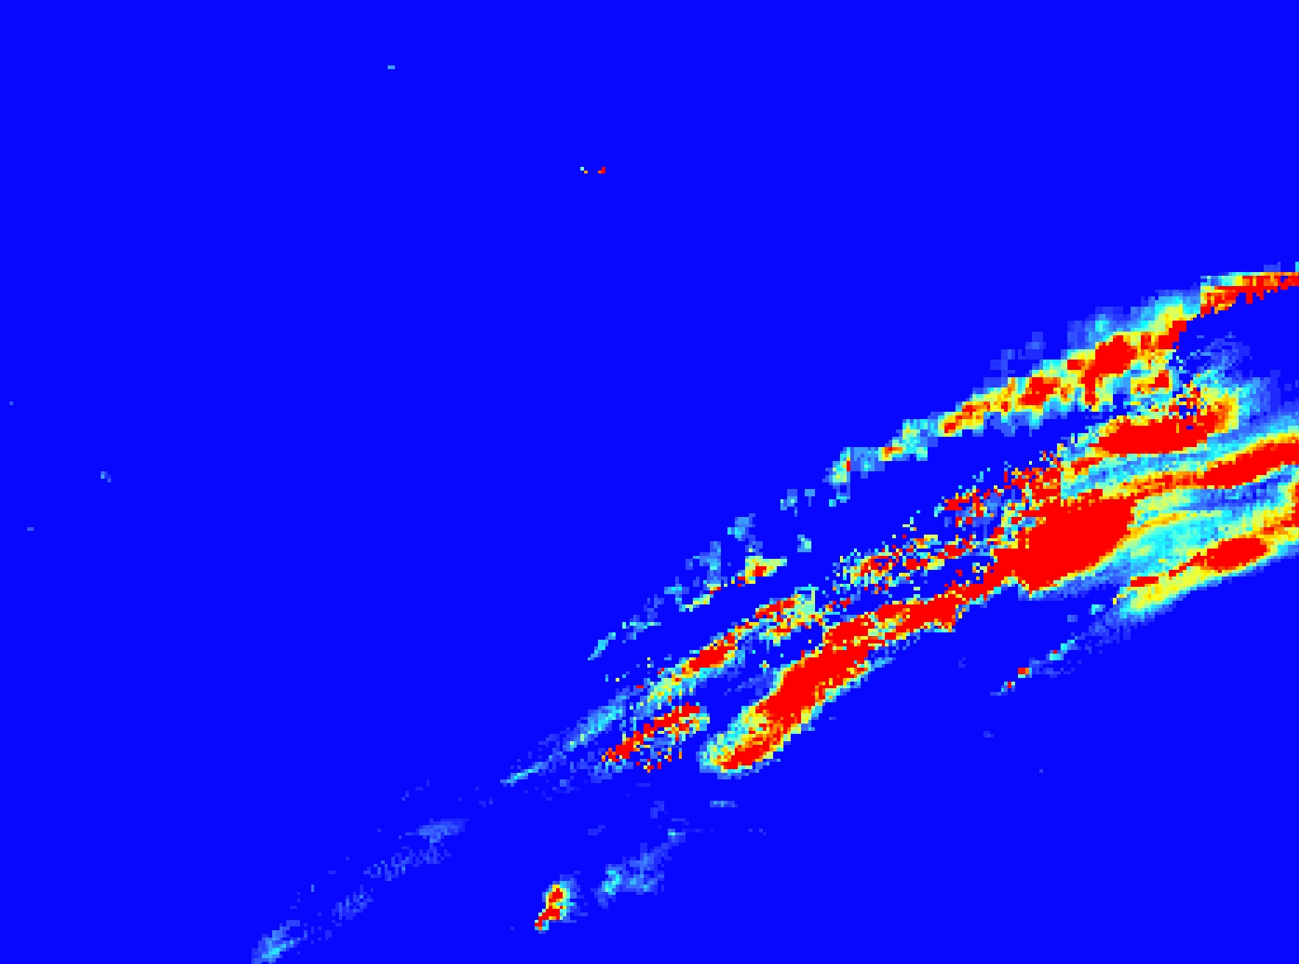
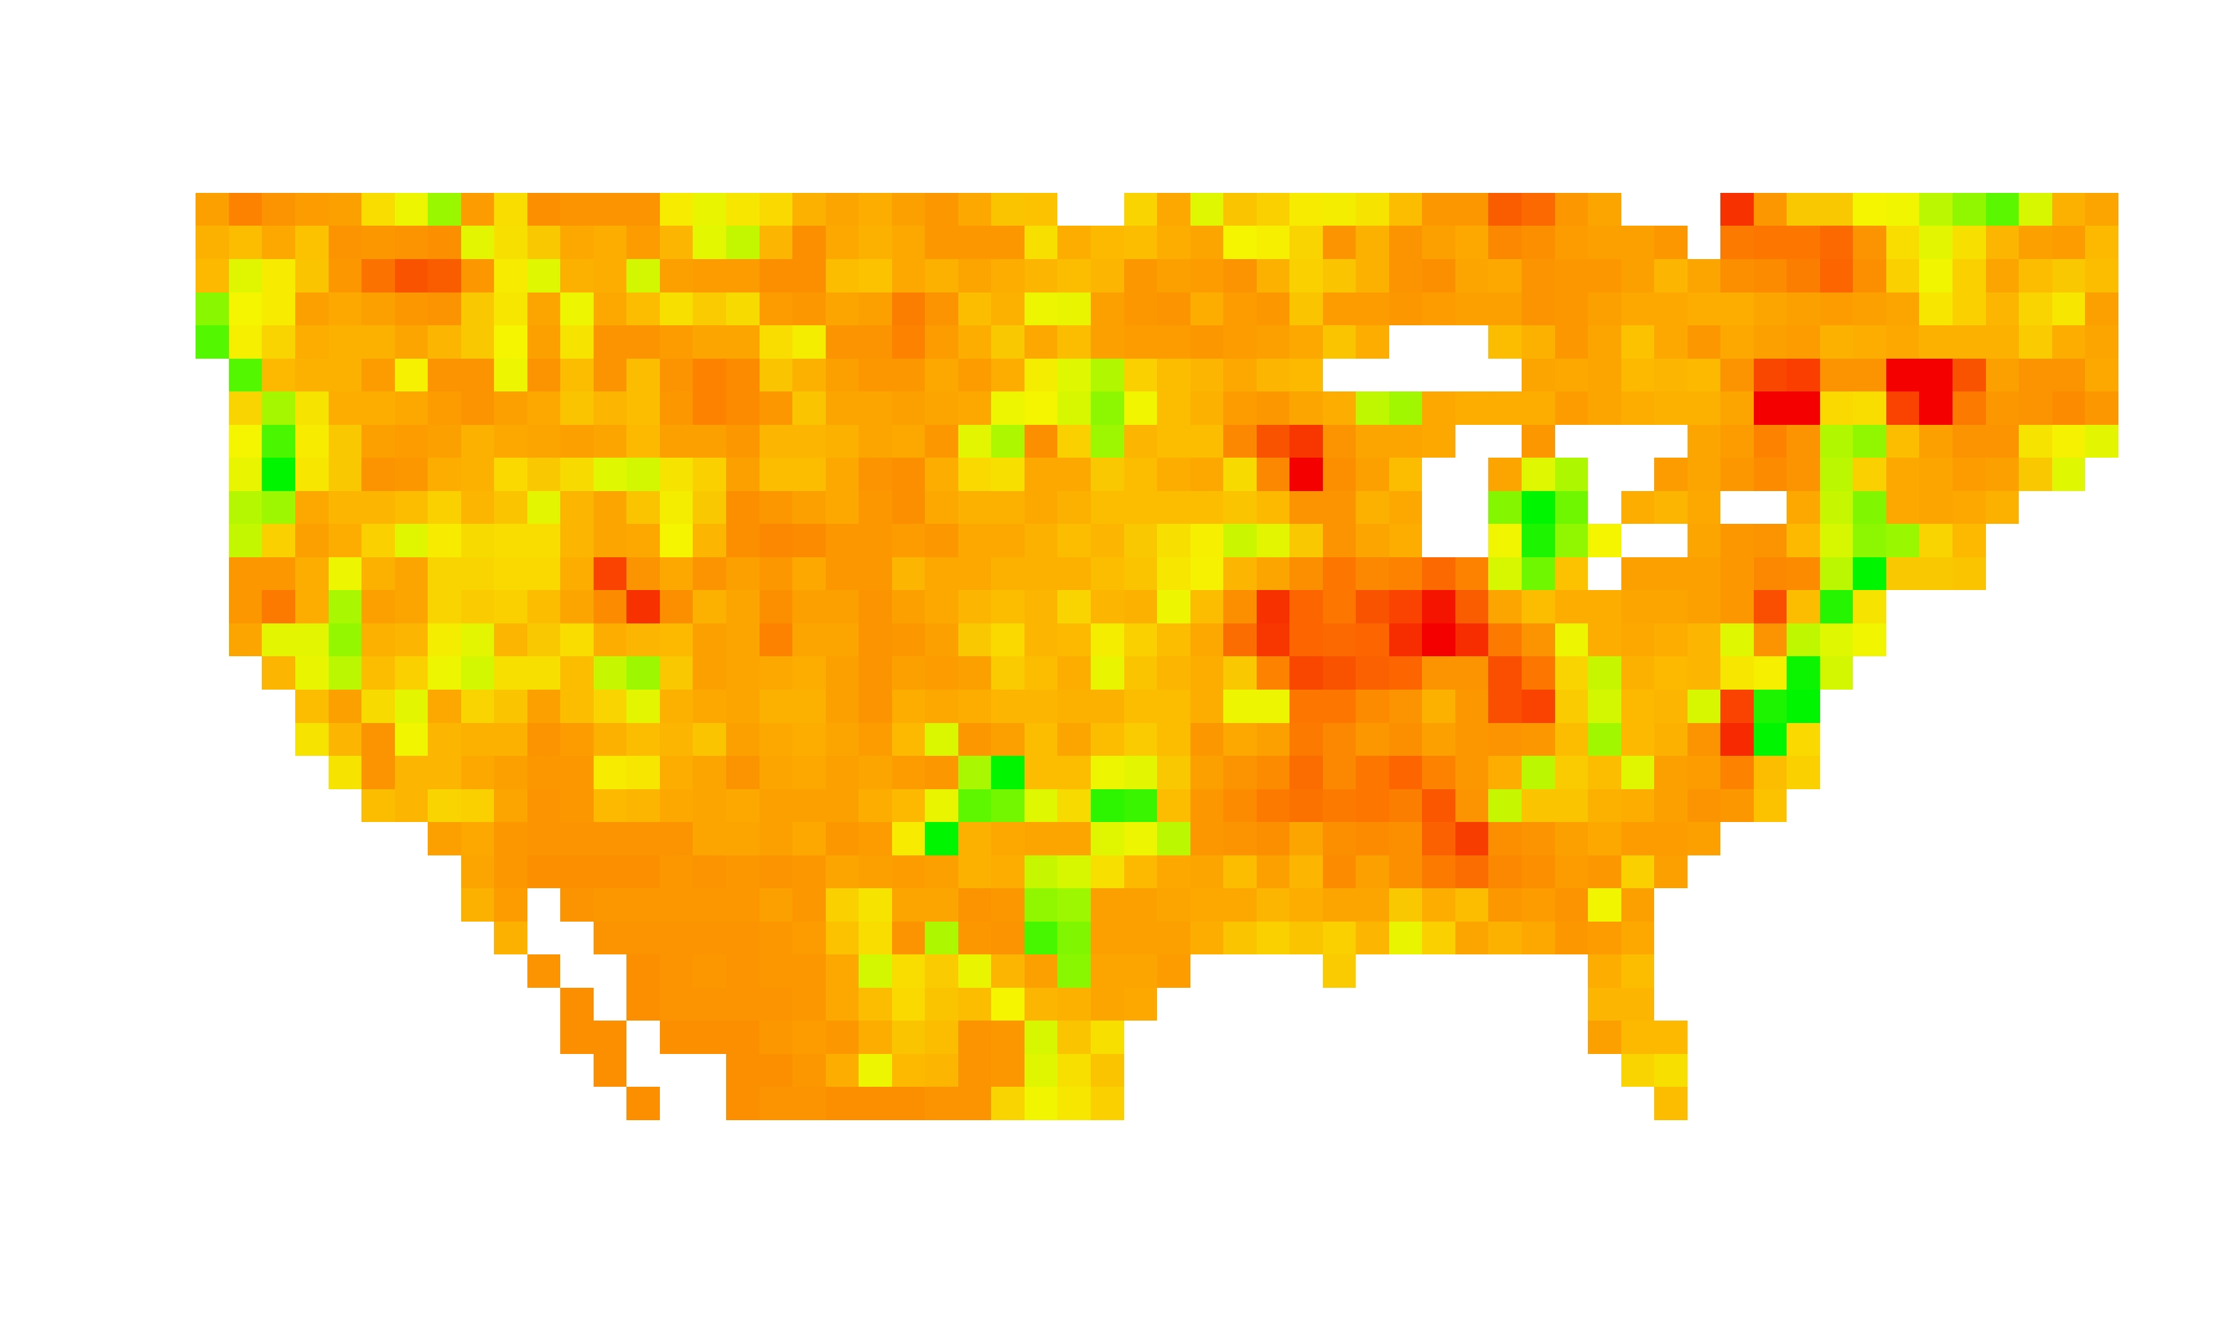
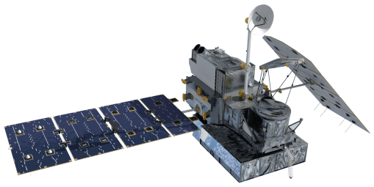
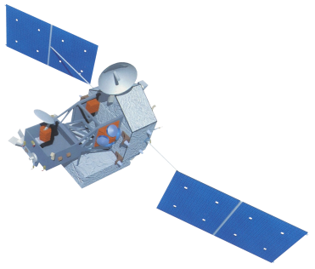
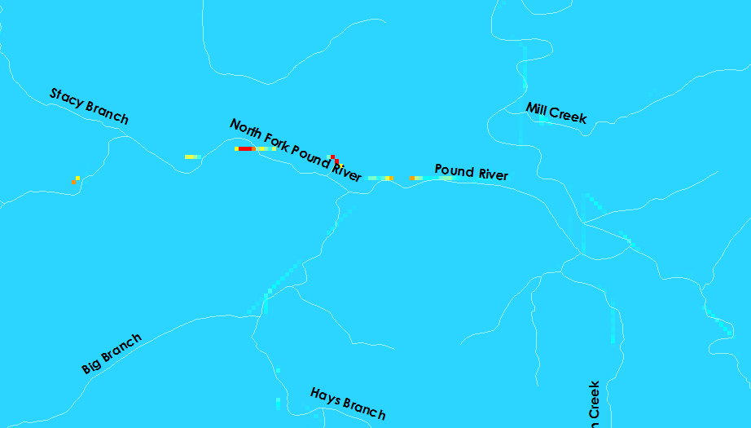
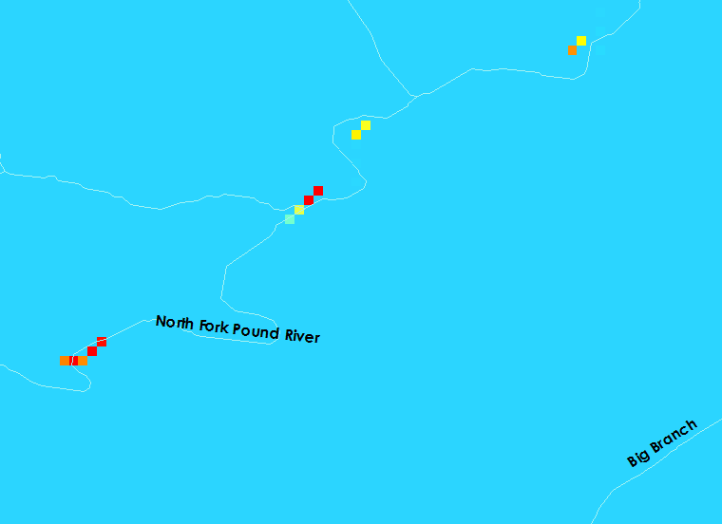


Wise County Disasters
Identifying the Historic and Future Extent of Flooding Throughout Wise County, Virginia.
Kimberly Berry (Project Lead), Abhijeet Singh Baghel, Grant Bloomer, Zachary Tate
NASA DEVELOP National Program at Wise County Clerk of Court’s Office
Abstract
Objectives
Wise County is located in the Appalachian Mountains of southwest Virginia. Mountainous terrain increases the amount of runoff into local drainage basins during strong storms, which can increase the frequency of flash floods. This project determined areas that are more susceptible to flooding using Esri ArcGIS and The Coupled Routing and Excess Storage (CREST) model to analyze data collected from Landsat 5 Thematic Mapper, Landsat 8 Operational Land Imager, and Shuttle Radar Topography Mission (SRTM). These sensors collected data on rainfall, elevation, and land use change from 2000-2015. The modeled flooding data was compared to estimated historical floods to increase the confidence of the CREST modeled flood predictions. Maps created from the flood models have been handed off to the Wise County Emergency Operations Center for use in planning for future flood events.
Compare historical floods to flood models
Understand when peak flooding conditions occur
Identify areas in Wise County susceptible to flooding
Provide information needed to help prepare for future floods
Study Area
Legend
Wise County
Elevation (Meters)
High: 1283
Low: 358
Methodology
Data Acquisition
Processed Data
0 10 20 30 40
Miles
Streams
Networks
Digital Elevation
Flow Accumulation
Flow
Direction
Data Acquisition
Basics Folder
Data Acquisition
Earth Observations
Precipitation
Data
CREST Model
Potential Evapotranspiration
Shuttle Radar
Topography Mission
(SRTM)
Rain Data
(PETs)
Global Precipitation Measurement
(GPM)
Surface Water Flow
Tropical Rainfall
Measuring Mission
(TRMM)
Results
Conclusions
Calculated Discharge
above Initial Conditions
(m³/s)
Before final conclusions can be reached, the CREST model requires calibration of hydrologic variables and the input of initial conditions.
Model may be improved for future use by including impervious areas and vegetation conditions.
Current plans to include more stream gauges in Wise County will improve stream monitoring coverage and can improve the calibration of the CREST model.
High: 20.2
Low: -8.5
N
N
Figure 1. CREST model showing calculated high stream discharge on North Fork Pound River.
Figure 2. Most recent iteration of the CREST model showing calculated high stream discharge on North Fork Pound River.
Team Members
Project Partners
Acknowledgements
Wise County Board of Supervisors
Wise County Office of Emergency Management
Dr. Kenton Ross, Science Advisor
Dr. DeWayne Cecil, Science Advisor
Bob VanGundy, Science Advisor
From left to right: Grant Bloomer, Kimberly Berry (Project Lead), Zachary Tate, Abhijeet Baghel
Wise County and City of Norton Clerk of Court’s Office

