Slide 1
North Carolina Ecological Forecasting II
Update of the NOAA C-CAP Wetland Delineation and Land Use Classes Using Remote Sensing
Ben Roberts-Pierel (Project Lead)
Jake Patrick
Brett Buzzanga
Benjamin Charlem
Michelle Pasco
Taylor Sage

Slide 2
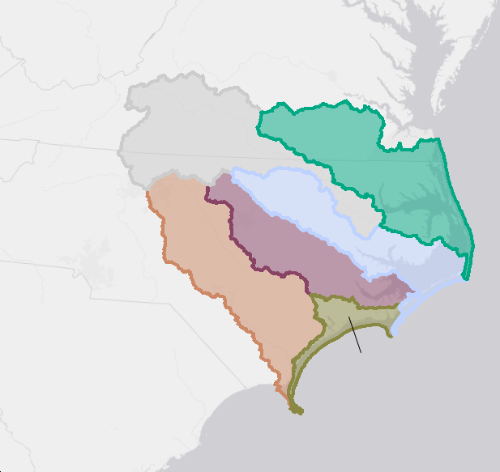
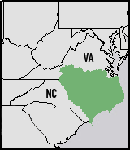


Study Area
Albemarle-Pamlico Estuarine System
Study Period: Spring 2015 to Fall 2015
Notes:
The Albemarle-Pamlico region is located on the coast of northeastern North Carolina and southeastern Virginia. The basin consists of 31,000 square miles of land and water, including two major sounds, Albemarle and Pamlico, and seven river basins, six of which APNEP monitors. Three major land cover classifications: forests (40.1%), croplands (25.3%) and wetlands (15.8%) account for most of the LULC in the basin. The basin is integral to economic activity, cultural heritage and ecosystem function in the area and constitutes one of the largest estuarine systems in the United States.

Slide 3
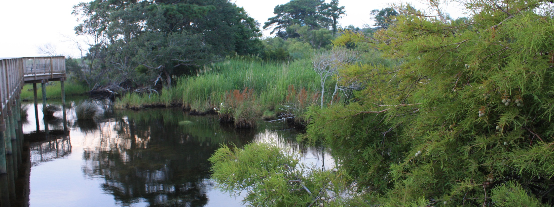
Image Credit: sugargliding
Status of the Basin
Climate Change
Population Growth
Water Quality Influences
Notes:
Wetlands absorb storm surges and strong winds; they minimize eutrophication by retaining and filtering agricultural and urban runoff; and they provide protection for developing fish and amphibian species thereby continuing the proliferation of terrestrial and oceanic biodiversity.
Climate change induced sea level rise.
Sea level is currently rising at a faster rate than wetland vegetation can keep pace with
leads to inundation and erosion
Population growth
In the twenty years between 1990 and 2010, the Albemarle-Pamlico region’s population grew by 36%, from 2,762,409 to 3,756,019
Necessitates land change in the form of urban development and agricultural clearing
Water quality influences
mismanagement of natural resources, waste production, and nutrient runoff have reduced the water quality and human health in the Albemarle-Pamlico watershed
Image Credit: sugargliding. IMG_2446. Outer Banks, North Carolina. July 2009. Image Modified. https://www.flickr.com/photos/xmrocks/3759181472/in/photolist-6JbMFE-6JbLHm-6J7Gtt-6J7MYv-6JbNSW-6JbNFs-6J7KG6-6J7LJT-6J7Jx4-6J7MDF-6JbPRS-6J7KSK-4ZZnYf-4ZZph1-4ZZoN9-5xNnLK-5xNmwT-6J7Ltx-6JbLVU-6J7L64-6JbNmq-6J7Gh2-6J7Jet-6J7Mj4-6J7M4Z-6JbN5C-6JbT1m-2JLKXH-6J7wmc-6JbA4S-6J7vRX-6JbAZo-6J7uWM-6J7zFX-6J7tMt-6JbDbq-6J7zYc-6JbEeL-6J7tUK-6J7vmk-6JbCA7-6Jbzfd-6J7wyV-6JbBFd-6Jbzq3-6J7vEx-6JbzDq-6JbDEq-6JbAqU-6JbyYJ

Slide 4
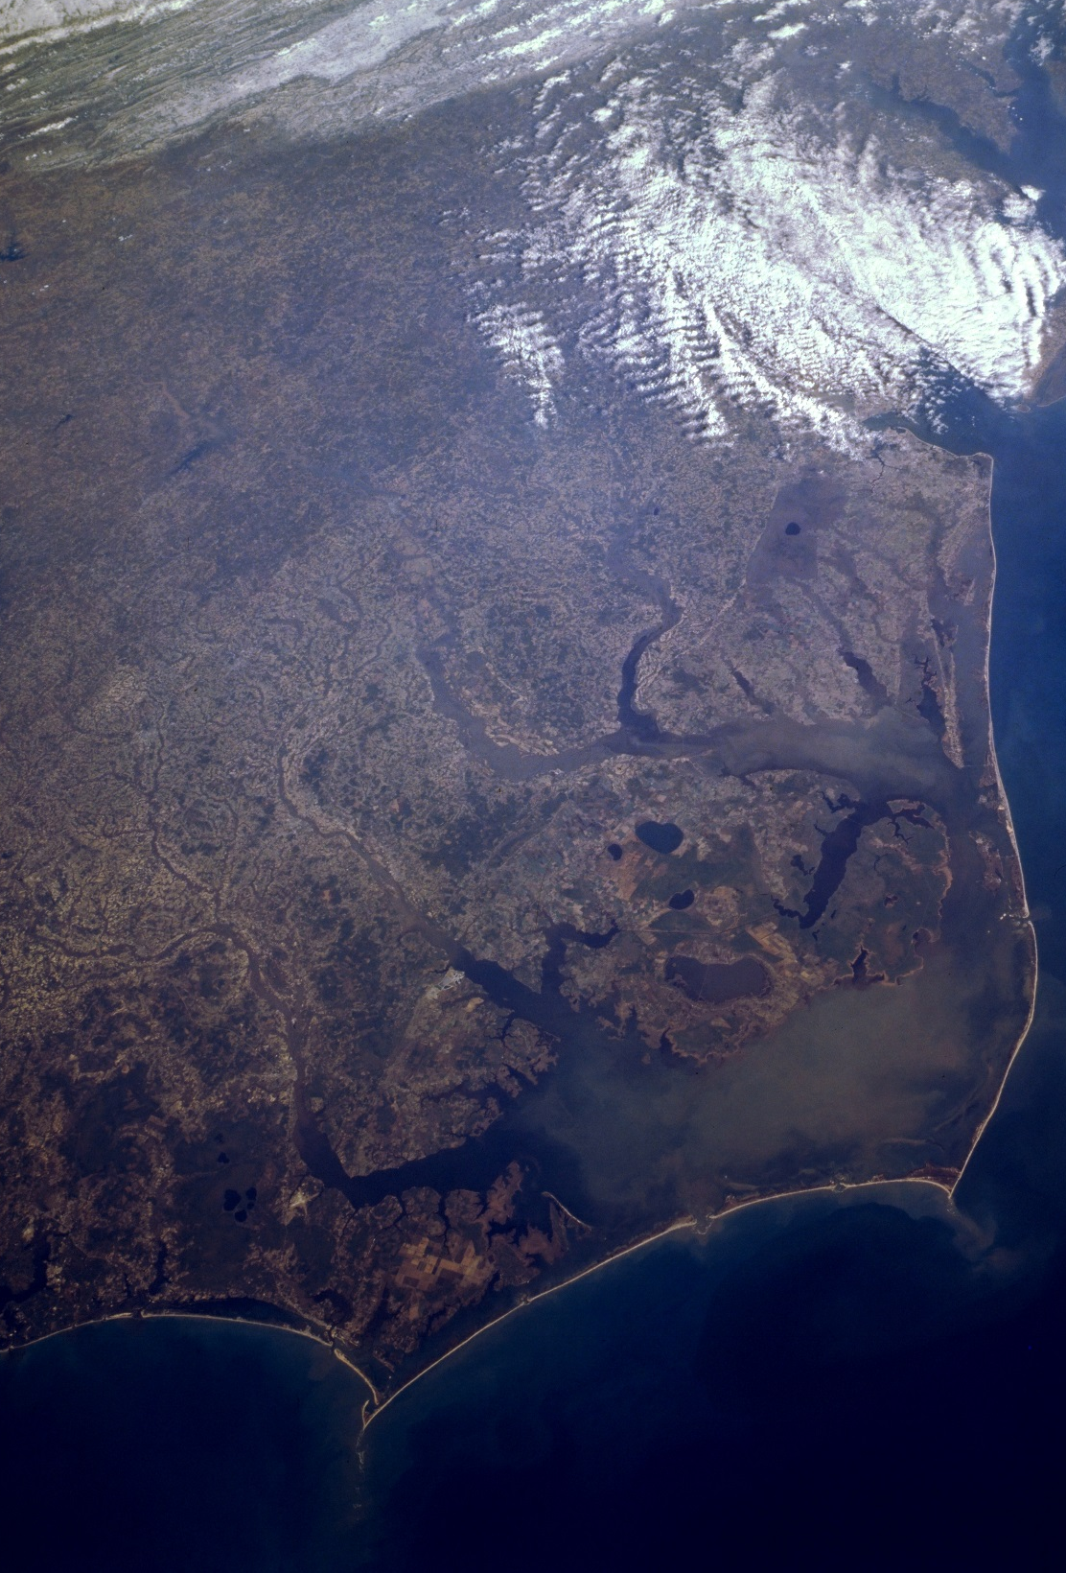
Objectives
Provide an updated land classification system
Create a replicable method
Establish a correlation between wetland health and type
Image Credit: NASA Johnson
Notes:
Current land classification is based on the NOAA Coastal-Change and Analysis Program (C-CAP), which is updated every five years and is for the entire coast of the contiguous United States. We aimed to provide a more regionally specific classification and a means of continuing to update this resource more frequently than C-CAP.
The summer term for this project, North Carolina Ecological Forecasting I looked at wetland health in the Albemarle-Pamlico watershed and we hoped to link our findings with theirs to improve the usefulness of our work and to create continuity between the two projects.
Image Credit: NASA Johnson. sts059-208-068. Pamlico Sound Area, North Carolina. March 1994. Image Modified. https://www.flickr.com/photos/nasa2explore/9366996364/in/photolist-3Mdf8a-3MicD5-3MhyFL-3MdShD-3MhVAG-3Miaqd-3MhVjQ-3MdCnn-3MhTUd-3MhUdj-3MdcDH-3MhUxL-3MdBAM-3MdBN6-3iEMY1-dwHknA-fgJiFj-fjDc9R-5xNhpv-5xTP2m-5xTNU9-5xSE9J-5xNkHP-5xSHA3-5xSDYQ-5xSGpw-5xPqgX-5xNjxM-3Rh9Y8-3iEN4o-3iApvP-3iApsD-3iENdy-3iApb2-3iENs1-3iEN2L-3iENg1-3iApAn-3iApyF-3iAtEK-3iENnb-3iApjv-41YnvS-3MhSPy-5xSDGf-5xSDmL-fgyXjx-fiPZkT-ffoZCE-ffp1oL/

Slide 5

NASA Earth Observations
Landsat 8
Operational Land Imager (OLI)
Thermal Infrared Sensor (TIRS)
Image Credit: USGS
Notes:
Although we considered using other data from the Terra mission such as NDVI from MODIS and DEMs derived from the ASTER instrument, we concluded that higher resolution or more purposeful imagery for our project was available from other sources, principally the USGS and USDA.

Slide 6
Methodology
Data Acquisition
NASA EOS
USGS
USDA
Data Processing
C-CAP
DEM
Crops
Aggregation of Data
SSURGO
Landsat
NHD
Training Sites
(Polygons)
Final Result
Supervised Class
Calibrate
Notes:
This is the Methodology flowchart. The dark green rectangles is the main flow of the presentation.
We first acquired data from NASA EOS, USGS, and USDA. and processed it. Then we put all of the data together. The data is represented by the light green rectangles and will be furthered discussed throughout the presentation.
We then moved on to training specific sites and gaining the final result.

Slide 7





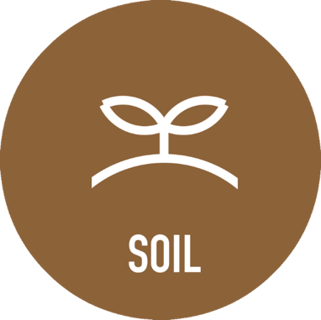
Data Sets
Notes:
Data was collected from different sources, but most came from the USGS and USDA.
All of the data came with some degree of preprocessing, the details of which will be discussed in the coming slides.
The main method of analysis was through the Landsat 8 composite images and the other datasets were used as ancillary data to cross-reference with what we were seeing in the Landsat images. The details of this will be discussed as well in coming slides.

Slide 8
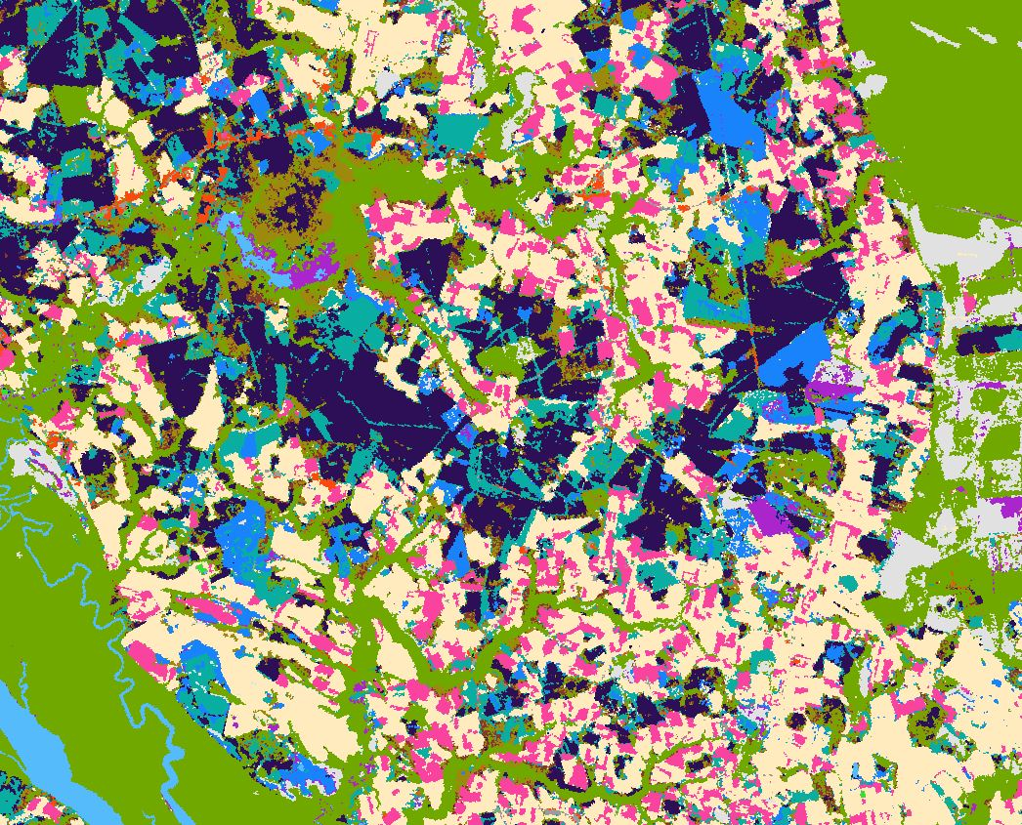
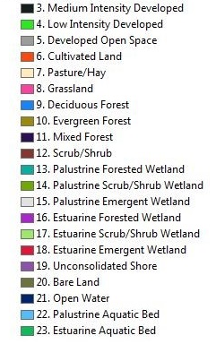

NOAA Coastal Change Analysis Program (C-CAP)
Notes:
The C-CAP dataset consists of 25 classes but some were removed because they were not relevant (ex. Tundra, ice/snow)
Product was created using an unsupervised classification and a number of ancillary datasets to cross reference.

Slide 9
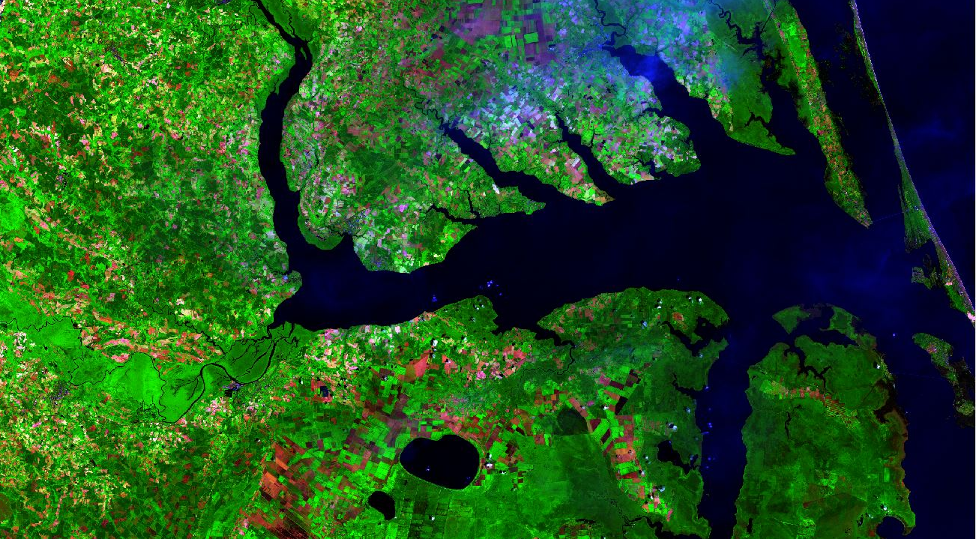

Landsat 8 Scenes
Land classification was carried out with these images and other ancillary data
Notes:
Images from February 15th 2015, May 22nd 2015, June 23rd 2015, July 23rd and August 10th were downloaded from Earth Explorer. The surface reflectance product was downloaded which has been corrected for both surface reflectance and some atmospheric interference. Two scenes were produced (14, 35 and 14, 36).
Bands were composited in ArcGIS to produce images that were useful for classifying land use types. Through research and trial and error we arrived at a band combination of 6 or 7 (Short Wave Infrared), band 5 (Near Infrared) and one of 4, 3 or 2 (the visual bands red, green and blue respectively).
We also changed the stretch on the composite images to adjust the histogram for the image to enhance the greens of the vegetation and better differentiate variances in the forest and wetland classes. The image on the slide has undergone this processing.

Slide 10
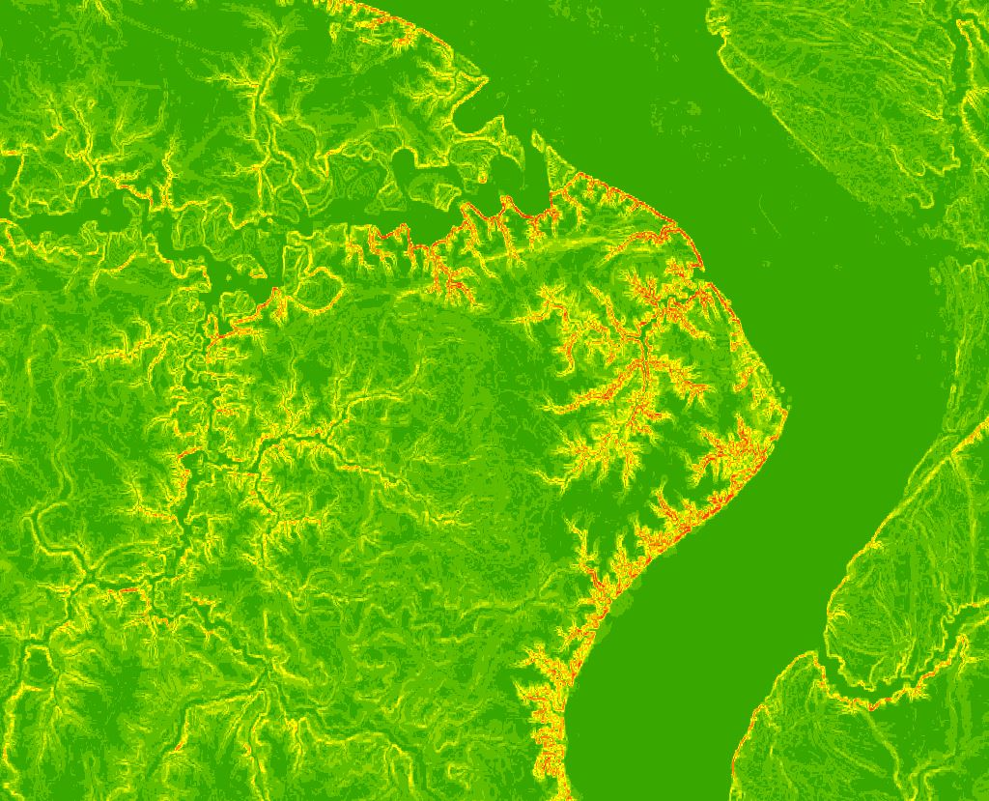
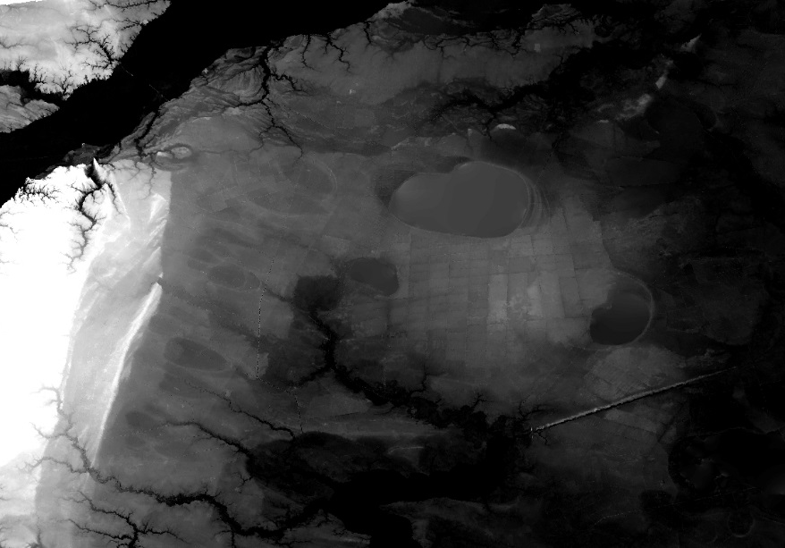
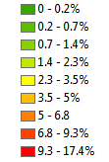

Digital Elevation Model (DEM)
Assists classification and differentiates low-lying wetland areas
Notes:
A digital elevation model is a commonly used data layer to assess elevations across a landscape. We used 3DEP (Digital Elevation Product) DEMs from the USGS. The DEMs used here are in resolutions of fractions of arc-seconds. The one arc-second DEM has a ~30m horizontal resolution, ~1/3, 10m and ~1/9, 3m. In the vertical dimension these DEMs are accurate to ~1.5m. They are derived from a combination of data, including: Lidar, satellite imagery, radar and digitized contours.
The slope layer is derived from a DEM through a tool in ArcGIS. The image shows percent slope which is sometimes more helpful than the DEM for easily identifying and highlighting areas of elevation change.
The DEM and Slope layers are useful for understanding the difference between forested wetlands and forests as they many times look similar on a Landsat or satellite image. As wetlands will generally occur in the lowest portions of a given landscape, differences in elevation can be particularly illuminating.

Slide 11

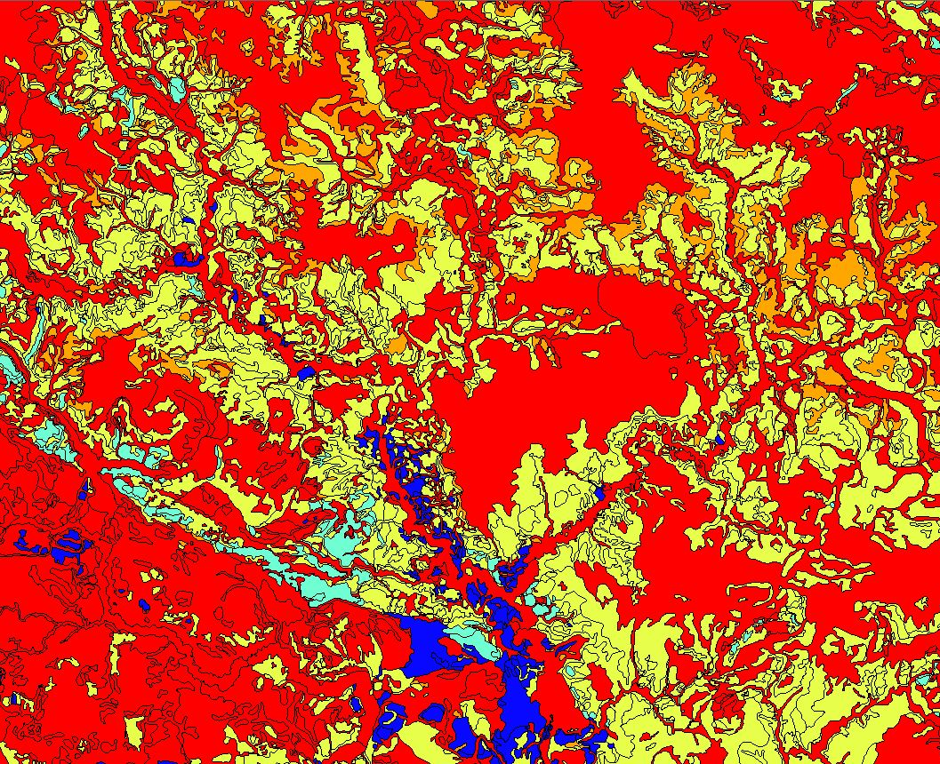

Soil Survey Geographic Database (SSURGO)
Depth to water table and percent hydric soils
Notes:
SSURGO is a large database of many different types of soil-related data obtained from USDA. We found that the Depth to Water Table and the Percent hydric soil was helpful in delineating differences between forests and forested wetland.
Hydric soil is the anoxic soil which is inundated for part of the year and is the soil generally found in wetlands.
In conjunction with the DEM data this served as very useful ancillary data in increasing the robustness of classes discernable in the Landsat composite images.

Slide 12
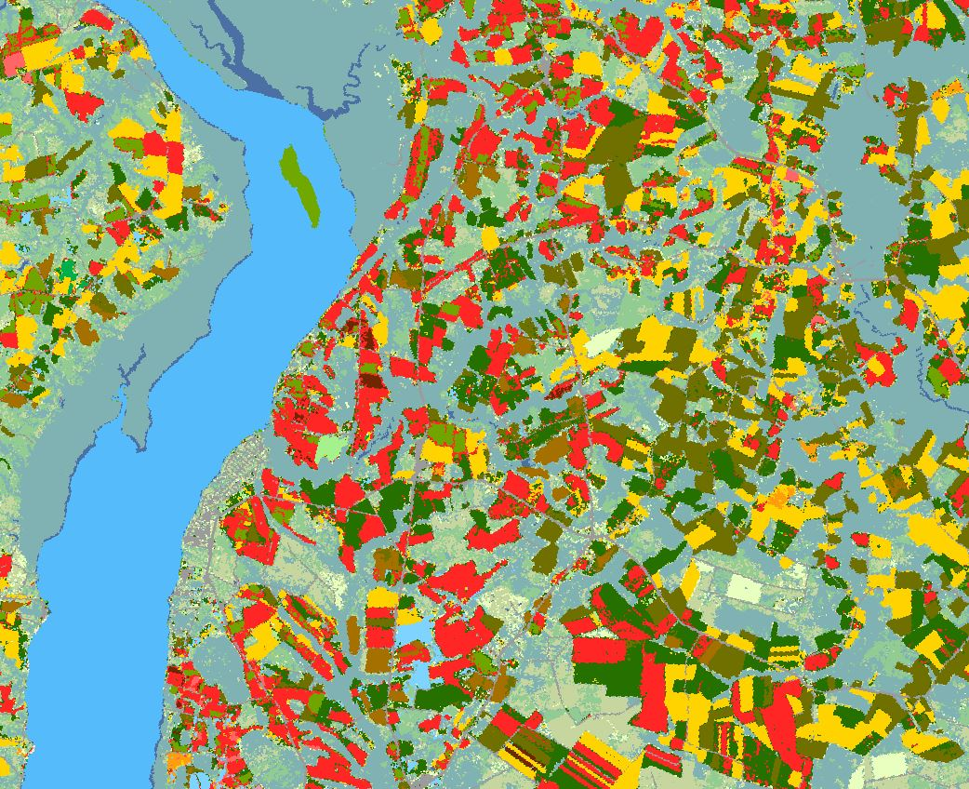
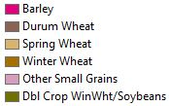

CropScape
Determination of crop types. The legend shows a sample of the agriculture classified.
Notes:
Cropscape is another land use classification dataset available from the USDA which focuses on crop type. Although this is the main focus it also characterizes forest types, two categories of wetlands and urban areas.
This dataset was very useful in determining crop types and allows the user to download data for a number of years. This is helpful because many crops are planted in a specific rotation so it makes it possible to establish a pattern and predict what was planted in many places in the 2015 season as this data is not yet available.
This dataset was also a useful alternative to the C-CAP which could be used to cross reference areas or classes that were difficult to characterize.

Slide 13
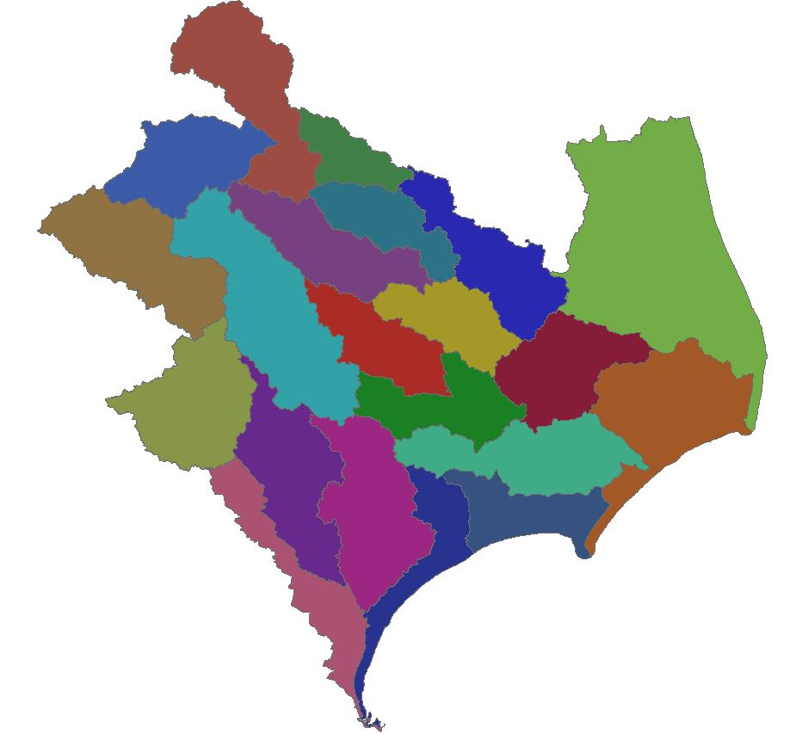

National Hydrography Dataset
(NHD)
Watershed boundaries and waterbody layers
Notes:
These are watershed boundaries and waterbody layers. They are useful for making images and understanding study area extent.

Slide 14
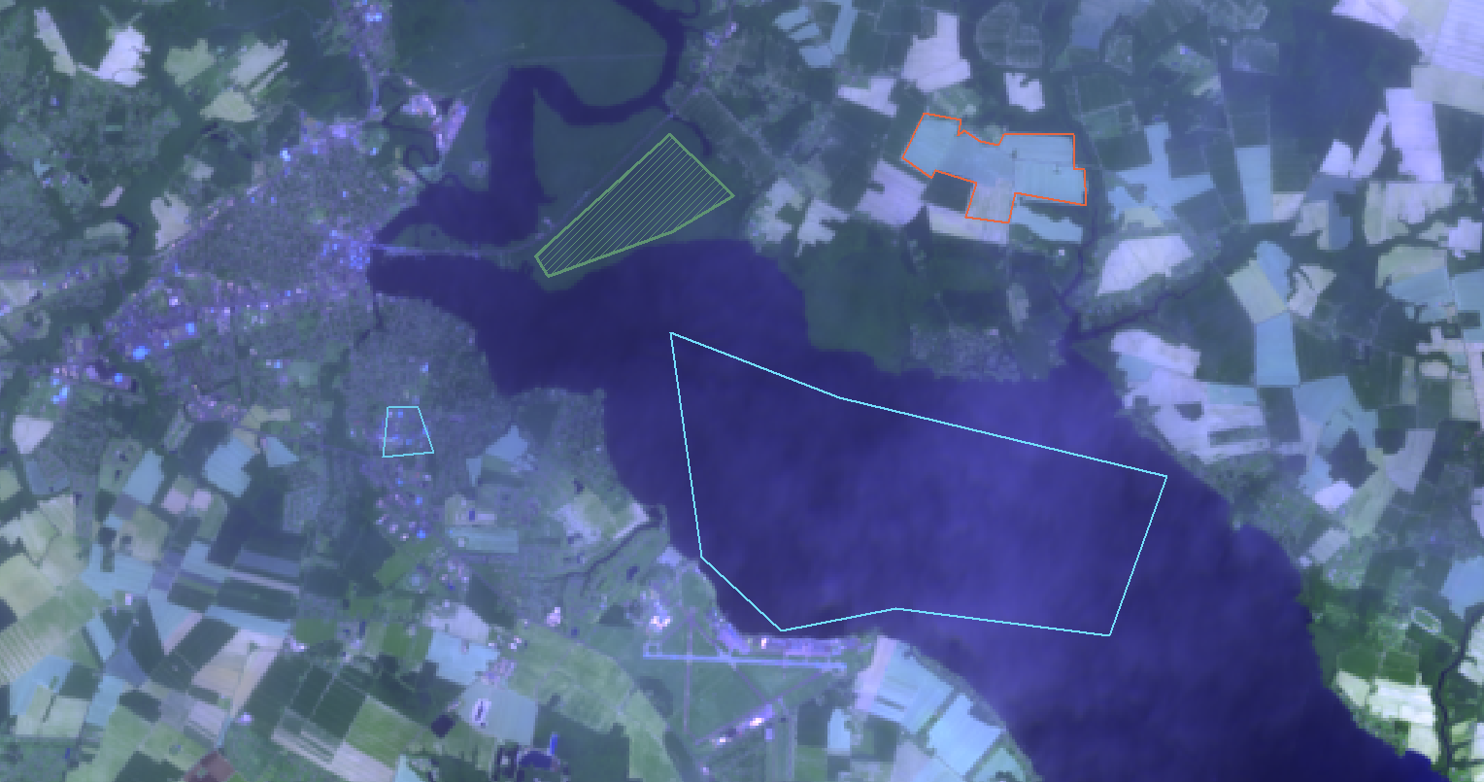
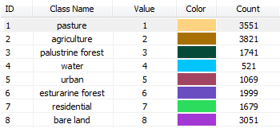
Training Sites (Polygons)
Notes:
We opted to use a supervised land use classification because of the greater degree of control we could exert over the outcome and in order to utilize more ancillary data more easily.
To conduct the supervised classification, training sites were selected by outlining polygons using the Image Classification toolbar in ArcGIS and attributing polygons with a given land class. The screen grab is just for demonstration purposes.

Slide 15
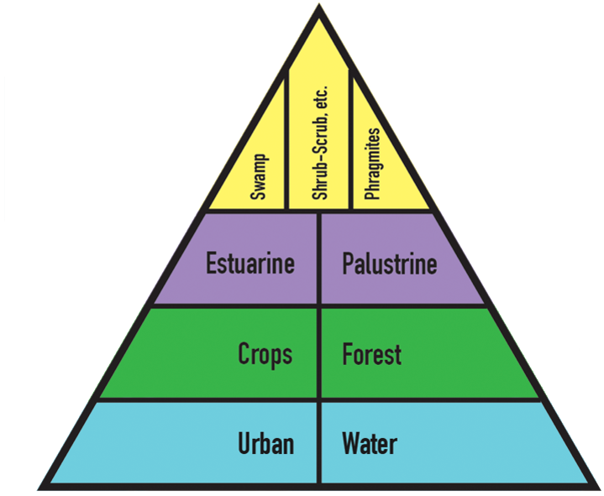
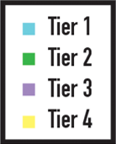
Classification Pyramid
Notes:
The pyramid graphic represents an approximation of the process we followed in selecting polygons. We started with those land types which were easiest to identify and worked our way up into delineating the types of wetlands. This was the most difficult group of classes to identify and the focus of our project.

Slide 16
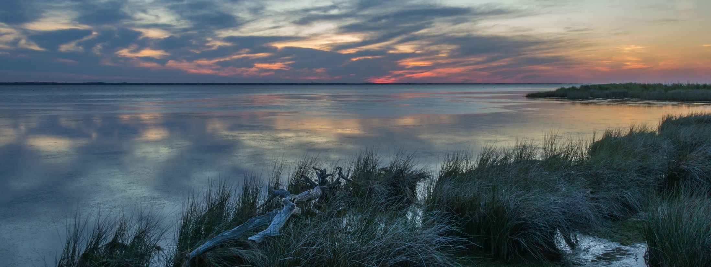
Image Credit: Shannon S.
Results & Conclusions
Highlight health decline in different types of wetlands
Notes:
The principal result of the project was the LULC map produced from the training sites assembled in ArcGIS. This particular classification was produced in Google Earth Engine (GEE) using a composite of seven bands from Landsat 8 and a slope layer derived from 1/3 arc second DEMs. Samples of the results depicting the Great Dismal Swamp in Northern North Carolina.
Image Credit: Shannon S. Perfect Ending. Currituck Sound, North Carolina. June 2014. Image Modified. https://www.flickr.com/photos/shannon-s/14422500500/in/photolist-nYt5VJ-qSYna-xsVar9-6J2G5c-6J6JuJ-a1CGXH-bCRDzD-eVZxQf-4ZZyHW-4ZZyeW-4ZVqtF-4ZZBFL-aifgHC-eTti9H-6J2Dpp-4ZZCyd-4ZVpyH-nNgjMP-4ZVoEX-4ZVmsH-ahXShh-6JbDSQ-6J7yBM-4ZYa1f-6JbNwj-4ZZGYC-6J6HVJ-6J6HaC-6J2BV8-6J2C32-6J6JAS-6J6H1J-6J6Hju-6J6HFb-6J2DSv-6J2D1e-6J6J4w-ntZiAB-4ZVi9F-6J2DZF-6J6Hsd-6J2CKr-6J2BLK-6J6Jm3-nLrfXN-cez8zY-4Uo24Z-6J6LJY-6J6MYm-6J6L49

Slide 17
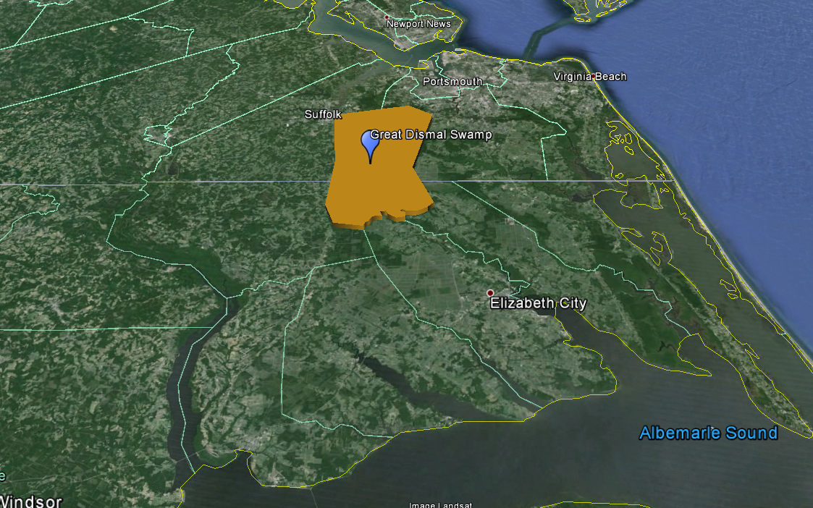
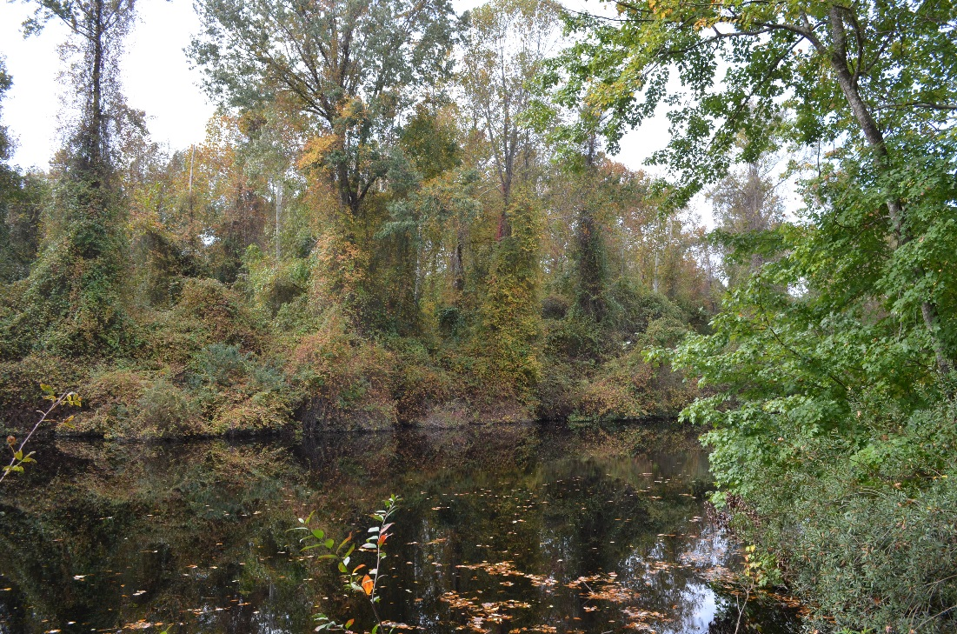
C-CAP vs OURS
Figure 1: The white box indicates what part of the Great Dismal Swamp Figure 2 is in.
Figure 2: Part of the Great Dismal Swamp.
Notes:
One of the goals of this project was to highlight certain areas that the team from last term identified as experiencing declines in wetland health. In order to show these areas a sample of our classification as well as the C-CAP was simply compared with their study focus areas to determine which types of wetland are identified as having declining wetland health.

Slide 18
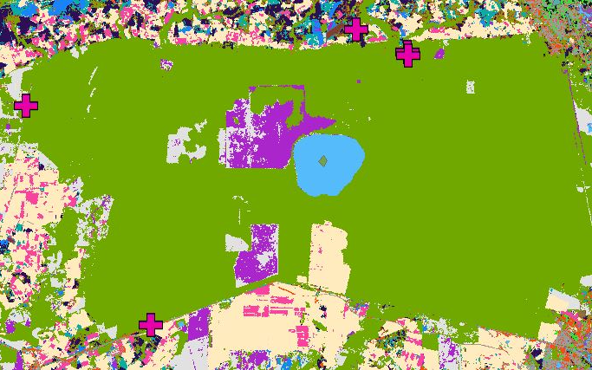
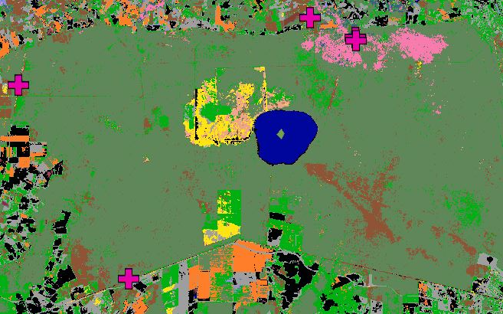
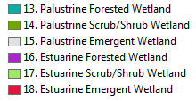
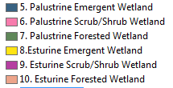
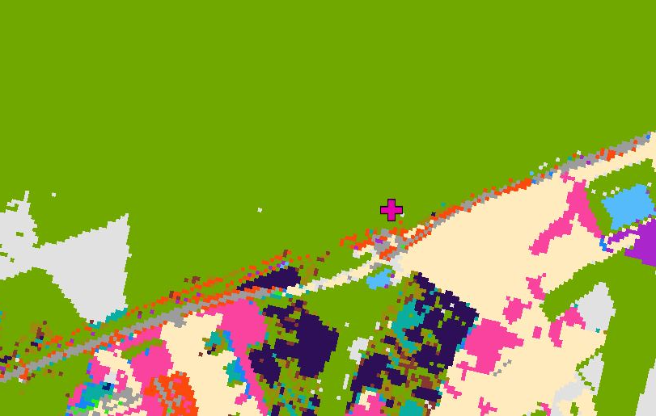
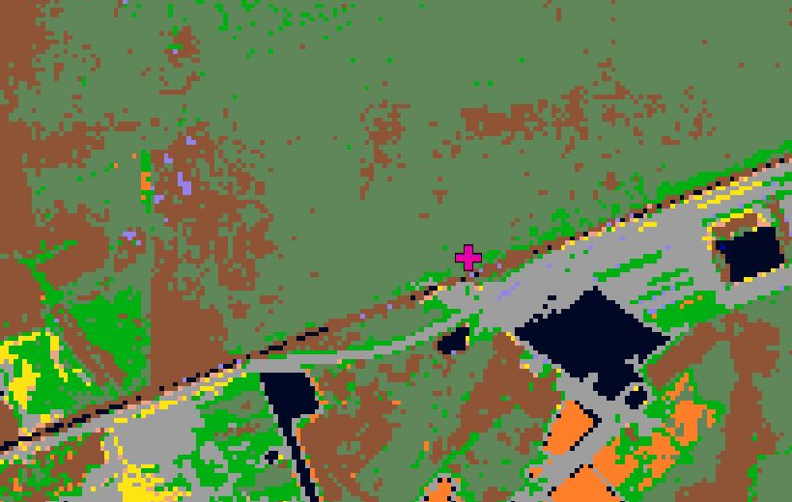
C-CAP vs OURS
N
N
Figure 3: C-CAP classification of the Great Dismal Swamp.
Figure 4: Our classification of the Great Dismal Swamp.
Palustrine Scrub/Shrub Wetland in C-CAP is classified as Palustrine Forested Wetland in ours.
Notes:
One of the principle uses of these results was to compare with the C-CAP product to highlight areas where our classifications differ from C-CAP, particularly in the wetland classes. The most prevalent differences found were in the classification of palustrine scrub/shrub wetlands by C-CAP when in reality much of this area should likely be defined as palustrine forested wetlands. Furthermore, there are large areas defined by C-CAP as grass or pasture which have been developed into urban or agricultural land.
There are a few potential sources of error in this project. The first and likely most influential is human error. The team developed a methodology for identifying wetland class types to attempt to standardize the process, however, selection of training sites remains largely subjective to the analyst. The process leveraged a wide range of data to cross reference and any error in these layers could also present a compounding factor. There is also a high level of potential error in the classification mechanism when trying to identify classes which have such a similar spectral signature (e.g. forest and forested wetland). In a similar realm, influences of factors such as clouds have an impact on the classification and how the algorithm is able to identify classes on the ground.

Slide 19
Advisors
Dr. Kenton Ross, NASA DEVELOP Science Director
Partners
Albemarle-Pamlico National Estuary Partnership (APNEP)
Others
Emily Adams, NASA DEVELOP Center Lead
Rebekke Muench, NASA DEVELOP Assistant Center Lead
North Carolina Ecological Forecasting I Team, NASA DEVELOP at Langley Research Center (Zand Bakhtiari, Stephen Zimmerman, Kayla Patel, Brad Gregory)

