Slide 1
Montana Ecological Forecasting
Utilizing NASA Earth observations to forecast the effects of climate change on northern goshawk nesting habitat
Erika Higa (Project Lead)
Sean McCartney
Amanda Clayton
Notes:
Welcome to the DEVELOP program’s fall 2015 closeout! We are the Montana Ecological Forecasting team: Erika, Sean and Amanda! The focus of our project was to model nesting habitat for the northern goshawk using NASA Earth observations, and to forecast the effects of climate change on nesting habitat by the year 2050.

Slide 2
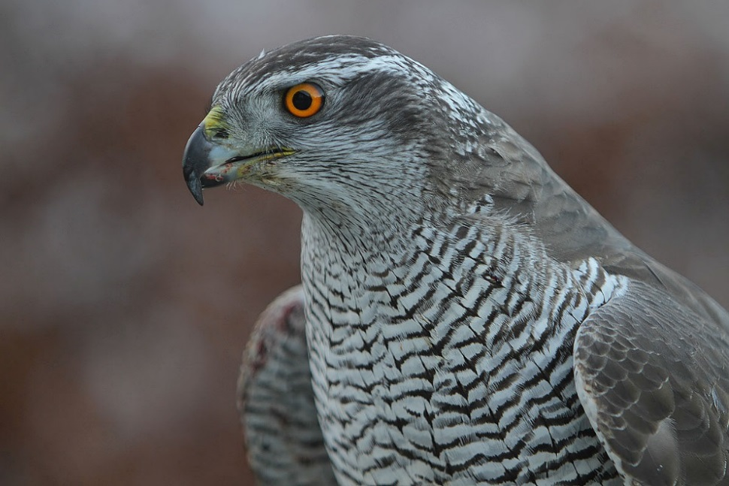
Scientific name: Accipiter gentilis
Generalist predator
Occupies boreal and temperate forests of the Holarctic
Nests in mature forests with dense canopy cover and open understory
Mountain pine beetle threat
Northern Goshawk
Photo credit: Steve Garvie
Notes:
The northern goshawk, Accipiter gentilis, is the largest species in the accipiter family. It is a generalist predator occupying boreal and temperate forests of the Holarctic. Goshawks often nest in mature forests with dense canopy cover and open understory. Currently, mountain pine beetle outbreaks are one of the biggest threats to northern goshawk habitats in the western US.
Image source: https://commons.wikimedia.org/wiki/File:Accipiter_gentilis_-owned_by_a_falconer_in_Scotland_-upper_body-8a.jpg

Slide 3
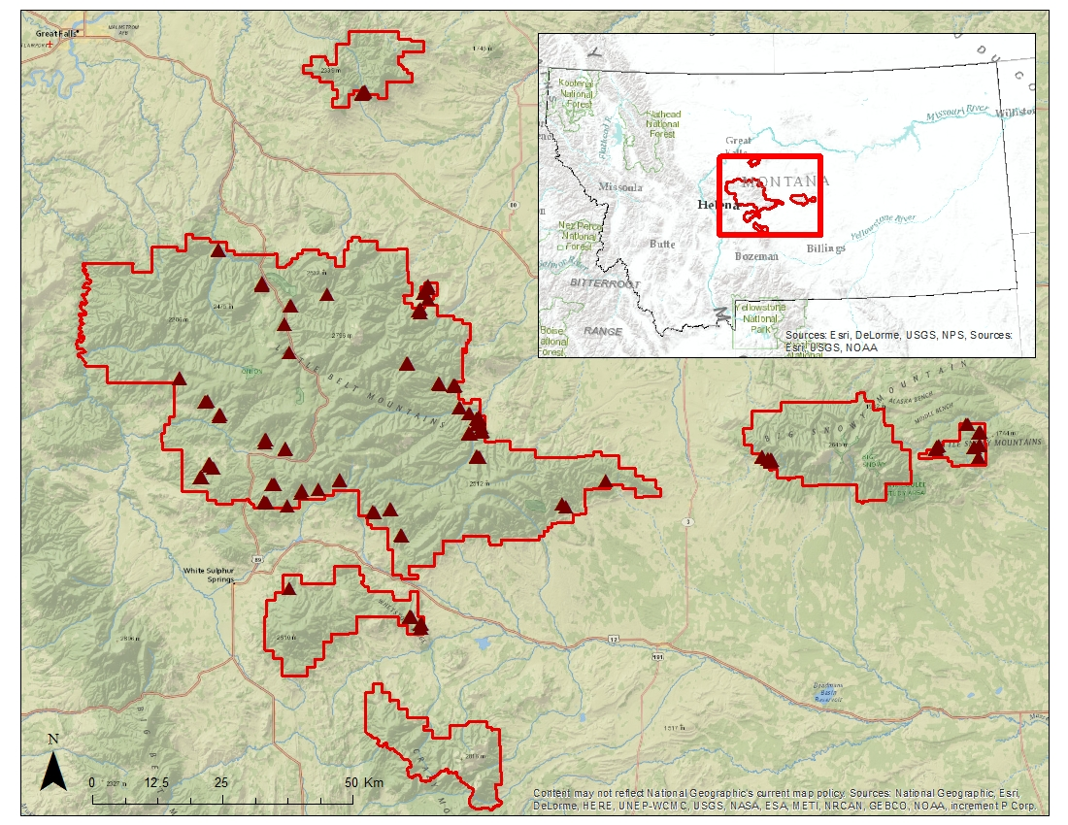
Study Area - Lewis and Clark National Forest (LCNF), Jefferson Division
4,900 km² area located in central Montana
Elevation: 1,200 - 2,800 m
Mixed grassland and conifer forest
190 nest sites collected from 1985 – 2013
LCNF Jefferson Division with nesting sites included
Notes:
The study area for this project is the Jefferson division of the Lewis and Clark National Forest in Montana. The Jefferson division is approximately 4,900 square kilometers in area with elevations ranging from 1,200 to 2,800 meters. Dominant land cover includes mixed grassland and conifer forests. For modeling nesting habitat we used 190 goshawk nest sites that were provided by our project collaborator, Dr. Nate Bickford, and Laura Conway from the US Forest Service. These nest sites were collected from 1985 to 2013.
Base layer sources: Esri, DeLorme, USGS, NPS, HERE, MapmyIndia, Open Street Map, UNEP-WCMC, USGS, NASA, ESA, METI, NRCAN, GEBCO, NOAA, and increment P Corp.

Slide 4
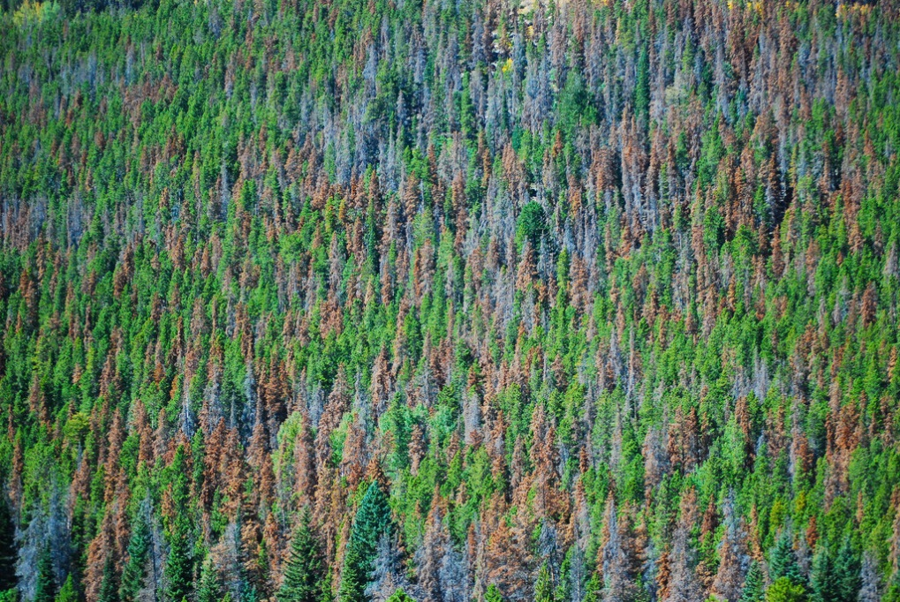
Community Concerns
Northern goshawk is designated as a Management Indicator Species in the LCNF
Fire, insect blight, and disease, are prevalent causing widespread changes in the landscape
Projected climate change will affect egg and nestling survival and the availability of suitable habitat
Photo credit: Don Becker, USGS
Notes:
In Montana, the northern goshawk is designated as a Management Indicator Species in the Lewis and Clark National Forest and is protected under the Migratory Bird Treaty Act of 1918. Fire, insect blight, and disease are prevalent throughout the region, causing widespread changes in the landscape. Projected climate change will affect egg and nestling survival and the availability of suitable habitat for goshawks.
Image source: https://www.flickr.com/photos/usgeologicalsurvey/16612752984

Slide 5
Background
Project partner Dr. Nate Bickford and his colleagues partnered with the DEVELOP program to address the feasibility of using Earth observations to model nesting habitat in the LCNF
Prior to this research no Earth observations were incorporated in their work
Photo credit: Don Becker, USGS
Video credit: NASA/GSFC
Notes:
Project partner Dr. Nate Bickford at the U. of Nebraska at Kearney, and his colleagues at the US Forest Service and the University of Oulu in Finland, partnered with the DEVELOP program to address the feasibility of using NASA Earth observations to model nesting habitat in the LCNF.
This was the group’s first attempt at using Earth observations to identify nesting habitat and hope to use suitability maps direct field teams to areas with a higher probability of nesting sites.
Video source: https://svs.gsfc.nasa.gov/cgi-bin/details.cgi?aid=4274

Slide 6
Objectives
Assess the use of NASA Earth observations, along with ancillary data, in creating environmental variables as inputs for habitat suitability modeling
Analyze three different habitat suitability models to form a consensus map for northern goshawk nesting habitat in the LCNF
Forecast the impacts of climate change on nesting habitat through the year 2050 by incorporating mountain pine beetle disturbance and fire risk
Notes:
Our three objectives for the project were to asses the use of NASA Earth observations, along with ancillary data, in creating environmental variables as inputs for habitat suitability models, to analyze three different habitat suitability models to form a consensus map for northern goshawk nesting habitat in the Lewis and Clark National Forest, and lastly, to forecast the impacts of climate change on nesting habitat until the year 2050.

Slide 7
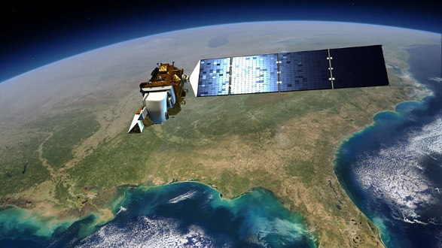
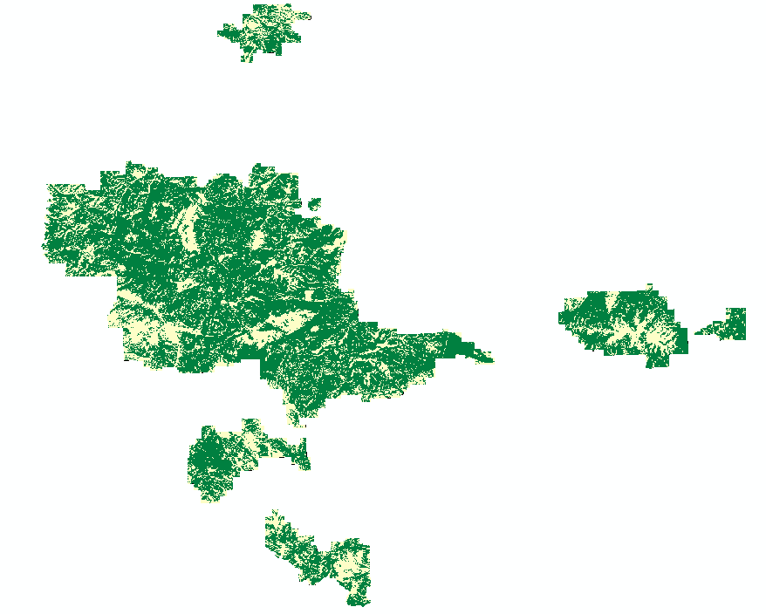
NASA Earth Observations
Landsat 8 – OLI
Land cover classification
Image credit: NASA GSFC
Overall Accuracy = 88%
Forest
Non-forest
Notes:
Data acquired from four NASA Earth observations were used in this study.
Landsat 8 – Operational Land Imager data were acquired as three scenes, atmospherically corrected, then mosaicked together. An object-based classification was used in creating a forest/non-forest land cover map. The overall accuracy for the classification was 88% (with an overall kappa value of 0.71).
Image source: https://commons.wikimedia.org/wiki/File:Landsat_8_%28LDCM%29_Satellite.jpg

Slide 8
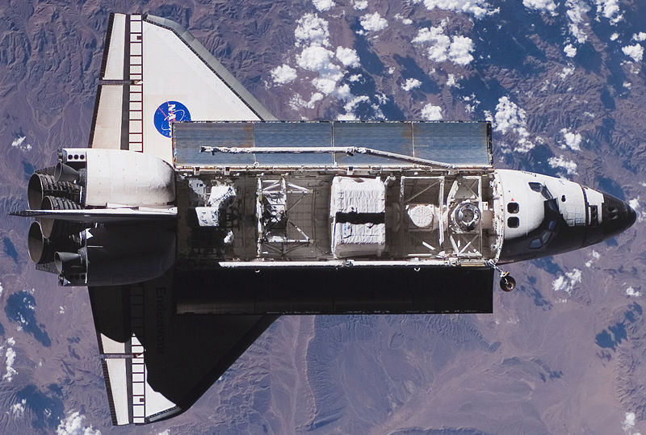
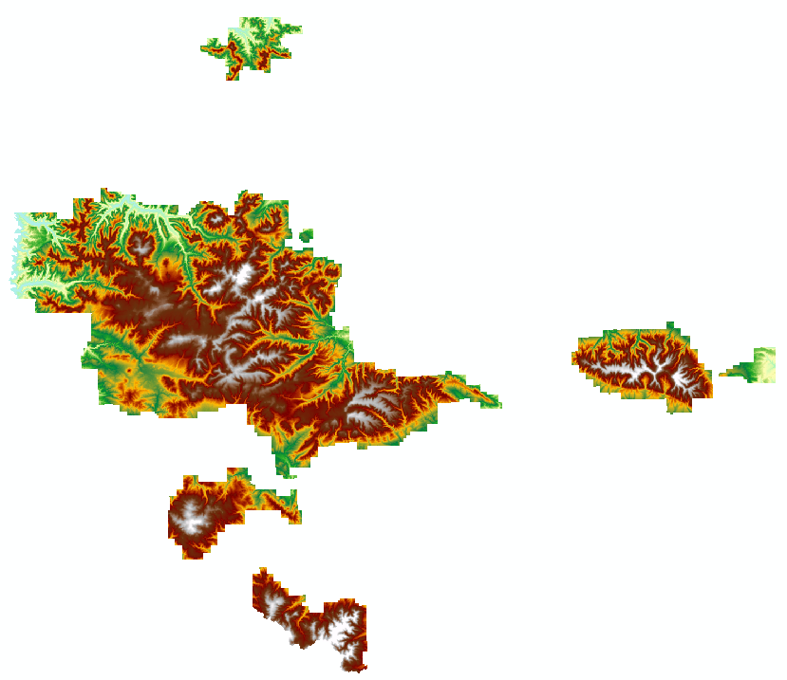
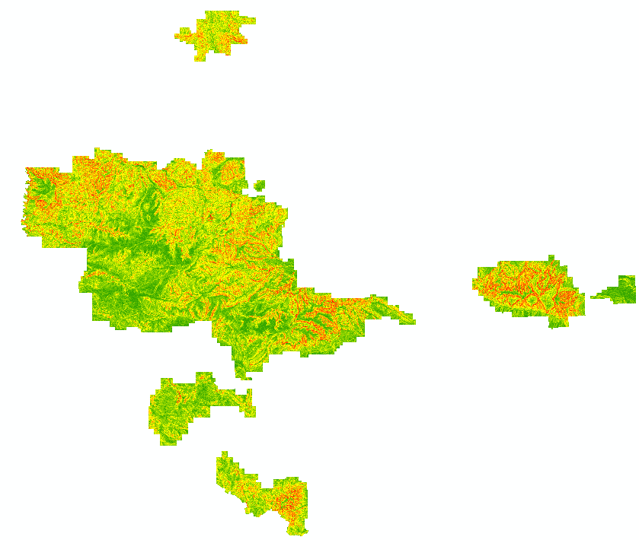
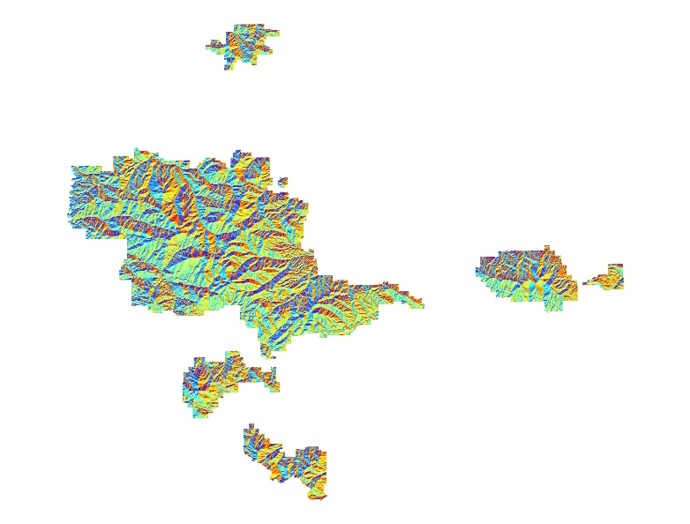
NASA Earth Observations
Shuttle Radar Topography Mission (SRTM)
Topographic features
Image credit: NASA
DEM
Slope
Aspect
Notes:
Five Shuttle Radar Topography Mission (SRTM) tiles were downloaded and mosaicked to create layers of topographic features, including a digital elevation model, slope, and aspect.
Image source: https://commons.wikimedia.org/wiki/File:STS-118_approaching_ISS.jpg

Slide 9
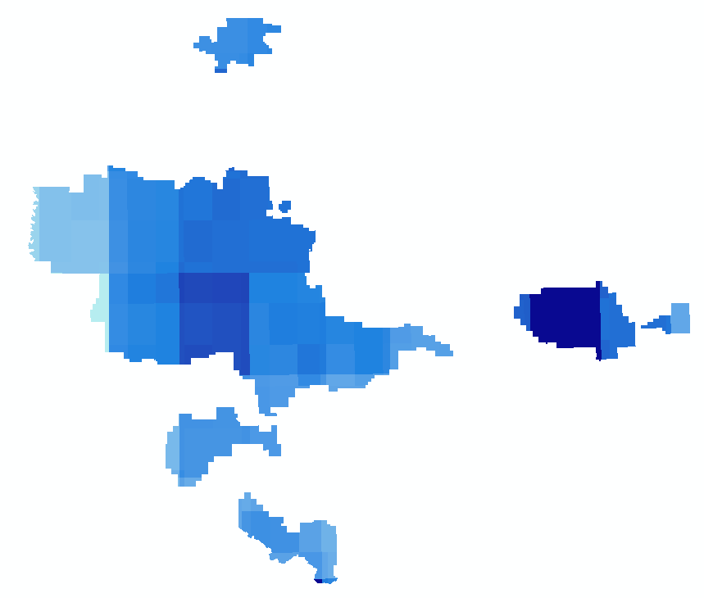
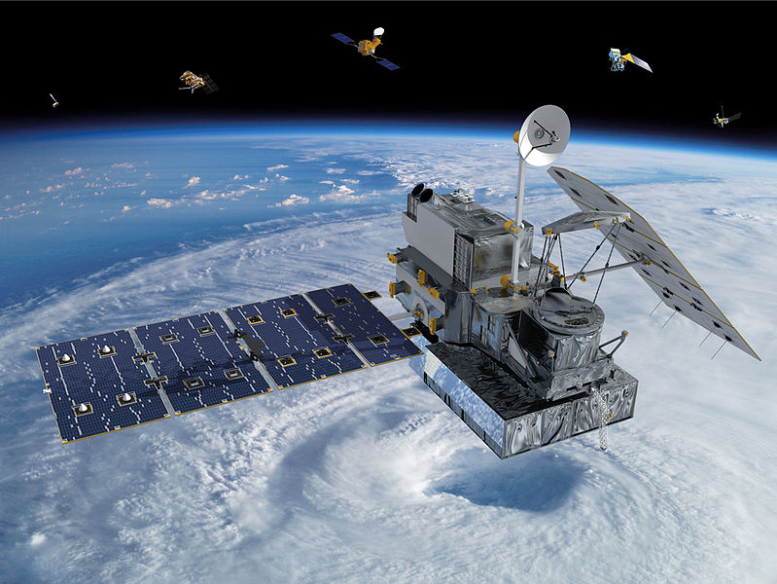
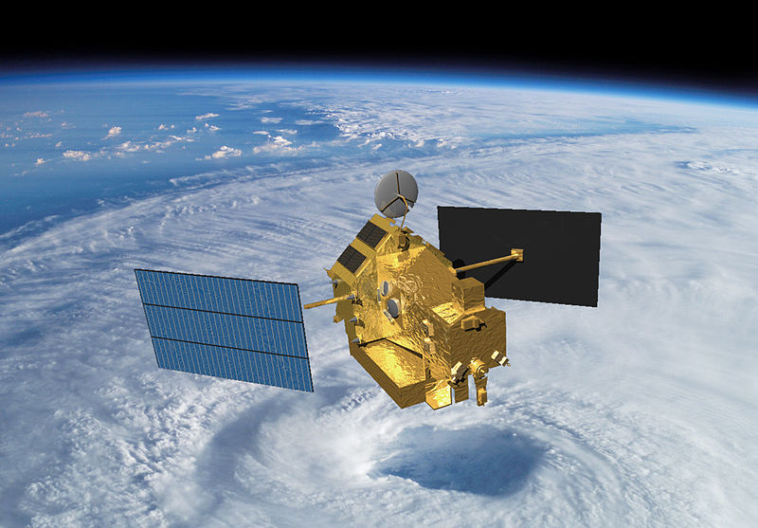
NASA Earth Observations
Tropical Rainfall Measurement Mission (TRMM)
Global Precipitation Measurement (GPM)
Precipitation 2010 - 2015
Precipitation mm/month
TRMM
GPM
Image credit: NASA
Image credit: NASA
Notes:
We obtained precipitation data from the Tropical Rainfall Measurement Mission (TRMM) and Global Precipitation Measurement (GPM) constellation of satellites, creating a dataset of average precipitation from 2010-2015. Combining monthly precipitation from TRMM for the years 2010-2014 and GPM for 2015, we created an average monthly precipitation for the goshawk nesting months from February to June.
Image source: https://en.wikipedia.org/wiki/Global_Precipitation_Measurement
Image source: https://commons.wikimedia.org/wiki/File:TRMM_in_Space_Large.jpg

Slide 10
HSM
Habitat
Suitability
Modeling
Notes:
We developed three separate habitat suitability models to determine the habitat needs of the northern goshawk in the LCNF. We chose the variables to run each model based on literature review and consultation with project partners. The results of these models prioritize areas to be searched for occupancy by nesting goshawks.

Slide 11
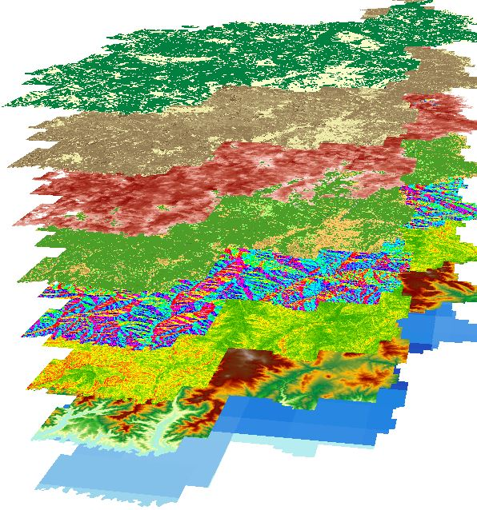
Habitat Suitability Modeling
Land Cover
Tree Canopy Cover
Basal Area
Vegetation Height
Aspect
Slope
Digital Elevation Model
Precipitation
BioMapper · Maxent · Mahalanobis Typicality
Notes:
Five environmental variables were derived from NASA Earth observations, and three ancillary variables were created using data from the US Forest Service (USDA Forest Service). These eight variables, along with the 190 nest site locations, were input into three habitat suitability modeling software – BioMapper, Maxent, and Mahalanobis Typicality– to create three suitability maps showing the probability for nesting sites based on presence only data and our bioclimatic variables.

Slide 12
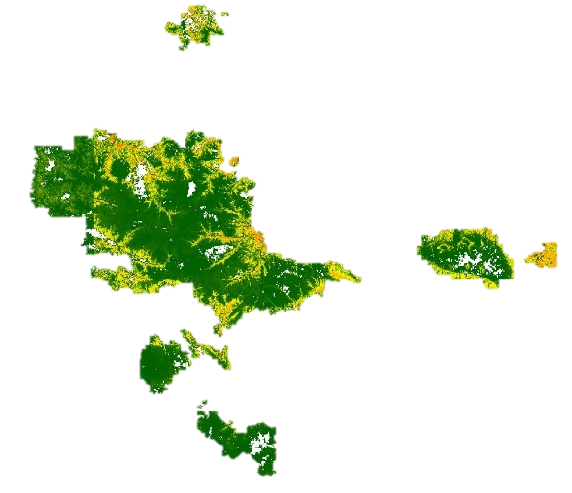
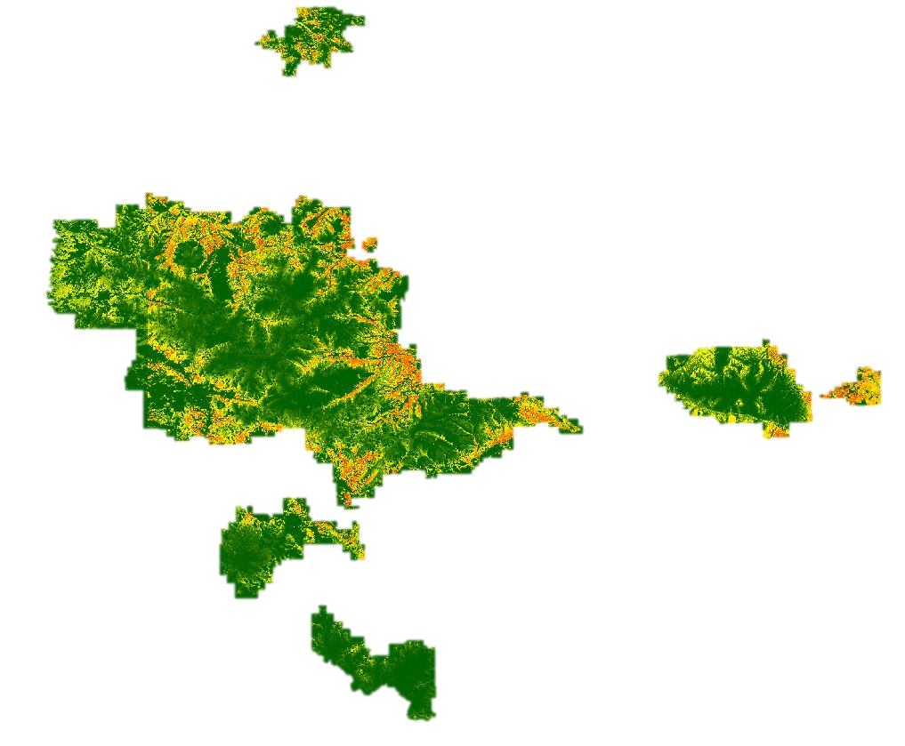
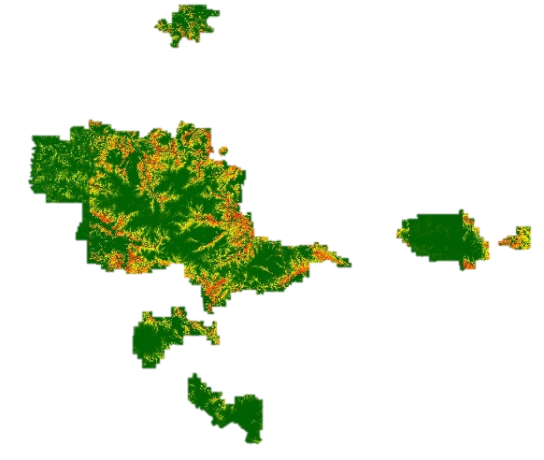
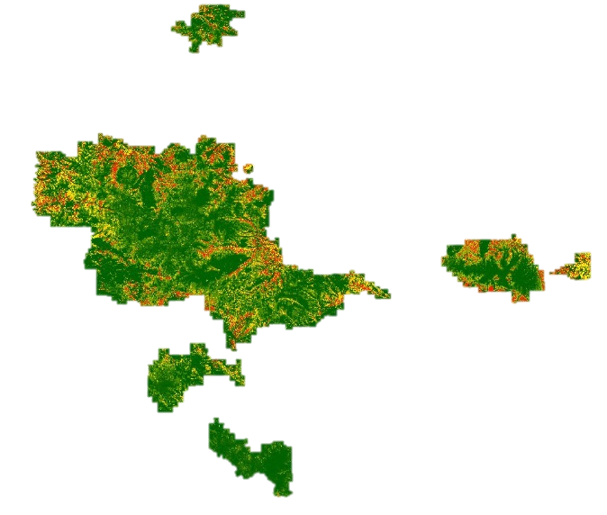
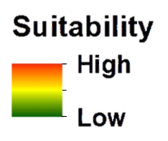
Results: Habitat Suitability Maps
Maxent
Consensus Suitability Map
Mahalanobis Typicality
BioMapper
Notes:
The results from the three habitat suitability maps were then combined creating a consensus map showing the mean probability of suitable areas for nesting sites. This map can improve search efficiency for nesting sites during the nesting season and help manage goshawk habitat in the LCNF.

Slide 13
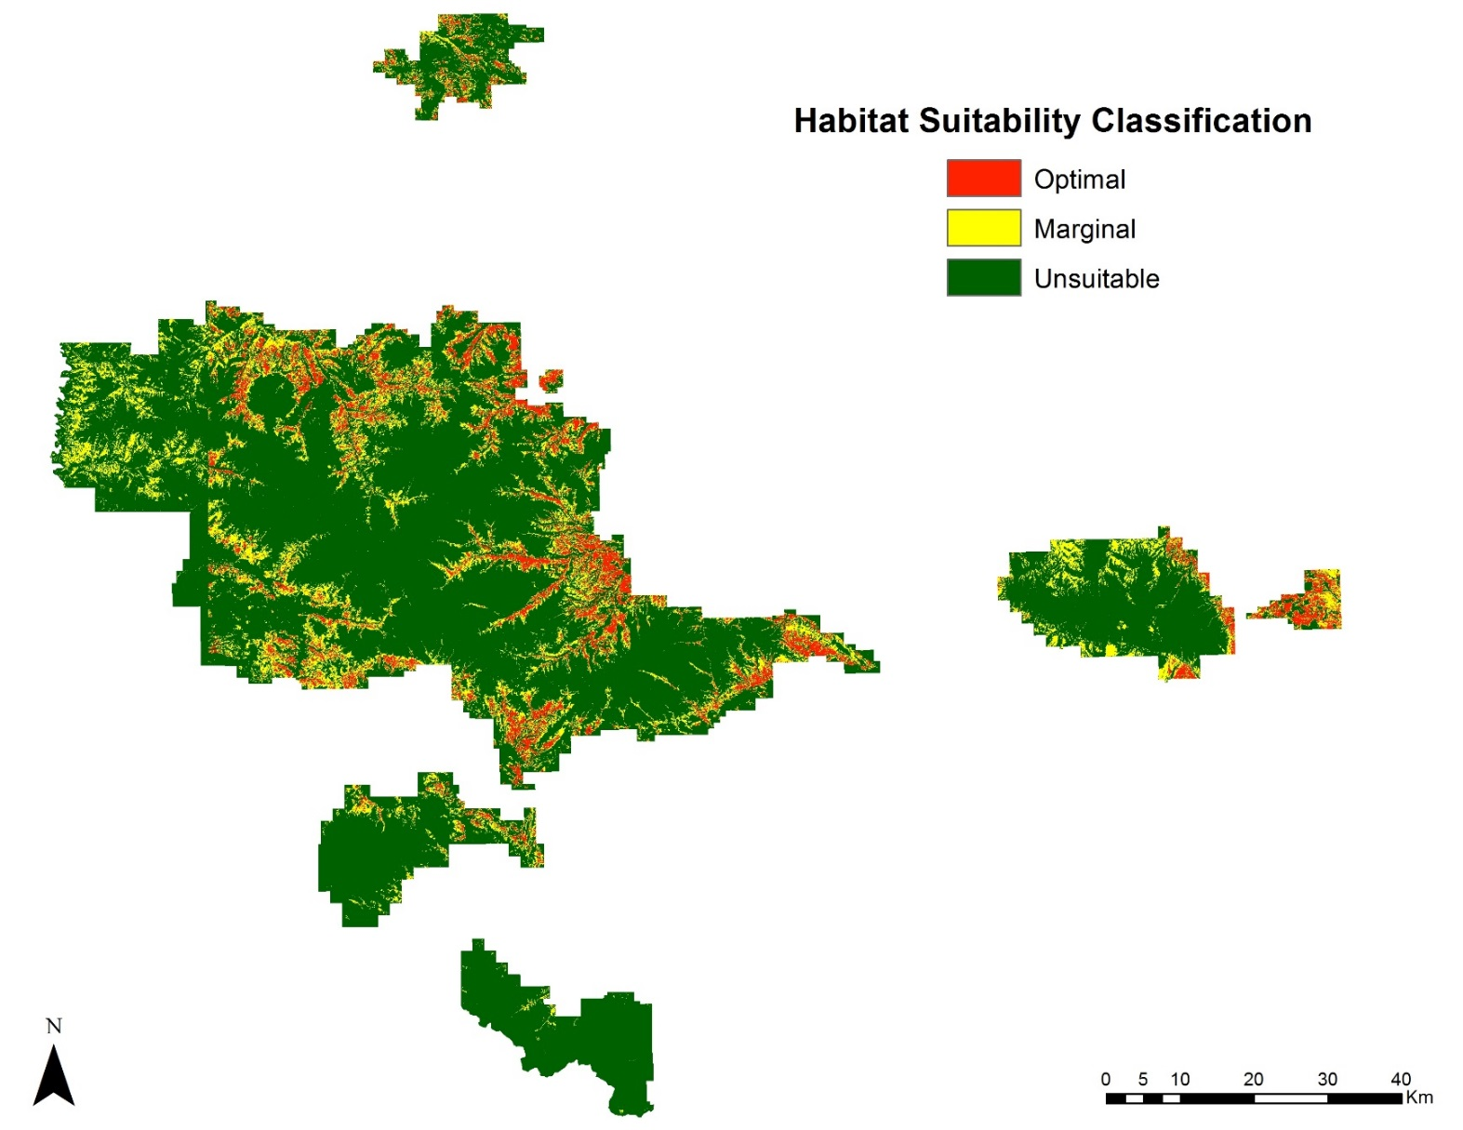
Notes:
The consensus map was then reclassified to identify areas of optimal, marginal, and unsuitable habitat using an equal interval classification. Approximately 7% of the study area, or 350 square kilometers, was modeled as optimal nesting habitat for the northern goshawk.

Slide 14
Forecasting
Effects of Climate Change and
Stochastic Variables
Notes:
The second part of the project focused on forecasting the impact of climate change, mountain pine beetle, and fires on the goshawk nesting habitat. Our goal was to see how climate change and these disturbances might affect available goshawk nesting habitat in the future.

Slide 15
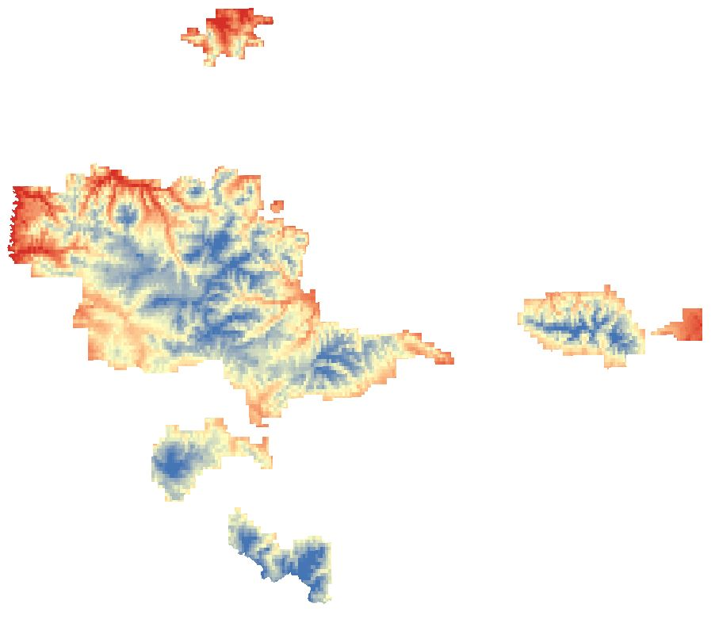
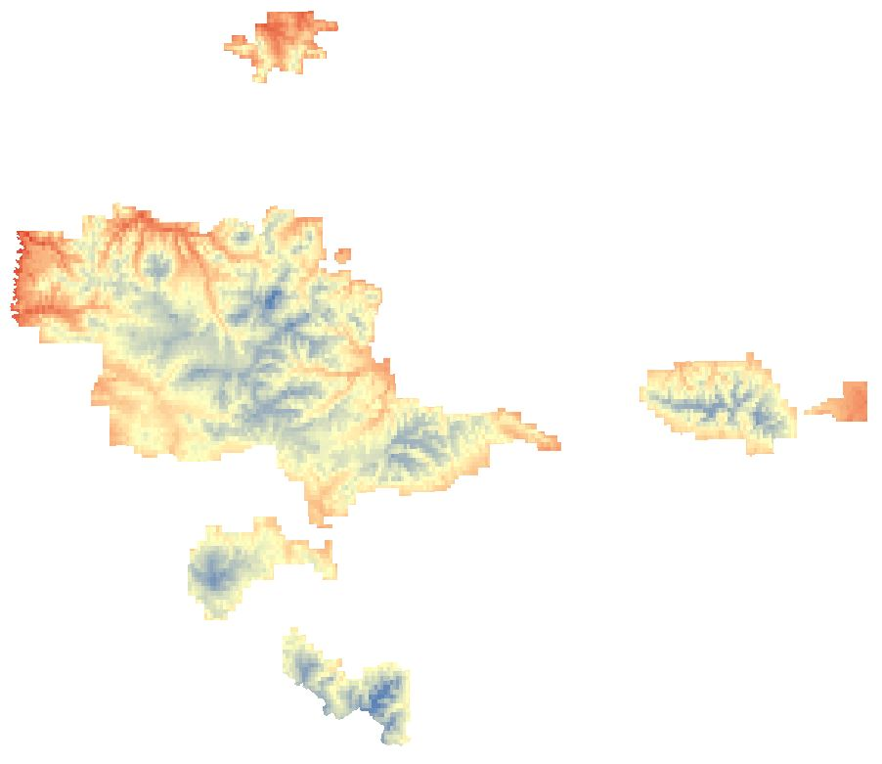
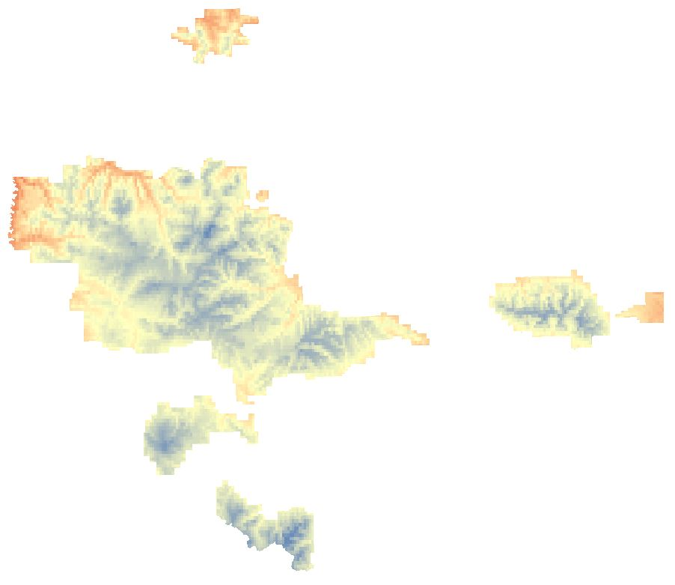
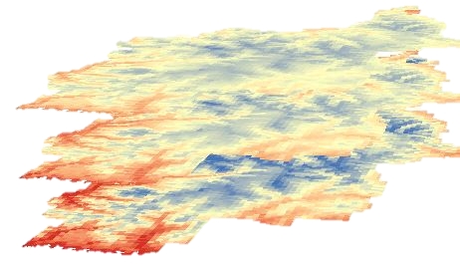
Forecasting: Climate Change
Goddard Institute for Space Studies ModelE/Russell Model (GISS-E2-R)
RCP 2.6: greenhouse gas emissions peak 2010 – 2020, then decline
RCP 4.5: emissions peak in 2040, then decline
RCP 8.5: emissions are constant
Notes:
To investigate how climate change will impact the nesting habitat, we used the NASA Goddard Institute for Space Studies E2-R climate model to project climate trends to 2050 for three representative concentration pathways (RCPs) scenarios with varying emissions projections. The RCP 2.6 scenario assumes that global annual greenhouse gas emissions peak between the years 2010 to 2020 and declines thereafter. The RCP 4.5 scenario assumes greenhouse gas emissions to peak in 2040 and then decline thereafter, while emissions continue to rise throughout the 21st century in the RCP 8.5 scenario.
We observed the projected climate trends using the GISS E2-R climate model for both the average monthly minimum temperature and average monthly precipitation.

Slide 16
Climate Change: Results
Notes:
Using in situ data from Tenderfoot Creek Experimental Forest, a weather station within our study area, the minimum temperature and precipitation were averaged from recent goshawk nesting seasons, which runs from February to June, and compared to the modeled climate in 2050. In all scenarios, the trend showed increased temperature and decreased precipitation.

Slide 17
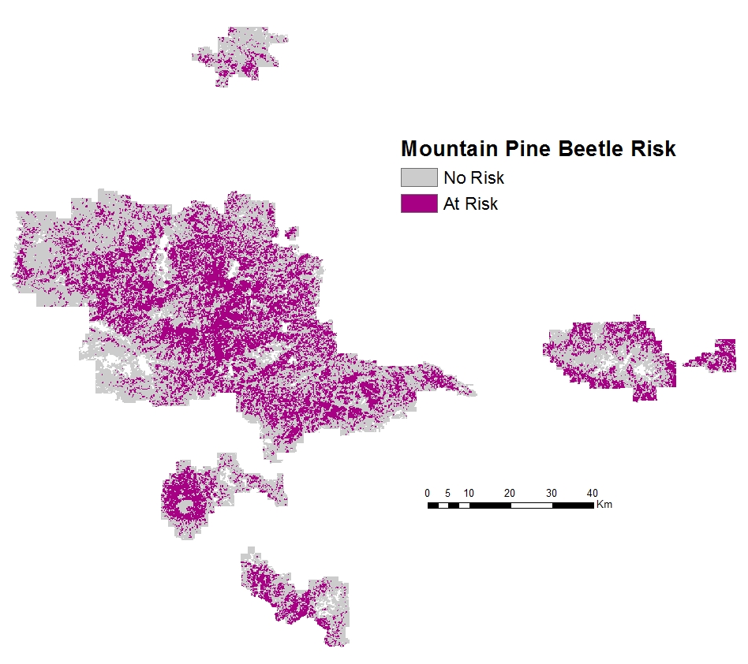
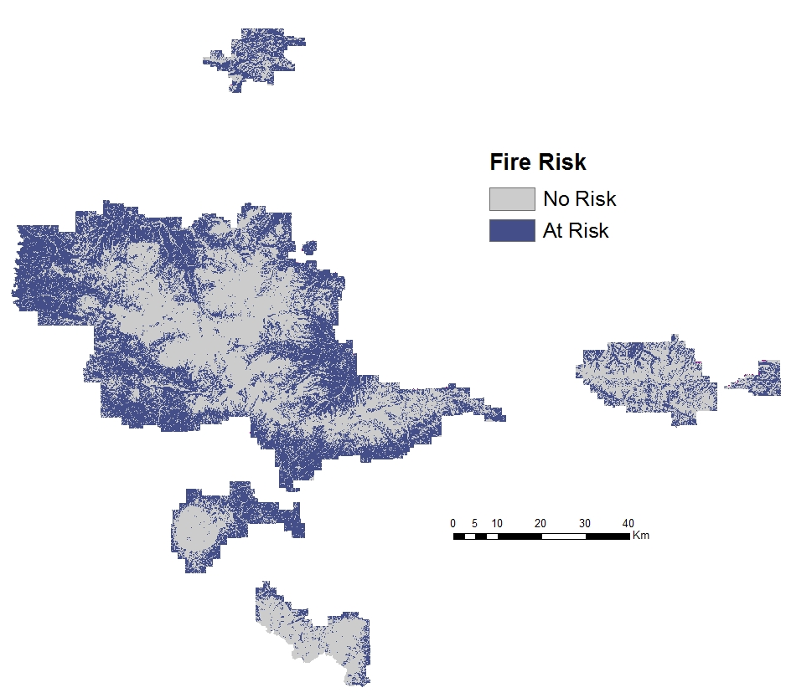
Forecasting: Beetle and Fire Risk
Notes:
We looked at a 2027 projected mountain pine beetle risk map from the USDA Forest Service National Insect and Disease Risk Data, and we took a look at the total projected basal area loss in square feet per acre. We also looked at the mean fire interval data from the USGS LANDFIRE program that displays historical fire regimes by categories of varying temporal length (in years). We reclassified the fire interval data so that areas that have a fire return interval between 11 to 35 years as higher risk areas.

Slide 18
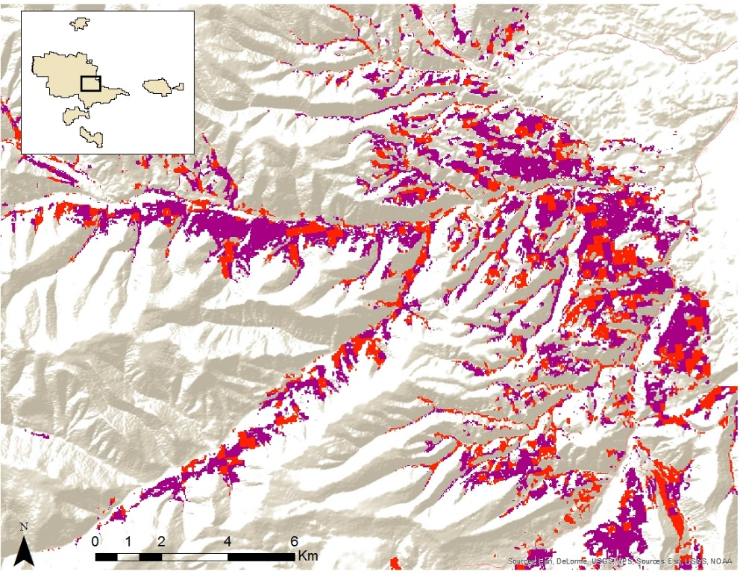
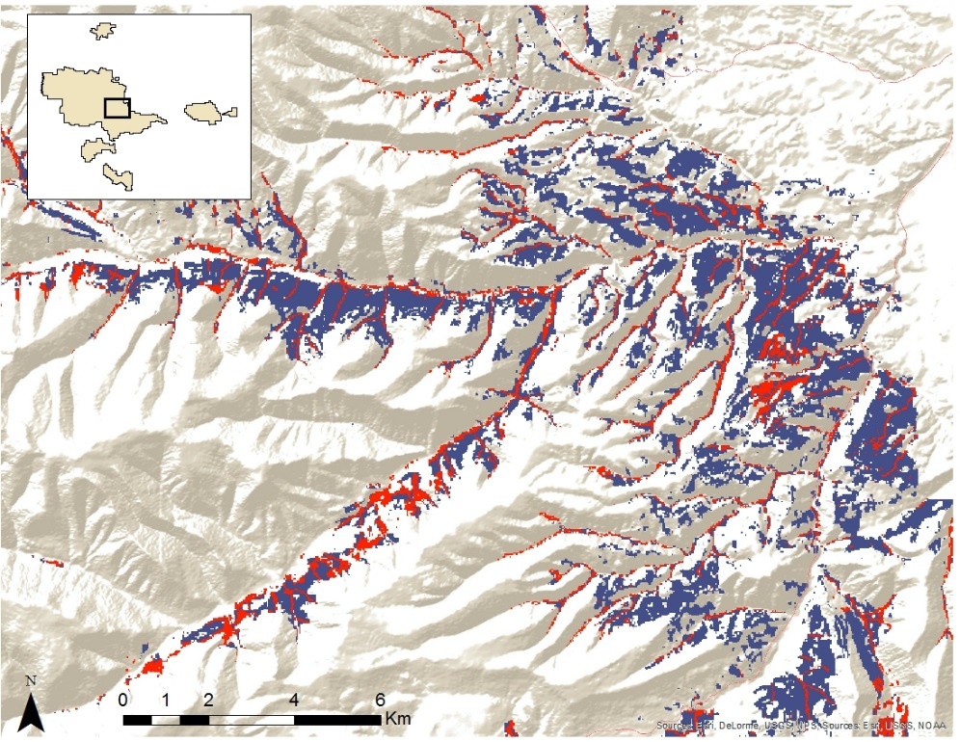
Beetle and Fire Risk: Results
52%
66%
Notes:
We overlaid the classified habitat suitability map with the mountain pine beetle risk map and found that 52% of modeled optimal habitat may be at risk for mountain pine beetle blight based on the 2027 projected beetle risk map. We assume that by 2050, there may be more than 52% of modeled habitat at risk since the pine beetles increase their geographic extent in warmer and drier conditions.
Furthermore, we overlaid the fire frequency map with the habitat suitability map and found that 66% of optimal habitat may be at risk for frequent wildfires. With the impact of climate change, we assume that the changing climate will increase the chances of fire to occur more frequently in our study area and this can adversely reduce the extent of available nesting habitat.

Slide 19
Conclusions
Earth observations with ancillary data are effective in modeling nesting sites for the northern goshawk
Climate change is expected to decrease nesting habitat by 2050
Methodology can be applied to model nesting sites in the Holarctic
Notes:
In conclusion, Earth observations with ancillary data are effective in modeling nesting sites for the northern goshawk. This methodology is important for improving the efficacy of field teams searching for goshawk nests during the nesting season, and can lead to better planning and management of the LCNF for conservation efforts for this indicator species.
Climate change is expected to decrease nesting habitat by 2050. The climate projections based on the GISS-E2-R model show there will be warmer and drier conditions in the future for all RCP scenarios. This means the geographic extent of the mountain pine beetle and its populations will increase, thus limiting the available nesting habitat for goshawks. In addition, the warmer and drier conditions may lead to an increased frequency of wildfires, further reducing the extent of optimal goshawk nesting habitat.
The importance of this study is realizing how freely-available Earth observing data, along with ancillary data, can be used as variables with open source software to replicate this methodology in other regions of the Holarctic. This will benefit both our project partners in the US as well as our partners working overseas in Finland.

Slide 20
Future Work
Incorporate LiDAR remote sensing to develop vegetation modeling variables
Validate habitat suitability model through field surveys
Shift to quantitative forecasting
Notes:
If given the opportunity to expand on what our team has accomplished this term we would incorporate LiDAR remote sensing to develop vegetation modeling variables to capture additional, necessary vegetation metrics such as understory and canopy structure, to validate the consensus map though field surveys, and to shift to quantitative, rather than qualitative, forecasting.

Slide 21
Advisors
Dr. Ross Nelson, NASA Goddard Space Flight Center
Dr. John Bolten, NASA Goddard Space Flight Center
Partners
Dr. Nate Bickford, University of Nebraska at Kearney
Dr. Risto Tornberg, Oulu University, Finland
Victor Murphy, USDA Forest Service
Other Contributors
Laura Conway, USDA Forest Service
Dr. Lee Vierling, University of Idaho
Dr. Jeff Hicke, University of Idaho
Notes:
We would like to thank our science advisors, Dr. Ross Nelson and Dr. John Bolten, for their guidance and support; our partner Dr. Nate Bickford for answering many of our questions and providing goshawk nest data. We would also like to thank Laura Conway for providing additional nest site data, as well as Dr. Lee Vierling and Dr. Jeff Hicke for their insight on the mountain pine beetle. Thank you and we would now like to open the floor to any questions you may have.

