Slide 1
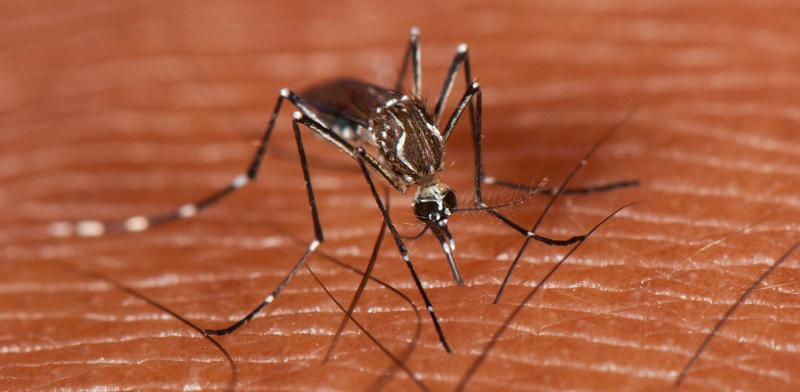
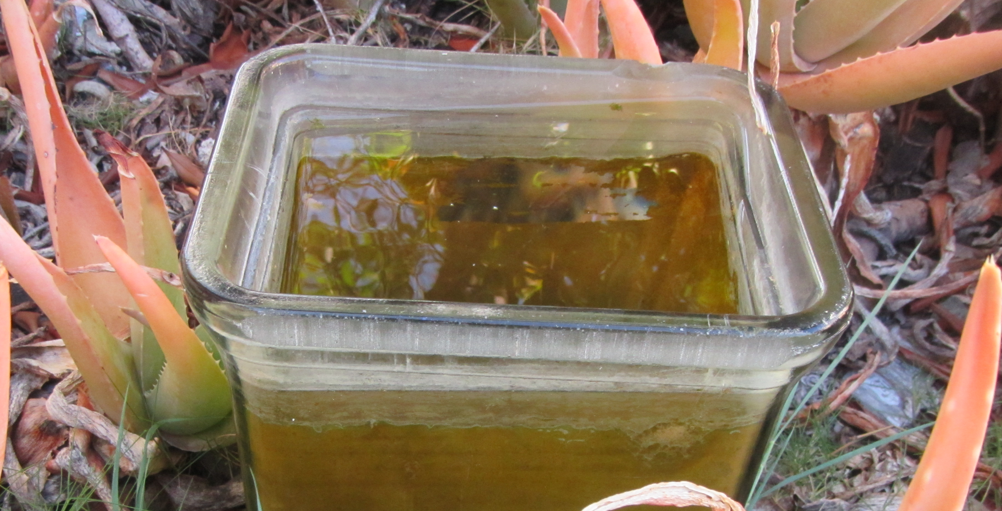
DEVELOP National Program
NASA Applied Sciences’ Capacity Building
Puerto Rico Health
Photo Credit: Mark Yokoyama
Authors
Andrew Nguyen (Project Lead)
Alannah Johansen
Martha Sayre
Photo Credit: Ron Reiring
Moving Forward
Supplementing infectious disease control efforts with analyses of Earth observations will help to increase our understanding of how these diseases are spread, and what we can do to prevent them. By applying remote sensing and geospatial modeling techniques to the field of disease ecology, we are able to learn how changes in the environment can contribute to outbreaks, and predict where epidemics are most likely to occur. This will allow public health authorities to allocate resources, educational efforts, and medical support to the communities that are most at risk.
Partners
Dr. Pablo Méndez-Lázaro¹
Dr. Roberto Barrera²
Jessica Cabrera³
Medical Sciences Campus of the University of Puerto Rico
U.S. Centers for Disease Control and Prevention (CDC) Dengue Branch
Puerto Rico Department of Health
A Geospatial Assessment of Environmental Variability in Puerto Rico and its Relation to Confirmed Dengue Fever Cases
Advisor
Dr. Juan L. Torres-Pérez^{1, 2}
DEVELOP National Program
Bay Area Environmental Research Institute
Photo Credit: Dr. Juan L. Torres-Pérez
NASA-DL-DEVELOP@mail.nasa.gov
http://develop.larc.nasa.gov

Slide 2
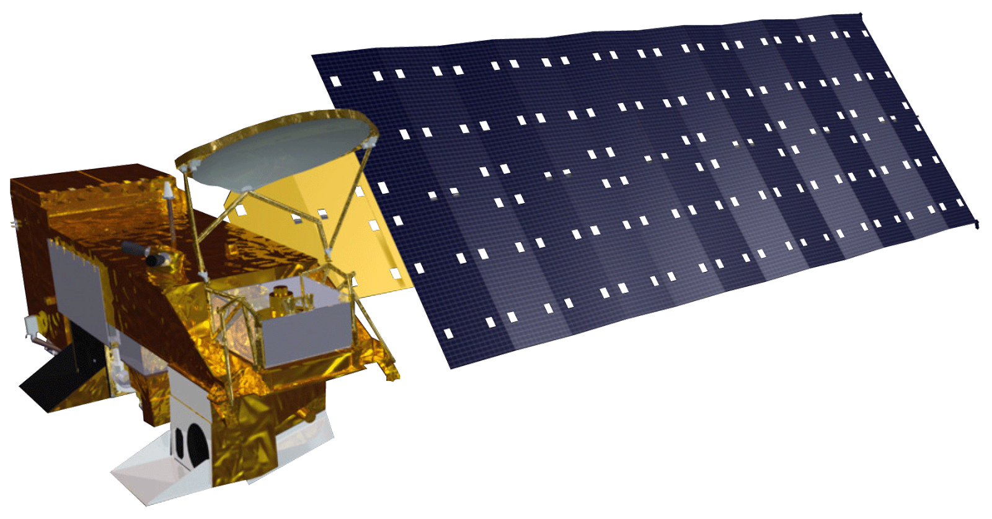
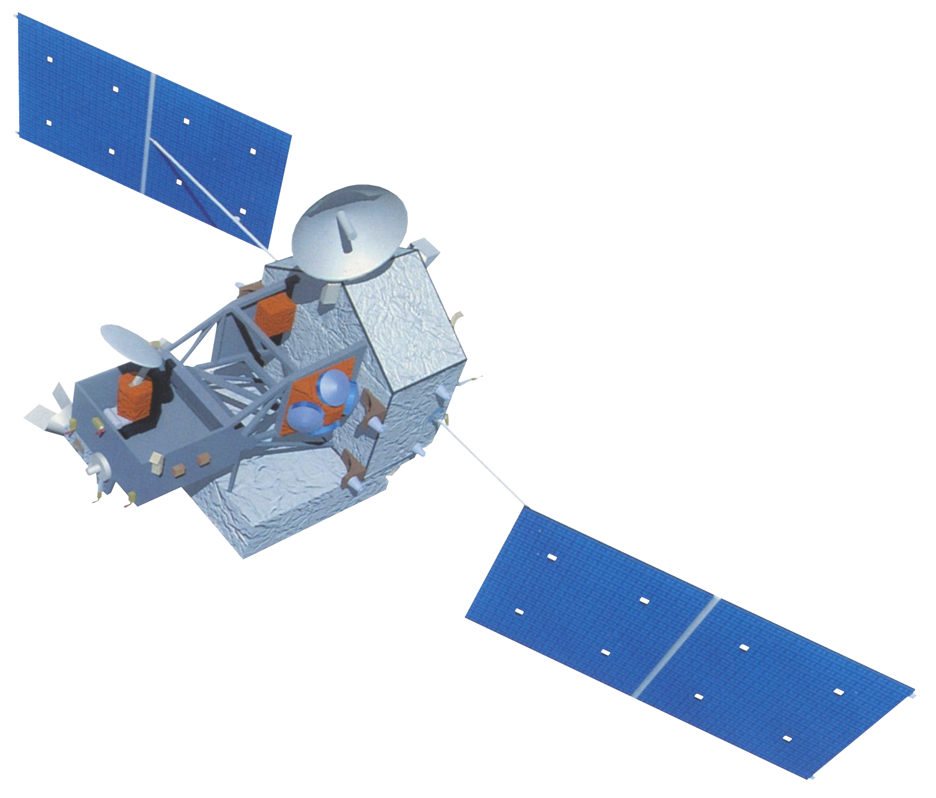
DEVELOP
1. Confirmed Dengue Fever Cases (CDFC) in Puerto Rico for August 2010 2. August 2010 Dengue fever risk assessment map (Warmer colors represent higher risk areas) 3. Close-up of the San Juan Metropolitan Area
The Applied Sciences’ DEVELOP National Program addresses environmental and policy issues through interdisciplinary research projects that apply NASA Earth Observations to community concerns around the globe. DEVELOP bridges the gap between NASA Earth Science and society, building capacity in both its participants and partner organizations to better prepare them to handle the challenges that face our society.
1
3
Study Area
Analyses were performed within the political boundaries of the Commonwealth of Puerto Rico. Puerto Rico is a small, densely-populated island with a total area of 9,104 km² and a population of over 3.5 million.
2
Objective
The objective of this project was to better understand how climate and environmental conditions contribute to dengue fever epidemics in Puerto Rico.
Concerns
Decision Support
Earth Observations
Dengue fever is a debilitating and potentially fatal mosquito-borne illness that is endemic in tropical regions. The Centers for Disease Control and Prevention (CDC) estimate that over 400 million people are infected globally each year. However, this disease has been particularly devastating in Puerto Rico due to several recent epidemics. Symptoms appear 3-7 days after being bitten by an infected mosquito and include fever, chills, rashes, vomiting, and joint pain. In addition, dengue fever can progress into advanced disease stages that include shock and severe bleeding in people with weakened immune systems.
In order to explore how environmental conditions affect the spread of the dengue virus in Puerto Rico, a Maximum Entropy Model was used to produce monthly dengue fever risk assessment maps that can be helpful in predicting where people are most at risk of contracting the disease. In addition, the model provides information about which environmental variables, such as rainfall, temperature, and humidity, contribute most to outbreaks. The methods used in this project will be beneficial for local health agencies and partner organizations to mitigate the impacts dengue fever epidemics in Puerto Rico.
Aqua-MODIS
Terra-MODIS
TRMM-PR

