Slide 1
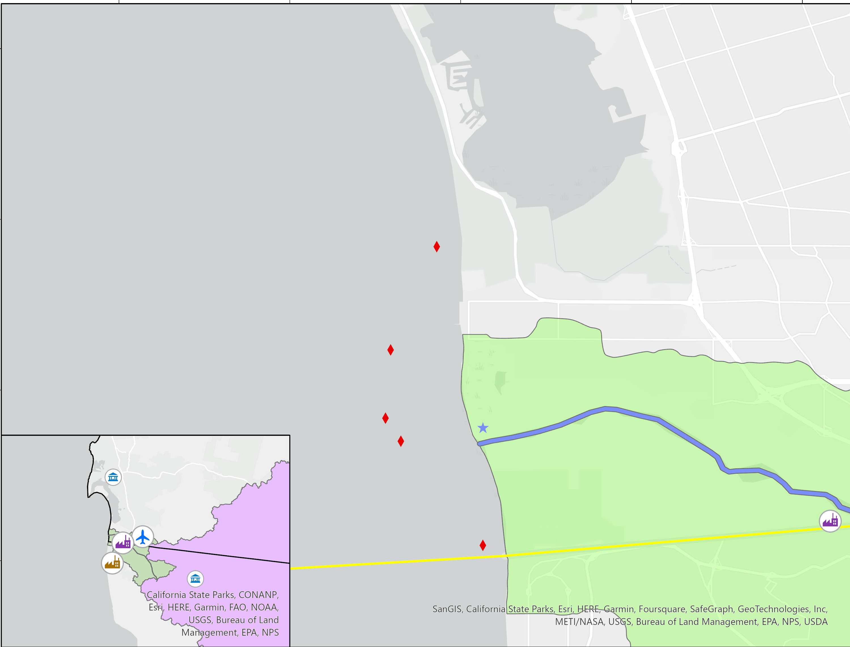
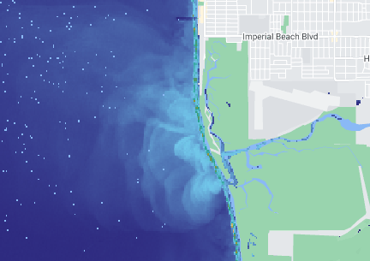
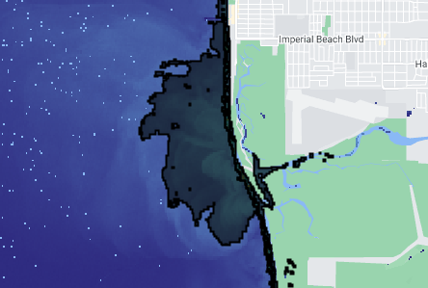
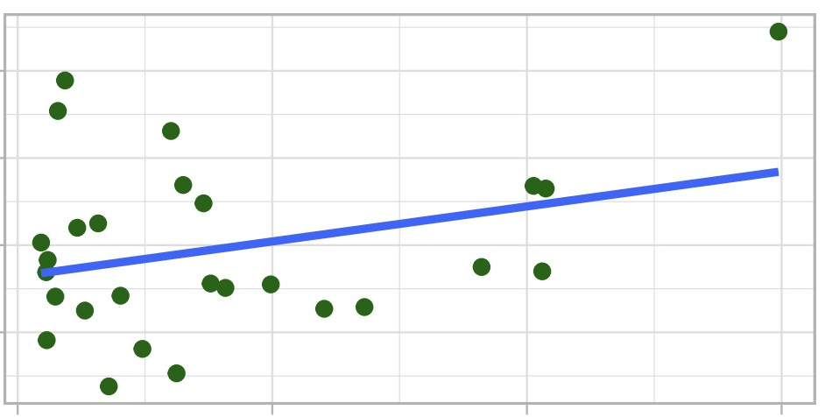
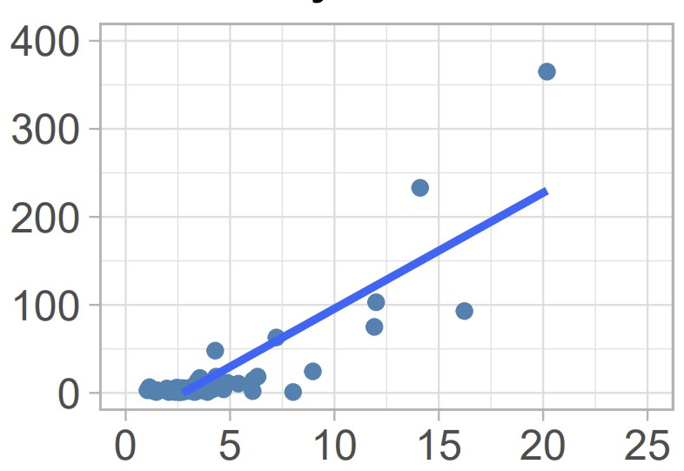
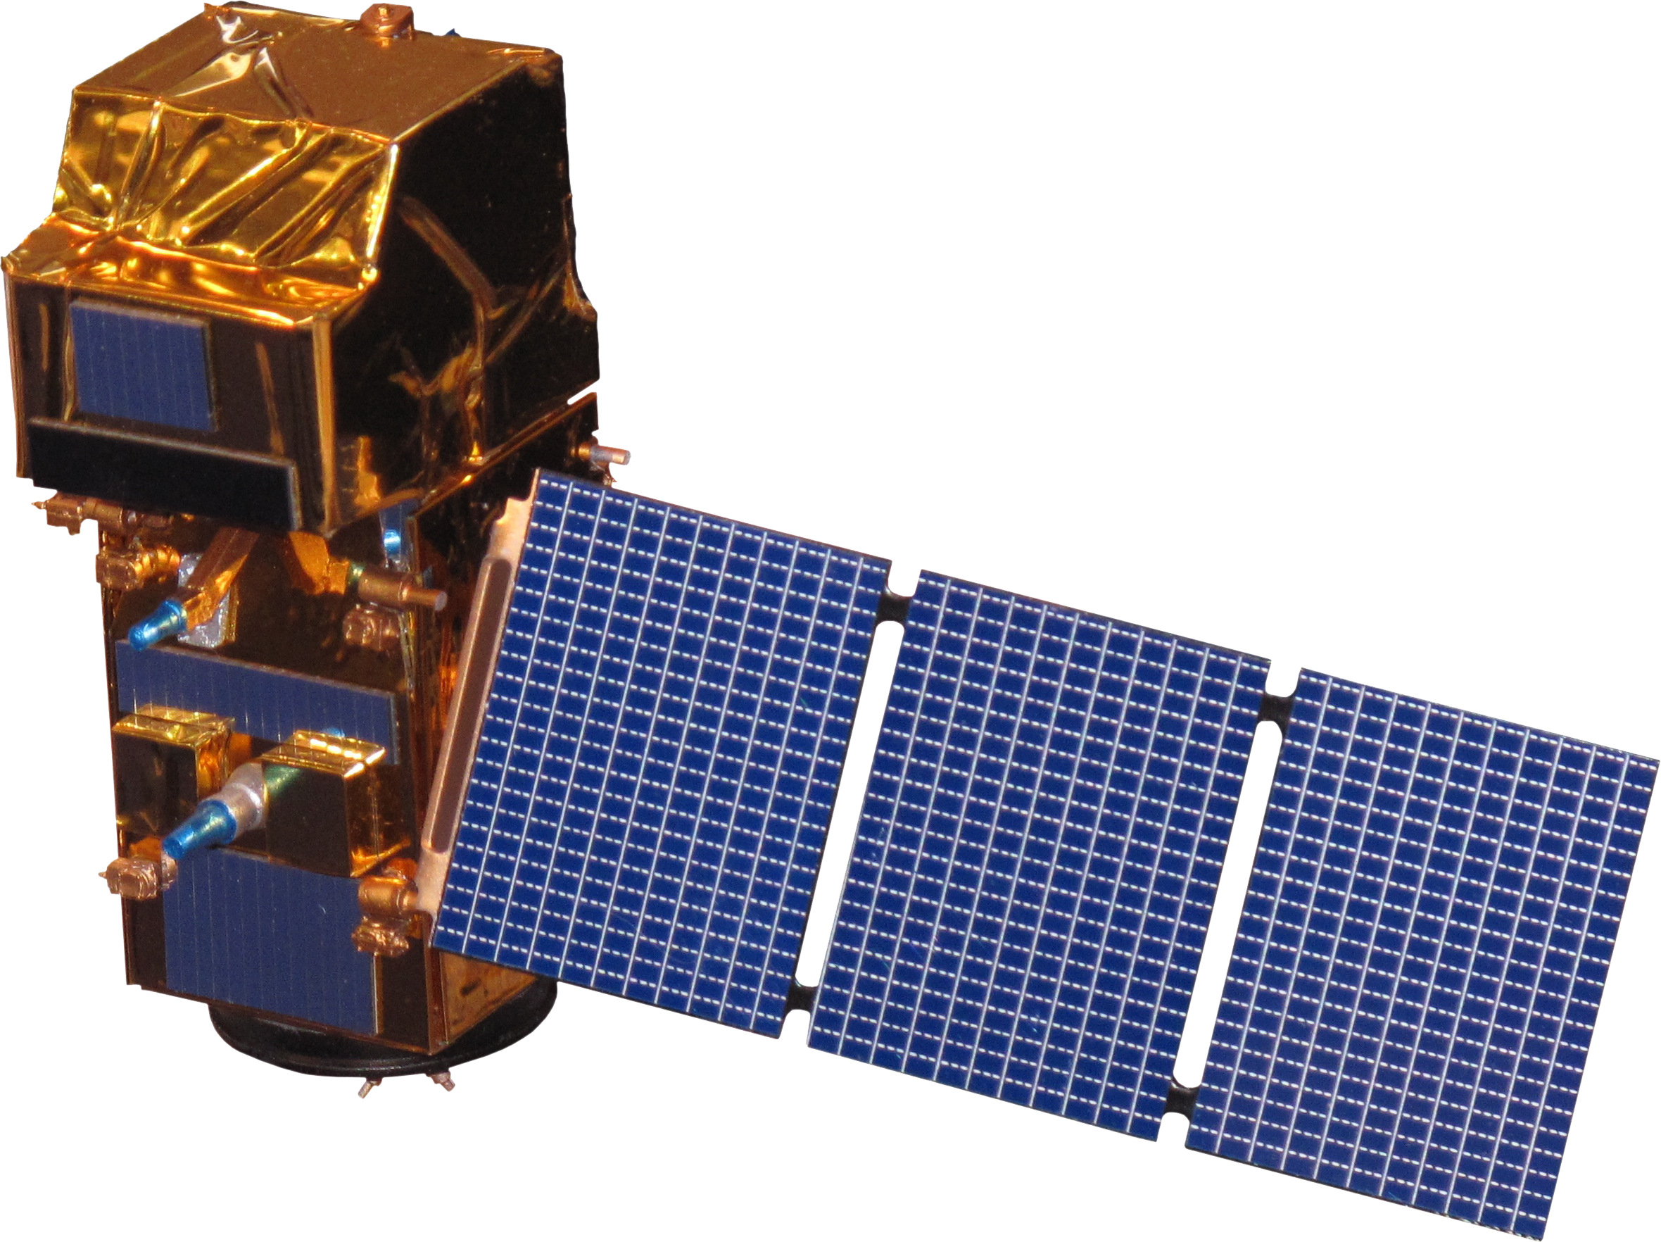
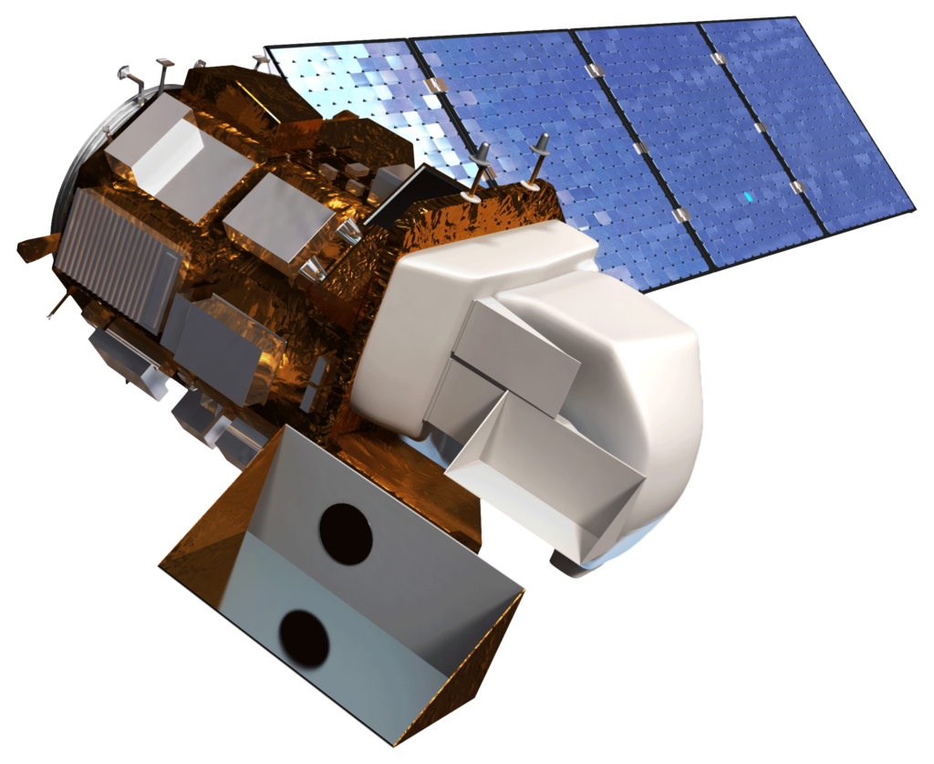
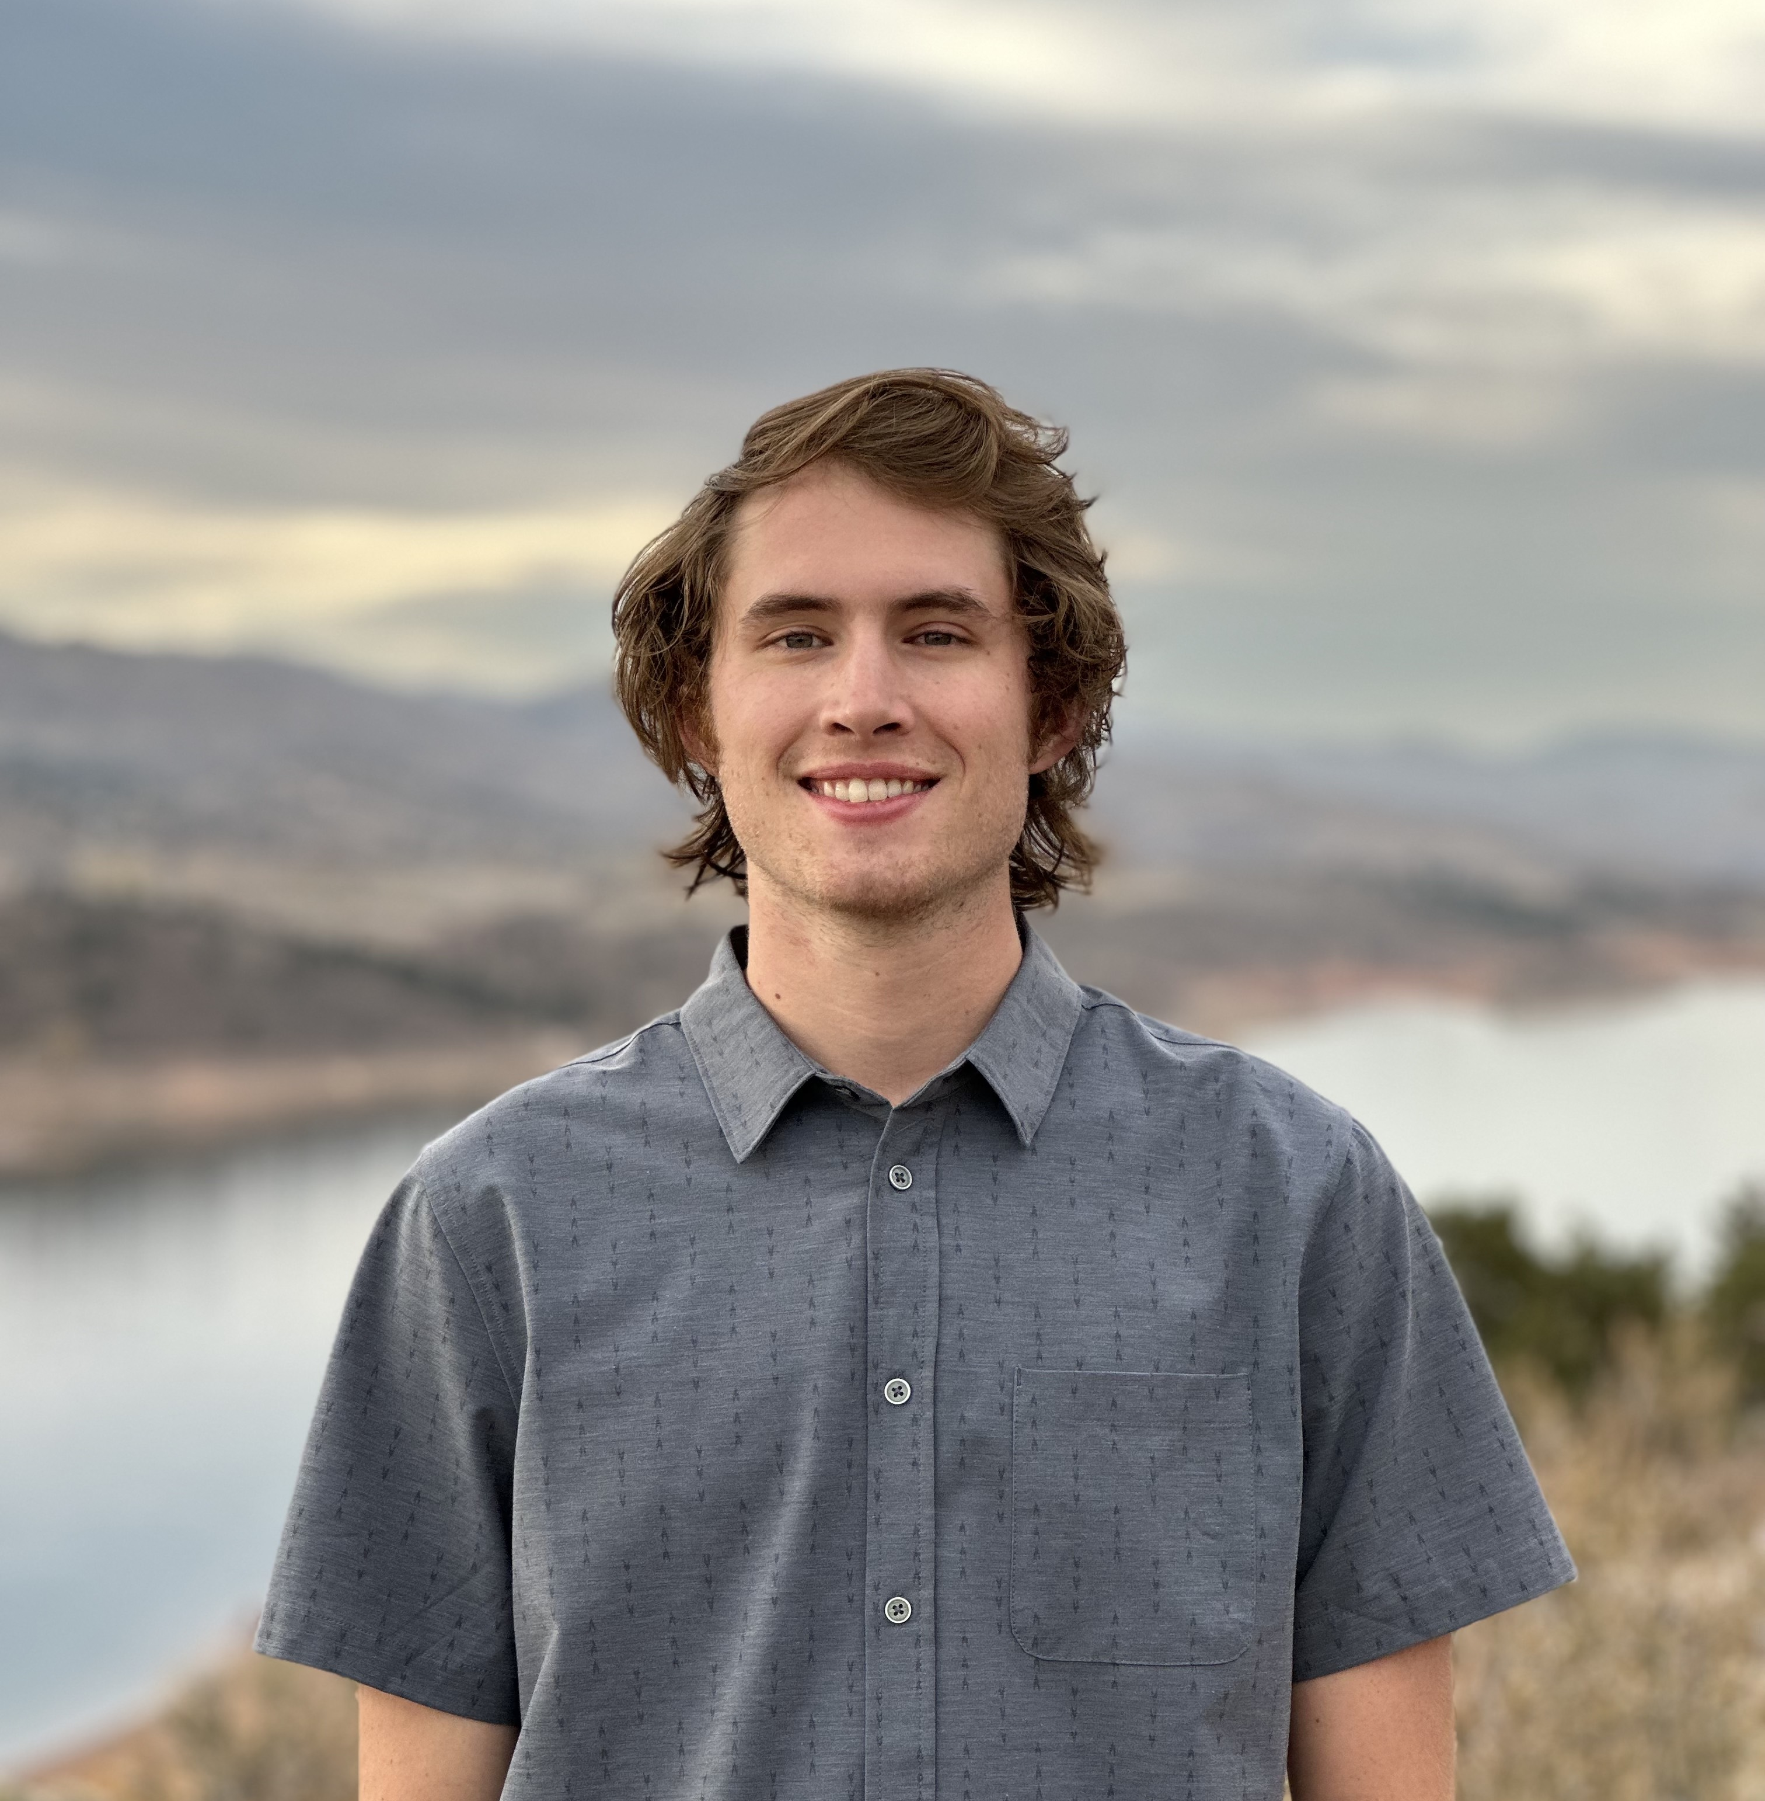
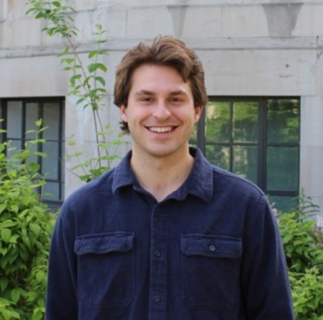
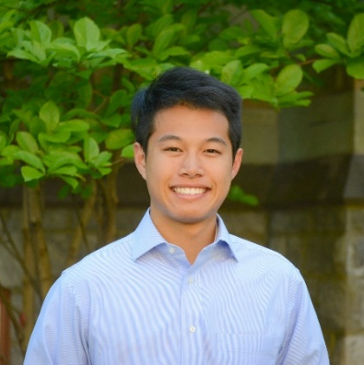
Monitoring Runoff Plumes Originating from the Tijuana River Estuary To Inform Water Quality Management
Abstract
Study Area
San Diego Coast Water Resources
Storm and wastewater runoff are large sources of pollutant discharge along the southern California coast and are major concerns pertaining to the health of local communities and ecosystems. However, studying the deteriorated water quality caused by these events along the coasts can be difficult given the dynamic nature of winds and currents. This project utilized satellite imagery and the Optical Reef and Coastal Area Assessment (ORCAA) Google Earth Engine tool to visualize and analyze the water quality of the San Diego coast after major storm and wastewater events as an alternative for in-situ sampling. Using Landsat 8 Operational Land Imager (OLI) and Sentinel-2 Multispectral Instrument (MSI), the team analyzed the extent of pollution plumes released from the Tijuana River Estuary from 2013 to 2022 and estimated water quality parameters, such as colored dissolved organic matter (CDOM). Remotely-sensed turbidity, chlorophyl-a, and CDOM were also cross validated with in-situ data from NOAA and the San Diego Public Utilities in the San Diego coastal area to evaluate the accuracy of water quality data derived from satellite imagery.
Brown Field Municipal Airport Precipitation Station
0 1 2 3 5
Kilometers
International Wastewater Treatment Plant
San Antonio de los Buenos Wastewater Treatment Plant
Cities
Offshore water sampling site
Boca Rio Water Quality Station
Methodology
0 15 30
Kilometers
Tijuana River Valley
Acquiring Data
Processing
Visualization
Outputs
San Diego
Tijuana River Watershed
Earth Observations
Landsat 8 OLI, Sentinel-2 MSI
Match remotely sensed data with in-situ data
Maps of plumes
GEE Tutorial
Ocean
Tijuana
Tijuana River
Results
U.S-Mexico Border
Find plume dates
Tables of water quality parameters vs plume types
Delineation of plume extent
Plume Type | Turbidity Thresholds | Area (mi²) | CDOM (m⁻¹) | Turbidity (FNU/NTU) | Chlorophyll-a (µg/L)
Storm | 3.48 | 4.18 | 1.04 | 5.59 | 5.26
Waste | 1.44 | 3.17 | 0.12 | 5.06 | 1.85
Mixed | 1.86 | 4.18 | 0.34 | 5.29 | 2.89
Ancillary Data
NERRS Sensors, IBWC River Gage, SD Public Utilities
Delineate plume extent in GEE using turbidity thresholds
Plots showing cross validation results
Regression models
Cross-validate with in-situ data
Plume Delineation
Measurement Comparisons: Remotely-sensed data vs. in-situ data
Conditions | Equation | R² | Sample Size (n)
CDOM (all) | 0.804x + 1.64 | 0.097 | 28
Chl-a (all) | 0.772x + 4.79 | 0.47 | 10
Turbidity (all) | 13.2x - 36.1 | 0.73 | 75
Turbidity (Stormwater) | 16.0x - 64.4 | 0.73 | 19
Turbidity (Wastewater) | 0.0930x + 2.51 | 0.030 | 35
Turbidity (Mixed) | 1.56x + 0.517 | 0.20 | 23
In-situ CDOM (m⁻¹)
0 1 2 3 4
y = 0.804x + 1.64
R² = 0.097, n = 28
0 0.5 1 2
0 0.5 1 2
0 0.5 1.0 1.5
Remotely-sensed CDOM (m⁻¹)
Objectives
In-situ Turbidity (FNU)
Improve the monitoring of pollution plumes along the southern California coast by incorporating remote sensing capabilities
Create a tool that can delineate pollution plumes from satellite imagery in GEE
Assess water quality parameters, such as turbidity and colored dissolved organic matter (CDOM)
Evaluate the effectiveness of using satellite imagery to estimate water quality parameters
0 100 200 300 400
y = 13.2x – 36.1
R² = 0.73, n = 75
0 5 10 15 20 25
Conclusions
Remotely-sensed Turbidity (FNU)
Earth Observations
Turbidity thresholds to map mixed, storm, and wastewater plumes extent were established
Stormwater plumes tend to be larger and have more severe water quality indexes
Remotely-sensed data accurately estimates turbidity and chlorophyll-a.
Remotely sensed data more accurately estimates turbidity for stormwater than wastewater.
Further analysis is need to evaluate measuring CDOM with remote sensing.
~5 days, 10-20m, 2018 +
~16 days, 15-100m, 2013 +
Project Partners
San Diego Regional Water Quality Control Board
Water Keeper Alliance
Tijuana River National Estuarine Research Reserve
City of San Diego and City of Imperial Beach
Sentinel-2 Multispectral Instrument
Level 2A Surface Reflectance
Landsat 8 Operational Land Imager
Level 2 Surface Reflectance Tier 1
Acknowledgements
Team Members
The San Diego Water Resources Team would like to thank Dr. Juan Torres-Pérez, Dr. Daniel Sousa, Dr. Christine Lee, Benjamin Holt, Dr. Kenton Ross, Mariam Ayad, Britnay Beaudry, and Lisa Tanh on their guidance, constructive feedback, time, and support throughout this project. We would also like to acknowledge former DEVELOPers Hayley Pippin, Arbyn Olarte, Roxana Pilot, and Vanessa Valenti for developing the ORCAA tool.
This material contains modified Copernicus Sentinel data (2017-2022), processed by ESA.
Ethan Gates
Project Lead
Stefanie Mendoza
Max VanArnam
Jonathan Szeto
California – Ames
Node Location

