Slide 1
Central Valley
Water Resources II
Groundwater Sustainability Management Support in the California Central Valley using GRACE and InSAR Datasets
Kathleen Lange, James Kitchens, Vanessa Valenti, & Elizabeth Perez
California – JPL

Slide 2
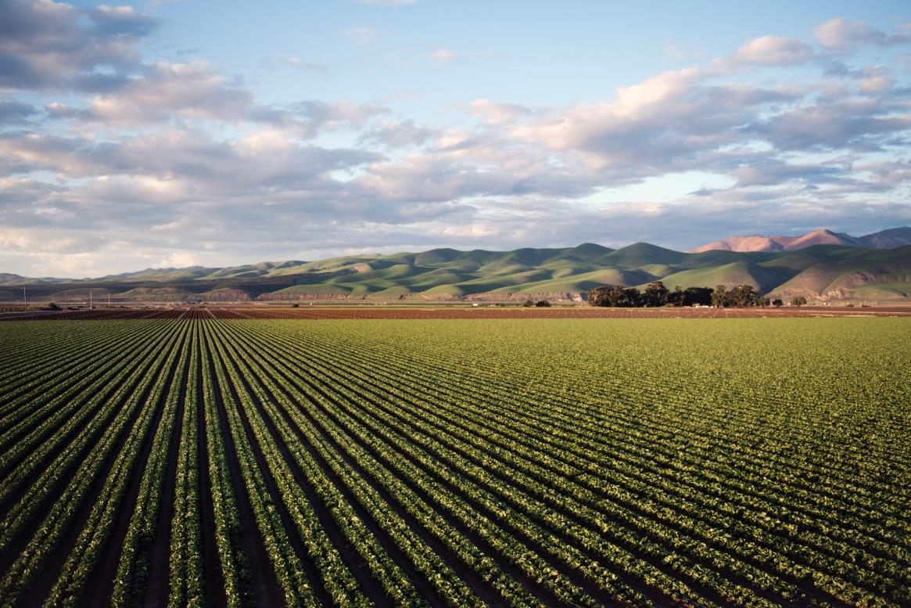
Outline
The Central Valley
Objectives
Partners
Study Design
Data Acquisition
Methodology
Data Analysis
Results
Conclusions
Future Work
Acknowledgements
Image Credit: Tim Mossholder (Pexels, 2018)
Notes:
For this presentation we are going to first step through some background information, including; groundwater storage in the Central Valley, the community concerns surrounding this issue, the current monitoring techniques, as well as details about this project's partners and objectives, as well as the study area and study period. We are then going to discuss the methodology established in this project, including; what satellites and sensors were used, as well as how the data was processed and analyzed. Finally we are going to show our results, including; our conclusions, the limitations and possible errors of this project, and how this project can be expanded upon in the future.​
Image Credit: Time Mossholder, Pexels (2018)
Image License: Pexels Creative Commons License
Image Source: https://www.pexels.com/photo/photo-of-green-field-near-mountains-974314/

Slide 3
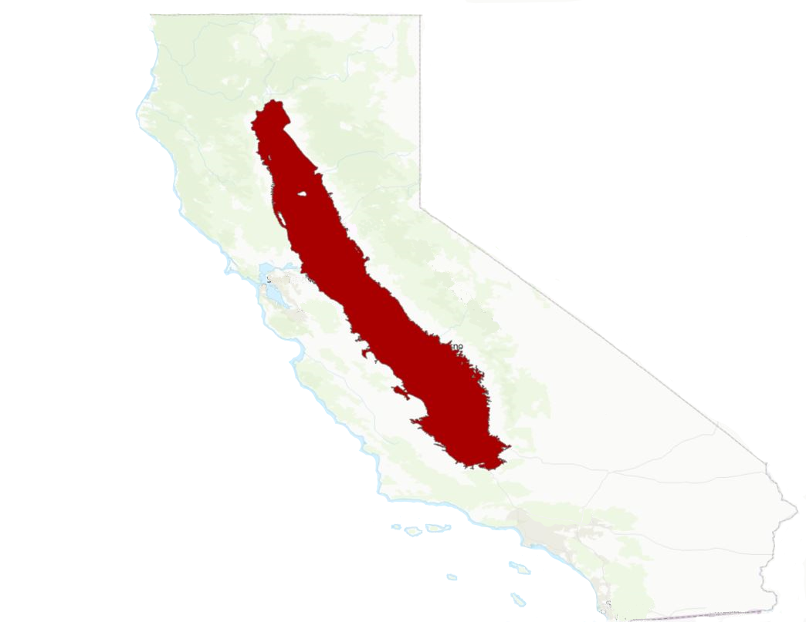
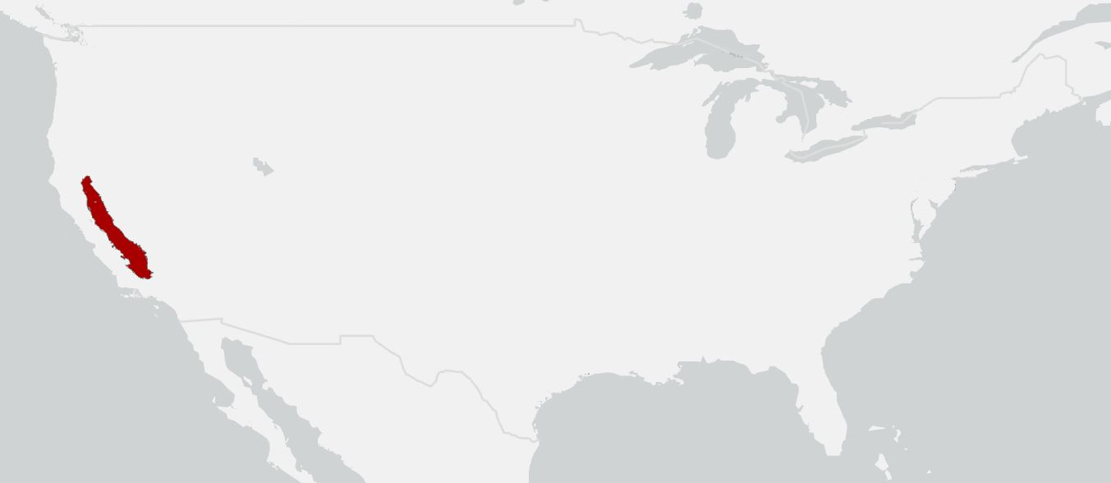
The Central Valley
20,000 square miles
Population expected to be 6 million in 2020
40% of the nation's fruits and nuts
Valued at $17 billion per year
Grows more than 250 crops
United States
Basemap credit: ESRI Topographic, Esri Light Gray Base
San Francisco
Sierra Nevada
Mojave
Desert
Los Angeles
Central Valley
Miles
0
80
160
Notes:
California's Central Valley is home to over 6 million people as well as the area where over 250 crops are cultivated. It has an economy valued at $17 billion per year and supplies 40% of the nation's fruits and nuts. The Central Valley, as implied, sits with the center of California and expands 20,000 square miles.
Basemap credit: Esri Topographic, Esri Light Gray Base

Slide 4
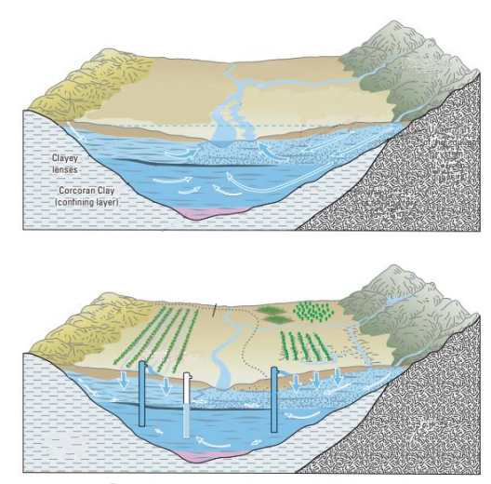
Geology and Hydrology
Sierra Nevada
Single heterogeneous aquifer
Unconfined conditions in the upper hundred feet
Confined underneath
Central Valley aquifer system is made of sand, gravel, silt and clay
Silt and clay, which make up a large area of the Central Valley aquifer, do not allow the vertical flow of water.
Freshwater
Recharge
Coast Ranges
Water Table
Confining Layer
Upper Part
of Aquifer
Subsidence Area
Pumping wells
Marine Deposits
Image credit: USGS, C.C Faunt
Notes:
The Central Valley aquifer is classified as one heterogeneous aquifer. The first hundred feet of the area is considered to be unconfined meaning groundwater is in direct contact with the atmosphere through pores in the soil. Underneath this area, confined conditions exist where an impermeable layer limits groundwater movement. Silt and Clay make up a large portion of this area making it hard for groundwater recharge.
Image Credit: USGS, C.C Faunt
Image License: Public Domain
Image Source: Faunt, C.C., ed., 2009, Groundwater Availability of the Central Valley Aquifer, California: U.S. Geological Survey Professional Paper 1766, 225 p.

Slide 5
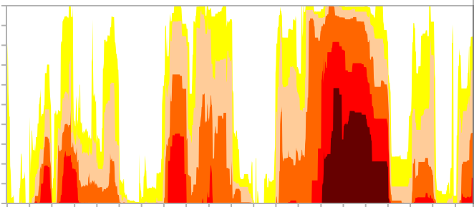
Community Concerns
Subsidence
Over pumping of groundwater has led to 5,200 square miles of loss of surface elevation
Drought
Up to 15,568,000 CA residents living in drought from 2000 to 2020
Longest duration of drought was from December 2011 to March 2019
Decrease in Groundwater Storage
0.4–3.25% of the aquifer system storage capacity was permanently lost from October 2011- 2015
Percent Area of California in Drought Conditions
100%
80%
60%
40%
20%
0%
2000
2005
2010
2015
2020
Abnormally Dry
Severe Drought
Exceptional Drought
Moderate Drought
Extreme Droughts
Image Credit: National Integrated Drought Information System
Notes:
Due to the high area of clay and human impact, the central valley aquifer has been over pumped faster than the rate of recharge. Over the years, droughts, or lack of water, has led to several negative impacts to the topography of the area including the loss of surface elevation. California has been hit with intense drought conditions in the past such as the longest drought period in the history of California that last from December 2011 to March 2019. The graph shows how drought has changed over a 20 year period from 2000 to 2020 with the years from 2014 to 2017 being categorized as exceptional drought conditions. Groundwater storage has been decreasing slowly with the decrease in groundwater recharge.
Image Credit: National Integrated Drought Information System
Image Source: National Integrated Drought Information System, National Drought Mitigation Center, USDA Federal Drought Assistance
Image License: Public Domain
Image URL: https://www.drought.gov/drought/states/california

Slide 6
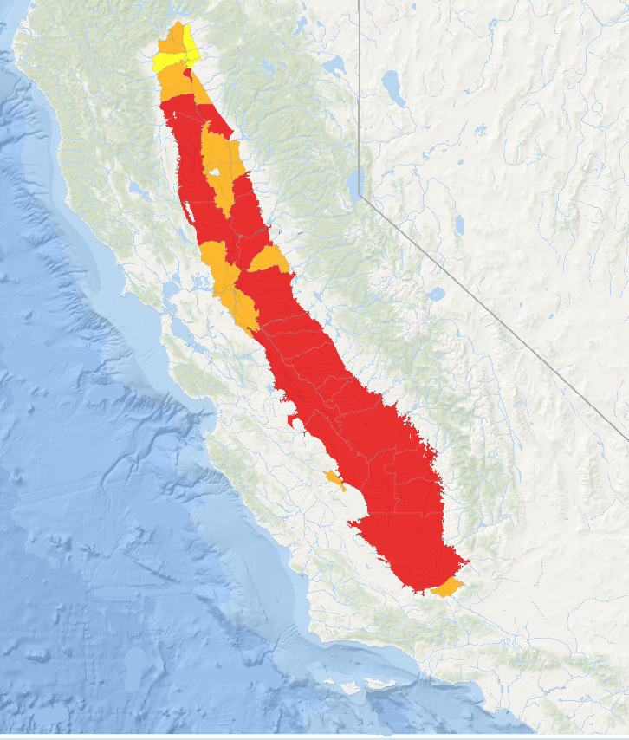
Sustainable Groundwater Management Act (SGMA)
Nevada
Governor Jerry Brown signed into law in 2014
Requires Groundwater Sustainability Agencies to implement a Groundwater Sustainability plan
High and medium priority basins required to stop overdraft and bring groundwater levels and quality to sustainable levels.
DWR uses in situ data
In some areas, data can be sparse and unreliable
San Francisco
Los Angeles
Basemap credit: ESRI Oceans
Basin Priority
Miles
Very Low
0
200
Medium
High
Notes:
In response to the negative impacts of droughts and over pumping, Governor Jerry Brown passed the Sustainable Groundwater Management Act in 2014. Since then, The Department Water of Resource has been working with local subbasin Groundwater Sustainability Agencies to improve groundwater conditions in high and medium priority basins where data is sparse, unreliable, sometimes nonexistent. Through this act, the goal is to achieve sustainability within the basins by 2040.
Basemap credit: Esri Oceans

Slide 7
Objectives
Evaluate remote sensing data to quantify groundwater storage change and land subsidence
Create executable tool to control backend of data processing and update datasets in the future
Develop interactive web visualization tool for digestible interpretation and visualization of results
Notes:
The main objectives of this research project were to quantify groundwater storage and land subsidence in the Central Valley using remote sensing and geospatial datasets. We also aimed to create an executable tool to handle backend data processing, as well as updating datasets in the future as more data becomes available. Finally, we developed an interactive web visualization tool to interpret results generated by the executable tool for ease of interpretation and understanding of results by water resource managers and researchers.

Slide 8
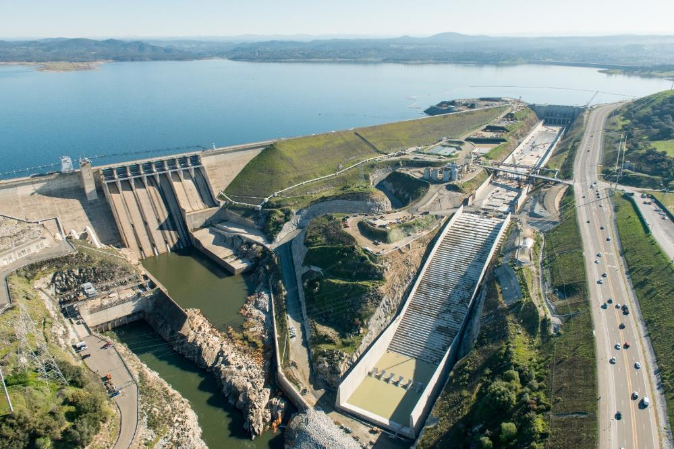
Partners
End Users
4California Department of Water Resources
4Bill Brewster, North Central Region
4Mike McKenzie, South Central Region
4Jack Tung, Southern Region
Collaborators
4 California State University - Los Angeles
4 Dr. Charles Hayes, Professor of
Physics & Astronomy
Image Credit: California Department of Water Resources (2017)
Notes:
To conduct this research we partnered with the California Department of Water Resources, working with scientists in the North Central, South Central, and Southern regions. These individuals are water resource scientists and managers who will receive our tool and final results. We also partnered with Dr. Charles Hayes, a professor of Physics and Astronomy at Cal State Los Angeles.
Image Credit: California Department of Water Resources
Image License: Public Domain
Image Source: https://pixel-ca-dwr.photoshelter.com/galleries/C0000vw4EWNXOIr0/G0000kmHcChJeKiQ/I0000VTQrCmn2lxI/FL-Folsom-Lake-0678-jpg

Slide 9
Study Design
GRACE & GRACE-FO
InSAR
Wells
GPS
Drought
Study Period
2002
2004
2006
2008
2010
2012
2014
2016
2018
2020
Notes:
For our study we incorporated several datasets to cover a time period from approximately 2003 to August 2020. GRACE and the accompanying GRACE-Follow on provide us with data starting in 2002 and stretching to the present, while inSAR, a product created using Sentinel-1 and ALOS PALSAR-2 satellites, we only have from 2015-present. Well and GPS data is thorough into the early 2000’s before becoming much more sporadic beyond that. We have also noted the significant droughts in California, with the initial drought in 2007-2010, and second, much worse and long-lasting drought from 2011 to 2017, which represents one of the most intense droughts in California’s history.

Slide 10
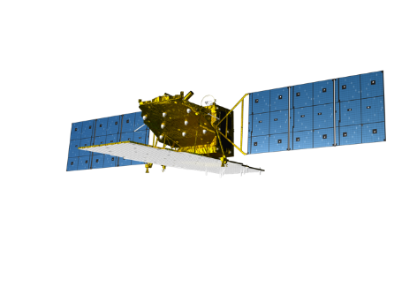
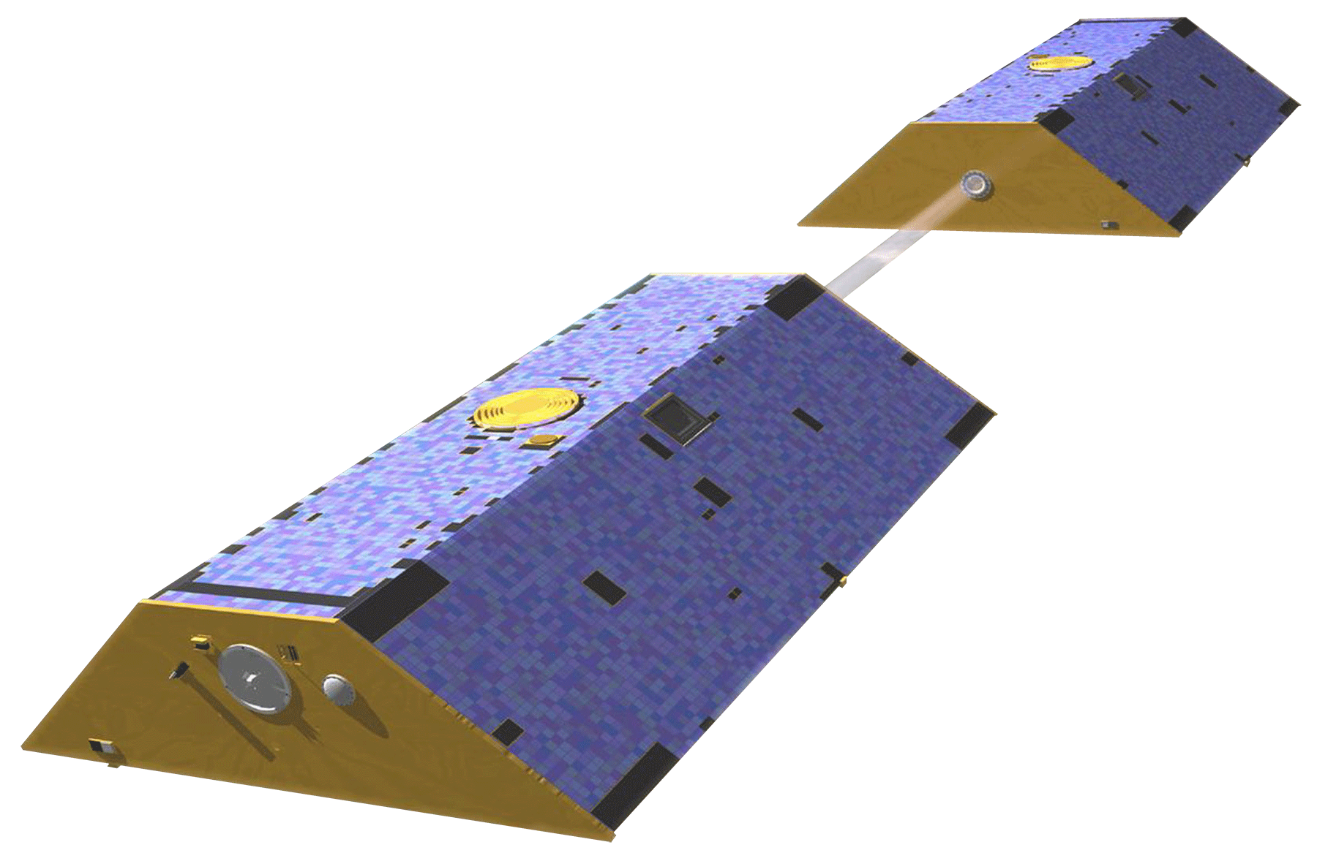
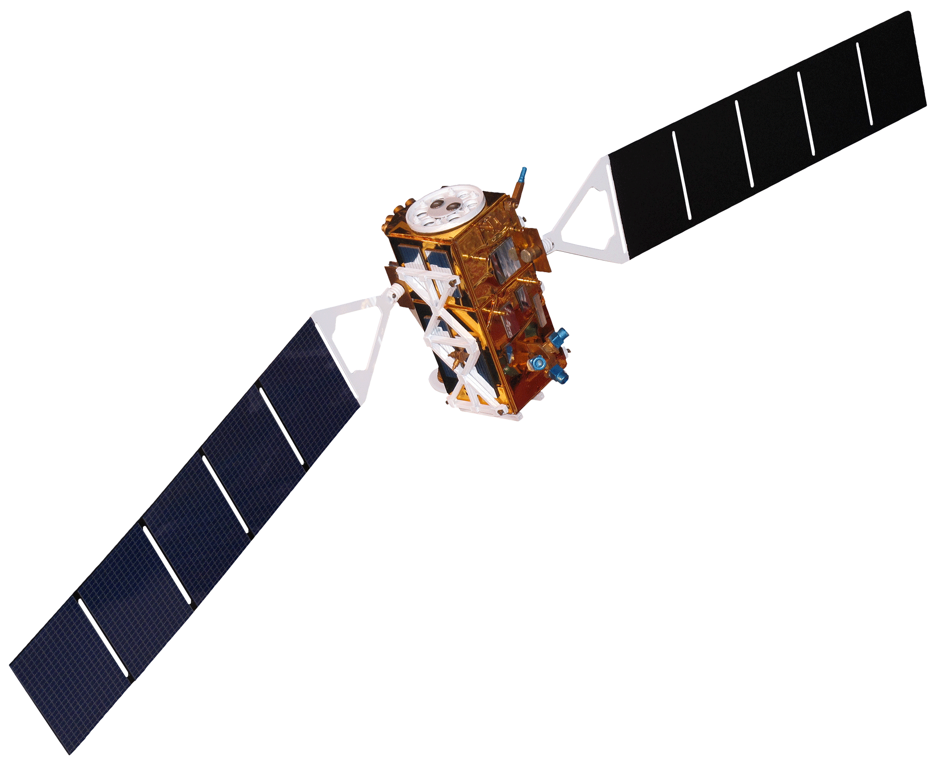
Data Acquisition
Dataset
GRACE & GRACE-FO
Sentinel-1
ALOS-2 PALSAR-2
GPS
Well data
Input
Groundwater thickness
InSAR
Surface elevation
Water level
UNR Geodetic Lab
CADWR USGS
Source
Earthdata Portal
ESA, JAXA, JPL
Image Credit: NASA, ESA, JAXA and Pixabay
Notes:
As for the geospatial and in-situ data included in this study, GRACE & GRACE-FO data were utilized for groundwater thickness, and obtained through the NASA Earthdata Portal. Sentinel-1 and ALOS PALSAR-2 are used for InSAR, to measure land surface subsidence. InSAR, otherwise known as Interferometric Synthetic Aperture data, is data processing technique where differences in phase waves are measured over time to generate maps of surface deformation. The InSAR data used was sourced from the Japanese Aerospace eXploration Agency, the European Space Agency, and processed by JPL. Both Sentinel-1 and ALOS PALSAR-2 were used to provide more temporal and spatial data coverage. GPS data was utilized to measure ground surface elevation and was downloaded from the University of Nevada – Reno (UNR) Geodetic Lab, while well data was used for water level measurements and sourced from the California DWR and the USGS.
Image: Satellites Images
Image Credit: DEVELOP
Image License: Public Domain
Image Source: Faunt, C.C., ed., 2009, Groundwater Availability of the Central Valley Aquifer, California: U.S. Geological Survey Professional Paper 1766, 225 p.
Image: GRACE/GRACE-FO
Image Credit: NASA
Image License: Public Domain
Image: Sentinel-1
Image Credit: ESA
Image License: Attribution-ShareAlike 2.0 France (CC BY-SA 2.0 FR) https://creativecommons.org/licenses/by-sa/2.0/fr/deed.en
Image: ALOS PALSAR-2
Image Credit: JAXA
Image License: Public Domain
Image Source:
Image: GPS Icon
Image Credit: Pixabay (User:DoomSlayer)
Image License: Pixabay Creative Commons License
Image Source: https://pixabay.com/vectors/navigation-pin-pointer-gps-marker-5109665/
Image: Well Icon
Image Credit: Pixabay (User: LucMahler)
Image License: Pixabay Creative Commons License
Image Source: https://pixabay.com/illustrations/well-water-water-well-orange-water-3262842/

Slide 11
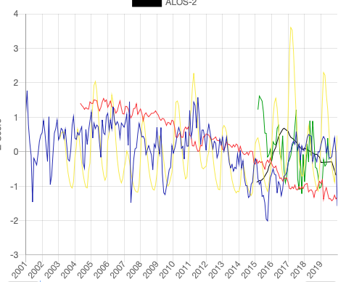
Methodology
Time Series Analysis
Overview
Zonal Mean
Aggregate
Calculate monthly averages for each dataset
Acquire and Filter
Data are clipped to subbasin boundaries and aggregated temporally(monthly)
Remotely sensed and in situ datasets are downloaded and cleaned by date and quality
Notes:
The team developed data processing scripts in Python to aggregate datasets both spatially and temporally. Users may input a shapefile containing regions of interest, in this case subbasins within California’s Central Valley, and the program grounds the datasets into their respective region based on location. Daily, monthly, and yearly averages are calculated to generate time series across various temporal scales. We visualized these time series through both static and interactive plotting methods to elucidate overall trends of the different datasets within subbasins.

Slide 12
Methodology
In Situ
Wells
DWR Periodic and Continuous
USGS NWIS Groundwater
GPS
Nevada Geodetic Laboratory
Web scrapers for DWR and USGS
Stations are scored based on quality and quantity
Create a 1 x 1km grid across the study area
Master Well Dataset
Web scraper for Nevada Geodetic Laboratory
Combine all stations measurements
GPS Dataset
Notes:
The first grouping of datasets that we are working with are the in situ datasets, including wells and GPS. These datasets consist of stations distributed throughout the Central Valley. As we described on the data acquisition slides, we are pulling well data from DWR Periodic and Continuous Groundwater Measurements as well as USGS National Water Inventory System Groundwater Field Measurements. To deal with the inconsistencies within well datasets provided by different governing agencies, we first score all wells based on the density of available measurements and quality of those measurements. We created a grid across the entire Central Valley consisting of 1km by 1km cells. Within each cell, we selected only the highest scoring well station to be included within what we refer to as the Master Well Dataset, used further on for analysis. The GPS workflow is simpler as we are only pulling from one data source, Nevada Geodetic Laboratory. For this we simply combined all of the station measurements from the dataset into a single file to be used as the input for the further processing.

Slide 13
Methodology
Remotely Sensed
InSAR
Sentinel-1
PALSAR-2 ALOS-2
GRACE-DA
Groundwater Thickness
Web scraper for EarthData
Converted from NetCDF to TIF from "gws" array
Clipped and Normalized
GRACE Dataset
Provided by JPL as TIFs
Clipped and Normalized
InSAR Datasets (Sentinel-1 and
ALOS-2)
Notes:
The second grouping of datasets that we are looking at is the remotely sensed datasets. These include GRACE/GRACE-FO and the two InSAR datasets from the Sentinel-1 and ALOS-2 satellites. From GRACE, we are particularly interested in the downscaled products for measuring groundwater thickness. EarthData provides a public version of the GRACE dataset at a downscaled resolution of 0.25 degrees. This dataset is provided as NetCDF files per date, which we convert to TIFs to allow for a more consistent workflow across datasets. To speed up our processing, we first clipped these TIFs to the extent of the Central Valley and then normalized the measurements over time. InSAR datasets were provided by Dr. Zhen Liu as TIFS, including two datasets, one for each satellite. Similarly to the GRACE TIFs, we clipped and then normalized these TIFs.

Slide 14
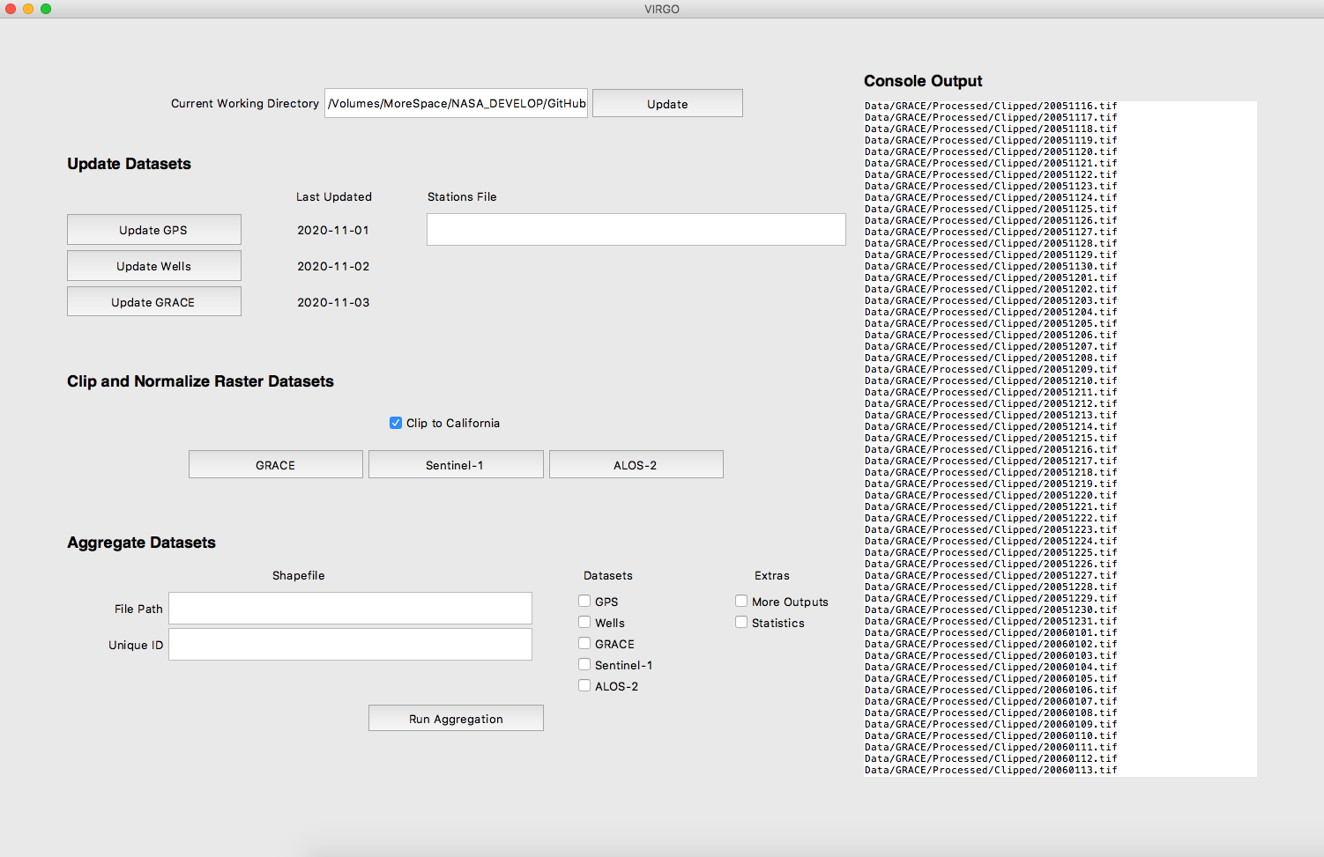
Methodology
Executable Tool
Web Scrapers
Preprocessing
Statistical
GUI PLACEHOLDER IMAGE
Files for Visualization
Notes:
In order to allow for easy replication of this project’s data acquisition, processing, and analysis, the team created an executable tool with a user-friendly graphical interface (GUI) and an interactive web-based visualization tool. The executable tool compiles the backend Python scripts that run the web scrapers, data cleaning and normalization processes, and statistical analysis into a downloadable application with a GUI (Figure 2). Users can then easily click through the backend processes without having to interact with the code directly. The executable tool’s final output files feed into the web-based visualization tool for users to update with more recently acquired data.

Slide 15
Methodology
Visualization Tool
User Specifications
Subbasin
Time Period
Data Type
Notes:
The web-based visualization tool, or the Visualization of In-situ and Remotely Sensed Observations (VIRGO) tool, is an interactive application that allows users to visualize trends at the subbasin level. Users can specify time periods, data type, and subbasin selection to customize their visualization output. The executable tool and web-based visualization tool allow decision makers with varying levels of remote sensing and coding experience to map and visualize groundwater and land subsidence trends into the future.
Tool demo included on slide

Slide 16
Data Analysis
Seasonality
Drought Periods
Zonal Subbasin Analysis
Spatial and Temporal Mean Value
Normalization
Pearson Correlation
Notes:
The team conducted a zonal subbasin analysis, both seasonally and through drought periods of 2007-2009 and 2011-2017.​ Each time series represents the average value spatially across the subbasin and temporally over the study period. In order to compare data trends from different measurement units, all data was normalized by taking the mean value of the time series for each station and subtracted this mean value from each timestep entry which was then divided by the standard deviation of the station of the time series to convert the values to a Z score. This method converted all data to a common Z-score, making the various data sources comparable. Pearson’s Correlation was performed within subbasins and across the Central Valley to quantify datasets relationships.

Slide 17
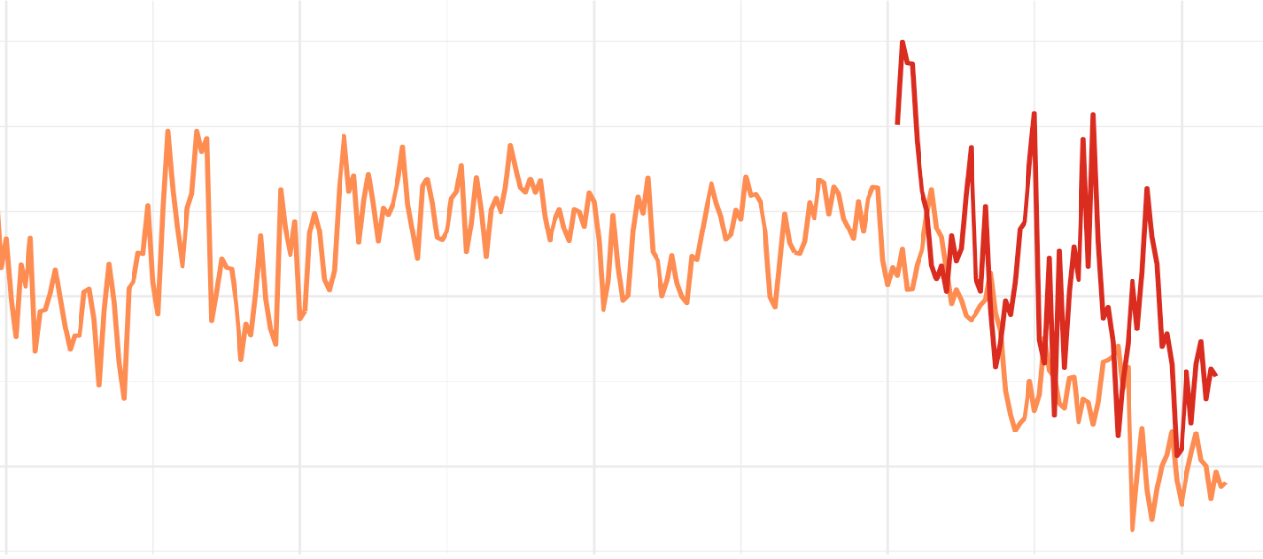
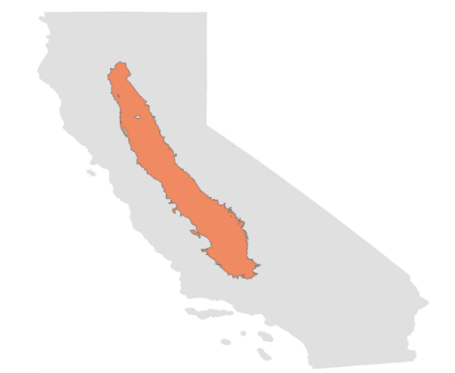
Results
Time Series Analysis
Central Valley
Sentinel-1
GPS
1
Z-Score
0
Central Valley
-1
Drought
2012-2017
2001
2005
2010
2015
2020
Year
Notes:
We conducted our time series analysis on the Central Valley as a whole and on the subbasin level. The next few slides focus on the time series of the entire Central Valley. In this slide, Sentinel-1 and GPS normalized measurements are shown from 2001-2020 with the 2012-2017 drought highlighted in yellow. The Sentinel-1 mission launched in 2015 and we have GPS measurements back to 2001. From this graph, a downward trend is observed after the 2012-2017 drought in both the GPS and Sentinel-1 data. It appears the GPS and Sentinel-1 measurements do not rebound after the drought had ended, indicating an inelastic response. An inelastic response is where a subbasin permanently loses groundwater storage and the land surface elevation does not fully recover. From 2015-2020, the period where we have both Sentinel-1 and GPS data, the overall trend appears to correlate quite well.

Slide 18
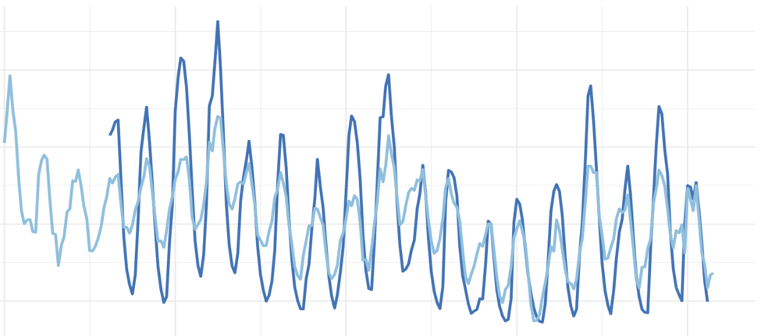
Results
Time Series Analysis
Central Valley
GRACE
Wells
Drought
2012-2017
2
1
Z-Score
0
Central Valley
-1
2001
2005
2010
2015
2020
Year
Notes:
In this slide, GRACE (shown in dark blue) and well (shown in light blue) normalized measurements are shown from 2001-2020 with the 2012-2017 drought highlighted in yellow. From this graph, a downward trend is observed after the 2012-2017 drought in both the GRACE and well data. It appears the GRACE and well measurements do slightly rebound after the drought had ended, however not to the same level before the drought period. Additionally, seasonality trends are clearly visible in both the well and GRACE data. The two datasets appear to correlate well both seasonally and in long term trends.

Slide 19
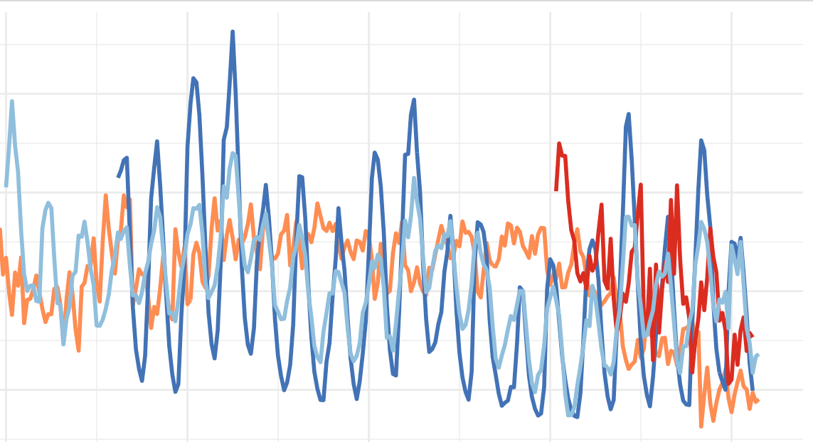
Results
Time Series Analysis
Central Valley
GRACE
Wells
Sentinel-1
GPS
Drought
2012-2017
2
1
Z-Score
0
Central Valley
-1
2001
2005
2010
2015
2020
Year
Notes:
This graph displays the previous two graphs combined in order to highlight the response time of land subsidence with respect to groundwater storage loss. In the years 2012-2017, both well and GRACE measurements show low Z-score values, in comparison Sentinel-1 and GPS remain above mean. It is not until the end of the drought in 2017 that we see Sentinel-1 and GPS measurements lowering. This indicates there is an offset period, where land subsidence does not occur until after groundwater storage has remained low for some time. Additionally, when groundwater storage does rebound, it appears the land surface elevation does not rebound simultaneously and potentially not to the same level it was before the drought.

Slide 20
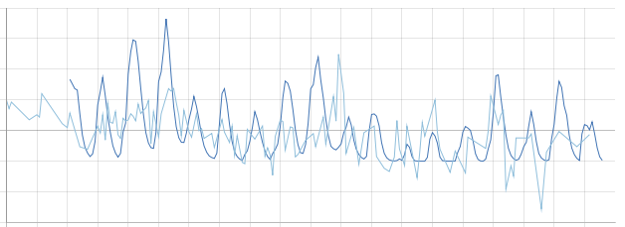
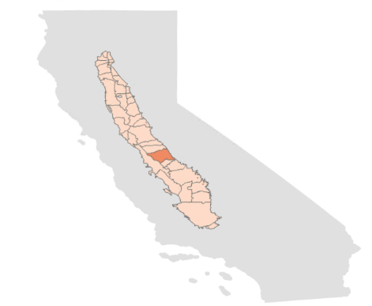
Results
Time Series Analysis
Merced Subbasin
GRACE
Wells
4
Drought
2012-2017
3
2
1
Z-Score
0
Merced
-1
-2
-3
2001
2005
2010
2015
2020
Year
Notes:
In order to understand groundwater and land subsidence conditions at a local level. The team created timeseries graphs at the subbasin level for all subbasins in the Central Valley. One of the subbasins our partners specified they were interested in, in shown in this slide as a case study. The Merced subbasin is located in the south central eastern portion of the Central Valley. The time series graph here shows GRACE and well normalized values from 2001-2020. The data was normalized, as mentioned in previous slides, in order too compare between datasets and look at overall trends. The drought period from 2012 to 2017 is highlighted. From this graph, it appears all datasets show a downward trend, most notably after the during and after the drought period. Additionally, it appears the well and GRACE data do not rebound to their original levels before the drought and reflects less seasonal variation during the drought period.

Slide 21
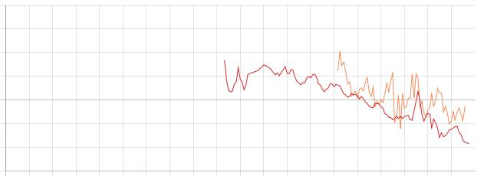
Results
Time Series Analysis
Merced Subbasin
Sentinel-1
GPS
4
Drought
2012-2017
3
2
1
Z-Score
0
Merced
-1
-2
-3
2001
2005
2010
2015
2020
Year
Notes:
In this slide, Sentinel-1 and GPS normalized measurements are shown from 2010-2020 with the 2012-2017 drought highlighted in yellow. From this graph, a downward trend is observed after the 2012-2017 drought in both the GPS and Sentinel-1 data. It appears the GPS and Sentinel-1 measurements do not rebound after the drought had ended, indicating an inelastic response. An inelastic response is where a subbasin permanently loses groundwater storage and the land surface elevation does not fully recover. From 2015-2020, the period where we have both Sentinel-1 and GPS data, the overall trend appears to correlate quite well. Additionally, seasonal variation is less apparent in these datasets.

Slide 22
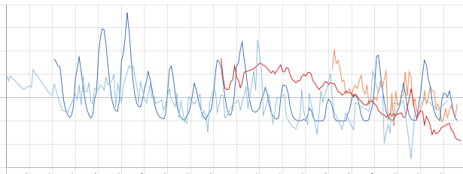
Results
Time Series Analysis
Merced Subbasin
GRACE
Wells
Sentinel-1
GPS
4
Drought
2012-2017
3
2
1
Z-Score
0
Merced
-1
-2
-3
2001
2005
2010
2015
2020
Year
Notes:
This graph displays the previous two graphs combined in order to highlight the response time of land subsidence with respect to groundwater storage loss. In the years 2012-2017, both well and GRACE measurements show low Z-score values, in comparison Sentinel-1 and GPS remain above mean. It is not until the end of the drought in 2017 that we see Sentinel-1 and GPS measurements lowering. This indicates there is an offset period, where land subsidence does not occur until after groundwater storage has remained low for some time. Additionally, when groundwater storage does rebound, it appears the land surface elevation does not rebound simultaneously and potentially not to the same level it was before the drought.

Slide 23
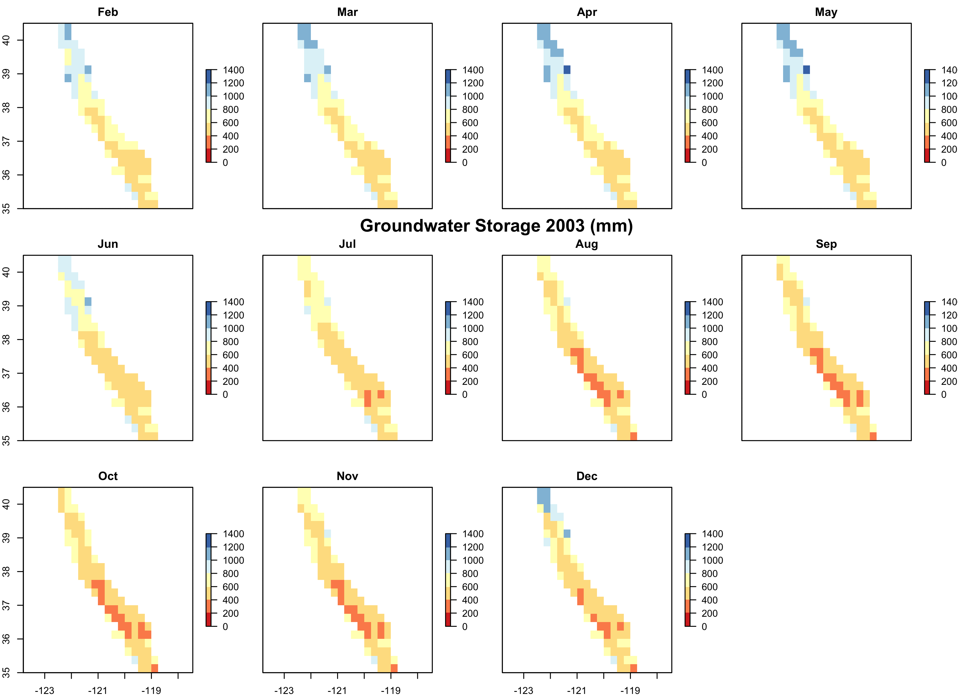
Results
GRACE Groundwater Storage Maps
Notes:
In this gif, we have GRACE groundwater storage maps from 2003 to 2020. The values shown here are groundwater thickness, represented in mm in the legend to the right of each plot, which ranges from 0 to 1400 mm. We have one GRACE image for each day of the entire year, which we then averaged for each month, and for each pixel to create each monthly plot. We can clearly see in these maps how water storage steeply drops in the 2007-2009 drought, recovers in 2010 and continues for 2011, before dropping again beginning in 2012 for the second drought. This drought starts in 2012, deepens, and reaches it’s worst point in 2014, before recovering into 2017, 2018, and 2019.

Slide 24
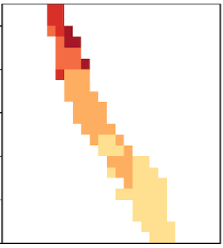
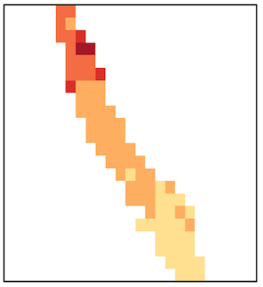
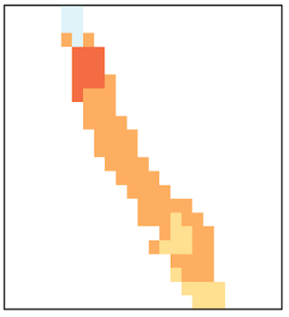
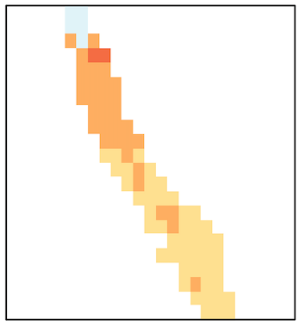
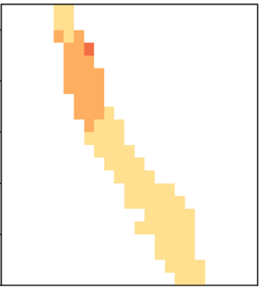
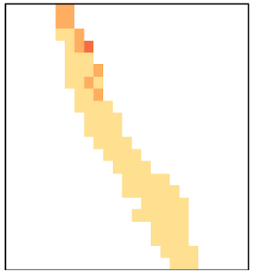
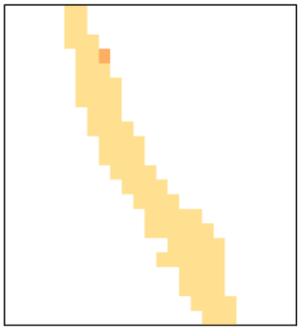
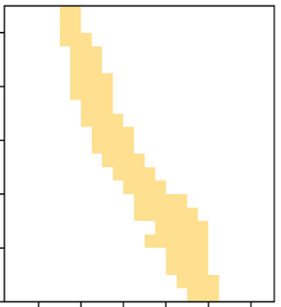
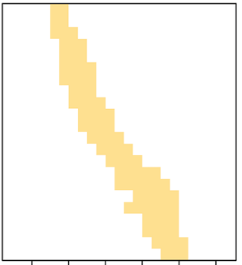
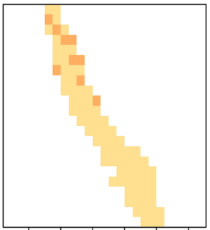
Results
Groundwater Storage Change Maps 2004-2014 (mm)
Jan
Feb
Mar
Apr
May
Jun
500
400
300
200
100
0
-100
-200
-300
-400
-500
Jul
Aug
Sep
Oct
Nov
Dec
Notes:
Here we have groundwater storage change from 2004 to 2014. The maps show the difference in groundwater storage from 2004 to 2014, highlighting the severity of the drought period, especially 2014 as one of the driest years in California’s history in comparison to a pre-drought year. Large differences for most of the valley, especially in January, February, and March, with many parts of the valley experiencing -200 to -300, even -400 and -500 in the far north, mm of groundwater thickness loss. While the entire valley, for every month except small parts of the north in December, show between 0 and -100 loss in groundwater compared to 2004.

Slide 25
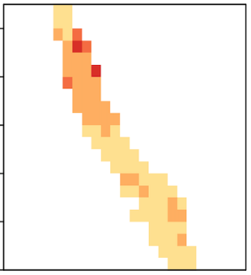
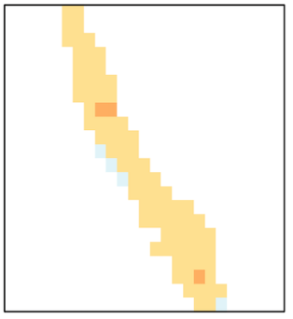
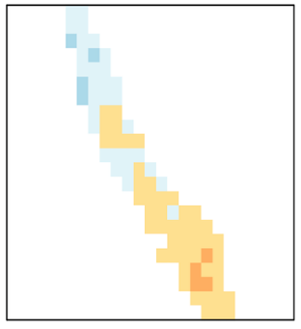
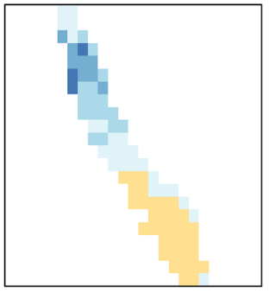
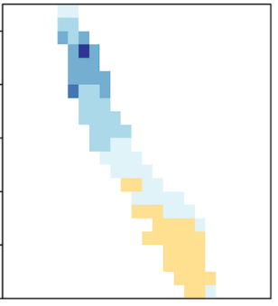
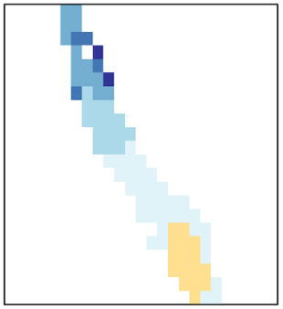
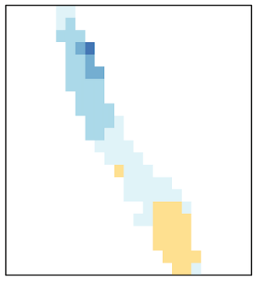
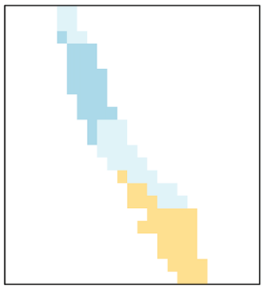
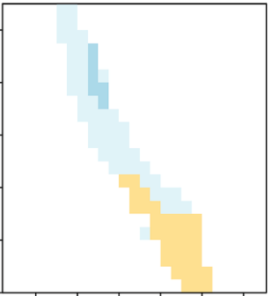
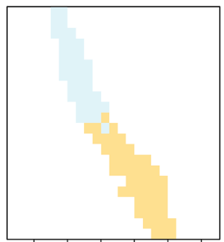
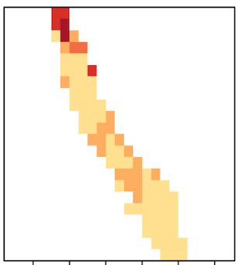
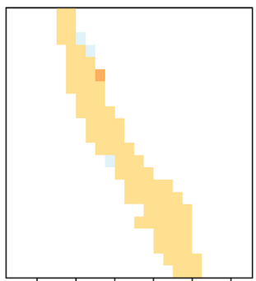
Results
Groundwater Storage Change Maps 2004-2019 (mm)
Jan
Feb
Mar
Apr
May
Jun
250
200
150
100
50
0
-50
-100
-150
-200
-250
Jul
Aug
Sep
Oct
Nov
Dec
Notes:
In these maps we’re highlighting how groundwater storage fares recently in 2019 compared to pre-drought levels in 2004. Although the winter months show deficits in groundwater compared to 2004, in the north and central area of the valley, the summer months actually show an increase in groundwater thickness.

Slide 26
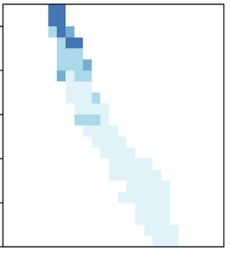
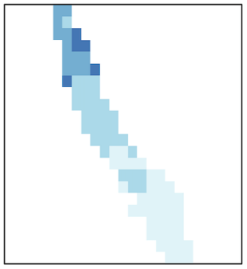
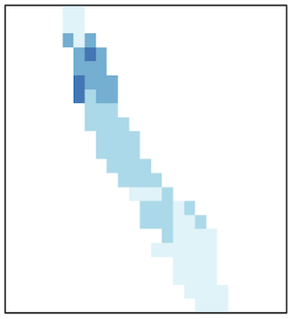
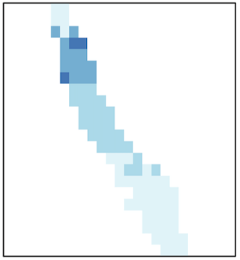
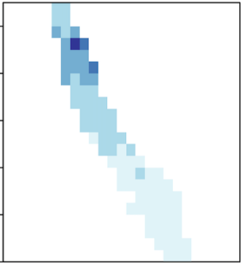
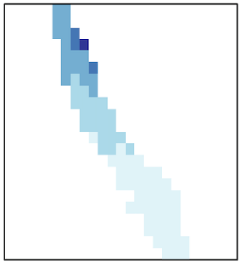
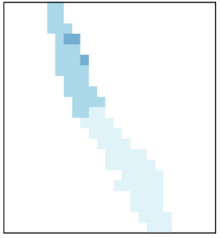
Results
Groundwater Storage Change Maps 2014-2019 (mm)
Jan
Feb
Mar
Apr
May
Jun
500
400
300
200
100
0
-100
-200
-300
-400
-500
Jul
Aug
Sep
Oct
Nov
Dec
Notes:
In these maps, we explore how groundwater has recovered since the drought. The overall positive gains in groundwater throughout most of the valley, barring November which sees some decrease in the southern and northern area of the valley, tells us that the entire Central Valley has seen an increase in groundwater thickness since the driest year of the drought in 2014. This supports that there has been some recovery of groundwater thickness in 2019 after ending the drought in 2018.

Slide 27
Conclusions
Remotely sensed GRACE and InSAR are capable of detecting groundwater storage change and subsidence
GRACE and InSAR can provide insight to subbasin elastic and inelastic response to drought
GRACE groundwater storage maps show greatest amount of groundwater storage loss in the southwest of the Central Valley
Cross platform comparisons of remotely sensed and in situ data at the subbasin scale provide decision makers with groundwater management tools in the context of SGMA
Image Credit: (Top)California Department of Water Resources (2014);(Bottom) California Department of Water Resources(2019)
Notes:
The projects comparisons across GRACE, InSAR, GPS, and well data concluded the following. Remotely sensed GRACE and InSAR are capable of detecting groundwater storage change and subsidence in the absence of in situ data and can be used by decision makers, such as the California Department of Water Resources, to aid in groundwater management. Additionally, GRACE and InSAR can provide insight to subbasin elastic and inelastic response to drought meaning that an inelastic response is where a subbasin permanently loses groundwater storage or it is elastic where water storage capacity can be recovered. This information can help our partners to monitor both groundwater levels and land subsidence response in times of drought. From our GRACE groundwater storage maps, we observed the greatest amount of groundwater storage loss in the south western portion of the Central Valley. Altogether, cross platform comparisons of remotely sensed and in situ data at the subbasin scale provide decision makers with groundwater management tools in the context of SGMA.
Image Credit: California Department of Water Resources
Image Description: Low water drought conditions at Folsom Dam and Lake located in Sacramento and El Dorado counties. Photo taken January 26, 2014.
Image License: Public Domain
Image Source: https://pixel-ca-dwr.photoshelter.com/galleries/C0000V_CtRs0xlAI/G00008Vrl5SJ89HI/I0000nGV5TagTX6M/JRC-Folsom-Lake-drought-20-jpg
Image Credit: California Department of Water Resources
Image Description: An aerial overview of Lake Oroville and the reconstructed Lake Oroville main spillway and emergency spillway at the Butte County, California site. Photo taken June 7, 2019.
Image License: Public Domain
Image Source: https://pixel-ca-dwr.photoshelter.com/galleries/C0000SrIiRvXKjiw/G0000sRgW1VVVTvU/I0000ZZnNfBFM1W4/FL-Oroville-0577-06-07-2019-jpg

Slide 28
Future Work
Expand InSAR coverage to entire Central Valley
Consider underlying geology in response to land subsidence
Implement the VIRGO tool outside the Central Valley to areas where groundwater storage and land subsidence is an issue
Image Credit: California Department of Water Resources (2019)
Notes:
InSAR coverage was limited to one portion of the Central Valley. Expansion of the data analysis would include an increased coverage of InSAR across the Central Valley in order to obtain land subsidence results across the whole region. Additionally, for this term, we did not consider the geology of the area which differs across the valley. In the future, geology should be studied to see how the classification of the soil affects groundwater storage and land subsidence. As the western region of the United States continue to go through drought conditions, areas in most of the western states are going through the same effects of loss of groundwater storage and land subsidence. The VIRGO tool may be edited to allow use of this tool in other states.
Image Credit: California Department of Water Resources
Image Description: A drone provides a view of a section of the California Aqueduct within the California State Water Project, located near John R. Teerink Pumping Plant, which convey California Aqueduct water between Buena Vista and John R. Teerink Pumping Plants within Kern County. Photo taken March 28, 2019.
Image License: Public Domain
Image Source: https://pixel-ca-dwr.photoshelter.com/galleries/C0000knJL28McpOA/G0000gJKyl5gbEQU/I0000OxM6VxsLdqI/KJ-Aqueduct-0002-03-28-19-JPG

Slide 29
NASA JPL Science Advisors
John T. Reager (NASA Jet Propulsion Laboratory, California Institute of Technology)
Zhen Liu (NASA Jet Propulsion Laboratory, California Institute of Technology)
Kyra Kim (NASA Jet Propulsion Laboratory, California Institute of Technology)
Project Partners
John T. Reager (NASA Jet Propulsion Laboratory, California Institute of Technology)
Bill Brewster (California Department of Water Resources, North Central Region Office Section Lead)
Mike McKenzie (California Department of Water Resources, South Central Region Office Section Lead)
Jack Tung (California Department of Water Resources, Southern Region Office Specialist Research Scientist)
Dr. Charles Hays (California State University, Los Angeles)
NASA JPL Support
Erica Carcelen (NASA DEVELOP National Program, Lead/Fellow)
Ben Holt (NASA Jet Propulsion Laboratory, California Institute of Technology)
Previous Contributors
Forrest Corcoran (California-JPL Central Valley Water Resources I)
Marissa Dudek (California-JPL Central Valley Water Resources I)
Patrick Saylor (California-JPL Central Valley Water Resources I)
This material contains modified Copernicus Sentinel data (2015-2020), processed by ESA
Notes:
We would like thank our science advisors at the NASA Jet Propulsion Laboratory (JPL) for their guidance during this term and for providing the Earth observation data required for this study. Additionally, a special thank you goes project partners at the California Department of Water Resources and Cal State LA for their support and guidance during this term. We also thank JPL’s Benjamin Holt and NASA DEVELOP Fellow Erica Carcelen for their support throughout this study.​ Finally, thank you to the previous contributors who were the Water Resources I team who started this project.

Slide 30
Backup Slide

Slide 31
AGOL Story Map
Notes:
To communicate the results of this project, the team produced a creative communication tool via the public facing StoryMap in ArcGIS Online, “Groundwater Sustainability Management Support in California’s Central Valley using GRACE and InSAR Datasets”

