Slide 1
DEVELOP National Program
About DEVELOP:
History, Organization, and Personnel

Slide 2
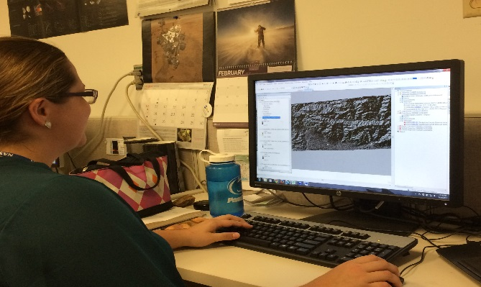
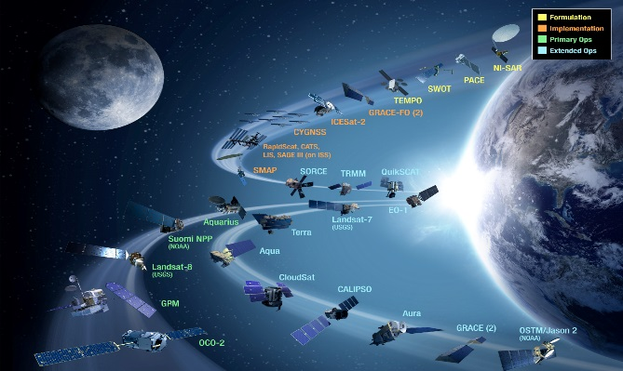
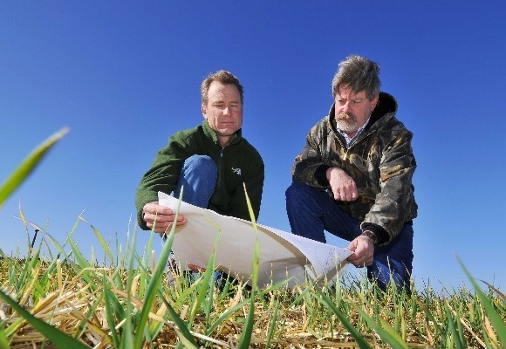
CBP’s DEVELOP National Program
“Shaping the future by integrating Earth observations into global decision making.”
Participants + Earth Observations + Decision Makers
DEVELOP bridges the gap between NASA Earth Science and society, building capacity in both its participants and end-user organizations
to better prepare them to handle the environmental challenges
that face society.
Capacity Building : www.nasa.gov/applied-sciences/capacitybuilding

Slide 3
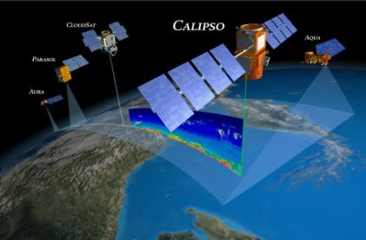
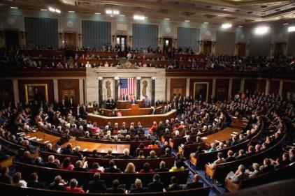
The DEVELOP Elevator Speech
So what is DEVELOP?
DEVELOP, part of NASA’s Applied Sciences Program, addresses environmental and public policy issues by conducting interdisciplinary feasibility projects that apply the lens of NASA Earth observations to community concerns around the globe. Bridging the gap between NASA Earth Science and society, DEVELOP builds capacity in both participants and partner organizations to better prepare them to address the challenges that face our society and future generations. With the competitive nature and growing societal role of science and technology in today’s global workplace, DEVELOP is fostering an adept corps of tomorrow’s scientists and leaders.
NASA’s Applied Sciences’
DEVELOP National Program
Measurements
and Predictions
Communities
DEVELOP’s Website: http://develop.larc.nasa.gov

Slide 4
DEVELOP’s Mission, Vision, & Core Values
MISSION
VISION
Integrating NASA Earth observations
with society to foster future innovation and cultivate the professionals of tomorrow by addressing diverse environmental issues today.
Shaping the future by integrating Earth observations into global decision making.
COLLABORATION
Cultivating teamwork, multi-disciplinary solutions, and open communication to bridge the gap between science and society
INNOVATION
Fostering rapid feasibility projects to harness ingenuity and demonstrate the applications of Earth science
PASSION
Pursuing all endeavors with energy, excitement, and enthusiasm to sustain a high level of excellence and respect
DISCOVERY
Exploring the potential of NASA’s investment in Earth science to make the extraordinary possible

Slide 5
NASA’s Core Values
Safety
Excellence
SAFETY
Mission Success
EXCELLENCE
TEAMWORK
INTEGRITY
Teamwork
Integrity

Slide 6
DEVELOP’s Current Core Values
COLLABORATION
Cultivating teamwork, multi-disciplinary solutions, and open communication to bridge the gap between science and society
INNOVATION
Fostering rapid feasibility projects to harness ingenuity and demonstrate the applications of Earth science
PASSION
Pursuing all endeavors with energy, excitement, and enthusiasm to sustain a high level of excellence and respect
DISCOVERY
Exploring the potential of NASA’s investment in Earth science to make the extraordinary possible

Slide 7
DEVELOP Locations (aka Nodes)

Slide 8
DEVELOP Chain of Command
NPO
National Level
Center Lead
Science Advisor
Mentor
Center Level
Assistant Center Lead
Fellow
Office Level
Project Lead
Project Level
Project Team
Team Level

Slide 9
National POCs
DEVELOP
NPO
Mike Ruiz
Karen Allsbrook
Lauren Childs-Gleason
Dr. Kenton Ross
Jennifer Tindell
Senior Fellows
Georgina Crepps
Tiffani Miller
Carrie Kelley
Jordan Vaa
DEVELOP
Fellows
Ryan Avery (LaRC)
Sean Cameron (UGA)
Sarah Carroll (FC)
Amanda Clayton (LaRC)
Dash Cruz (MSFC)
Elaina Gonsoroski (MCHD)
Erika Higa (JPL)
Sol Kim (JPL)
Kelly Meehan (NCEI)
Christie Stevens (WC)
Alison Thieme (GSFC)
Caitlin Toner (ID)
Jenna Williams (ARC)
DEVELOP Node Leadership
Langley
Emily Gotschalk (CL)
Amanda Clayton (ACL)
Ryan Avery (ACL)
Marshall
Maggi Klug (CL)
Dash Cruz (ACL)
Mobile
Tyler Lynn (CL)
Elaina Gonsoroski (ACL)
NOAA NCEI
Alec Courtright (CL)
Kelly Meehan (ACL)
UGA
Caren Remillard (CL)
Sean Cameron (ACL)
Wise County
Michael Brooke (CL)
Christie Stevens (ACL)
Goddard
Sean McCartney (CL)
Alison Thieme (ACL)
Idaho
Courtney Ohr (CL)
Caitlin Toner (ACL)
JPL
Nick Rousseau (CL)
Erika Higa (ACL)
Ames
Jenna Williams (CL)
John Dilger (ACL)
Arizona
Lance Watkins (CL)
Fort Collins
Brian Woodward (CL)
Sarah Carroll (ACL)

Slide 10
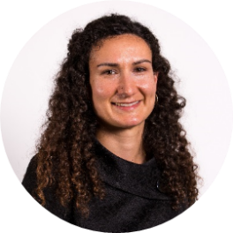
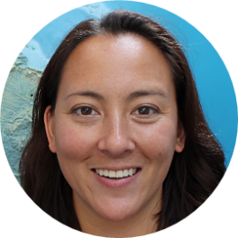
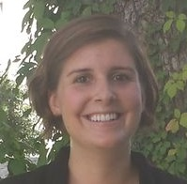
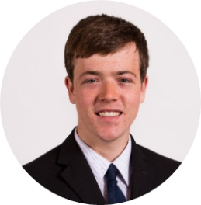
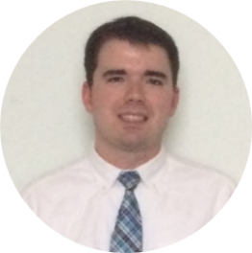
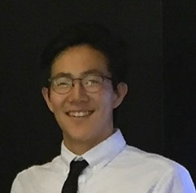
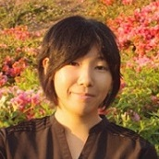
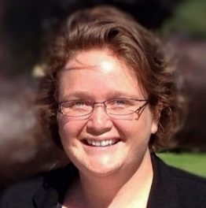
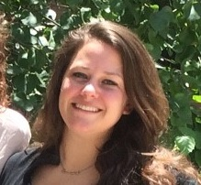
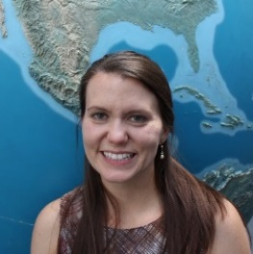
FY17 Fellows Class
What is a DEVELOP Fellow?
A recent college graduate who spends one year with DEVELOP growing both personally and professionally, and contributing to the program as a whole. Each Fellow serves in a dual-role, splitting their time between their node and NPO-related tasks.
Kelly Meehan
Geo (NCEI)
Allison Thieme
Geo (GSFC)
Elaina Gonsoroski
IA (MCHD)
Dash Cruz
IA (MSFC)
Sarah Carroll
IA (FC)
Ryan Avery
PC/Geo (LaRC)
Sean Cameron
PC (UGA)
Sol Kim
Geo/Mission Apps (JPL)
Erika Higa
Geo (JPL)
Caitlin Tonner Comm (ID)
Christie Stevens
Comm (WC)
Jenna Williams
Comm (ARC)
Aubrey Hilte
PC (WC)
Amanda Clayton PC (LaRC)

Slide 11
Questions? Contact…
Karen: contracts, payroll, status reports/invoices, schedule adjustments, online app system, travel, SSAI
Lauren: projects, deadlines, conferences, telecons, Fellow class, CL position competition, publications, international activities, state/local government activities, partner engagement, project hand-offs, media interactions, Wise County
Georgina: Impact Analysis Team-related items, tracking metrics, indicators, socioeconomic impact analysis, PSI, participant surveys, alumni survey
Carrie: Communications Team-related items, graphic design support, social media, newsletter, VPS, video help, recruiting, military engagement, recruiting, outreach activities, Ambassador Corps, print materials
Tiffani: Project Coordination Team-related items, publications, deliverables, using the national telecon line
Jordan: IT Team-related items, DEVELOPedia, DEVELOP website, DEVELOP Exchange, software, hardware, software release authority
Topics Not Listed Here: ANYONE! We love answering questions and will direct you to the right person if we can’t answer ☺

Slide 12
Social Media
DEVELOP National Program: features projects, node highlights & accomplishments, VPS announcements www.facebook.com/developnationalprogram
Once a DEVELOPer, Always a DEVELOPer: job posts
https://www.facebook.com/groups/387243741376125/
Articles & Important Events: Tweet @NASA_DEVELOP or #NASADEVELOP
http://twitter.com/#!/nasa_develop
NASA DEVELOP National Program:
VPS and promotional videos www.youtube.com/user/NASADEVELOP
NASA DEVELOP National Program: features projects, node highlights & accomplishments, and VPS announcements
https://plus.google.com/+NASADEVELOP
NASA DEVELOP National Program: job posts, job skills & tips, and important events. This is a private group! Follow the link to join!
www.linkedin.com/groups/4343498
Watch time spent on social media. If you are going to be on there it should probably be on the DEVELOP pages liking and commenting on DEVELOP things!

Slide 13
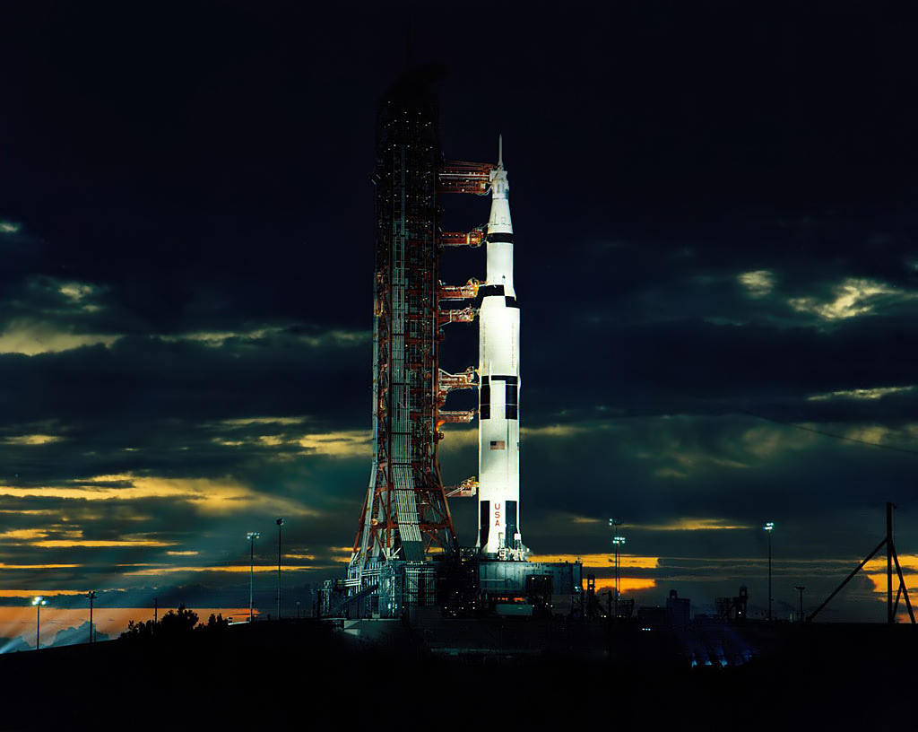
THANK YOU!
Joining the DEVELOP family means being part of NASA’s Legacy.
Learn it.
Know it.
Live it.

