Slide 1
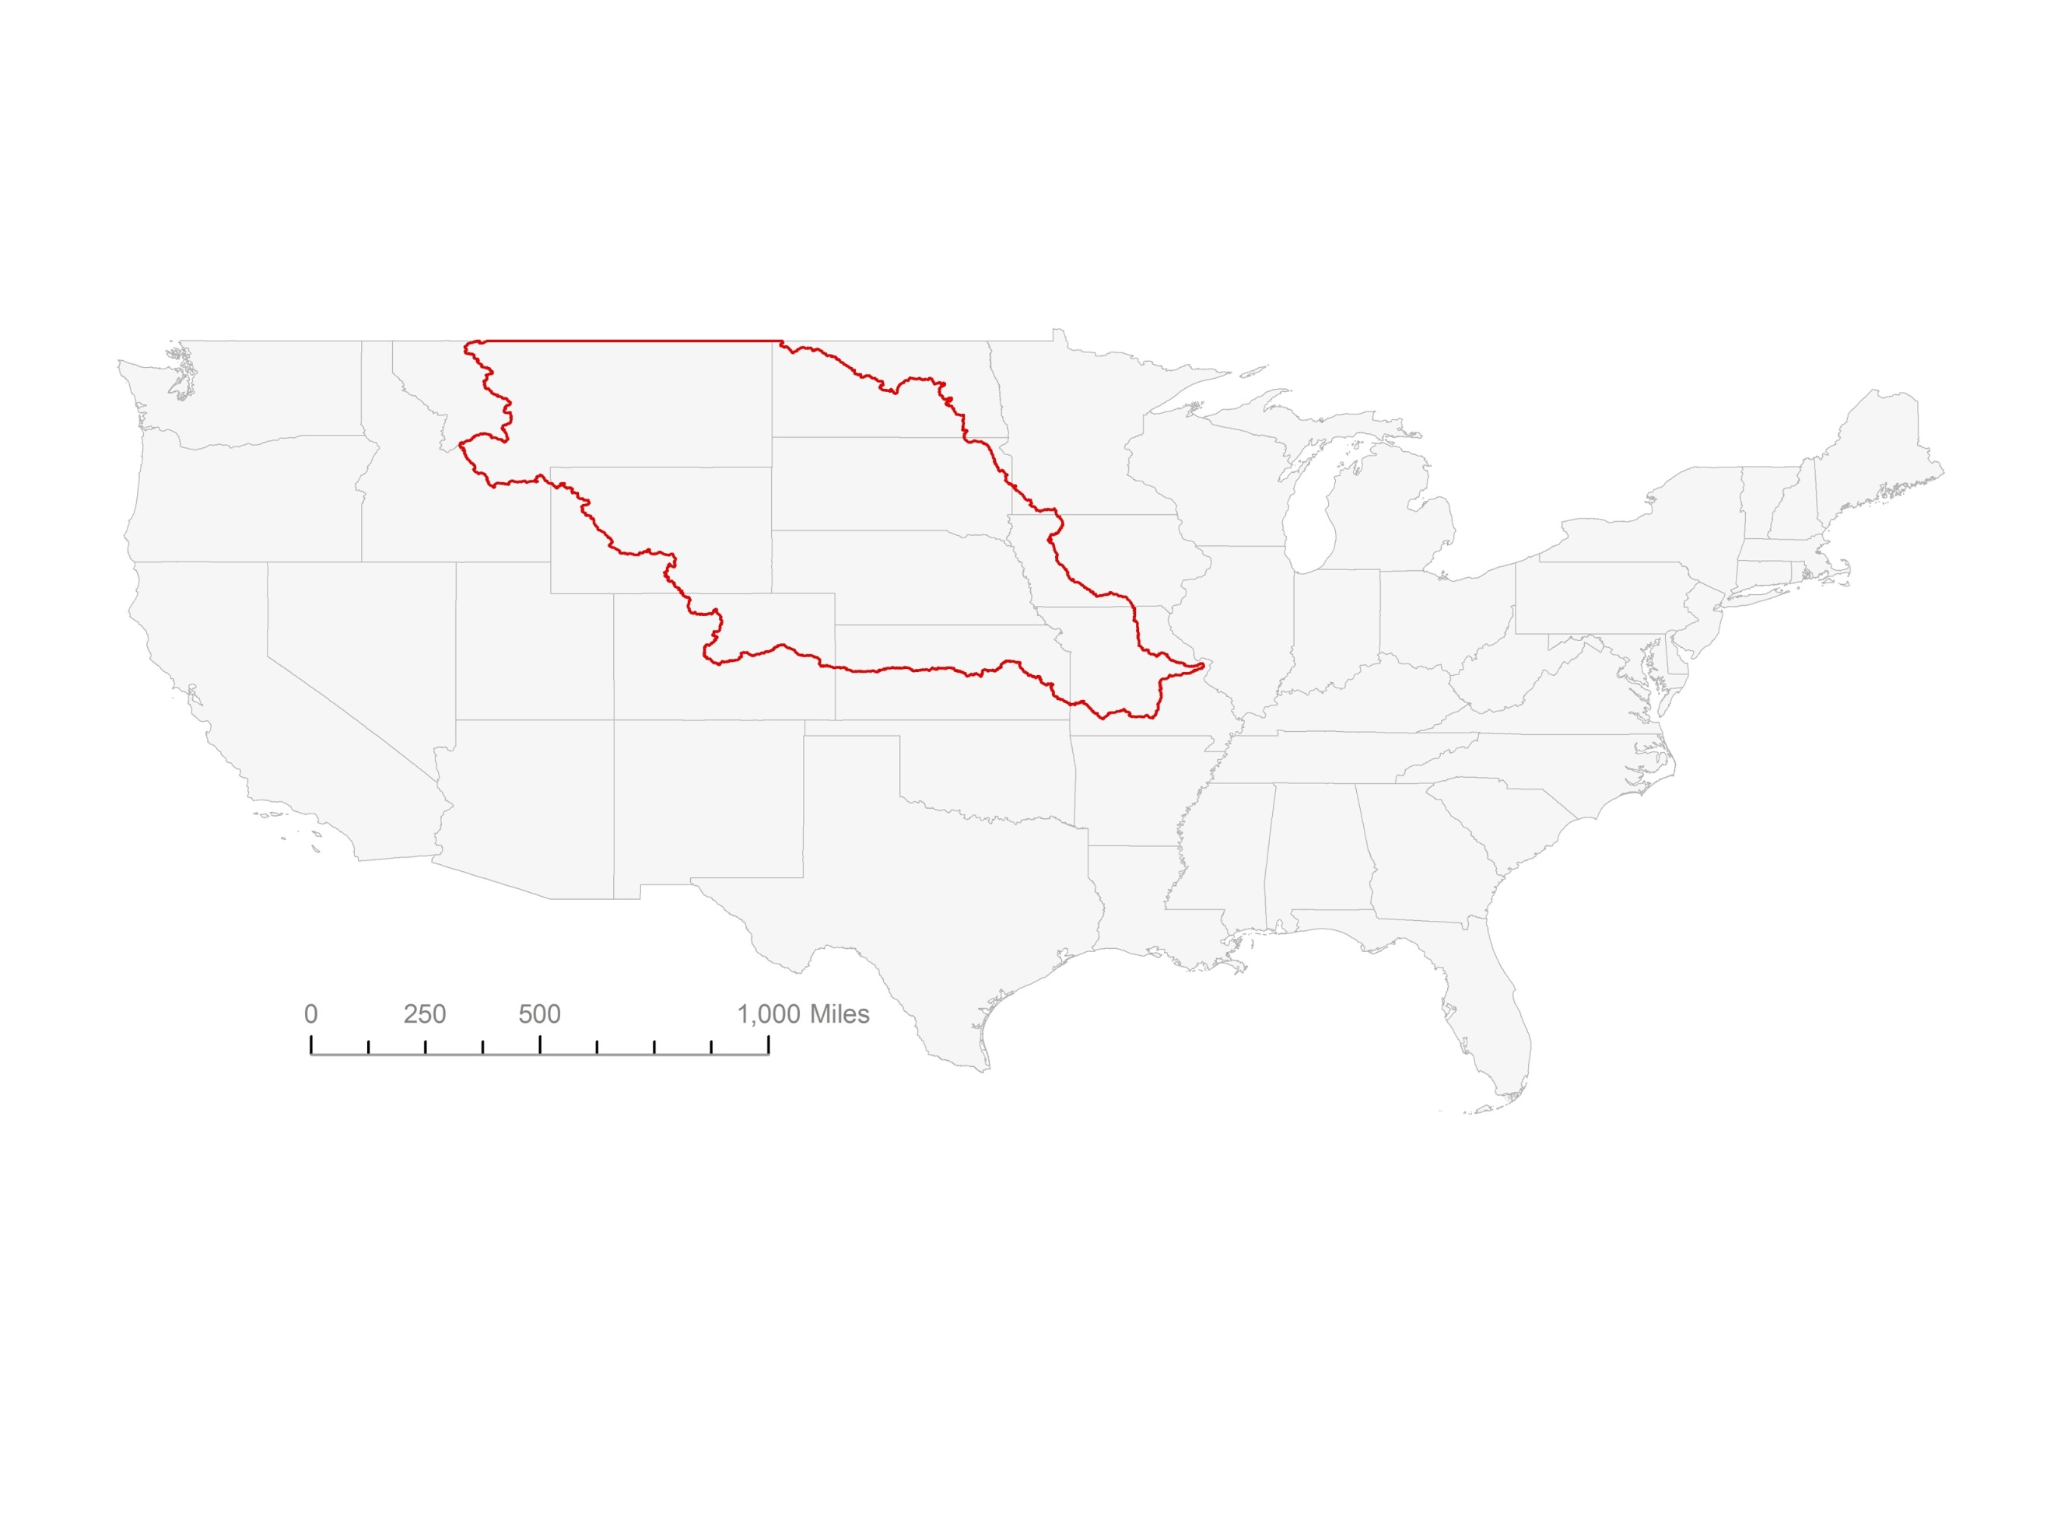
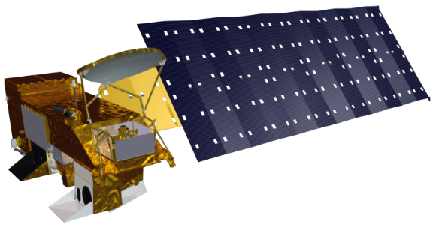
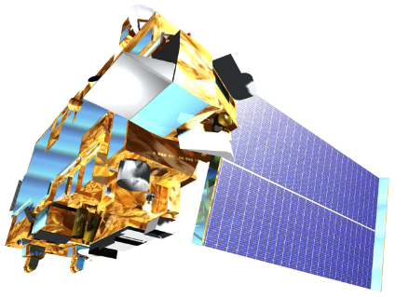
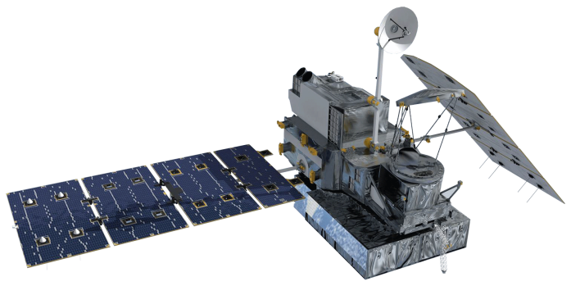
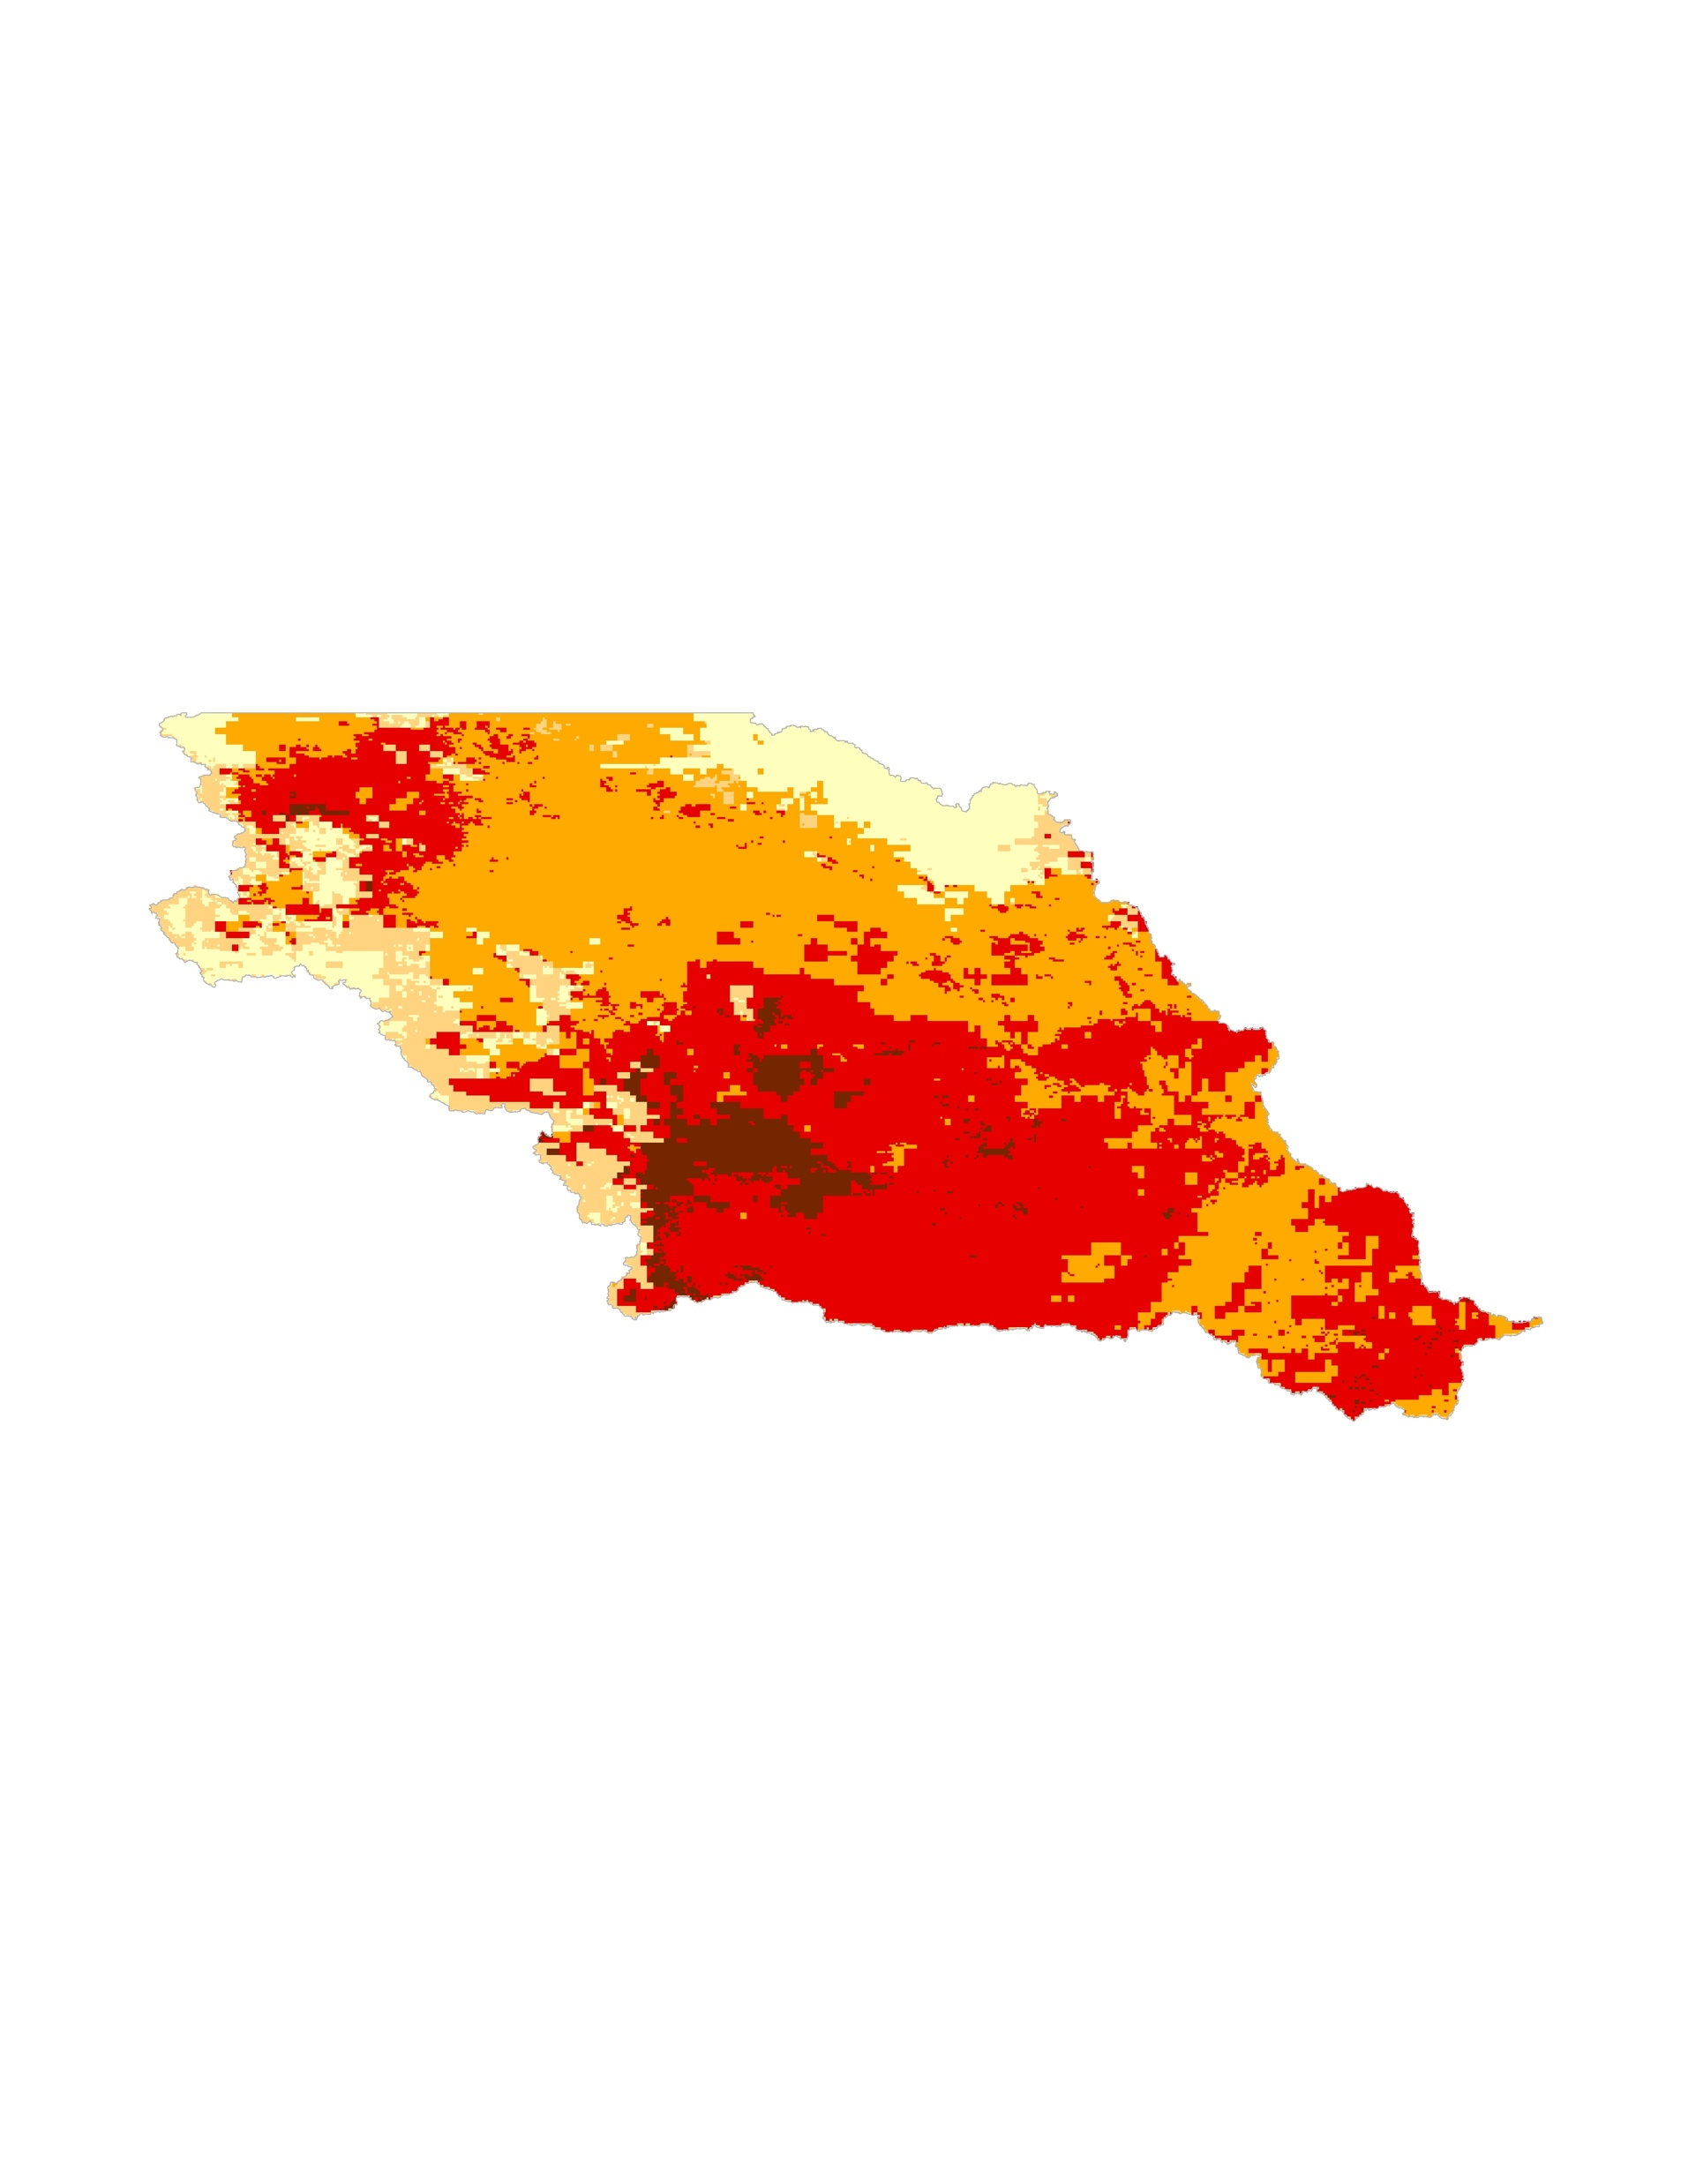
Utilizing NASA Earth Observations and NOAA Data Records to Produce Climate Indicators for Wildland Fire
Abstract
Objectives
Grasslands in the Missouri River Basin (MRB) cover the majority of the landscape and are essential for agriculture. However, they are susceptible to wildland fires, with each year averaging approximately 6.6 million acres (2000-2010 average - National Interagency Fire Center) burned in this region. Due to sparse data sources, fire managers in the MRB are unable to quickly discern spatial differences in the wildland fire potential. The region is in need of a robust, communicable, and easily distributable method of analyzing fire potential. This project combined fuel moisture content derived from NASA’s MODIS sensor aboard the Terra and Aqua satellites; wind speeds, temperature, and relative humidity from NOAA’s Real-Time Mesoscale Analysis (RTMA); and precipitation estimates from Global Precipitation Measurement Mission (GPM) to train and construct a wildland fire potential matrix of the MRB. The NASA DEVELOP team used this data to create and distribute an updateable script for generating fire potential maps. This interface allows fire managers to quickly discern the potential for complex wildland fires throughout the MRB.
Combine several climatic variables influencing wildland fire potential, including drought conditions, wind speeds, precipitation, humidity, and cured fuels, to estimate wildland fire potential
Create fire potential maps to help identify spatial differences in fire potential
Develop transferrable open-source code for partners to build-upon and improve near-real time wildland fire potential maps
Study Area
Missouri River Basin
Earth Observations
Aqua - MODIS
Terra - MODIS
Global Precipitation
Measurement (GPM)
Methodology
RTMA
(Wind speed, Humidity, Temperature)
Modeled Data
Criteria for Large Fire Potential
GPM
(Precipitation)
Palmer
Drought
Severity
Index
Validate
Indicators Against
Historical Fires
Indicator | Threshold*
Wind Speeds | > 30 mph
Temperature | > 40 ºF
Relative Humidity | < 30%
Drought | < -1 PSDI
Precipitation | >1/10 in
Precipitation | < 7 days
MODIS
NDII
(Fuel Moisture)
DATA
Missouri River Climate II
nClimGrid
(temperature)
MODIS
NDSI
(Snow Cover)
Earth Observations
*Thresholds provided by project partners based on their
analysis of severe fires in the study area
Conclusions
Results
The fire potential map will allow partners to identify areas with heightened fire potential.
The user-friendly interface will enable fire managers with limited GIS experience to easily access and spread fire potential data.
The open-source nature of the project will enable future users to update data sources and indicator thresholds as new data and research become publicly available.
High
Low
Fire Potential
Project Partners
Bureau of Indian Affairs
NOAA NCEI Regional Climate Services Director, Central Region
South Dakota School of Mines and Technology
Great Plains Tribal Water Alliance
US Army Corps of Engineers, Missouri River Basin Water Management
Example of daily map generated from the criteria for large fire potential.
Team Members
Acknowledgements
Science Advisors, Collaborators and mentors
Michael Kruk, Michael J. Brewer, Dr. L. DeWayne Cecil, Darren Clabo, Doug Kluck, David Martin, Nancy McCraw, Andrew Backe, James Adams, Kelly Meehan, Sol Kim
Previous team members
Nancy Barnhardt, Alec Courtright, Emily Sturdivant, and Samuel Swanson
Kimberly Berry
Team Lead
Alec Courtright
Kathy Dooley
Ben House III
NOAA National Centers for Environmental Information – Spring 2017

