Slide 1
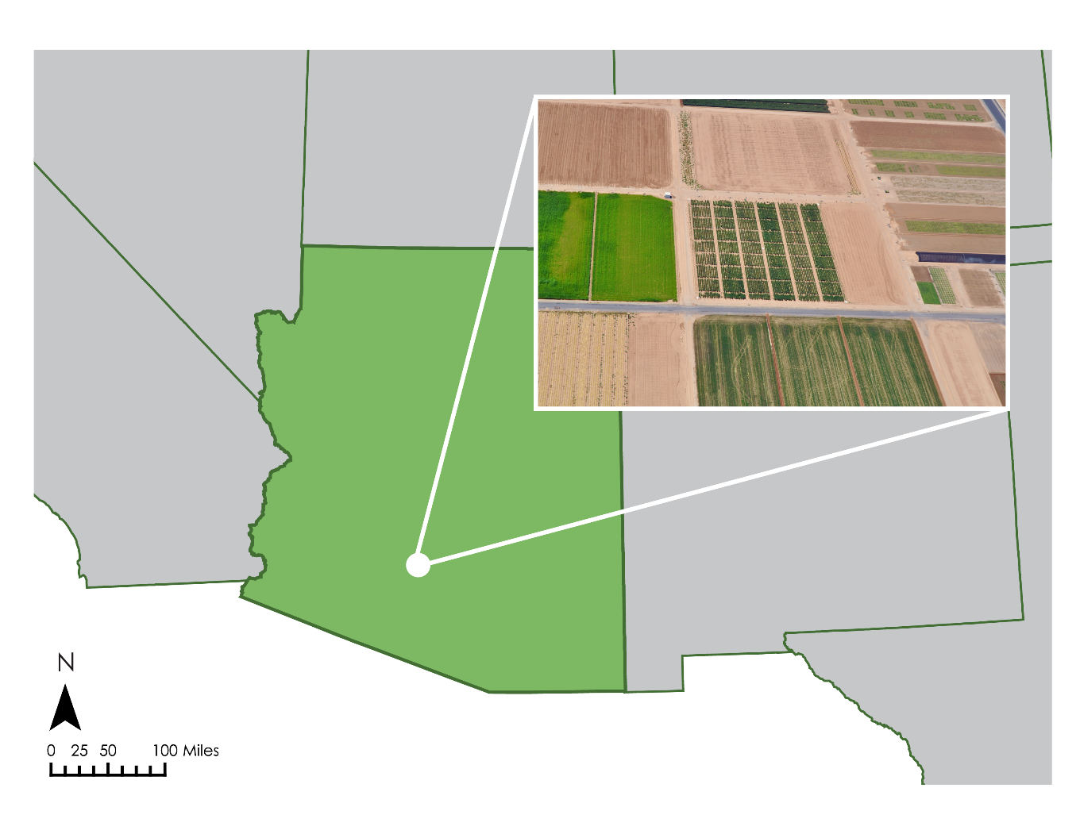
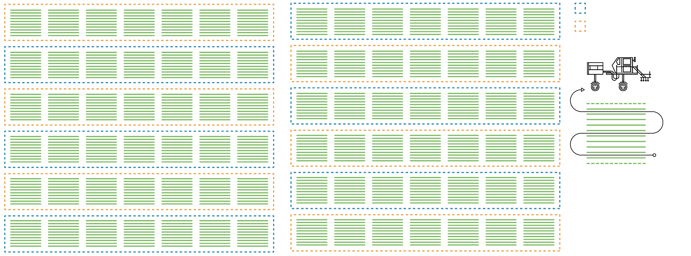
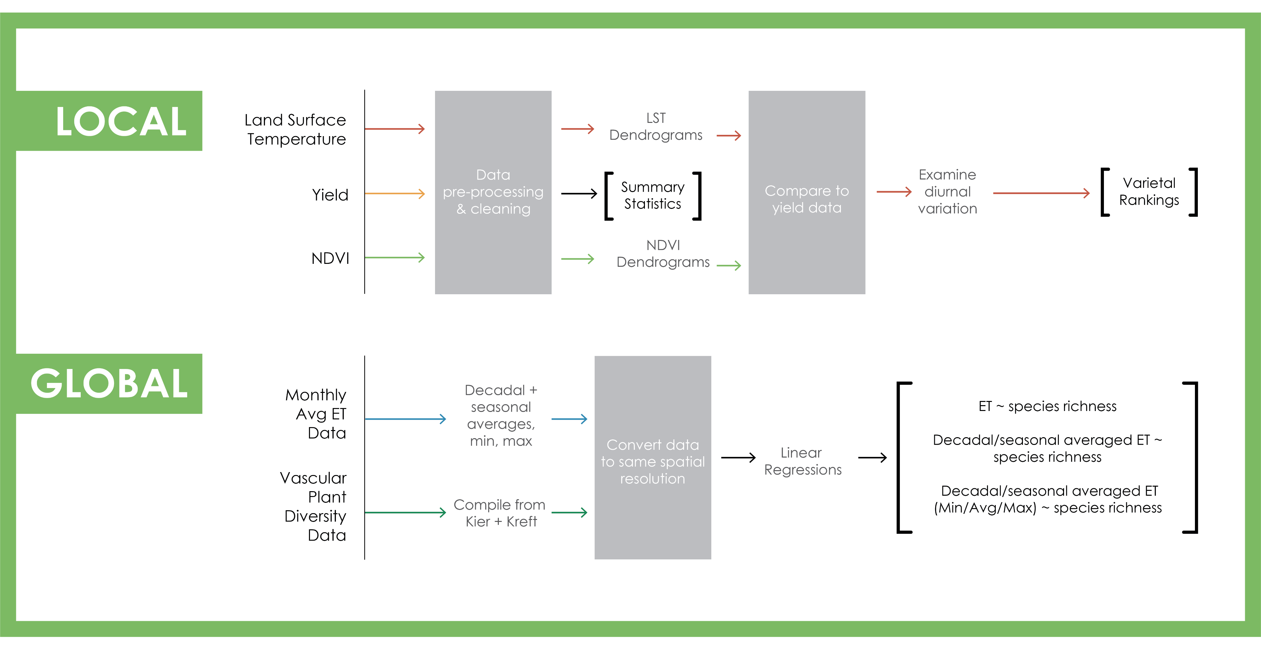
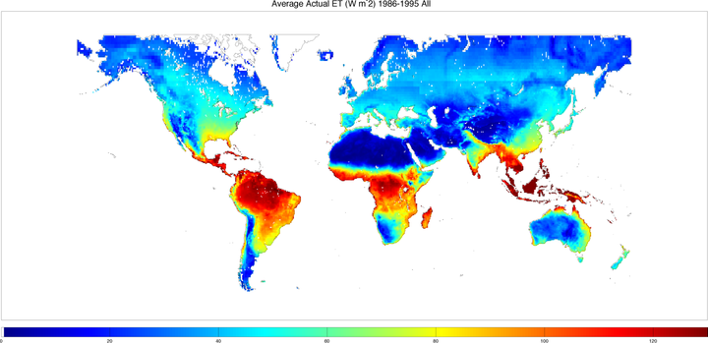
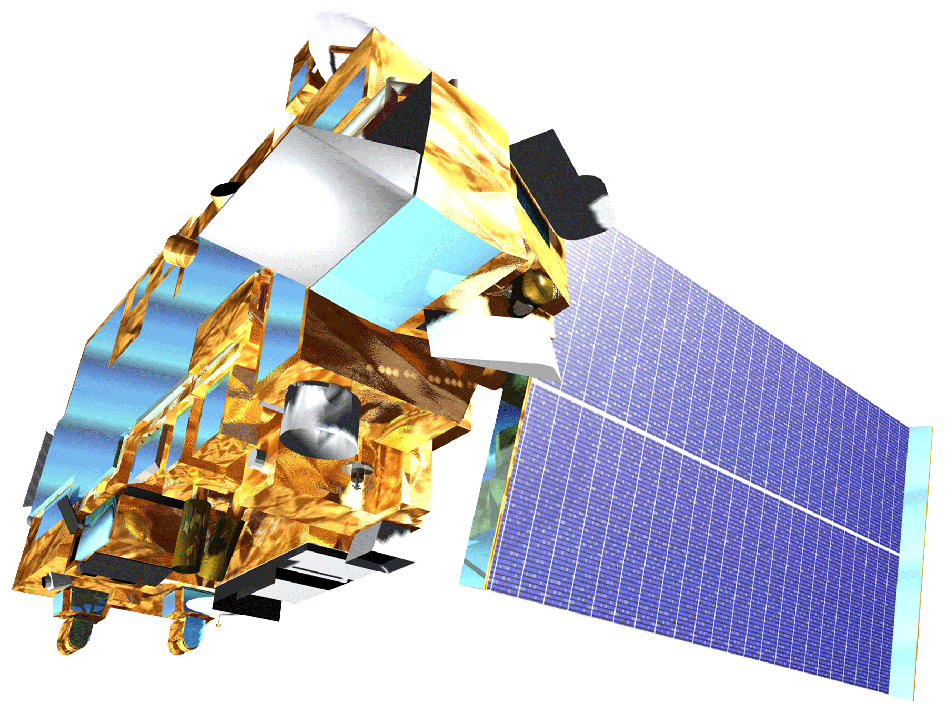
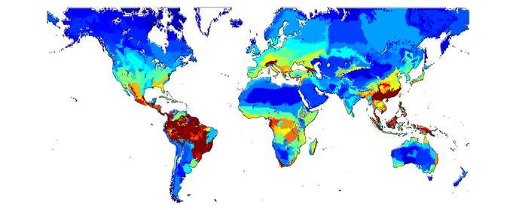
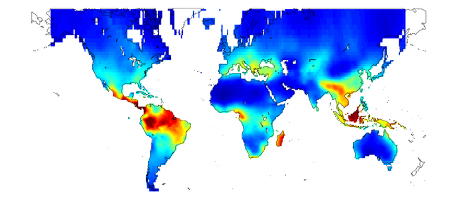
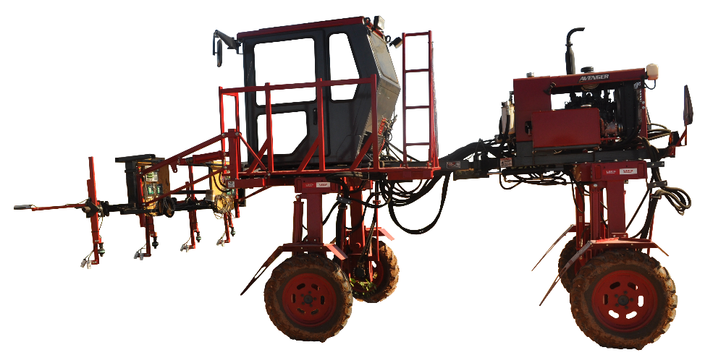
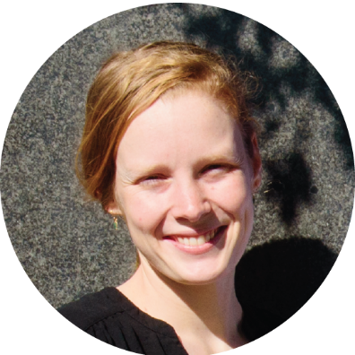
Demonstrating the Potential Applications of ECOSTRESS Evapotranspiration Products in Plant Phenotyping and Predicting Patterns in Global Species Richness
Objectives
Study Area
Investigate the utility of non-destructive, image analysis-based phenotyping via remote sensing to select superior crop varieties at the farm scale
Expand evapotranspiration analysis to the global scale, evaluating applicability in global biodiversity studies and creating a framework for future studies utilizing ECOSTRESS data
2013
2014
Well-Watered
Water-Limited
Maricopa, AZ
Abstract
Methodology
LEFT: Arizona map with inset plot aerial view. RIGHT: Plot diagram with IRT tractor path outlined.
A changing climate has the potential to affect both agricultural productivity and global levels of biodiversity. In the agricultural context, the ability to rapidly identify more water-efficient and drought tolerant crop varieties will be vital for international food security. Current methods of phenotyping superior crop types are often destructive, time-intensive, and costly. Remote sensing affords the opportunity to expedite the phenotyping process by expanding both the spatial and temporal scale of analyses – bypassing the limitations of current genetic testing and plant breeding trials. As biodiversity research presents analogous constraints to in situ phenotyping, similar resolution benefits are attributed to monitoring shifts in species richness at the global scale using remote sensing technologies. With the anticipated launch of the ECOsystem Spaceborne Thermal Radiometer Experiment on Space Station (ECOSTRESS) in 2018, we investigated the potential applications of its evapotranspiration (ET) products to inform agricultural management practices and global conservation efforts. Evapotranspiration, or water vapor entering the atmosphere from the combination of transpiration and evaporation, differs by plant type and has been used in previous work to model species richness. On the farm-scale, we investigated the utility of ET to phenotype and identify the best performing varieties of cotton in water-stressed conditions. We then examined how well evapotranspiration can predict global vascular plant species richness.
Arizona Agriculture
Results
Average Actual ET (mm²/month) 1986-1995
On the local scale, we were able to rank varieties by degree of water stress (below). The best-performing cotton varieties had consistently lower temperature measures, which we used as a proxy for ET. Global analyses (right) indicated strong correlations between ET and vascular plant species richness, with the highest R² values for each dataset occurring at the ET decadal average.
 | KIER | KREFT
ET | R² | R²
Decadal | 0.493 | 0.595
Summer | 0.159 | 0.157
Fall | 0.463 | 0.565
Winter | 0.329 | 0.422
Spring | 0.472 | 0.584
Earth Observations
Cotton Varietal Rankings 2013-2014
Vascular Plant Diversity
Terra MODIS
TOP PERFORMING:
GA_2009100
DP_393
BOTTOM PERFORMING:
LA10307108 PD05064 LA09309116
AU55052
Kier
Kreft
Tractor-mounted IRT
Conclusions
Global vascular plant biodiversity is strongly correlated with evapotranspiration, especially when comparing to a decadal average. Land managers can therefore utilize longer term ET trends to track anomalies and better target conservation efforts.
The local scale analysis demonstrates the potential for plant phenotyping based on ET, especially in water limited conditions.
As water availability becomes less predictable, scientists need a way to monitor changes in ecosystems. ECOSTRESS will enable us to better understand the diurnal cycle of ET for plant varieties to both better inform land management practices and understand patterns of global biodiversity.
Project Partner
USDA-ARS, US Arid Land Agricultural Research Center
Team Members
Acknowledgements
Dr. Andrew French (USDA-ARS, US Arid Land Agricultural Research Center)
Dr. Joshua Fisher (Jet Propulsion Laboratory, California Technical Institute)
Dr. Christine Lee (Jet Propulsion Laboratory, California Technical Institute)
Dr. Ryan Pavlick (Jet Propulsion Laboratory, California Technical Institute)
Ben Holt (Jet Propulsion Laboratory, California Technical Institute)
Molly Spater
(Team Lead)
Sol Kim
Leah Kucera
NASA Jet Propulsion Laboratory – Spring 2017

