Slide 1
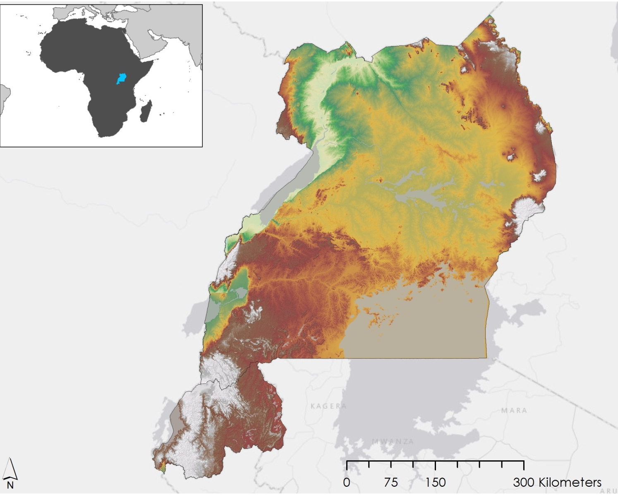
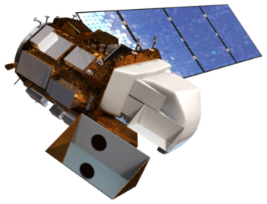
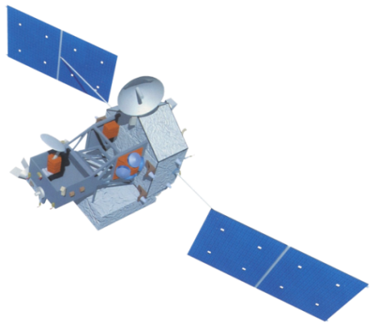
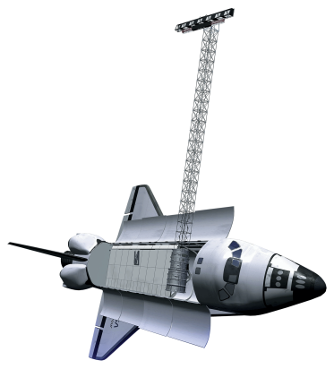
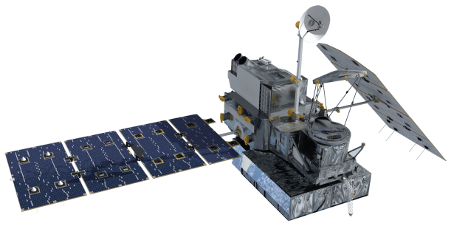
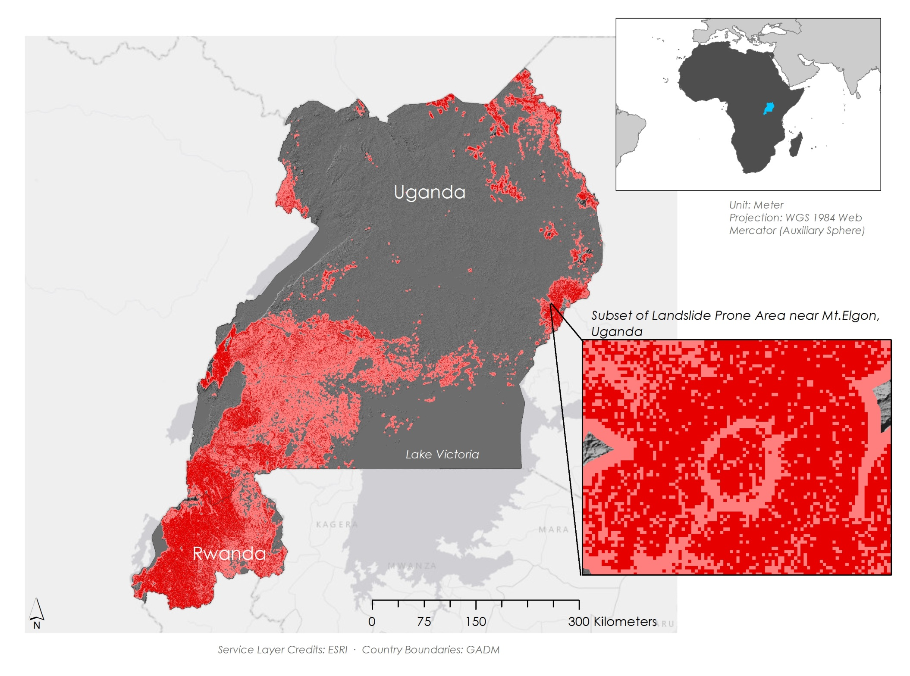
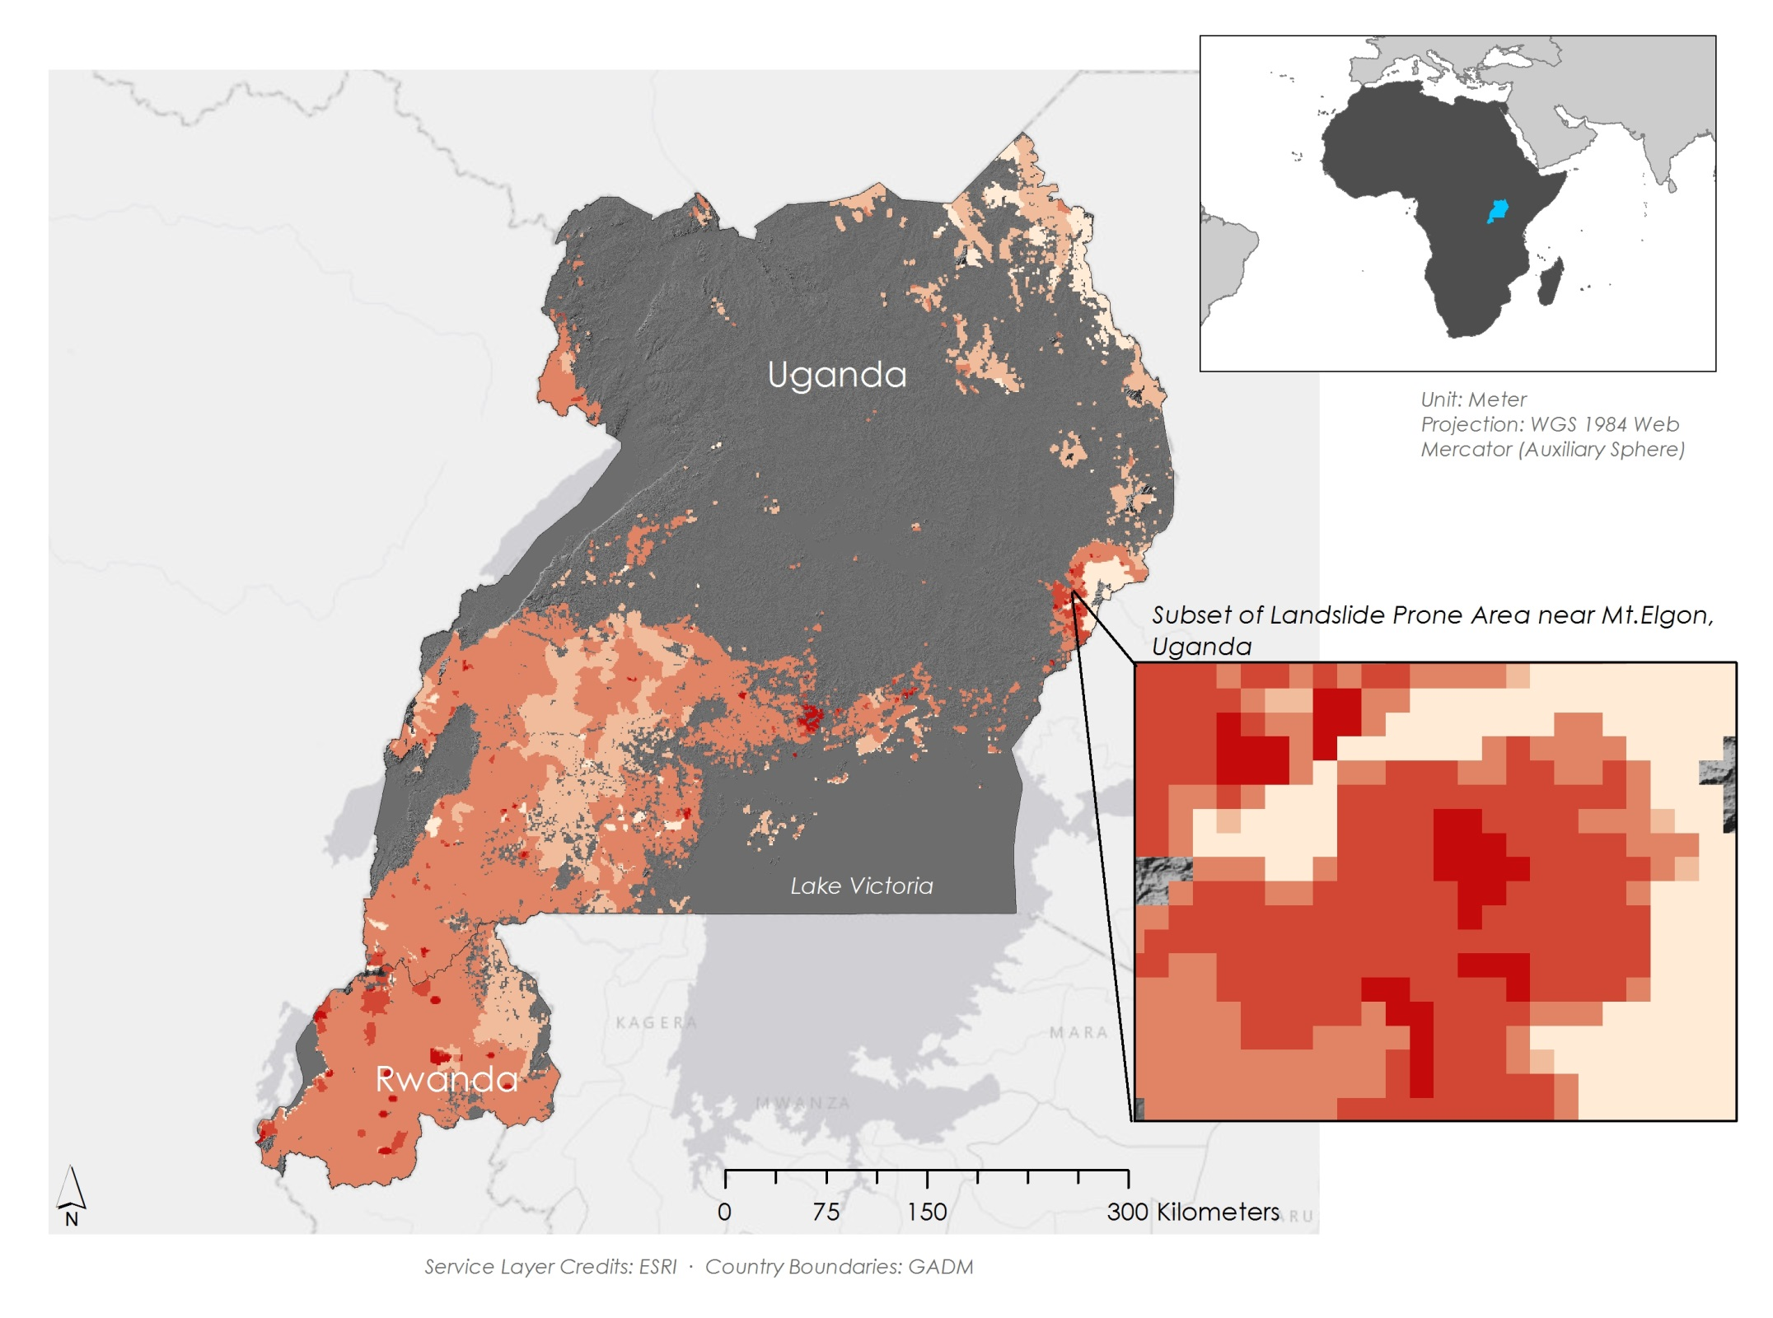
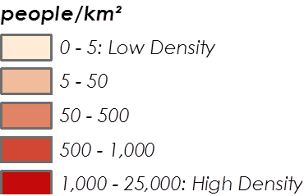
East Africa Disasters
Assessing landslide characteristics and developing a Landslide Hazard Map and a Landslide Susceptibility Map in Rwanda and Uganda using NASA Earth observations
Leigh Sinclair (Project Lead), Padraic Conner (Co-Project Lead), Tyler Finley, Jeanné le Roux
NASA DEVELOP National Program at Marshall Space Flight Center
Abstract
Objectives
.
Supply updates to SERVIR’s Global Landslide Catalog (GLC), an online database documenting rainfall-triggered landslides around the world
Create a Landslide Susceptibility Map and a Landslide Hazard Map for the study area using a sample of landslide data from the GLC and landslides found through Google Earth
Assess performance of GPM and TRMM at identifying landslide conditions
The International Emergency Disasters Database indicates that a total of 482 people have been killed and another 27,530 have been affected by landslides in Rwanda and Uganda, although the actual numbers are thought to be much higher. Data for individual countries are poorly tracked, but hotspots for devastating landslides occur throughout Rwanda and Uganda due to the local topography and soil type, intense rainfall events, and deforestation. In spite of this, there has been little research in this region that utilizes satellite imagery to estimate areas susceptible to landslides. This project utilized Landsat 8 Operational Land Imager (OLI) data and Google Earth to identify landslides that occurred within the study area. These landslides were then added to SERVIR’s Global Landslide Catalog (GLC). Next, Landsat 8 OLI, the Tropical Rainfall Measuring Mission (TRMM), the Global Precipitation Measurement (GPM), and Shuttle Radar Topography Mission Version 2 (SRTM V2) data were used to create a Landslide Susceptibility Map. This was combined with population data from the Socioeconomic Data and Applications Center (SEDAC) to create a Landslide Hazard map. A preliminary assessment of the relative performance of GPM and TRMM in identifying landslide conditions was also performed. The additions to the GLC, the Landslide Susceptibility Map, the Landslide Hazard Map, and the preliminary assessment of satellite rainfall performance will be used by SERVIR and the Regional Centre for Mapping of Resources for Development (RCMRD) for disaster risk management, land use planning, and determining landslide conditions and moisture thresholds.
Study Area
Methodology
1
Update Global Landslide Catalog
2
Google Earth [Landslide locations]  News Reports [Time of Landslide]  Landsat 8 [Time of Landslide]
Create a Landslide Susceptibility Map
Landslide Thresholds [Elevation, Slope, etc.]  Fuzzy Model
Variables
Elevation
Slope
Plan Curvature
Profile Curvature
Distance from Roads
Distance from Streams
Distance from Ridge
Terrain Roughness
Soil Depth
Topographic Wetness Index
Assign Fuzzy Membership Type
Elevation | Large
Slope | Near
Plan Curvature | Near
Profile Curvature | Near
Distance from Roads | Linear
Distance from Streams | Linear
Distance from Ridge | Small
Terrain Roughness | Near
Soil Depth | Large
Topographic Wetness Index | Near
Fuzzy
Overlay
Landslide
Susceptibility
Map
Earth Observations
Landsat 8 OLI
TRMM TMPA
3
Conduct a Preliminary Assessment of GPM and TRMM
GPM DPR
GPM Data [Precipitation]  TRMM [Precipitation]  CHIRPS [Precipitation]
SRTM-V2 C-Band
4
Create a Landslide Hazard Map
Conclusions
Landslide Susceptibility Map  SEDAC [Population Density Data]
Western Uganda and Southeastern Rwanda are susceptible to landslides
Approximately 16 million people are at risk of being affected by a landslide
All measures had very strong correlation at the monthly scale and strong correlation at the daily scale for the overall assessment
For extreme rainfall events GPM and TRMM had very strong correlation to each other at the monthly scale and strong correlation at the daily scale, however they showed weak correlation to CHIRPS
Results
Landslide Hazard Map
Landslide Susceptibility Map
Global Landslide Catalog
Team Members
Project Partners
Rainfall Assessment
NASA SERVIR Coordination Office at NASA Marshall Space Flight Center
SERVIR Applied Sciences Team at NASA Goddard Space Flight Center
Regional Centre for Mapping of Resources for Development (RCMRD)
Monthly Total Rainfall
Monthly Extreme Rainfall
Acknowledgements
Daily Total Rainfall
Daily Extreme Rainfall
We would like to thank our Science Advisor, Dr. Jeffrey Luvall (NASA at NSSTC), Science Mentor Dr. Robert Griffin (University of Alabama in Huntsville), and Eric Anderson (SERVIR) for their guidance on this project.
Tyler Finley, Leigh Sinclair, Padraic Conner, and Jeanné le Roux
NASA Marshall Space Flight Center

